Slide 1




NSTX-U
Supported by
NSTX-U FY2012 3rd Quarter Review Presentation
Coll of Wm & Mary
Columbia U
CompX
General Atomics
FIU
INL
Johns Hopkins U
LANL
LLNL
Lodestar
MIT
Lehigh U
Nova Photonics
Old Dominion
ORNL
PPPL
Princeton U
Purdue U
SNL
Think Tank, Inc.
UC Davis
UC Irvine
UCLA
UCSD
U Colorado
U Illinois
U Maryland
U Rochester
U Tennessee
U Tulsa
U Washington
U Wisconsin
X Science LLC
R. Strykowski, M. Ono, J. Menard
Culham Sci Ctr
York U
Chubu U
Fukui U
Hiroshima U
Hyogo U
Kyoto U
Kyushu U
Kyushu Tokai U
NIFS
Niigata U
U Tokyo
JAEA
Inst for Nucl Res, Kiev
Ioffe Inst
TRINITI
Chonbuk Natl U
NFRI
KAIST
POSTECH
Seoul Natl U
ASIPP
CIEMAT
FOM Inst DIFFER
ENEA, Frascati
CEA, Cadarache
IPP, Jülich
IPP, Garching
ASCR, Czech Rep
PPPL – B233
August 7, 2012

Slide 2
Agenda
NSTX Upgrade progress report – R. Strykowski
NSTX-U operational highlights – M. Ono
5 year plan progress, collaborations – J. Menard

Slide 3
Recent accomplishments
Good progress across all fronts
Umbrella legs replacement underway (3 legs cut off).
TFTR TC Lintel removed (for NB relocation).
Neutral beam box test lift.
NB services line installation underway .
Outer clevis pad welding ~33% complete.
CHI gap resolution. New tiles to be designed and installed.
Inner TF bundle fabrication; 13 bars received, 11 soldered, 10 sandblasted/primed, 4 wrapped.
Coil support fabrication and installation continues.
Inner TF conductor deliveries on track

Slide 4
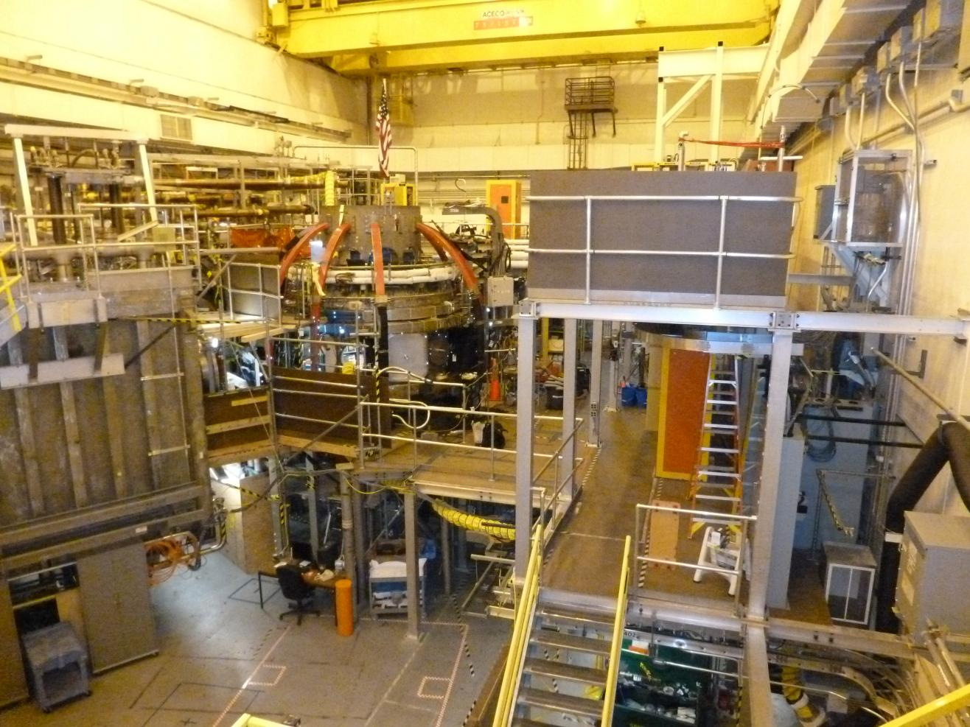
NSTXU Test Cell - Current
Coil support modifications- Rib welding complete. New clevis pads, PF4/5 supports, umbrella legs
TF 11 and TF7 removed
Bay K nozzle removed. Vessel to be plasma cut with new NB port installed (June)
Permanent platforms installed.
Relocation of racks started.
Work underway inside the vessel (passive plates, NB armor, Bay j/k/l reinforements)
Neutral Beam area now cleared

Slide 5
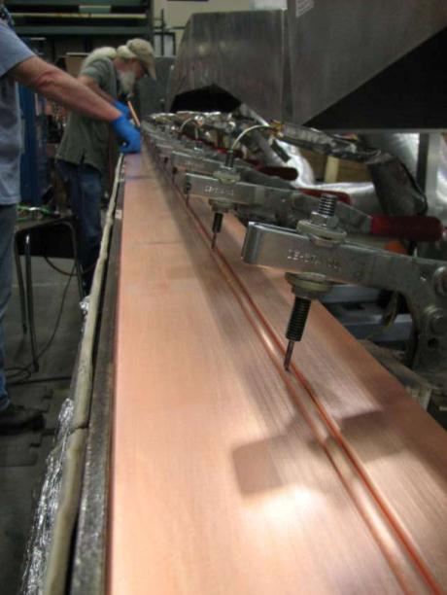
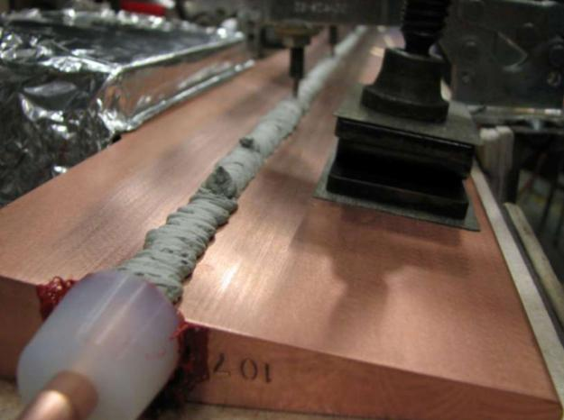
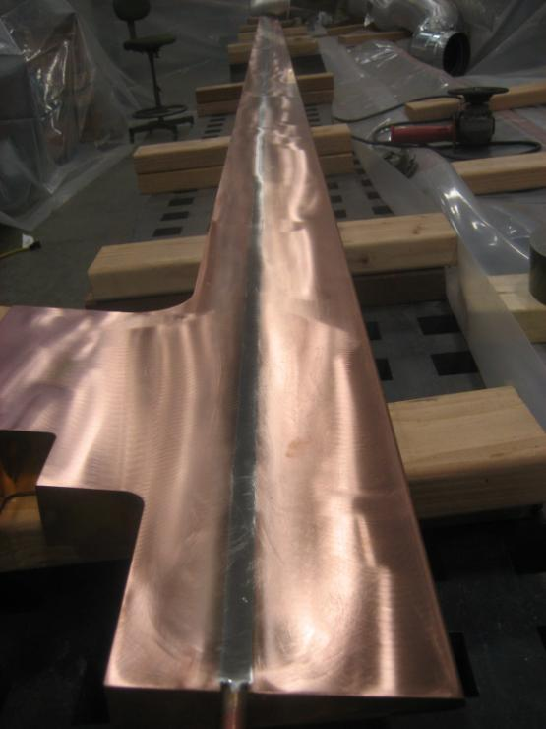
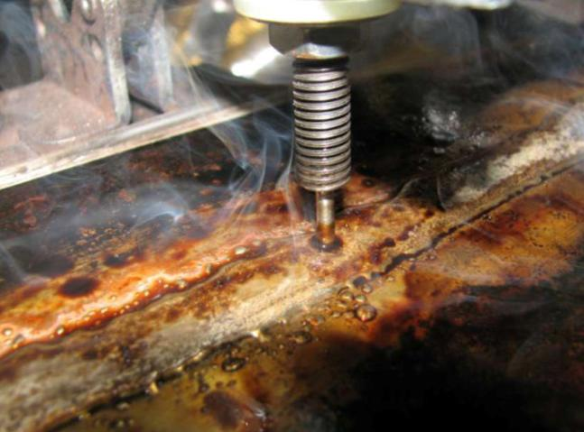
Center Stack - Inner TF soldering development successful! issues; solder flux, heating process, quality of final product (ie voids, trapped gases)
Bar ground smooth.
Bar heated, solder paste added
Bar placed on heat plate, cooling tube inserted into grove
Solder flowing. Supplemental heat applied by torch.

Slide 6
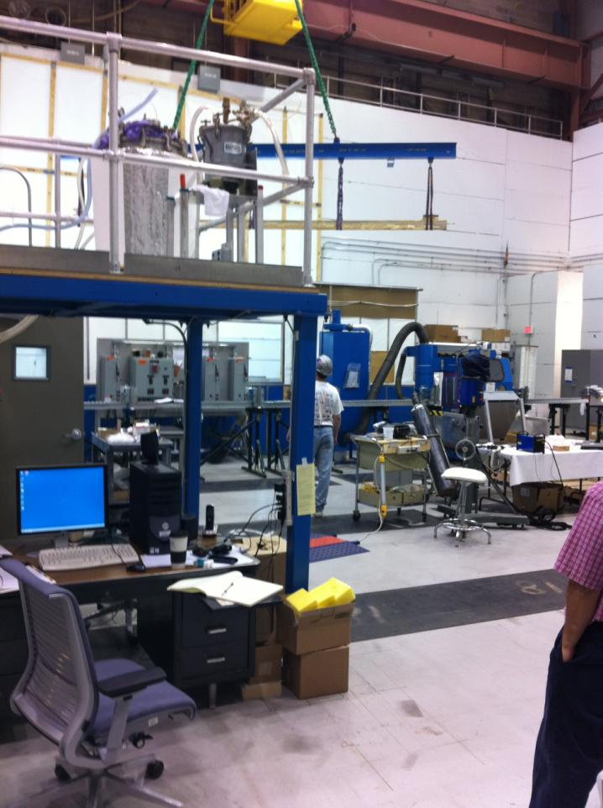
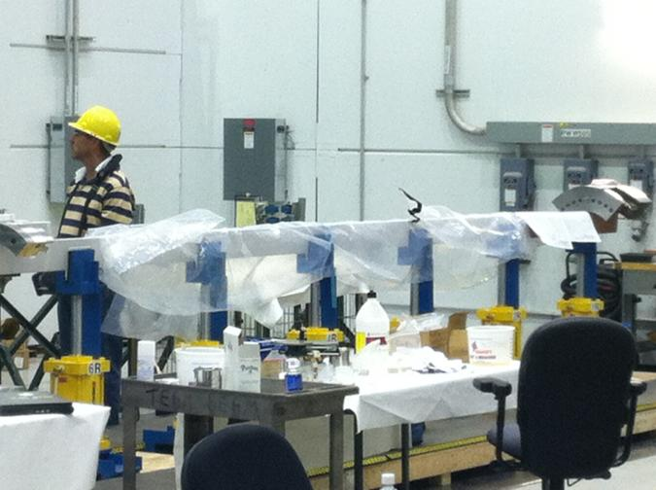
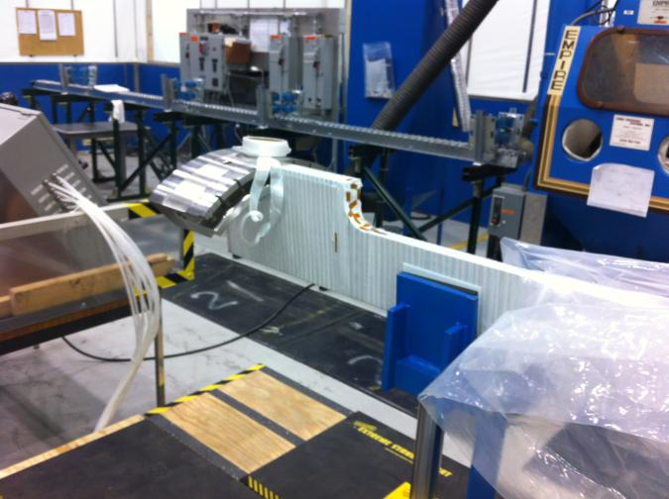
Center Stack - Fabrication underway
Conductor bar being removed from oven after post solder bake out
First bar being test wrapped with insulation
Entering the riskiest stage of the project. Inner TF and OH fabrication and VPI.

Slide 7
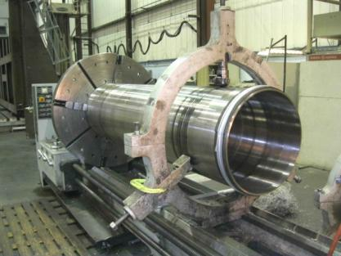
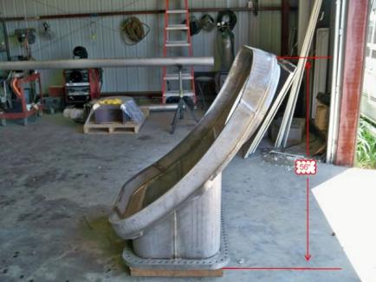
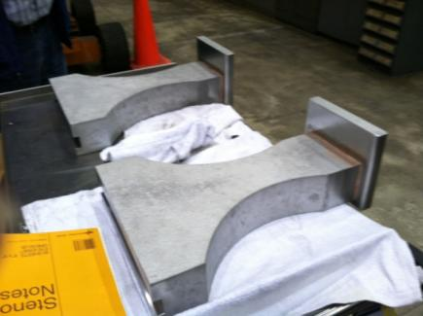
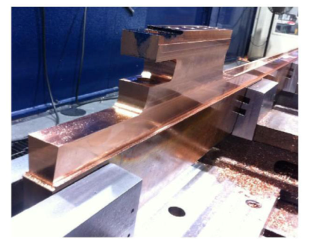
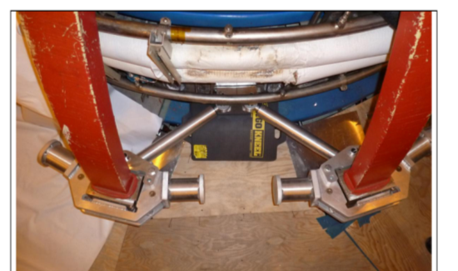
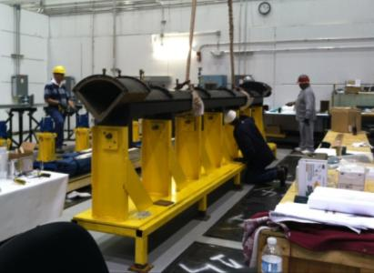
Parts and components being fabricated and delivered by industry
Center stack casing
Neutral Beam port
Umbrella structure legs
Machined Inner TF conductor
Inner TF quadrant mold
Outer TF prototype supports

Slide 8
Near term schedule
6/25 - 9/28 TF clevis welding
7/19 - 11/2 Umbrella legs and PF2/3 clamps
7/2 - 8/17 TF flag holes
7/23- 8/8 Repair JK cap welds
w/o 8/8 Set‐up for vessel cutting at L
8/8 Leak check JK cap
w/o 8/6 Trial fit JK cap to vacuum vessel
w/o 8/13 Vessel cutting at JK
w/o 8/13 Weld JK cap onto vessel
8/8 VPI mockup trials
w/o 8/6 Penetration hole cutting (NSTX test cell into TFTR)
w/o 8/6 Modify TF quadrant mold
w/o 8/13 Begin assembling TF quadrant
September VPI first TF quadrant, Relocate NB box, 36 inner TF conductors received
October CS Casing delivered, all Inner TF conductor cooling tubes soldered
November Install Bay MPTS port, VPI 2nd TF quadrant

Slide 9
On track for early completion
Inner TF bundle fabrication late.
Late Conductor deliveries.
Re-estimated Fabrication time
Bay J/K cap installation due to rework.
Late delivery of coil supports

Slide 10
Performance metrics good
Cost
  CPI = 0.97 CV = - $1,023K
Schedule
  SPI = 1.11 _{(against baseline plan)} Total float = 6 months PLUS 12 months schedule contingency to CD-4
Completion
  Target = April 2014
  Forecast = June 2014
  CD-2 Baseline Early Finish = September 2014
  CD-4 DOE Milestone (PEP) = September 2015
BAC =$79.9 EAC= $82.8 TPC =94.3M
Cost to date = $38.1 M 46% complete
Risk: $2,000k retired since CD-2 Currently $4, 657 remain
Free balance contingency 31% - 26% _{($13.0M)} (27% at CD-2)

Slide 11
Cost
FY 2012
Budget= $23.25M
EAC=$22.25
11

Slide 12
Near Term Risks
COST
Startup/learning curve for CS winding operations
  Mitigation plan;
    manage staff for maximum efficiencies
    bottoms ETC and process ECP for additional budget
Out year funding uncertainties. Reduced funding would increase EAC
Scope creep -Diligence in managing “must, needs, and wants”
TECHNICAL
Inner TF VPI operations (August) epoxy handling issue and TF quadrant hi-pot test.
Mitigation plan ;
Perform epoxy trials and mockup fill
SCHEDULE
Inner TF conductor delivery delays.
Mitigation plan ;
Continued vigilance in meeting with vendor and emphasizing criticality

Slide 13
Summary
The project continues to make good progress but as we enter the more challenging parts of the project additional cost pressures may surface.
Currently, on track for early completion by mid-late FY 2014 with incremental funding.

Slide 14
Agenda
Status of NSTX Upgrade Project – R. Strykowski
NSTX-U operational highlights – M. Ono
5 year plan progress, collaborations – J. Menard

Slide 15
NSTX-U Operational Highlights
Significant research contributions are being made in diverse science areas by the NSTX research team. Summary will be presented today (see next talk), and also available on the web: http://nstx.pppl.gov/DragNDrop/Collaboration/NSTX_collaboration_highlights
NSTX “Snowflake Divertor” team won 2012 R&D 100 Award!
NSTX well represented at PSI, High Temperature Plasma Diagnostic, and EPS meetings.
Expect strong presence at the fall APS and IAEA meetings.
NSTX-U Engineering and Research Operations:
  Rectifier firing generator production run started
  Good CHI gap and PF1C protection design developed
  New 32-core control computer delivered for Plasma Control System
  NSTX-U physics operation planning started

Slide 16
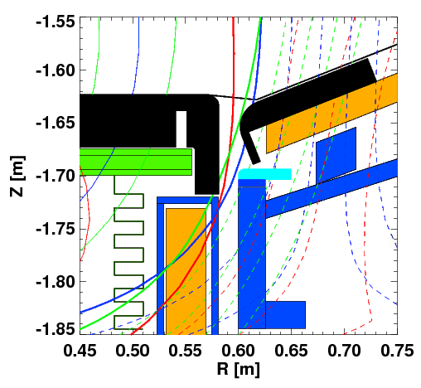
Lower CHI Gap Protection Included in the Upgrade Scope
Need for protecting PF 1C and much greater heatload
Extend IBD edge down to top of PF1C can, increasing thickness to 4.2, leaving a .06” gap between can and tile.
Extend OBD edge down to flange, increasing overall thickness to 3.315
21.5 degrees
Thermocouple
Extend OBD tiles out to R47.25”, changing the design from a facet to a radius
Extend IBD tiles to R22.875
Minimum 1/8 inch gap between the vessel and graphite sections to allow CHI gas injection
PF1C

Slide 17
Proposed Goals are to operate at full forces (I_{P}I_{P}, I_{P}B_{T}, B_{T}B_{T}) in 2 Years, full coil heating in 3rd year
 | NSTX | Year 1 NSTX-U | Year 2 NSTX-U | Year 3 NSTX-U | Ultimate Goal
I_{P} [MA] | 1.4 | 1.6 | 2.0 | 2.0 | 2.0
I_{P}I_{P} [MA²] | 2.0 | 2.5 | 4.0 | 4.0 | 4.0
B_{T} [T] | 0.55 | 0.8 | 1.0 | 1.0 | 1.0
B_{T}B_{T} [T²] | 0.3 | 0.65 | 1.0 | 1.0 | 1.0
I_{P}B_{T} [MA*T] | 0.61 | 1.3 | 2 | 2.0 | 2
Allowed I²t Fraction On Any Coil | 1.0 | 0.5 | 0.75 | 1.0 | 1.0
I_{P} Flat-Top at max. allowed I²t, I_{P}, and B_{T} [s] | ~0.7 | ~3.5 | ~3. | 5 | 5
Table based on assessment of physics needs for first year of operations.
1st year goal: operating points with forces 1/2 the way between NSTX and NSTX-U, ½ the design-point heating of any coil:
  OH F_{Z} apparently requires full influence matrices for essentially ANY operations.
2nd year goal: Full field and current, but still limiting the coil heating.
  Of course, will revisit year 2 parameters once year 1 data has been accumulated.
3rd year goal: Full capability

Slide 18
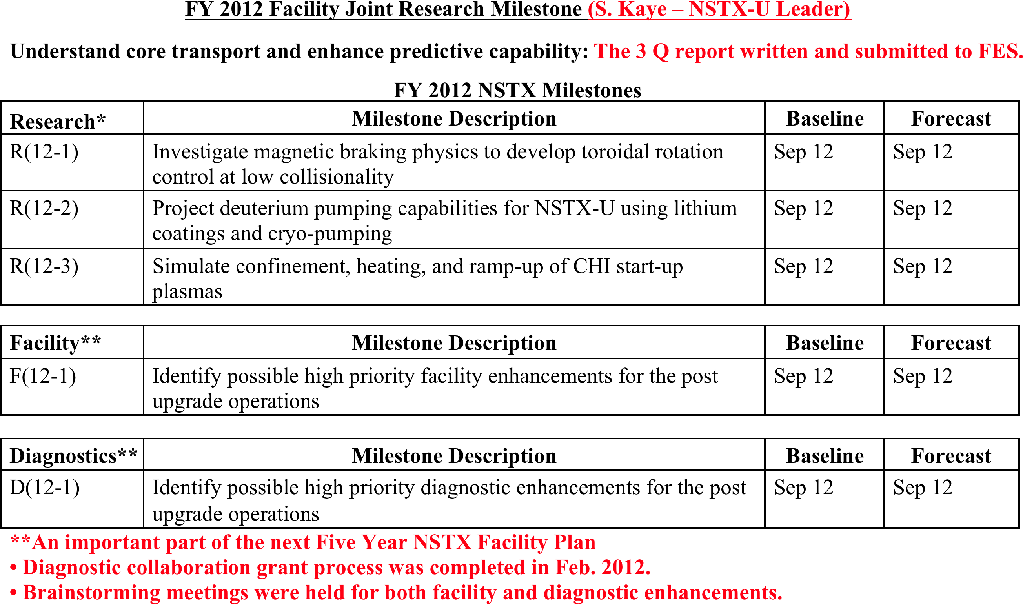
Making Steady Progress on FY12 Milestones
Through Data Analyses, Theory/Modeling, and Collaborations
Notes:
18

Slide 19
Lithium Safety Assessment for NSTX-U
Liquid lithium contact with water must be prevented
Based on the discussions, it appears that because of design and engineering features and inventory limits, lithium work in LTX, NSTX and T260 does not have the potential for an explosive event similar to the one that took place at Sandia.
However, the following potential issues were raised for future lithium activities on NSTX-U:
Need to consider the potential for and consequences of a major magnet arc to the NSTX vacuum vessel that could breach the vacuum boundary and possibly put in-vessel lithium in contact with water leaking/spraying from a failed coil.
Need to consider the potential for and consequences of a water leak inside an NSTX neutral beam box that might come in contact with lithium.
Items 1 & 2 need to be addressed in the forthcoming Safety Assessment Document (SAD) for the NSTX-U and will be reviewed by the NSTX Activity Certification Committee (ACC).
• Near term – LITER, dropper, slapper are likely to be ok due to the relatively modest inventory level.
• Longer term – Possible flowing liquid lithium system with significant volume will require careful safety assessment.

Slide 20
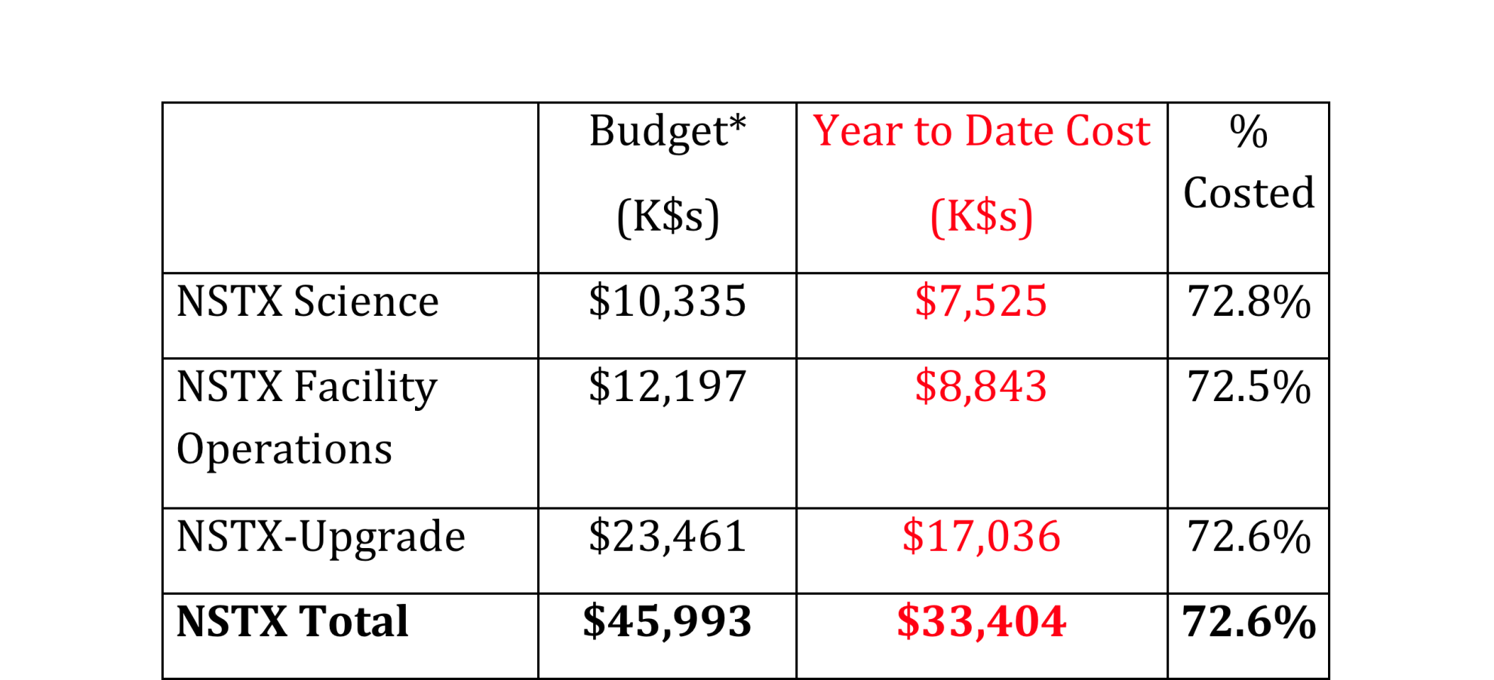
NSTX-U Program Budget (June 30, 2012)
*- Budget reflects June 2012 Close plus $1,515 K additional NSTX-U Funds included in July Fin Plan and includes FY2011 carryover of $884K.
• No Issues to Report
  FY2012 Estimate at Completion within 3% of FY2012 Budget at FY2012 baseline rates

Slide 21
Agenda
Status of NSTX Upgrade Project – R. Strykowski
NSTX-U operational highlights – M. Ono
5 year plan progress, collaborations – J. Menard

Slide 22
Progress on 5 year plan (2014-18) preparation
April/May: Presented initial ideas to PAC-31, got feedback
June-August 2012 – formulate/finalize plan elements and outline, identify/finalize authors, begin writing chapters
  2 weeks ago held internal topical science group review of research thrusts, proposed capabilities and timelines, chapter outlines
  Draft outline will be shared with entire team for comment next week
  Finalizing long-term goals, assessing budgets and achievable scope
    Guidance: For FY2014 and beyond escalate FY2012 by 2.5% each year
    Ok to include an over target case that is 10% higher than the baseline
October 2012 – First drafts of plan chapters due
Nov-Dec 2012 – Internal review/revision/editing of plan
Jan/Feb 2013 – 5 yr plan presentation ‘dry-run’ to PAC-33
Written report due April 1, 2013
Plan presented to review committee and FES early May 2013

Slide 23


Developed comprehensive long-range plan for NSTX-U supporting ITER and FNSF – next step is to down-select based on priorities and budgets
2014 | 2015 | 2016 | 2017 | 2018 | 2019 | 2020 | 2021 | 2022 | 2023
Upgrade Outage
1.5 → 2 MA, 1s → 5s
Advanced PFCs, 5s → 10-20s
Start-up and ramp-up
0.3-0.5 MA CHI
0.5-1 MA CHI
0.2-0.4 MA plasma gun
up to 1 MA plasma gun
Extend NBI duration or implement 2-4 MW off-axis EBW H&CD
New
center-stack
ECH/EBW
1MW
2 MW
Boundary physics
Divertor cryo-pump
Divertor Thomson
Diagnostics for high-Z wall studies
U.S. FNSF conceptual design including aspect ratio and divertor optimization
Materials and PFCs
U or L
Mo divertor
U + L
Mo divertor
All High-Z PFCs
Hot High-Z FW PFCs
Li granule injector
Upward
LiTER
Flowing Li divertor or limiter module
Full toroidal flowing Li divertor
Lithium
MGI disruption mitigation tests
Enhanced RFA/RWM sensors
MHD
NCC coils
NCC SPA upgrade
Transport & turbulence
DBS, PCI or other intermediate-k
High k_{θ}
δB
polarimetry
Wave-particle interactions
HHFW feedthru & limiter upgrade
HHFW straps for EHO, *AE
Dedicated EHO or *AE antenna
2nd NBI
Scenarios and control
Rotation control
Snowflake
control
Divertor
radiation
control
q_{min} control
Control integration

Slide 24
NSTX researchers pursuing targeted collaboration program on fusion facilities in support of NSTX-U, ITER, FNSF
Transport and Turbulence
Macroscopic Stability
Energetic Particles
Solenoid-Free Plasma Start-up
Wave Heating and Current Drive
Advanced Scenarios and Control
Boundary Physics and Lithium Research

Slide 25
NSTX researchers pursuing targeted collaboration program on fusion facilities in support of NSTX-U, ITER, FNSF
Transport and Turbulence
Macroscopic Stability
Energetic Particles
Solenoid-Free Plasma Start-up
Wave Heating and Current Drive
Advanced Scenarios and Control
Boundary Physics and Lithium Research

Slide 26
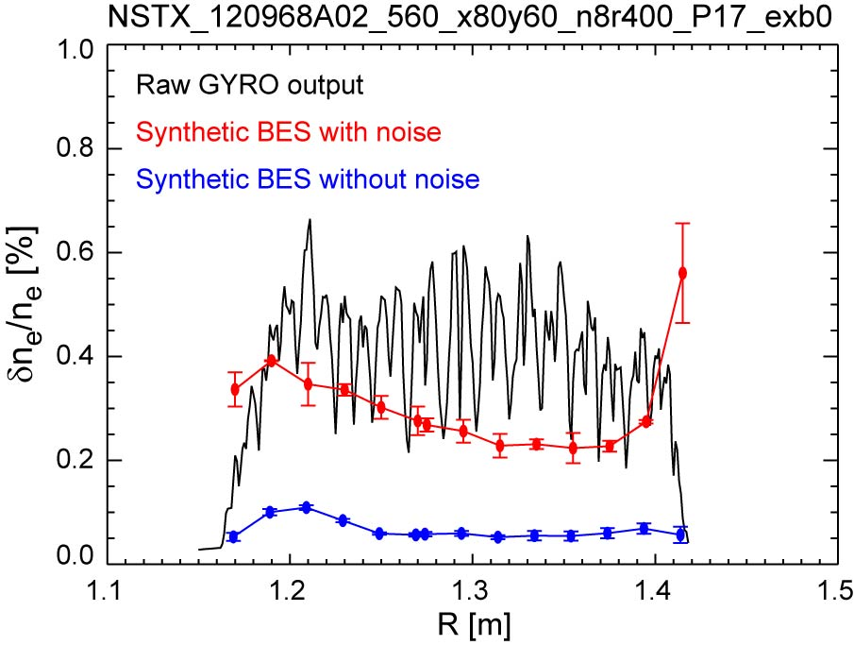
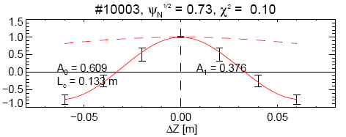
MAST-NSTX collaboration testing sensitivity of BES to microtearing turbulence through synthetic diagnostics
Using nonlinear NSTX microtearing simulations from GYRO with synthetic diagnostic for MAST BES
  Difficult to detect MT with expected signal-to-noise ratio (uncorrelated noise dominates)
  If S/N can be increased (e.g. significant time averaging) MT features may be measurable, such as:
  detectable correlated fluctuation levels (δn/n~0.1%)
  large poloidal correlation lengths (L_{p}~15-20 cm)
Future plans:
Pursue non-linear simulations for MAST discharges with available BES data
Propose experiments for FY13 at next MAST research forum (Dec 2012) to focus on relationship between collisionality scaling and microtearing turbulence
Density fluctuation (rms)
Poloidal correlation from synthetic diagnostic
(without noise)
W. Guttenfelder, et al. PPPL

Slide 27
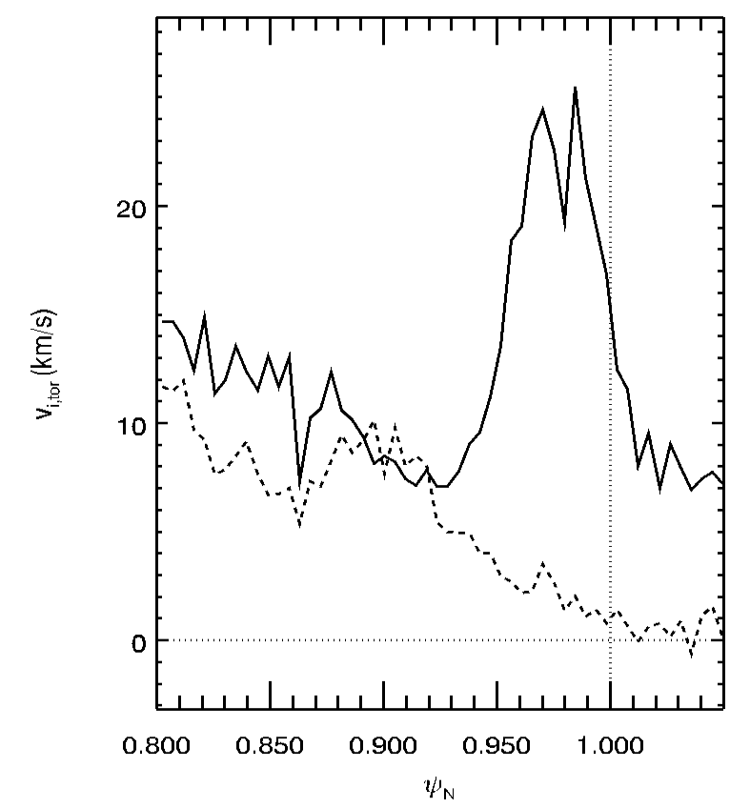
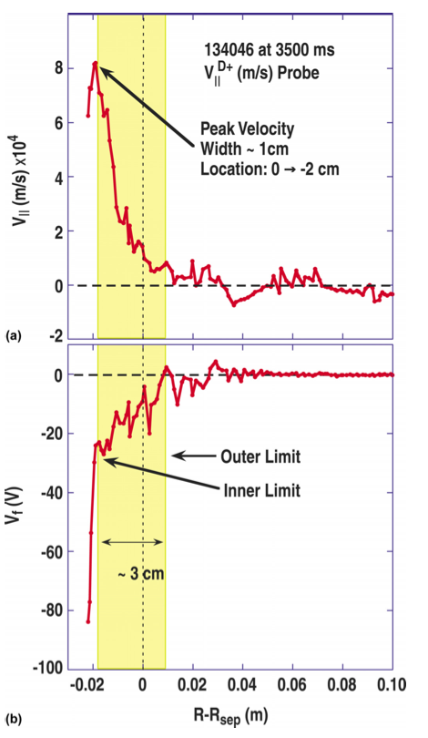
Kinetic neoclassical effects in DIII-D H-mode pedestal using XGC0
To help answer important questions on edge rotation, main-ion physics and SOL flows.
Preliminary results using XGC0 simulation of edge main-ion velocity driven by X-loss
Deuterium edge velocity measured by Mach Probe
J.A. Boedo et al., PoP 18 032510 (2011)
Initial profile
End of simulation
D. Battaglia et al., (PPPL)

Slide 28
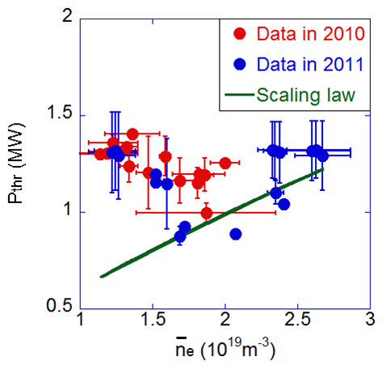
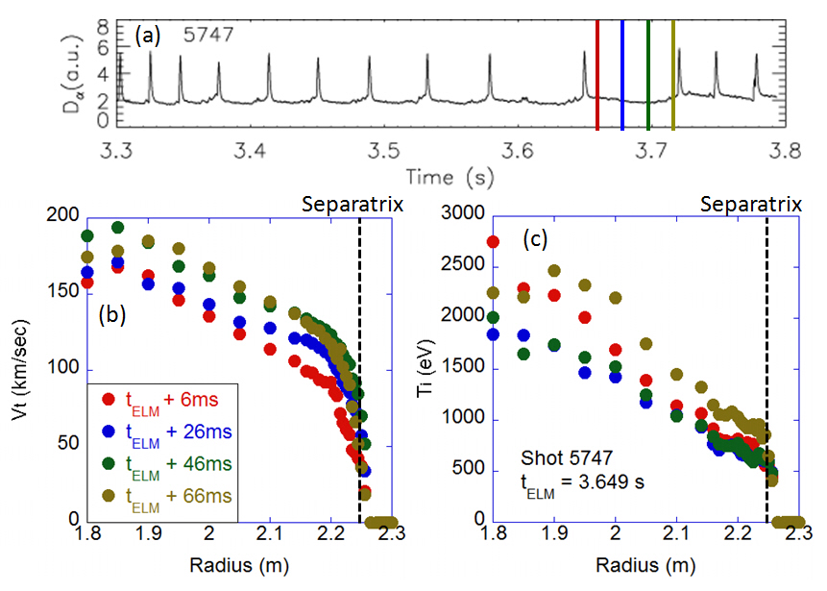
H-mode power threshold and confinement / ELM study at KSTAR
Dependence of L-H power threshold (P_{thr}) on density revealed roll-over at n_{e} ~ 2e19 m⁻³, while there is no such a dependence in the present multi-machine scaling laws.
Four types of ELMy H-mode were identified even with low NBI power (P_{NBI} = 1.5MW); (1) large type-I ELMs with H₉₈=0.8-0.9, (2) intermediate (possibly type-III) ELMs with H₉₈=0.6-0.8, (3) mixed (type-I + small) ELMs with H₉₈=0.9-1.0, and (4) small ELMs with H₉₈=0.8-0.9
Measured L-H power threshold in low density regime¹
Profile measurement for type-I ELMy H-mode shows that the recovery of T_{i} pedestal after the ELM crash only occurs at the last stage of the inter-ELM period, i.e. > 80 % of the ELM cycle. V_{t} and T_{e} pedestal continue to build up during the whole ELM cycle.
Vt and Ti profile evolution during the ELM cycle¹
¹J-W. Ahn, ORNL submitted to NF (2012)

Slide 29
NSTX researchers pursuing targeted collaboration program on fusion facilities in support of NSTX-U, ITER, FNSF
Transport and Turbulence
Macroscopic Stability
Energetic Particles
Solenoid-Free Plasma Start-up
Wave Heating and Current Drive
Advanced Scenarios and Control
Boundary Physics and Lithium Research

Slide 30
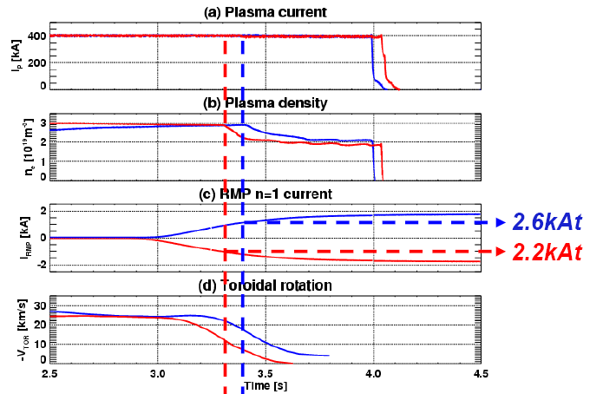
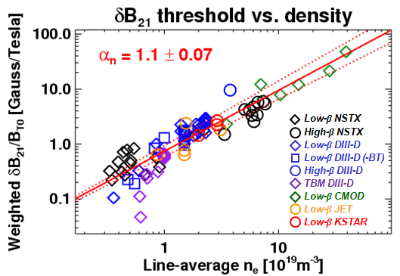
Study on Error Field and Locking in KSTAR
In 2011, n=1 EF study was successfully initiated
Non-axisymmetric plasma response was investigated with resonant (+90 phasing) and non-resonant (-90 phasing) fields, indicating the possibility of a very small intrinsic error field
Resonant field thresholds were analyzed by IPEC and consistently combined with locking scaling for tokamaks (ITPA activity)
Plan for 2012: The n=1 EF study will be extended to full 4 toroidal phase scan in both resonant and non-resonant cases, and also to fully shaped L-mode and H-mode plasmas
J-K Park, et al., PPPL

Slide 31
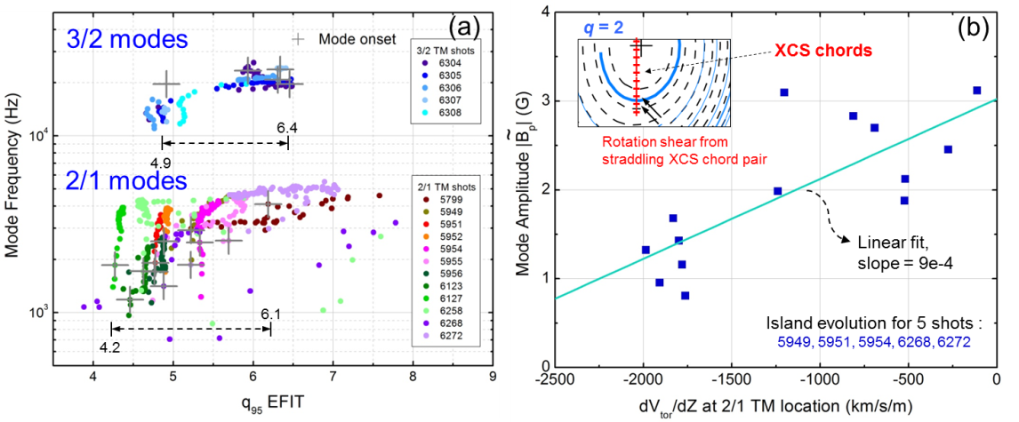
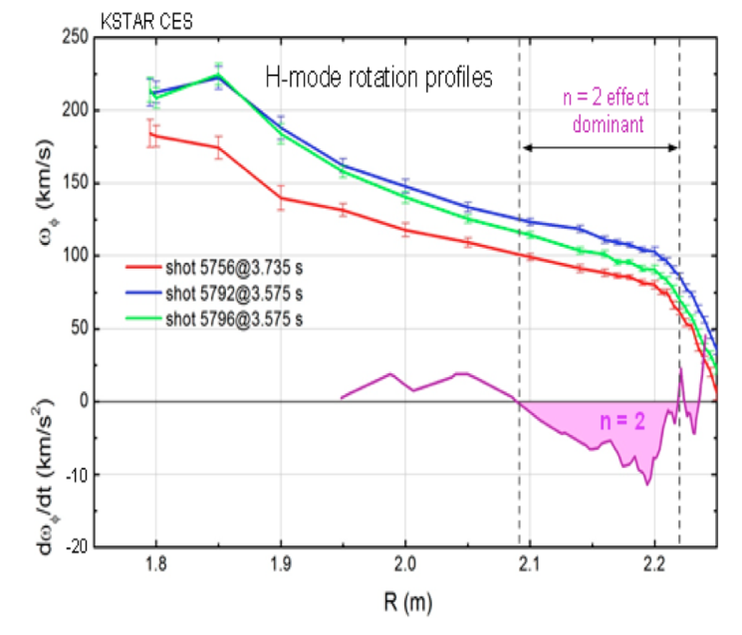
KSTAR 2/1 and 3/1 rotating MHD mode onset, and correlation with plasma rotation shear, and n=2 NTV braking profile characterized
Initial assessment of tearing mode onset (indicated by crosses) vs. q95.
Tearing mode amplitude vs. rotation shear for KSTAR plasmas.
n = 2 NTV braking profile on KSTAR using KSTAR CHERS data.
Columbia Plans for 2012
  Conduct experiment to approach/reach the n = 1 no-wall stability limit
  Characterize MHD instabilities in this regime, experimentally examine RWM stability
  Compute non-resonant NTV braking profile; examine neoclassical offset velocity and dependence on collisionality
Y.S. Park, S. Sabbagh et al., Columbia U

Slide 32
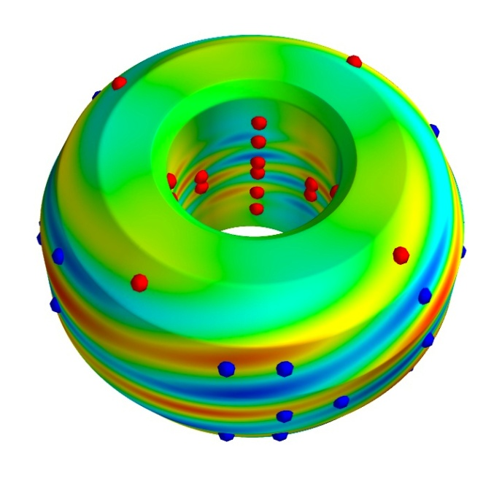
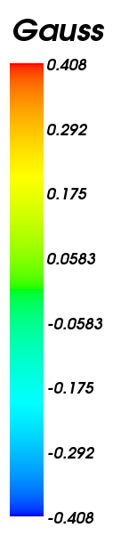
NSTX IPEC Graduate Thesis Collaboration with DIII-D will use expanded magnetic probe array to study E-M torque sources
Ideal Perturbed Equilibrium Code (IPEC) applied in Physics Validation Review of 3D Magnetic Sensor Upgrade (Spring 2012)
  New python post processor: 3D/2D visualization, synthetic diagnostics, vessel geometry, mode reconstruction, error sensitivity analysis, etc.
  Over 100 new probes to be installed: Optimized for n ≤ 4 plasma response detection
    High field side sensors fully redesigned for expected complex poloidal structures
  Calibration and installation to begin this fall
Perturbed plasma field at DIII-D wall (with synthetic diagnostic locations)
Semi-automated EM torque measurement GUI completed in preparation for upgraded magnetic data for NTV and resonant breaking (spring 2012)
  Initial application for n ≤ 2 has exposed required accuracy limits
NTV torque module being built into IPEC (summer 2012)
  Extension to non-ideal equilibrium calculation (2012-13) will be applied in support of 3D magnetics EM torque measurement experiments
Full thesis proposal presented last week
N.C. Logan et al., (PPPL)
Advisors: J. Menard, J-K Park, T. Strait

Slide 33
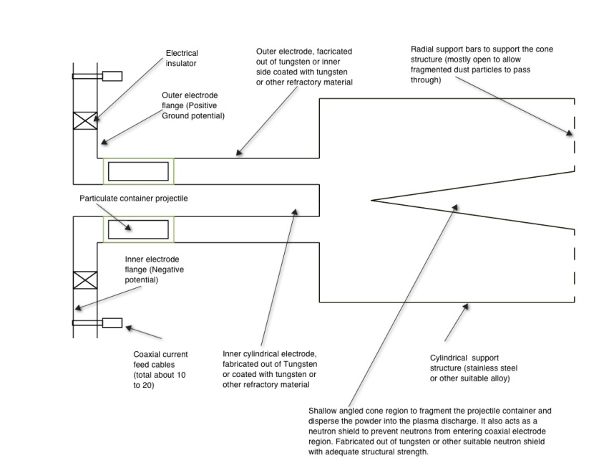
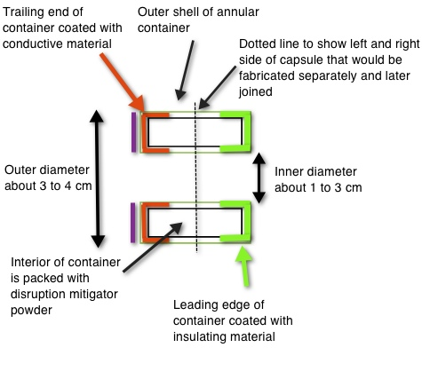
An Electromagnetic Massive Particle Delivery System has Several Advantages over Conventional Methods for Disruption Mitigation in ITER
Well suited for long stand-by mode operation
  Large particle inventory
  All particles delivered at nearly the same time
  Particles tailored to contain multiple elements in different fractions and sizes
  Single system for varying initial plasma parameters
    Tailored particles fully ionized only in higher current discharges
  - Particle penetration not impeded by B-fields
Toroidal nature and conical disperser ensures that,
  - The capsule does not enter the tokamak intact
  - The capsule will fragment symmetrically and deliver a uniform distribution of particles (or via. tapered final section)
Coaxial Rail Gun is a fully electromagnetic system with no moving parts, so should have high reliability from long stand-by mode to operate on demand
  Conventional gas guns will inject gas before capsule
Injector
Capsule
Detailed design of a proto-type system now underway
R. Raman et al, U. Washington

Slide 34
NSTX researchers pursuing targeted collaboration program on fusion facilities in support of NSTX-U, ITER, FNSF
Transport and Turbulence
Macroscopic Stability
Energetic Particles
Solenoid-Free Plasma Start-up
Wave Heating and Current Drive
Advanced Scenarios and Control
Boundary Physics and Lithium Research

Slide 35
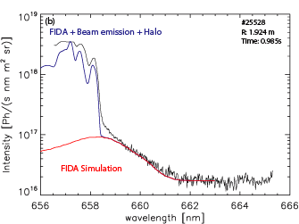
UC Irvine collaborations on Fast-ion D-alpha (FIDA) diagnostics on ASDEX-U and MAST
Assisted development by Ben Geiger of ASDEX FIDA diagnostic¹
Geiger developed faster version of our synthetic diagnostic code FIDASIM²
Assisted development by Clive Michael of MAST FIDA diagnostic
Ongoing collaboration with Mirko Salewski (Danish Technical University) on inferring the distribution function from FIDA measurements³
Advised Rob Akers (Culham) on a new fast-ion simulation code that uses graphical processing units
ASDEX-U Data
¹Geiger, PPCF 53 (2011) 065010
²Heidbrink, CiCP 10 (2011) 716
³Salewski, NF 52 (2012) accepted

Slide 36
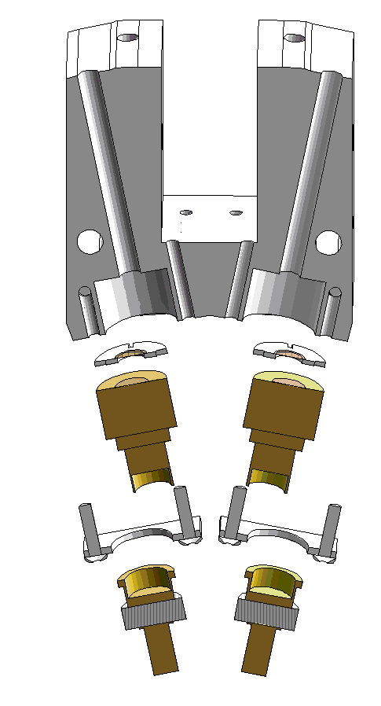
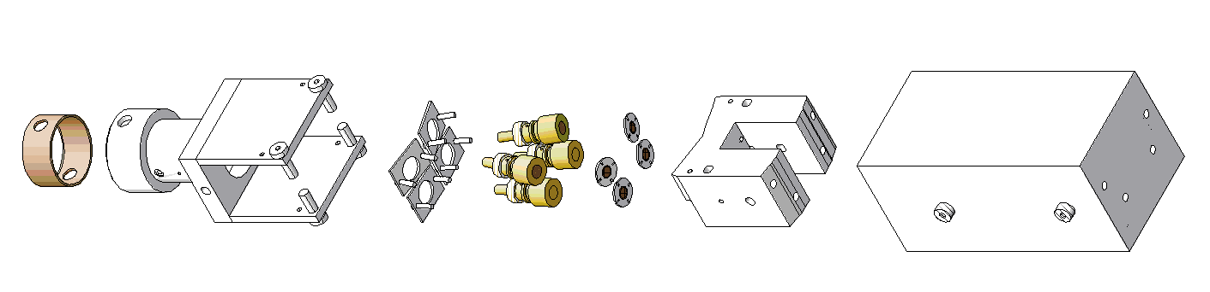
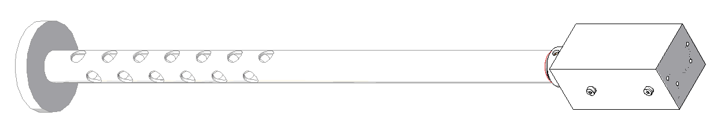
NSTX-U Charged Fusion Products Diagnostic on MAST
Provides fusion reactivity profile due to MHD and other phernomena
Collaborators: FIU, MAST, PPPL
MAST Installation: November 2012
Objective: obtain time-dependent, precise information on the d(d,p)t fusion rate profile with the goal of determining the neutral beam ion density profile as a function of R, z, and t
Shield
Module
Foils
Detectors
Bases
Connector
R. Perez et al., Florida International University

Slide 37
NSTX researchers pursuing targeted collaboration program on fusion facilities in support of NSTX-U, ITER, FNSF
Transport and Turbulence
Macroscopic Stability
Energetic Particles
Solenoid-Free Plasma Start-up
Wave Heating and Current Drive
Advanced Scenarios and Control
Boundary Physics and Lithium Research

Slide 38
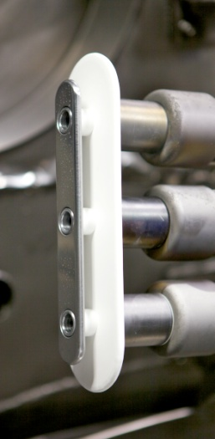
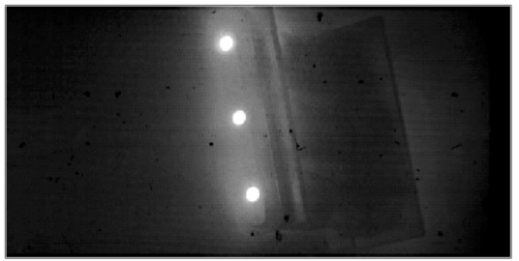
Developments in Conceptual Design of Local Helicity Injectors for Potential NSTX-U Application
Tests on Pegasus ST experiment
• Plasma gun current sources with integrated electrode assembly tested in Pegasus over last ¾ year.
• New single-gun/electrode assembly installed for testing this Summer-Fall.
- With integrated piezo-controlled gas valve
Arc plasma current source
Electrode current source
Framing camera images (~10 µsec) of current injectors in the scrape-off-layer region of a Pegasus discharge. I_{inj} ~ 3 kA; I_{p} ~ 100 kA.
Three arc sources and integrated Mo electrode assembly
R. Fonck et al, U. Wisconsin
D. Mueller (PPPL) to collaborate with Pegasus

Slide 39
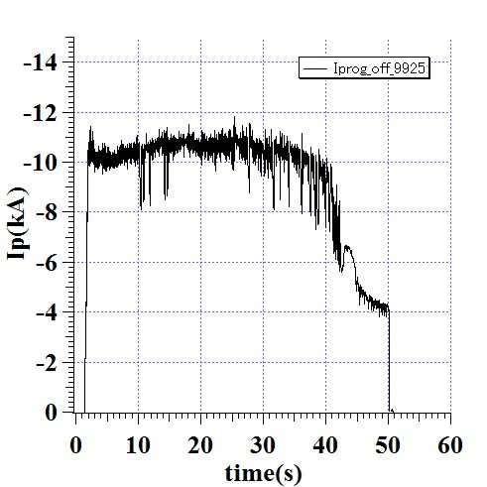
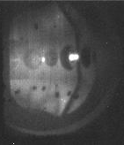
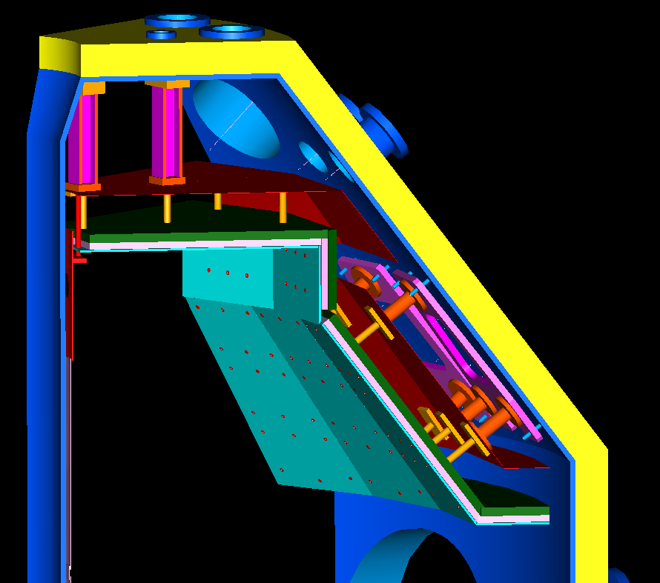
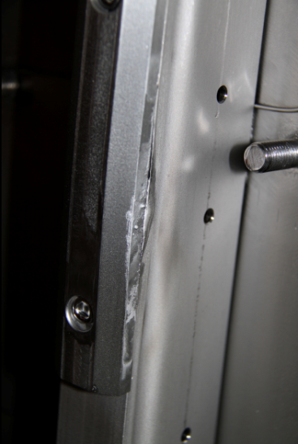
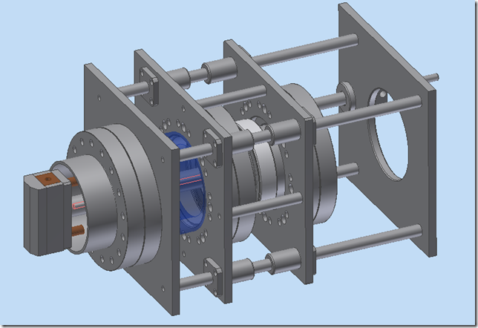
Collaboration with QUEST
Newest ST in Japan: All metal PFCs, non-inductive long pulse
ECH sustained discharge
Hot spot developed
R. Raman et al, U. Washington
Future Direction:
• Higher power ECH (8.5 GHz, 28 GHz)
Total power ~ 1 MW long pulse
• Hot wall for particle control
• All metal CHI being considered
U. Washington / NSTX collaboration
Hot spot
8.2 GHz, ~ 100 kW
Hot wall (up to 500 °C) planned for 2014
Melted moly limiter
Water cooled tungsten movable limiter
Radiation
Shield
Heater
Cooling panel
Thermal
Isolator
Hot wall
Vacuum Vessel

Slide 40
NSTX researchers pursuing targeted collaboration program on fusion facilities in support of NSTX-U, ITER, FNSF
Transport and Turbulence
Macroscopic Stability
Energetic Particles
Solenoid-Free Plasma Start-up
Wave Heating and Current Drive
Advanced Scenarios and Control
Boundary Physics and Lithium Research

Slide 41
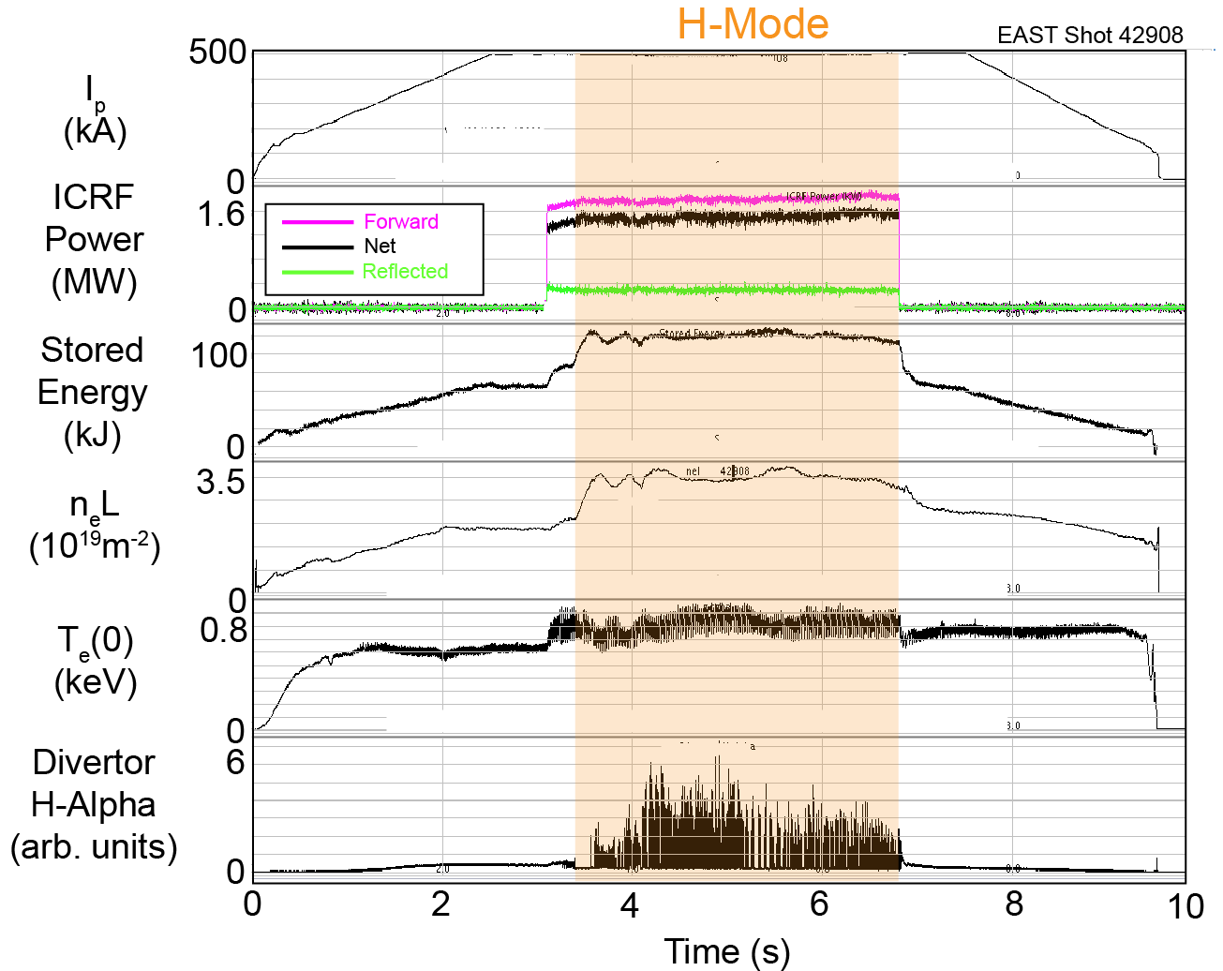
EAST: Achieved 3.5 s duration ICRF-generated H-mode on Terminated only when ICRF power was turned off
200 ms ELM-free
period after L→H
Transition
Followed by
"Grassy" ELMing
until H→L back
transition
ELM frequency
150 - 500 Hz
Measured core
electron heating
30% increase in
stored energy at
L→H transition
G. Taylor, et al., PPPL
June 20, 2012

Slide 42
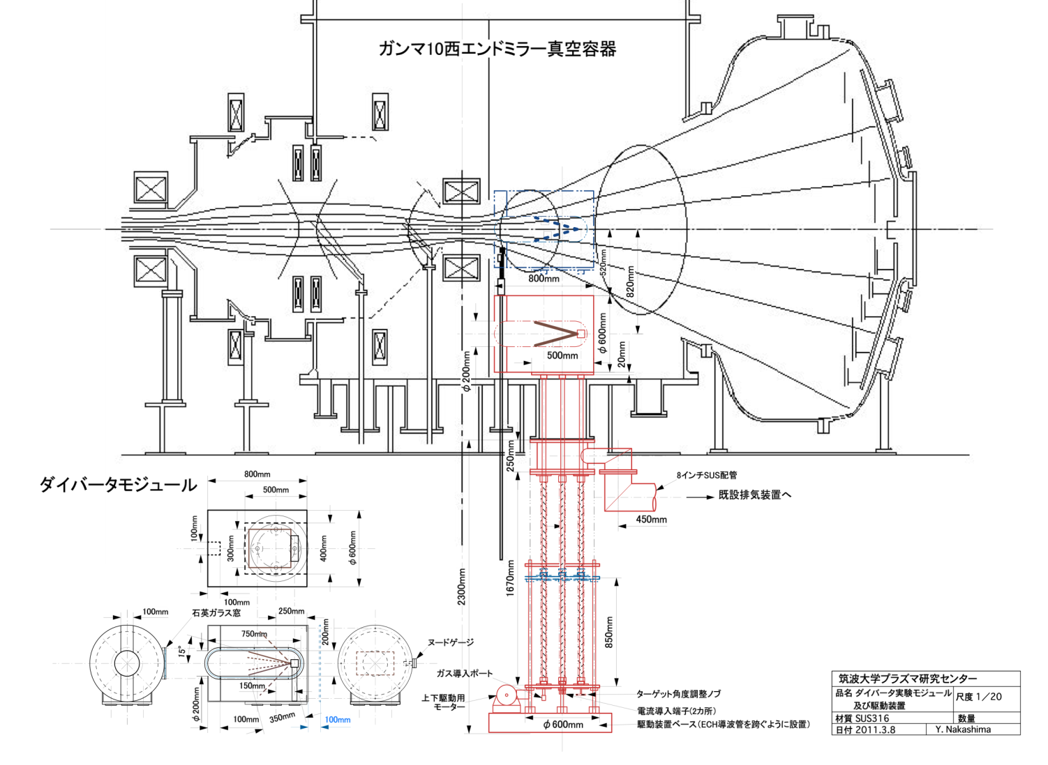
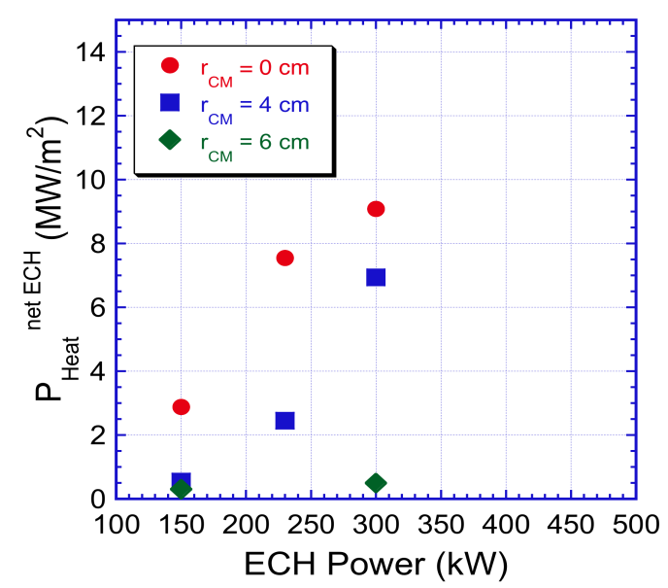
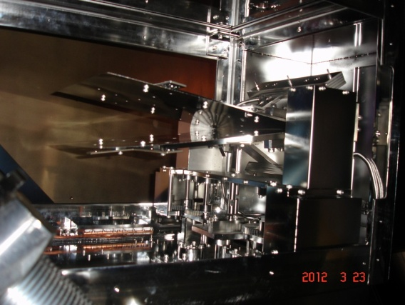
Collaboration with Gamma-10 Group
New PMI research direction and 28 GHz Gyrotron R&D
28GHz Gyrotron is required in GAMMA10
This Gyrotron will be used to achieve higher plasma performance.
Ex) axial ion confining potential, heats electrons, heat flux
28GHz Gyrotrons are required in some plasma experimental devices.
  • NSTX (Princeton University ):
  2MW – several seconds
  Ex) ECH, ECCD, EBW experiment etc.
  Improved design of 28GHz 1MW Gyrotron for development of 2MW Gyrotron
Targeted heat-flux level
ITER relevant level
ECH Power limit
M. Ono et al, PPPL

Slide 43
NSTX researchers pursuing targeted collaboration program on fusion facilities in support of NSTX-U, ITER, FNSF
Transport and Turbulence
Macroscopic Stability
Energetic Particles
Solenoid-Free Plasma Start-up
Wave Heating and Current Drive
Advanced Scenarios and Control
Boundary Physics and Lithium Research

Slide 44
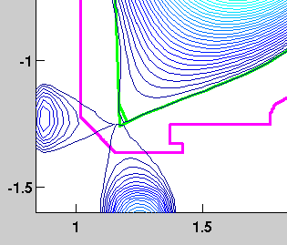
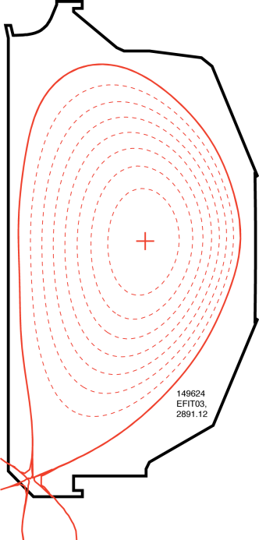
Snowflake divertor studies started at DIII-D
  • LLNL collaboration with PPPL and GA on magnetic control development on-going
    - Successfully implemented snowflake divertor scenario at DIII-D enabling the initial physics experiment
  • DIII-D: Evaluation of snowflake geometry on pedestal stability, steady-state and ELM divertor heat flux, radiation, and cryo-pump operation
    Ran a ½ run day snowflake divertor experiment in July 2012
    Demonstrated steady-state (2-3 s) snowflake-minus and plus configurations at σ = d_{X-X}/a_{minor}=0.15-0.20
    Demonstrated beneficial magnetic geometry properties
    Demonstrated significant (x4-8) steady-state peak divertor heat flux reduction via geometry compatible with good confinement
    Demonstrated radiative detachment at 0.6-0.75 x n/n_{G} with large radiation fraction and slight confinement degrardation
Modeling
DIII-D experiment
V. Soukhanovskii (LLNL) and E. Kolemen (PPPL) et al.,

Slide 45
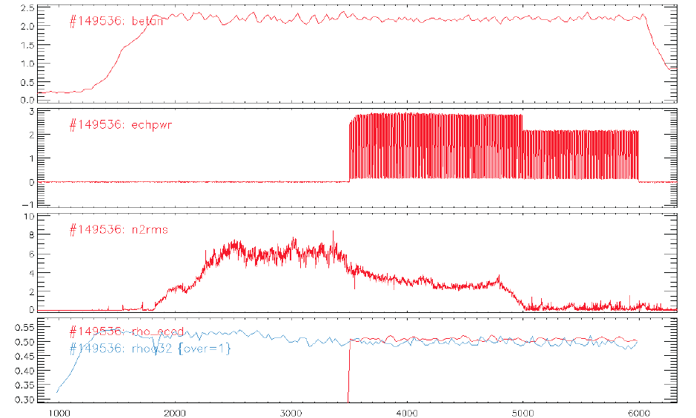
Successful NTM suppression with feed-back on q-surface with real-time steerable mirror – important for ITER, extend to NSTX-U EBW-CD?
Real-time steerable mirror control of the EC deposition location
– Faster NTM suppression
– Capability to run experiments consistently in high beta.
– Possibility to control NTMs with lower EC power.
– Suppress multiple islands at the same time
• Calculate the q-surface location corresponding the NTM mode (3/2, 2/1).
• Request the mirror to move to follow the angle that correspond to intersection of the q-surface with the 2fce using Ray tracing.
• Control designed for tracking performance using Relay-Feedback.
• Great performance with <<1 cm error.
E. Kolemen et al., (PPPL)

Slide 46
NSTX researchers pursuing targeted collaboration program on fusion facilities in support of NSTX-U, ITER, FNSF
Transport and Turbulence
Macroscopic Stability
Energetic Particles
Solenoid-Free Plasma Start-up
Wave Heating and Current Drive
Advanced Scenarios and Control
Boundary Physics and Lithium Research

Slide 47
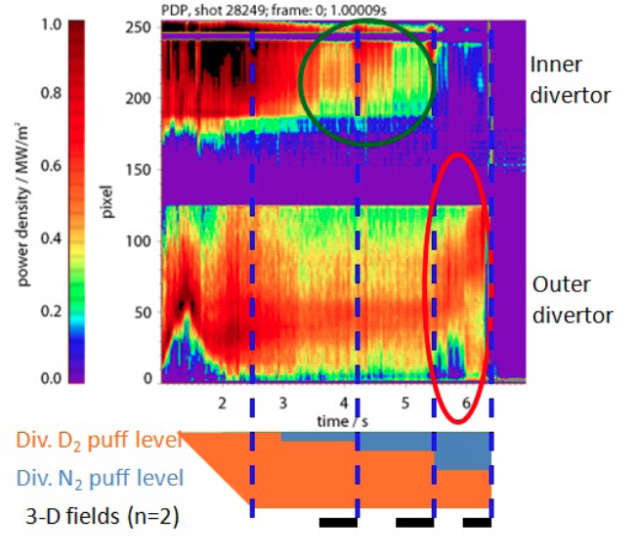
3-D Field Effects on Divertor Detachment
Explored in ASDEX-U
Temporal evolution of divertor heat flux profile during the divertor gas puff and 3-D field application
Deuterium gas puffing induced power detachment at outer divertor but particle detachment was only produced by additional nitrogen puffing
3-D fields (n=2) application reduced the inner divertor power density but there was no change at the outer divertor.
Applied 3-D fields reduced particle detachment at the outer divertor, which is consistent with the NSTX result.
3-D fields brought the outer divertor heat zone back in, closer to the strike point (sign of power re-attachment, similar to the observation in NSTX) although the particle detachment was becoming stronger. This data suggests that there is a possibility of a de-coupling of the power and particle detachments.
J-W. Ahn et al. ORNL

Slide 48
Pedestal Width and Height Scalings in C-Mod
Profile analyses of the density and temperature between ELMs performed
Profile analyses of the density and temperature between ELMs performed to characterize the pedestal width and height scalings.
These characterizations motivated the design and planning of future C-Mod experiments targeting the inter-ELM fluctuations characterizations and comparison with EDA- H mode fluctuations.
This experiment has been approved, awaiting scheduling for its execution.
Left: Dalpha time trace showing the fast and slow ELMs. Right: Trends of the pedestal height and width during the various parts of the ELM cycle.
A. Diallo et al., PPPL

Slide 49



Material erosion studies at C-Mod
(high-Z wall and low-Z coatings)
LLNL postdoc on-site at Alcator C-Mod tokamak
Novel LLNL intensified camera diagnostic for molybdenum and boron erosion studies
  Camera installed and calibrated, contributing to physics operations
  Improving techniques for accounting for continuum and Plank emissions
  Analyzing moly and boron limiter erosion and core moly penetration factors including RF, inner-wall startup, and boronization effects
Collaboration with ADAS consortium on improved Mo I and Mo II atomic physics calculations for gross and net erosion measurements
Vlad Soukhanovskii et al., LLNL
Pre-boronization
1120613003 0.2s
Post-boronization
1120614002 0.2s
LLNL moly camera viewing geometry
Mo I emission pre- and post-boronization in C-Mod

Slide 50

NSTX Dust Detector Demonstrated on Tore Supra
C. Skinner et al, PPPL

Slide 51






Preliminary results from EAST GPI experiments
Interested in developing similar multi-view capabilities for NSTX-U
in-vessel hardware
upper GPI image
Inferred turbulence velocities
Side-view
reentrant windows
lower GPI image
Gas manifold
S. Zweben, et al., PPPL

Slide 52

JHU Multi-Energy Soft X-Ray System being implemented for EAST – will serve as prototype for NSTX-U

Slide 53

Cryo-pumping quite sensitive to strike-pt position on EAST and results will help inform NSTX-U cryo-design
Only case with increased density pump-out places strike-point directly at divertor corner (plenum entrance)
Other nearby shapes with +/- 1-2cm x-point height change do not show significant pumping
  Implies precise strike-point control likely needed for particle control with cryo
Potentially important for density control in long-pulse H-mode
  Topic for future EAST collaboration, and for NSTX-U cryo-pump design
Z
[m]
R [m]
J. Menard, M. Jaworski et al., PPPL

Slide 54

From G. Z. Zuo – “Lithium Coating for H-Mode and High Performance Plasmas on EAST in ASIPP” – PSI2012

Slide 55


PPPL Lithium Granule Injector Tested on EAST
Dennis Mansfield (PPPL, retired)
Lane Roquemore (PPPL)
Jiansheng Hu and D. Mansfield
6 inch
Independent Control:
Granule Size
(change between shots)
Injection Speed
(ramp during shots)
Pacing Frequency
(ramp during shots)
Dropper
5.5 inch
10 mm
Li Granules
8 inch
V = 0 - 100 m/s
Freq = 0 - 100 Hz

Slide 56

Triggered ELMs (~ 25 Hz) with 0.7 mm Li Granules @ ~ 45 m/s → could be very useful for triggering ELMs in Li-ELM free H-modes in NSTX-U

Slide 57

Measured lithium pumping trends on EAST versus integrated shot time + shaping parameters (June 2012)
J. Menard, M. Jaworski et al., PPPL
Compared shots with same magnetic balance but similar increment in shot number
  USN pumping stronger than LSN
Observe 30-50% reduction in pumping after 6-8 shots
  Each shot ~10s → 60-80 shot seconds of strong Li pumping
Pumping decreased by factor of 2 after 20-25 shots (not shown)
  200-250 shot seconds
  significant Li passivation

Slide 58


NSTX/PPPL/PU collaboration shows
lithium reacts quickly with residual gases
New Surface Analysis Labs at PPPL
Li surface oxidation time
1 monolayer of lithium on TZM Mo (AES O 1s)
– H₂O
– O₂
– air
– CO
oxide concentration (a.u.)
(TZM = 99% Mo, 0.5% Ti 0.08% Zr)
seconds at 1e-6 torr
Solid lithium (XPS Li 1s))
Surface analysis experiments show PFC oxide coverage is expected in 10s of seconds from residual H₂O at typical NSTX intershot pressures ~1e-7 torr.
Plasma facing surface after Li evaporation is a mixed material rather than ‘lithium coating’.
Short reaction times motivate
flowing Li PFCs
C. Skinner et al, PPPL
PU-PPPL

Slide 59


NSTX MAPP System is being installed on LTX in support of NSTX milestone R(13-2) in collaboration with Purdue U.
Lithium Tokamak Experiment has: 1. 120 cm² Li-filled dendritic W limiter heatable ≤ 500 C
  Thick (>100 micron) evaporated Li films on 3,000 – 5,000 cm² upper heated liner
  Few hundred cm³ pool of liquid Li in the lower shells (total ≤ 85% of plasma surface)
  Will investigate plasma-surface interactions, Li influx vs. temp., confinement, Te profile,
  liquid metal flows in B fields up to 0.3T
Materials Analysis and Particle Probe (MAPP) will be used first on LTX in support of NSTX milestone R(13-2): “Investigate relationship between lithium-conditioned surface composition and plasma behavior” and transferred to NSTX-U later.
MAPP’s innovative design enables sample exposure to plasma and inter-shot surface analysis.
MAPP will be installed on midplane LTX port
MAPP

Slide 60

Lithium transport near divertor target being studied with Magnum-PSI linear test stand
Transport of eroded lithium needed for plasma modeling and PFC development
  Heat flux reduction via lithium radiation in the SOL – how does it get there?
  Control of lithium inventory critical to reactors to avoid tritium codeposition and build-up
Magnum-PSI reproduces divertor plasmas on target
  Lithiated TZM example shown
  Emission profiles in known background plasma provide basis for testing transport models
Lithiated Target
Plasma
Source
Li-I emission during exposure
Li-I emission profile
Shorter decay length
Found in higher density
center
λ_{center} ~ 5mm
λ_{edge} ~ 13mm
M. Jaworski et al, PPPL
Notes:
60

Slide 61
Summary
NSTX Upgrade Project on-track, proceeding well
Good progress in preparing for NSTX-U operations
5 year plan development underway
Team strongly engaged in collaborations supporting NSTX-U, ITER, FNSF → broad scientific impact

Slide 62
Backup

Slide 63


Study on Neoclassical Toroidal Viscosity and Magnetic Braking in KSTAR – extends results from NSTX, DIII-D
In 2011, n=1 resonant magnetic perturbations were successfully used to modify ELMs, under strong collaborations with PPPL
Magnetic braking of rotation was also observed and analyzed by combined NTV theory
Combined NTV theory predicted +180 phasing>midplane alone>+90 phasing for NTV, consistently with observed magnetic braking and rotation damping
Plan for 2012: NTV braking experiments, focused on bounce-harmonic and superbanana-plateau resonances, will be performed, and PPPL support on computations will be continued
Theory
180P
Mid
90P
Mid (~1/sec)
Experiment
J-K Park, et al., PPPL

Slide 64
KSTAR equilibrium operation space compared to n = 1 ideal no-wall MHD stability limit demonstrating KSTAR plasma approach toward this limit.
Standard (l_{i}, β_{N}) operational stability space diagram for KSTAR through the year 2011 along with the static ideal n = 1 MHD no-wall for H-mode pressure profiles. The red arrow indicates the primary direction targeted for plasmas in this experiment.
(l_{i}, κ) operational stability diagrams for the present KSTAR database. The grey area represents the design target region.
Y.S. Park, S. Sabbagh et al., Columbia U

Slide 65


Lab-based R&D on liquid metal technology will inform long term PFC decisions:
Thin flowing Li film in FLiLi (Zakharov)
Pre-NSTX-U restart R&D initiated by PPPL:
Laboratory studies of D uptake as a function of Li dose, C/Mo substrate, surface oxidation, wetting…
Tests of prototype of scalable flowing liquid
lithium system (FliLi) at PPPL and on HT7
Basic liquid lithium flow loop on textured surfaces
Analysis and design of actively-cooled PFCs with Li flows due to capillary action and thermoelectric MHD
Magnum-PSI tests begin June 2012
Four proposals on Li-PFCs submitted to OFES Materials Solicitation to extend above work.
Preparing for upcoming international collaboration solicitation, which will include possible tests of
Li PFCs on HT-7 and EAST
Soaker hose capillary porous system concept (Goldston)
mesh
Li
Coolant
(He, supercritical CO₂, Na heatpipe…)
R. Kaita et al, PPPL

