Slide 1




NSTX-U
Supported by
NSTX-U FY2013 Year-end Report:
Notable outcomes, research milestones
Coll of Wm & Mary
Columbia U
CompX
General Atomics
FIU
INL
Johns Hopkins U
LANL
LLNL
Lodestar
MIT
Lehigh U
Nova Photonics
Old Dominion
ORNL
PPPL
Princeton U
Purdue U
SNL
Think Tank, Inc.
UC Davis
UC Irvine
UCLA
UCSD
U Colorado
U Illinois
U Maryland
U Rochester
U Tennessee
U Tulsa
U Washington
U Wisconsin
X Science LLC
J. Menard (PPPL)
Culham Sci Ctr
York U
Chubu U
Fukui U
Hiroshima U
Hyogo U
Kyoto U
Kyushu U
Kyushu Tokai U
NIFS
Niigata U
U Tokyo
JAEA
Inst for Nucl Res, Kiev
Ioffe Inst
TRINITI
Chonbuk Natl U
NFRI
KAIST
POSTECH
Seoul Natl U
ASIPP
CIEMAT
FOM Inst DIFFER
ENEA, Frascati
CEA, Cadarache
IPP, Jülich
IPP, Garching
ASCR, Czech Rep
FES Room G258
PPPL Room B205
October 22, 2013

Slide 2
FES FY2013 Notable Outcomes for NSTX-U
Outcome 1.1a “Support the FES joint research target to explore enhanced confinement regimes without large edge instabilities, but with acceptable edge particle transport and a strong thermal transport barrier and to extrapolate these regimes to ITER.”
Outcome 1.2a “Carry out high impact research relevant to NSTX-U through domestic and international collaborations”
Outcome 3.1b – “Develop a prioritized research plan for NSTX-U to provide an assessment, within five years, of the viability of the ST concept as an attractive Fusion Nuclear Science Facility”

Slide 3
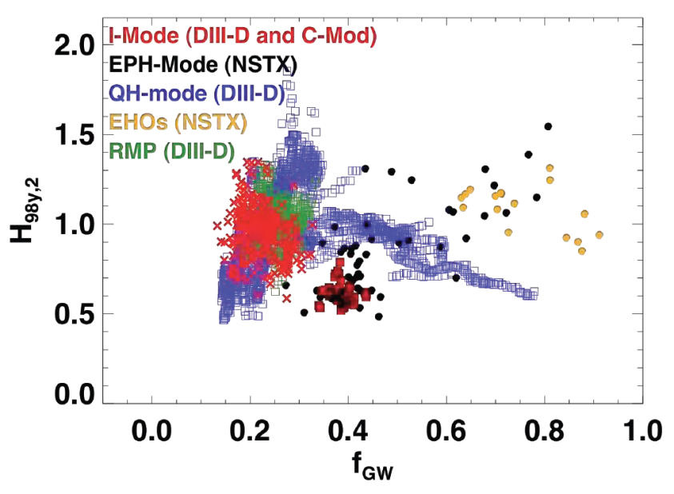
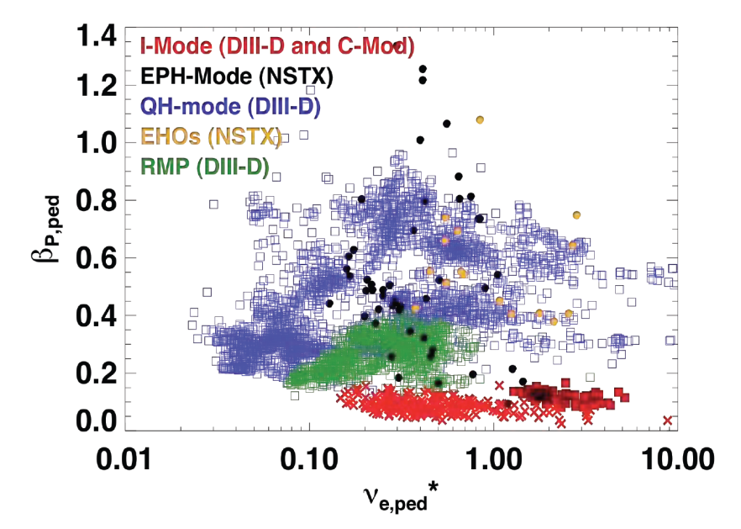
Outcome 1.1a “Support the FES joint research target (1) to explore enhanced confinement regimes without large edge instabilities, but with acceptable edge particle transport and a strong thermal transport barrier and to extrapolate these regimes to ITER.”
Stefan Gerhardt (PPPL) was JRT leader and coordinated group telecons and discussions/meetings between the participating researchers
NSTX team contributed data from Enhanced Pedestal H-mode (EP H-mode) – an attractive regime of nearly stationary high confinement + high β
NSTX research into EP H-mode developed:
  Better understanding of the range of ion temperature profile shapes in EPH
  Improved correlations between T_{i} pedestal parameters and the edge rotation shear
  An assessment of turbulence as inferred from the edge reflectometer (UCLA), and examined those results with XGC0 and GS2 modeling

Slide 4
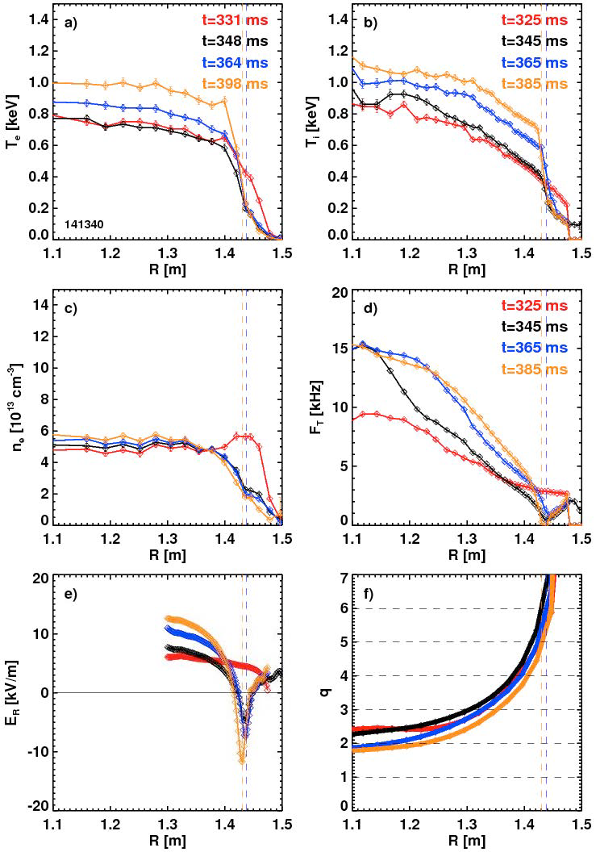
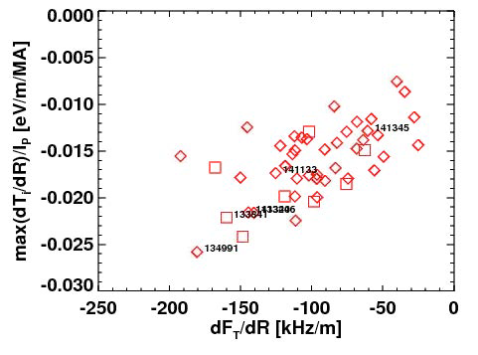
Outcome 1.1a “Support the FES joint research target (2) to explore enhanced confinement regimes without large edge instabilities, but with acceptable edge particle transport and a strong thermal transport barrier and to extrapolate these regimes to ITER.”
Maximum normalized Ti gradient proportional to rotation shear
BES, FIR: no reduction in fluctuation amplitudes evident during EPH
XGC0: ion thermal profiles most consistent w/ kinetic neoclassical
GS2: plasma is 2nd stable (KBM not observed), increasing ∇T_{i} stabilizing, most dominant mode TEM/KBM hybrid

Slide 5
Outcome 1.2a “Carry out high impact research relevant to NSTX-U through domestic and international collaborations”
A few examples:
Heat-flux mitigation development on DIII-D
CHI start-up system design for QUEST at Kyushu, Japan
EBW start-up, fast-ion, and transport research on MAST
MHD stability and NTV research on KSTAR

Slide 6
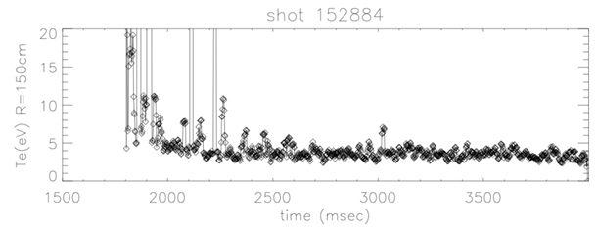
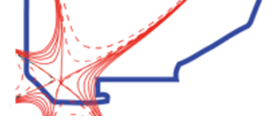
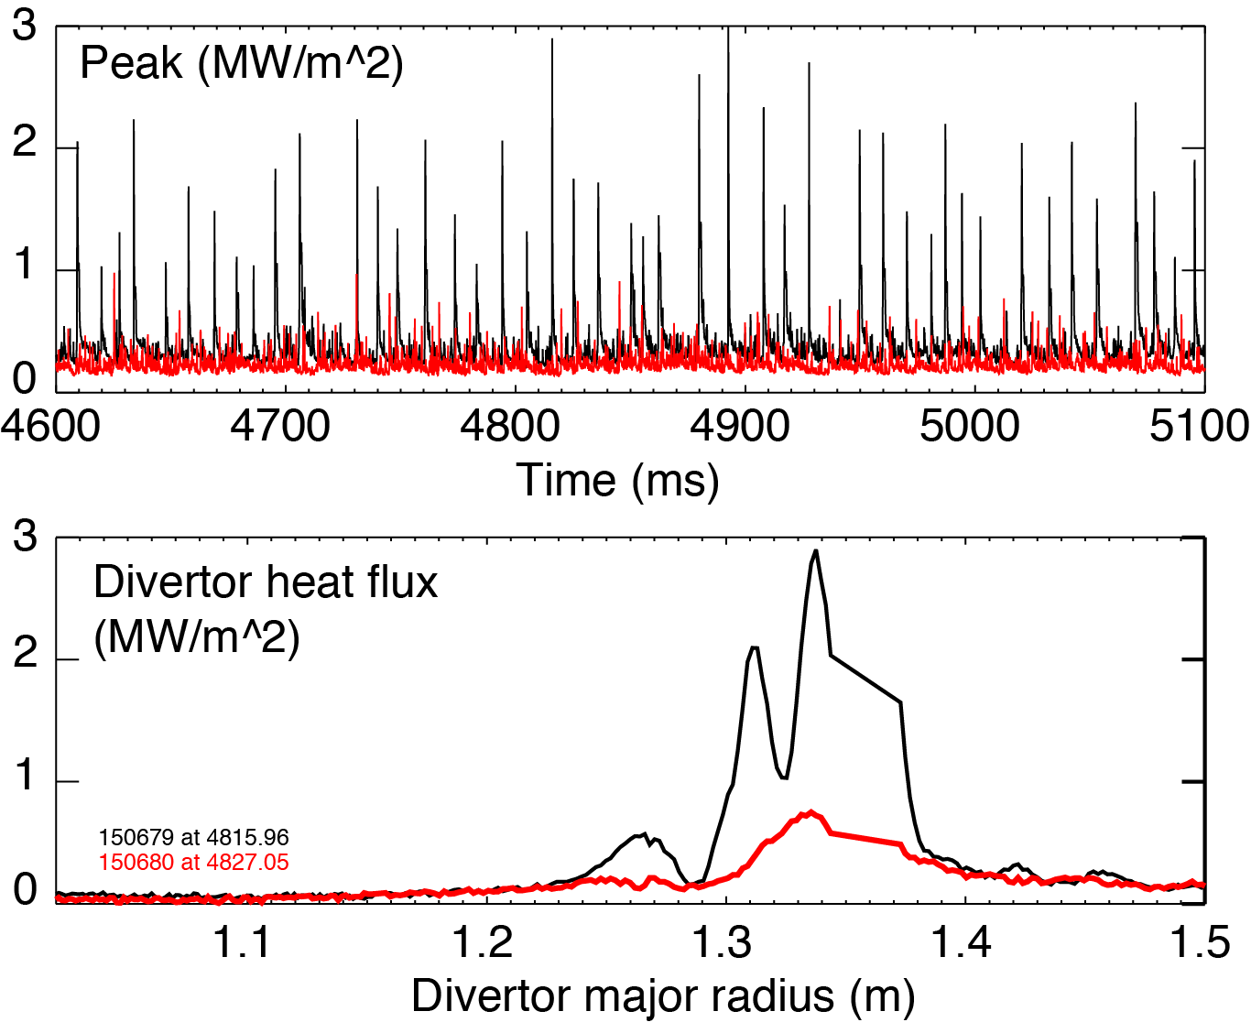
Developed snowflake and radiative detachment control on DIII-D in preparation for usage on NSTX-U
Significant heat flux reduction between and during ELMs in DIII-D snowflake
Developed SF magnetic control
Real-time divertor radiation / detachment control developed, sustained detachment achieved
E. Kolemen (PPPL)
Detached - Standard Snowflake
V. Soukhanovskii (LLNL)
Real-time diagnostics: bolometry, D_{β}, interferometry, Thomson (divertor, core, tangential)
Actuators: D₂ and Ne gas puffing to obtain desired level of detachment and/or radiation.
n_{e} / n_{G} = 0.60
Peak ELM
V. Soukhanovskii was co-leader of snowflake-divertor portion of heat-flux mitigation experiments in recently completed DIII-D “National Campaign”
6

Slide 7
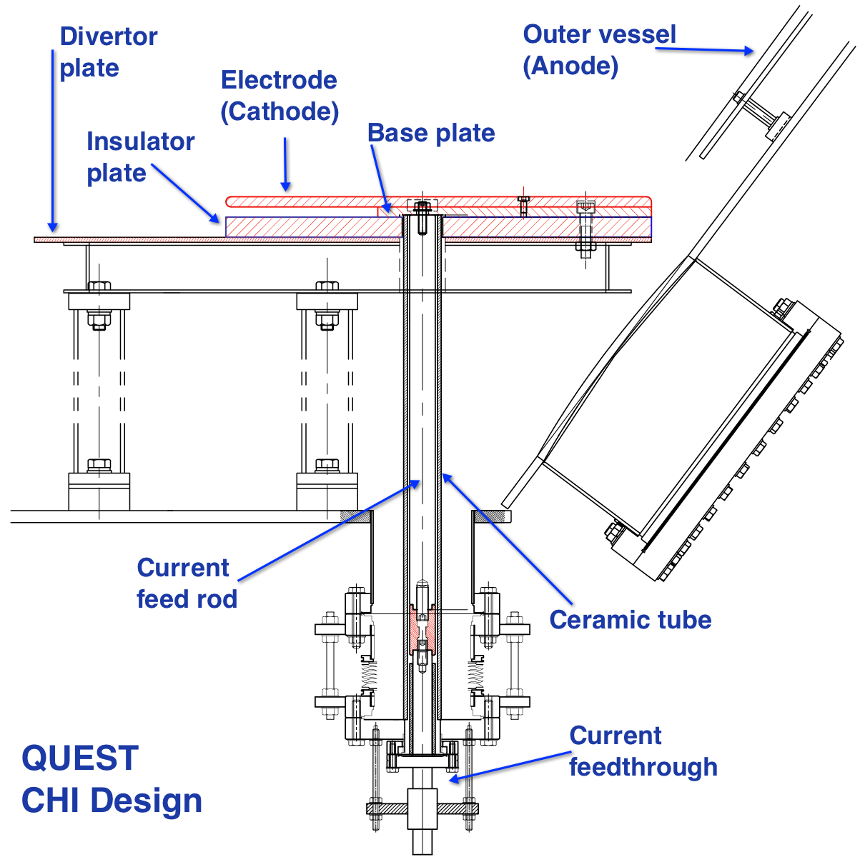
CHI Design for QUEST Supports NSTX-U and FNSF Research
R. Raman (Univ. Washington) collaboration with Kyushu University (Japan)
QUEST ST aims to develop technologies for SS operation
  Use CHI in biasing mode to vary edge density gradient for EBW experiments
  High CHI current provides new target for SS CD studies on QUEST
  Interested in potential of steady-state CHI for edge current drive (aided by all metal nature of QUEST + ECH)
Benefits to NSTX-U & QUEST
  Test metal electrodes to reduce low-Z impurities
  Test ECH heating of CHI target at 0.5MW level
  Test new electrode configuration to enhance compatibility with FNSF
Electrodes mounted on top of existing divertor plate

Slide 8
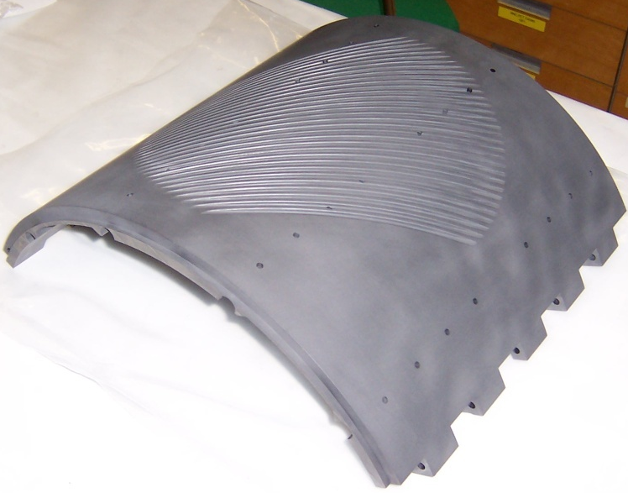
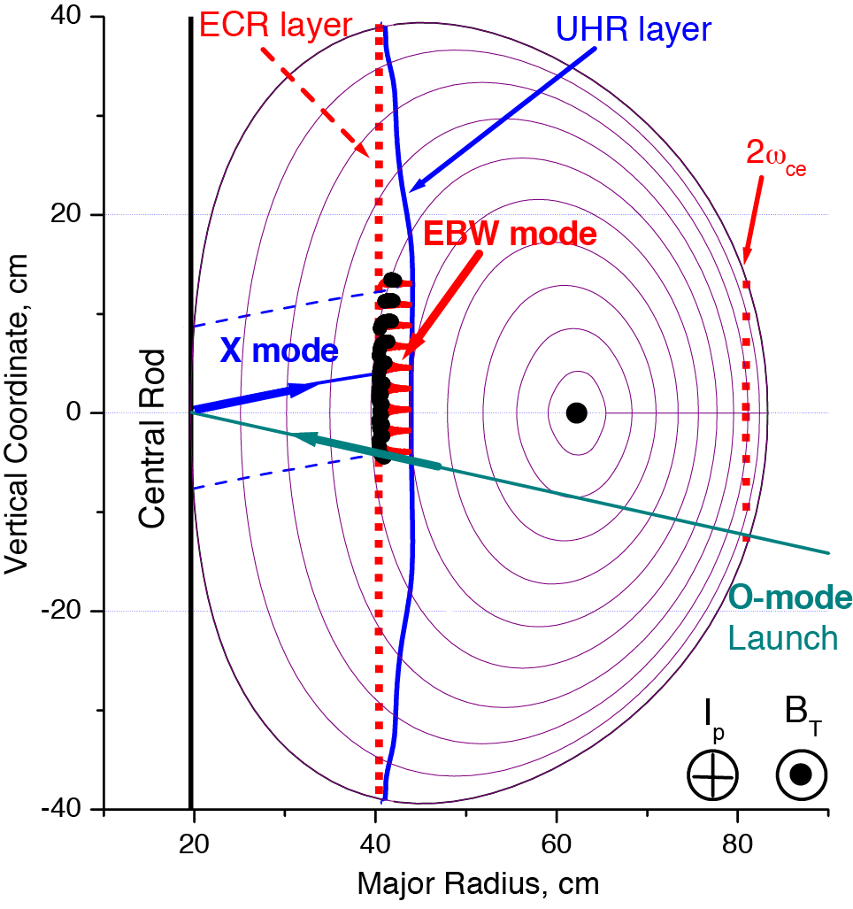
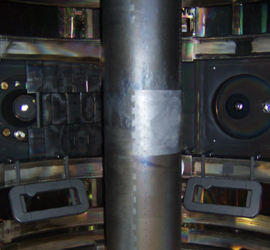
MAST: 28 GHz EBW start-up campaign in 2013 used new
low-loss transmission line to achieve record plasma current
  Grooved reflecting polarizer machined into center column in MAST
28 GHz O-mode weakly absorbed (< 2%) below n_{e} ~ 1 x 10¹⁹ m⁻³ cut off
Polarizer on center column converts to X-Mode that then 100% converts to EBWs
Previously achieved I_{p}~33 kA but arcs in waveguide limited RF power [Sept 2009]
During two one-week EBW start-up campaigns in 2013 coupled 70-100 kW for 300-400 ms achieving I_{p} = 50-75 kA
G. Taylor (PPPL), with ORNL
8

Slide 9
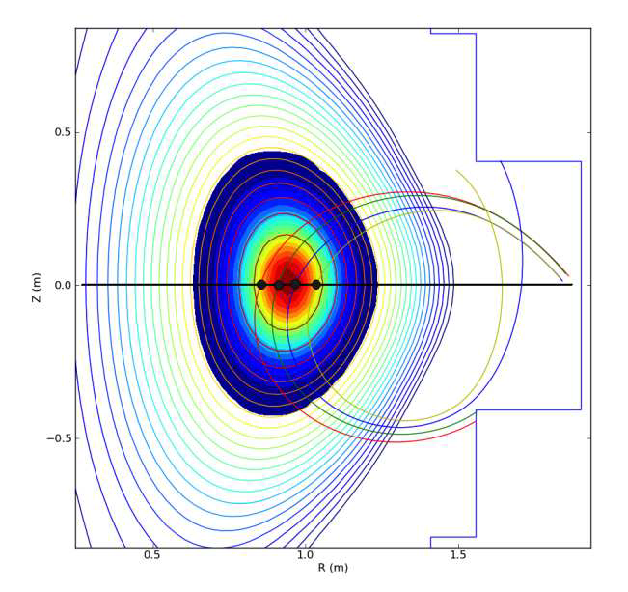
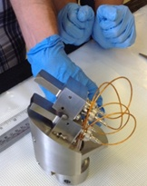
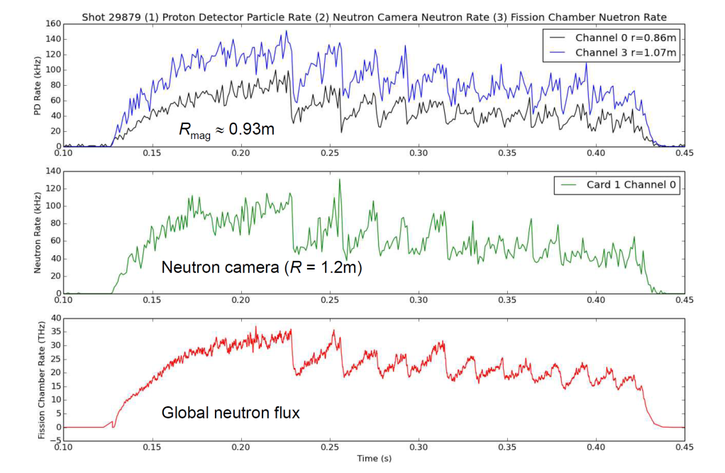
Fast ion diagnostic collaboration with MAST
D. Darrow (NSTX-U/PPPL) visited MAST August 2013 to contribute to tests of Florida International University (FIU) MeV proton detector on MAST
Detector measures radial profile of DD fusion reactivity through detection of the 3 MeV protons and 1 MeV tritons produced in DD reactions
  Testing conducted in conjunction with Prof. W. Boeglin and R. Perez (FIU), and the MAST team.
Data on the radial profiles obtained under range of conditions:
  Quiescent plasmas, sawtoothing discharges, and during fishbone modes
Comparisons with profiles obtained from MAST neutron camera are underway
Results encouraging for development of a higher channel count system for NSTX-U

Slide 10
Additional fast-ion and transport collaborations with MAST during M9
Studied fast ion redistribution caused by TAE avalanches, extending previous studies on NSTX (Podesta, Fredrickson)
  D-alpha emission found to be sensitive to fast-ion losses
Measured momentum transport in MAST L-modes using 3D field perturbations for rotation braking (W. Guttenfelder)
  Also initiated particle transport exts (gas puffs, high time-res Thomson)
DBS diagnostic implemented on MAST – collaboration with UCLA and NSTX-U (A. Diallo, M. Podesta)
  Observed transitions from a negative- to a positive-frequency-peaked spectrum related to change in core intrinsic rotation
  Fluctuations with f~100–150 kHz from TAEs, possibly due to a fluctuating ExB flow associated with the TAE electric field perturbation
  Diagnostic will be installed on NSTX-U after MAST M9 is complete

Slide 11
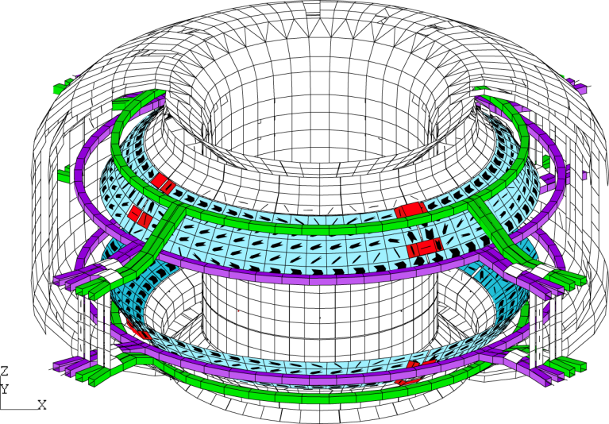
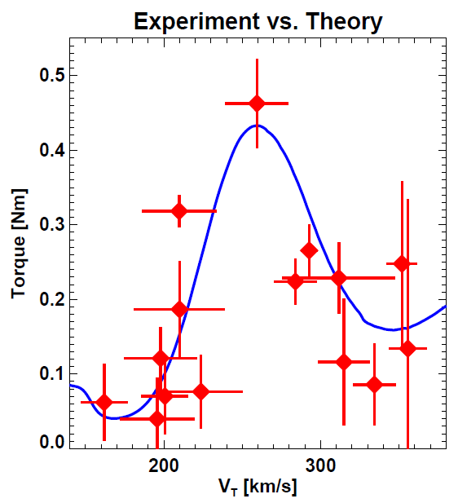
NSTX experience in scenario development, high-beta, and 3D physics is having significant impact on KSTAR research
Improved shape control, improved access to low l_{i} + high κ: D. Mueller, D. Battaglia, E. Kolemen (PPPL)
Studying MHD stability near no-wall beta limit: S. Sabbagh (CU)
Bounce-harmonic resonance in NTV observed in KSTAR for the first time in tokamak, and compared to theory/IPEC: J-K Park (PPPL – 2010 ECRP)
→ Published in PRL

Slide 12
Outcome 3.1b – “Develop a prioritized research plan for NSTX-U to provide an assessment, within five years, of the viability of the ST concept as an attractive Fusion Nuclear Science Facility”
Highest priority research goals for 5 year plan:
Demonstrate 100% non-inductive sustainment at performance that extrapolates to ≥ 1MW/m² neutron wall loading in FNSF
Access reduced ν* and high-β combined with ability to vary q and rotation to dramatically extend ST physics understanding
Develop and understand non-inductive start-up and ramp-up
(overdrive) to project to ST-FNSF with small/no solenoid
4. Develop and utilize high-flux-expansion “snowflake” divertor
and radiative detachment for mitigating very high heat fluxes
5. Begin to assess high-Z PFCs + liquid lithium to develop high-duty-factor integrated PMI solutions for next-steps
Longer-term (5-10 year) goal:
Integrate 100% non-inductive + high β and τ_{E} + divertor solution + metal walls

Slide 13


NSTX-U goal staging: first establish ST physics + scenarios, transition to long-pulse + PMI integration (5YP incremental)
2014 | 2015 | 2016 | 2017 | 2018 | 2019 | 2020 | 2021 | 2022 | 2023
Upgrade Outage
Establish ST physics, scenarios
Integrate long-pulse + PMI solutions
Increase CHI closed-flux current
Achieve NI start-up/ramp-up
New
center-stack
Start-up and Ramp-up
Assess plasma gun start-up at increased device size
Increase/extend ramp-up heating and off-axis current-drive for advanced scenarios
Develop/understand ECH/EBW H&CD for ST
Boundary Physics
Establish main-ion density and ν* control
Understand snowflake divertor performance
Understand high-Z first-wall erosion, migration, particle sources & sinks
Materials and PFCs
Assess baseline graphite PFC performance
Assess high-Z tile/divertor impact and performance
Assess high-Z divertor and/or first-wall
Assess impact of high-temperature first-wall
Inform choice
of FNSF:
aspect ratio, divertor, and PFCs
Liquid
metals / lithium
Establish low impurities / Z_{eff} , assess increased Li coverage, replenishment
Test flowing liquid metal for heat-flux mitigation, surface replenishment
Assess flowing LM PFC with full toroidal coverage
MHD
Understand kinetic MHD, extend mode and disruption detection, develop mitigation
Enhance non-axisymmetric field spectrum and capabilities with off-midplane coils for control of: RWM, EF, RMP, rotation, NTM, EP
Transport & Turbulence
Understand ES and EM turbulence at high β, low ν*, emphasizing e-transport
Extend wave-number coverage of turbulence measurements
Waves and Energetic Particles
Characterize AE stability, fast-ion transport, NBI-CD, support plasma start-up, assess effectiveness of fast-wave in NBI H-modes
Prototype driving edge-harmonic oscillations (EHOs) and/or *AE
2nd NBI
Scenarios and Control
Demonstrate full non-inductive, high I_{P} & P_{AUX} operation Control: boundary, β, divertor heat flux, Ω & q profiles
Assess integrated control of long-pulse / high-performance

Slide 14
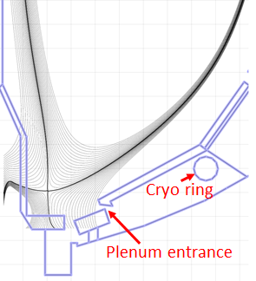
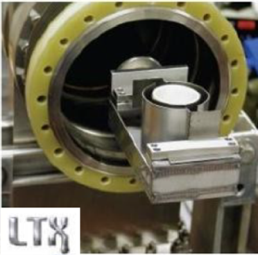
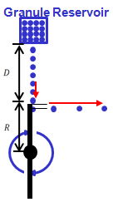
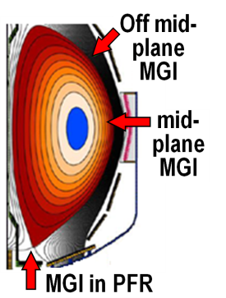

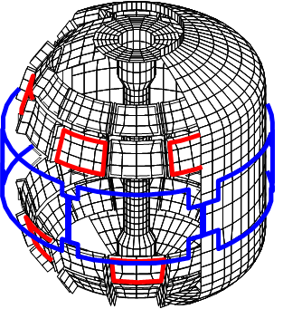
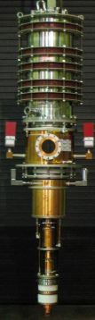
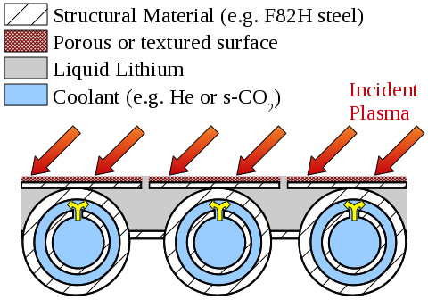
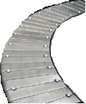
5 year plan includes longer-term facility enhancements to fully utilize Upgrade capabilities, support ITER and FNSF
Improved particle control tools
  Control deuterium inventory and trigger rapid ELMs to expel impurities
  Access low ν*, understand role of Li
Disruption avoidance, mitigation
  3D sensors & coils, massive gas injection
ECH to raise start-up plasma T_{e} to enable FW+NBI+BS I_{P} ramp-up
  Also EBW-CD start-up, sustainment
Begin transition to high-Z PFCs, assess flowing liquid metals
  Plus divertor Thomson, spectroscopy
Upward Li evaporator
Divertor cryo-pump
Li granule injector (LGI)
Midplane + off-midplane non-axisymmetric control coils (NCC)
Extended low-f MHD sensor set
1-2MW
28 GHz
gyrotron
High-Z tiles
Actively-supplied, capillary-restrained, gas-cooled LM-PFC

Slide 15
The NSTX-U 5 Year Plan review comments were largely favorable
Programmatic comments (from debrief report):
  “The quality of the proposed research is excellent, employing state-of-the-art diagnostics to obtain data that will be compared to theory using a wide variety of numerical models.”
  “The proposed research addresses fundamental problems in magnetic fusion and will advance the state of knowledge in a number of areas.”
  “The proposed research is essential for advancing the ST to a nuclear science mission.”
Facility enhancement comments (from written report):
  “The addition of a divertor cryo-pump will be an excellent addition to their program.”
  “NCC will greatly enhance physics studies and control”
  “Given the essential need for non-inductive startup for FNSF-ST, acquisition of a 28 GHz gyrotron to provide capability for heating CHI plasmas to allow better absorption of HHFW, is important to the long-term program”
  “The proposed additions of the flowing liquid Lithium divertor and divertor Thomson scattering diagnostic are desirable.
    Reassessment of the importance of the flowing Lithium divertor relative to other items covered under base funding is recommended.”
15

Slide 16
NSTX-U FY2013 Research Milestones
R(13-1): Perform integrated physics and optical design of new high-k_{θ} FIR system
R(13-2): Investigate the relationship between lithium-conditioned surface composition and plasma behavior
  See results slide in Masa’s presentation
R(13-3): Perform physics design of ECH and EBW system for plasma start-up and current drive in advanced scenarios
R(13-4): Identify disruption precursors and disruption mitigation and avoidance techniques for NSTX-U and ITER
16

Slide 17
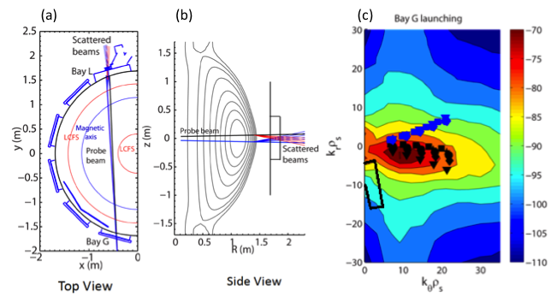
R(13-1): Perform integrated physics and optical design of new high-k_{θ} FIR system
System will provide measurement of k_{θ}-spectrum of both ETG and ITG modes
  NSTX 280 GHz high-k tangential system of NSTX will be replaced by a 604 GHz (CO₂-pumped FIR laser) poloidal scattering system being developed by UC Davis
  The reduced wavelength in the poloidal system will result in less refraction and extend the poloidal wavenumber coverage from the current 7 cm⁻¹ up to > 40 cm⁻¹
Anisotropy in 2D k-spectrum of ETG turbulence (i.e. ETG streamers), can be determined by comparing k-spectrum measured by different schemes:
  Total of 4 scattering schemes possible w/ different combinations of toroidal, poloidal tilt angles
Schematic of the toroidal cross section of the high-k scattering beam geometry
Poloidal cross sectional view of the beam geometry
Regions in 2D k_{r} and k_{θ} space covered by two scattering schemes
Y. Ren (PPPL), with UC Davis
17

Slide 18
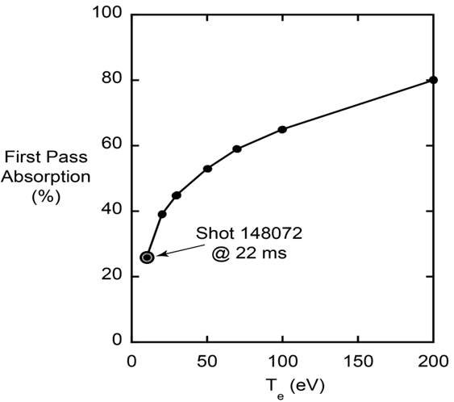
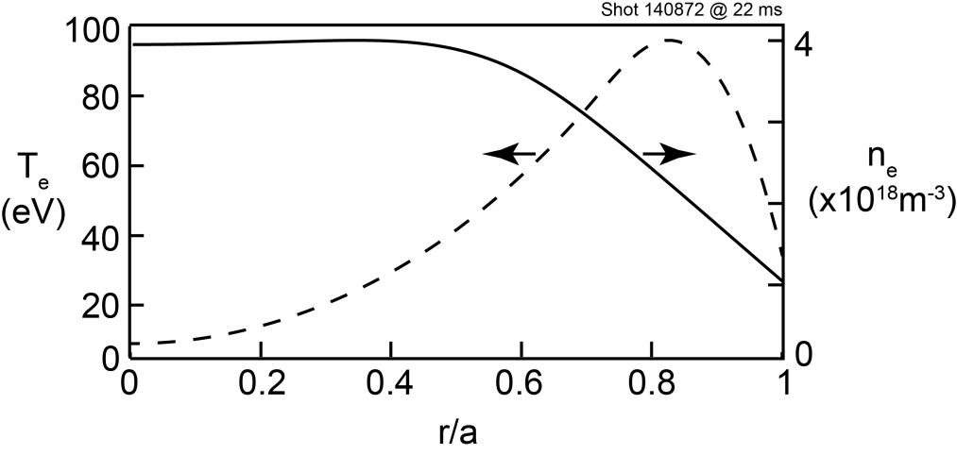
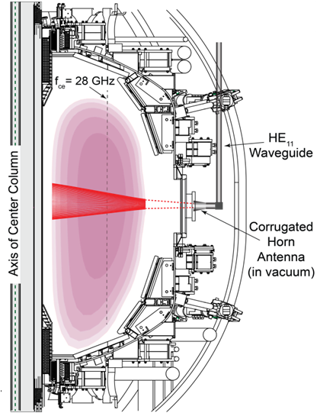
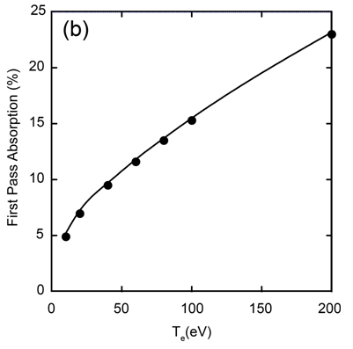
R(13-3): Perform physics design of ECH and EBW system for plasma start-up and current drive in advanced scenarios (1)
Low n_{e} = 3-4 x 10¹⁸ m⁻³ CHI discharges amenable to 28GHz EC heating:
NSTX CHI Shot 140872 @ 22 ms
  GENRAY
CHI Shot 140872
@ 22 ms
At B_{T}(0) = 0.55T, first pass EC absorption ~25% → expect rapid heating to ~200 eV
At B_{T}(0) = 1T, first pass EC absorption (at fundamental) is reduced by factor of ~4
G. Taylor (PPPL), with CompX
18

Slide 19
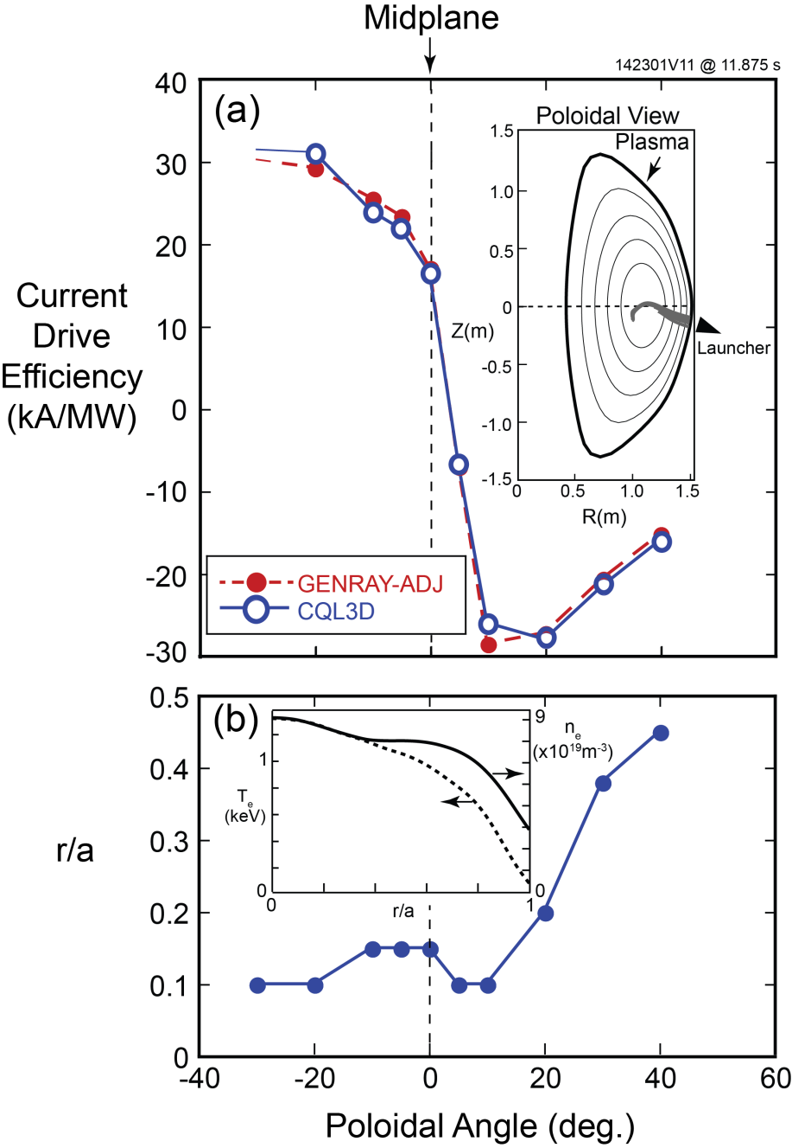
R(13-3): Perform physics design of ECH and EBW system for plasma start-up and current drive in advanced scenarios (2)
I_{P} =1.1 MA, B_{T}(0) = 1T, H-mode
EBWH, CD modeling tools:
  GENRAY ray tracing + ADJ quasi-linear package
  CQL3D Fokker-Planck
Max. O-X-B mode conversion efficiency: n|| = ± 0.7 at launch
Poloidal launch angle scanned from -30˚ to 40˚
  Max CD efficiency: ~±30kA/MW
  Normalized efficiency comparable to NBICD
Deposition minor radius variable between 0.1 to 0.5
Adjusting B_{T} or f_{RF} → can position peak J_{EBWCD} at r/a ≥ 0.8
19

Slide 20
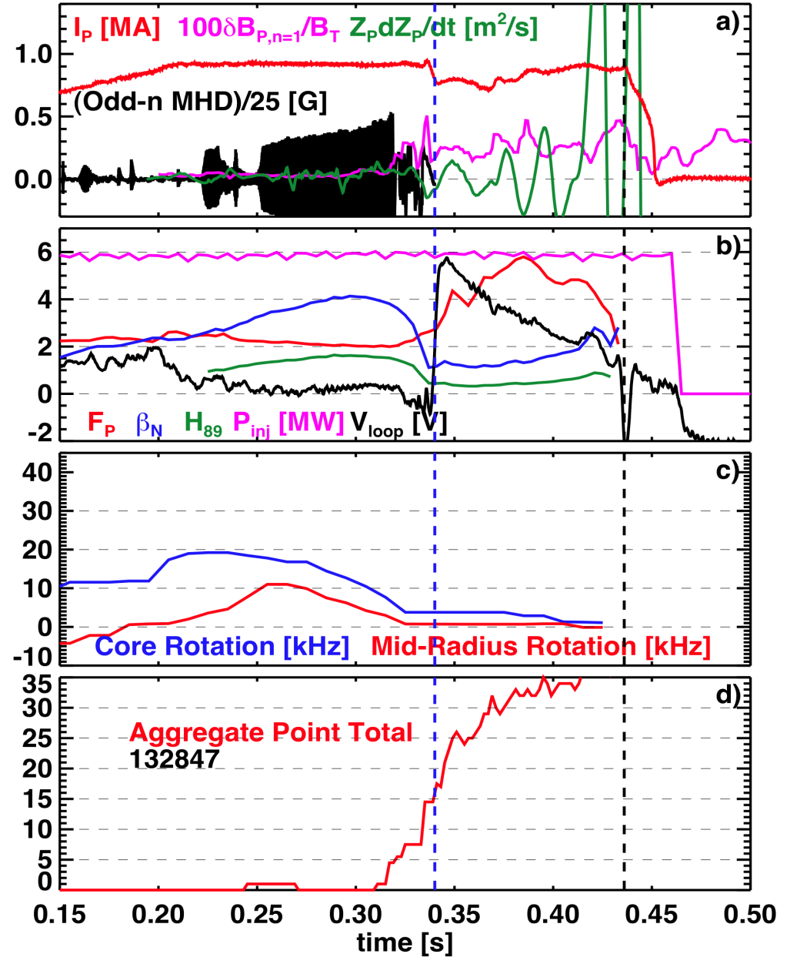
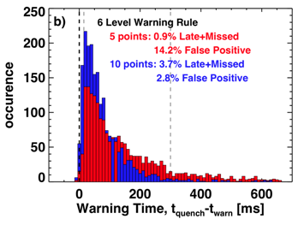
R(13-4): Identify disruption precursors and disruption mitigation and avoidance techniques for NSTX-U and ITER (1)
Most critical measurements, analysis:
  I_{P} vs request, δB, Z*dZ/dt, F_{P}, β_{N}, H₈₉, V_{LOOP}, rotation frequency, neutron rate…
Disruption warning methodology:
  Each threshold test is executed, # of points for each test is evaluated
  Points from individual tests are totaled to form “aggregate” total
  Disruption warning declared if total exceeds a pre-defined threshold
Late or missed disruptions can be traded against false-positives
S. Gerhardt (PPPL)
20

Slide 21
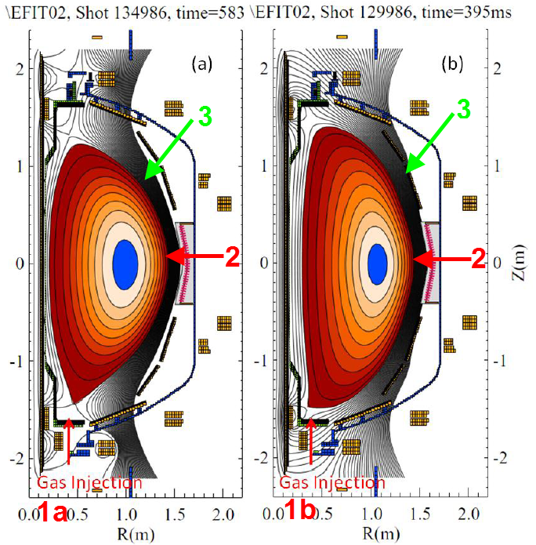
R(13-4): Identify disruption precursors and disruption mitigation and avoidance techniques for NSTX-U and ITER (2)
Predictors
Disruption Warning System
Mitigation
γ contours
Control Algorithms
Kinetic Physics
Evaluate simple physics criteria for global mode marginal stability in real-time
Avoidance Actuators
MHD Spectroscopy
Use real-time MHD spectroscopy while varying rotation, q_{min}, and β_{N} to predict disruptions
q, v_{φ} , β_{N} control
Resonant Field
Amplification (G/G)
1
RWMSC observer
Compare mismatch between the RWMSC observer and sensor measurements, and disruption occurence
  ITER gas-loading :
  Injection into private flux region with higher assimilation efficiency?
3D fields, feedback

Slide 22
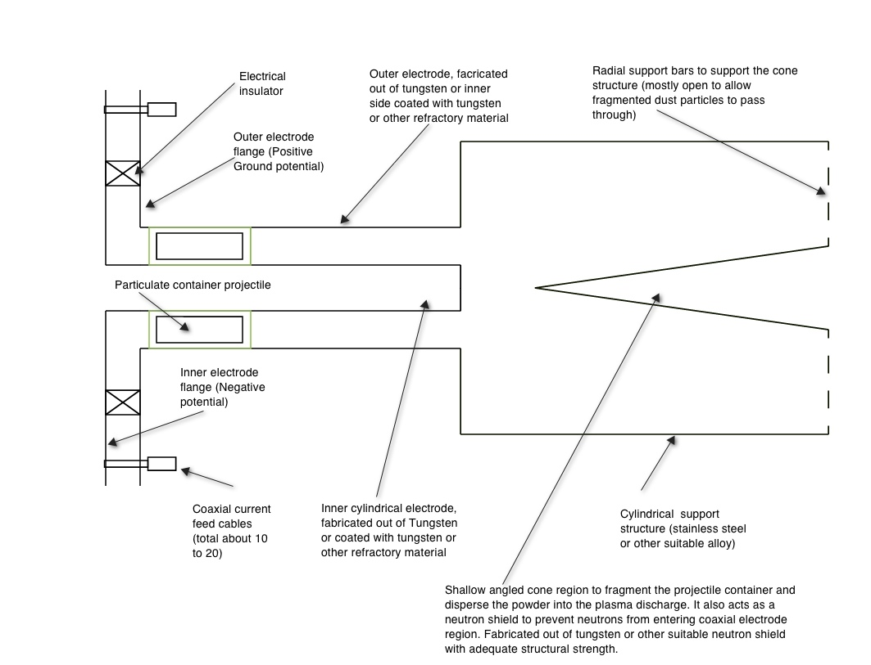
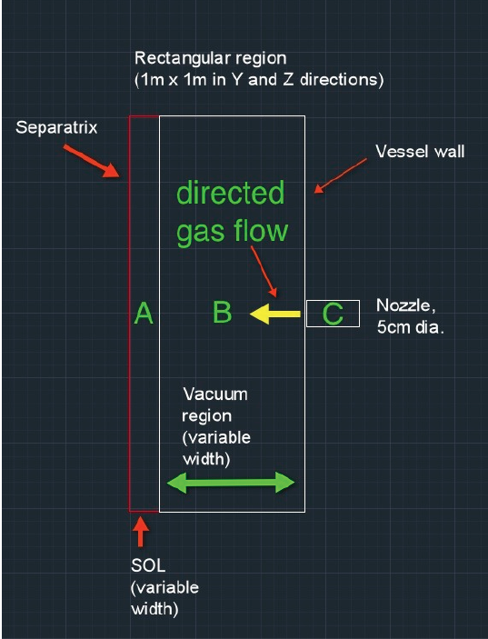
R(13-4): Identify disruption precursors and disruption mitigation and avoidance techniques for NSTX-U and ITER (3)
MGI research will assess gas penetration efficiency by injection at different poloidal locations
Development of a novel mitigation technology – an electromagnetic particle injector (EPI) – is proposed to terminate plasmas
Cone for shattering
Particulate container projectile
Rail gun electrodes
The EPI is capable of delivering:
  A large particle inventory
  All particles at nearly the same time
  Particles tailored to contain multiple elements in different fractions and sizes
  Tailored particles fully ionized only in higher current discharges (to control current quench rates)
Well suited for long stand-by periods
Predictive capability: Modeling using DEGAS-2 is quantifying the gas penetration past the SOL for NSTX-U
NSTX-U can offer new insight by
  Reducing the amount of gas
  Injecting gas into the private flux and lower x-point regions of divertor to determine if these are more desirable locations for MGI.
R. Raman (U. Washington)

Slide 23
Maintained strong team and publication and conference participation, development of early career researchers
 | PPPL/PU | National Team (non-PPPL/PU) | International | Total |  | Number of institutions
Total Researchers | 79 | 166 | 61 | 306 |  | Total | 61
Post-Docs | 5 | 9 | 0 | 14 |  | Domestic | 32
Students | 3 | 26 | 4 | 33 |  | International | 29
Calendar Year | Refereed Publications | PRLs | APS Invited | IAEA Papers
2009 | 45 | 6 | 5
2010 | 63 | 5 | 10 | 25
2011 | 58 | 5 | 8
2012 | 56 | 1 | 4 | 30
2013 | 52 so far | 4 (so far) | 6
Ahmed Diallo (PPPL) received 2013 DOE Early Career Research Program (ECRP) award for: “Edge Pedestal Structure Control for Maximum Core Fusion Performance”
NSTX snowflake divertor team featured in October 2012 FES Science Highlights, led by V. Soukhanovskii (LLNL - 2010 ECRP) – also leading DIII-D snowflake expts.

Slide 24
Thank you!

Slide 25


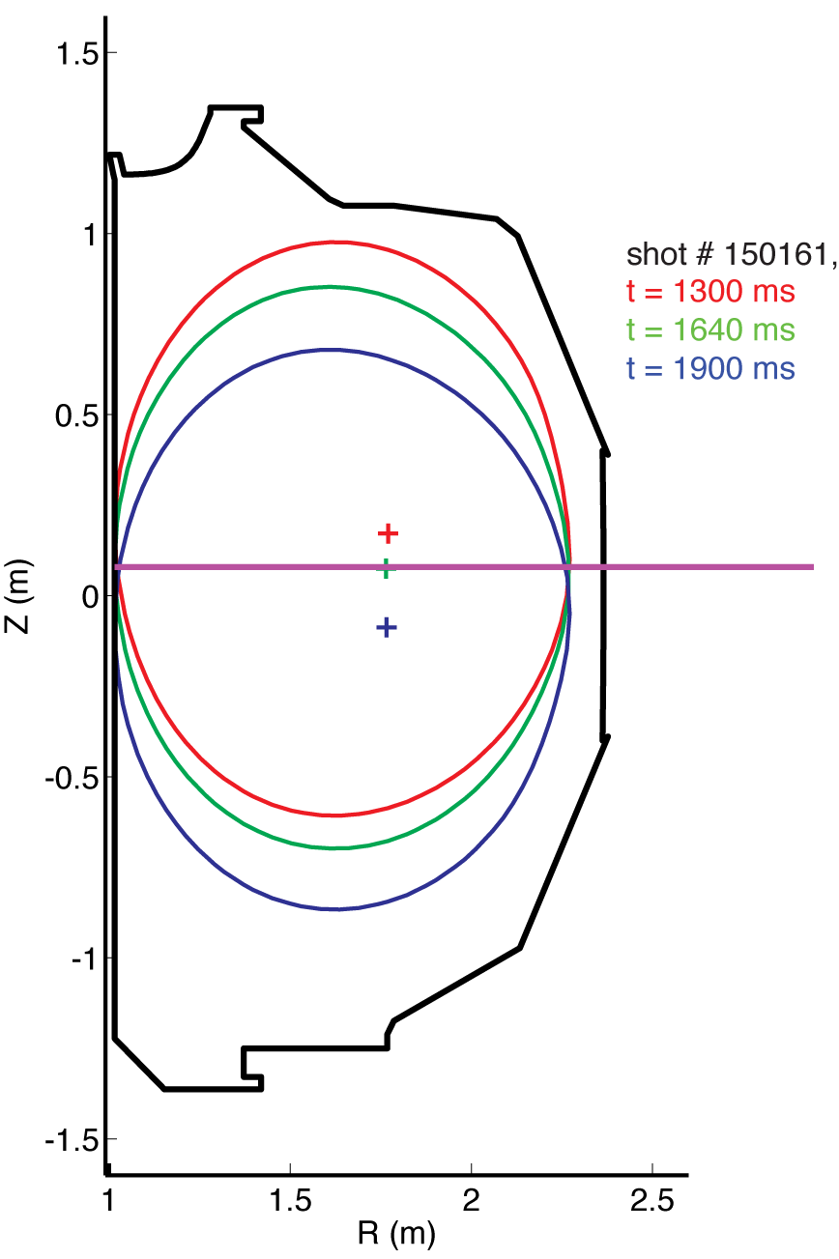
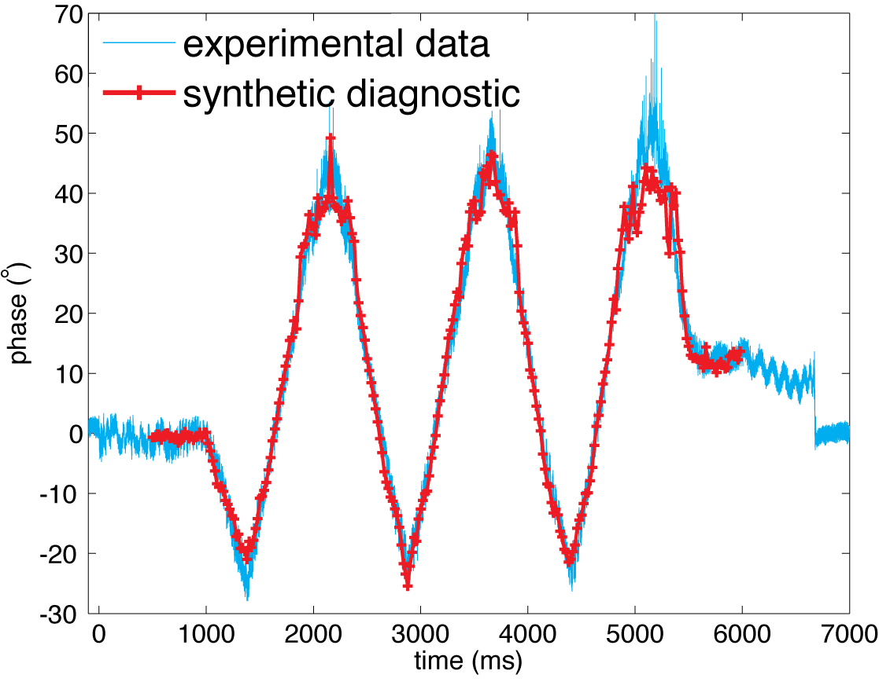
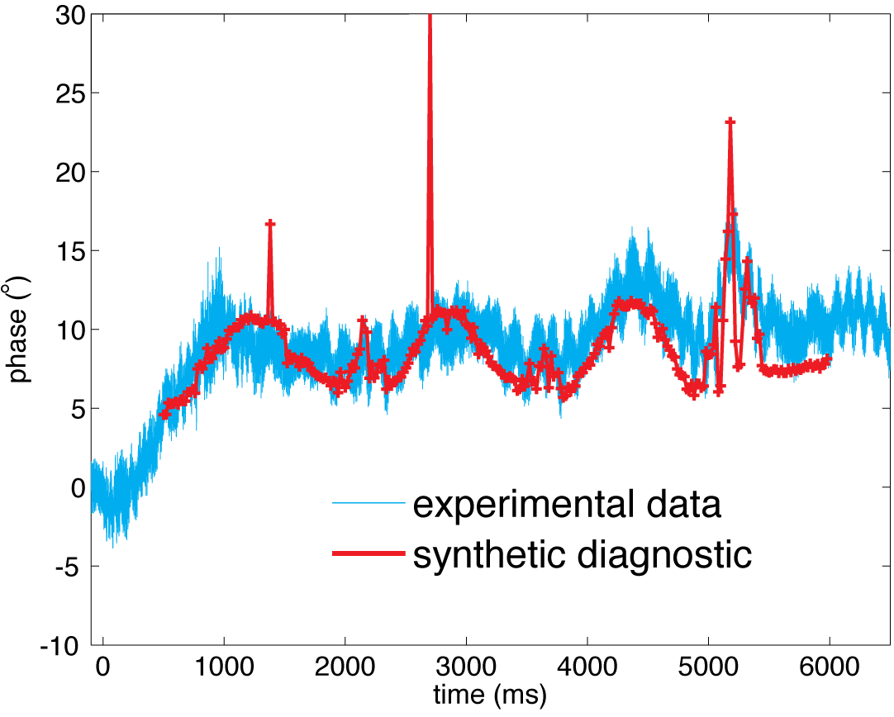
UCLA successfully tested 288 GHz polarimeter for NSTX-U on DIII-D
UCLA Graduate Student: J. Zhang – Thesis Project
Dedicated DIII-D run time to test polarimeter over wide range of conditions: phase response predicted to vary strongly with vertical position and B_{T}.
  Moving plasma vertically → Faraday rotation due to horizontal B ranges from weak to strong
  Wide range of B_{T} → elliptization (Cotton-Mouton effect) ranges from weak to strong
Synthetic diagnostic calculations agree with measured phase over wide range of B_{T} (0.75-2.0 T), plasma height
polarimeter beam
mirror
0.75 T
2.0 T
Faraday rotation dominated
Cotton-Mouton effect dominated
Polarimetry planned to be used to measure μ-tearing δB in NSTX-U

Slide 26
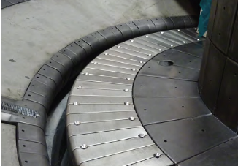
Boundary Facility Capability Evolution
NSTX-U will have very high divertor heat flux capability of ~ 40 MW/m²
2015
2016
2017
2018
C
BN
Li
High-Z
Lower
OBD
high-Z row of tiles
Cryo + high-Z FW and OBD
+ liquid Li divertor (LLD)
Cryo + high-Z FW and OBD
PFCs
High-Z tile row
Cryo-pump
Bakeable cryo-baffle for liquid Li
NSTX Moly Tiles
ORNL

Slide 27
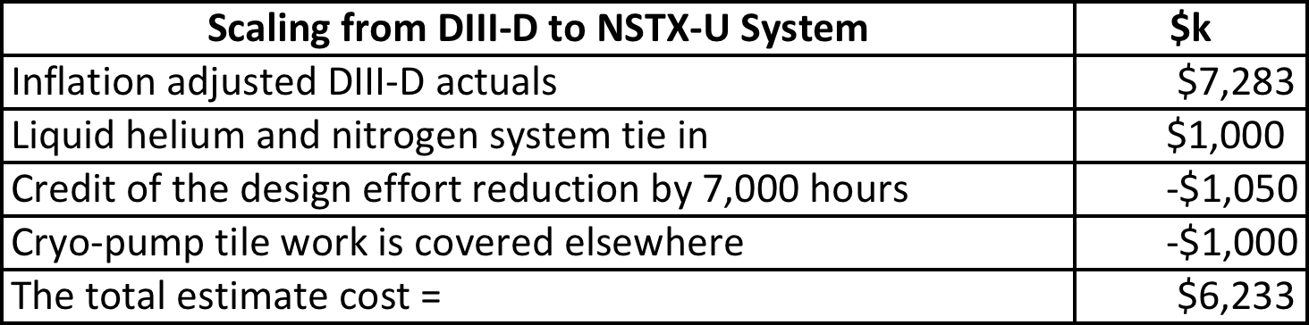
Divertor Cryo-pump for particle control
Particle pumping for broad range of divertor parameters
Basis for Divertor Cryo-Pump Budget:
• Divertor cryo-pump is well developed. DIII-D has a long history of cryo-pump implementation.
• NSTX-U will adopt DIII-D cryo-pump design.
• Utilize DIII-D cryo-pump actual cost and adapt it to NSTX-U.
Cost Estimate Assumptions:
• No credit taken for smaller radius of NSTX-U
• SWIP cryo-pump system design achieved 14,000 hours design effort reduction. NSTX-U will take 50% of the credit.

Slide 28
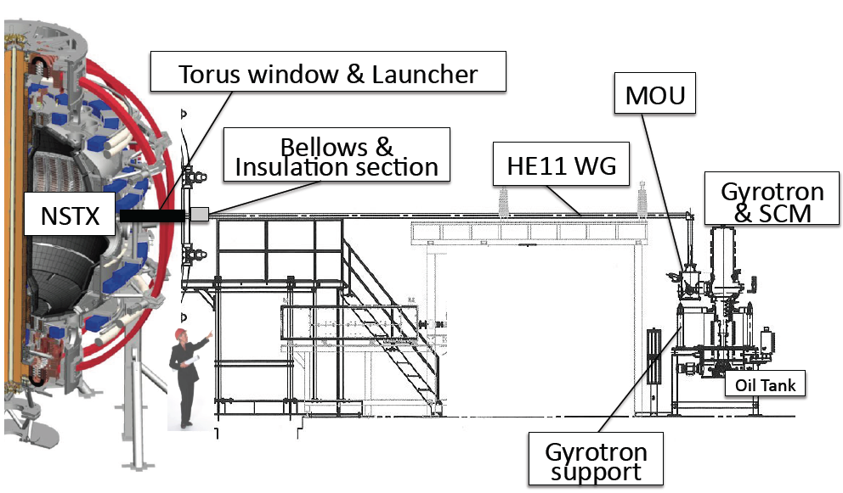
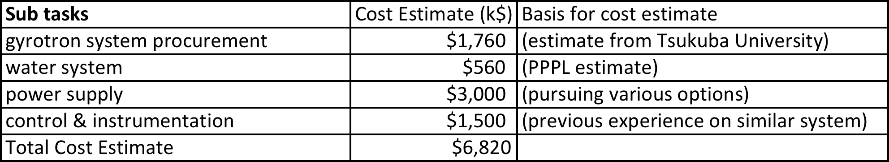
1 MW 28 GHz Gyrotron System
For bridging the start-up temperature gap and EBW research
Basis for 1 MW 28 GHz Gyrotron Budget:
• System is well defined. Similar system working in Japan (Tsukuba and QUEST).
• PPPL has a collaboration with DIII-D on ECH. Some internal ECH expertise.
• ~ 50% of budget is procurement
• Antenna and waveguide is costed elsewhere.
• But with some implementation uncertainties:
- Actual location is not finalized.
- Power supply configuration not finalized. Utilize NBI power supply? Need for a polarity switch. Procure a new power supply?

Slide 29
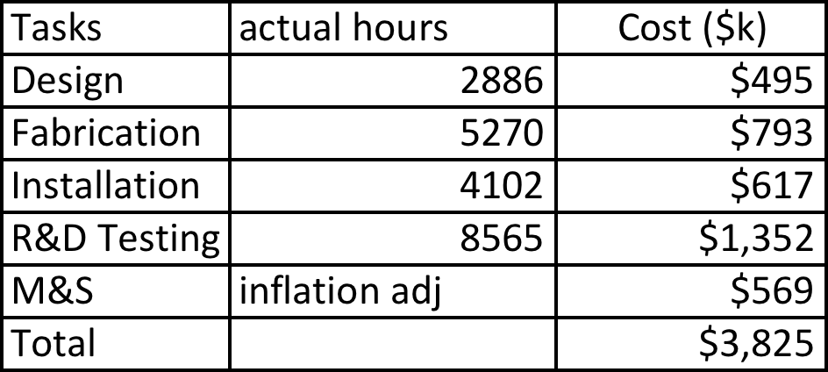
Partial NCC Coils - New MHD and Plasma Control Tools Sustain high β_{N}, control rotation, modify edge transport
Basis for Partial NCC Budget:
• NCC utilized the cost actuals from the DIII-D I-Coil work.
• Actual hours spent on the I-coil tasks are the same for the NCC coils by the PPPL personnel with similar skills ($).
• M&S cost is inflation adjusted.
• DIII-D spent significant R&D and Testing of I-Coils. Assume the same level of effort for the NCC coil R&D and Testing. This may generate savings.
Partial NCC option (2 x 6 odd parity)
Cost Estimate Assumptions:
• The # of coils are the same for NCC and I-Coil systems.
• No credit taken for the NCC coil size to be half that of the I-Coil.
• NCC (RWM) diagnostics are separately funded.

Slide 30
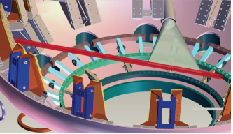
Divertor Thomson Scattering System
For divertor and SOL heat and particle transport studies
Basis for Divertor Thomson Budget:
• Relatively detailed engineering study was performed in 2008.
• A base-up cost estimate developed.
• There are two main components: Thomson scattering laser system related items and related vacuum vessel modifications and utilities.
Divertor Thomson Scattering Geometry
Beam path
Collection optics
Cost Estimate Assumptions:
• Laser components and related items are estimated to cost ~ $950k. This includes computer, laser optics, laser safety, cooling, and 10% contingency.
• Device modification estimate is ~ $3,550k. This includes system design, laser room, AC power, interlocks, E-stop, diagnostic racks, light collection optics, laser focusing optics, vacuum vessel modification, cable tray, flight tube. We assume ~ 35% contingency due to relative complexity of the in-vessel work.
• The total cost estimate is $5.6M with overall 30% contingency.

