Slide 1




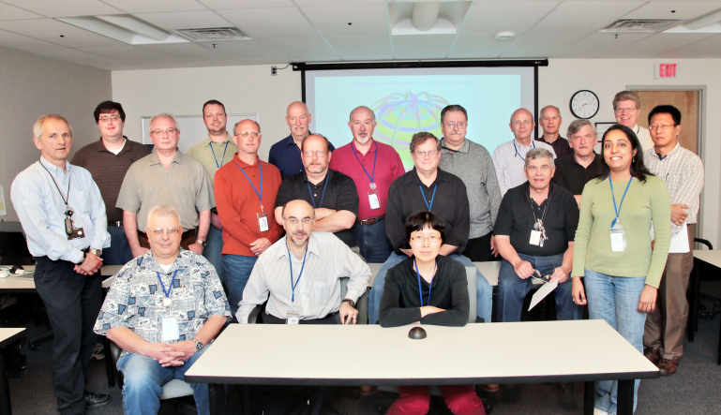
NSTX-U
Supported by
NSTX-U FY2014 Q4 Report Presentation
Vlad Soukhanovskii (LLNL)
Masa Ono
Jon Menard
For the NSTX-U Team
Coll of Wm & Mary
Columbia U
CompX
General Atomics
FIU
INL
Johns Hopkins U
LANL
LLNL
Lodestar
MIT
Lehigh U
Nova Photonics
Old Dominion
ORNL
PPPL
Princeton U
Purdue U
SNL
Think Tank, Inc.
UC Davis
UC Irvine
UCLA
UCSD
U Colorado
U Illinois
U Maryland
U Rochester
U Tennessee
U Tulsa
U Washington
U Wisconsin
X Science LLC
Culham Sci Ctr
York U
Chubu U
Fukui U
Hiroshima U
Hyogo U
Kyoto U
Kyushu U
Kyushu Tokai U
NIFS
Niigata U
U Tokyo
JAEA
Inst for Nucl Res, Kiev
Ioffe Inst
TRINITI
Chonbuk Natl U
NFRI
KAIST
POSTECH
Seoul Natl U
ASIPP
CIEMAT
FOM Inst DIFFER
ENEA, Frascati
CEA, Cadarache
IPP, Jülich
IPP, Garching
ASCR, Czech Rep
PPPL and FES
November 25, 2014
*This work supported by the US DOE Contract No. DE-AC02-09CH11466

Slide 2
Agenda
LLNL collaboration on NSTX-U: status and plans
  Vlad Soukhanovskii - 25 minutes
NSTX-U Project and Facility Status
  Masa Ono and Ron Strykowsky - 35 minutes
FESAC, APS highlights, FY15 research prep, FNSF
  Jon Menard - 40 minutes

Slide 3



NSTX-U
Supported by
LLNL collaboration on NSTX-U:
status and plans
Coll of Wm & Mary
Columbia U
CompX
General Atomics
FIU
INL
Johns Hopkins U
LANL
LLNL
Lodestar
MIT
Lehigh U
Nova Photonics
ORNL
PPPL
Princeton U
Purdue U
SNL
Think Tank, Inc.
UC Davis
UC Irvine
UCLA
UCSD
U Colorado
U Illinois
U Maryland
U Rochester
U Tennessee
U Tulsa
U Washington
U Wisconsin
X Science LLC
Vlad Soukhanovskii
Principal Investigator
Leader of the LLNL Collaboration on NSTX-U
Culham Sci Ctr
York U
Chubu U
Fukui U
Hiroshima U
Hyogo U
Kyoto U
Kyushu U
Kyushu Tokai U
NIFS
Niigata U
U Tokyo
JAEA
Inst for Nucl Res, Kiev
Ioffe Inst
TRINITI
Chonbuk Natl U
NFRI
KAIST
POSTECH
Seoul Natl U
ASIPP
CIEMAT
FOM Inst DIFFER
ENEA, Frascati
CEA, Cadarache
IPP, Jülich
IPP, Garching
ASCR, Czech Rep
FES NSTX-U Q4 Review
25 November 2014

Slide 4
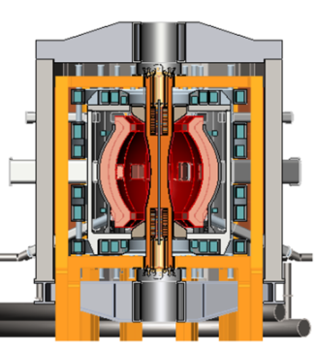

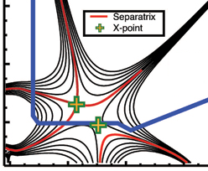
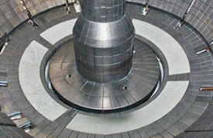

LLNL collaboration directly supports NSTX-U mission elements and highest priority goals of NSTX-U 5 year plan
Advance ST for Fusion Nuclear Science Facility
  Demonstrate 100% non-inductive sustainment at performance that extrapolates to ≥ 1MW/m² neutron wall loading in FNSF
  Develop and understand non-inductive start-up and ramp-up
  (overdrive) to project to ST-FNSF with small/no solenoid
Develop solutions for plasma-material interface challenge
  Develop and utilize high-flux-expansion “snowflake” divertor and radiative detachment for mitigating very high heat fluxes
  Begin to assess high-Z PFCs + liquid lithium to develop high-duty-factor integrated PMI solutions for next-steps
Explore unique ST parameter regimes to advance predictive capability - for ITER and beyond
  Access reduced ν* and high-β combined with ability to vary q and rotation to dramatically extend ST physics understanding

Slide 5
Research elements of LLNL collaboration are funded by FES via LAB 12-03 and ECRP, and by LLNL LDRD
SOL and Divertor physics
  Snowflake divertor
  Radiative (detached) divertor and divertor control
  SOL and divertor transport and radiation, particle balance, fueling, cryo-pumping
Plasma-surface interactions and material migration
  Divertor and wall recycling
  Divertor and wall erosion and sources
  Mixed-material interactions (Li, B, C, O, Mo, W)
Core impurity transport
  Low and high-Z impurity transport and particle balance
    Laser blow-off impurity injector
ECRP
LAB12-03
LAB12-03
LAB12-03
LLNL LDRD

Slide 6
LLNL collaboration includes on-site (at PPPL) and off-site LLNL staff
Vlad Soukhanovskii, Physicist, Principal Investigator, on-site
Peter Beiersdorfer, Senior Physicist, off-site
Filippo Scotti, Postdoctoral Researcher, on-site
Postdoctoral Researcher - Experiment, TBD, FY2015, on-site
Postdoctoral Researcher - Experiment, TBD, FY2015, on-site
Postdoctoral Researcher - Modeling, TBD, FY2015, on-site
Staff member(s) – Modeling, off-site
Technical staff at LLNL, as needed, on-site and off-site

Slide 7
1. Support the NSTX-U high priority goal “Develop and utilize high-flux-expansion snowflake divertor and radiative detachment for mitigating very high heat fluxes”
DIII-D experiments elucidate on geometry and transport properties of the snowflake configuration (2012-2015)
  Oral talks at PSI, EPS, IAEA FEC 2014 conferences (V. A. Soukhanovskii)
  Invited talk at APS DPP 2014 on new UEDGE model developments
  (T. D. Rognlien)
Using multi-fluid edge transport code UEDGE to understand NSTX experiments and make projections to NSTX-U and ST-FNSF
  PSI and IAEA FEC 2014 presentations (E. T. Meier)
On-going work and near-term plans
  Develop snowflake equilibria and discharge scenarios using NSTX-U PF coils and start-up (2014-2015)
  Study snowflake divertor transport, turbulence, radiation and ELM/pedestal properties on NSTX-U (2015-2016, NSTX-U R(16-1))
  Model snowflake divertor transport with UEDGE, XGC and BOUT++ (2014-2017)
ECRP

Slide 8
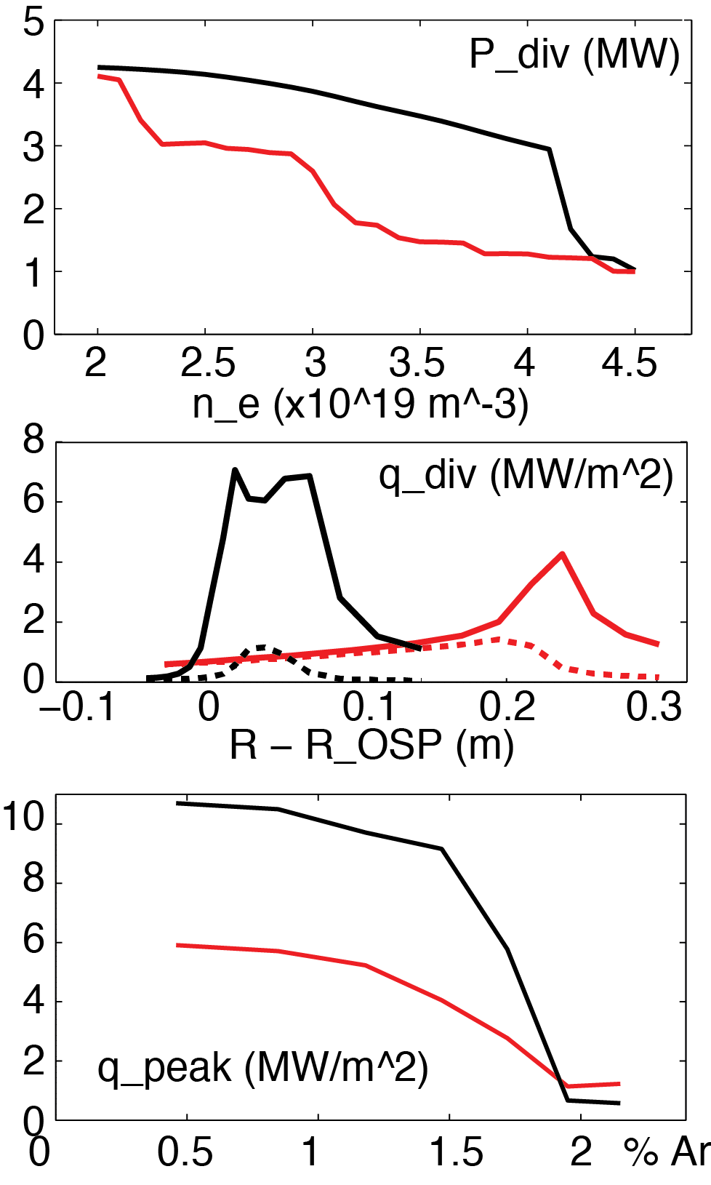
Modeling supports snowflake divertor and impurity-seeded radiative divertor as leading heat flux mitigation candidates in NSTX-U
  Upper-lower standard and snowflake radiative divertor
    Supported by NSTX-U divertor coils and compatible with coil current limits
  Radiative snowflake with 3% carbon
    Wide density operational window as low as n_{e}/n_{G}≤0.4
    Peak heat flux reduced up to 50% stronger (cf. standard radiative divertor) at lower n_{e}
  Less impurity seeding (argon or neon) needed for lower peak heat flux
  Multi-fluid code UEDGE
  B_{t} = 1.0 T, I_{p} = 2 MA, P_{SOL} = 9 MW
  NSTX-like transport χ_{i,e}=2-4 m²/s, D=0.5 m²/s
Standard Snowflake
Total
Rad.
heating

Slide 9
1. Support the NSTX-U high priority goal “Develop and utilize high-flux-expansion snowflake divertor and radiative detachment for mitigating very high heat fluxes”
Radiative divertor feedback control for long-pulse optimization (2015)
  Developing spectroscopic diagnostic prototypes
    Divertor low-Z line radiation (upgraded LLNL divertor SPRED)
    High-n deuterium series emission and photorecombination continuum for divertor T_{e}, n_{e} (new imaging spectrometer)
    Impurity radiation front dynamics (new divertor filtered camera)
  HTPD 2012 and 2014 presentations, two RSI papers (V. A. Soukhanovskii)
DIII-D Divertor Thomson Scattering operation and analysis (2012-2015)
  Unique T_{e}<1 eV measurements, detachment front dynamics for model validation
    PSI 2014 oral talk (A. G. McLean)
  New divertor near-infrared spectrometer (2014-2015)
Conceptual design of Divertor Thomson Scattering for NSTX-U
  Two HTPD 2014 presentations, two RSI papers (A. G. McLean, V. A. Soukhanovskii)
On-going work and near-term plans
  Install and commission radiative divertor control diagnostics on NSTX-U
  Initial radiative divertor experiments (2015-2016, NSTX-U R(16-1))
  Finalize design of Divertor Thomson Scattering diagnostic for NSTX-U proposal
ECRP

Slide 10
  2. Support the NSTX-U high priority goal “Begin to assess high-Z PFCs and liquid lithium to develop high-duty-factor integrated PMI solutions for next-steps”
Analysis of lithium and carbon erosion in NSTX shows temperature-enhanced lithium sputtering and weak reduction of divertor carbon sputtering with lithium coatings
  PSI 2014 presentation (F. Scotti)
New and upgraded spectroscopic diagnostics to enable recycling, low/high Z impurity erosion flux and divertor profile measurements in NSTX-U (2014-2015)
  Molybdenum erosion diagnostic moved from Alcator C-Mod to tests on LTX
On-going work and near-term plans
  Support cryo-pump physics design experiments (2015)
  Assess role of oxygen in lithium coating pumping and effect on recycling, low and high-Z fluxes (2015-2016, R(16-2))
  Collaborate with UIUC on MAPP probe PSI support (2015-2016)
  Develop modeling capability of lithium coatings and vapor shielding on high-Z substrates using UEDGE, REDEP/WBC, CRETIN (2014-2017)
LAB12-03

Slide 11
3. Support the NSTX-U high priority goal “Access reduced ν* and high-β combined with ability to vary q and rotation to dramatically extend ST physics understanding”
LAB12-03
Lithium and carbon accumulation analysis in NSTX shows complex interplay of neoclassical transport, natural or triggered ELMs and divertor sources
  F. Scotti, Princeton University PhD thesis
  APS DPP 2014 presentation (F. Scotti)
Develop and install three extreme ultraviolet spectrometers for impurity studies (2014-2015)
  Spectrometers delivered to PPPL on 17 November 2014
Develop and install Laser Blow-Off Impurity Injector (2015)
  Supported in part by LLNL LDRD for edge impurity transport measurements and code validation on NSTX-U
  Conceptual design review planned for 01/2015
On-going work and near-term plans
  Provide routine plasma impurity monitoring (2014-2017)
  Perform impurity transport experiments using LBO (2015-2016)
  Assess high-Z impurity transport before and after high-Z PFCs are installed
LLNL LDRD

Slide 12
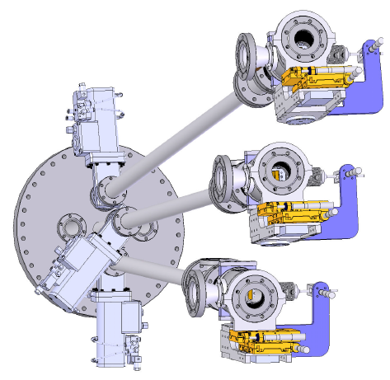
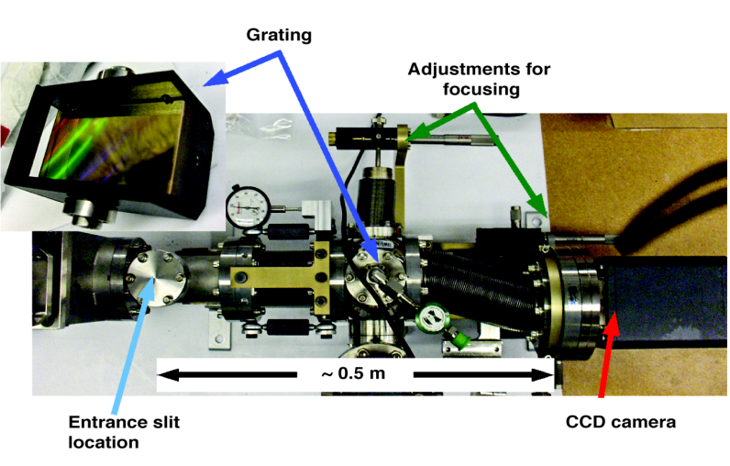
Three XUV spectrometers will provide continuous spectral coverage from 65 to 450 A for low and high-Z line emission measurements
Described in
  J. K. Lepson, J. Phys. B: At. Mol. Opt. Phys. 43, 144018 (2010)
  J. Clementson, RSI 81, 10E326 (2010)
  J. K. Lepson, RSI 83, 10D520 (2012)
Two NSTX spectrometers
  XEUS, 5 to 65 Å region, 2400 gr/mm grating
  LoWEUS, 250 to 450 Å region, 1200 l/mm grating
New MonaLisa (Metal Monitor and Lithium Spectrometer Assembly) spectrometer, 65 to 250 Å
  0.5 m, 1200 l/mm grating
  Princeton Instruments PIXIS XO 100B CCD detector
Delivered to PPPL on 17 November 2014
LLNL XUV spectrometer placement on NSTX-U at Bay E midplane
MonaLisa spectrometer layout

Slide 13
Backup slides

Slide 14
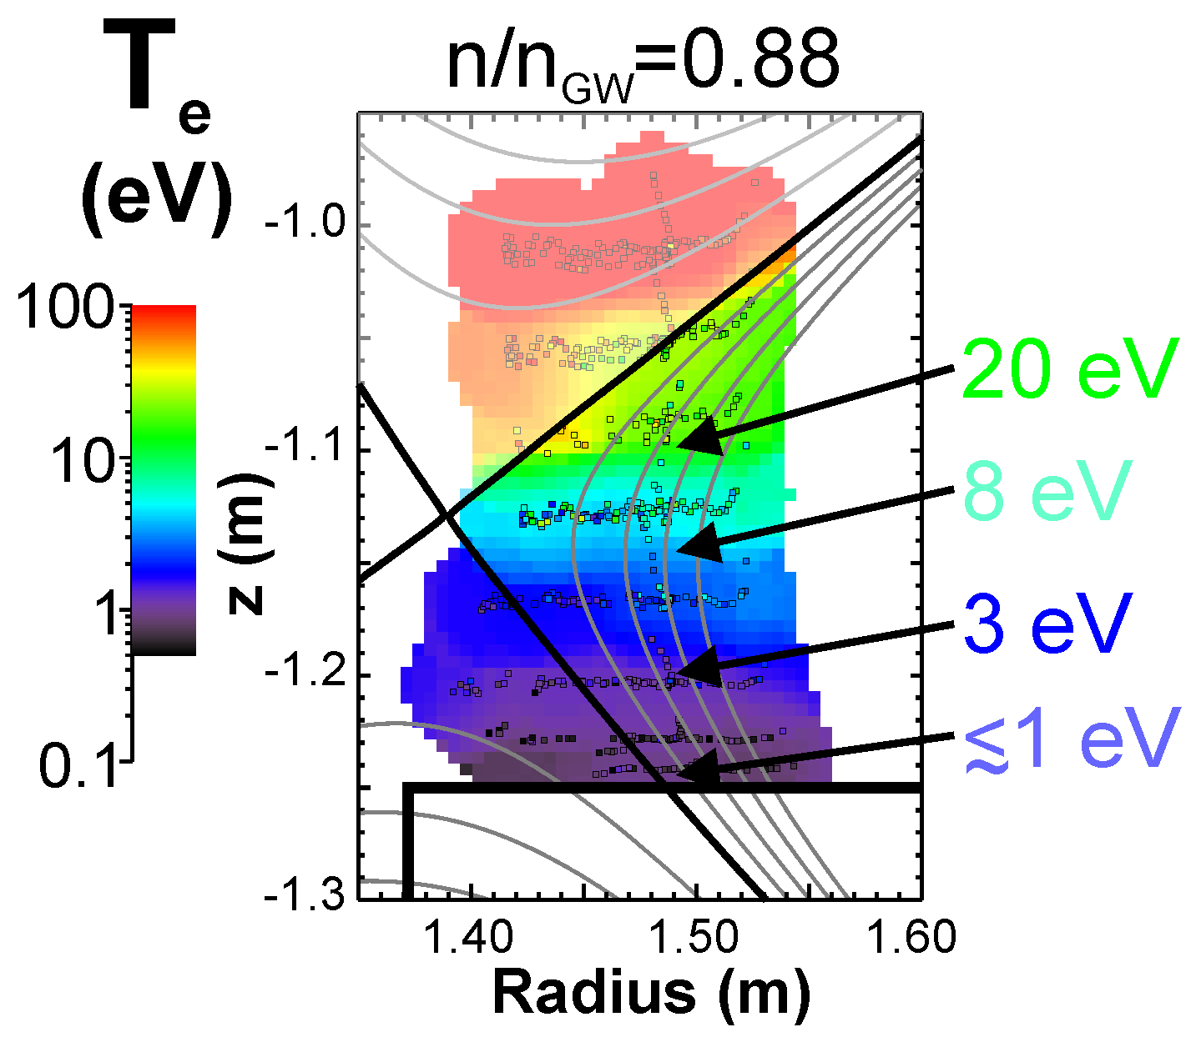
Electron pressure balance in the SOL through the transition to detachment at DIII-D (A. G. Mclean, PSI 2014)
The transition to detachment has been well characterized in DIII-D using standard diagnostics and supplemented with divertor Thomson scattering in 2D
Low temperature capability of upgraded divertor Thomson allows precise determination where conditions exist for low temperature processes (e.g., 3-body recombination, molecular assisted dissociation/recombination)
Plasma conditions in the divertor at detachment onset are weakly correlated to conditions upstream
A rapid transition occurs incrementally from the target to the X-point and above as n/n_{GW} is increased
A.G. McLean, PSI-21 Kanazawa, Japan, May 2014

Slide 15
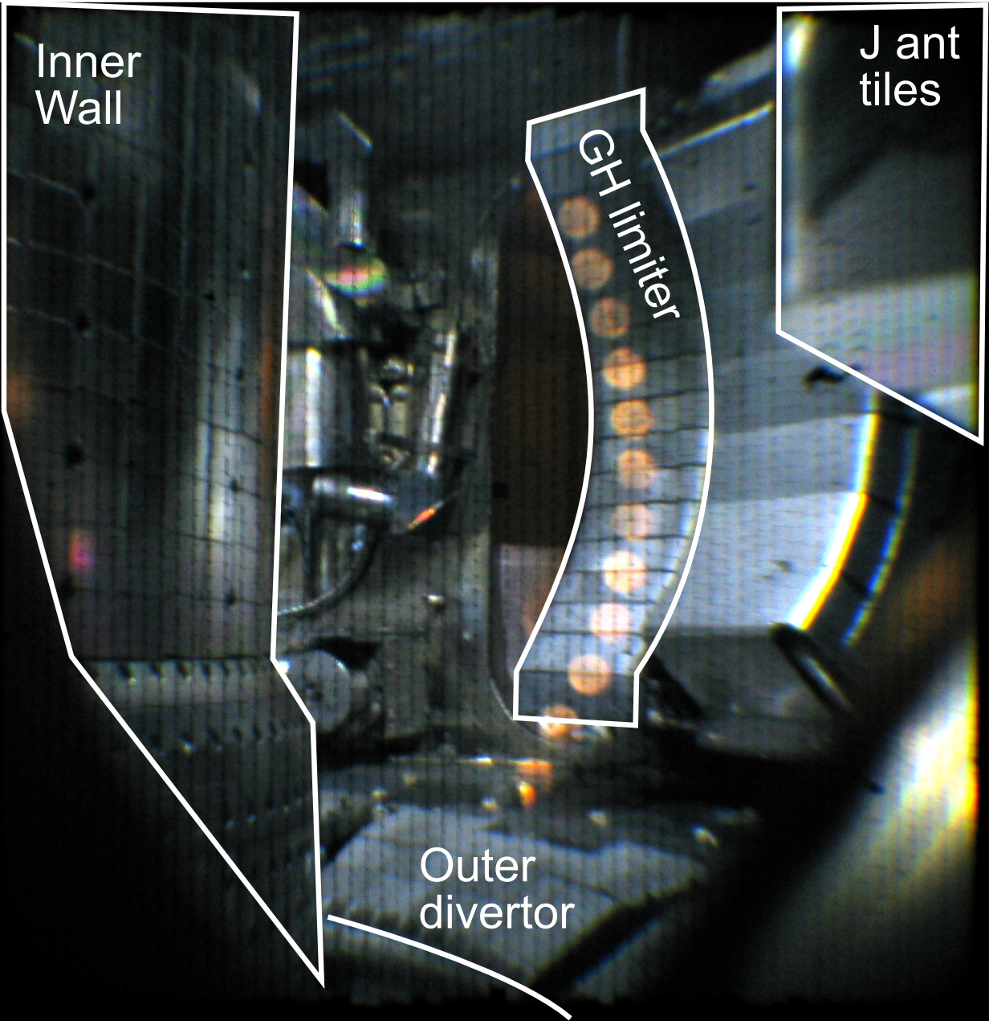
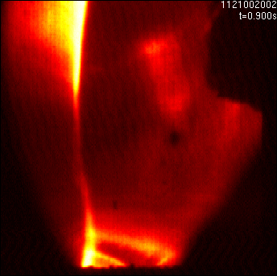
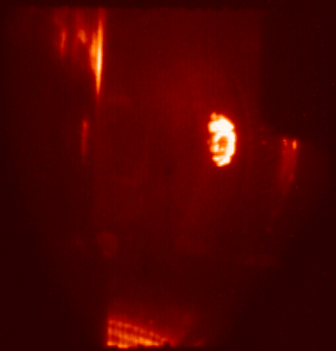
New CIDTEC camera will be used for measurements of Li, B coatings, oxygen emission, and high-Z erosion
Used by LLNL at Alcator C-Mod for Mo I measurements
  Described in A. James, Plasma Phys. Control. Fusion 55, 125010 (2013)
Radiation-hardened intensified camera CIDTEC I3710DX9 from Thermo Schientific
  30 Hz, VGA resolution, UV-capable
  Photonis XX1450UV image intensifier
  Schott IG-154 imaging bundle
Presently being setup for NSTX-U
  Will be used for Li, B, O, Mo and W emission measurements where line emission is weak
  Image splitter enables
    simultaneous measurements of neutral and singly-ionized species for gross vs net erosion analysis
    Line ratio measurements for T_{e}, etc
    Relative impurity measurements (e.g., Li to C, B to C etc)
B II
Mo I + VB + Plank
CIDTEC camera setup in the lab and examples of Alcator C-Mod images.

Slide 16

Developing the Snowflake Divertor Physics Basis For High-power Density Tokamaks at DIII-D
SF divertor configurations compatible with high
H-mode confinement and high pressure pedestal
Snowflake geometry may offer multiple benefits for inter-ELM and ELM heat flux mitigation
  Geometry enables divertor inter-ELM heat flux spreading over larger plasma-wetted area, multiple strike points
  Broader parallel heat fluxes may imply increased radial transport
  ELM divertor peak target temperature and heat flux reduction, especially in radiative snowflake configurations

Slide 17
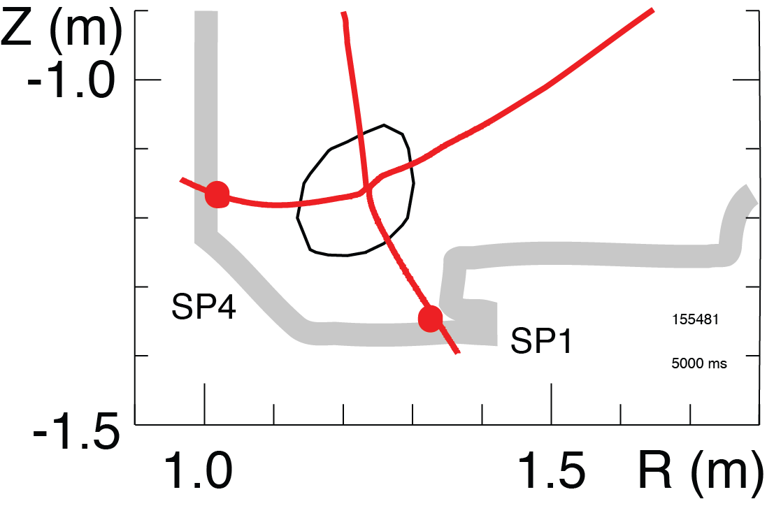
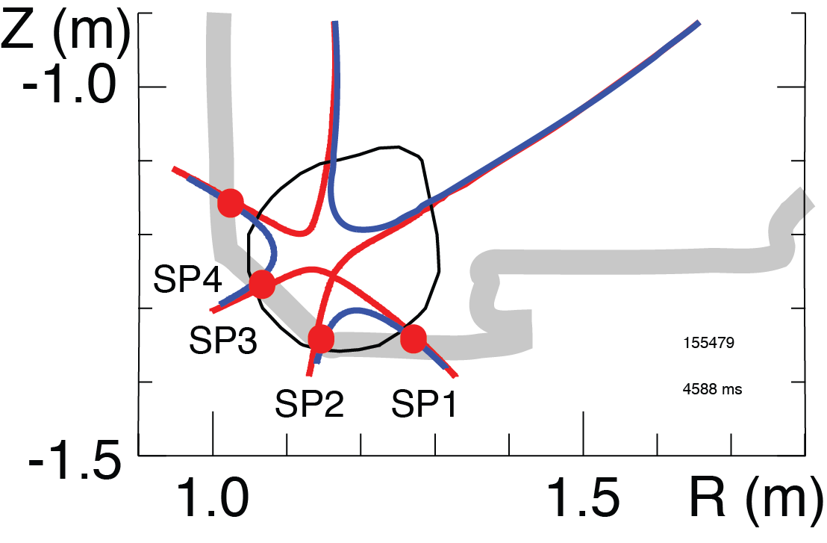
Large Region of Low B_{p} Around Second-order Null in Snowflake Divertor is Predicted to Modify Power Exhaust
Standard
Geometry properties
Criterion: d_{XX} ≤ a (λ_{q} /a)^{1/3}
  Higher edge magnetic shear
  Larger plasma wetted-area A_{wet} (f_{exp})
  Larger parallel connection length L||
  Larger effective divertor volume V_{div}
Transport properties
Criterion: d_{XX} ≤ D*~a (a β_{pm} / R)^{1/3}
  High convection zone with radius D*
  Power sharing over four strike points
  Enhanced radial transport (larger λ_{q})
“Laboratory for divertor physics”
Snowflake
Low B_{p} contour: 0.1 B_{p}/B_{p}^{mid}
d_{SF} ≤ a (λ_{q} /a)^{1/3} d_{SF}≤D*

Slide 18
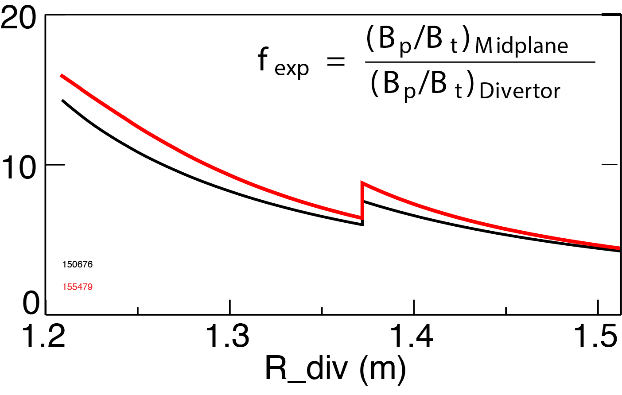
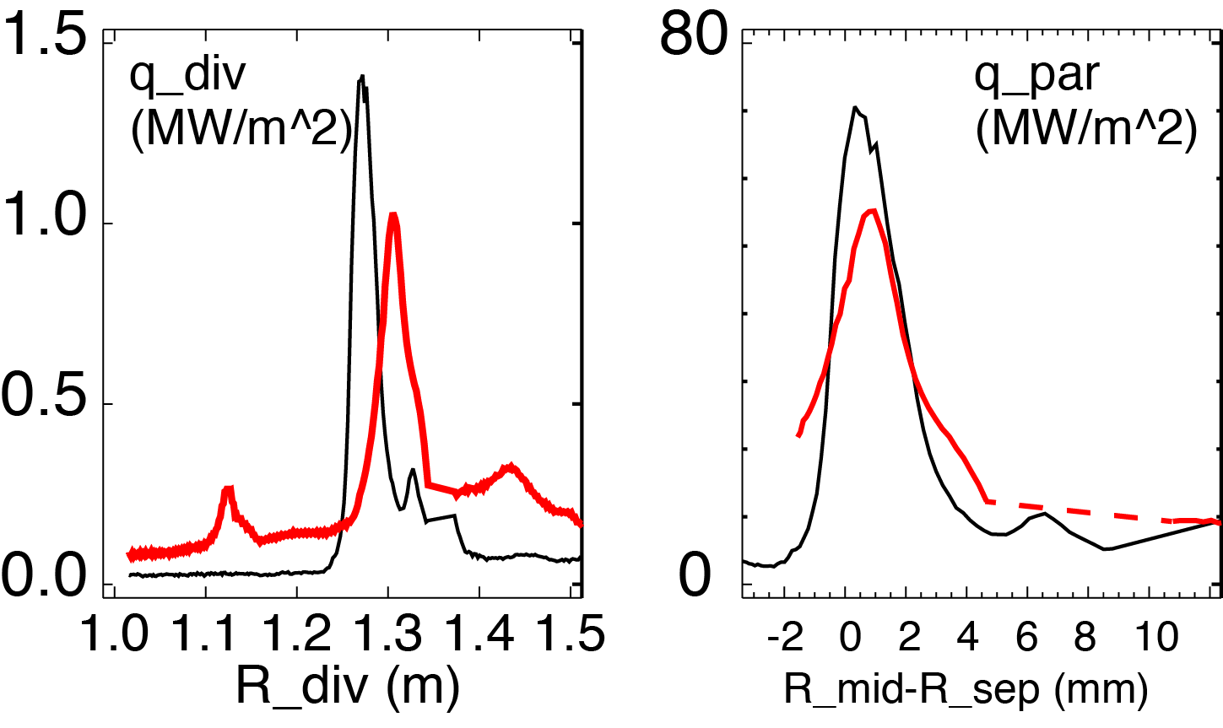
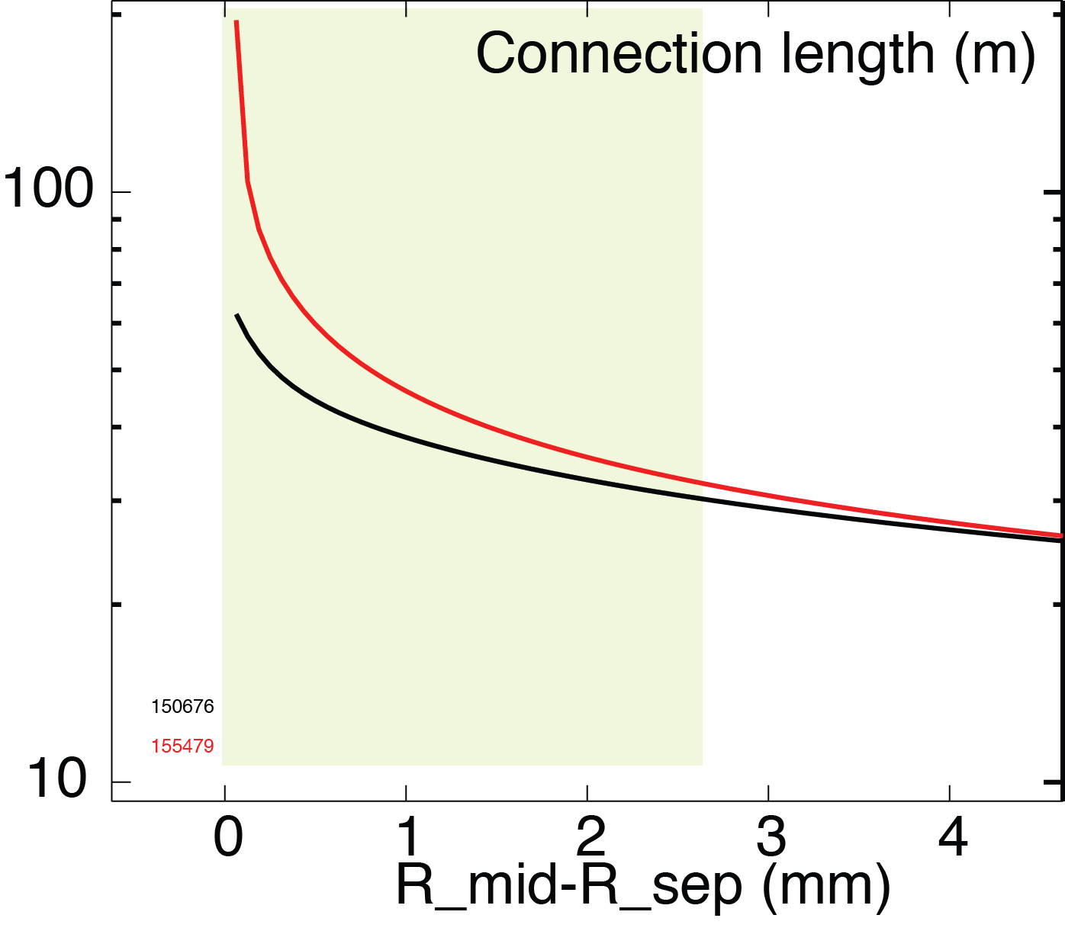
q_{peak} Reduction in Snowflake Divertor Partly Due to Increased A_{wet} and L||
Standard Snowflake
Strike
point
Flux expansion increased ~20%
  Depends on configuration, can be up to X3
L|| increased by 20-60% over SOL width
Divertor heat flux reduced ~30%
Parallel heat flux reduced ~20%
SOL width
18

Slide 19
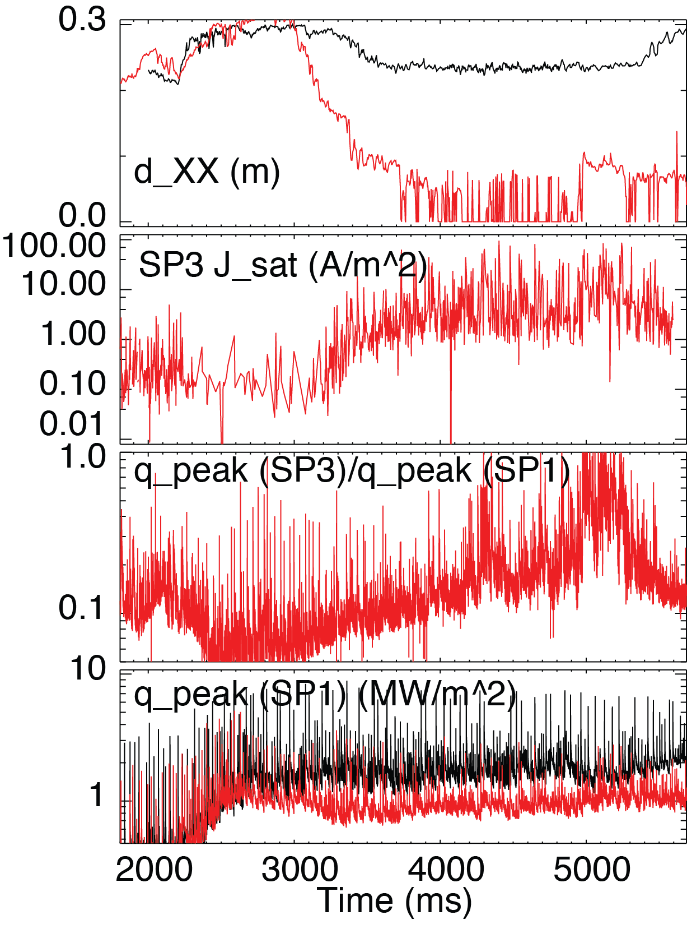
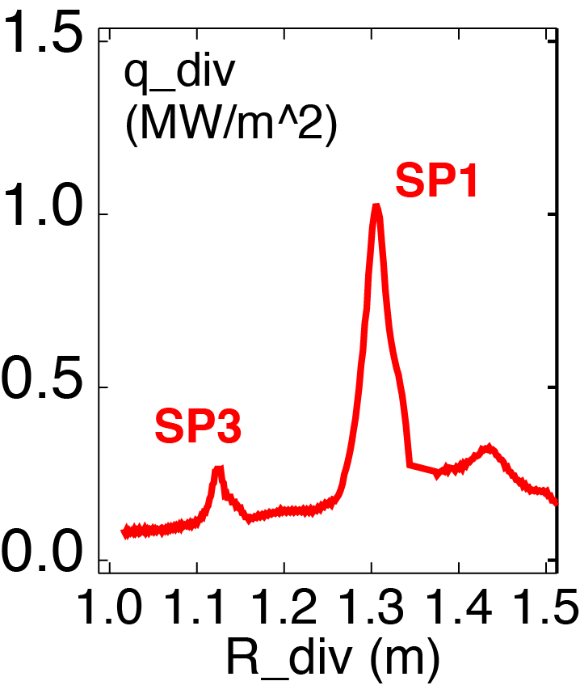
Heat and Particle Fluxes Shared Among Strike Points in Snowflake Divertor
Standard Snowflake
Γ_{SP3}
q_{SP3}
q_{SP1}
q_{SP3} / q_{SP1} < 0.5
P_{SP3} / P_{SP1} < 0.3
Sharing fraction maximized at low d_{XX}
19

Slide 20
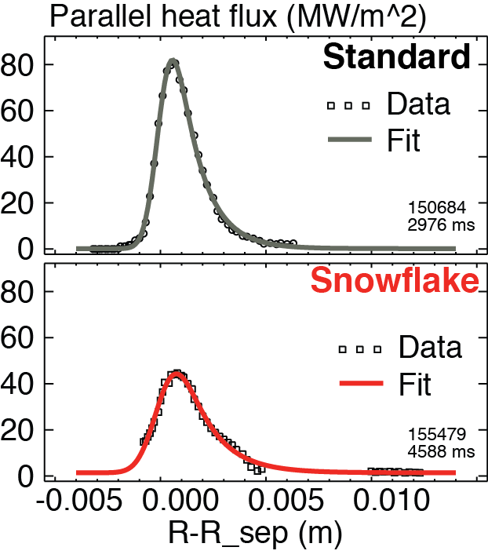
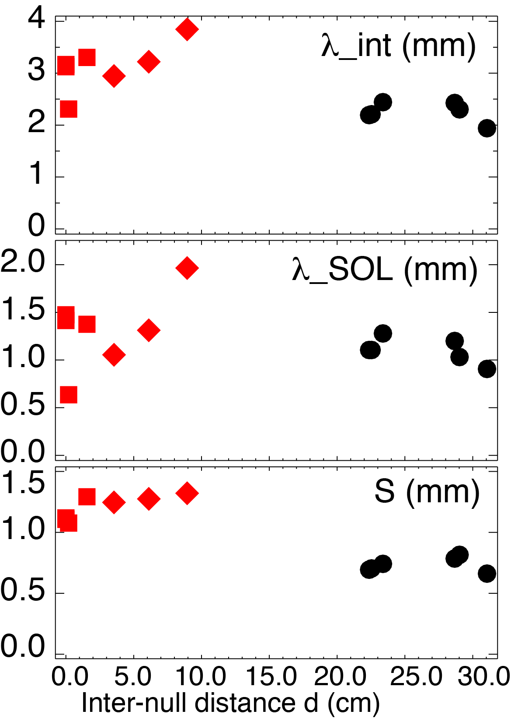
Broader q|| Profiles in Snowflake Divertor May Imply Increased Radial Transport
Parallel heat flux (MW/m²)
Standard Snowflake
λ_{q} = 2.40 mm
λ_{q} = 3.20 mm
Fit q|| profile with Gaussian (S) and Exp. (λ_{SOL}) functions (Eich PRL 107 (2011) 215001)
Increased λ_{q} may imply increased transport
  Increased radial spreading due to L||
  SOL transport affected by null-region mixing
  Enhanced dissipation may also play role

Slide 21
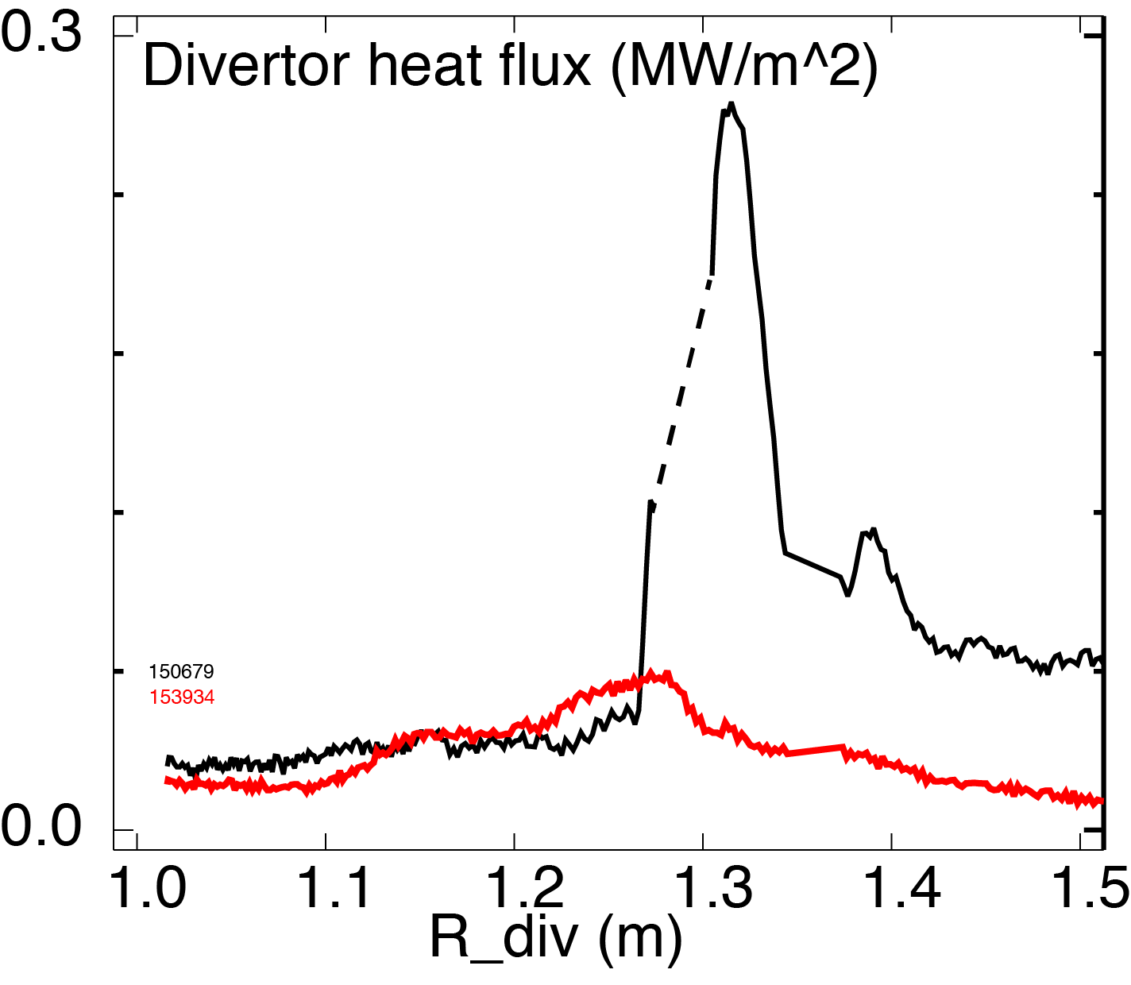
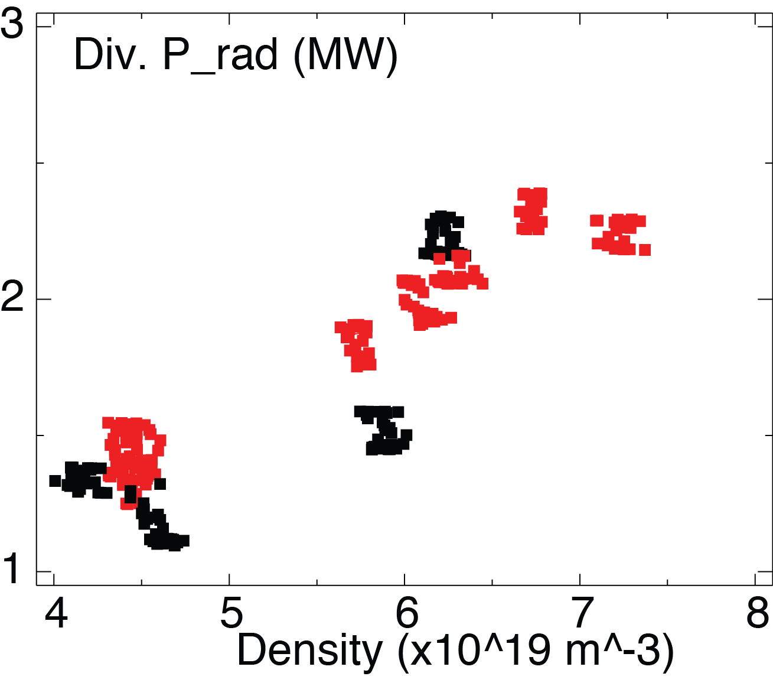
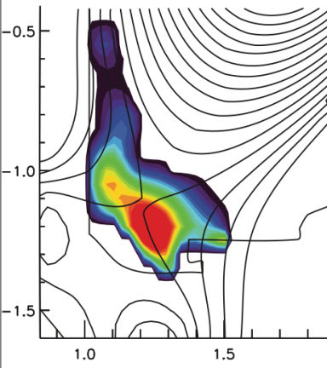
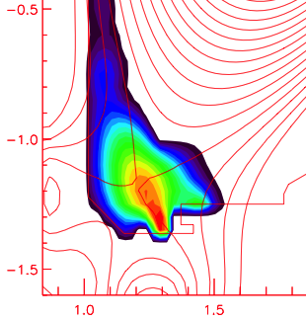

Divertor Radiation More Broadly Distributed in Snowflake for Radiative Divertor, q_{peak} Reduced by x5
Standard Snowflake
Divertor heat flux (MW/m²)
P_{SOL} = 3-4 MW
Standard Snowflake
Detached radiative divertor produced by D₂ injection with intrinsic carbon radiation
In radiative snowflake nearly complete power detachment at P_{SOL}~3 MW

Slide 22


NSTX-U
Supported by
NSTX-U Project / Facility Status
Culham Sci Ctr
U St. Andrews
York U
Chubu U
Fukui U
Hiroshima U
Hyogo U
Kyoto U
Kyushu U
Kyushu Tokai U
NIFS
Niigata U
U Tokyo
JAEA
Tsukuba U
Hebrew U
Ioffe Inst
RRC Kurchatov Inst
TRINITI
NFRI
KAIST
POSTECH
SNU
ASIPP
ENEA, Frascati
CEA, Cadarache
IPP, Jülich
IPP, Garching
ASCR, Czech Rep
Columbia U
CompX
General Atomics
FIU
INL
Johns Hopkins U
LANL
LLNL
Lodestar
MIT
Nova Photonics
New York U
ORNL
PPPL
Princeton U
Purdue U
SNL
Think Tank, Inc.
UC Davis
UC Irvine
UCLA
UCSD
U Colorado
U Illinois
U Maryland
U Rochester
U Washington
U Wisconsin
Masa Ono and Ron Strykowsky
for the NSTX-U Team
NSTX-U FY 2014 Q4 Review Meeting
November 25, 2014

Slide 23
Outline
Upgrade Project Status
Preparation toward Operation
Research Operation Schedule
NSTX-U Organization
Summary

Slide 24
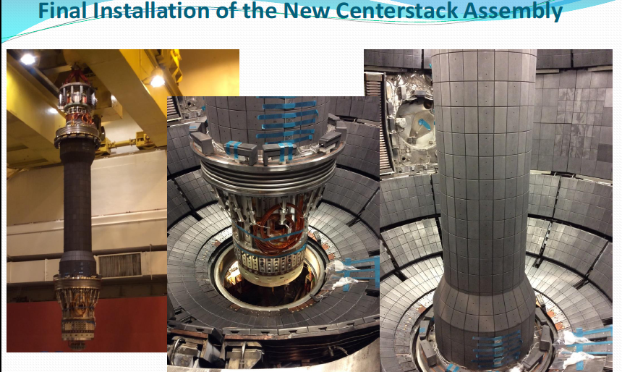
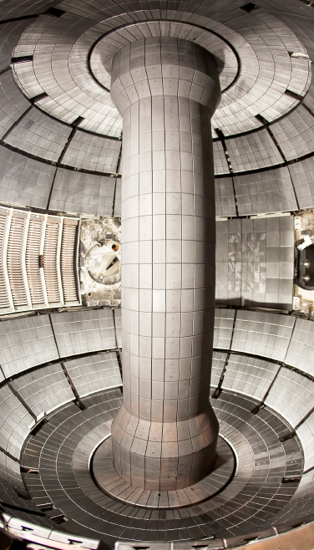
New Center-Stack Installed In NSTX-U
Vacuum pump-down is planned for December
First NBI access port duct installed last week. Smaller flanges being installed

Slide 25
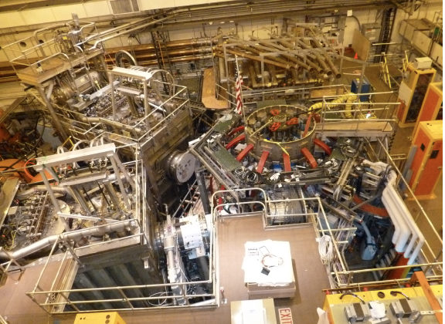
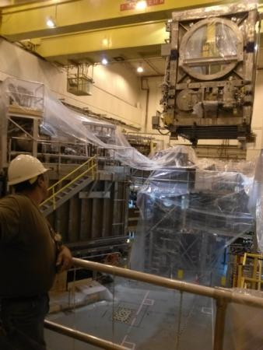
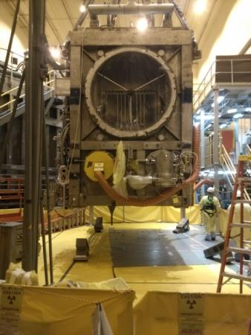
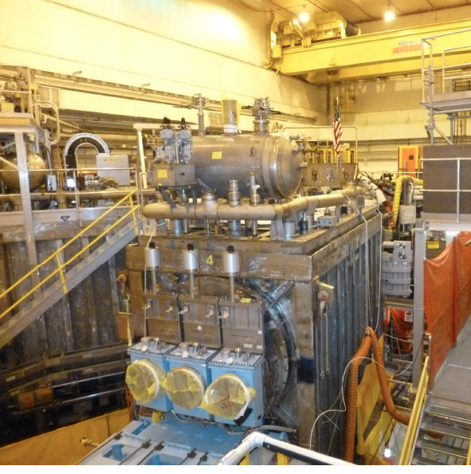
NSTX Upgrade Project Is 95% Complete
Recent aerial view of NSTX-U Test Cell (Oct. 27, 2014)
HHFW System
1st NBI
NSTX-U
CS Casing
2nd NBI

Slide 26
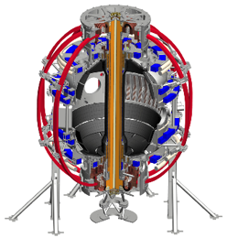
New Digital System Provides Comprehensive Coil Protection
Protects NSTX-U machine against electromagnetic loads
Computes forces and stresses in real-time based on reduced models of the full mechanical structure
Redundant systems
System #1 is undergoing final integrated testing, will be used during rectifier dummy-load testing in December, providing real world experience before plasma ops.
System #2 is 90% complete and it will be ready to support CD-4 and beyond.
Full commissioning system will be a key part of early operations
Power Supply Suppress and Bypass
Coil and Plasma Current Measurements
Realtime Acquisition #1
Realtime Acquisition #2
Stand Alone Digital Coil Protection Computer
Digital Coil Protection & Plasma Control Computer
Level-1 Fault Interface
System #1
System #2
Rectifier Hardware Controls
Notes:
A bunch of sensors give conditioned current inputs
Output is Go/NoGo… Fault/No Fault

Slide 27
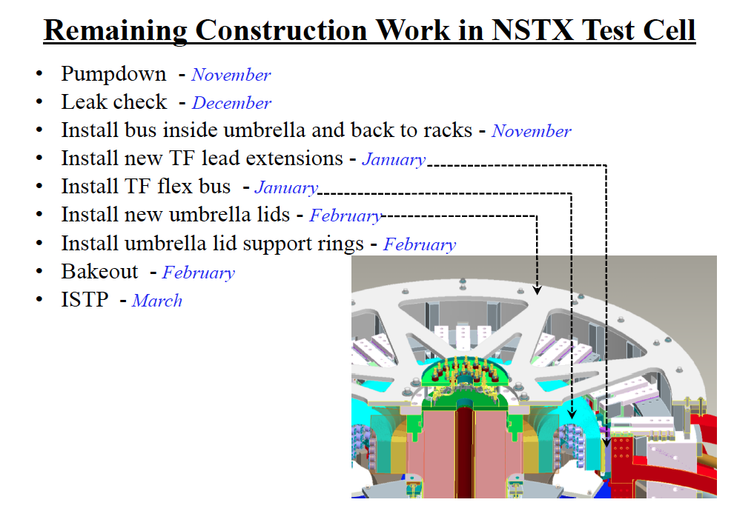
December
December - January
November - December

Slide 28
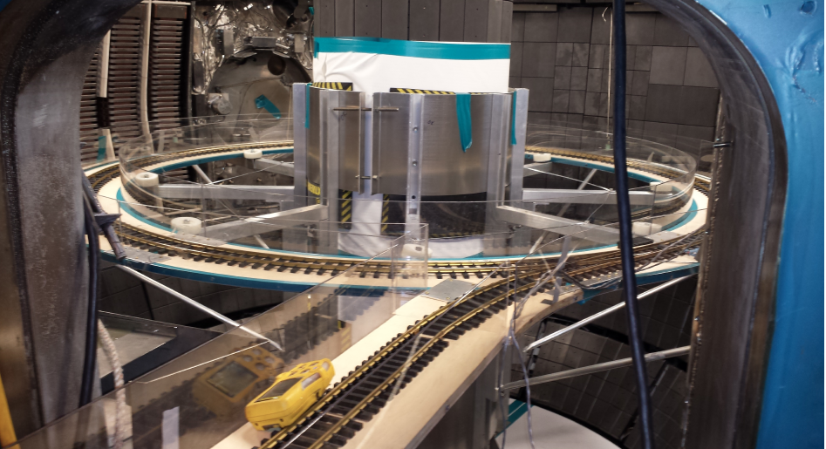
Neutron calibration was performed safely with a stronger neutron source inside the NSTX-U vacuum chamber
The neutron calibration was performed with two major radii with a neutron source mounted on a model train car on a set of circular tracks inside the NSTX-U vacuum chamber.
Dr. Kunihiro Ogawa from the LHD group (NIFS, Japan) observed the calibration, in anticipation of a similar calibration that is to be done on LHD a few months from now.

Slide 29
Approvals for Operations
The NSTX-U Activity Certification Committee (ACC) reviews continue, and is comprised of representatives from PPPL Engineering, Research, Safety, and the DOE PSO is currently reviewing technical and safety systems for NSTX-U
A PPPL Internal QA Audit of NSTX-U Start-Up has been performed, and has resulted in a punch list of critical Start-Up and Test Procedures for both CD-4 and subsequent physics operations.
A Readiness for Operations Review (Dec. 9 -11) is being arranged through the University, and is prerequisite for our safety certificate prescribing allowable operating parameters. Committee members from LANL, GA, JLAB, MIT, ORNL, CCFE & UW will be here for this review.

Slide 30
Preparations for Operations
PF1 Field Changes
  FCPC has been configured.
  Connections/labeling in the test cell still required.
MG#1 Weld Repairs
  Maintenance procedures in progress with plans to spin up the set in December.
Field Coil Power Conversion (FCPC) Commissioning
  AC primary Power Systems and new rectifier firing generators ready to support Ops
  The new PLC-based fault relaying system to replace electromagnetic relays is complete and tested. Individual rectifiers are being prepared for open circuit testing.
  The Digital Coil Protection System (DCPS) has been installed, and is undergoing pre-operational testing.
  The Power System Real Time Control (PSRTC) is being tested in conjunction with the rectifier firing generators. DCPS and PSRTC will be ready to support FCPC Dummy Load testing in December.

Slide 31
Neutral beam injection (NBI) system should be available for CD-4 and research operations
Neutral Beam Injection #2
  Pre-operational testing in progress.
  NBI#2 will be ready to pump-down in December.
  Helium Refrigerator compressors have been started and clean-up of process gas in progress.
  Expect to start ion source pre-operational testing (PTP-11) in December to complete the NB! #2 CD-4 in Jan/Feb.
Neutral Beam Injection #1
  After CD-4, will begin to re-commission NBI#1, although will attempt to make parallel progress whenever possible.
Test Cell Mods
  A design for a new North Door shield wall has been completed. Installation in Dec/Jan.

Slide 32
Considerable Effort Being Dedicated to Plasma Control Commissioning
Critical magnetic diagnostics
  Final in-vessel sensor installation and repairs completed.
  Presently recommissioning the magnetic integrators.
  New plasma current rogowski processing electronics nearing completion.
  Excellent new magnetic diagnostics on the CS expertly installed.
Making rapid progress in control software development.
  New 64 core plasma control computer to be delivered in a few weeks, with plans to purchase a backup computer in January.
    Supports all plasma control + DCPS System #2.
  Upgrades to realtime data link successfully tested.
    Presently testing new power supply control software.
  Have written new gas delivery system control software, to be tested in December.
  Beginning a “scrub” of remaining plasma control software to remove legacy dependencies.
  Hired a replacement realtime software developer to provide expanded capability and redundancy in this critical area.

Slide 33
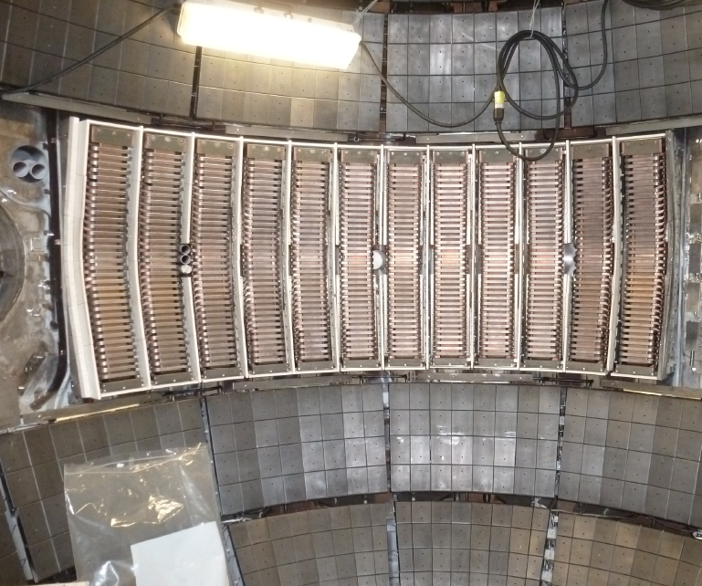
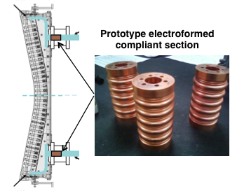
HHFW System for Electron Heating and Current Ramp-up
Improved Antennas were installed on NSTX-U
New Compliant Antenna Feeds
Will allow HHFW antenna feedthroughs to tolerate 2 MA disruptions
Additional ground installed
• Transmission lines are in the process of being installed & tuned.
Remaining tasks:
• RF power supplies to be re-energized in March 2015 time frame to be ready for research operation in May 2015.
Prototype compliant feeds tested to 46 kV in the RF test-stand. Benefit of back-plate grounding for arc prevention found.
Antennas were re-installed with the new feeds and back-plate grounding

Slide 34
NSTX-U diagnostics to be installed during first year
All center stack sensors mounted & ex-vessel terminations in progress
MHD/Magnetics/Reconstruction
  Magnetics for equilibrium reconstruction
  Halo current detectors
  High-n and high-frequency Mirnov arrays
  Locked-mode detectors
  RWM sensors
Profile Diagnostics
  MPTS (42 ch, 60 Hz)
  T-CHERS: T_{i}(R), V_{φ}(r), n_{C}(R), n_{Li}(R), (51 ch)
  P-CHERS: V_{θ}(r) (71 ch)
  MSE-CIF (18 ch)
  MSE-LIF (20 ch)
  ME-SXR (40 ch)
  Midplane tangential bolometer array (16 ch)
Turbulence/Modes Diagnostics
  Poloidal FIR high-k scattering (installed in 2016)
  Beam Emission Spectroscopy (48 ch)
  Microwave Reflectometer,
  Microwave Interferometer
  Ultra-soft x-ray arrays – multi-color
Energetic Particle Diagnostics
  Fast Ion D_{α} profile measurement (perp + tang)
  Solid-State neutral particle analyzer
  Fast lost-ion probe (energy/pitch angle resolving)
  Neutron measurements
Edge Divertor Physics
  Gas-puff Imaging (500kHz)
  Langmuir probe array
  Edge Rotation Diagnostics (T_{i}, V_{φ}, V_{pol})
  1-D CCD H_{α} cameras (divertor, midplane)
  2-D divertor fast visible camera
  Metal foil divertor bolometer
  AXUV-based Divertor Bolometer
  IR cameras (30Hz) (3)
  Fast IR camera (two color)
  Tile temperature thermocouple array
  Divertor fast eroding thermocouple
  Dust detector
  Edge Deposition Monitors
  Scrape-off layer reflectometer
  Edge neutral pressure gauges
  Material Analysis and Particle Probe
  Divertor VUV Spectrometer
Plasma Monitoring
  FIReTIP interferometer
  Fast visible cameras
  Visible bremsstrahlung radiometer
  Visible and UV survey spectrometers
  VUV transmission grating spectrometer
  Visible filterscopes (hydrogen & impurity lines)
  Wall coupon analysis
New capability, Enhanced capability

Slide 35
Considerable Success In Diagnostic Installation Before Vessel Closure With the Support of the Upgrade Project
Neutron detector installation & calibration (with in-vessel train track) completed.
Fiber installation and in-vessel alignments for MPTS Upgrade complete.
MAPP checked for interferences with outboard divertor at sample insertion point and probe drive stand secured to NTC floor.
Tile on CS machined to provide reflecting surface for interferometer/polarimeter.
New shutters installed for “Synthetic Aperture Microwave Imaging” (SAMI) and MSE-LIF diagnostics.
Toroidal CHERS diagnostic recalibrated following window replacement.
Sample coupons placed on vacuum vessel walls and quartz deposition monitors installed.
All flanges required for pumpdown identified and installation in progress.
All major profile diagnostics (MSE, MSE-LIF, CHERS, P-CHERS, MPTS, FIDA, T-FIDA) achieved spatial calibrations before pump-down.

Slide 36
Operations Team Continuing to Make Progress in Boundary Physics Operations to Prepare the Facility for Research
Massive Gas Injection | Installation procedures for MGI valves have been released. Critical valve components delivered to PPPL (from U. Washington), and support brackets fabricated. Will be installed in parallel with the inner-PF bus work.
Fuelling and Density Control | All gas valves will be under PCS control Allowing SGI to be used for density feedback Divertor injectors for radiation control
Boronization | New engineer with extensive experience in hazardous gas handling completed design for trimethyl borane system Components have been ordered with goal of availability of system for start of research operations
Lithium Evaporators (LITERs) | Fume hood installation and other upgrades complete for laboratory for LITER filling and maintenance Lithium handling procedures being updated – engineer responsible for boronization system involved
Granule Injectors for NSTX | New injector expected to be available for plasma operations – new postdoc responsible for system Lithium granules to be manufactured by UIUC

Slide 37
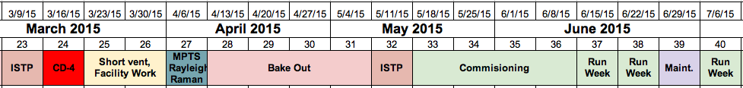
Activities between CD4 and Research Run
Important to optimize them to start the timely research run!
Short Vent to Install New Diagnostics (no manned entry!) only if needed.
Data Acquisition & Diagnostics Commissioning
Ex-Vessel Diagnostic Installations
Gas Delivery System Final Checks
Magnetics Debugging
Beamline #1 Final Checks
Commissioning
I_{p}<=1.0 MA, B_{T}<=0.5
Breakdown and current ramp scenarios
EFIT & rtEFIT Reconstructions
Shape & position control
Reliable H-mode
Diagnostic operations
DCPS under plasma operations
Boronizaton +He GDC for PFCs
Calibrations:
Magnetic
MSE
CHERS
Neutrons
Boronization / GDC
We will try to move the short vent before CD-4.
We will also perform MPTS Rayleigh Raman before CD-4 if possible.
We will try to minimize the commisioning time to move on to the research run as quickly as possible.

Slide 38
Nominal NSTX-U run schedule for FY2015
Nov. 2014
Dec. 2014
Jan. 2015
Feb. 2015
Mar. 2015
Apr. 2015
May 2015
Jun. 2015
Jul. 2015
Aug 2015
Sep. 2015
Bakeout
ISTP / Comm
Research Plasma Operation
12-14 Run Weeks
CD4
Aquapour + CS casing installation issues caused a CD-4 delay of ~ 3-4 weeks
~ 2 month period allocated between CD-4 and research plasma operations → CD-4 in mid-March, research ops in mid-May
Plan: ~12-14 run weeks (assumes 1 maintenance week / month)
If machine is running well at end of FY15, may run into early FY16
  Provide additional data for APS 2015 and IAEA synopses for 2016

Slide 39
NSTX-U Organization Chart for FY2015

Slide 40
Summary of Preparation toward NSTX-U Operation
• NSTX Upgrade Project is 95% complete and it has entered the final phase. The vacuum pump-down is planned for December. The coil bus installation is starting and expect to last to early February. ISTP is starting at the end of February and CD-4 early March.
• Digital Coil Protection System software implementation is progressing well. Hardware implementation is complete and it is being prepare to support the rectifier commissioning.
• Research operation schedule / commissioning – Presently planning to start research plasma operation in May 2014. Working toward minimizing the research prep time after CD-4.
HHFW system preparation is underway. In-vessel antenna and RF probe installations were complete. The ex-vessel work is ~ 50% complete.
Diagnostic Enhancements / Commissioning are progressing well. All of the planned diagnostics should be available during the first year of plasma operations.
Boundary Physics Enhancement / Preparation is going well (lithium and boronization).
NSTX-U Organization is formulated.

Slide 41
Backup slides

Slide 42
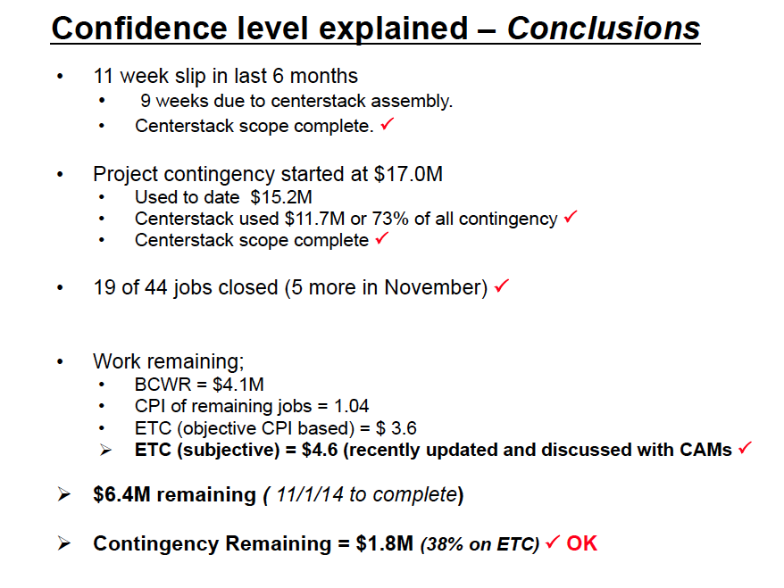
42

Slide 43
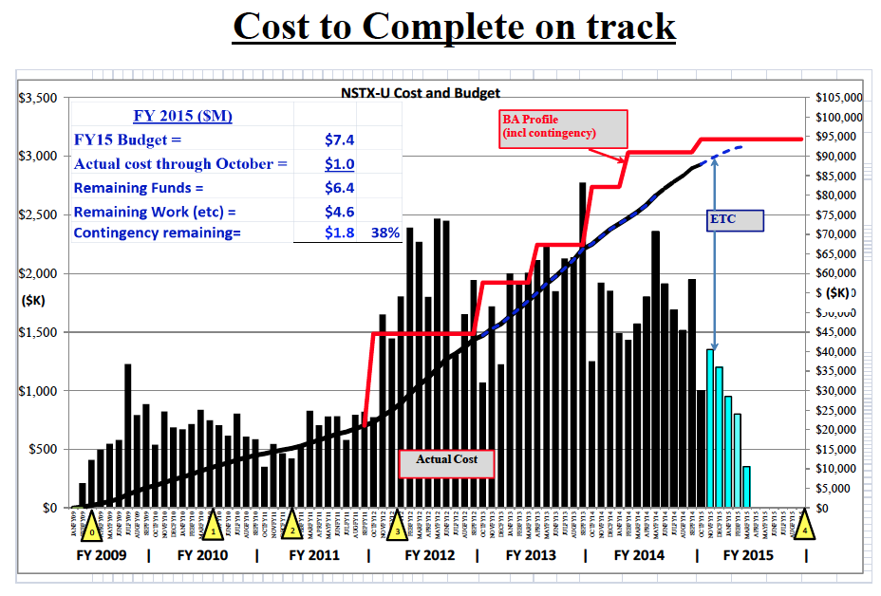

Slide 44
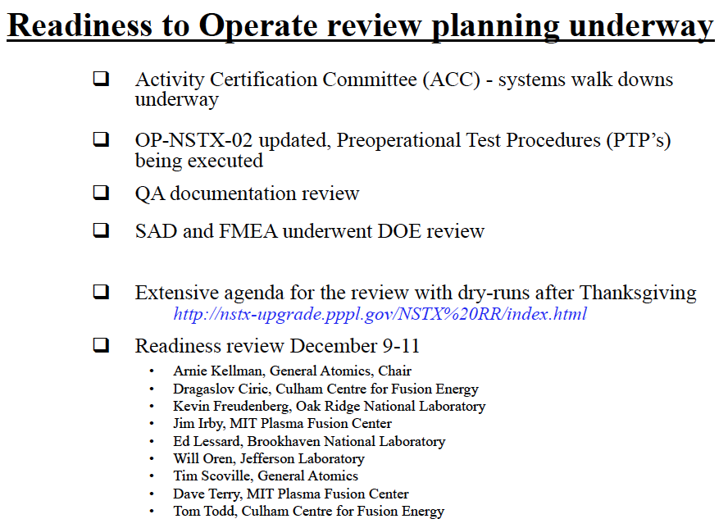

Slide 45
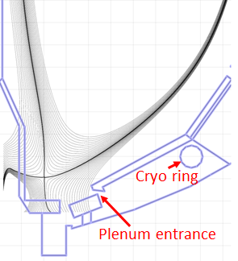
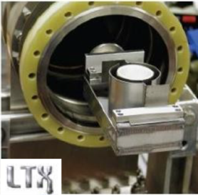
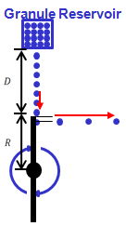
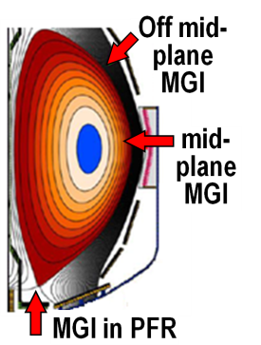

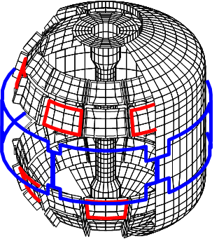
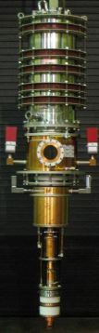
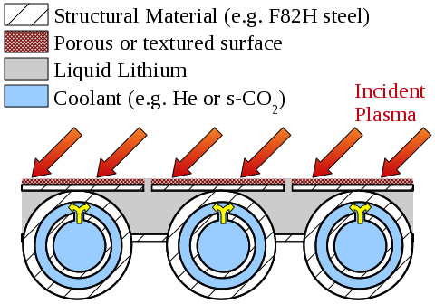
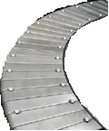
NSTX-U facility enhancements proposed for 5 year plan support FESAC Tiers/Priorities
Improved particle control tools
  Control D inventory, rapidly trigger ELMs to expel impurities
  Low ν* to understand ST confinement to support FNSF, validation
Disruption avoidance, mitigation
  Massive gas injection, detect halos, disruptions, control v_{φ}, RWM, ELM
ST start-up and ramp-up tools
  ECH to raise start-up plasma T_{e} to enable FW + NBI + BS I_{P} ramp-up
  Test EBW-CD start-up, sustainment
  Start-up/ramp-up critical for ST-FNSF
Begin transition to high-Z PFCs, assess flowing liquid metals
  Plus divertor Thomson, spectroscopy
Upward Li evaporator
Divertor cryo-pump
Li granule injector (LGI)
(Transients, PMI)
(FNSF, Predictive)
(Transients, Predictive)
Midplane + off-midplane non-axisymmetric control coils (NCC)
(FNSF)
Extended low-f MHD sensor set
1MW
28 GHz
gyrotron
(PMI, FNSF)
High-Z tiles
Actively-supplied, capillary-restrained, gas-cooled LM-PFC

Slide 46
NSTX-U
Supported by
NSTX-U FY2014 Q4 - Program Highlights
Coll of Wm & Mary
Columbia U
CompX
General Atomics
FIU
INL
Johns Hopkins U
LANL
LLNL
Lodestar
MIT
Lehigh U
Nova Photonics
Old Dominion
ORNL
PPPL
Princeton U
Purdue U
SNL
Think Tank, Inc.
UC Davis
UC Irvine
UCLA
UCSD
U Colorado
U Illinois
U Maryland
U Rochester
U Tennessee
U Tulsa
U Washington
U Wisconsin
X Science LLC
Jon Menard
For the NSTX-U Team
Culham Sci Ctr
York U
Chubu U
Fukui U
Hiroshima U
Hyogo U
Kyoto U
Kyushu U
Kyushu Tokai U
NIFS
Niigata U
U Tokyo
JAEA
Inst for Nucl Res, Kiev
Ioffe Inst
TRINITI
Chonbuk Natl U
NFRI
KAIST
POSTECH
Seoul Natl U
ASIPP
CIEMAT
FOM Inst DIFFER
ENEA, Frascati
CEA, Cadarache
IPP, Jülich
IPP, Garching
ASCR, Czech Rep
PPPL and FES
November 25, 2014
*This work supported by the US DOE Contract No. DE-AC02-09CH11466

Slide 47
Outline
FESAC strategic plan and NSTX-U
APS-DPP 2014 highlights
FY15 research organization preparation
ST-FNSF LDRD/IAEA/TOFE conclusions/highlights

Slide 48
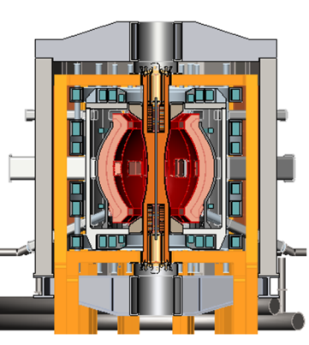
NSTX Upgrade mission elements
Advance ST as candidate for Fusion Nuclear Science Facility (FNSF)
Develop solutions for the plasma-material interface challenge
Explore unique ST parameter regimes to advance predictive capability - for ITER and beyond
Develop ST as fusion energy system
ST-FNSF
Liquid metals/Li
“Snowflake”
ITER

Slide 49
NSTX-U team-members proposed many innovative initiatives to FESAC SPP aligned with NSTX-U missions
FNSF
Menard, NSTX-­U: ST research to accelerate fusion development
Majeski, LTX: Exploring the advantages of liquid lithium walls
Fonck, Initiatives in non-­solenoidal startup and edge stability dynamics at near-­unity aspect ratio in the PEGASUS experiment
Raman, Simplifying the ST & AT concepts (CT injection fueling/momentum + EBW)
Maingi, A liquid‐metal plasma-­facing-­component initiative
Jaworski, Liquid metal plasma-­material interaction science and component development toward integrated demonstration
Allain, Establishing the surface science and engineering of liquid-­metal plasma-­facing components
Podestá, Development of tools for understanding, predicting and controlling fast­ion‐driven instabilities in burning plasmas
Sabbagh, Critical need for disruption prediction, avoidance, mitigation in tokamaks
Crocker / Guttenfelder, Validating electromagnetic turbulence and transport effects for burning plasmas
PMI
Burning plasmas, discovery science

Slide 50
NSTX-U missions aligned with FESAC SPP report
Quotes from the report:
“The primary mission of the NSTX-U subprogram element is to evaluate the potential of the low-aspect ratio tokamak, or spherical torus, to achieve the sustained high performance required for a FNSF.”
“Innovative plasma-material-interaction (PMI) solutions are another important element of this program”
“ITER-relevant research on NSTX-U includes energetic particle behavior and high-beta disruption control”
“NSTX-U should primarily focus on resolving the technical issues underpinning the FNSF-ST design.”
  “Key issues: non-solenoidal startup, sustainment of the plasma current, and scaling of confinement with collisionality.”
  LTX, Pegasus: important support for PMI and current initiation

Slide 51
FESAC SPP Report Priorities:
Tier 1
  Control of deleterious transient events: This Initiative combines experimental, theoretical, and simulation research to understand highly damaging transients and minimize their occurrence in ITER-scale systems.
  Taming the plasma-material interface: This Initiative combines experimental, theoretical, and simulation research to understand and address the plasma-materials interaction (PMI) challenges associated with long-pulse burning plasma operation.
Tier 2
  Experimentally validated integrated predictive capabilities: This Initiative develops an integrated “whole-device” predictive capability, and will rely on data from existing and planned facilities for validation.
  A fusion nuclear science subprogram and facility: This Initiative will take an integrated approach to address the key scientific and technological issues for harnessing fusion power.
Tier 1 Initiatives are higher priority than Tier 2 Initiatives. Within a tier, the priorities are equal.
In concert with above Initiatives, Discovery Plasma Science will advance the frontiers of plasma knowledge to ensure continued U.S. leadership.

Slide 52
Outline
FESAC strategic plan report
APS-DPP 2014 highlights from review/invited talks
  Talk topics are well aligned with FESAC-SP Tier topics
FY15 research organization preparation
ST-FNSF LDRD/IAEA/TOFE conclusions/highlights

Slide 53
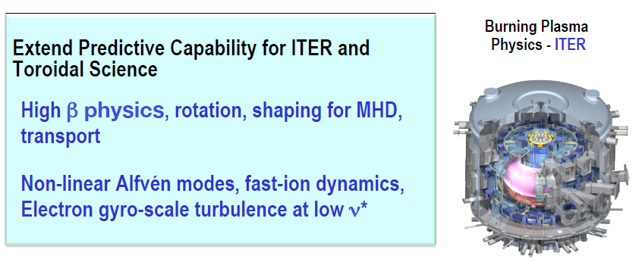
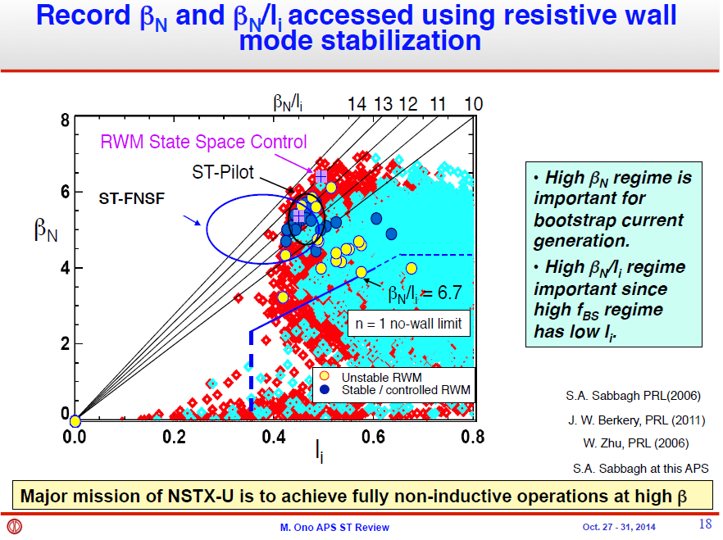


FR-1: “Recent Progress on Spherical Torus Research and
Implications for Fusion Energy Development Path” – M. Ono

Slide 54



GI1.00003: “Broadening of the divertor heat flux footprint with increasing number of ELM filaments in NSTX” – J.-W. Ahn

Slide 55

GI1.00003: “Broadening of the divertor heat flux footprint with increasing number of ELM filaments in NSTX” – J.-W. Ahn

Slide 56



TI1.00001: “Simulation of 3D effects on partially detached divertor conditions in NSTX and Alcator C-Mod” – J. Lore
Connection Length
16 10/30/2014

Slide 57

TI1.00003: “Drift Kinetic Effects on 3D Plasma Response in High-β Tokamak Resonant Field Amplification Experiments” – Z.R. Wang

Slide 58


VI2.00002: “Unification of Kinetic Resistive Wall Mode Stabilization Physics in Tokamaks” – S.A. Sabbagh

Slide 59

YI1.00006: “Energy Channeling & Coupling of NBI-driven Compressional Alfven Eigenmodes to Kinetic Alfven Waves in NSTX” – E. Belova

Slide 60

YI1.00006: “Energy Channeling & Coupling of NBI-driven Compressional Alfven Eigenmodes to Kinetic Alfven Waves in NSTX” – E. Belova

Slide 61
Outline
FESAC strategic plan report
APS-DPP 2014 highlights
FY15 research organization preparation
ST-FNSF LDRD/IAEA/TOFE conclusions/highlights

Slide 62
Update on increasing University engagement in the NSTX-U program
Increasing engagement was FY2014 “Notable Outcome”
Previously developed ideas to enhance participation:
  Expand Early Career Research (ECR) awards to University Scientists
    No support within DoE Office of Science to extend this beyond tenure-track
  Support students with coordinated senior projects and targeted run-time
    Will consider once NSTX-U resumes routine/full operation (late FY15)
  Implementing enhanced collaboration tools (remote control rooms)
    Will engage NSTX-U Science Groups to determine optimal tools (during FY15)
  Implement “NSTX-U Innovative Research Award (NIRA)” with funding targeting primarily university researchers
    No FES funding available, consider funding from NSTX-U post-Upgrade
  Consider direct financial support for start-up and initial salary for tenure-track professor positions (Same answer as previous question)
  More strongly engage University Principal Investigators and researchers in the management of the NSTX-U scientific program
    Implementing this for FY2015 run

Slide 63
NSTX-U research program will be (re-)organized along 3 “Science Groups” starting with FY15 run
Each TSG will have a leader, deputy, theory rep, and at least 1 university rep to enhance university participation

Slide 64
Motivations for restructuring science program
TSGs provide expertise in broad range of topics, but program would benefit from better coordination between TSGs
  SG leader responsibility: Coordinate TSG physics research plans, experimental/shot plans, diagnostic coverage & usage
Experiments that engage more than one TSG will receive increased priority for run-time
  Example: experiment on 3D fields generating data for: plasma response, turbulence, energetic particle loss
Efficient shot usage especially important during first run year (many systems need to be re-commissioned)
Incorporate much wider set University researchers/PIs in planning + coordination of research program (FES/PPPL goal)
NEW: Task-force for long-pulse particle control → cross-cutting goal supporting entire research program

Slide 65
Upcoming research planning/advisory activities
Pre-forum meeting #1 – Early / mid Dec (~1 day)
  Review experiments needed to support restart, physics-ops
    Draft machine/experimental proposal (XMP/XP) list – goals, authors
    Action: SG/TSGs to solicit people to commit to writing these proposals
Pre-forum meeting #2 – Last week of Jan (1.5-2 days)
  Goal: Provide up-to-date operations status to aid scheduling
  Day 1: Diagnostics/operations readiness meeting
    Status updates and projections for all systems needed for research ops
  Day 1.5-2: Update from SG/TSGs on XMP/XP solicitations
Research Forum – Feb 24-27th, 2015 at PPPL
  Plenary session, TSG break-outs, SG sessions, team joint session, summary (also safety session and team photo)
NSTX-U PAC-36 – Sept/Oct 2015 (end of/after FY15 run)

Slide 66
Research Forum Overview
Science groups will nominally follow priorities/detailed plans developed for 5 year plan (until they are obsolete…)
Abbreviated eXperimental Proposals (XPs) (developed in Dec-Jan) will be presented at the forum
  Motivation, goal, shot plan, # of run days, diagnostics, analysis…
Prioritization carried out at forum using abbreviated XPs
~70-90% of prioritization completed by end of forum
  Highest priority research in research milestones / task forces
  Proposals that address milestones will receive the most run time
  If abbreviated proposal idea is “priority 1”, the author is asked to develop full proposal for operational + program review/approval
Expect ~1/3 of all XPs for year to be approved, ready at start of physics campaign (April 2015), then roll forward
  Typically schedule XPs ~1-2 months in advance

Slide 67
First run year priorities support mission and 5YP goals
Mission Elements and 5YP 5 Highest Priorities
FY2015 Milestones / Task Forces:
Advance ST for FNSF
  Demonstrate full non-inductive sustainment at FNSF-relevant performance levels
  Advance non-inductive start-up and ramp-up (overdrive) for ST-FNSF with small/no solenoid
Develop solutions for PMI challenge
  Develop / utilize high-flux-expansion and radiative detachment to mitigate high heat flux
  Begin to assess high-Z PFCs + liquid Li to develop high-duty-factor integrated PMI solution
Explore unique ST parameter regimes to advance predictive capability - for ITER and beyond
  Access reduced ν* + high-β + varied q and rotation to dramatically extend ST understanding
R15-3
Develop physics + operational tools for high-performance discharges (κ, δ, β, EF/RWM)
Particle Control Task Force (PC-TF)
Long-pulse main-ion and impurity control
R15-2
Characterize effects of NBI injection angle on fast-ion distribution and NBI-CD profile
IR15-1
Develop snowflake configuration, study edge and divertor properties
NOTE: IR15-1 accelerates snowflake part of R16-1 by 1 year
R15-1
Assess H-mode confinement, pedestal, SOL characteristics at higher B_{T}, I_{P}, P_{NBI}
JRT-15
Quantify impact of broadened J(r) and p(r) on tokamak confinement and stability

Slide 68
Outline
FESAC strategic plan report
APS-DPP 2014 highlights
FY15 research organization preparation
ST-FNSF LDRD/IAEA/TOFE conclusions/highlights

Slide 69

PF coil set identified that supports combined
Super-X + snowflake divertor for range of equilibria
Components:
TF coil
PF coil
Vessel
Blanket
All equilibrium PF coils outside vacuum vessel
Increased strike-point radius reduces B, q||
Strike-point PFCs also shielded by blankets
2nd X-point/snowflake increases SOL line-length
PF coil set supports wide range of l_{i}: 0.4 – 0.8
  Elongation and squareness change with l_{i} variation
  Fixed strike-point R, controllable B-field angle of incidence (0.5-5˚)
Divertor coils in TF coil ends for equilibrium, high δ
Breeding in CS ends important for maximizing TBR

Slide 70

0.5 MeV NNBI favorable for heating and current drive (CD) for R=1.7m ST-FNSF
NBCD increases for E_{inj} ≤ 0.5 MeV but saturates for E_{inj} = 0.75 – 1MeV
0.50
Maximum efficiency: R_{tan}=2.3-2.4m
Fixed target parameters in DD:
  I_{P} = 7.5MA, β_{N} = 4.5, l_{i} = 0.5
  n_{e} / n_{Greenwald} = 0.75, H_{98y,2} = 1.5
  A=1.75, R=1.7m, B_{T} = 3T, κ = 2.8
  ⟨T_{e}⟩=5.8keV, ⟨T_{i}⟩=7.4keV
Optimal tangency radii:
1.7m ≤ R_{tan} ≤ 2.4m
Control q(0), q_{min}
Shine-thru limit

Slide 71


R=1.7m configuration with long-leg divertor
Design features
Vertical maintenance
TF coils
Cu/SC PF coils housed in VV upper lid
SC PF coils pairs located in common cryostat
VV outer shell w/ shield material
Cu/SC PF coils housed in VV lower shell structure
Ports for TBM, MTM, NBI
Blankets
TF leads
Angled DCLL concentric lines to external header

Slide 72

Two sizes (R=1.7m, 1m) assessed for shielding, TBR
Parameter:
Major Radius 1.68m 1.0m
Minor Radius 0.95m 0.6m
Fusion Power 162MW 62MW
Wall loading (avg) 1MW/m² 1MW/m²
TF coils 12 10
TBM ports 4 4
MTM ports 1 1
NBI ports 4 3
Plant Lifetime ~20 years
Availability 10-50%
30% avg
6 Full Power Years
(FPY)
Neutron source distribution

Slide 73

Peak Damage at OB FW and Insulator of Cu Magnets
R=1.7m configuration
Dose to MgO insulator = 2x10⁸ Gy @ 6 FPY < 10¹¹ Gy limit
Dose to MgO insulator = 6x10⁹ Gy @ 6 FPY < 10¹¹ Gy limit
OB Blanket
Center Stack
Peak dpa at OB midplane = 15.5 dpa / FPY
Peak He production at OB midplane = 174 appm/FPY
He/dpa ratio = 11.2
3-D Neutronics Model of Entire Torus

Slide 74

TBR contributions by blanket region
0.0004
Breeding at CS ends important:
ΔTBR = +0.07
0.034
Inner Blanket Segment = 0.81
Outer Blanket Segment = 0.15
Total TBR ~ 1.03 with no penetrations or ports
(heterogenous outboard blanket)
0.034
0.0004
R=1.7m configuration

Slide 75






Impact of TBM, MTM, NBI ports on TBR
No ports or penetrations,
homogeneous breeding zones:
TBR = 1.03
Add 4 Test Blanket
Modules (TBMs)
TBR = 1.02 (ΔTBR = -0.01)
TBM
LiPb,
cooling channel,
FCI
Approx. ΔTBR per port:
TBM: -0.25%
MTM: -2.0%
NBI: -0.75%
MTM
Ferritic Steel
1 Materials Test Module (MTM)
TBR = 1.01 (ΔTBR = -0.02)
4 TBM + 1 MTM + 4 NBI
TBR = 0.97

Slide 76

Options to increase TBR > 1
PF Coils
Add to PF coil shield a thin breeding blanket (ΔTBR ~ +3%)
Smaller opening to divertor to reduce neutron leakage
Uniform OB blanket (1m thick everywhere; no thinning)
Reduce cooling channels and FCIs within blanket (need thermal analysis to confirm)
Thicker IB VV with breeding
Potential for TBR > 1 at R=1.7m

Slide 77


R₀ = 1m ST-FNSF achieves TBR = 0.88
Distribution of T production
TBM
NBI
1m device cannot achieve TBR > 1 even with design changes
Solution: purchase ~0.4-0.55kg of T/FPY from outside sources at $30-100k/g of T, costing $12-55M/FPY
MTM

Slide 78
Summary
FESAC strategic plan aligned with NSTX-U missions
  FNSF, PMI, ITER/predictive capability
NSTX-U researchers scientifically productive in FY14
  Led analysis for JRT-2014 / plasma response to 3D fields (reported at Q3)
  40 publications + 13 submitted (as of early September) for FY14
  IAEA: 4 orals on NSTX/ST-FNSF, 2 on DIII-D, 1 on C-Mod
  APS-DPP: 6 Invited NSTX/ST-review talks
NSTX-U organizational re-structuring complete, preparing for Research Forum, FY15 campaign
PPPL-led ST-FNSF LDRD completed
  IAEA/TOFE invited talks, identified mission vs. size tradeoff (TBR vs. R)

Slide 79
Backup slides

Slide 80
10 year goal: Integrate high-performance core + metal walls
NSTX-U 5 year goal: Establish ST-FNSF physics/scenarios
Plan presented at FESAC:
2015-2019
2020-2024
Establish ST physics / scenarios:
High-performance + metal walls
Non-inductive start-up, ramp-up
Confinement vs. β , collisionality
Sustain high β with advanced control
Mitigate high heat fluxes
Test high-Z divertor, Li vapor shielding
Convert all PFCs from C to high-Z
Static → flowing Li divertor module(s), full toroidal flowing Li divertor, high T_{wall}
5s → 10-20s for PFC/LM equilibration
Assess ST with high-Z, high-Z + Li
Inform choice of
FNSF configuration:
Inform choice of FNSF / DEMO
plasma facing materials:
Lower A or higher A?
Standard, snowflake, Super-X (MAST-U)?
High-Z acceptable? or need high-Z + Li?
Assess for both divertor and first-wall

Slide 81
NSTX-U facility enhancements proposed for 5 year plan support FESAC Tiers/Priorities
Improved particle control tools
  Control D inventory, rapidly trigger ELMs to expel impurities
  Low ν* to understand ST confinement to support FNSF, validation
Disruption avoidance, mitigation
  Massive gas injection, detect halos, disruptions, control v_{φ}, RWM, ELM
ST start-up and ramp-up tools
  ECH to raise start-up plasma T_{e} to enable FW + NBI + BS I_{P} ramp-up
  Test EBW-CD start-up, sustainment
  Start-up/ramp-up critical for ST-FNSF
Begin transition to high-Z PFCs, assess flowing liquid metals
  Plus divertor Thomson, spectroscopy
Upward Li evaporator
Divertor cryo-pump
Li granule injector (LGI)
(Transients, PMI)
(FNSF, Predictive)
(Transients, Predictive)
Midplane + off-midplane non-axisymmetric control coils (NCC)
Extended low-f MHD sensor set
(FNSF)
1MW
28 GHz
gyrotron
High-Z tiles
(PMI, FNSF)
Actively-supplied, capillary-restrained, gas-cooled LM-PFC

Slide 82
NSTX-U will continue to contribute strongly to model validation, and support development of integrated models
MHD: Kinetic MHD for RWM stability, plasma response, momentum transport from 3D fields (MISK, IPEC, POCA, VALEN, PENT, MARS-K, M3D-C1, R-DCON…)
Transport: High-β/electromagnetic effects on electron transport from micro-tearing, Alfvenic instabilities (GYRO, GTS, GTC, …, HYM, ORBIT)
Boundary: Edge kinetic neoclassical & turbulent transport (GENE, GYRO, GS2, XGC), SOL turbulence (SOLT), snowflake/detachment: neutrals, impurities (UEDGE, SOLPS, BOUT++, EIRENE, DEGAS2, DIVIMP)
Fast-ions: Gyro-center and full orbit following (ORBIT, SPIRAL), linear and non-linear Alfven instability, fast-ion transport (NOVA-K, M3D-K, HYM)
RF: Heating, edge power loss (AORSA, TORIC, SPIRAL), RF/fast-ion interactions (hybrid FOW CQL3D), ECH/EBW heating & CD (GENRAY)
Scenarios: 2D/3D helicity injection physics (TSC, NIMROD), time-dependent ramp-up/sustainment modeling (TSC/TRANSP/NUBEAM)

Slide 83


FY2015-16 research milestones target exploitation of new capabilities, exploration of new regimes
Incremental (full ops)
FY2015
FY2016
Expt. Run Weeks:
18
20
16
20
Previous
center-stack
New
center-stack
Macroscopic Stability
Support JRT on profile effects on stability
Lead JRT on disruption physics
IR16-1
Transport and Turbulence
R15-1
Assess confinement and local transport and turbulence at low ν* with full range of B_{T}, I_{P}, and NBI power
Assess H-mode confinement, pedestal, SOL characteristics at higher B_{T}, I_{P}, P_{NBI}
Boundary
Physics
R16-1
Develop snowflake configuration, study edge and divertor properties
Assess heat-flux mitigation and PFC response using advanced divertor configurations + radiation at high q_{||-div}
Materials & PFCs
IR15-1
TF OD = 20cm
TF OD = 40cm
R15-2
R16-2
Waves+Energetic Particles
Characterize effects of NBI injection angle on fast-ion distribution and NBI-CD profile
Assess fast-wave SOL losses and core thermal / fast ion interactions at increased B_{T}, I_{P}
Solenoid-free Start-up/ramp-up
R16-3
Develop high-non-inductive fraction NBI H-modes for ramp-up & sustainment
Adv. Scenarios and Control
R15-3
Develop physics+operational tools for high-performance discharges (κ, δ, β, EF/RWM)
Present NBI
New 2nd NBI
ITER Needs + Cross-cutting
Joint Research Target (JRT)
Quantify impact of broadened J(r) and p(r) on tokamak confinement and stability
Assess disruption mitigation, initial tests of real-time warning and prediction techniques

Slide 84
NSTX-U has long-term goal to assess compatibility of high τ_{E} and β + 100% non-inductive with metallic PFCs
5 year plan base budget case
Nominal 2014-18 5 year plan steps for implementation of cryo-pump + high-Z PFCs + LLD
2015
2016
2017
2018-19
2021
2022-23
High-Z
tile row
All
high-Z FW + divertors
+ flowing LLD module
C
BN
Li
High-Z
Cryo +
full lower
outboard high-Z divertor
Cryo + high-Z FW and OBD
+ liquid Li divertor (LLD)
Lower
OBD
high-Z row of tiles
Cryo + U+L OBD
high-Z rows of tiles
High-Z
tile row
High-Z tile row
Cryo-pump
Bakeable cryo-baffle for liquid Li
Flowing Li module
High-Z / Li implementation could be accelerated pending results and additional resources

Slide 85



Up/down-symmetric Super-X/snowflake projected to maintain peak divertor heat flux below material limits
λ_{q} = 0.8mm, assume S ≈ λ_{q} (closed divertor)
(T. Eich NF 2013)
λ_{q} ≈ 1.2mm (J. Canik IEEE 2013)
Upstream
T_{e}
[eV]
Divertor
Target
Max.
q⊥
[MW/m²]
Conducted
Peak q⊥ < 10MW/m²
Radiation
(Partial) detachment projected
to reduce peak q⊥ to < 2MW/m²

Slide 86

Free-boundary TRANSP/NUBEAM used to compute profiles for 100% non-inductive plasmas with Q_{DT} ~2
Neoclassical χ_{ion}
n_{e} / n_{Greenwald} = 0.7
H_{98,y2} = 1.4
I_{P} = 8.9MA, B_{T} = 2.9T
f_{NICD} = 100%, f_{BS} = 65%
P_{NNBI} = 80MW (0.5MeV)
P_{fus} = 200MW (50-50 DT)
  2.6% alpha bad orbit loss
Q_{DT} = 2.5
β_{N} = 5.5, W_{tot} = 58MJ
  W_{fast} / W_{tot} = 14%
Maintain q_{min} > 2
q(0) / q_{min} controllable via R_{tan} and density

Slide 87


ST-FNSF shielding and TBR analyzed with sophisticated 3-D neutronics codes
CAD coupled with MCNP using UW DAGMC code
Fully accurate representation of entire torus
No approximation/simplification involved at any step:
  Internals of two OB DCLL blanket segments modeled in great detail, including:
    FW, side, top/bottom, and back walls, cooling channels, SiC FCI
  2 cm wide assembly gaps between toroidal sectors
  2 cm thick W vertical stabilizing shell between OB blanket segments
  Ports and FS walls for test blanket / materials test modules (TBM/MTM) and NNBI
LiPb,
cooling channel,
FCI
TBM
NBI
Heterogeneous OB Blanket Model,
including FW, side/back/top/bottom walls, cooling channels, and SiC FCI

Slide 88


Mapping of dpa and FW/blanket lifetime
(R=1.7 m Device)
R=1.7m configuration
Peak =
15.5 dpa / FPY
FW/blanket could operate for 6 FPY
if allowable damage limit is 95 dpa
dpa / FPY
→ Peak EOL Fluence = 11 MWy/m²

Slide 89



Summary of ST-FNSF TBR vs. device size
R=1.7m: TBR ≥ 1
R=1.0m: TBR < 1 (≈ 0.9)
TBM
NBI
NBI
TBM
MTM
1m device cannot achieve TBR > 1 even with design changes
Solution: purchase ~0.4-0.55kg of T/FPY from outside sources at $30-100k/g of T, costing $12-55M/FPY
MTM

Slide 90





FNSF center-stack can build upon NSTX-U design and incorporate NSTX stability results
Like NSTX-U, use TF wedge segments (but brazed/pressed-fit together)
  Coolant paths: gun-drilled holes or grooves in side of wedges + welded tube
Bitter-plate divertor PF magnets in ends of TF achieve high triangularity
  NSTX data: High δ > 0.55 and shaping S ≡ q₉₅I_{P}/aB_{T} > 25 minimizes disruptivity
  Neutronics: MgO insulation can withstand lifetime (6 FPY) radiation dose

Slide 91




Bitter coil insert for divertor coils in ends of TF
Insulator
Glidcop plates

Slide 92


MgO insulation appears to have good radiation resistance for divertor PF coils

Slide 93



PF coil currents and current densities
β_{N} = 5
l_{i} = 0.58
3
4
5
6
2
1
7
8

Slide 94

R=1.7m ST-FNS facility layout
using an extended ITER building
TF center-stack
Upper TF horizontal legs
Full blanket assembly
Upper dome structure located on test cell shield plug
VV lid / PF cryostat enclosure
TF power supplies
JT-60SA NNBI

Slide 95
FNSF Summary: R = 1m and 1.7m STs with Γ_{n} = 1MW/m² and Q_{DT} = 1-2 assessed for FNS mission
Ex-vessel PF coil set identified to support range of equilibria and Super-X/snowflake divertor to mitigate high heat flux
0.5MeV NNBI optimal for heating & current drive for R=1.7m
Vertical maintenance approach, NBI & test-cell layouts identified
Shielding adequate for MgO insulated inboard Cu PF coils
  Outboard PF coils (behind outboard blankets) can be superconducting
Calculated full 3D TBR; TBR reduction from TBM, MTM, NBI
Threshold major radius for TBR ~ 1 is R₀ ≥ 1.7m
R=1m TBR = 0.88 → 0.4-0.55kg of T/FPY → $12-55M/FPY
R=1m device will have lower electricity and capital cost → future work could assess size/cost trade-offs in more detail

