Slide 1
NSTX-U Program - FY2015 Q3 Report*
Jon Menard, Masa Ono
For the NSTX-U Team
PPPL and FES
July 23, 2015
*This work supported by the US DOE Contract No. DE-AC02-09CH11466

Slide 2
Outline
Research highlights for Q3
Emphasis on fast ion physics this time…
Preparation for FY2016 run campaign

Slide 3
Accurate Modeling of Halo Neutrals is Important for Proper Interpretation of Fast Ion Diagnostic Signals
Neutral Particle Analysis (NPA) and Fast-ion D_{α} (FIDA) are key diagnostics for interpreting the fast-ion distribution, transport
Both measure aspects of the energetic neutral density population
Halo neutral density is comparable with beam neutral density
Increase NPA and FIDA signal, critical for synthetic diagnostics
Affect fast ion CX loss, thus impact basic TRANSP calculations, e.g. NB driven current, neutron yield, power balance
Halo neutrals have a broader profile than beam neutrals
Could affect spatial localization of NPA and FIDA diagnostics
Could affect relative contribution to diagnostics from beam, halo neutrals
A new 3D Halo model was recently developed in TRANSP / NUBEAM to replace the incorrect “volume averaged” halo neutral model.
D. Liu¹, S. S. Medley², M. V. Gorelenkova², W. W. Heidbrink¹, L. Stagner¹
¹ University of California, Irvine, ² Princeton Plasma Physics Laboratory

Slide 4
Halo Neutrals are Created in the Vicinity of Neutral Beam Footprint through Charge-Exchange Reactions
Both NPA and FIDA diagnostics rely on charge-exchange (CX) reactions
between fast ions and beam/halo neutrals.
Signal ∝ n_{fi} n_{neutral}
< σ v >
Fast-ion D-alpha (FIDA)
beam neutrals
Neutral Beam (NB)
halo neutrals
Neutral Particle Analyzer (NPA) cold edge neutrals
_{D}+
+ D⁰ → D⁰ + D⁺
NB fast NB
fast
_{D}+
+ D⁰ → D⁰ + D⁺
NB halo NB
bulk
_{D}+
+ D⁰ → D⁰ + D⁺
fast
halo fast bulk
_{D}+
+ D⁰ → D⁰ + D⁺
halo halo _ high _ generation
bulk

Slide 5
Excellent Agreement between TRANSP and FIDAsim when Using the Same ADAS Ground State Cross Section Tables (1)

Slide 6
Excellent Agreement between TRANSP and FIDAsim when Using the Same ADAS Ground State Cross Section Tables (2)
rotation
halo neutral
beam neutral
Halo neutral
beam neutral
The peak of halo neutrals shifts in the same direction as toroidal rotation, as expected

Slide 7
Key result: UCI + PPPL have verified halo models in TRANSP and FIDAsim
When using same cross section databases, TRANSP & FIDAsim predictions of beam & halo neutral densities get excellent agreement in both magnitude & spatial profile.
Halo neutral density is comparable with beam neutral density and halo neutrals spread broader than beam neutrals due to multi-generations and halo diffusion.
Halo neutrals significantly increase the NPA flux and FIDA emission, but they have minor effects on NPA energy spectrum or FIDA spectrum/spatial profile.
The calculation of halo neutral density (and also fast ion density, NBCD, neutron rate) is relatively sensitive to the choice of atomic cross section databases.

Slide 8
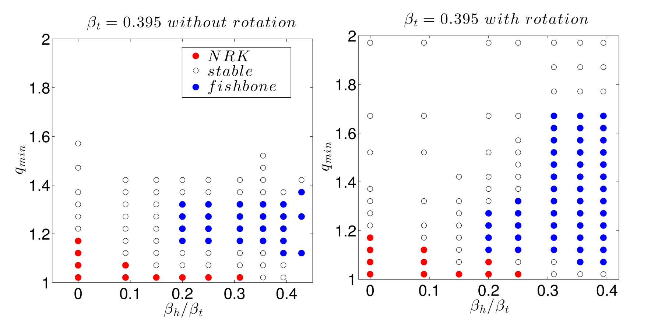
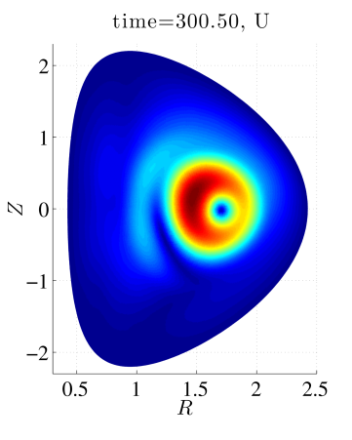
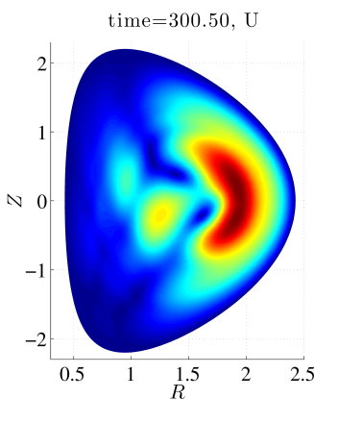
Linear stability analysis of fishbones with M3D-K finds rotation / rotation shear destabilizing at elevated q
Guoyong Fu, Feng Wang
NSTX-U / theory partnership
Eigenfunction broadens with rotation
Enhanced fast-ion transport or triggering / seeding of tearing modes?
Next step: investigate with non-linear runs.

Slide 9
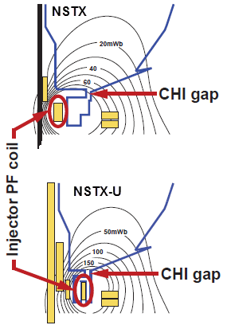
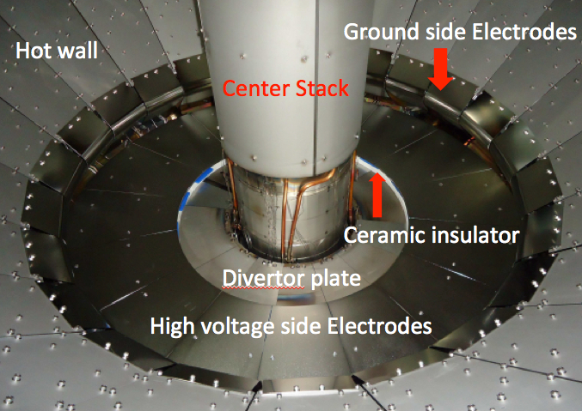
Collaborating with QUEST to explore CHI + ECH solenoid-free start-up in support of ST-FNSF
CHI Start-Up
CHI Implementation on QUEST
showing installed electrodes
• Inj. Flux in NSTX-U is about 2.5 times higher than in NSTX
• NSTX-U coil insulation greatly enhanced for higher voltage ~ 3 kV operation
U. Washington
Refurbishment of CHI Cap Bank completed.
Fabrication of the CHI gas injection system and operation procedure for the QUEST ST experiment in Japan completed.
Fabrication of the CHI capacitor bank for QUEST is nearing completion.

Slide 10
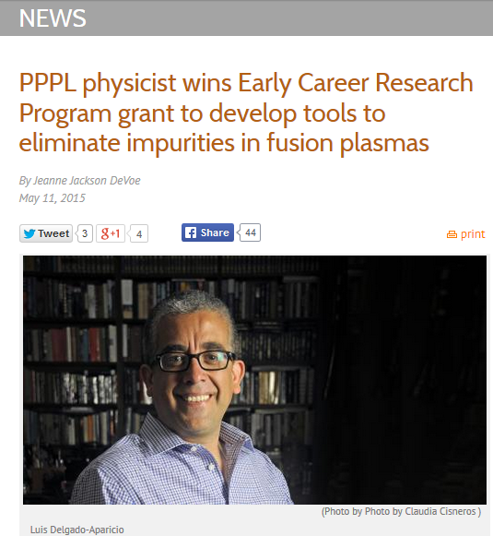
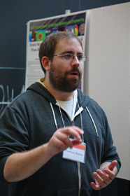
Ramping up efforts to study high-Z impurity sources, transport, mitigation techniques
Matt Reinke recently hired by ORNL to work at NSTX-U
Leading revival / upgrade of NSTX-U bolometry systems
Leadership for ORNL NSTX-U experimental boundary physics

Slide 11
NSTX-U collaborators helped lead Data Resources Survey to improve computational environment
D. Smith (UW), H. Yuh (Nova Photonics), K. Tritz (JHU)
Goals
Increase scientific productivity of NSTX/NSTX-­U data
Reduce barriers to entry for new team members
Reduce burden for data publication requirements
Objectives
Identify inefficiencies in data ecosystem
Develop strategies for improvement
Software framework for data access and management

Slide 12
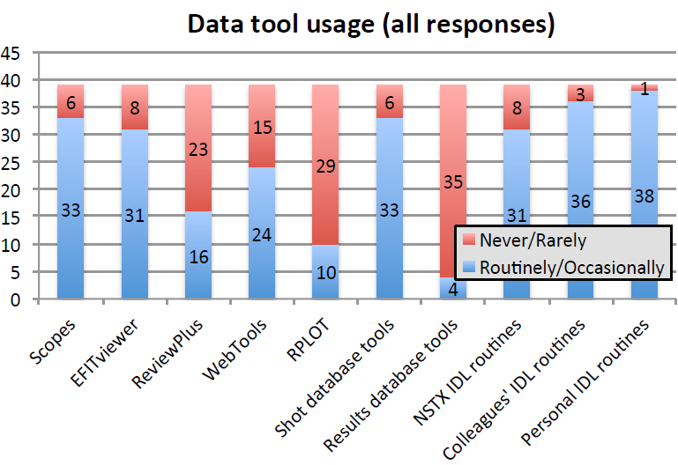
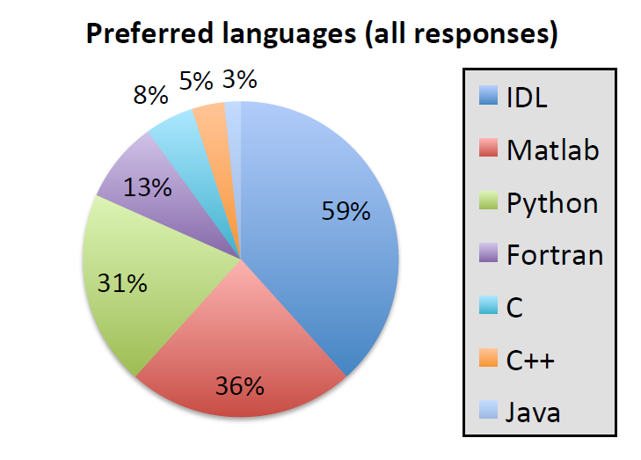
A few sample survey results
Most popular: scopes, EFITviewer, IDL, shot db
Next: WebTools and ReviewPlus
Least: RPLOT, results db tools
Earlier career responses
more ReviewPlus, less WebTools
Overall usage
59% IDL, 36% Matlab, 31% Python
Earlier career responses
Higher usage of Matlab & Python (47%/ 47%)

Slide 13
Key findings / action items
Language usage: 60% IDL, 35% Matlab, 30% Python
Among earlier career responses: 60% / 50% / 50%
There is overall agreement that the computing staff provides sufficient software support
Broad agreement that signiﬁcant and inefficient code duplication exists within the NSTX team
Contend that better software framework could improve efficiency, extensibility, scalability, collaboration
Likely actions:
Improve/better document code repository for key IDL routines
Need to identify and focus on most important and widely-used routines: flux mapping, profile fitting, boundary identification… (TBD)
Pilot / test python as improved software framework

Slide 14
NSTX-U university collaborators spearheaded new outreach seminar effort – to begin this fall
J. Berkery (CU)
D. Smith (UW)

Slide 15
FES solicitation for U.S. University and Industry DIAGNOSTIC Collaboration on NSTX-U now available
FES solicitation cycle divided into 3 groups:
University & Industry → Diagnostics → National Laboratories
Issue Date for FOA: 07/01/2015
Pre-Application Due Date: 07/29/2015 at 5 PM Eastern Time
Pre-Application is required, 2-3 pages (Title, abstract, collaborators, …)
Application Due Date: 09/18/2015 at 11:59 PM Eastern Time
NSTX-U gathered 30+ diagnostic ideas from team
Shared with SG/TSG leaders for final comment/consideration/inclusion
PAC-36 reviewed draft Program Letter June 23
PAC report very helpful for improving letter
PAC would like to be more frequently informed of project status
PAC now has option to be included in weekly highlights e-mail distribution

Slide 16
Outline
Research highlights for Q3
Preparation for FY2016 run campaign

Slide 17
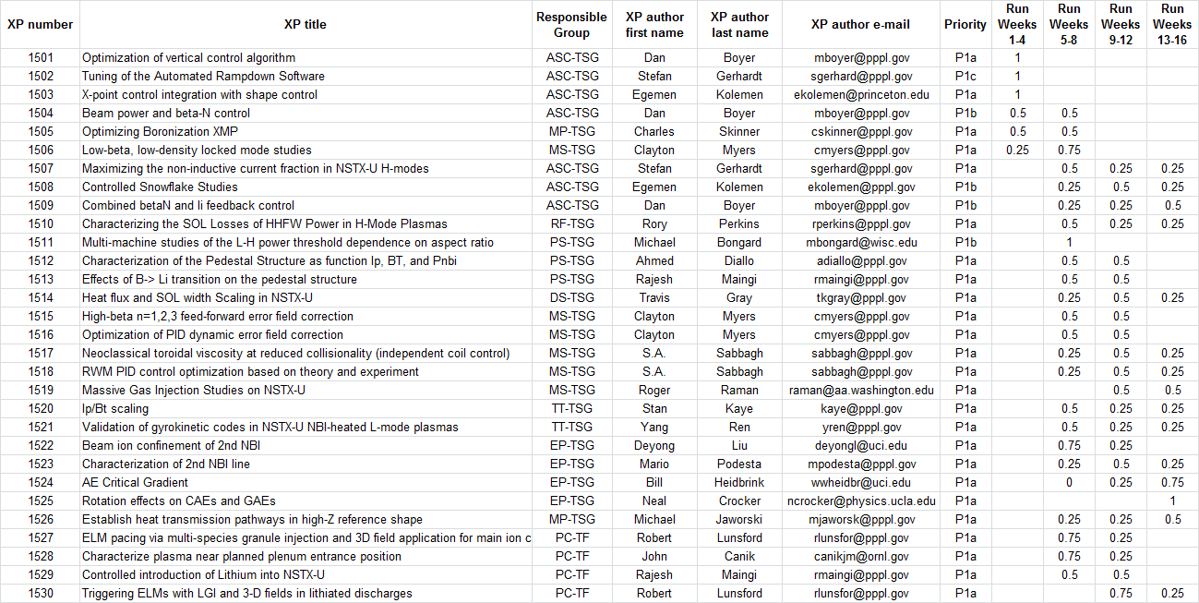
Chosen first 30 experiments to review: Order based on Priority 1 + expected period to be run during campaign
At least 30 XPs will be fully reviewed prior to start of research campaign
17 XPs already reviewed
►
►
►
►
►
►
►
►
►
►
►
►
►
►
►
►
►
►

Slide 18
Latest run plan for 2016 Goal is to operate 14-16 run weeks as per research forum
➔ Want as much data as possible for IAEA synopses (due Jan/Feb)
October: 3-4 run weeks
November: 0-2 run weeks
May want to pause for ST workshop, APS, Thanksgiving
December: 3 run weeks
January: 2 run weeks
Mid-run assessment (if applicable), PAC-37
Feb-Mar: 3-8 run weeks, complete FY16 run
Mar/Apr: Start outage: install high-k, high-Z tiles, …
Resume operations fall 2016 for FY17

Slide 19
Overview of FY2015-17 NSTX-U research milestones
FY2016
Obtain first data at 60% higher field/current, 2-3× longer pulse:
Re-establish sustained low l_{i} / high-κ operation above no-wall limit
Study thermal confinement, pedestal structure, SOL widths
Assess current-drive, fast-ion instabilities from new 2nd NBI
FY2017
Extend NSTX-U performance to full field, current (1T, 2MA)
Assess divertor heat flux mitigation, confinement at full parameters
Access full non-inductive, test small current over-drive
First data with 2D high-k scattering, prototype high-Z tiles
FY2018
Study low-Z and high-Z impurity transport
Assess causes of core electron thermal transport
Test advanced q profile and rotation profile control
Assess CHI plasma current start-up performance
See backup for detailed Research Milestone timeline

Slide 20
NSTX-U Milestone Schedule for FY2016-18
FY2016
FY2017
FY2018
Run Weeks:
Incremental
14
16
16
18
12
16
R16-1
R17-1
R18-1
Boundary Science
+ Particle Control
Assess H-mode confinement, pedestal, SOL characteristics at higher B_{T}, I_{P}, P_{NBI}
Assess scaling, mitigation of steady-state, transient heat-fluxes w/ advanced divertor operation at high power density
Assess impurity sources and edge and core impurity transport
R17-2
IR18-1
Assess high-Z divertor PFC performance and impact on operating scenarios
Investigation of power and momentum balance for high density and impurity fraction divertor operation
R16-2
R17-3
IR18-2
Assess effects of NBI injection on fast-ion f(v) and NBI-CD profile
Assess τ_{E} and local transport and turbulence at low ν* with full confinement and diagnostic capabilities
Assess role of fast-ion driven instabilities versus micro-turbulence in plasma thermal energy transport
Core Science
Begin ~1 year outage for
major facility enhancement(s) sometime during FY2018
IR17-1
R18-2
R16-3
Assess fast-wave SOL losses, core thermal and fast ion interactions at increased field and current
Control of current and rotation profiles to improve global stability limits and extend high performance operation
Integrated Scenarios
Develop physics + operational tools for high-performance: κ, δ, β, EF/RWM
R17-4
R18-3
Develop high-non-inductive fraction NBI H-modes for sustainment and ramp-up
Assess transient CHI current start-up potential in NSTX-U
FES 3 Facility Joint Research Target (JRT)
C-Mod leads JRT
DIII-D leads JRT
NSTX-U leads JRT
Assess disruption mitigation, initial
tests of real-time warning, prediction
TBD… possibly something
on energetic particles
TBD

Slide 21
Summary
Continued scientific productivity during long outage
But very excited to get some new data!
Research milestones shifted by ~1 fiscal year due to OH arc fault
Taking advantage of the extra time, XP reviews on track to have ≥ 1/2 of run-time fully defined before run

