Slide 1

NSTX-U Program - FY2015 Q4 Report*
Jon Menard, Stan Kaye, Masa Ono (PPPL)
For the NSTX-U Team
PPPL and FES
October 26, 2015
*This work supported by the US DOE Contract No. DE-AC02-09CH11466

Slide 2
Outline
Notable Outcomes
Research Milestones
FY2015 Research Highlights
Upcoming events
Summary

Slide 3
Notable outcome overview
Objective 1.2 “Perform experimental research on NSTX-U to resolve key spherical torus issues at magnetic field, plasma current, and pulse length beyond that achieved in NSTX, after completion of CD-4 for the project”
  Did not have experimental campaign in FY2015, but generated many new analysis and simulation results, reorganized science groups, planned run
Objective 1.2 “Provide leadership, coordination, and support to the FES joint research target with the goal of quantifying the impact of broadened current and pressure profiles on tokamak plasma confinement and stability”
  Led by M. Podesta with emphasis on energetic particle physics w/ DIII-D
Outcome 3.2 “Develop a plan to continue the NSTX-U/PPPL Theory partnership within projected funding levels”
  FY15 budget favorable → maintained/expanded partnership
  Several / many partnership result examples shown in research highlights

Slide 4
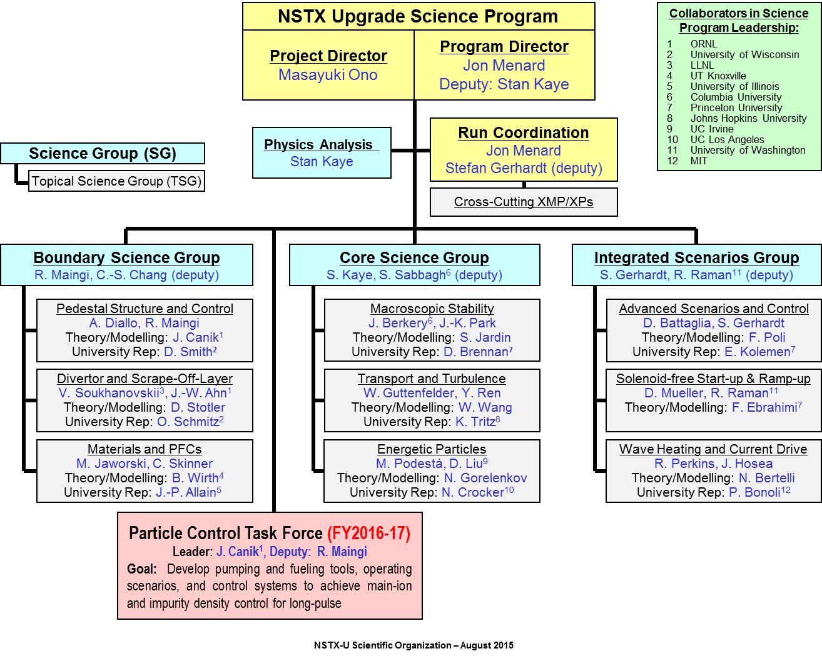
Developed new NSTX-U Science Program organizational structure with 3 Science Groups
Each TSG will have a leader, deputy, theory rep, and at least 1 university rep to enhance university participation

Slide 5
Very strong interest in NSTX-U research
Requested research time exceeds available time by 4-5×
Requested / Available Run Time:
  Total: 273 / 80 = 3.4×
  Research: 248 / 55 = 4.5×
84 unique lead author names
~85% of requested time
Areas of highest interest / need

Slide 6
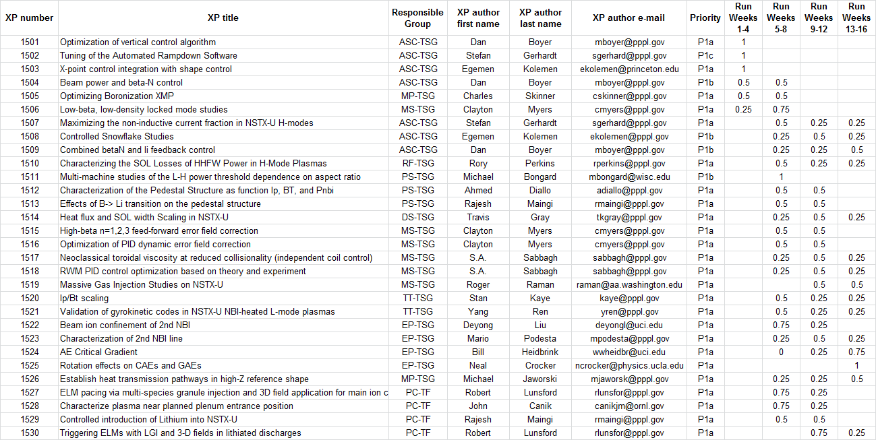
Review of first 30 high priority experimental proposals (XPs) nearly complete
Only 2 of 30 high-priority XPs remain to be reviewed
►
Expectation of when XP will run
►
►

Slide 7
Latest run plan schedule for 2016
Goal is to operate 14-16 run weeks as per research forum
If FY16 budgets are favorable enough, may run more run weeks
Want as much data as possible for IAEA synopses/meeting, APS-2016
November: ~ ISTP/Commissioning (XMP)
  May want to slow/pause for ST workshop, APS, Thanksgiving
December: 2-3 run weeks (XMP → XP)
January: ~2 run weeks (XP)
  PAC-37
February: ~ 3 run weeks
  Mid-run assessment (if applicable)
March – May 7-8 run weeks, complete FY16 run
May/June: Start outage: install high-k, high-Z tiles, …
Resume operations fall/winter 2016 for FY17

Slide 8
FY2015 Research Milestones
JRT-2015: Conduct experiments and analysis to quantify the impact of broadened current and pressure profiles on tokamak plasma confinement and stability.
R(15-1): Assess H-mode energy confinement, pedestal, and scrape-off-layer characteristics with higher B_{T}, I_{P} and NBI heating power
R(15-2): Assess the effects of neutral beam injection parameters on the fast ion distribution function and neutral beam driven current profile
R(15-3): Develop the physics and operational tools for obtaining high-performance discharges in NSTX-U
No XPs in FY2015 → emphasize analysis/modelling, research prep
FY2015 Research Milestones shifted to FY2016 largely unchanged

Slide 9
NSTX-U Milestone Schedule for FY2016-18
FY2016
FY2017
FY2018
Run Weeks:
Incremental
14
16
16
18
12
16
R16-1
R17-1
R18-1
Boundary Science
+ Particle Control
Assess H-mode confinement, pedestal, SOL characteristics at higher B_{T}, I_{P}, P_{NBI}
Assess scaling, mitigation of steady-state, transient heat-fluxes w/ advanced divertor operation at high power density
Assess impurity sources and edge and core impurity transport
R17-2
IR18-1
Assess high-Z divertor PFC performance and impact on operating scenarios
Investigation of power and momentum balance for high density and impurity fraction divertor operation
R16-2
R17-3
IR18-2
Assess effects of NBI injection on fast-ion f(v) and NBI-CD profile
Assess τ_{E} and local transport and turbulence at low ν* with full confinement and diagnostic capabilities
Assess role of fast-ion driven instabilities versus micro-turbulence in plasma thermal energy transport
Core Science
Begin ~1 year outage for
major facility enhancement(s) sometime during FY2018
IR17-1
R18-2
R16-3
Assess fast-wave SOL losses, core thermal and fast ion interactions at increased field and current
Control of current and rotation profiles to improve global stability limits and extend high performance operation
Integrated Scenarios
Develop physics + operational tools for high-performance: κ, δ, β, EF/RWM
R17-4
R18-3
Develop high-non-inductive fraction NBI H-modes for sustainment and ramp-up
Assess transient CHI current start-up potential in NSTX-U
FES 3 Facility Joint Research Target (JRT)
C-Mod leads JRT
DIII-D leads JRT
NSTX-U leads JRT
Assess disruption mitigation, initial
tests of real-time warning, prediction
Examine effect of configuration on operating space for dissipative divertors
TBD

Slide 10
Outline
Notable Outcomes
Research Milestones
FY2015 Research Highlights
Upcoming events
Summary

Slide 11
NSTX-U Research Team Has Been Scientifically Productive
Very Active in Scientific Conferences, Publications, and Collaborations
Strong APS meeting participation in 2014: 1 ST review talk, 5 invited talks, 44 additional presentations.
Collaboration research contributions made in range of topics directly relevant to NSTX-U program
  DIII-D: Pedestal saturation, fast-ions, RWM, RFA, QH TEM
  KSTAR: NTV rotation damping, error fields, RMP
  C-Mod: ELM cycle, high-Z spectroscopy
  Halo current data/studies: DIII-D, AUG, C-Mod
Strong technical NSTX-U / next-step presentations at 2015 SOFE, Li Symposium, IAEA-TM on divertors
45 refereed publications for FY2015

Slide 12
Topical Science Group Research Highlights
Boundary Science
  Pedestal Structure and Control
  Divertor and Scrape-off Layer
  Materials and Plasma Facing Components
Core Science
  Macroscopic Stability
  Transport and Turbulence
  Energetic Particles
Scenario Integration
  Advanced Scenarios and Control
  Solenoid-Free Start-up and Ramp-up
  Wave Heating and Current Drive
Emphasis on PPPL Theory / NSTX-U Partnership

Slide 13
Topical Science Group Research Highlights
Boundary Science
  Pedestal Structure and Control
  Divertor and Scrape-off Layer
  Materials and Plasma Facing Components
Core Science
  Macroscopic Stability
  Transport and Turbulence
  Energetic Particles
Scenario Integration
  Advanced Scenarios and Control
  Solenoid-Free Start-up and Ramp-up
  Wave Heating and Current Drive

Slide 14
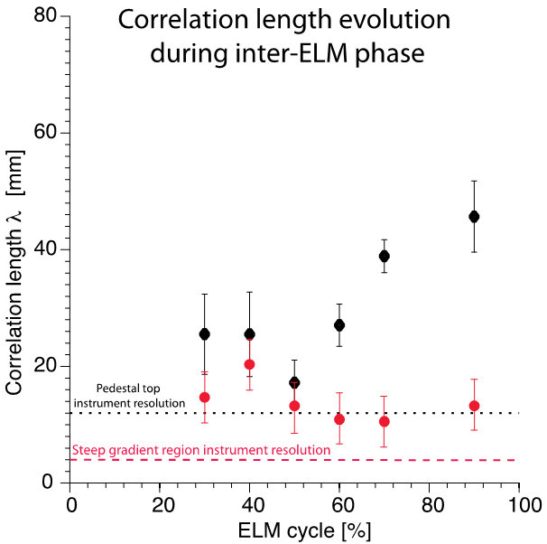
Electromagnetic (EM) effects critical for understanding transport in the pedestal and core of NSTX/NSTX-U
XGC-1 (full-f, global PIC) recently implemented hybrid EM effects (kinetic ions, fluid electrons - kinetic electrons under development)
Used to study pedestal turbulence in NSTX H-modes
Linear simulations → transition from ITG to KBM at pedestal top for β_{e}~12%
Expt → abrupt change in turbulence at ped. top at 50% of ELM cycle (β_{e}~8%)
Diallo et al, 2013
Theory 2015 Notable Outcome
NSTX-U / PPPL
Theory Partnership
R15/16-1, 17-3, 18-1
XP1512 (Diallo): Characterization of pedestal structure

Slide 15
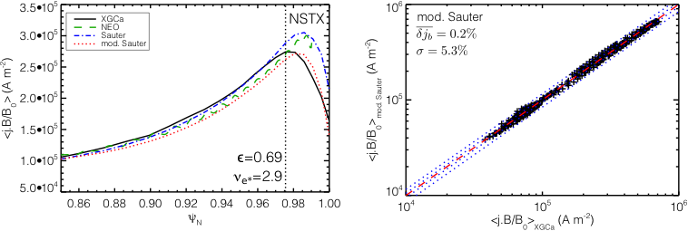
Non-local effects can reduce bootstrap current in NSTX edge/pedestal region at high collisionality
Model: Global gyrokinetic neoclassical code XGCa
  Fully non-linear Fokker-Planck-Landau collision operator
  Includes effects of banana and gyro-orbits >> pedestal width
Also developed modified analytic Sauter formula
NSTX-U / PPPL
Theory Partnership

Slide 16
Topical Science Group Research Highlights
Boundary Science
  Pedestal Structure and Control
  Divertor and Scrape-off Layer
  Materials and Plasma Facing Components
Core Science
  Macroscopic Stability
  Transport and Turbulence
  Energetic Particles
Scenario Integration
  Advanced Scenarios and Control
  Solenoid-Free Start-up and Ramp-up
  Wave Heating and Current Drive

Slide 17
XGC1 simulations aiding in understanding of SOL heat flux width trends in NSTX
Expt shows contraction of SOL heat flux width at midplane with I_{p} as well as influence of Li conditioning
XGC1 w/ collisions → similar trends
20
XPs:
(Gray) – Heat flux width scaling in NSTX-U; extend range of I_{p}, shape, Li dep
(Gray) – Is interchange drive responsible for SOL contraction with Li (in collaboration with LODESTAR)
N
ST
X
0 mg
Ex
p
e
r
i
m
e
n
t
150 mg
300 mg
15
XG
C
1
B
P
s
c
a
n
Using 139047 at 665ms, 50 mg Li
10
λ_{q} (mm)
5
0
0.4
0.6
0.8
1
1.2
1.4
I_{P} (MA)
Heat flux width determined primarily by neoclassical processes
NSTX-U / PPPL
Theory Partnership
R15/16-1, 17-1

Slide 18
Initiated investigation of interactions of 3D magnetic perturbations with snowflake divertor
General Atomics
T. Evans, G. Canal
Short L_{c} fine-scale field line bundles (green, light green) extend well into the confined plasma region
  These magnetic field line bundles represent open field line bundles with 3-5 times the characteristic SOL length
  Second null generates strong lobes on HFS
  Potential for substantial parallel losses to the target

Slide 19
Topical Science Group Research Highlights
Boundary Science
  Pedestal Structure and Control
  Divertor and Scrape-off Layer
  Materials and Plasma Facing Components
Core Science
  Macroscopic Stability
  Transport and Turbulence
  Energetic Particles
Scenario Integration
  Advanced Scenarios and Control
  Solenoid-Free Start-up and Ramp-up
  Wave Heating and Current Drive

Slide 20
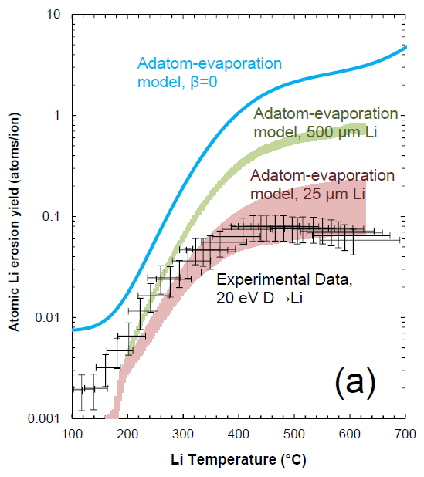


Reminder: Suppressed Li erosion and trapping at target observed in MAGNUM-PSI linear plasma device
Mixed-material effect reduces erosion due to LiD formation
Plasma pre-sheath potential well large enough to retain eroded Li
Significant implications for evaporative cooling concepts
T. Abrams 2014 PhD Princeton U.,
T. Abrams 2015 Nucl. Fusion submitted,
M. Chen 2015 Nucl. Fusion submitted.
Li-I emission, t=2.5s
Neutral Li emission
Li Trapping
Plasma
Target
T>700C
Neutral D emission
10 mm
Jaworski, 3rd ISLA, 2013

Slide 21
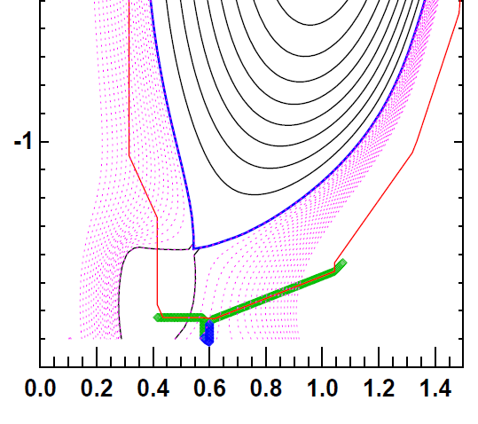
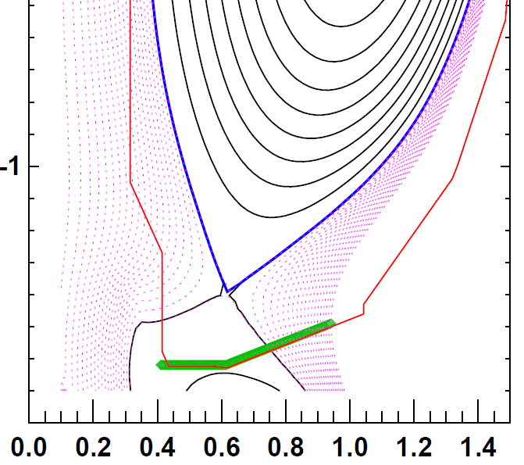
FY15 modelling → outboard row of high-Z tiles can access high heat-flux, maintain operational flexibility
High-performance discharge
Shape developed to perform dedicated tests on outboard PFCs
  ISOLVER free-boundary solver utilized with specified β_{N}
  0D-analysis obtains heating power for assumed confinement multiplier H_{98y2}
Zero-radiation power exhaust provides heat flux figure-of-merit (FOM)
  FOM calculates incident power accounting for magnetic shaping only
  High-Z shape FOM is 66% of similar full-power, high-triangularity scenario
FOM ~ 60 MW/m²
High-Z reference discharge
FOM ~ 40 MW/m²

Slide 22
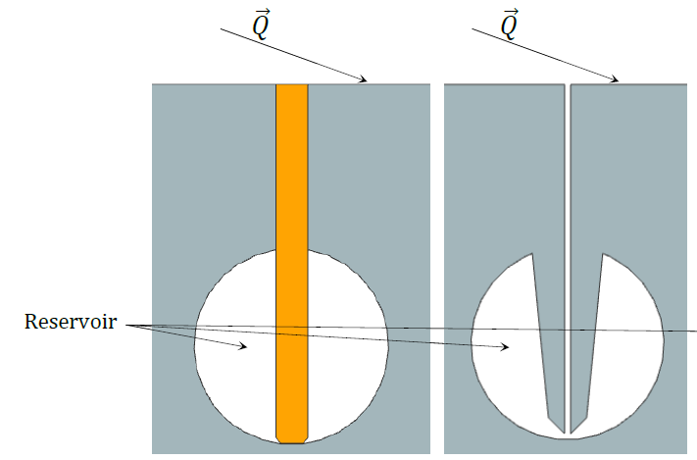
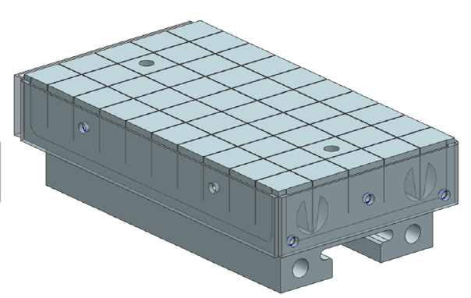
Developing pre-filled target concept integrating Li reservoir with high-Z tile scheme
Similar to CPS device but applicable as divertor PFC
Utilizes wire-EDM fabrication to obtain complex geometry
Emphasizes passive replenishment via capillary action
Textured
surface
Wick Structure
Reservoir
P. Rindt, TU/Eindhoven Thesis Project (advisor: M. Jaworski)

Slide 23
Topical Science Group Research Highlights
Boundary Science
  Pedestal Structure and Control
  Divertor and Scrape-off Layer
  Materials and Plasma Facing Components
Core Science
  Macroscopic Stability
  Transport and Turbulence
  Energetic Particles
Scenario Integration
  Advanced Scenarios and Control
  Solenoid-Free Start-up and Ramp-up
  Wave Heating and Current Drive

Slide 24
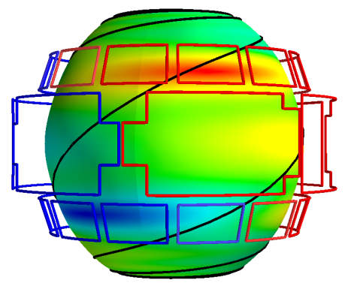
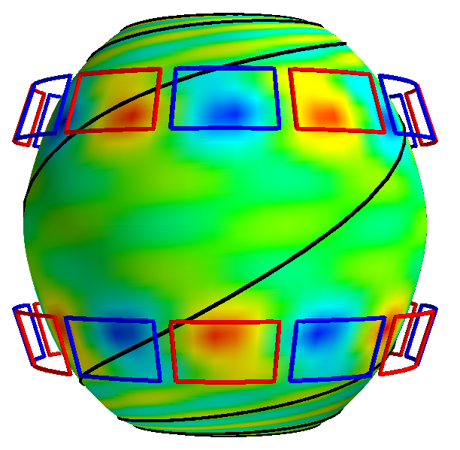
NCC physics design completed: Optimization for
NTV braking performed with IPEC coupling matrix
NCC and midplane coils can be combined to remove the dominant resonant modes up to the second, giving the optimized NTV for core
  NCC 2x12 provides n=1,2,3,4,6 optimized NTV, and 2x6 provides n=1,2,6
  Optimized NTV can be used to control local torque with minimized resonance
n=1
*Ratio of coil currents (phasing)
*T_{max} is based on max. 3kAt
Higher n’s
n=6

Slide 25
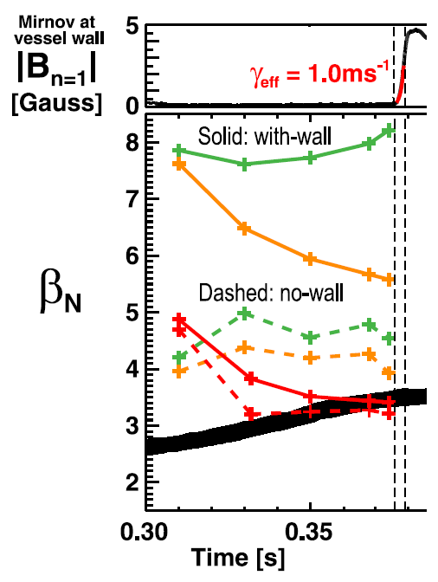
Rotation shear and fast-ion population both reduce
“with-wall” β limit set by Ideal Wall Mode (IWM)
Hybrid MHD-drift-kinetic MARS-K consistent with NSTX Ideal Wall Mode onset at high rotation, β_{fast}
Low-rotation fluid with-wall limit is very high → marginal β_{N} ~ 7-8
Increasing rotation lowers max β_{N} to ~5.5 at mode onset time
Full kinetic treatment including fast-ions → marginal β_{N} ~3.5 → most consistent with experiment
Experimental β_{N}
NTV + 2nd NBI will be used to optimize rotation shear, fast-ion profiles to maximize β limits
J. Menard, PRL 2014

Slide 26
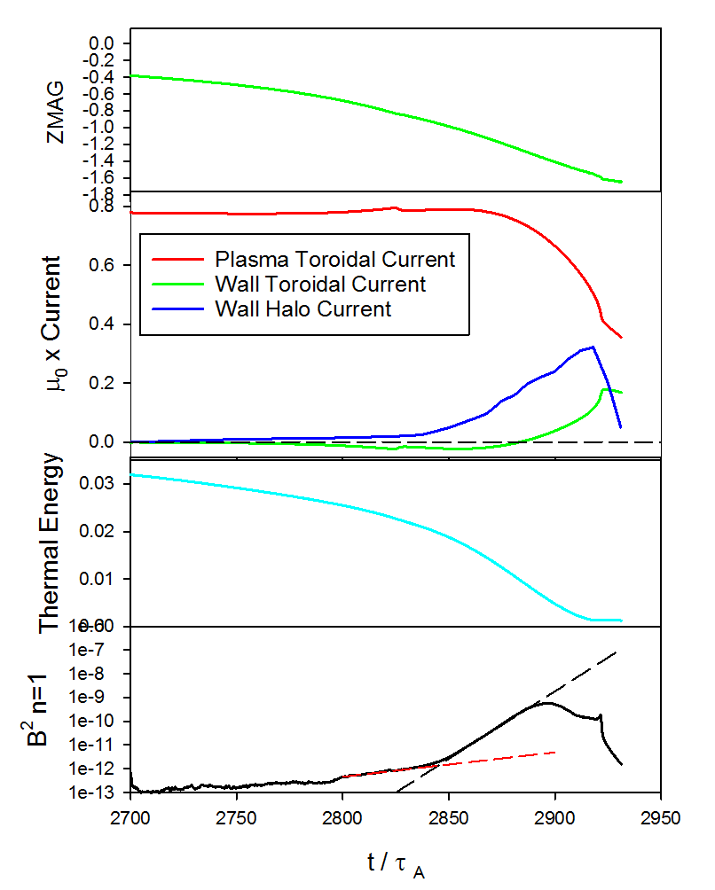
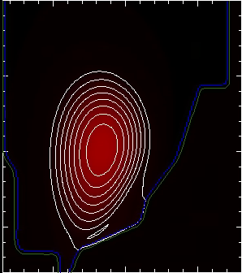
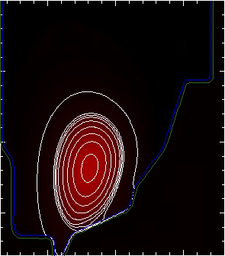
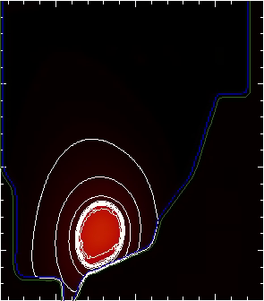
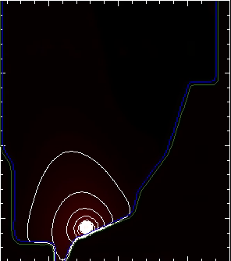
M3D-C¹ modeling of Vertical Displacement
Events (VDEs) has been extended to 3D
Implemented arbitrary thickness resistive wall, giving 3 region computational space (vacuum, RW, plasma)
3D modeling of NSTX VDE with realistic wall resistivity (Jardin, Ferraro)
  n=1 growth slow during drift (RWM?), growth then accelerates (external kink?)
  Halo currents begin to form when plasma makes contact with vessel
RB_{T} t = 2850
RB_{T} t = 2875
NSTX Discharge 132859
Disruption phase 2700 < t < 2950
Contours of RB_{T} show halo currents
RB_{T} t = 2900
RB_{T} t = 2918
NSTX-U / PPPL
Theory Partnership

Slide 27
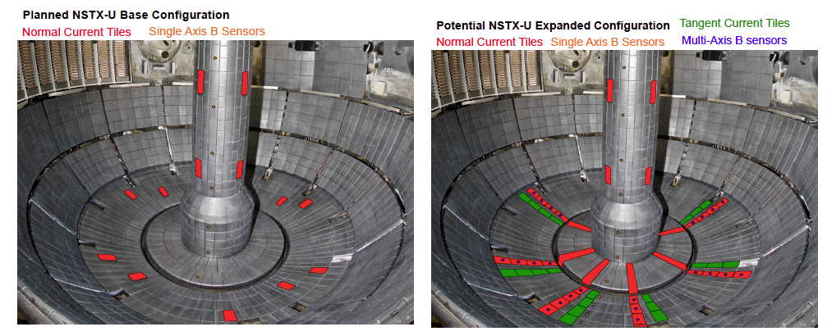
M3D-C¹ with resistive wall capability will be used to determine optimal placement of new halo sensors
Dynamics of halo currents and forces critical for ITER: particular concern are halo current asymmetries and rotation
New sensors will measure halo currents, B-fields and JxB forces in NSTX-U
Critical theoretical issues: (i) role of boundary conditions (ii) halo current distributions in 3D conducting structures (new post-doc D. Pfefferle)
NSTX-U / PPPL
Theory Partnership
  R15/16-3, 17-2, 18-2, 2016 JRT

Slide 28
Topical Science Group Research Highlights
Boundary Science
  Pedestal Structure and Control
  Divertor and Scrape-off Layer
  Materials and Plasma Facing Components
Core Science
  Macroscopic Stability
  Transport and Turbulence
  Energetic Particles
Scenario Integration
  Advanced Scenarios and Control
  Solenoid-Free Start-up and Ramp-up
  Wave Heating and Current Drive

Slide 29
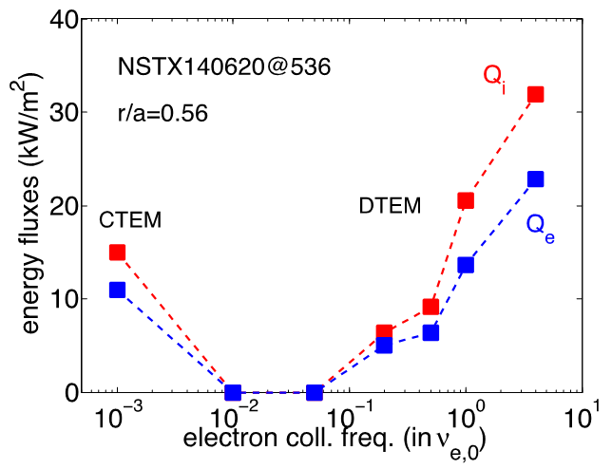
Global, non-linear GTS simulations giving insight into causes of thermal electron and ion transport
New simulations have shown possible role of Dissipative TEM in contributing to observed favorable collisionality scaling (Bτ_{th}~ν_{*e}^{-0.8})
  In addition to microtearing
E-M capability presently being implemented (Startsev, Wang)
  Benchmarked for cylindrical geometry up to β=5%
  Extend to toroidal geometry, higher β by end of CY15
  Theory Notable Outcome
XP1520 (Kaye): I_{p}/B_{T} scaling
  Extend to lower ν_{*e}
  Impact of microtearing, DTEM
XP1521 (Ren): validation of g-k codes in L-mode plasmas
R15/16-1, 17-3, 18-1
NSTX-U / PPPL
Theory Partnership
W. Wang et al., accepted for pub. in NF Letters

Slide 30
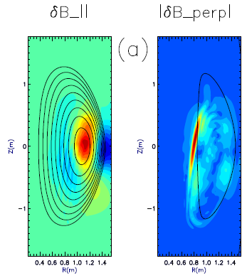
CAE mode-conversion to kinetic Alfvén waves (KAW) predicted to transfer core NBI power to mid-ρ electrons
CAEs also couple to KAW - Poynting flux redistributes fast ion energy near mid-radius, E|| resistively dissipates energy to thermal electrons
  P_{CAE→KAW} ~ 0.4 MW from QL estimate + experimental mode amplitudes
  P_{e,NBI} ~ 1.7 MW for ρ <0.3, NBI power deposited on core electrons
HYM code
E. Belova, PRL 2015
CAE
(n=8)
KAW
Up to 25% of electron heating power transferred to KAW off-axis
NSTX-U / PPPL
Theory Partnership
XP1525 (Crocker): Rotation effects on CAE/GAEs
XP1520 (Kaye), 1523 (Podesta): Effects of collisionality, power on transport
ω_{A}(R,Z)=ω_{CAE}
R15/16-1,2, 17-3, 18-2 IR18-2

Slide 31
Topical Science Group Research Highlights
Boundary Science
  Pedestal Structure and Control
  Divertor and Scrape-off Layer
  Materials and Plasma Facing Components
Core Science
  Macroscopic Stability
  Transport and Turbulence
  Energetic Particles
Scenario Integration
  Advanced Scenarios and Control
  Solenoid-Free Start-up and Ramp-up
  Wave Heating and Current Drive

Slide 32
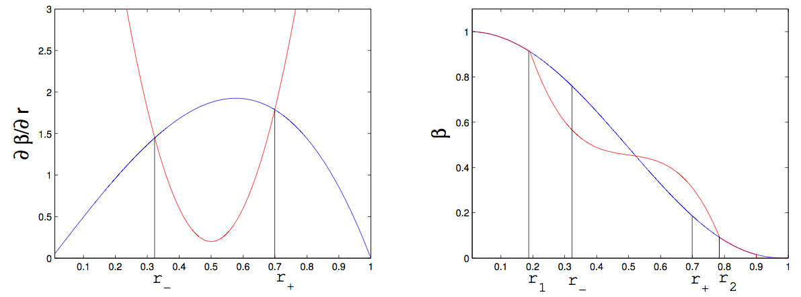
Beam ion confinement: predictive models for fast ion profile relaxation in presence of *AEs
“Kick” model (Podesta)
  PDF computed by ORBIT (White) in presence of TAEs
  Mode structures computed by NOVA (Gorelenkov)
  Kicks ~ mode amplitude
Critical Gradient Model (Gorelenkov)
  Compute critical ∂β_{EP}/∂r due to AE
  Mode growth/damping computed by NOVA-K (Fu, Gorelenkov)
  Include ion Landau, collisional electron, radiative damping of modes
Critical gradient
Classical profile
Originally benchmarked against DIII-D data
JRT-15, R15/16-2, R18-2, IR18-2

Slide 33
CGM recently validated for NSTX, will be much more extensively tested on NSTX-U
Multiple TAE unstable discharge chosen for validation
XP1524 (Heidbrink) directly tests CGM
  Fashioned after successful DIII-D expt.
  Different AE activity on NSTX(-U) crucial test for validating theory
Other related XPs include XP1522, 1523 (characterize 2nd beam, beam confinement)

Slide 34
Topical Science Group Research Highlights
Boundary Science
  Pedestal Structure and Control
  Divertor and Scrape-off Layer
  Materials and Plasma Facing Components
Core Science
  Macroscopic Stability
  Transport and Turbulence
  Energetic Particles
Scenario Integration
  Advanced Scenarios and Control
  Solenoid-Free Start-up and Ramp-up
  Wave Heating and Current Drive

Slide 35
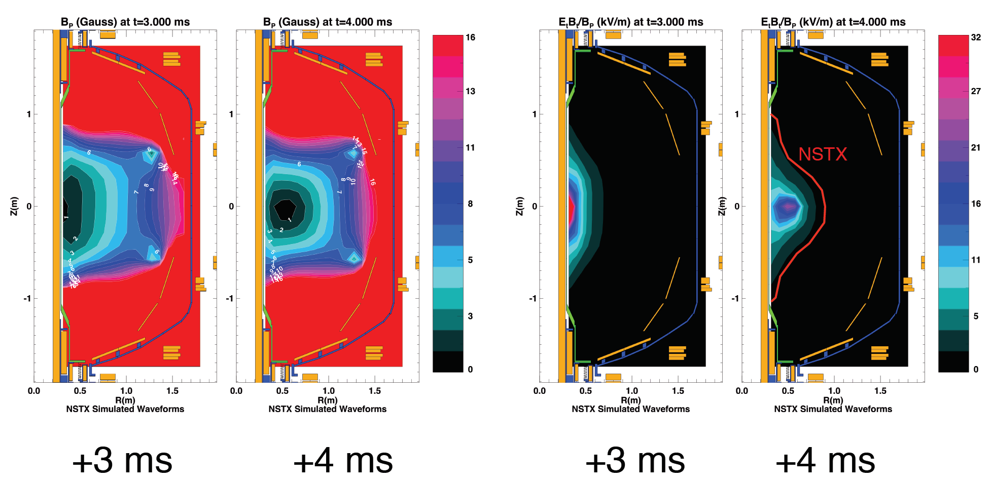
Advanced Scenarios TSG led efforts to generate good field null, breakdown, ramp-up to 140kA first test plasma
Only CS was baked → high impurities → high loop voltage → modelling very important

Slide 36
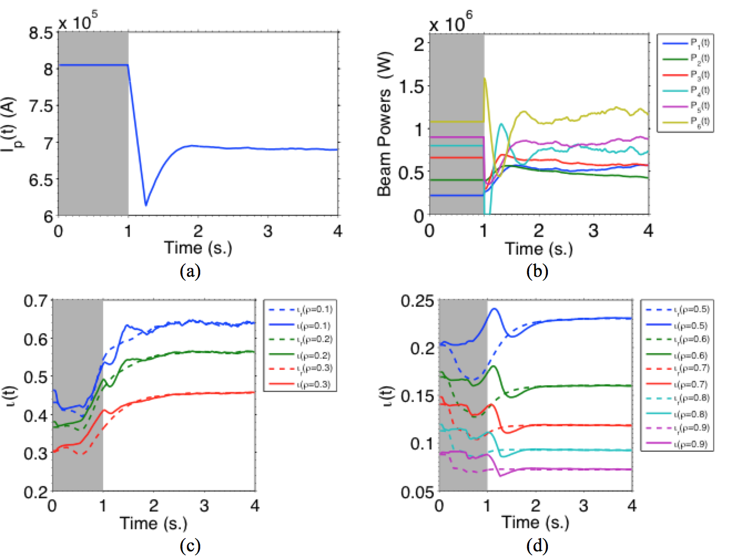
Using TRANSP to develop current (iota) profile control algorithm using 6 NBI sources
Controller off during gray phase
Target (dashed), actual/TRANSP (solid)
Core
Mid-radius → edge
Several ASC XPs ready to test and utilize l_{i} control, prep for q(r) control

Slide 37
Topical Science Group Research Highlights
Boundary Science
  Pedestal Structure and Control
  Divertor and Scrape-off Layer
  Materials and Plasma Facing Components
Core Science
  Macroscopic Stability
  Transport and Turbulence
  Energetic Particles
Scenario Integration
  Advanced Scenarios and Control
  Solenoid-Free Start-up and Ramp-up
  Wave Heating and Current Drive

Slide 38
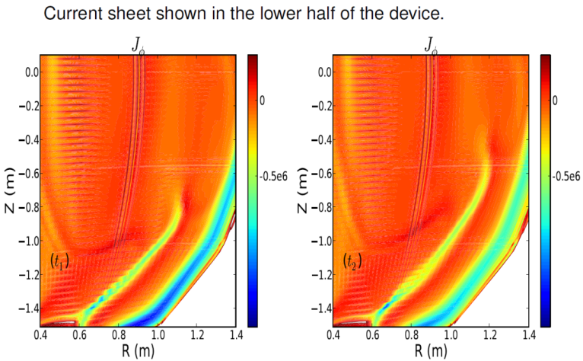
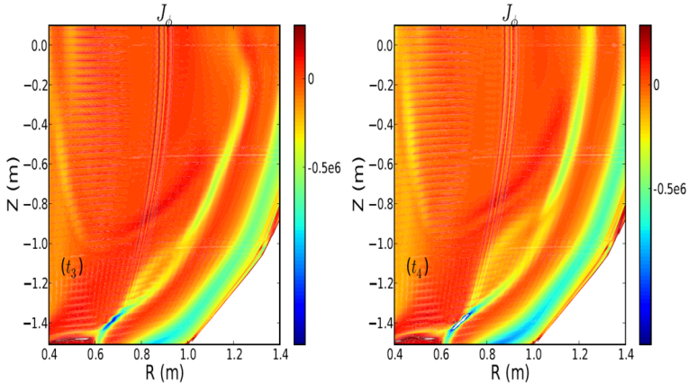
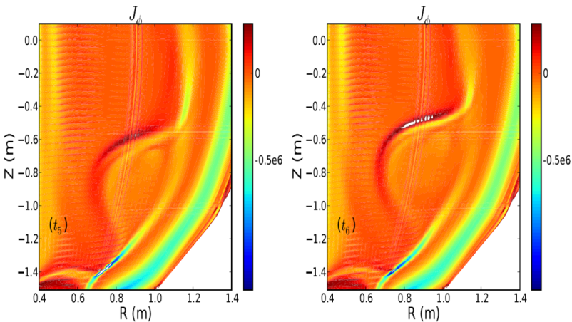
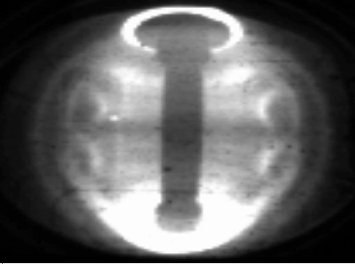
Formation of “Plasmoids” found in NIMROD simulations of Coaxial Helicity Injection (CHI) start-up
Sweet-Parker reconnection basis for CHI flux closure
  Break-up of S-P thin current layer leads to formation of plasmoids, which are inferred in expt
NIMROD simulations (Ebrahimi et al., PoP 2013, PRL 2015) shown below:
XP on Transient CHI in NSTX-U (Raman et al.)
R17-4, 18-3
NSTX
Need to assess if plasmoids impact CHI start-up extrapolation to FNSF/Pilot

Slide 39
Topical Science Group Research Highlights
Boundary Science
  Pedestal Structure and Control
  Divertor and Scrape-off Layer
  Materials and Plasma Facing Components
Core Science
  Macroscopic Stability
  Transport and Turbulence
  Energetic Particles
Scenario Integration
  Advanced Scenarios and Control
  Solenoid-Free Start-up and Ramp-up
  Wave Heating and Current Drive

Slide 40
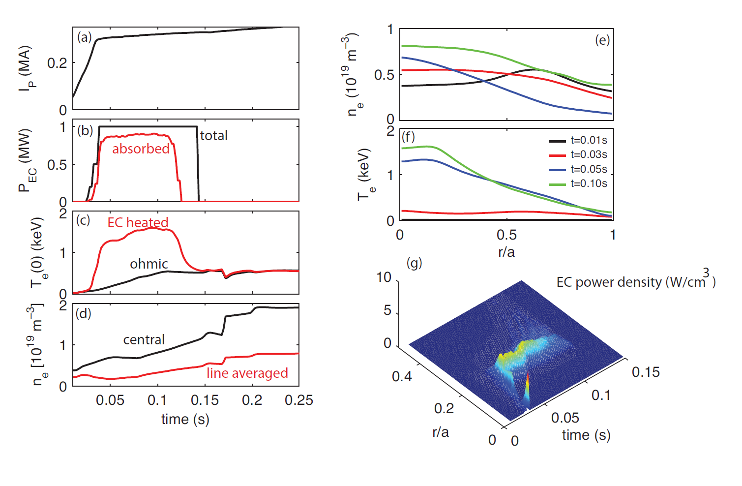
TRANSP modelling: ECH is game-changer for non-inductive ramp-up
Heats low temperature plasma to 1-1.5keV in ~30ms
ECH accessibility limited to low density, but compatible with CHI

Slide 41
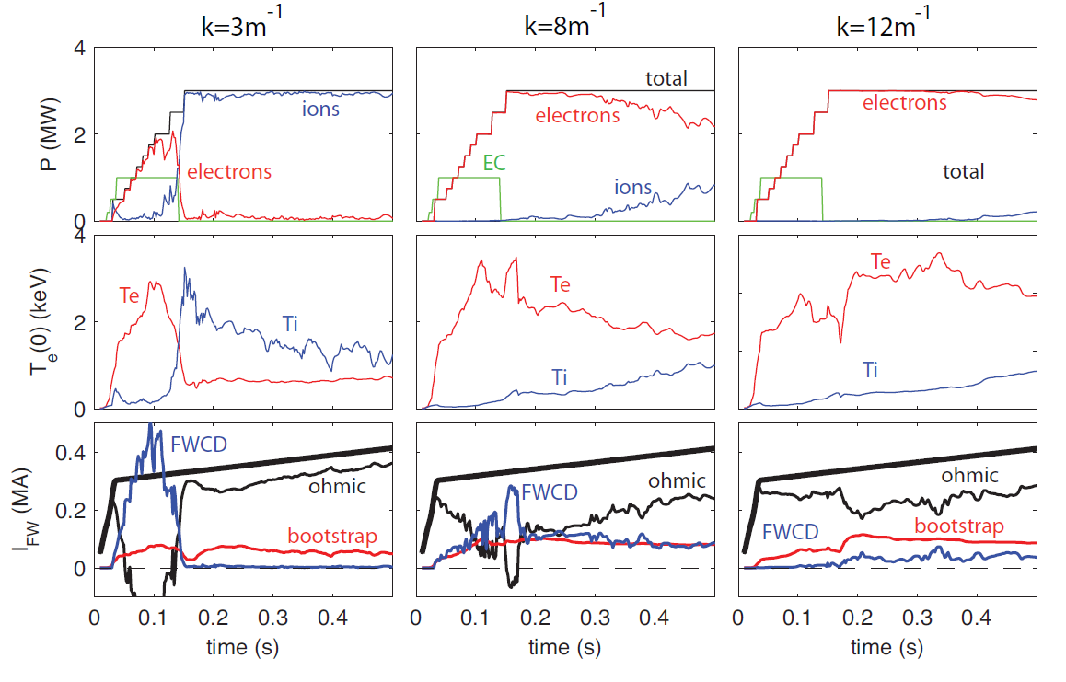
EC + FWCD synergistic for lowest FW phasing k_{φ}=3m⁻¹
Half power needed to drive 400kA compared to no EC
ECH enables sustained T_{e} conditions for higher FW k_{φ}
Need to optimize FW phasing during shot to sustain H&CD
(heating phasing)

Slide 42
Outline
Notable Outcomes
Research Milestones
FY2015 Research Highlights
Upcoming events
Summary

Slide 43
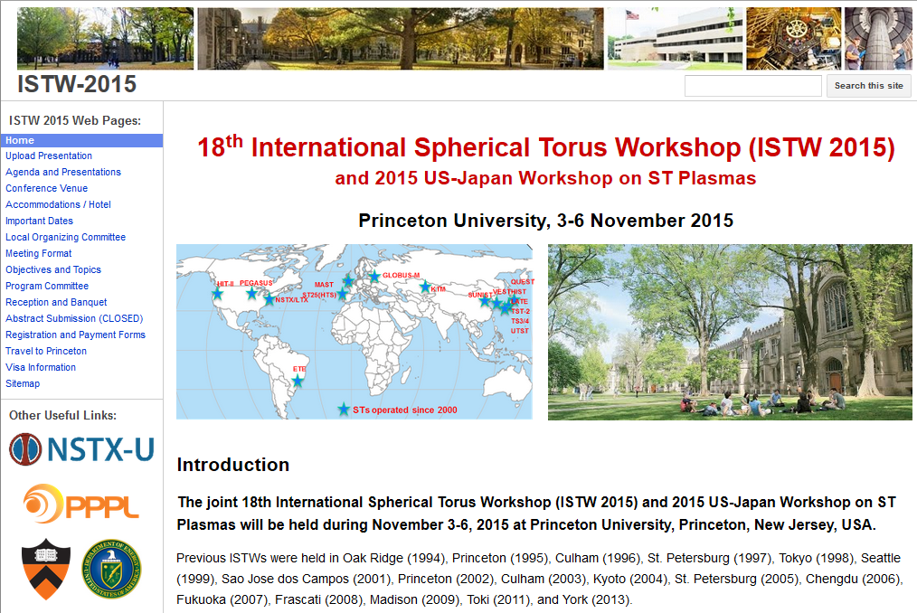
PPPL hosting 18th International ST Workshop
November 3-6 on Princeton University campus

Slide 44
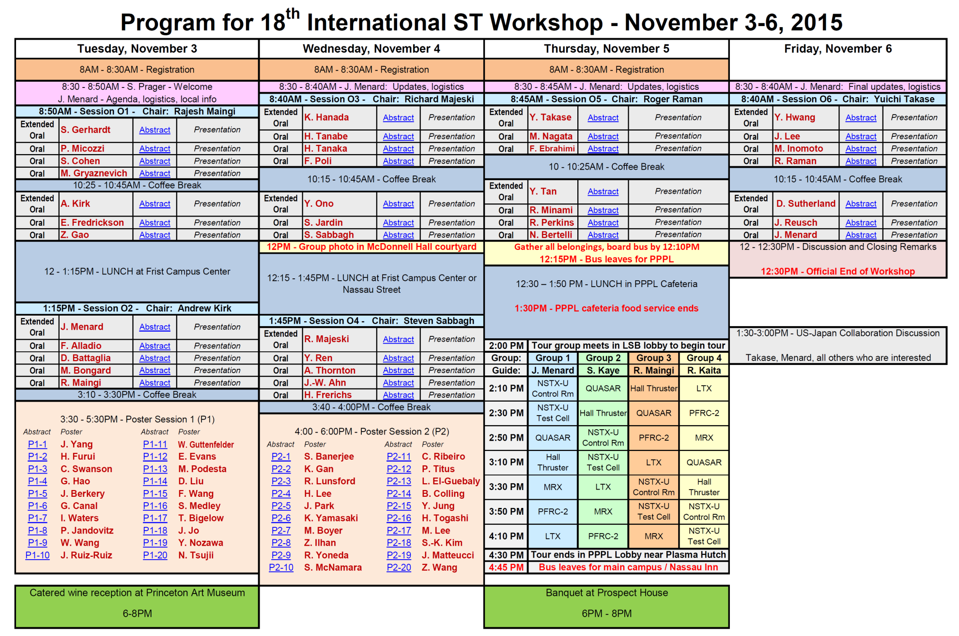
~100 registrants, 10 Overviews, 28 orals, 40 posters
~50% international covering CTs, start-up, EP, core/edge transport, MHD, boundary, RF
3 events during workshop:
  Reception at Art Museum
  NSTX-U / PPPL tour
  Banquet at Prospect House

Slide 45
NSTX-U PAC-37
Dates: January 26-28, 2016
Aiming to have 3-5 run weeks complete before PAC
Possible PAC charge topics:
  Progress, next-steps in NSTX-U / PPPL theory partnership
  Missing elements, new opportunities for FY2015 experiments
  Prioritization / strategy on facility enhancements, high-Z walls
  Ideas for further enhancing University, collaborator roles in NSTX-U research and program
We welcome (request) FES input / comment on possible PAC charge questions
  Any pressing / urgent NSTX-U issues from FES perspective?

Slide 46
Summary
NSTX-U research team remained very scientifically productive during FY2015
High priority experimental proposals already reviewed for first ~50-75% of FY15 run-time
Very excited and ready to get new data!

Slide 47
Backup

Slide 48
Overview of FY2016-18 NSTX-U research milestones
FY2016
  Obtain first data at 60% higher field/current, 2-3× longer pulse:
    Re-establish sustained low l_{i} / high-κ operation above no-wall limit
    Study thermal confinement, pedestal structure, SOL widths
    Assess current-drive, fast-ion instabilities from new 2nd NBI
FY2017
  Extend NSTX-U performance to full field, current (1T, 2MA)
    Assess divertor heat flux mitigation, confinement at full parameters
  Access full non-inductive, test small current over-drive
  First data with 2D high-k scattering, prototype high-Z tiles
FY2018
  Study low-Z and high-Z impurity transport
  Assess causes of core electron thermal transport
  Test advanced q profile and rotation profile control
  Assess CHI plasma current start-up performance
See backup for detailed Research Milestone timeline

Slide 49
NSTX-U/Theory Partnership is focusing on issues central to achieving NSTX-U goals
Both over-arching goals and specific yearly Research Milestones
  Matched personnel to topical choices
  Attempted to provide mapping to Goals, Milestones
Partnership funding now integrated into the NSTX-U budget
  No longer incremental
Theory work not limited to PPPL Theory Dept.
  Augmented by project theorists, collaborations, SCIDAD, direct Theory coverage of personnel
Significant synergy with work on DIII-D by same theory personnel – aspect ratio, β, ν*, ρ* leverage on theory validation
  Fast ion confinement/effects of AE modes on fast-ion distribution
  RMP/NTV/RWM physics, RF heating and current drive, pedestal/SOL characteristics, core transport

Slide 50
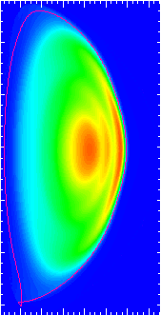
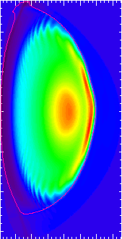
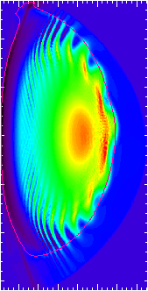
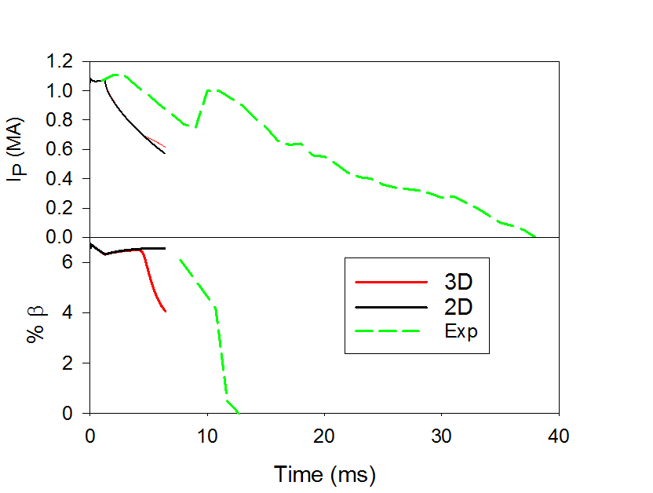
Developing M3D-C¹ simulations of NSTX disruption induced by rapid current ramp down
High W_{MHD} disruption in NSTX: Large negative V_{loop} to drive OH current to zero
M3D-C¹ simulation
  Large # toroidal modes unstable both linearly and non-linearly
  Instability starts at edge, moves inward
1.28 ms
4.10 ms
4.62 ms
Comparison with expt needs improvement (realistic vessel, V_{loop}, match T_{e})
NSTX-U / PPPL
Theory Partnership
XPs for validation: Jardin (MS), Poli (ASC) – current ramp down studies
R15/16-3, 17-1, JRT 2016

