Slide 1

NSTX-U Project / Facility Status
Masa Ono and Jon Menard
NSTX-U FY 2015 Q4 Review Meeting
October 26, 2015

Slide 2
Outline
Post CD-4 activities
Research operations plan
Facility / diagnostic enhancement activities
Summary

Slide 3
Preparing to start FY 2016 plasma operations
Expected to run 14 – 16 run weeks in FY 2016
August 2015
September 2015
October 2015
Novembe 2015
December 2015
PTP/ISTP
R/R, Vent PF1b, dTMB
Bakeout
Post bake
ISTP
Commissioning
Research Plasma Operation
Boronization
CD4 First Plasma (8/10)
Bakeout concluded on 10/20/2015
  Achieved 3.8x10⁻⁶ Second best compared to 3.5x10⁻⁶ achieved in 2010
Dummy load testing
MPTS R&R completed
NBI 1 & 2 - Sources are being conditioned
• The NBI CD-4 KPP achieved on May 11, 2015.
• The CS CD-4 KPP achieved on August 10, 2015.
MAPP, Fast Mirnov, X-ray, bolometer, plasma TV, VIPS, etc.
Boronization, GDCs, gas Injector-4, LITER, SGI, Divertor inj., MGI, CGI, etc.

Slide 4
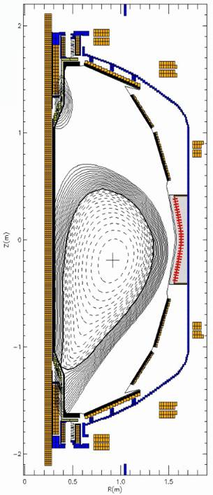
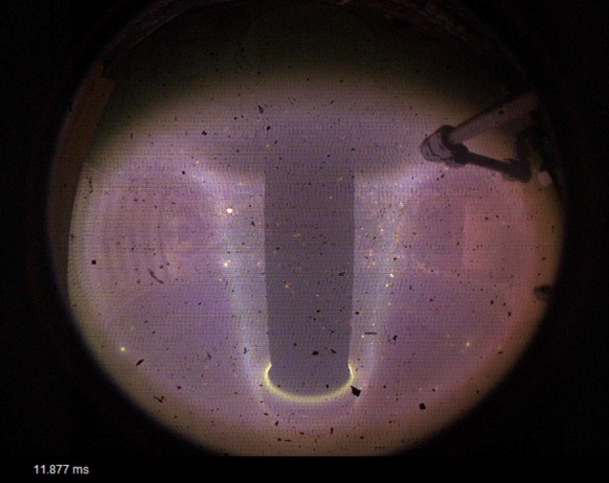
CD-4 KPP #1 Plasma achieved on August 10, 2015
27 out of 29 attempts were “good” over 2 days
Shot 201085
Time: 28ms
I_{p} = 117 kA
B_{T0} = - 0.482 T
R₀ = 0.8 m
Z₀ = - 0.2 m
I_{wall} ~ 0.4 MA
EFIT I_{p}
Calibrated and compensated magnetics, EFITs plasma movie all showed consistent pictures

Slide 5
Bakeout Progression
Improvements identified for better reliabilty and shorter duration bake
Started on 9/12/2015
  Observed significant poloidal variations in the temperature.
  Maxed of the He skip power.
Paused on 9/18/2015
  Had achieved ~1.4x10⁻⁵, from 1x10⁻³
  PF-1b water heating system was improved
  Insulation on the manifolds, plumbing was improved
Restarted on 9/23/2015, 9/24/2015, 9/28/2015
  Twice had to pause for leak repairs on hot He system, fix bad motor coupling on the He blower
Blower basically failed on 9/30/2015
  Sent to factory for rebuild on 9/30/2015, returned and reinstalled on 10/2/2015
Bakeout restarted on 10/6/2015
  2 weeks at temperature projects to ending on 10/23/2015
Bakeout concluded on 10/20/2015
  Achieved 3.8x10⁻⁶ Second best compared to 3.5x10⁻⁶ achieved in 2010

Slide 6
Expected Schedule
(subject to change…including scenarios where things move earlier.)
10/19/2015: End the bake
10/19/2015-11/8/2015: Bakeout Recovery and Final Activities
  Leak checking and diagnostic installations, etc…
11/9/2015: Begin the ISTP
  3-5 days
11/16/2015: Ready for plasma operations
ST workshop (11/2/2015-11/6/2015): Under favorable circumstances, the ISTP may overlap.
APS week (11/16/2015-11/20/2015): No operations due to APS + DOE Conduct of Operations training

Slide 7
Highlights of Diagnostic Progress
MPTS installation complete, Rayleigh-Raman scattering successfully performed, and ready to take data
IR cameras at Bays G and H are installed and took calibration data during the bake (ORNL)
BES fiber bundles have been run to a point close to the machine (UW)
MAPP probe (UI) is connected to NSTX-U and leak checked
XEUS, LoWEUS and MONA LISA EUV spectrometers are installed. Vacuum pumping manifold is being fabricated. (LLNL)
Design for the Fusion Products diagnostic (FIU) is complete.
Lithium Granule Injector stand has been fabricated
SAMI rack has been installed (U. York)
Design work is ongoing for:
  FIReTIP interferometer (UCD)
  Laser-blow off system (LLNL)
  Metal foil bolometers for main plasma and divertor (ORNL)
  Pulse Burst Laser for MPTS

Slide 8
Steady Progress on Magnetic Diagnostics
Complete set of magnetics calibration shots take in August
Plasma current, loop voltage, poloidal flux and field measurements in good shape.
  All integrators recalibrated before bakeout started.
  Rogowski coils fully calibrated, and pickup compensations being refined.
  All Mirnov sensors and flux loops have had their position determinations refined based on calibration shots.
New diamagnetic loop system is showing promise.
  If successful, then eliminates the old TF-coil diamagnetic system.
High-n array data acquisition is installed and functioning.
RWM sensor calibration codes have been exercised.

Slide 9
Significant Progress in Plasma Control System
Lots of PCS success during CD-4 and ISTP activities
  Pre-programmed PF control
  Gas injection and pre-fill control
  Pre-programmed TF and OH control
  Realtime magnetic sensor calibrations
  Background testing of vertical control code
SPA control from PCS has been restored.
New algorithms for NB control and vertical position control have been fully tested.
Some older less-reliable realtime digitizers have been replaced, and a new every-shot latency measurement system is being tested.
Near term PCS steps
  Finish testing rtEFIT and flux-projection boundary control algorithm.
  Then move on to profile control and snowflake divertor control, other code improvements,…
New computer for data serving and data acquisition has been commissioned and is now supporting operations

Slide 10
NBI Heating System Operations
Both Neutral Beams are at Lhe temperatures.
Neutral Beam #2
  N2A Source has just started Beam conditioning at 33kV
  N2B Source is Beam conditioning and running well at 45kV
  N2C Source has completed Arc Conditioning and ready for High Voltage conditioning
Neutral Beam #1
  All three NB#1 ion sources have completed arc conditioning, and are being prepared to start High Voltage conditioning.

Slide 11
Physics Operators Course Was Completed Over 25 people attended each talk.
17 total talks, including by not limited to
  Camp: Chief Operating Engineer role and control room responsibilities
  Davis: IT support for physics operations
  Gates: Intro. To PCS and Control
  Hosea: HHFW systems on NSTX-U
  Mueller: Breakdown and current ramp
  Raman: Coaxial Helicity Injection
  Stevenson: Neutral Beams
  W. Que: NSTX-U Power systems
  Battaglia: PCS Layout,
  Gerhardt: Magnetic diagnostics, 3D fields, DCPS
  Sabbagh: NSTX-U EFIT
  E. Kolemen: Control theory
Slides posted here or http://nstx.pppl.gov/DragNDrop/Operations/Physics_Operations_Course/
Videos of talks posted here or http://cctest.pppl.gov/KalturaAPI.aspx?x=PPPL%3ECourses%3EPhysics%20Operators%20Training%20Course
Three individuals interested in actually becoming physics operators, have read the required procedures, and are ready for on the job training.

Slide 12
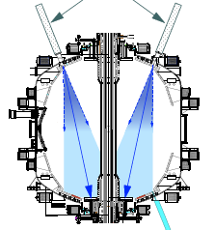
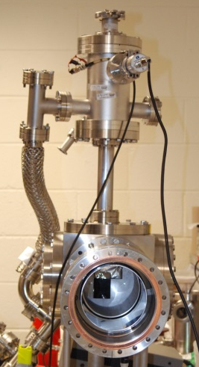
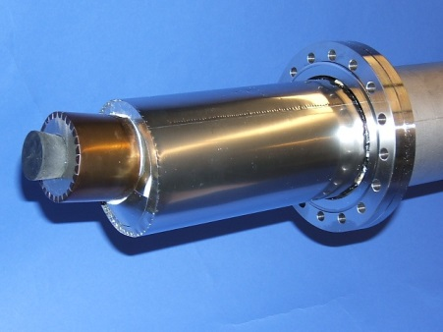
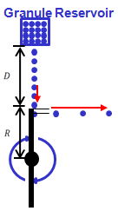
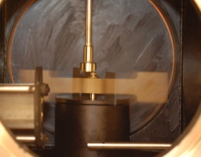
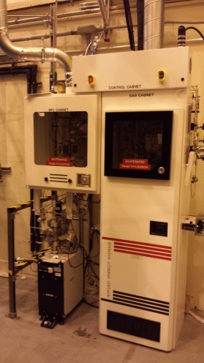
First Year Boundary Physics Tools
Boronization, Lithium Evaporators, Granule Injector
Lithium Evaporator (LITERs)
Granule injector (GI) for ELM pacing
LITERs
Successfully tested
on EAST and DIII-D
Granules: Li, B₄C, C
f ~ up to 500 Hz
Granular Reservoir
• LITERs filing set up in high bay south of NSTX-U Test Cell
• LITER software for LIFTER successfully tested
• New lithium filling procedure written and reviewed
• New procedure for remote LITER control nearly complete
Rotating Impeller
• Remote control undergoing tests
• Stand complete
• Vacuum interlock requirements identified and implementation plan specified
Boronization System
• PLC modifications for operation of deuterated trimethyl borane (dTMB) system complete – new software to be loaded and tested after NSTX-U bakeout ends
• System commissioning in early November
dTMB Gas Cabinet.

Slide 13
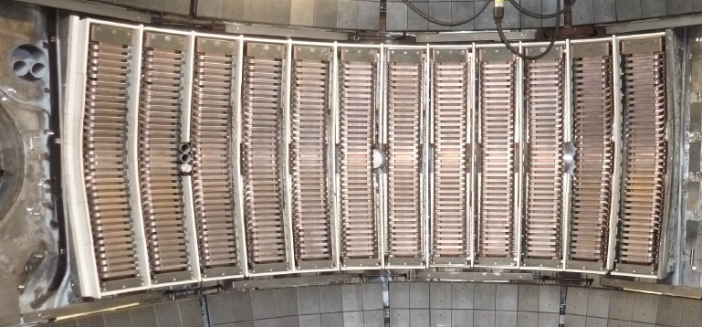
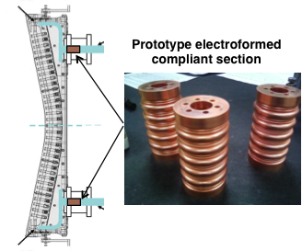
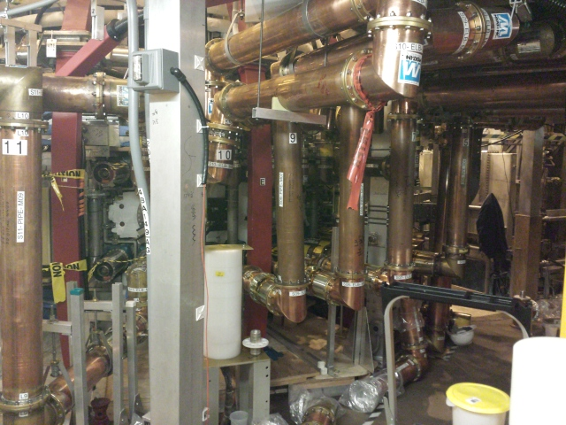
HHFW system preparation is going well
All sources are ready to start antenna conditioning
New Compliant Antenna Feeds
Allow HHFW antenna feedthroughs to tolerate 2 MA disruptions
Antennas were re-installed with the new feeds and back-plate grounding
Transmission lines installed & tuned.
Additional ground installed
- Prototype compliant feeds tested to 46 kV in the RF test-stand. Benefit of back-plate grounding for arc prevention found.
- RF diagnostics also installed.
• All sources are ready. Conditioning to start when the machine is ready for operation in early November.

Slide 14
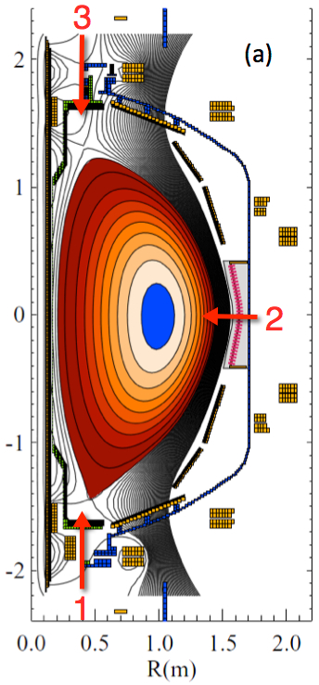
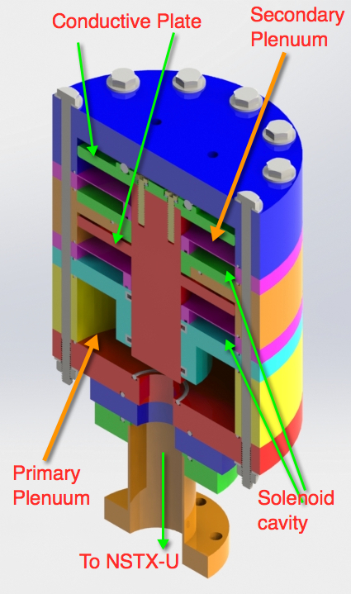
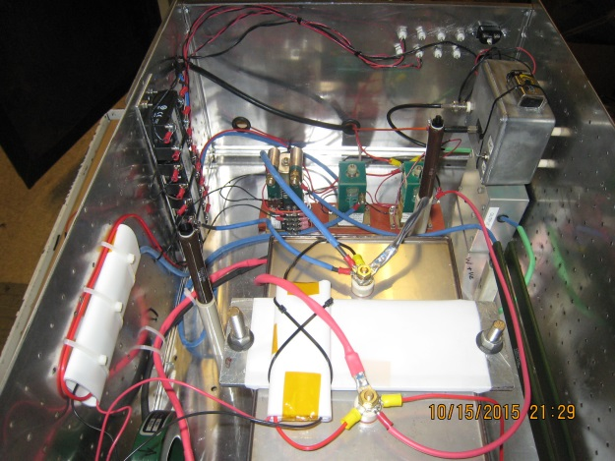
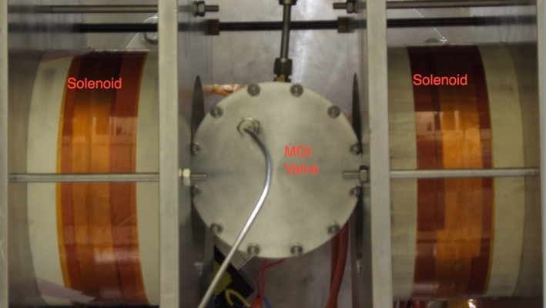
Disruption and Plasma Control Tools for NSTX-U
Massive gas injection system for disruption mitigation study
NSTX-U MGI Valve
  - Massive gas injector system at multi
  poloidal location with identical injection set-up
  - Compact power supply proto-type tested at UW
  - A new double solenoid MGI design (zero net J x B
  torque) based on the ORNL ITER MGI design
Compact MGI Power Supply for NSTX-U installation
  MGI also being tested on the U. Washington test stand with magnetic field
Magnets
Magnets
MGI
Valve
U. Washington
Status:
• Conceptual Design Review of MGI system was held on October 16. Recommended changes were incorporated into the power system hardware.
• A Real-Time Velocity (RTV) diagnostic is ready for plasma test with the plasma control system for feedback control of the plasma rotation profile.

Slide 15
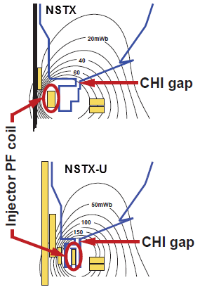
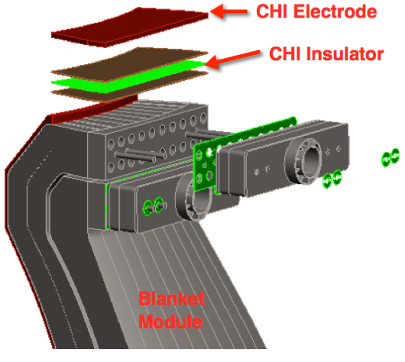
Solenoid-free start-up in support of ST-FNSF
NSTX-U CHI configuration permits ~ 400 kA level start-up
CHI Start-Up in NSTX-U
QUEST CHI Experiment
• Inj. Flux in NSTX-U is about 2.5 times higher than in NSTX
• NSTX-U coil insulation greatly enhanced for higher voltage ~ 3 kV operation
ST-FNSF CHI configuration
R. Raman, et al., FST (2015)
U. Washington
• CHI will start with the present 2 kV capability then enhanced to higher voltage as needed.
• Control system updates for the CHI cap bank have been completed, and the system is ready for remote testing.
• The CHI control room procedure has been updated.
An ST-FNSF like CHI configuration will undergo plasma tests on QUEST after FY 2016 NSTX-U operation
CHI electrodes installed in QUEST, CHI power supply and gas injection system fabricated at U-Washington

Slide 16
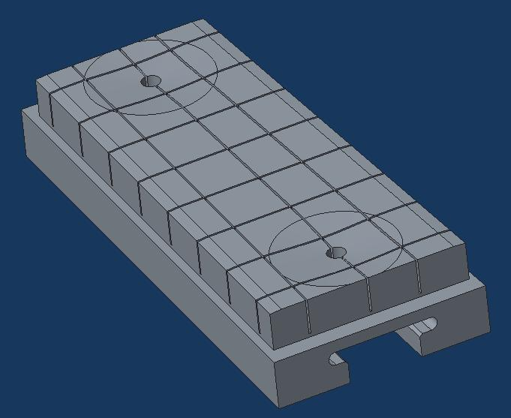
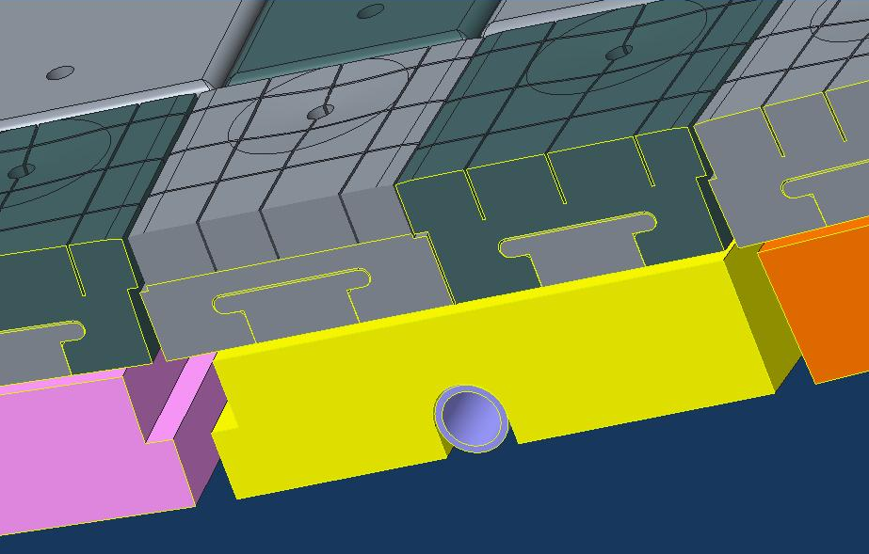
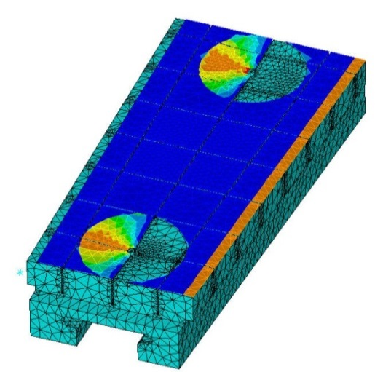
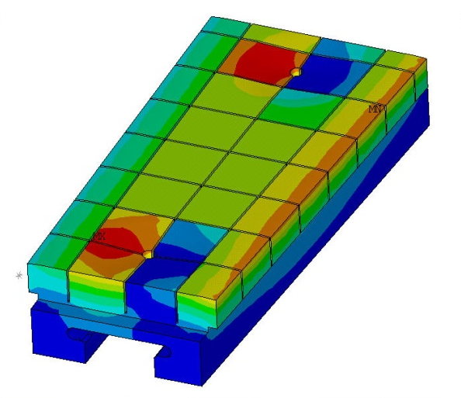
High-Z Tile Design Progressing
(plan to be ready by the 2016 outage ~ June 2016)
Successful CDR held in June
  75% of Chits resolved PDR planned
  for early Nov.
  Raw material procurement underway
2nd design iteration analysis nearly complete
  Installation flexibility introduced to accommodate “as built” vessel tolerances
  Edge and access-way chamfers introduced to reduce heat-flux peaking
Thermal analysis of new leading edge geometry indicates ~30% reduction in peak temperature
  1000 °C lower peak surface temperature vs. graphite reference design
Seamless integration with existing mounting scheme minimizes installation time
Surface heat flux
Temperature

Slide 17
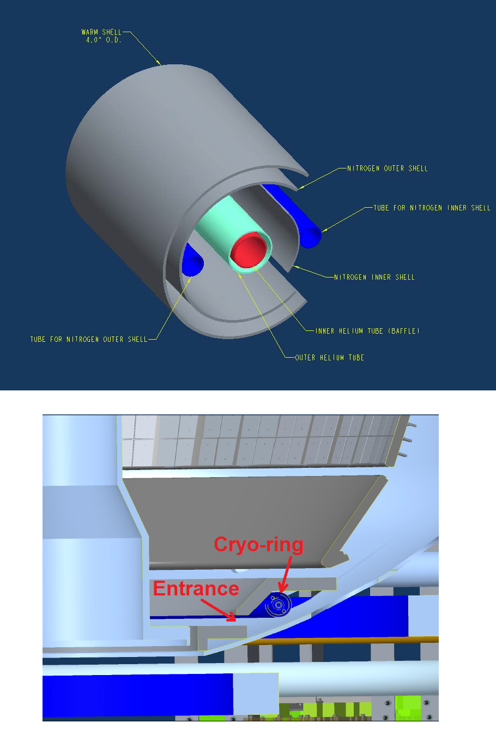

Divertor Cryo-pump Physics Design Activities Started
Develop engineering design and cost/schedule this year
Scoping work for the modified divertor & tiles has started
  Engineer assigned to this task.
  Requirements are being formulated
Cost & Schedule continues to be developed
  Working on scoping estimate to get through CDR
  Will generate WAF when definition of job elements matures.
PPPL & MIT are working on a agreement to fund MIT/PSFC staff to work on the in-vessel LHe pump design.
Working on system integration.
  a working group that will look at the impact of the new pump/divertor on the lower diagnostics will start meeting in October
CDR - Q1 CY’16
Cryo-ring
Transfer line layout

Slide 18
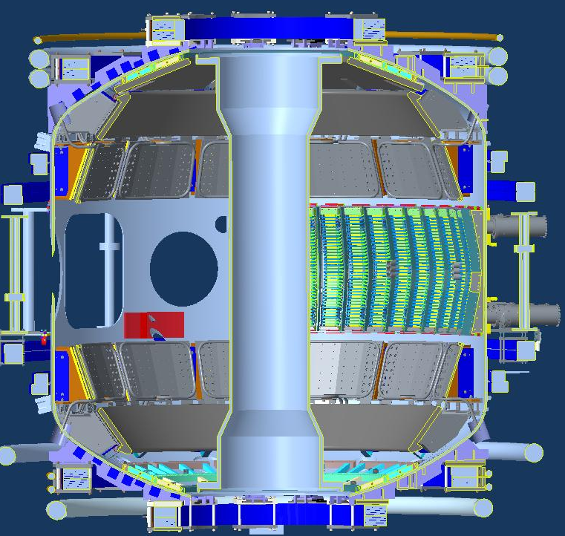
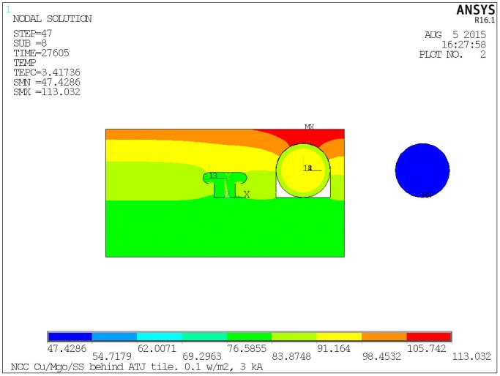
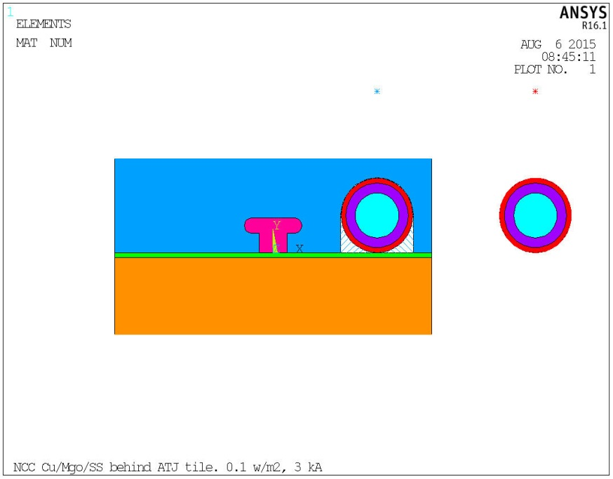
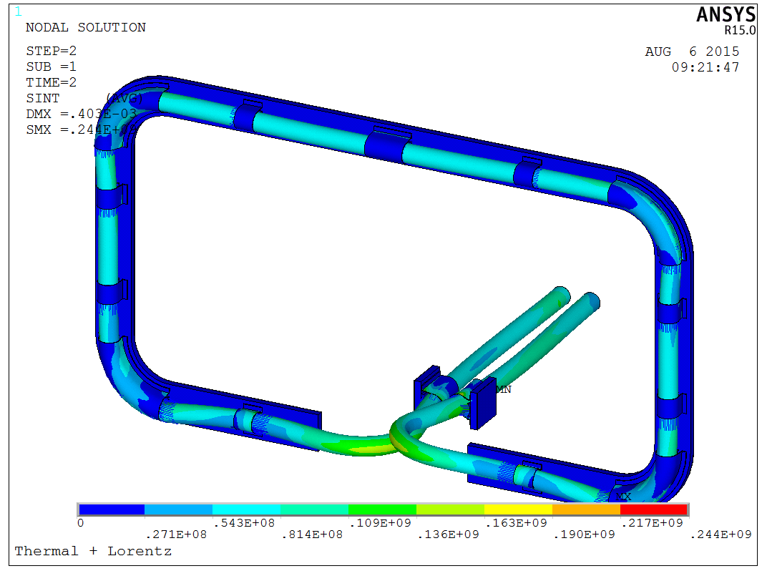
NCC Lorentz and Thermal
Stress Analysis
NCC Coils Design Activity Made Significant Progress
Develop engineering design and cost/schedule
NCC = Non-axisymmetric Control Coil
2 x 12
Coil
Thermal Analysis
Tile
End of Last Pulse Temp (8 hours)
PP
Lead
Selected round cross-section conductor. Order of test sample is placed: Dia. 0.965, Conductor Dia. 0.58, Length 20 feets are considered. The selection criteria include thermal capability, manufacturability, impact on interfacing objects, fabrication lead time and cost.
Helium cooling system or no direct cooling options will be quantified.
A WAF estimate (cost and schedule) will be prepared as part of the CDR which is targeted for May, 2016.
3 kA,0.1 MW/m2 Plasma Heating,5s pulse,1200 s reprate
With Lead Clamp, 50 C Heat-up, 3kA+ Background Field

Slide 19
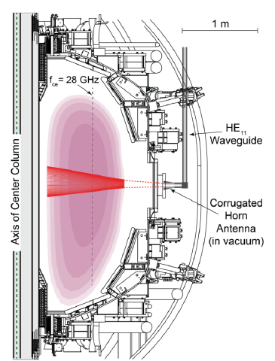
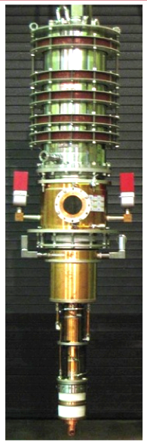
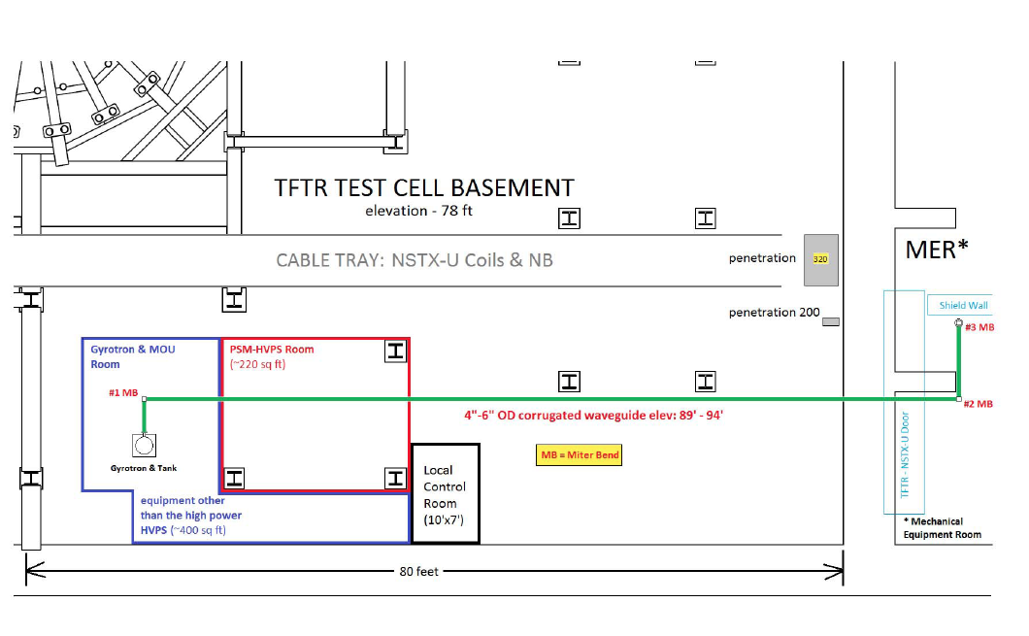
28 GHz ECH System Design Progressing Well
Develop engineering design and cost/schedule this year
CHI can form a 200-400 kA seed plasma, but it is too cold for HHFW absorption.
Use of ECH can “bridge the T_{e} gap” to where HHFW and then NB current drive can support the ramp and sustain the current – crucial for OH solenoid-free compact STs.
  Good first pass absorption predicted.
Goal of first ECH power in 2019 run with 15% incremental funding.
28 GHz 1 MW Tube by Tsukuba
28 GHz Gyrotron Room
NSTX-U
Test Cell
Gyrotron will be located in the TFTR basement. Stray magnetic fields was measured to be negligible.
A commercial waveguide manufacturer was contacted and expect be able to complete the list of the components we need for our NSTX-U 1+ MW ECH waveguide system.
Gyroton room
Power Supply Room

Slide 20

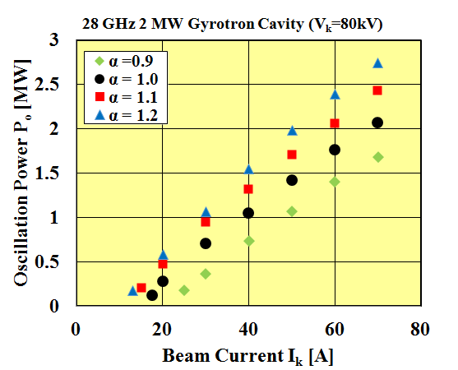
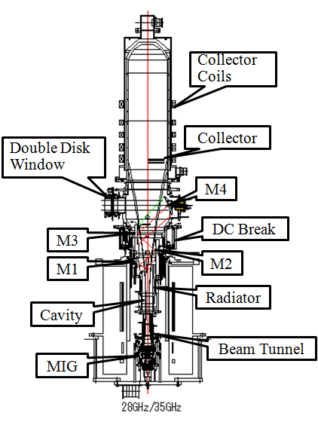
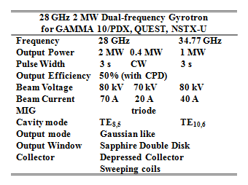
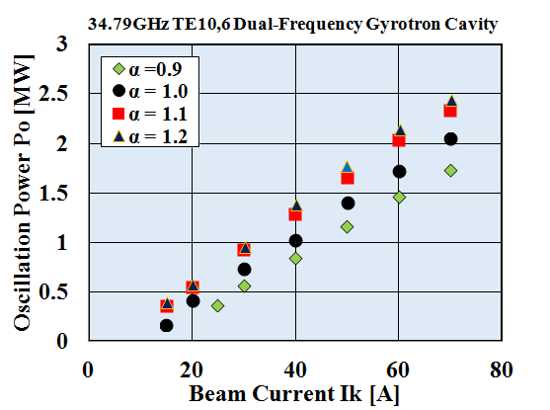
Tsukuba University is developing Prototype 28 / 35 GHz Gyrotron for NSTX-U & G-10/PDX
→ New design of cathode, cavity and mode converter for 1.5 – 2 MW
3
●Design Parameters of New Tube
Power (MW)
28 GHz
0
0
80
Beam Current (A)
3
2986 mm
Power (MW)
34.77 GHz
0
0
80
Beam Current (A)
TE_{8,5} (28 GHz) & TE_{10,6} (35 GHz) by the selection rule
• 2 MW calculated outputs at both 28 & 35 GHz are obtained.
• We (Tsukuba) started its fabrication and it will be tested in FY 2016.

Slide 21
Summary of Facility and Diagnostics
Team is preparing for research operations
• CD-4 KPP#1 Plasma successfully achieved on August 10, 2015. The upgrade project was concluded in September 2015.
• Bake-out has concluded on October 20, 2015.
• Research preparation progressing well. All of the planned diagnostics and research tools should be available during the first year of plasma operations.
• Vacuum leak check is on going and diagnostics are being installed.
• ISTP should start in November followed by commissioning.
• Research operation should start in early December 2015.
• Engineering design work continuing for the major facility enhancements: high-Z tiles, divertor cryo-pump, ECH, and NCC.

Slide 22
Back-Up slides

Slide 23
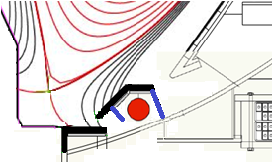

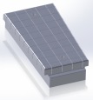
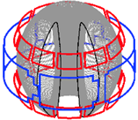


Five Year Facility Enhancement Plan (green – ongoing)
2015: Engineering design for high-Z tiles, Cryo-Pump, NCC, ECH
Fiscal Year:
2015 | 2016 | 2017 | 2018 | 2019
Major enhancements:
Base funding
+15% incremental
Upgrade Outage
1.5 → 2 MA, 1s → 5s
Run Weeks:
14-16
16-18
12-16
10-12
New
center-stack
Pulse-burst MPTS
Lower divertor cryo-pump
Boundary Science
+ Particle Control
Boronization
High-Z tile row on lower OBD
High-Z PFC diagnostics
Li granule injector
Upward
LiTER
LLD using bakeable cryo-baffle
MAPP
MGI disruption mitigation
Upgraded halo sensors
Off-midplane 3D coils (NCC)
Core Science
δB diag. - incremental
Enhanced MHD sensors
Laser blow-off
42 ch MPTS
DBS, PCI, or other intermediate-k
48 ch BES
High k_{θ}
MSE/LIF
Charged fusion product
Neutron collimator
4 coil AE antenna
Establish control of:
Rotation
q_{min}
HHFW limiter upgrade
Snowflake
Integrated Scenarios
FIReTIP
n_{e}
Divertor P_{rad}
2nd NBI
1 MW ECH/EBW
Upgraded CHI for ~0.5MA
0.5-1 MA CHI
up to 1 MA plasma gun

Slide 24
High Priority NTC Activities Following the Bake
Shutter and TIV connections to the PLC
Diagnostic installation
Boronization system commissioning
I_{P} Calculator Tuning
RWM coil high-pots, resistance checks, polarity checks
Ground loop cleanup on diagnostics

Slide 25
NSTX-U diagnostics to be installed during first year
All center stack sensors mounted & ex-vessel terminations completed
MHD/Magnetics/Reconstruction
  Magnetics for equilibrium reconstruction
  Halo current detectors
  High-n and high-frequency Mirnov arrays
  Locked-mode detectors
  RWM sensors
Profile Diagnostics
  MPTS (42 ch, 60 Hz)
  T-CHERS: T_{i}(R), V_{φ}(r), n_{C}(R), n_{Li}(R), (51 ch)
  P-CHERS: V_{θ}(r) (71 ch)
  MSE-CIF (18 ch)
  MSE-LIF (20 ch)
  ME-SXR (40 ch)
  Midplane tangential bolometer array (16 ch)
Turbulence/Modes Diagnostics
  Poloidal FIR high-k scattering (installed in 2016)
  Beam Emission Spectroscopy (48 ch)
  Microwave Reflectometer,
  Microwave Interferometer
  Ultra-soft x-ray arrays – multi-color
Energetic Particle Diagnostics
  Fast Ion D_{α} profile measurement (perp + tang)
  Solid-State neutral particle analyzer
  Fast lost-ion probe (energy/pitch angle resolving)
  Neutron measurements
  Charged Fusion Product
Edge Divertor Physics
  Gas-puff Imaging (500kHz)
  Langmuir probe array
  Edge Rotation Diagnostics (T_{i}, V_{φ}, V_{pol})
  1-D CCD H_{α} cameras (divertor, midplane)
  2-D divertor fast visible camera
  Metal foil divertor bolometer
  AXUV-based Divertor Bolometer
  IR cameras (30Hz) (3)
  Fast IR camera (two color)
  Tile temperature thermocouple array
  Divertor fast eroding thermocouple
  Dust detector
  Edge Deposition Monitors
  Scrape-off layer reflectometer
  Edge neutral pressure gauges
  Material Analysis and Particle Probe
  Divertor VUV Spectrometer
Plasma Monitoring
  FIReTIP interferometer
  Fast visible cameras
  Visible bremsstrahlung radiometer
  Visible and UV survey spectrometers
  VUV transmission grating spectrometer
  Visible filterscopes (hydrogen & impurity lines)
  Wall coupon analysis
New capability,
Enhanced capability

Slide 26
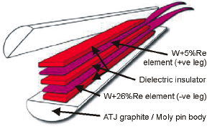
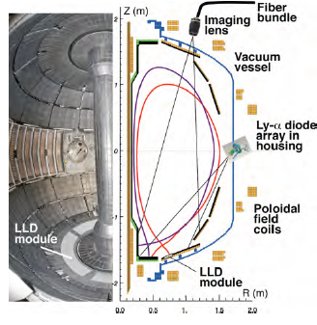
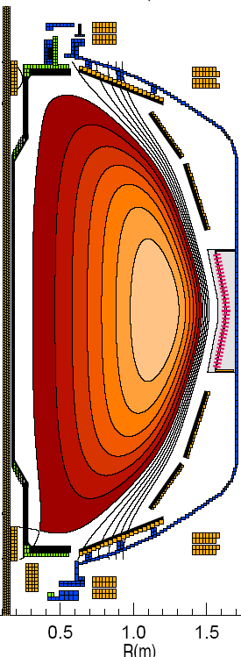
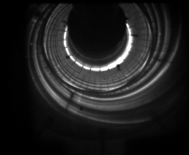
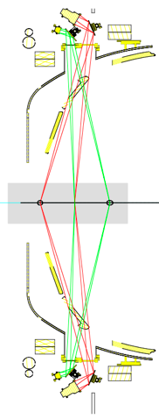
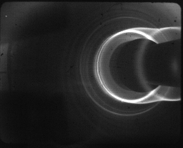
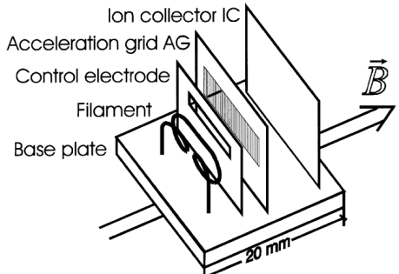
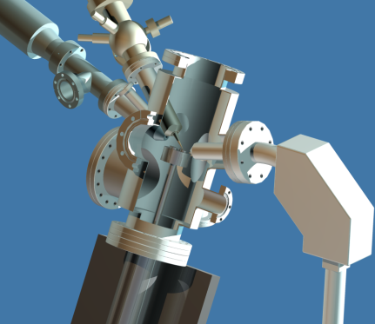
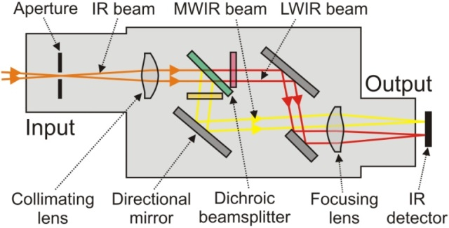
Enhanced Capability for PMI Research
Multi-Institutional Contributions
Divertor fast eroding thermocouples
Two fast 2D visible and IR cameras with full divertor coverage
Divertor Imaging
Spectrometer
ORNL
LLNL, ORNL, UT-K
LLNL
Li I
  Lithium CHERS
ORNL
C II
Divertor fast pressure gauges
MAPP probe for between-shots surface analysis – Tested in LTX
Dual-band fast IR Camera
U. of Illinois

