Slide 1

NSTX-U Program
FY2016 Q1 Report
Jon Menard, Stan Kaye, Masa Ono (PPPL)
For the NSTX-U Team
PPPL and FES
February 8, 2016
*This work supported by the US DOE Contract No. DE-AC02-09CH11466

Slide 2
Outline
Overview of initial operation of NSTX-U
PAC-37 charges, recommendations
Run Coordination status

Slide 3
Summary of NSTX-U Plasma Operations
CD-4 milestone (I_{p} > 50kA) completed August, 2015
  I_{p} ~ 150 kA with GDC and CS bake
2.5 days of operation following full vessel bake, before boronization (December, 2015)
  I_{p} = 500 kA flattop with inner-wall limited L-mode
  Progress enabled by I_{p}, gap and Z feedback control
2.5 weeks of operations in January, 2016
  Neutral beam heating: up to 4MW total from four sources
  Diverted L-mode and H-mode operations at I_{p} = 600 kA
    Good progress toward goal: 1.4 MA, 2s ELMy H-mode by week 8
  Three boronizations completed

Slide 4
Significant progress over the first few weeks in commissioning NSTX-U
Boronization
First NBI
H-mode
Boronization
Boronization
Maximum Stored Energy (kJ)
Diverting

Slide 5
Reliable H-mode access has been achieved on NSTX-U
H-mode with NBI > 1.5 MW at I_{p} > 500 kA, B_{T} = 0.65T
  H-mode achieved with only 0.9 MW NBI in a few cases
  B_{T} exceeds maximum in NSTX
202946
Odd n MHD (G)
Lower divertor
Stored energy (kJ)
MHD efit01
Inner gap
(cm) efit01

Slide 6
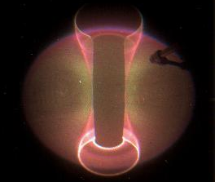
Excellent diagnostic availability has enabled rapid progress
202946
L-mode 0.30s
H-mode 0.48s
I_{p} | 0.58 MA
B_{T0} | 0.61 T
P_{NBI} | 3 MW
P_{OH} | 0.2 MW
A | 1.6
κ | 1.53
l_{i} | 0.97
δ_{lower} | 0.55
W | 151 kJ
β_{T} | 7.86%
β_{P} | 1.22%
β_{N} | 4.66
τ_{e} | 50 ms
ψ_{N}
Lower div D_{α}
L-H transition
Mid D_{α}
LFS gas
ELMs
HFS gas
Divert

Slide 7
Stationary diverted L-mode operations has also been achieved
202814
1 MW NBI
26 kA swing
These discharges have already been used to support research operations

Slide 8
Significant progress has been made on a number of commissioning activities
XMP-101: Inductive startup on NSTX-U
XMP-106: Magnetics calibration
XMP-126: Initial I_{p} and R control
XMP-105: Initial n=0 control
XMP-118: Boronization characterization
XMP-127: Neutral beam checkout
XMP-132: Automated rampdown development
XMP-107: Neutron calibration transfer
XMP-133: Increase elongation in L-mode
XMP-116: Initial H-mode access in NSTX-U
XMP-121: Six SPA and RWM coil checkout
XP-1506: Low-beta locked mode studies

Slide 9
Inductive startup scenario informed by vacuum field modeling
Solenoid provides confining B_{Z}
  Bipolar PF3 coils null this field
  V_{loop} via ramping OH and PF3 fields
Null properties sensitive to fields from induced wall currents
  LRDFIT wall model used to prepare scenarios in advance
  About 200 kA total wall current at breakdown
PF3 and PF5 coils provide additional B_{p} following breakdown
  Must maintain passive R and Z stability
Simulated B_{p} fields at breakdown
PF3

Slide 10
Routine startup at two OH precharge levels has been demonstrated
Goal: scalable scenario for arbitrary OH precharge
  Some experiments desire flexible precharge to optimize constraints from coil heating and coil current limits
202567
202573
Limited L-mode Helium

Slide 11
New capability: automated rampdown used in routine operations
Plasma control system detects loss of control
  OH solenoid near maximum current
  Vertical oscillations exceed threshold
  Abs( I_{p} - I_{p request} ) too large
Feedback control switches to new “states” that attempt to gently end the discharge
See S. Gerhardt’s PAC talk
I_{P}
I_{P} Request
(including asynchronous transition to rampdown)
  Z_{P}(dZ_{P}/dt) threshold
  Z_{P}(dZ_{P}/dt)
“State”
Insufficient I_{P}
Fast I_{P} Rampdown
Normal
  Z_{P} from EFIT

Slide 12
Operations will restart with continued goal of developing fiducial ELMy H-mode discharge
H-mode operations open path to lower l_{i}
  Permits larger κ and I_{p} range
  Target l_{i} ~ 0.5 via an earlier L-H transition, larger NBI power and improved wall conditions
Target fiducial for FY2016 is an ELMy H-mode discharge at I_{p} = 1.4 MA
140
120
100
80
60
40
20
0
Average stored energy over flattop
<W>_{FT} (kJ)
Average l_{i} over flattop
1.5
1.0
0.5
0
<l_{i}>_{FT}
First 66 shots: L-mode He
Next 66 shots: L-mode D, NBI
Last 66 shots: Diverted

Slide 13
Ongoing commissioning activities will prepare NSTX-U for research program
Near-term activities include …
  Optimization of vertical control (see S. Gerhardt’s PAC talk)
  ISOFLUX shape control
    rtEFIT has been successfully running and is ready to support operations
  Error field identification and correction
    Low-beta error field measurements have been completed
  Diagnostic commissioning and calibration
    MPTS, CHERS, MSE, NPAs, FIDA
  NBI power modulation for β control from PCS
    PCS control of beam termination has been used
  MHD spectroscopy and RWM control
    Real-time mode detection in PCS is nearly complete
Covered in more detail in Jon Menard’s PAC talk

Slide 14
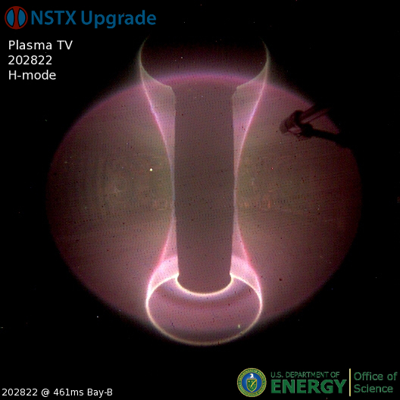
Plasma operations on NSTX-U is off to a great start!
First days of NSTX-U have produced H-mode and stationary diverted L-mode discharges
Control and diagnostic capabilities established quickly
Research program starting in parallel with commissioning activities

Slide 15
Outline
Overview of initial operation of NSTX-U
PAC-37 charges, recommendations
Run Coordination status

Slide 16
PAC-37 held Jan 26-28 – 4 charge questions:
Please assess the research planned to be carried out for the NSTX-U FY2016 experimental campaign
  Are there any major missing elements, or new opportunities?
Please assess the alignment between the NSTX-U research plans and goals and the FESAC / FES initiatives, research opportunities, and ITER urgent research needs.
Please comment on the progress and plans for the NSTX-U / PPPL theory partnership, and how well this partnership and the broader NSTX-U research activities support “integrated predictive capability”.
Please comment on the present team prioritization of planned facility enhancements including:
  Divertor cryo-pump, non-axisymmetric control coils (NCC), 28GHz gyrotron, conversion to high-Z PFCs + liquid metals research
The following slides are an abridged version of the full PAC-37 debrief comments

Slide 17
PAC Comments on 1st Charge Question
Please assess the research planned to be carried out for the NSTX-U FY2016 experimental campaign. Are there any major missing elements, or new opportunities?
“You commented a number of times on how the new organization structure for the NSTX-U program with three overarching science groups (core, boundary, integrated scenarios) has been effective in helping you define priorities and optimize the run plan. The PAC sees the benefits of this new organization, and we anticipate this will be a very effective foundation for the NSTX-U program going forward.”
“The PAC is concerned that the milestones for FY17 rely heavily on progress in FY16. The challenges for attaining sufficient progress in FY16 may be greatest in the boundary science area.”

Slide 18
PAC Comments on 2nd Charge Question
Please assess the alignment between the NSTX-U research plans and goals and the FESAC / FES initiatives, research opportunities, and ITER urgent research needs.
“NSTX-U program is well aligned with priorities and initiatives identified in recent community strategic planning and workshops”
“As for ITER, while the NSTX-U program is well connected via ITPA, your present research could impact ITER urgent needs:
  Unique capability to investigate massive gas injection at different locations in the poloidal plane, which should be highest priority
  The digital coil protection system (DCPS) is likely to be a good model for ITER
  Active prediction and avoidance of disruptions in the PCS
  Novel pellet-pacing experiments for ELM control using lithium, B4C, and vitreous graphite
  NSTX-U is likely to produce important input to RMP control physics and development”

Slide 19
PAC Comments on 3rd Charge Question
3. Please comment on the progress and plans for the NSTX-U / PPPL theory partnership, and how well this partnership and the broader NSTX-U research activities support “integrated predictive capability”
“The PAC is very pleased to see that the theory partnership is officially established following the one-year trial period. We strongly endorse continuing the partnership.”
“The goal for integrated predictive capability obviously extends beyond NSTX-U and PPPL. While the partnership is founded on several flagship codes and modeling capabilities, it is essential to maintain strong collaborations for a goal as large as predictive capability, both to and from the PPPL-based research activities.”

Slide 20
PAC Comments on 4th Charge Question (1)
4. Please comment on the present team prioritization of planned facility enhancements including: divertor cryo-pump, non-axisymmetric control coils (NCC), 28GHz ECH/EBW gyrotron, and conversion to all high-Z PFCs and liquid metals research.
“The PAC agrees that all of the planned facility enhancements could bring valuable and important new capabilities to NSTX-U.”
“The PAC agrees with your assessment that the divertor cryo-pump is highest priority. The plan for finalizing the physics and engineering design appears sound, but it is not conservative. The PAC urges that sufficient resources be dedicated to finalizing the design and completing the construction no later than the one-year outage planned for 2018.”

Slide 21
PAC Comments on 4th Charge Question (2)
4. Please comment on the present team prioritization of planned facility enhancements including: divertor cryo-pump, non-axisymmetric control coils (NCC), 28GHz ECH/EBW gyrotron, and conversion to all high-Z PFCs and liquid metals research.
“Recent research, e.g., ASDEX Upgrade and JET, shows that core RF heating is essential with an all-metal-wall boundary.
Neoclassical transport is accentuated in the ST, and the effect of impurities related to a metal wall could be even more challenging.
There is presently no capability for core RF heating in NSTX-U that is compatible with large NBI heating.
The gyrotron opens the possibility for EBW heating, but the physics basis is still in development.
The PAC strongly recommends increased emphasis on HHFW, as described in slides following.”

Slide 22
Other PAC comments highlighted by JEM (1/4)
“TRANSP should be listed in the set of flagship codes.
  Broadening the contributions by the theory partnership to TRANSP and predictive TRANSP would be beneficial to NSTX-U and the broader community as well as to the goal of improving our integrated predictive capability.”
“Macrostability TSG research thrusts respond to urgent ITER needs. Hugely impressive growth in DPAM aligned with FES strategy and ITER priorities, and well coupled with Theory. Well done!”
“In FY 16, organization of experiments around multi-TSG XPs is very effective in the investigation of the impact of major upgrades Ip/BT and 2nd NBI, covering global confinement aspects as well as local physics on multiple transport channels.”

Slide 23
Other PAC comments highlighted by JEM (2/4)
“The PAC recommends emphasis be given to experiments which can also assess probability of achievement of long term goals: In particular characterization of impact of rotation (neoclassical vs turbulent) and HHFW on high Z impurities (and bulk plasma). Neon may not be sufficiently high Z.”
“Recommend Core SG to widely look at the effect of rotation on stability. This can probably be captured parasitically. NSTX-U is likely to rotate very rapidly, so you should exploit this unique capability. Perhaps a small working group to oversee this is warranted, including theory where flowing equilibria may be needed in analysis”

Slide 24
Other PAC comments highlighted by JEM (3/4)
“Commend the NSTX-U team for moving the transition to high-Z and liquid Li earlier in the 5-year plan. This is important in terms of mission of clarifying a ST-FNSF and to further establish and continue NSTX-U’s global uniqueness.”
“The completion of some (boundary) milestones seems overly aggressive and the PAC is concerned some may not be able to completed on this aggressive schedule due to limitations of machine capabilities and availabilities. For example, can the impact of high-Z on operation scenarios in 2017 be assessed with only a single row of high-Z?”
  The PAC recommends accelerated development of control of divertor radiation feedback, implementation of divertor radiation diagnostics, snowflake control development, as well as time to test appropriate control algorithms, in order to meet the R17-1 milestone

Slide 25
Other PAC comments highlighted by JEM (4/4)
“The integrated modelling work done in preparation for experiments on plasma control and current drive studies, both using TRANSP, is impressive.
  Examples are the preparation for experiments on several different control schemes and the modelling of fully non-inductive start-up.”
“The run-time allocation is reasonably well balanced and addresses the main research milestones set-out for 2016. However, the time allocated to HHFW and CHI is marginal.”
    “HHFW should have increased experimental and simulation effort to find a path to avoid SOL losses and minimize absorption on beam ions”
“The PAC congratulates the NSTX-U Team on the design, implementation, and routine use of an active disruption avoidance scheme based on a “state machine. This is well aligned with the recommendations of the recent FES Transients Workshop, and we recommend that this continue to be used as an expanding platform incorporating additional disruption causes beyond the present VDE emphasis.”

Slide 26
PAC-37 written report expected early March
Nominal schedule (from J. Sarff):
  Feb 5, drafts for the PPPL/NSTX-U theory partnership and science group sections of the report submitted
  Feb 10, J. Sarff circulates first draft of the combined report
  Feb 17, comments due on first draft (track-changes)
  Feb 22, J. Sarff circulates second (and hopefully final) draft
  Feb 26, send final version to NSTX-U team
After final written report is received, Program will have TSG/SG meetings in mid-March to discuss the recommendations and develop responses

Slide 27
Outline
Overview of initial operation of NSTX-U
PAC-37 charges, recommendations
Run Coordination status

Slide 28
Experimental proposal preparation and execution well underway
29 eXperimental Machine Proposals (XMP) for commissioning / calibration identified and/or written
  11 of the 29 already being executed (see Battaglia listing)
  Expect ~5-6 run weeks of XMP
27 eXperimental Proposals (XPs) written, reviewed for highest priority (P1a) experiments ~6 run weeks
►~1/2-2/3 of FY16 run-time has XMP/XP ready
Additional allocations:
  High priority experiments - P1b,c ~3.5-4 run weeks
  Priority P2a,b ~ 1.5-2 run weeks
  Reserve ~1 run week
For more info see: Master Spreadsheet of XMPs and XPs

Slide 29
Research Operations Goals for first 2 run-months
(still consistent with Forum guidance / assumptions)
Machine Commissioning – ~1 month (run weeks 1-4)
  Develop basic breakdown, current ramp, shape/position control, diverted plasmas, H-mode access, basic fuelling optimizations.
  Diagnostic commissioning
  Boronized PFCs
  Mostly XMPs
  Goal: 1 MA, 0.5 T, NBI-heated H-mode (i.e. ~NSTX fiducial levels)
1st Month of Science Campaign (run weeks 5-8)
  Boronized PFCs, possibly begin Li coatings (end of period)
  Operations and basic profile diagnostics, neutron rate,…
  HHFW available for commissioning
  6 beam sources up to 90 kV
  Operation up to 1.4 MA and 0.65 T, 2 seconds
We are here at
~2.3 run weeks
M. Ono talk will cover operational readiness

Slide 30
Backup

Slide 31
Startup scenario identified via calculations enabled rapid progress in achieving CD-4
Shot #11
50 kA CD-4 requirement
Shot #5

Slide 32
Loop voltage required for breakdown in good agreement with calculations
NSTX
I_{TF} = 65 kA
I_{OH} = 24 kA
NSTX-U
I_{TF} = 80 kA
I_{OH} = 8 kA
NSTX-U
I_{TF} = 80 kA
I_{OH} = 20 kA
Lloyd parameter:
Model:
V_{loop} = 2.0 V
V_{loop} = 2.4 V
V_{loop} = 2.5 V
V_{loop} = 3.3V
V_{loop} = 3.7 V
Experiment:

Slide 33
Digital coil protection system successful in preventing unacceptable coil operation
Example of a hard shutdown in response to a force limit
- I_{OH}
+ I_{PF1A}
Vertical force on PF1A
More details in Facility Status talk (M. Ono)

Slide 34
First boronization had positive impact on discharge performance
Flux consumption and oxygen content reduced
Measurements of boron deposition and impurity migration have been completed (see M. Jaworski’s talk)
Limited L-mode Helium
202439
202532

Slide 35
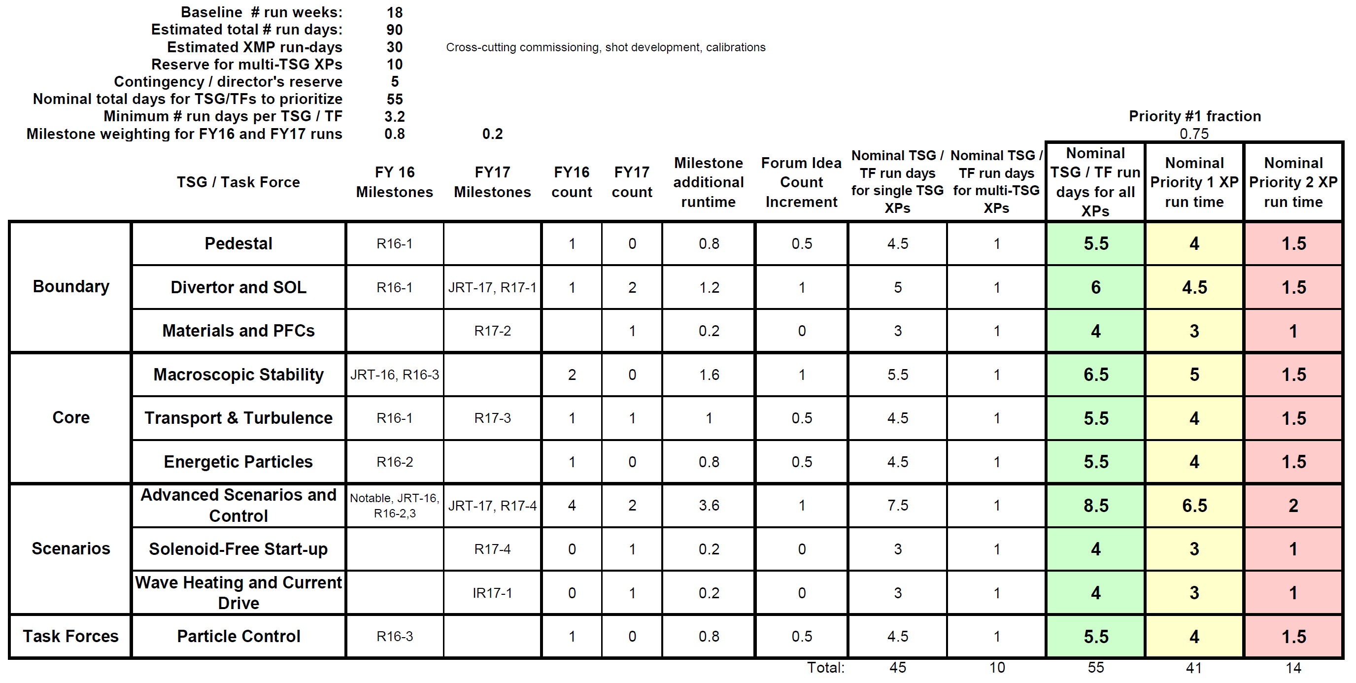
Run Time Guidance for XP Prioritization (February 2016)
Similar to Research Forum, but +1 week for XMP, +1 week for XP
Some of additional XMP time may go to HHFW commissioning
SGs/TSGs should update XP run-time assignments

