Slide 1

NSTX-U Project / Facility Status
Masa Ono and Jon Menard
NSTX-U FY 2016 Q3 Review Meeting
July 28, 2016

Slide 2
Outline
Facility Operations Status and Plan
On-Going Facility Enhancement Status and Plan
Summary

Slide 3
FY 2016 NSTX-U Run Ended Early Due to PF-1AU Coil Short(s)
~ 10.03 run weeks achieved (18 week target) with 1066 plasma shots
IAEA
APS
Completed Plasma Operations
PF-1AU Arc Assessment
Outage
December 2015: 0.4 run weeks (XMP)
January 2016 (3 weeks): 2 run weeks (H-mode), PAC-37
Two week maintenance: NBI T-line repair, Argon purge system, Diagnostics
• February – March (4 weeks): 2.4 run weeks (routine H-mode)
Two week maintenance: BN piece recovery, NBI Auto/transformer/T-line repair,
March – April: (3 weeks) 2.4 run weeks (high power H-mode)
Three week maintenance: NBI LHe refrigeration regeneration & leak repair, Granular Injector, Diagnostics
May: (3 weeks) ~ 1.75 run weeks
Three week maintenance: PF-1A flex bus, MGI, GPI, LITER commissioning, Diagnostics
June: (2weeks) ~ 1.1 run weeks
After assessing the PF 1A-U internal short and potential risks, it was decided to discontinue the run on July 25 in consultation with FES.

Slide 4
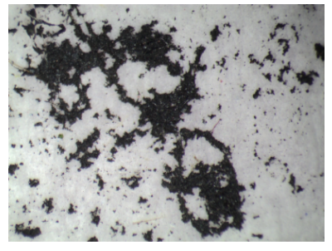
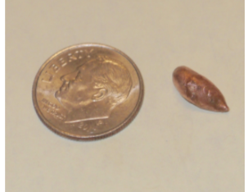
PF-1AU Coil Failure History
Detailed Narrative by Stefan Gerhardt Available
On June 28, Tuesday, the PF 1A upper coil cooling water blockage developed terminating the run. No significant coil electrical nor cooling water/temperature anomaly found until the last shot.
On June 29, black substance came out of PF-1A coil. The water had a pungent smell. Sample analyses showed elevated level of yeast/fungi. The black substance is organic as it is disolved by hydrogen peroxide and heat.
  On July 1, a copper piece came out of the PF-1AU The copper piece is a mixture of copper and carbon consistent with arcing involving coil and insulation. No sign of braze material so the arc is likely to be not at the braze in-line joints. But the presence trace amount of aluminum is still a puzzle.
  • On July 5, while trying to release the blockage, the walter leak occurred in the PF-1AU coil. At this point, we decided that PF-1AU is no longer usable and decided to operate without PF-1AU.

Slide 5
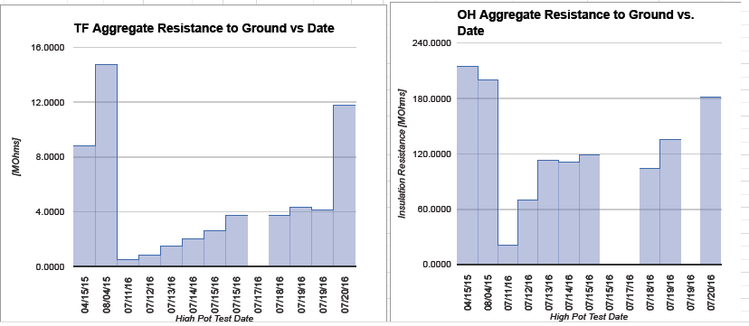
PF-1AU Developed Water Leak Wetting TF and OH
Normal TF and OH electrical coil insulation attained after drying
• On July 5, large water leak developed on PF-1AU and water went down the center-stack soaking TF and OH coils and other CS components including microtherm.
• Mild bake of up to 90 °C applied to CS casing for about three days. Additional drying of pedestal with heated/dried air enabled us to recover the normal impedance
TF
OH
Water leak
On July 5, 2015
Water leak
On July 5, 2015

Slide 6
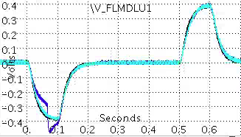
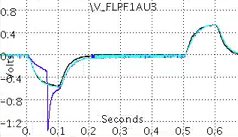
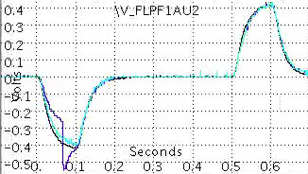
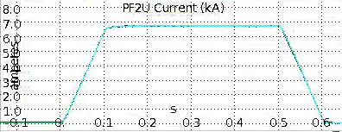
Operations restarted on July 20 without PF-1AU
Intermittent turn-to-turn short(s) observed during the coil test shots
202124 - reference
205321 – 1st 50% PF2U
205323 – next 50% PF2U
Glitch on 203521
7/20/16

Slide 7
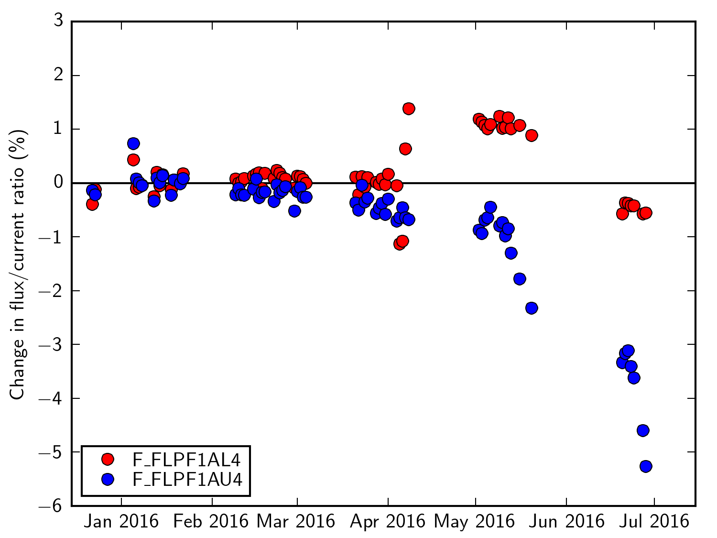
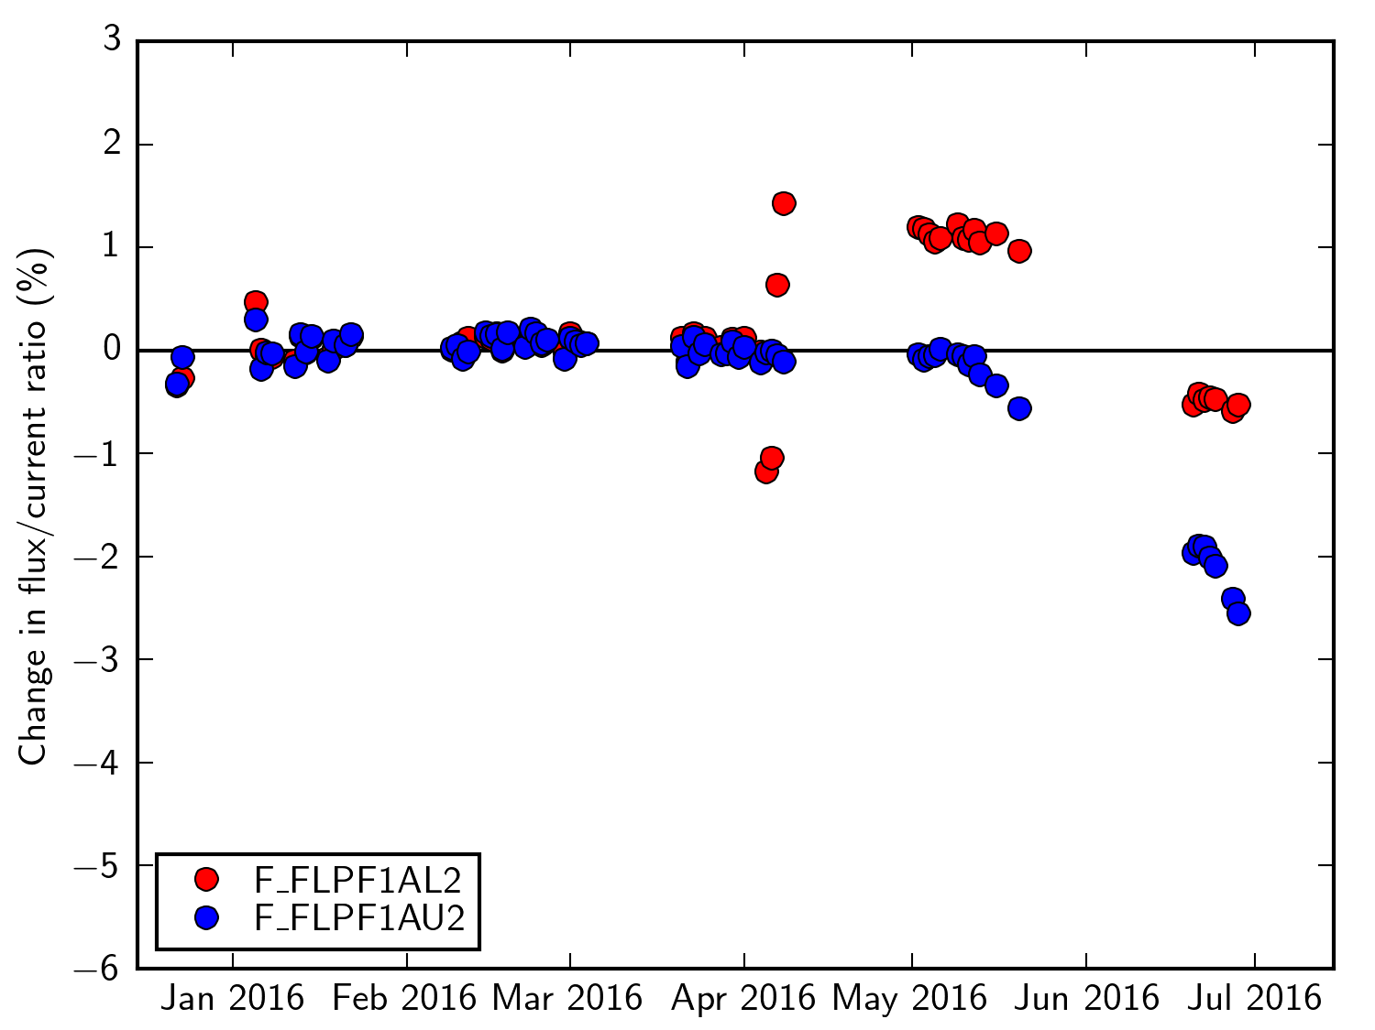
Able to obtain the gradual coil deterioration history of PF-1AU
→ coil inductance has decreased 2-5% over three months period
PF4 removed from
the test shot.
204124
204124
PF-1AL thus far looks normal.
PF-1AU likely to be arcing locally for the last 2-3 months. The arc got worse until melting copper caused cooling water line blockage. The sustained arc condition may explain the growth of the organic material.
A coil inductance monitoring system for all coils to be implemented.

Slide 8
Summary of PF-1AU
• PF-1AU coil suffered internal arc damage which were active for the last 2-3 months. The cause is unknown but likely to be coil insulation failure resulting from a small water leak (conductor defect?), presence of foreign object (metal chip?), manufacturing error during winding (insulation damaged?), or epoxy curing problem (charred .
• Damaged PF-1AU coil will be removed from the machine by early October and will be examine for the cause of failure. X-ray imaging will be performed immediately then followed by excavation. A forensic team was formed to plan and investigate and to report within 4 weeks of coil extraction..
• A design review will be held on the PF-1AU coil with external reviewers to identify any potential issues with the present design.
• The PF-1AU mandrel has been ordered to be available by early October.
• The coil winding would take 12 weeks. Pros and cons of fabrication at PPPL or by a vendor are considered.

Slide 9
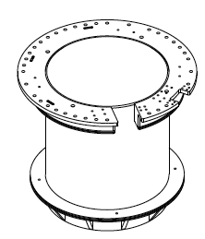
Replacement activities of PF-1AU has started
• PF-1AU coil mandrel procurement has started. The vendor was selected and purchase order placed within one week (record time!)with 10 week delivery schedule.
• The coil winding would take 12 weeks for both at PPPL and by a vendor. PPPL fabrication would cost more but has a better chance of on-time completion and QA/QC. Coil shop and manpower available at PPPL. This will require starting up the coil shop preparation now to be ready in October.
• The coil conductor is available to make PF-1AU but it is prudent to order the coil conductor at this time for possible future needs.
• Options are being considered:
  Fabricated a new PF-1AU and install it for the next run. This would shorten the FY 2017 run to only up to 3- 4 months for the best case.
  Install PF 1A-U mandrel only. Then fabricate a new PF-1AU for the following outage. This option should provide more FY 2017 run weeks ~ 6 - 7 months.

Slide 10
Critical Path Scenarios
Scenario #1 gives sufficient time for FY-17 run
Remove TF LE
Install TF LE
Bakeout
Pump
ISTP
FY-17 Run
Scenario #1:
Mandrel Only
Remove PF-1AU
Install PF-1AU
Mandrel
Diag Cal.
Scenario #2:
Duplicate and install PF-1AU
Wind and VPI PF-1AU
Install TF LE
Bakeout
Pump
ISTP
FY-17 Run
Install PF-1AU
Diag Cal.
Scenario #3:
Duplicate but
Install PF-1AU after autopsy
Autopsy and verify design
Wind and VPI PF-1AU
Install TF LE
Bakeout
Pump
ISTP
FY-17 Run
Install PF-1AU
Diag Cal.
Scenario #4:
Redesign and install PF-1AU after autopsy
Autopsy and redesign
Wind and VPI PF-1AU
Install TF LE
Pump
Install PF-1AU
Diag Cal.
Common / Parallel Tasks
Diagnostic Installation Tasks Includes:
  • Fusion Products
  • Divertor SPRED
  • FIReTIP waveguide, optics box, and table.
  • Resisitive Bolometer
  • High-K Scattering
  • Pulse-burst MPTS
  • Laser blow-off
Vent & purge
Diag Cal.
Passive Plate
High-Z Tiles?
PF-1AU mandrel fabr.
Diag. Install
OH Water Heater

Slide 11
A Suggested Scenario
Scenario #1 + 4 gives sufficient time for FY-17 run
Remove TF LE
Install TF LE
Bakeout
Vent & purge
Pump
ISTP
FY-17 Run
Remove PF-1AU
Install PF-1AU
Mandrel
Diag Cal.
PF-1AU mandrel fabr.
Install PF-1AU after FY 17 run
Autopsy PF-1AU and redesign
Wind and VPI new PF-1AU
Diag Cal.
Passive Plate
High-Z Tiles
Diag. Install
OH Water Heater
Comments:
• This scenario enables ~ 14 – 16 run weeks in FY 2017.
• We can energize PF-1BU utilizing the PF-1AU power supply to give more upper triangularity flexibility.
• We can take the time to examine PF-1AU and if needed redesign PF-1AU before winding.
• But the time would be very limited. Need to consider priority of diagnostic installations.
• Also needs to consider if we are ready for the high-Z tiles programmatically.

Slide 12
Heating System Operations
Both NBI and HHFW are ready at full power
Liquid helium and nitrogen cryogenics systems continue to operate at full capacity (over 19 months continuously)
All 6 neutral beam sources have been conditioned to 90 kV or higher
  All major power supply issues have been resolved
NBI Source Shop has three source refurbishments in progress to build and test as spares for the next run. Grid parts have arrived to build more source grid modules.
All 6 HHFW systems have been conditioned into dummy load to 1 MW and performed antenna conditioning to approximately 20 kV for plasma operations
  All AC Power protective relays have been installed and tested

Slide 13
NSTX-U device performance progression
1st year:
  Operated mostly at B_{T} ~ 0.65T
  Pulse length was extended to ~ 2 sec
2nd year goal: Operate up to full field but at 75% plasma current, coil heating to 60% of limit
3rd year goal: Full capability
Parameter | NSTX (Max.) | Year 1 NSTX-U Operations | Year 2 NSTX-U Operations | Year 3 NSTX-U Operations | NSTX-U Ultimate Goal
I_{P} [MA] | 1.2 | ~1.1 | 1.5 | 2.0 | 2.0
B_{T} [T] | 0.55 | ~0.65 | 1.0 | 1.0 | 1.0
Allowed TF I²t [MA²s] | 7.3 | 25 | 100 | 160 | 160
I_{P} Flat-Top at max. allowed I²t, I_{P}, and B_{T} [s] | ~0.4 | ~2 | ~3 | 5 | 5

Slide 14
Outline
Facility Operations Status and Plan
On-Going Facility Enhancement Status and Plan
Summary

Slide 15
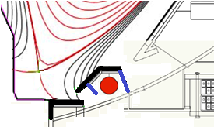

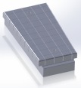
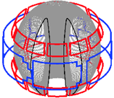

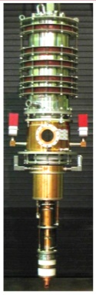
Five Year Facility Enhancement Plan (green – ongoing)
Incremental enables 5 year plan enhancements including NCC, ECH
Fiscal Year:
2015 | 2016 | 2017 | 2018 | 2019
Major enhancements:
Base funding
incremental funding
Upgrade Outage
0.5 T → 1T, 1.5 → 2 MA, 1s → 5s
Run Weeks:
10
16
16
12
New
center-stack
Pulse-burst MPTS
Lower divertor cryo-pump
Boundary Science
+ Particle Control
Boronization
?
High-Z tile row on lower OBD
Scanning MLP
Li granule injector
Upward
LiTER
Graphite CHI/Lower Bullnose
LiTER
APD-based GPI
MAPP
Resistive
Bolometer
MGI disruption mitigation
XICS
Off-midplane 3D coils (NCC)
Upgraded halo sensors
Enhanced MHD sensors
Core Science
sß
42 ch MPTS
Laser blow-off
CPS δB diag.
DBS, PCI, or other intermediate-k
48 ch BES
High k_{θ}
MSE/LIF
4 coil AE antenna
Charged fusion product
Neutron collimator
Establish control of:
Rotation
HHFW limiter upgrade
Integrated Scenarios
n_{e}
Snowflake
Divertor P_{rad}
2nd NBI
FIReTIP
1 MW ECH/EBW
Upgraded CHI for ~0.5MA
Up to 1 MA plasma gun

Slide 16
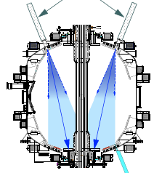
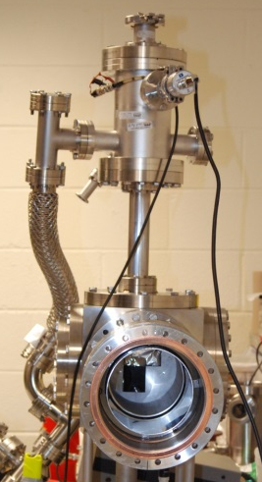
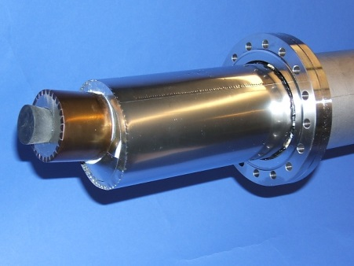
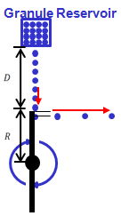
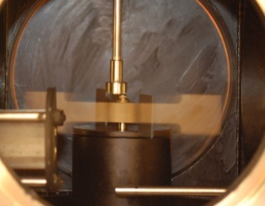
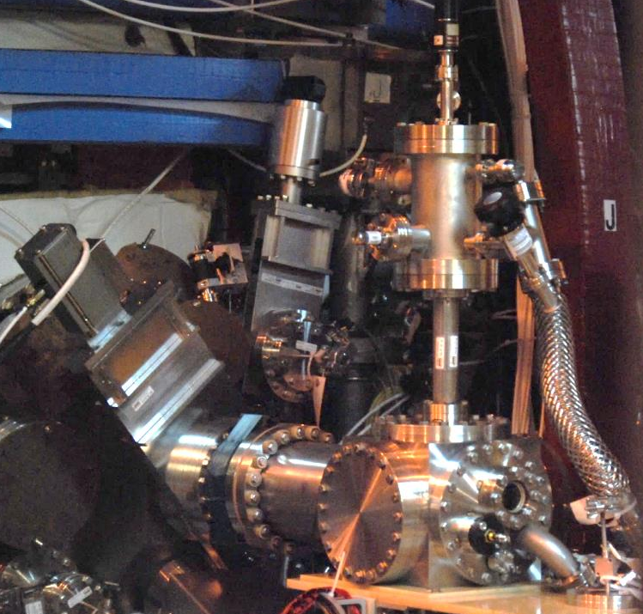
First Year Boundary Physics Tools Operational
Boronization, Lithium Evaporators, Granule Injector
Lithium Evaporator (LITERs)
LITERs
Granule injector (GI) for ELM pacing
Successfully tested
on EAST and DIII-D
Granules: Li, B₄C, C
f ~ up to 500 Hz
Granular Reservoir
• LITERs filing set up in high bay south of NSTX-U Test Cell.
• Argon purge system implemented for Li safety, used for the quick argon vent.
• Ready to support the run.
Rotating Impeller
Boronization System
• Multiple injection and glow made more uniform boronization.
• System is working very well. Multiple # of boronization including daily ones performed. Also being used for He glow discharges.
• GI is now operational.
GI installed on NSTX-U

Slide 17
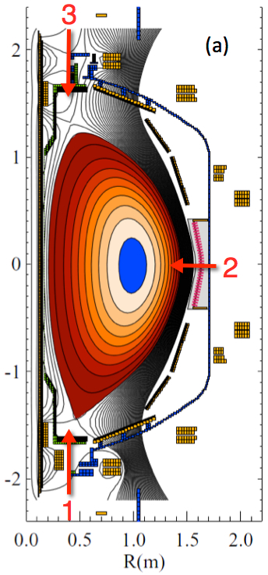
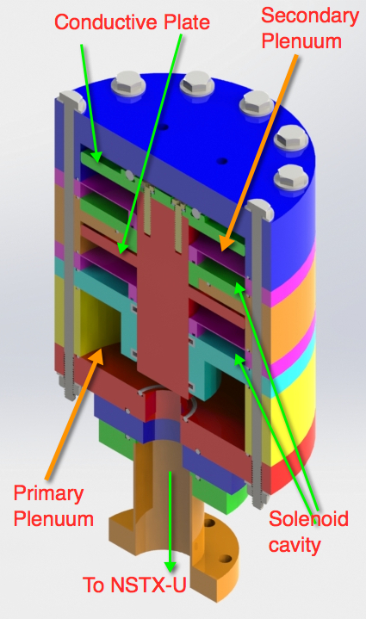
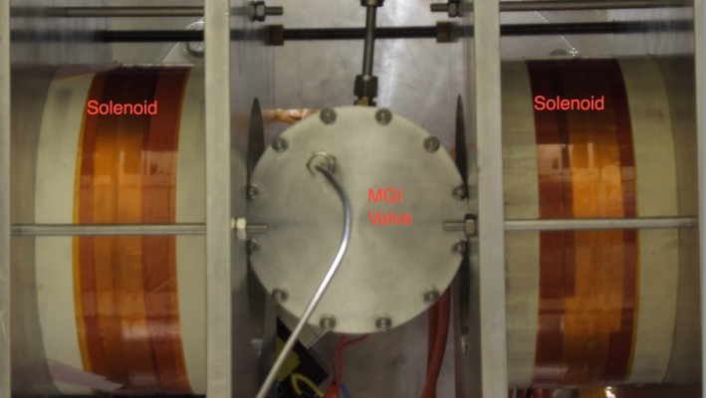
Disruption Mitigation System for NSTX-U
Massive gas injection system at multiple poloidal positions
NSTX-U MGI Valve
  - Massive gas injector system at multi
  poloidal location with identical injection set-up
  - Compact power supply proto-type tested at UW
  - A new double solenoid MGI design (zero net J x B
  torque) based on the ORNL ITER MGI design
  MGI also tested on the U. Washington test stand with magnetic field
Magnets
Magnets
MGI
Valve
U. Washington
• Successful final Design Review of MGI system was held on February 18, 2016.
• All the MGI components were installed on NSTX-U and the control is being installed.
• Initial gas pulses into NSTX-U were performed and it is ready to support the operations.

Slide 18
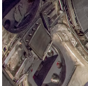
Enhanced FIDA will measure NBI distribution function
For NBI fast ion transport and current drive physics
Fast Ion D-Alpha Diagnostics
Taking data on NSTX-U
FIDA Views
CHI Gap
• Both vertical (perpendicular) and new tangential (parallel) FIDA systems are ready.
• Both FIDA systems have 10 ms, 5 cm, ≈ 10 keV resolutions.
Vertical
Center-Stack
Tangential
HHFW
Antennas
FY 2016 - 2017 Energetic Particle Conceptual Design and Diagnostic Upgrade
  SS-NPA installed and taking data.
  sFLIP installed for lost ion measurements
  Active 2 X 2 TAE antennas installed. Initially passive spectroscopy then active excitation at few kW level.
  Proto-type charged fusion product (CFP) profile diagnostic is being prepared to be installed.
  8+8 reflectometry array available for AEs.
TAE antennas
UCI
sFLIP
FIU
UCLA

Slide 19
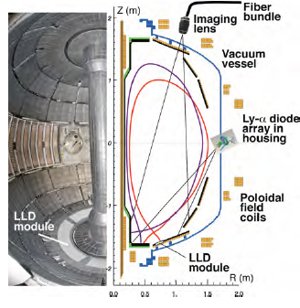
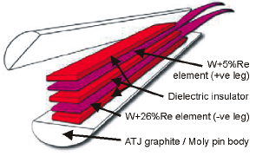
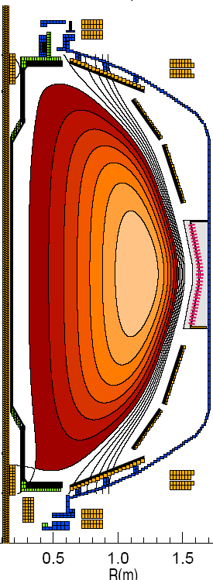
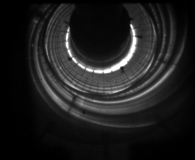
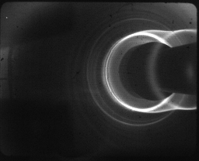
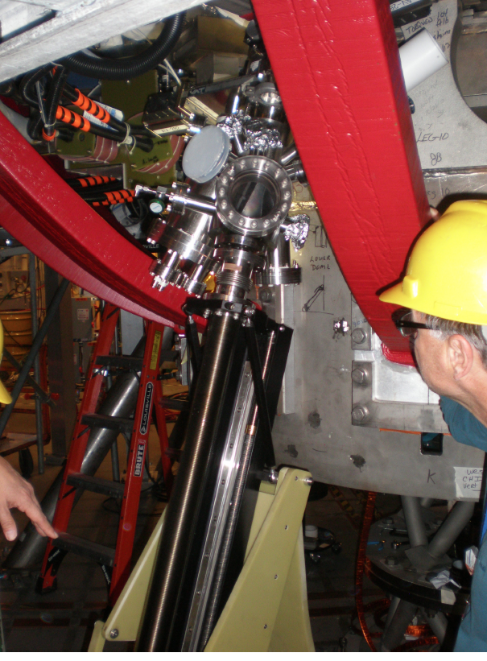
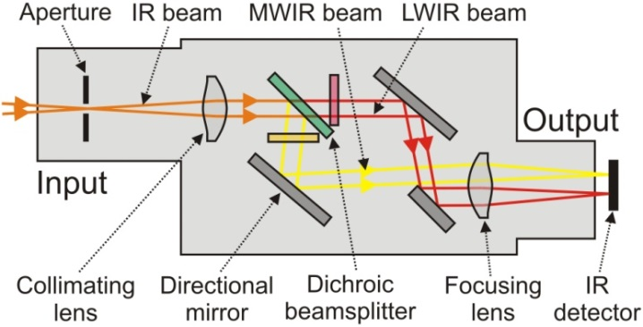
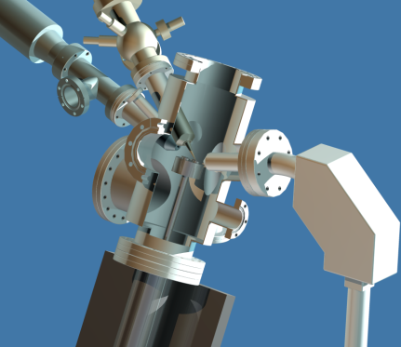
Enhanced Capability for PMI Research
Multi-Institutional Contributions
Divertor fast eroding thermocouples
Multiple fast 2D visible and IR cameras with full divertor coverage
Divertor Imaging
Spectrometer
ORNL
LLNL, ORNL, UT-K
LLNL
Li I
ORNL
C II
Dual-band fast IR Camera
MAPP probe for between-shots surface analysis – Now taking data
U. of Illinois, PPPL

Slide 20
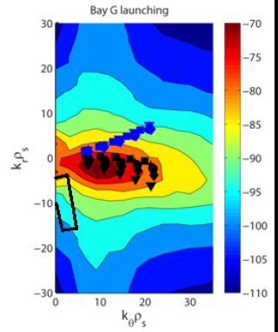
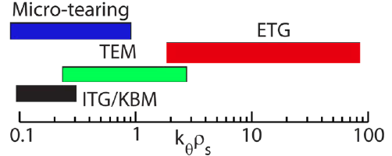
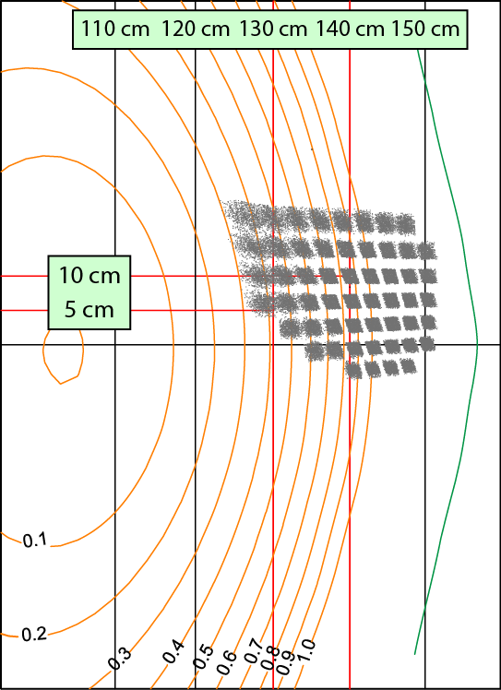
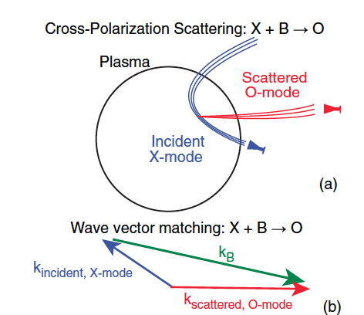
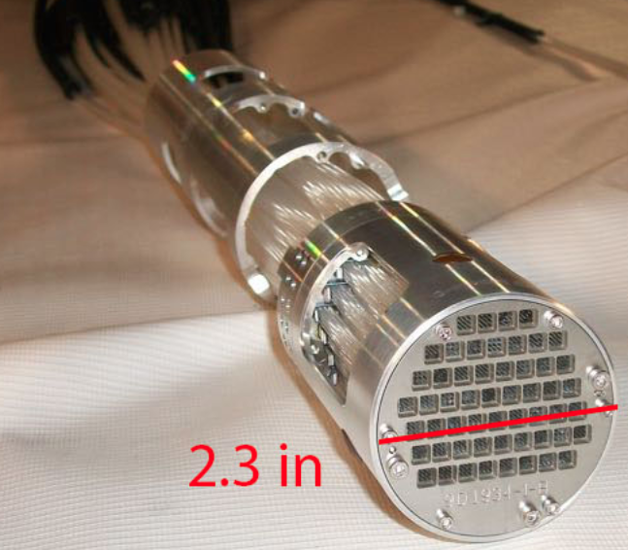
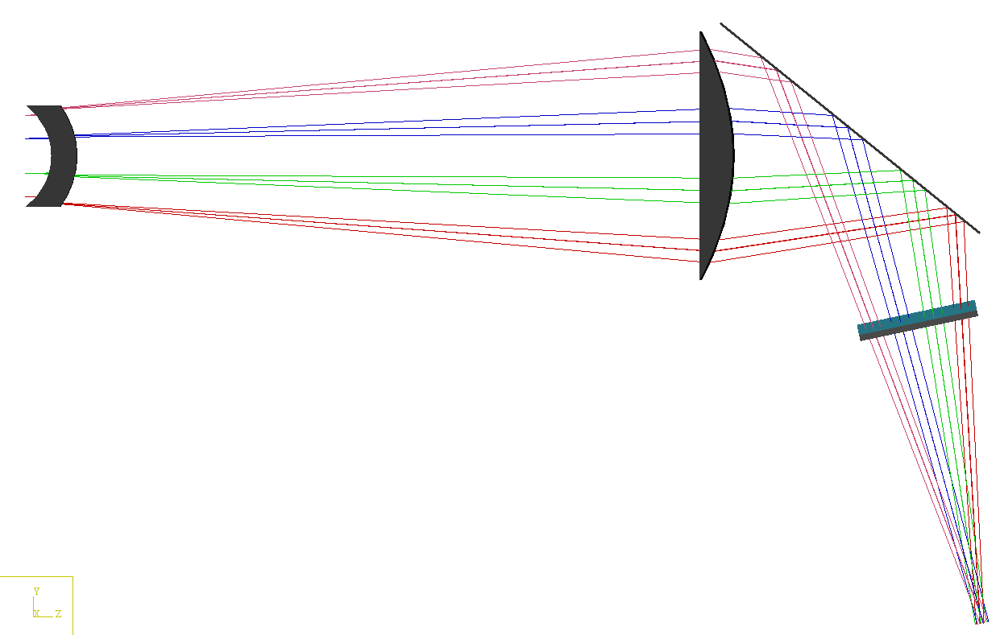
Microturbulence Diagnostics Being Enhanced
To measure ion to electron gyro-scale, magnetic fluctuations
Beam Emission Spectroscopy
for low k turbulence
48 chs being readied
Low k
High-k scattering for ETG
High k
Cross-Polarization Scattering for magnetic fluctuations being developed in collaboration with DIII-D and MAST
UC Davis
BES-2D-Fiber
Assembly
Collection optics (Bay L)
4x1 subharmonic mixer array
U Wisconsin
4–channel CPS system in 2017
UCLA
Available for FY 17

Slide 21
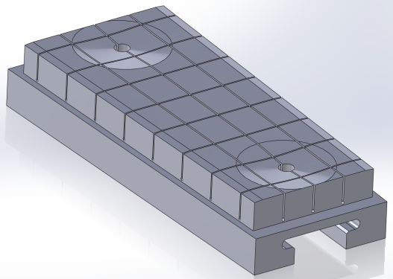
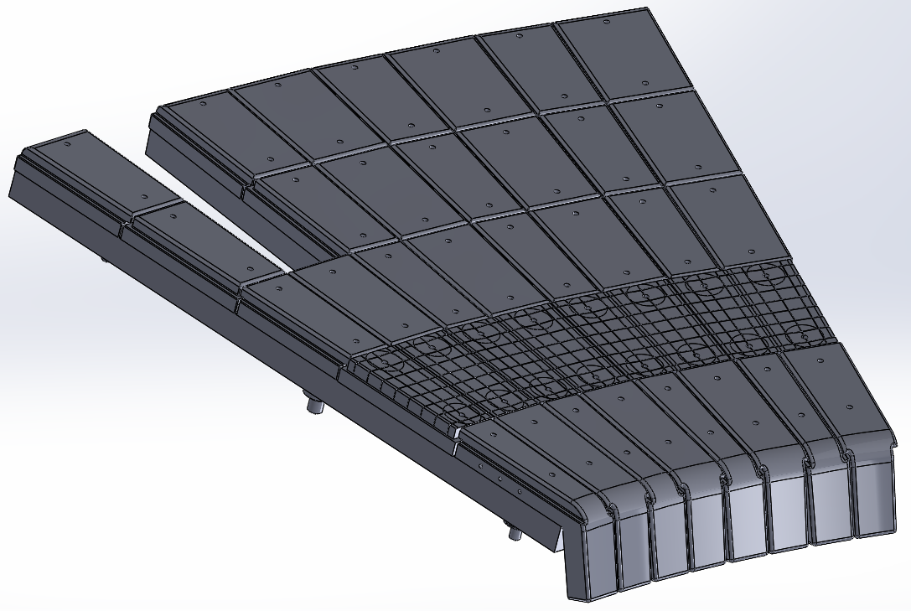
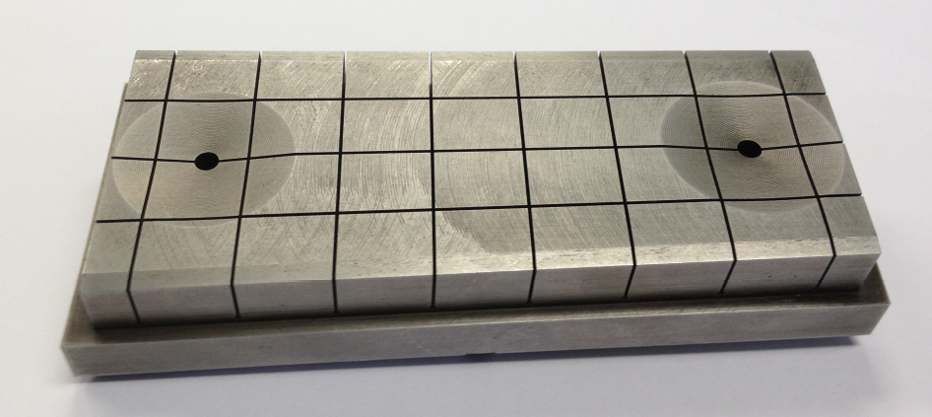
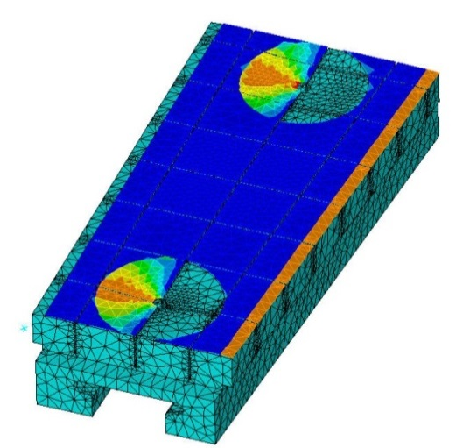
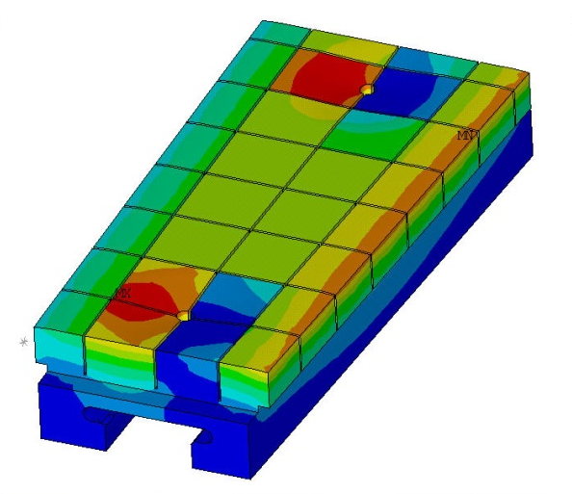
Being assessed to install High-Z Tile for FY 2017 run
Design to replace a row of the graphite tiles in lower outer divertor
Procurement awarded
  Schedule to be delivered in September in time for the installation in NSTX-U
  The first fabricated tile (see below) looks quite good!
  While high-Z tile should be available, whether to install the at this outage will be decided by the programmatic needs.
Surface heat flux
Temperature
First fabricated high-Z tile

Slide 22
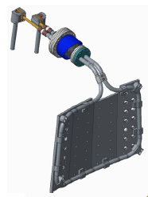
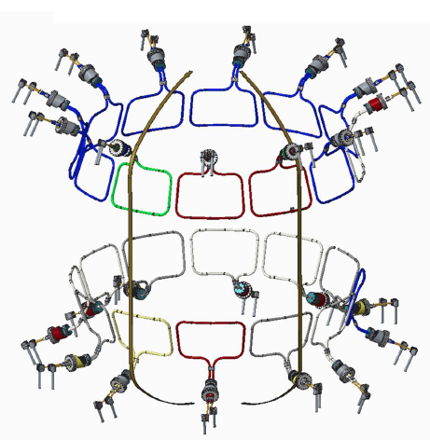
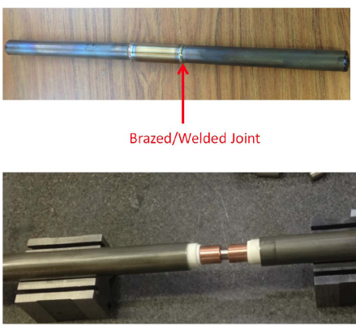
NCC Coils Conceptual Design Successfully Completed
NCC = Non-axisymmetric Control Coil
• CDR design includes selection criteria include thermal capability, manufacturability, impact on interfacing objects, fabrication lead time and cost.
• Cost and schedule were prepared as part of the CDR which is completed on May 13, 2016.
Prototype testing of joint design conducted

Slide 23
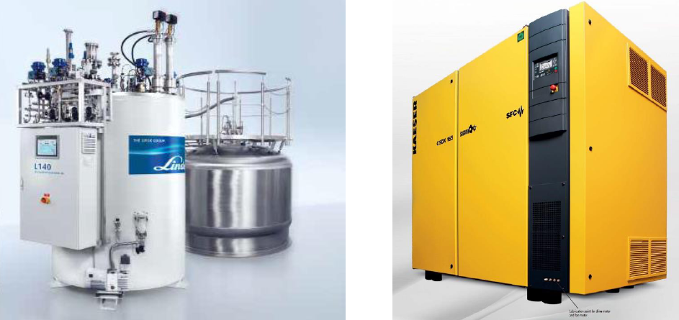
Successful Peer Review of NSTX-U NBI LHe Refrigerator
Held on 6/3/16 at PPPL, PDR in September
• To be located in the Cryogenics Compressor Room near NSTX-U, accommodates all envisioned loads (NBI + top and bottom Divetor cryo pumps) due to greatly reduced piping and heat loss (x 3-4).
• The unit would reuse power and space previously used for a 225 Watt refrigerator with all the utilities and compressors available.
• The new refrigerator would remove down time risk and reduce operating and maintenance cost.
• Specification has been drafted and is in review. Plan to submit the requisition and spec to go out for bids hopefully next week.
500 feet of supply and return piping
Proposed 400 W L-He Linde LR-140 refrigerator

Slide 24
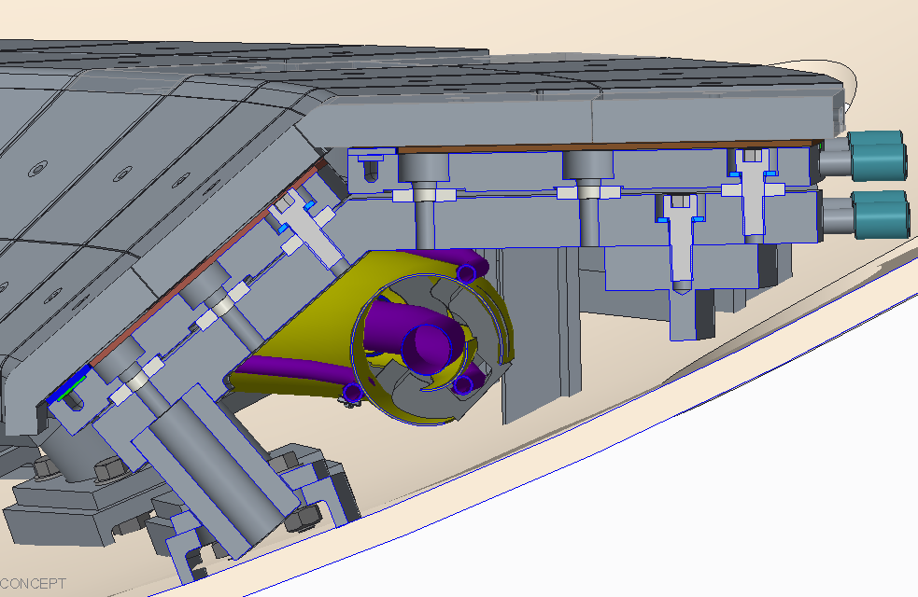
Divertor Cryo-pump Design Making Good Progress
CDR is scheduled on August 3, 2016
“Upper Bullnose” (UB)
“Baffle Top” (BT)
Initial in-vessel geometry has been laid out.
MIT is designing the cryo-ring.
  Pump radius, throat dimensions taken from the modeling.
  The entire lower outer divertor region to be reduild.
• Cryo-baffle design to be finalized at CDR.
  Diagnostic access and cryo-ring maintainability are important design consideration.
  Graphite PFC option with bakeout capability is pursued for CDR.
Transfer line layout

Slide 25
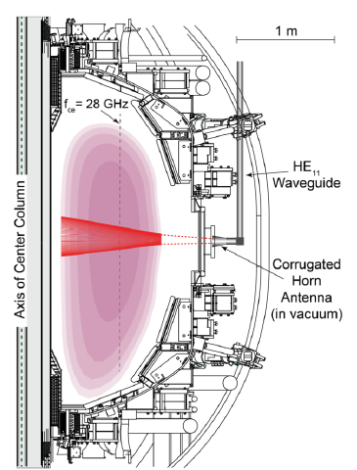

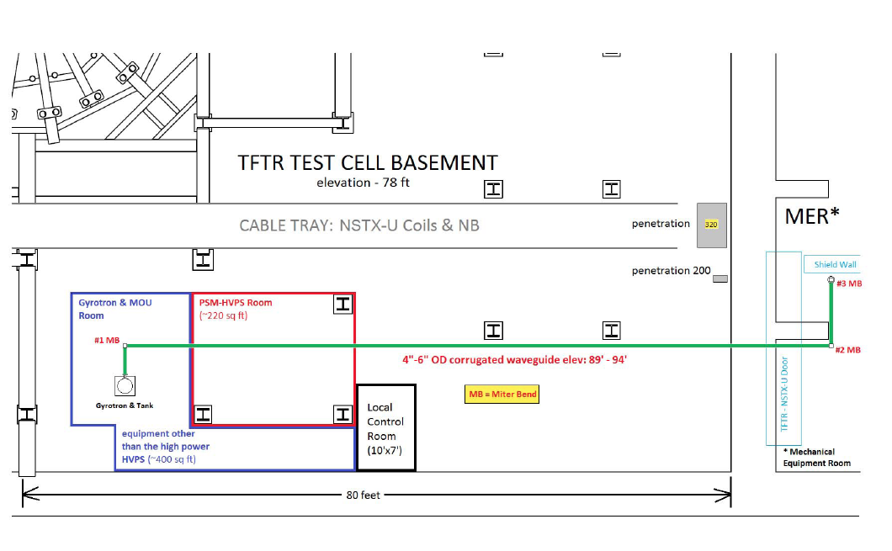
28 GHz ECH System Design
Completed conceptual design and cost/schedule
CHI can form a 200-400 kA seed plasma, but it is too cold for HHFW absorption.
Use of ECH can “bridge the T_{e} gap” to where HHFW and then NB current drive can support the ramp and sustain the current – crucial for OH solenoid-free compact STs
  Good first pass absorption predicted.
Goal of first ECH power in 2019 run with 15% incremental funding.
28 GHz 1 MW Tube by Tsukuba
28 GHz Gyrotron Room
NSTX-U
Test Cell
28 GHz Gyrotron Development
• 2nd generation 1.5 MW 28/35 GHz gyroton being developed at Tsukuba University.
• The tube was delivered to Tsukuba and the preliminary power test looks promising for 1.5 MW operations.
Gyroton room
Power Supply Room
Gyrotron will be located in the TFTR basement. Stray magnetic fields was measured to be negligible

Slide 26



MIT PSFC Complements Well Existing NSTX-U Capabilities
Discussions Started on Various Diagnostic Implementations
MIT will enhance NSTX-U GPI systems
X-ray Imaging Crystal Spectroscopy
Avalanche-PhotoDiode (APD)-based GPI
CDR is planned on July 29, 2016.
MIT is developing a next generation, servo-driven, compact scanning MLP system

Slide 27
Summary of Facility and Diagnostics
• NSTX-U plasma operation was ended due to the PF-1AU coil failure. The facility achieved 10.03 run weeks (18 run weeks target) with 1066 plasma shots.
• PF-1AU coil failure is identified as an internal arc which has been initiated 2 – 3 months prior to the coil failure likely due to a manufacture error or defect. Possible causes includes copper conductor defect causing small water leak, foreign metallic material trapped in the insulator, coil winding error, or epoxy cure error.
• A new PF-1AU coil fabrication is planned. The coil mandrel procurement is placed with a vendor. Various options for the coil manufacturing are being investigated. Outage plan is also being developed.
• Both NBI and and HHFW system are now operational at full power level.
• Good progress were made on a number of enhancements are being implemented to support the NSTX-U research plan. High-k, Pulse-Burst MPTS, Resistive Bolometers. Completed CDR for NCC and ECH.
• Good progress toward the divertor cryo-pump CDR next week.

