Slide 1

NSTX-U Program
FY2016 Q3 Report
Jon Menard, Masa Ono (PPPL)
For the NSTX-U Team
PPPL and FES
July 28, 2016

Slide 2
Outline
Recent research highlights (since Q2)
Progress toward milestones
Future milestone discussion

Slide 3
Outline
Recent research highlights
  Charge exchange diagnostic results
  MHD
  Energetic Particles
  Boundary Physics

Slide 4
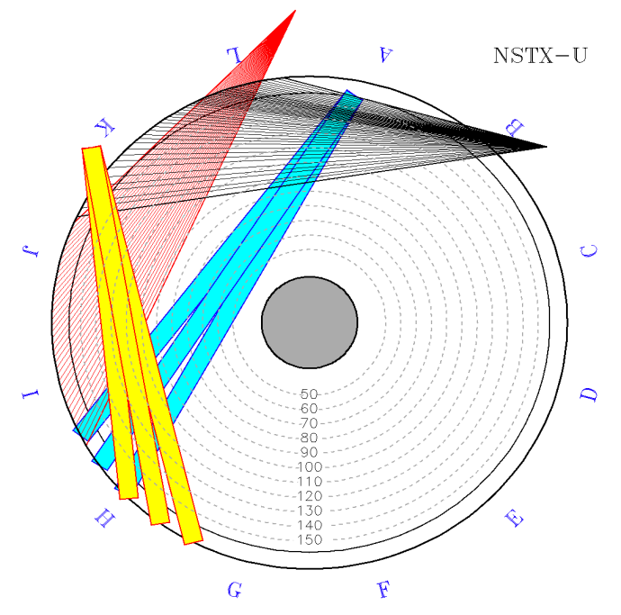
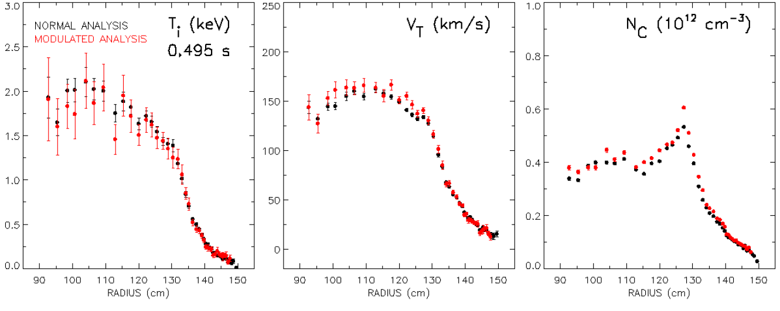
New CHERS analysis developed for operation with second NSTX-U beam
Charge Exchange Recombination Spectroscopy (CHERS) measures ion temperature, velocity, and impurity density
“Standard” CHERS analysis uses background view to isolate intrinsic emission present in active view
NB2 emission compromises the CHERS background view and the standard CHERS analysis
Analysis using a single modulated NB1 source developed
  Adequate S/N for profile measurements of T_{i}, V_{t}, N_{c}
  Lower time resolution
  Larger error bars than with multiple NB1 sources
Background
View
NB1
NSTX-U
NB2
Active
View
Extraction of signal from one modulated NB source from steady source demonstrated
  Allows CHERS measurement when NB2 sources are operating
  Would allow a continuous MSE measurement with a modulated source for CHERS
FY17 upgrade to CHERS will
substantially improve S/N

Slide 5
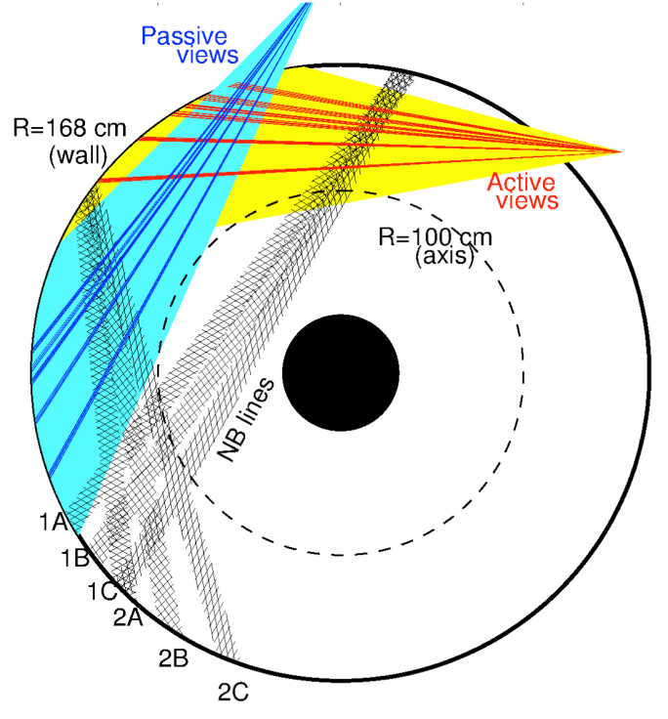
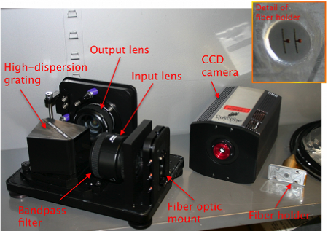
Real-Time Velocity (RTV) system achieved all design goals, routinely taking data
System based on active charge-exchange spectroscopy on NB1 line
Monitor C VI, n=8-7 line @ 5291nm
RTV views interleaved with CHERS views at mid-plane (active & background views)
  4 views available: R=112, 125, 132, 140cm
Acquisition and analysis software improved after first data from NSTX-U plasmas
  Demonstrated RT analysis for v_{φ}, possibly T_{i} (!) at sampling rate up to 5kHz
  Developed post-discharge analysis tools
    v_{φ} from real time analysis available right after shot
    Quick analysis (v_{φ}, T_{i}) available ~1 minute after shot
    Full analysis (CHERS-like: v_{φ}, T_{i}, n_{C}) available ~5 minutes after shot
Implemented & tested data transfer to PCS
Data now routinely available to develop & test v_{φ} control algorithm(s) in PCS
[M. Podestà, RSI 83 033503 (2012)]

Slide 6
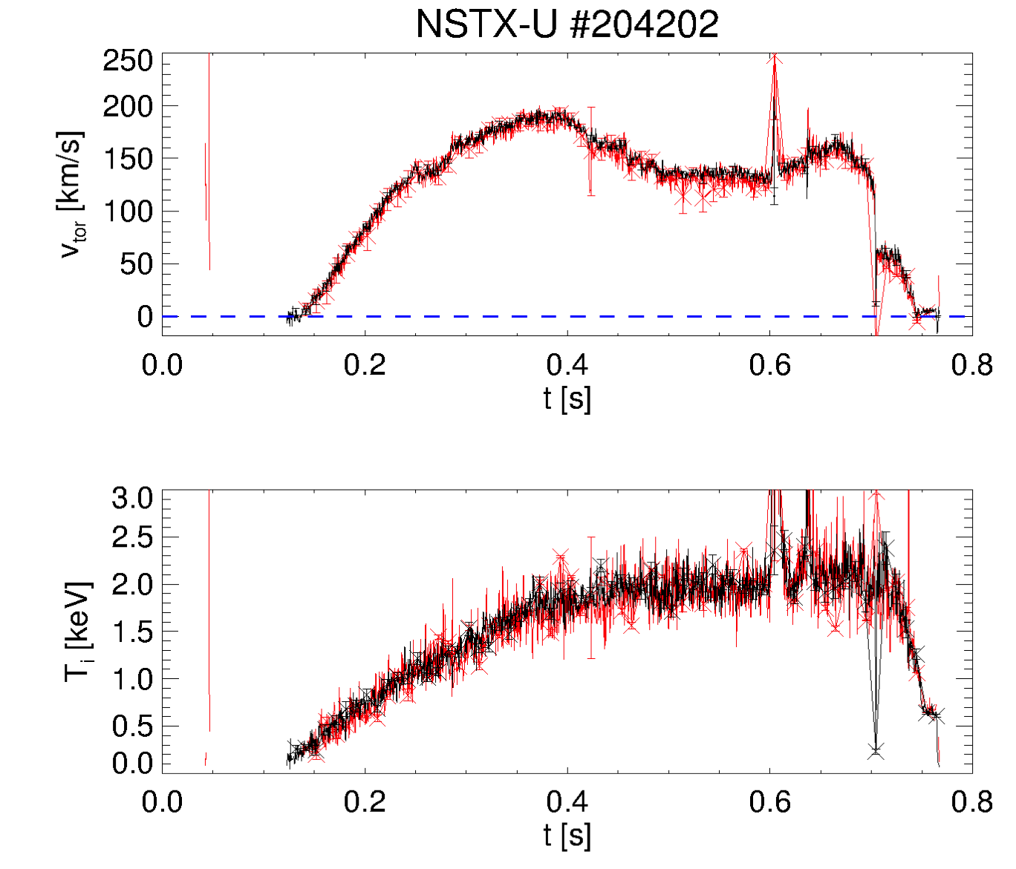
Real-time analysis provides accurate data for rotation feedback (and more)
Good agreement with main CHERS system
Good match for both v_{φ} and T_{i} between real-time and post-discharge analysis
First RTV data from NSTX-U confirm achievement of design goals
System is ready to support development & testing of v_{φ} control on NSTX-U
RTV @ R~125cm
post-discharge
real-time
Additional physics insight can be gathered from post-discharge analysis
  E.g. effects of RMPs, MHD, ELMs, pellets/granules on v_{φ}, T_{i}, n_{C}
  Complements high spatial resolution of CHERS with sub-millisecond time resolution at 4 radii
[M. Podestà, PPCF (submitted 2016)]

Slide 7
Outline
Recent research highlights
  Charge exchange diagnostic results
  MHD
  Energetic Particles
  Boundary Physics

Slide 8
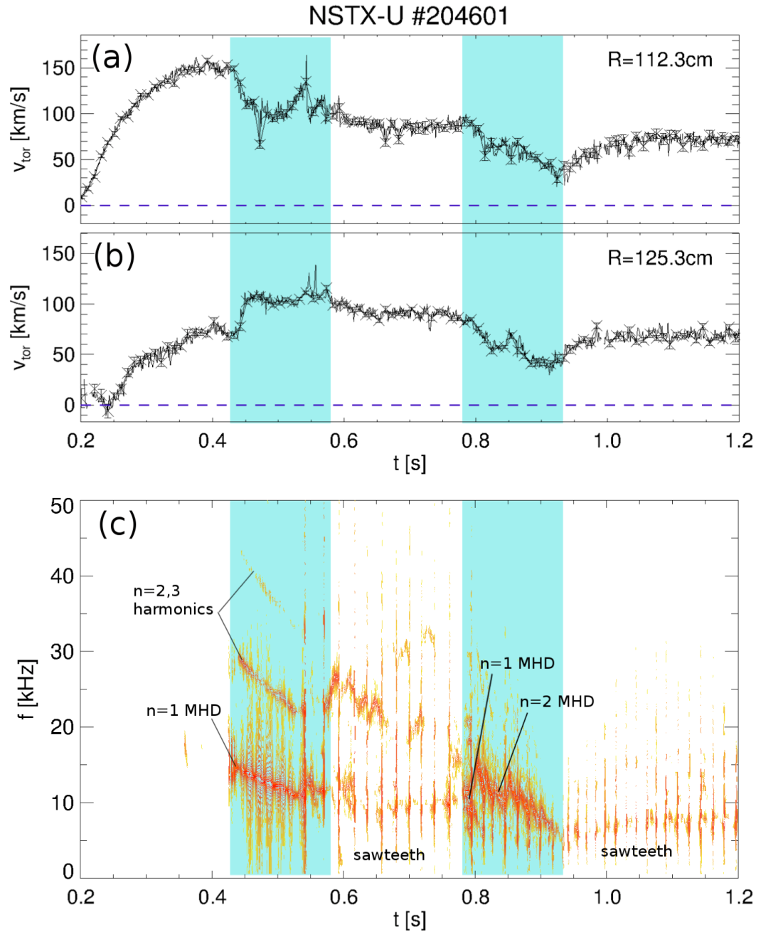
MHD, sawteeth can compete in v_{φ} redistribution; different time scales, high f_{samp} enable separation
Complex scenario
  MHD n=1,2 modes act on ~10ms time scale
  Sawteeth act on ~1ms time scale
High f_{samp} of RTV allows to differentiate time scales
Complements high spatial resolution CHERS profiles

Slide 9
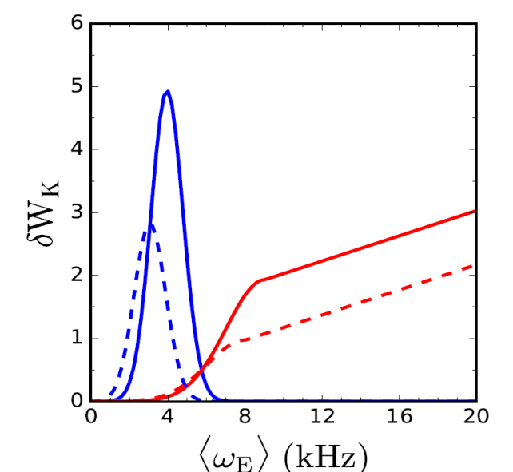
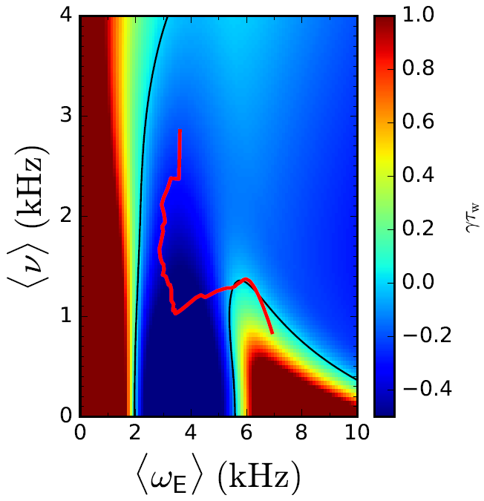
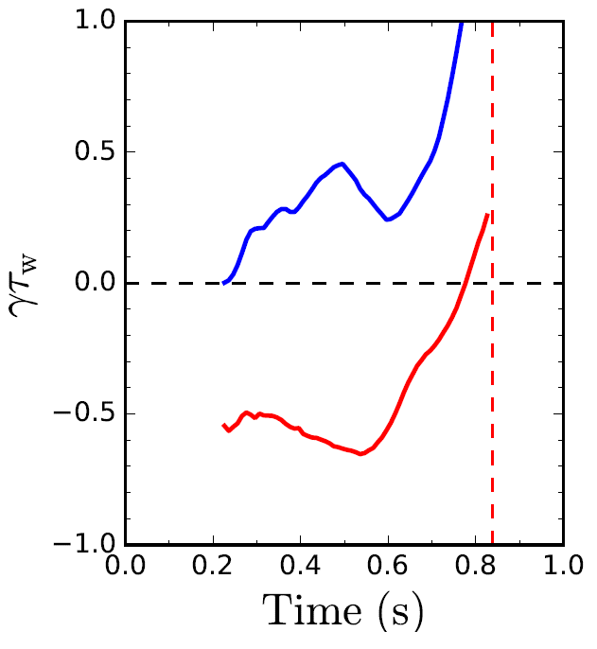
      Reduced kinetic RWM model in DECAF results in a calculation of γτ_{w} vs. time for each discharge
Kinetic component δW_{K}
γτ_{w} contours vs. ν and ω_{φ}
Normalized growth rate vs. time
Precession resonances
Increasing time
ideal
Bounce/transit resonances
γτ_{w}
unstable
stable
Ideal + kinetic
<ν> = 1 kHz
disruption
139514
  Gaussian forms used to reproduce precession and bounce/transit resonances
  Height, width, position of peak depend on collisionality
predicted instability
Favorable characteristics
  Stability contours CHANGE for each time point (last time point shown left frame)
  Possible to compute growth rate prediction in real time
Initial tests on NSTX RWM database
  86% of RWM shots are predicted unstable

Slide 10
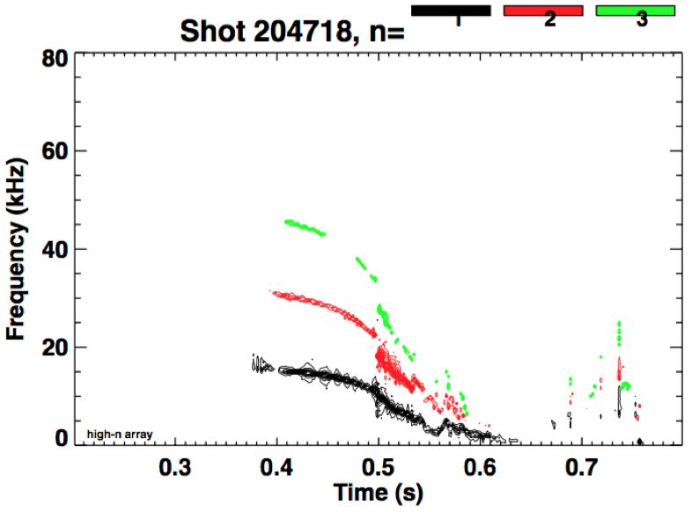
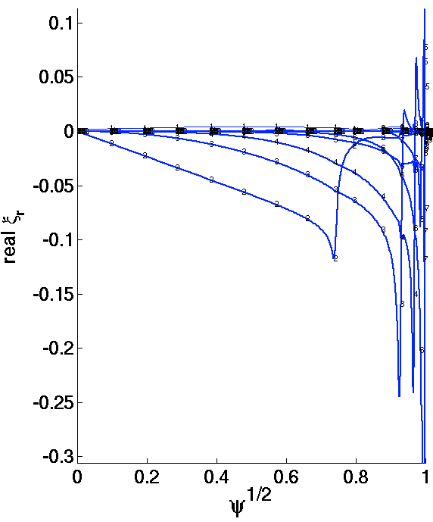
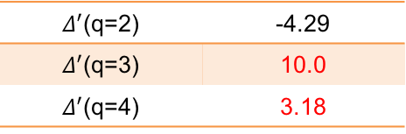
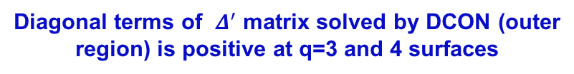
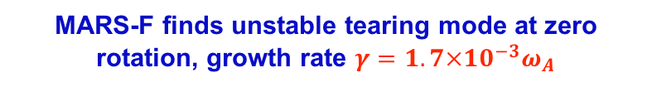
MARS-F and new developed resistive DCON predict unstable tearing mode consistent with NSTX-U observation
Unstable n=1 tearing mode is observed in L mode NSTX-U discharge (204718).
Resistive DCON and MARS-F predict unstable n=1 tearing modes at q>2 singular surfaces.
Diagonal terms of $Δ^{′}$ matrix solved by DCON (outer region) is positive at q=3 and 4 surfaces
NSTX-U experiment observes n=1 unstable mode which drives n=2, 3 modes later
$Δ^{′}$(q=2) | -4.29
$Δ^{′}$(q=3) | 10.0
$Δ^{′}$(q=4) | 3.18
MARS-F finds unstable tearing mode at zero rotation, growth rate $γ=1.7×{10}^{−3}ω_{A}$
n=2,3 modes driven by n=1 mode
Odd parity
(Tearing)
Unstable n=1 mode
m=2
3
Even parity
4

Slide 11
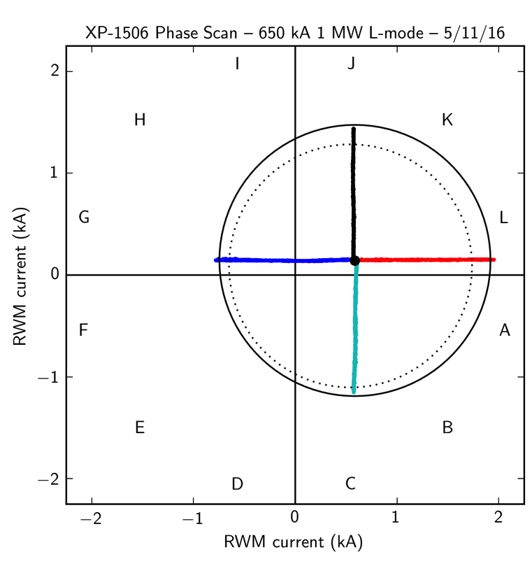
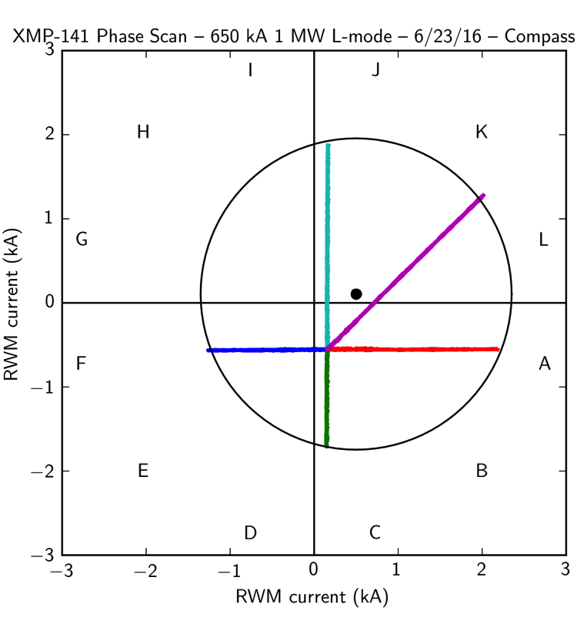
Multiple compass scans confirm the optimum L-mode
EFC phase and amplitude in the flattop
Higher density
Different OH pre-charge (8 kA vs. 20 kA)

Slide 12
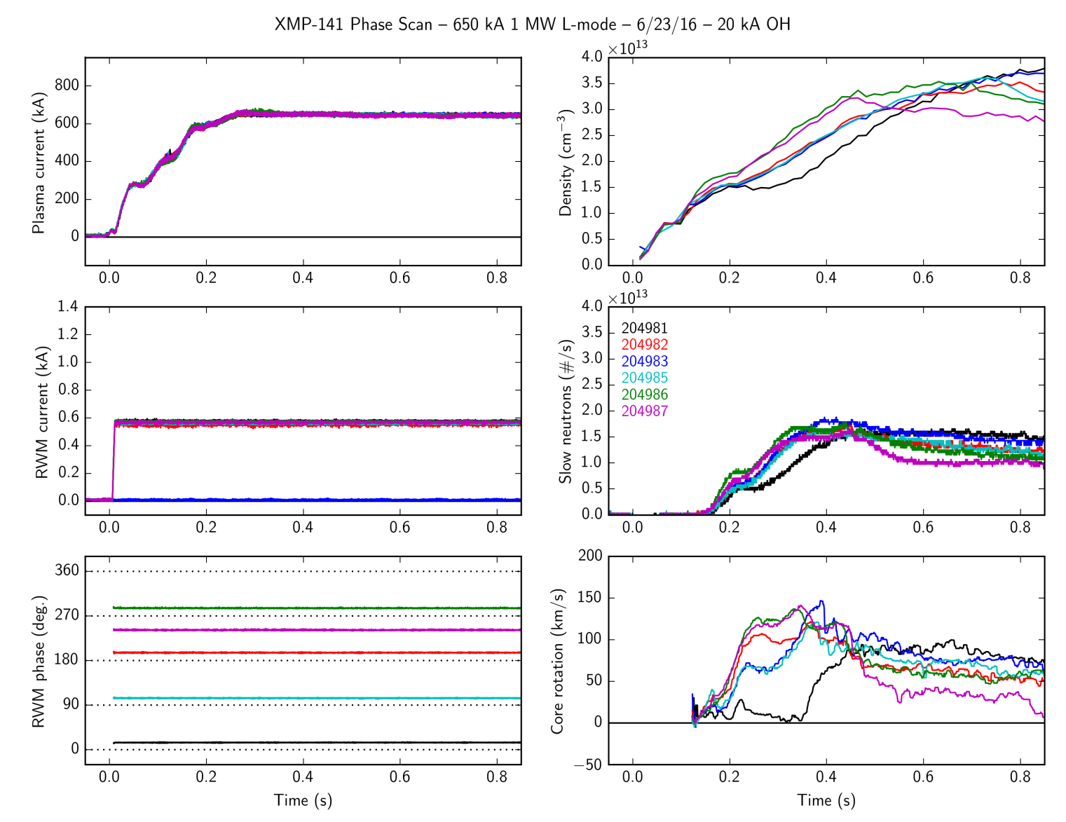
Static EFC scan early in time → different EFC phase
Static EFC scan early in the discharge shows different optimum correction phase
Flattop phase of 15° is counter-productive early on
Phase asymmetry visible in density, neutrons, and core rotation
Search for the time-evolving error field source is ongoing
  Tilted TF, vessel currents?

Slide 13
Outline
Recent research highlights
  Charge exchange diagnostic results
  MHD
  Energetic Particles
  Boundary Physics

Slide 14
Beam Ions are Reasonably Well Confined at High Injection Energy, but Some Discrepancy at Low Injection Energy
March 31, 2016, E_{inj}=65keV, 1MW
Source | Rise (Exp/TRANSP) | Decay (Exp/TRANSP)
1B (R_{tan} 60cm) | 0.55 | 0.88
1C (R_{tan} 50cm) | 0.60 | 0.88
2A (R_{tan} 130cm) | 0.58 | 0.88
2C (R_{tan} 110cm) | 0.58 | 0.72
At E_{inj}=65keV, the rise is smaller and decay is faster than predicted.
At E_{inj}=85keV, the agreement is much better → Beam ions are reasonably well confined.
The machine is cleaner so that the TRANSP assumption that Zeff=1.5 is better or
The voltage is higher so that the reported power is more accurate or
Beam species at high voltage is more reliable
June 28, 2016, E_{inj}=85keV, 2MW
Source | Rise (Exp/TRANSP) | Decay (Exp/TRANSP)
1B (R_{tan} 60cm) | 0.80 | 1.04
1C (R_{tan} 50cm) | 1.08 | 1.05
2A (R_{tan} 130cm) | 1.02 | 1.06
2C (R_{tan} 110cm) | 0.86 | 0.98

Slide 15
Off-axis beams suppress counter-propating Global Alfvén Eigenmodes (GAE)
GAE activity, excited by one or two BL#1 sources can be suppressed by adding one BL#2 source, either 2a, 2b or 2c.
Valuable tool for study of possible GAE-induced electron energy transport.
Addition of source 2a
Addition of source 2b
Addition of source 2c

Slide 16
Counter-propagating TAE seen with off-axis Neutral Beam Injection (source 2a)
Counter-propagating TAE have been predicted for hollow fast-ion profiles.
Preliminary analysis suggests profile isn’t hollow.
Up and down frequency chirps can be used to measure linear growth rate of mode for comparison to theory.

Slide 17
Outline
Recent research highlights
  Charge exchange diagnostic results
  MHD
  Energetic Particles
  Boundary Physics

Slide 18
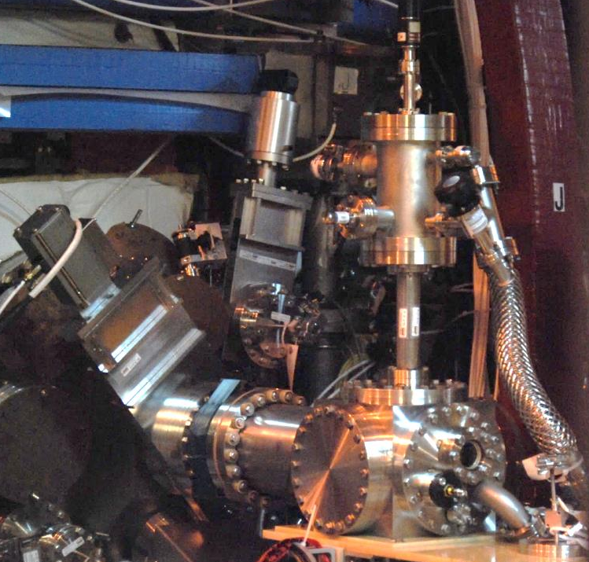
Granule Injector Commissioned on NSTX-U
Granule sizes :
900μm, 700μm, 500μm, 300μm
Injection Species : Li, B₄C, C
Injection Velocity : 50 – 150 m/sec
Granule to Granule Injection Frequency : 50 – 500 Hz
Particle drop rates are controlled by a piezoelectric disk.
Granules driven into the plasma by a pneumatic rotary impeller
NSTX-U Granule Injector

Slide 19
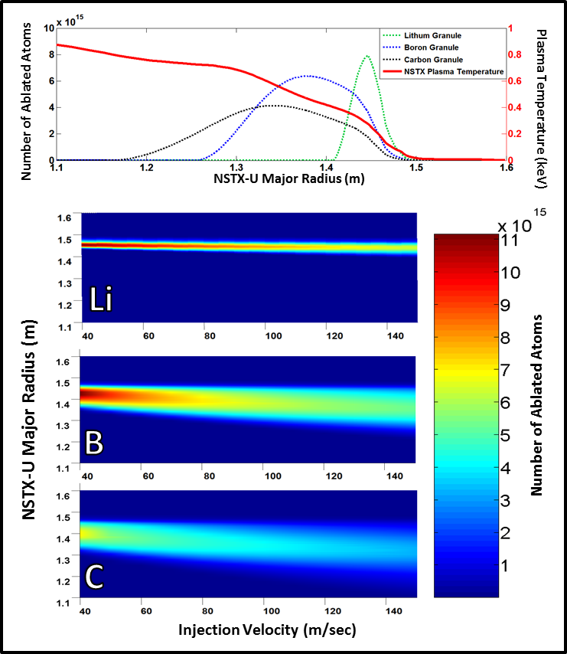
Calculated multi-species injection profiles on NSTX-U
Utilizing different materials and injection velocities tailors the ablation rate and mass deposition location
 | Lithium | Boron Carbide | Carbon (Vitreous)
Density | .534 g/cm ³ | 2.52 g/cm ³ | 2.09 – 2.23 g/cm ³
Mass in a 1mm sphere (mg) | 0.279 | 1.319 | 1.131
Number of atoms/molecules | 2.426E+19 | 1.438E+19 | 5.670E+19
Sublimation Energy (eV/atom) | 1.65 | 5.3 (B) | 7.5
Sublimation Energy Per Granule (J) | 6.415 | 61.070 | 68.154
First Ionization Energy (eV) | 5.3917 | 8.2980 (B) | 11.2603

Slide 20
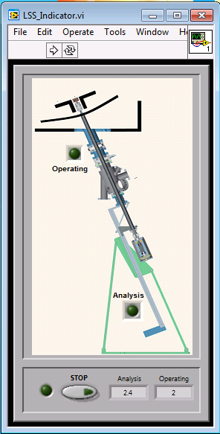
MAPP update
Full remote operation (EPICS and LabView® Interface) now possible for in between plasma discharges measurements
Flush with LD tiles at bay J
(boronization, lithiumization, D⁺ plasma exposures)
Sequence of operation
XPS, ISS, DRS
measurements

Slide 21
Effect of boronization on PFCs in NSTX-U
Boron oxidation due to plasma exposure measured with MAPP via X-ray Photoelectron Spectroscopy (XPS)
3. ATJ post boronization post plasma exposure
High oxygen % Low % of B in metallic state
Days after boronization
D⁺ fluence increasing
XPS data obtained at the end of each plasmas operations day
Low oxygen % High % of B in metallic state
2. ATJ post boronization
1. ATJ graphite

Slide 22
Outline
Recent research highlights
Progress toward milestones
Future milestone discussion

Slide 23
Progress toward Milestones (I)
R16-1: Assess H-mode energy confinement, pedestal, and SOL characteristics with higher B_{T}, I_{P} and NBI heating power
  All key diagnostics took data, except MSE – was waiting for 90kV on NB1A – got to 90keV on 1A in last 2 weeks.
  Checking data consistency via TRANSP
  Need robust / longer-pulse higher current H-mode scenarios
R16-2: Assess effects of NBI parameters on fast ion distribution function and neutral beam driven current profile
  Neutron, FIDA, ssNPA functional (but no MSE data in FY16)
  Started studies of fast ion confinement vs. R_{tan} and effect of NB#2 on *AE modes, NBI source scans in L-modes

Slide 24
Progress toward Milestones (II)
R16-3: Develop physics and operational tools for high-performance discharges.
  Developed shape & vertical control, new inboard gap control, EFC, HFS & LFS fueling, automated shutdown
    Early EF identified, important impact on ops, source not yet understood
  Future: commission n=1 DEFC, RWM control, test LGI
Notable Outcome: Perform experimental research …at magnetic field, I_{P}, pulse length beyond that achieved in NSTX….
  NSTX-U pulse lengths (>2s) exceeded NSTX (< 1.8s) at field (0.65T) exceeding maximum NSTX field (0.55T)
  Achieved I_{P} ~ 1MA – did not exceed max NSTX I_{P} = 1.3MA, will require early EFC + improved early H-mode scenarios
    Not having PF1AU coil could make achieving high current more difficult

Slide 25
Progress toward Milestones (III)
The JRT overlaps with a Notable Outcome:
  JRT: Conduct research to detect and minimize the consequences of disruptions in present and future tokamaks
  Notable Outcome: Conduct NSTX-U experiments and data analysis to support the FES joint research target ….
Made good progress on this Notable:
  Automatic shutdown algorithms developed
  Detecting disruptions in real-time via the I_{P} error, vertical motion, and (soon) the n=1 locked mode signature.
  DECAF code progressing toward real-time application
  MGI using an electromagnetic valve similar to ITER design
    2 MGI valves installed on the machine, fully commissioned, but could not be tested into plasma due to PF1AU fault

Slide 26
NSTX-U Experiments Are Using a Significantly Expanded Plasma Shutdown Scheme
NSTX PCS: No means of detecting a disruption, or ramping down the plasma current based on events.
NSTX-U PCS: State machine orchestrates the shutdown.
SS=0:
Ramp-Up & Flat-Top
“SS” = “Shutdown State”
SS=1:
Slow I_{P} Rampdown
Disruption Imminent
Disruption Imminent
SS=2:
Fast I_{P} Rampdown
SS=3:
I_{OH} Loss of Control
SS=4: Insufficient I_{P}

Slide 27
Example of automated ramp-down now used in routine operations
Plasma control system detects loss of control
  OH solenoid near maximum current
  Vertical oscillations exceed threshold
  Abs( I_{p} - I_{p request} ) too large
Feedback control switches to new “states” that attempt to gently end the discharge
I_{P}
I_{P} Request
(including asynchronous transition to rampdown)
  Z_{P}(dZ_{P}/dt) threshold
  Z_{P}(dZ_{P}/dt)
“State”
Insufficient I_{P}
Fast I_{P} Rampdown
Normal
  Z_{P} from EFIT

Slide 28
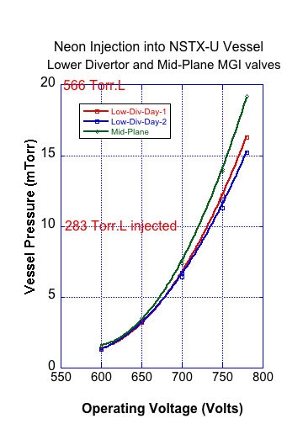
Mid-Plane & Divertor MGI Valves ready to support Plasma Operations
The Pre-operational Test Procedure (PTP) for both MGI valves were completed
Valve power supplies operated at 1kV during PTP
Both valves were calibrated in Nitrogen, Helium and Neon at the full operating pressure
During these tests 400Torr.L of neon was injected into the NSTX-U vessel, this is about twice the amount of neon injection planned for the first MGI experiments to be conducted on NSTX-U

Slide 29
Outline
Recent research highlights
Progress toward milestones
Future milestone discussion

Slide 30
Additional discussion points
PF5 usage for MSE-LIF (for next Monday)
Notable outcomes for FY17
PF1AU recovery plans / long-term strategy

Slide 31
Summary
Many nice physics results from NSTX-U (CHERS, MHD, EP, …) despite limited run time
Research milestones partially completed, but need to revisit and complete milestones requiring higher I_{P}
  Propose that most research milestones shift by ~1 fiscal year
Will prioritize diagnostics and XPs to maximize contributions to FY17 JRT

Slide 32
Backup

Slide 33
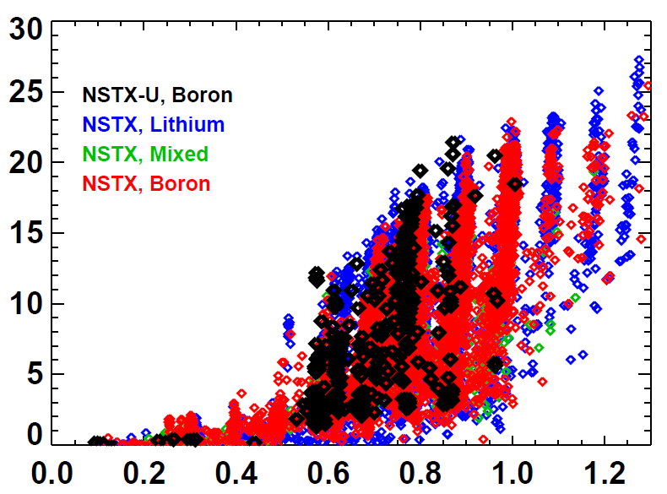
NSTX-U has matched NSTX highest flat-top pressures for plasma currents up to 0.9MA
NSTX-U, Boronized
NSTX, Lithium
NSTX, Mixed
NSTX, Boronized
Volume Average Pressure [kPa]
Plasma Current [MA]
Next-step goal: I_{P} → 1.1 – 1.3MA

Slide 34
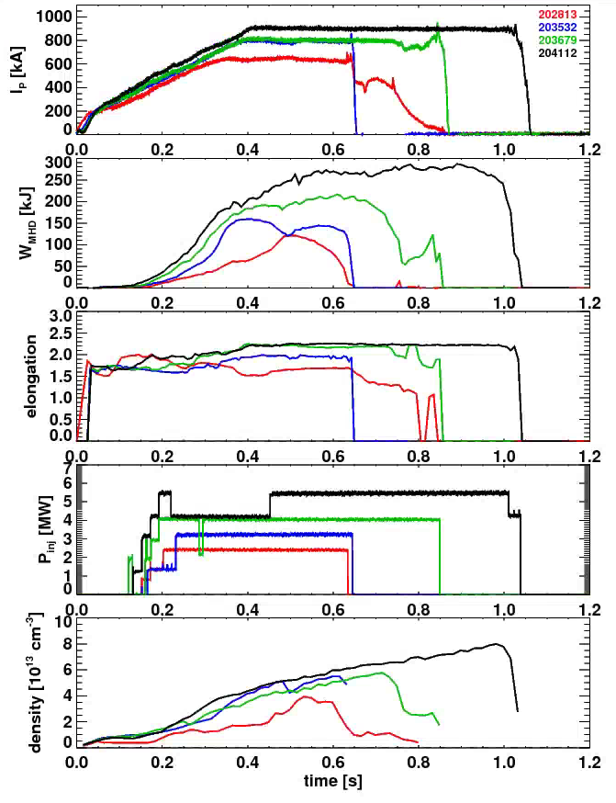
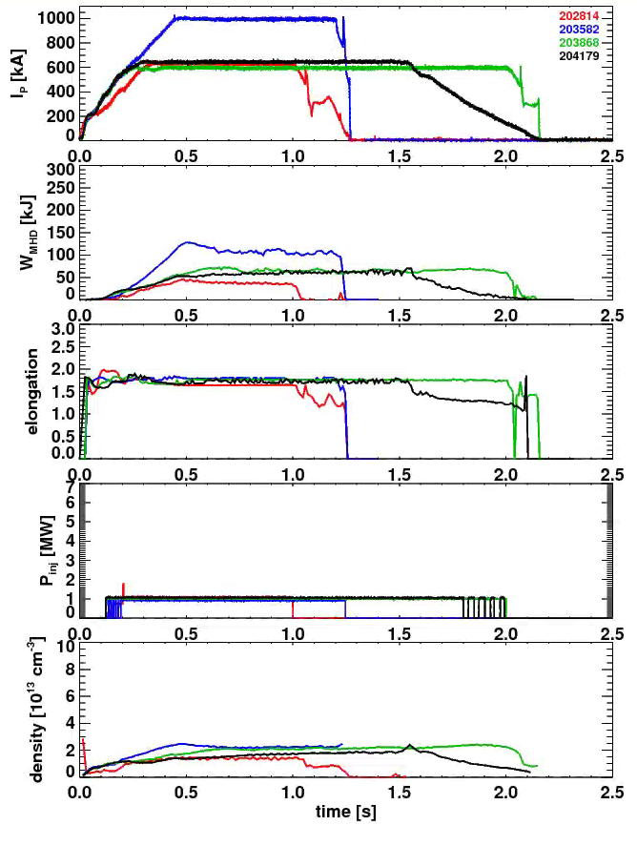
Substantial Progress in Developing L- and H-Mode Scenarios
H-Mode Development
L-Mode Development
First H-Mode
“Best” Shots From
January
February
March
April
NSTX Longest Shot

Slide 35
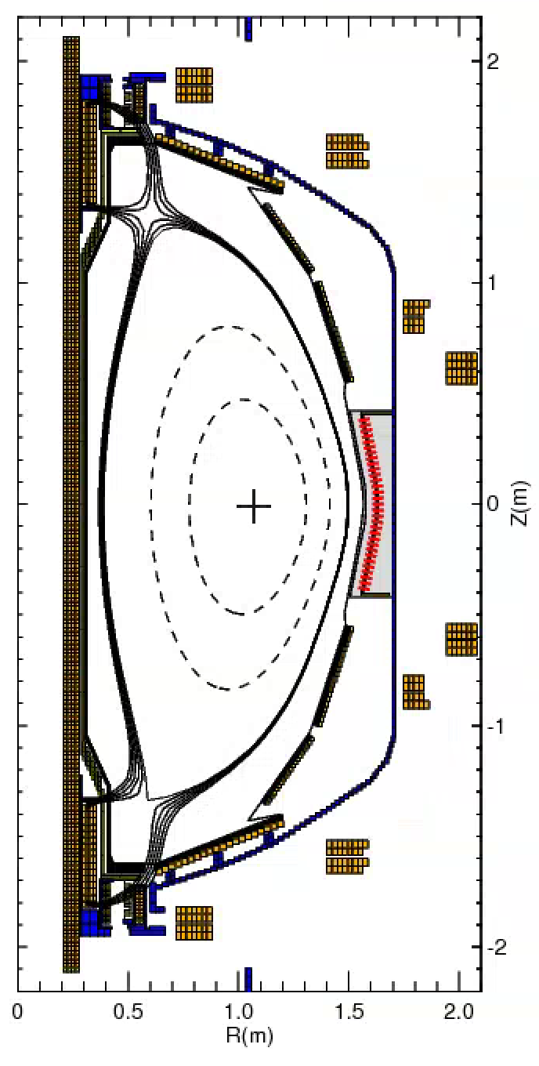
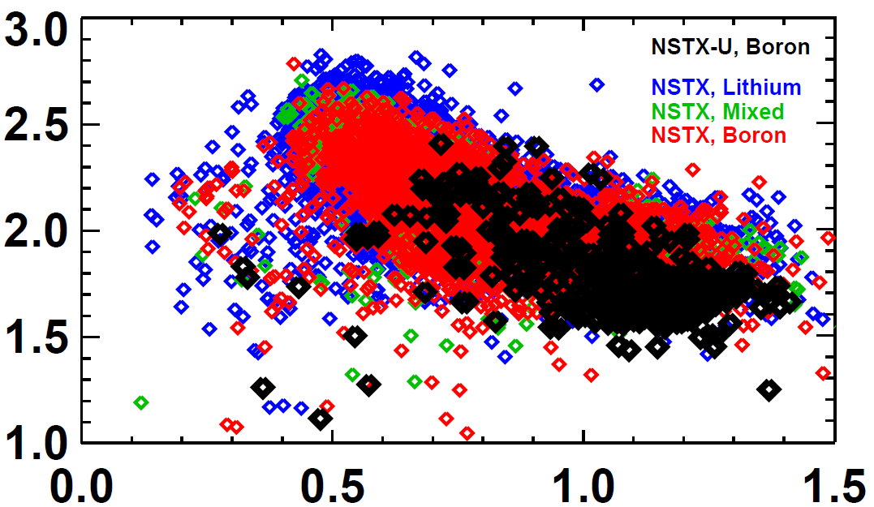
Shape and Vertical Position Control Are In Good Position to Support the Future Experiments
rtEFIT/ISOFLUX control established for the plasma radius, vertical position, X-points.
  NSTX didn’t routinely do closed loop X-point control.
  Now multi-threaded rtEFIT with greater capabilities
New vertical control sensors & algorithms -> matching the NSTX elongation for the same l_{i}, but at higher A.
NSTX-U, Boronized
NSTX, Lithium
NSTX, Mixed
NSTX, Boronized
Elongation
Internal Inductance

Slide 36
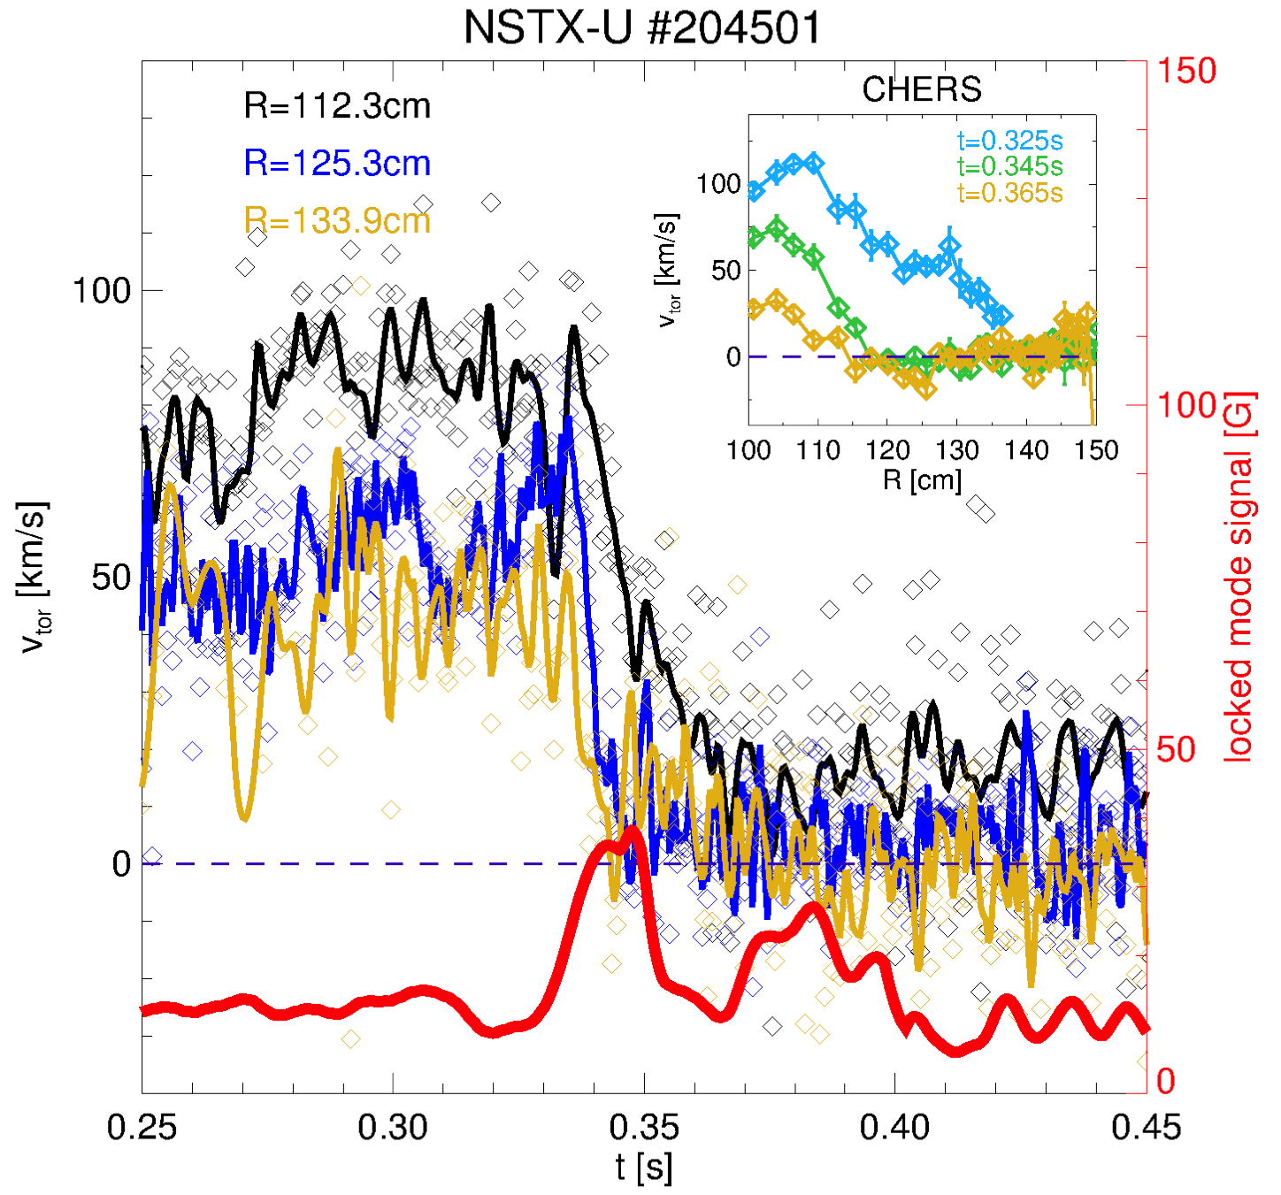
Mode locking and associated fast dynamic clearly observed on RTV data
L-mode
P_{NB}~1.1MW
Mode grows after t~0.33s, then locks over 10ms
First, fast response observed outside mid-radius
  Then propagates to the core
CHERS provides full profiles pre/post locking (inset)

Slide 37
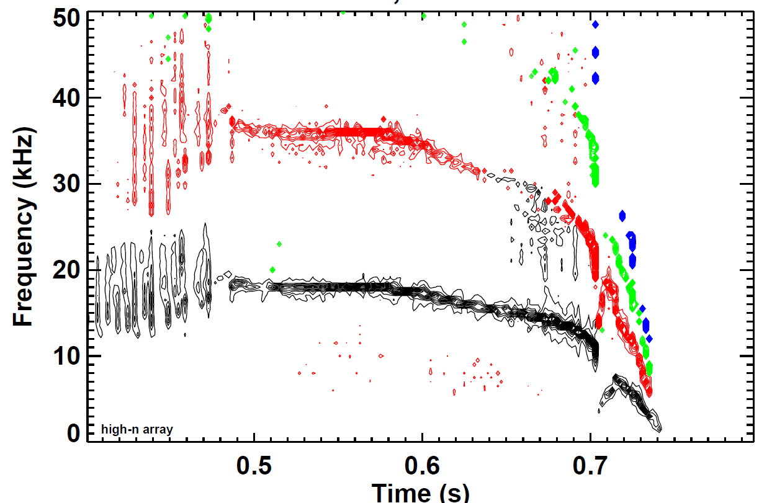
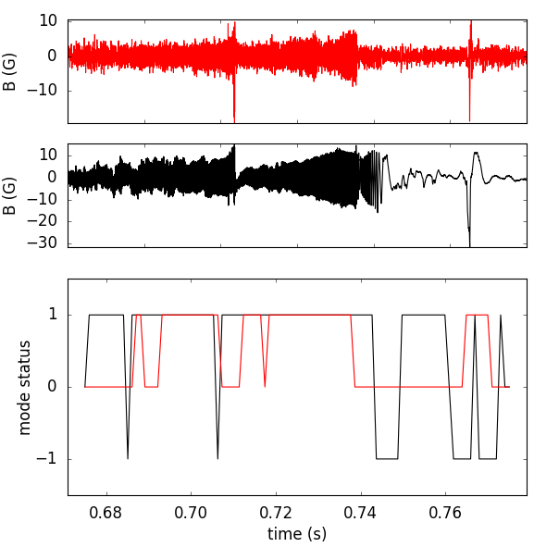
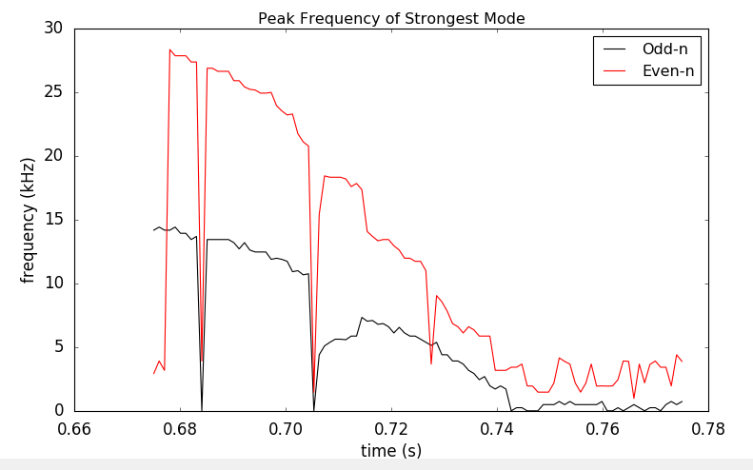
      Essential step for DECAF analysis of general tokamak data: Identification of rotating MHD (e.g. NTMs)
Magnetic spectrogram of rotating MHD in NSTX-U
  Apply FFT to determine mode frequency, bandwidth evolution
  Determine bifurcation, mode locking
NSTX-U
204202
J. Riquezes (U. Michigan – SULI student)
Even-n magnetic signal
Odd-n magnetic signal
n = 1 mode frequency vs. time
(new code)
DECAF mode status
1 = Mode present
0 = No mode
-1 = Mode locked

Slide 38
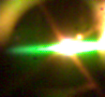
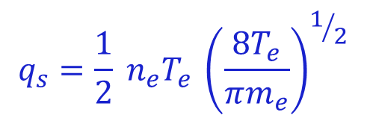
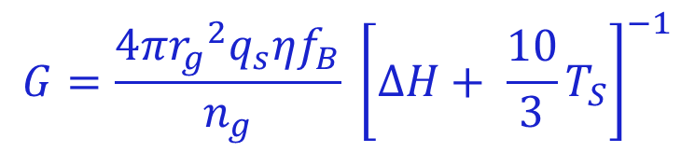
Neutral Gas Shielding (NGS) Model benchmarked on DIII-D
600 μm
600 μm
600 μm
600 μm
Neutral Ablatant Cloud
Ionized Material
Solid Granule
magnetic field
Li granule injected into DIII-D
Ablation Rate of the injected granule :
$$G=\frac{4π{r_{g}}^{2}q_{s}ηf_{B}}{n_{g}} {\left[∆H+ {\frac{10}{3}T}_{S}\right]}^{−1}$$
η : Cloud Shielding Parameter
f_{B} : Field directed heating anisotropy
ΔH: Sublimation Energy
T_{S} : Granule Surface Temperature
$$q_{s}=\frac{1}{2} {n_{e}^{}T}_{e }{\left(\frac{8T_{e}}{πm_{e}}\right)}^{1/2}$$
Adapted from Parks et al. Nucl. Fusion 34 (1994) & Kocsis et al. PPCF 41 (1999)

