Slide 1

NSTX-U Research
FY2017 Q3 Quarterly Review
J. Menard, S. Kaye, S. Gerhardt - PPPL
For the NSTX-U Research Team
August 21, 2017
FES, PSO, and PPPL

Slide 2
NSTX-U Research Overview
Research Contributions to Recovery
FY2017 Milestone Progress
Additional Research Highlights
Collaboration Status and Plans

Slide 3
NSTX-U researchers actively engaged in Recovery efforts
Aided Extent of Condition reviews:
  Aided in System Design Description (SDD) formulation, edits
  Design Validation and Verification Reviews (DVVRs)
    Aided in preparation of presentations, chit submission, chit response
New PFC requirements working group (next slide)
  Extent of Condition review process identified PFC power handling issues that must be addressed
    Narrower SOL width not incorporated in GRD (2009-2012)
    Increased halo peaking on IBDH → T-bar design insufficient
  Extensive equilibrium & heat-flux scans performed, more to come
Topical Science Group contributions:
  Re-assessed scenario needs: first 2yrs of ops + 5/7 year plan
    Magnetic balance and δ variations influence PFC design considerations
  Assessed impact of polar region mods on research plans

Slide 4
New Working Group formed for NSTX-U PFC performance and monitoring requirements
Leader / deputy:
  Matt Reinke (ORNL) / Mike Mardenfeld (PPPL engineering)
Working Group charges: (click here for more info)
  Define which (additional) parameters need to be specified in an updated requirements document for the NSTX-U PFCs
  Facilitate generation of updated requirements utilizing:
    Available reduced models, empirical scalings, boundary simulations
    Ultimately, a validated model for specifying heat loads to all plasma facing components for arbitrary NSTX-U scenarios
  In preparation for operations, develop:
    Instrumentation plan for intra and inter-shot PFC monitoring
    A reduced model for heat loading for pre-shot planning
    Guidance on how to best integrate monitoring with operations
    Control, diagnostic requirements for real-time heat-flux control
  Work w/engineers/analysts to develop/implement requirements

Slide 5

Use Conservative Approach: Assume Narrow λ_{q}
Three scalings of heat flux width, λ_{q}, with eng. parameters
Heuristic Drift Scaling [Eich, PRL 2011]: (7), (9-10) results in $λ_{q} \sim B_{T}^{−7/8}q_{cyl}^{9/8}$
MAST scaling [Thornton, PPCF 2014]: $λ_{q}\left[mm\right]=1.84\left(±0.48\right)B_{pol,omp}^{−0.68(±0.14)}P_{SOL}^{0.18(±0.07)}$
Eich Scaling [Eich, NF 2013]: $λ_{q}\left[mm\right]=1.35{ε^{0.42}R}_{geo}^{0.04}B_{pol,omp}^{−0.92}P_{SOL}^{−0.02}$
1.95 [mm]
4.09 [mm]
2.96 [mm]
2 MA, 1 T, 10 MW
Scenario
PFC Requirements developed assuming Heuristic Drift Scaling
PFC requirements assume 30% radiated power fraction based on best-fits to scalings (small data set)

Slide 6
NSTX-U Research Overview
Research Contributions to Recovery
FY2017 Milestone Progress
Additional Research Highlights
Collaboration Status and Plans

Slide 7
FY2017 NSTX-U Milestones
JRT-2017: FES Joint Research Target (led by DIII-D)
  Conduct research to examine the effect of configuration on operating space for dissipative divertors
Research Milestones
  R(17-1): Simulation-based projection of divertor heat flux footprint
  R(17-2): Advanced divertor operating scenario modeling for NSTX-U
  R(17-3): Identify, mitigate, and develop correction strategies for intrinsic error field sources in NSTX-U
  R(17-4): Assess high-f Alfvén Eigenmode stability & associated transport
  R(17-5): Analysis & modelling of I_{P} ramp-up dynamics in NSTX/NSTX-U
Diagnostic Milestone
  D(17-1): Complete installation and preliminary commissioning of the pulse burst laser system

Slide 8
FY2017 NSTX-U Milestones
JRT-2017: FES Joint Research Target (led by DIII-D)
  Conduct research to examine the effect of configuration on operating space for dissipative divertors
Research Milestones
  R(17-1): Simulation-based projection of divertor heat flux footprint
  R(17-2): Advanced divertor operating scenario modeling for NSTX-U
  R(17-3): Identify, mitigate, and develop correction strategies for intrinsic error field sources in NSTX-U
  R(17-4): Assess high-f Alfvén Eigenmode stability & associated transport
  R(17-5): Analysis & modelling of I_{P} ramp-up dynamics in NSTX/NSTX-U
Diagnostic Milestone
  D(17-1): Complete installation and preliminary commissioning of the pulse burst laser system → COMPLETED
TODAY

Slide 9
R17-3: Identify, mitigate, and develop correction strategies for intrinsic error fields
Goals: Complete characterization of coil positions, shapes, model plasma response, provide guidance on TF bundle re-alignment requirements
Tools: IPEC, M3D-C1, metrology (FARO arm, laser tracking)
Impact: Minimize intrinsic error fields, access high performance more rapidly during next ops
  Critical to highest performance
  Responsive to FY2016 PEMP concern

Slide 10
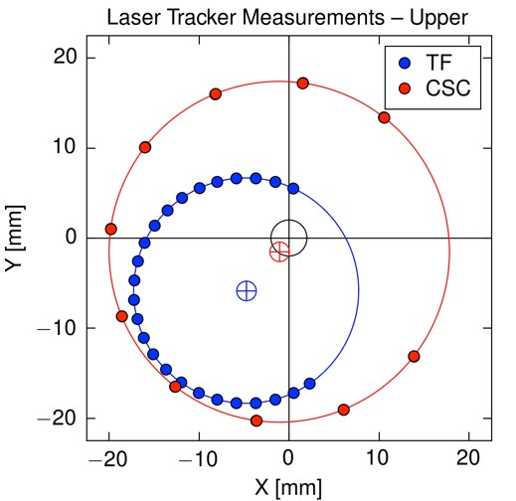
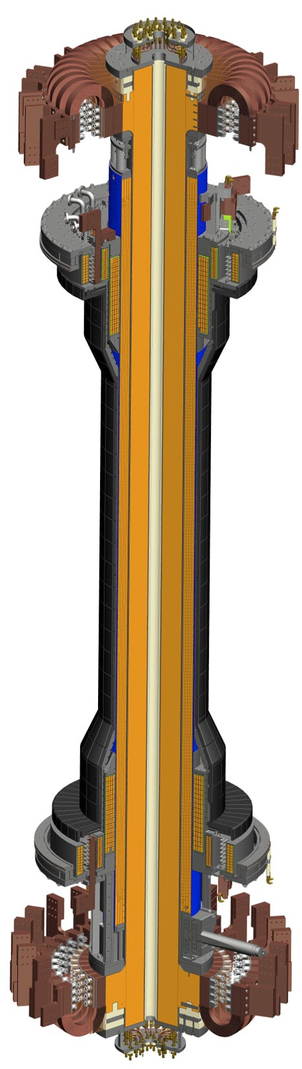
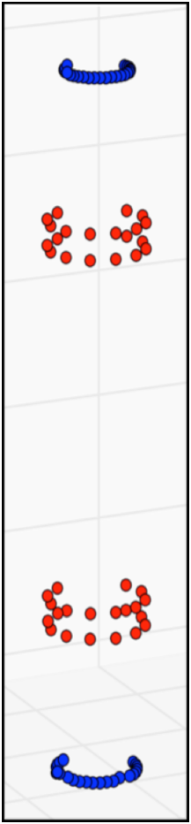
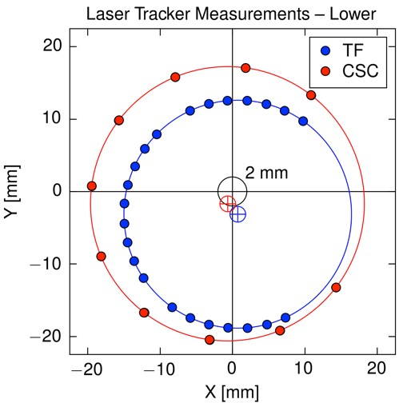
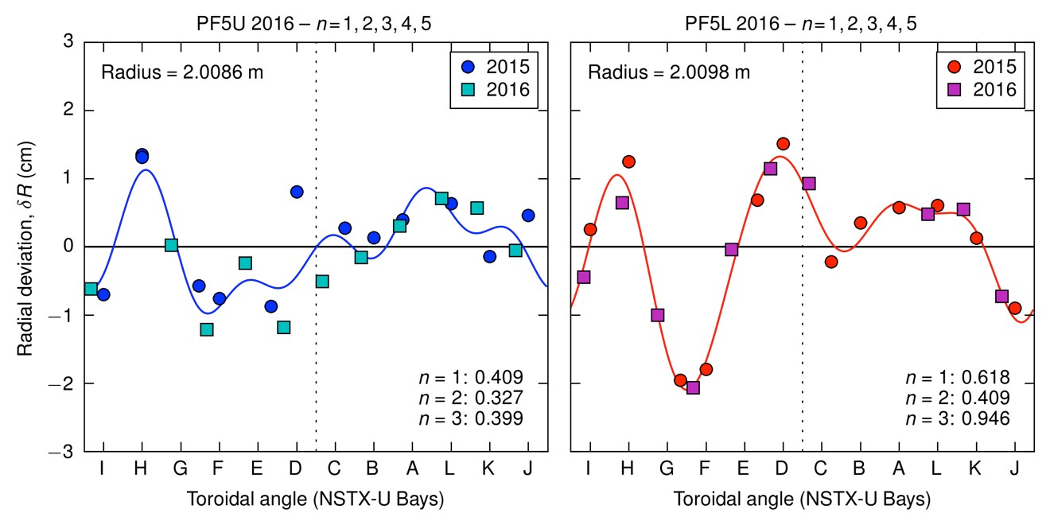
Coil metrology conducted on
TF rod, center-stack casing (CSC), and PF5 coil
Combine metrology techniques: ruler, ROMER arm, laser tracker
PF5 n = 1 amplitude and phase:
  δR ~ 6 mm at ϕ = 16°
TF rod shift and tilt:
  Shift = 4.9 mm at ϕ = 246°
  Tilt = 1.2 mrad at ϕ = 206° (6 mm)

Slide 11
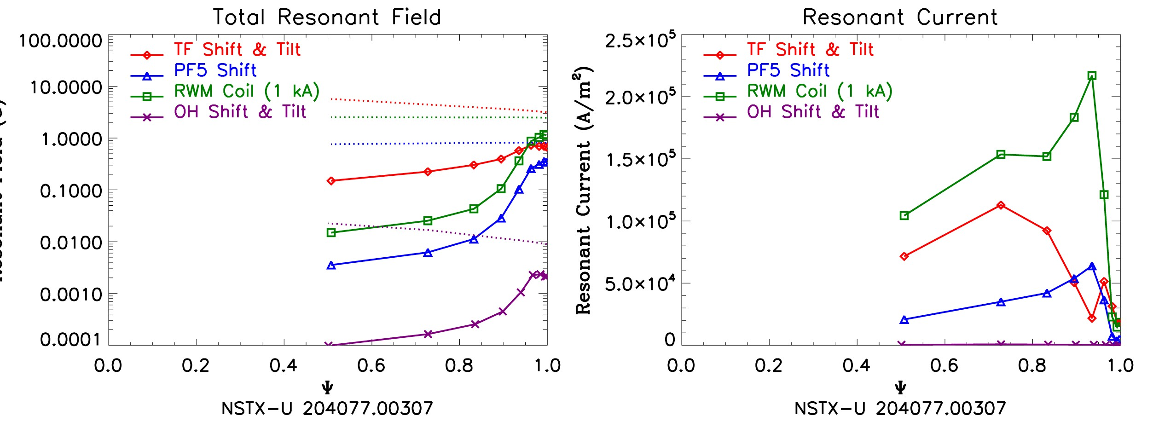
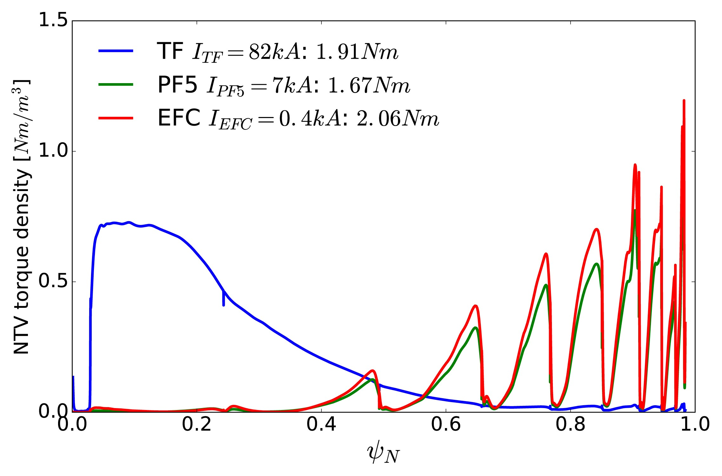
Modeling results → need to impose 2 mm tolerance for TF alignment to mitigate TF error field effects
Metrology → coil shape models
  Feed to IPEC & M3D-C1
Resonant fields and currents:
  TF error field is dominant
  TF EF phase not constant
  Difficult to correct
Neoclassical toroidal viscosity:
– RWM coils are poorly matched to TF NTV spectrum
Model H-mode
142301
Tolerance of 2 mm:
  Resonant fields below locking threshold without EFC
  Reduces TF NTV by 10×

Slide 12
R(17-3) milestone progress to-date
Error field assessment report:
  Report issued to Recovery Project on 30 April
  Recommend TF alignment tolerance of ≤ 2 mm (×3 reduction)
Additional metrology and magnetic measurements:
  Ex-vessel metrology of PF5 → coil plane w.r.t. ROMER arm
    Completed last week
  Define the vertical axis to which the TF should be aligned
  In-vessel B-measurements during outer PF validation testing
Reinstallation and realignment planning:
  Shim / post-machine CS casing to ensure TF bundle centered
  Repeat CSC / TF metrology to verify alignment
  Design flexibility into end flanges to facilitate CS alignment (?)
  Use ROMER arm to quantify CS alignment upon installation

Slide 13
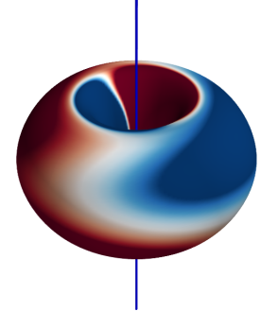
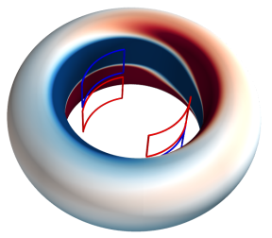
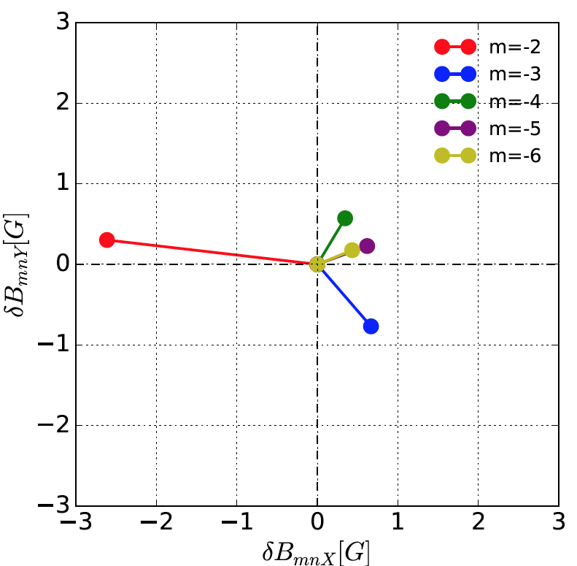
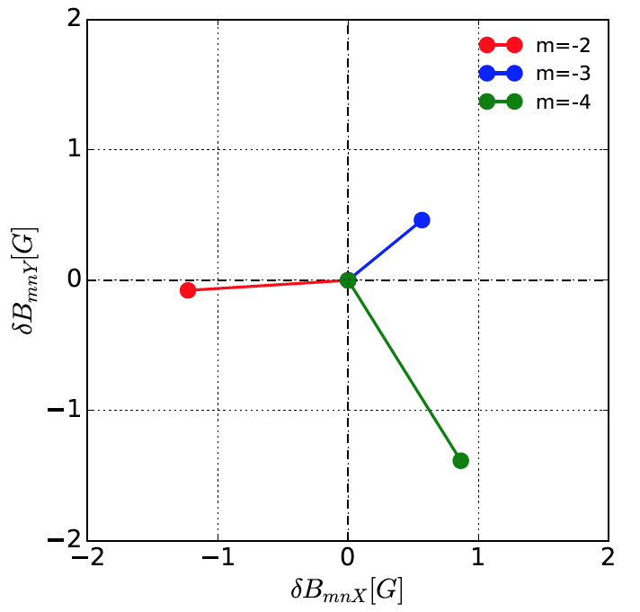
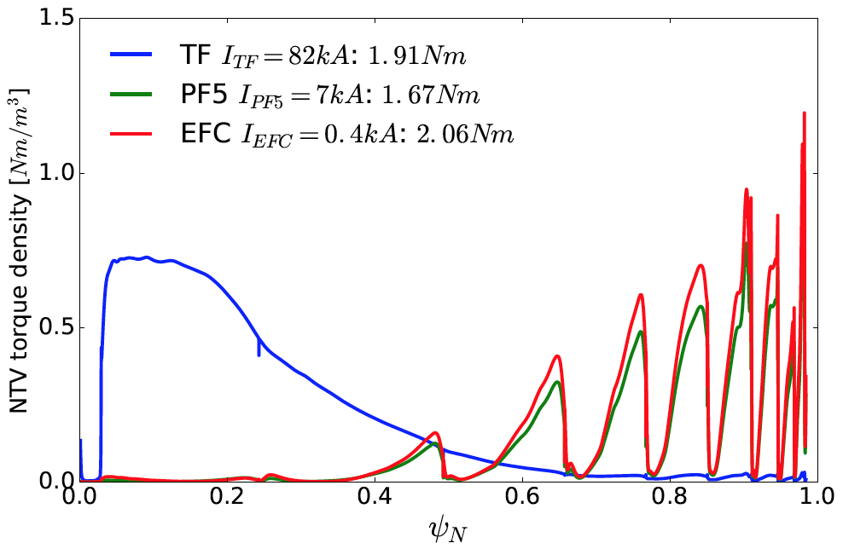
NSTX-U TF error field (EF) presents a challenge to single-mode approaches to ITER EF correction
NSTX-U TF EF effects vary significantly depending on equilibrium evolution
Collaboration in COMPASS confirms multi-modes characteristics of HFS EF
Also, HFS non-resonant field is not easily correctable by LFS control coils
HFS n=1 resonant fields driving islands (IPEC)
HFS non-resonant field driving NTV torque
NSTX-U high-β modeling
NSTX-U (#204077)
COMPASS (#11832)
Progress and remaining challenges on ITER error field correction for ITER
are reviewed in J.-K. Park et al., 2017 ITPA MHD MDC-19 Report

Slide 14
Error Field modeling informing PFC design
Error fields may significantly affect heat flux to divertor PFCs
  Change incidence angle of B-field
  Cause radial and toroidal variations in the heat flux due to magnetic lobes
Effect of error fields on magnetic pitch angle calculated with M3D-C1 for high-performance model NSTX-U equilibria
Largest known error field in NSTX-U (TF error) would cause pitch angle changes of up to 0.5°
  This is significant, but likely not large enough to cause concern after improved TF realignment
Pitch Angle Change
Vertical Divertor
Toroidal Angle
Radians
Horizontal Divertor
Toroidal Angle
Radians
N. Ferraro

Slide 15
R17-4: Assess high-frequency Alfvén Eigenmode stability, associated transport
Goals: (1) Extend simulations of NSTX-U CAE/GAE to high heating power, plasma current, toroidal field, (2) Further validate simulations, (3) initial assessment of Ion Cyclotron Emission (ICE) observations from NSTX-U
Tools: HYM code, DIII-D National Campaign XPs
Impact: Project fast-ion, thermal electron transport from CAE/GAE, ICE for inferring ITER f_{fast}(v)
  Builds on new physics discovered during FY16 NSTX-U run campaign
Related Activities:
  Analyzing high-k data for evidence of CAE coupling to kinetic Alvfén waves
  High-f AE experiment on DIII-D (planned July 2017)
    Some data from single source, B_{T} ramp shots obtained in piggyback
    Useful data about CAE stability vs P_{NB}, V_{inj}, R_{tan}, n_{e}, B_{T}

Slide 16
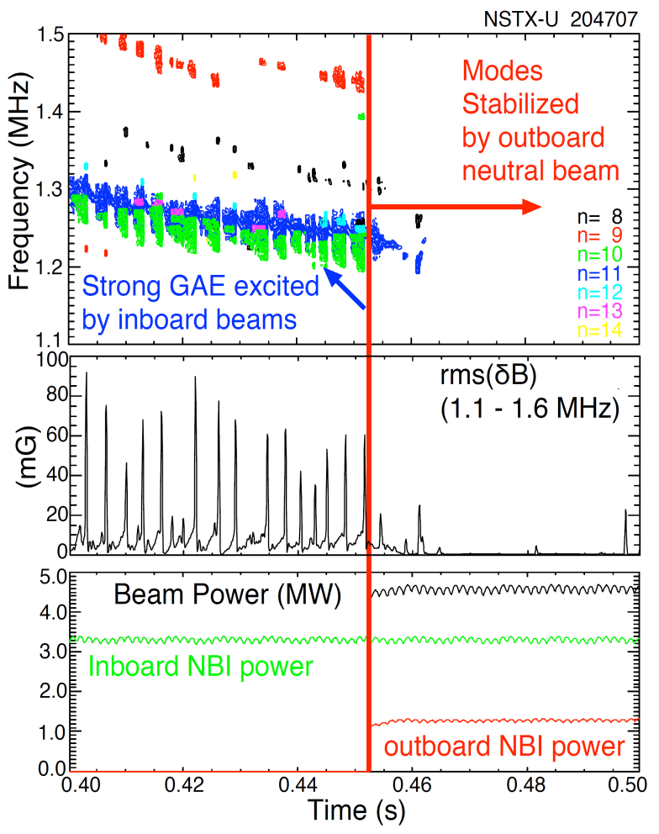
NSTX-U: Tangential 2nd neutral beam suppresses Global Alfven Eigenmode (GAE) – consistent with simulation
Published in PRL in June 2017 - E. Fredrickson et al.
HYM code simulation of #204707, n=10
|δB_{n} |²
t=0.44s
t=0.47s
t ω_{ci}
HYM code: growth of n=10 counter-GAE from 1st NBI
HYM: suppression of n=10 counter-GAE by 2nd NBI
Most unstable n-number, mode ω consistent with HYM

Slide 17
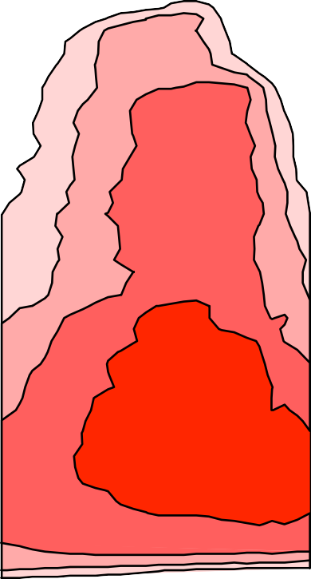
Analytic theory providing insight into HYM simulations of GAE stability
Fast ions can be stabilizing/ destabilizing depending:
NSTX-U 204707A02
100
Stable : Unstable:
a) 0.44s
Resonant
b) 0.47s
0 ≤ k⊥ρ⊥ ≤ 1.9
1.9 ≤ k⊥ρ⊥ ≤ 4
Resonant
Energy (keV)
2
2
Resonant outboard beam ions with pitch > 0.9 have small ρ⊥, are stabilizing by this theory.
Estimates based on dispersion relation and resonant condition suggest that 65keV outboard beam ions might be just marginal to reach resonant condition.
NSTX (low field) parameter regime might be very different.
50
5
10
5
10
k⊥ρ>1.9
k⊥ρ>1.9
20
20
k ρ<1.9
k ρ<1.9
⊥
⊥
0
0.0 0.5 1.0 0.0 0.5
Pitch (V||/V)
(Gorelenkov, NF 2003)
1.0

Slide 18
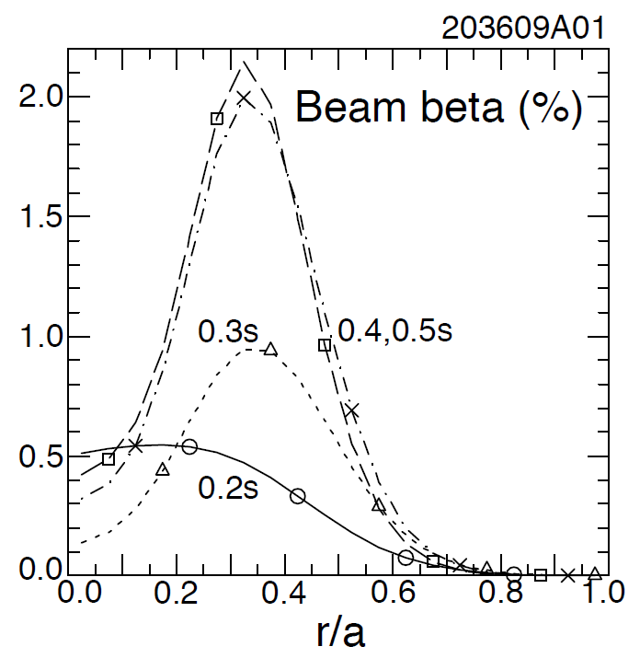
NSTX-U: Off-axis co-NBI destabilizes counter-propagating Toroidal Alfvén Eigenmodes (TAEs)
Hollow fast ion profile reduces stabilization of counter-propagating TAEs
H.V. Wong, H. Berk, Phys. Lett. A 251 (1999) 126.
Preliminary analysis reveals important role of large orbit width, FLR effects
TRANSP: as current builds up, fast-ion beta profile predicted to become hollow
  1st evidence of off-axis NBI in NSTX-U
Co-TAEs are stabilized, but cntr-TAEs become unstable with only 1MW NBI

Slide 19
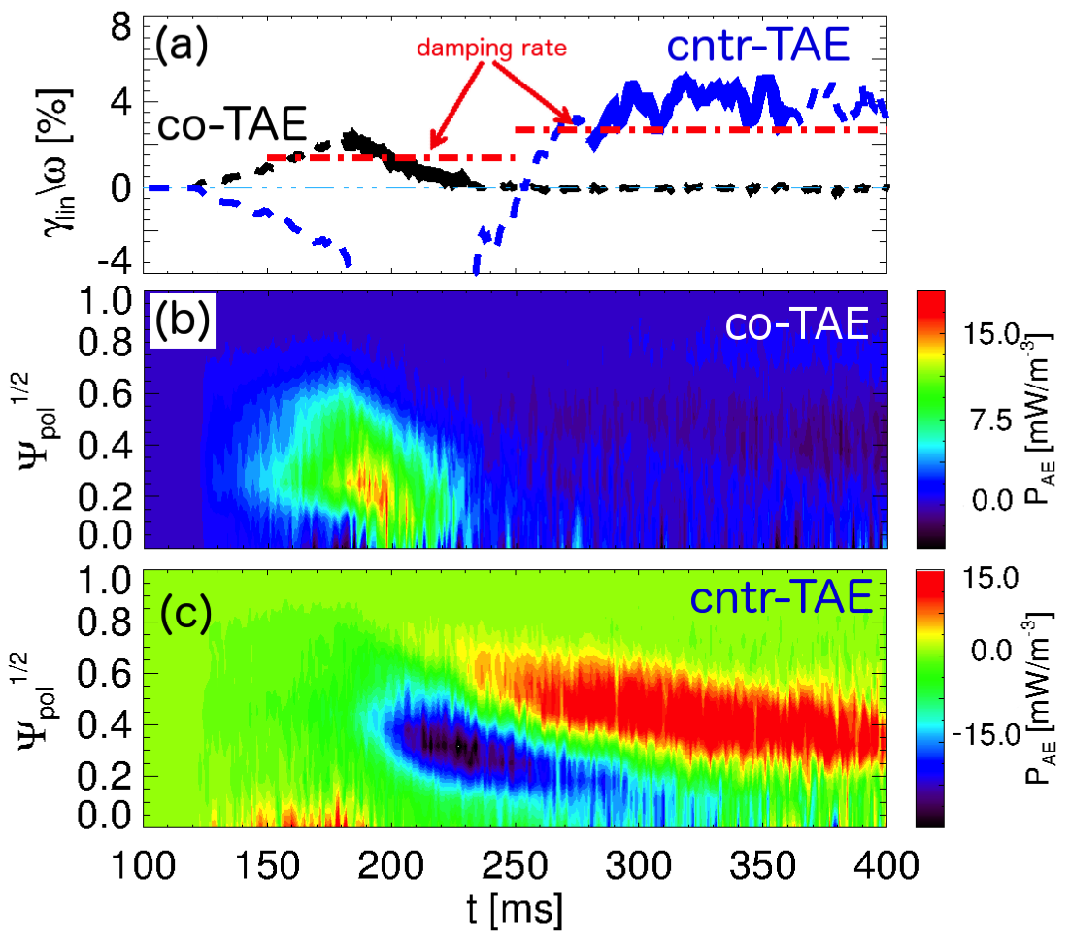
Linear TAE stability vs time from TRANSP + kick model is consistent with NSTX-U experiments
Compute power from fast ions to mode
  Infer growth rate
  Using damping rate from NOVA-K
Timing of most unstable |n|=1 TAE modes compares well with experiments
Stability related to gradients in both radius & energy
  Not the usual “universal drive”
[Podestà, PRL 2017 (submitted)]
[Podestà, PPCF 2017]
Flexibility of TRANSP + kick model approach enables scenario development for realistic geometry
  Example: ~0.5MW “blips” with 1st NBI predicted to stabilize cntr-TAEs

Slide 20
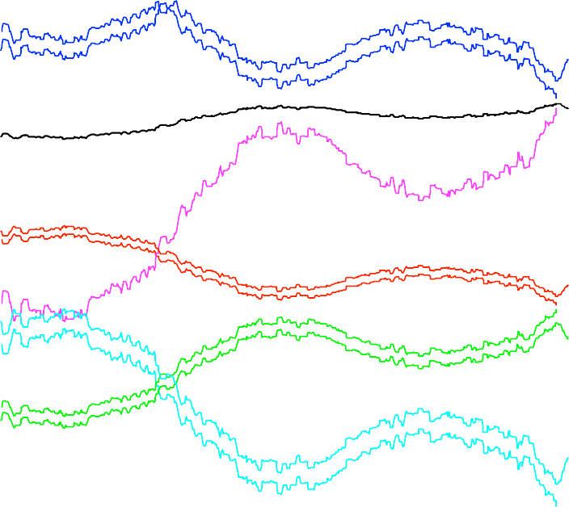
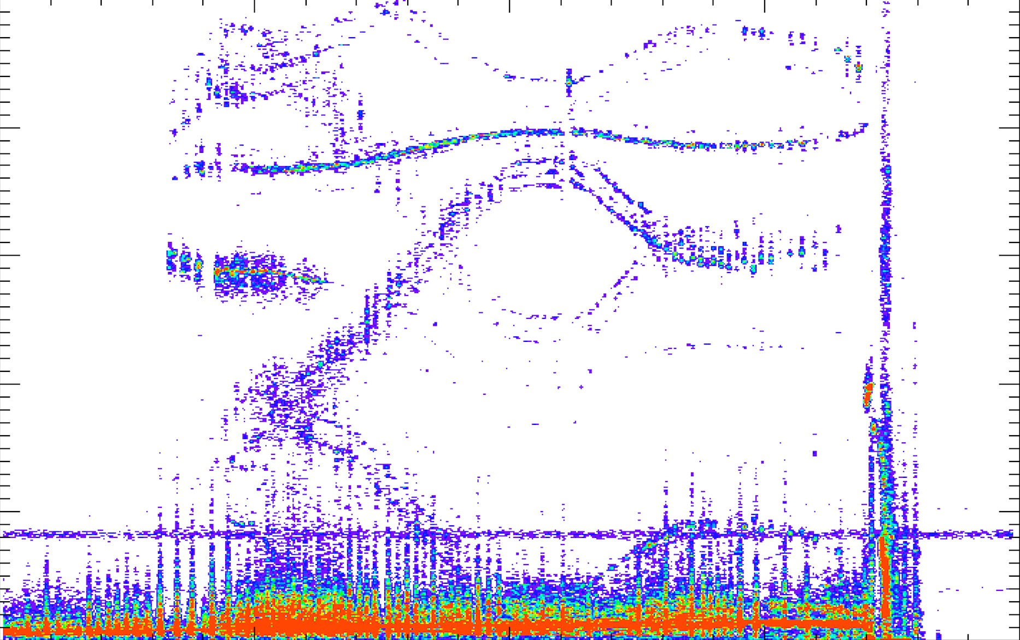
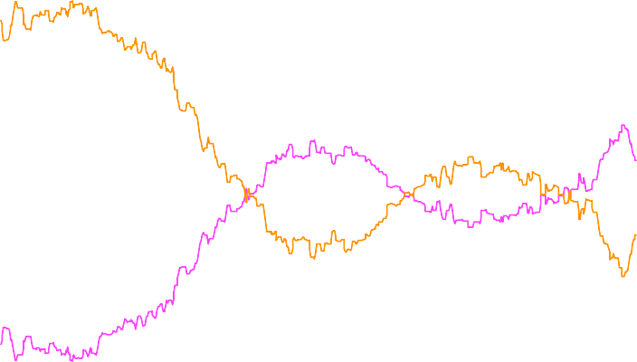
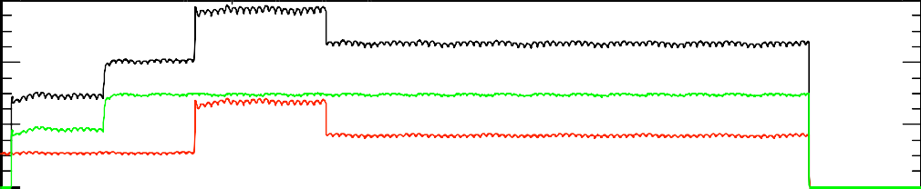
Investigating newly observed Ion Cyclotron Emission (ICE) from NSTX-U discharges
Spatially coherent → argues for mode
Bursty rather than CW → unstable mode - what defines mode f ?
Doesn’t follow Alfvénic scaling - not Alfvén eigenmode?
Like conventional ICE, higher harmonics largest amplitudes
5.0
NSTX-U 204645
Strongest ICE correlated with source 1C – the most perpendicular source
Amplitude decreases with increasing density
TRANSP runs started to study β_{fast} dependence
Can ICE be correlated with confined fast-ion distribution parameters?
Needs theory support
4
7
Frequency (MHz)
4.0
1
3.0
2
6
5
3
2.0
1.0
0.0
6
4
2
0
0.15
0.20
0.25
Time (s)
0.30
0.35

Slide 21
NSTX-U Research Overview
Research Contributions to Recovery
FY2017 Milestone Progress
Additional Research Highlights
Collaboration Status and Plans

Slide 22
Leading halo current propagation studies
C. Myers (PPPL)
The concern for ITER:
  Concern is for asymmetric halo currents during unmitigated disruptions
  Forces are dynamically amplified if N_{rot} > 2-3
  Critical mechanical resonances in the 3-8 Hz range [Schioler FED 2011]
  Overall response is broader (10-20 Hz) [Bachmann FED 2011 & Lehnen]
Could halo current forces be dynamically amplified in ITER?
  Could the halo currents rotate at frequencies below 20 Hz?
  Could the rotation last long enough to complete 2-3 rotations?
Substantial halo current rotation observed in a number of devices:
  JET Noll 1996, Riccardo 2004 & 2009, Gerasimov 2014 & 2015
  C-Mod Granetz et al. Nucl. Fusion 36, 545 (1996)
  DIII-D Evans et al. J. Nucl. Mater. 241-243, 606 (1997)
  AUG Pautasso et al. Nucl. Fusion 51, 043010 (2011)
  NSTX Gerhardt Nucl. Fusion 53, 023005 (2013)

Slide 23
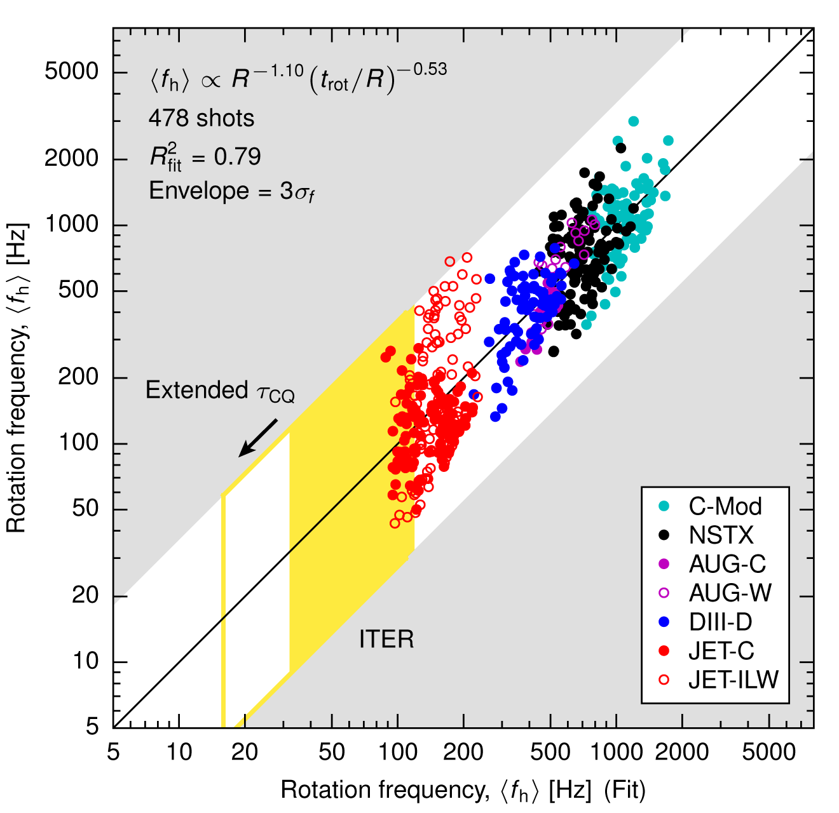
Simple rotation frequency scaling: ⟨f_{h}⟩ ~ 1/R
Cannot rule out dynamic force amplification in ITER
Key quantities:
  N_{rot} = number of rotations
  t_{rot} = rotation duration
  ⟨f_{h}⟩ = N_{rot} / t_{rot} = rotation frequency
Carry out regression using two parameters → R, t_{rot}
Additional parameters do not improve regression (e.g., I_{p}, B_{T})
  ⟨f_{h}⟩ ~ 1/R ~ constant ⟨v_{h}⟩
ITER projection:
  Rotation at ⟨f_{h}⟩ < 20 Hz probable
  Rotation duration analysis → Cannot rule out dynamic force amplification in ITER
C. E. Myers, et al. (Manuscript submitted to Nuclear Fusion)

Slide 24
Developing high-k synthetic diagnostics for quantitative comparison of ETG plasma turbulence spectrum
|δn_{e}|²(f)
P [a.u.] ∝ |δn_{e}|²(f)
Recovered spectral peak, spectral width.
NOTE: a quantitative comparison is not yet available: correct experimental units determining the amplitude are not included in Synthetic diagnostic.
turbulent
spectral
peak
Synthetic
diagnostic
Experiment
k-filter
turbulent
spectral
peak
experimental noise
at f = 0
J. Ruiz Ruiz (MIT)
PhD thesis project

Slide 25
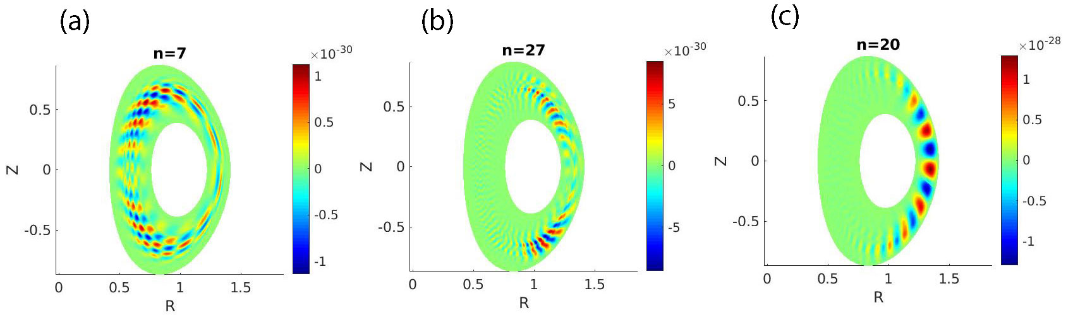
Developing of electromagnetic capabilities in GTS relevant to NSTX / STs
Startsev-Lee EM scheme to include toroidal effects, simulate ion-temperature-gradient (ITG), kinetic ballooning mode (KBM) transition, tearing and micro-tearing modes (MTM) with new electromagnetic version of GTS code (EM-GTS)
Recently extended to enable shaped plasmas like NSTX
ES potential φ in poloidal plane of NSTX
β_{e} = 0.5%
Low-n MTM
β_{e} = 1.6%
High-n MTM
β_{e} = 3.2%
KBM

Slide 26
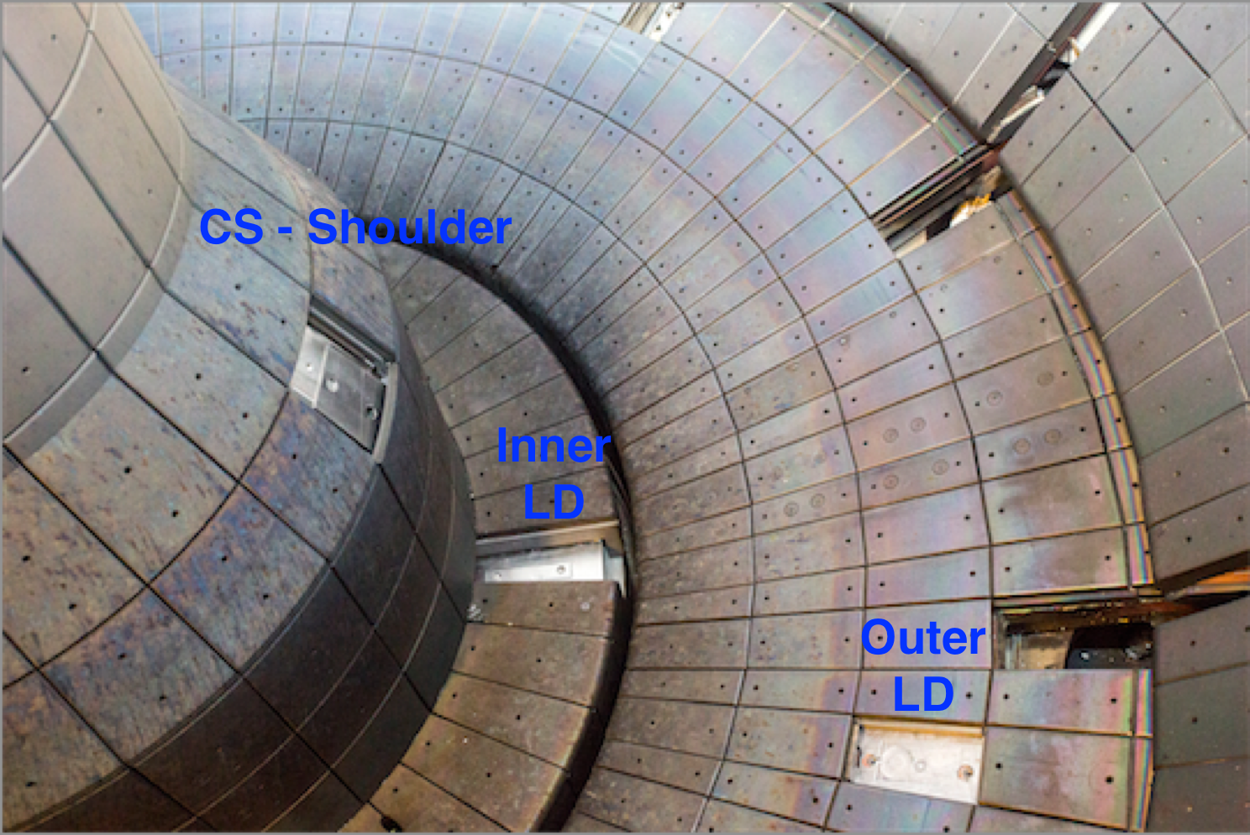
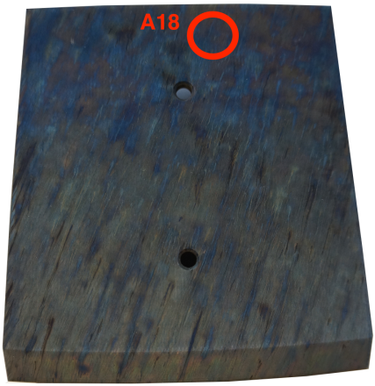
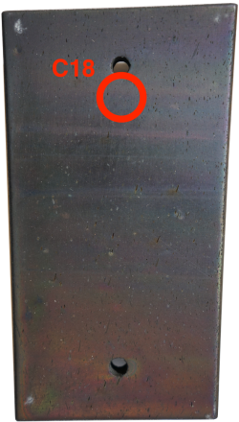
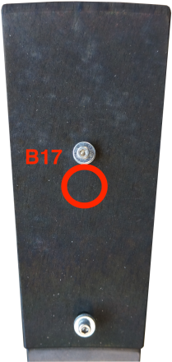
PFC conditioning techniques and their correlation with plasma performance (Allain)
F. Bedoya (U. Illinois) completed his PhD thesis on MAPP analysis of NSTX-U PMI
Also completed NSTX-U PFC post-run analysis
Core C18 – OSP
Core B17 – ILD
Core a18 - ISP

Slide 27
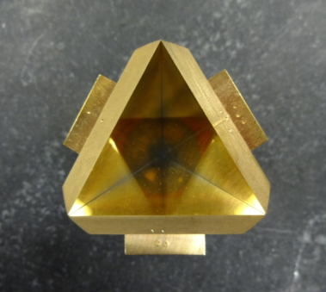
Adaptive filter approach prototyped to provide vibration compensation for FIReTIP*
  Implementation of FIReTIP for real-time density control motivated development of active noise cancellation by digital adaptive filtering
  Use Kalman filter as adaptive method that takes prior system state to predict next state based on state-space model of system
  In-vessel retroreflector for FIReTIP probe beam sensitive to vibrations suggested test of concept with vacuum vessel model
  Model system response determined from “carefully controlled” striking of vacuum vessel with brass hammer
  *Work performed by University of California at Davis doctoral student Evan Scott for thesis entitled “Interferometry and Vibration Compensation on the National Spherical Torus Experiment – Upgrade“

Slide 28
NSTX-U Research Overview
Research Contributions to Recovery
FY2017 Milestone Progress
Additional Research Highlights
Collaboration Status and Plans

Slide 29
NSTX-U / DIII-D Campaign MPs and status
(Process coordinated by S. Kaye)
Boundary Studies (3 days)
  Impurity transport in response to Li aerosol injection (R. Lunsford; FY18)
  Divertor detachment: JRT2017 (V. Soukhanovskii, 6/21)
  Enhancement of divertor radiation in SAS divertor (A. Bortolon; FY18)
Core Studies (4.5 days)
  Collisionality dependence of ion- and electron-scale turbulence in hybrid scenarios with ST-relevant q₉₅ (Y. Ren; 7/10)
  Studying electromagnetic effects on transport in high performance plasmas (W. Guttenfelder; 7/18)
  Impact of resonant vs non-resonant applied 3D fields on n=2 locking (C. Myers, N. Ferraro; 6/22)
  CAE frequency and wavenumber dependence on beam pitch angle and energy (S. Tang – UCLA; 7/11)
  Scaling of SPI penetration in high temperature plasmas (R. Raman – U. Wash; 7/31)
Scenarios and control (evening control session + 0.5 days)
  Feedback control of stored energy and rotation, combined with stable ramp-down control (D. Boyer; 7/11,19)
TODAY

Slide 30
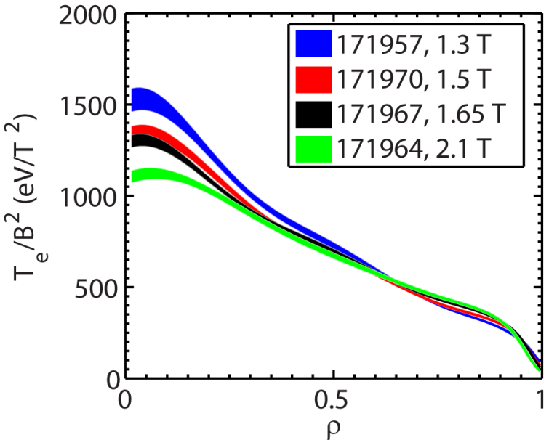
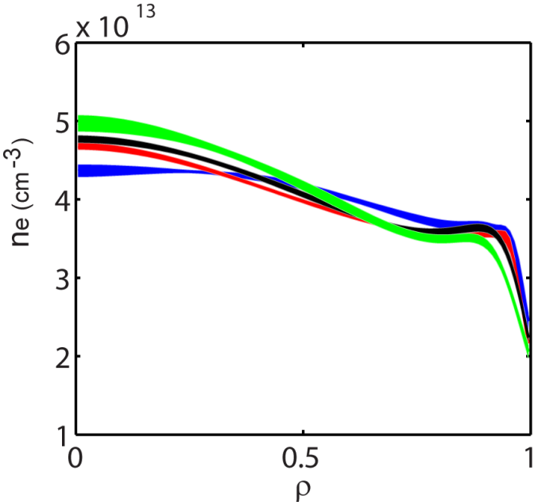
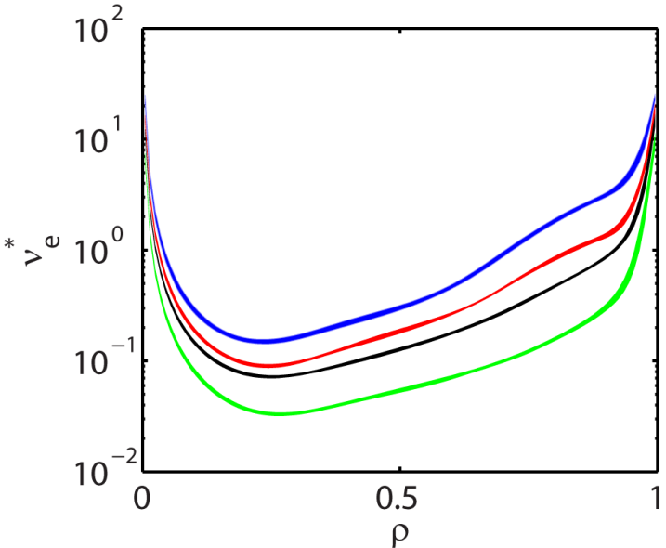
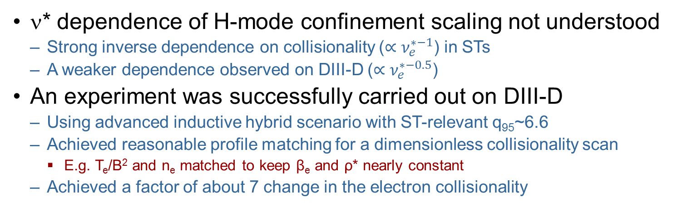
Collisionality Dependence of H-mode Energy Confinement Scaling was Studied in the DIII-D/NSTX-U National Campaign
ν* dependence of H-mode confinement scaling not understood
  Strong inverse dependence on collisionality ($∝ν_{e}^{∗−1}$) in STs
  A weaker dependence observed on DIII-D ($∝ν_{e}^{∗−0.5}$)
An experiment was successfully carried out on DIII-D
  Using advanced inductive hybrid scenario with ST-relevant q₉₅~6.6
  Achieved reasonable profile matching for a dimensionless collisionality scan
    E.g. T_{e}/B² and n_{e} matched to keep β_{e} and ρ* nearly constant
  Achieved a factor of about 7 change in the electron collisionality
ν*_{e}
T_{e}/B²
n_{e}
Profiles averaged from t=3 to 4 s

Slide 31
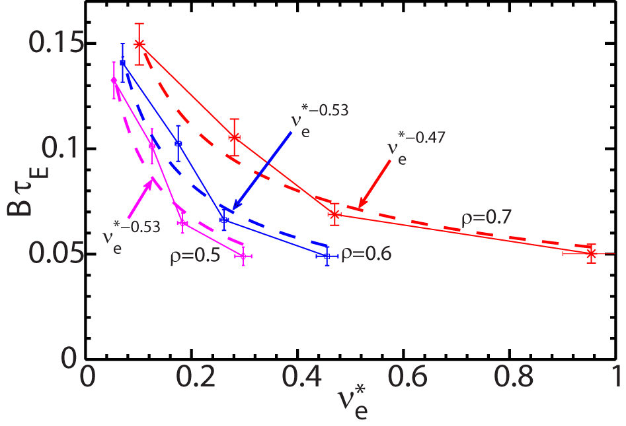
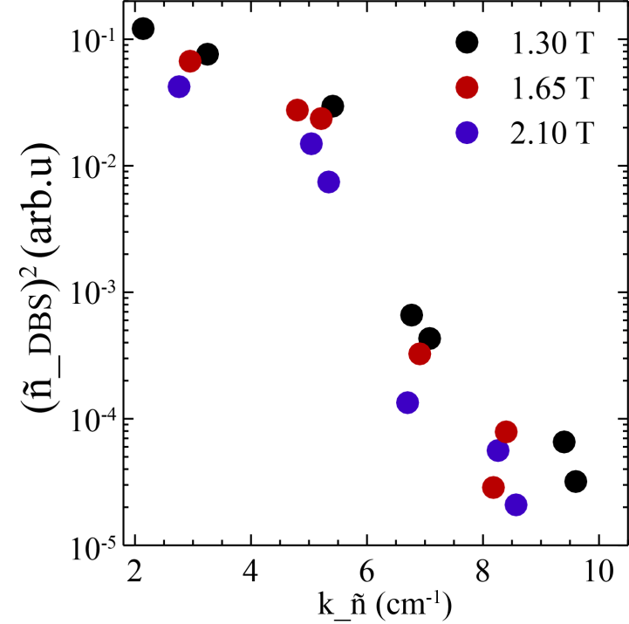
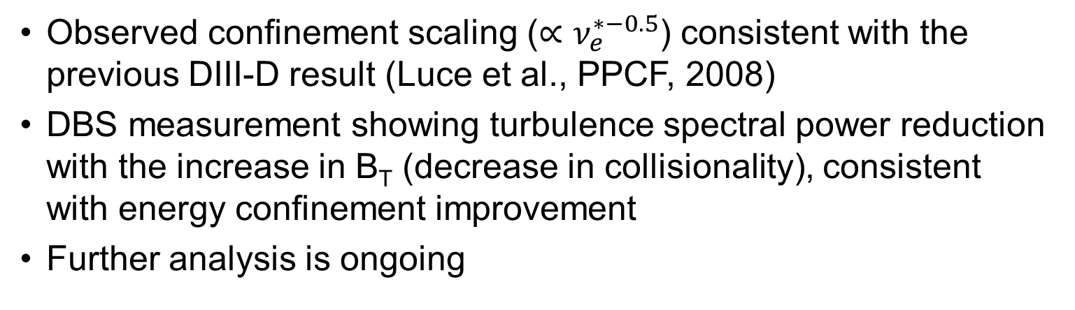
Collisionality Dependence of H-mode Energy Confinement Scaling was Studied in the DIII-D/NSTX-U National Campaign
Observed confinement scaling ($∝ν_{e}^{∗−0.5}$) consistent with the previous DIII-D result (Luce et al., PPCF, 2008)
DBS measurement showing turbulence spectral power reduction with the increase in B_{T} (decrease in collisionality), consistent with energy confinement improvement
Further analysis is ongoing
DBS measurement at ρ~ 0.55-0.65, averaged for t=3.75-4 s

Slide 32
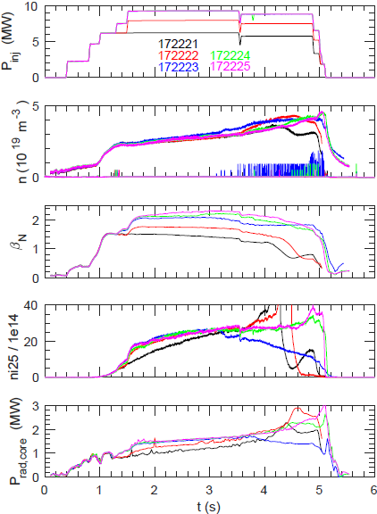


DIII-D “NSTX-U campaign” MP to measure core CPS (~δB) to validate electromagnetic microturbulence effects
EM effects important in spherical tokamak (ST) H-modes and deep core (ρ<0.5) tokamak H-mode
  Increasing β stabilizes ITG, TEM
  Can lead to EM instabilities: MTM, KBM
Obtained β_{N} scan (1.5-2.3)
  Large impurities, performance evolving throughout day
Goal: measure δB using UCLA cross-polarization scattering (CPS) to validate GK predictions (plans to install CPS on NSTX-U)
QH-modes

Slide 33
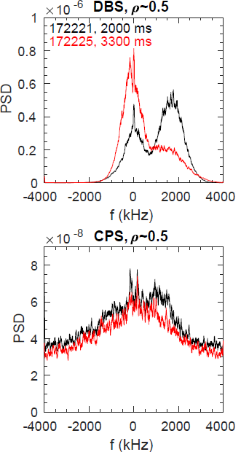
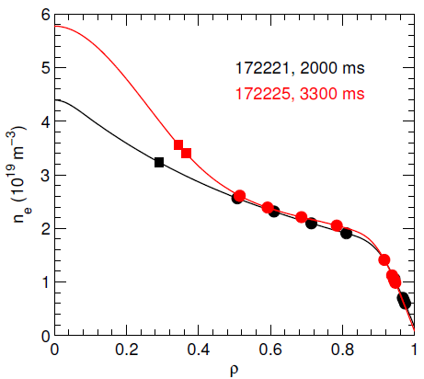


Initial results: core (ρ~0.5) CPS measurement distinct from DBS, both change with increasing power
Broad range of locations and wavenumbers:
  CPS (k_{r}𝛒_{s}=1.2–6), DBS (k_{𝛉}𝛒_{s}= 0.3–3)
Will require extensive ray tracing + synthetic diagnostics for comparison & gyrokinetic validation
β_{N}=1.5
β_{N}=2.3
(higher T_{i}/T_{e}, n_{beam}/n_{e}, …)
• Simultaneous CPS & DBS
Core W-band DBS
Two of three DBS systems (W- & V-band) on loan from UCLA/NSTX-U

Slide 34
Enhancing NSTX-U / DIII-D collaboration on access to high non-inductive fraction scenarios
Background / Motivation:
  NSTX-U next ops will focus on partial inductive ramp-up and understanding/optimizing early H-mode access
    Provide elevated low-l_{i}, high κ, elevated q_{min}, and access to MHD-stable high I_{P} plasmas for confinement and stability studies
  DIII-D has related interest in physics of how to access advanced (i.e. high-β_{P} non-inductive) scenarios predictably
    NSTX-U / STs interested in non-inductive sustainment and ramp-up
    Follow up on previously performed NI ramp-up experiments on DIII-D
Collaboration focus: Analyze, simulate, control high q_{min} scenarios – improve access, performance
  J. Ferron (GA), C. Holcomb (LLNL), E. Schuster (Lehigh), …
  Grierson / Poli (TRANSP), Boyer (control), Diallo (pedestal), Guttenfelder (transport), Park, Wang, Menard (MHD stability)

Slide 35
MAST-U areas of collaborative opportunities (1)
(coordinated by S. Kaye)
Startup development – LRDFIT for null, wall modeling, vertical shape control, real-time EFIT and PCS upgrade:
  D. Battaglia spending 2 ½ months at MAST-U – through August
    Also engaging D. Boyer, K. Erickson both from PPPL
Core physics
  Transport and confinement: TRANSP, expts (S. Kaye)
  Core turbulence using BES, DBS (Y. Ren)
  MHD stability
    Error fields and tearing modes (N. Ferraro, C. Myers)
    Equilibrium reconstruction and MHD stability (S. Sabbagh, J. Berkery)
Energetic particles
  TAE modes, NB characterization (M. Podesta, E. Fredrickson, E. Belova, N. Gorelenkov)
  High-frequency AE (N. Crocker)

Slide 36
MAST-U areas of collaborative opportunities (2)
(coordinated by S. Kaye)
Pedestal physics
  Turbulence, pedestal structure (A. Diallo – continuing active collaboration, T. Rhodes)
  Gas puff imaging (S. Zweben)
  Pedestal & ELM stability modeling: (possibly G. Canal)
Exhaust physics
  Bolometry, radiative divertor physics (M. Reinke – already funded)
  Divertor IR: TBD (J.-W. Ahn, T. Gray)
  Divertor spectroscopy, turbulence, snowflake divertor ops (V. Soukhanovskii)

Slide 37
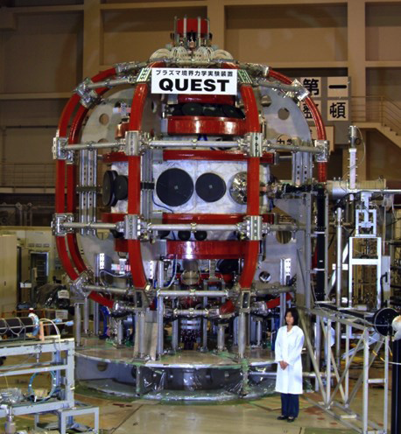
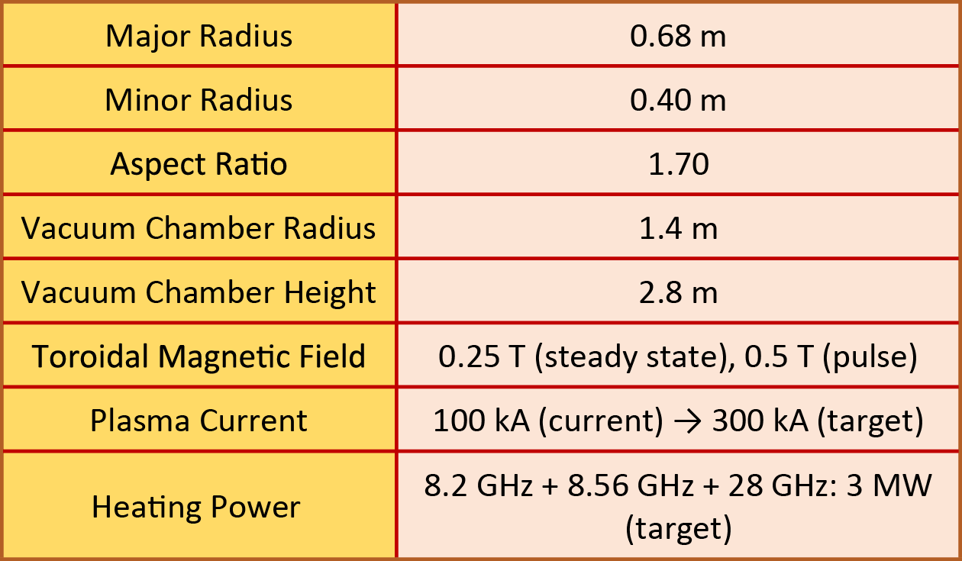
Major goal of the QUEST program is to generate steady-state fully non-inductive plasmas
QUEST will ultimately use a combination of 2.45, 8.2, 8.56 and 28 GHz heating to generate steady-state, fully non-inductive plasmas with 3 MW of RF power:
  Present capability:
  ~ 50 kW of 2.45 GHz
  ~ 400 kW of 8.2 GHz
  ~ 250 kW of 28 GHz
The QUEST CHI system has been commissioned by University of Washington team and will be used with 28 GHz heating later this year
QUEST
Spherical
Tokamak
QUEST Parameters

Slide 38
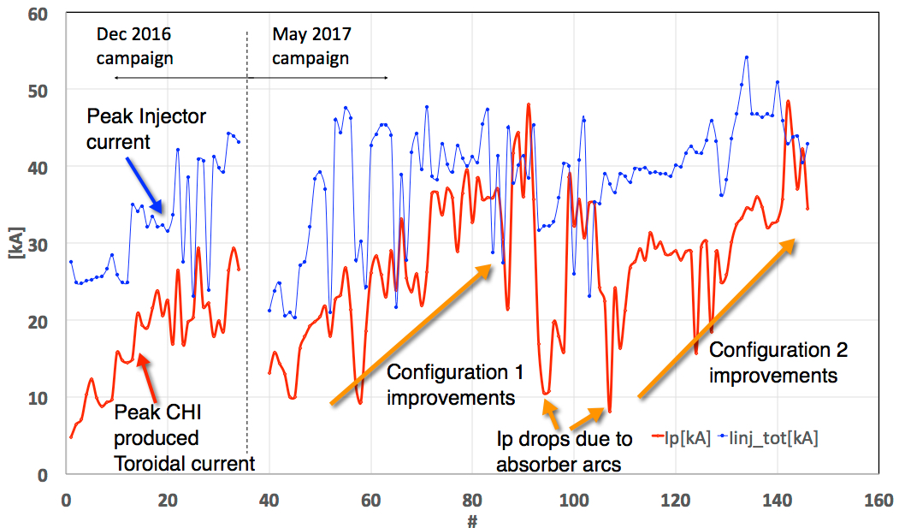
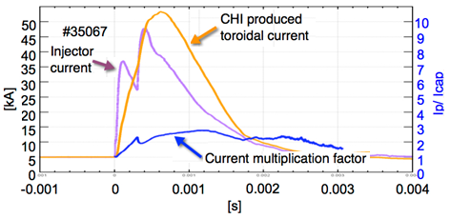
QUEST: Steady progress increasing plasma current using Coaxial Helicity Injection (CHI)
Increased peak toroidal current from 29 kA (Dec 2016) to 48 kA
CHI produced toroidal current exceeded injector current during this campaign
Config. 2 used VF & narrower flux footprint
Considerable amount of magnetics data to be analyzed to further improve discharges during Campaign 3

Slide 39
Initiated Work on TSC Simulations of CHI on QUEST & Physics Design of High-Current Transient CHI System for PEGASUS
PEGASUS | QUEST
High injector flux >60 mWb (I_{p} ~400kA) | Low injector flux ~28mWb (I_{p} ~100kA)
B_{T} to be upgraded to 0.6T, with 0.9T enabled by larger power supply in future Quite important for injecting large quantities of poloidal flux | B_{T} on QUEST is 0.25T
ECH heating needed to support sustained current operation | QUEST has access to high power ECH capability
Plan to test multiple electrode materials and also change the electrode location to improve understanding of CHI system optimization for larger fusion experiments | QUEST is an all metal machine, and the CHI electrodes are metallic Provides early supporting data on operation of CHI with metal electrodes
Will use double biased electrode configuration to more clearly define current path | QUEST is testing a new, single biased configuration
Detailed QUEST vessel model developed for simulations with TSC
Comparative studies using simplified vessel model is in progress
  With insulators in NSTX-like configuration, and coils close to the CHI break
  With insulator as in QUEST, and the coils much farther away, as on QUEST
R. Raman, M. Ono

Slide 40
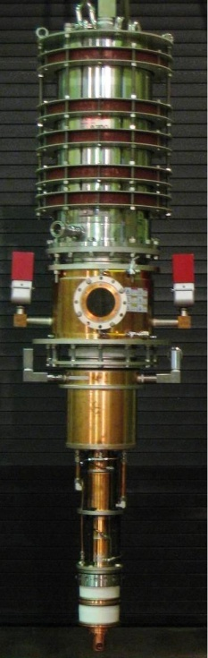
QUEST uses 28GHz Gyrotron developed by Tsukuba (similar to gyrotron proposed for NSTX-U)
28 GHz gyrotron had been developed for Gamma-10/PDX projects at Tsukuba University
28 GHz Gyrotron Design Parameters
Frequency 28GHz Output Power 1 MW Pulse Width 1 s Output Efficiency 35% (W/O CPD) Beam Voltage 80 kV Beam Current 40 A Cavity Oscillation mode TE_{8,3} Output mode Gaussian like Output Window Sapphire Single Disk Aperture diameter 112 mm

Slide 41
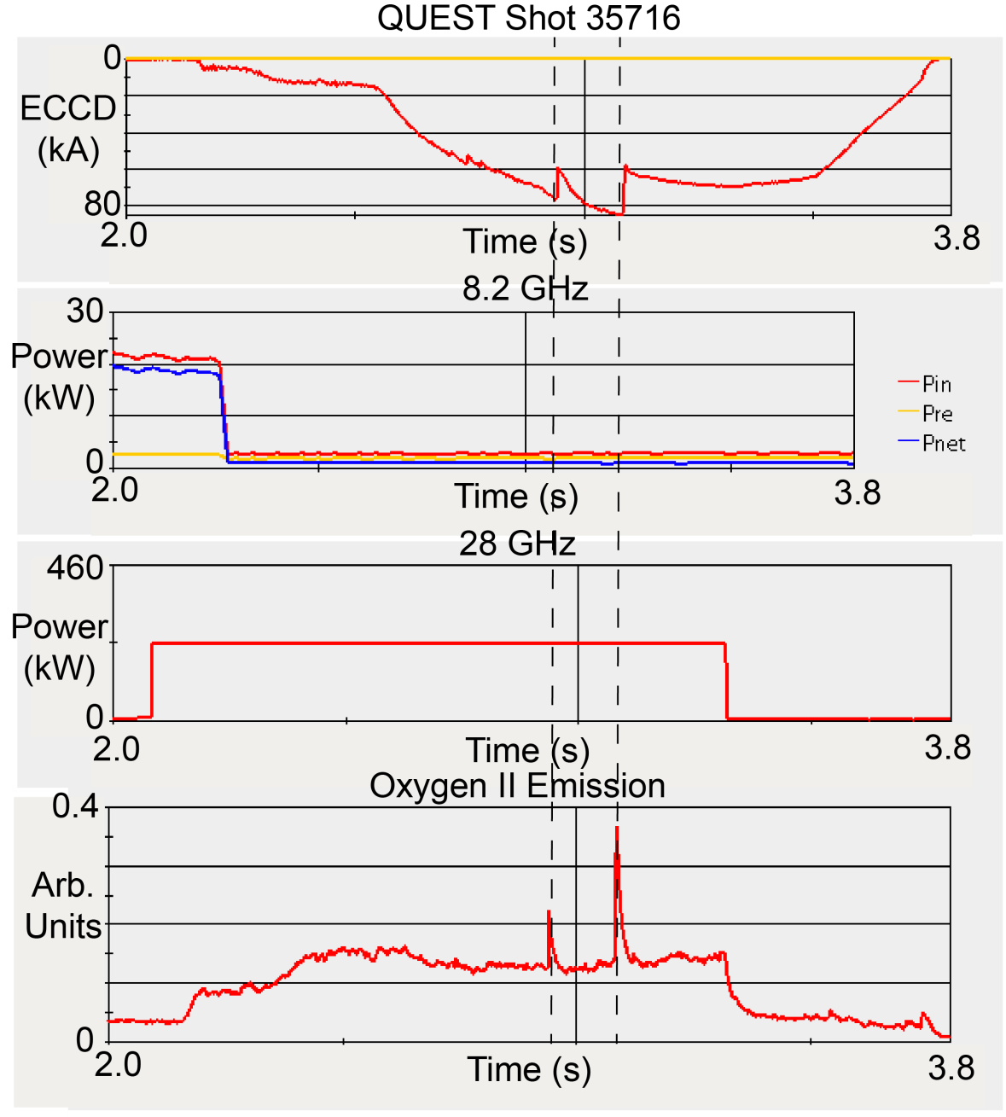
Generated up to 85 kA with 230 kW
Limited by large drops in generated current, coincident with bursts in the Oxygen-II emission
Analysis ongoing to investigate cause
Also collaborating on kinetic modelling of energetic electron population and current drive (Bertelli - PPPL)
G. Taylor (PPPL)

Slide 42
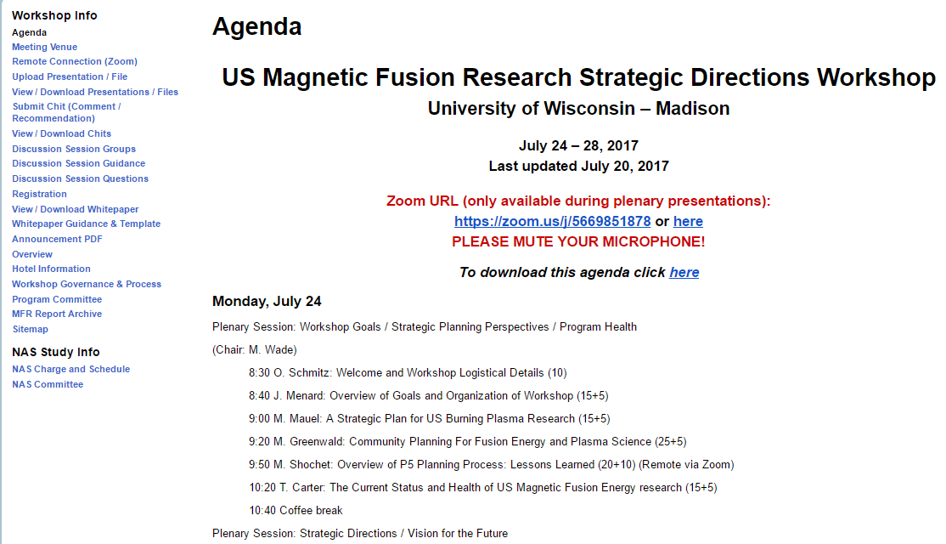
NSTX-U researchers also actively engaged in generating input for National Academy panel

Slide 43
Thank you!
Any questions?

Slide 44
Backup - milestone progress

Slide 45
Scope of JRT-2017 contribution from NSTX-U
JRT-2017 deliverable: “…data will be used to assess the impact of edge magnetic configurations and divertor geometries on dissipative regimes, as well as their effect on the width of the power exhaust channel”
No divertor experimental data from NSTX-U, so are utilizing additional / new analysis of NSTX divertor experiments:
  Summarize partially detached divertor operating space, characteristics
  Analyze how detachment depends on divertor flux expansion
  Analyze how the radial extent of the partially detached region depends on divertor scrape-off layer width and gas seeding
  Compare to multi-fluid transport model predictions
Large experimental NSTX database:
  XPs: 605, 708, 814, 816, 826, 1045, 1050
    But, only later XPs had full complement of divertor diagnostics

Slide 46
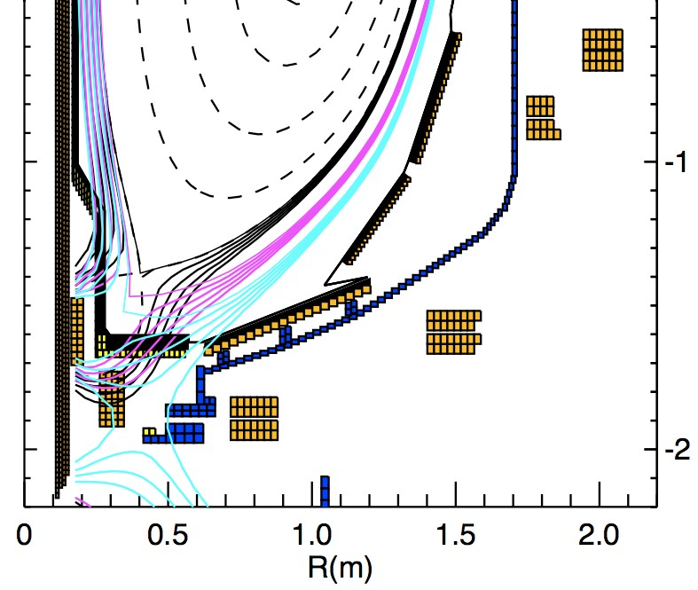
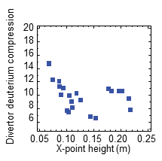
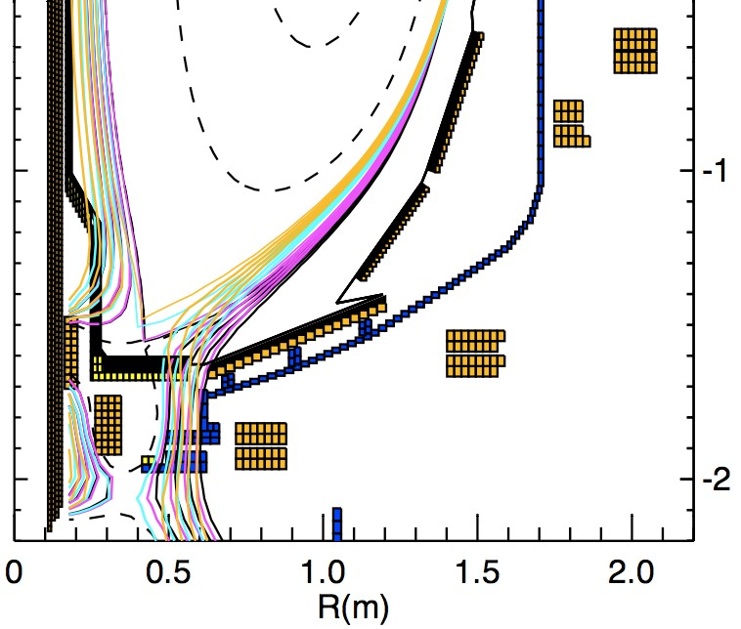
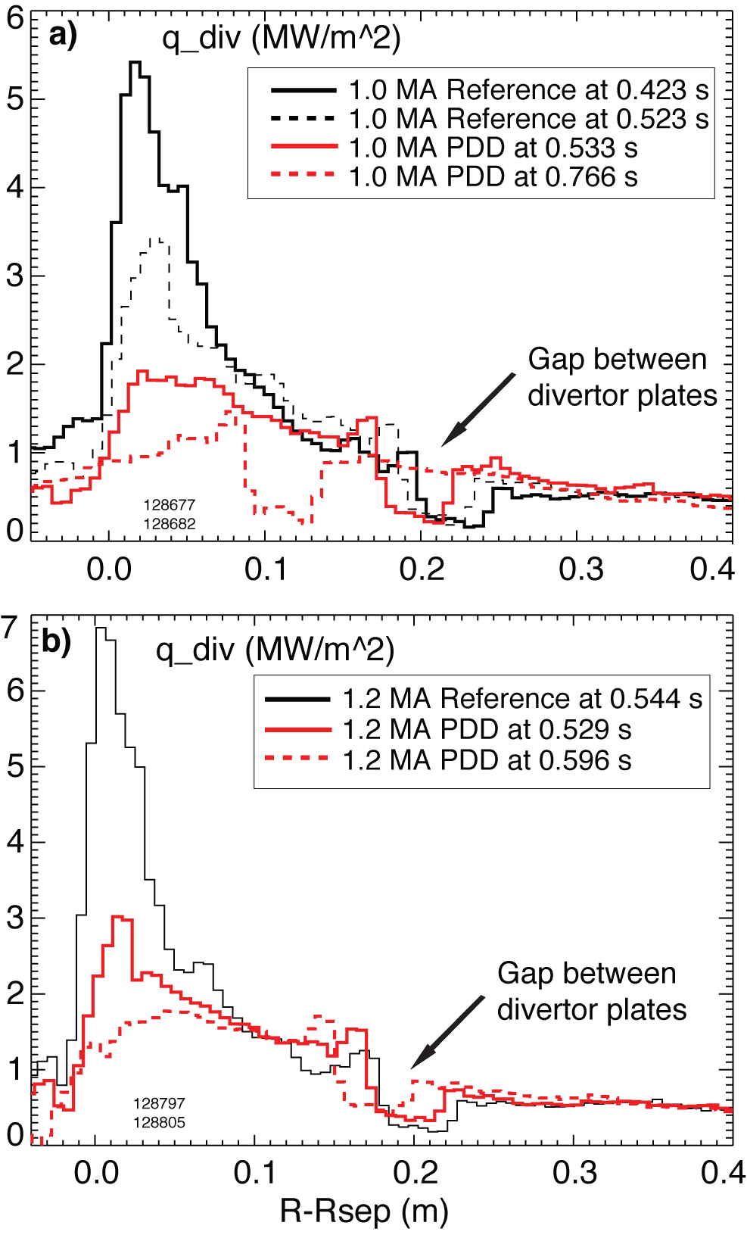
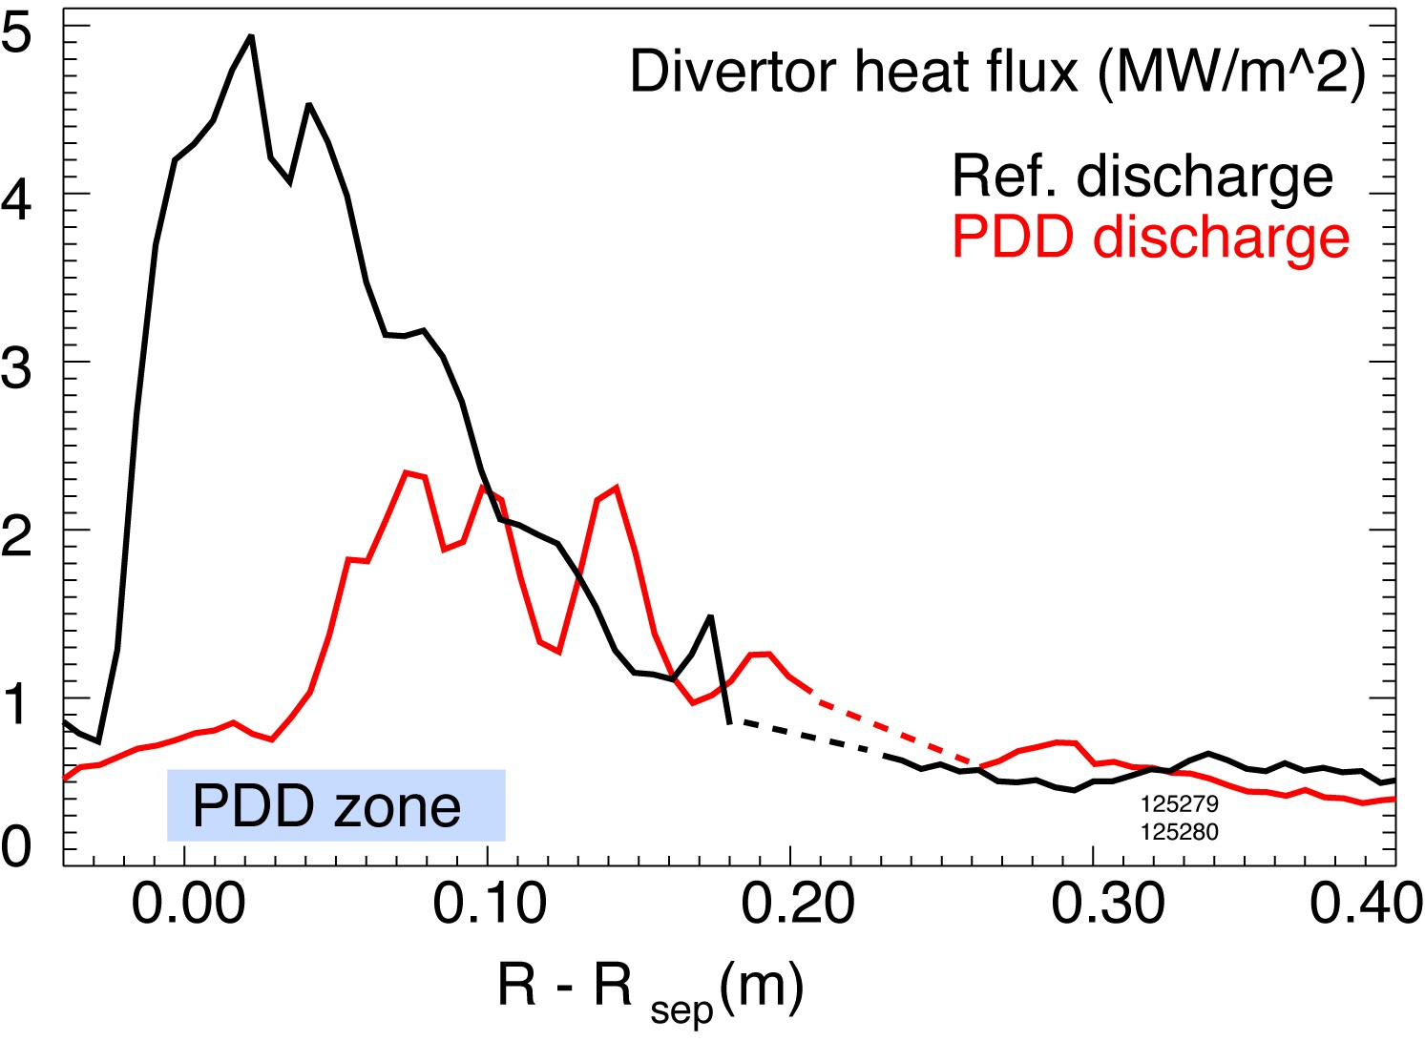
Assessing how detachment depends on flux expansion, how detachment width depends on SOL width
New analysis of NSTX divertor detachment onset as function of standard divertor geometry (l||, f_{exp}, R_{SP}, etc)
  UEDGE modeling underway for 6 different configurations with charge-state resolved carbon and n_{e} scans
  National campaign: 1 run day MP on divertor detachment similarity to NSTX / NSTX-U
Can extent of detachment be linked to radial transport via λ_{q}?
  Initiated analysis of the radial detachment region extent as function of divertor scrape-off layer width and gas seeding (0.8, 1.0, 1.2 MA)
Scenario | Coils | X-pt height | OSP major radius | Flux expansion
# 1 | PF1AL | 6-23 cm | 0.30-0.39 m | 6-26
# 2 | PF1AL & PF1B | 4-11 cm | 0.42-0.45 m | 14-35

Slide 47


New result from data mining: Inter-ELM power to lower-outer strike point is reduced as dR_{sep}→0
dR_{sep} = radial distance at the outer midplane between the flux surfaces connected to the upper and lower X–points
Near double-null:
  10% ≤ P_{div, OSP/PSOL} ≤ 30%
λ_{q} broadens as dR_{sep} → 0
Next steps in analysis:
  Use Langmuir probe data to estimate power deposition at other strike points without IR data
  Quantify changes in λ_{q} with dR_{sep}
May impact expected heat fluxes in NSTX-U DND?

Slide 48

R(17-1): Simulation-based projection of divertor heat flux in NSTX-U
Goal: Extend SOL heat-flux width simulations up to 2MA, 10MW NSTX-U scenarios – make prediction for NSTX-U
Tools: XGC1 – including magnetic drift of warm ions across separatrix, cross-field E×B-drift heat-flux from edge turbulence
Impact: Understand neoclassical vs turbulent SOL transport
  Important to NSTX-U heat flux mitigation, ITER power exhaust challenge
Progress:
  Completed 1MA NSTX
    11% of 29 peta-flop Cori Xeon-Phi nodes at NERSC, 3 days
  1 and 2MA NSTX-U cases now running on Cori
  Will report final results Q4
Physics bifurcation

Slide 49
R17-2: Advanced divertor operating scenario modeling for NSTX-U
Goals:
  Assess dependence of advanced divertor vs solenoid and PF currents, perturbed 3D fields (could increase local peaking)
  Assess divertor radiation & heat fluxes vs current, input power, density, and seeded impurities
Tools: ISOLVER, CORSICA, SOLPS, UEDGE, GINGRED, M3D-C1, EMC3-EIRENE
Impact: Define advanced divertor operational space
  Responsive to Recovery Project issue / concern
Progress:
  Extensive heat-flux reduced modelling vs. OH, PF1 currents for PFC requirements specifications and PF1 coil design
    Reported at several FES Thursday meetings, EoC (not repeated here)

Slide 50






Designed controlled experiment for NSTX-U to assess heat flux and detachment vs. flaring (UT Austin)
Can hold core fixed while varying divertor (CORSICA+SOLPS)
  I_{P} = 1.1MA, B_{T} = 0.74T, A~1.73, q₉₅~6, κ=2, δ_{L} = 0.47, P_{SOL} = 2.9MW
X-divertor (2nd x-point under target plate) promotes detachment
  Gas-puff scan: 4, 6, 8, 10 ×10²¹ particles / second
Standard divertor
X-divertor

Slide 51

Assessing impact of 3D fields on advanced divertors incorporating different plasma response models
n=3 RMP using mid-plane RWM/EF coils
Lobe structure and connection length both sensitive to divertor type, plasma response model
  Snowflake has larger/longer lobe structure than conventional single-null divertor
    May result in stronger asymmetries at divertor target (?)
  Plasma response stronger from 2-fluid model than from single-fluid model
G. Canal, et al., recently published in Nuclear Fusion 2017

Slide 52
R17-5: Analysis and modelling of current ramp-up dynamics in NSTX and NSTX-U
Goal: Understand, optimize evolution and global stability of current ramp-up phase to lower inductance, access high current scenarios to support wide-range of NSTX-U research goals
Analysis: L-H transition vs. density, shape, current, vertical growth rate (LRDFIT, TOKSYS), TRANSP, DCON/RDCON
Impact: Accelerate access to high plasma current, power scenarios when NSTX-U operation resumes
  Responsive to FY2016 PEMP, supports entire research program

Slide 53
Specific goals for R17-5
Evaluate elongation limits during ramp-up phase using data and calculations
  What factors limit the elongation before, during and after diverting?
  Identify growth rate of vertical instability to predict controllability of high-κ shapes
Establish the dependence of the L-H transition on density, plasma shape, etc. to inform modeling of threshold criteria and scenario targets
Perform stability analysis of experimental and modeled discharges to identify MHD limits during ramp-up
Prepare for FY2018: establish TOKSYS framework for testing and optimizing control

Slide 54

Oscillations often observed just after diverting on NSTX-U appear to be sustained by ‘kicks’ that occur when crossing dRsep=0 with velocity/growth rate dependent magnitude that decreases in time
dz/dt
[m/s]
Kick
Peak
Zero crossing
Kick size increases with vertical speed, larger at low li (early in time)
dR_{sep} [m]
Should try to avoid vertical motion and high growth rate just after time of diverting
Should avoid crossing drsep=0 near time of diverting
Will study ways to make controller less sensitive to kicks (Filtering, time/equilibrium dependent gains)
Given growth rate, kick size appears to decrease in time

Slide 55


Flat-top growth rate calculations will allow projection of NSTX-U limits to lower l_{i}
Calculations within LRDFIT quantify open loop vertical growth rate
– Evaluate growth rate just prior to VDE time
Growth rate [1/s]
Maximum growth rates for NSTX-U, NSTX similar
  Implies NSTX-U κ can approach NSTX κ at low l_{i}
Many ‘VDEs’ occur below limit ~ 120-140 s⁻¹
  Probably have different triggers, e.g., locked modes
  Will refine filtering of VDE database (DECAF)
Circles = NSTX Diamonds = NSTX-U
Elongation
Harder to control
Internal inductance

Slide 56
Database of normalized P_{loss} vs line-averaged n_{e}
Some discharges stay in L-mode despite P_{loss} >> P_{LH-ITPA}
  While some shots enter H-mode with P_{loss} ~ P_{LH-ITPA}
H-mode
L-mode
P_{loss} / P_{LH-ITPA}
7
6
5
4
3
2
1

Slide 57
Identify parameters that isolate L-H time points from L-mode timepoints
Restrict database such that all L-mode database points are excluded
  Above a minimum density: n_{ebar} > 1.25 x 10¹⁹ m⁻³
  Low surface V (pause I_{p} ramp): V_{surf} < 1.15 V
  Near double null: |d_{rsep} - 0.2 cm| < 0.6 cm
  Clean wall conditions: O II_{LD} / D_{γLD} < 1.1
About half (36 / 68) of the H-mode database points satisfy this criteria
  Most L-H points with lowest P_{loss} satisfy this criteria
Informs operational targets for improved reliability in L-H timing

Slide 58










Modeling framework aims to accelerate ramp-up scenario and control development
Synthetic real-time diagnostics (magnetics …)
Actuator model
(Power supplies)
(NBI)
(Gas)
…
PCS
Commands
Plasma model
TOKSYS
TOKSYS: Matlab code used to develop actuator and plasma models for testing PCS algorithms (supported by GA)
Two major development efforts
  Design and validate plasma model using experimental data and simulations (i.e. TRANSP, DCON)
  Develop non-linear models and/or switching between linear models
    Flattop modeling typically uses linearized model around a reference case
Ultimate goal: develop, test and optimize scenarios and control in the ramp-up phase in offline simulations

Slide 59
Progress in establishing
TOKSYS simulations for NSTX-U
Vessel current model, linearized plasma response model, synthetic magnetic signals generated
  Supports snowflake control development and testing
  Validation of plasma response model will begin soon
Power supply models have been developed
  Model includes simplified bridge rectifier model
  Working toward end-to-end optimization of vertical stability
Recently demonstrated coupling between PCS and the models within TOKSYS

Slide 60
Backup - Core

Slide 61

Modeling Finds that Resistive Modes May Explain ELMs in STs
Ideal-MHD models of ELM stability have not been accurate in STs
  Ideal-MHD model often finds ELMing plasma to be stable
New modeling with M3D-C1 shows that ELMing discharges in NSTX are unstable to resistive peeling-ballooning modes
This may resolve longstanding question about ELM stability in STs
G. Canal

Slide 62

Create an ITPA halo current rotation database:
C-Mod, DIII-D, AUG, NSTX, and JET
C-Mod
NSTX
AUG-C
AUG-W
DIII-D
JET-C
JET-ILW
JET-ILW

Slide 63


Energetic-particle-modified GAEs
Self-consistent simulations reveal strong energetic particle modifications to high frequency global Alfvén eigenmodes (GAEs)
Demonstrates that the nonperturbative regime for these modes was routinely accessed in NSTX operating conditions
  Challenges assumption that GAEs in NSTX(-U) are well described by perturbative models
May indicate existence of a new, previously unidentified energetic particle mode (EPM)
  Observable in future NSTX-U experiments
Potential implications for understanding the anomalously flat electron temperatures observed in NSTX at high beam power (correlated with CAE/GAE excitation)
  Magnitude of energy channeling and orbit stochastization effects may be modified when incorporating these modes vs traditional GAEs
Figure: Change in frequency for |n|=8 GAEs as a function of the normalized injection velocity $v_{b}/v_{A}$. Cntr-GAEs are marked by circles, co-GAEs by squares. Color denotes the central pitch $λ_{0}=μB_{0}/ε$ of the beam distribution in each simulation. The on-axis cyclotron frequency is 2.4 MHz.

Slide 64
Probe Plasma Turbulence at NSTX using a High-k Scattering Diagnostic
Scattered Power
Three wave-coupling between incident beam (k_{i} , ω_{i}) and plasma (k , ω)
ω_{i ,} ω_{s} >> ω imposes Bragg condition
k of the turbulence is selected by geometry.
k_{s}
k
k_{i}
ω_{s} = ω + ω_{i}
=
+
2w₀
k = 2k_{i}sin(θ_{s}/2)
View from top of NSTX
Notes:
Bachelor et al (2007 Plasma Sci. Technol . 9 312– 87)

Slide 65



Two Equivalent Ways to Perform a Synthetic Diagnostic for High-k Scattering at NSTX Using Gyrokinetic Simulation
Filter fluctuations in real space
Filter fluctuations in k-space
Re(δn_{e}) (R, Z)
Re(𝛅n_{e}) (k_{r}, k_{θ})
GYRO
GYRO
k_{r}𝝆_{s}
(Zoom)
k_{θ}𝝆_{s}
Scattering system is spatially
localized (R, Z, 𝝋)
Scattering system is wavenumber selective (k_{r}, k_{θ,} k_{𝝋})

Slide 66




Filter Turbulent Fluctuations in Real and Wavenumber Space to Obtain a Synthetic Signal
Filter in real space: 𝛙_{R}($\vec{r}$)
Filter in wavenumber space: 𝛙_{K}($\vec{k}−\vec{k}$₀)
k_{r}𝝆_{s}
k_{θ}𝝆_{s}
k_{r}𝝆_{s}
k_{θ}𝝆_{s}
$δ\hat{n}esyn\left(t\right)=\int{\tilde{n}e(\vec{r},t)}$𝛙_{R}($\vec{r}$)$e^{\text{−}\text{i}\vec{k}0∙\vec{r}}d3\vec{r}$
$δ\hat{n}esyn\left(t\right)=\frac{1}{\left(2π\right)3}\int{\tilde{n}e(\vec{k},t)}$𝛙_{K}($\vec{k}$-$\vec{k}$₀)$d3\vec{k}$
Obtain a time series of turbulent density fluctuations $δ\hat{n}esyn\left(t\right)$

Slide 67
Synthetic diagnostic applied to the cyclone base case: direct comparisons with experiment not yet available
Proof of principle showing equivalence between real space filtering and wavenumber space filtering
k_{r}𝝆_{s}^{exp}= 0.27
k_{𝞱}𝝆_{s}^{exp}= 0.42
GOOD AGREEMENT BETWEEN R & K FILTERS
Direct comparisons between both synthetic diagnostic methods and experiments require additional big box electron scale simulations – to be computed at NERSC Edison/Cori supercomputers

Slide 68
Backup - Boundary

Slide 69



Partial detachment operating space in NSTX
Only no lithium data (2004-2008)
Standard divertor configuration
  Compact (small geometric area - ST)
  High divertor power and peak heat flux
  Never reaches detachment naturally at high n_{e}~0.9 n_{G}
  Detachment onset strongly depend on
    Magnetic flux expansion
    Gas puffing location
    Plasma current (B_{p}, λ_{q} ?)
 | NSTX high κ,δ | Tokamak
Aspect ratio | 1.3 | 2.7
In-out SOL area ratio | 1:3 | ~ 2:3
Parallel connection length L||, midplane to target (m) | 8-12 | 30-80
L|| , X-point to target (m) | 5-8 | 10-20
Angle at target (deg) | 5-15 | 1-2

Slide 70


Heat-load width for lower inboard divertor in NSTX
Large-scale XGC1 gyrokinetic simulation used 11% of 29 peta-flop Cori Xeon-Phi nodes at NERSC for 3 days
NSTX #139047, B_{p,mid}=0.25T, Heat input=3.8MW
XGC1 finds that the heat-flux width for lower inboard divertor discharge in NSTX still follows the Eich-Goldston scaling
XGC1 also finds that P_{outer leg}/P_{inner leg} ≈ 2.3
Prediction for heat-load width and density in NSTX-U will be reported in Q4.
Physics bifurcation

Slide 71

Analysis of outboard power fraction vs. dR_{sep} / λ_{q}
± 2

Slide 72

PFC impurity emission during irradiations (post-mortem analysis)
Impurity emission during irradiations
Different m/q , shown as PP (left axis)
Ion flux (Ar+(pink) or D⁺(purple) (right axis)
D+ and Ar+ Irradiation of Core A17
Two D+ ((a) and (b)) and two Ar+ ((c) and (d)) irradiations.
D₂ dominated (a) and (b) as expected, so did Ar in (c) and (d)
D₂ is visible in (c) and (d) !!
D₂ signal in (d) is lower than that in (c) (decreasing with increasing Ar+ fluence)
Evidence of D₂ retention by the boron coatings !!

Slide 73
NSTX-U Surface Science Research*
R. Kaita and M.A. Jaworski, Princeton Plasma Physics Laboratory
B.E. Koel, Dept. of Chemical and Biological Engineering, Princeton University
USDOE Budget Planning Meeting
June 15, 2017
*Work supported by US Department of Energy Contract DE-AC02-09CH11466

Slide 74
Surface science on NSTX-U – multi-institutional collaborative effort
  J.P. Allain (University of Illinois at Urbana-Champaign)
    F. Bedoya – PhD student
    H. Schamis – first-year graduate student
  D. Donovan (University of Tennessee at Knoxville)
    A. Maan – PhD student
    S. Lee – visiting graduate student in summer of 2017
  M.A. Jaworski, R. Kaita and C.H. Skinner (PPPL)
    J. Nichols – PPPL PhD student
  B.E. Koel (PU Chemical & Biological Eng. Dept. - CBE)
    L. Buzi – PPPL postdoctoral research fellow
    M. Hofman – PU CBE PhD student
    A. (“Oak”) Nelson – PPPL first-year graduate student
    Y. Yang – PU CBE PhD student
  P. Krstic (Stony Brook University)
    F. Javier Domínguez-Gutiérrez – postdoctoral research fellow

Slide 75
Extensive experimental and computational capabilities leveraged for NSTX-U mission
  PPPL
    Facilities including ALISS (Alkali Ion-Scattering Spectroscopy) and (SAM) Scanning Auger Microprobe operated jointly with PU CBE Dept.
  Princeton University
    High-resolution X-ray and ion and electron beam instrumentation at IAC (Imaging and Analysis Center)
  University of Illinois at Urbana-Champaign
    Facilities including IIAX (Ion-surface InterAction eXperiment) and IGNIS (in-situ, in operando modification and analysis)
    Development of Materials Analysis and Particle Probe – MAPP
  University of Tennessee at Knoxville
    Facilities including ion exposure stage for materials analysis
  Stony Brook University
    LI-red cluster with multiple Cray compute nodes for 100 teraflop capability and access to ORNL NCCS supercomputing facility

Slide 76


Development during NSTX-U outages permit efficient implementation of new capabilities
  Materials Analysis and Particle Probe – MAPP – tested and commissioned on LTX
  M. Lucia, Material Surface Characteristics and Plasma Performance in the Lithium Tokamak Experiment, PhD thesis, Princeton U. (2015)
  Successfully installed and operated for first in vacuo boronization studies of plasma-facing components on NSTX-U
  F. Bedoya, Plasma Facing Components Conditioning Techniques and their Correlation with Plasma Performance in the National Spherical Torus Experiment Upgrade (NSTX-U), PhD thesis, U. of Illinois at Urbana-Champaign (2017)

Slide 77
First quantitative agreement between boronization chemistry theory and experiment demonstrated*
Experiment
Theory
  Quantum-classical molecular dynamics calculations follow experimental evolution of percentage of bonds of O, C, and B to other surface constituents as D concentration increases with plasma exposure
  Concentrations of O, B and C in boronized graphite sample with time – and increasing plasma exposure – measured in vacuo with MAPP
  Continuing laboratory experiments and development of computational tools during outage can enhance surface science for future NSTX-U operations
*F. Javier Domínguez-Gutiérrez et al., Unraveling the plasma-material interface with real time diagnosis of dynamic boron conditioning in extreme tokamak plasmas, in press Nuclear Fusion

Slide 78


Building toward whole-device models with surface science advancements
NSTX-U mixed-material environment is complex
  Plasma redistribution of material
  Multiple, chemically reactive species
  Complex plasma-surface interactions impact machine
Computational efforts underway to integrate new surface science
  PhD student J. Nichols implementing WallDYN
  Mixed-material erosion models can continue to be improved by surface science
NSTX Divertor conditions
Comparison of erosion models
J. Nichols, M. Jaworski and K. Schmid, Sensitivity of WallDYN material
migration modeling to uncertainties in mixed-material surface binding energies, in press J. Nucl. Materials

Slide 79
Backup - Scenarios

Slide 80



First feedback algorithm using DIII-D’s variable beam voltage/perveance tested in DIII-D/NSTX-U National Campaign, demonstrated energy/rotation control
171990
Feedback on
Voltage in co- and cntr- beams adjusted to achieve required torque and power
Fast changes in perveance used to compensate slow response of voltage to requested change
Fraction of optimal perveance

Slide 81
Backup - Collaborations

Slide 82
Motivation for n=2 locking studies
High-level motivation:
  Expand DIII-D n=2 locking database
    Physics understanding of n=2 locking (B_{T} dependence, etc.)
    ITPA MDC-19 → EFC strategy for ITER
  Inform n=2 EFC strategy in NSTX-U
    NSTX-U EFC (RWM) coils similar to C-coils → mixed resonance
    Possible Non-axisymmetric Control Coil (NCC) facility enhancement → motivate control of resonance spectrum
Specific goals of MP2017-08-06 (1 day):
  Touch base with MP2016-23-01 (Lanctot)
  Primary scans: n=2 field resonance spectrum, B_{T}, and density

Slide 83

Obtained 22 point B_{T} scan (L-mode + ohmic)
Locking threshold decreases with increasing B_{T}
Easier to lock the plasma with max resonant fields (I-coils only)
Able to lock with mixed resonant / non-resonant fields (C-coils only) at all points except B_{T}=1T
Locking threshold declines with increasing B_{T} in all cases
A little bit of NBI goes a long way → L-modes harder to lock than ohmic

Slide 84
Enhanced collaborations during NSTX-U outage
Targets NSTX-U research goals
EAST: edge physics, plasma materials interactions (high-Z, Li)
  R. Maingi + collaborators leading expts
JET: EP studies, plasma ramp-down scenarios and modeling
  M. Podesta, D. Darrow, F. Poli
KSTAR: Core MHD, rotation physics, plasma control
  Columbia Univ (Sabbagh, Berkery, Park et al.), J-K Park, J-W Ahn (ORNL)
MAST-U: Control, scenario modeling supporting first plasma
  D. Battaglia (on-site for several months), D. Boyer
W7-X: wall conditioning using boron powder dropper
  R. Lunsford
WEST: Start-up, RF physics, high-Z PMI, real-time wall protection
  Mueller (?), M. Reinke (ORNL), RF physicists
QUEST: Coaxial Helicity Injection (CHI) + ECH/EBW heating
  R. Raman (UW), M. Ono
LAPD: RF coupling and heating physics, cavity modes
  R. Perkins
DIII-D, HL-2A (China): Dedicated campaigns (see following vgs)

Slide 85

First CHI experiments carried out on QUEST
QUEST
R = 0.68 m
a = 0.4 m
B_{T} = 0.25T
V_{plas} ~3.8m³
QUEST
CHI
V = 2 kV
C = 30 mF
Inj. Flux ~28mWb
Electrodes: metal
CHI Cap Bank
Goals:
Commission all CHI hardware
  Cap bank, gas injectors, snubbers, vessel safety resistors, fast voltage monitors on vessel
Establish reliable gas breakdown using 2kV CHI power supply
Measure toroidal current generation

Slide 86


28 GHz gyrotron system has been upgraded with a focusing mirror launcher and polarizer
Added quasi-optical polarization control to provide the desired
X-mode polarization to obtain good single pass absorption
Added focusing mirror launcher to obtain a narrow beam
This new 28 GHz transmission line was commissioned in July
Launcher
with a
focusing
mirror
λ/4
polarizer
λ/8
polarizer
X-mode Injection
for 2fce ECCD

Slide 87

QUEST: 29kA Toroidal Current Generated by operating Injector coil at 30% of full capability (1.5kA)
Injector current ~39kA is high due to very low B_{T}
Peak in Ip (~29kA) occurs after injector current is ~20kA
  Not enough information to know if absorber arching is occurring, but it is not keeping the plasma discharge from forming
  QUEST CHI should be more prone to absorber arcs
Electrode voltage at 3 toroidal current injection locations overlaps – good no toroidal asymmetries
All CHI capacitor bank monitor signals and vessel voltage monitors worked well

