Slide 1
M&P TSG Group Discussion of NSTX-U Polar Region Modifications
MA Jaworski
NSTX-U Materials and PFCs Topical Science Group
B252 – PPPL
May 11th, 2017
*Work supported by DOE contract DE-AC02-09CH11466

Slide 2
Outline
Two charges from Jon
Obtain input from team on impact of proposed polar-region changes to the TSG science mission using 5-year plan as a guide as well as the FY16-17 research campaigns
Document plasma shapes and parameters (e.g. strike-point position, heating power) necessary to accomplish TSG goals
Re-evaluate FY18-19 milestones
Polar-regions review
5-year plan review
Previous shots in NSTX-U
Milestone discussion

Slide 3
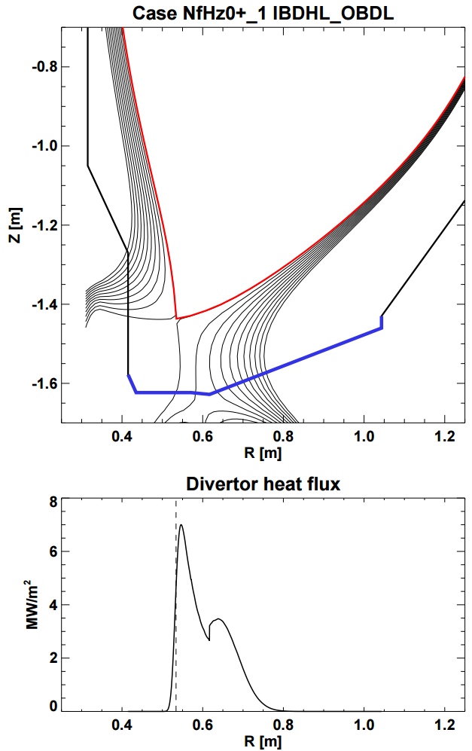
Scan 1 example: No PF1B, use PF1C for high flux expansion
Example case from scan:
κ = 2.5
l_{i} = 0.6
I_{OH} = -12kA (~mid/late flat-top)
No PF1B, use PF1C for flux expansion → R_{strike} variation
Need to narrow or close CHI gap
0.7MW
2.8MW
PF1A, C used
PF1B not used
θ_{B} = 1.1°

Slide 4
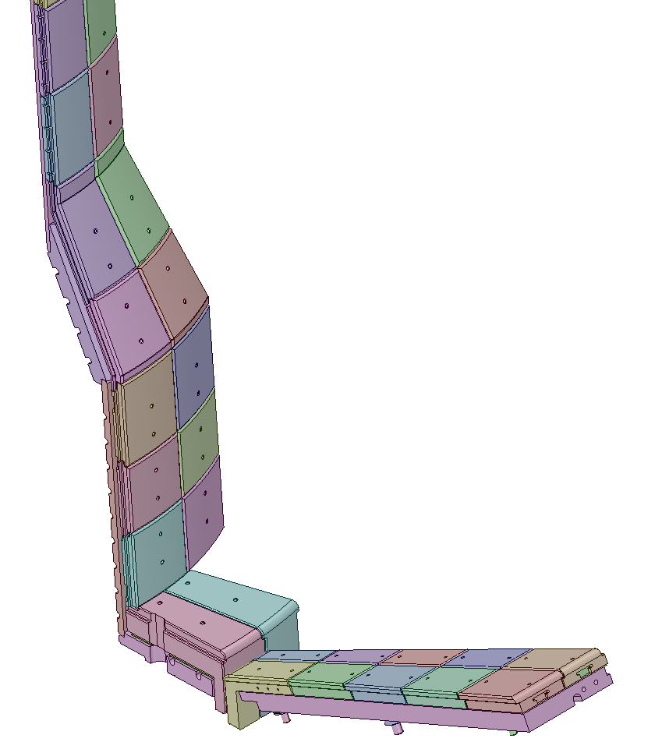
These are the Polar Region Tiles
CS First Wall Tiles
CS Angled Section
Inboard Divertor, Vertical (IBDV)
Inboard Divertor, Horizontal (IBDH)
Outboard Divertor

Slide 5
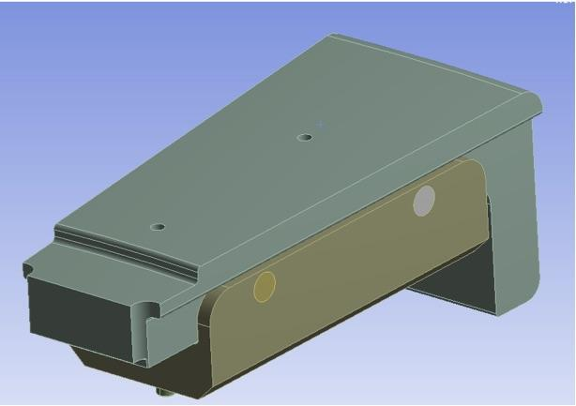
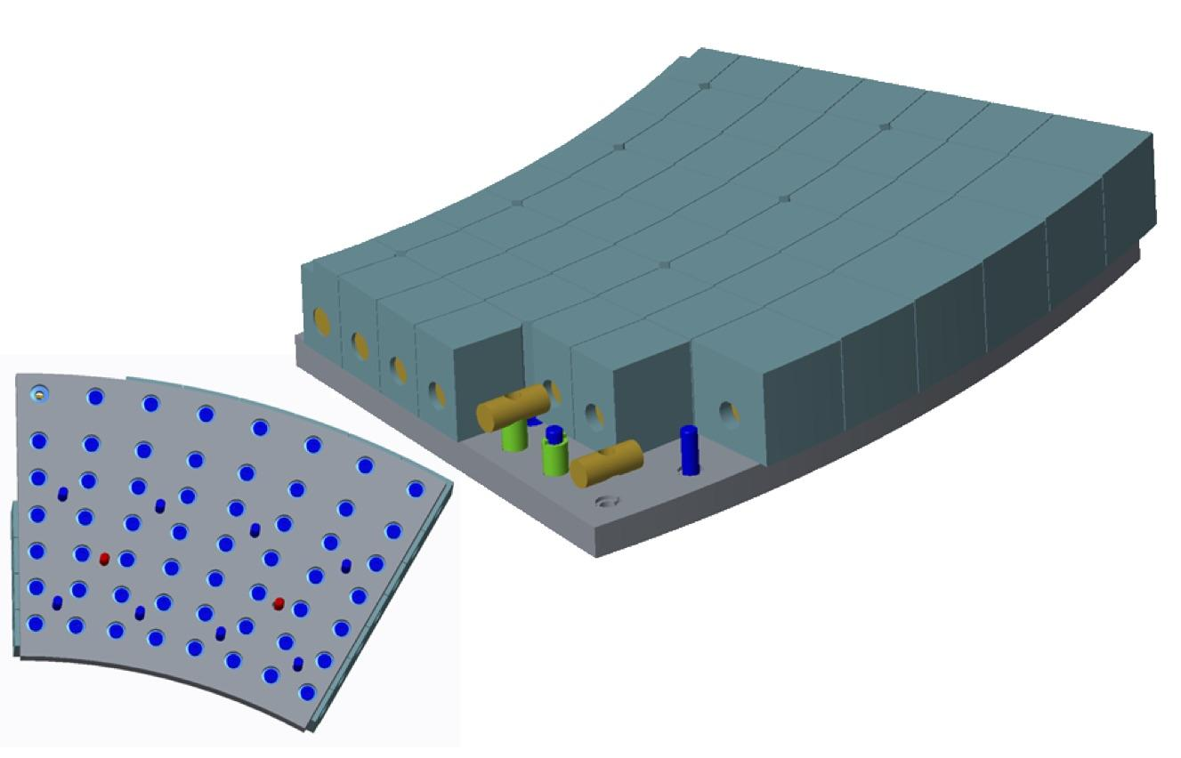
Assessed Two Concepts For New Inner Horizontal Target Tiles
A. Brooks
M. Mardenfeld
Recommended for further evaluation
Simple Cassette, Sigrafine, 1 or 2 sub-tiles |  | Fake Monoblock (Mardenblock)
Advantage | Disadvantage | Advantage | Disadvantage
Meets GRD heat flux, especially with subdivided tiles | Will be thermal stress limited, likely less operating space | No surface features if fishscaled No Leading Edges No Stress Concentrators | Tends toward wanting fishscaling
Pins react radial halo currents force | Stress concentrations, surface features for bolt holes, diagnostic | Limited by max T | Substantial diagnostic redesign
 |  | Replace cubes to change helicity
 |  | Halo Current Forces Smaller
We continue to evaluate the optimal path forward, including optimal fish-scaling angles

Slide 6
Still Working to Resolve Our Final Position on Other Tiles
Initial studies indicate that their may be sufficient thermal margin in an average sense.
Risk of strong leading edge heating on vertical target
Recently revised both physics and analysis assumptions regarding halo currents on the CS.
Halo current loads are large and likely problematic
Refining both the requirements and the analysis to better assess this issue.
A. Brooks

Slide 7
Agenda
FES perspective on Recovery / Research: Josh King
Organizational Diagnosis Status / Next Steps: Rich and Jon
Recovery:
DVVR / EoC status and next steps (Rich Hawryluk)
Updates on divertor heat flux and PF coil requirements (Jon Menard)
Recent engineering design activities in polar regions (Stefan Gerhardt)
Research:
Status and plans for PFC Requirements working group (Matt Reinke)
Impact of polar region options on research ops flexibility (Matt / Jon)
Overview of upcoming FESAC and NAS workshops (Rajesh Maingi + Jon)

Slide 8
NSTX-U PFC Performance and Monitoring Requirements Working Group (PFCR-WG)
Formed and charged by JEM after 3/22 Team Meeting:
1. Define which (additional) parameters need to be specified in an updated requirements document for the NSTX-U PFCs
2. Facilitate generation of updated requirements utilizing:
a. Available reduced models, empirical scalings, boundary simulations
b. Ultimately, a validated model for specifying heat loads to all plasma facing components for arbitrary NSTX-U scenarios
3. Develop instrumentation plans and operational guidance
4. Work closely with engineers and analysts to develop and implement requirements
Kick-off meeting on 3/29 (Deputy: Mike Mardenfeld)
38 members: theory, experiment and engineering participation
PPPL, ORNL, U. Wisconsin, U. Washington, UT-K, LLNL and CCFE
Want to increase participation within the NSTX-U team
Many open questions that need physics input to guide engineering design and outline future operations guidance
See website for open ACTION ITEMS, please submit your own!
literature investigations, NSTX/NSTX-U data mining, interaction with other devices

Slide 9
Recent Work and Future Plans
Directly contributed to the drafting of the requirements document which was reviewed at PFCR-WG meeting
charge 1, close to being complete (rev0 of requirements soon)
summarized evolution of requirements process on MAST-U
In-progress/near complete contributions (MEMOS!)
guidance to Recovery Project on EoC recommendations for real-time protection of PFCs (needs further WG consensus)
guidance on reversed field requirements and tile shaping options (next slide)
impact of error fields like CS alignment on tile shaping (Ferraro)
review of literature/designs on carbon temperature limits (Raman)
Need to start working on Charge 2 to help improve the accuracy in the heat loading data that is in the requirements (future meeting)
start from Menard model, check accuracy & question assumptions
examine uncertainties in the IBDV that could impact design decisions
respond to PFC Engineering team as they analyze other regions of the machine
try and bound physics uncertainty to ensure requirements are accurate
eventually move to proven community tools (PFCFlux, SMARDDA?) that can robustly handle shaped tiles
not the first facility to deal with this and should take advantage of existing knowledge

Slide 10
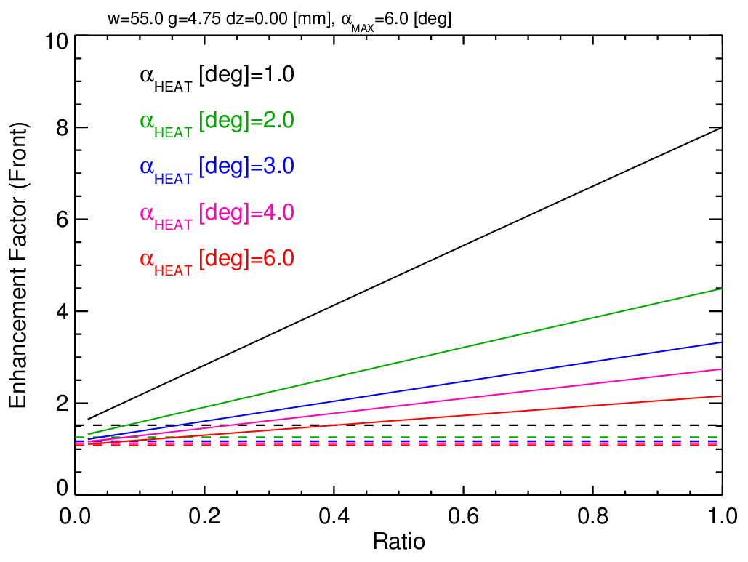
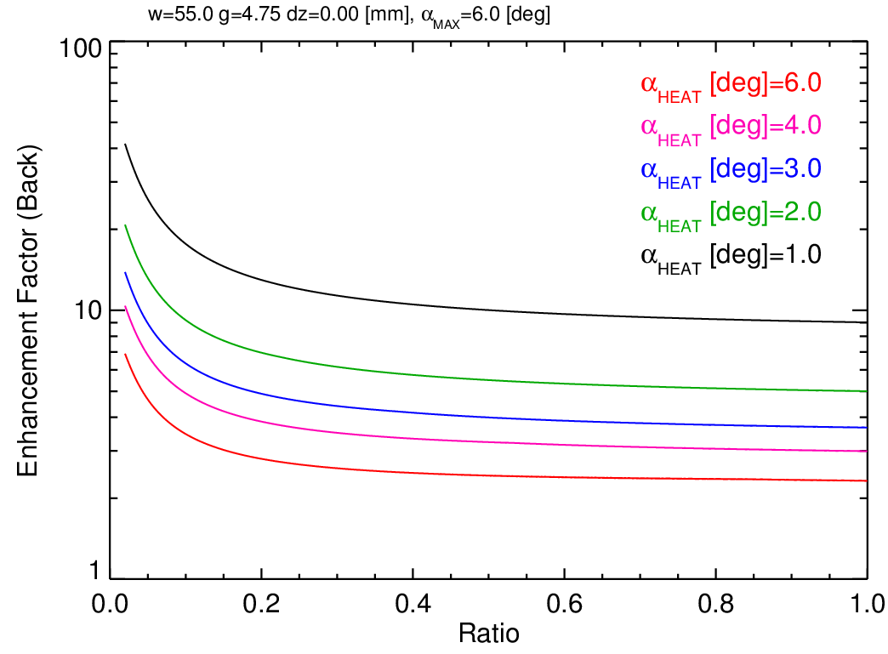
Challenge to Shape Tiles for Flexibility
GOOD HEAT FLUX HANDLING SURFACE
POOR HEAT FLUX HANDLING SURFACE
PFCR-MEMO-002 (draft)
high heat flux divertors typically shape tiles toroidally to hide leading edges created by tooling gaps, diagnostics and installation/fabrication tolerance
necessarily give up heat flux handling to gain operational flexibility
‘fish-scaling’ (uni-directional) or ‘roof-top’ (bi-directional)
plotted ‘enhancement factor’ qualitatively means either dropping heat flux (proportionally) or operational time (squared) [it’s really a bit more complicated than this]
optimal tile shape driven by desired operational space
desired range of field line angles, expected heat flux on forward/rear surfaces
even if we decided on an optimized case, still need operational space to get to it!

Slide 11
Impact of polar region options on research flexibility
No ceramic breaks would eliminate CHI capability
Tile fish-scaling required in several regions to manage high heat fluxes of 2MA/10MW/5s → Eliminates reversed B_{T}
Langmuir probes, gas feeds / divertor MGI, other sensors in tiles will also need to be redesigned in concert with PFCs
(Near) perfect snowflake divertors (SFDs), other advanced divertors will have reversed helicity for some tile regions
Need requested SFD equilibria ASAP to assess tile impact / options
Bi-directional tiles may be an option for lower q⊥ divertor regions
Pedestal/ELM/H-mode threshold studies - need additional specs of requested range of ΔR_{SEP}, duration, κ, δ, R_{strike}
Up/down asymmetric boundary increases q_{peak}, reduces Δt_{flat}
BP SG/TT TSG charged to provide info to PFCR-WG/JEM

Slide 12
Outline
Two charges from Jon
Obtain input from team on impact of proposed polar-region changes to the TSG science mission using 5-year plan as a guide as well as the FY16-17 research campaigns
Document plasma shapes and parameters (e.g. strike-point position, heating power) necessary to accomplish TSG goals
Re-evaluate FY18-19 milestones
Polar-regions review
5-year plan review
Previous shots in NSTX-U
Milestone discussion

Slide 13
M&P research will develop understanding of material migration and heat-flux handling of high-Z and liquid Li PFCs
5-Year Plan Research Thrusts
MP-1: Understand lithium surface-science for long-pulse
Assess impact of more complete Li coverage
Use the Material Analysis and Particle Probe (MAPP) and laboratory studies to link tokamak performance to PFC surface composition
MP-2: Unravel the physics of tokamak-induced material migration and evolution
Confirm erosion scalings and evaluate extrapolations
Determine migration patterns to optimize technical solutions
MP-3: Establish the science of continuous vapor-shielding
Determine the existence and viability of stable, vapor-shielded divertor configurations
Determine core compatibility and extrapolations for extended durations and next-step device parameters

Slide 14
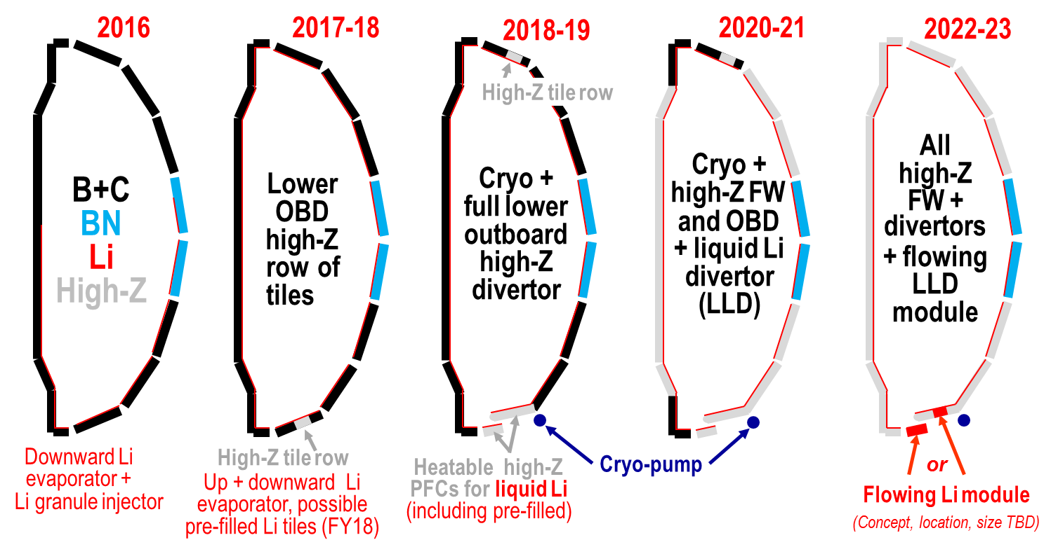
Staged conversion mitigates risk and enables comparative assessment of both high-Z and liquid Li
Open divertor and flexible magnetic configuration enables multiple studies and material selection
Single-variable experiment in single campaign enabled by conversion (i.e. high-Z vs. lithium PFCs)

Slide 15
High-Z tile row will provide design and engineering assessments
Replace continuous row of graphite tiles with high-Z
Avoid Li substrate diffusion for longer-pulse experiments
Examine protection of high-Z substrate w/ low-Z coatings
Provide operational experience and validate engineering design and analysis with an eye to future deployments of metallic PFCs
Continue experiments on evaporated Li films on high-Z substrate in diverted configuration

Slide 16
Rapid experiments facilitated by direct replacement of graphite tiles
Machine installation time minimized with 1-for-1 replacement
TZM-alloy provides high-Z, Li-compatible substrate and machinability
Surface castellations relieve thermo-mechanical stresses
Separate peak stress from peak temperature
Several design iterations to optimize for NSTX-U tile shape

Slide 17
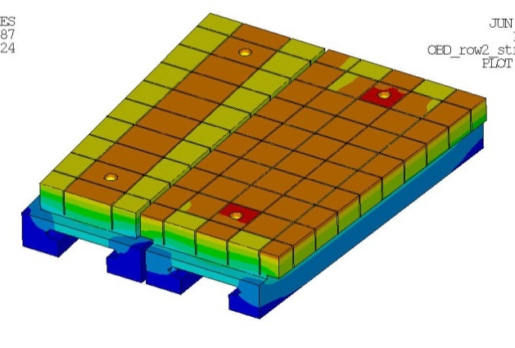
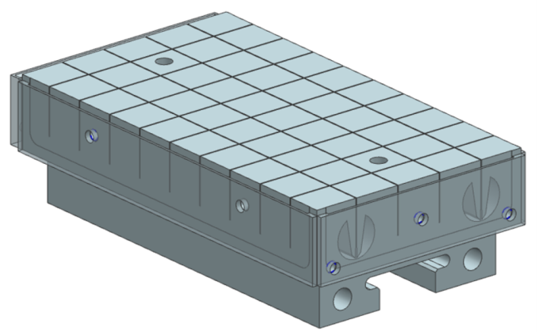
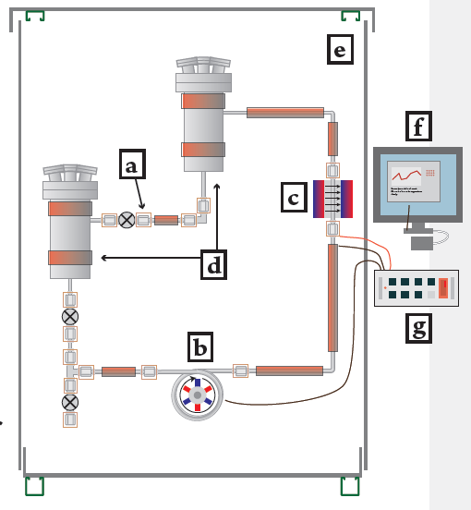
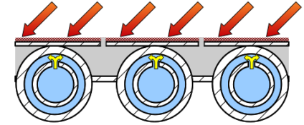
A three-step progression leads to flowing, liquid metal PFCs
High-Z divertor tiles + LITER
Pre-filled liquid-metal target
Flowing LM PFC
NSTX-U High-Z Divertor Upgrade 1
Conceptual design for pre-filled LM target
Flowing PFC loop integration

Slide 18
High-Z divertor tiles + Li evaporated coatings examine C-free PMI processes at high temperature
High-Z divertor tiles + LITER
Technical goals:
Establish non-intercalating substrate for evaporated Li
Provide high-heat flux substrate for Li experiments
Scientific goals:
Quantify maintenance of Li on high-temperature substrate and protection of substrate
Re-examine suppression of erosion in high-flux divertor
Understand impact and core-edge compatibility of high-temp. target with limited inventory of Li
NSTX-U High-Z Divertor Upgrade 1
Conceptual design for pre-filled LM target
Flowing PFC loop integration

Slide 19
Pre-filled targets test LM coverage, resupply and impact of significant Li source
Pre-filled liquid-metal target
Technical goals:
Achieve introduction of Li in NSTX-U without evaporation
Realize complex target production as high-heat flux target
Scientific goals:
Test models of maintenance of LM wetting and coverage
Understand limits of LM passive resupply
Understand impact and core-edge compatibility of high-temp. target with larger inventory of Li
NSTX-U High-Z Divertor Upgrade 1
Conceptual design for pre-filled LM target
Flowing PFC loop integration

Slide 20
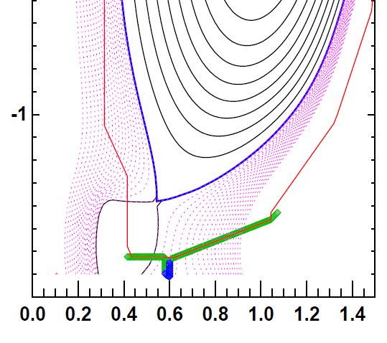
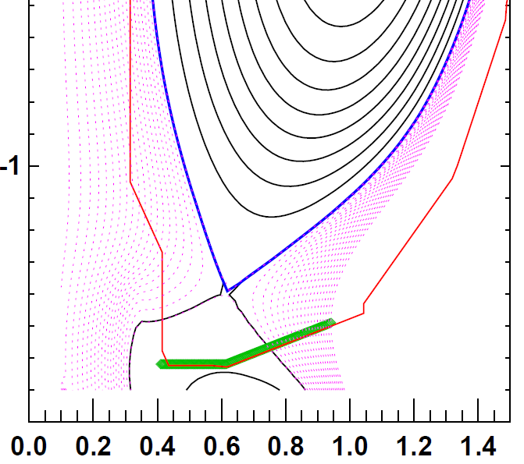
Replacement of outboard row of tiles provides significant heat-flux and maintains operational flexibility
Shape developed to perform dedicated tests on outboard PFCs
ISOLVER free-boundary solver utilized with specified β_{N}
0D-analysis obtains heating power for some assumed confinement (ITERH98)
Zero-radiation power exhaust provides heat flux figure-of-merit (FOM)
FOM calculates incident power accounting for magnetic shaping only
High-Z shape FOM is 66% of full-power, high-triangularity scenario
High-performance discharge
FOM ~ 60 MW/m²
High-Z reference discharge
FOM ~ 40 MW/m²

Slide 21
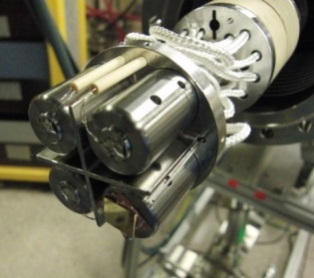
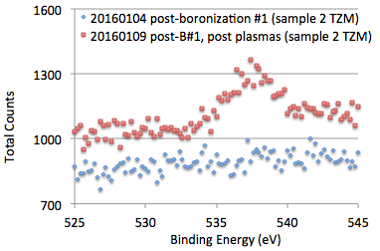
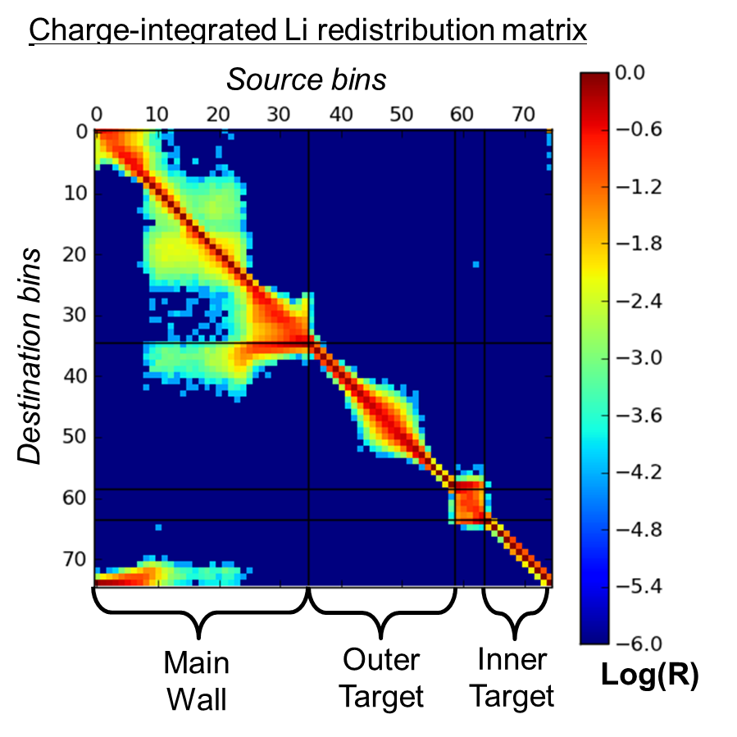
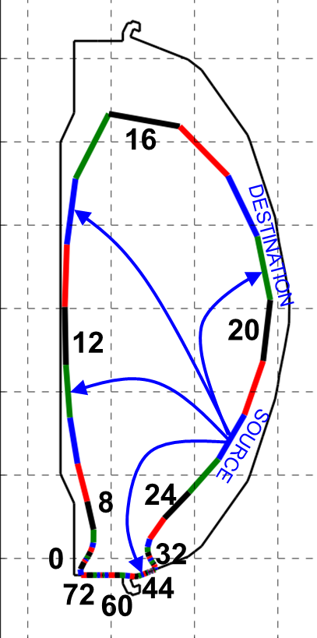
High-Z progression highlights mixed-material PMI and coordinated lab studies
Material Analysis and Particle Probe enables compositional analysis
Measurements of C, Li, Mo, B, O via XPS
D retention via TPD
Material migration modeling with WallDYN
PPPL PhD thesis, collaboration with IPP-MPG & PU
QCM and witness plate measurements in vacuum vess.
Mixed-material erosion model development with surf. sci. lab
Post-boronization
Post-plasma operations
C. Skinner
Oxygen peak appears
J. Nichols

Slide 22
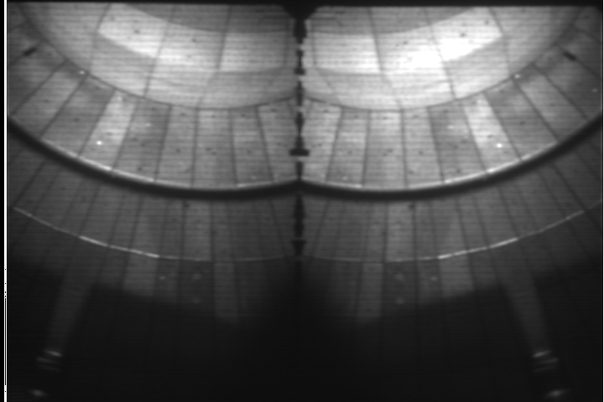
High-Z, mixed-material erosion examined in experiment and with quantum modeling
Extensive diagnosis of PFCs via plasma
Multiple imaging systems, spectrometers
Langmuir probes
Infrared thermography
Atomic scale quantum modeling of lithium mixed-material (Li+D on TZM)
Examined LiD “rock-salt” formation in liquid lithium
Results coupled into analysis of Magnum-PSI experiment on TZM(Abrams, NF 2016)
2-color simultaneous imaging
CD Band
D-gamma
F. Scotti, RSI 2015
Increased D concentration
β = N_{D}/N_{Li}
Chen, NF 2016

Slide 23
Outline
Two charges from Jon
Obtain input from team on impact of proposed polar-region changes to the TSG science mission using 5-year plan as a guide as well as the FY16-17 research campaigns
Document plasma shapes and parameters (e.g. strike-point position, heating power) necessary to accomplish TSG goals
Re-evaluate FY18-19 milestones
Polar-regions review
5-year plan review
Previous shots in NSTX-U
Milestone discussion

Slide 24
Current Milestone R18-2
R(18-2): Performance evaluation of high-Z candidate design and materials for NSTX-U
Description: The NSTX-U has a multi-year program to transition the interior plasma-facing components from the existing graphite materials to metallic substrates. This transition is expected to mimic conditions expected in future power reactors as well as enable more reactor-relevant studies of lithium as a plasma-facing component. The NSTX-U conducted a project in FY15-16 to develop a continuous row of high-Z tiles for installation in the NSTX-U outboard divertor. The design was optimized for high-heat flux performance under the criteria that the existing mounting scheme be re-used. The analysis conducted during the project highlighted certain critical thermo-mechanical properties as well as the need for cyclic fatigue data in stress and temperature conditions expected in the NSTX-U. This research milestone will undertake accelerated-time testing of these relevant properties in a range of experimental devices. In particular, the impact of surface recrystallization and stress concentrators will be evaluated to determine if there are significant impacts on the overall life-time of refractory-metal components. Prototype diagnostics relevant to the high-Z material program will also be tested in order to further optimize the NSTX-U implementation. The data obtained in this research milestone will be used to validate the engineering efforts conducted in the high-Z design project and provide additional guidance for future, high-heat flux upgrades of the NSTX-U plasma-facing components. Models of boron- and lithium-coated metals will be further developed and compared to experimental results as appropriate.

Slide 25
Proposed Milestone Revision
Modify to reflect current NSTX-U Recovery activities and questions
High-Z deferred to later date; Considering fish-scaled tiles design and/or CFC
Evaluate stress-limits of proposed graphite design and high-Z design in high-heat flux facility (e.g. Magnum-PSI, e-beam, other?)
Current, rounded-corner tiles predicted to exceed engineering allowable stress at 1400C
Current draft of Requirements document allows 1600C on surface, 2000C at corner for carbon ablation
Previous High-Z tile design activity allowed 1400C on TZM due to recrystallization
Evaluate self-limiting materials behavior of high-temperature graphite
Philipps 1992 TEXTOR paper observed clamping of temperature of graphite limiter well below radiative self-cooling limit at ~3000C
Also concluded that radiation-enhanced sublimation not an issue due to redeposition of thermally-emitted carbon
High-similarities to vapor-trapping phenomenon observed on Magnum-PSI with lithium and part of the general physics of self-limiting materials
If carbon self-limits at a temperature below the structural limitation of graphite, then PFC will be robust to plasma-loading and increases reliability of NSTX-U to operate

Slide 26
Discussion for other impacts
Two charges from Jon
Obtain input from team on impact of proposed polar-region changes to the TSG science mission using 5-year plan as a guide as well as the FY16-17 research campaigns
Document plasma shapes and parameters (e.g. strike-point position, heating power) necessary to accomplish TSG goals
Re-evaluate FY18-19 milestones

