Slide 1
NSTX
Supported by
Comparison of Private Flux Region with the Conventional Mid-Plane MGI on NSTX-U
College W&M
Colorado Sch Mines
Columbia U
Comp-X
General Atomics
INL
Johns Hopkins U
LANL
LLNL
Lodestar
MIT
Nova Photonics
New York U
Old Dominion U
ORNL
PPPL
PSI
Princeton U
Purdue U
SNL
Think Tank, Inc.
UC Davis
UC Irvine
UCLA
UCSD
U Colorado
U Maryland
U Rochester
U Washington
U Wisconsin
Culham Sci Ctr
U St. Andrews
York U
Chubu U
Fukui U
Hiroshima U
Hyogo U
Kyoto U
Kyushu U
Kyushu Tokai U
NIFS
Niigata U
U Tokyo
JAEA
Hebrew U
Ioffe Inst
RRC Kurchatov Inst
TRINITI
KBSI
KAIST
POSTECH
ASIPP
ENEA, Frascati
CEA, Cadarache
IPP, Jülich
IPP, Garching
ASCR, Czech Rep
U Quebec
R. Raman, S.P Gerhardt, D. Mueller,
D. Battaglia, J. Berkery, L-A. Delgado, A. Diallo, N. Eidietis, V.A. Izzo, T.R. Jarboe, B.P. LeBlanc, W-S. Liang, S.A. Sabbagh, F. Scotti, V. Soukhanovskii, K. Tritz, others…
Macroscopic TSG
This work is supported by US DOE contract numbers FG03-96ER5436, DE-FG02-99ER54519 and DE-AC02-09CH11466
30 June 2015
PPPL, Princeton, NJ

Slide 2
Overall Goals
Predicting and controlling disruptions is an important and urgent issue for ITER. Reactors based on the ST and Tokamak concepts will carry several MA of plasma current and therefore have the potential to disrupt, which can cause expensive, and unacceptable, vessel damage
Several tokamaks have studied the use of massive gas injection (MGI) from the low field side to safely terminate tokamak discharges
NSTX-U MGI research will improve the knowledge base on disruption mitigation (DM) with MGI by studying the importance of the poloidal gas injection location, and especially from the private flux region
This is the first MGI experiment to be conducted on NSTX/NSTX-U, so a primary objective is to implement MGI capability on NSTX-U to support the FY16 JRT on DM research

Slide 3
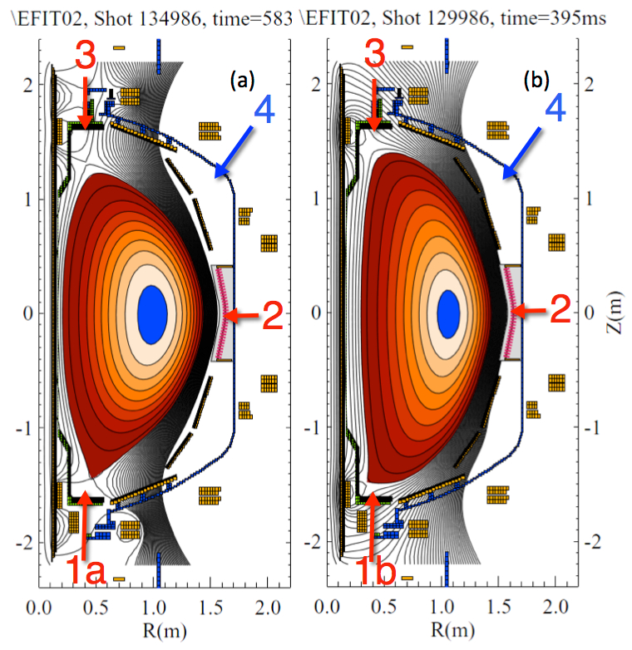
Overview of Planned Experiments
Asses benefits of injection into the private flux region & the high-field side region vs. LFS mid-plane
Part A (Establish critical trigger times)
  Establish Thomson trigger times
  Establish calibration settings for diagnostics
  Test diagnostics in a MGI triggered disruptive plasma
Part B (MGI into plasma)
  Establish vessel halo currents and divertor heat loads from a reference disruptive discharge without MGI mitigation
  Inject MGI from location 1 and 2 into a DN or LSN discharge to assess benefits
1a: Private flux region
1b: Lower SOL, Lower Divertor
2: Conventional mid-plane
3: Upper divertor
4: Future installation

Slide 4
General Considerations for this First MGI XP on NSTX-U
200 Torr.L of Ne will be used for all experiments (based on FY2013 and 2014 DIII-D experience)
Will conduct XP after the vessel Li levels are low in NSTX-U
Will rely on long HeGDC to restore operating conditions
Will use NBI heated L-mode discharge (~700 kA)
  Will use H-mode plasmas if possible
Will use Double Null discharge with PFR (private flux region) over injection port. Will use LSN, if necessary
NBI will be turned off at MGI injection time
Will conduct a limited set of experiments using a high-current H-mode discharge to begin to develop plasma conditions for FY16 JRT (Will need 1-2 days in addition to this, to run dedicated shots for the 2016 JRT, towards the end of FY16)
  Need details about breakdown for FY15 and 16 run allotments

Slide 5
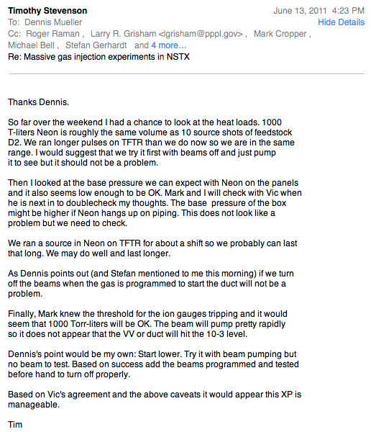
200 Torr.L Ne Should be OK
NBI will be turned off, so beam re-ionization not an issue
  With 200 Torr.L, even beam re-ionization probably not an important issue
Vessel pressure will increase to 7 mTorr (based on vessel volume only of 28,000 L)
  Actual pressure may be 3.5-7 mTorr
As a precaution, Initially we will watch background pressure in NB duct to see if starts to on subsequent shots (Re: Larry Grisham, 2011/06/13)

Slide 6
Part A: XMP - Establish plasma conditions and the trigger times for NBI, MGI & start of VDE
Time sequence for initiation of an MGI triggered disruption
Typical estimated
Times:
T0 = 390ms
T1 = 400ms
T2 = 401ms
T3 = 402ms
T0 = MGI Trigger
T1 = PF3U/3L Freeze + PF3U Voltage offset
PF3U
T3 = Time when MGI gas front
contacts plasma edge
PF3L
Day – 1
2 hours needed
T1 = start of VDE
Plasma current
NBI
T2 = NBI turn-off time after
T2 = T1
PCS does not allow MGI to run until beams are OFF.
Need to test this as part of the XMP

Slide 7
Establish VDE and NBI Times – 6 shots
Load a 700kA DN or LSN L-mode discharge
Test VDE
  Freeze the PF3U/L voltage at 400ms (time = T1)
  At 401ms impose a +30V increment to PF3U
Repeat a total of 3 times
  Measure time it takes for plasma to disrupt
  Measure divertor temperature and halo currents (diagnostic assessment)
Adjust T2 (based on Ip value & based on T1) to turn off NBI
  Turn NBI off at T1 (T2 = T1, set manually)
Day – 2
2 hours needed

Slide 8
Establish MGI Time
In the reference 700 kA discharge…..
After Ip reaches flat top, trigger the Mid-Plane MGI and then repeat with the lower divertor MGI (2 shots with each MGI valve)
  Use Neon at 5000-7500 Torr, and inject 200 Torr.L
  Set MGI trigger time to be 400 ms
  Inject first from mid-plane MGI (configured for Config. 1)
  Then, inject using the lower MGI
  On a different day, inject from mid-plane MGI (configured for Config. 3)
  Use Hα, SXR and bolometers to determine time delay from MGI trigger to evidence for gas contacting the plasma edge
  Set the two Thomson Laser trigger times to be 400.25 and 400.50 ms, and adjust on each shot to obtain the widest possible time separation, consistent with reliable EFIT re-constructions of the plasma boundary
Now re-load the reference shot with VDE and re-establish the Thomson trigger times for the mid-plane case
4 hours on Day 3
2 hours on Day 4

Slide 9
Prior to the MGI XMP
Develop 700 kA (L-mode shot with 2-3 NBI sources and with PFR over lower gas injection port)
Develop 1 MA (H-mode shot with 3-5 NBI sources and with PFR over lower gas injection port)
As a back-up, also develop a 700kA H-mode shot that may be used instead of the L-mode shot
Test implementing the VDE
Test if NBI turn-off interlock is functional

Slide 10
Accomplishments of the MGI XMP
Operate and calibrate MGI with TF only
Test implementing the VDE
  Collect divertor halo current and IR camera data
Test NBI turn-off interlock
Adjust gains and required optical filters, and timing for Thomson
Test and adjust gains on needed diagnostics: Spectroscopic systems, SXR, bolometer, fast visible cameras
Test reproducibility of low and high current shots (700 kA and 1MA, with PFR over MGI port), without Li usage
  Determine if we wish to use L-mode or H-mode

Slide 11
Part B-1: START of Main XP
Comparison of Mid-Plane to Lower Divertor Injection
Start with Config-1 for Mid-Plane MGI
Load the reference shot with the PFR over the MGI gas port (2 reference shots)
At t1 = 400ms, inject using the mid-plane MGI (2 shots)
Conduct 20 minutes HeGDC between shots
Repeat by injection using the lower divertor MGI (2 shots)
On two shots, vertically disrupt the plasma to measure divertor heat loading and divertor halo currents (2 shots)
Repeat Mid-plane and Lower-divertor injections at two different times (t2 and t3) so that there is a measurable difference in the proximity of the q = 2 surface to the plasma edge (8 shots)
Day 5- Total 16 shots: Total 8 hours

Slide 12
Part B-2: Pre-TQ Duration and Radiated Power to MGI Proximity to Plasma
Use Config. 3 for Mid-plane MGI
Restore Reference shot from Part B-1 (2 shots)
At the same three times inject form the Mid-plane MGI location (2 shots at each condition for the q=2 surface) (6 shots)
Now Load a 1MA, 4-6 source H-mode discharge (2 shots)
At a suitable time, inject using the mid-plane injector (2 shots)
Vertically disrupt the discharge to obtain divertor heat loading and halo-current data (2 shots)
If time permits, repeat using the lower divertor injector (2 shots)
Day 6 Total 10-12 shots: Total 8 hours

Slide 13
If this is the only XP for the JRT – Need additional 1-2 days
Goal 1: Test the effectiveness of the Lower MGI during VDEs that move towards the lower divertor
Load the reference VDE shot developed in Part B-I (1MA H-mode). T_vde is the VDE trigger time (2 shots)
  Obtain reference halo current and divertor heat loading data
At 4 different times (2 shots at each time) trigger the lower MGI (T_vde, T_vde + 1ms, T_vde -1ms, T_vde +0.5ms) [8 shots)
Repeat with the Mid-Plane MGI to obtain reference comparison (MGI in Config-1)
  The times refer to the time when the gas front contact the plasma edge (established from XMP)

Slide 14
Planned Analysis
Compare the following parameters for the three cases:
  Duration of pre-TQ and TQ
  Power radiated and profile during pre-TQ and TQ
  Divertor heat loading
  Divertor halo currents
  Gas assimilated by the discharge
Case 1: PFR vs. Mid-plane injection - (PFR injection, Mid-plane injection, and Un-mitigated VDE)
Case 2: Mid-plane with Short and Long connection tubes
Case 3: High-power and Low-Power discharges with short connection mid-plane tubes

Slide 15
Required Machine, NBI, RF, CHI and Diagnostics Capabilities
700 kA DN or LSN L-Mode or H-Mode Plasma with private flux region above organ pipe location
  2 to 3 NBI sources, no RF, no CHI
1 MA DN or LSN H-Mode plasma if possible with private flux region above organ pipe location
  4 to 6 NBI sources, no RF, no CHI
Key diagnostics
  Core diagnostics
    Thomson scattering, Soft X-ray, Bolometer, Magnetics
  Edge diagnostics
    Hα, Spectroscopic diagnostics
  Divertor diagnostics
    Halo current monitors, Langmuir probes
    Eroding thermocouples, Two color divertor IR camera
    Lower divertor visible camera in X-point mode with outer mid-plane views

Slide 16
Integration of Diagnostics and Resulting data
Thomson scattering, EFIT
Physics of gas penetration (fraction that penetrates separatrix)
H-alpha array, Spectroscopic detectors
System response time (gas trigger time to first detection of injected gas interacting with the plasma edge)
Multi-color Soft X-ray, H-alpha, Ip, EFIT, Thomson scattering, Mirnov coils
Delay in current quench after the gas contacts plasma edge
Rate of current quench and vertical dynamics of the plasma
3-D MHD response to the whole equilibrium and MHD activity
Thermal quench evolution & pedestal collapse
Bolometer array- Core radiated power dynamics
Halo current sensors- Dependence on halo current amplitude on gas assimilation (Mitigated vs. a VDE disruption)
Two color divertor fast infrared camera and Eroding thermocouples
Spatial distribution of Thermal loads & fast heat flux measurements

Slide 17
Publication of Results
Even the data obtained from the first 8 hours devoted to commissioning the MGI system (the MGI XMP) is publishable, and suitable for the 2016 IAEA meeting
Data collected during the second 8 hours provides results from mid-plane to PFR injection comparison, which are all internationally new results (6 good shots are adequate for this work). The additional data at two additional values of the q=2 location substantially improves the data set.
Data from the third day will determine if installing the MGI closer to the vessel allows more gas to be assimilated, or if the pre-TQ duration simply gets shorter. It also provides data on the overall response time of the MGI system for the short, and the more-realistic long injection configurations.
The limited data from the 1MA discharge is to begin to prepare for the FY16 JR, and to identify any difficulties.

