Slide 1

3D Fields: Status
Stefan Gerhardt, Clayton Myers
Dec. 8th, 2015

Slide 2
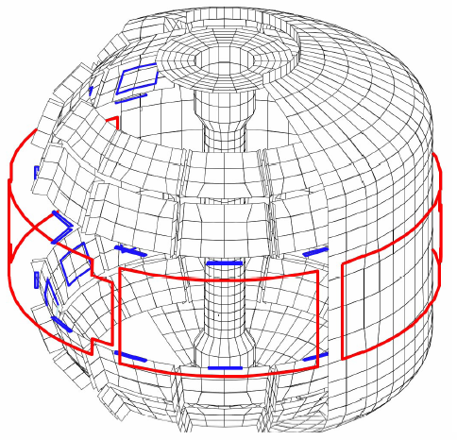
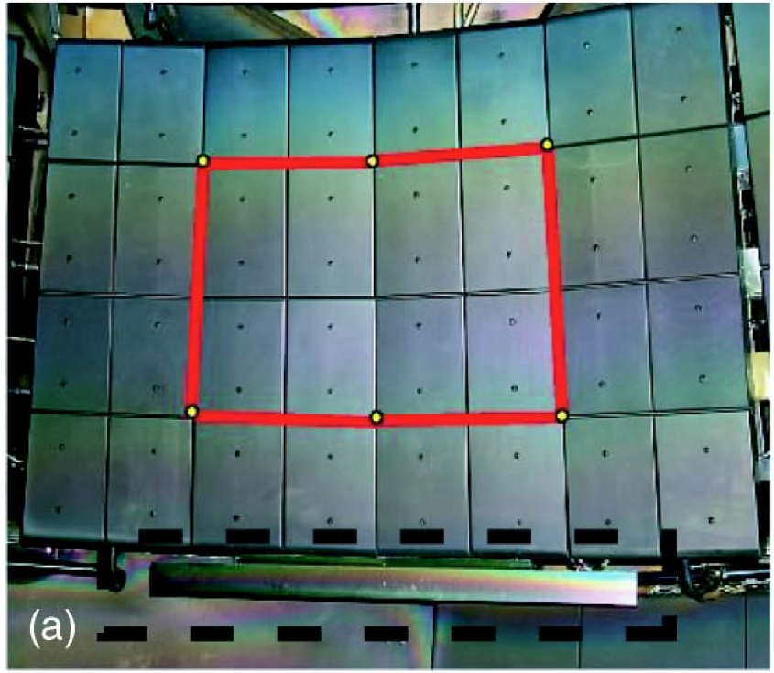
NSTX-U has Off-Midplane Internal 3D Field Sensors
Copper passive
conductor plates
SS Vacuum
Vessel
Sontag et al., Physics of Plasmas 12 056112 (2005)
B_{R}
B_{P} sensor
B_{P} Sensor in a Stainless Box
6 ex-vessel midplane control coils
B_{R} sensor is a loop behind the tiles, but in front of the plate.
VALEN Model of NSTX (Columbia Univ.)

Slide 3
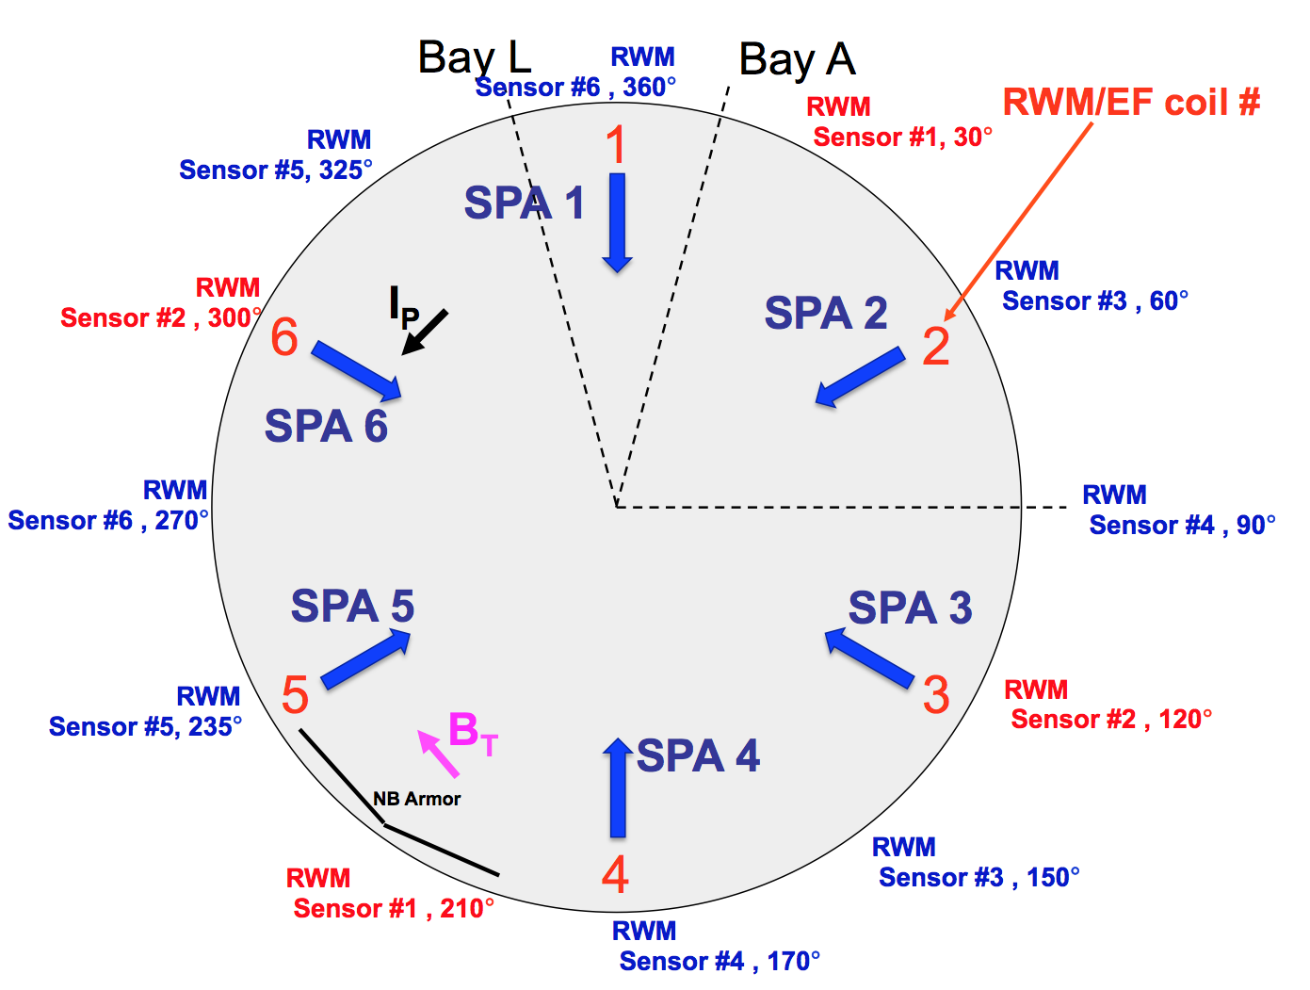
We Actually Integrate Sensor Sums and Differences

Slide 4
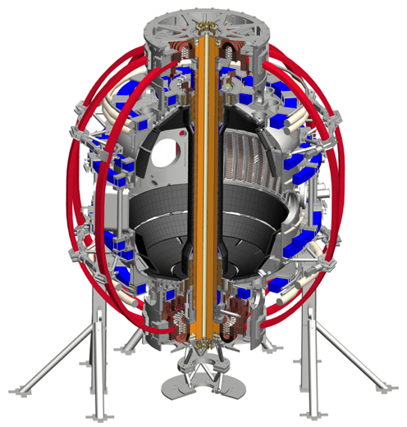

Slide 6
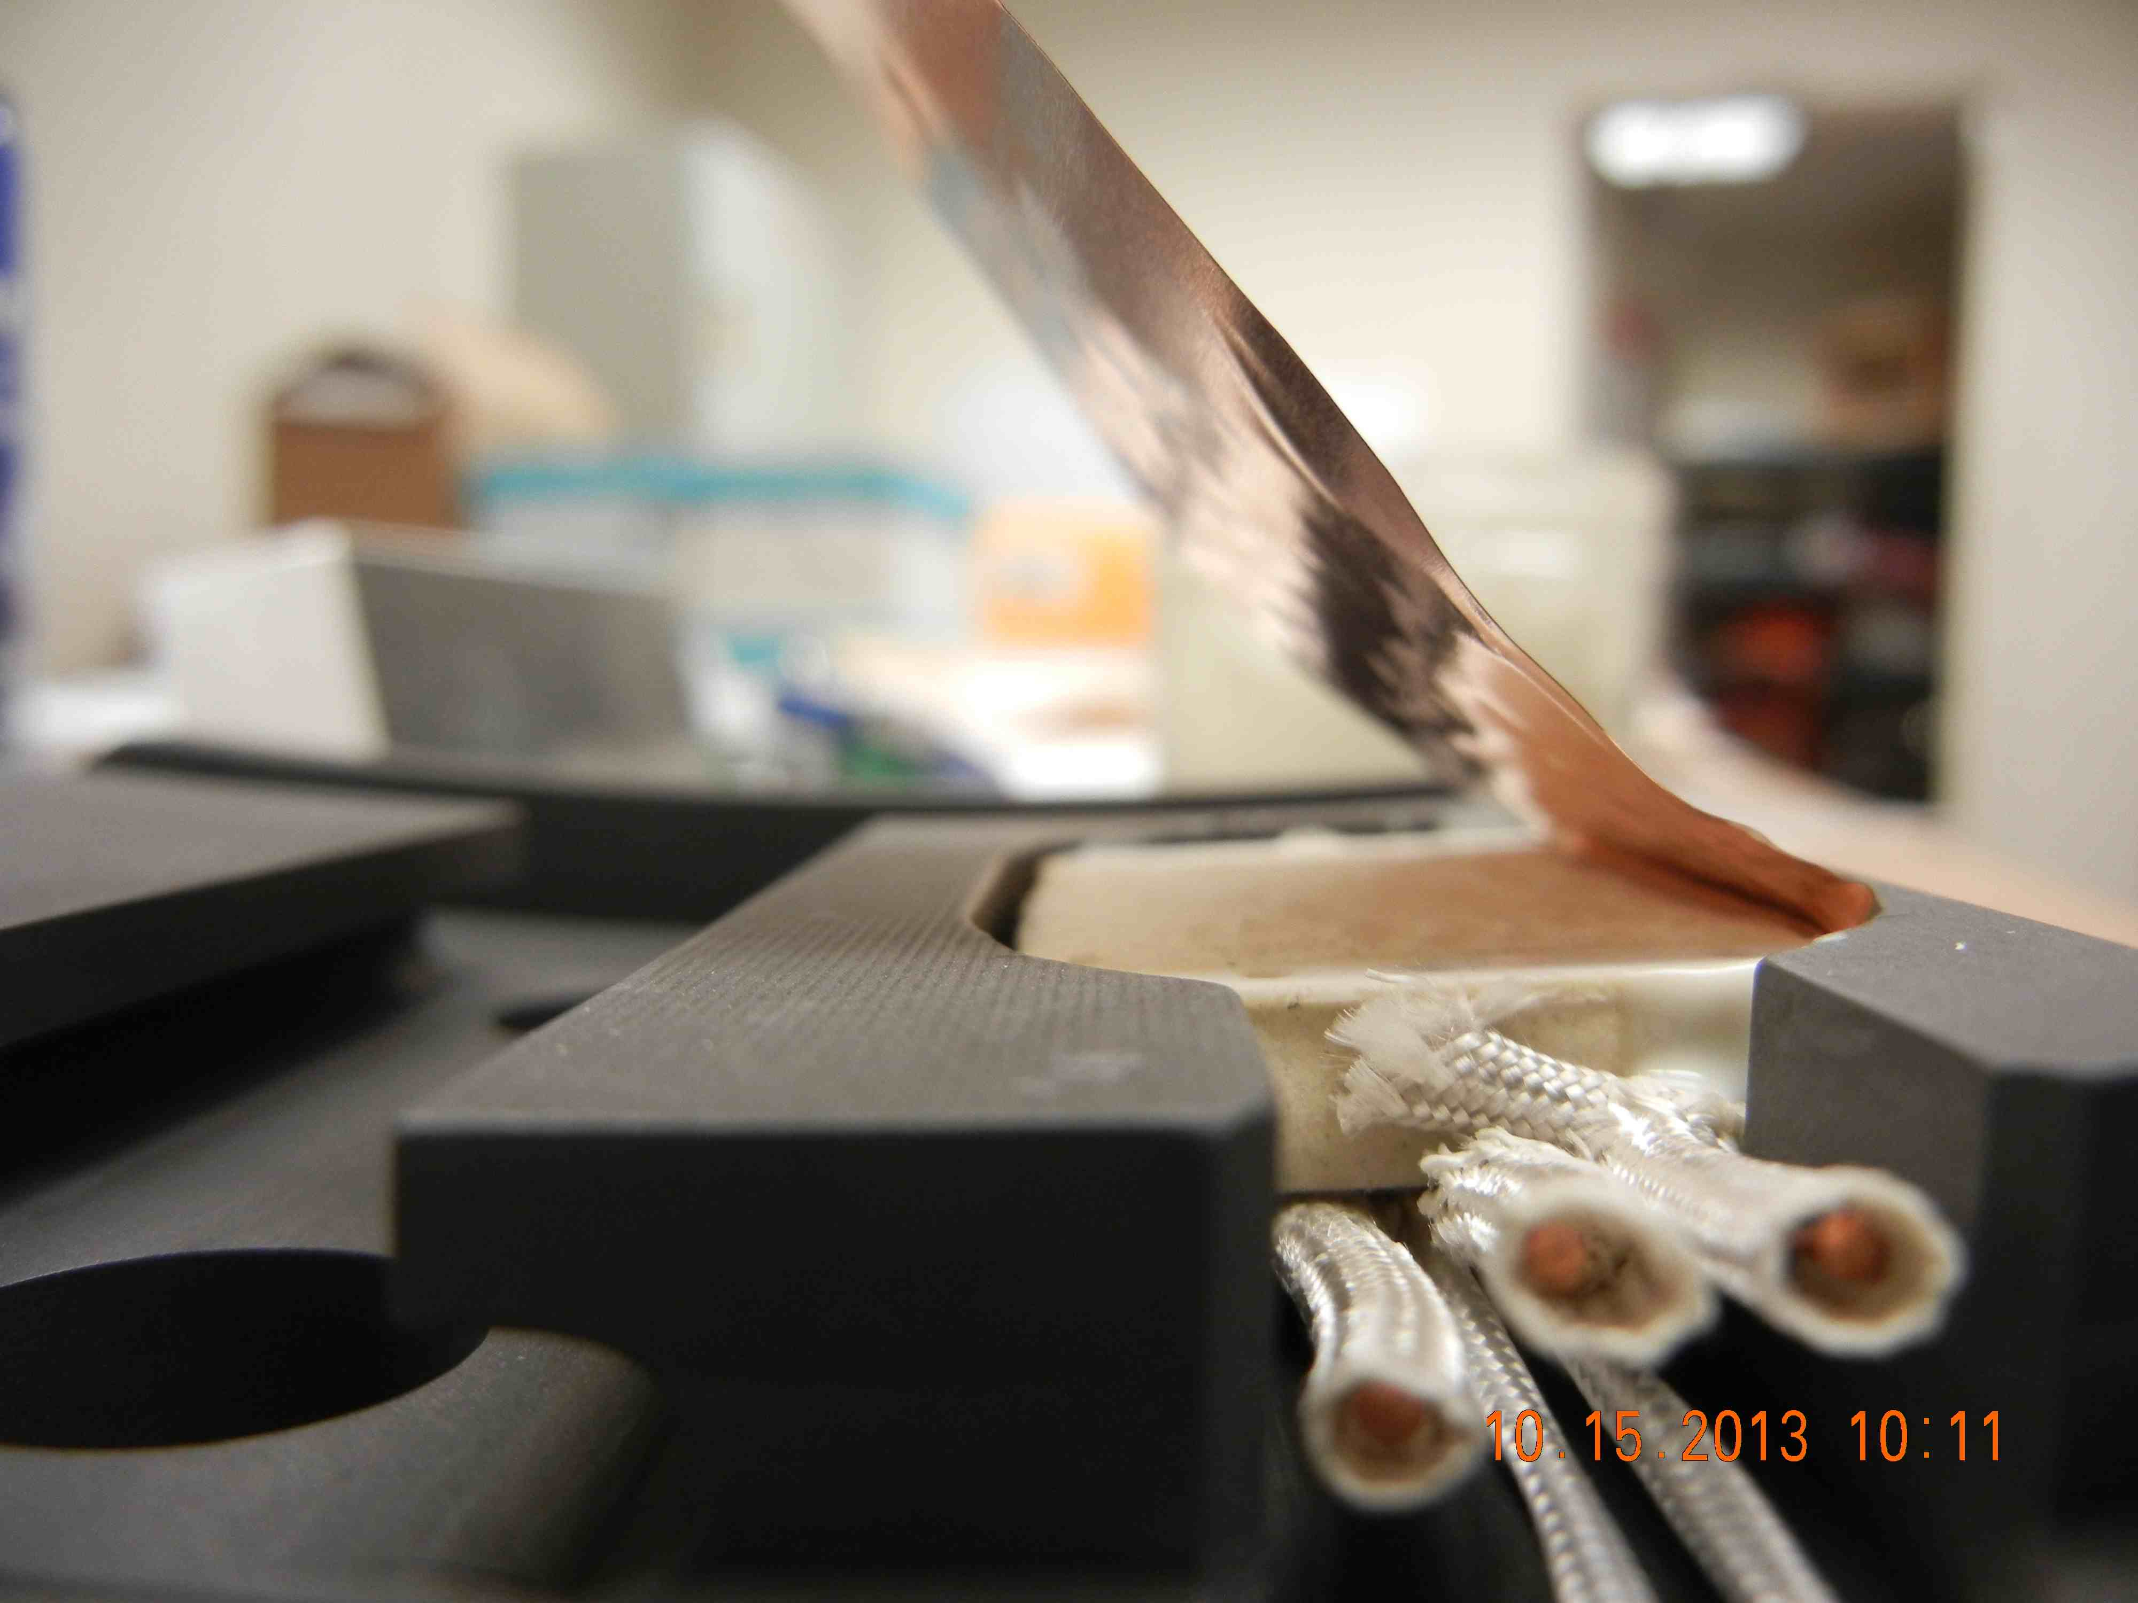
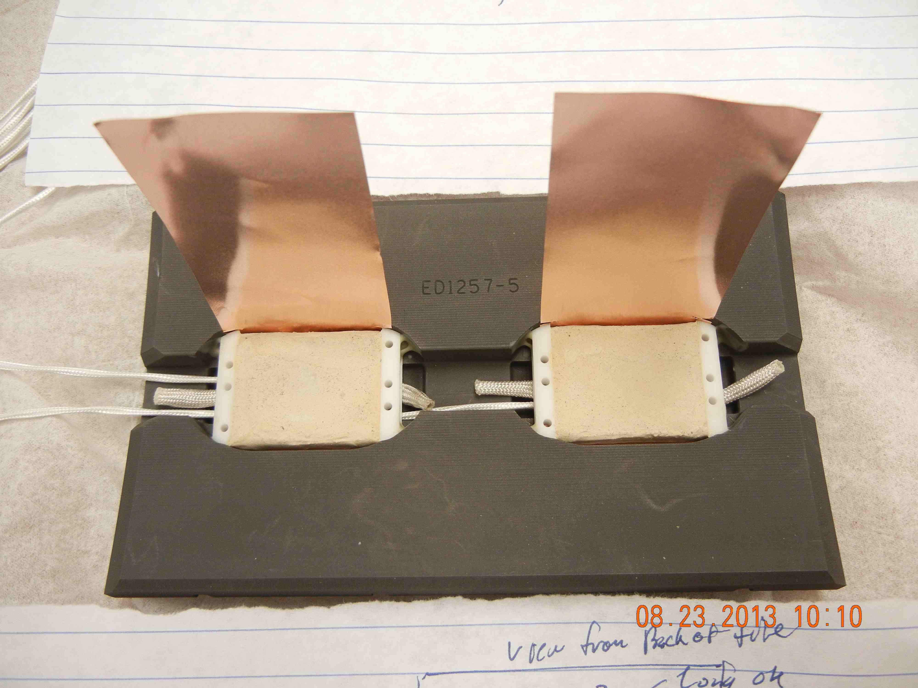
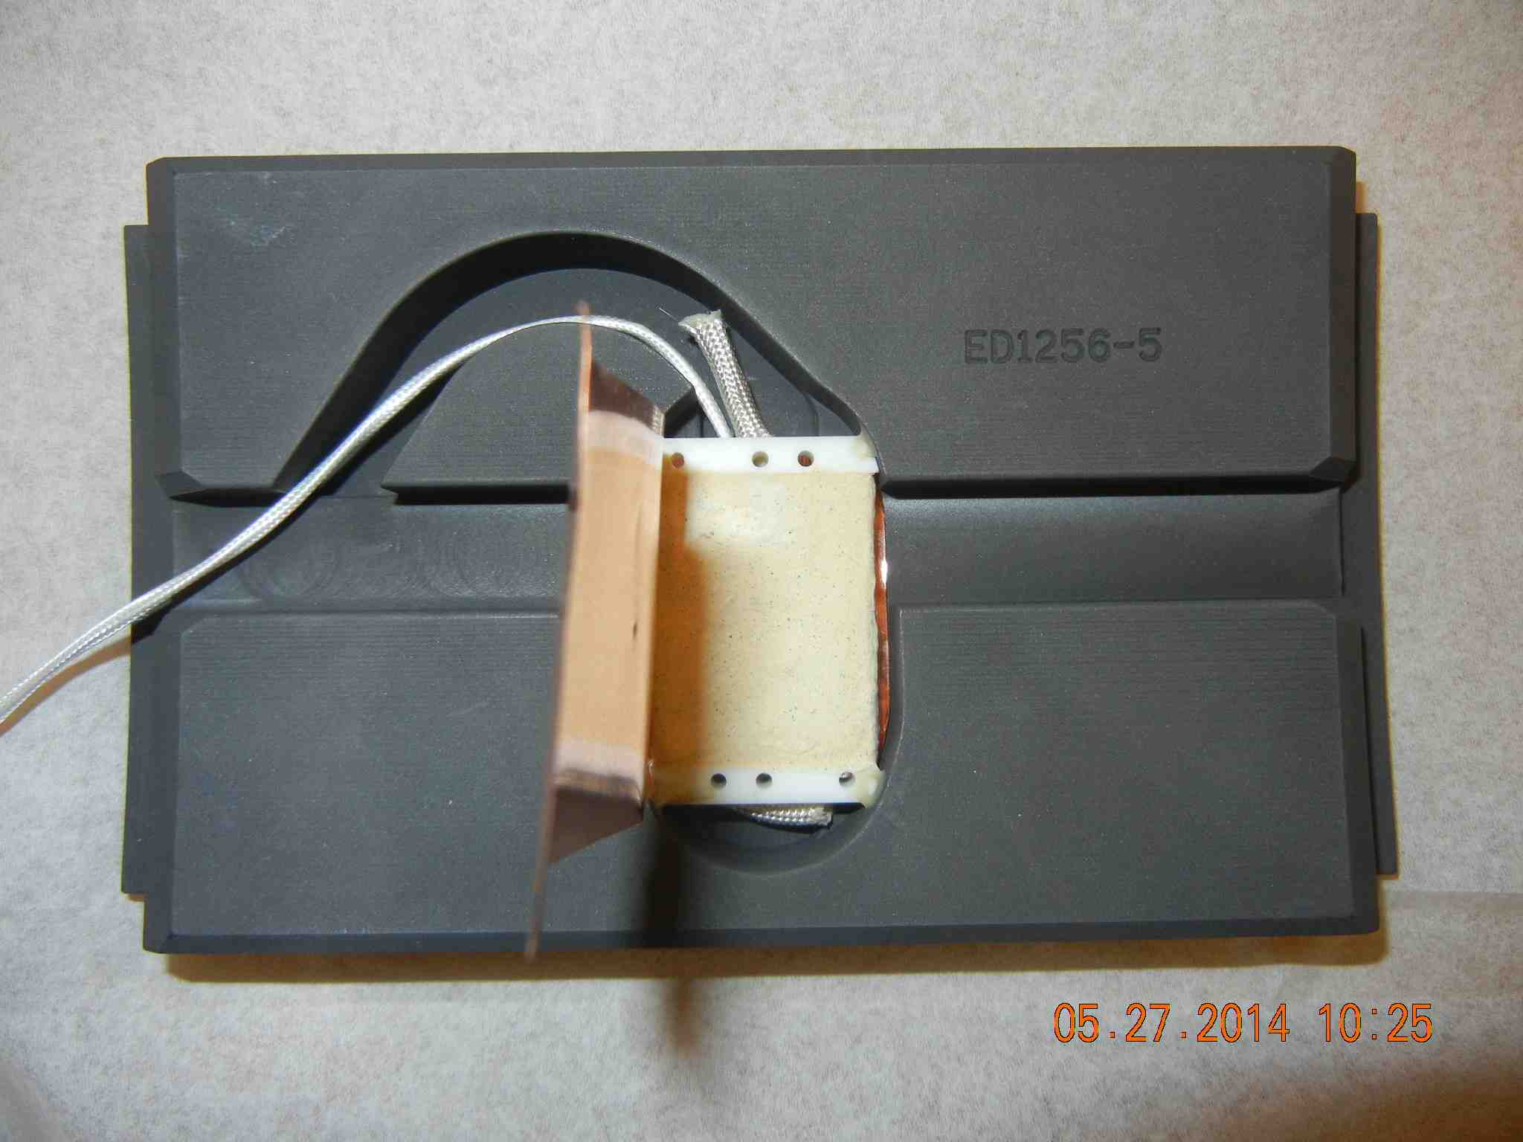
Mirnov Sensors
Detail of 2D Mirnov Installation
Tilted 1D Mirnov
Two 1D Mirnovs in a Single Tile

Slide 7
Notes
Only bad sensor is BP-RWM-PPP-L-GH
  Part of sensor #1.
  This is a 180 degree pair.
Best near-term option for CS magnetics is to do sums/differences of existing CS array pairs.
Expansion to new sensors is a major task, would require significant PFC rework.

