Slide 1




NSTX-U
Supported by
Recap of RWM magnetic sensor upgrade plan for NSTX-U (from 5 Year Plan)
Coll of Wm & Mary
Columbia U
CompX
General Atomics
FIU
INL
Johns Hopkins U
LANL
LLNL
Lodestar
MIT
Lehigh U
Nova Photonics
ORNL
PPPL
Princeton U
Purdue U
SNL
Think Tank, Inc.
UC Davis
UC Irvine
UCLA
UCSD
U Colorado
U Illinois
U Maryland
U Rochester
U Tennessee
U Tulsa
U Washington
U Wisconsin
X Science LLC
S. A. Sabbagh, J.W. Berkery, J. Bialek, S.P Gerhardt et al.
Columbia University, PPPL
Culham Sci Ctr
York U
Chubu U
Fukui U
Hiroshima U
Hyogo U
Kyoto U
Kyushu U
Kyushu Tokai U
NIFS
Niigata U
U Tokyo
JAEA
Inst for Nucl Res, Kiev
Ioffe Inst
TRINITI
Chonbuk Natl U
NFRI
KAIST
POSTECH
Seoul Natl U
ASIPP
CIEMAT
FOM Inst DIFFER
ENEA, Frascati
CEA, Cadarache
IPP, Jülich
IPP, Garching
ASCR, Czech Rep
Macrostability Topical Science Group Meeting
February 8th, 2015
PPPL
V1.0

Slide 2
NSTX-U
Supported by
Discussion of magnetic sensor upgrade plan for NSTX-U
Coll of Wm & Mary
Columbia U
CompX
General Atomics
FIU
INL
Johns Hopkins U
LANL
LLNL
Lodestar
MIT
Lehigh U
Nova Photonics
ORNL
PPPL
Princeton U
Purdue U
SNL
Think Tank, Inc.
UC Davis
UC Irvine
UCLA
UCSD
U Colorado
U Illinois
U Maryland
U Rochester
U Tennessee
U Tulsa
U Washington
U Wisconsin
X Science LLC
Culham Sci Ctr
York U
Chubu U
Fukui U
Hiroshima U
Hyogo U
Kyoto U
Kyushu U
Kyushu Tokai U
NIFS
Niigata U
U Tokyo
JAEA
Inst for Nucl Res, Kiev
Ioffe Inst
TRINITI
Chonbuk Natl U
NFRI
KAIST
POSTECH
Seoul Natl U
ASIPP
CIEMAT
FOM Inst DIFFER
ENEA, Frascati
CEA, Cadarache
IPP, Jülich
IPP, Garching
ASCR, Czech Rep
J.W. Berkery, S. A. Sabbagh, J. Bialek, A. Diallo, S.P. Gerhardt, N. Logan, J-K Park, R. Raman, V. Soukhanovskii, et al.
NSTX-U 5 Year Plan Meeting
January 11th, 2013
PPPL
V1.5

Slide 3


NSTX-U
Supported by
RWM active control performance analysis using NCC actuators and realistic sensors
Coll of Wm & Mary
Columbia U
CompX
General Atomics
FIU
INL
Johns Hopkins U
LANL
LLNL
Lodestar
MIT
Lehigh U
Nova Photonics
ORNL
PPPL
Princeton U
Purdue U
SNL
Think Tank, Inc.
UC Davis
UC Irvine
UCLA
UCSD
U Colorado
U Illinois
U Maryland
U Rochester
U Tennessee
U Tulsa
U Washington
U Wisconsin
X Science LLC
S. A. Sabbagh and J.M Bialek
Department of Applied Physics, Columbia University, New York, NY
Culham Sci Ctr
York U
Chubu U
Fukui U
Hiroshima U
Hyogo U
Kyoto U
Kyushu U
Kyushu Tokai U
NIFS
Niigata U
U Tokyo
JAEA
Inst for Nucl Res, Kiev
Ioffe Inst
TRINITI
Chonbuk Natl U
NFRI
KAIST
POSTECH
Seoul Natl U
ASIPP
CIEMAT
FOM Inst DIFFER
ENEA, Frascati
CEA, Cadarache
IPP, Jülich
IPP, Garching
ASCR, Czech Rep
NSTX-U NCC Working Group Meeting
January 30th, 2015
PPPL
V1.2

Slide 4
Upgraded magnetic sensor plan status discussed at recent meeting
Global mode diagnosis
  Measure theoretically expected mode alteration at high β_{N}
RWM physics and control
  Improve RWM state space active control and observer
  Enhance input to disruption warning system
Disruption characteristics
  Expanded shunt tile set for halo current diagnosis, etc.
  Do questions remain re: specs for halo current meas. / shunt tile set?
Snowflake divertor and ELM characteristics
  Additional requests / detail needed for probes to run snowflake?
  Further extensions of magnetics for ELM research?
CHI
  Additional flux loop positions requested – what about B probes?
1) These elements to
be discussed here
2) Further discussion on topical cross-cutting,
improvements
3) Status of these elements discussed yesterday
Additional detail not needed for today’s discussion

Slide 5
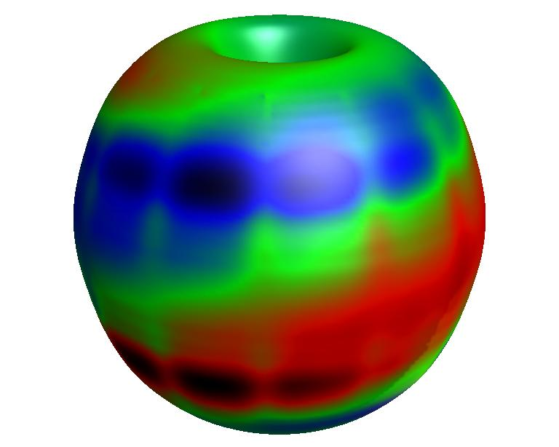
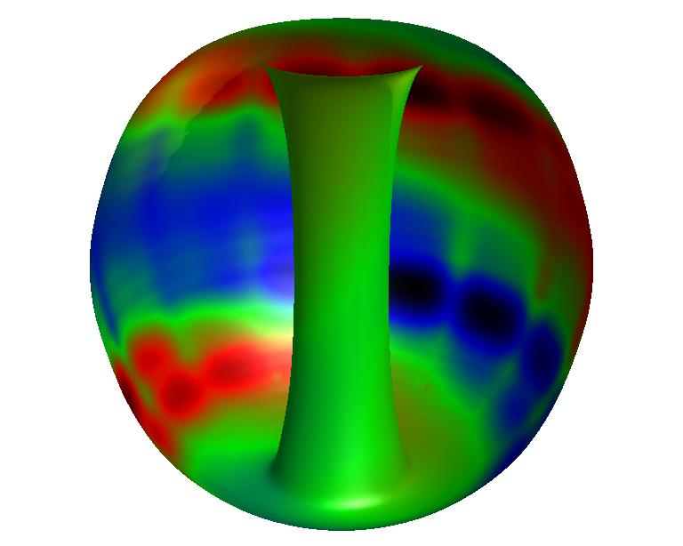
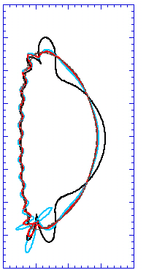
Multi-mode computation shows 2nd eigenmode component has dominant amplitude at high β_{N} in NSTX stabilizing structure
δB^{n} RWM multi-mode composition
δB^{n} from wall, multi-mode response
β_{N} = 6.1
2.0
133775
mode
2
t = 0.655s
1.0
mode 1
Z(m)
θ
0.0
mode
3
δB^{n} amplitude (arb)
-1.0
mode 3
-2.0
mode 2
The two primary global modes have increased amplitude in the divertor region
This was also found theoretically for NSTX for single mode computations during the design of the present NSTX system
0.0
1.0
2.0
R(m)
mode
1
Unstable
Stabilized by rotation
S. Sabbagh, et al., NF 2004
ideal eigenmode number
mmVALEN code
S.A. Sabbagh, et al., IAEA FEC 2010 (Paper EXS/5-5)

Slide 6
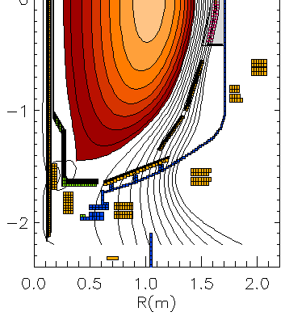
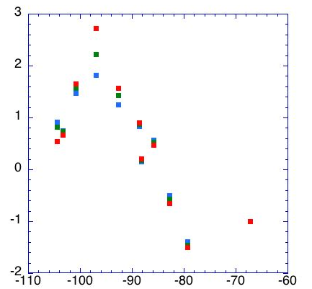
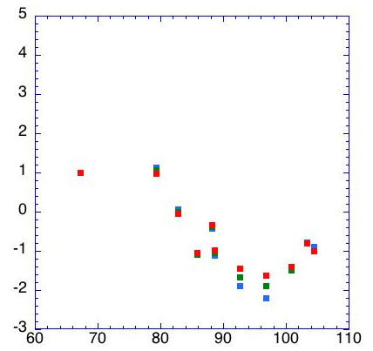
Review: 3D analysis of extended MHD sensors show significant mode amplitude off-midplane, incl. divertor region
n = 1 ideal eigenfunction for high beta plasma (three mode sum)
Z(m)
Present sensor locations
B_{R} sensors (nominally normal, B_{norm})
B_{p} sensors (nominally tangential, B_{tan})
θ
New sensor locations (includes
one new location above midplane)
R(m)
B_{norm} vs. theta (normalized to present Br sensors)
Z_{plasma} = -10 cm
Model characteristics
  New 3D model of divertor plate
  3D sensors with finite toroidal extent; n*A of existing sensors
Results summary
  Field amplitude up to factor of 6 larger with new sensors
  Perturbed field reversals observed with new sensors
  Signals sufficient with plasma shifted off-midplane
= -5 cm
= 0 cm
Present sensors
B_{norm}(normalized)
Φ = 0 deg
Φ = 0 deg
θ (deg)
θ (deg)

Slide 7
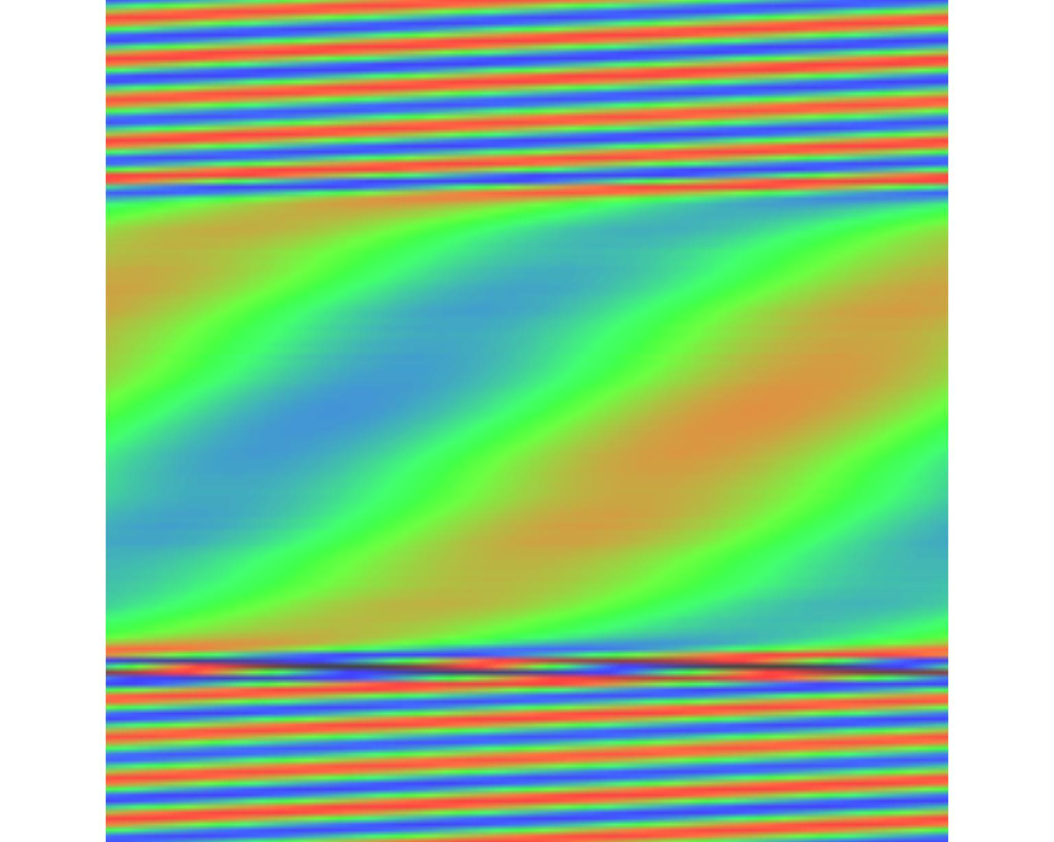
Significant change to toroidal phase (n = 1 mode shown) would be clearly measured in new sensor location range
poloidal angle
center
column
outboard
midplane
Approximate range
for new sensors
Present
sensor positions
toroidal angle
Approximate range
for new sensors
120047 t=0.745s
Due to significant field line pitch in this region
Still have relatively long poloidal wavelength (vs. center column region)

Slide 8
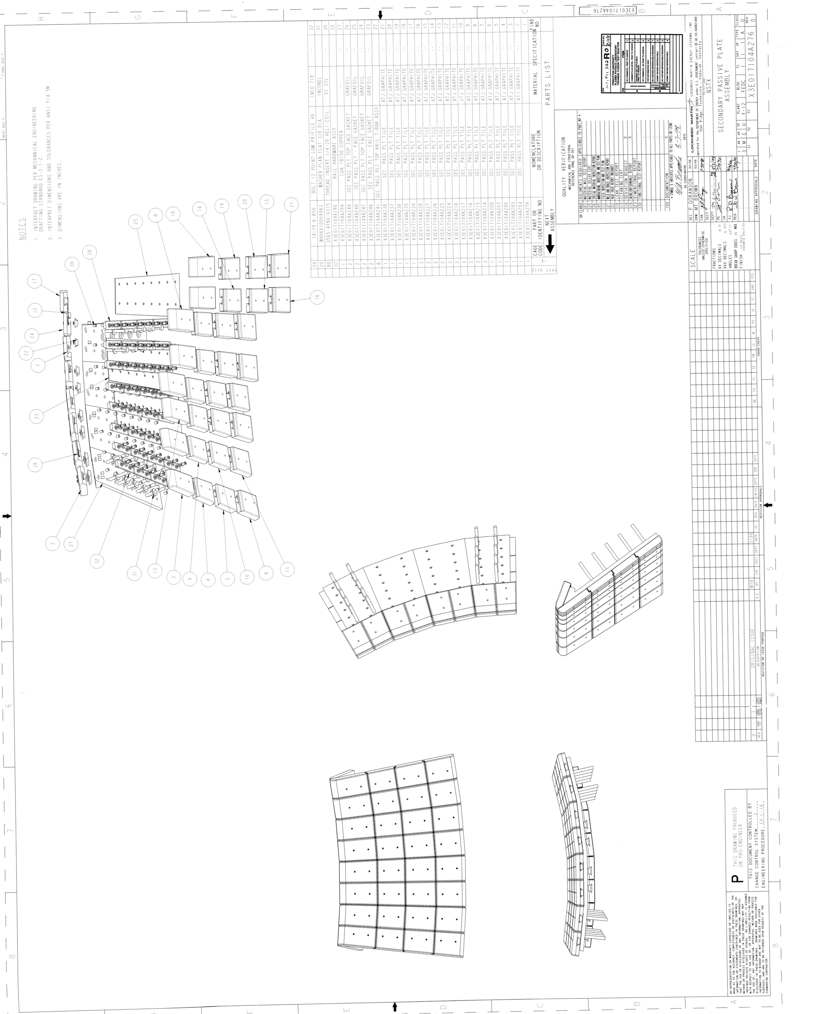
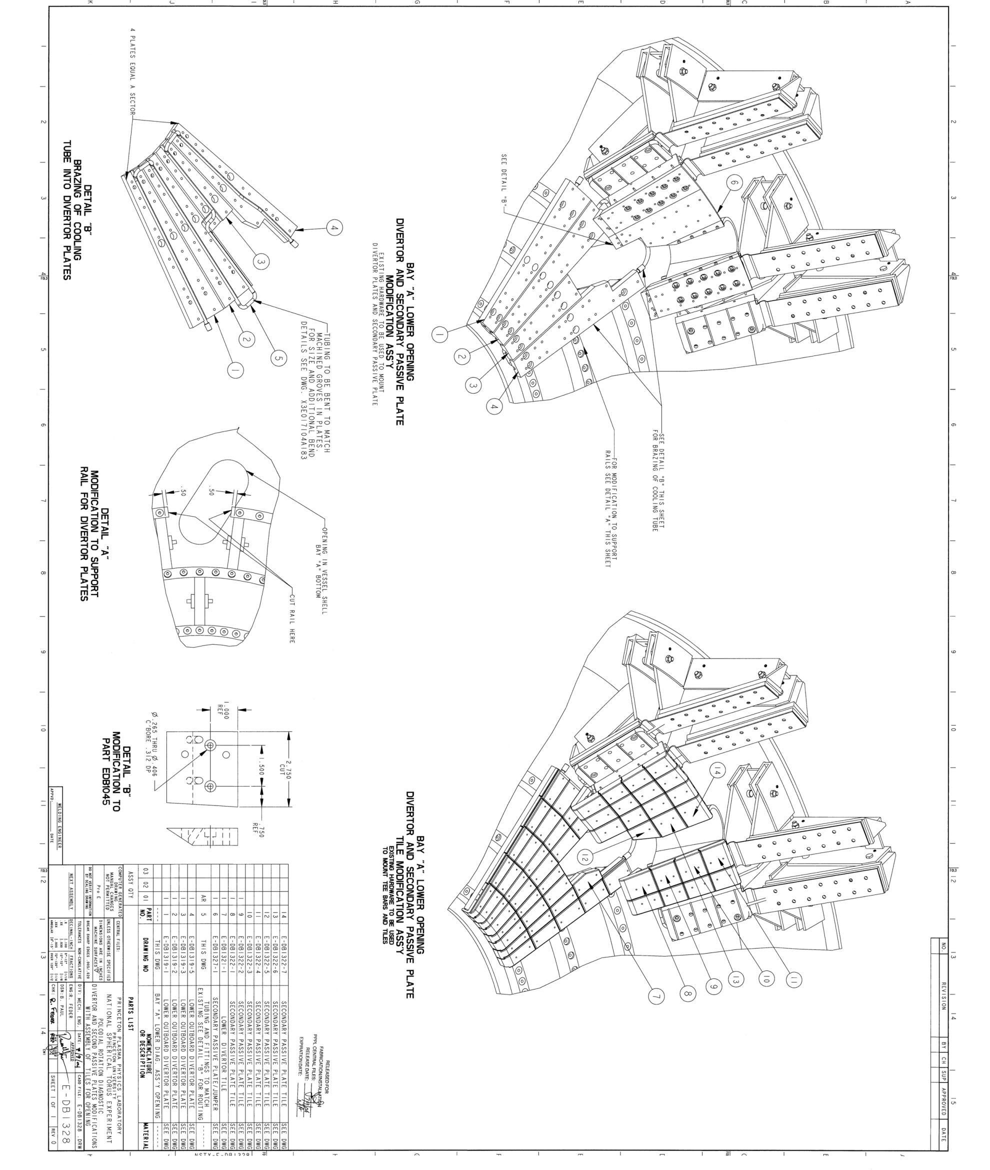
SPG Idea #1: Mount them under Secondary Passive Plate Lip
Replace this tile with sensor box.
Would be partially shielded by SPP
Might need to retain part of the front of the tile, but much could likely be eliminated.
Wire extraction fairly simple.
Boxes may need to be curved to follow outline of plate.

Slide 9
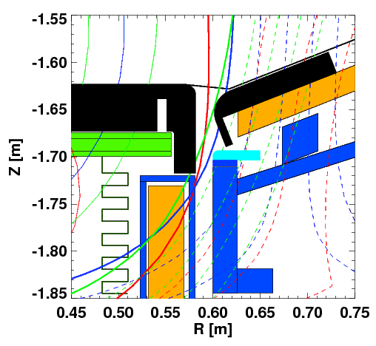
SPG Idea #2: Mount them under outer divertor bull nose tiles
Place curved sensor box in this volume.
Is reasonably well shielded from plasma by improved bull-nose tiles.
Wire extraction likely to be difficult.
Would be partially electromagnetically shielded by divertor.

Slide 10
SPG Idea #3: Sensors in Tiles
Tiles are only about 0.9” thick, and have a T-bar right down the center.
  Makes installation of a traditional B_{P} (~B_{R}) sensor difficult.
  Could imagine a very thin “Hiro” sensor mounted above the T-bar.
Could fabricate a single larger tile, taking the area of 2-4 existing tiles.
  Wrap a B_{N} (~B_{Z}) sensor around the tile edges.
    Sort of like how the B_{R} sensors are mounted to the PPPs
  Would likely trap the t-bars
  Are there thermal issues with larger tiles?
  Need to check the effective area.
Outline of larger tile

Slide 11
Theory indicates that positioning new sensors closer to divertor will improve mode measurement
n = 1 ideal eigenfunction for fiducial plasma
Z(m)
Present sensor locations
B_{R} sensors (nominally normal, B_{norm})
B_{p} sensors (nominally tangential, B_{tan})
New sensor locations discussed (schematic) (includes possible locations in THIS range (+ one position above midplane)
Present suggestions (based on recent meeting – combination of physics needs, machine hardware constraints, and budget (discussion continues):
  Consider 12 toroidal positions, 4 arrays (48 sensors) as “baseline”
  1st: B_{tan} or B_{norm} at smallest R (best accessible) in outer divertor region
  2nd: B_{tan} just below secondary passive plate (in Z position) – (B_{norm} possible here?)
  3rd: B_{norm} sensors in the lower divertor tiles (R position TBD)
  4th: B_{norm} or B_{tan} sensors at smallest R (best accessible), opposite Z in outer divertor
  Are other positions possible to improve higher n (higher m) detection?
R(m)

Slide 12
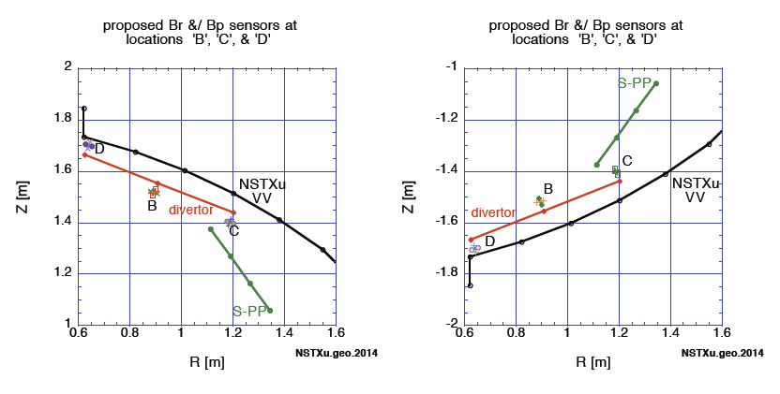
Extended RWM sensors proposed – consider use for RWM active feedback (RWM and NCC actuator coils)
Motivation: Initial calculations using existing RWM sensors and NCC yielded inferior performance to idealized sensors
Can new sensor positions improve active control performance?
  New positions considered possible from past discussions to extend RWM sensor set

Slide 13
Extensive VALEN calculations of RWM active control performance with new sensors considered several variations
Configuration variations (all using “full” NSTX-U model)
  Sensor position variations
  Partial and full NCC sets; midplane RWM coils added (or not)
  NOTE: “intermediate β_{N}” equilibrium used
    Higher β_{N} equilibrium shows greater mode amplitude deeper into divertor region (in poloidal angle), but control must work over full range of β_{N}
Feedback parameter variations
  Feedback phase scans
  Feedback gain scans
  “Smart shell” and “active control” analyses
    The latter implements sensor compensation of the applied 3D field
Extensive combinations of sensors and actuators, feedback phases and gains
  Will only summarize “best” performance to compare configurations

Slide 14
Existing RWM sensors (Bottom B_{p}) driving Midplane RWM coils: calculation used for comparison
ideal wall
(worst/best phase)
Sensors
  Present RWM sensors (bottom B_{p}), compensated
Actuators
  Midplane RWM coils
Performance
  Nearly identical to idealized midplane coils (as expected)
passive
Growth Rate (1/s)
active
control
β_{N}

Slide 15
Existing RWM sensors (Bottom B_{p}) driving upper NCC: sensors sufficiently decoupled from induced wall currents
Sensors
  Present RWM sensors (bottom B_{p}), compensated
Actuators
  Top NCC coils (1x12)
Performance
  Superior to midplane RWM coils by Δβ_{N} ~ 0.5
  Uncompensated sensor results similar (bottom B_{p} driving upper NCC)
  BUT: Present RWM sensors driving neighboring NCC results in decreased performance – consider new sensor positions
ideal wall
(worst/best phase)
passive
Growth Rate (1/s)
active
control
β_{N}

Slide 16
Proposed “B position” sensors in upper divertor driving midplane RWM coils close to present system performance
ideal wall
(worst/best phase)
Sensors
  Top B_{p}, position B; compensated
Actuators
  Midplane RWM coils
Performance
  Somewhat superior to existing RWM sensors (Δβ_{N} ~ 0.25)
passive
Growth Rate (1/s)
active
control
β_{N}

Slide 17
Proposed “B position” sensors in upper divertor driving upper & lower NCC significantly improves performance
Sensors
  Top B_{p}, position B; compensated
Actuators
  Top and bottom NCC (2x12)
Performance
  Uncompensated sensor results similar
  Significantly superior performance to existing sensors/coils (Δβ_{N} ~ 1.25)
ideal wall
(worst/best phase)
passive
Growth Rate (1/s)
active
control
β_{N}

Slide 18
Proposed “B position” sensors in upper divertor driving upper & lower NCC and midplane RWM coils also works well
Sensors
  Top B_{p}, position B; compensated
Actuators
  Top and bottom NCC (2x12), and RWM coils
Performance
  Uncompensated sensor results similar
  Slightly inferior performance to upper/lower NCC alone (Δβ_{N} ~ -0.1)
  In reality, w/midplane coil may be superior if mode “bulges” (Sabbagh, PRL 2006)
ideal wall
(worst/best phase)
passive
Growth Rate (1/s)
active
control
β_{N}

Slide 19
The other potential “new” sensors (Positions C and D) tested are inferior to the “B position” sensor results
Sensors
  Top B_{p}, position C, compensated
Actuators
  Bottom NCC (1x12)
Performance
  Inferior to “Position B” sensor results by Δβ_{N}~ -0.85
  NOTE: “Position D” sensor should not be considered for control at intermediate β_{N}
    Need β_{N} > 5 for sufficient mode amplitude at high poloidal angle
ideal wall
(worst/best phase)
passive
Growth Rate (1/s)
active
control
β_{N}

Slide 20
Positions have been found for new RWM sensors to allow superior RWM feedback performance with NCC
Past result: Active RWM control calculations showed superior performance to RWM coils with NCC and idealized sensors
Issue: Further calculations showed existing RWM B_{p} sensors driving neighboring NCC coils yielded relatively poor performance
Present calculations
  Existing RWM B_{p} sensors driving NCC on the opposite side of the midplane can improve feedback performance (Δβ_{N} ~ +0.5)
  Sensors in correct positions near the divertor plates driving the full 2x12 NCC yield significant performance improvement (Δβ_{N} ~ +1.25)
  Partial NCC (2x6) also show significant performance improvements: (odd, or even parity options yield Δβ_{N} ~ +0.9)

Slide 21
Stefan’s Comments/Questions re: extended RWM sensors (+ SAS replies)
Is it necessary that these be up/down symmetric?
  Maybe focus on LSN discharges for the first installation?
    SAS comment: Up/down asymmetric ok – also has advantage of higher m resolution (helps address comment by Jong-Kyu regarding higher n’s)
Is likely premature to consider the details:
  Is lower divertor going to be modified for pumps or lithium systems?
    Suggested locations need changes if a cryopump placed in lower divertor.
    But, cryopump would also allow for opportunities for sensor integration
    Reply: Sensors to be installed at same time / must be compatible w/cryo.
  How many years of operating with these sensors is required to make them worth the effort?
    SAS: Even one year would provide key data, and results might argue to keep them in (e.g. for improved operation of RWM state-space controller)
Who will do this work?
  SPG not likely to have time (if accepted in plan, person would be found)

