Slide 1


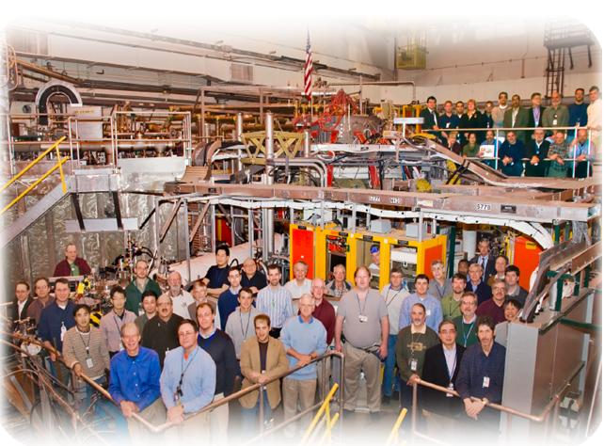

NSTX
Supported by
MS TSG Pre-Forum Meeting
Comments on R11-2
College W&M
Colorado Sch Mines
Columbia U
CompX
General Atomics
INL
Johns Hopkins U
LANL
LLNL
Lodestar
MIT
Nova Photonics
New York U
Old Dominion U
ORNL
PPPL
PSI
Princeton U
Purdue U
SNL
Think Tank, Inc.
UC Davis
UC Irvine
UCLA
UCSD
U Colorado
U Illinois
U Maryland
U Rochester
U Washington
U Wisconsin
Stefan Gerhardt
Culham Sci Ctr
U St. Andrews
York U
Chubu U
Fukui U
Hiroshima U
Hyogo U
Kyoto U
Kyushu U
Kyushu Tokai U
NIFS
Niigata U
U Tokyo
JAEA
Hebrew U
Ioffe Inst
RRC Kurchatov Inst
TRINITI
KBSI
KAIST
POSTECH
ASIPP
ENEA, Frascati
CEA, Cadarache
IPP, Jülich
IPP, Garching
ASCR, Czech Rep
U Quebec

Slide 2
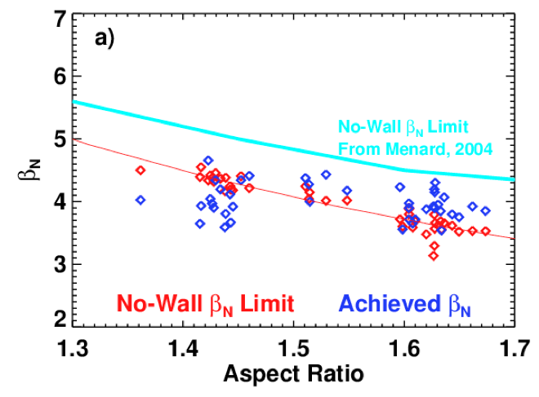
Some Background
NSTX typically scans A and κ simultaneously.
No inner gap control (at present).
Calculations (using experimental profiles) show a reduced ideal no-wall limit when A and κ are increased.
Have never done a dedicated experiment to test the experiment beta limit vs. (high) κ and A.
From TRANSP database of high-performance discharges
CHEASE fixed boundary + DCON

Slide 3
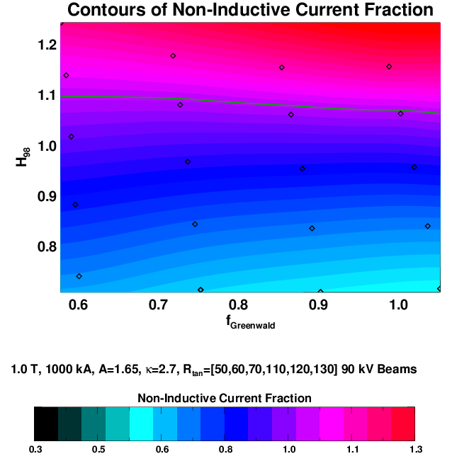
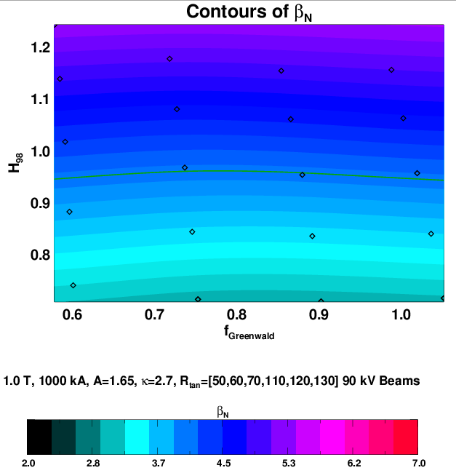
We need to robustly sustain β_{N}=4.5-5 at high A and κ
Simulations for 1.0 T, 1.0 MA, κ=2.7, A=1.65, 12 MW
  Need β_{N}=4.5-5, at H₉₈=1.1, for fully non-inductive operation.
Scenarios with lower current and more NBCD will likely need A~1.8, κ~2.9-3.0 for more off-axis CD.

Slide 4
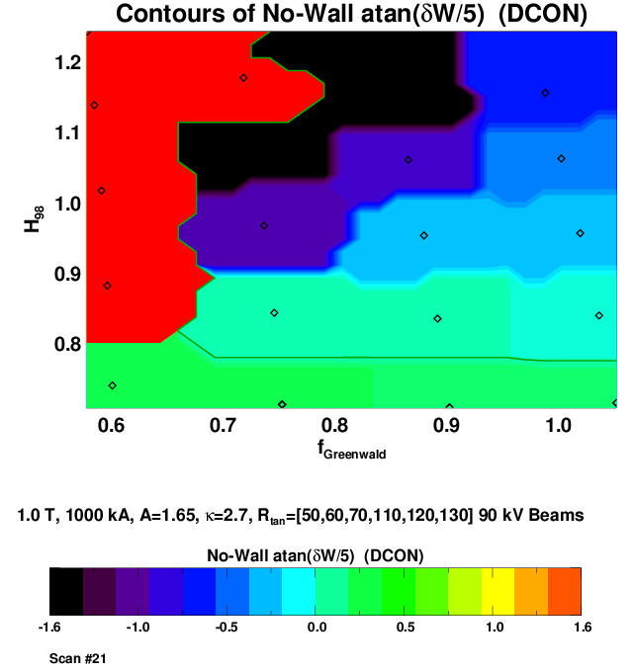
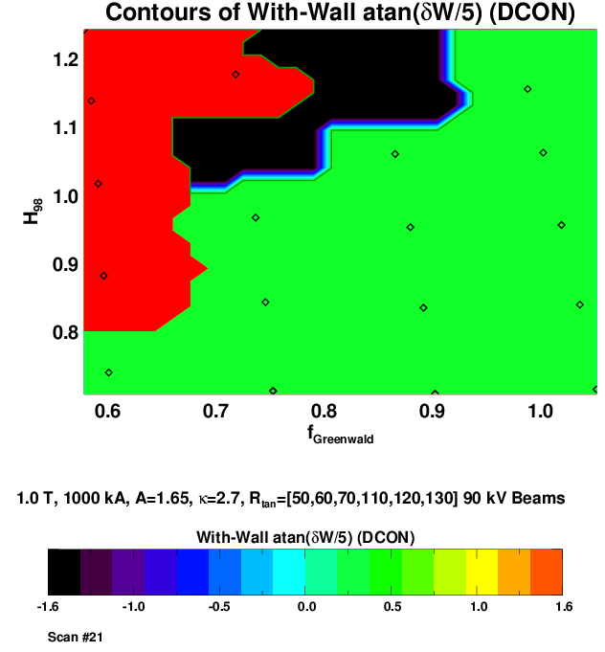
Ideal Stability May Further Limit the Operating Space
q_{min} to low
Internally unstable
Pressure
peaking
too large
q_{min} to low
Internally unstable
Pressure
peaking
too large
Wall Stabilized Regime
Preliminary!
Important future task: re-run with some additional fast ion diffusion to reduce the central NBCD and pressure peaking.
Also would be nice to inmprove the resolution in [H₉₈,f_{GW}] space.

Slide 5
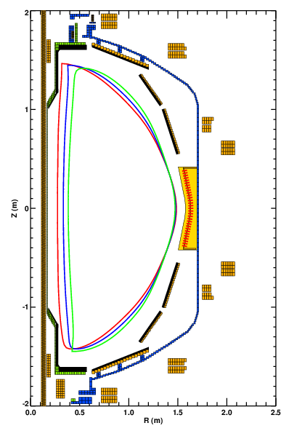
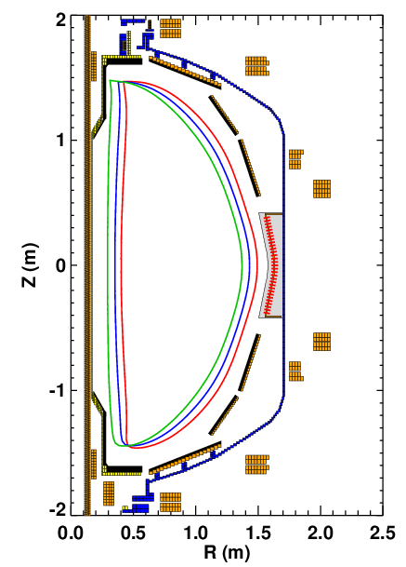
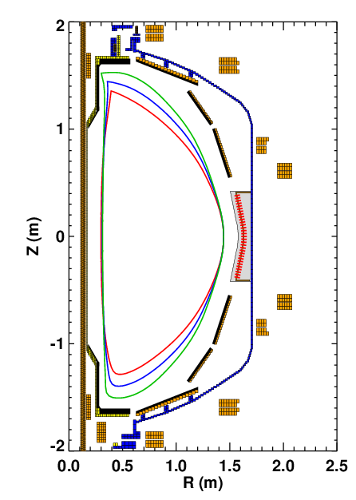
What kind of shape changes are possible?
Inner gap scan at fixed outer gap.
Simultaneously increases A and κ.
Maintains (nearly) constant distance to the plates and B_{P} RWM sensors.
Increase the outer gap for κ=3, A=1.75
All scans at 700 kA to avoid hitting PF-1A coil current limit!
Aspect ratio scan at fixed κ.
Inner and outer gaps change at fixed plasma height
κ scan at fixed aspect ration.
Plasma height changes with fixed inner and outer gaps.

Slide 6
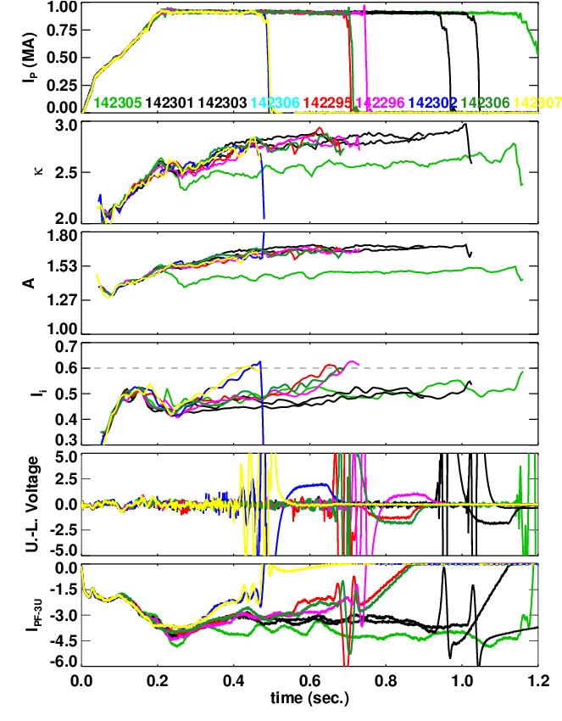
Possible (Likely?) ASC Contributions to R11-2
Milestone has a component related to n=0 stability and control.
Improve the vertical controller (SPG).
  Produce a better realtime estimate of dZ/dt.
  Optimize the derivative gain.
    Proportional controller is the ISOFLUX algorithm.
  If necessary, test use of RWM coils for vertical control.
Test more advanced shape control algorithms (EK).
  Use a fully populated “M-Matrix”
  Use it to develop better inner- and bottom- gap control.
Performance impact of κ and A (SPG).
  Scan A at fixed κ, and κ at fixed A.
  Use reduced input power to avoid disruptions.
  Test confinement (and current drive) changes due to shape modifications.
Loss of vertical control when l_{i}>0.6

Slide 7
XP Idea #1: The impact of elongation and aspect ratio on the ideal stability of ST plasmas
NSTX has a large database of stability results with A<1.55 and κ<~2.4.
  High-performance NSTX upgrade scenarios will run at larger values of both these parameters.
It is hard to scan these parameters independently in NSTX…
  Will be even harder in NSTX-U.
  This run is the last chance for these types of scans.
Relevant Milestone Text: The maximum sustainable normalized beta will be determined versus aspect ratio (up to A=1.7) and elongation (up to 3) and compared to ideal stability theory using codes such as DCON and PEST.
Propose to do three types of scans (with fast RWM control off?):
  Scan #1: Mixed κ & A scan at fixed outer gap (12 shots).
    Use RFA analysis to look for passive instability.
  Scan #2: A scan at fixed kappa (10 shots).
    Test the disruptive β_{N} limit (use the β_{N} controller to ramp to a disrupting in a controlled way).
  Scan #3: Kappa scan at fixed A (10 shots).
    Test the disruptive β_{N} limit (use the β_{N} controller to ramp to a disrupting in a controlled way).
Goals:
  Determine if, within the achievable range of A and κ, there is a measurable change in global stability.
    Compare to ideal stability theory.
  Collect data validating the β-limit assumptions for NSTX Upgrade.

Slide 8
XP Idea #2:MHD Stability at Very High Toroidal-β and Normalized Current
ST reactor designs typically assume very high toroidal β.
  PPPL Pilot: 30-39%, ARIES-ST: 50%, Culham 59%
It may be time to revisit discharge scenarios with very high β_{T.}
  We have made many improvements in control & discharge development since these were last tried in 2005.
    Reduced PCS latency, RWM control, Li PFC conditioning, stronger shaping, better control during the I_{P} ramp.
  We have many new and important diagnostics since 2005.
    MSE, RWM sensors, better USXR systems.
  We may have trouble making these shots again.
    Higher aspect ratio of NSTX-U will lower ideal stability limits.
Propose to revisit discharges in the β_{T}~40% regime.
  Characterize the limiting instabilities.
    What is the maximum stable β_{T} at low q* during the phase when q_{min}>~1.1 (i.e. before kink/tearing starts).
    Can we modify this limit via the profiles? Allow l_{i} to peak up to improve confinement and stability?
  Determine to what extent recent operations improvements facilitate this regime.
  Study disruption precursors.
    Are disruptions detectable in advance?

