Slide 1




NSTX-U
Supported by
Anisotropy
Coll of Wm & Mary
Columbia U
CompX
General Atomics
FIU
INL
Johns Hopkins U
LANL
LLNL
Lodestar
MIT
Lehigh U
Nova Photonics
Old Dominion
ORNL
PPPL
Princeton U
Purdue U
SNL
Think Tank, Inc.
UC Davis
UC Irvine
UCLA
UCSD
U Colorado
U Illinois
U Maryland
U Rochester
U Tennessee
U Tulsa
U Washington
U Wisconsin
X Science LLC
Culham Sci Ctr
York U
Chubu U
Fukui U
Hiroshima U
Hyogo U
Kyoto U
Kyushu U
Kyushu Tokai U
NIFS
Niigata U
U Tokyo
JAEA
Inst for Nucl Res, Kiev
Ioffe Inst
TRINITI
Chonbuk Natl U
NFRI
KAIST
POSTECH
Seoul Natl U
ASIPP
CIEMAT
FOM Inst DIFFER
ENEA, Frascati
CEA, Cadarache
IPP, Jülich
IPP, Garching
ASCR, Czech Rep
J.W. Berkery
Department of Applied Physics, Columbia University, New York, NY, USA
Rochester, New York
March 15, 2012

Slide 2
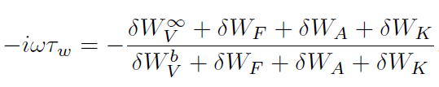
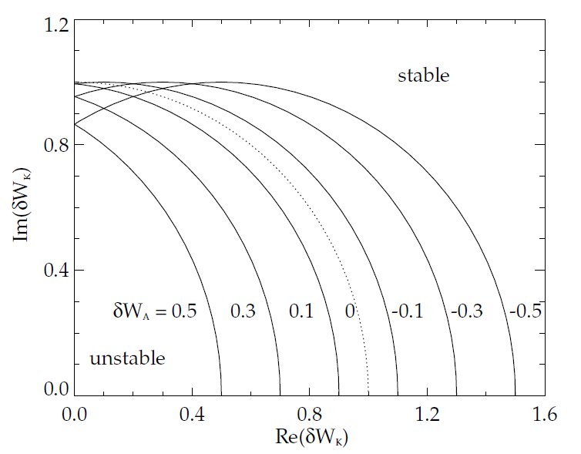

Pressure anisotropy leads to a modification of the Energy Principle
δW_{V} : usual changes in vacuum potential energy without a wall, and with an ideal wall
δW_{F} : usual isotropic fluid term
δW_{A} : anisotropic fluid correction
δW_{K} : kinetic term (also modified by anisotropy)
Stability diagram showing contours of γτ_{w} = 0 on Re(δW_{K}) vs. Im(δW_{K}) with δW ͚ = -1 and δW_{b} = 1 [arb.].
Positive δW_{A} shifts the unstable region to the left, negative δW_{A} to the right.
ω_{r} : real mode rotation frequency
γ : RWM growth rate

Slide 3

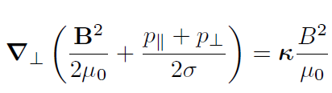

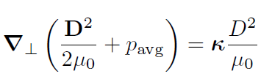
The effect of anisotropy on the plasma equilibrium must be small for the perturbative approach to stability calculation
Define an anisotropy parameter:
Then the plasma equilibrium in the perpendicular direction is:
Now define a corrected magnetic field:
Then:
So, the plasma equilibrium can be considered to first order the isotropic equilibrium, and then having an anisotropic correction of the second order. The perturbative approach is valid as long as σ ≈ 1.

Slide 4
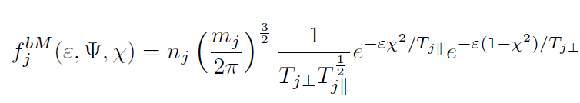
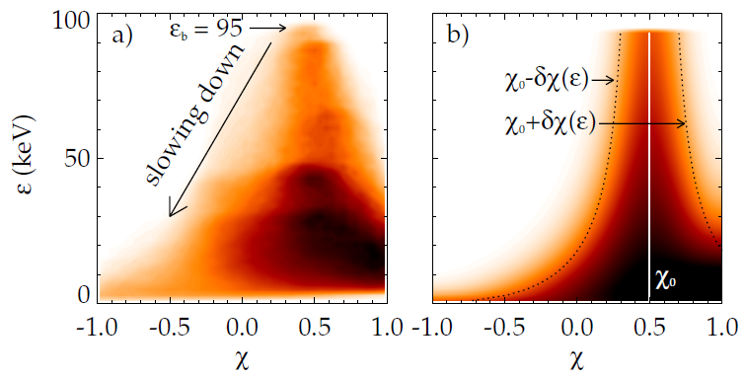
Two anisotropic distributions are considered: bi-Maxwellian for thermal particles, slowing-down for energetic particles
A bi-Maxwellian distribution with different temperatures ⊥ and ∥ to the magnetic field:
A slowing down distribution function with a Gaussian distribution of particles in χ:
Beam ions are injected with injection pitch angle χ₀ and initial spread δχ₀
f(ε,χ) at a particular Ψ for an
NSTX equilibrium from
TRANSP
model (with χ₀ = 0.5 δχ₀ = 0.2)

Slide 5


The kinetic approach is used to obtain δW_{K};
Anisotropic distribution functions affect the kinetic terms
δW terms are calculated starting from a plasma force balance:
with:
CGL pressures are akin to assumption of fast rotating mode (not the RWM), and will not be used. Instead in the kinetic approach, the perturbed pressures are calculated rigorously from the perturbed distribution function:
Kinetic effects are modified by inclusion of bi-Maxwellian or anisotropic slowing-down distributions in frequency resonance fraction calculation

Slide 6
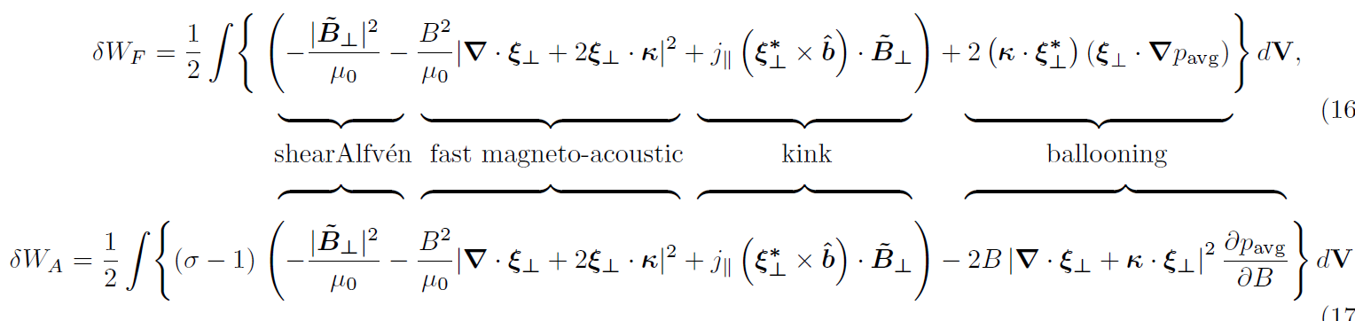
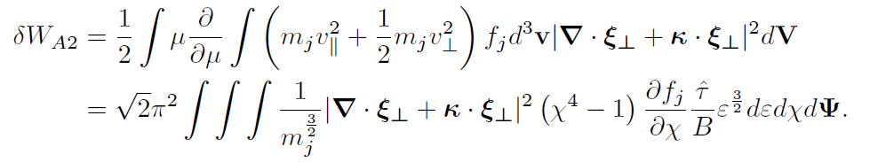
Additionally, an anisotropic correction to the fluid term principally modifies the ballooning destabilization term
1
2
3
4
These will be small due to σ ≈ 1.
Note: terms 1, 2, and 3 together can be shown to be self-adjoint, so that δW_{F}+δW_{A} is self-adjoint
4
The anisotropic correction to the ballooning term depends upon the derivative of the distribution function with respect to pitch angle, χ = v∥/v.

Slide 7
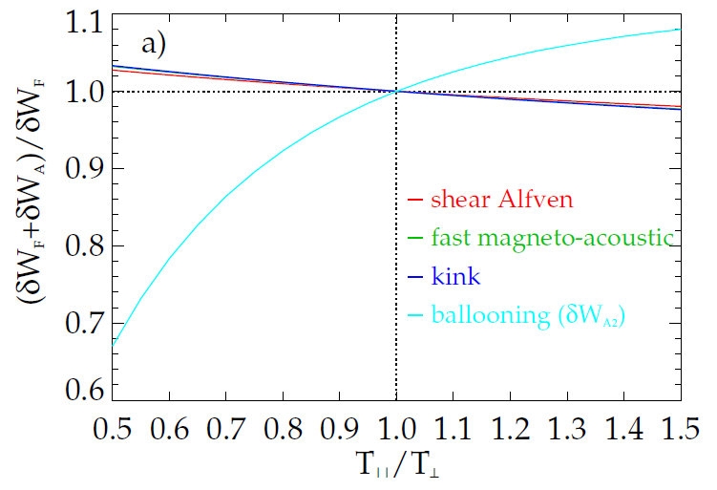
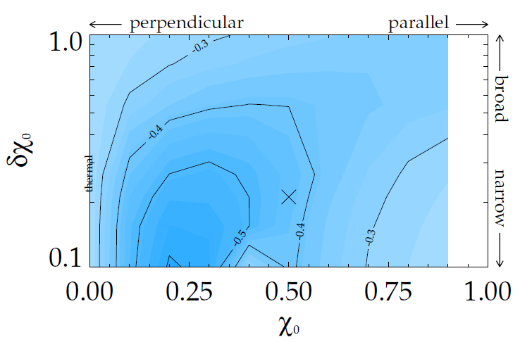
The anisotropic ballooning correction can make a significant impact on the calculated RWM growth rate
Anisotropic thermal particles
Anisotropic energetic particles
(and isotropic thermal particles)
~NSTX
As T∥/T⊥ is reduced, the destabilizing ballooning term is reduced.
Up to 30% reduction in RWM fluid growth rate in a test case.
Contours of γτ_{w} with δW_{A2} included
With thermal particles only γτ_{w} = -0.24.
With approx. NSTX values of χ₀ = 0.5 and δχ₀=0.2, stability is improved by almost a factor of two!

Slide 8
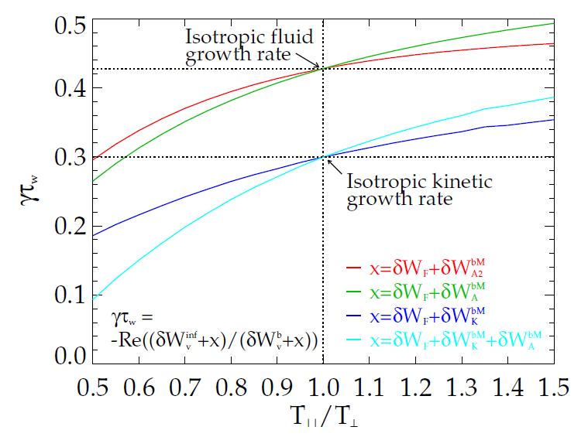
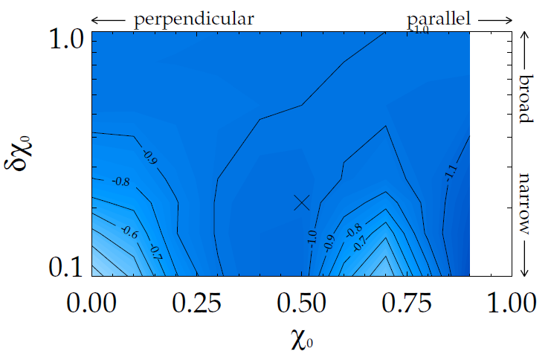
The kinetic effects of anisotropic particles also make a significant impact on the calculated RWM growth rate
Anisotropic thermal particles
Anisotropic energetic particles
(and isotropic thermal particles)
~NSTX
As T∥/T⊥ is reduced, the stabilizing kinetic term is increased.
Up to 66% reduction in RWM kinetic growth rate in a test case with both kinetic effects and anisotropic fluid corrections (δW_{A}).
Contours of γτ_{w} with δW_{K} for beam ions and δW_{A2} included
Large increase in RWM kinetic stability for an NSTX case from kinetic effects of anisotropic EPs and anisotropic fluid corrections (δW_{A}).

Slide 9
xxx

Slide 10
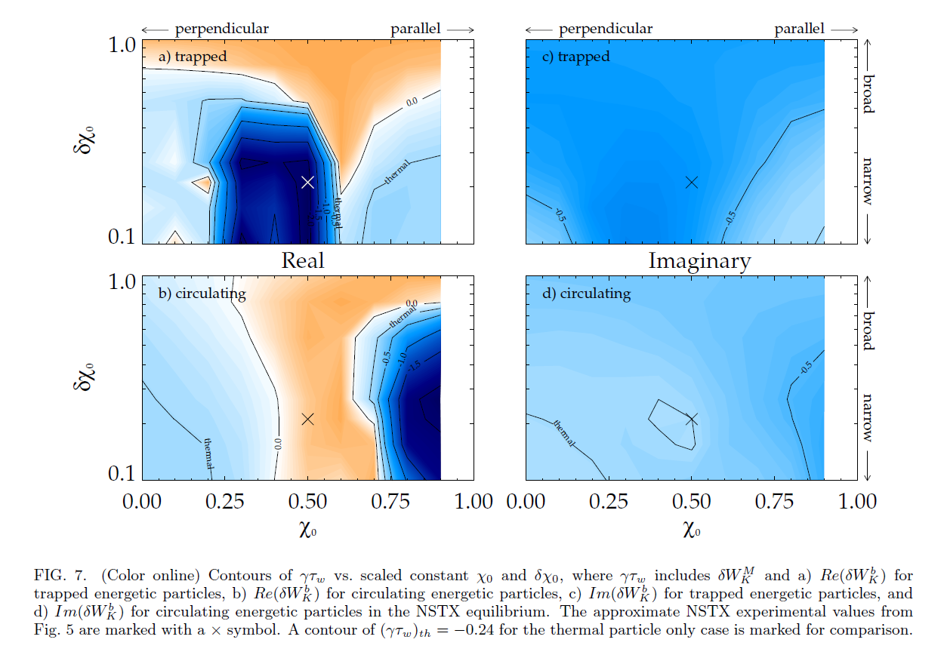
xxx

Slide 11
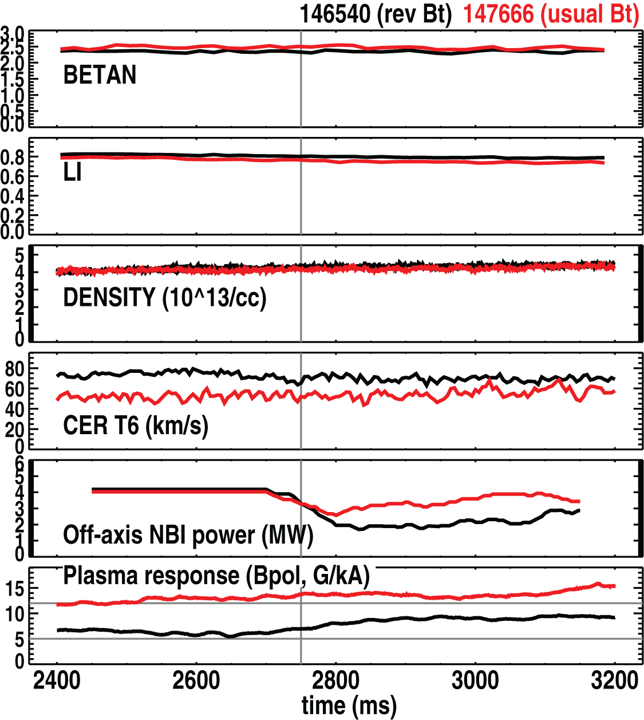
Nov 2011 Joint Experiment - Off-axis NBI appears to have a smaller impact on RWM stability in usual B_{t}
In reversed B_{t}, (Sept. 2011) observed reduction in plasma response with off-axis NBI
  Consistent with increased RWM stability
In usual B_{t}, modulating the off-axis beam leads to smaller impact on plasma response
Note:
  Slightly differing levels on β_{N}, ℓ_{i}, rotation between the two shots
  Couldn’t modulate off-axis power more than ~25% at constant β (Nov 2011)
  Ideal, kinetic stability calculations planned to understand results

Slide 12
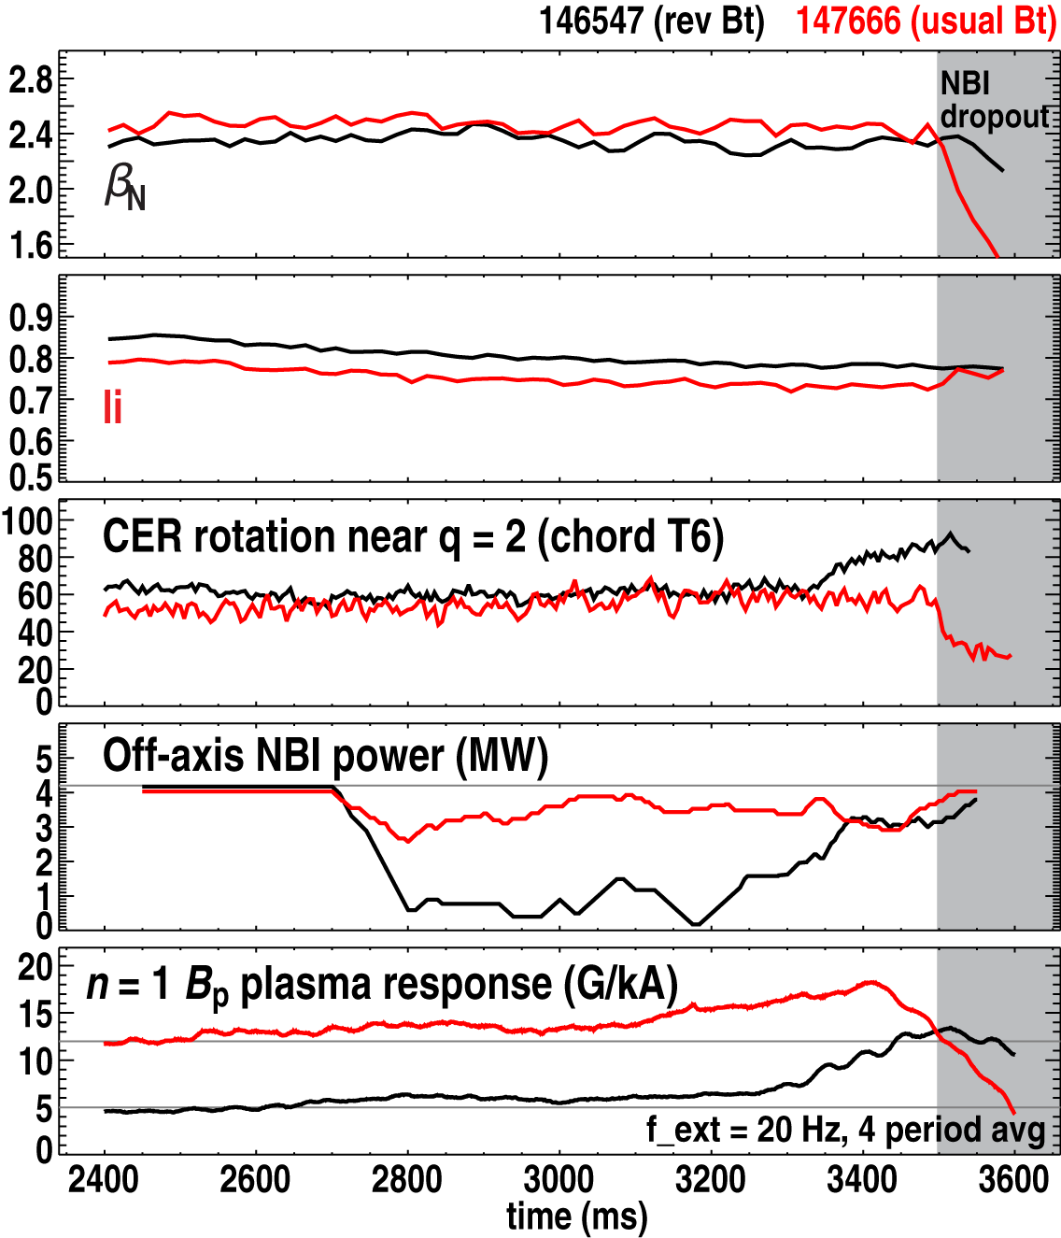
Nov 2011 Joint Experiment – Shot taken with lowest RWM stability observed in this experiment to date
Part of experiment aimed to minimize plasma stability
  Choose parameters from previous scans that give largest plasma resonant field amplification
  1 shot: Maximized β_{N}/ℓ_{i} at intermediate NBI torque -> maximum plasma response
Associated goal: demonstrate reduced stability most clearly by driving RWM unstable
  By changing NBI sources, plasma rotation
  Did not occur during this run at slightly reduced τ_{E}, reduced NBI
  Modified experimental idea submitted for 2012

Slide 13
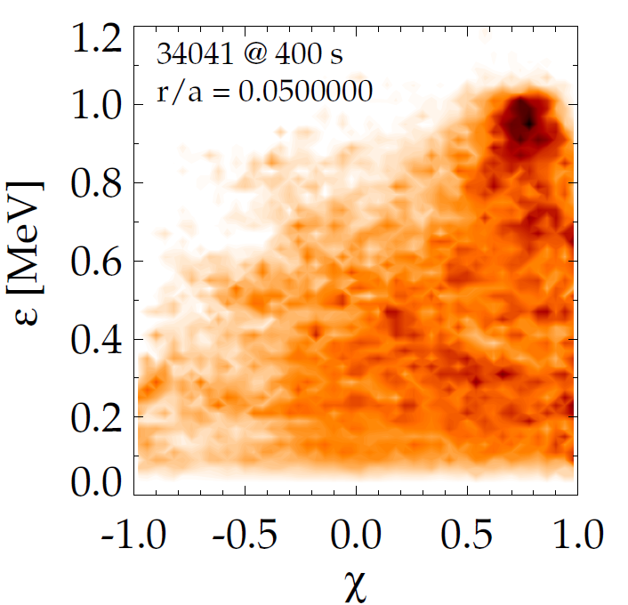
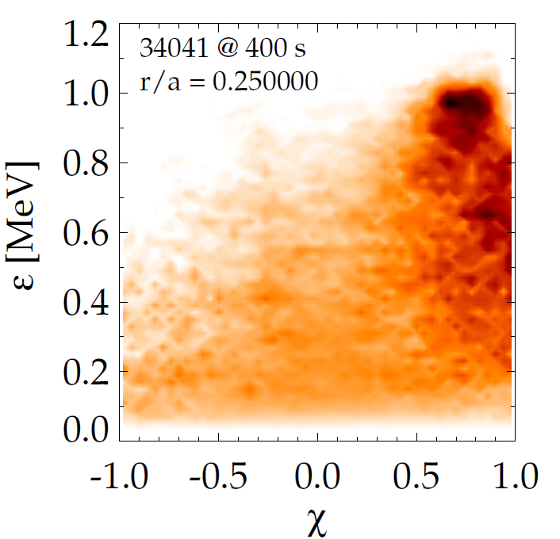
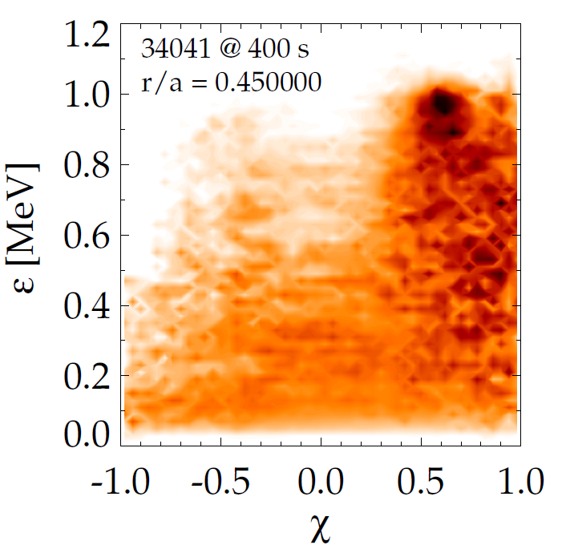
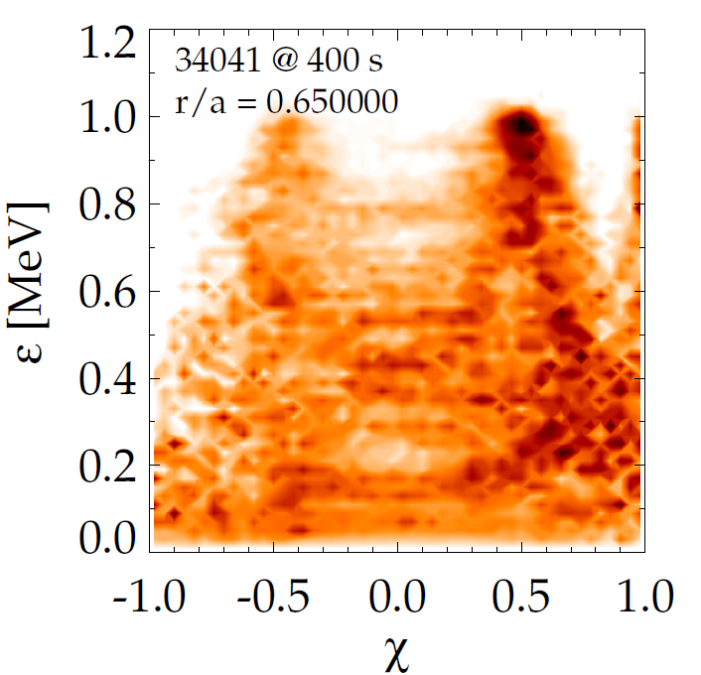
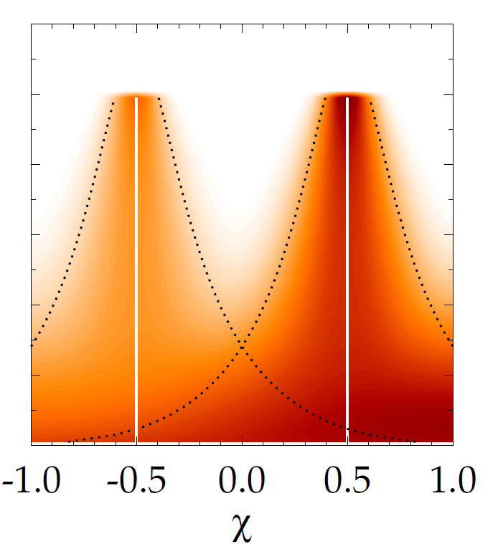
Energetic particle distribution function 34041 @ 400s
Model attempt
EPDF from TRANSP is complex
  Multiple heating sources
  Can attempt to model it with Gaussian distributions

