Slide 1




NSTX-U
Supported by
Benchmarking
Coll of Wm & Mary
Columbia U
CompX
General Atomics
FIU
INL
Johns Hopkins U
LANL
LLNL
Lodestar
MIT
Lehigh U
Nova Photonics
Old Dominion
ORNL
PPPL
Princeton U
Purdue U
SNL
Think Tank, Inc.
UC Davis
UC Irvine
UCLA
UCSD
U Colorado
U Illinois
U Maryland
U Rochester
U Tennessee
U Tulsa
U Washington
U Wisconsin
X Science LLC
Culham Sci Ctr
York U
Chubu U
Fukui U
Hiroshima U
Hyogo U
Kyoto U
Kyushu U
Kyushu Tokai U
NIFS
Niigata U
U Tokyo
JAEA
Inst for Nucl Res, Kiev
Ioffe Inst
TRINITI
Chonbuk Natl U
NFRI
KAIST
POSTECH
Seoul Natl U
ASIPP
CIEMAT
FOM Inst DIFFER
ENEA, Frascati
CEA, Cadarache
IPP, Jülich
IPP, Garching
ASCR, Czech Rep
J.W. Berkery
Department of Applied Physics, Columbia University, New York, NY, USA
Rochester, New York
March 15, 2012

Slide 2
MDC-2 Benchmarking of kinetic models: overview & steps
Codes: HAGIS, MARS-K, MISK
Choice of equilibria for benchmarking
  Start by using Solov’ev
    HAGIS / MARS-K, and MISK / MARS-K benchmarked to different degrees using Solov’ev equilibria; collect/cross compare results
      HAGIS/MARS results published [Y. Liu et al., Phys. Plasmas 15, 112503 (2008)]
    Simplicity may lead to unrealistic anomalies – better to use realistic cases?
  Move on to ITER-relevant equilibria
    Use Scenario IV, or new equilibria recently generated for WG7 task by Y. Liu (more realistic; directly applicable to ITER)
  Need kinetic profiles as well as fluid pressure
Approach to stability comparison – start with
  ideal fluid quantities (δW^{no-wall}, δW^{wall}, etc.)
  n = 1 (consider n > 1 in a future step)
  perturbative approach on static eigenfunction input - ensure that unstable eigenfunction is consistent among codes (e.g. no-wall ideal for MISHKA)
  no-wall / with-wall β_{N} limits (equilibrium β scan needed)
Spring 2011
Fall 2011

Slide 3
Initial comparison of stability calculations for Solov’ev, ITER cases (Oct. 2011)
Work in progress!
 | r_{wall}/a | Ideal δW /(-δW∞) | Re(δW_{K}) /(-δW∞) | Im(δW_{K}) /(-δW∞) | γτ_{w} | ωτ_{w} | δW_{K} /(-δW∞) (ω_{E} → ∞)
Solov’ev 1 (MARS-K) (MISK) | 1.15 | 1.187 1.122 | 0.0256 0.0243 | -0.0121 0.0280 | 0.804 0.850 | -0.0180 -0.0452 | 0.157 0.236
Solov’ev 3 (MARS-K) (MISK) | 1.10 | 1.830 2.337 | 0.208 0.371 | -0.343 0.060 | 0.350 0.232 | -0.228 -0.027 | 0.689
ITER (MARS-K) (MISK) | 1.50 | 0.682 0.677 | 141.5 0.665 | 2.286 -0.548 | -0.988 0.071 | 0.00019 0.437 | 8.46
Calculations from MISK, and MARS-K (perturbative)
  Good agreement on ideal δW, Solov’ev 1 Re(δW_{K}), γτ_{w}
  Less agreement on Solov’ev 3, ωτ_{w}
  Very different ITER result (do we have different input?)

Slide 4
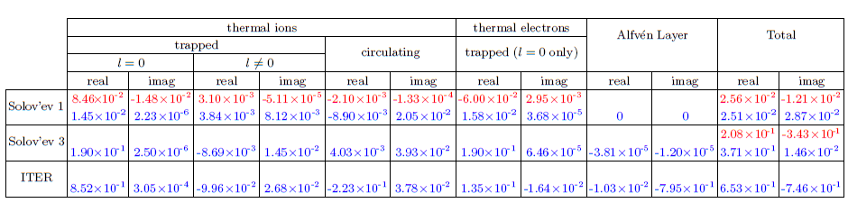
We have compared results for Solov’ev 1 case broken down into particle types, and they do not agree.
MISK now has the ability to separate l=0 and l≠0 components.
δW_{K}/-δW ͚ for MISK (blue) and MARS-K (red)

Slide 5
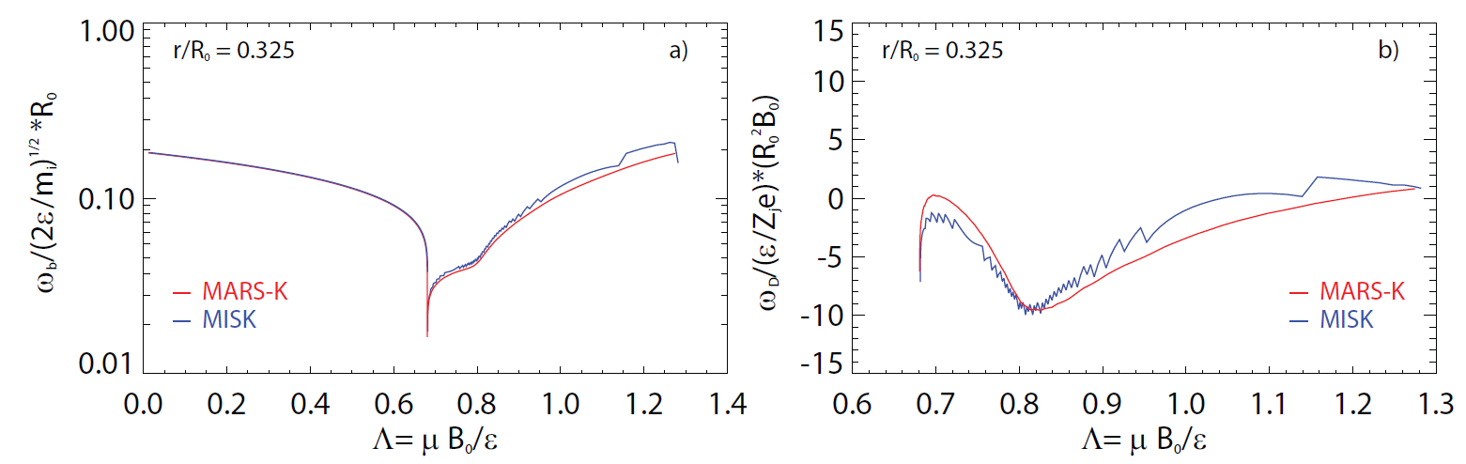
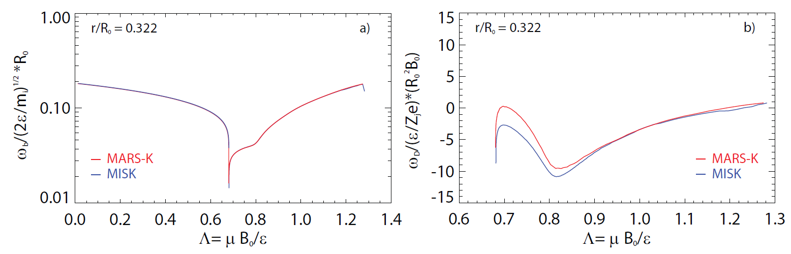
MISK frequency calculation improved by analytic calculation of integrals involving 1/v|| at v|| –> 0. Note: does not affect the outcome very much.
ITER case
Old
Old
New
New

Slide 6
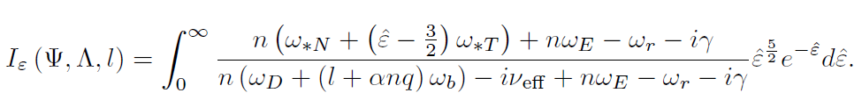
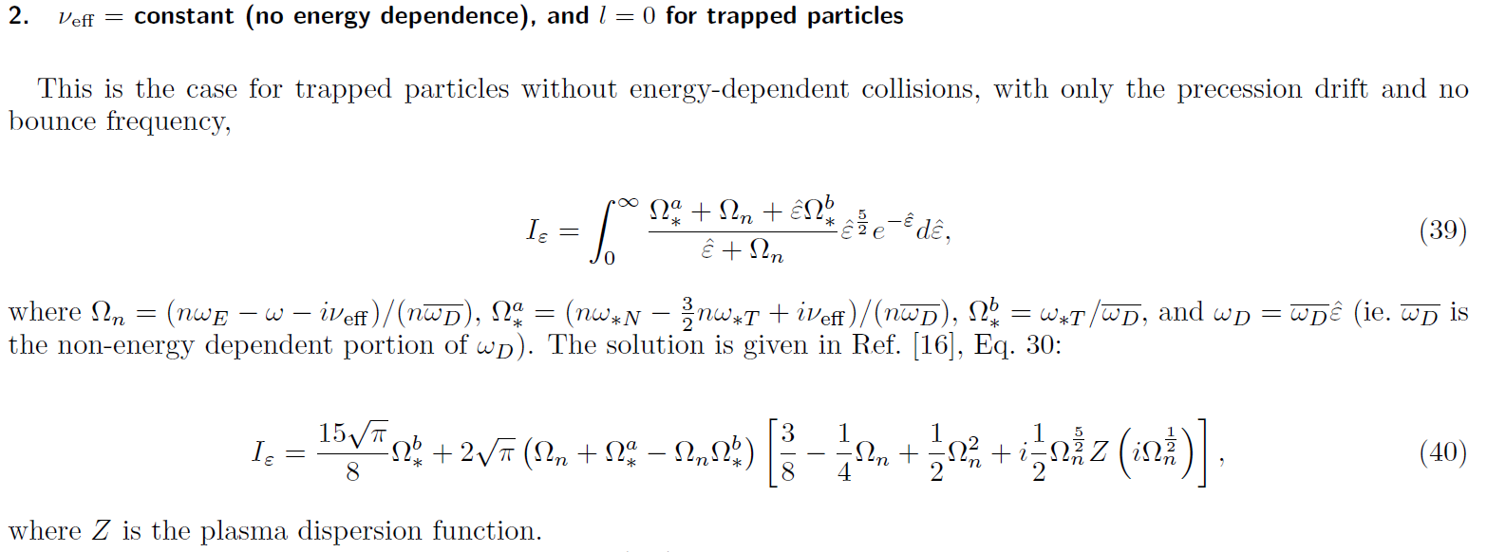
MISK calculates the energy integral numerically, MARS-K does it analytically
Analytical solutions are only possible in certain cases:

Slide 7
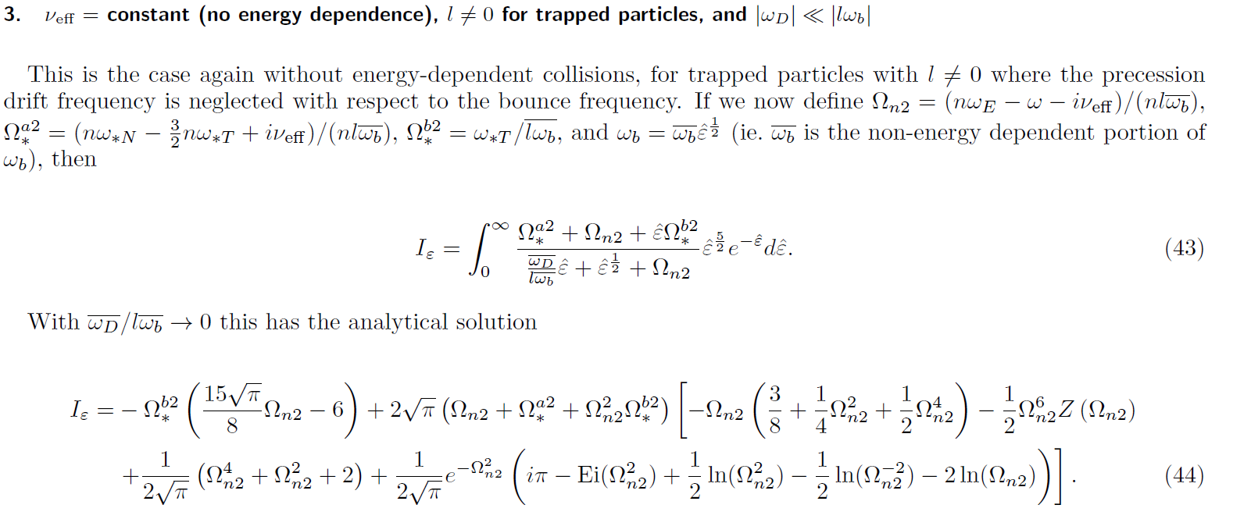
MISK calculates the energy integral numerically, MARS-K does it analytically (cont.)
Analytical solutions are only possible in certain cases:

Slide 8
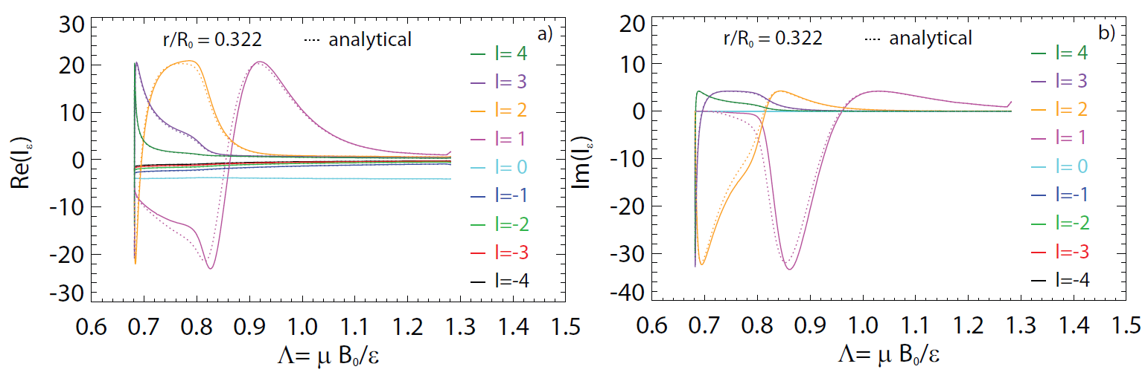
MISK used to compare numerical/ analytical solution of I_{e} for ITER case: compares well*
Reasonable agreement gives confidence that MISK is properly computing the energy integral
  Useful when comparing to other codes
  Similar calculation made for both Solov’ev 1 and 3 cases using MISK
    Also found that numerical computation compares well to analytical
  *Note: calculation for trapped thermal ions
ITER case

Slide 9
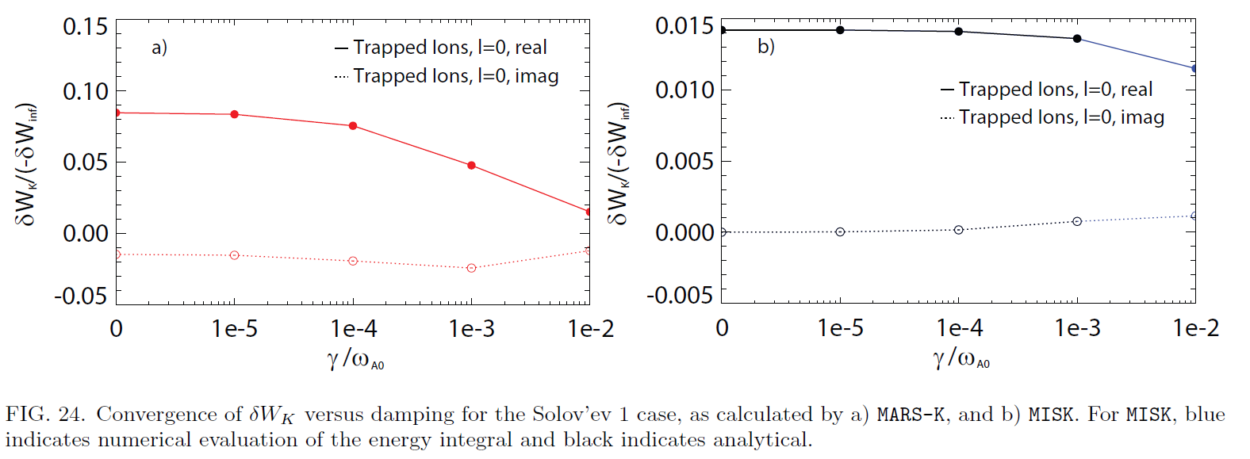
Convergence study vs. damping parameter shows no issues with zero damping
Damping from either collisions or mode growth rate.
Both codes converge, but to different values.

Slide 10
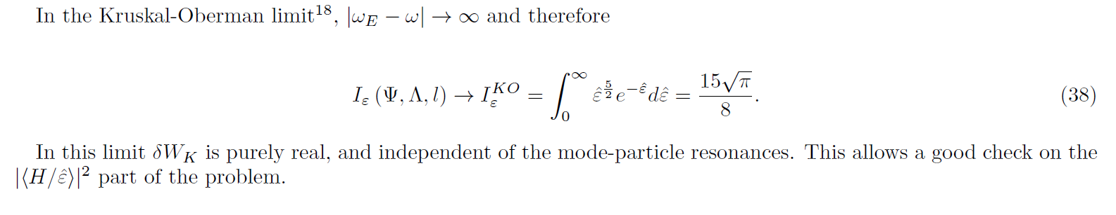
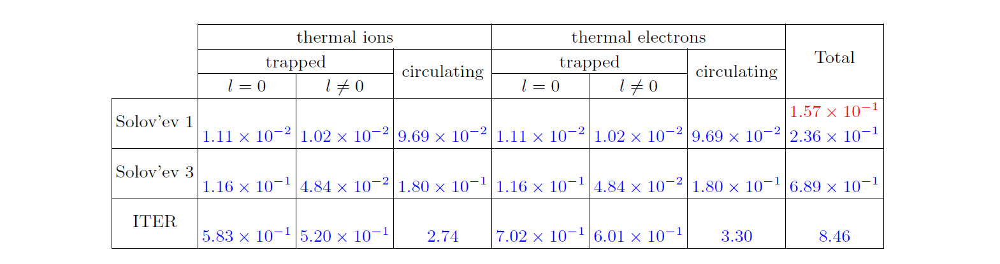
Kruskal-Oberman limit calculations performed: MISK and MARS-K results differ by 50% (should be closer)
δW_{K}/-δW ͚ for MISK (blue) and MARS-K (red)
Major simplification (I_{ε} = constant) gives key clue to issue
  Different indicates the issue is in the perturbed Lagrangian.
  Solution to differences in Lagrangian may eliminate most of the problem.

Slide 11
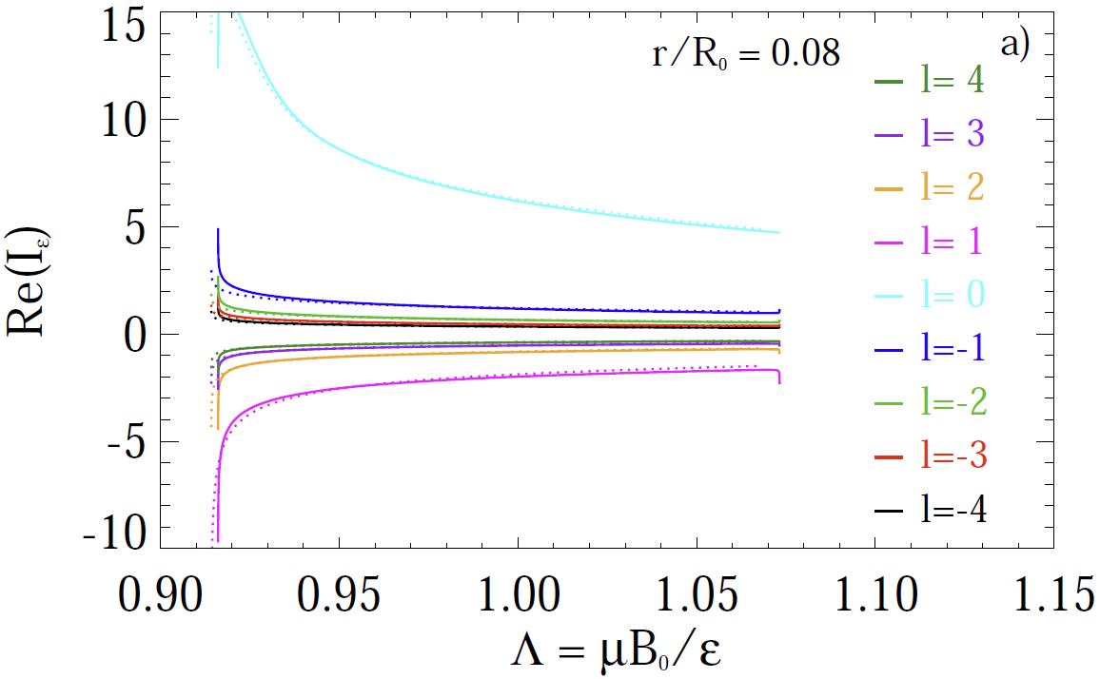
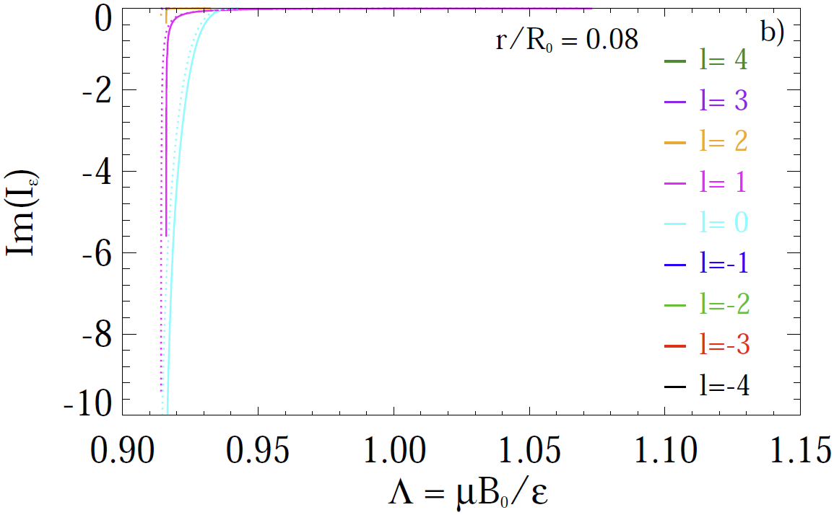
MARS-K and MISK energy integrals now agree* for Solov’ev 1 equilibrium
Attaining agreement
  Required properly matching frequency inputs
  Flip sign of imaginary part
  Positive l in MISK is negative in MARS-K
    Because of MARS-K left-handed coordinate system?
  *Note: calculation for trapped thermal ions
    Expand to all particles
MARS-K
MISK

Slide 12
xxx

Slide 13
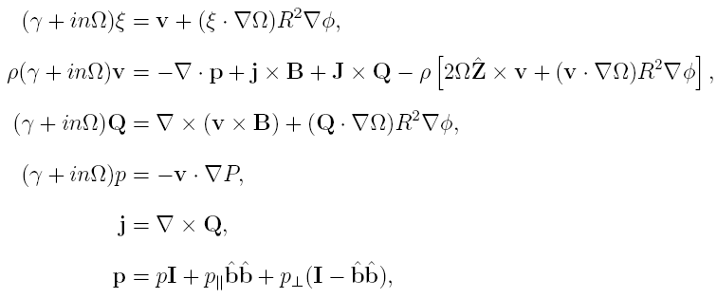
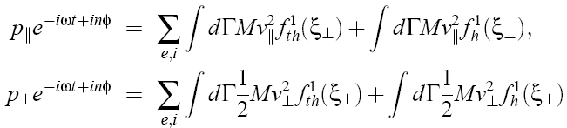


MARS-K adopts an MHD – drift kinetic hybrid formulation for both thermal & hot particles
Self-consistent
MHD-kinetic
coupling
Y. Liu
thermal
Energetic particles

Slide 14
HAGIS Suite of codes (+references) - Stability
(1)
Equilibrium configuration
HELENA
MISHKA-F
(2)
δW_{MHD}
Eigenfunction
(6)
δW_{h}
(3)
HAGIS
ASCOT
α distribution
Wave & Particle Evolution
JETTO
(4)
NBI distribution
TRANSP
(5)
SELFO
ICRH distribution
Huysmans et al, CP90 Conf on Comput Phys, p371 (1990)
Chapman et al, Phys Plasmas, 13, 062511 (2006)
JA Heikennen et al, Comput. Phys. Comm., 76, 215 (1993)
Budny et al, Nucl Fusion, 32, 429 (1992)
Hedin et al, Nucl Fusion, 42, 527 (2002)
Pinches et al, Comput Phys Commun, 111, 133 (1998)
I. Chapman

Slide 15
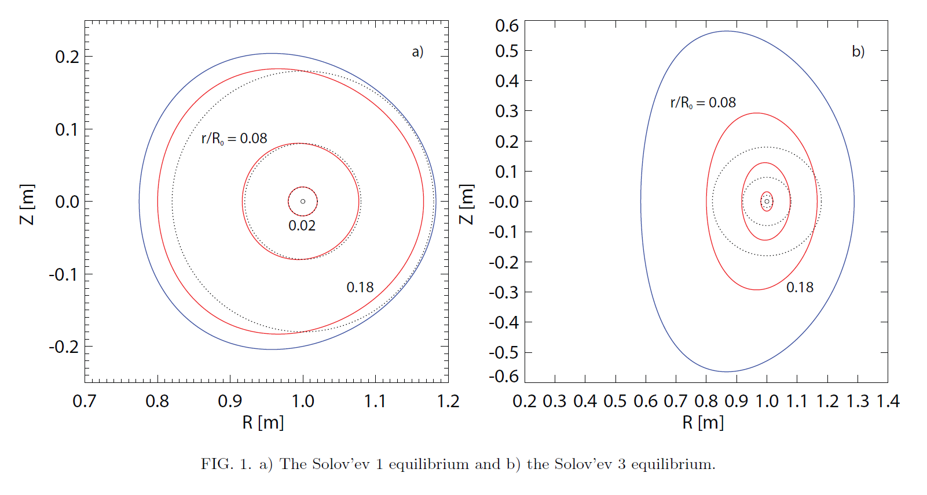
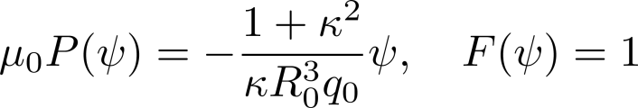
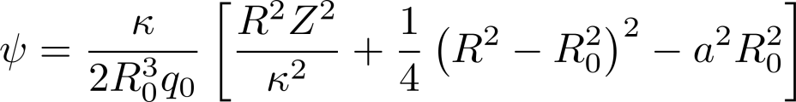
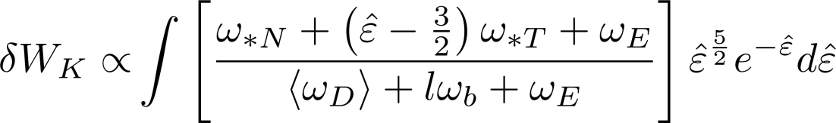
Started code comparison with simple equilibria and profile assumptions
Solov’ev case 1 (near-circular)
Solov’ev case 3 (shaped)
  Common ground for codes (MARS / HAGIS / MISK)
  Solov’ev equilibria
  Codes run in perturbative mode
  Density gradient constant
  No energetic particles
  ω_{r}, γ, ν_{eff} = 0
Simplified resonant denominator due to assumptions
Notes:
15

Slide 16
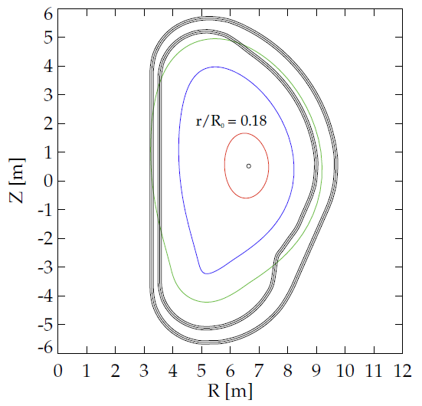
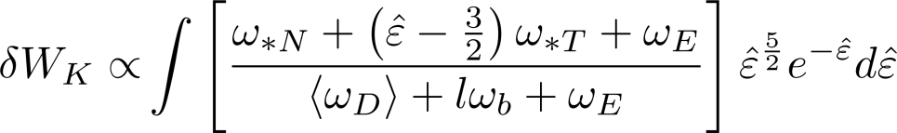
Expanded comparison to include ITER equilibrium
  More realistic case (ITER)
  ITPA MHD WG7 equilibrium
    I_{p} = 9 MA, β_{N} = 2.9 (7% above n = 1 no-wall limit)
  Codes run in perturbative mode
  With/without energetic particles
  ω_{r}, γ, ν_{eff} = 0
Note: Simplified resonant denominator due to assumptions
Notes:
16

Slide 17
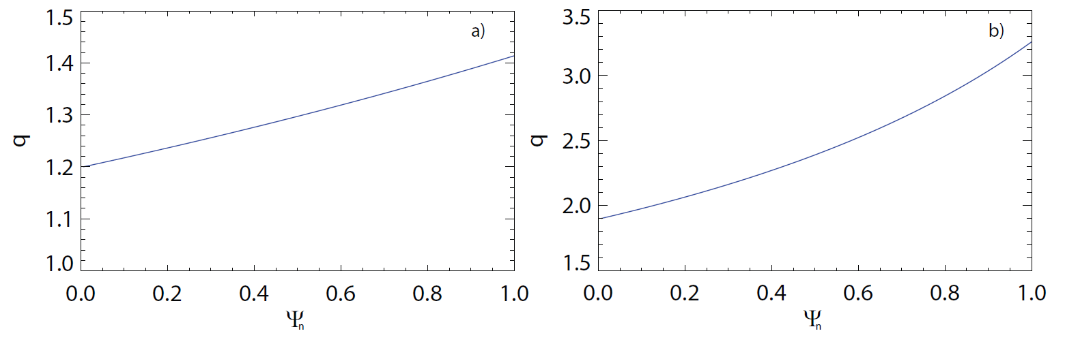
Shaped vs. near-circular Solov’ev cases have important q profile differences for benchmarking
Solov’ev case 1 (near-circular)
Solov’ev case 3 (shaped)
  No n = 1 rational surfaces
  Eliminates potential differences between calculation of kinetic dissipation at rational surfaces
  Simple, key n = 1 rational surfaces
  q = 2, 3 surfaces in the plasma
  ITER equilibrium: rev. shear, q₀ ~ 2.2, q_{min} ~ 1.7, q_{a} ~ 7.1
Differences in how MARS, MISK, HAGIS consider mode dissipation at rational surfaces is thought to be key – will be a main focus of next steps

Slide 18
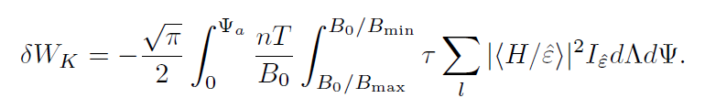
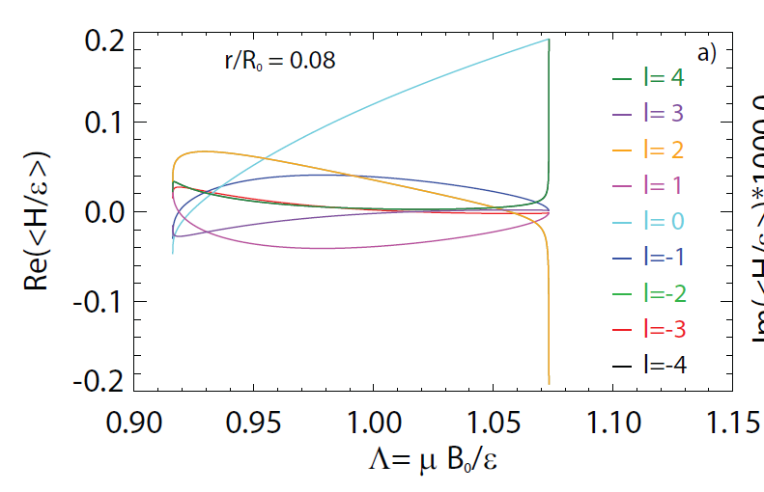
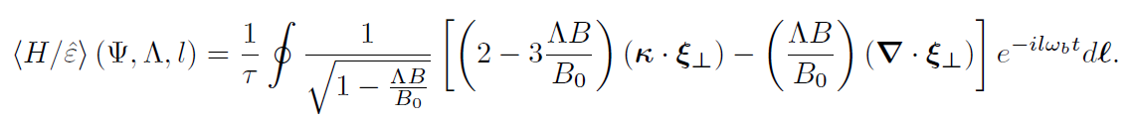
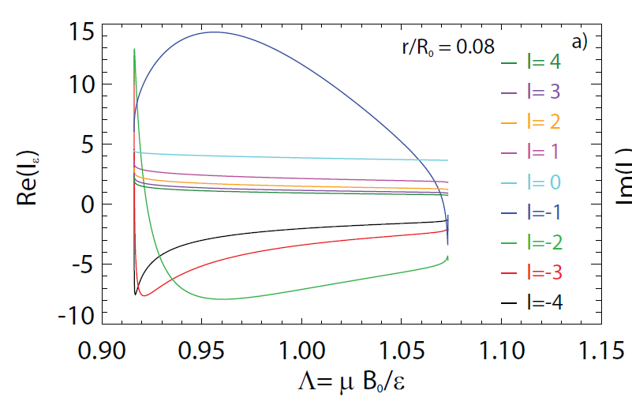
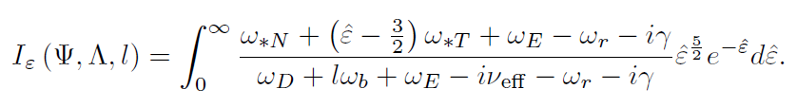
The kinetic term can be split into two pieces that depend on the eigenfunction or the frequencies, for code comparison
Solov’ev case 1 (near-circular)
Perturbed Lagrangian
Depends mostly on the eigenfunction.
Energy integral of the frequency resonance fraction
Does not depend on eigenfunction, just frequency profiles

Slide 19
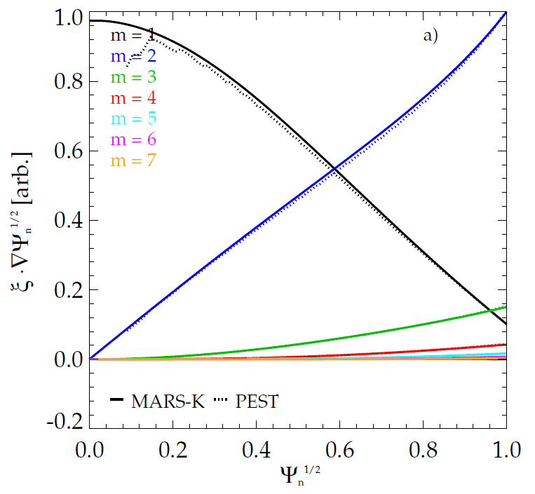
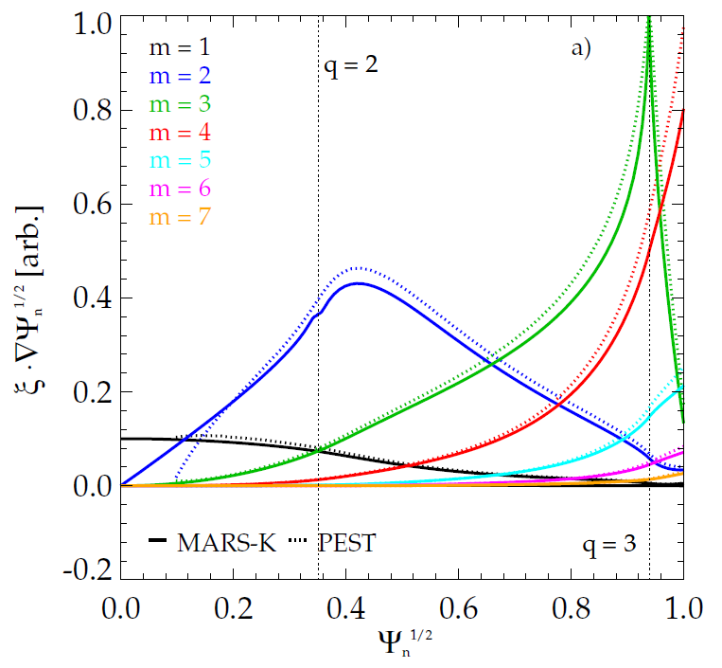
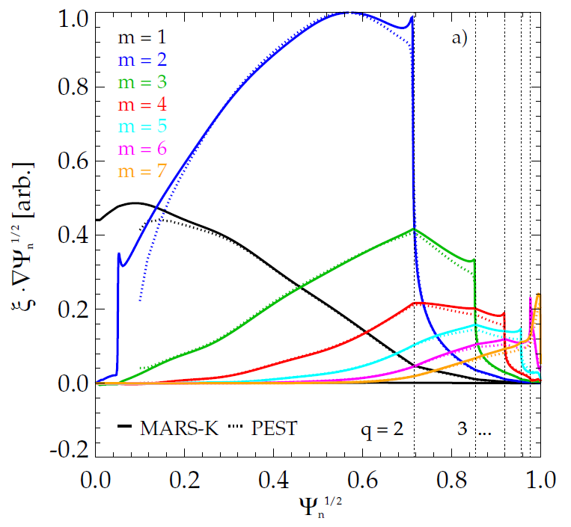
Eigenfunction benchmarking calculations were made to yield similar eigenfunctions, which are verified
Solov’ev case 1 (near-circular)
Solov’ev case 3 (shaped)
ITER
PEST, MARS-K compared with-wall RWM
  In PEST we use the wall position that yields marginal stability
  PEST, MARS-K, and MISHKA compared for no-wall ideal kink
There are some differences at rational surfaces
  May lead to stability differences between MISK and MARS-K calculations

Slide 20
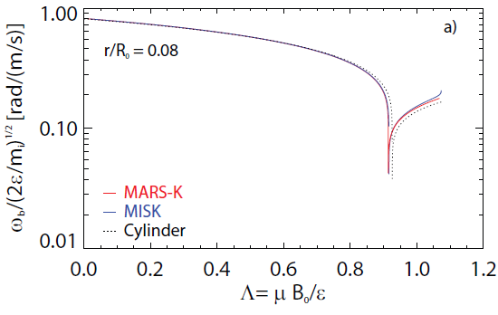
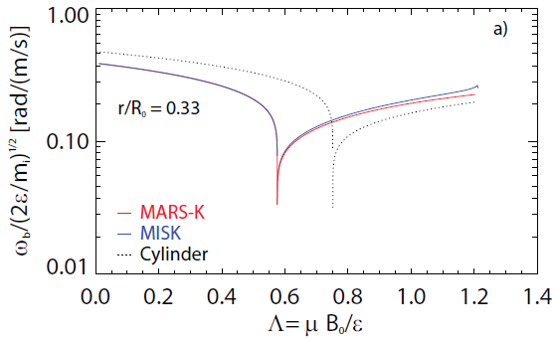



Bounce frequency vs. pitch angle compares well between codes
Solov’ev case 1 (near-circular)
Solov’ev case 3 (shaped)
circulating
circulating
particles
trapped
trapped
large aspect ratio approximation
here, є_{r} is the inverse aspect ratio, s is the magnetic shear, K and E are the complete elliptic integrals of the first and second kind, and Λ = μB₀/ε, where μ is the magnetic moment and ε is the kinetic energy.

Slide 21
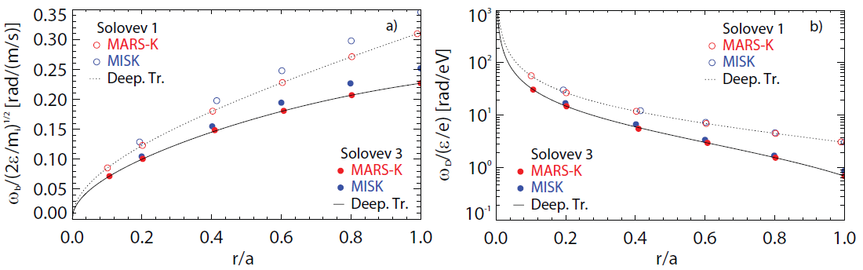
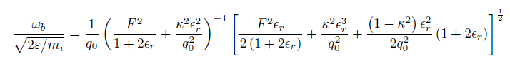
Bounce and precession drift frequency radial profiles agree (deeply trapped regime shown)
Bounce frequency
Precession drift frequency
Deeply trapped limit
Good agreement across entire radial profile

Slide 22
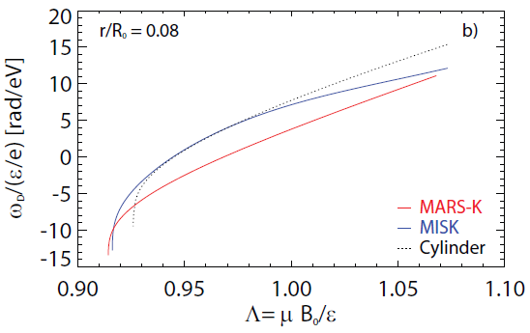
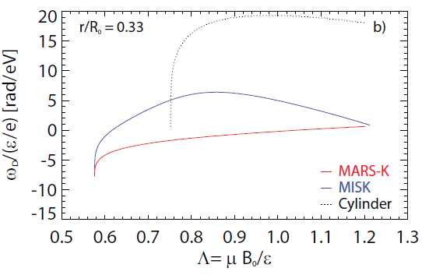
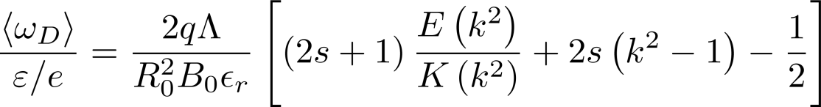
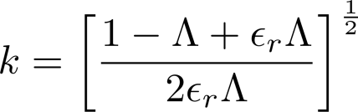
Significant issue found: precession drift frequencies did not agree
Solov’ev case 1 (near-circular)
Solov’ev case 3 (shaped)
Clear difference in drift reversal point, even in near-circular case
Issue found and corrected: metric coefficients for non-orthogonal grid incorrect in PEST interface to MISK
large aspect ratio approximation
[Jucker et al.,
Phys. Plasmas 15, 112503 (2008)]

Slide 23
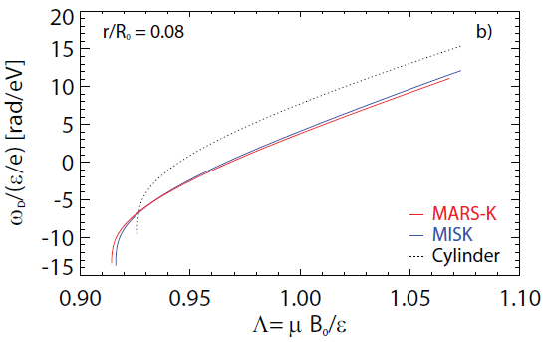
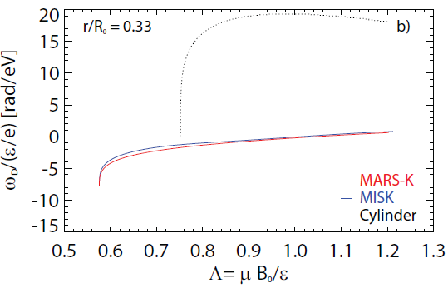
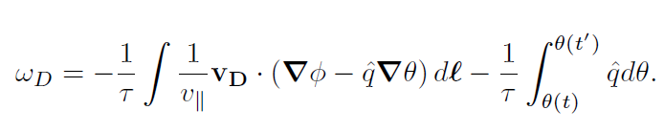
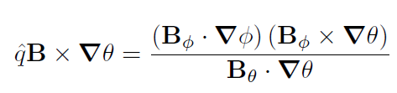
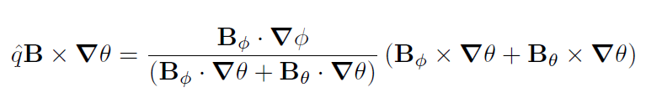
Significant issue resolved:
The precession drift frequencies now agree
Solov’ev case 1 (near-circular)
Solov’ev case 3 (shaped)
Metric coefficients corrected in PEST interface to MISK
add equation
if Ψ and θ are orthogonal:
But in PEST, Ψ and θ are non-orthogonal:

Slide 24
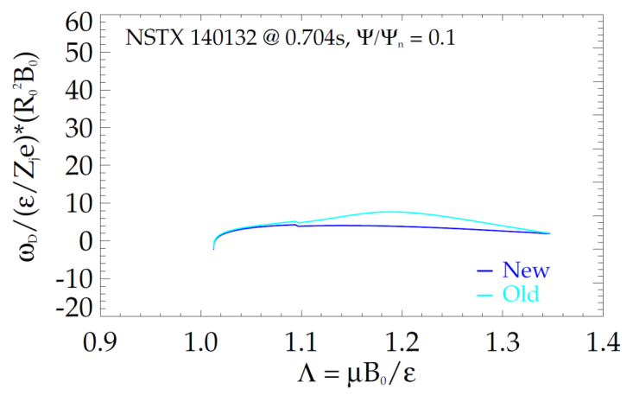
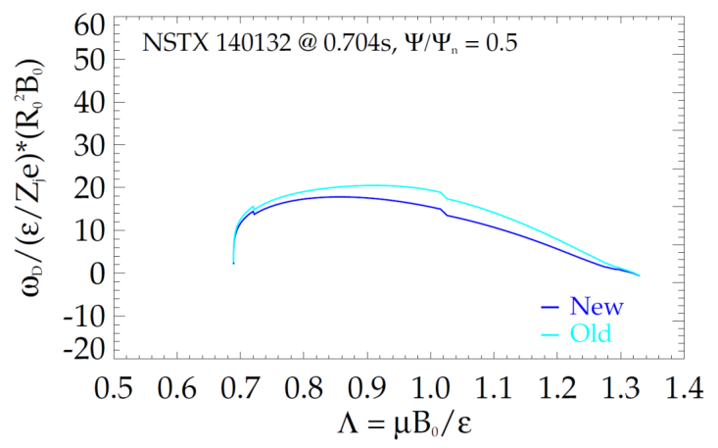
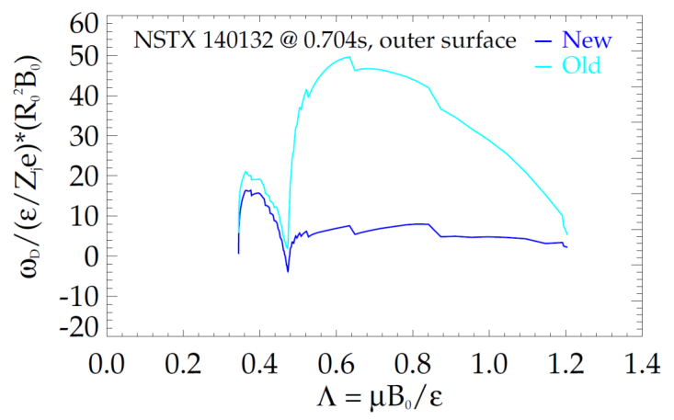
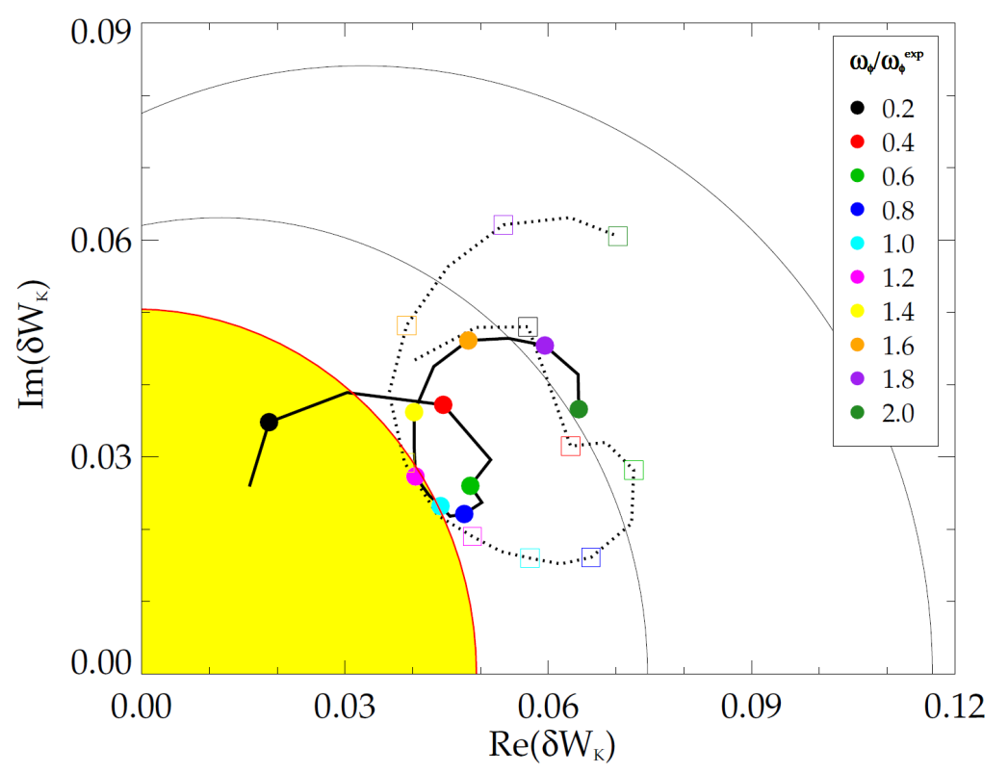
How does ω_{D} correction effect NSTX results? Mostly affects outer surfaces; characteristic change of γτ_{w} with ω_{φ} is the same.
RWM stability vs. ω_{φ} (contours of γτ_{w})
Affects magnitude of δW_{K}, but not trends
In this case, agreement with the experimental marginal point improves
  Calculations continue to determine the effect of the correction on wider range of cases
0.4
140132 @0.704s
γτ_{w}
0.2
2.0
0.0
ω_{φ}/ω_{φ}^{exp}
Marginal stability in experiment
NEW
OLD
1.0

