Slide 1




NSTX-U
Supported by
ITER
Coll of Wm & Mary
Columbia U
CompX
General Atomics
FIU
INL
Johns Hopkins U
LANL
LLNL
Lodestar
MIT
Lehigh U
Nova Photonics
Old Dominion
ORNL
PPPL
Princeton U
Purdue U
SNL
Think Tank, Inc.
UC Davis
UC Irvine
UCLA
UCSD
U Colorado
U Illinois
U Maryland
U Rochester
U Tennessee
U Tulsa
U Washington
U Wisconsin
X Science LLC
Culham Sci Ctr
York U
Chubu U
Fukui U
Hiroshima U
Hyogo U
Kyoto U
Kyushu U
Kyushu Tokai U
NIFS
Niigata U
U Tokyo
JAEA
Inst for Nucl Res, Kiev
Ioffe Inst
TRINITI
Chonbuk Natl U
NFRI
KAIST
POSTECH
Seoul Natl U
ASIPP
CIEMAT
FOM Inst DIFFER
ENEA, Frascati
CEA, Cadarache
IPP, Jülich
IPP, Garching
ASCR, Czech Rep
J.W. Berkery
Department of Applied Physics, Columbia University, New York, NY, USA
Rochester, New York
March 15, 2012

Slide 2
Long-Wavelength MHD Stability at High Pressure Required for ITER and Other Next-Step Devices
Motivation
  The resistive wall mode (RWM) is a primary cause of plasma disruption at high β
  Understanding passive stabilization physics determining RWM stability is critical to extrapolate stability requirements for future devices
Very brief history
  Early theory: RWM can be stabilized by sufficient plasma rotation
  Critical ω_{φ} for passive stability assessed (Ω_{crit})
  Low levels of Ω_{crit} (< 0.5% Alfven at q =2) suggested
  RWMs found to be unstable at relatively high ω_{φ}, and stability depends on profile, not simple scalar value – no simple, low Ω_{crit}!
  Stability model including kinetic effects evaluated (NSTX) - can explain greater complexity of RWM marginal stability
  Present effort: comparison of stability model in codes and experiments

Slide 3
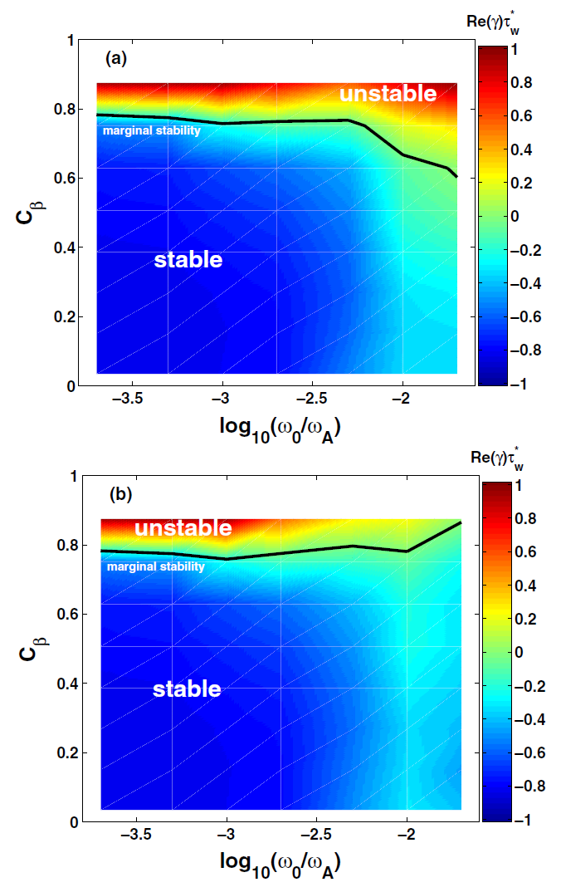
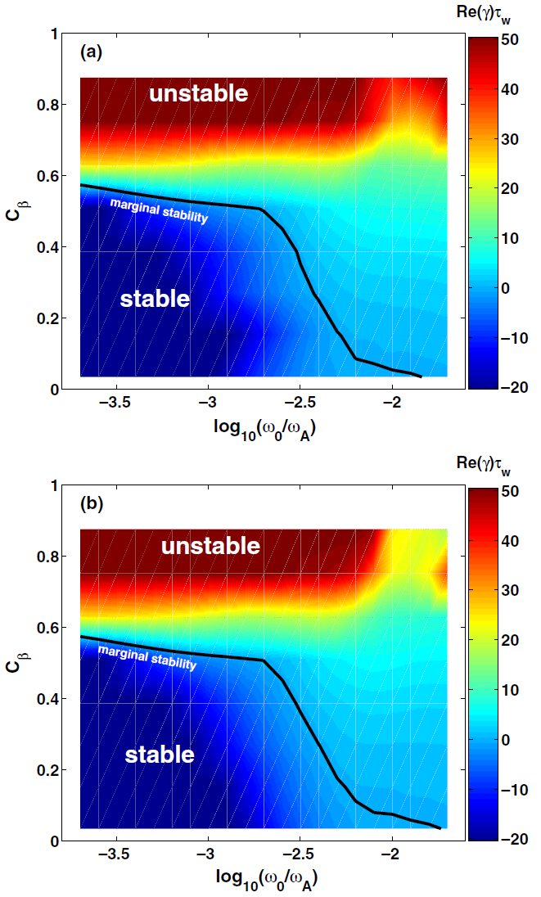
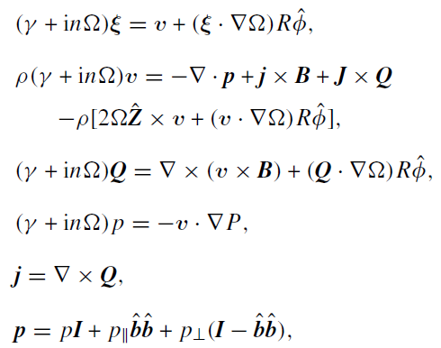
MARS-K ITER Results
MARS-K perturbative approach
MARS-K self-consistent approach
without alphas
[Y. Liu, Nucl. Fusion 50 095008 (2010)]
without alphas
  Alphas are only slightly stabilizing
  Self-consistent approach much more unstable
  How can γτ_{w} be 50?
with alphas
with alphas

Slide 4
Finite Orbit Width Kinetic damping of RWMs
Orbit widths can be very important for fast ions
Use guiding-centre following code to capture this physics
HAGIS code
For typical MAST case, simple beam distribution
RWM passively stable in ITER Advanced Scenario due to kinetic damping
Only capture these effects by including orbit widths
Sensitive to rotation, so should not be relied upon!

Slide 5
ITER RWM stability
Including damping from fast ions allows RWM to be passively stabilised above target pressure
HAGIS code

Slide 6
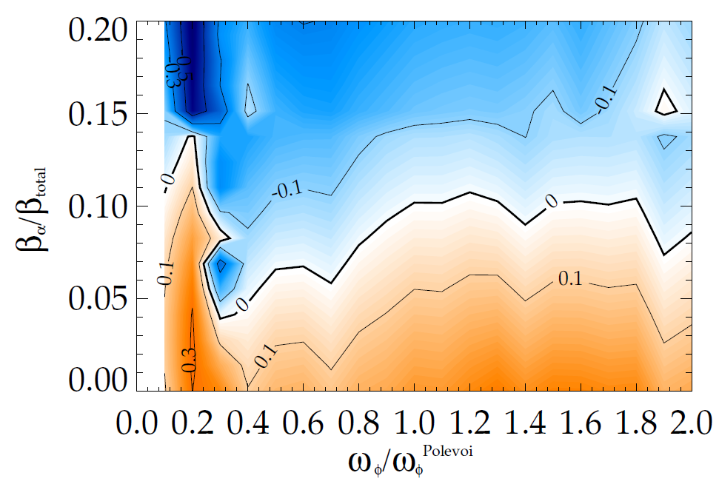
MIKS results: ITER requires alpha particles for RWM stability across all rotation values
  ITER requires alpha particles for stabilization across all rotation values.
  Quantitatively different, but generally consistent with previously analyzed case (in: [J.W. Berkery et al., Phys. Plasmas 17, 082504 (2010)])
Correction to ω_{D} makes calculation more stable, but doesn’t affect the general conclusions
γτ_{w} contours vs. β_{α} and ω_{φ}
stable
expected
β_{α}
expected ω_{φ}
unstable

Slide 7
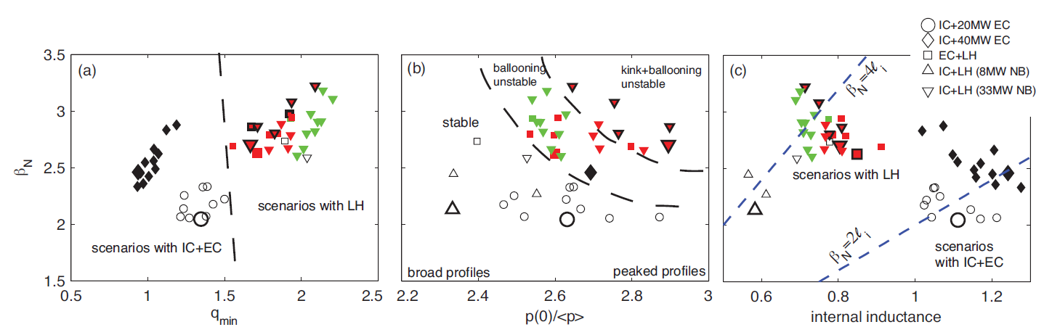
Kinetic RWM stability analysis started with MISK for a greater set of ITER advanced scenario equilibria
34036
34041
34039
34036
34041
34011
34039
34041
34011
34039
34001
34001
34036
34011
34001
[F. Poli et al., submitted to Nucl. Fusion (2012)]
Five discharges selected
  Full discharge evolutions – created by combination of TSC and TRANSP codes
  Range of β_{N} = 2.65 – 3.25; ideal n=1 no-wall unstable
  Have internal transport barriers
Include EPs from: 33MW N-NBI (D), 20 MW IC, 40 MW LH

Slide 8
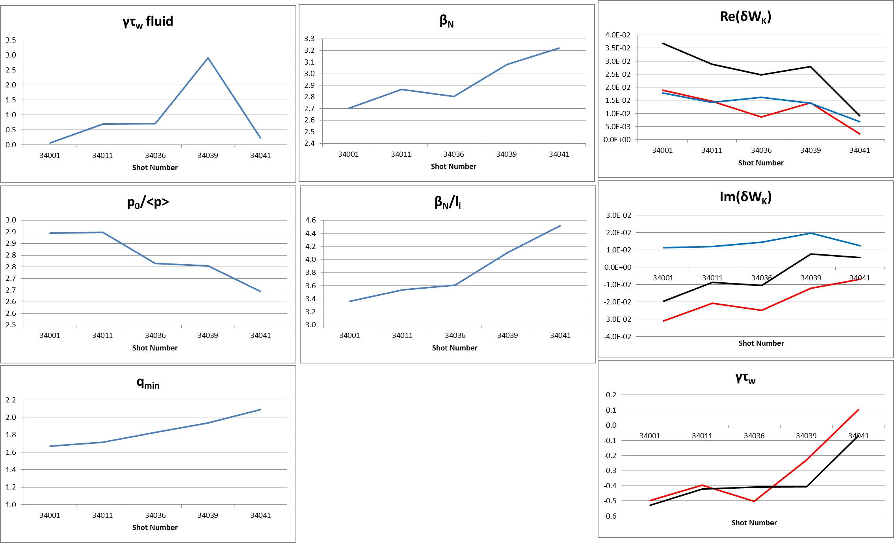
Various parameters vs. shot number

Slide 9
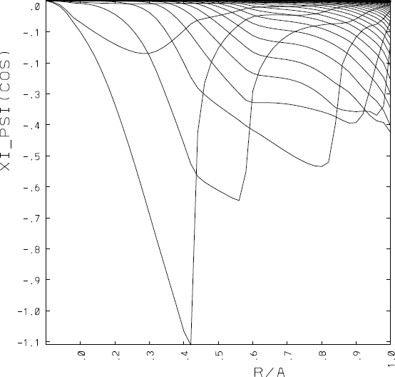
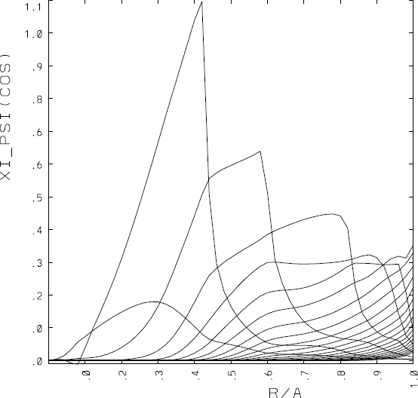
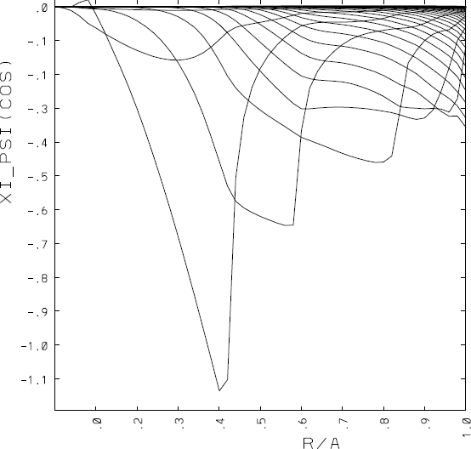
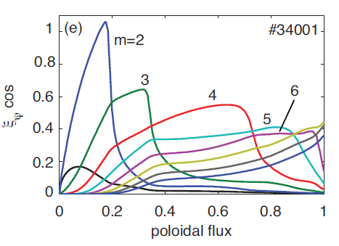
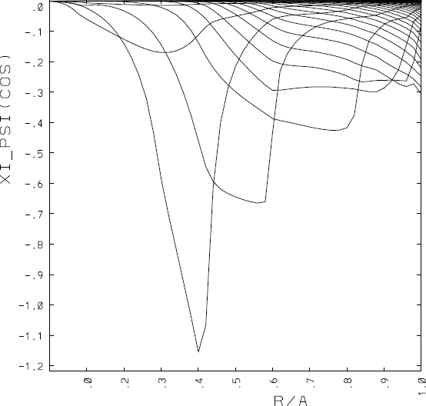
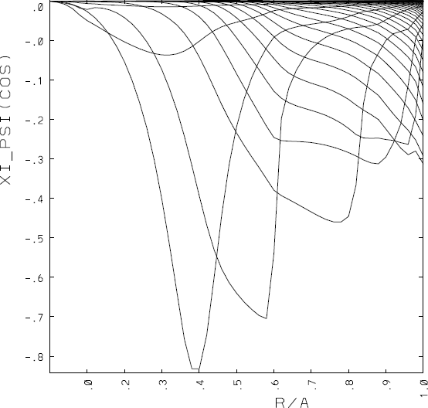
The eigenfunctions (from PEST) all are “infernal”-like modes
34011
34001
34036
[F. Poli et al., submitted to Nucl. Fusion (2012)]
34039
34041
Note scales are different: this one has the smallest peak

Slide 10
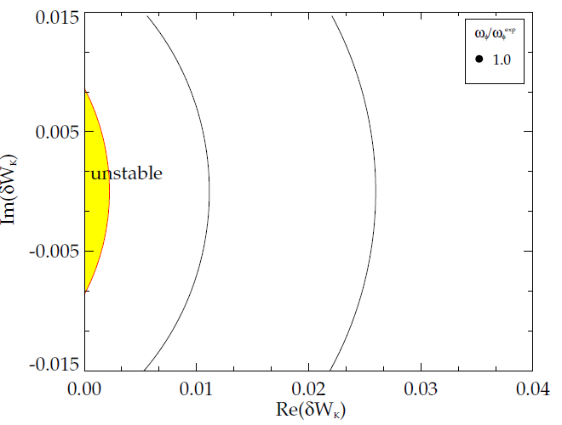
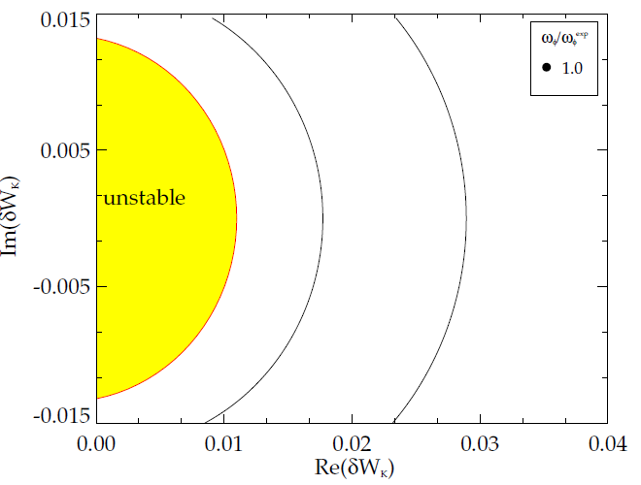
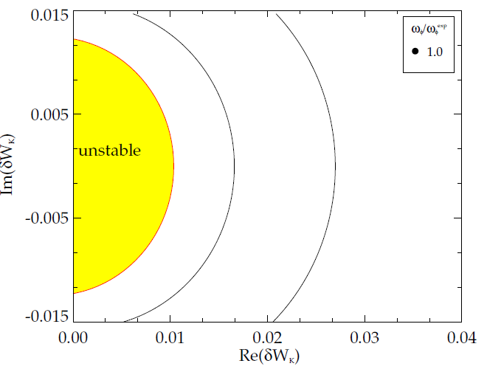
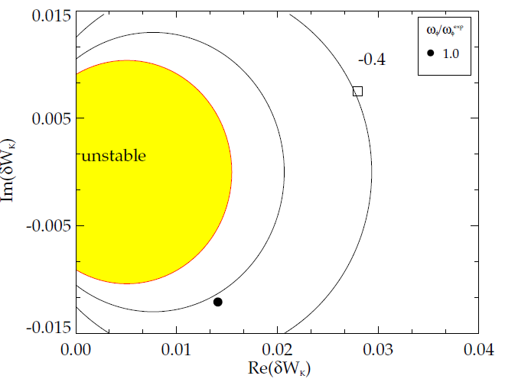
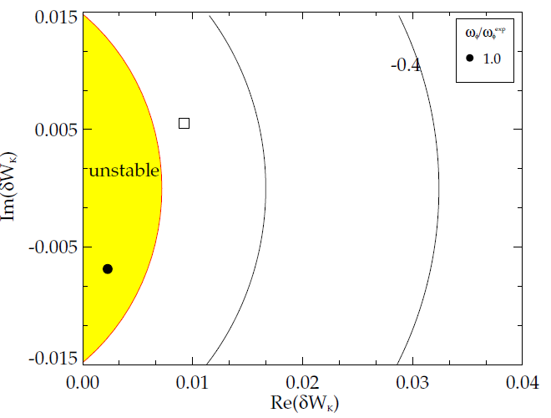
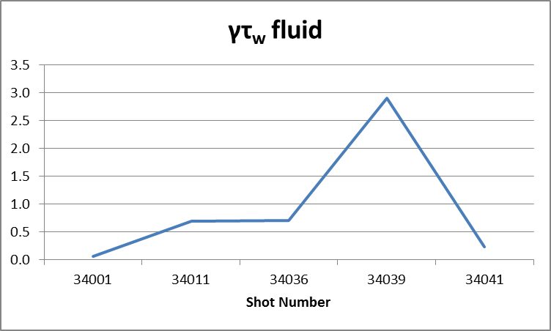
PEST Fluid δW results
34001
34011
34036
34039
34041

Slide 11
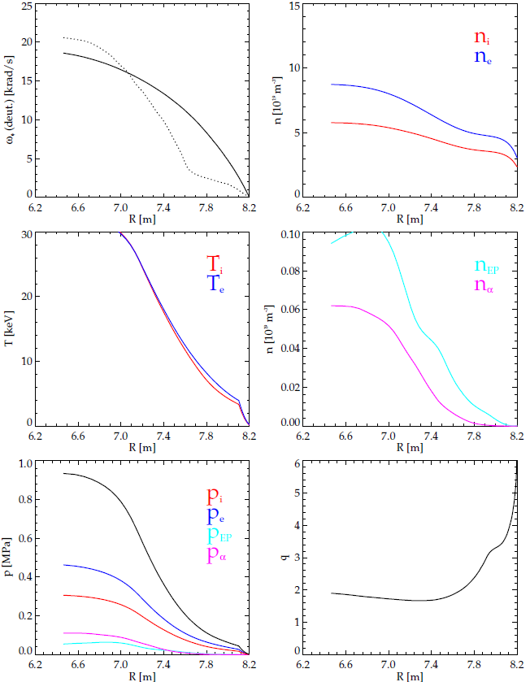
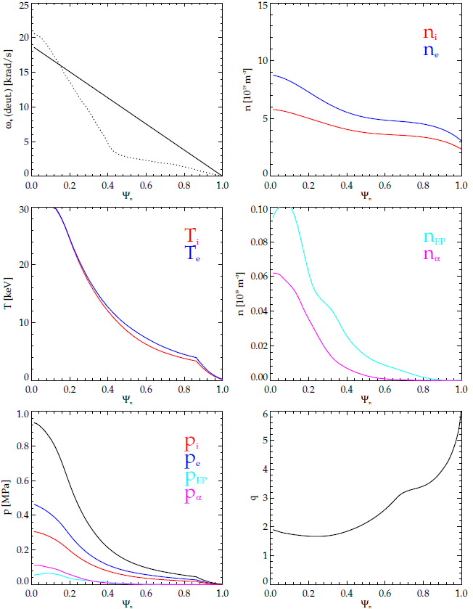
Profiles, 34001 @ 2500s

Slide 12
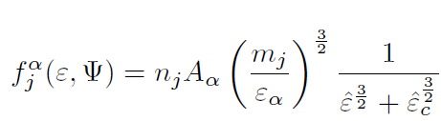
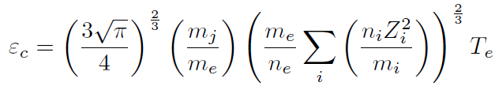
Notes on MISK δW_{K} results with deuterium and tritium
go like m^{-1/2}
Splitting to 50% deuterium and 50% tritium makes very little difference (vs. 100% deuterium). Need to recheck the effect on Alfven layers.
When including alpha particles, I had to pay close attention to the 50% deuterium and 50% tritium mix, because it matters for the alpha’s slowing-down distribution:
Note: I assumed alpha particles were isotropic (as usual). Nikolai has said that alphas can be beam-like in ITER, especially near the edge. I should ask him about that.

Slide 13
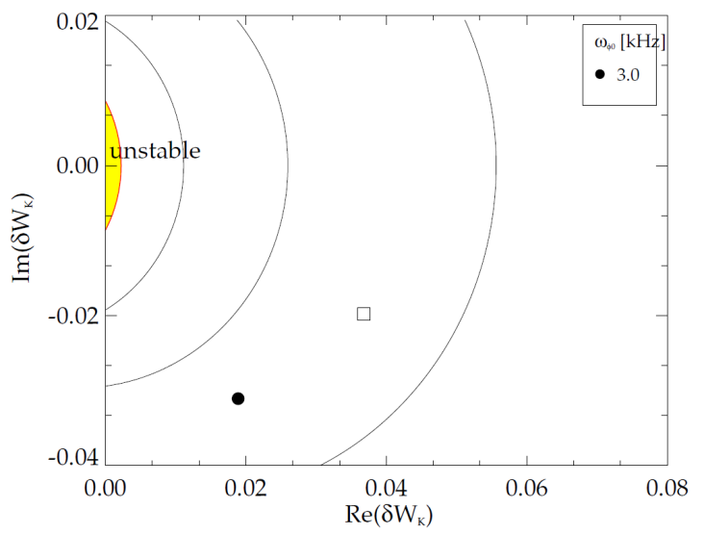
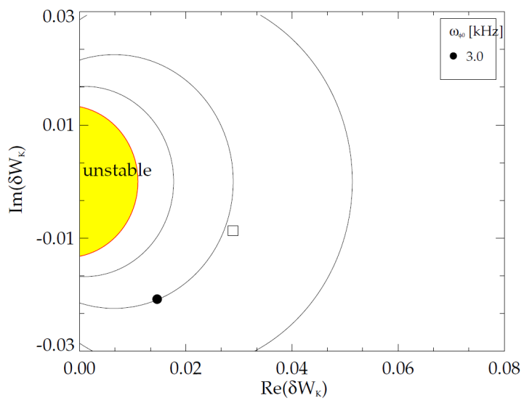
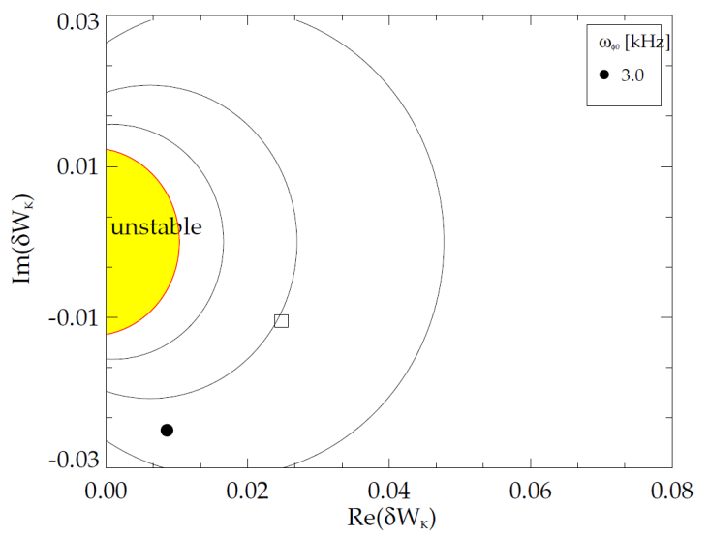
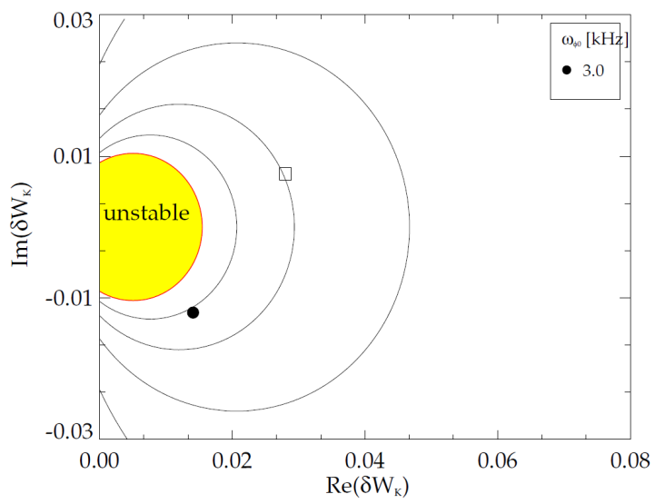
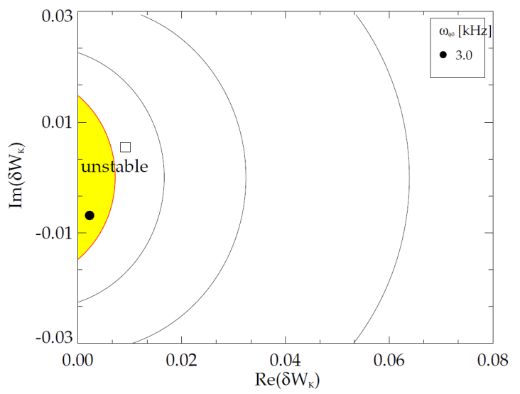
MISK Kinetic δW_{K} results, thermal particles only
34001
34011
34036
Kinetic effects basically continually decrease with shot number. What is causing this? Have to look in detail.
34039
34041

Slide 14
Results with alpha particles included
34001
34011
34036
Alpha particles provide a roughly constant increment to δW_{K}, as expected.
Interestingly, the imaginary increment is roughly the same as the real increment, which is unexpected.
34039
34041

Slide 15
Various parameters vs. shot number
Thermal only
Alphas only
Both

Slide 16
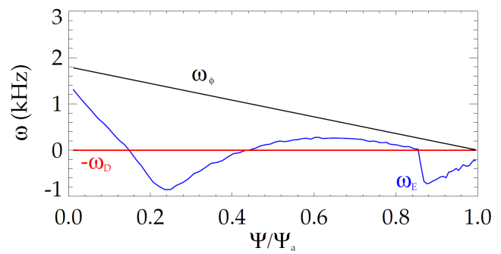
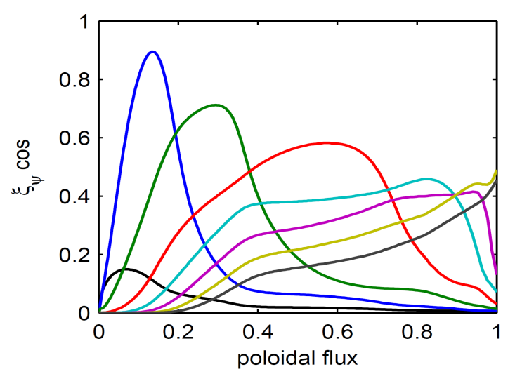
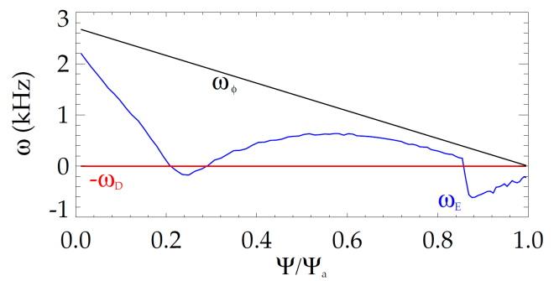
Initial analysis: Stable region appears at low rotation with no alpha particles – may be due to “infernal” eigenfunction
Higher ω_{φ} = no core resonance
Re(δW_{K})
Im(δW_{K})
γτ_{w}
unstable
stable
1
2
ω_{φ0} [kHz]
ω_{φ0} [kHz]
ω_{φ0} [kHz]
1
2
1
ω_{φ0} =1.8 kHz
Stable regions found with no alphas
  Low ω_{φ}
  Unstable region at higher ω_{φ}
Precession drift resonances
2
ω_{φ0} =2.7 kHz
≈0
1
2
[F. Poli et al., submitted to Nucl. Fusion (2012)]

Slide 17
When resonances are close to the rational surface, MISK might not properly include them
trapped electrons l=0
Re[∂(δW_{K})/∂Ψ]
Im[∂(δW_{K})/∂Ψ]
trapped ions l=0
trapped alphas
precession resonances
1
ω_{φ0} =1.8 kHz
q= 1.95
q= 2.05
q profile
Resonance near the q=2 surface
  MISK Alfven layer scheme might cut off important effects (between 1 and 2)
  How can we deal with this?

Slide 18
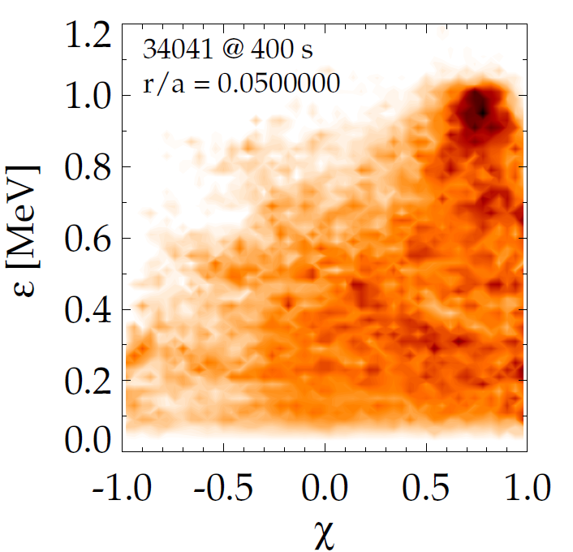
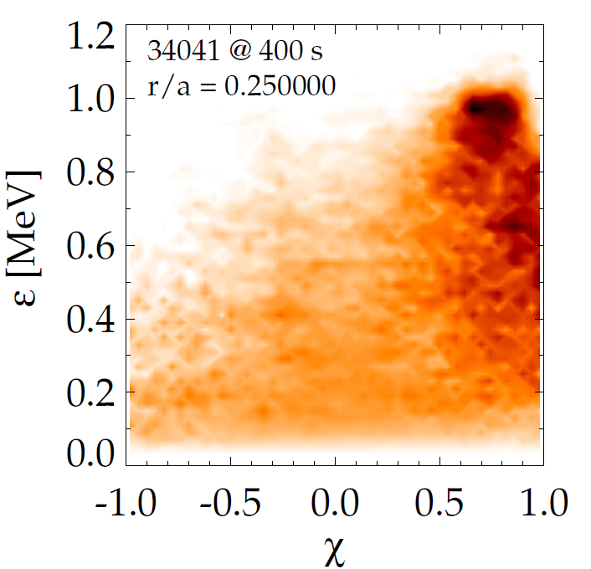
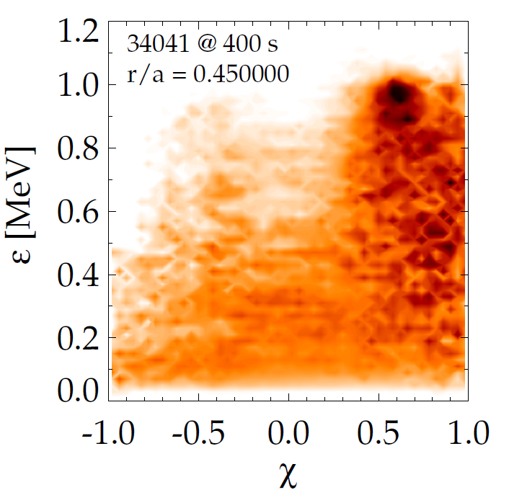
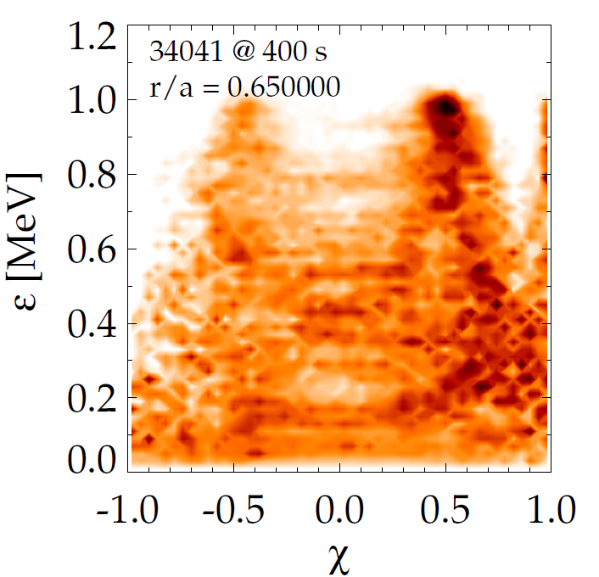
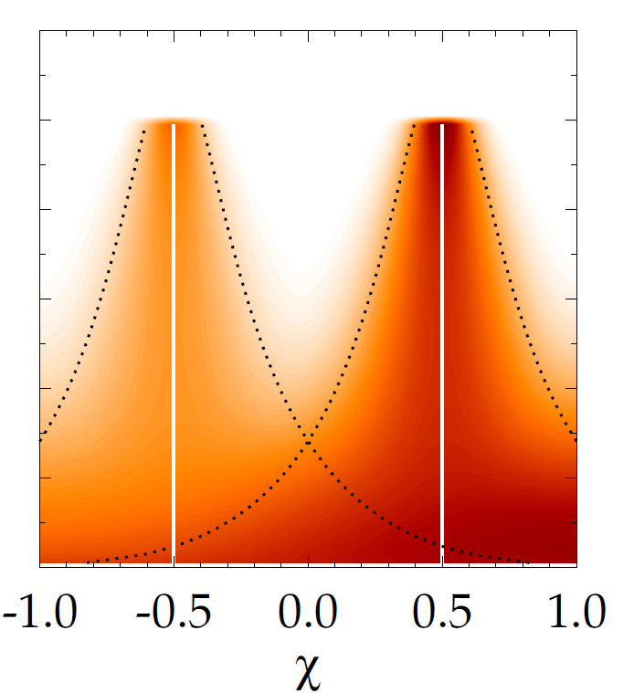
Energetic particle distribution function 34041 @ 400s
Model attempt
EPDF from TRANSP is complex
  Multiple heating sources
  Can attempt to model it with Gaussian distributions

Slide 19
xxx

Slide 20
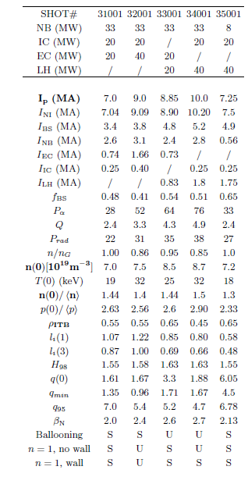
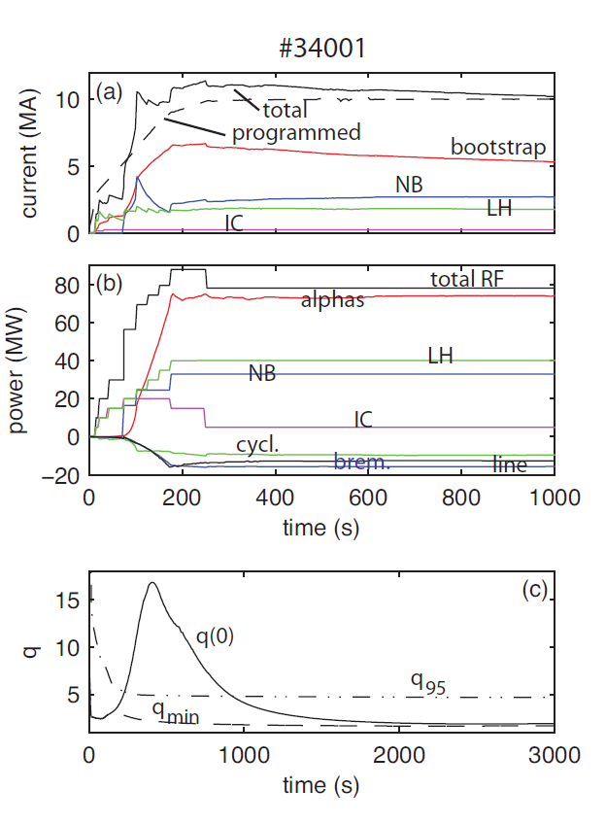
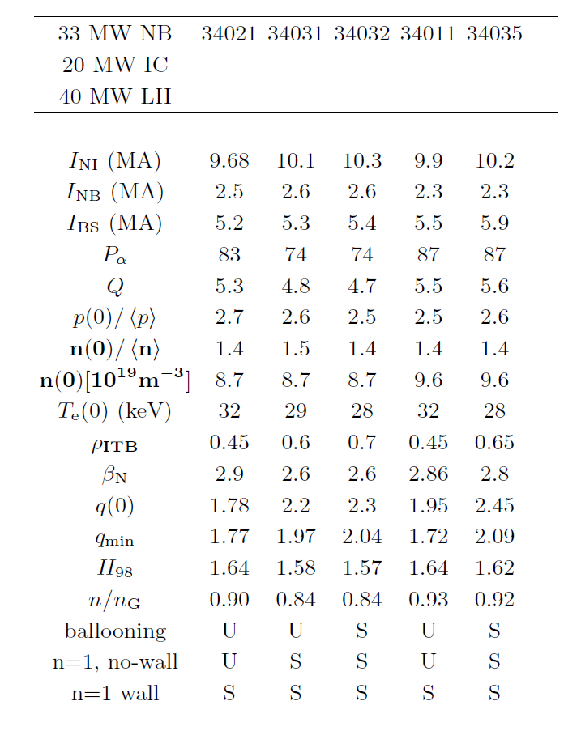
Some figures from Francesca’s paper

Slide 21
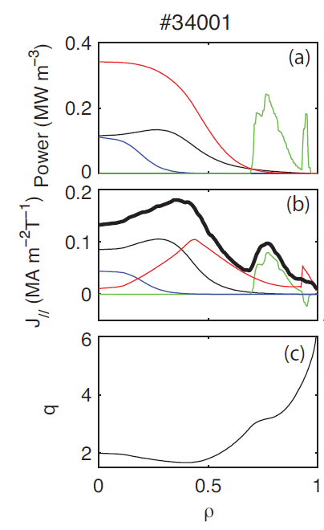
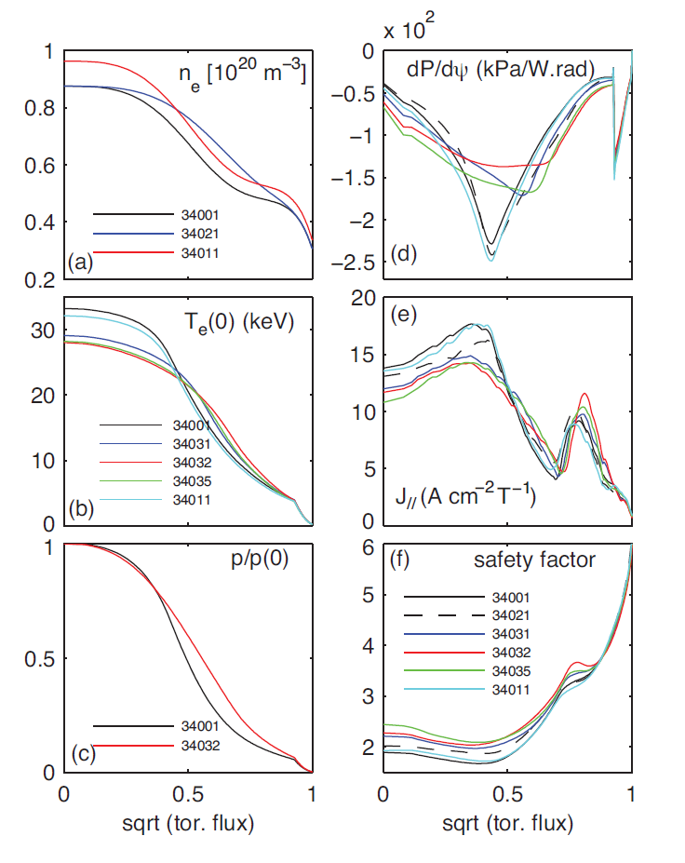
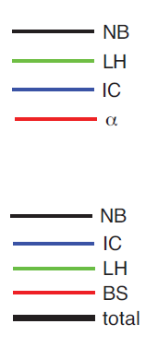
Some figures from Francesca’s paper

Slide 22
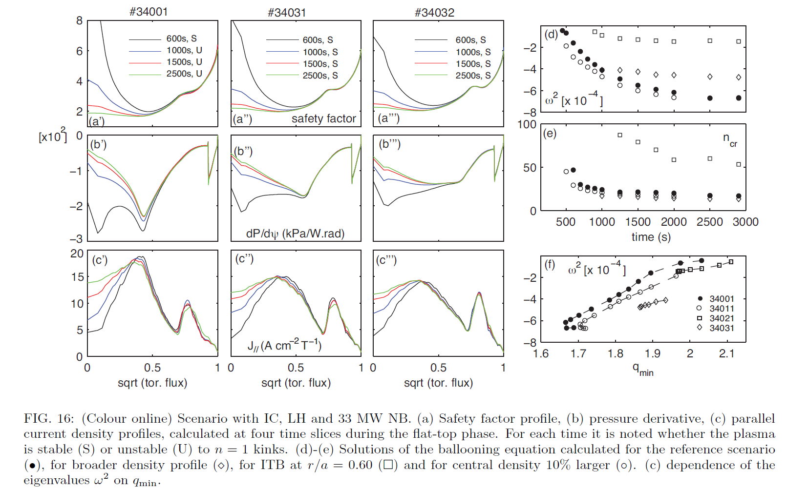
Some figures from Francesca’s paper

Slide 23
PEST Fluid δW results
34001 @ 2500s
Marginal b = 1.20
Marginal eigenvalue = -0.1883e-5
δWinf = -0.2246451e-2
δW_{b} = 0.3334449e-1 (b = 0.35)
β_{N} = 2.7038
p₀/<p> = 2.8950
q_{min} = 1.66856
l_{i} = 0.8036
34011 @ 2500s
Marginal b = 0.561
Marginal eigenvalue = -0.2105e-5
δWinf = -0.1098658e-1
δW_{b} = 0.1593027e-1 (b = 0.35)
β_{N} = 2.8645
p₀/<p> = 2.8984
q_{min} = 1.71432
l_{i} = 0.8088
34036 @ 2500s
Marginal b = 0.555
Marginal eigenvalue = -0.9399e-5
δWinf = -0.1035962e-1
δW_{b} = 0.1456835e-1 (b = 0.35)
β_{N} = 2.8045
p₀/<p> = 2.7648
q_{min} = 1.82644
l_{i} = 0.7772
34039 @ 2500s
Marginal b = 0.414
Marginal eigenvalue = -0.3469e-5
δWinf = -0.15478102e-1
δW_{b} = 0.53414071e-2 (b = 0.35)
β_{N} = 3.0790
p₀/<p> = 2.7543
q_{min} = 1.93668
l_{i} = 0.7493
34041 @ 2500s
Marginal b = 0.789
Marginal eigenvalue = -0.6606e-6
δWinf = -0.72005936e-2
δW_{b} = 0.30589234e-1 (b = 0.35)
β_{N} = 3.2207
p₀/<p> = 2.6452
q_{min} = 2.09046
l_{i} = 0.7130
Results with the real wall are very similar to a conformal wall at b = 0.35, so we have used the conformal wall.

Slide 24
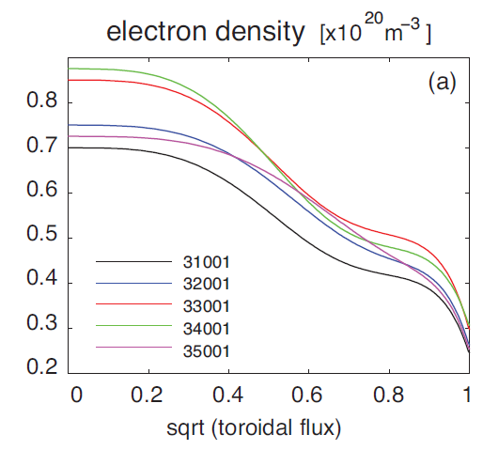
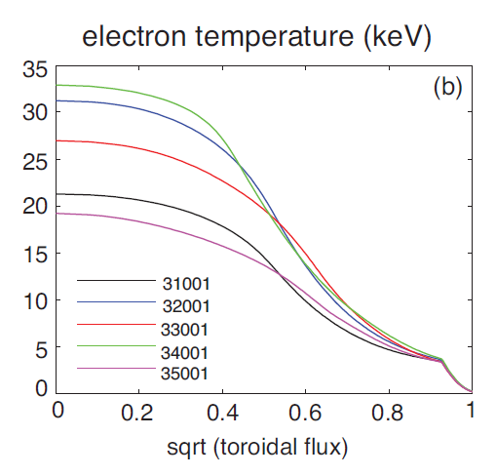
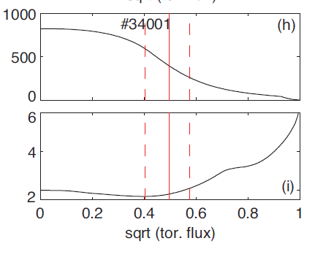
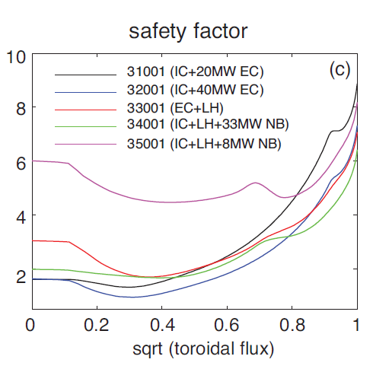
Profiles, 34001 @ 2500s
Compare to figures from
[F. Poli et al., submitted to Nucl. Fusion (2012)]
(green profile is same shot, but at t = 2000s)
pressure
q

Slide 25


Profiles, 34011 @ 2500s

Slide 26
Profiles, 34011 @ 2500s

Slide 27
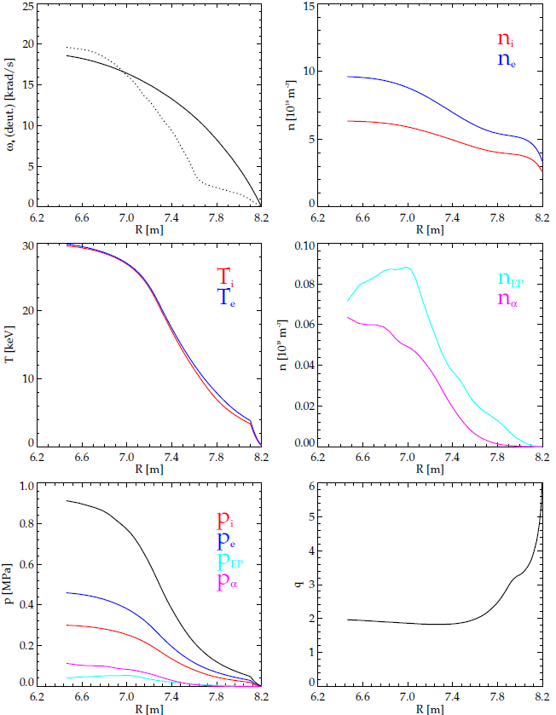
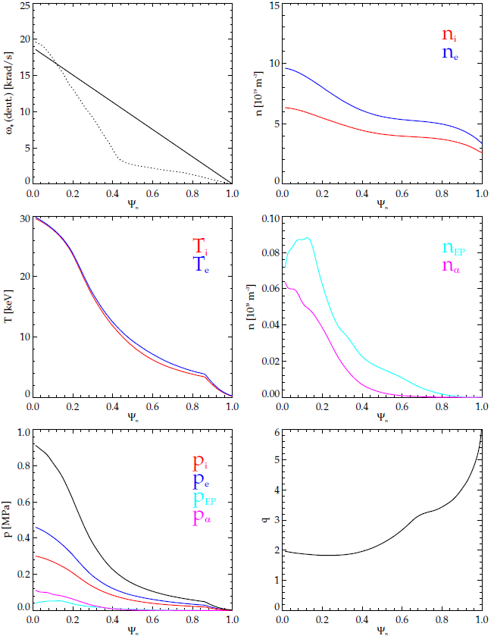
Profiles, 34036 @ 2500s

Slide 28
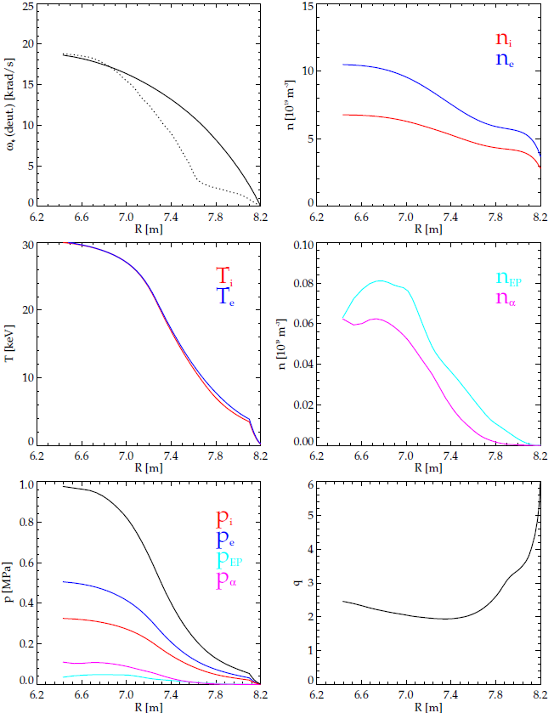

Profiles, 34039 @ 2500s

Slide 29
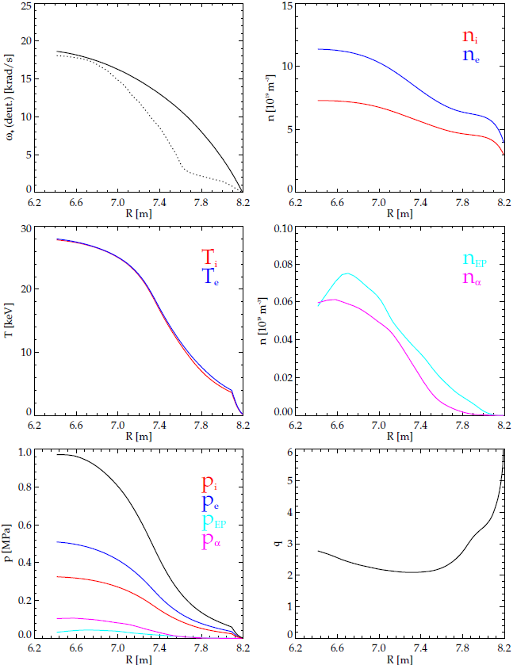

Profiles, 34041 @ 2500s

Slide 30

Various parameters vs. shot number

Slide 31


Results with scaled rotation profiles
34039
34041
ω = ω₀(1-Ψ_{n})
Nominal ω₀ = 3kHz
Still working on this

Slide 32






Energetic particle distribution function 34039 @ 400s

