Slide 1




NSTX-U
Supported by
Theory Improvements
Coll of Wm & Mary
Columbia U
CompX
General Atomics
FIU
INL
Johns Hopkins U
LANL
LLNL
Lodestar
MIT
Lehigh U
Nova Photonics
Old Dominion
ORNL
PPPL
Princeton U
Purdue U
SNL
Think Tank, Inc.
UC Davis
UC Irvine
UCLA
UCSD
U Colorado
U Illinois
U Maryland
U Rochester
U Tennessee
U Tulsa
U Washington
U Wisconsin
X Science LLC
Culham Sci Ctr
York U
Chubu U
Fukui U
Hiroshima U
Hyogo U
Kyoto U
Kyushu U
Kyushu Tokai U
NIFS
Niigata U
U Tokyo
JAEA
Inst for Nucl Res, Kiev
Ioffe Inst
TRINITI
Chonbuk Natl U
NFRI
KAIST
POSTECH
Seoul Natl U
ASIPP
CIEMAT
FOM Inst DIFFER
ENEA, Frascati
CEA, Cadarache
IPP, Jülich
IPP, Garching
ASCR, Czech Rep
J.W. Berkery
Department of Applied Physics, Columbia University, New York, NY, USA
Rochester, New York
March 15, 2012

Slide 2
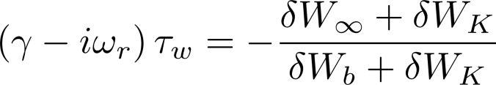

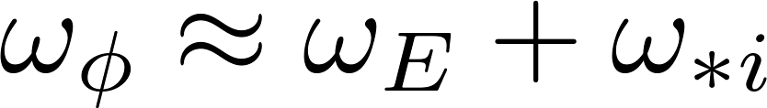
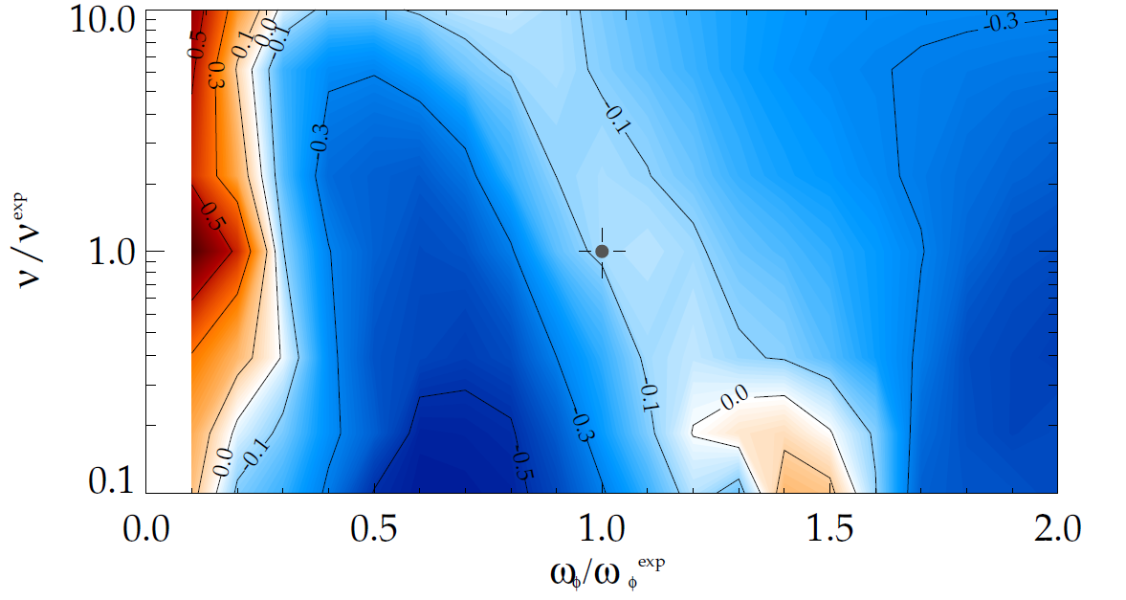
Kinetic terms in the RWM dispersion relation enable stabilization; theory consistent with experimental results
Dissipation (Im(δW_{K})) and restoring force (Re(δW_{K})) from kinetic term enables stabilization of the RWM:
[B. Hu et al., Phys. Plasmas 12, 057301 (2005)]
Precession Drift
~ Plasma Rotation:
Collisionality
γτ_{w} contours vs. ν and ω_{φ}
Bounce
Theory Development
Collisionality model improvements
Anisotropy of energetic particles
Further rotation effects (inc. poloidal)
Eigenfunction modifications
Neoclassical orbit modification? (with G. Kagan)
Precession drift
resonance stabilization
Marginal stability
Bounce/transit
resonance stabilization
instability
(experiment)
[J. Berkery et al., Phys. Rev. Lett. 104, 035003 (2010)]

Slide 3
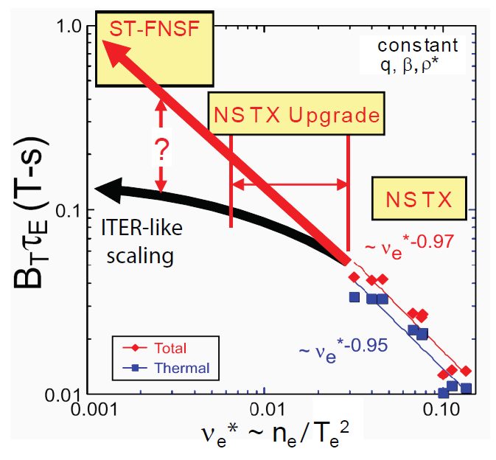
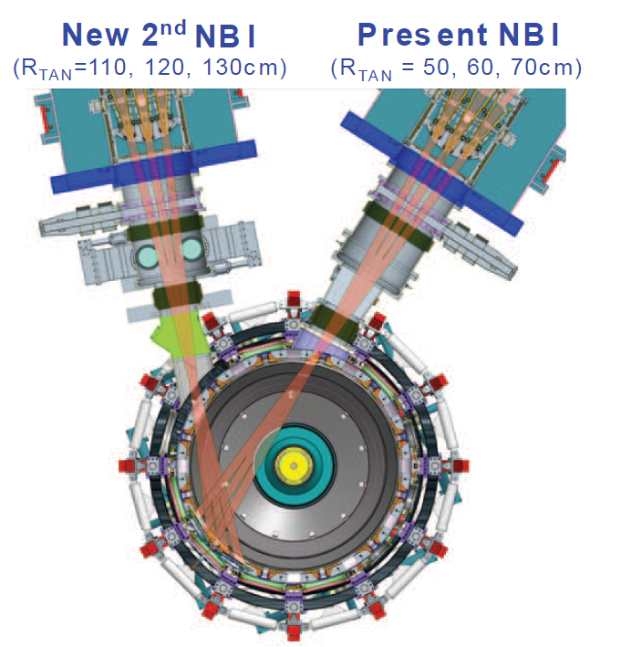
NSTX-U will have lower collisionality and second, off-axis neutral beam
[J. Menard et al., submitted to Nucl. Fusion (2011)]

Slide 4
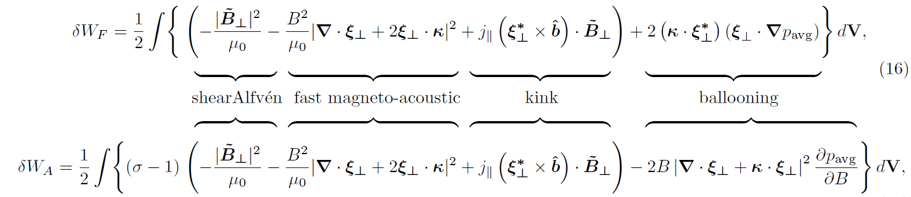
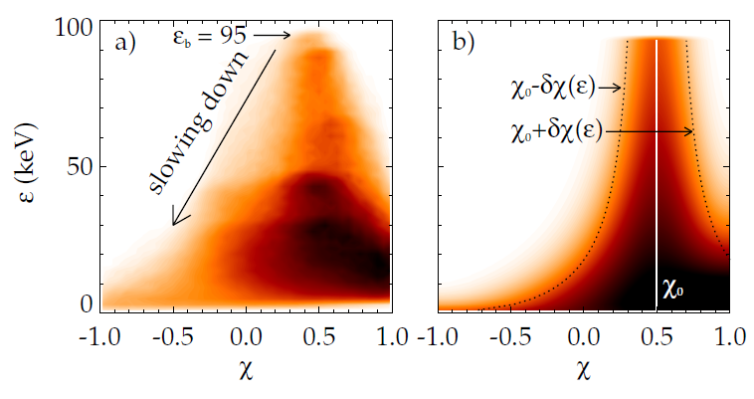
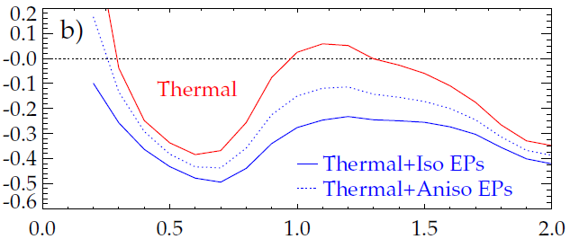
EPs have a generally stabilizing effect that is independent of rotation; Anisotropic distribution impacts stability
Anisotropy effects fluid terms, mostly through ballooning term.
Also effects kinetic term, through pitch angle dependence of distribution function.
[N. Gorelenkov et al., Nucl. Fusion 45, 226 (2015)]
unstable
stable
γτ_{w}
Addition of simple anisotropy model
(χ₀ = 0.75, δχ = 0.25)
reduces stabilizing effect, consistent with quantitative comparison to NSTX
ω_{φ}/ω_{φ}^{exp (marginally stable)}
[J.W. Berkery et al., Phys. Plasmas 17, 082504 (2010)]

Slide 5
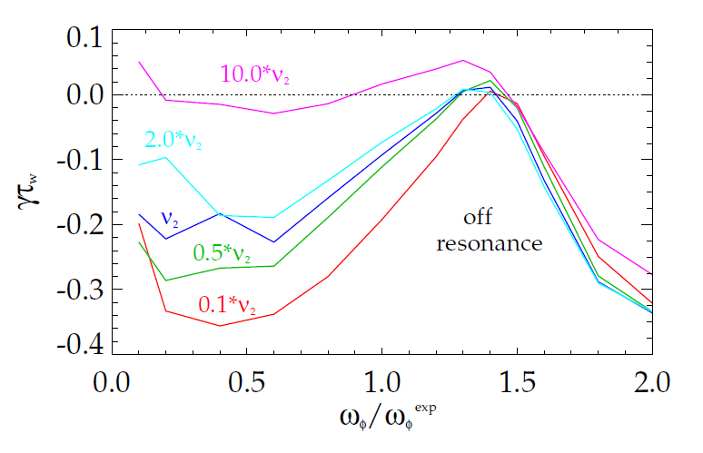
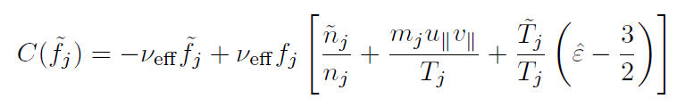
Reduced collisionality (ν) is stabilizing for RWMs, but only near kinetic resonances
unstable
MISK currently uses an energy-dependent collisionality, MARS-K uses a constant.
Possible improvements:
RWM growth rate (γτ_{w})
Particle, momentum, and energy conserving Krook operator for like-particle collisions (suggested by G. Hammett):
140132 @ 0.704
NSTX-tested kinetic RWM stability theory: 2 competing effects at lower ν
  Stabilizing collisional dissipation reduced (expected from early theory)
  Stabilizing resonant kinetic effects enhanced (contrasts early RWM theory)
Lorentz operator with pitch angle dependence:
[J. Berkery et al., Phys. Rev. Lett. 106, 075004 (2011)]

Slide 6
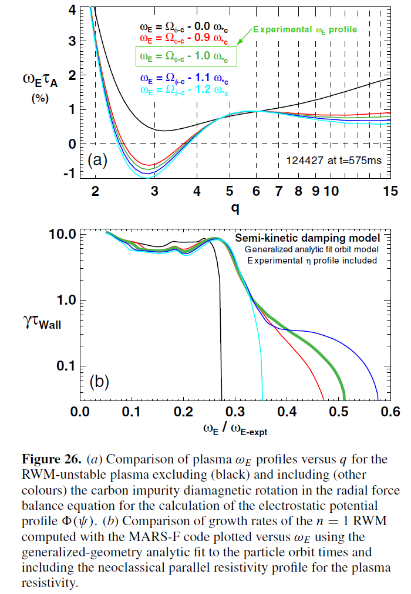
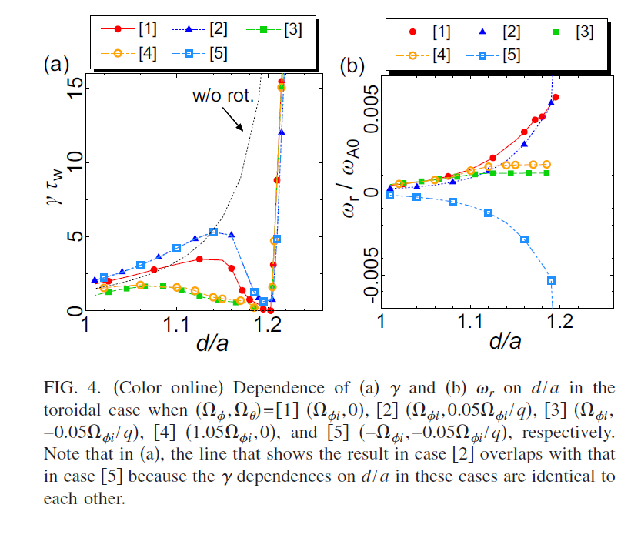
Further exploration of the effect of plasma rotation
Effect on equilibrium
Including poloidal rotation
Eigenfunction modification (next slide)
[J. Menard, APS 2010 and 2011]
[J. Menard et al., Nucl. Fusion 50, 045008 (2010)]
[N. Aiba et al., Phys. Plasmas 18, 022503 (2011)]

Slide 7
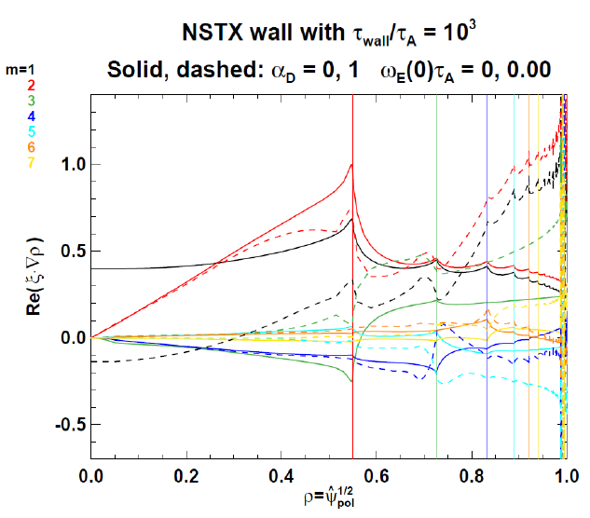
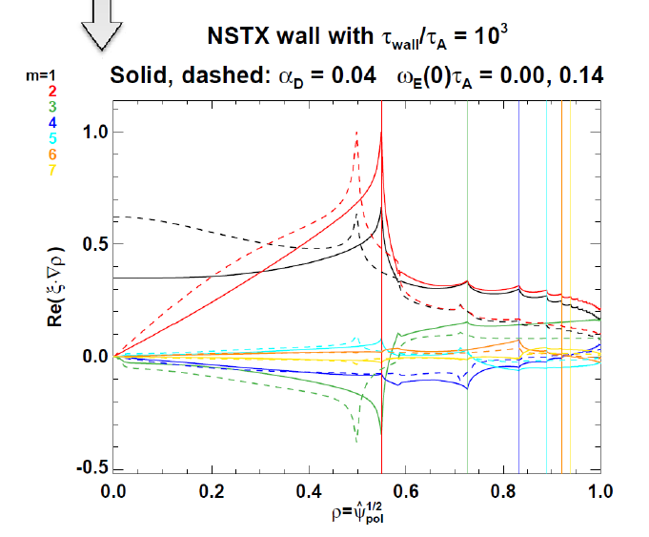
The RWM eigenfunction may be modified by several factors
[J. Menard and Y.Q. Liu, APS 2011]
Kinetic dissipation
Plasma rotation
The importance of eigenfunction modification and Alfven resonances at rational surfaces will come out of code benchmarking.

Slide 8




How can we approximate eigenfunction modification in MISK with an iterative approach?
We take the eigenfunction from the PEST marginally-stable eigenfunction: γ -> 0, δI -> 0, δW_{F} = -δW_{V} (at the marginal wall position).
We can calculate a fluid growth rate with that fixed eigenfunction, the true wall position, and the assumption that the inertial term is still negligible.
We can calculate a kinetic growth rate and mode rotation frequency by including kinetic effects and anisotropy corrections, but still assuming a fixed eigenfunction and negligible inertial term.
We can even iterate for corrected γ and ω_{r}, and solve for multiple roots. [J. Berkery et al., Phys. Plasmas 18, 072501 (2011)]
Keeping the eigenfunction fixed, we could additionally try to include the inertial term (which actually involves multiple roots as well):
Now, if the eigenfunction is allowed to change, how do we solve for a new one?

Slide 9
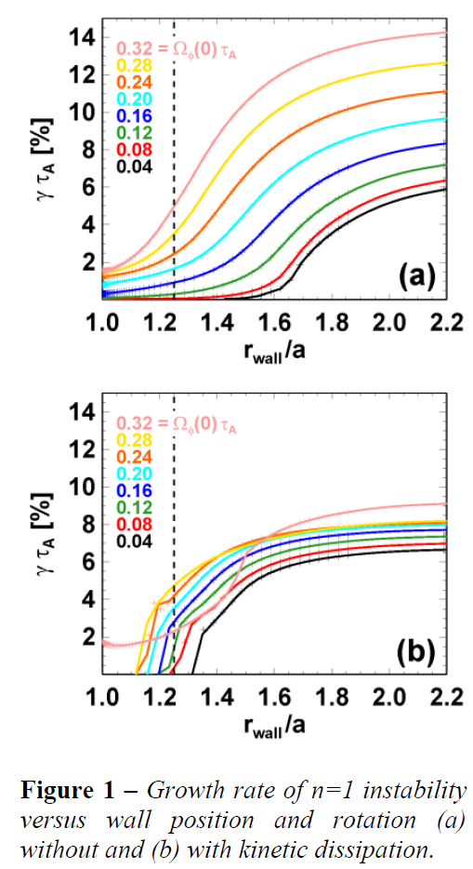
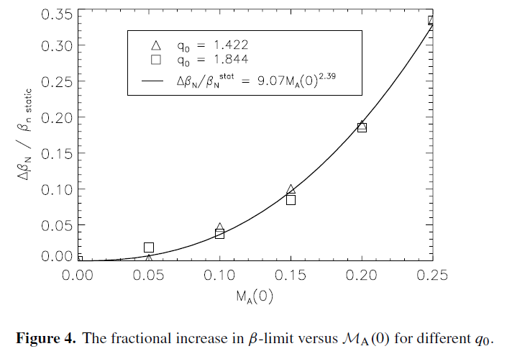
Rotation and kinetic damping may also affect the ideal no-wall stability limit
[I. Chapman et al., Plasma Phys. Control. Fusion 53 125002 (2011)]
[J. Menard and Y.Q. Liu, EPS 2012]

Slide 10
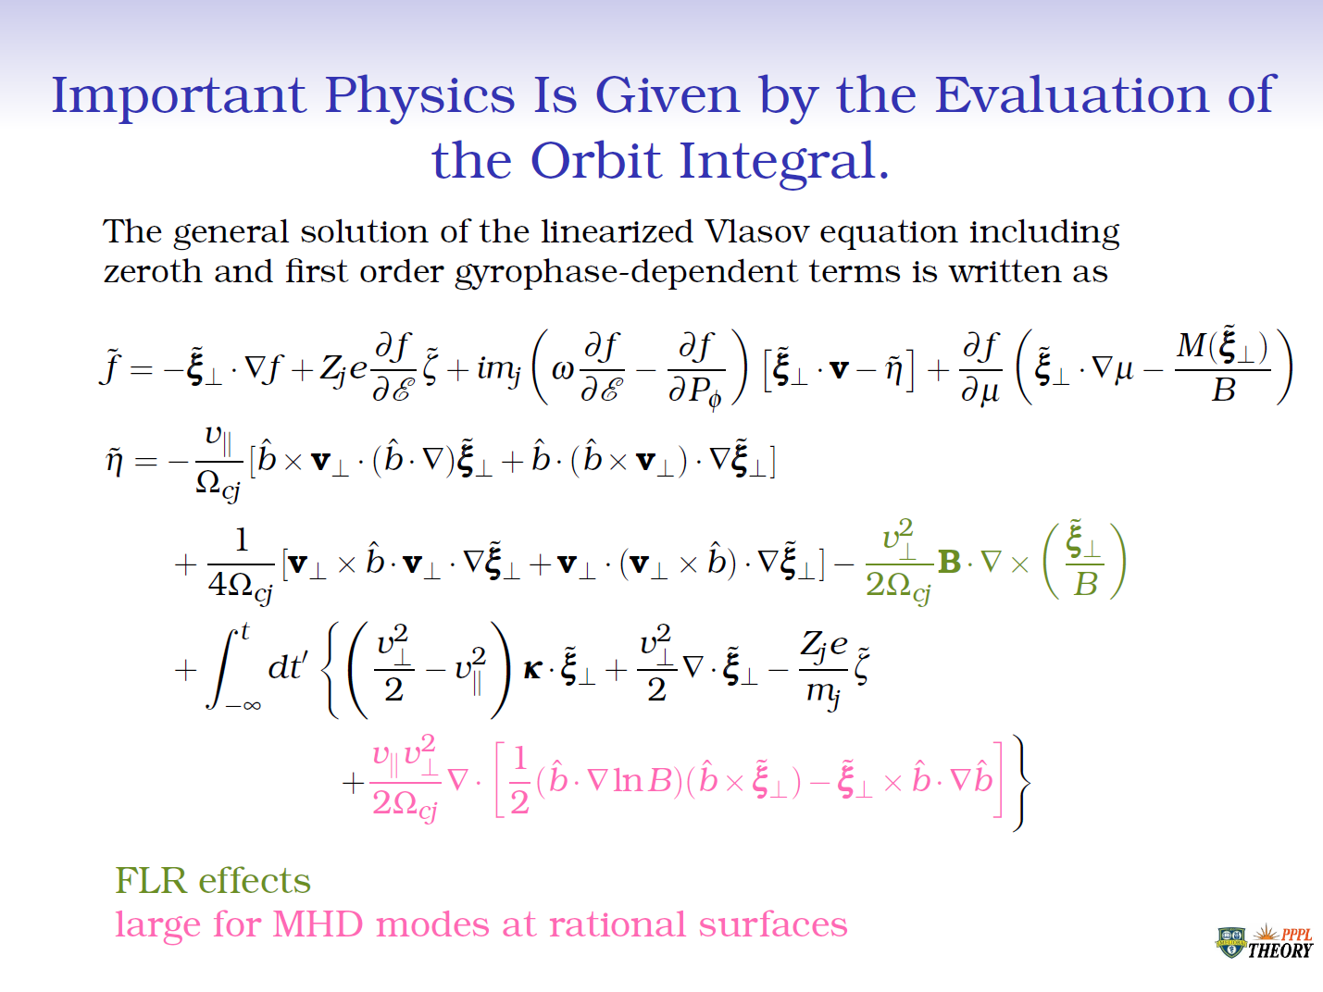
Finite Larmor Radius Effects

Slide 11
Finite Orbit Width Kinetic damping of RWMs
Orbit widths can be very important for fast ions
Use guiding-centre following code to capture this physics
HAGIS code
For typical MAST case, simple beam distribution
RWM passively stable in ITER Advanced Scenario due to kinetic damping
Only capture these effects by including orbit widths
Sensitive to rotation, so should not be relied upon!

Slide 12
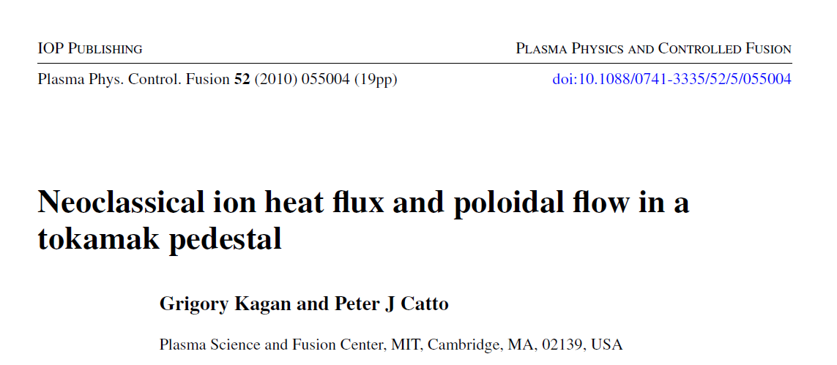
Finite Orbit Width
Ian Chapman email:
“I need to talk to YQ and Jon Graves who probably have insight from the algebraic formulation with FOW included that they’re working on.”

Slide 13
xxx

