Slide 1
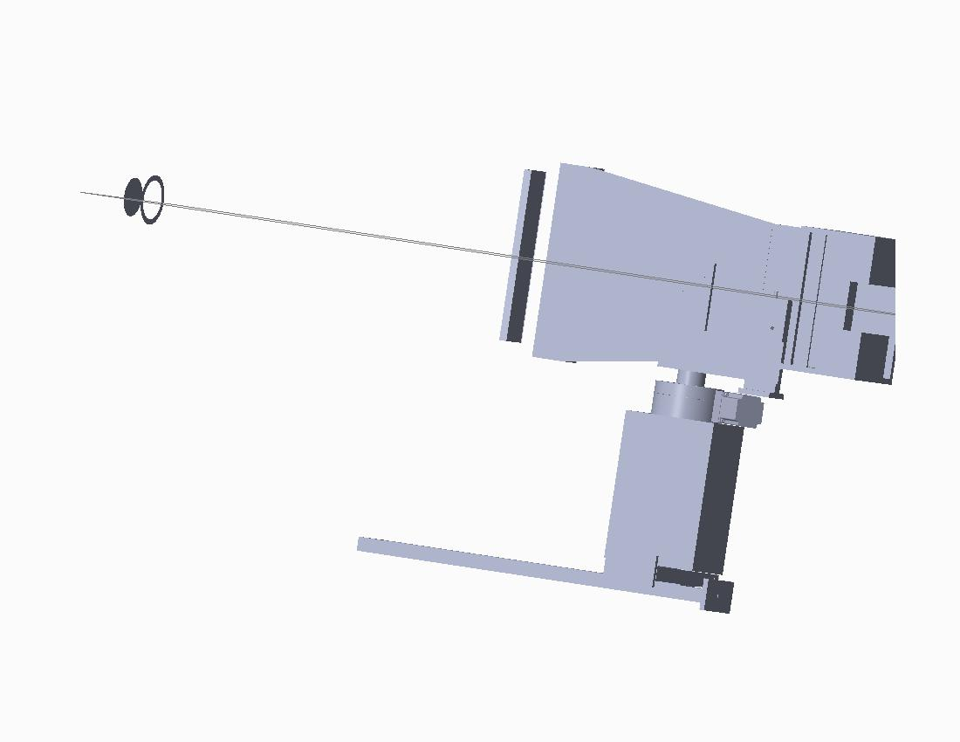
On midplane of NSTX-U?

