Slide 1

Recent Progress in Understanding Electron Thermal Transport in NSTX and NSTX-U
Y. Ren¹
E. Belova¹, W. Guttenfelder¹, N. Gorelenkov¹, S.M. Kaye¹, E. Mazzucato¹, W.X. Wang¹, K. Tritz², R.E. Bell¹, B.P. LeBlanc¹, C.W. Domier³,
D.R. Smith⁴, H. Yuh⁵, K.C. Lee⁶, and the NSTX Team
1. PPPL 2. JHU 3. UC-Davis 4. UW-Madison
5. Nova Photonics 6. NFRI
18th International Congress on Plasma Physics
June 27th-July 1st, 2016, Kaohsiung, Taiwan

Slide 2
Outline
Introduction
Recent results on electron thermal transport in NSTX
  Micro-tearing turbulence in NSTX high-beta and high-collisionality H-mode plasmas
  ETG turbulence in NSTX L and H-mode plasmas
  Fast-ion-driven Alfven eigenmodes in the core region of NSTX high-power H-mode plasmas
NSTX-U Plans for electron thermal transport
Summary

Slide 3
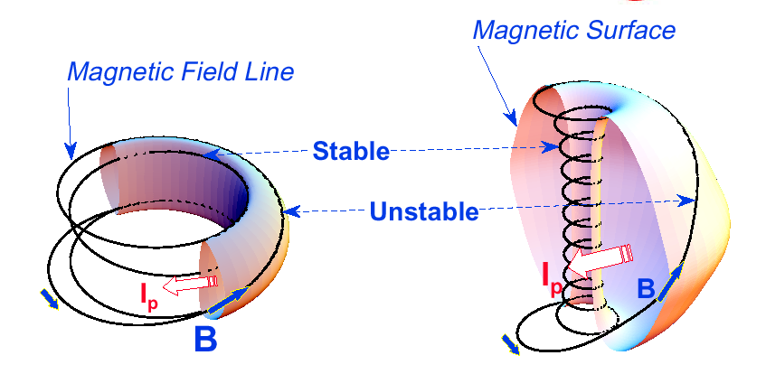
Spherical Tokamaks Have Some Significant Advantages over Conventional Tokamak
The low aspect ratio of spherical tokamaks leads to improved ¯ limit than conventional tokamaks
  More compact and lower-cost future devices, e.g. Fusion Nuclear Science Facility (FNSF) and power plant
The effective shaping and/or strong ExB shear from low aspect ratio lead to reduced ion-scale turbulence
  Neoclassical ion thermal transport and different confinement scaling for H-mode plasmas

Slide 4
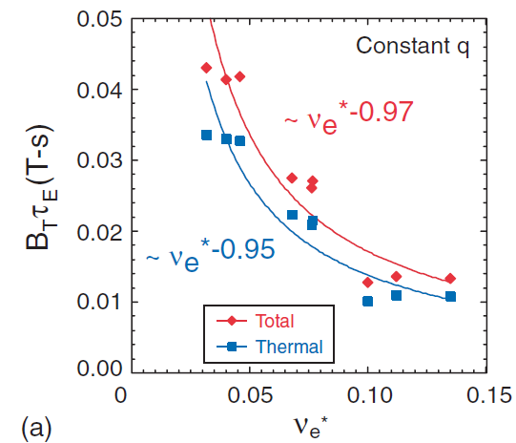
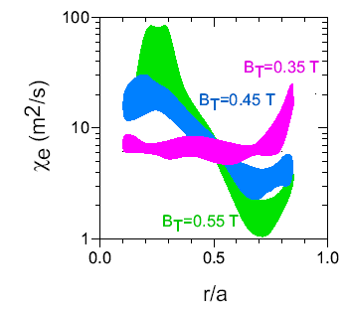
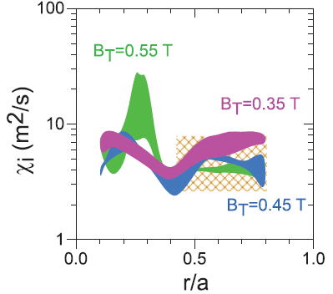
NSTX Thermal Confinement Has Strong Collisionality Scaling in H-mode Plasmas
Kaye et al., Nucl. Fusion, 2007
NSTX
MAST
Valovič et al.,Nucl. Fusion, 2011
ITER
Doyle et al., Nucl.Fusion 2007
Neoclassical transport by GTC-NEO
Ion transport is neoclassical, consistent with strong flow shear and strong shaping
The confinement scaling is determined by electron thermal transport

Slide 5
Multiple Mechanisms Should be Responsible for Anomalous Electron Thermal Transport
Different mechanisms needed to account for the always anomalous electron thermal transport
  Different radial regions
    Core flat region (small gradient drive)
    Core gradient region (large gradient drive)
    Edge region (steepest gradient, connection to SOL, e.g. H-mode pedestal)
  Different parametric regimes
    Large/small plasma beta/collisionality, magnetic shear, ExB shear, etc.
T
Edge region
Core flat region
Core gradient region
r

Slide 6
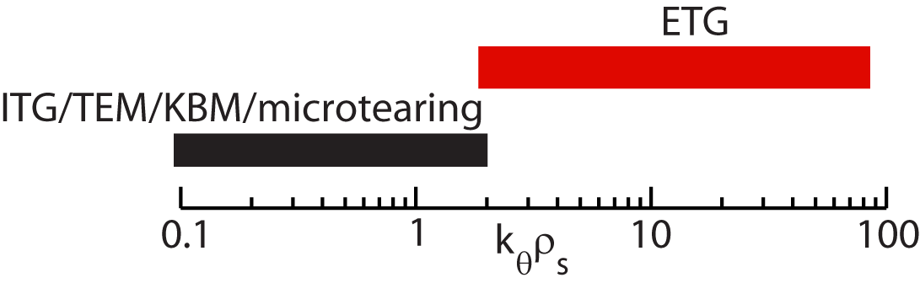
Multiple Mechanisms Should be Responsible for Anomalous Electron Thermal Transport
Different mechanisms needed to account for the always anomalous electron thermal transport
  Different radial regions
    Core flat region (small gradient drive)
    Core gradient region (large gradient drive)
    Edge region (steepest gradient, connection to SOL, e.g. H-mode pedestal)
  Different parametric regimes
    Large/small plasma beta/collisionality, magnetic shear, ExB shear, etc.
Evidence exists for gradient driven electrostatic and electromagnetic ballooning drift instabilities:
  Low-k (ion-scale): ITG/TEM/KBM/microtearing modes
  High-k (electron-scale): ETG modes
  Turbulent ExB drift and magnetic flutter effects
Fast ion driven Alfvenic eigenmodes found relevant
  GAE and/or CAE modes
  Alfvenic eigenmode induced electron drift orbit stochasticity
T
Edge region
Core flat region
Core gradient region
r

Slide 7
Micro-tearing turbulence in high-collisionality and high-beta H-mode plasmas
T
Core flat region
Core gradient region
r

Slide 8
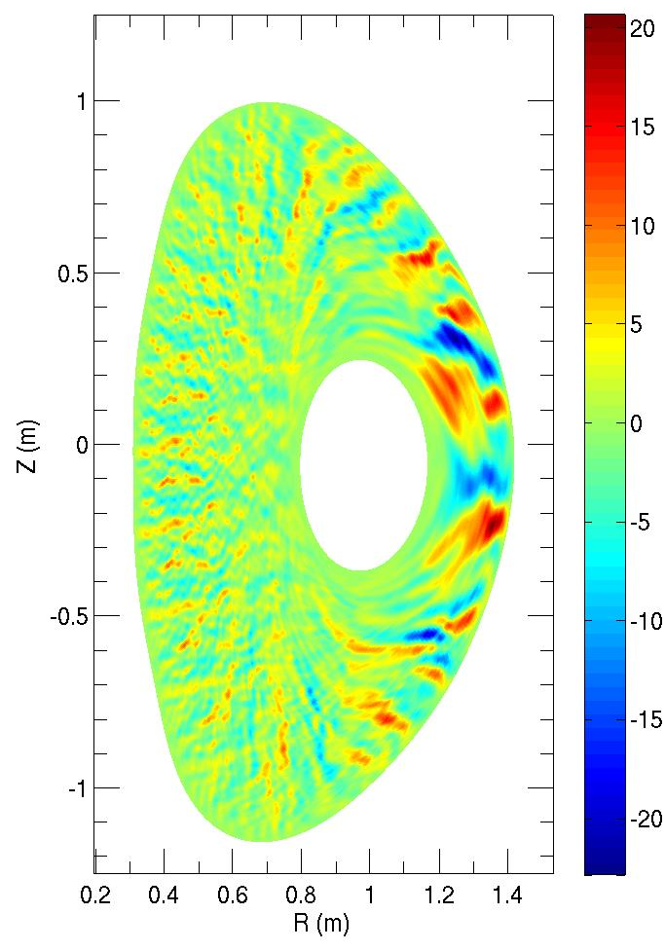
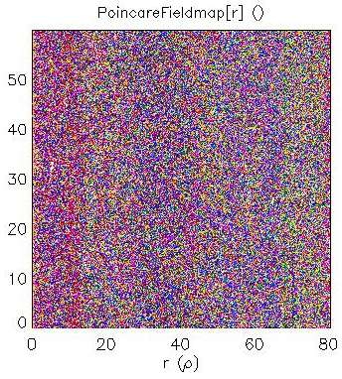
First Successful Nonlinear Microtearing Simulations for NSTX
~98% of transport due to magnetic “flutter” contribution
w_{island}(n) > δr_{rat}(n), island overlap → perturbed field line trajectories are stochastic*
χ_{e,EM} =1.25 ρ_{s}c_{s}²/a close to collisionless Rechester-Rosenbluth** (λ_{mfp}=12 m, L_{c}≈2.5 m)
B_{T0}=3.5 kG
δB_{r} (Gauss)
*E. Wang et al., PoP (2011).
**A.B. Rechester & M.N. Rosenbluth, PRL (1978)
Movies at http://www.pppl.gov/~wgutten/
W. Guttenfelder et al., PRL (2011)

Slide 9
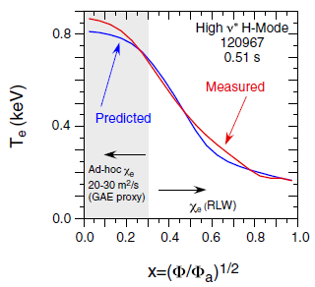
Micro-tearing Mode Predictions are Consistent with NSTX H-mode Plasmas
Non-linear transport
As transport drops, a/L_{Te} will increase (for fixed heat flux), at some point ETG (TEM/KBM?) should become important
This transition likely to determine limit of “favorable” ν* scaling
A representative NSTX H-mode
Using micro-tearing-based RLW electron thermal diffusivity model
Good agreement seen when micro-tearing linearly important
W. Guttenfelder et al., PRL (2011)
Kaye et al., NF (2015)

Slide 10
ETG turbulence in NSTX L and H-mode plasmas
T
Core flat region
Core gradient region
r

Slide 11
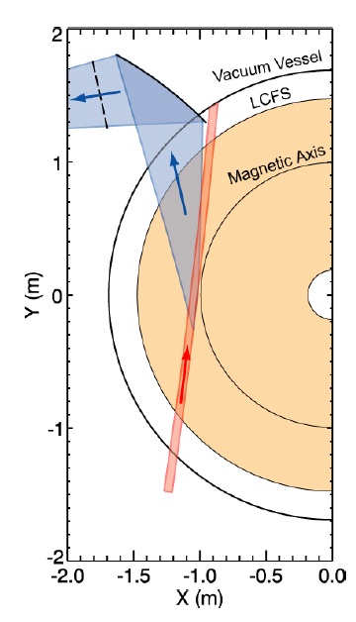
A High-k Microwave Scattering System was Used to Measure Electron-scale Turbulence in NSTX
Spherical mirror
High-k turbulence measurement
 | r/a | Measured quantity | Spatial & temporal resolution
280 GHz microwave scattering system | ~0.2-1 from core to edge | Density fluctuation | 3 ≤ k┴ρ_{s} ≤ 12 ΔR ~ ±2 cm f~ 5 MHz
k_{p}
Scattered light
θ_{s}
k_{s}
k_{i}
Probe beam
Probe beam
D.R. Smith, PhD thesis, 2009

Slide 12
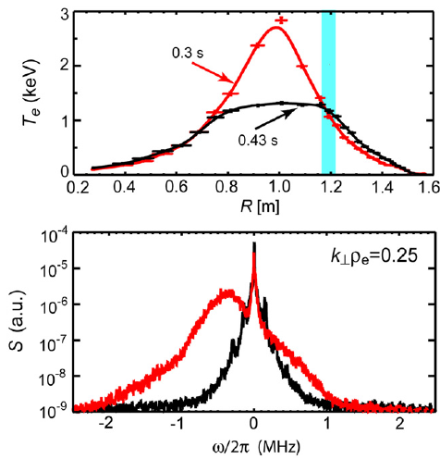
First Identification of ETG Turbulence in NSTX RF-heated L-mode Plasmas
The measured high-k turbulence is shown to be driven by electron temperature
  In RF-heated helium L-mode plasma (1.2 MW, 5.5 kG, 700 kA)
  Fluctuation propagates in the electron diamagnetic direction
  Clear reduction in turbulence spectral power at lower electron temperature gradient
$$k_{⊥}=14 {cm}^{−1},k_{⊥}ρ_{s}=8−10$$
Electron direction
Mazzucato et al., PRL 2008, NF 2009

Slide 13
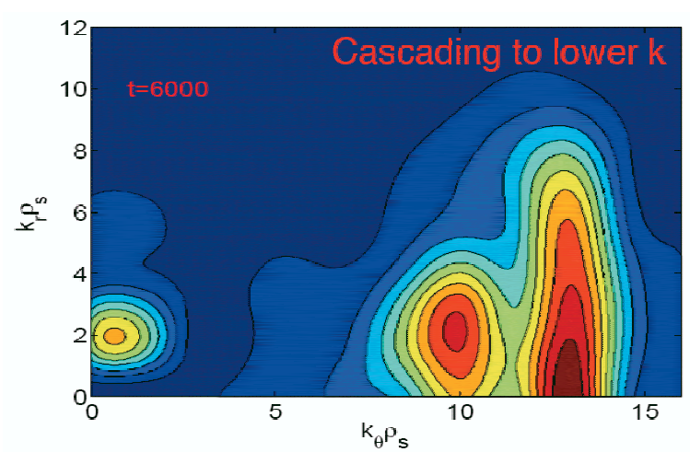
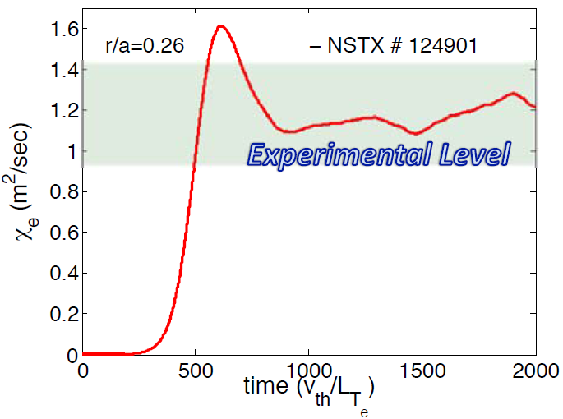
ETG Turbulence can Produce Experimentally Relevant Electron Thermal Transport
Significant ETG-induced contributions to anomalous Â_{e} confirmed with global gyrokinetic code GTS
Strong energy coupling to electron version of GAM (very high-ω ZF)
W.X. Wang et al., PoP (2015)

Slide 14
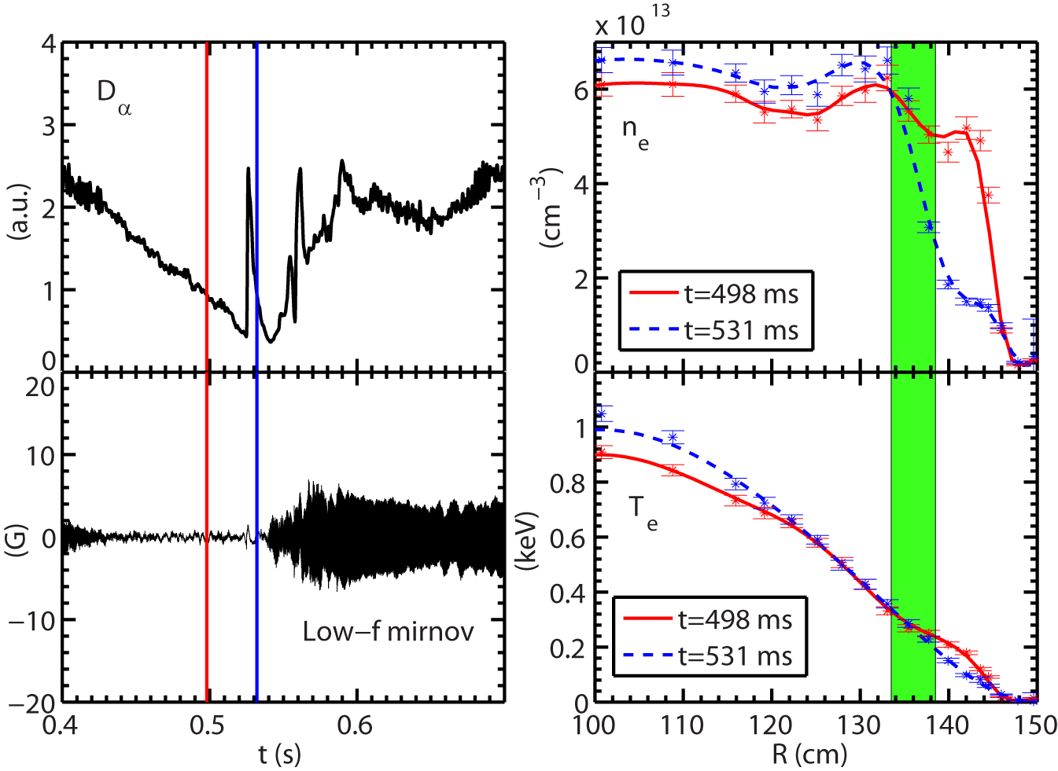
Large ELM Event Induces Density Profile Steepening in the Core Region
ELM event
After the ELM event:
  Large density gradient developed in the high-k measurement region.
  Electron temperature gradient also increases
  Electron density has only a moderate decrease
  Electron temperature remains essentially constant
No large MHD mode appears before and right after the ELM event
High-k measurement region
Shot=140620

Slide 15
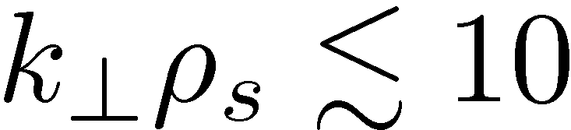
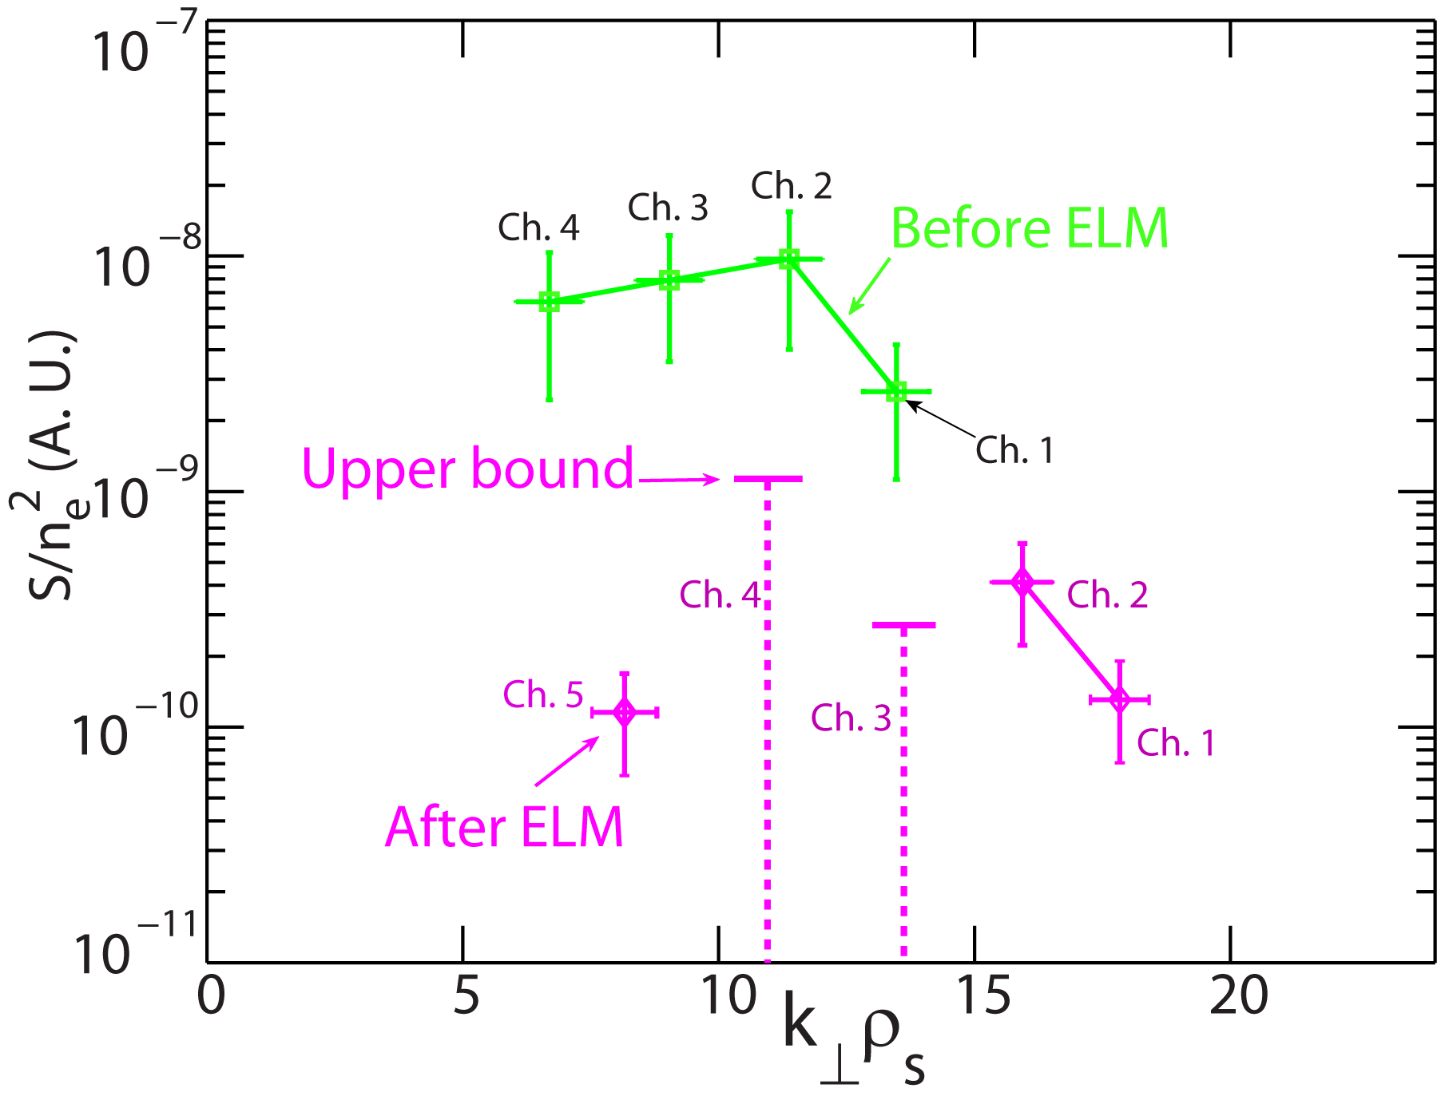
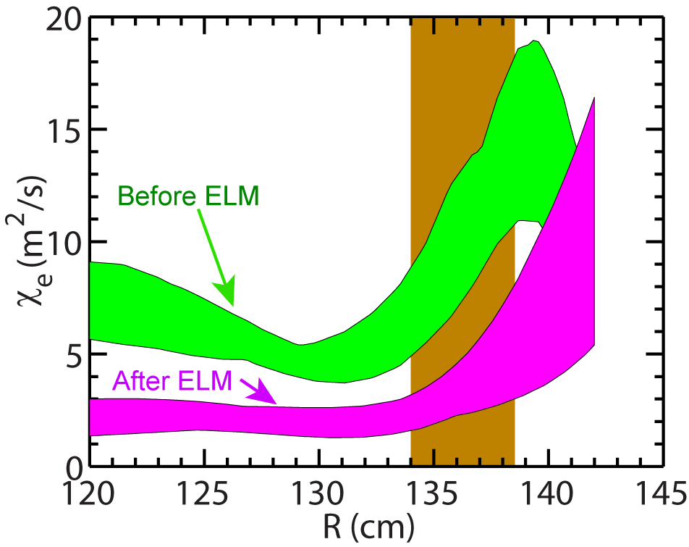
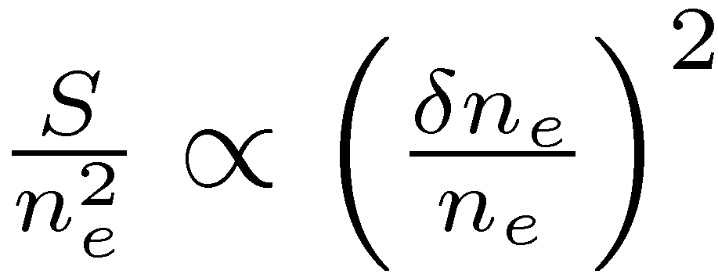
Reduced ETG Turbulence Intensity and Electron Thermal Transport is Observed with Density Profile Steepening
Significant decrease in spectral power in electron-scale observed for
Electron thermal diffusivity is decreased by a factor of ~2 after the ELM event
High-k region
See Y. Ren et al., PRL 2011, PoP 2012
Density gradient stabilization of high-k turbulence further confirmed in J. Ruiz-Ruiz et al., PoP 2015

Slide 16
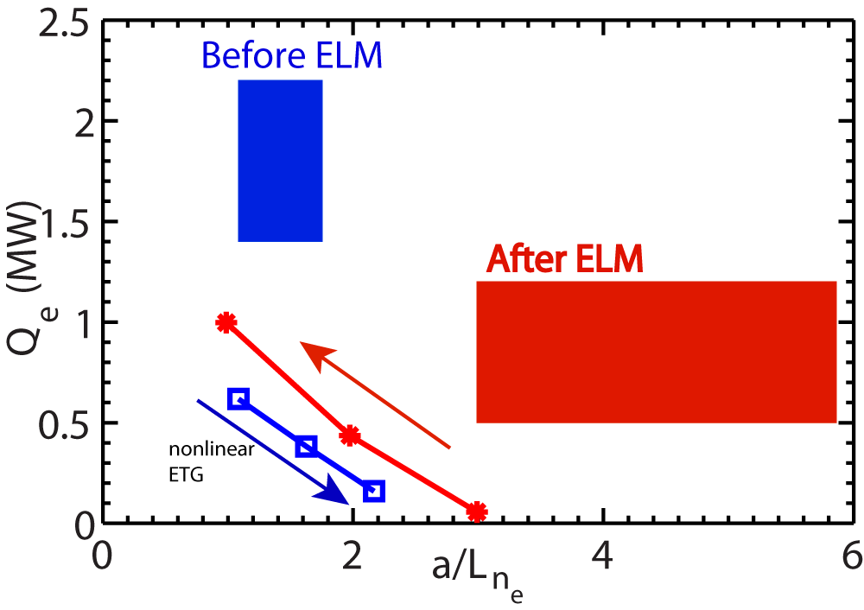
Nonlinear ETG Simulations Reproduce Observed Dependence of Electron Transport on Density Gradient
Experimental Q_{e} is found to decrease after the ELM event with large density gradient
The same trend is found from nonlinear ETG simulations, but does not agree quantitatively
experiment
Nonlinear GYRO ETG simulations with: local general equilibrium, kinetic ions and electrons, collisions, electromagnetic, flow and flow shear
simulations

Slide 17
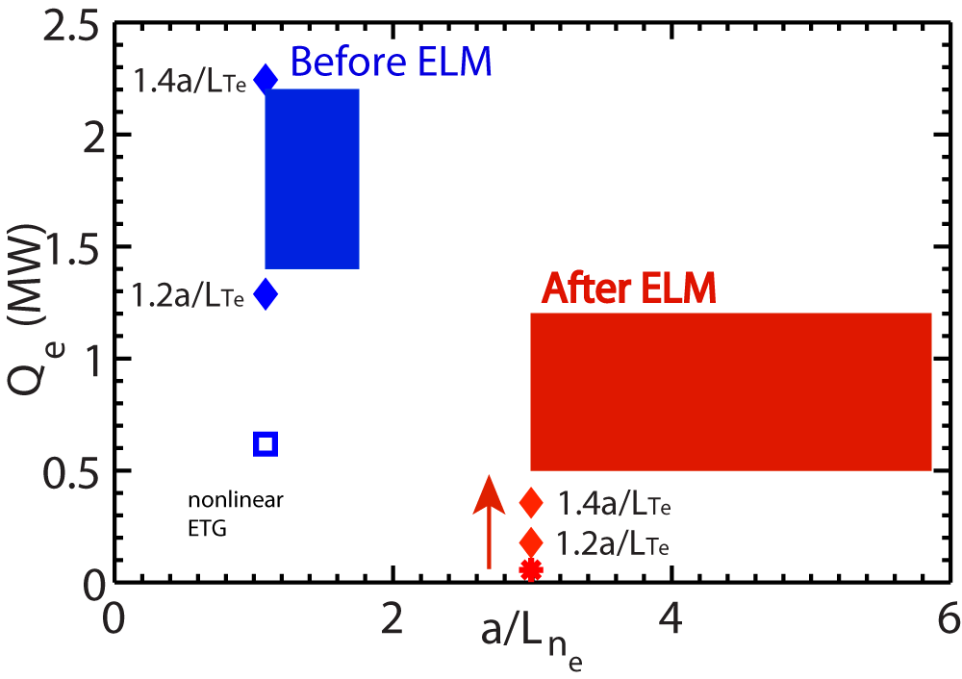
Predicted Q_{e} is Sensitive to Electron Temperature Gradient
Before ELM, a 20-30% increase in a/L_{Te} is able to match the experimental Q_{e}
After ELM, increasing a/L_{Te} by 40% after still cannot match experimental Q_{e}

Slide 18
Fast-ion-driven Alfven eigenmodes in the core region of NSTX high-power H-mode plasmas
T
Core flat region
Core gradient region

Slide 19
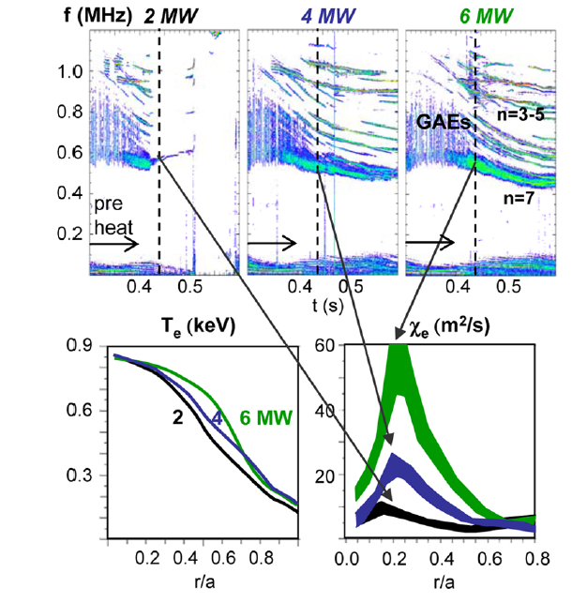
Core T_{e} Flattening in High-power NBI H-mode Plasmas is Observed to be Correlated with *AE Activities
Core T_{e} flattening correlated with NBI power
  No simultaneous increase in central T_{e}
Almost a factor of 10 increase in core Â_{e} (r/a~0.2)
  Â_{e} calculated with TRANSP power balance analysis
CAEs/
D. Stutman et al., PRL (2009)

Slide 20
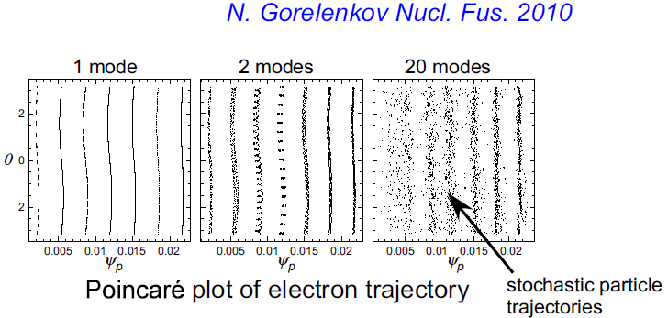
Core T_{e} Flattening in High-power NBI H-mode Plasmas is Observed to be Correlated with *AE Activities
Core T_{e} flattening correlated with NBI power
  No simultaneous increase in central T_{e}
Almost a factor of 10 increase in core Â_{e} (r/a~0.2)
  Â_{e} calculated with TRANSP power balance analysis
  Consistent with stochastic electron thermal transport induced by Alfvenic eigenmode (GAE and/ CAE)

Slide 21
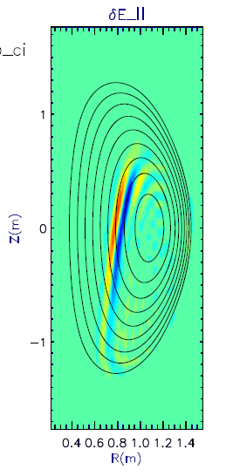
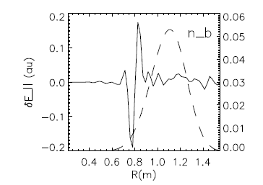
Core T_{e} Flattening in High-power NBI H-mode Plasmas is Observed to be Correlated with *AE Activities
Core T_{e} flattening correlated with NBI power
  No simultaneous increase in central T_{e}
Almost a factor of 10 increase in core Â_{e} (r/a~0.2)
  Â_{e} calculated with TRANSP power balance analysis
  Consistent with stochastic electron thermal transport induced by Alfvenic eigenmode (GAE and/ CAE)
Coupling of CAEs with KAWs, an alternative explanation
E. Belova et al., PRL (2015)

Slide 22
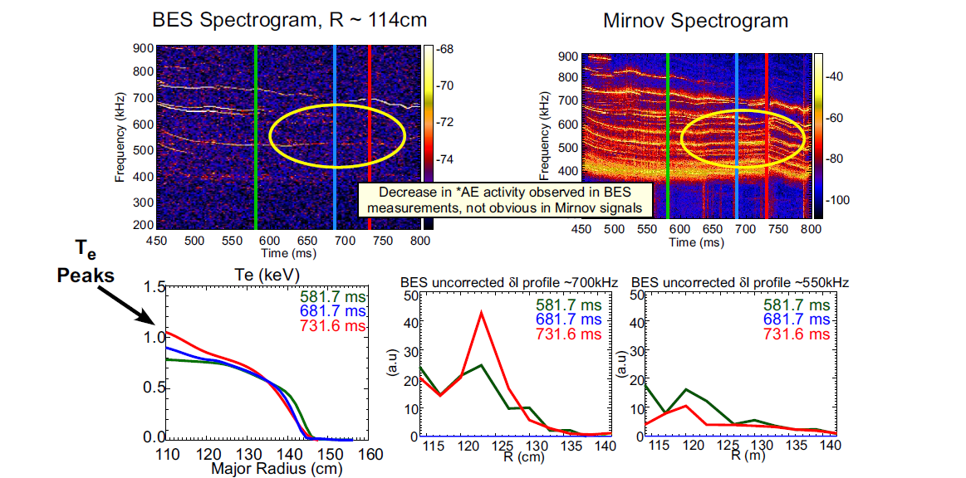
Decrease in *AE Activity Measured by BES Corresponds with Peaking of Central Electron Temperature
T_{e} remains peaked even with large single mode (bulk *AE still largely suppressed)
  Consistent with both mechanisms

Slide 23
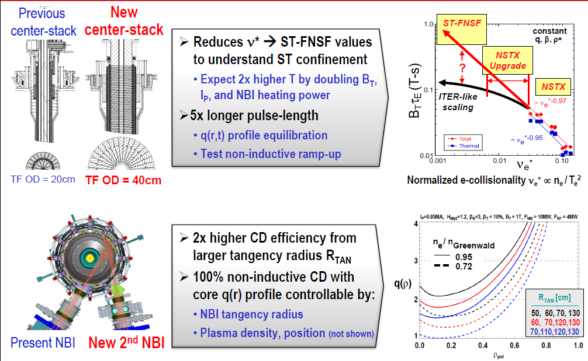
Improved Capabilities of NSTX-U will Strongly Support the Study of Electron Thermal Transport
Doubled B_{T}, I_{P} and NBI-heating power
  3-6 times lower in ν_{e}*; flow/q profile control
More details presented by J. Menard on Monday

Slide 24
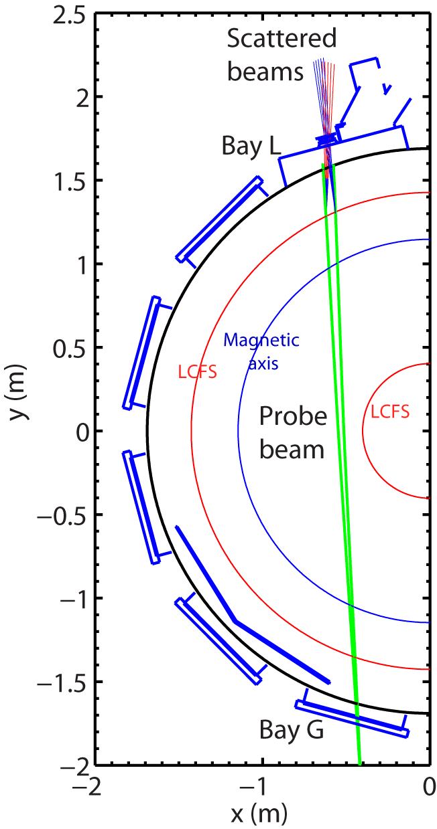
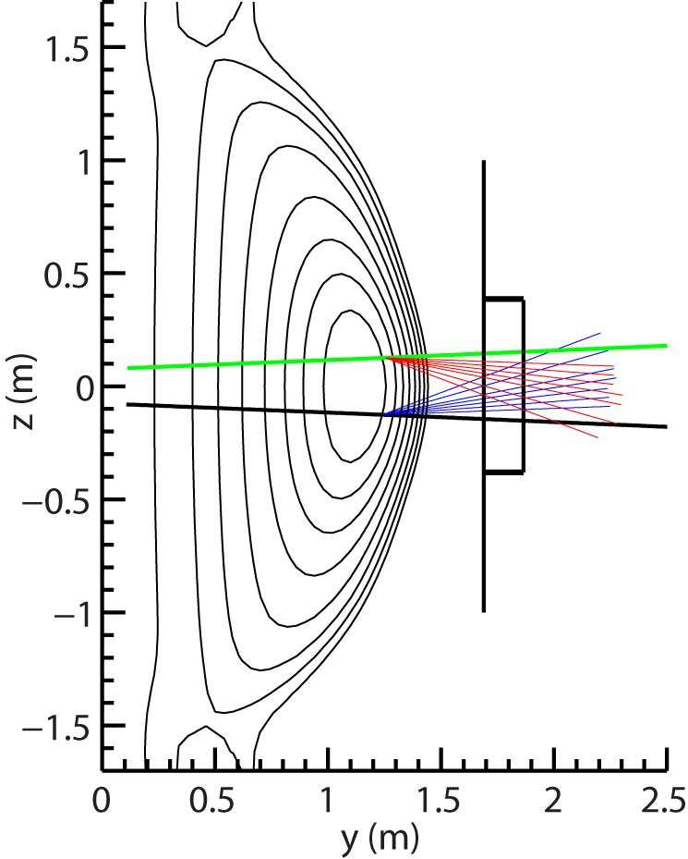
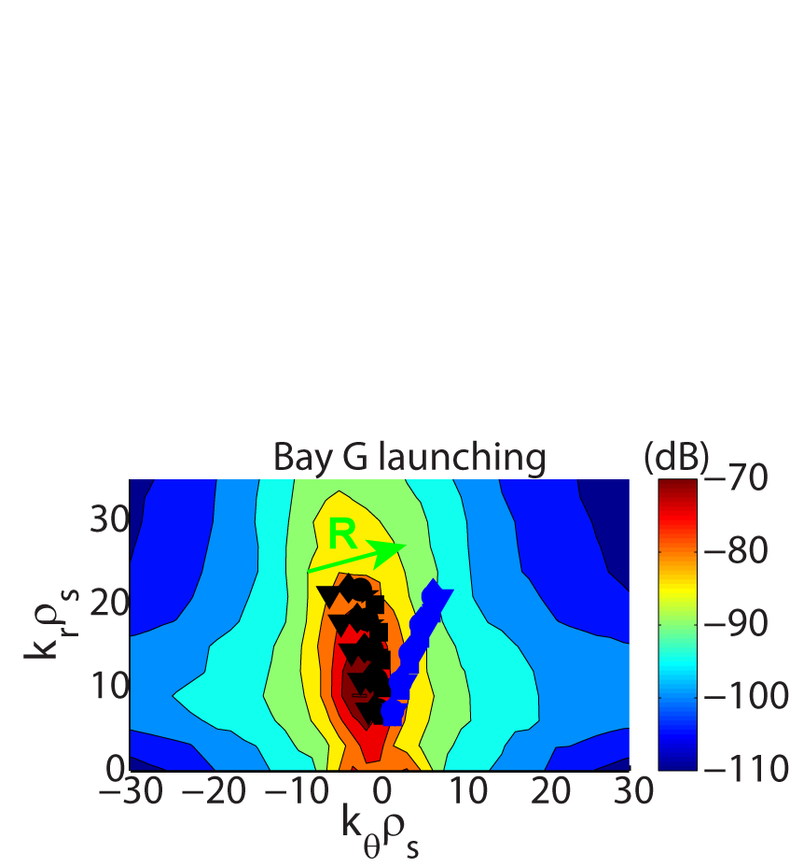


Improved Capabilities of NSTX-U will Strongly Support the Study of Electron Thermal Transport
Doubled B_{T}, I_{P} and NBI-heating power
  3-6 times lower in ν_{e}*; flow/q profile control
A new FIR high-k_{θ} scattering system being designed at UC-Davis
  To be installed for FY17 run campaign
$$k_{θ}ρ_{s}$$
$$k_{r}ρ_{s}$$

Slide 25
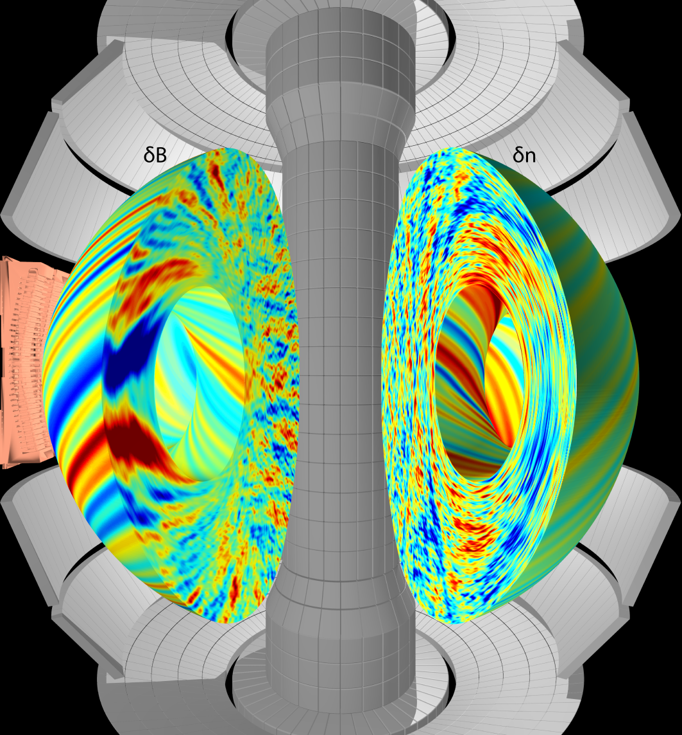
Improved Diagnostics on NSTX-U will Strongly Support the Study of Electron Thermal Transport
Doubled B_{T}, I_{P} and NBI-heating power
  3-6 times lower in ν_{e}*; flow/q profile control
A new FIR high-k_{θ} scattering system being designed at UC-Davis
  To be installed for FY17 run campaign
A DBS/CPS system will be installed for FY17 run campaign
  Measure ion-scale turbulence
  Able to measure magnetic fluctuations (CPS)
48 BES channels are now available on NSTX-U
  16 more than NSTX
Micro-tearing turbulence gyrokinetic simulation

Slide 26
NSTX-U T&T Research Plan Aims to Identify Operational Regimes of Instabilities Responsible for Electron Thermal Transport
Near-term plan
  Identify dominant modes in lower ν_{e}* H-mode plasmas of NSTX-U
  Characterize low/high-k turbulence and electron thermal transport in isolated regimes of micro-instabilities guided by GK simulations
  BES/reflectometry for CAE/GAE measurements with a range of B_{T}, I_{p}, ν_{e}* and P_{NBI}, coupled with ORBIT code
  Cold pulse propagation (Laser Blow-off and ME-SXR) for profile stiffness
  Couple with turbulence diagnostics, GK simulations and experimental tools
Long term plan
  Identify operational regimes of ETG, microtearing, AE (CAE/GAE) and ITG/TEM/KBM using the full set of turbulence diagnostics
  Expand turbulence and electron thermal transport parametric dependence, e.g. on β, ½*, T_{i}/T_{e} and Z_{eff}
  Study electron thermal transport and turbulence in long pulse and fully non-inductive scenario
  Develop physics-based reduced models for electron thermal transport

Slide 27
Summary
NSTX has made significant progress towards understanding anomalous electron thermal transport
  First nonlinear gyrokinetic simulation of microtearing turbulence to produce experimental confinement scaling and transport in NSTX H-mode plasmas
  ETG turbulence driving electron thermal transport in L and H-mode plasmas, supported by linear and nonlinear gyrokinetic simulations
  *AE-induced core Te flattening, consistent with electron stochastic transport from ORBIT simulations and the coupling between CAEs and KAWs
Electron thermal transport will be the key part of the transport and turbulence research plan for NSTX-U
  Ip ~2 MA, BT ~1 T, 2nd NBI (~12 MW), a suite of turbulence diagnostics, e.g. new high-k scattering system and DBS/CPS

Slide 28
Backup slides

Slide 29
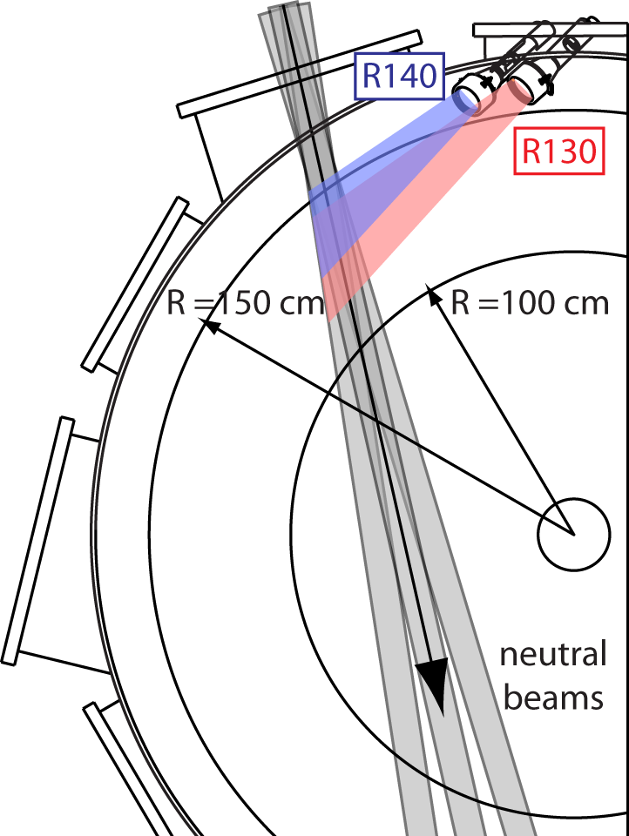
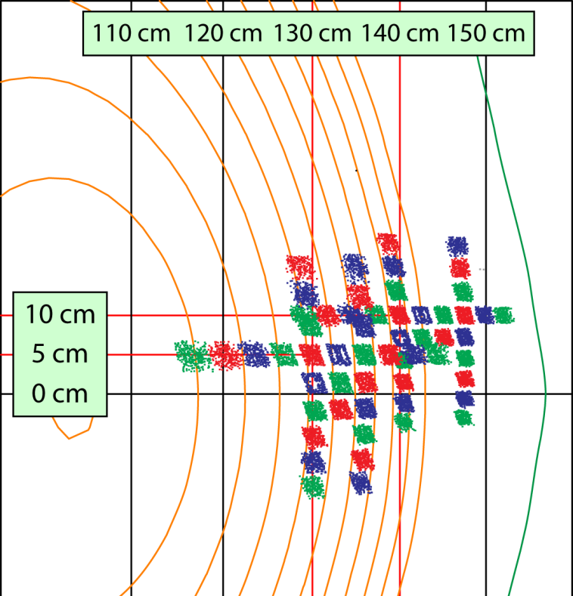
Beam Emission Spectroscopy (BES) Diagnostic Provides the Capability of Measuring Internal *AE Mode Structure
32 detection channels for NSTX and to be upgraded to 48 channels for NSTX-U
56 sightlines in radial and poloidal arrays spanning core to SOL
2 MHz sampling
k┴ρ_{i} ≤ 1.5 & 2-3 cm spot size
Field-aligned optics with high throughput (etendue = 2.3 mm²-ster)
density
fluctuation
C ≈ 1/2
neutral beam
D_{α} emission
D.R. Smith et al., Rev. Sci. Instrum (2010)

Slide 30
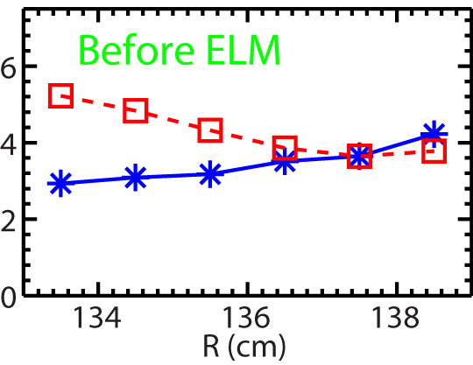
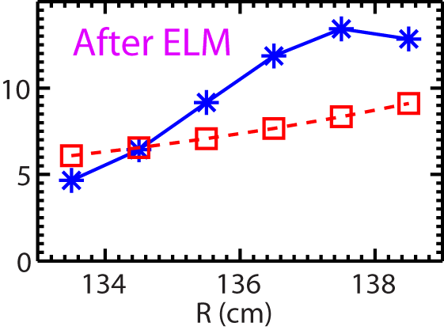


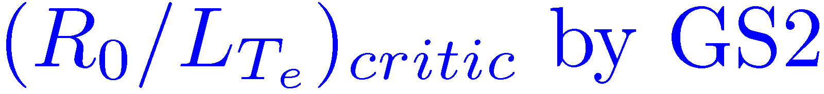
Threshold Gradients for ETG modes are much Higher after the ELM
Before ELM, ETG is largely unstable
After ELM, ETG is largely stable
Stability analysis performed with GS2 code (Kotschenreuther et al., 1995)

Slide 31
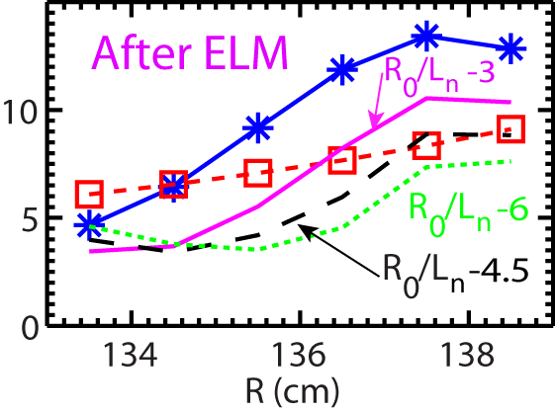
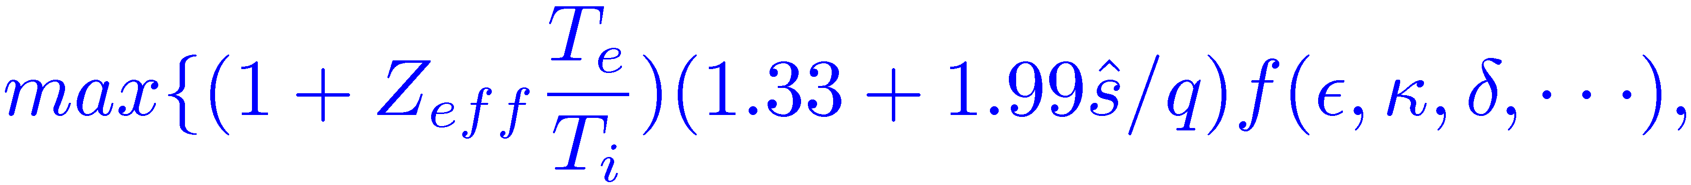
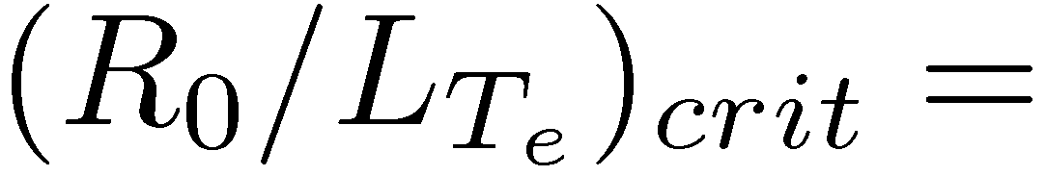
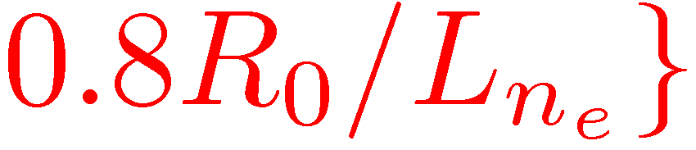
Increase in ETG Threshold Gradient is due to Large Density Gradient
Before ELM, ETG is largely unstable
After ELM, ETG is largely stable
Manually decreasing R/L_{ne} brings down critical gradient as expected from linear theory (e.g. Jenko et al, 2001)
Stability analysis performed with GS2 code (Kotschenreuther et al., 1995)

Slide 32
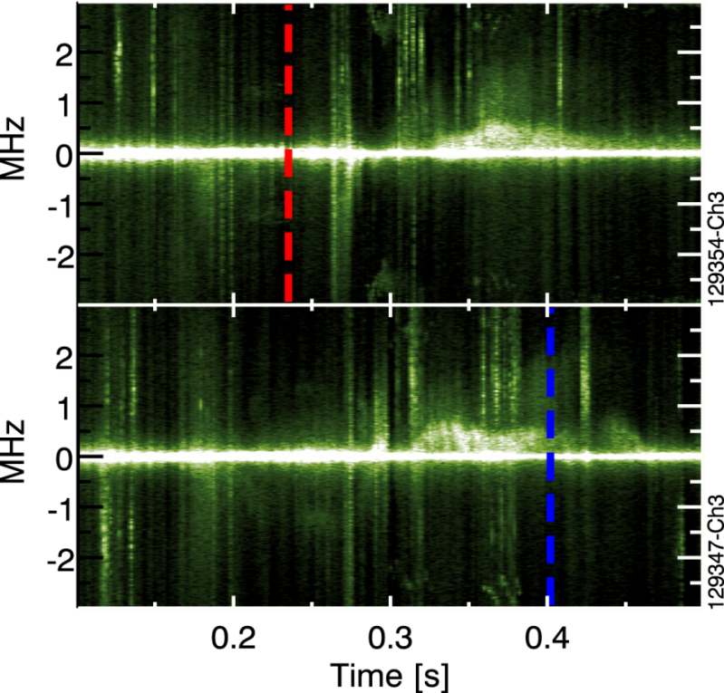
ETG Turbulence Stabilization by Reversed Magnetic Shear is Responsible for ITB Formation
k┴ρ_{e} ≈ 0.1-0.2
HHFW only with beam blips
Yuh et al., NF 2009 and PRL 2011

Slide 33
ETG Turbulence Stabilization by Reversed Magnetic Shear is Responsible for ITB Formation
k┴ρ_{e} ≈ 0.1-0.2
HHFW only with beam blips
Yuh et al., NF 2009 and PRL 2011

Slide 34
ETG Turbulence Stabilization by Reversed Magnetic Shear is Responsible for ITB Formation
k┴ρ_{e} ≈ 0.1-0.2
HHFW only with beam blips
Minimal ExB shearing rate due to cold ions with low toroidal rotation
Magnetic shear alone suppresses electron turbulence
Yuh et al., NF 2009 and PRL 2011

Slide 35
Predicted Q_{e} is Sensitive to Electron Temperature Gradient
Before ELM, a 20-30% increase in a/L_{Te} is able to match the experimental Q_{e}
After ELM, increasing a/L_{Te} by 40% after still cannot match experimental Q_{e}

Slide 36
Trapped Electron Mode (TEM) Destabilized by Large Density Gradient may Contribute to Transport
Before ELM, a 20-30% increase in a/L_{Te} is able to match the experimental Q_{e}
After ELM, increasing a/L_{Te} by 40% after still cannot match experimental Q_{e}
Large TEM-induced transport (~30 MW) is predicted after ELM without E×B shear stabilization
Using experimental E×B shear almost completely suppresses transport
→ does not require much residual transport to match experimental Q_{e}
~30 MW

