Slide 1
Controlled Snowflake Studies
P. Vail, E. Kolemen

Slide 2
XP1508: Controlled Snowflake Studies
We request multiple days with a few shots each
  This will allow fixing code and updating control in between tests
Independent control for lower and upper SFD (two different days)
  Control of snowflake radius, angle, and combined control (radius + angle).
  Snowflake centroid control PF1AL, PF1CL, and PF2L (+upper coils)
  Show we can achieve the SFD-, SFD+, SFD with varying parameters with minimal coil perturbation
Combined upper and lower SFD using PF coils.
  Checking out the 4 X-points are calculated consistently.
Solving issues related to integration of upper and lower SFD control with the full shape control
  Inner gap control coupling, drsep and vertical control coupling

Slide 3
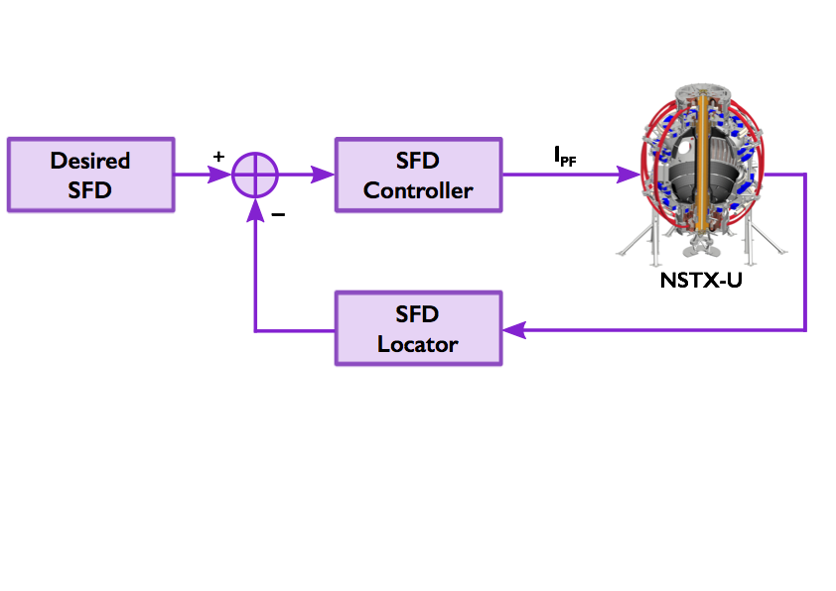
Snowflake control system
Block diagram of NSTX-U snowflake control system.
First implemented at the DIII-D tokamak.
Kolemen et al., JNM 2015.

Slide 4


Snowflake locator
Need one-step algorithm for approximating location of two x-points
Local expansion of the flux function in the Grad-Shafranov equation to third-order*
*Based upon Ryutov et al. Plasma Physics and Controlled Fusion (2010).

Slide 5
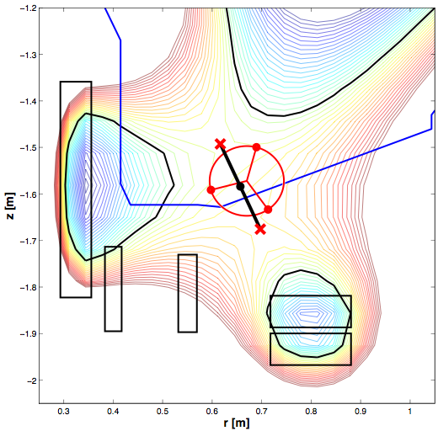
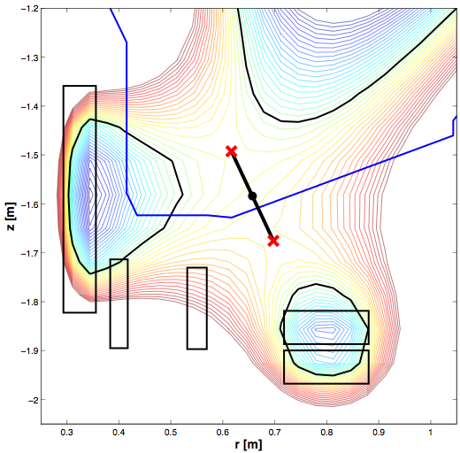


Calculate the expansion coefficients
Six unknown coefficients
Magnetic Field at 3 points
Six equations
Control parameters: radius, angle, centroid.

Slide 6
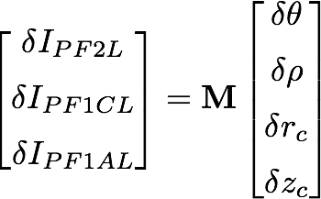
Snowflake controller
Control coils
Snowflake parameters
Need to find control matrix M

Slide 7
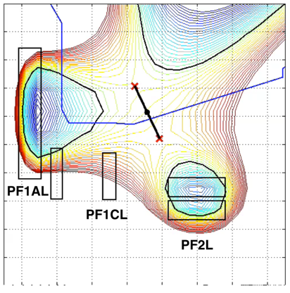
Snowflake control simulation
Using TokSys toolbox developed by General Atomics.
Set of MATLAB functions and scripts for tokamak modeling (including plasma control).
Grad-Shafranov solver for plasma equilibria + additional tools.
Wrote scripts for calculating snowflake location and control Jacobian.
Can run various simulations from different initial equilibria.

Slide 8
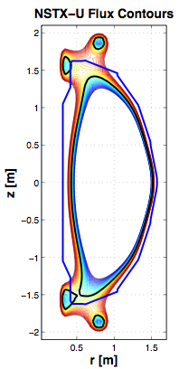
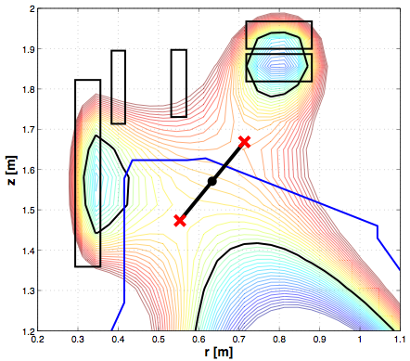
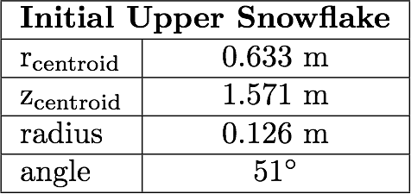
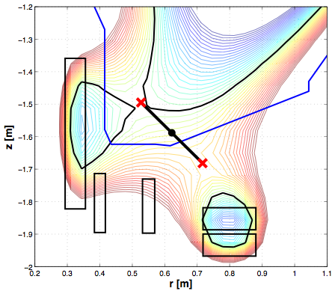
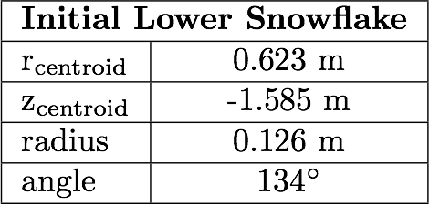
Snowflake Control Simulation - initial equilibrium
The starting point for snowflake control simulation for NSTX-U is an equilibrium with an upper and lower snowflake divertor designed using the TokSys toolbox from General Atomics.

Slide 9
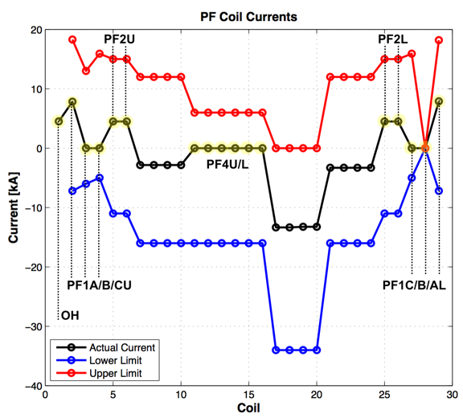
Initial equilibrium - PF coil currents

Slide 10
Snowflake Control - Development Plan
Phase 1: Independent control for upper and lower SFD.
  Control of snowflake radius, angle, and combined control (radius + angle).
  Achieved and controlled upper and lower SFD using PF coils.
  Majority of development work thus far performed for lower SFD using PF1AL, PF1CL, and PF2L coils for control.
  Further development needed for snowflake centroid control.
Phase 2: Integrated control of upper and lower SFD.

Slide 11
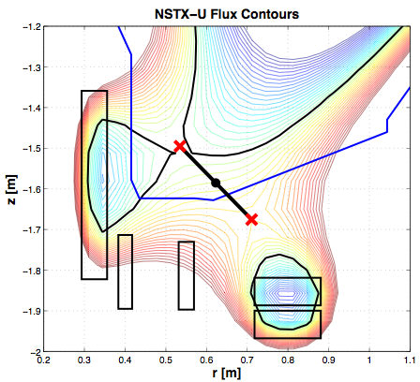
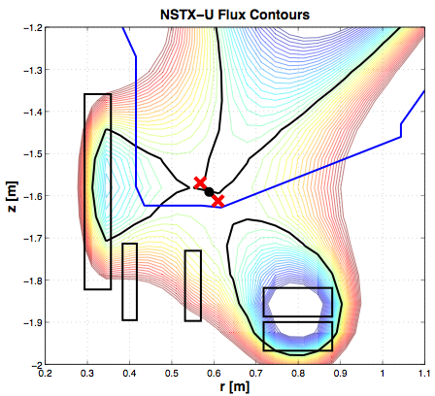
Snowflake Radius Control
Scenario: Scan the snowflake radius from ~12 cm to ~3 cm at a constant angle in the snowflake minus configuration.

Slide 12
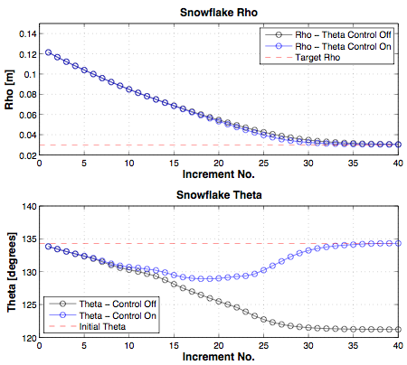
Snowflake Radius Control

Slide 13
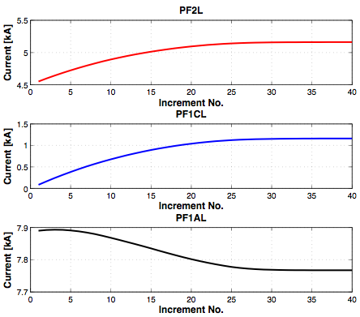
Snowflake Radius Control - coil currents with theta control engaged

Slide 14
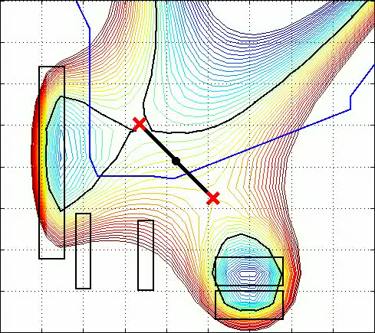
Snowflake Radius Control

Slide 15
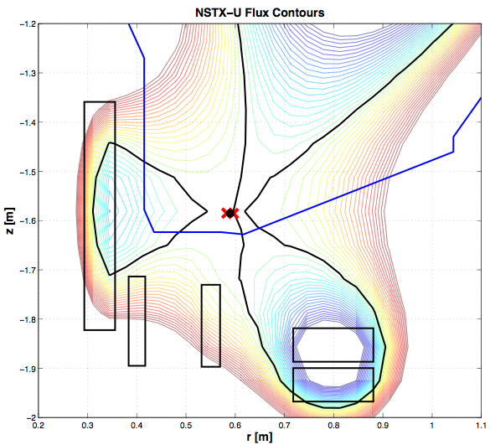
Snowflake Radius Control - Perfect Snowflake
Scenario: Scan the snowflake radius from ~12 cm to ~0 cm (perfect snowflake).

Slide 16
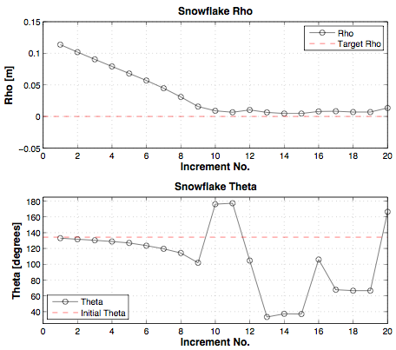
Snowflake Radius Control - Perfect Snowflake

Slide 17

Snowflake Radius Control to Perfect Snowflake

Slide 18
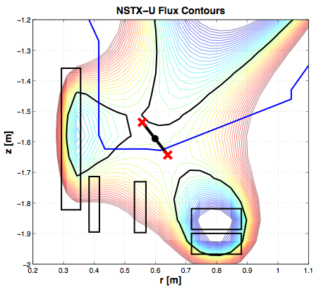
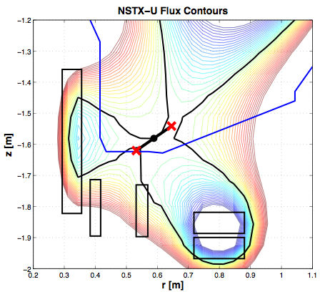
Snowflake Angle Control
Scenario: Scan from a snowflake minus (theta ~ 120°) to a snowflake plus (theta ~ 30°) configuration at constant x-point separation (rho).

Slide 19
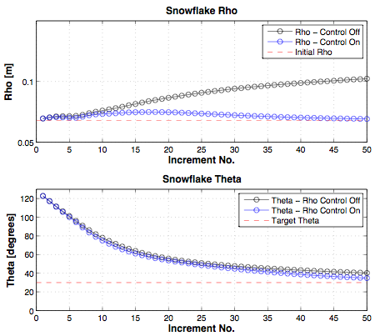
Snowflake Angle Control

Slide 20
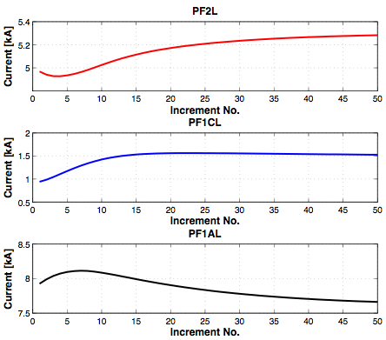
Snowflake Angle Control - coil currents with rho control engaged

Slide 21
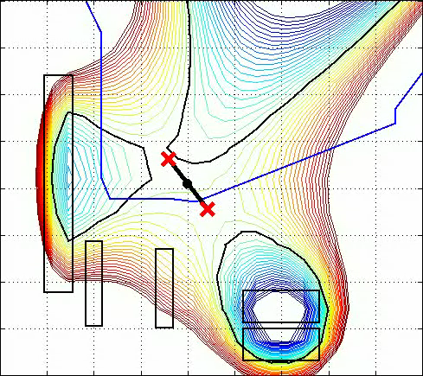
Snowflake Angle Control

Slide 22
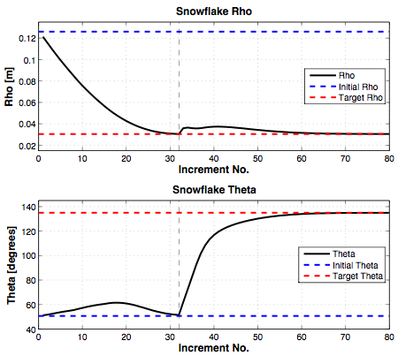
Snowflake Control - Upper Divertor
Similar control simulation has been performed for upper SFD.
Change Radius
Change Angle
Change Radius
Change Angle

Slide 23
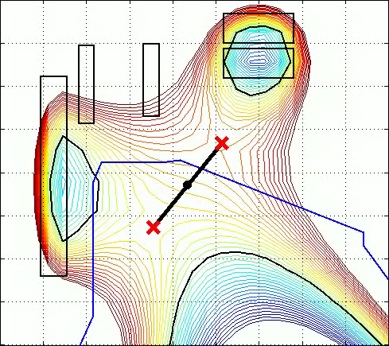
Snowflake Control - Upper Divertor

Slide 24


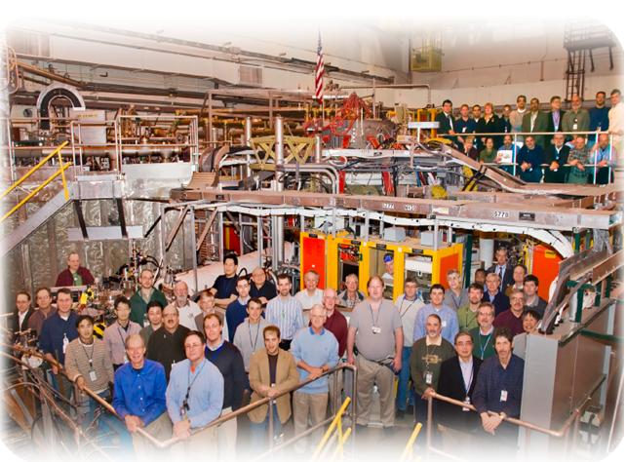

NSTX
Supported by
Relay Feedback and X-point Height Control
College W&M
Colorado Sch Mines
Columbia U
CompX
General Atomics
INL
Johns Hopkins U
LANL
LLNL
Lodestar
MIT
Nova Photonics
New York U
Old Dominion U
ORNL
PPPL
PSI
Princeton U
Purdue U
SNL
Think Tank, Inc.
UC Davis
UC Irvine
UCLA
UCSD
U Colorado
U Illinois
U Maryland
U Rochester
U Washington
U Wisconsin
Culham Sci Ctr
U St. Andrews
York U
Chubu U
Fukui U
Hiroshima U
Hyogo U
Kyoto U
Kyushu U
Kyushu Tokai U
NIFS
Niigata U
U Tokyo
JAEA
Hebrew U
Ioffe Inst
RRC Kurchatov Inst
TRINITI
KBSI
KAIST
POSTECH
ASIPP
ENEA, Frascati
CEA, Cadarache
IPP, Jülich
IPP, Garching
ASCR, Czech Rep
U Quebec
Egemen Kolemen
S. Gerhardt and D. A. Gates
2010 Results Review
Nov/30/2010

Slide 25
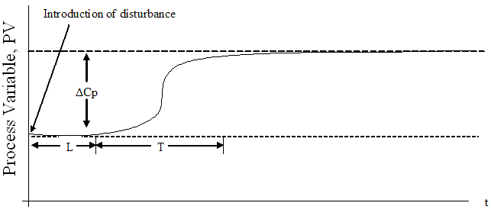
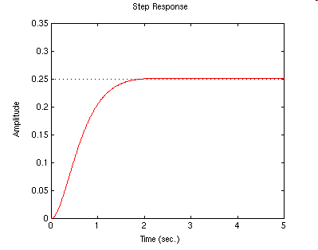
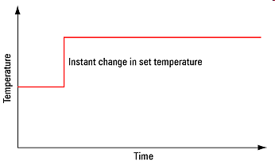
2009 Run: Experimental System ID (Open Loop)
System Id: Identify the effect of the actuator on the boundary shape.
Reaction Curve Method
From Step Response obtain:
  Time delay, rise time
  and size of change gives
  the control tuning parameters.
ΔP
Time

Slide 26
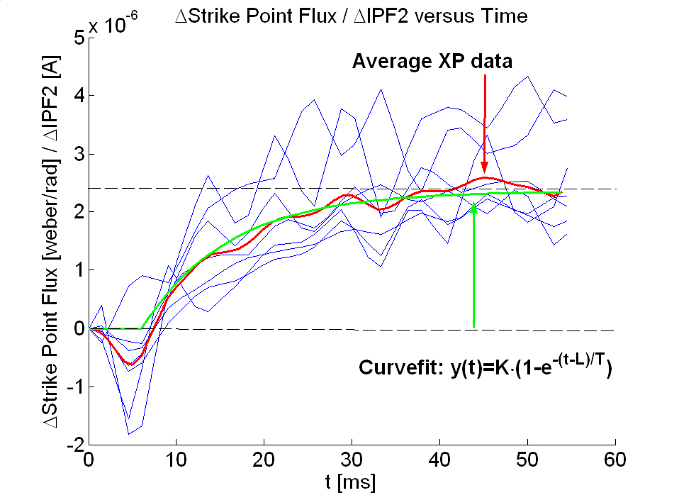
2009 Run: Experimental System ID (Open Loop)
System Id: Identify the effect of the actuator on the boundary shape.
Reaction Curve Method
Problem:
  Many shots needed
  Need the actuator in open loop.
  Not precise
ΔP
System Id results from 2009 run

Slide 27
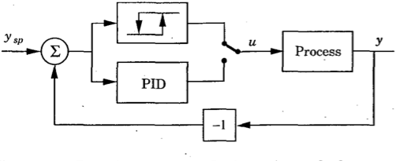
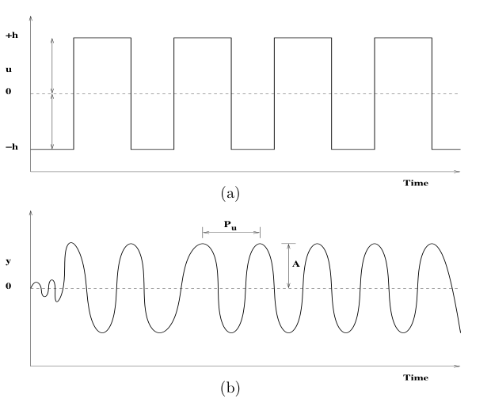
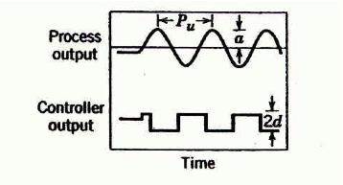
Experimental System ID:
Closed Loop Auto-tune with Relay Feedback
Advantages:
  Only a single experiment is needed.
  Closed loop:
    More stable
    Enable system ID for actuators that can’t be open loop (for example: vertical control)
Control
Output
→
The closed-loop plant response period (P_{u}) & amplitude (A) are used for PID controller tuning.
Process
Output

Slide 28
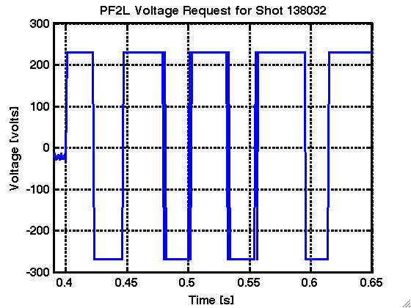
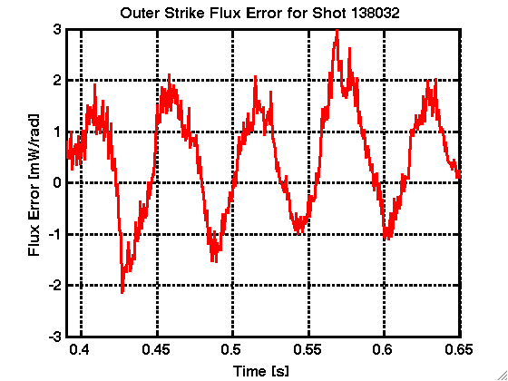
Experimental System ID:
Closed Loop Auto-tune with Relay Feedback
Advantages:
  Only a single experiment is needed.
  Closed loop:
    More stable
    Enable system ID for actuators that can’t be open loop (for example: vertical control)
h
Control
Output
→
The closed-loop plant response period (P_{u}) & amplitude (A) are used for PID controller tuning.
Process
Output
A
P_{u}

Slide 29
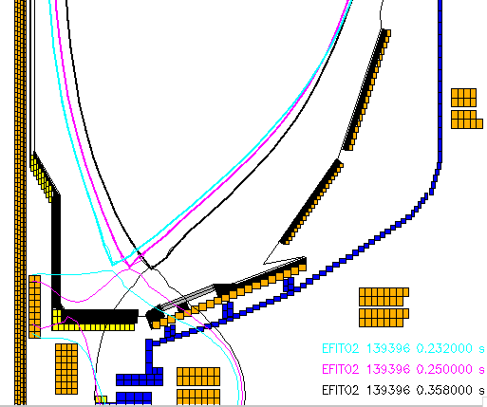
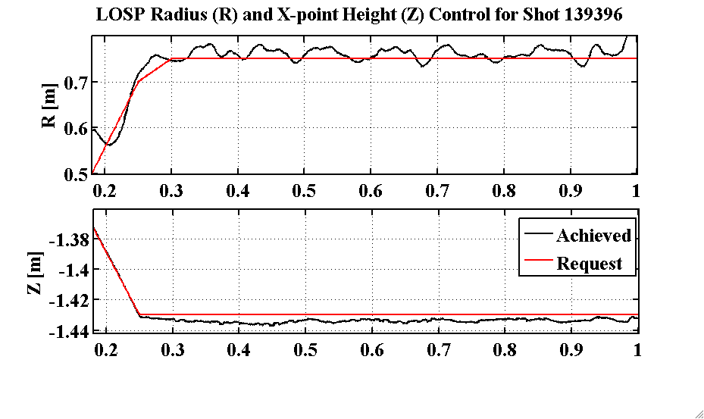

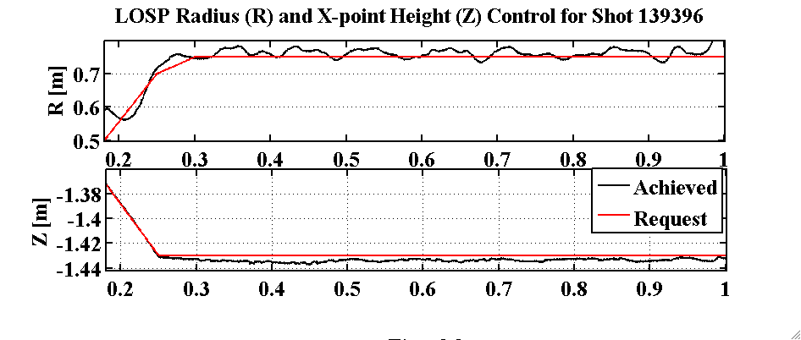
Successful Developed Combined X-point Height / SP Control
Tuned via Relay-Feedback.
Achieved RMS <1 cm X-point height error and <2 cm SP.
Scenario used for LLD experiments.
Evolution of Plasma Boundary: X-point height roughly constant as OSP ramps

Slide 30
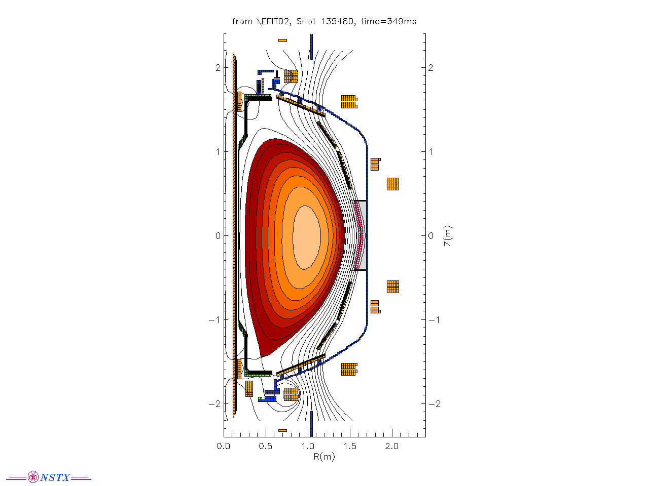
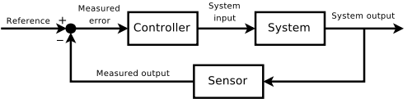
If time Permits Start Working on the
Full Multiple-Input-Multiple-Output (MIMO) Control
-Inner Gap
-Lower Inner Strike Point
-Vertical Position
-Squareness
Upper X-point Height …
The main issue will be inner gap (Coupling with other controls needed)
Then, move to other shape parameters

Slide 31
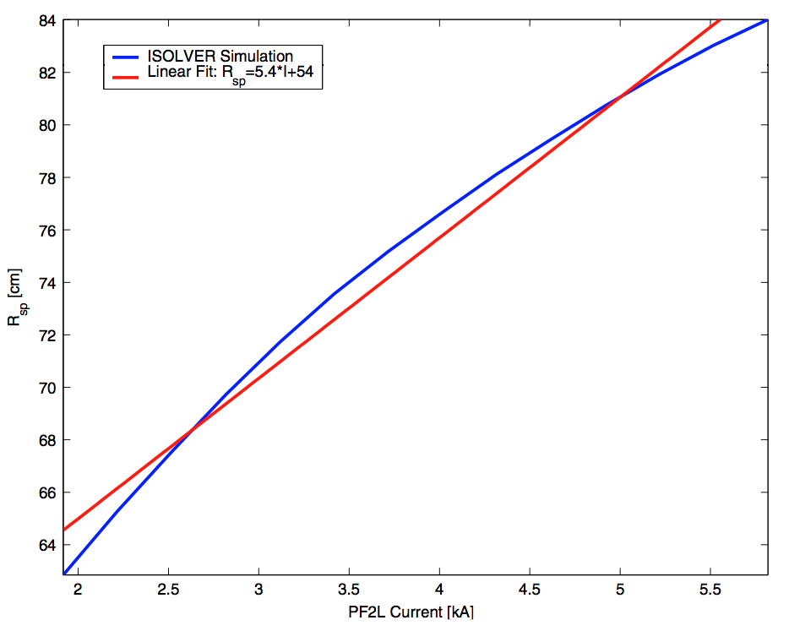
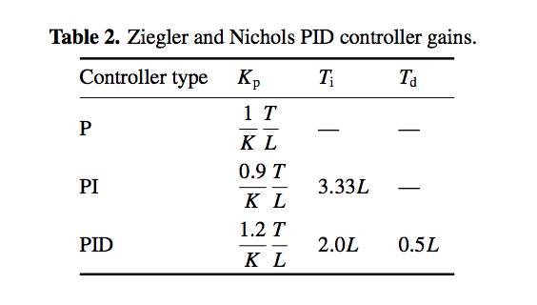
Implementation of the MIMO Control
We will compare the toksys MIMO control design to previous year method based on PID tuning based on three parameters (Kolemen, NF 2010)
In this method, we use K, the DC gain (obtained from ISOLVER), L the delay in the system (known parameter), T the rise time of flux response to the voltage input. The only unknown here is the T which is a function of the T_{coil} and T_{plasma}. T_{coil} is known (Inductance/Res.), T_{plasma} (wall penetration time) can be guessed based on previous experiments.
I_{PF2} versus R_{osp} location via ISOLVER
simulations. DC Gain (ΔR_{osp}/ΔI_{PF2})
Can be obtained via these simulations.
Sample Tuning based on the
K (DC gain), T (Rise time), L (Delay)

Slide 32
X-Point R, Z Control:
Time required ~Two ½ Days
Use PF1/2 coils
Should be able to determine gains with 4-6 shots on one day to measure system response and 5-10 shots to demonstrate gains
Practical limits on R_{X} and Z_{X} range will require about 8 shots each to determine
Tuning the other shape controls:
  Start Initial Design of the full shape control
  Attention to vertical stability and inner gap

