Slide 1
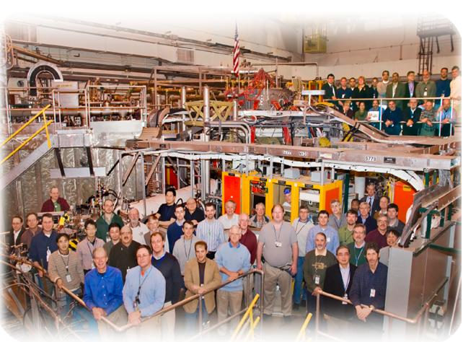

NSTX
Supported by
The Role of Kinetic Effects, Including Plasma Rotation and Energetic Particles, in Resistive Wall Mode Stability
College W&M
Colorado Sch Mines
Columbia U
CompX
General Atomics
INEL
Johns Hopkins U
LANL
LLNL
Lodestar
MIT
Nova Photonics
New York U
Old Dominion U
ORNL
PPPL
PSI
Princeton U
Purdue U
SNL
Think Tank, Inc.
UC Davis
UC Irvine
UCLA
UCSD
U Colorado
U Illinois
U Maryland
U Rochester
U Washington
U Wisconsin
Jack Berkery
Department of Applied Physics, Columbia University, New York, NY, USA
Culham Sci Ctr
U St. Andrews
York U
Chubu U
Fukui U
Hiroshima U
Hyogo U
Kyoto U
Kyushu U
Kyushu Tokai U
NIFS
Niigata U
U Tokyo
JAEA
Hebrew U
Ioffe Inst
RRC Kurchatov Inst
TRINITI
KBSI
KAIST
POSTECH
ASIPP
ENEA, Frascati
CEA, Cadarache
IPP, Jülich
IPP, Garching
ASCR, Czech Rep
U Quebec
51st Annual Meeting of the Division of Plasma Physics
Atlanta, Georgia
November 3, 2009

Slide 2
NSTX
Supported by
In collaboration with:
S.A. Sabbagh, H. Reimerdes
Department of Applied Physics, Columbia University, New York, NY, USA
R. Betti, B. Hu
Laboratory for Laser Energetics, University of Rochester, Rochester, NY, USA
R.E. Bell, S.P. Gerhardt, N. Gorelenkov,
B.P. LeBlanc, J. Manickam, M. Podesta
Princeton Plasma Physics Laboratory, Princeton University, Princeton, NJ, USA
K. Tritz
Dept. of Physics and Astronomy, Johns Hopkins University, Baltimore, MD, USA
… and the NSTX team
Supported by:
U.S. Department of Energy Contracts
DE-FG02-99ER54524, DE-AC02-09CH11466, and DE-FG02-93ER54215
College W&M
Colorado Sch Mines
Columbia U
CompX
General Atomics
INEL
Johns Hopkins U
LANL
LLNL
Lodestar
MIT
Nova Photonics
New York U
Old Dominion U
ORNL
PPPL
PSI
Princeton U
Purdue U
SNL
Think Tank, Inc.
UC Davis
UC Irvine
UCLA
UCSD
U Colorado
U Illinois
U Maryland
U Rochester
U Washington
U Wisconsin
Culham Sci Ctr
U St. Andrews
York U
Chubu U
Fukui U
Hiroshima U
Hyogo U
Kyoto U
Kyushu U
Kyushu Tokai U
NIFS
Niigata U
U Tokyo
JAEA
Hebrew U
Ioffe Inst
RRC Kurchatov Inst
TRINITI
KBSI
KAIST
POSTECH
ASIPP
ENEA, Frascati
CEA, Cadarache
IPP, Jülich
IPP, Garching
ASCR, Czech Rep
U Quebec

Slide 3
The resistive wall mode (RWM) is disruptive; it is important to understand the physics of its stabilization
  Motivation
  The RWM limits plasma pressure and leads to disruptions.
  Physics of RWM stabilization is key for extrapolation to:
    sustained operation of a future NBI driven, rotating ST-CTF, and
    disruption-free operation of a low rotation burning plasma (ITER).
  Outline
  RWM experimental characteristics in NSTX
  Kinetic RWM stabilization theory: window of ω_{φ} with weakened stability
  Comparison of theory and NSTX experimental results
  The role of energetic particles
3

Slide 4
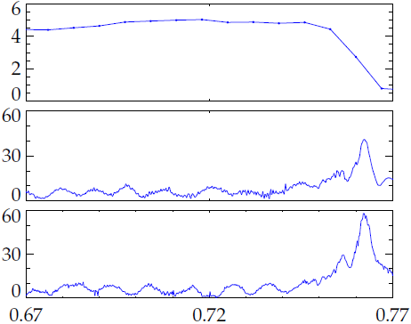
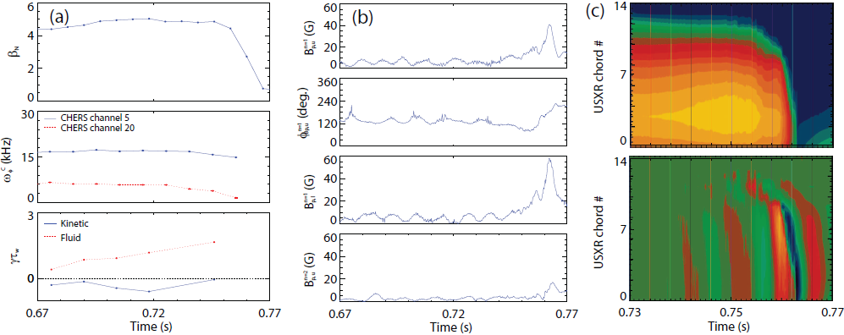
The RWM is identified in NSTX by a variety of observations
edge
β_{N}
NSTX 130235
USXR magnitude
upper B_{p} n=1 sensor
core
B_{p} (G)
edge
USXR phase
lower B_{p} n=1 sensor
B_{p} (G)
core
0.73
0.75
0.77
Time (s)
Time (s)
  Growing signal on low frequency poloidal magnetic sensors
  Global collapse in USXR signals, with no clear phase inversion
  Causes a collapse in β and disruption of the plasma
4

Slide 5
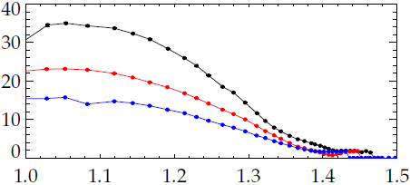
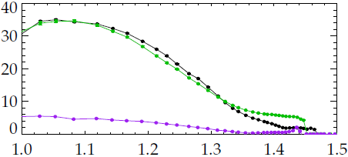
NSTX experimental RWM instability can not be explained by scalar critical rotation theory
NSTX 121083 @ 0.475 s
128856 @ 0.526 s
130235 @ 0.745 s
  In NSTX, the RWM can go unstable with a wide range of toroidal plasma rotation, ω_{φ}.
  A.C. Sontag et. al., Nucl. Fus., 47 (2007) 1005
  Stable discharges can have very low ω_{φ}.
ω_{φ} (kHz)
marginally stable profiles
R (m)
NSTX 121083 @ 0.475 s
121083 @ 0.435 s
135306 @ 0.686 s
ω_{φ} (kHz)
stable!!
stable
R (m)
  A theoretical model broad enough in scope to explain these results is needed.
5

Slide 6


Kinetic δW_{K} term in the RWM dispersion relation provides dissipation that enables stabilization
1
Ideal theory alone shows instability above the no-wall limit:
Calculation of δW_{K} with the MISK code includes:
  Trapped Thermal Ions
  Trapped Electrons
  Circulating Thermal Ions
  Alfven Layers (analytic)
  Trapped Energetic Particles
  Typically, trapped thermal ions account for 70-80% of Re(δW_{K})
3
2
Dissipation enables stabilization:
(Hu, Betti, and Manickam, PoP, 2005)
6

Slide 7
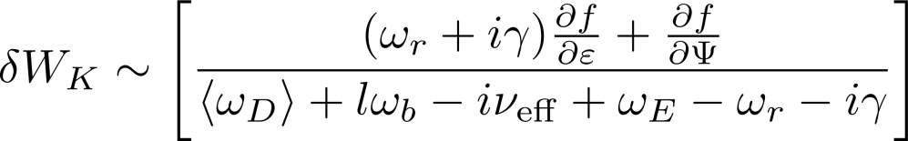

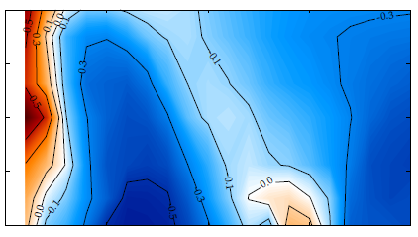
The dependence of stability on plasma rotation is complex
  Trapped Ions:
precession drift
bounce
collisionality
E⨉B
Contours of γτ_{w}
blue stable
red unstable
white marginal
ω_{D}
weakened stability
ω_{b}
collisionality
ω_{D}
ω_{b}
weakened stability
plasma rotation
7

Slide 8
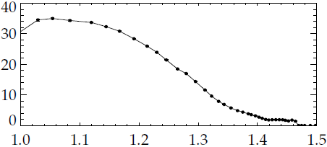
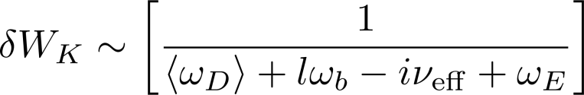


A window of weakened stability can be found between the bounce and precession drift stabilizing resonances
What causes this rotation profile to be marginally stable to the RWM?
Examine relation of ω_{φ} to other frequencies:
  l=0 harmonic: resonance with precession drift frequency:
  l=-1 harmonic: resonance with bounce frequency:
NSTX 121083 @ 0.475 s
ω_{φ} (kHz)
marginally stable profile
R (m)
8

Slide 9
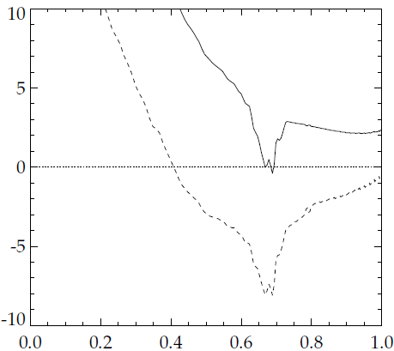


A window of weakened stability can be found between the bounce and precession drift stabilizing resonances
NSTX 121083 @ 0.475 s
128856 @ 0.526 s
130235 @ 0.745 s
l=0 resonance
ω_{φ} (kHz)
marginally stable profiles
frequency resonance (kHz)
R (m)
l=-1 resonance
Ψ/Ψ_{a}
The experimentally marginally stable ω_{φ} profile is in-between the stabilizing resonances.
  Is this true for each of the widely different unstable profiles?
8

Slide 10
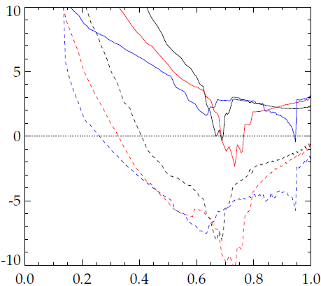
A window of weakened stability can be found between the bounce and precession drift stabilizing resonances
NSTX 121083 @ 0.475 s
128856 @ 0.526 s
130235 @ 0.745 s
ω_{φ} (kHz)
marginally stable profiles
frequency resonance (kHz)
R (m)
Ψ/Ψ_{a}
The experimentally marginally stable ω_{φ} profile is in-between the stabilizing resonances.
  Is this true for each of the widely different unstable profiles: Yes
8

Slide 11
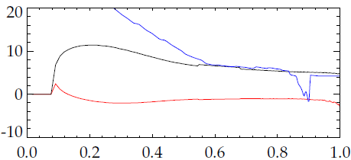
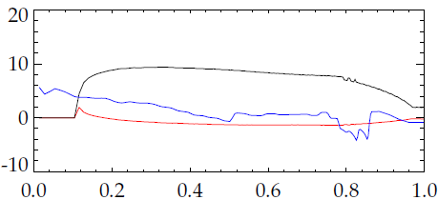
When the rotation is in resonance, the plasma is stable
NSTX 121083 @ 0.475 s
121083 @ 0.435 s
135306 @ 0.686 s
ω_{E} ≈ ω_{b}
stable
ω (kHz)
ω_{φ} (kHz)
-ω_{D}
stable!!
ω_{b}
R (m)
ω (kHz)
ω_{E} ≈ -ω_{D}
Ψ/Ψ_{a}
Stable cases in bounce resonance at high rotation
Stable cases in precession drift resonance at low rotation
9

Slide 12
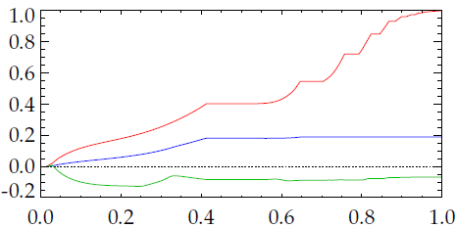
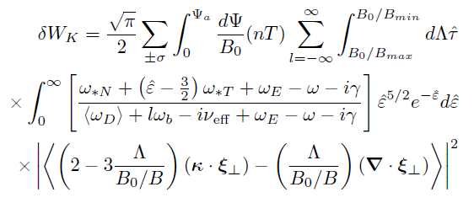
Full MISK calculation shows that trapped thermal ions are the most important contributors to stability
NSTX 121083 @ 0.475 s
q=3…
δW_{K}
q=2
trapped thermal ions
trapped electrons
circulating thermal ions
Full δW_{K} eqn. for trapped thermal ions
Ψ/Ψ_{a}
Examine δW_{K} from each particle type vs. Ψ
  Thermal ions are the most important contributor to stability.
  Flat areas are rational surface layers (integer q ± 0.2).
Entire profile is important, but q > 2 contributes ~60%
  RWM eigenfunction and temperature, density gradients are large in this region.
10

Slide 13

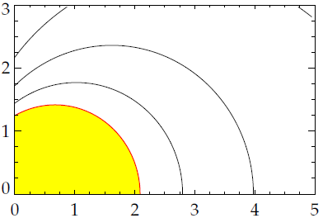
The dispersion relation can be rewritten in a form convenient for making stability diagrams
  Contours of γ form circles on a stability diagram of Im(δW_{K}) vs. Re(δW_{K}).
Im(δW_{K})
Let us now scale the experimental rotation profile to illuminate the complex relationship between rotation and stability
unstable
γτ_{w} = 0.0
-0.2
-0.4
Re(δW_{K})
11

Slide 14
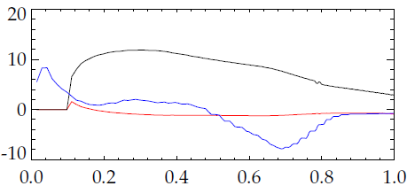
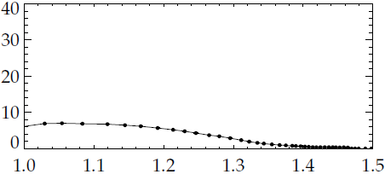
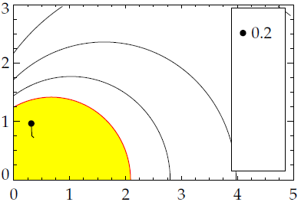
Scaling the experimental rotation profile illuminates the complex relationship between rotation and stability
ω_{b}
NSTX 121083 @ 0.475 s
ω_{E}
ω (kHz)
0.2
ω_{φ} (kHz)
-ω_{D}
ω_{φ}/ω_{φ}^{exp} = 0.2
Ψ/Ψ_{a}
R (m)
Rotation profile scan:
  0.2: Instability at low rotation.
ω_{φ}/ ω_{φ}^{exp}
Im(δW_{K})
unstable
γτ_{w} = 0.0
-0.2
-0.4
Re(δW_{K})
12

Slide 15
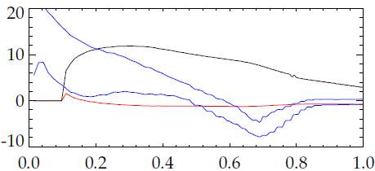
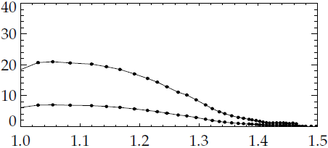
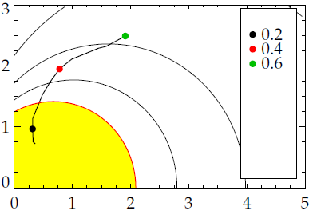
Scaling the experimental rotation profile illuminates the complex relationship between rotation and stability
ω_{b}
NSTX 121083 @ 0.475 s
0.6
ω_{E}
ω (kHz)
0.2
ω_{φ} (kHz)
0.6
-ω_{D}
0.2
Ψ/Ψ_{a}
R (m)
Rotation profile scan:
  0.2: Instability at low rotation.
  0.6: Stable: ω_{D} resonance.
ω_{φ}/ ω_{φ}^{exp}
Im(δW_{K})
unstable
γτ_{w} = 0.0
-0.2
-0.4
Re(δW_{K})
12

Slide 16
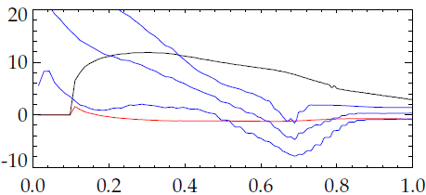
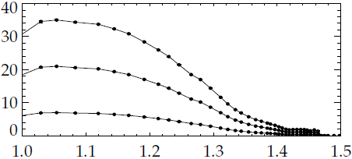
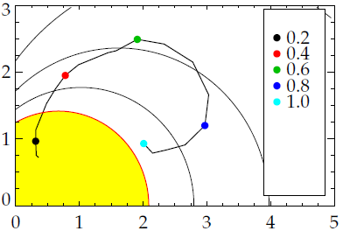
Scaling the experimental rotation profile illuminates the complex relationship between rotation and stability
ω_{b}
1.0
NSTX 121083 @ 0.475 s
0.6
1.0
ω_{E}
ω (kHz)
0.2
ω_{φ} (kHz)
0.6
-ω_{D}
0.2
Ψ/Ψ_{a}
R (m)
Rotation profile scan:
  0.2: Instability at low rotation.
  0.6: Stable: ω_{D} resonance.
  1.0: Marginal: in-between resonances (actual experimental instability).
ω_{φ}/ ω_{φ}^{exp}
Im(δW_{K})
unstable
γτ_{w} = 0.0
-0.2
-0.4
Re(δW_{K})
12

Slide 17
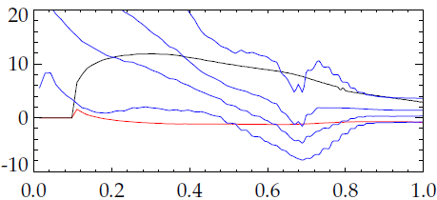
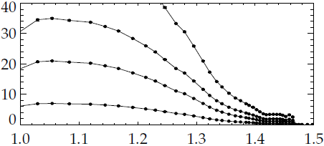
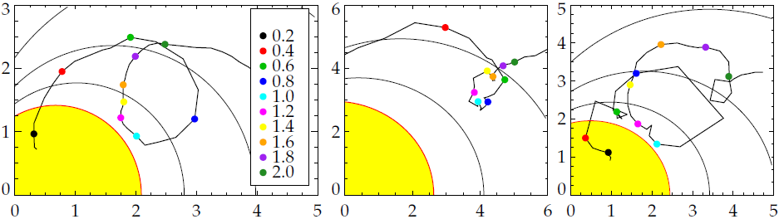
Scaling the experimental rotation profile illuminates the complex relationship between rotation and stability
ω_{b}
1.0
1.8
NSTX 121083 @ 0.475 s
0.6
1.0
ω_{E}
1.8
ω (kHz)
0.2
ω_{φ} (kHz)
0.6
-ω_{D}
0.2
Ψ/Ψ_{a}
R (m)
Rotation profile scan:
  0.2: Instability at low rotation.
  0.6: Stable: ω_{D} resonance.
  1.0: Marginal: in-between resonances (actual experimental instability).
  1.8: Stable: ω_{b} resonance.
ω_{φ}/ ω_{φ}^{exp}
Im(δW_{K})
unstable
γτ_{w} = 0.0
-0.2
-0.4
Re(δW_{K})
12

Slide 18
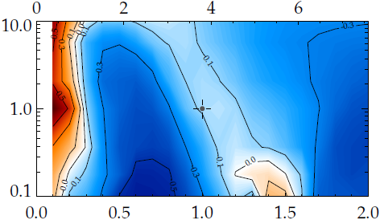
The weakened stability rotation gap is altered by changing collisionality
Scan of ω_{φ} and collisionality
  scale n & T at constant β
  Changing ν shifts the rotation of weakened stability.
(ω_{φ}/ω_{A})_{q=2} (%)
ω_{φ}/ ω_{φ}^{exp}
Im(δW_{K})
ν/ν^{exp}
unstable
γτ_{w} = 0.0
-0.2
-0.4
Re(δW_{K})
ω_{φ}/ω_{φ}^{exp}
13

Slide 19
The weakened stability rotation gap is altered by changing collisionality
Scan of ω_{φ} and collisionality
  scale n & T at constant β
  Changing ν shifts the rotation of weakened stability.
(ω_{φ}/ω_{A})_{q=2} (%)
ω_{φ}/ ω_{φ}^{exp}
ν/ν^{exp}
ω_{D}
ω_{b}
Im(δW_{K})
weakened stability
unstable
γτ_{w} = 0.0
-0.2
-0.4
Re(δW_{K})
ω_{φ}/ω_{φ}^{exp}
NSTX exp. instability
13

Slide 20
Widely different experimentally marginally stable rotation profiles each are in the gap between stabilizing resonances
Sometimes the stability reduction is not enough to quantitatively reach marginal
  Investigating sensitivities to inputs.
NSTX 121083 @ 0.475 s
128856 @ 0.526 s
130235 @ 0.745 s
ω_{φ} (kHz)
marginally stable profiles
R (m)
xxx
  xxx
ω_{φ}/ ω_{φ}^{exp}
Im(δW_{K})
unstable
unstable
unstable
γτ_{w} = 0.0
-0.2
-0.4
γτ_{w} = 0.0
-0.2
γτ_{w} = 0.0
-0.2
Re(δW_{K})
Re(δW_{K})
Re(δW_{K})
121083 @ 0.475 s
128856 @ 0.526 s
130235 @ 0.745 s
14

Slide 21
Widely different experimentally marginally stable rotation profiles each are in the gap between stabilizing resonances
Sometimes the stability reduction is not enough to quantitatively reach marginal
  Investigating sensitivities to inputs. ex: Δq = 0.15 – 0.25
NSTX 121083 @ 0.475 s
q=3…
δW_{K}
q=2
trapped thermal ions
trapped electrons
circulating thermal ions
Ψ/Ψ_{a}
xxx
  xxx
ω_{φ}/ ω_{φ}^{exp}
Im(δW_{K})
unstable
unstable
unstable
γτ_{w} = 0.0
-0.2
-0.4
γτ_{w} = 0.0
-0.2
γτ_{w} = 0.0
-0.2
Re(δW_{K})
Re(δW_{K})
Re(δW_{K})
121083 @ 0.475 s
128856 @ 0.526 s
130235 @ 0.745 s
14

Slide 22

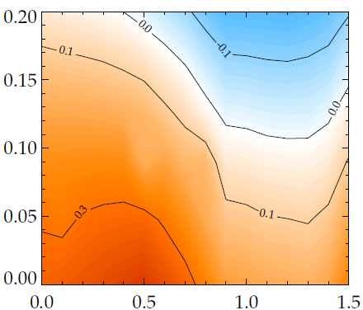
Present inclusion of energetic particles in MISK: isotropic slowing down distribution (ex. alphas in ITER)
Thermal Particles: Maxwellian
E.P.s: Slowing-down
  Energetic particles add to δW_{K}, lead to greater stability
  Example: α particles in ITER
  Higher β_{α} leads to greater stability
  Isotropic f is a good approx.
stable
marginal
β_{α}/β_{total}
unstable
ITER Advanced Scenario 4:
β_{N} ~20% above the no-wall limit
ω_{φ}/ω_{φ}^{model}
15

Slide 23
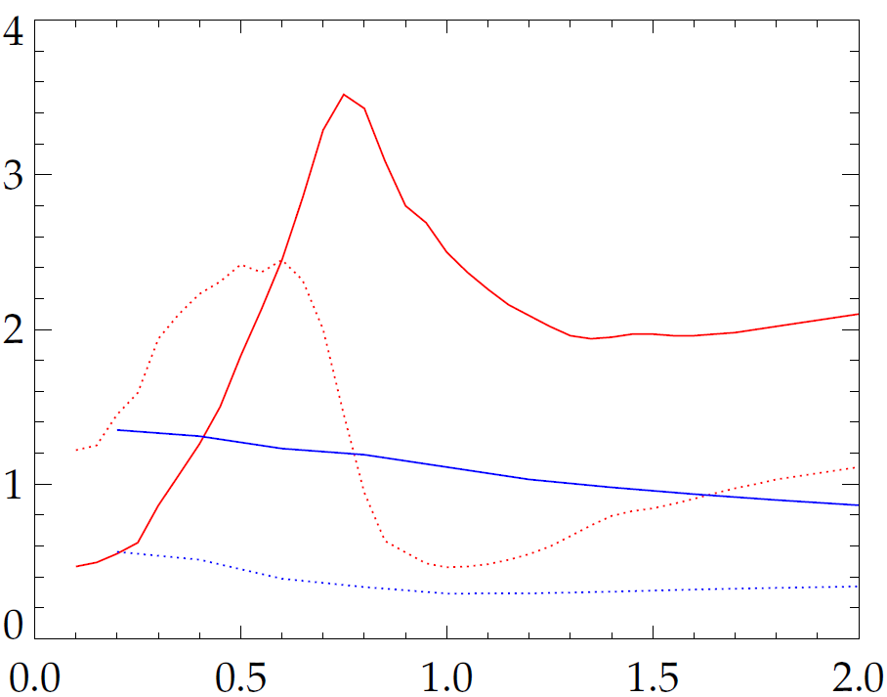
Energetic particles provide a stabilizing force that is independent of rotation and collisionality
NSTX 121083 @ 0.475 s
for energetic particles:
δW_{K}
Imag. Therm.
Real Therm.
small
Real E.P.
Imag. E.P.
ω_{φ}/ω_{φ}^{exp}
  Significant Re(δW_{K}), but nearly independent of ω_{φ}
  Energetic particles are not in mode resonance
  Effect is not energy dissipation, but rather a restoring force
16

Slide 24
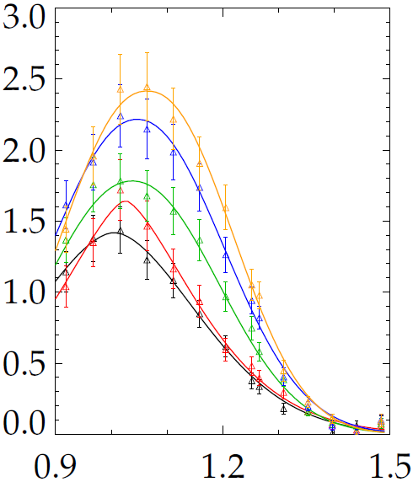
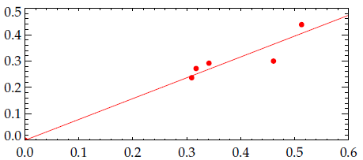
NSTX experiment in 2009 found that energetic particles contribute linearly to RWM stability
0.7 MA, 0.35 T
0.8 MA, 0.40 T
0.9 MA, 0.45 T
1.0 MA, 0.50 T
1.1 MA, 0.55 T
Change in growth rate from energetic particles
NSTX discharges at
marginal stability
s-FIDA (arb.)
-Δγτ_{w}
β_{fast}/β_{total}
R (m)
    Despite the additional theoretical stability, these shots experimentally went unstable
  Investigating whether stabilization from thermal particles is overpredicted by MISK.
  The overprediction of -Δγ from E.P.s is under investigation…
17

Slide 25
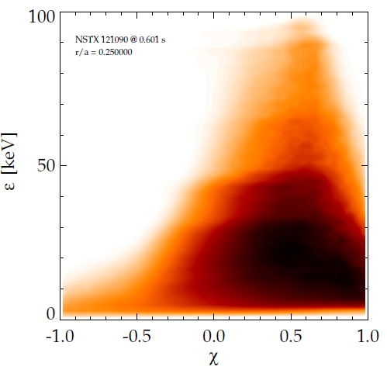
A new, more accurate energetic particle distribution function is being implemented
injection
  Presently f is considered independent of pitch angle
  Not a good approximation for beam ions
  Overpredicts stabilizing trapped fraction
  Towards better quantitative agreement:
  Use f from TRANSP directly
f from TRANSP
NSTX 121090
@ 0.6s
r/a = 0.25
ε (keV)
slowing down
trapped
pitch angle (v‖/v)
18

Slide 26
Kinetic RWM stability theory can explain complex relationship of marginal stability with ω_{φ}
High plasma rotation alone is inadequate to ensure RWM stability in future devices
  A weakened stability gap in ω_{φ} exists between ω_{b} and ω_{D} resonances.
  Use ω_{φ} control to stay away from, and active control to navigate through gap.
Favorable comparison between NSTX experimental results and theory
  Multiple NSTX discharges with widely different marginally stable ω_{φ} profiles fall in this gap.
Energetic particles provide an important stabilizing effect
  Works towards quantitative agreement with experiment is ongoing.
  Visit the poster this afternoon for more detail
19

Slide 28
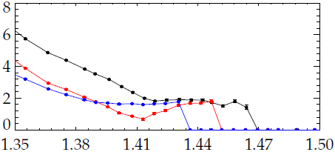
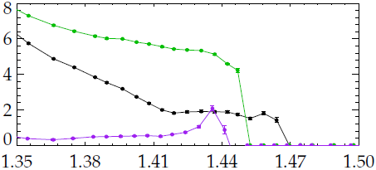
Zooming in on rotation near the edge
NSTX 121083 @ 0.475 s
128856 @ 0.526 s
130235 @ 0.745 s
ω_{φ} (kHz)
R (m)
R (m)
NSTX 121083 @ 0.475 s
121083 @ 0.435 s
135306 @ 0.686 s
ω_{φ} (kHz)
stable!!
R (m)
R (m)
stable 40ms earlier
14

Slide 29
Kinetic RWM stability theory may explain complex relationship of marginal stability with ω_{φ}
High plasma rotation alone is inadequate to ensure RWM stability in future devices
  A weakened stability gap exists between ω_{b} and ω_{D} resonances.
  Use ω_{φ} control to stay away from, and active control to navigate through gap.
Favorable comparison between NSTX exp. results and theory
  Multiple NSTX discharges with different marginally stable ω_{φ} profiles fall in this gap
  Energetic particles provide an important stabilizing effect
(ω_{φ}/ω_{A})_{q=2} (%)
ν/ν^{exp}
ω_{D}
ω_{b}
weakened stability
NSTX exp. instability
ω_{φ}/ω_{φ}^{exp}
  Visit the poster this afternoon for more detail
19

Slide 30
Abstract
Continuous, disruption-free operation of tokamaks requires stabilization of the resistive wall mode (RWM). Theoretically, the RWM is thought to be stabilized by energy dissipation mechanisms that depend on plasma rotation and other parameters, with kinetic effects being emphasized¹. Experiments in NSTX show that the RWM can be destabilized in high rotation plasmas while low rotation plasmas can be stable, which calls into question the concept of a simple critical plasma rotation threshold for stability. The present work tests theoretical stabilization mechanisms against experimental discharges with various plasma rotation profiles created by applying non-resonant n=3 braking, and with various fast particle fractions. Kinetic modification of ideal stability is calculated with the MISK code, using experimental equilibrium reconstructions. Analysis of NSTX discharges with unstable RWMs predicts near-marginal mode growth rates. Trapped ions provide the dominant kinetic resonances, while fast particles contribute an important stabilizing effect. Increasing or decreasing rotation in the calculation drives the prediction farther from the marginal point, showing that unlike simpler critical rotation theories, kinetic theory allows a more complex relationship between plasma rotation and RWM stability. Results from JT-60U show that energetic particle modes can trigger RWMs². Kinetic theory may explain how fast particle loss can trigger RWMs through the loss of an important stabilization mechanism. These results are applied to ITER advanced scenario equilibria to determine the impact on RWM stability.
[1] B. Hu et al., Phys. Plasmas 12 (2005) 057301. [2] G. Matsunaga et al., IAEA FEC 2008 Paper EX/5-2.

Slide 31
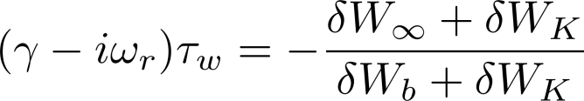
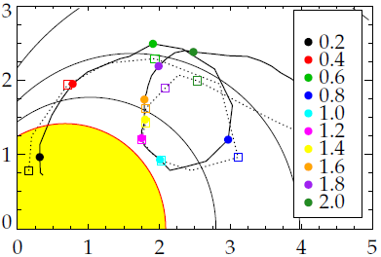
Non-linear inclusion of γ and ω_{r} in dispersion relation makes very little difference to MISK results
  γ and ω_{r} appear non-linearly on both sides of the dispersion relation.
ω_{φ}/ ω_{φ}^{exp}
  MARS-K is self-consistent, MISK can use iteration to include the non-linear effect.
  Iteration with τ_{w} = 1ms (dashed line) makes very little difference to the result, especially when γ is small.
Im(δW_{K})
unstable
γτ_{w} = 0.0
-0.2
-0.4
Re(δW_{K})

Slide 32
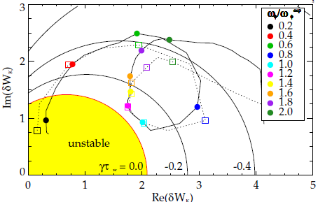
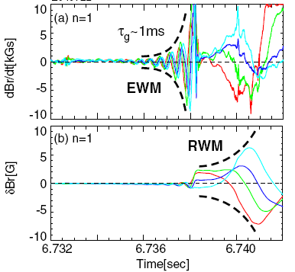
Improvements to the theory and calculation, to use as a quantitative predictor of instability
1. Examine sensitivity of calc.
  Non-linear inclusion of ω_{r} and γ: Iteration (τ_{w} = 1ms)
  Sensitivities to inputs: ex: Δq = 0.15 – 0.25
2. Include energetic particles
  Important stabilizing kinetic effects in theory
  E.P. modes known to “trigger” RWM in experiment
(Matsunaga et al., PRL, 2009)
JT-60U
121083 @ 0.475 s

Slide 33
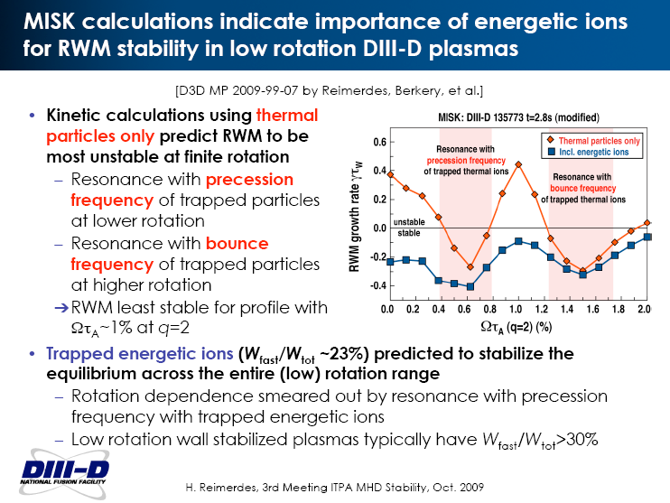
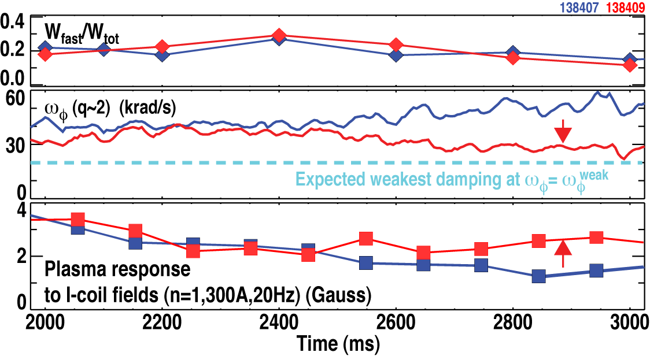
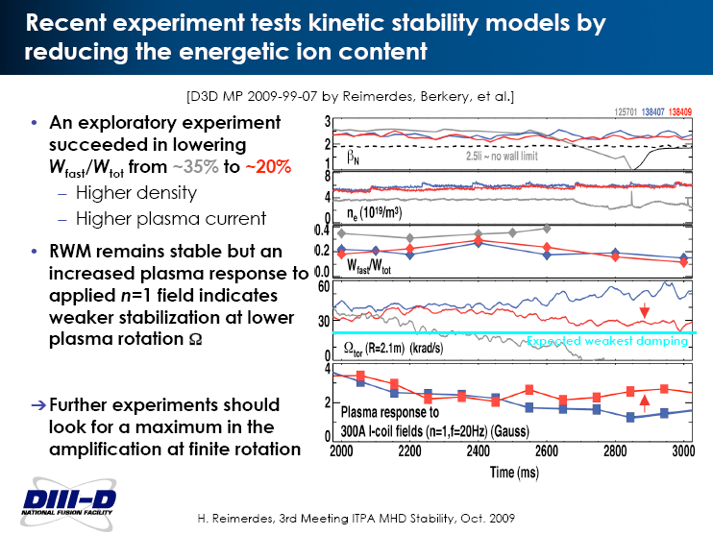
DIII-D experiment motivated by MISK results explored the effect of energetic particles on RWM stability
MISK Analysis
DIII-D Experiment (with Reimerdes)
Higher n_{e} and I_{p} reduced W_{f}/W_{t} by 40% over previous exp.
Predicted instability inconsistent with experiment
Adding energetic particles makes RWM stable - consistent
Weakened ω_{φ} profile remains
RWM remains stable, but response higher as ω_{φ}→ω_{φ}^{weak}

Slide 34
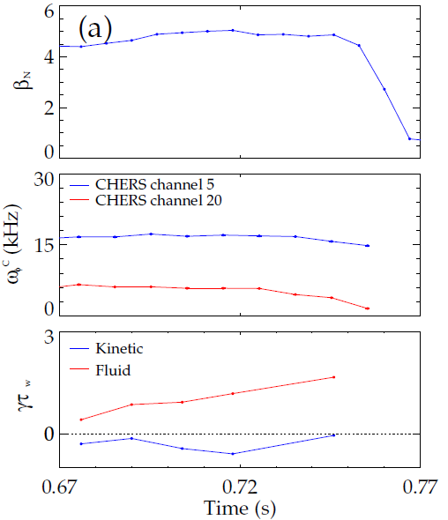
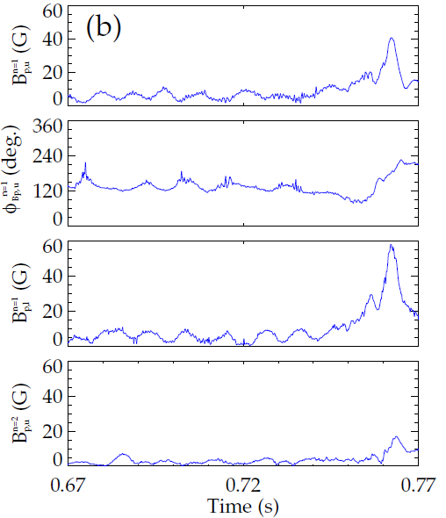
The RWM is identified in NSTX by a variety of observations
upper B_{p} n=1 sensor
plasma β
upper B_{p} n=1 phase
plasma rotation
magnitude
lower B_{p} n=1 sensor
phase
predicted growth rate
upper B_{p} n=2 sensor
NSTX 130235 @ 0.746 s
  Change in plasma rotation frequency, ω_{φ}
  Growing signal on low frequency poloidal magnetic sensors
  Global collapse in USXR signals, with no clear phase inversion
  Causes a collapse in β and disruption of the plasma

Slide 35
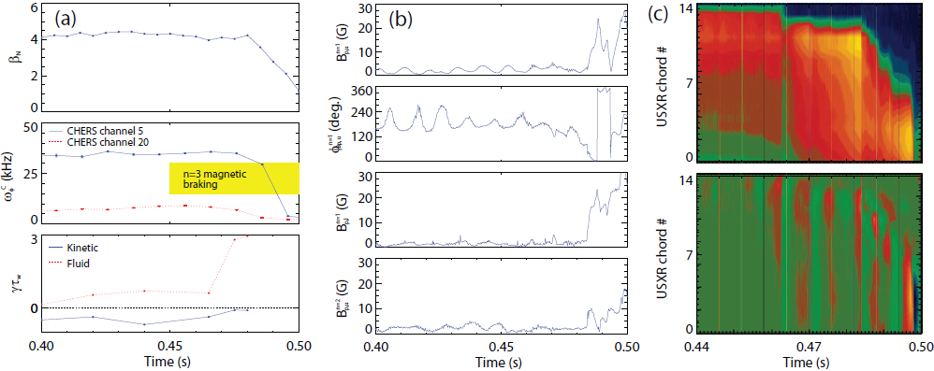
NSTX 121083 @ 0.475 RWM characteristics

Slide 36
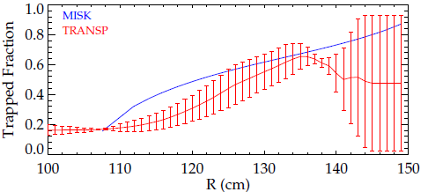
Present isotropic distribution function for energetic particles overestimates the trapped ion fraction
  First-order check:
  MISK isotropic f overestimates the trapped ion fraction (compared to TRANSP).
NSTX 121090 @ 0.59-0.60 s

Slide 37
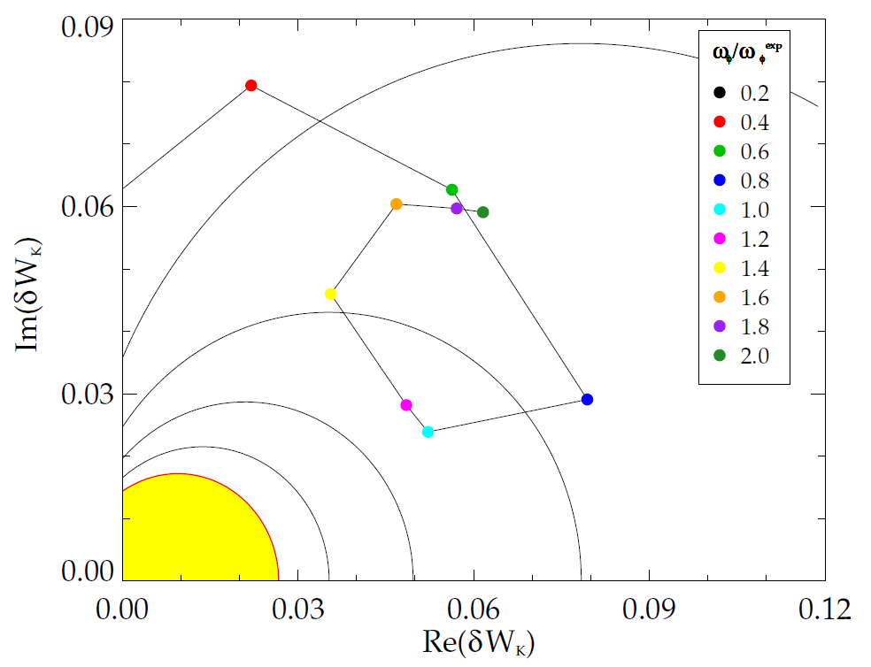
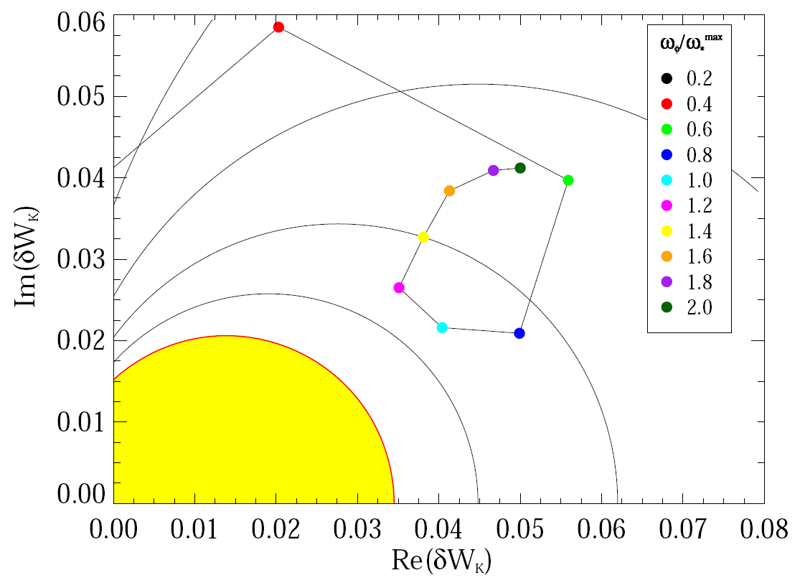
MISK sometimes overpredicts stability
unstable
stable
128856 @ 0.529
133367 @ 0.635

Slide 38
Perturbative vs. Self-consistent Approaches
and
Three Roots of the RWM Dispersion Relation

Slide 39
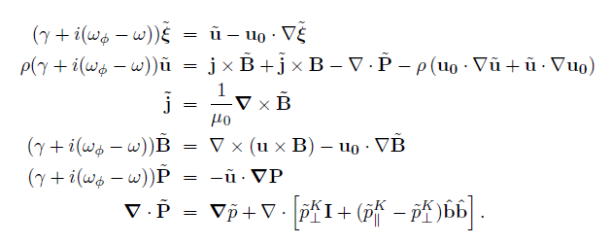

γ is found with a self-consistent or perturbative approach
The self-consistent (MARS) approach: solve for γ and ω from:
The perturbative (MISK) approach: solve for γ and ω from:
with δW∞ and δW_{b} from PEST. There are three main differences between the approaches:
The way that rational surfaces are treated.
Whether ξ is changed or unchanged by kinetic effects.
Whether γ and ω are non-linearly included in the calculation.

Slide 40
Rational surfaces are treated differently
The self-consistent (MARS) approach: solve for γ and ω from:
MARS-K: “continuum damping included through MHD terms”. This term includes parallel sound wave damping.
In MISK a layer of surfaces at a rational ±Δq is removed from the calculation and treated separately through shear Alfvén damping.

Slide 41

Unchanging ξ may be a good assumption
For DIII-D shot 125701, the eignfunction doesn’t change due to kinetic effects.
(Y. Liu, APS DPP 2008)

Slide 42
Non-linear inclusion of γ and ω can be achieved in the perturbative approach through iteration
Example: NSTX 121083 @ 0.475
 | τ_{w} = 0.1ms |  | τ_{w} = 0.5ms |  | τ_{w} = 1.0ms
Iteration | γ | ω | γ | ω | γ | ω
0 | -2577 | -1576 | -515 | -315 | -258 | -158
1 | -4906 | 431 | -508 | -172 | -256 | -139
2 | -5619 | 800 | -505 | -177 | -257 | -140
3 | -5745 | 828 | -504 | -179
4 | -5834 | 835
5 | -5855 | 838
6 | -5835 | 819

Slide 43
The effect of iteration depends on the magnitudes of γ, ω

Slide 44

The dispersion relation has three roots
Liu’s simple example: a=0, c₂ = 0.18, ω_{*T} = 0
Plot contours of 1/|D|
γ
(Y. Liu, APS DPP 2008)
ω

Slide 45
MISK and MARS-K Benchmarking

Slide 46



MISK and MARS-K were benchmarked using a Solov’ev equilibrium
  Simple, analytical solution to the Grad-Shafranov equation.
  Flat density profile means ω_{*N} = 0.
  Also, ω, γ, and ν_{eff} are taken to be zero for this comparison, so the frequency resonance term is simply:
  MARS-K: (Liu, Phys. Plasmas, 2008)
(Liu, ITPA MHD TG Meeting, Feb. 25-29, 2008)

Slide 47


Drift frequency calculations match for MISK and MARS-K
MARS
MISK
(Liu, ITPA MHD TG Meeting, Feb. 25-29, 2008)
large aspect ratio approximation (Jucker et al., PPCF, 2008)
here, є_{r} is the inverse aspect ratio, s is the magnetic shear, K and E are the complete elliptic integrals of the first and second kind, and Λ = μB₀/ε, where μ is the magnetic moment and ε is the kinetic energy.

Slide 48


Bounce frequency calculations match for MISK and MARS-K
MARS
MISK
(Liu, ITPA MHD TG Meeting, Feb. 25-29, 2008)
large aspect ratio approximation (Bondeson and Chu, PoP, 1996)

Slide 49
MISK and MARS-K match well at reasonable rotation
Good match for trapped ions and electrons at high rotation, but poor at low rotation.
The simple frequency resonance term denominator causes numerical integration problems with MISK that don’t happen with realistic equilibria.

Slide 50
DIII-D Energetic Particle Experiment

Slide 51
xxx

Slide 52
xxx

Slide 53
δW_{K} in the limit of high particle energy
Writing δW_{K} without specifying f:
Rewriting with explicit energy dependence:
So that, for energetic particles, where ε is very large:
large
large
large
Note: this term is independent of ε.

Slide 54
xxx

