Slide 1



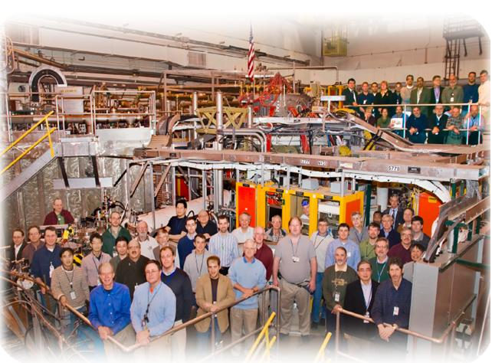

NSTX
Supported by
Edge Stability of Small-ELM Regimes in NSTX
College W&M
Colorado Sch Mines
Columbia U
CompX
General Atomics
INL
Johns Hopkins U
LANL
LLNL
Lodestar
MIT
Nova Photonics
New York U
Old Dominion U
ORNL
PPPL
PSI
Princeton U
Purdue U
SNL
Think Tank, Inc.
UC Davis
UC Irvine
UCLA
UCSD
U Colorado
U Illinois
U Maryland
U Rochester
U Washington
U Wisconsin
Aaron Sontag
J. Canik, R. Maingi, R. Bell, S. Gerhardt, S. Kubota,
B. LeBlanc, J. Manickam, T. Osborne, P. Snyder, K. Tritz
and the NSTX Research Team
Culham Sci Ctr
U St. Andrews
York U
Chubu U
Fukui U
Hiroshima U
Hyogo U
Kyoto U
Kyushu U
Kyushu Tokai U
NIFS
Niigata U
U Tokyo
JAEA
Hebrew U
Ioffe Inst
RRC Kurchatov Inst
TRINITI
KBSI
KAIST
POSTECH
ASIPP
ENEA, Frascati
CEA, Cadarache
IPP, Jülich
IPP, Garching
ASCR, Czech Rep
U Quebec
APS - DPP
Chicago, Il
Nov. 10, 2010

Slide 2
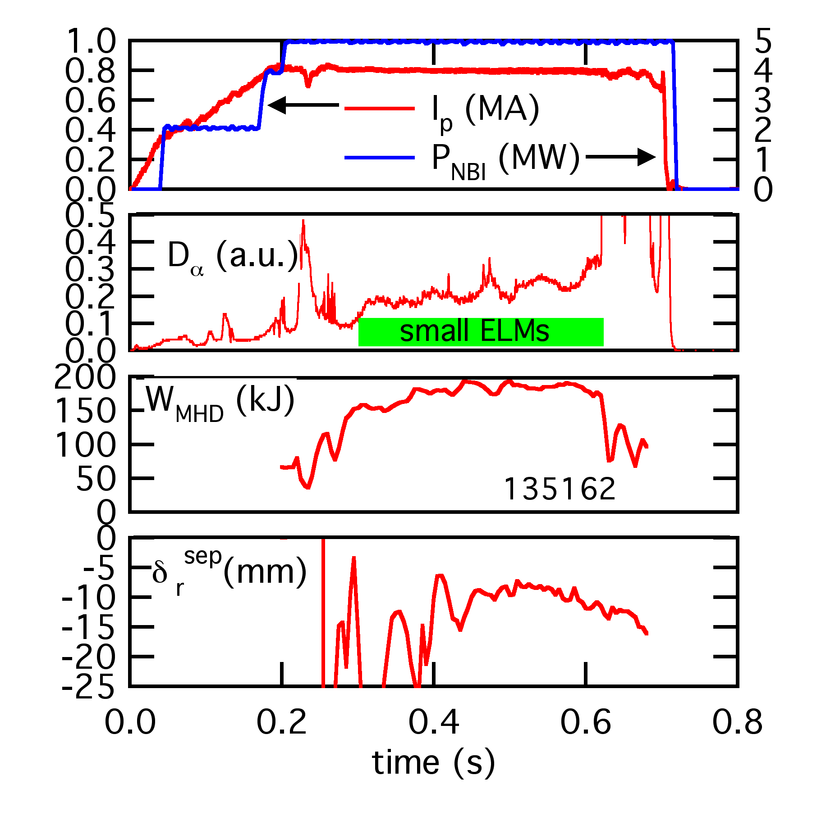
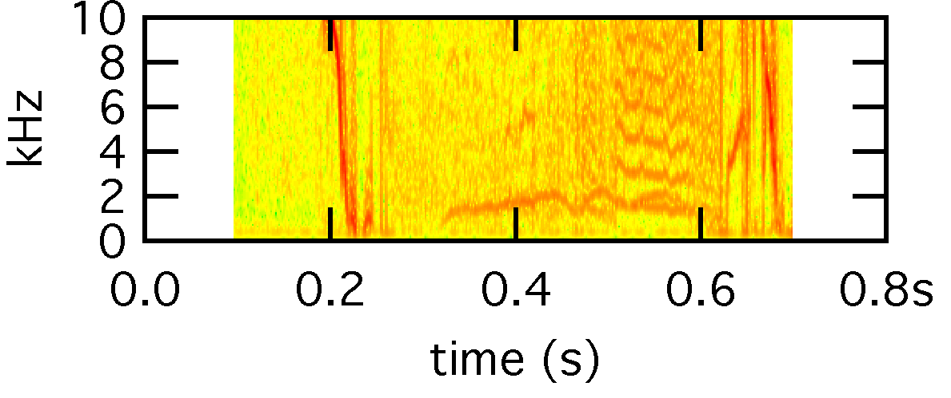
Small-ELM Regime in NSTX Coincident with Edge Instability
Small-ELM (Type-V*) operation highly desirable in NSTX
  δW_{MHD} < 1% per ELM
Downward bias & high edge collisionality required for access
  δ_{r}^{sep} < -5 mm necessary
  ν*_{ped} > 1-2
  no correlation with edge rotation or rotation shear
    still need to determine E x B shear correlation
Low-f (< 10 kHz) oscillations coincident with Type-V ELM transition
  ST equivalent to edge harmonic oscillation (EHO)?
    EHO allows access to ELM-free QH-mode at standard-A
    EHO provides edge transport, reduces peeling-ballooning instability drive
Harmonics
Fundamental
  *R. Maingi, et al., Nucl. Fusion 45 (2005) 264

Slide 3
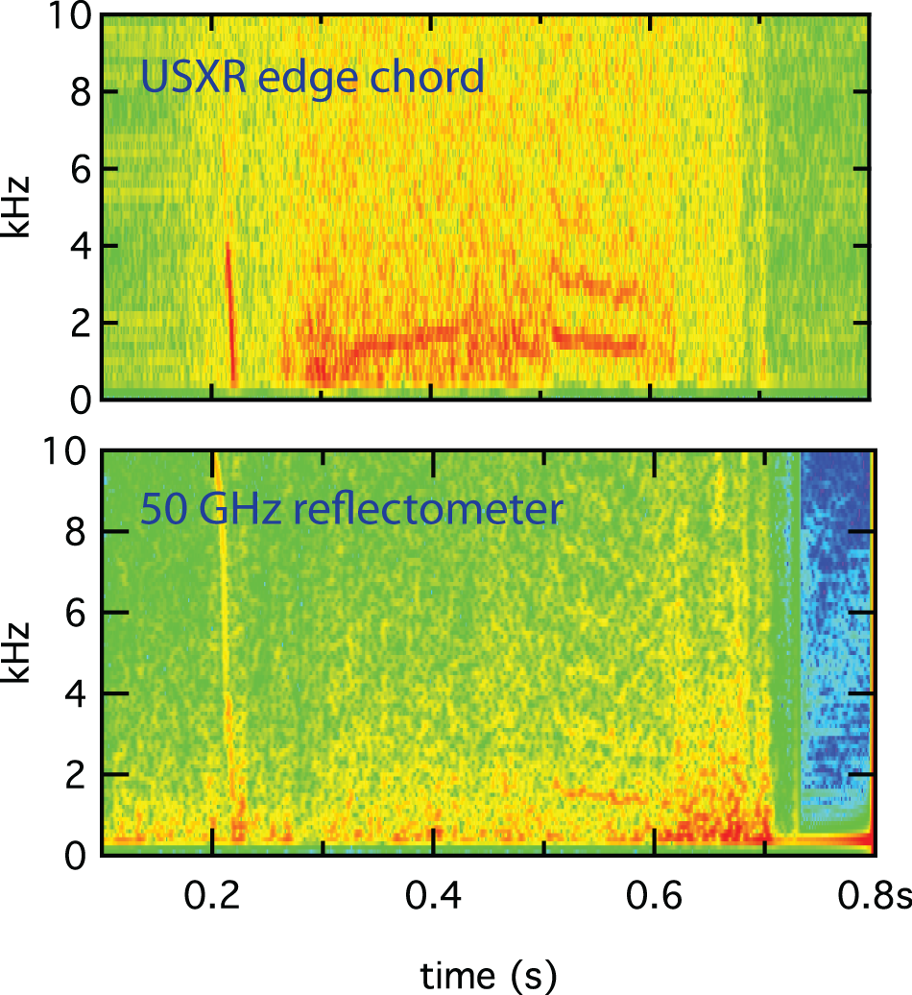
Edge Instability Observed in Multiple Diagnostics
USXR signal peaks near top of pedestal
  peak amplitude at USXR R_{tan}~ 140 cm
  10 μm Be filter eliminates edge light
  unfiltered USXR shows ELM spikes independent of mode
  oscillations not observed inside 130 cm
Low-f matches plasma rotation frequency
  Mirnov array indicates n = 1 fundamental
  f_{φ} = 2 kHz at 140 cm
Edge reflectometer shows density fluctuations
  R_{cutoff} ~ 140 cm during mode
  fluctuations at same frequency as Mirnovs/USXR
  relatively weak compared to core modes
Edge transport analysis needed to determine if mode is affecting stability
Harmonics
Fundamental
Harmonics
Fundamental

Slide 4
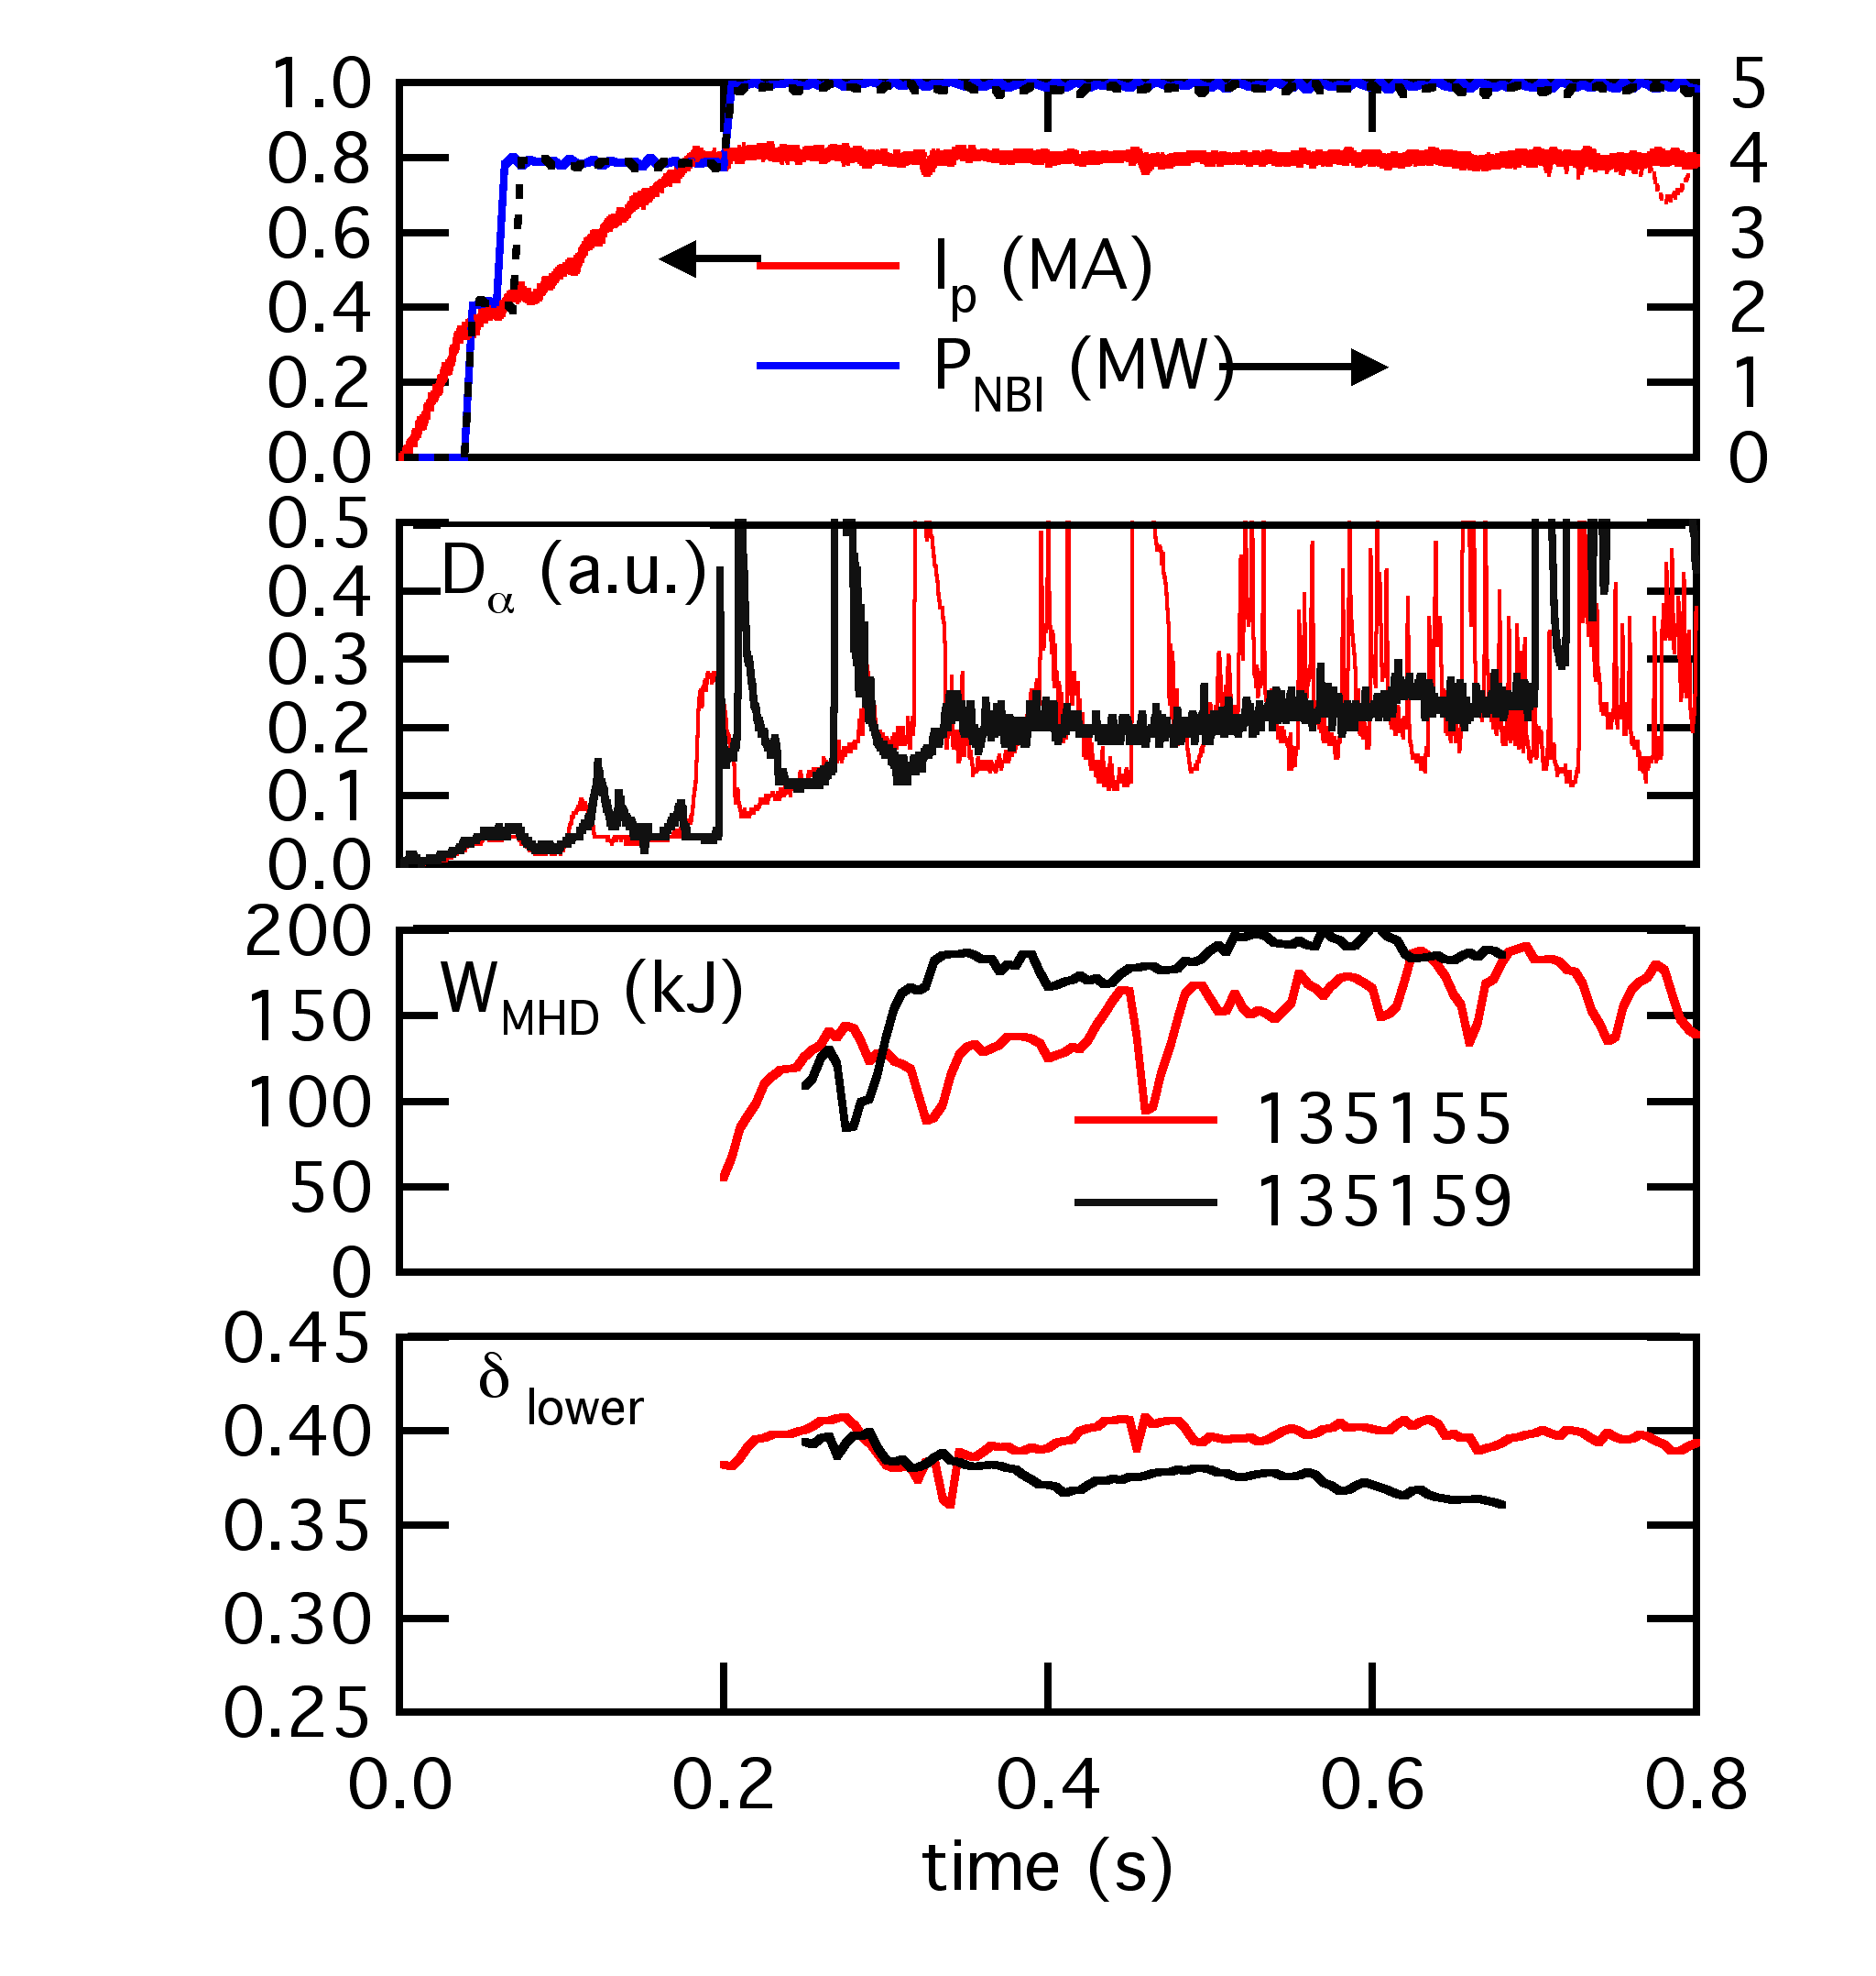
Type-I ELM Stabilization Observed with Change in Triangularity
Both shots have Type-I prior to 0.3 s
  δW_{MHD} > 10% for Type-I
  δW_{MHD} < 1% for Type-V
δ ramp down triggers transition
  other shape parameters constant
  plasma moves down in vessel
Multiple factors could be affecting edge stability
  shape change affects peeling-ballooning stability
  downward motion changing δ_{r}^{sep}
  fueling affected by moving lower X-point near divertor plate

Slide 5
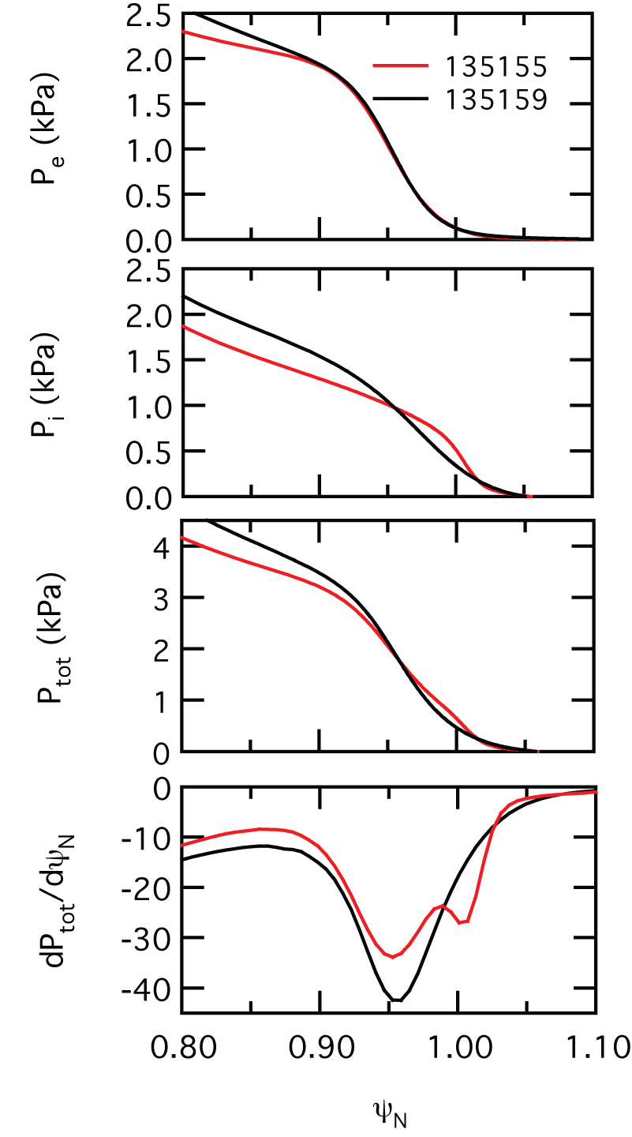
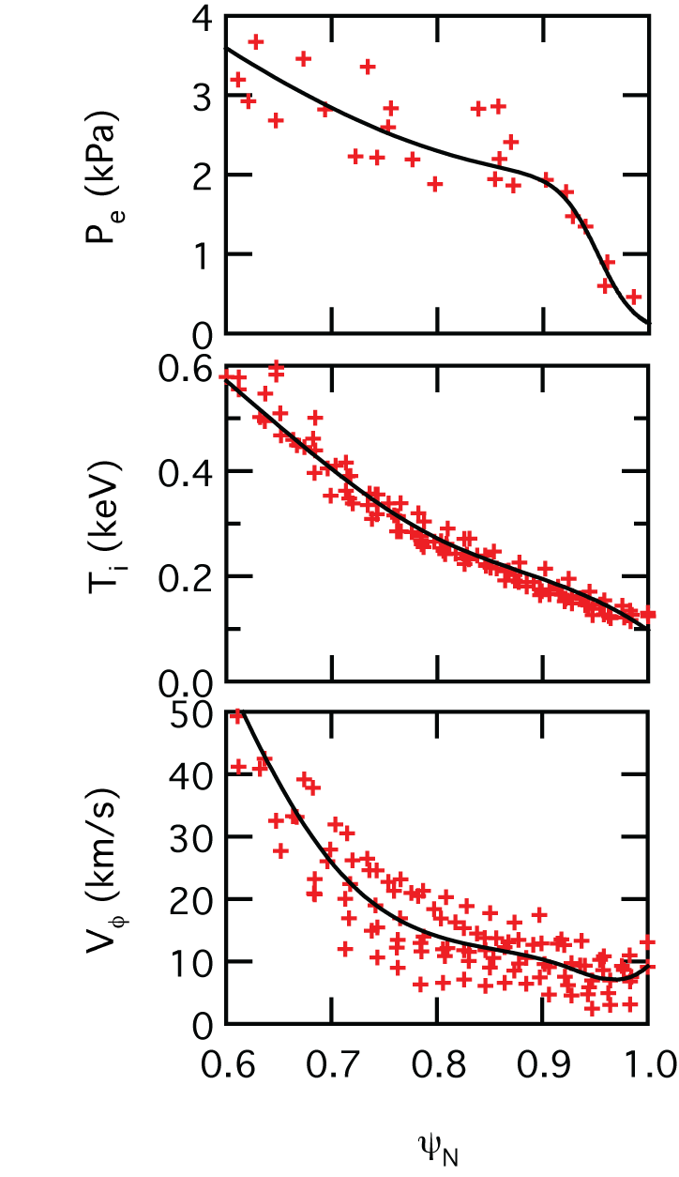
Multiple Time Slice Averaging Used to Analyze Profiles
Technique developed on DIII-D
  run EFIT at TS laser times
  map n_{e}, T_{e}, T_{i} to ψ_{N} space
  fit tanh function to re-mapped profiles
  compute kinetic EFIT using tanh fits
  calculate j_{BS} from Sauter model
Pedestal pressure peak shifted inward & increased for Type-V
  P_{e} nearly identical
  Pi most strongly affected
Type-V case has higher magnitude pressure gradient
Need more shots for statistics
Shot 135155

Slide 6
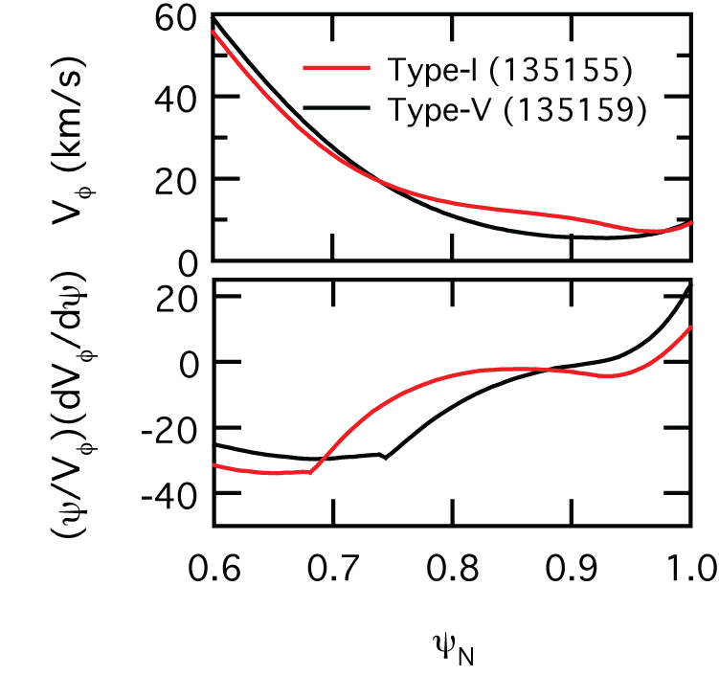
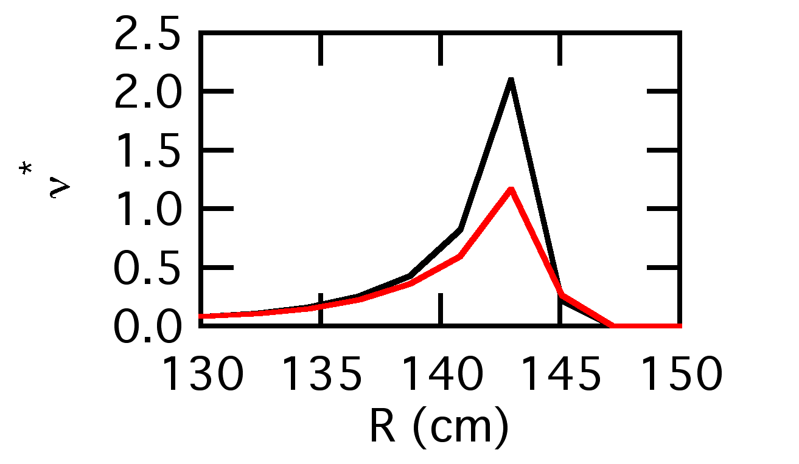
Increased Collisionality May Affect Edge Stability
No correlation with toroidal rotation or rotation shear
  consistent across single time database and multi time slice averaged profiles
  large error bars near edge
  large relative fluctuations
Edge collisionality increased in Type-V case
  consistent with previous observation of increased ν* stabilizing Type-I*
  is collisionality altering j_{BS} or indicative of increased edge pressure?
  *R. Maingi, et al., Nucl. Fusion 45 (2005) 264

Slide 7
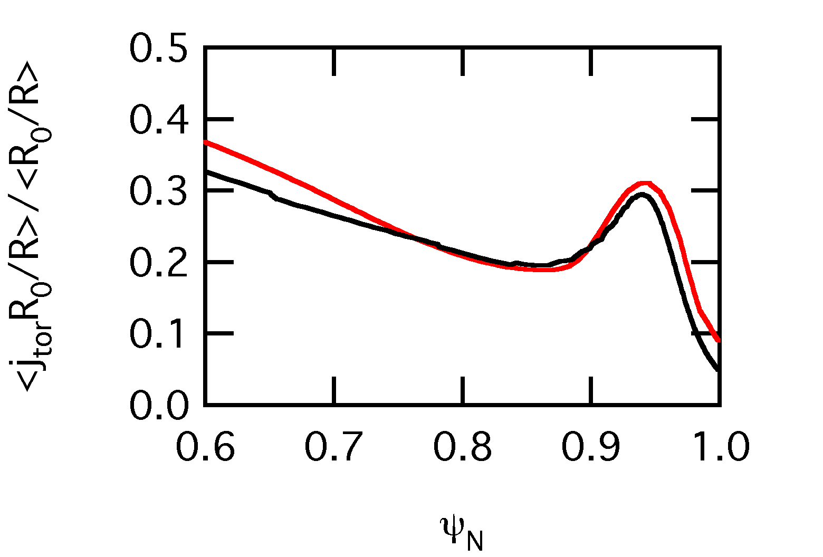
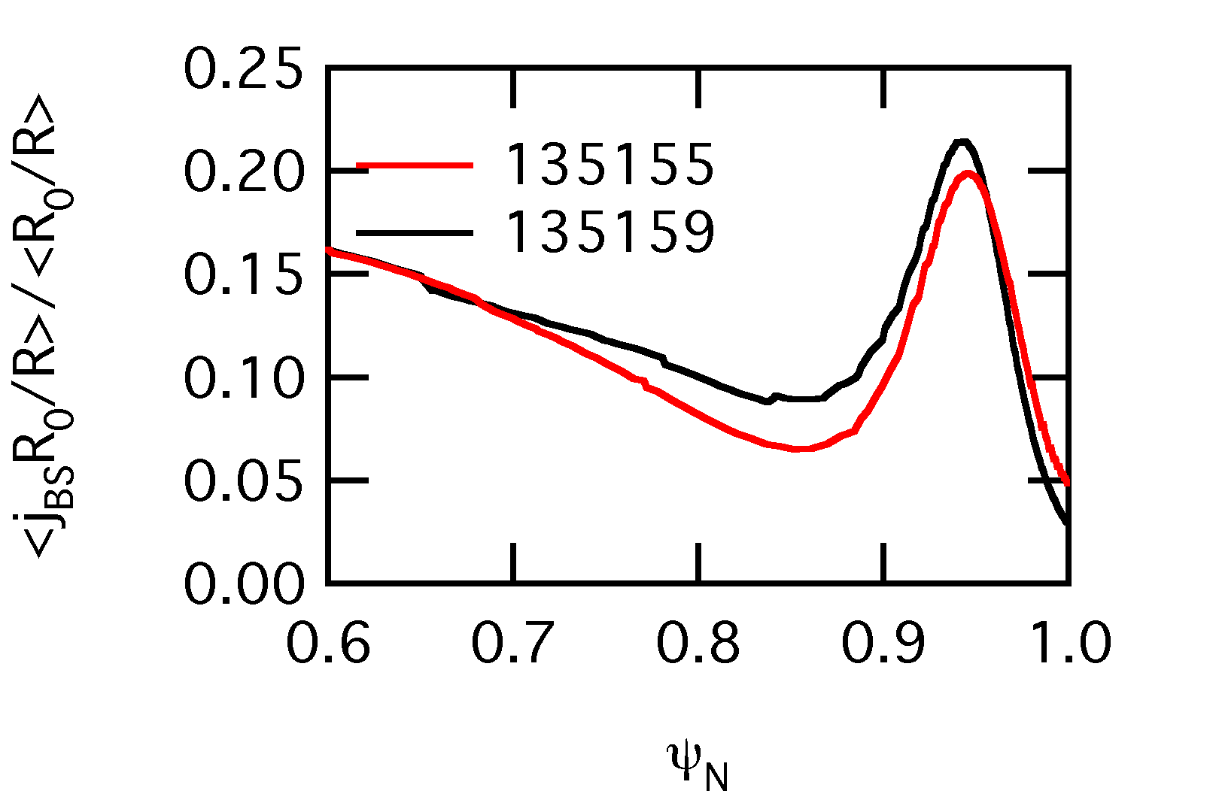
Edge Current Slightly Reduced in Type-V Case
j_{BS} slightly increased in Type-V case
  increased pressure dominating over increased ν*
More shots for statistics
  need peeling-ballooning stability calculations
Toroidal Current Profiles
Bootstrap Current Profiles

Slide 8
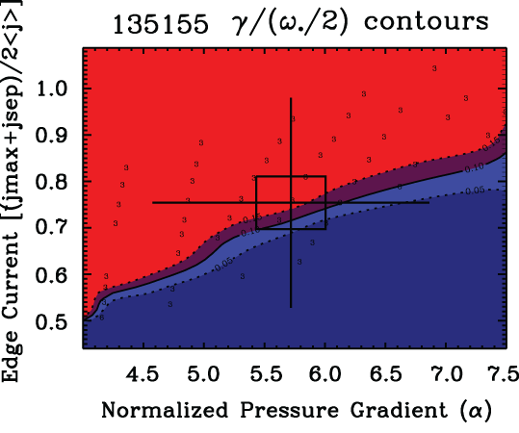
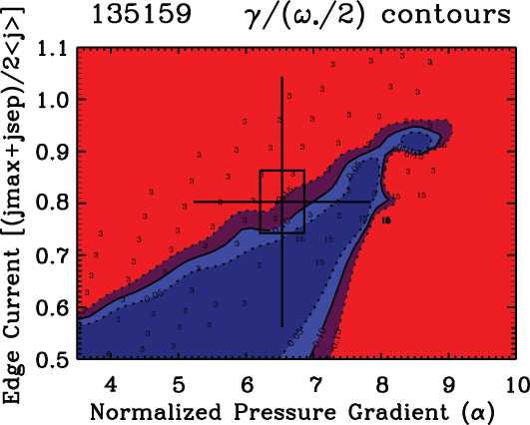
ELITE Shows Type-V Case Closer to Ballooning Boundary
n = 3 most unstable for both cases
  calculation run for n = 3, 6, 9, 12, 15
  PEST also shows n = 3 most unstable
  NSTX typically on peeling side of curve
    ST geometry naturally leads to higher j_{BS}
    high shaping stabilizing to ballooning
Decreased δ moves operating point closer to ballooning boundary
  near to n = 15
Change in operating point not the same as ELMy to QH-mode
  EHO moves operating point across peeling boundary
  both NSTX cases still on peeling boundary
Unstable
γ/ω*/2 = 0.1
Stable
Unstable
Stable

Slide 9
Further Analysis Required to Determine Cause of Stabilization of Type-I ELMs
Edge instability observed coincident with small-ELM transition
  observed in many NSTX discharges
  may have similar role to EHO at normal-A ➔ need to determine how instability affects transport
No correlation with toroidal rotation or rotation shear
  need to examine ExB shearing rate
Increased collisionality (ν_{e}* > 2) and δ_{r}^{sep} < -5 mm needed for Type-V ELMs
  Type V cases have increased pedestal pressure
Stability analysis shows Type-V case closer to ballooning boundary
  need to include MSE in equilibrium reconstructions
  need to analyze more shots for better statistics
Need to include particle sources and sinks to determine if mode is affecting transport

