Slide 1



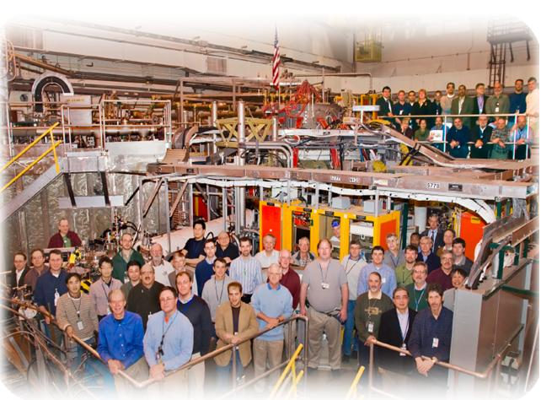
NSTX
Supported by
Role of plasma edge region
in global stability on NSTX*
College W&M
Colorado Sch Mines
Columbia U
CompX
General Atomics
INL
Johns Hopkins U
LANL
LLNL
Lodestar
MIT
Nova Photonics
New York U
Old Dominion U
ORNL
PPPL
PSI
Princeton U
Purdue U
SNL
Think Tank, Inc.
UC Davis
UC Irvine
UCLA
UCSD
U Colorado
U Illinois
U Maryland
U Rochester
U Washington
U Wisconsin
J. Menard (PPPL), Y.Q. Liu (CCFE)
R. Bell, S. Gerhardt (PPPL)
S. Sabbagh (Columbia University)
and the NSTX Research Team
Culham Sci Ctr
U St. Andrews
York U
Chubu U
Fukui U
Hiroshima U
Hyogo U
Kyoto U
Kyushu U
Kyushu Tokai U
NIFS
Niigata U
U Tokyo
JAEA
Hebrew U
Ioffe Inst
RRC Kurchatov Inst
TRINITI
KBSI
KAIST
POSTECH
ASIPP
ENEA, Frascati
CEA, Cadarache
IPP, Jülich
IPP, Garching
ASCR, Czech Rep
U Quebec
52nd Annual Meeting of the APS DPP
November 8-12
Chicago, IL
*This work supported by US DoE contract DE-AC02-09CH11466

Slide 2
Outline
Experimental motivation
Role of E×B drift frequency profile
Kinetic stability analysis using MARS code
  Comparisons with experiment
  Self-consistent vs. perturbative approach

Slide 3
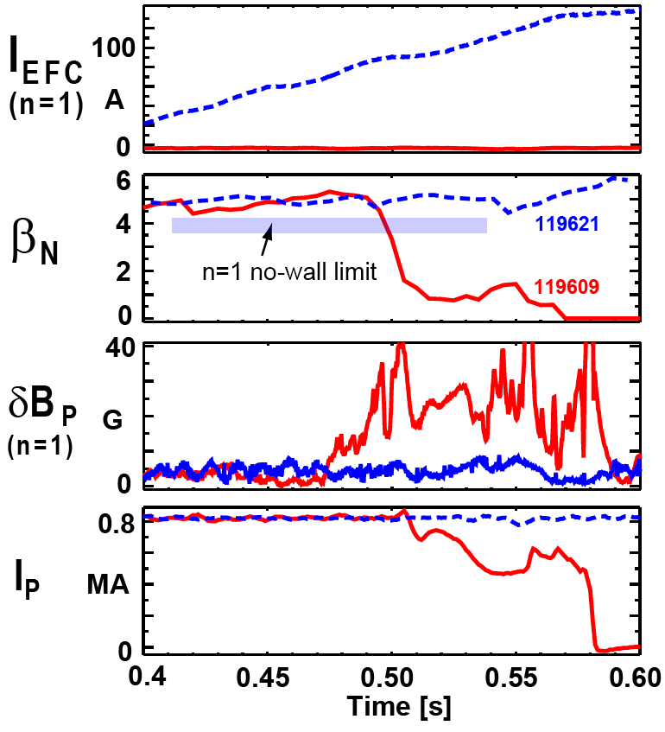
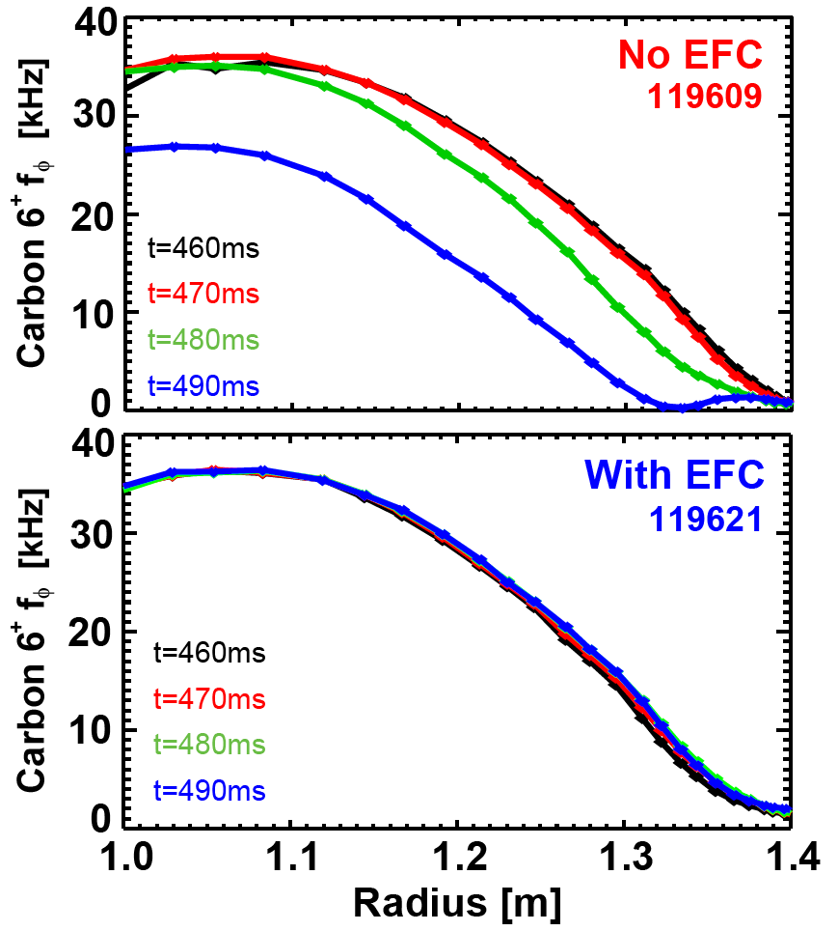
Error field correction (EFC) often necessary to maintain rotation, stabilize n=1 resistive wall mode (RWM) at high β_{N}
No EFC → n=1 RWM unstable
With EFC → n=1 RWM stable
J.E. Menard et al, Nucl. Fusion 50 (2010) 045008

Slide 4
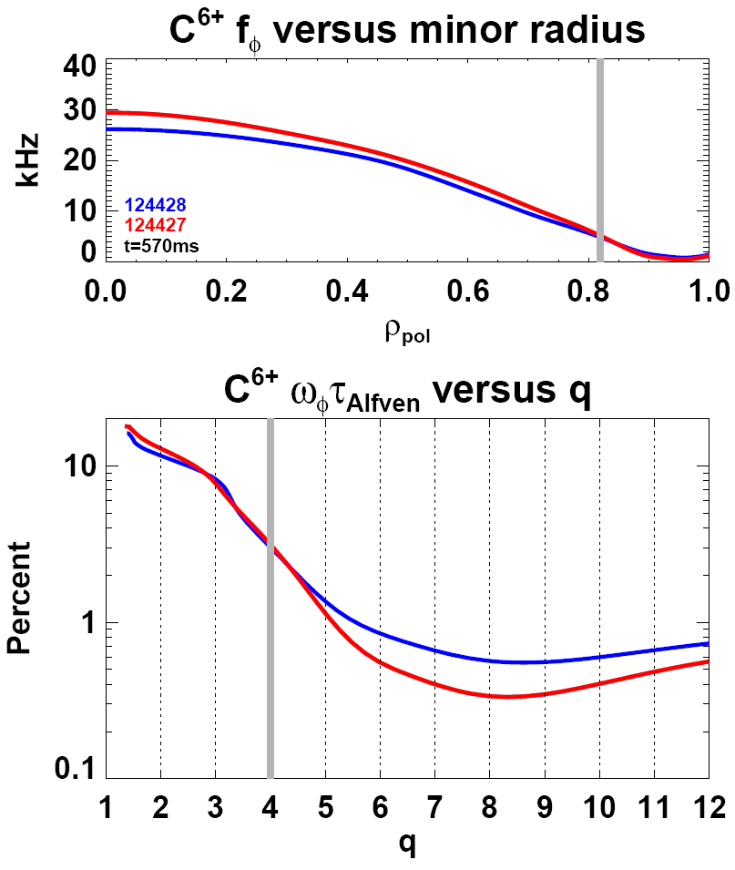
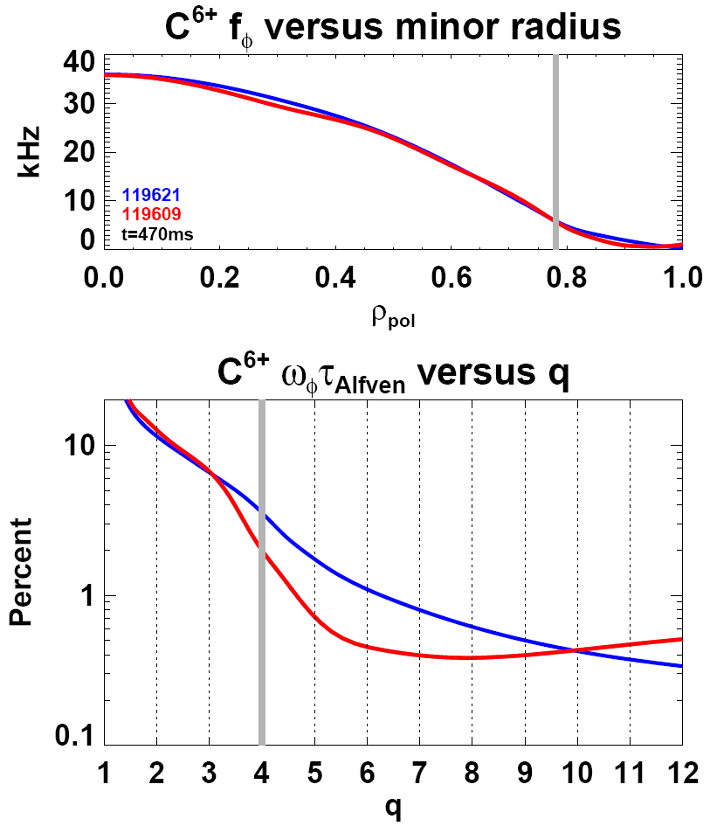
EFC experiments show edge region with q ≥ 4 and r/a ≥ 0.8 apparently determine stability
n=3 EFC → stable
No EFC → n=1 RWM unstable
n=1 EFC →stable
No EFC → n=1 RWM unstable
unstable
stable
stable
unstable
stable
stable
unstable
unstable

Slide 5
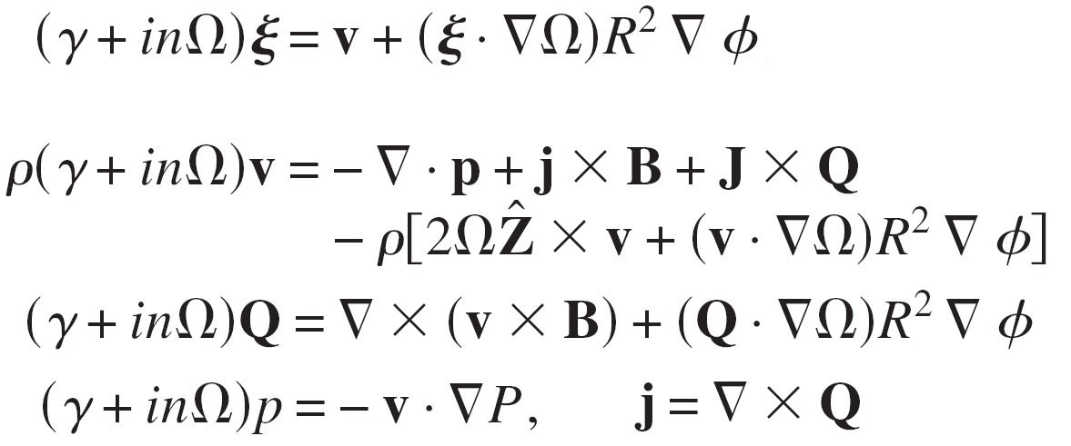

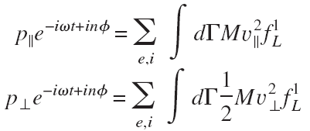

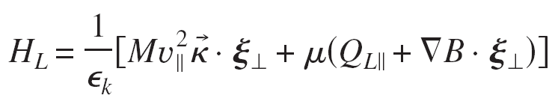
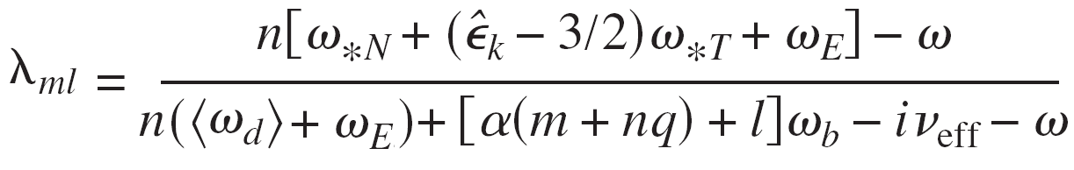
MARS is linear MHD stability code that includes toroidal rotation and drift-kinetic effects
Single-fluid linear MHD
Kinetic effects in perturbed p:
Y.Q. Liu, et al., Phys. Plasmas 15, 112503 2008
Mode-particle resonance operator:
MARS-K:
MARS-F:
+ additional approximations/simplifications in f_{L}¹
Fast ions: MARS-K: slowing-down f(v), MARS-F: lumped with thermal

Slide 6
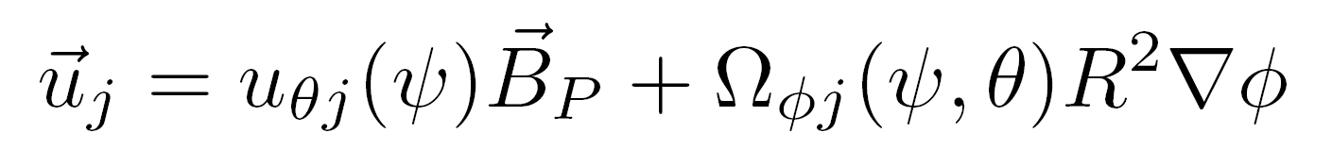
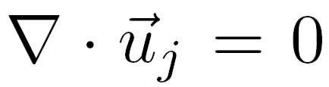
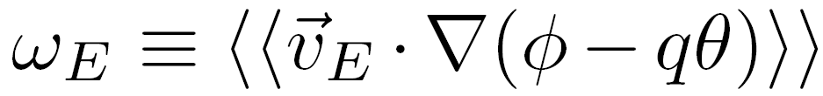
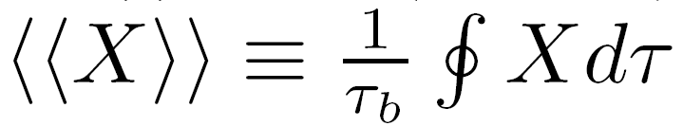

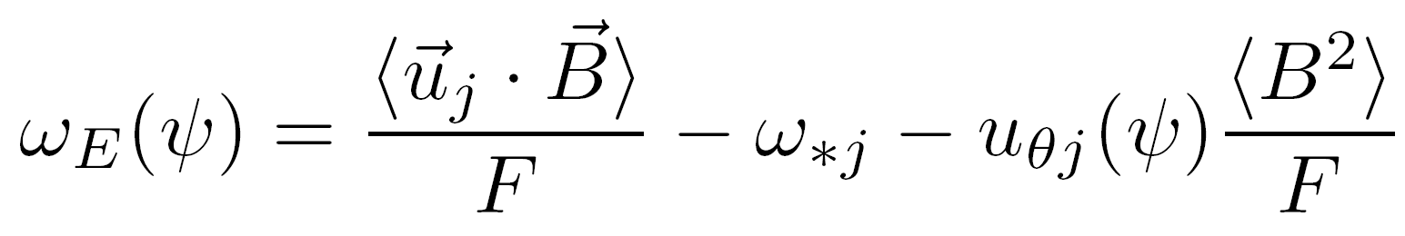
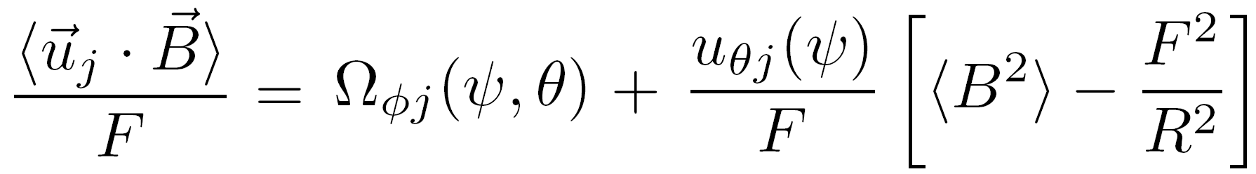
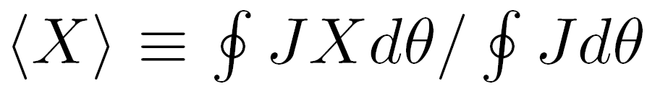
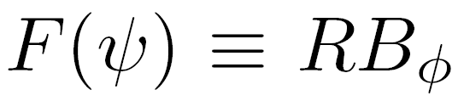
Sensitivity of stability to rotation motivates study of all components of E×B drift frequency ω_{E}(ψ)
Decompose flow of species j into poloidal + toroidal components:
satisfying
Orbit-average E×B drift frequency:
Bounce average:
= E×B drift velocity
F. Porcelli, et al., Phys. Plasmas 1 (1994) 470
Ignoring centrifugal effects (ok in plasma edge), ω_{E} reduces to:
1. parallel/toroidal
2. diamagnetic
3. poloidal
measured
measured or neoclassical theory
Y.B. Kim, et al., Phys. Fluids B 3 (1991) 2050
Flux-surface average:
flux function
measured
reconstructions

Slide 7
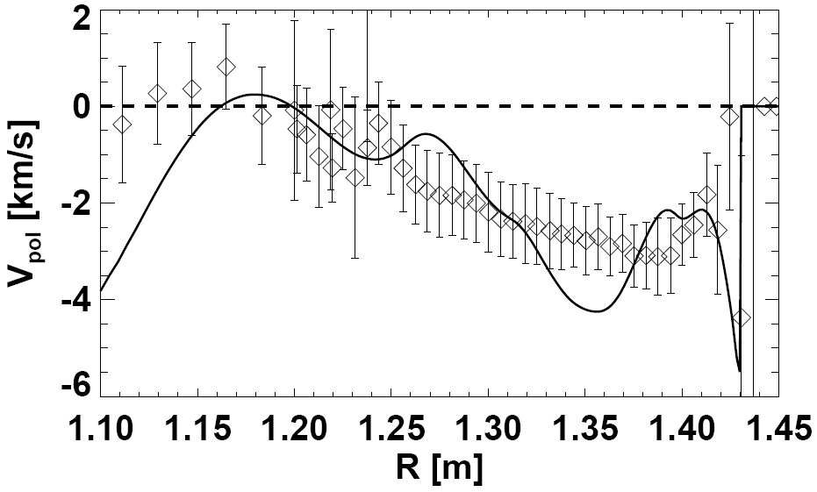
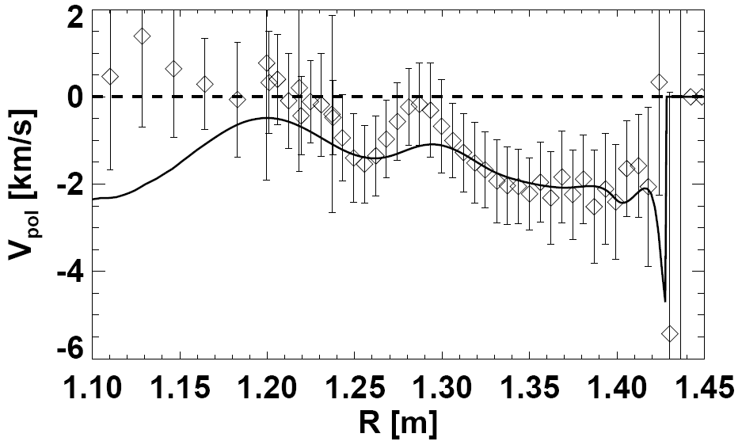
NSTX edge v_{pol} ≈ neoclassical (within factor of ~2)
V_{pol} ∝ 1/B – trend
consistent with neoclassical
B_{T} = 0.34T
B_{T} = 0.54T
r/a = 0.6
r/a = 0.6
Separatrix
Separatrix
Measured v_{pol} neoclassical
Largest deviation in core
Subsequent MARS calculations use
neoclassical v_{pol}, but v_{pol} = 0 for r/a < 0.6
  NSTX results: R. E. Bell, et al., Phys. Plasmas 17, 082507 (2010)
  Neoclassical: W. Houlberg, et al., Phys. Plasmas 4, 3230 (1997)

Slide 8
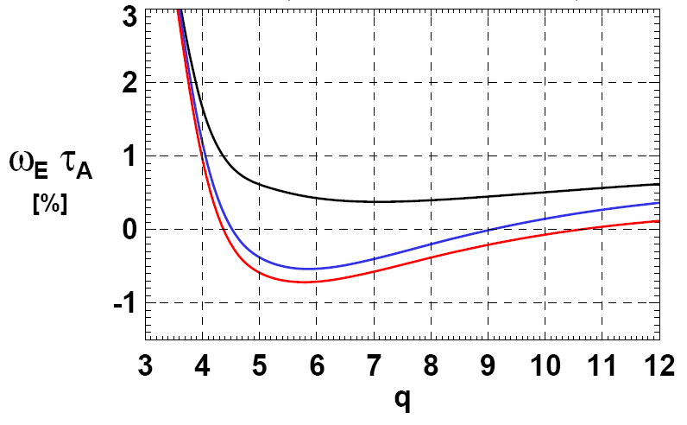
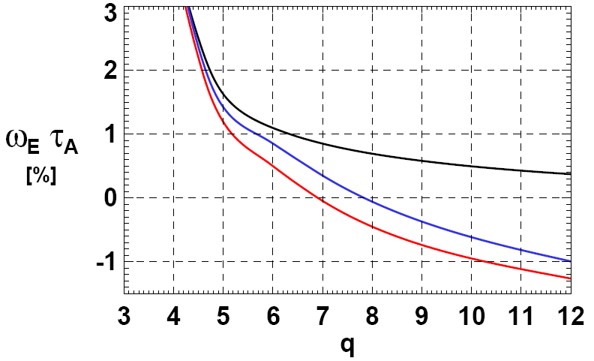
n=1 EFC profiles show impurity C diamagnetic and poloidal rotation modify |ω_{E} τ_{A}| ~ 1% in edge → potentially important
n=1 RWM unstable (no n=1 EFC)
n=1 RWM stable (n=1 EFC)
119609
t=470ms
119621
t=470ms
Toroidal
Toroidal
Tor + dia
Tor + dia
Tor + dia + pol
Tor + dia + pol
C⁶⁺ Toroidal rotation only:
Toroidal + diamagnetic:
Toroidal + diamagnetic + poloidal:
ω_{E} = Ω_{φ-C}(ψ)
ω_{E} = Ω_{φ-C}(ψ) – ω_{*C}
ω_{E} = ⟨u_{C}⋅B⟩/F – ω_{*C} – u_{θ-C}⟨B²⟩/F
Diamagnetic contribution to ω_{E}τ_{A} ≈ -0.5 to -1.0%
Neoclassical v_{pol} contribution to ω_{E}τ_{A} ≈ -0.2 to -0.4%

Slide 9
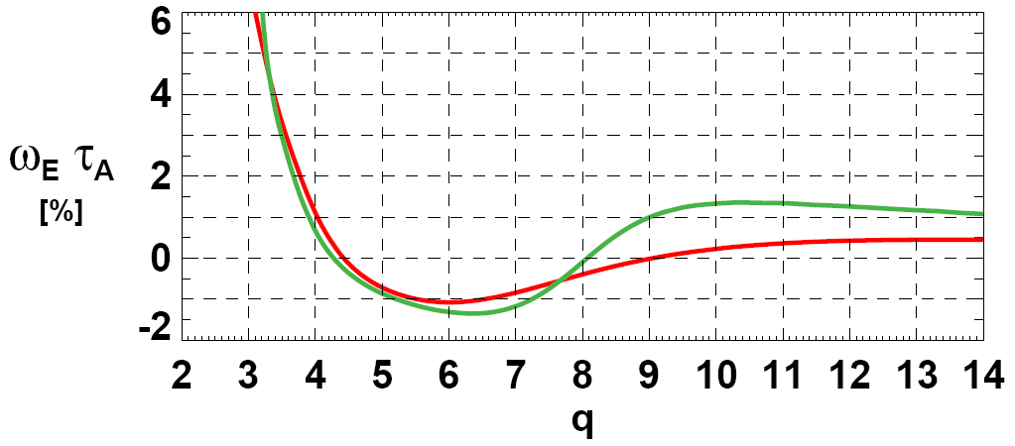
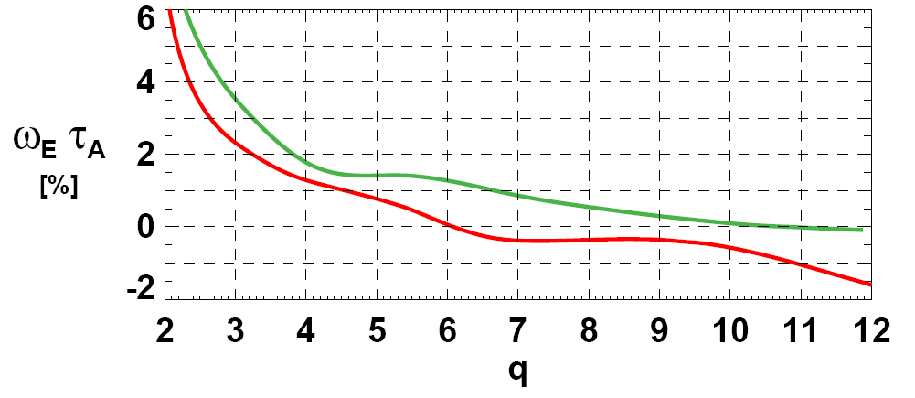
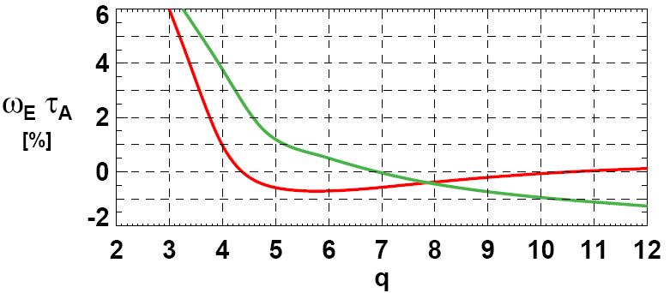
A range of edge ω_{E} profile shapes can be stable, but unstable profiles can often be nearby
Toroidal + diamagnetic + poloidal
127427
124428
t=580ms
Separation between stable and unstable profiles typically small:
Δ(ω_{E}τ_{A} ) ≤ 1%
ω_{E} ≈ 0 over most of edge may correlate with instability
Edge ω_{E} (r) control could potentially provide RWM stabilization technique
Motivation for RWM active feedback control remains
n=3 EFC
β_{N}=4.5, q*=3.5
Stable
Unstable
n=3 braking
β_{N}=4, q*=2.8
128901
128897
t=450ms
n=1 EFC
β_{N}=5, q*=3.5
119609
119621
t=470ms

Slide 10
Kinetic stability analysis using MARS-F
  Experimentally unstable case
  Experimentally stable case
  Comparison of unstable and stable cases

Slide 11
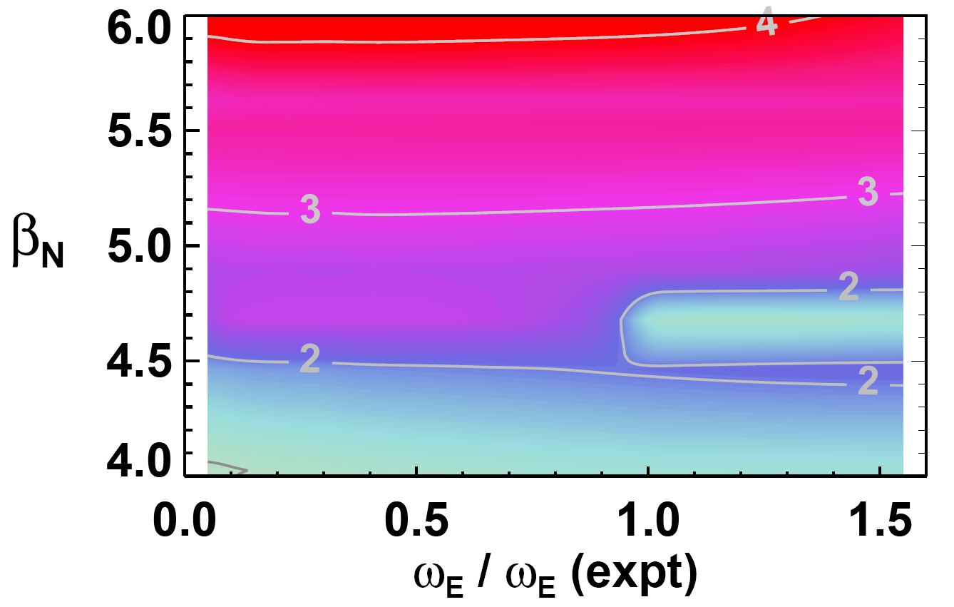
MARS-F using marginally unstable ω_{E} = Ω_{φ-C} predicts n=1 RWM to be robustly unstable → inconsistent with experiment
β_{N} – β_{N} (no-wall)
β_{N} (wall) – β_{N} (no-wall)
C_{β} ≡
Calculated n=1 γ τ_{wall}
Using experimentally marginally unstable profiles
C_{β}=1
γ depends only weakly on rotation
γ increases with β_{N}
Expt
C_{β}=0
ω_{*C} / ω_{*C} (expt) = 0, u_{θ} = 0

Slide 12
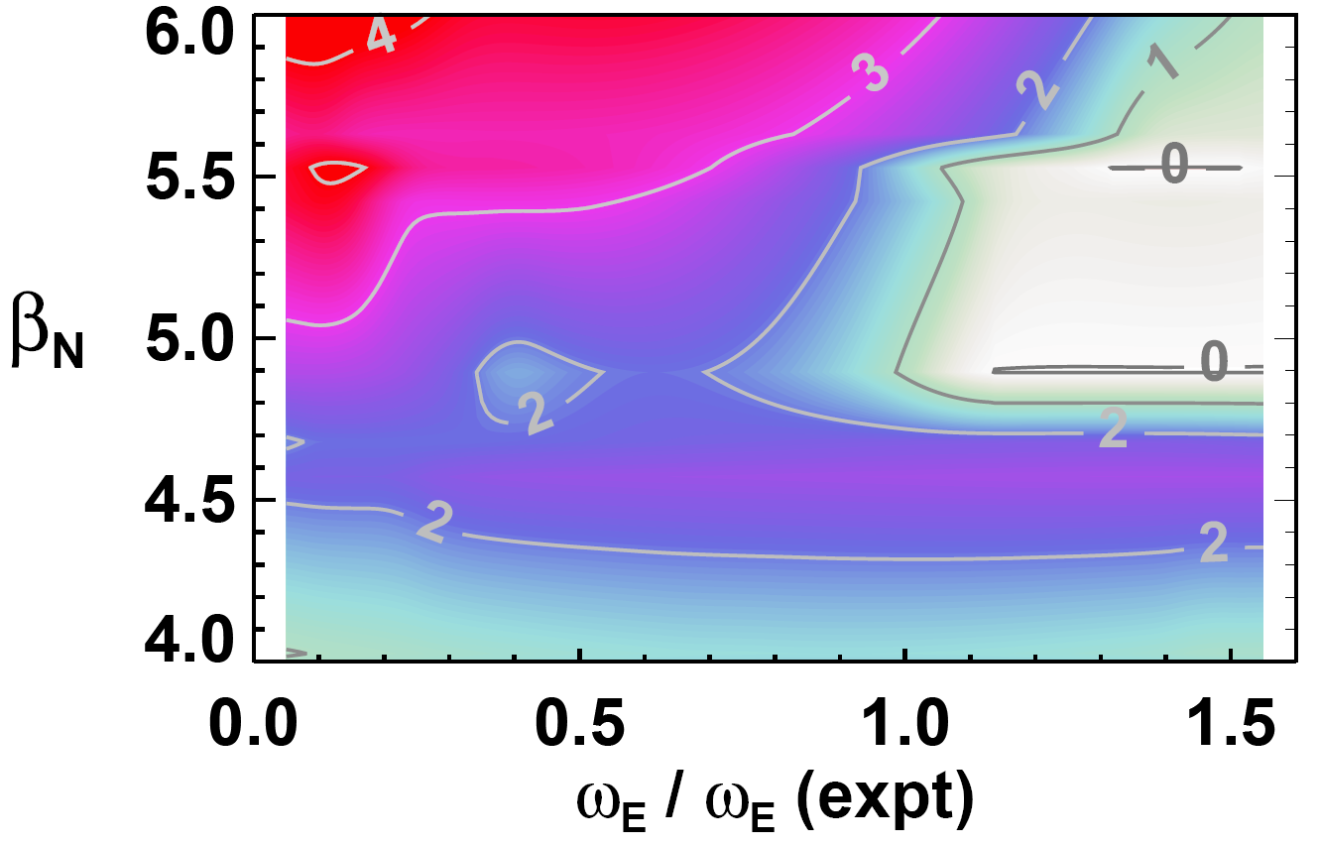
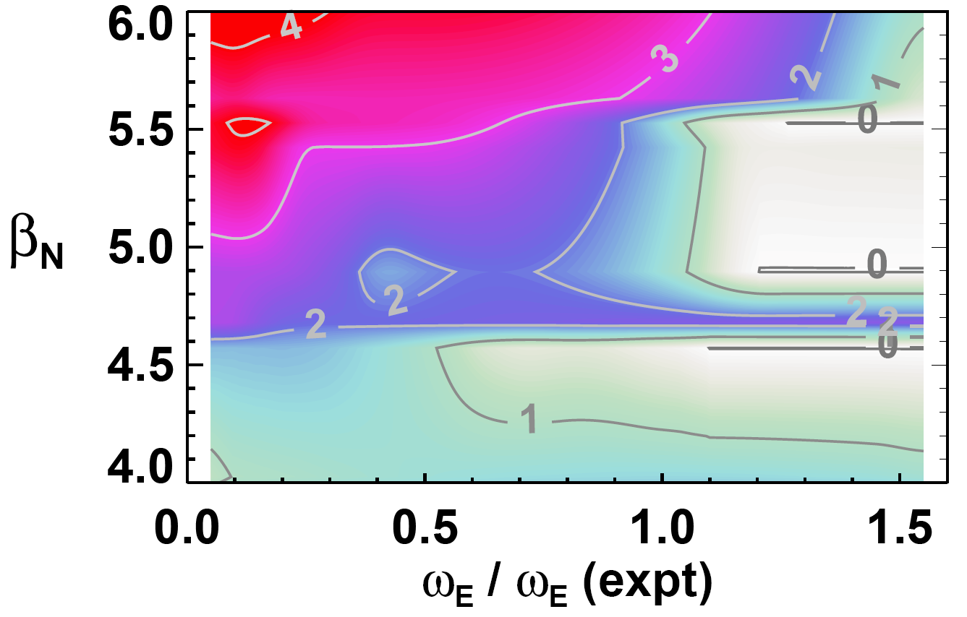
MARS-F using marginally unstable full ω_{E} predicts n=1 RWM to be marginally unstable → more consistent with experiment
Calculated n=1 γ τ_{wall}
using experimentally marginally unstable profiles
Expt
Expt
ω_{*C} / ω_{*C} (expt) = 1
u_{θ} = 0
ω_{*C} / ω_{*C} (expt) = 1
u_{θ} = neoclassical

Slide 13
Kinetic stability analysis using MARS-F
  Experimentally unstable case
  Experimentally stable case
  Comparison of unstable and stable cases

Slide 14
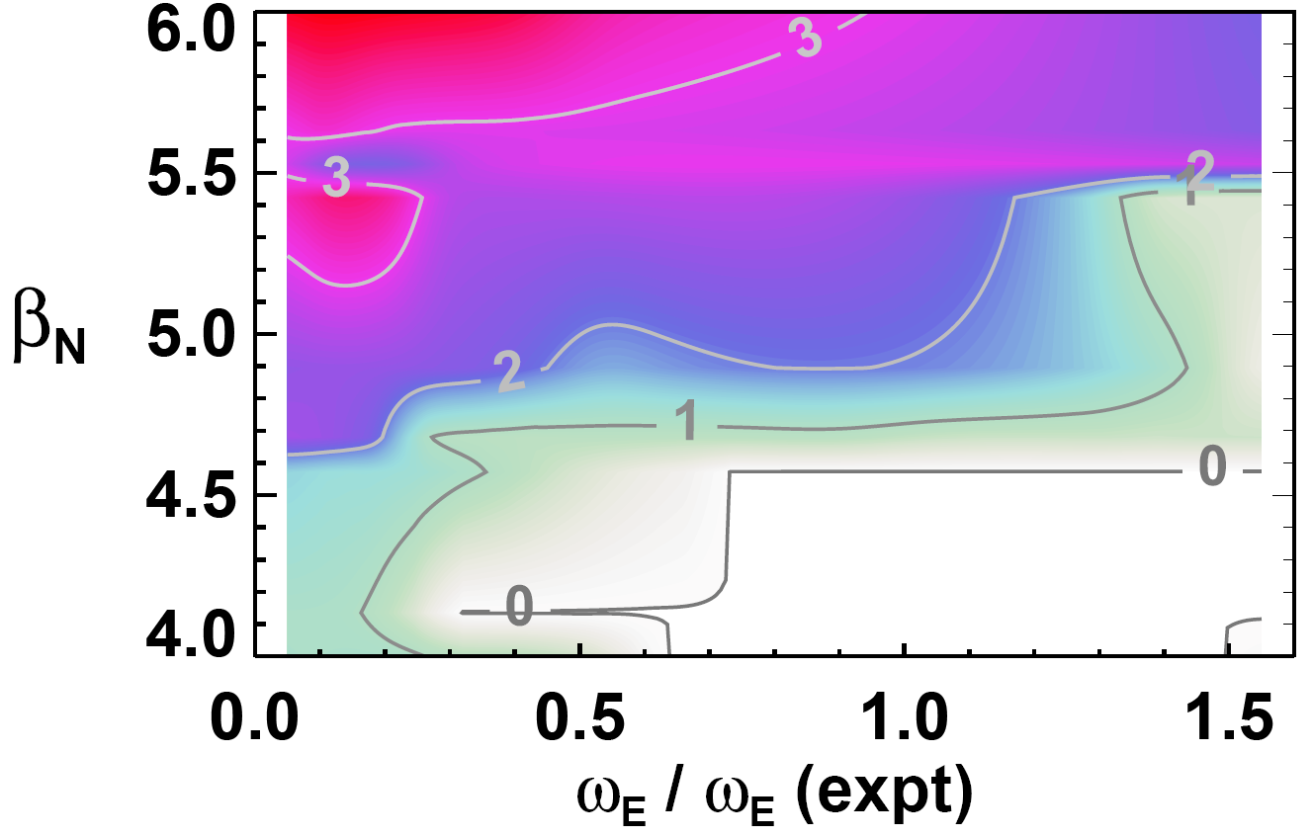
MARS-F using stable ω_{E} = Ω_{φ-C} profile predicts n=1 RWM to be unstable → inconsistent with experiment
Calculated n=1 γ τ_{wall}
using experimentally stable profiles
n=1 RWM predicted to be unstable for β_{N} > 4.6, but actual plasma operates stably at β_{N} ≥ 5
Expt
ω_{*C} / ω_{*C} (expt) = 0, u_{θ} = 0

Slide 15
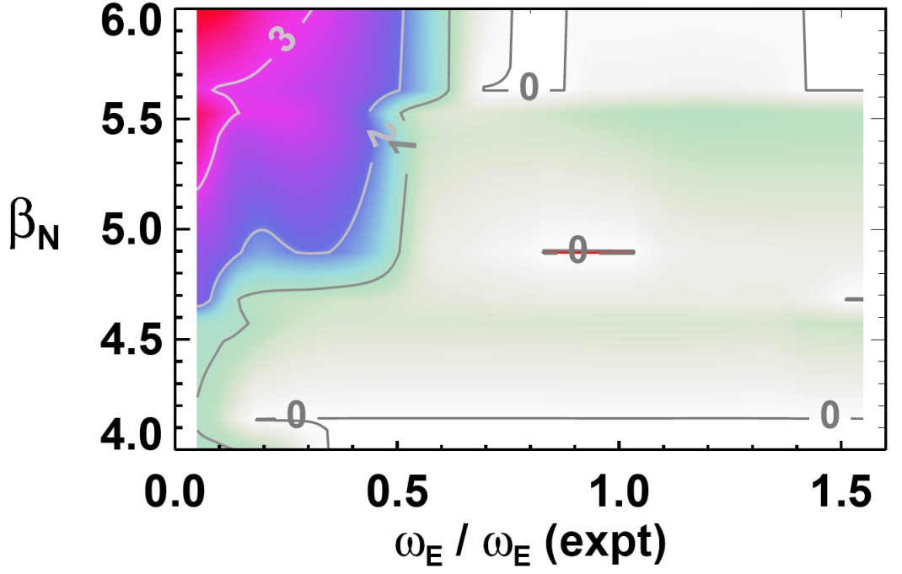
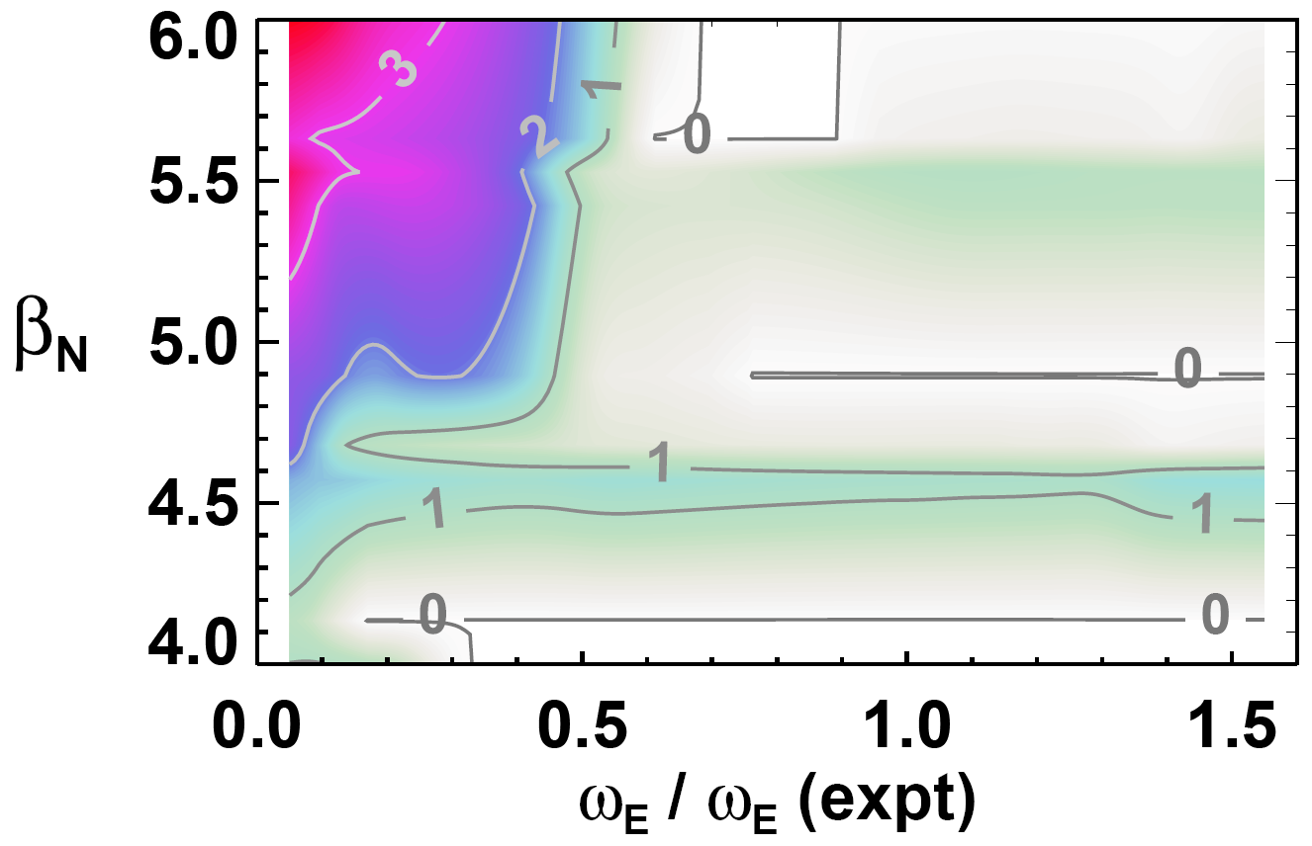
MARS-F using stable full ω_{E} profile predicts wide region of marginal stability → more consistent with experiment
Calculated n=1 γ τ_{wall}
using experimentally stable profiles
Expt
Expt
ω_{*C} / ω_{*C} (expt) = 1
u_{θ} = 0
ω_{*C} / ω_{*C} (expt) = 1
u_{θ} = neoclassical

Slide 16
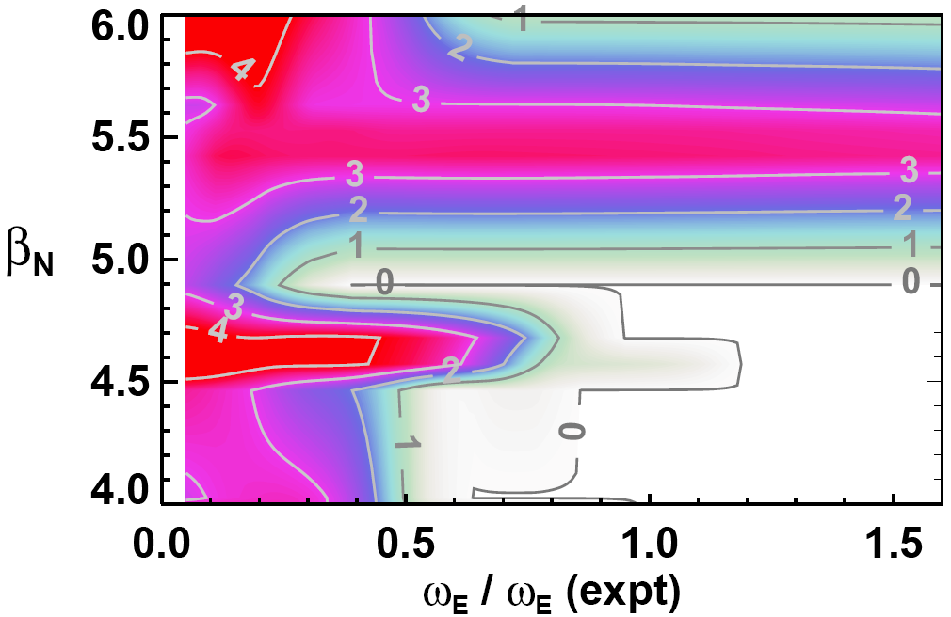
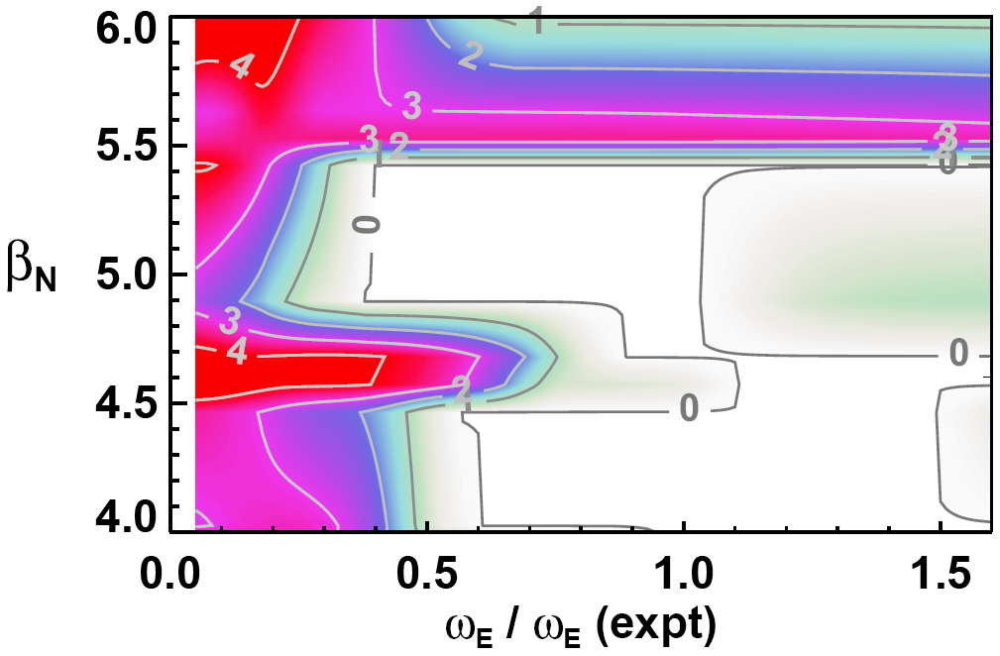
Inclusion of v_{pol} in ω_{E} can sometimes modify marginal stability boundary – example: wall position variation
Calculated n=1 γ τ_{wall}
experimentally stable profiles and b_{wall} / a artificially increased × 1.1
Expt
Expt
ω_{*C} / ω_{*C} (expt) = 1
u_{θ} = 0
ω_{*C} / ω_{*C} (expt) = 1
u_{θ} = neoclassical
Increased wall distance lowers with-wall limit to β_{N} ~ 5.5
Case with u_{θ}=0 has lower marginal stability limit β_{N} ~ 5

Slide 17
Kinetic stability analysis using MARS-F
  Experimentally unstable case
  Experimentally stable case
  Comparison of unstable and stable cases

Slide 18
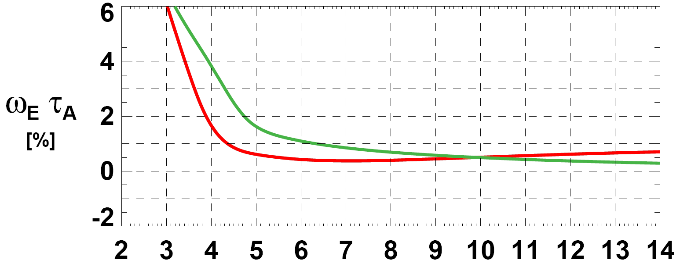
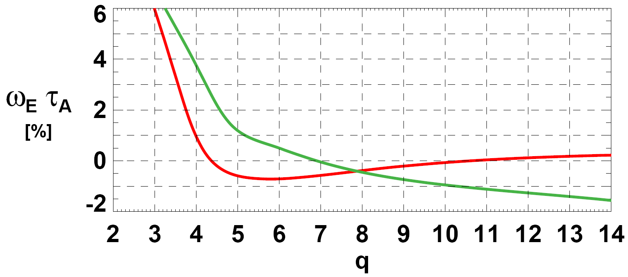


Inclusion of ω_{*C} in ω_{E} increases separation between stable and unstable ω_{E}(ψ) and provides consistency w/ experiment
Toroidal rotation only
Unstable rotation profile
Stable rotation profile
Stable
Expt
Expt
Unstable
Predictions inconsistent with experiment
Toroidal + diamagnetic
Unstable rotation profile
Stable rotation profile
Stable
Expt
Expt
Unstable
Predictions more consistent with experiment

Slide 19

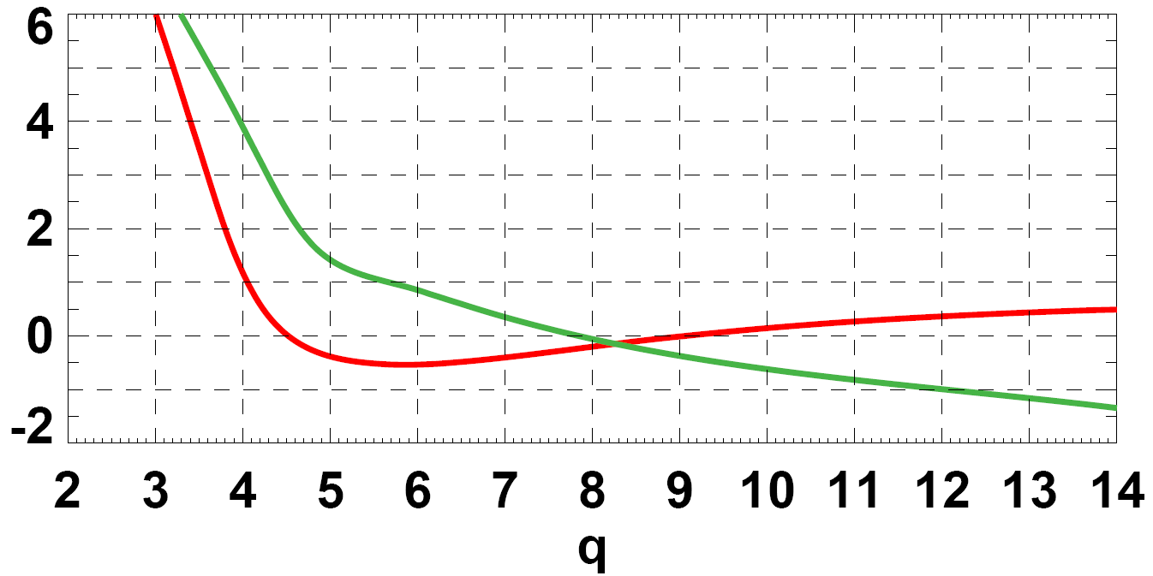
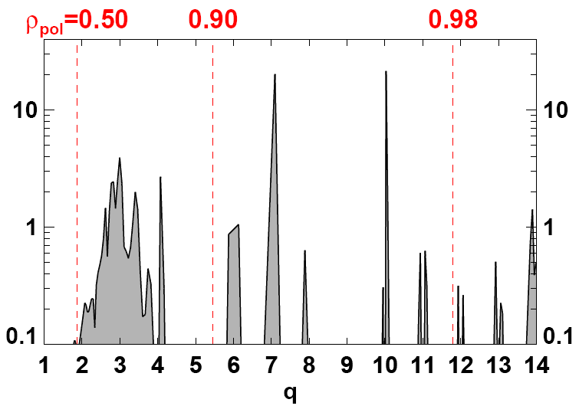
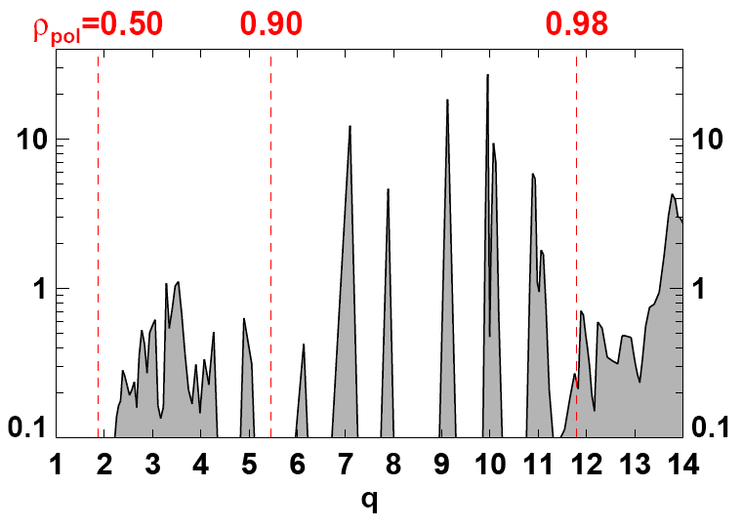
Mode damping in last 10% of minor radius calculated to determine stability of RWM in n=1 EFC experiments
Toroidal + diamagnetic
ω_{E} / ω_{E} (expt) = 0.5 used so unstable modes can be identified and local damping computed
Unstable
rotation
profile
Stable
rotation
profile
Local mode
damping ∝
∂(δW_{K-imag})
∂ V
Higher core damping
Lower core damping
Lower edge damping
Higher edge damping

Slide 20
Kinetic stability analysis using MARS-K
  Comparison with experiment
  Self-consistent vs. perturbative approach
  Modifications of RWM eigenfunction

Slide 21
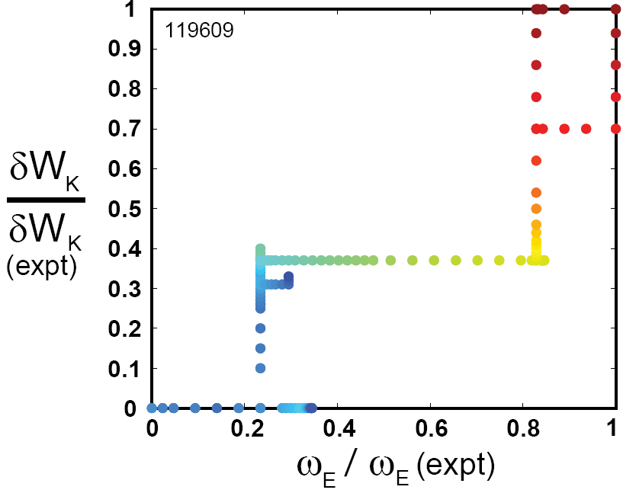
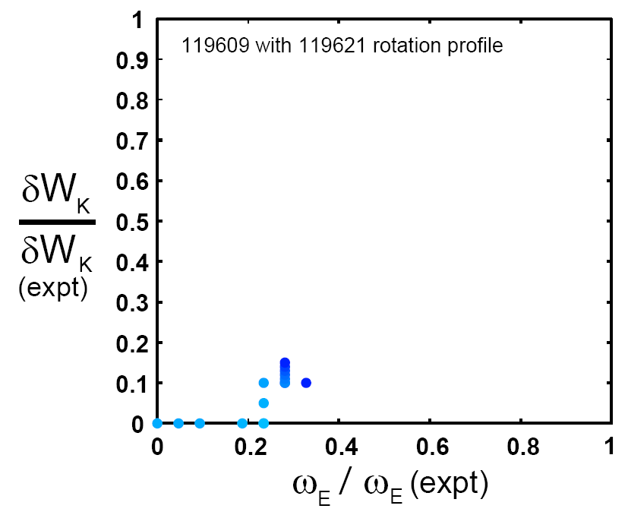
MARS-K consistent with EFC results and MARS-F trends
MARS-K full kinetic δW_{K} → multiple modes can be present
  Mode identification and eigenvalue tracking more challenging
Track roots by scanning fractions of experimental ω_{E} and δW_{K}:
Experimentally
unstable case
stable
unstable
Experimentally
stable case
Kinetic
Kinetic
β_{N}=4.9
Mode remains unstable even at high rotation
Mode stabilized at low rotation and small fraction of δW_{K}
Fluid
Fluid

Slide 22
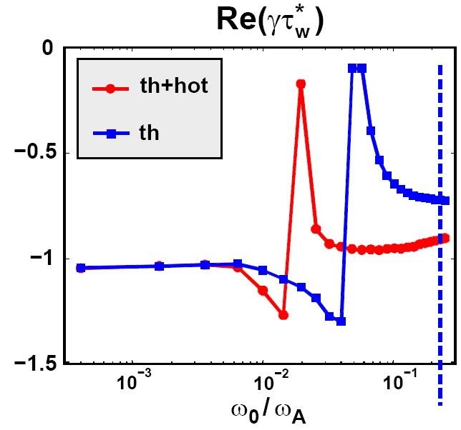
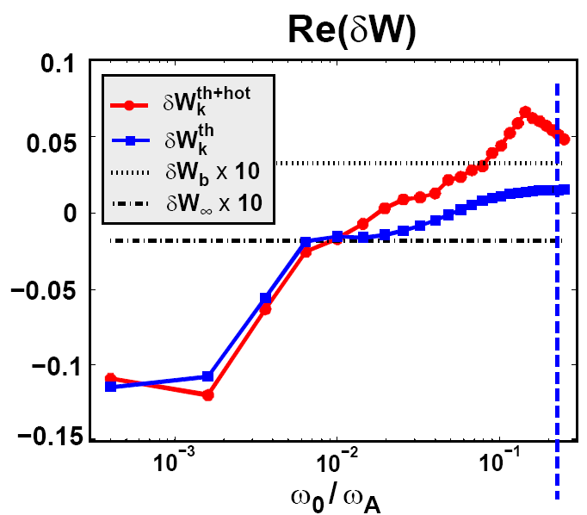
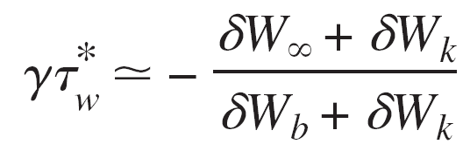
Perturbative approach predicts unstable case to be stable → inconsistent with self-consistent treatment and experiment
Perturbative approach uses marginally unstable fluid eigenfunction at zero rotation in limit of no kinetic dissipation
For cases treated here, |δW_{K}| can be >> |δW| and |δW_{b}|
  Possibility that rotation/dissipation can modify eigenfunction & stability
Experimentally unstable case
Perturbative kinetic RWM stable for all rotation values
Experimental
rotation
Experimental
rotation

Slide 23
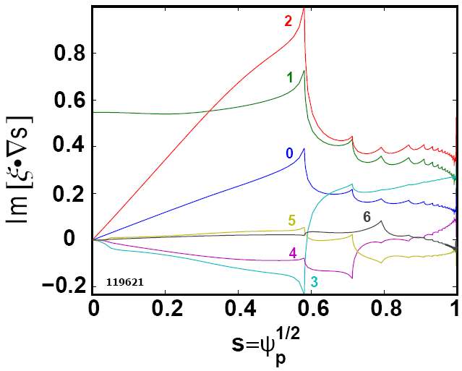
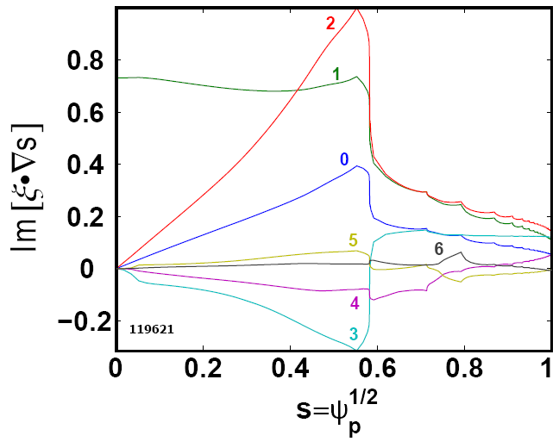


MARS-K self-consistent calculations for stable case indicate modifications to eigenfunction begin to occur at low rotation
Fluid
Self-
consistent
Experimentally stable
Self-consistent (SC) eigenfunction qualitatively similar to fluid eigenfunction in plasma core
SC RWM ⊥ amplitude reduced at larger r/a
  Low ω_{E} / ω_{E} (expt) = 0.3%, δW_{K}/δW_{K} (expt) = 12%
  Reduced amplitude could reduce dissipation, stability

Slide 24
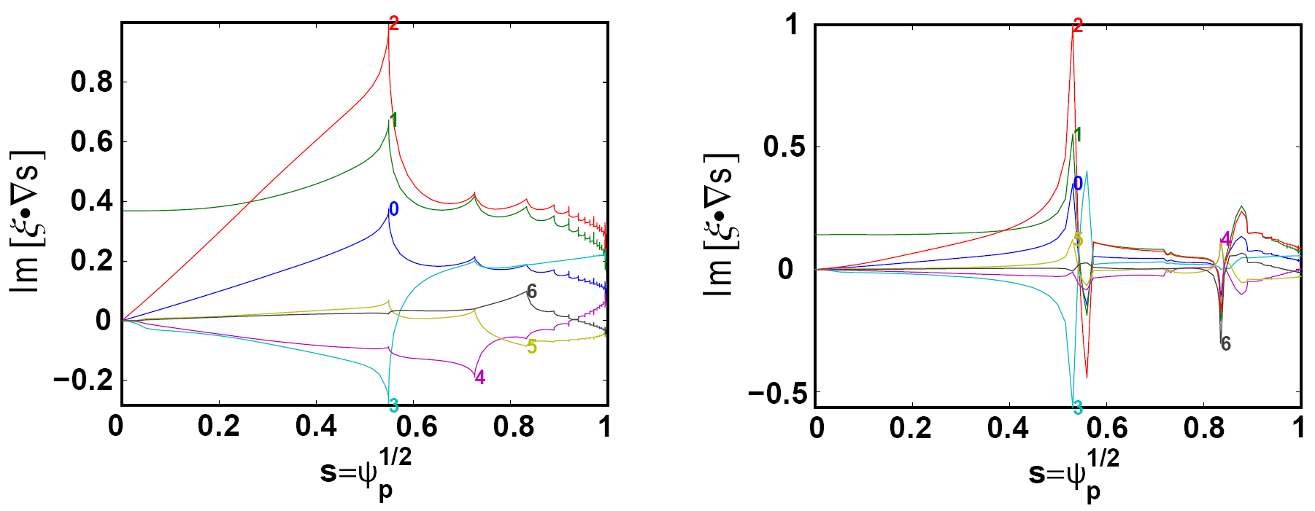


MARS-K self-consistent calculations indicate expt. rotation and dissipation can strongly modify RWM eigenfunction
Fluid
Self-
consistent
Experimentally unstable
Self-consistent (SC) eigenfunction shape differs from fluid eigenfunction in plasma core
SC RWM ξ⊥ substantially different at larger r/a
  Moderate ω_{E} / ω_{E} (expt) = 22%, δW_{K}/δW_{K} (expt) = 37%
  Differences could be even larger at full rotation and δW_{K}
  Does reduced edge ξ⊥ amplitude explain reduced stability?

Slide 25
Summary
Edge rotation (q ≥ 4, r/a ≥ 0.8) important for RWM
  Trends consistent with stability calculations using MARS-F
  Provides insight, method for optimal error field correction
Stability quite sensitive to edge ω_{E} profile
  Essential to include accurate edge ∇p in E_{r} profile
  Poloidal rotation can also influence marginal stability
Full kinetic stability (MARS-K) consistent w/ experiment
Perturbative treatment inconsistent – overly stable
  Edge eigenfunction strongly modified by rotation/dissipation
  Reduction in ξ⊥ amplitude may reduce kinetic stabilization

