Slide 1





NSTX-U
Supported by
Structure, Amplitude and Identification of CAEs and GAEs in NSTX
Neal A. Crocker
E. Belova, E. D. Fredrickson, N. N. Gorelenkov,
W. A. Peebles, S. Kubota, R. E. Bell, B. P. LeBlanc,
J. E. Menard, M. Podestà, K. Tritz and H. Yuh
Coll of Wm & Mary
Columbia U
CompX
General Atomics
FIU
INL
Johns Hopkins U
LANL
LLNL
Lodestar
MIT
Lehigh U
Nova Photonics
ORNL
PPPL
Princeton U
Purdue U
SNL
Think Tank, Inc.
UC Davis
UC Irvine
UCLA
UCSD
U Colorado
U Illinois
U Maryland
U Rochester
U Tennessee
U Tulsa
U Washington
U Wisconsin
X Science LLC
Culham Sci Ctr
York U
Chubu U
Fukui U
Hiroshima U
Hyogo U
Kyoto U
Kyushu U
Kyushu Tokai U
NIFS
Niigata U
U Tokyo
JAEA
Inst for Nucl Res, Kiev
Ioffe Inst
TRINITI
Chonbuk Natl U
NFRI
KAIST
POSTECH
Seoul Natl U
ASIPP
CIEMAT
FOM Inst DIFFER
ENEA, Frascati
CEA, Cadarache
IPP, Jülich
IPP, Garching
ASCR, Czech Rep
54th Annual Meeting of the APS Div. of Plasma Physics
October 29 - November 2, 2012
Providence, Rhode Island

Slide 2
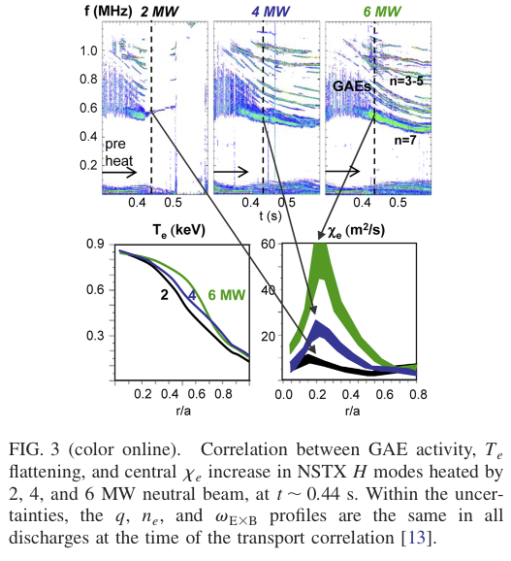
Observed χ_{e} enhancement motivates measurement and identification of high frequency AEs
Beam-ion-excited high frequency Alfvén Eigenmodes (AE) correlate with enhanced core χ_{e}
  posited cause: resonant interaction of
  multiple modes with electron
High frequency AE structure
measured with reflectometer array
  Measurements reveal two kinds of mode
Local dispersion relations help
identify modes
  Two kinds of mode are CAEs and GAEs
Measurements consistent with
transport hypothesis
[N. N. Gorelenkov et al., Nucl. Fusion 50, 084012 (2010)]
[D. Stutman et al., PRL 102 115002 (2009)]

Slide 3
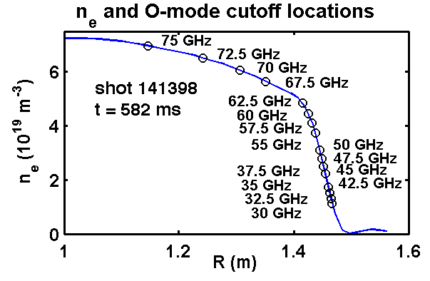
AE radial structure measured with array of reflectometers
magnetic axis
Reflectometer measures path length change (δL) of microwaves reflected from plasma
  Microwaves reach cutoff at ω² = ω_{p}² = e²n₀/ε₀m_{e}
For large scale modes, cutoff displaces due to δn at cutoff ⇒
“effective displacement” ξ ≡ δL/2 approximates cutoff displacement

Slide 4
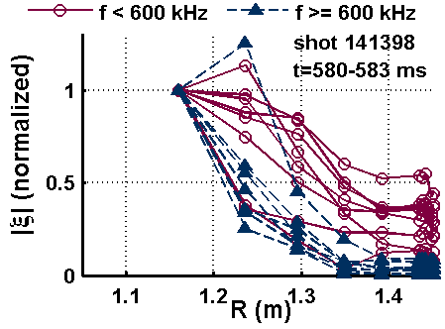
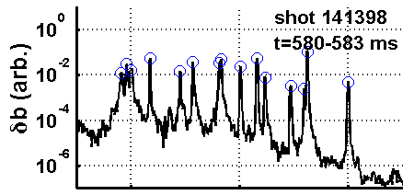
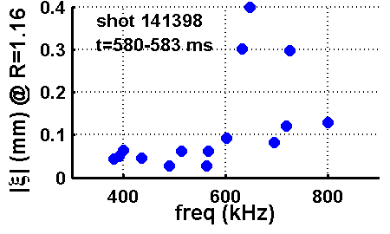
Measurements reveal two kinds of high frequency AEs
Structure measured with
reflectometer array
Toroidal mode number (n) measured
with edge δb toroidal array
Structures tend to fall in two categories:
  broad structure, peaking toward core
    mostly f < ~ 600 kHz, n = -6 – -8
  strongly core localized
    mostly f > ~ 600 kHz, n = -3 – -5

Slide 5
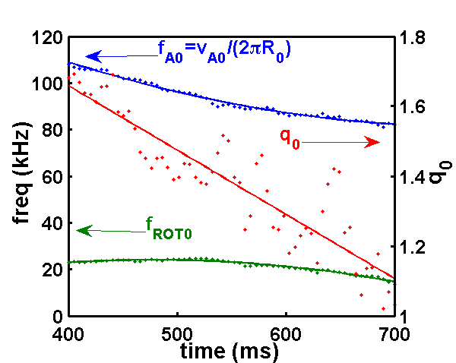
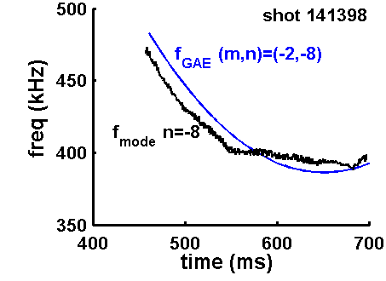
Broad structure (f < ~ 600 kHz) modes are GAEs
GAEs are shear Alfvén:
  peak at weak shear, e.g. at axis
Strong q₀ variation ⇒ comparison
with f_{GAE}(t) stringent test of identity
  Fit to f_{GAE}(t) ⇒ m
  f_{GAE}(t) sensitive to m/q if |m| >> 1
  q₀ varies substantially (1.7 – 1.1)
  over t = 400 – 700 ms
Modes with f < ~ 600 kHz:
f(t) ~ f_{GAE} (t)
  Modes with f > ~ 600 kHz:
  f(t) NOT consistent with f_{GAE}(t)
Equilibrium trends
q₀
For “GAEs”, f_{GAE} predicts f_{mode} well

Slide 6
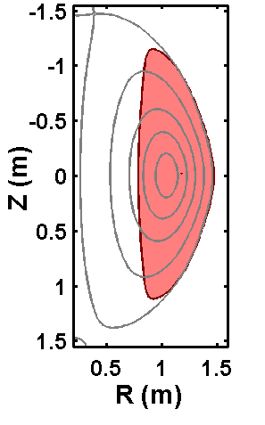
Strongly core localized modes are CAEs
Compressional Alfvén waves propagate ONLY where:
“Well” formed in R–Z plane
CAE must fit inside “well”
  V ⇒ R-Z “wavelength”:
Well width & λ_{R-Z} compared
  λ_{R-Z} calculated at deepest point in well
  Width (ΔR) determined in midplane
  Toroidal Doppler shift taken into account
Modes with f > ~ 600 kHz: ”well” is sufficiently deep
  Modes with f < ~ 600 kHz: no “well”, or “well” too shallow
CAE “well”
f = 633 kHz, n = -4 (shot 141398, t = 582 ms)
V < 0

Slide 7
Measurements consistent with
ORBIT modeling prediction for enhanced χ_{e}
ORBIT modeling ⇒ χ_{e} enhancement due to resonant electron interaction with multiple modes
    [N. N. Gorelenkov et al., Nucl. Fusion 50, 084012 (2010)]
  total fluctuation level needed to explain χ_{e} ehancement:
  α = δA||/B₀R₀ = 4 x 10⁻⁴
  threshold at ~ 15 modes
For GAEs, α = 3.4 x 10⁻⁴ in core, consistent with prediction
  for shear Alvén modes: ξ_{r} = δB_{r}/ik||B₀ = αR₀kθ/k||
  ξ_{r} estimated by reflectomter |ξ| @ R = 1.16 m
  k|| & kθ estimated using shear dispersion relation
Number of modes (including CAEs) is 15, consistent with prediction

Slide 8
Summary
Observed χ_{e} enhancement motivates measurement and identification of high frequency AEs
Measurements reveal two kinds of mode
  broad structure, mostly f < ~ 600 kHz, n = -6 – -8
  strongly core localized, mostly f > ~ 600 kHz, n = -3 – -5
Local dispersion relations help identify modes
  broad structure modes are GAEs
  strongly core localized modes are CAEs
Amplitude and number of modes consistent with hypothesis for χ_{e} enhancement, resonant interaction with multiple modes.
Future Work
Use measurements to guide ORBIT modeling to predict χ_{e}
(K. Tritz, GO6.00004)
Validate simulations of HYM code (E. Belova, PP8.00022)

Slide 9
Backup Slides

Slide 10
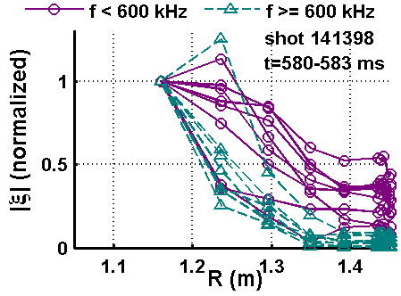
Overview
Motivation: beam-ion-excited high frequency Alfvén Eigenmodes (AE) correlate with enhanced core χ_{e}
[D. Stutman et al., PRL 102 115002 (2009)]
  posited cause: resonant interaction in presence of multiple modes
Structure measurements:
high frequency AE structure
measured with reflectometer array
  Measurements reveal two kinds of mode
Identification analysis: local dispersion
relations used with f & n to identify modes
  Two kinds of mode are CAEs (f > ~ 600 kHz) and GAEs (f < ~ 600 kHz)
Comparison with transport hypothesis:
[N. N. Gorelenkov et al., Nucl. Fusion 50, 084012 (2010)]
  Amplitude and number of modes consistent with posited cause of enhanced core electron thermal transport

Slide 11
High frequency AEs proposed as cause of observed χ_{e} enhancement [D. Stutman et al., PRL 102 115002 (2009)]
high f AE activity in core of NSTX beam-heated plasmas – correlates with enhanced χ_{e}
f ~ f_{be} ~ 600 kHz ⇒ resonant orbit
modification
  f_{be} ≡ trapped electron bounce frequency
High f AEs identified as GAEs
GAE core localization expected ⇒
active in region of enhanced χ_{e}
Orbit modeling ⇒
significant χ_{e} enhancement
from multiple modes
  [N. N. Gorelenkov et al., Nucl. Fusion 50, 084012 (2010)]
  threshold at ~ 15 modes

Slide 12
AE radial structure measured with array of reflectometers
Reflectometer measures path length change of microwaves reflected from plasma
  Microwaves propagate to “cutoff” layer, where density high enough for reflection (ω² = ω_{p}² = e²n₀/ε₀m_{e})
for large scale modes, cutoff displaces due to δn at cutoff ⇒
“effective displacement” ξ ≡ δφ/2k_{vac} approximates cutoff displacement
  δφ = phase between reflected and launched waves changes
Two arrays of reflectometers:
  Q-band: 8 channels — 30–50 GHz
  V-band: 8 channels — 55–75 GHz
Cutoffs span large radial range
in high density plasmas
(n₀ ~ 1 – 7 x 10¹⁹ m⁻³)

Slide 13
Measurements reveal two kinds of high frequency AEs in H-mode beam-heated plasmas
Effective displacement (ξ) measured at
16 radii with reflectometer array
  shear AEs: ξ dominated by displacement of ∇n₀
  compressional AEs: compressional δn
  contributes to ξ
Toroidal mode number (n) measured with
δb_{θ} edge toroidal array
  12 locations, irregular spacing (Δφ)
  10° ≤ Δφ ≤ 180° ⇒ resolves |n| ≤ 18
Modes structures tend to fall in two categories:
  broad structure, peaking toward core
  with significant edge |ξ|
    mostly f < ~ 600 kHz, n = -6 – -8
    typically larger core |ξ| & larger edge δb
  (2) strongly core localized, vanishing edge |ξ|
    mostly f > ~ 600 kHz, n = -3 – -5
    typically larger larger core |ξ| &
    smaller edge δb

Slide 14
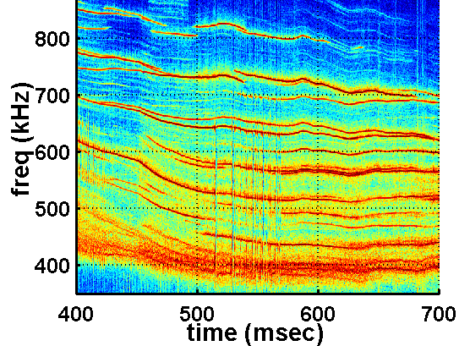
Modes can be identified as CAEs or GAEs via mode number and frequency evolution
Dispersion relation parameters measured:
  q₀ and B₀ from equilibrium reconstruction using magnetic field pitch from Motional Start Effect
  n_{e0} measured via Multipoint Thomson Scattering
  Alfvén velocity, v_{A0} = B₀/(μ₀ρ₀)^{½}
    ρ₀=m_{D}n_{e0,} m_{D}=Deuterium mass
  Toroidal rotation frequency, f_{ROT0}, from Charge Exchange Recombination Spectroscopy
For GAEs, expect f(t) consistent with local shear Alfvén dispersion relation, but not CAEs
Expect CAEs to fit in CAE “well”, but not GAEs
  compressional Alfvén waves propagate ONLY where:
  “wavelength” in R-Z plane must fit inside “well”
AE frequency evolution
δb
141398
n=−3
n=−3
n=−4
n=−8
Equilibrium trends
q₀

Slide 15
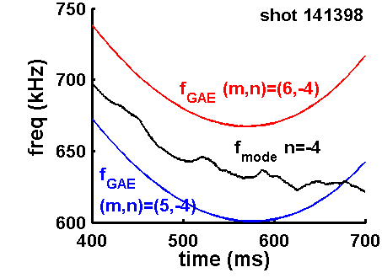
Sensitivity of f_{GAE} to q₀ helps distinguish CAEs & GAEs
For “GAEs”, f_{GAE} predicts f_{mode} well
GAEs are shear Alfvén:
f_{GAE}(t) sensitive to m/q₀ if |m| >> 1
q₀ varies substantially (1.7 – 1.1) over
t = 400 – 700 ms
Modes with f < ~ 600 kHz, n = -6 – -8:
f(t) ~ f_{GAE} (t)
  |n| >> 1 ⇒ low |m| ⇒ f_{GAE}
  insensitive to q₀
Modes with f > ~ 600 kHz, n = -3 – -5:
f(t) NOT consistent with f_{GAE}(t)
  low |n|, high f ⇒ high |m| ⇒
  strong q₀ sensitivity
For “CAEs”, f_{GAE} predicts f_{mode} poorly

Slide 16
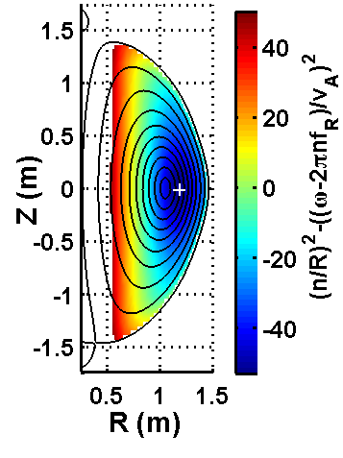

For identification as CAE, sufficiently wide & deep “well” must exist for mode with measured f and n
CAE “well” for f = 633 kHz, n = -4
(shot 141398, t = 582 ms)
For n ≠ 0, compressional Alfvén “well” formed:
  compressional Alfvén waves propagate ONLY where:
CAE “wavelength” in R-Z plane must fit inside “well”
For observed modes, f & n used to determine well
width and λ_{R-Z}
  λ_{R-Z} calculated at deepest point in well
  Width (ΔR) determined in midplane
Modes with f > ~ 600 kHz, n = -3 – -5 sufficiently
wide and deep
Modes with f < ~ 600 kHz, n = -6 – -8 do not fit in “well”
  For some f & n, (n/R)²v_{A}² – (ω-nω_{ROT}) ² > 0 everywhere
  For some f & n, λ_{R-Z} >> ΔR

Slide 17
Amplitude and number of modes consistent with
ORBIT modeling prediction for enhanced χ_{e}
ORBIT modeling indicates significant χ_{e} enhancement due to resonant electron interaction of multiple modes
    [N. N. Gorelenkov et al., Nucl. Fusion 50, 084012 (2010)]
  total fluctuation level needed to explain χ_{e} ehancement:
  α = δA||/B₀R₀ = 4 x 10⁻⁴
    χ_{e} scales strongly with α ⇒ bursty fluctuations give more χ_{e} than would expect from r.m.s α ⇒ should evaluate time dependence carefully
  threshold at ~ 15 modes
For modes with f < 600 kHz, calculated r.m.s. α = 3.4 x 10⁻⁴ in core, consistent with prediction for necessary fluctuation level
  for shear Alvén modes: ξ_{r} = δB_{r}/ik||B₀ = αR₀kθ/k||
  ξ_{r} estimated by reflectomter |ξ| @ R = 1.16 m
  k|| & kθ estimated using f ≈ k||v_{A}/2π + nf_{ROT}, kθ = m/r, k|| = |m/q – n|/R,
  taking q = q₀ and r = 1.16 m – R₀
Number of modes (including CAEs) is 15, consistent with prediction for necessary fluctuation level
Model needed for CAE effect on χ_{e}

Slide 18
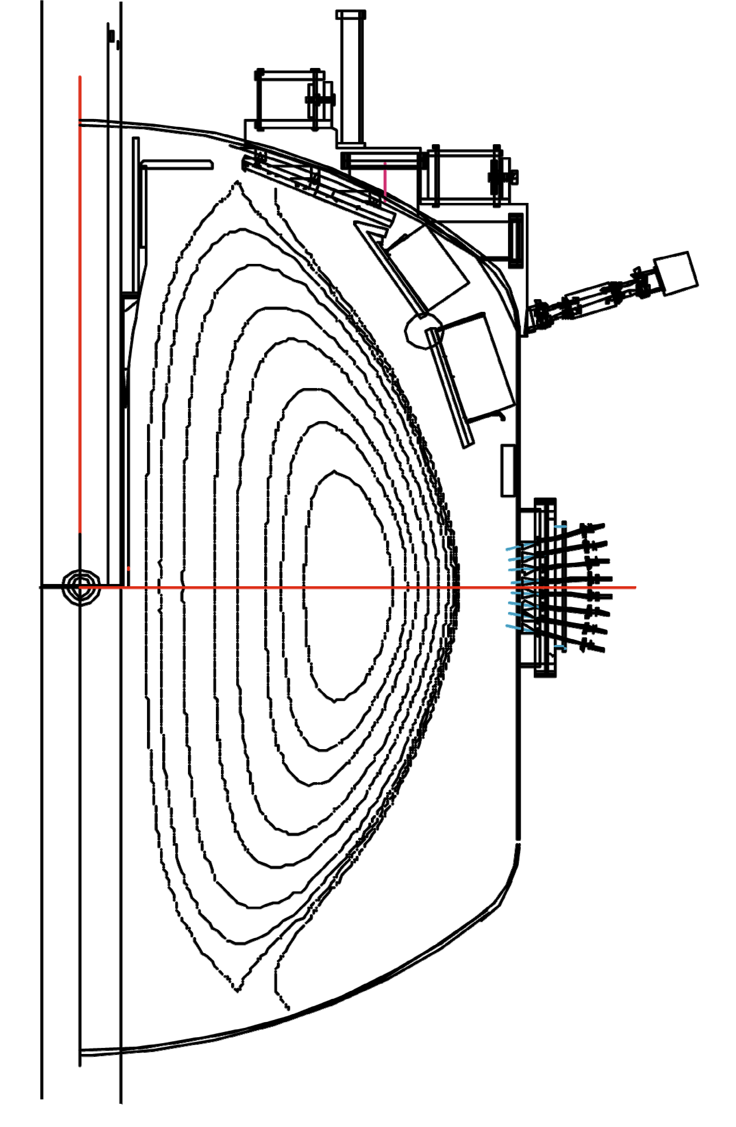
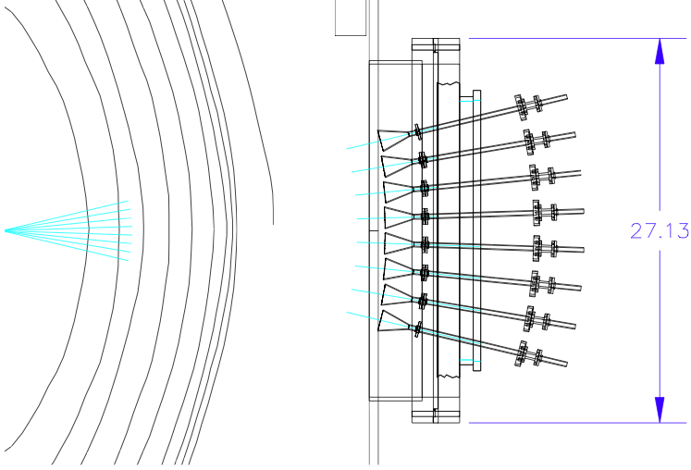
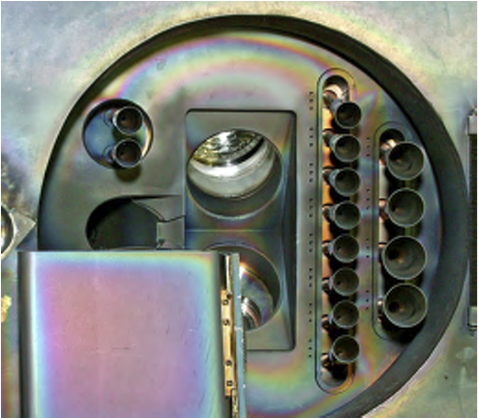
AE radial structure measured with array of reflectometers
NSTX cross-section
Two arrays: “Q-band” & “V-band”
  Q-band: 30, 32.5, 35, 37.5, 42.5, 45, 47.5 & 50 GHz
  V-band: 55, 57.5, 60, 62.5, 67.5, 70, 72.5 & 75 GHz
Arrays closely spaced (separated ~ 10° toroidal)
Single launch and receive horn for each array
Horns oriented perpendicular to flux surfaces ⇒ frequency array = radial array
Cutoffs span large radial range in high density plasmas (n₀ ~ 1 – 7 x 10¹⁹ m⁻³)
Launch and Receive Horns
(Interior View)
30-50 GHz
n_{e} from Multipoint Thomson Scattering
55-75 GHz
(not shown: horns modified to optimize for frequency range)

Slide 19
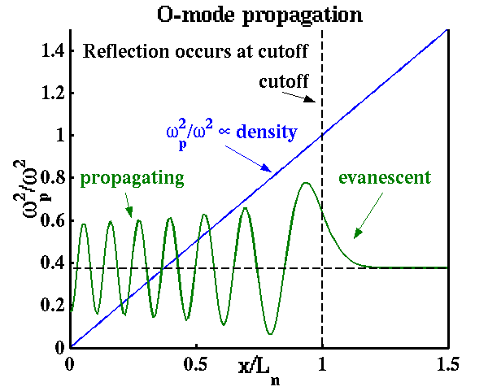
Reflectometers used to measure local AE density fluctuation
Microwaves propagate to “cutoff” layer, where density high enough for reflection (ω_{p} = ω)
  Dispersion relation of “ordinary mode”
  microwaves: ω² = ω_{p}² + c²k²,
  ω_{p}² proportional to density (ω_{p}² = e²n₀/ε₀m_{e})
  k → 0 as ω → ω_{p},
  microwaves reflect at k = 0
Reflectometer measures path length
change of microwaves reflected
from plasma
  phase between reflected and launched waves changes (δφ)
for large scale modes, cutoff displaces due to δn at cutoff ⇒
“effective displacement” ξ ≡ δφ/2k_{vac} approximates cutoff displacement
Microwave (“O-mode”) propagation
electric field

Slide 20
High frequency AEs commonly excited by beam ions in NSTX
High f AEs (f /f_{c0} > ~ 0.2) commonly observed in NSTX with reflectometers & edge δb
Excited by Doppler-shifted resonance
with beam ions
  Edge δb_{θ} toroidal array typically shows
  |n| < ~ 15, propagation counter to
  beam ions (n < 0 )
High f AE activity correlated with
enhanced χ_{e}
Other significant effects on plasma
  shown to cause fast-ion transport
  postulated to cause ion heating
f_{c0} = 2.4 MHz
δb
141398

Slide 21
Future Work
Extend ORBIT modeling to include CAEs in prediction of χ_{e} enhancement
Use mode structure measurements to guide inputs to ORBIT modeling
Investigate effects of CAEs and GAEs on fast-ion transport using ORBIT modeling with measured mode structures
Compare CAE/GAE amplitude and structure measurements with theory predicting ion heating

Slide 22
Future Work
Use mode structure measurements to guide inputs to ORBIT modeling
  see GO6.00004: “Investigation of CAE/GAE-induced electron thermal transport for NSTX-U”, K. Tritz
Validate CAE/GAE simulations of HYM (HYbrid kinetic and MHD) code
  see PP8.00022: “Numerical Simulations of NBI-driven CAE modes in H-mode Discharges in NSTX”, E. Belova

