Slide 1
Progress in Nonsolenoidal Startup via Local Helicity Injection in the Pegasus Experiment
R.J. Fonck, J. Barr, M. Bongard, M. G. Burke,
E. Hinson, J. Perry, A. Redd, D. Schlossberg, N. Schoenbeck, P. Shriwise, K. Thome
Department of Engineering Physics
University of Wisconsin-Madison, USA
54th Annual Meeting of APS
Division of Plasma Physics
October 29 – November 2, 2012
Providence, RI

Slide 2
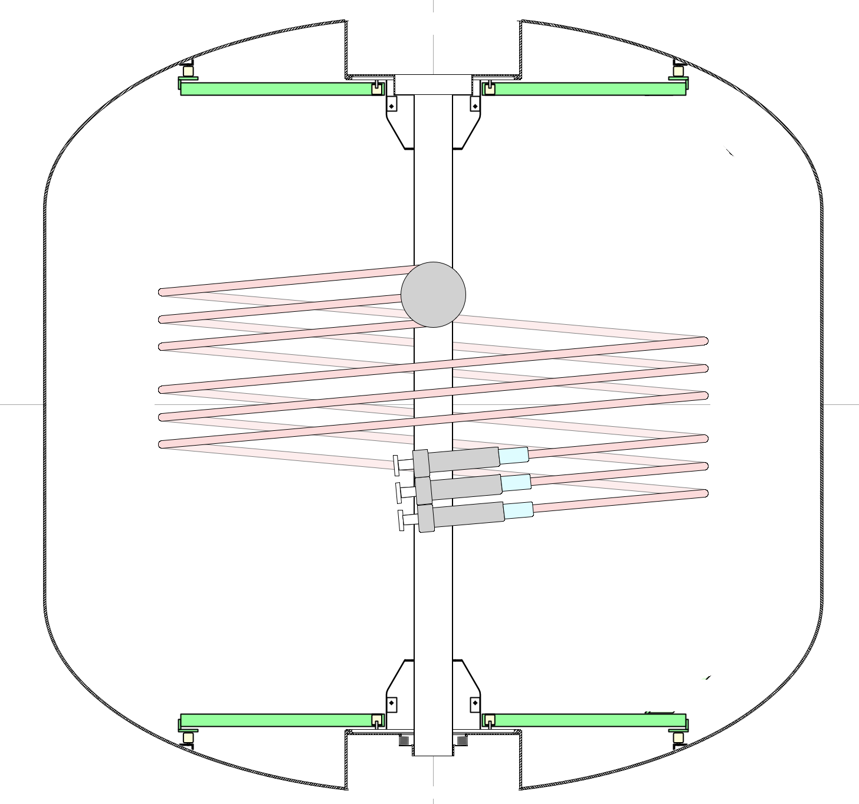
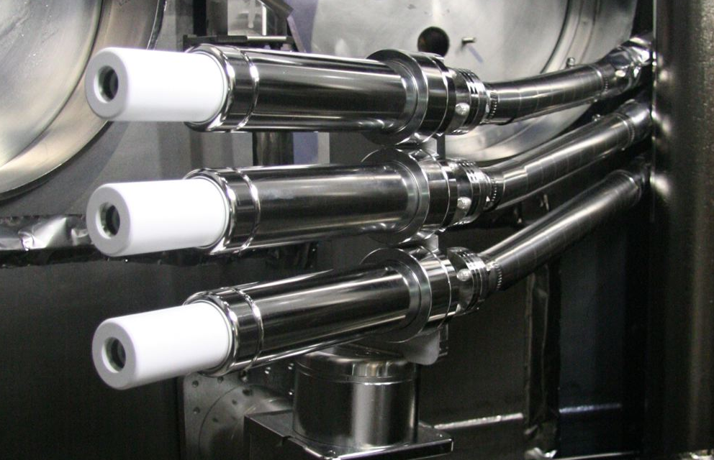
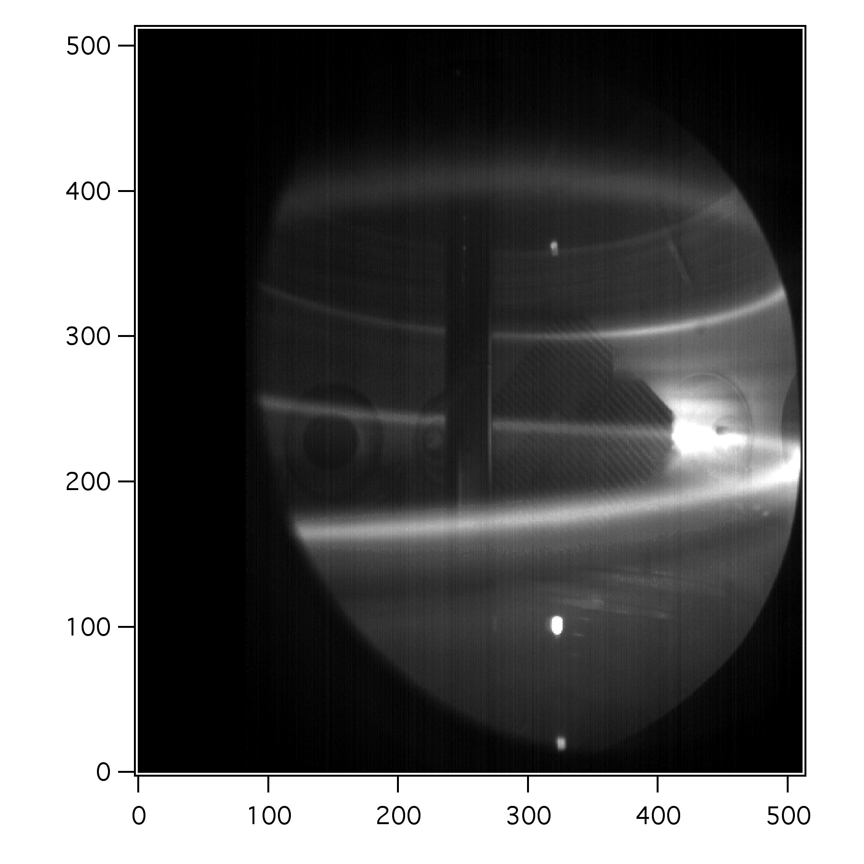
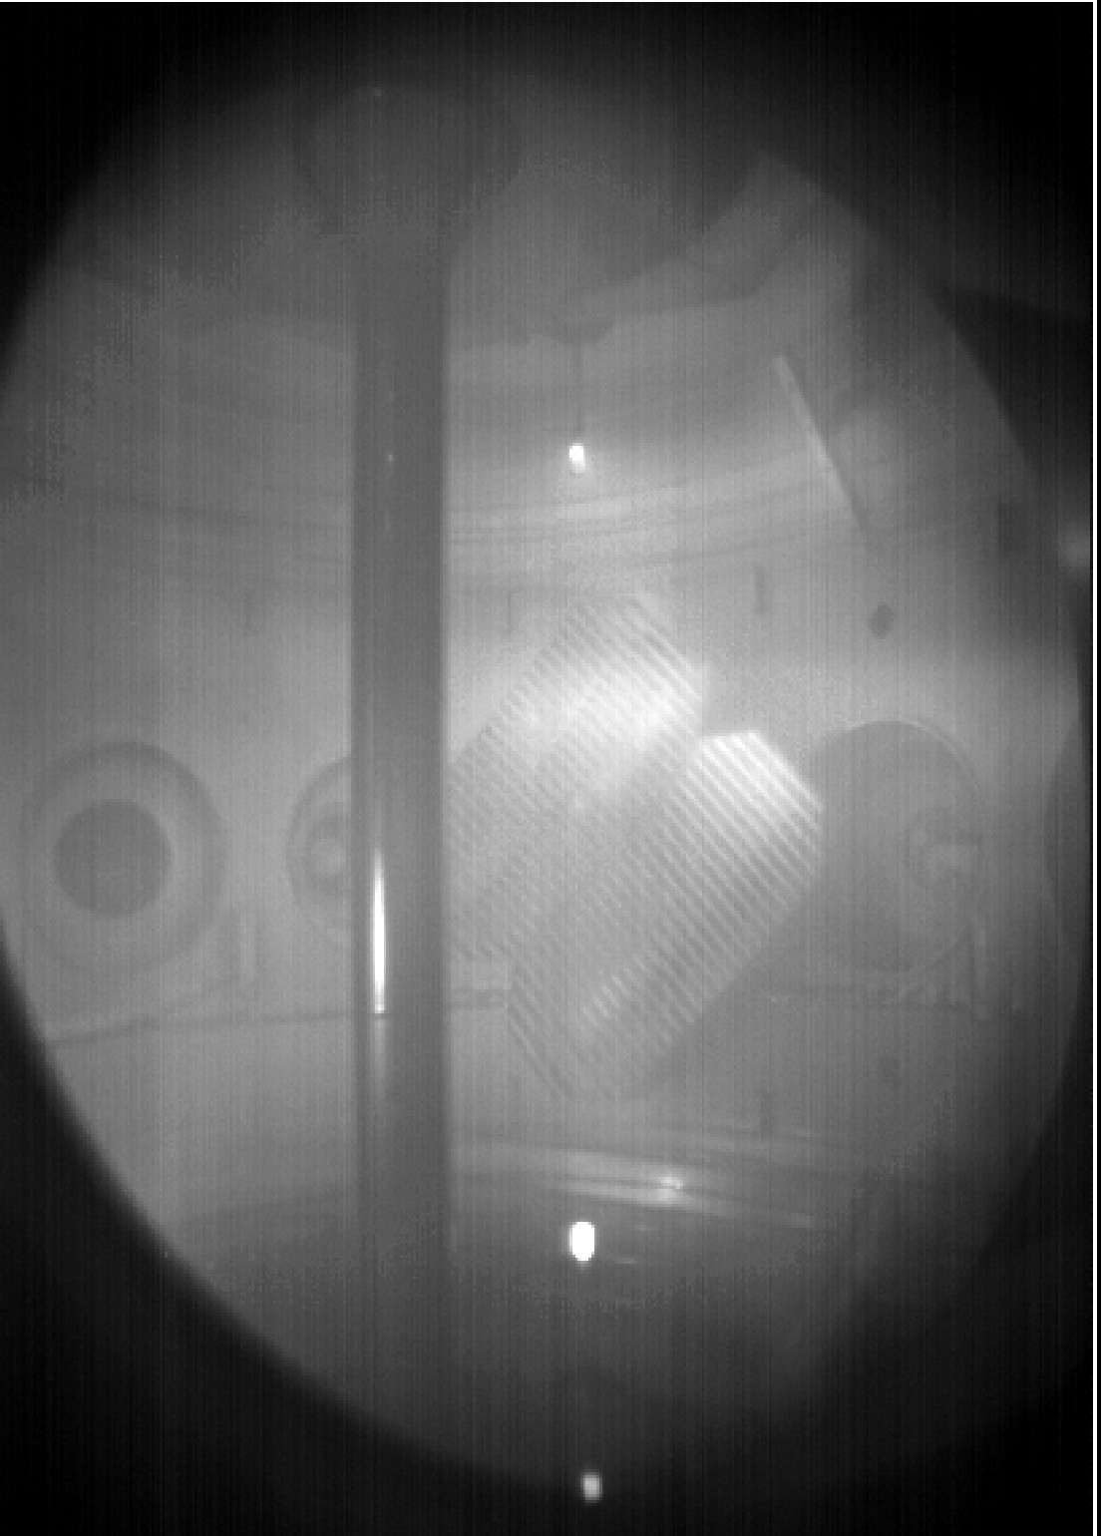
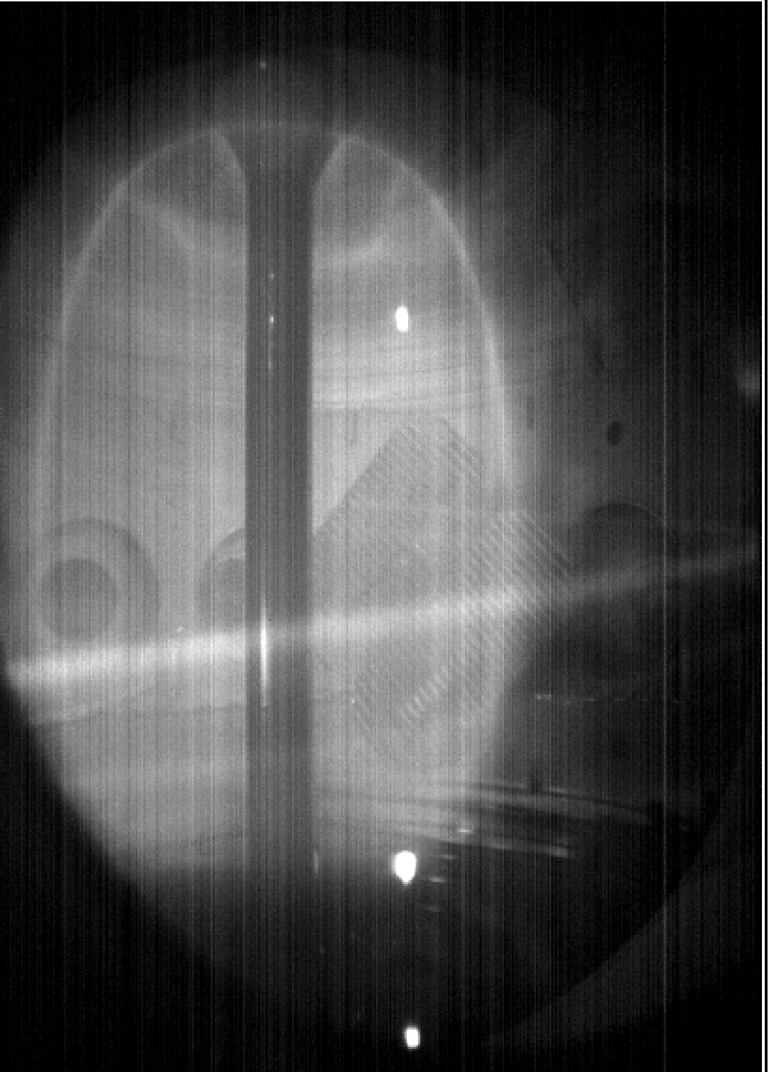
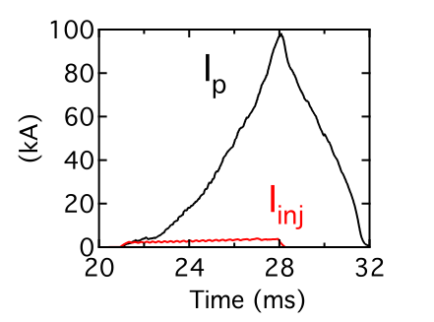
Local Helicity Injection uses LFS Injection Plus Poloidal Induction for ST Startup
Flexible injector geometry
Startup sequence:
  PF field weakened by current streams
  Relaxation to tokamak-like state
  Rapid inward expansion and growth in I_{p} at low A
  Poloidal field induction adds to current growth
  Goal:0.3 MA non-solenoidal I_{p}
  To extrapolate to next level/NSTX-U
  Issues: j_{edge}, Z_{inj}, confinement, injector technology, etc.
Anode
Plasma streams
3 plasma guns
Pegasus shot #40458: two midplane guns, outer-PF ramp
I_{p}=2-3 kA
Filaments only
I_{p}=42 kA
Driven plasma
I_{p}=37 kA
Guns off
Decaying

Slide 3
Local Helicity Injection Offers Scalable Nonsolenoidal Startup
Inject Helicity for I_{p} startup using electron current source at the tokamak plasma edge
  Helicity balance via resistive dissipation losses:
  Max I_{p} via relaxation to Taylor (constant λ) state:
Maximizing I_{p} requires:
  Large helicity input rate: High A_{inj}, V_{inj}
  High relaxation limit: High I_{inj}, & B_{TF}, low w
A_{p} Plasma area
C_{p} Plasma circumference
Ψ_{T} Plasma toroidal flux
w Edge current channel width

Slide 4
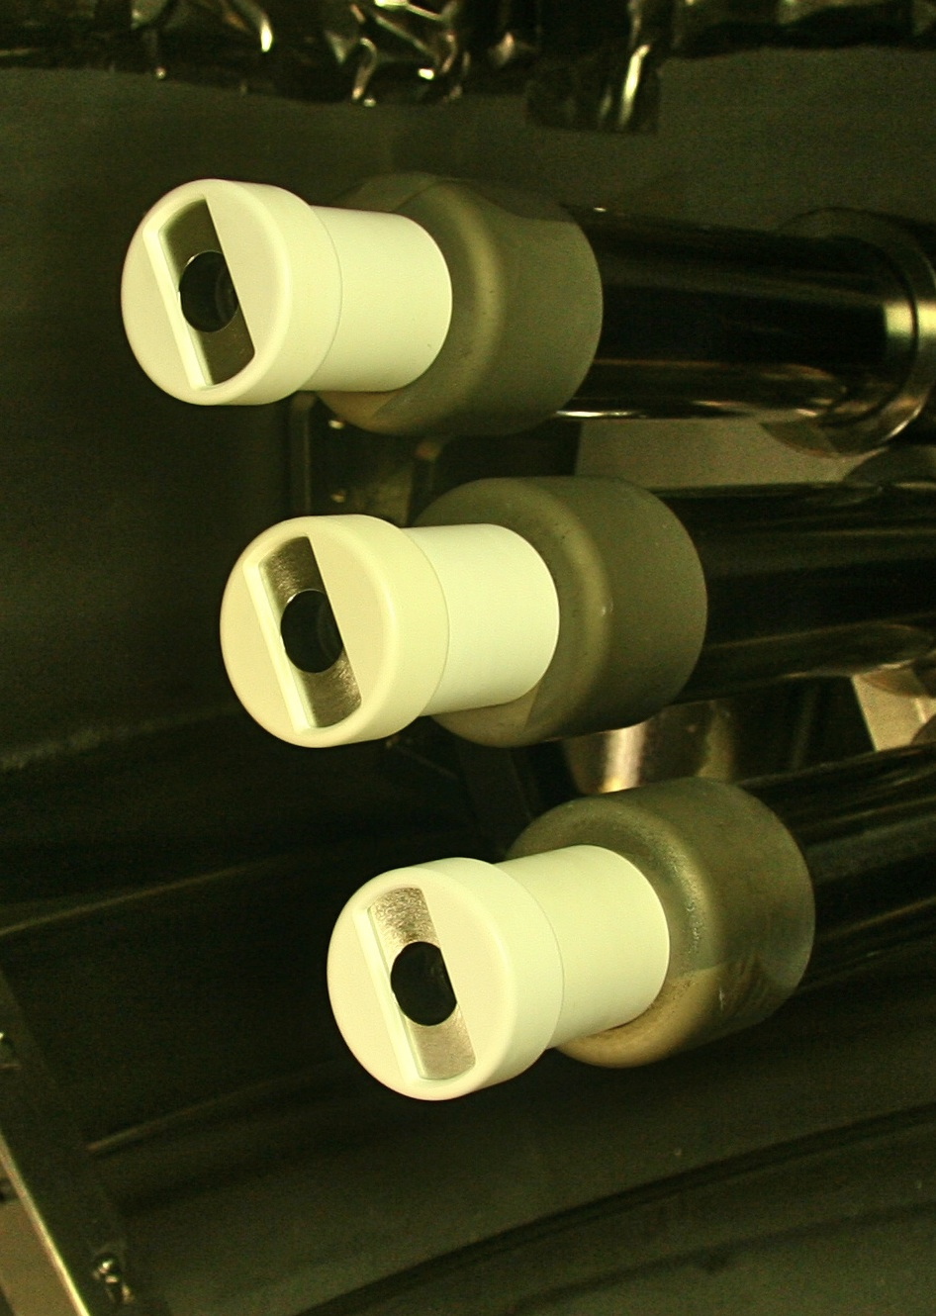
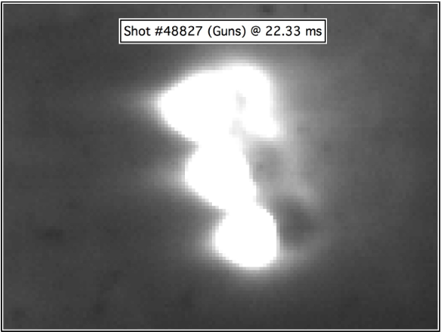
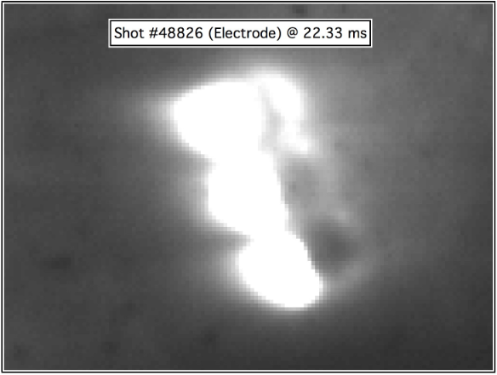
Exploring Passive Injectors to Increase Area for Higher Helicity Injection Rates
Mitigate cost/complexity of producing high electron current: passive current sources?
  Step 1: Form tokamak-like state with active arc gun
    I_{inj} ~ 2-4 kA; A_{inj} ~ 4-6 cm²
  Step 2: Increase I_{p} via electrodes in edge plasma
    I_{inj} ~ 12 kA; A_{inj} ~ 60 cm²
First tests are promising
  Arc current off after relaxation to tokamak-like state
  I_{p}(t) is the same

Slide 5
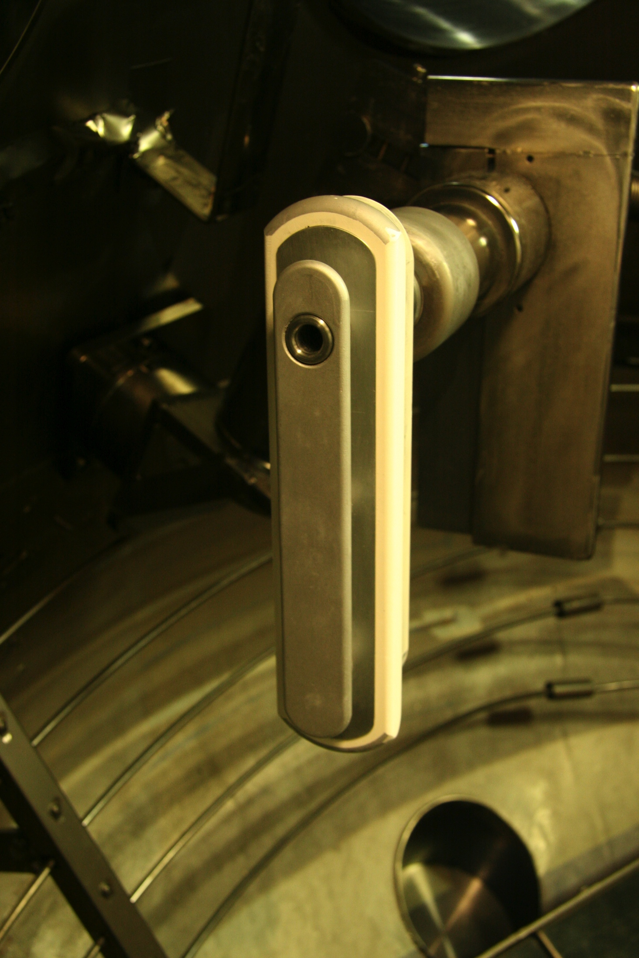

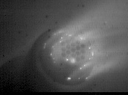
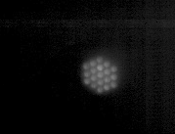
Gas-Fed, Large-Area Electrode May Mitigate Requirement for Arc Sources
Need to spread I_{inj} across large area
  Effective area of metallic electrode = small → low HI rate
Gas-fed hollow cathode electrode to provide required large-area source of charge carriers
  In edge of tokamak plasma
Small cathode spots emit current from simple metallic electrode
Single arc source with integrated large-area passive electrode
I_{inj} = 2 kA
I_{inj} = 0.5 kA
  Perforated electrode (no plasma arc) with beveled edge to avoid electrode-BN arcing

Slide 6
Predictive Impedance Models Required to Project to Future Startup Systems
Injector impedance couples Helicity and Relaxation limits
  Defines power requirements
Double-sheath space-charge limits I_{inj} at low I_{inj}, V_{inj}
Magnetic current limit at high I_{inj} > I_{A} and V_{inj} > 10 kT_{e}/e
  For uniform current density
  Sheath expansion can also contribute here
So far, implies impedance dominated by local processes
  Influence of background plasma not clear

Slide 7
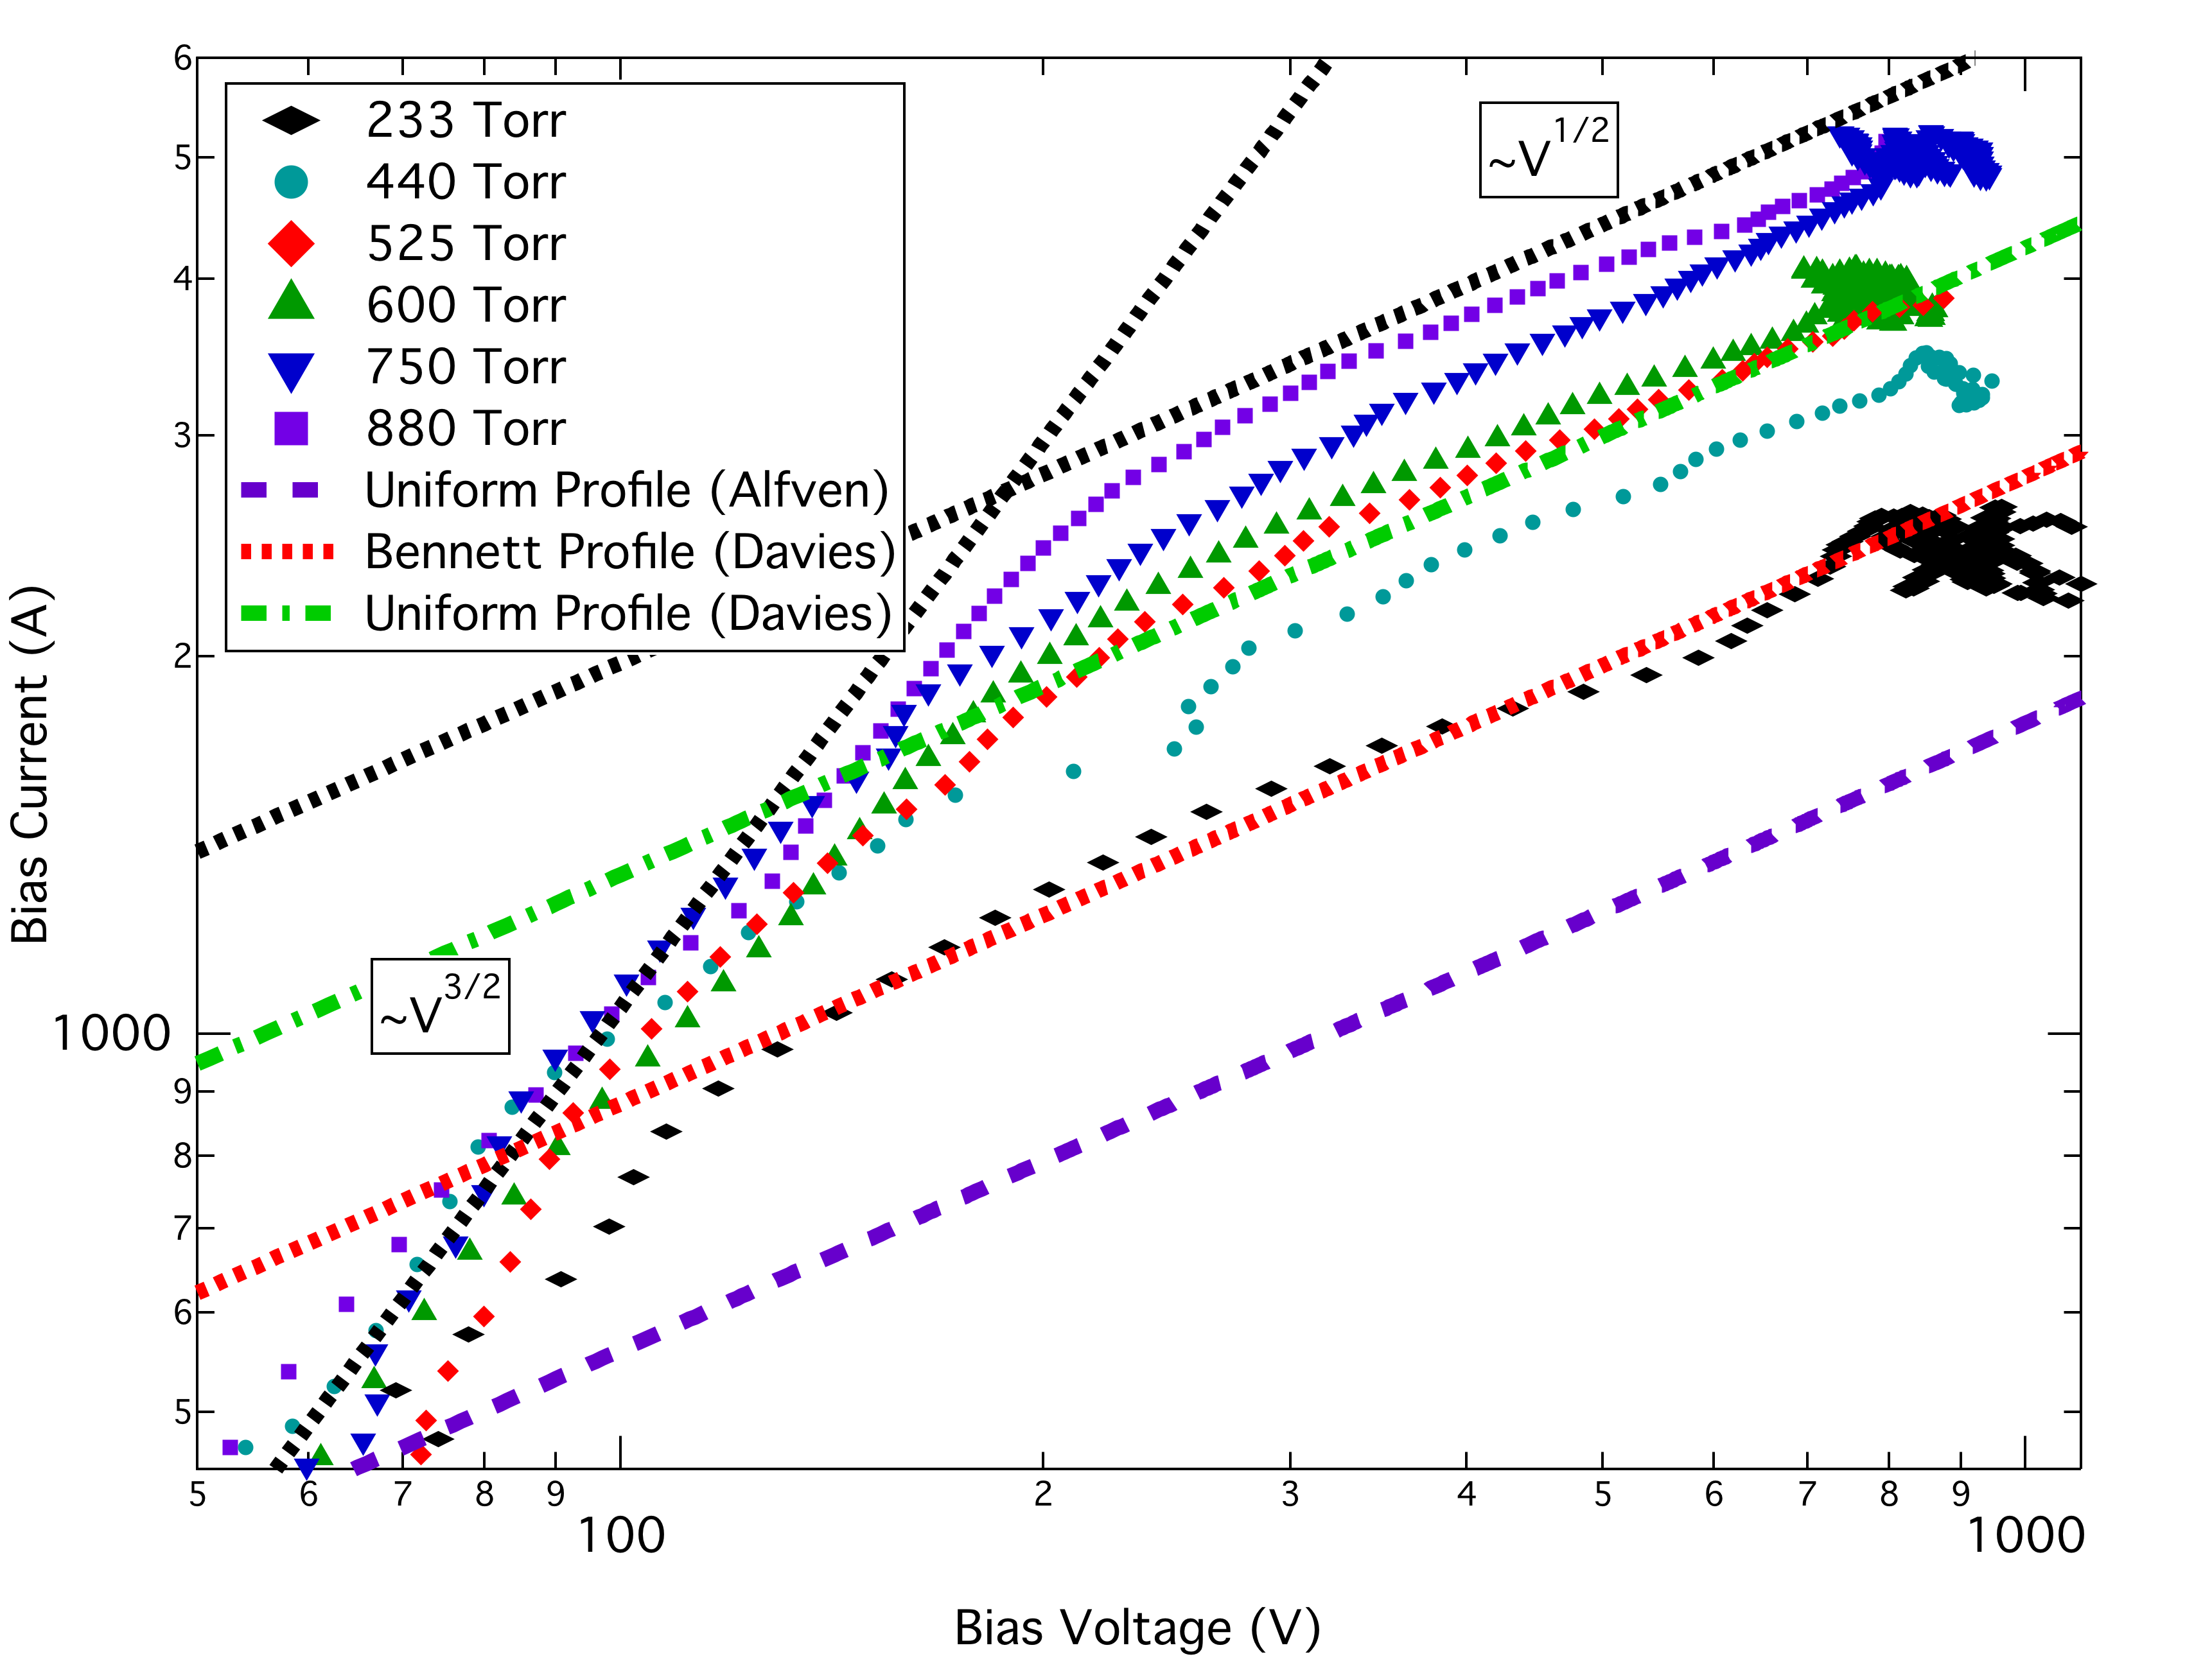
Magnitude, Scaling of Data Consistent with Sheath and Magnetic limits
Magnetic limit is expected at currents of order I_{A}
Suggests current profile is changing with density
E.T. Hinson, APS-DPP Meeting 2012, Oct 29-Nov 2, 2012

Slide 8
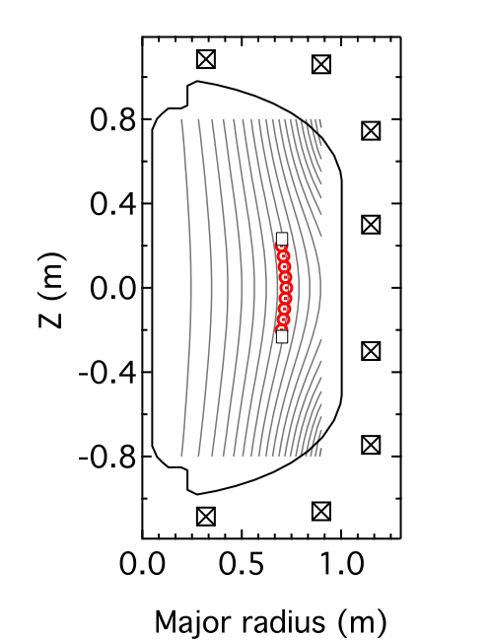
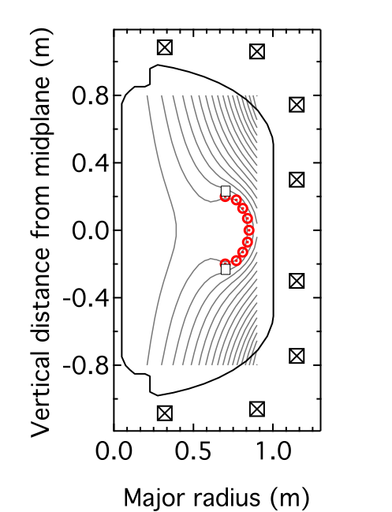
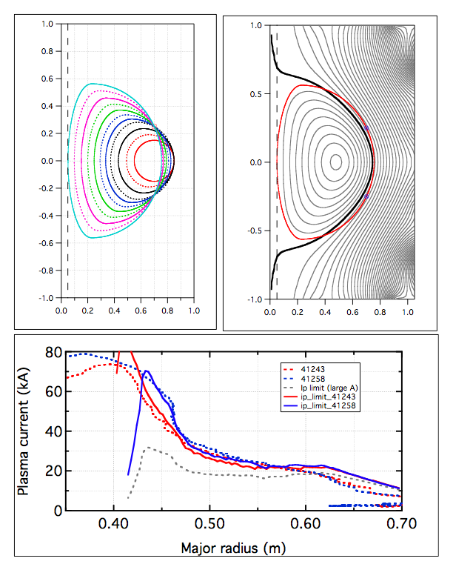

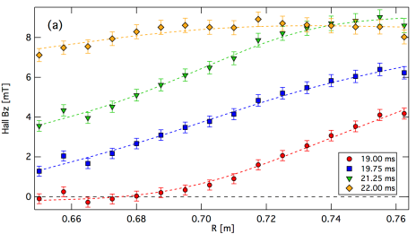
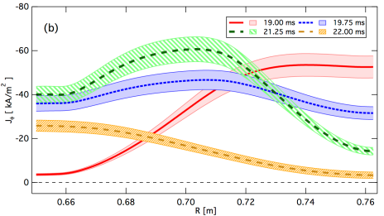
HI Physics: Poloidal Null Formation During Relation to Tokamak Verified
(a) B_{z}(R,t) shows expected* poloidal null formation
(b) J_{T}(R,t) shows core current buildup
  Plasma moves inward (red -> green)
  J = typical peaked tokamak profile after detachment (yellow)
Anode
Anode
Gun
Plasma guns
I_{φ} = 0 A
I_{φ} = 4 kA
*D. J. Battaglia, et al., Nucl. Fusion, 51, 073029, 2011
!

Slide 9
HI Physics: n=1 Mode Correlates with Rise in Plasma Current
Bursty and continuous n=1 mode coincident with rises in I_{p}
  Similar to that seen in HI-driven spheromaks and tokamaks
  n=1 MHD power peaked at 16 kHz
Power peaked at current injector radius
  From internal B_{z}(R,t) measures
Toroidally asymmetric
  Follows injector location
  Tentatively: line-tied kink mode

Slide 10
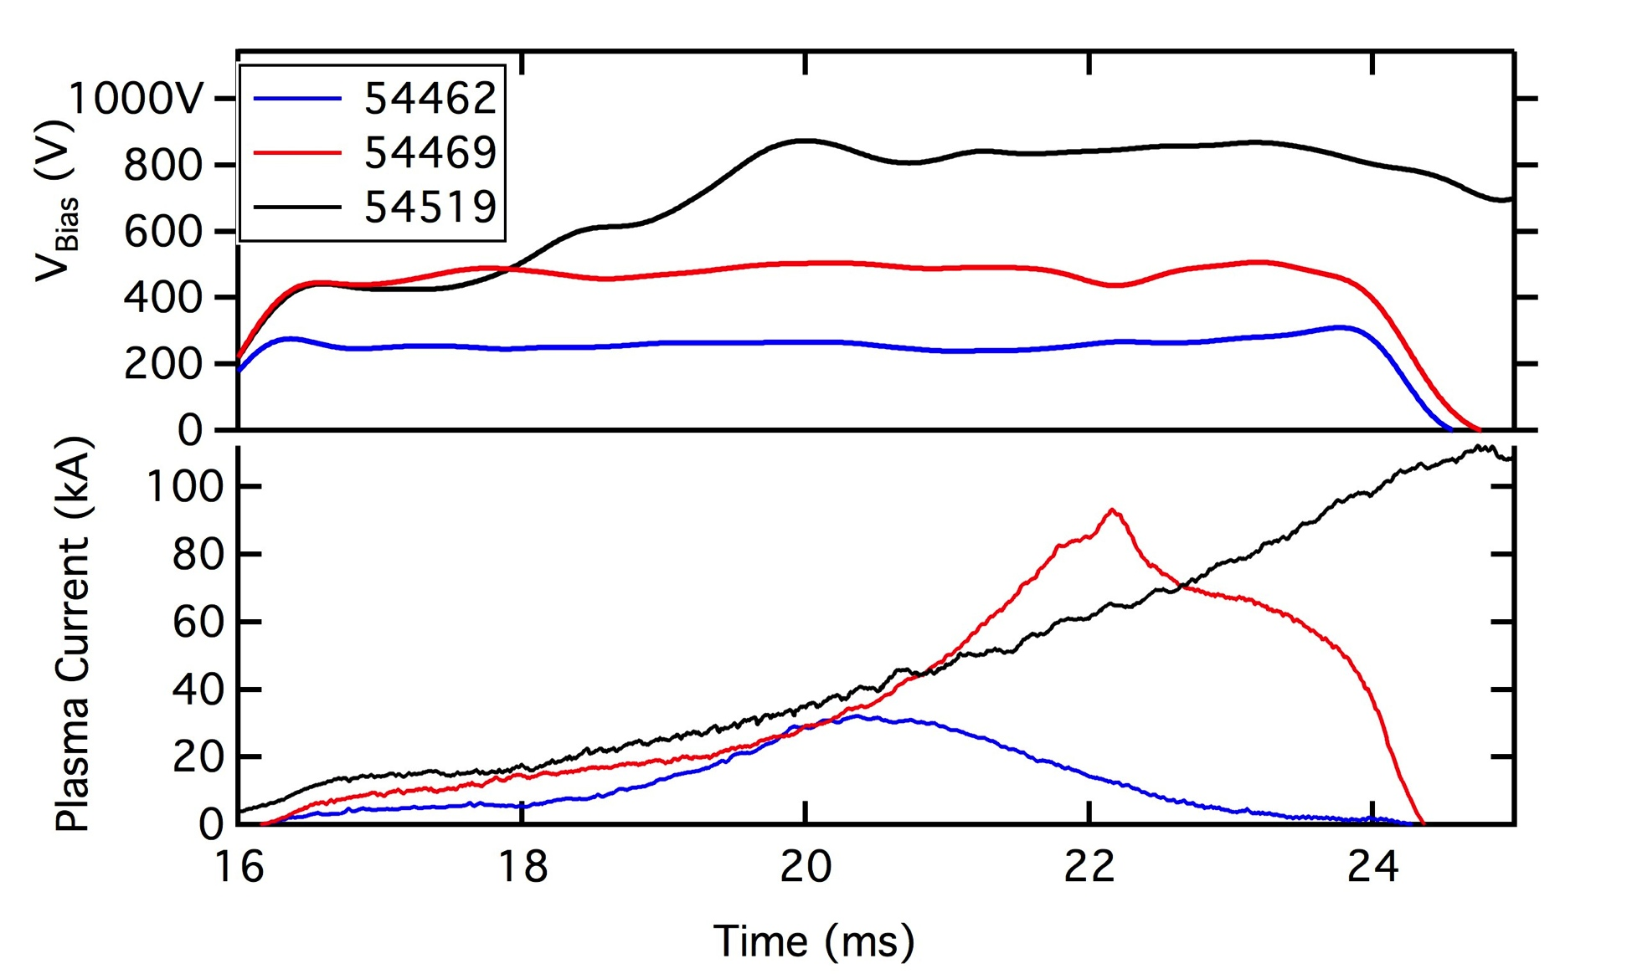
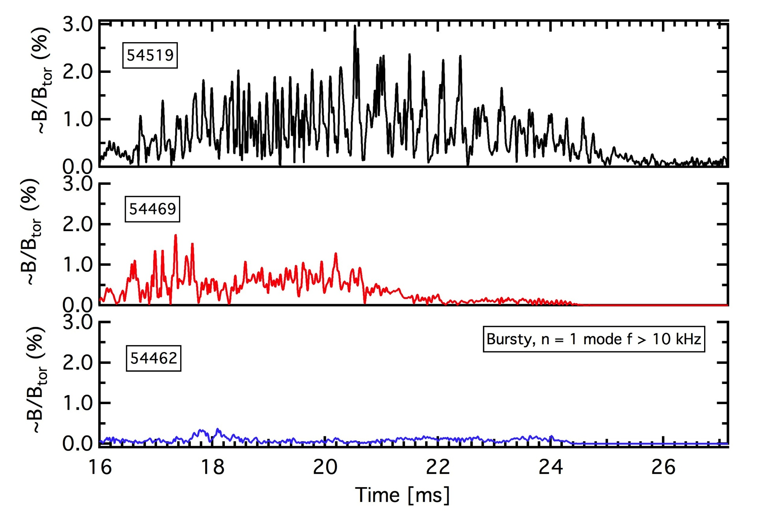
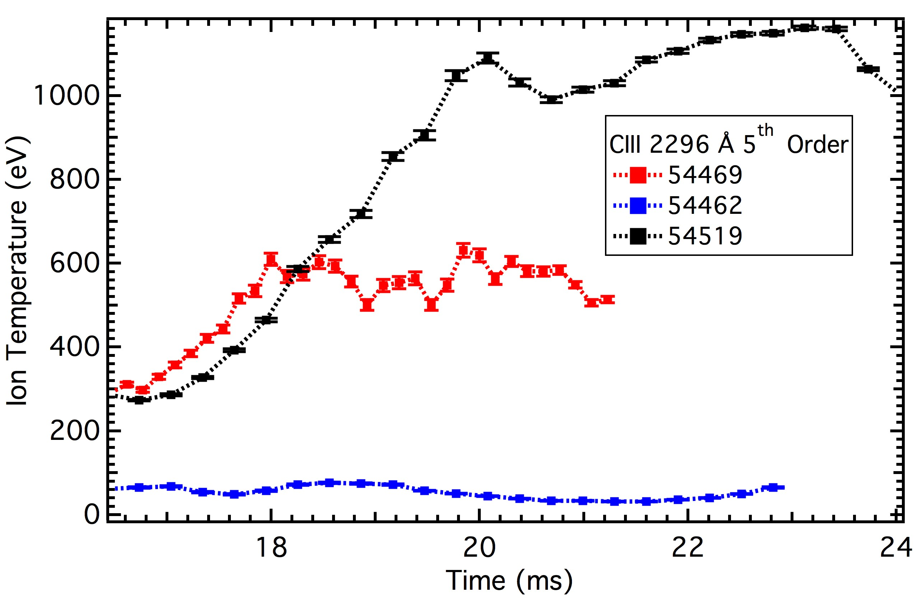
HI Physics: Strong Ion Heating Correlates with MHD Amplitude and Power Input
Strong ion heating observed via impurity lines during helicity injection
  Radially integrated spectroscopy
  VUV spectroscopy: T_{e} ~ 50 eV or so
Heating correlates with n = 1 activity
T_{i⊥} > T_{i||}
  Similar to that seen on MST with large reconnection during sawtooth crash

Slide 11
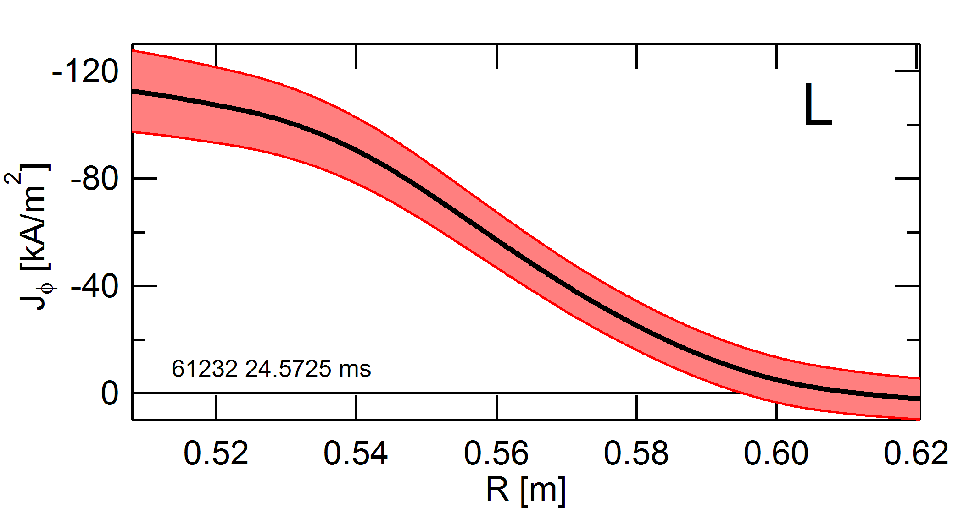
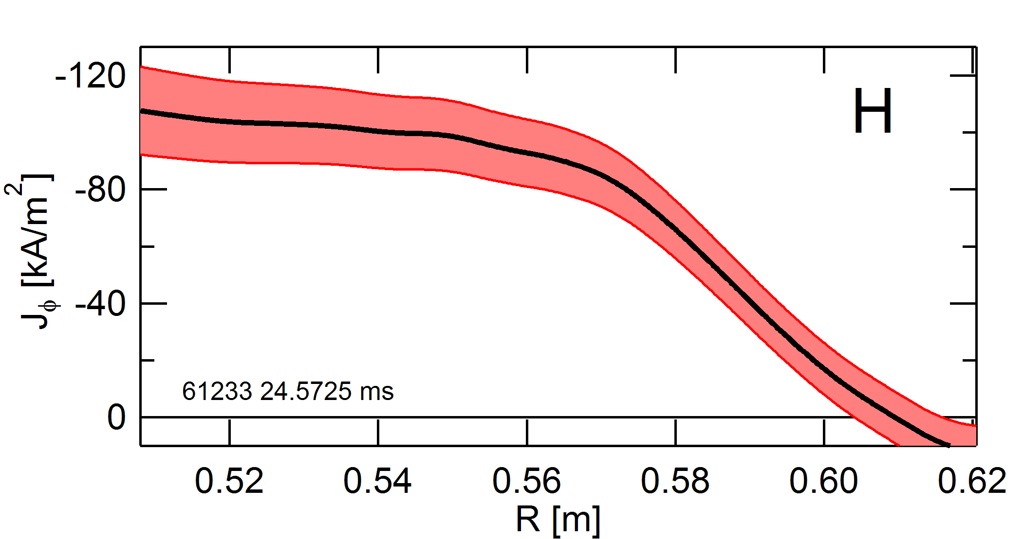
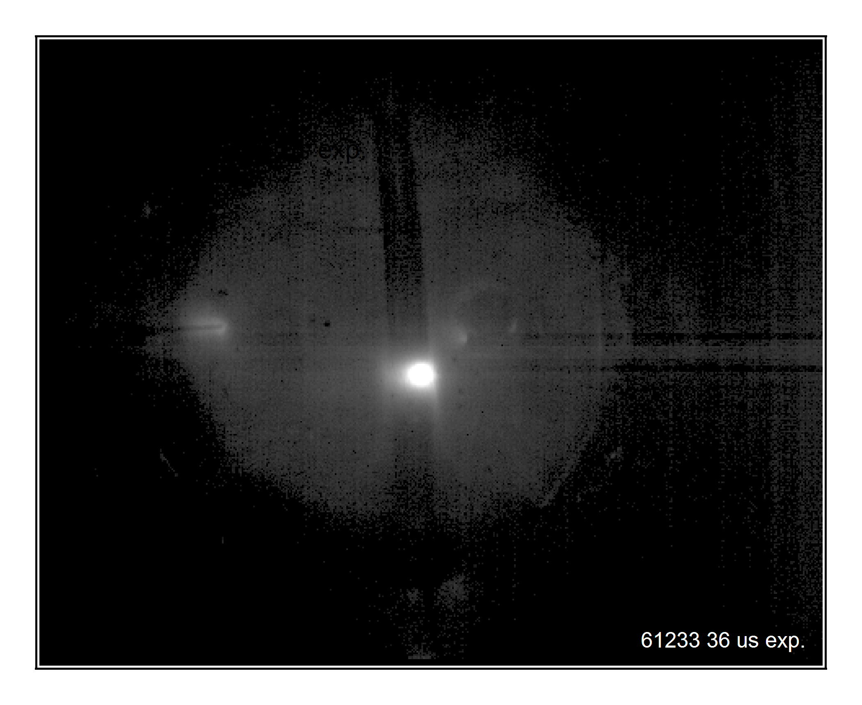
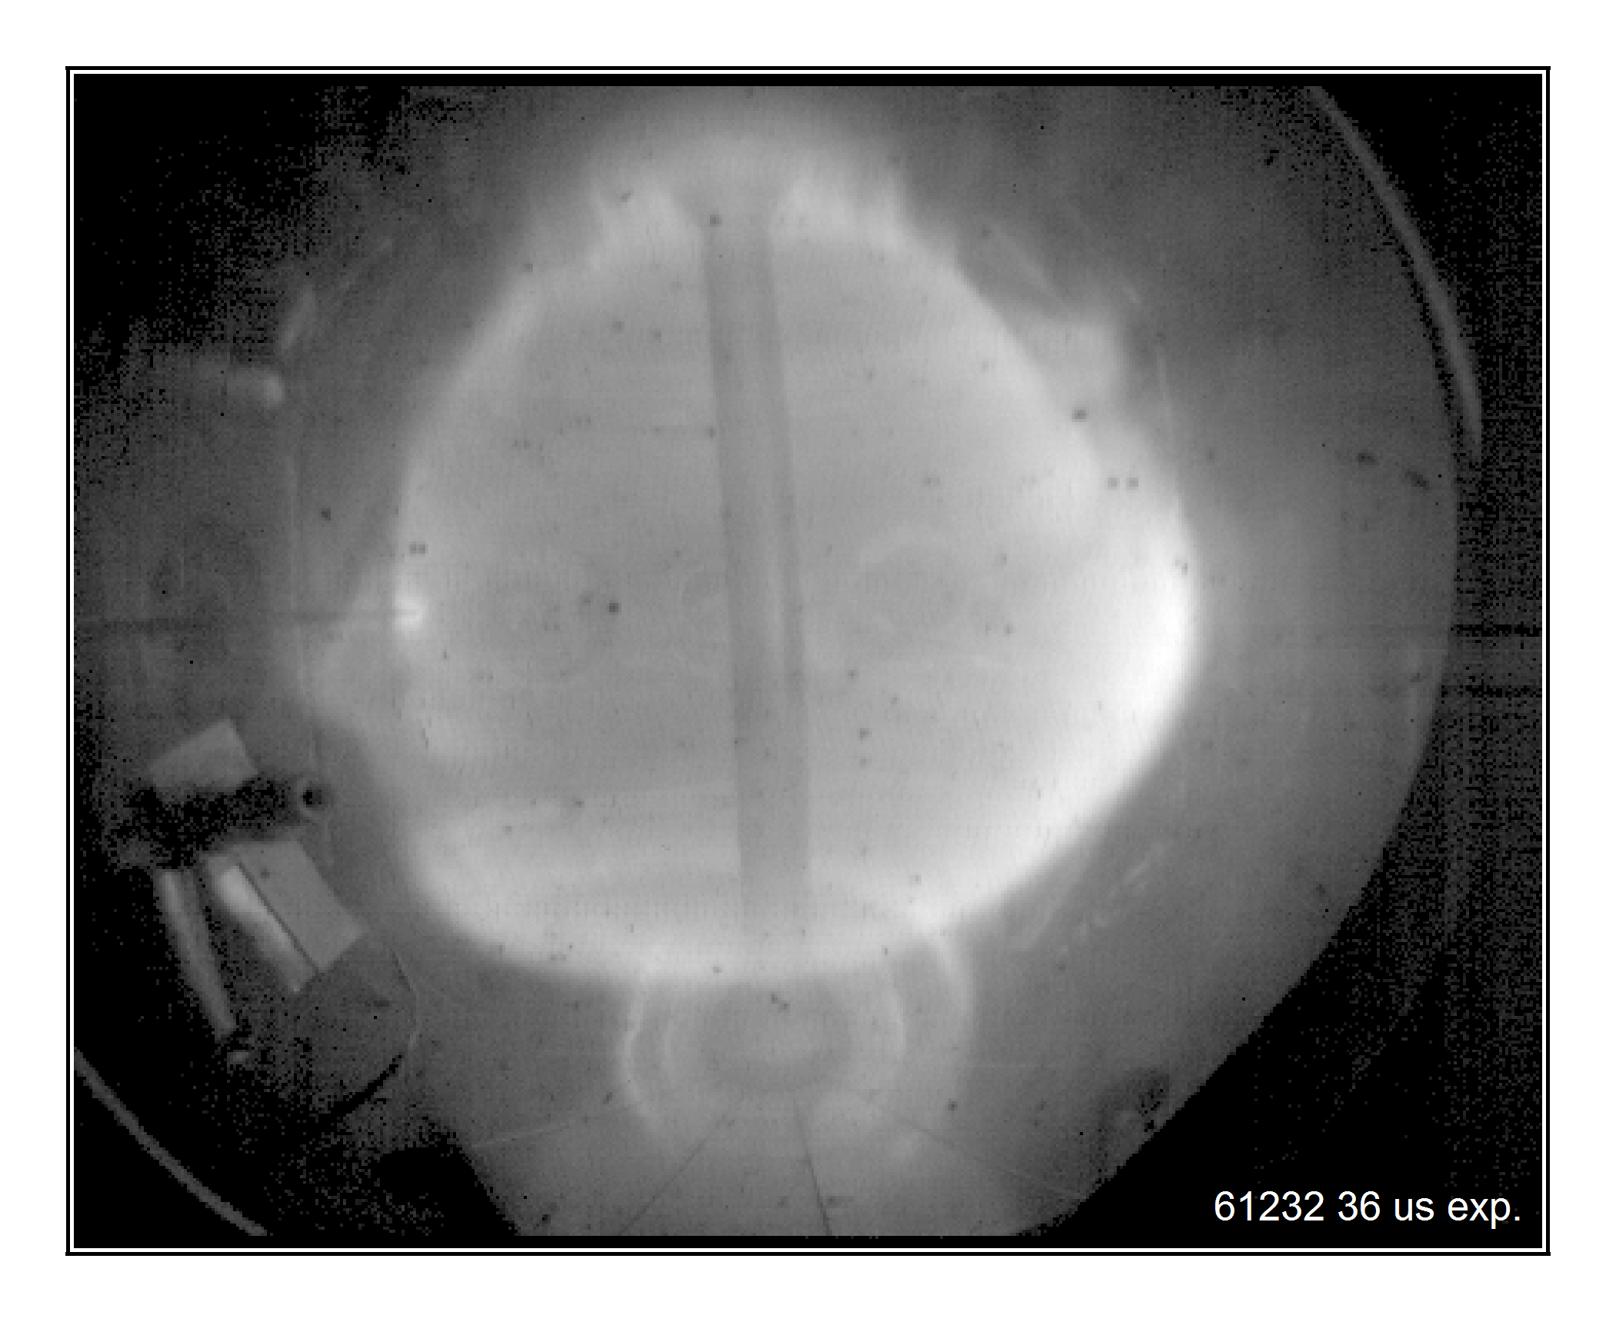
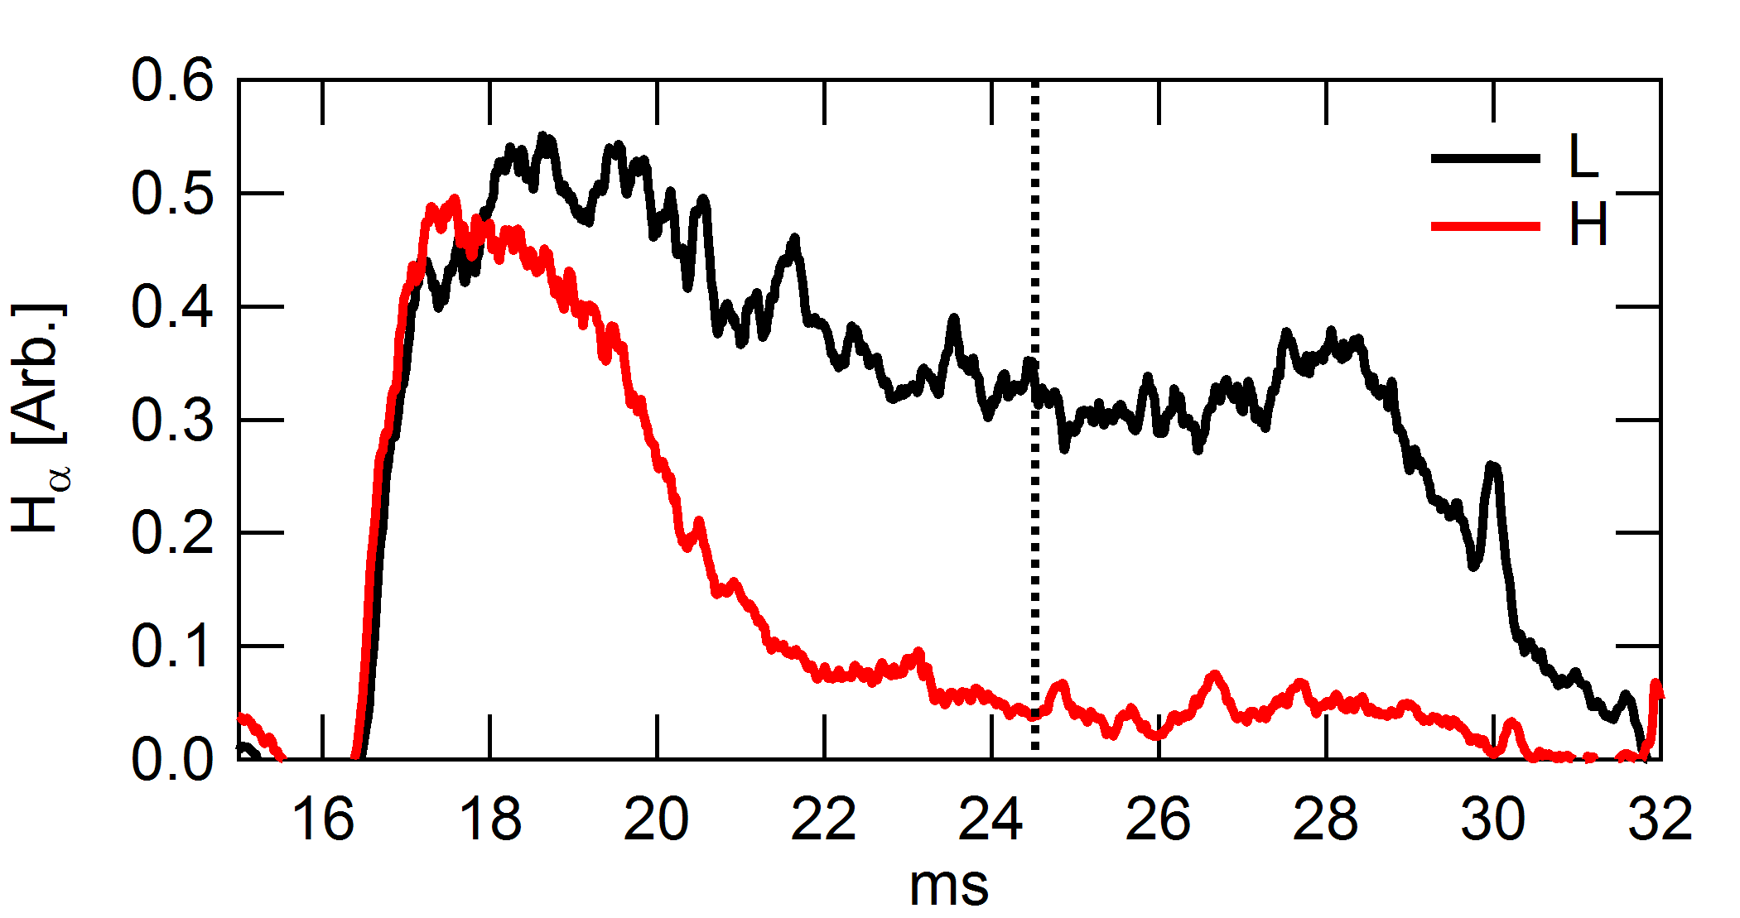
Access to Ohmic H Mode may help Startup and Consequent Current Drive
Ohmic H-mode via centerstack fueling
  I_{p} ~ 0.12 MA
Pedestal in j(R,t) observed
  Internal B measurements from Hall array* yield local J_{ϕ}(R,t)**
Gradient scale length significantly reduced in H mode
  L → H: 6 → 2 cm
*: M.W. Bongard et al., Rev. Sci. Instrum. 81, 10E105 (2010)
**: C.C. Petty et al., Nucl. Fusion 42, 1124 ( 2002)

Slide 12
Summary: Progress in Developing Local Helicity Injection for ST Startup
Local current sources support non-solenoidal startup of ST and other confinement devices
  NSTX-U class power systems deployed on Pegasus
  Preliminary: gas-fed electrodes may be combined with plasma arc sources to drive high I_{p}
Arc source impedance, and helicity injection rate, appear to be governed by sheath effects and magnetic current limits
Plasma properties during helicity injection similar to other reconnecting plasmas
  N=1 MHD activity related to current buildup
  Current buildup and poloidal null formation
  Anomalous ion heating during reconnection
Ohmic H-mode attained: should aid startup studies
  J(R,t) pedestal and perturbations during ELM readily observed

Slide 13
Related Posters for Details
NP8.00060: Bongard: Non-solenoidal Startup and Pegasus Program
NP8.00061: Barr: MHD and Helicity Injection on Pegasus
NP8.00062: Hinson: Injector Impedance Studies
NP8.00063: Burke: Ion Heating and Flow Measurements on Pegasus
NP8.00064: Thome: Plasma Fueling and H-mode Access in Pegasus
NP8.00065: Schlossberg: Thomson Scattering and Plans for Confinement Studies
NP8.00066: Schoenbeck: Multipoint Thomson Scattering System for Pegasus
NP8.00067: Shriwise: New Pegasus Divertor Design for Helicity Optimization
NP8.00068: Perry: Power Systems and Magnetics Upgrades
NP8.00069: O’Bryan: Simulation of current-filament dynamics and relaxation in Pegasus
PP8.00024: Redd: Design Considerations for Local Helicity Injection on NSTX-U

Slide 14
Extras

Slide 15
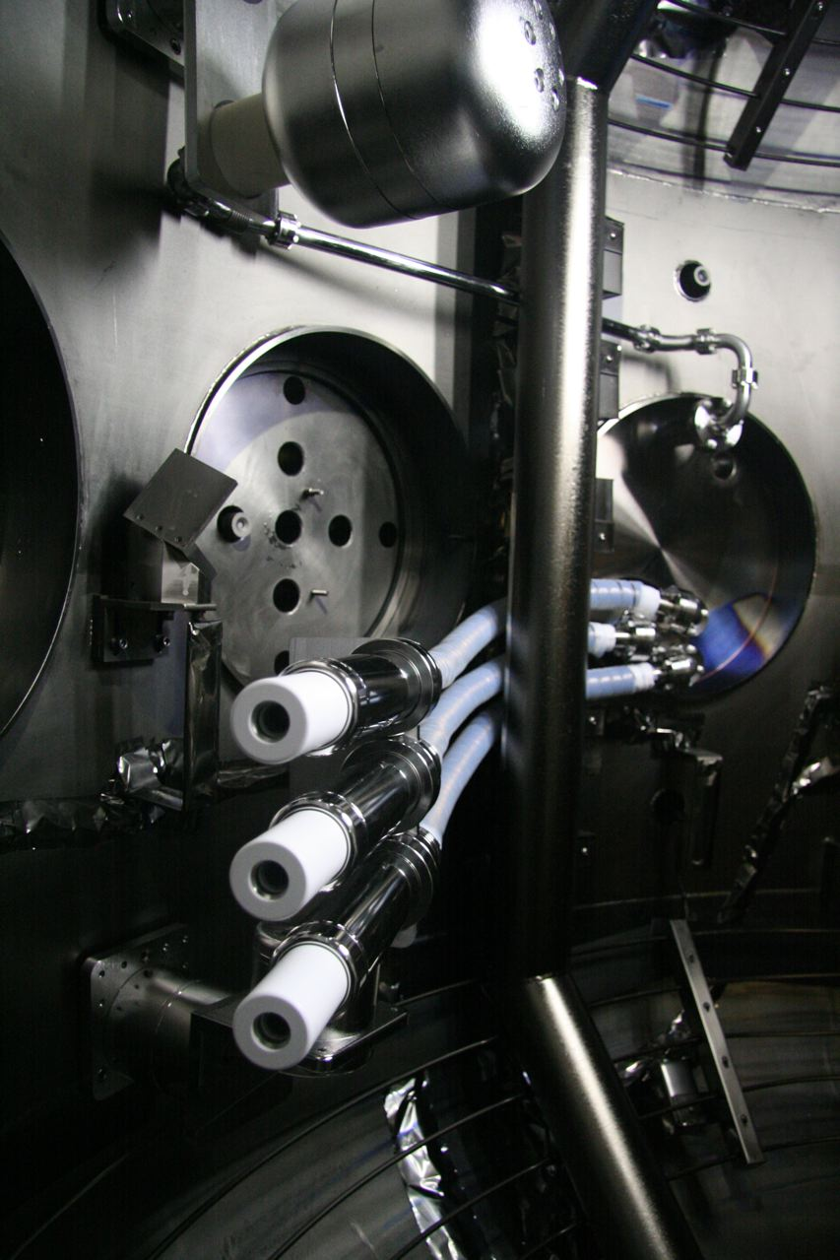
Power Systems and Current Injectors Being Developed to Test Startup to High I_{p}
New power systems deployed
  NSTX-U class power level
  Bias: I_{inj} ≤ 14 kA @ V_{inj} ≤ 2.2 kV
  Arc: Simple PFN
Injectors under development
  Active: plasma-arc current sources
    Intense beam ~ 1 kA/cm²
  Passive: large-area electrodes
    Metallic electrodes to develop insulation designs
    Gas-fed designs under test
Anode
40 cm
Outer limiter
Plasma guns

Slide 16
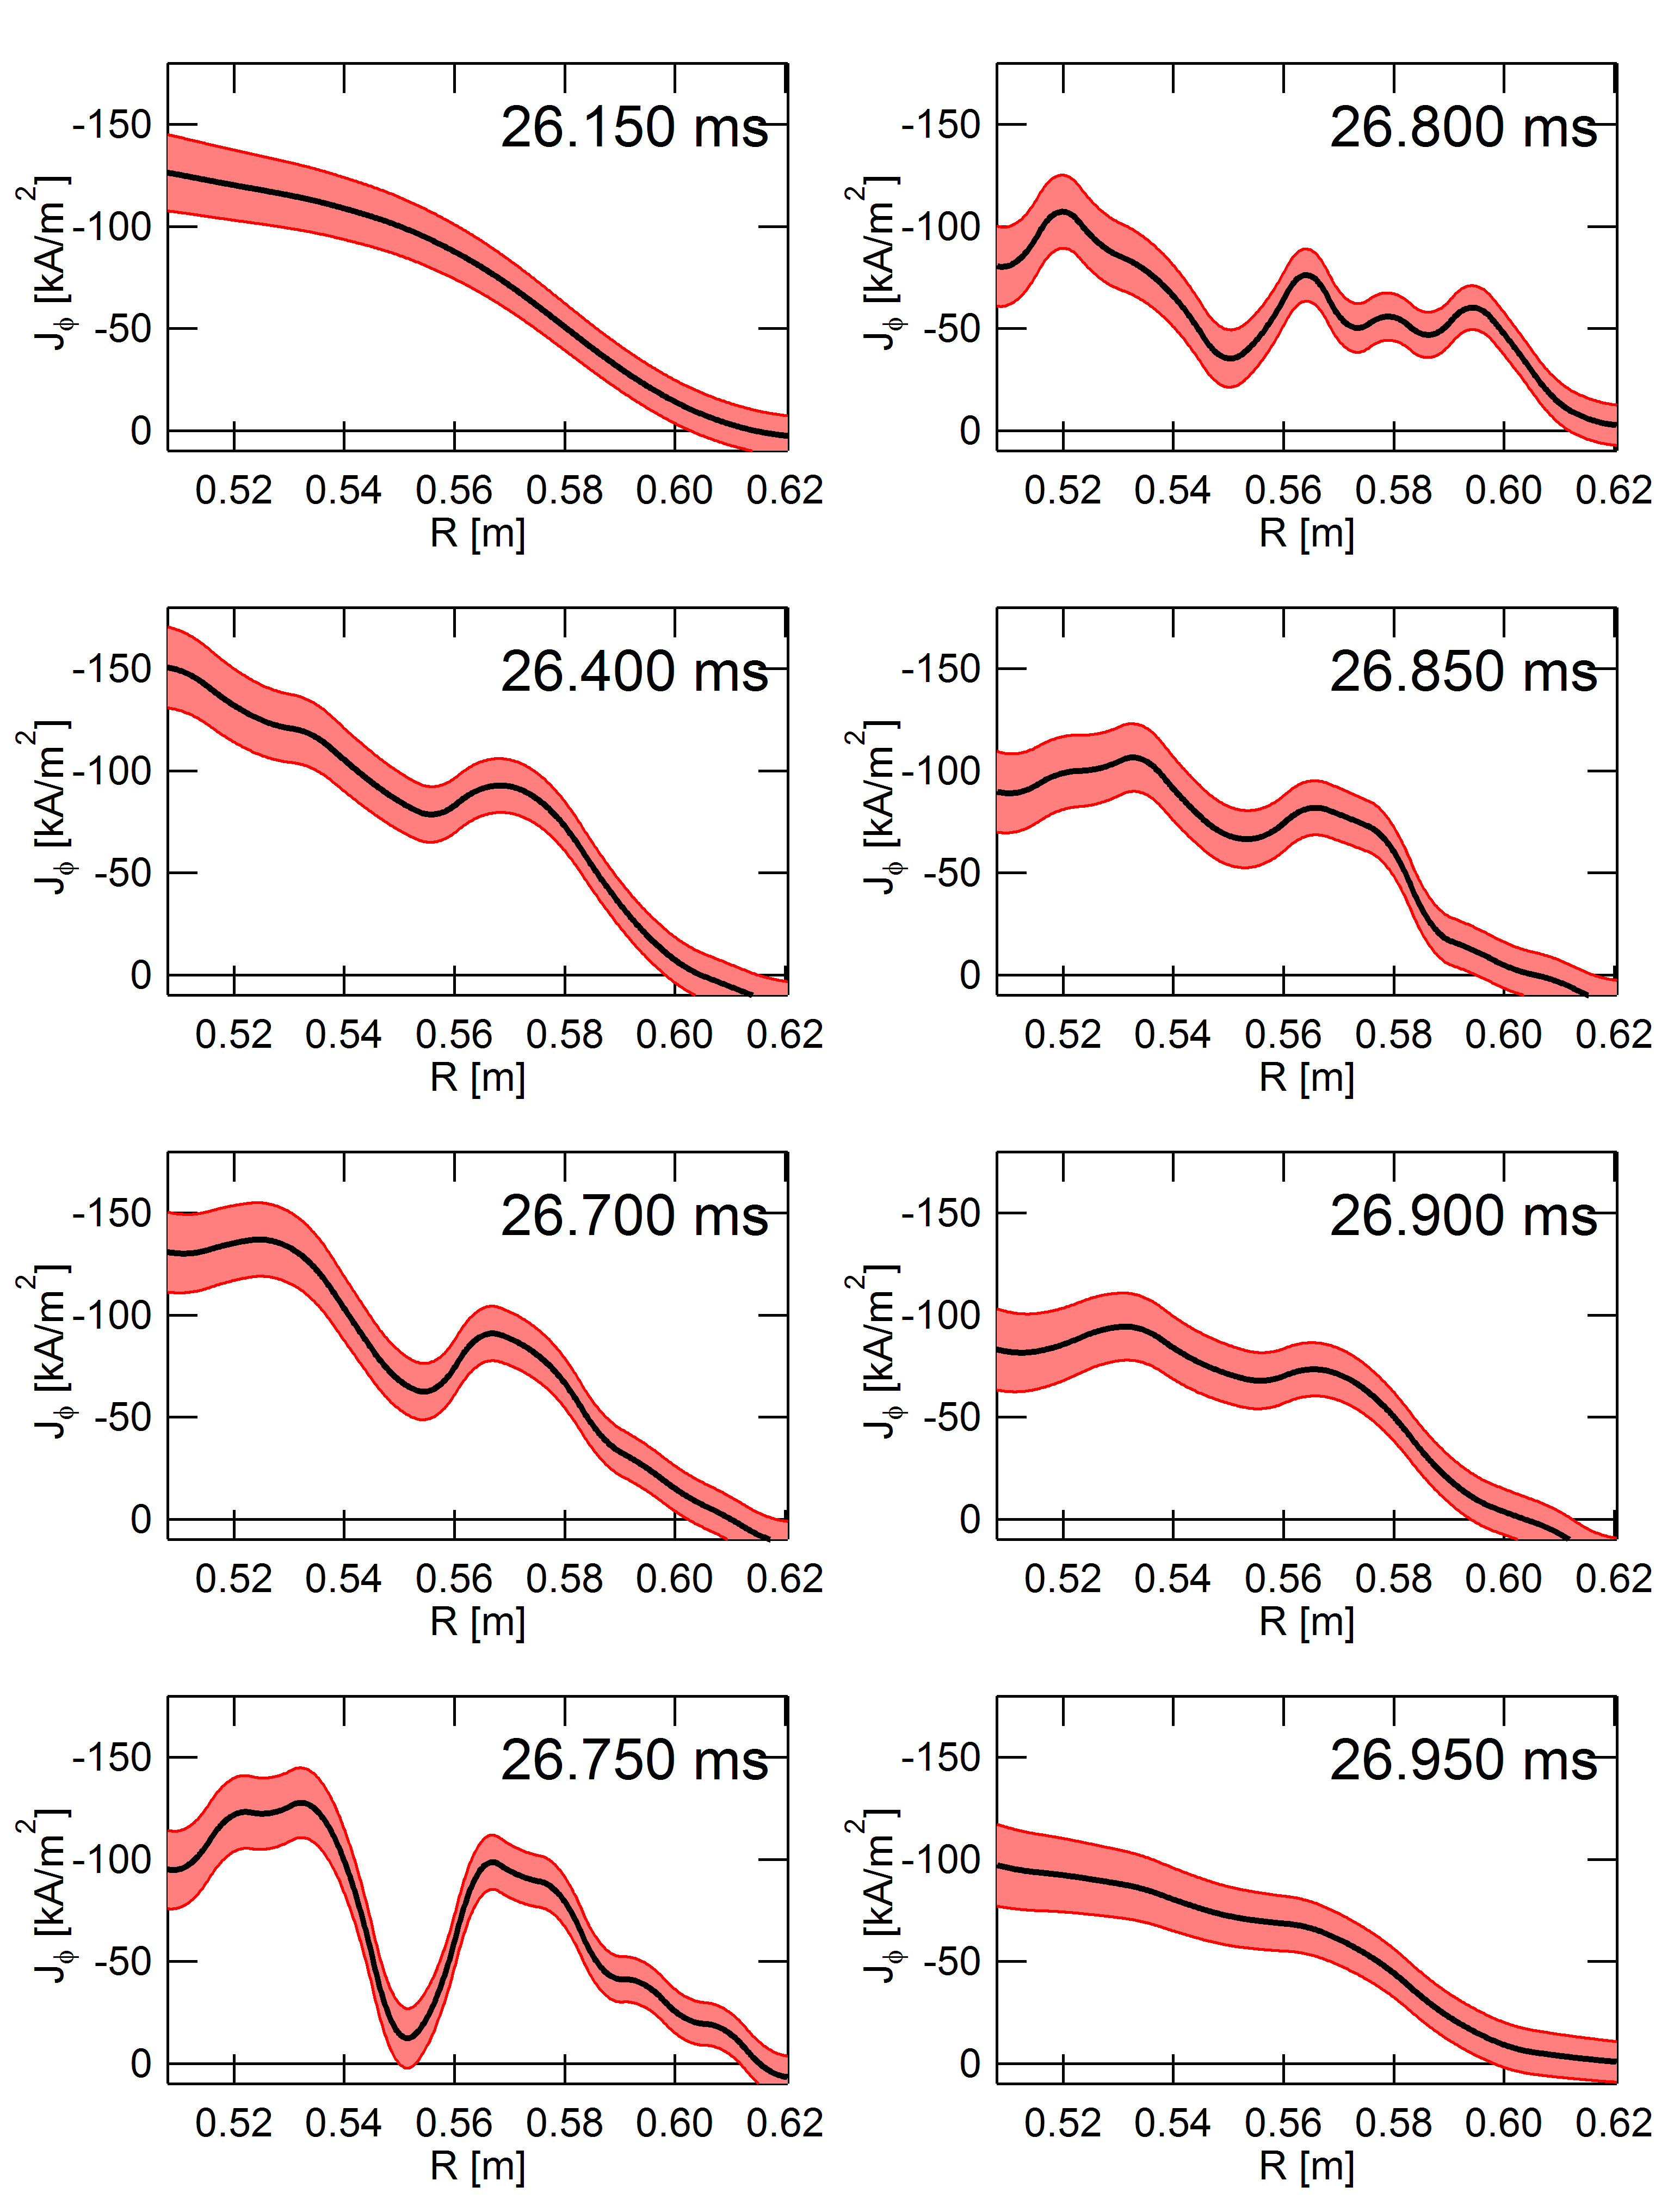
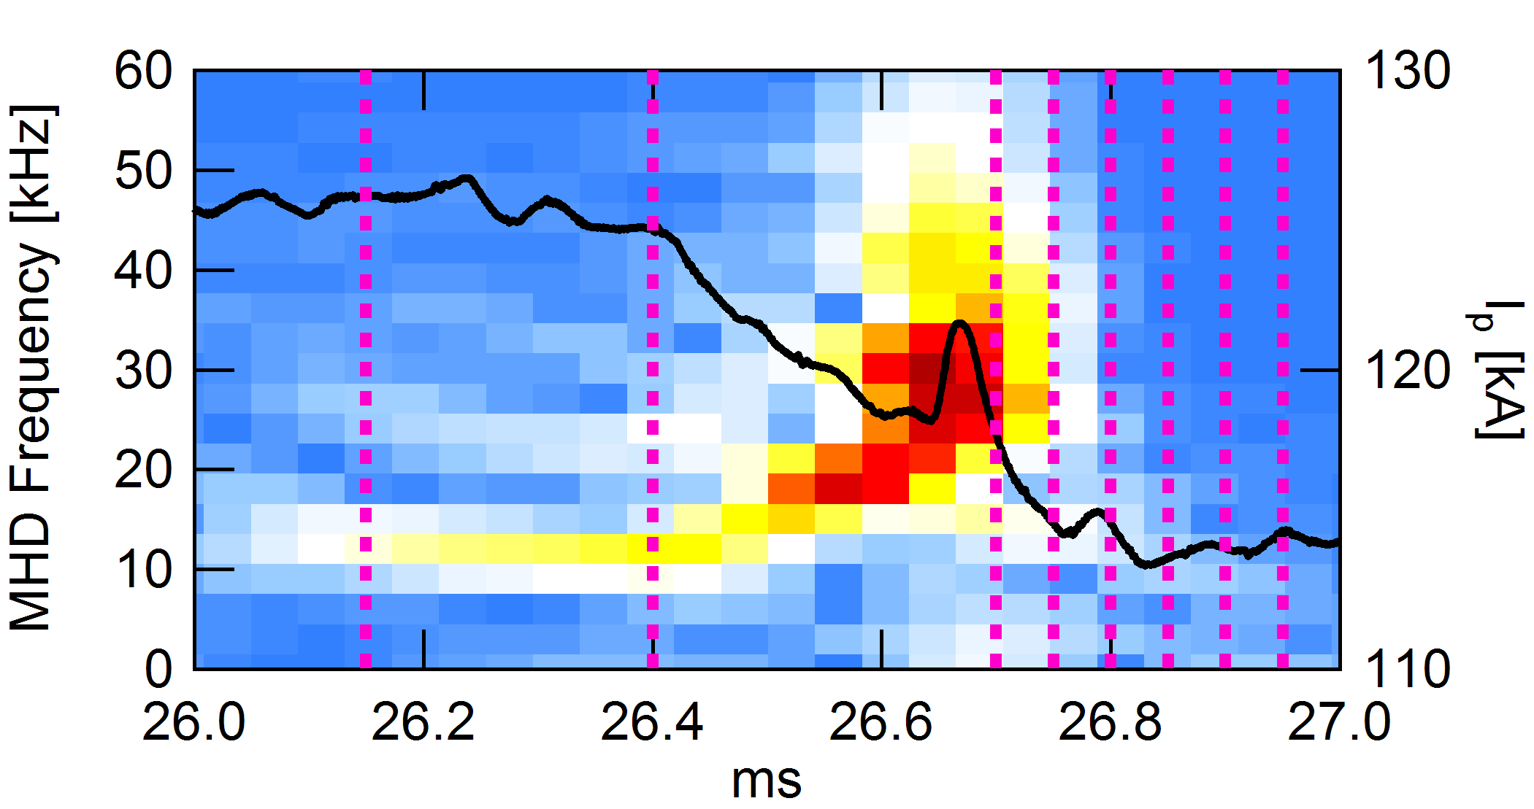
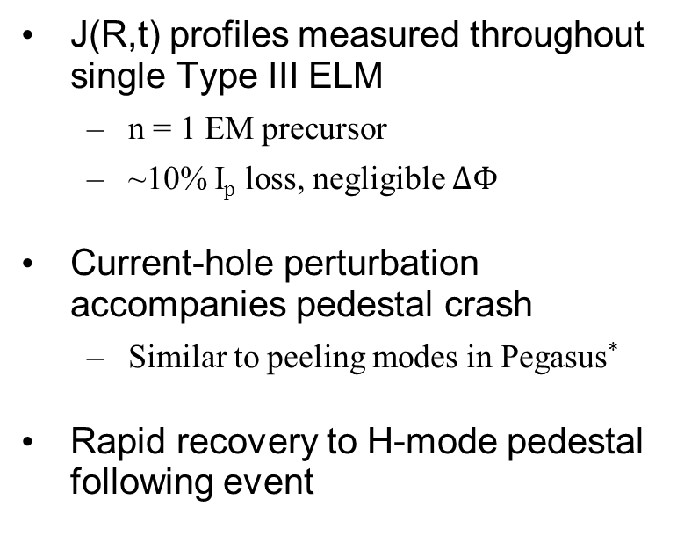
J_{edge} ELM Dynamics Observed
J(R,t) profiles measured throughout single Type III ELM
  n = 1 EM precursor
  ~10% I_{p} loss, negligible $ΔΦ$
Current-hole perturbation accompanies pedestal crash
  Similar to peeling modes in Pegasus*
Rapid recovery to H-mode pedestal following event
*: Bongard et al., Phys. Rev. Lett. 107, 035003 (2011)

