Slide 1


Energetic Particles Interaction with the Non-resonant Internal Kink in Spherical Tokamaks
55th Annual Meeting of the APS Division of Plasma Physics, November 11-15, 2013 Denver, Colorado
Feng Wang*, G.Y. Fu**, J.A. Breslau**, E.D. Fredrickson**, J.Y. Liu*
*Dalian University of Technology, Dalian, China
**Princeton Plasma Physics Laboratory, Princeton, NJ, USA.

Slide 2
Outline
Background of the Non-Resonant internal Kink (NRK).
Energetic Particles (EP) Interaction with the NRK:
  EP effects on the NRK mode linear stability.
  The NRK-induced EP redistribution.
  Fishbone mode in spherical tokamaks.
Summary.

Slide 3
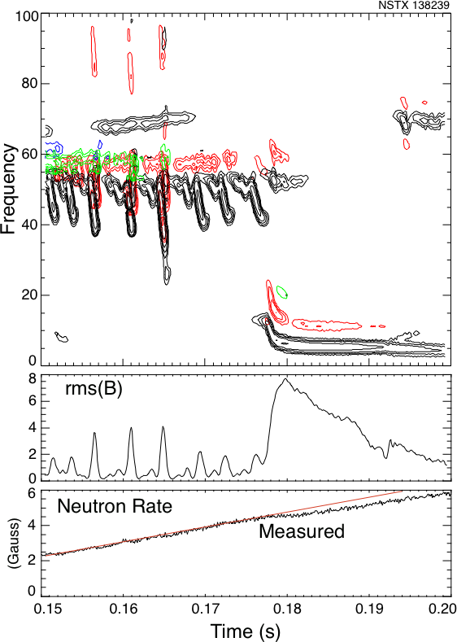
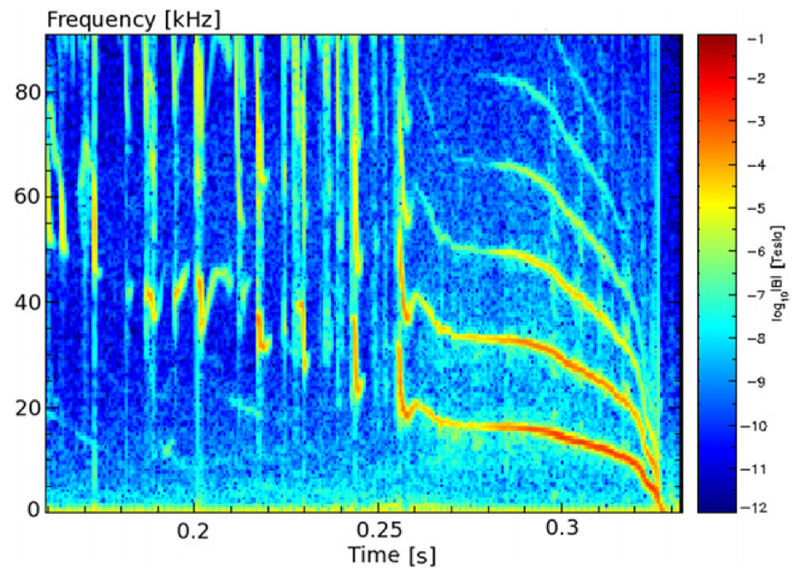
The Fishbone and the NRK in MAST and NSTX
Experimental observations show that plasmas in MAST and NSTX can be unstable to the fishbone mode, and it is often followed by the NRK mode.
The NRK happens with q_{min} above 1, but it is dominated by 1/1 component.
It can saturate nonlinearly and persist for a long time, so it is called long-lived mode for MAST.
This mode has strong interaction with EPs.
(I.T. Chapman et al, 2010 Nuclear Fusion)
E.D. Fredrickson
n=1 fishbone
n=1 NRK
Time

Slide 4
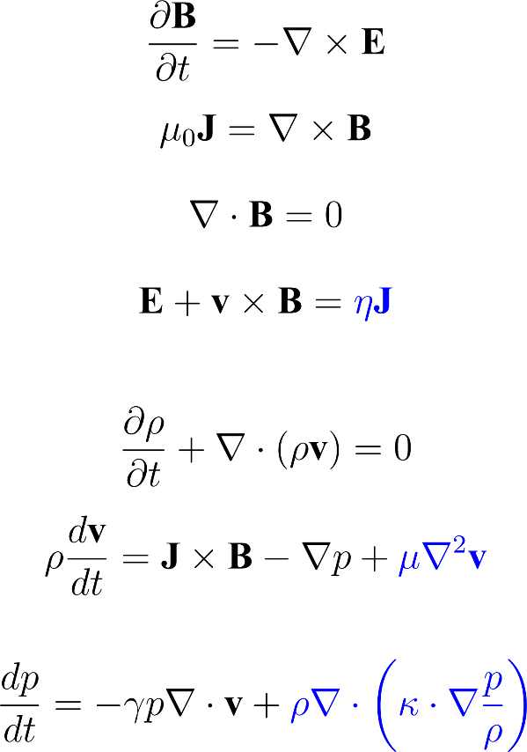

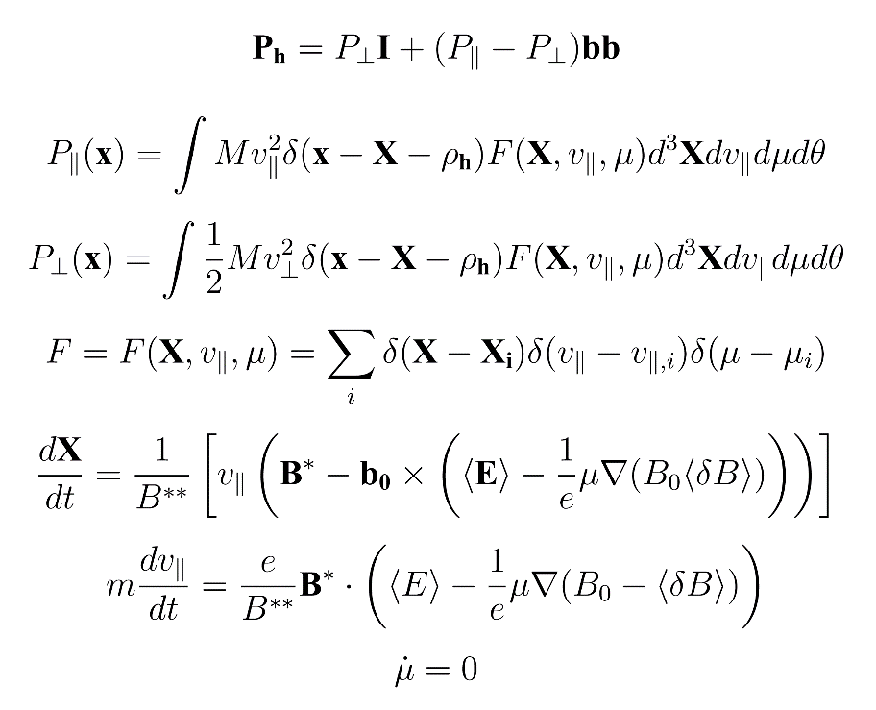
M3D-K physics model
A 3D extended MHD model
EP is coupled to MHD equation with pressure tensor
The pressure tensor is calculated using gyrokinetic equations (via PIC mehtod).

Slide 5
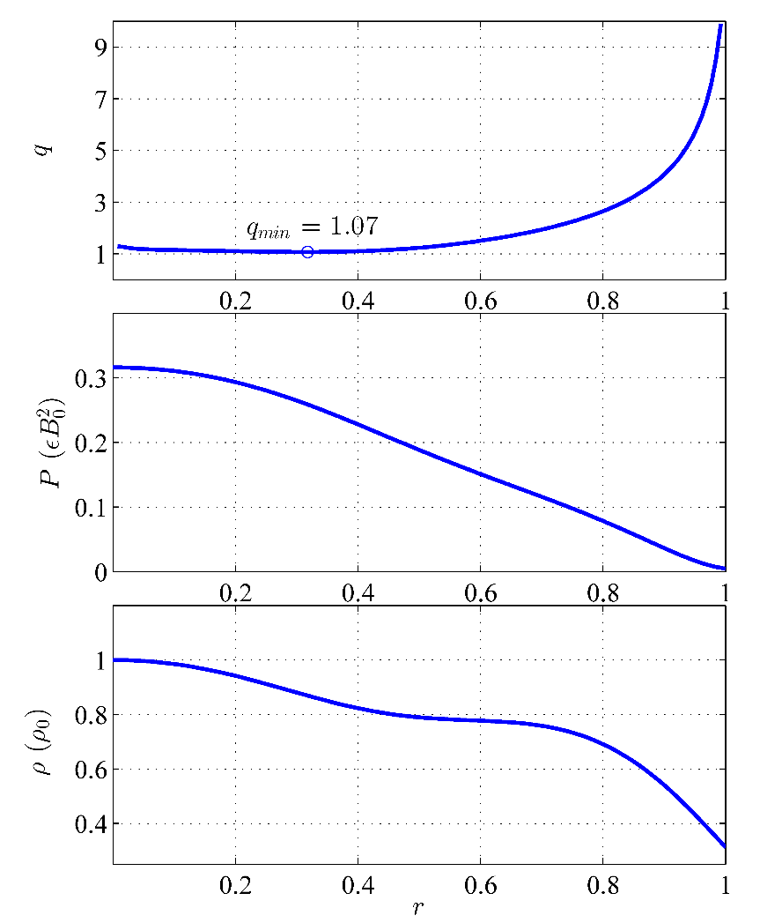
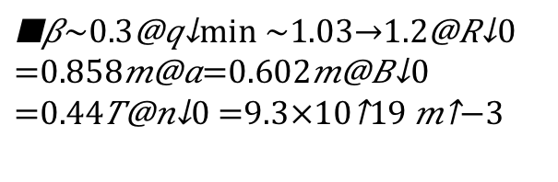
Equilibrium profiles and parameters
NSTX #124379 at t= 0.635s
central total
β_{beam}=0.1

Slide 6
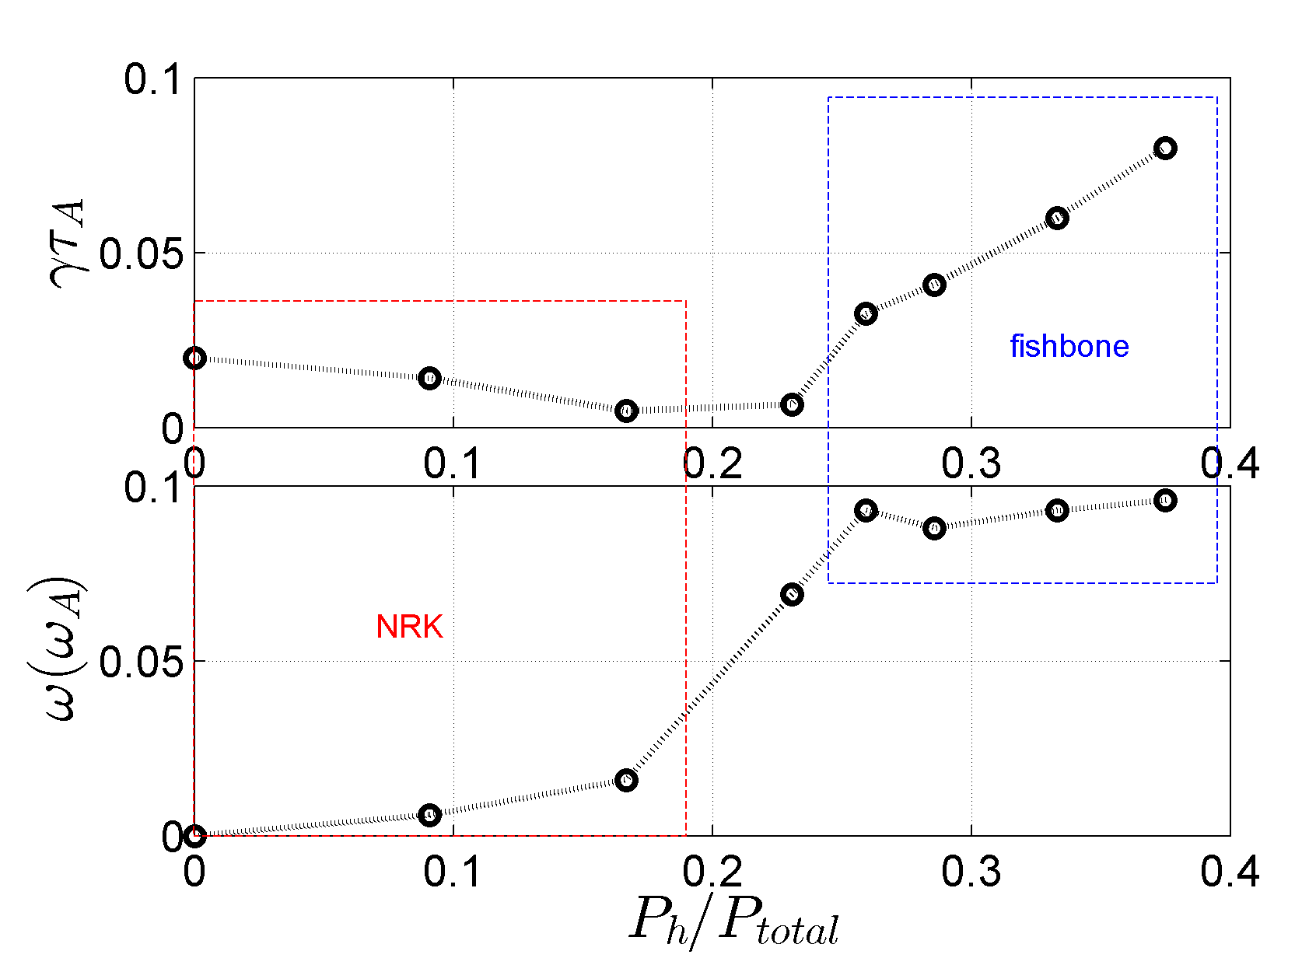
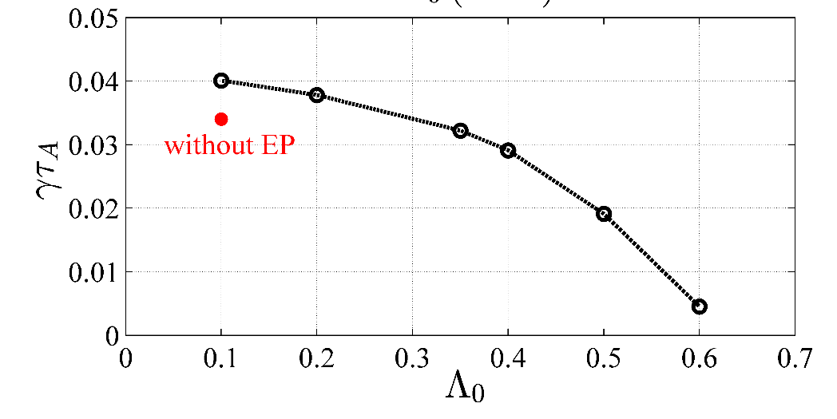
EP Effects on the NRK mode
Fixed thermal pressure
With EP pressure increasing, there are two different regimes:
At low EP pressure, the NRK is unstable, and EP has strong stabilizing effect on the NRK.
At high EP pressure, EP excites a fishbone mode with frequency close to trapped particle precessional drift frequency.
Passing particle
Trapped particle
The stabilizing effect on the NRK mainly comes from trapped particles.
P_{beam}/P_{total}=0.09

Slide 7
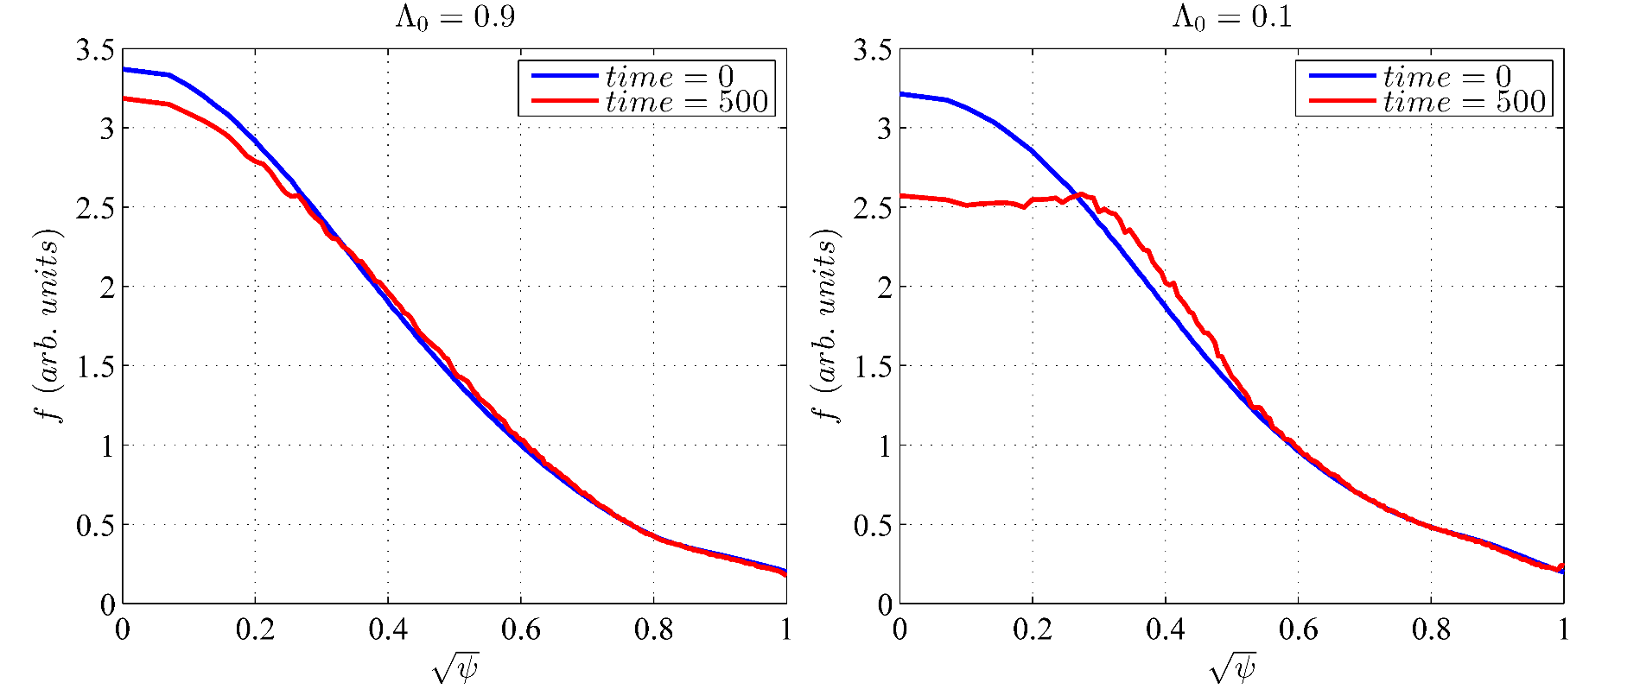
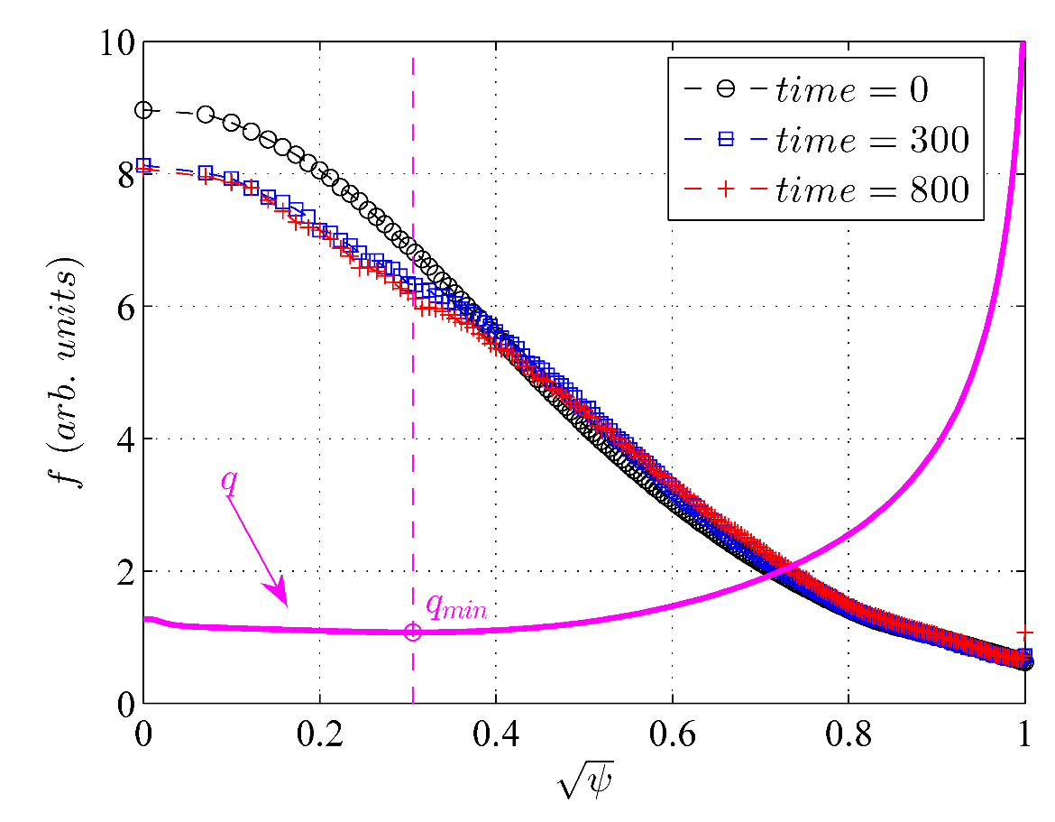
NRK mode induces EP redistribution
Significant redistribution occurs for passing particles.
The redistribution mainly occurs inside the qmin surface, and when the mode saturates, the distribution function reaches a steady state.

Slide 8
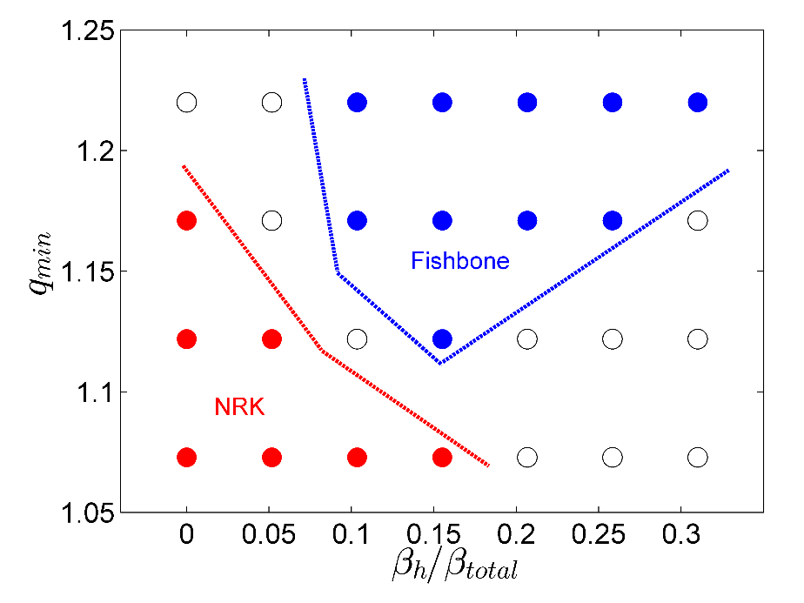
Fishbone linear instability
With fixed P_total at axis
(I.T. Chapman et al, 2010 Nuclear Fusion)
n=1 fishbone
n=1 NRK
In the MAST, the fishbone often shows before the LLM.

Slide 9
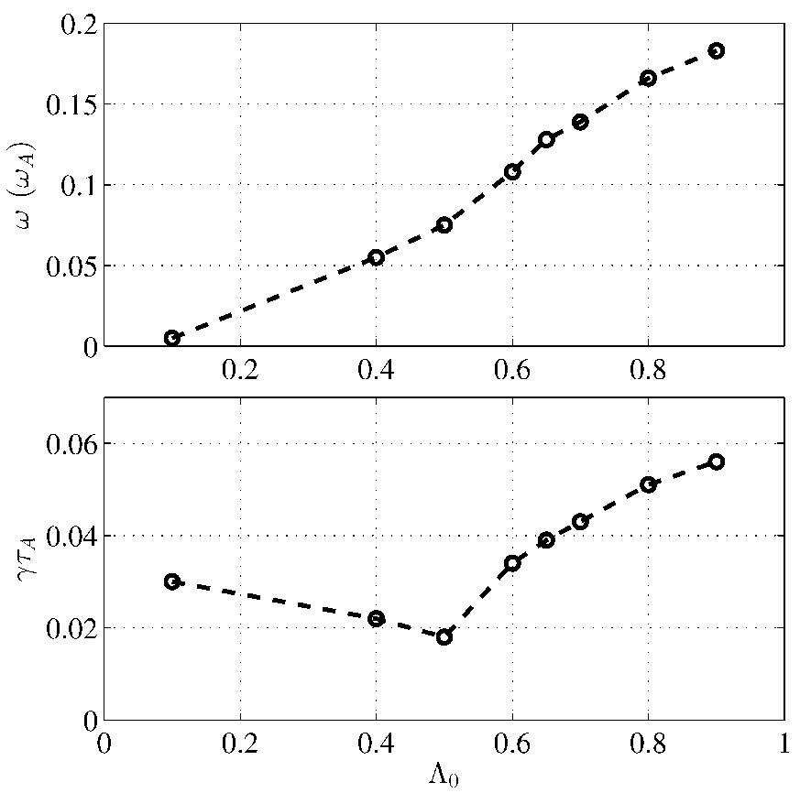
The fishbone mode is driven by trapped particles.
NRK
fishbone

Slide 10
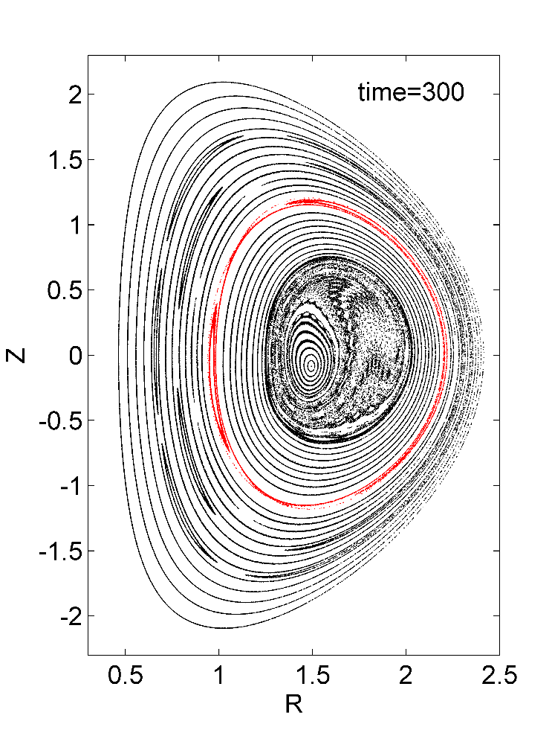
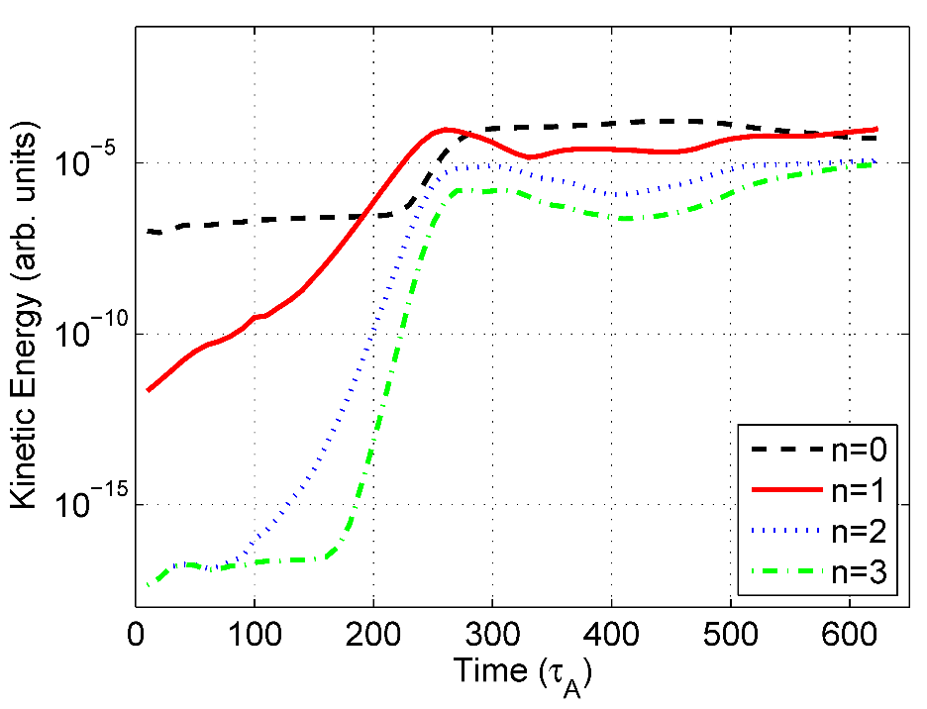
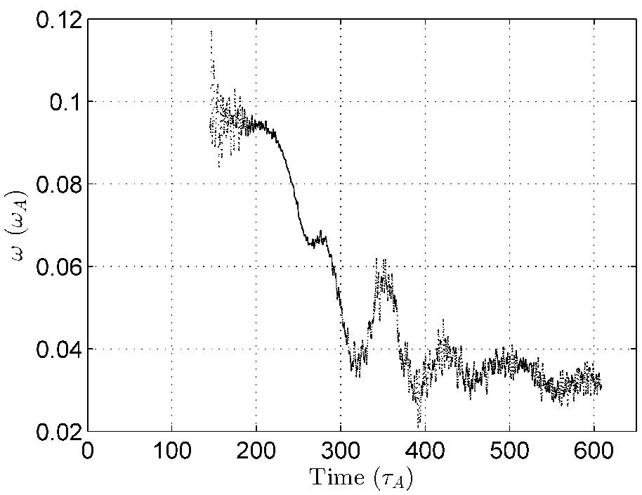
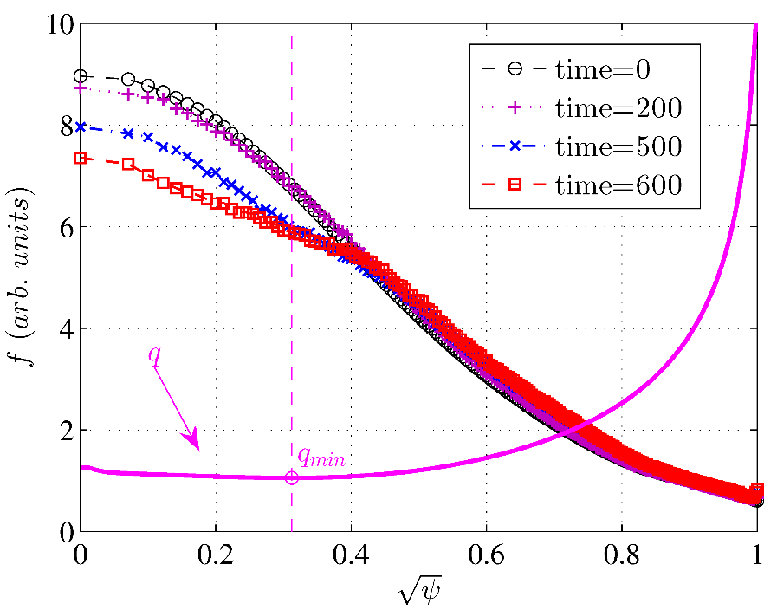
Fishbone nonlinear evolution
Nonlinearly, the fishbone shows strong frequency chirping,
It induces strong beam ion profile flattenting inside the qmin surface.
Fishbone induces 2/1 island and some other islands nonlinearly, which could trigger NTM.

Slide 11
Summary
Linearly, trapped energetic particles have strong stabilizing effects on the (Non-)NRK mode.
The NRK can redistribute energetic particles significantly (especially for passing particles)
With reversed shear q profile and q_{min} above unit, the fishbone mode can be excited by beam ions, and it is more unstable at higher q_{min,} which explains why the fishbone mode usually appears before the NRK. The fishbone mode’s nonlinear evolution shows strong frequency chirping and induces 2/1 island. It also induces strong beam ion profile flattening inside q_{min} surface.

