Slide 1

Spherical Torus
Session FR1
Recent Progress on Spherical Torus Research and Implications for Fusion Energy Development Path
Masayuki Ono
PPPL, Princeton University
On behalf on the world ST community!
APS-DPP 2014
October 27 – 31, 2014
Notes:
Thank you chairman and I would like to thank the Program Committee for giving us the opportunity to present to you the recent….

Slide 2
Acknowledgements
US Institutions:
Columbia U
CompX
General Atomics
FIU
INL
Johns Hopkins U
LANL
LLNL
Lodestar
MIT
Nova Photonics
New York U
ORNL
Princeton U
International Institutions:
*Culham Sci Ctr
U St. Andrews
York U
*Tokamak Energy
Chubu U
Fukui U
Hiroshima U
*Hyogo U
*Kyoto U
*Kyushu U
Kyushu Tokai U
NIFS
Niigata U
*U Tokyo
Tsukuba U
JAEA
Hebrew U
*PPPL
Purdue U
SNL
Think Tank, Inc.
UC Davis
UC Irvine
UCLA
UCSD
U Colorado
U Illinois
U Maryland
U Rochester
U Tennessee
*U Washington
*U Wisconsin
*Ioffe Inst
RRC Kurchatov Inst
TRINITI
D.V.Efremov Inst
INTEKHMASH
NFRI
KAIST
POSTECH
*Seoul National U
*Beijing National L
ASIPP
ENEA, Frascati
CEA, Cadarache
IPP, Jülich
IPP, Garching
ASCR, Czech Rep
* With ST Facility
• At present, over 500 researchers and 140 graduate students are engaged in ST research worldwide.
• Over 1,000 ST related refereed publications since 2000.
For more detail, M. Ono and R. Kaita, ST review paper for PoP
Notes:
I would like to acknowledge the world ST community with researchers from a large number of institutions.
At present there are over 500 researchers engaged in the ST research.
I should also note that there is a strong educational component of ST research with over 140 graduate students performing research.
There are over 1000 ST related refereed publications since 2000 so I can only mention just a small fraction of the work.
I also borrowed heavily from the recent review paper written for PoP.

Slide 3
Talk Outline
Unique ST properties
ST Fusion Energy Development Path
World ST Facilities
Unique ST Physics Regimes
ST-FNSF Relevant Experiments
ST Facility Upgrade Status
Summary
Notes:
Here is the outline of this review to give you an overview of the world ST research.

Slide 4
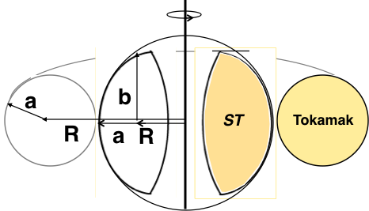
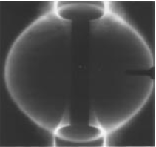
ST is a low aspect ratio tokamak with A < 2
Natural elongation makes its spherical appearance
Aspect Ratio A = R /a
Elongation κ = b/a
“natural” = “without active shaping”
Camera image from START
B_{TF} ∝ I_{TF}/R
I_{p}
I_{TF}
I_{TF}
I_{p}
I_{p}
x
I_{p}
I_{p}
I_{p}
x
x
A. Sykes, et al., Nucl. Fusion (1999).
Note: ST differs from FRC, spheromak due to B_{TF}
Y-K.M. Peng, D.J. Strickler, NF (1986)

Slide 5
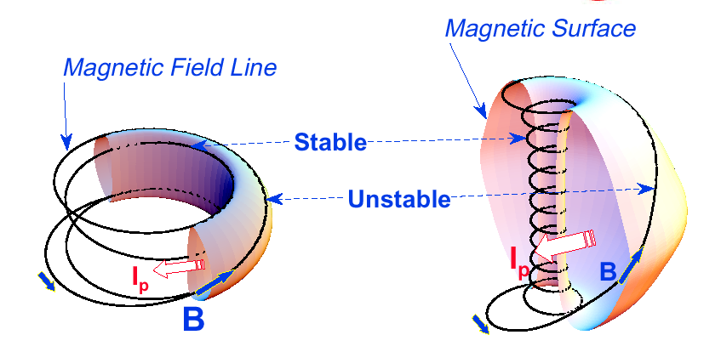
A spherical tokamak (ST) is a high beta tokamak
Favorable average curvature improves stability at high beta
Aspect Ratio A = R /a
Elongation κ = b/a
Toroidal Beta β_{T} = ⟨p⟩ / (B_{T0}²/ 2μ₀)
Tokamak
ST
A ~ 3,
κ = 1.5-2,
q₉₅ = 3-4,
β_{T} = 3-10%
A ~ 1.5,
κ = 2-3,
q₉₅ = 8-12,
β_{T} = 10-40%
Notes:
A spherical tokamak is a low aspect ratio tokamak. Tokamak is a donut like aspect ratio of about 3 where as ST is aspect ratio of about 1.5. As the aspect ratio is reduced, the hole of the donut is reduced and it disappears entirely at A = 1. As the aspect ratio is reduced, the plasma elongate naturally takes on the spherical shape due to self fields. Another important property is the magnetic field line. The tokamak magnetic field line goes around torus at relatively constant pitch where as the ST geometry, the field line transit the outboard unstable region quickly but spend many toroidal transits in the inboard stable region. This makes ST plasma stable for high beta and also makes the edge safety factor high ~ 10 compared to ~ 3 for tokamak.
As a result, there are a number of new unique physics regimes which can be accessed at low aspect ratio, which can be utilized to enhance the understanding of toroidal confinement physics and improve predictive capabilities for ITER and future fusion facilities.

Slide 6
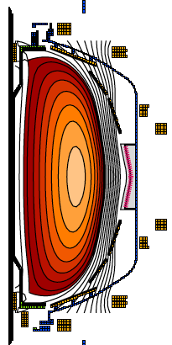
ST can be compact, high beta, and high confinement
Higher elongation κ and low A lead to higher I_{p}, β_{T} and τ_{E}
Aspect Ratio A = R /a
Elongation κ = b/a
Toroidal Beta β_{T} = ⟨p⟩ / (B_{T0}²/ 2μ₀)
• ST has high Ip due to high κ and low A
High κ ∼ 3.0 equilibrium in NSTX.
I_{p} ~ I_{TF} (1 + κ² / (2 A² q*)
S. Jardin et al., FS&T (2003)
• Ip increases tokamak performance
τ_{E} ∝ I_{p}
β_{T  }≡ β_{N} I_{p} / (aB_{T0})
• ST can achieve high performance cost effectively
I_{p} ~ I_{TF} for ST due to low A and high κ
D.A. Gates et al., NF (2007).
$
Notes:
A spherical tokamak is a low aspect ratio tokamak. Tokamak is a donut like aspect ratio of about 3 where as ST is aspect ratio of about 1.5. As the aspect ratio is reduced, the hole of the donut is reduced and it disappears entirely at A = 1. As the aspect ratio is reduced, the plasma elongate naturally takes on the spherical shape due to self fields. Another important property is the magnetic field line. The tokamak magnetic field line goes around torus at relatively constant pitch where as the ST geometry, the field line transit the outboard unstable region quickly but spend many toroidal transits in the inboard stable region. This makes ST plasma stable for high beta and also makes the edge safety factor high ~ 10 compared to ~ 3 for tokamak.
As a result, there are a number of new unique physics regimes which can be accessed at low aspect ratio, which can be utilized to enhance the understanding of toroidal confinement physics and improve predictive capabilities for ITER and future fusion facilities.

Slide 7
New physics regimes are accessed at low aspect ratio, enhancing the understanding of toroidal confinement physics
  Lower A → increased toroidicity → higher β, strong shaping
  Higher β → electromagnetic effects in turbulence, EP-modes, RF heating and CD
  Higher fraction of trapped particles (low A), increased normalized orbit size (high β), and flow shear (due to low B, low A)→ broad range of effects on transport and stability
  Increased normalized fast-ion speed (high β) → simulate fast-ion transport/losses of ITER
  Compact geometry (small R) → high power/particle/neutron flux relevant to ITER, reactors
Notes:
A spherical tokamak is a low aspect ratio tokamak. Tokamak is a donut like aspect ratio of about 3 where as ST is aspect ratio of about 1.5. As the aspect ratio is reduced, the hole of the donut is reduced and it disappears entirely at A = 1. As the aspect ratio is reduced, the plasma elongate naturally takes on the spherical shape due to self fields. Another important property is the magnetic field line. The tokamak magnetic field line goes around torus at relatively constant pitch where as the ST geometry, the field line transit the outboard unstable region quickly but spend many toroidal transits in the inboard stable region. This makes ST plasma stable for high beta and also makes the edge safety factor high ~ 10 compared to ~ 3 for tokamak.
As a result, there are a number of new unique physics regimes which can be accessed at low aspect ratio, which can be utilized to enhance the understanding of toroidal confinement physics and improve predictive capabilities for ITER and future fusion facilities.

Slide 8
Talk Outline
Unique ST properties
ST Fusion Energy Development Path
World ST Facilities
Unique ST Physics Regimes
ST-FNSF Relevant Experiments
ST Facility Upgrade Status
Summary
Notes:
Here is the outline of this review to give you an overview of the world ST research.

Slide 9
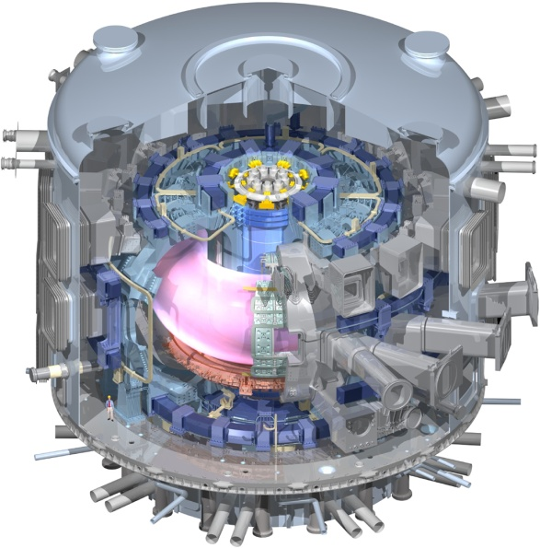
Unique ST properties support and accelerate
a range of development paths toward fusion energy
Extend Predictive Capability for ITER and Toroidal Science
  High β physics, rotation, shaping for MHD, transport
  Non-linear Alfvén modes, fast-ion dynamics, Electron gyro-scale turbulence at low ν*
Burning Plasma Physics - ITER

Slide 10
STs Narrow Gaps to FNSF/Pilot/DEMO:
Goal: 100% non-inductive + high β
Plasma-Material Interface Research
  Strong heating + smaller R → high P/R, P/S
  Novel solutions: snowflake, liquid metals, Super-X, hot high-Z walls
Enable Compact Fusion Nuclear Science Facility
  High neutron wall loading
  Potentially smaller size, cost
  Smaller tritium (T) consumption at fixed neutron wall loading
  Accessible / maintainable

Slide 11
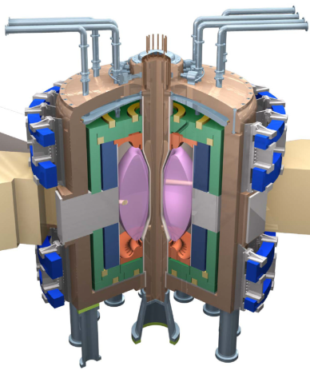
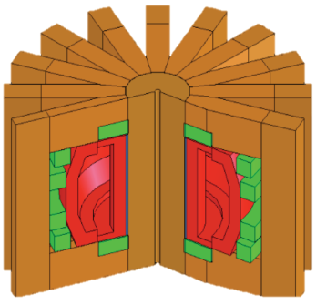
Fusion needs FNSF(s) (modest cost, low T, and reliable) to Test and Qualify Fusion Components
Fusion needs to develop reliable/qualified components which are unique to fusion:
Divertor/PFC
Blanket and Integral First Wall
Vacuum Vessel and Shield
Tritium Fuel Cycle
Remote Maintenance Components
FNSFs
FNSF-ST
FNSF-AT
Without R&D, fusion components could fail prematurely which often requires long repair/down time. This would cripple the DEMO operation.
FNSF can help develop reliable fusion components.
Such FNSF facilities must be modest cost, low T, and reliable.
If the cost of volume neutron source (FNSF) facility is “modest” << ITER, DEMO, it becomes highly attractive development step in fusion energy research. M.A. Abdou, et al., FTS (1996)

Slide 12
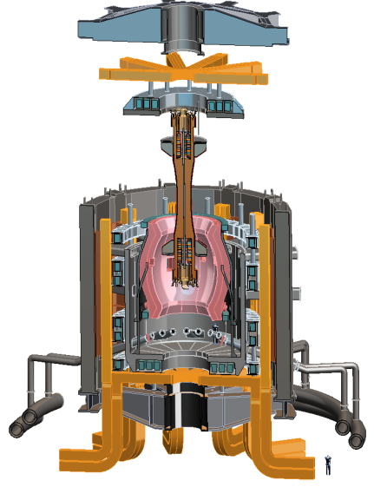
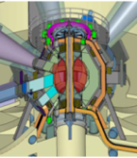
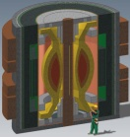
There have been several studies of ST-FNSF showing the potential attractiveness of this approach
Projected to access high neutron wall loading at moderate R₀, P_{fusion}
  W_{n} ~ 1-2 MW/m² , P_{fus} ~ 50-200MW, R₀ ~ 0.8-1.8m
Modular, simplified maintenance
Tritium breeding ratio (TBR) near 1
  Requires sufficiently large R₀, careful design
R&D Needs for an ST-FNSF
  Non-inductive start-up, ramp-up, sustainment
    Low-A → minimal inboard shield → no/small transformer
  Confinement scaling (especially electrons)
  Stability and steady-state control
  Divertor solutions for high heat flux
  Radiation-tolerant magnets, design
Example ST-FNSF concepts
PPPL
ORNL
Culham (UK)
UT Austin

Slide 13
Talk Outline
Unique ST properties
ST Fusion Energy Development Path
World ST Facilities
Unique ST Physics Regimes
ST-FNSF Relevant Experiments
ST Facility Upgrade Status
Summary
Notes:
Here is the outline of this review to give you an overview of the world ST research.

Slide 14
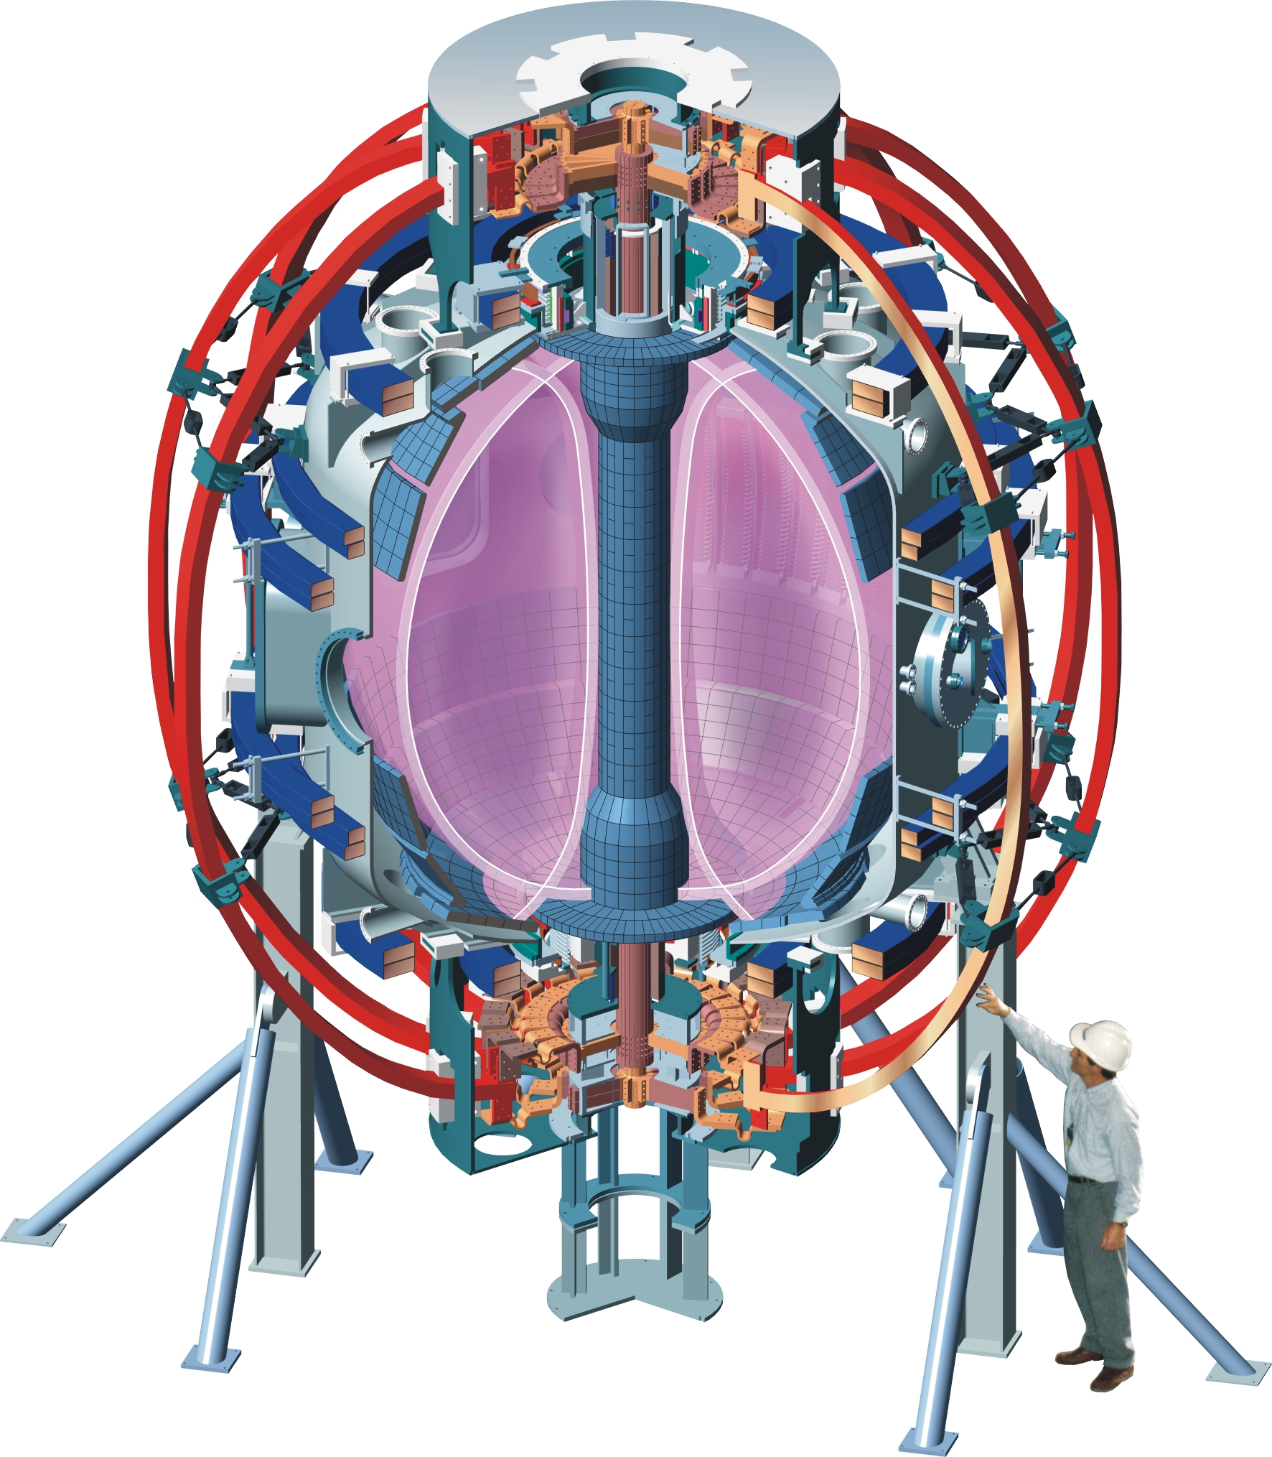
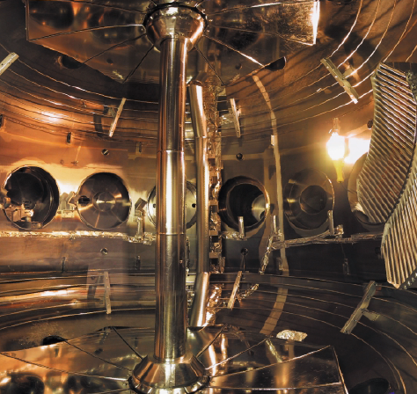
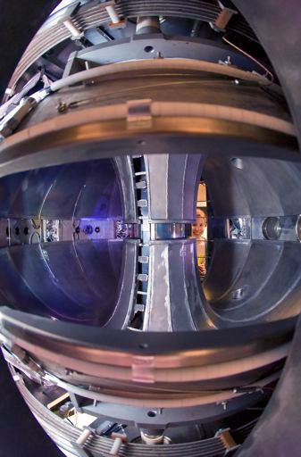
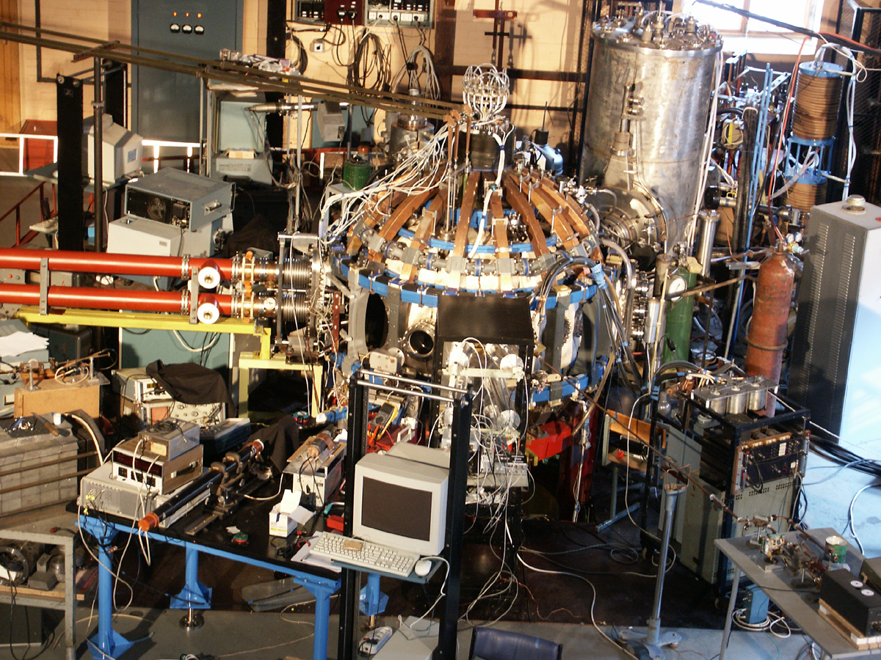
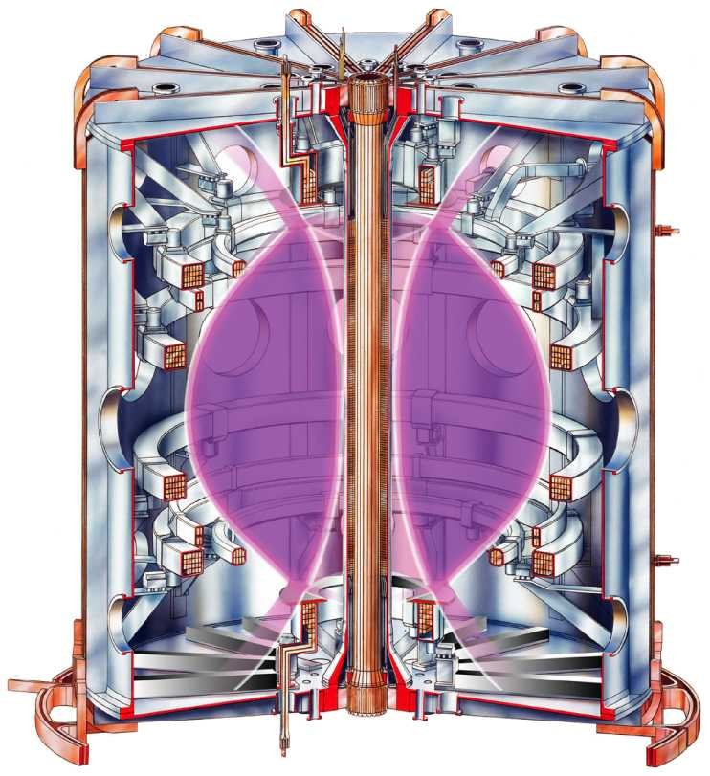
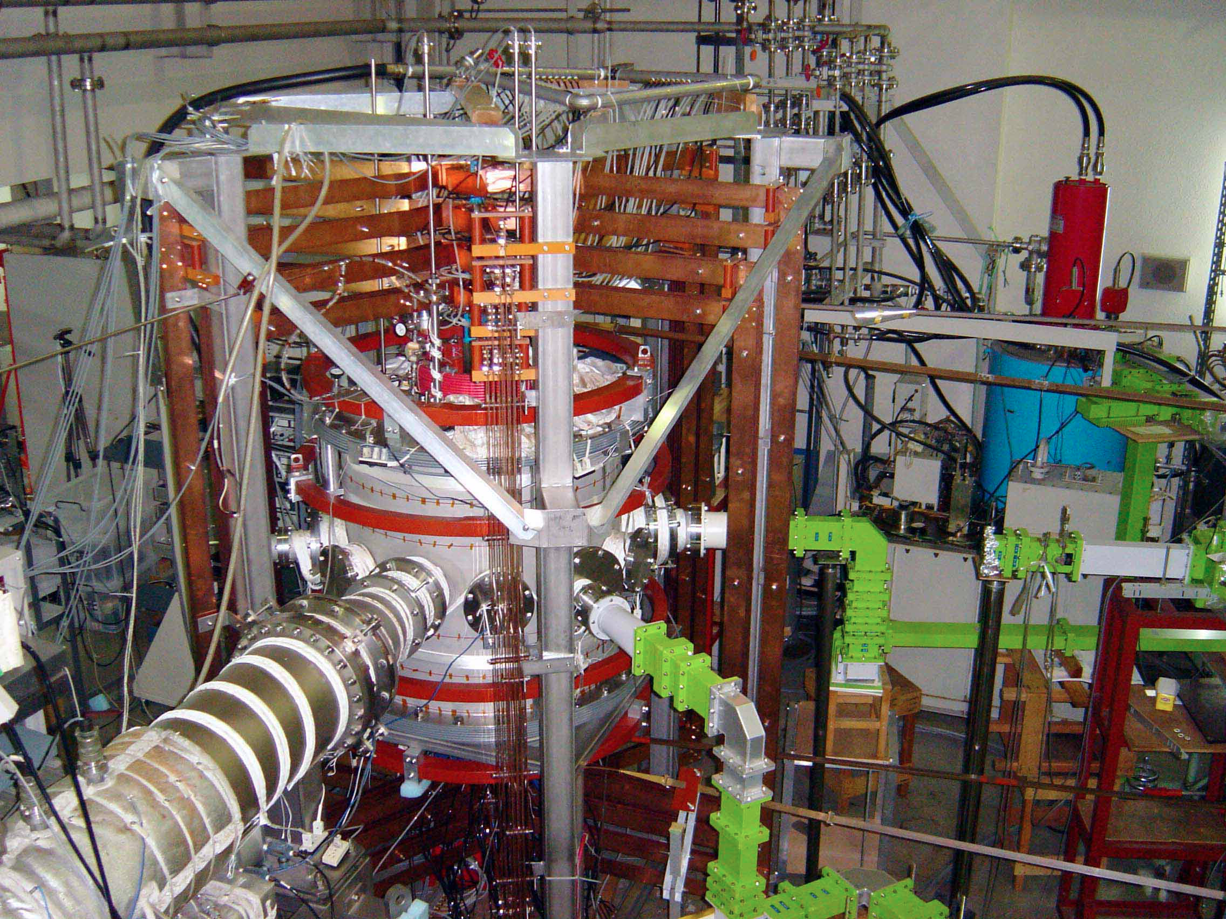
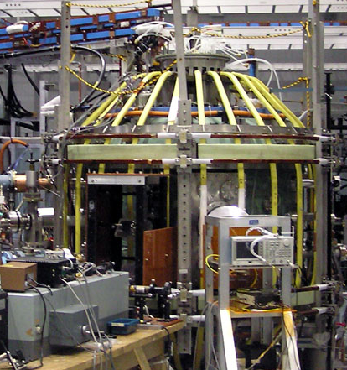
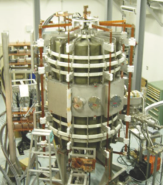
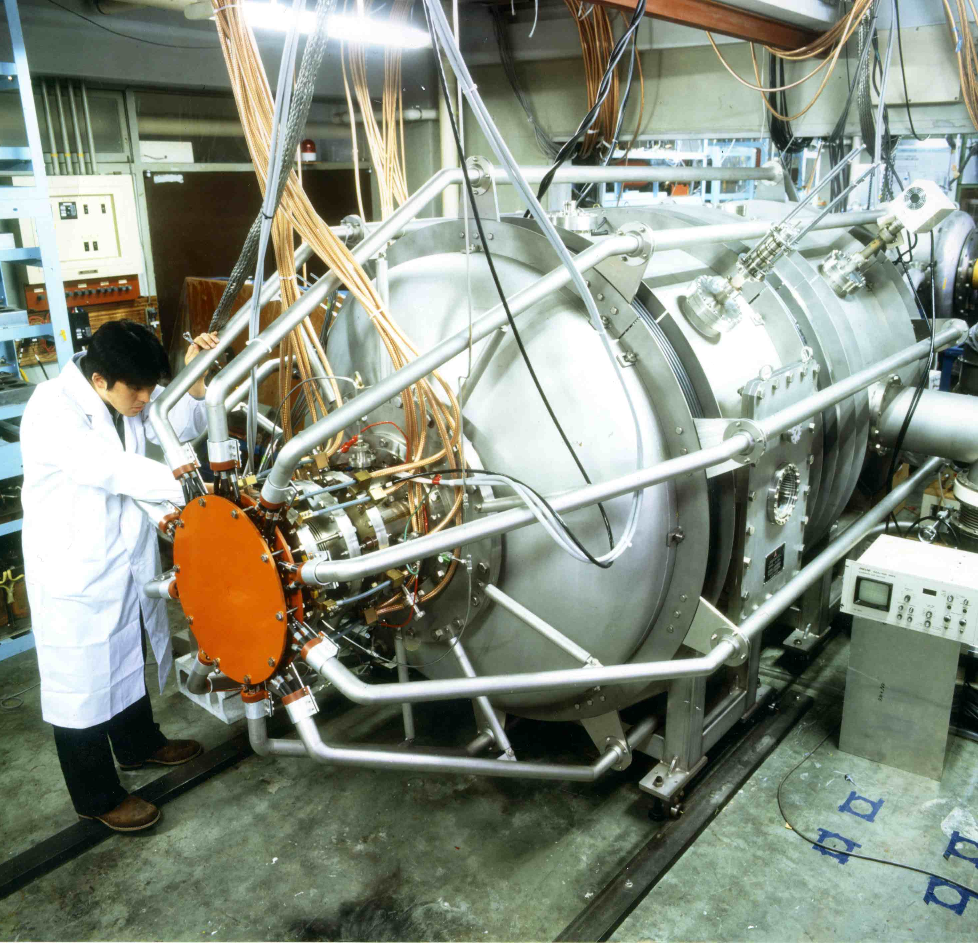
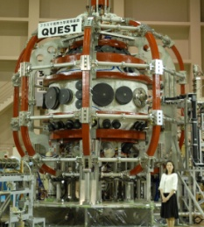
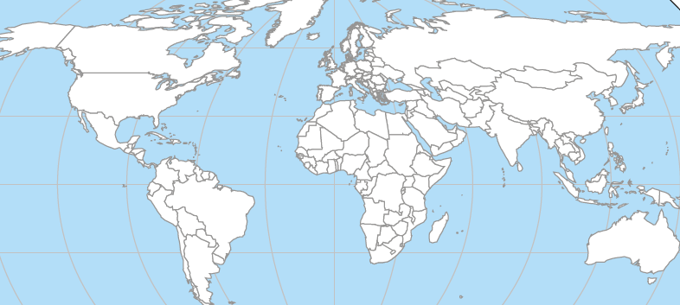
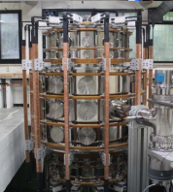
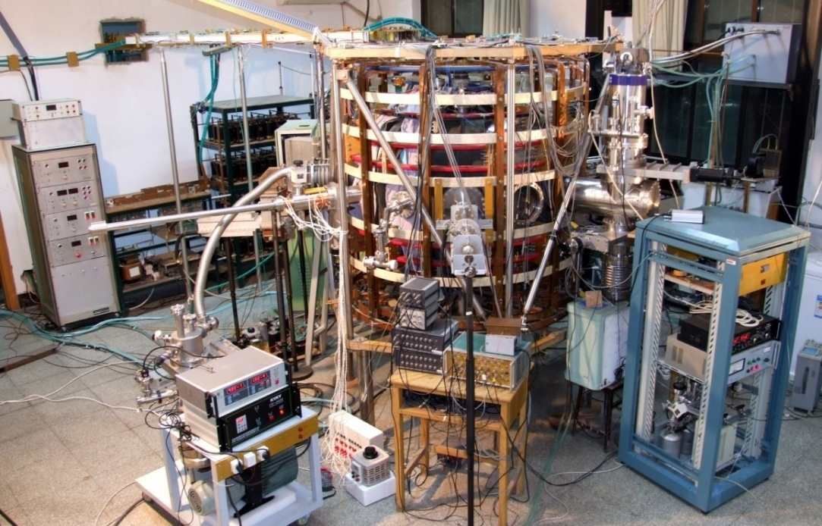

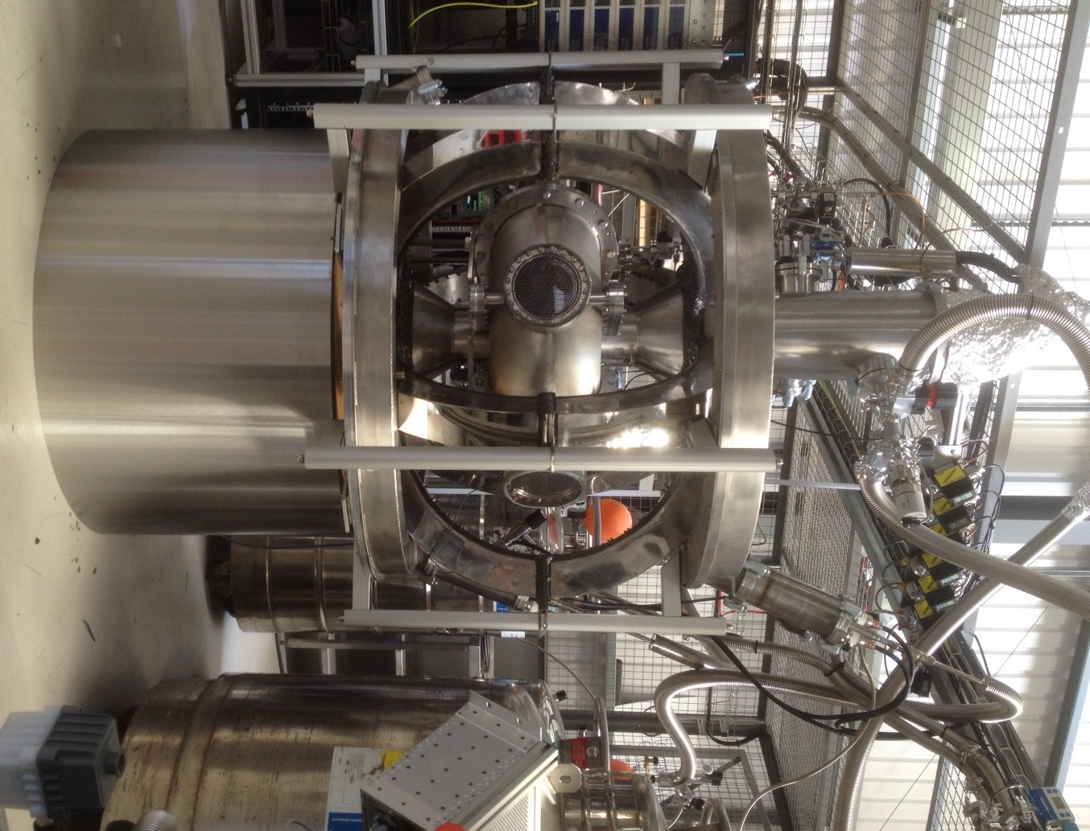

Operating ST Research Facilities Since 2000
NSTX and MAST: MA-class STs, Smaller STs addressing topical issues
NSTX, USA
PEGASUS, USA
LTX/CDX-U, USA
GLOBUS-M, Russia
MAST, UK
HIST, Japan
LATE, Japan
TST-2, Japan
UTST, Japan
R₀ ~ 0.75 m
QUEST/CPD, Japan
R₀ ~ 0.85 m
VEST, Korea
HIT-II, USA
HIT-II
PEGASUS
GLOBUS-M
QUEST
HIST
LATE
TST-2
TS3/4
UTST
MAST
z
z
KTM
SUNIST
VEST
NSTX/LTX
ST25(HTS)
SUNIST, China
ETE, Brazil
ST25, UK
TS3/4, Japan
ETE
z
STs operated since 2000
Notes:
NSTX and MAST are MA class STs so they are the flag ships of ST research. They are at present undergoing upgrades for 1 T operation. Globus-M is a medium size ST and it is undergoing upgrade to 1 T operation. There a large number of STs in Japan. And the QUEST device is the largest and their flagship device. It aim is to operate steady-state. There are also STs in China, Korean, Kazakhstan, and Brazil. One recent addition is ST25 which is the first all high temperature SC magnet tokamak by Tokamak Energy which is private funded enterprise. You can see quite a range of aspect ratio. The lowest one is PEGASUS with A = 1.15 with extremely slender center post. LTX is a lithium dedicated machine with A = 1.5. I do not have the time to cover the lithium research but there are companion papers at this conference for those interested. NSTX and MAST are 1.32. The ST devices spans quite broad range to make sure we capture necessary low A physics.

Slide 15
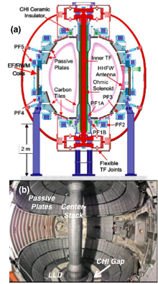
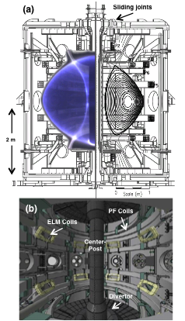
MA-Class ST Research Started in 2000
Complementary Physics Capabilities of NSTX and MAST
NSTX
Complementary Capabilities
MAST
Passive Plates
Heilicity Injection
HHFW
1 x 6 RWM Coils
Large divertor volume
Merging/Compression
ECH
2 x 12 ELM coils
Similar Capabilities
NSTX
R = 85 cm
A ≥ 1.3
= 1.7 - 3.0
B_{T} = 5.5 kG
I_{p} ≤ 1.5 MA
V_{p} ≤ 14 m³
P_{NBI} = 7.4 MW
MAST
R = 80 cm
A ≥ 1.3
= 1.7 – 2.5
B_{T} ~ 5.0 kG
I_{p} ≤ 1.5 MA
V_{p} ≤ 10 m³
P_{NBI} = 4.0 MW
Comprehensive diagnostics
Physics integration
Scenario development
M. Ono, et al., IAEA 2000, NF 2001
A. Sykes, et al., IAEA 2000, NF 2001

Slide 16
Talk Outline
Unique ST properties
ST Fusion Energy Development Path
World ST Facilities
Unique ST Physics Regimes
ST-FNSF Relevant Experiments
ST Facility Upgrade Status
Summary
Notes:
Here is the outline of this review to give you an overview of the world ST research.

Slide 17
Higher β_{T} enables higher fusion power and compact FNSF for required neutron wall loading
P_{fusion} ∝ ⟨p⟩ ² x Vol
Data base from START, MAST, PEGASUS and NSTX
β_{N} = 6
40
5
P_{fusion} ∝ β_{T}² B_{T0}⁴ x Vol
Toroidal β (%)
4
$
ST-FNSF
Product
Physics Knob
3
Investment
20
Tokamak
2
High neutron wall loading W_{n} possible in a compact ST
ITER
0
8
0
4
W_{n} ∝ P_{fusion} / Area
I_{p}/aB_{T0} (MA/mT)
W_{n} ∝ β_{T}² B_{T0}⁴ a (not strongly size dependent)
W_{n} ~ 1 MW/m² with R ~ 1 m FNSF feasible!

Slide 18
Record β_{N} and β_{N}/l_{i} accessed using resistive wall mode stabilization
High β_{N} regime is important for bootstrap current generation.
High β_{N}/l_{i} regime important since high f_{BS} regime has low l_{i}.
ST-FNSF
Unstable RWM
Stable / controlled RWM
S.A. Sabbagh PRL(2006)
J. W. Berkery, PRL (2011)
W. Zhu, PRL (2006)
S.A. Sabbagh at this APS
Major mission of NSTX-U is to achieve fully non-inductive operations at high β

Slide 19
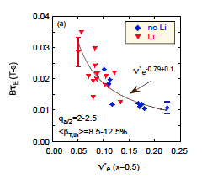
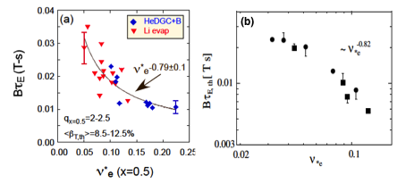
Favorable Confinement Trend with Collisionality and β found
Important implications for future STs and Demo with much lower ν
τ_{E, th} ∝ ν^{-0.1} β^{-0.9} tokamak empirical scaling (ITER98_{y,2})
τ_{E, th} ∝ ν^{-0.8} β^{-0.0} ST scaling
NSTX
Fig. 70. (a) Normalized confinement time as a function of collisionality at mid-radius in NSTX. Blue points are from discharges that used HeGDC+B wall conditioning, while red points are from discharges that used Li. Reprinted with permission from S.M. Kaye et al., Nucl. Fusion 53 063005 (2013). Copyright (2013). Institute of Physics.
(b) Collisionality scan of thermal energy confinement time in MAST. Reprinted with permission from M. Valovic et al., Nucl. Fusion 51 073045 (2011). Copyright (2011) Institute of Physics.
NSTX
MAST
~ ν_{*e} ^{-0.82}
B τ_{E,th} [ T s]
ν_{*e}
S.M. Kaye et al., NF (2007) (2013)
M. Valovic et al., NF (2011)
Very promising ST scaling to reactor condition, if continues on NSTX-U/MAST-U

Slide 20
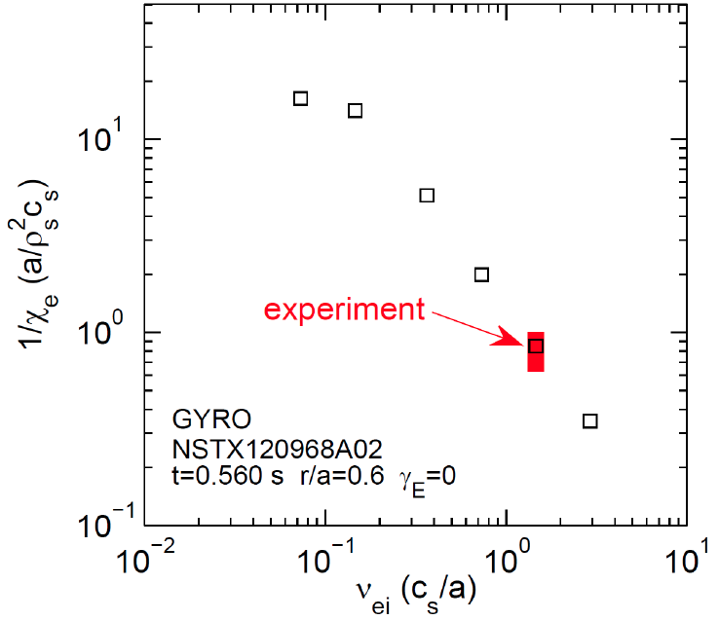


Microtearing-driven (MT) transport may explain ST collisionality scaling
Microtearing-driven χ_{e} vs. ν_{ei} using the GYRO code.
MT growth rate decreases with reduced collisionality in qualitative agreement with the NSTX experiment.
Futher electron confinement improvement expected for NSTX-U and MAST-U due to reduced collisionality.
NSTX-U /MAST-U
W. Guttenfelder, et al., PoP(2012)

Slide 21
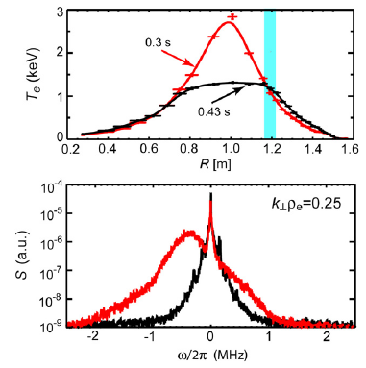
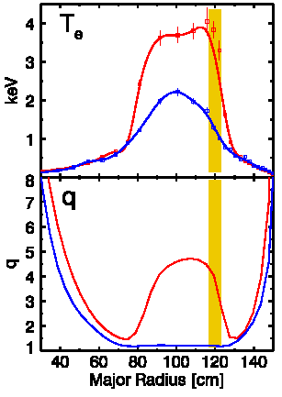
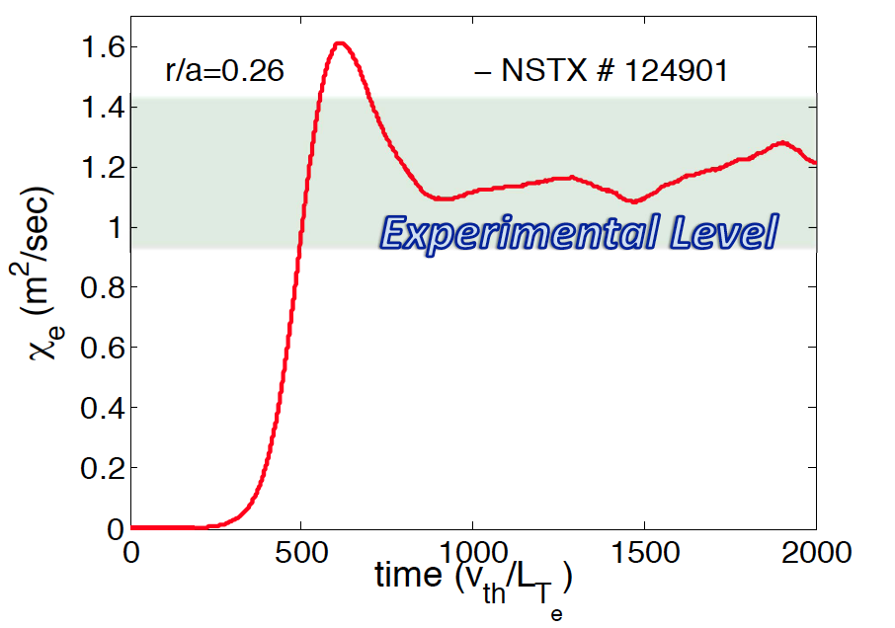
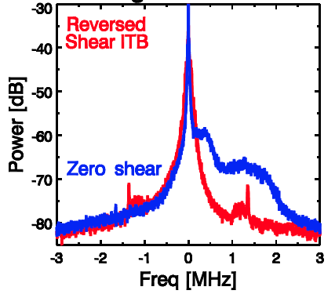
ETGs measured for the first time with high-k scattering
High β_{e} or larger ρ_{e} ∝ β_{e}^{0.5} of ST plasma enabled measurement of ETGs.
Electron Temperature Gradient Mode (ETG) Excitation with Core Electron Heating
ETG Suppression in Reversed Shear
Calculated ETG χ_{e} by GTS code agrees with experiment
χ_{e} (m²/sec)
χ_{e} (m²/sec)
χ_{e} (GTS)
time (V_{th}/L_{Te})
S. Ethier et al., IAEA (2010)
E. Mazzucato et al., NF (2009)
Shear stabilization of ETGs D. R. Smith, et al., PRL (2009)
Density gradient stabilization of ETGs Y. Ren, et al., PRL (2011)
Note: Here we call electron gyro-scale turbulence as ETGs
H.Y. Yuh et al., PoP (2009)
J.L. Peterson, et al., PoP(2011).

Slide 22
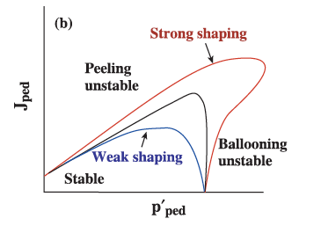
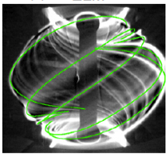
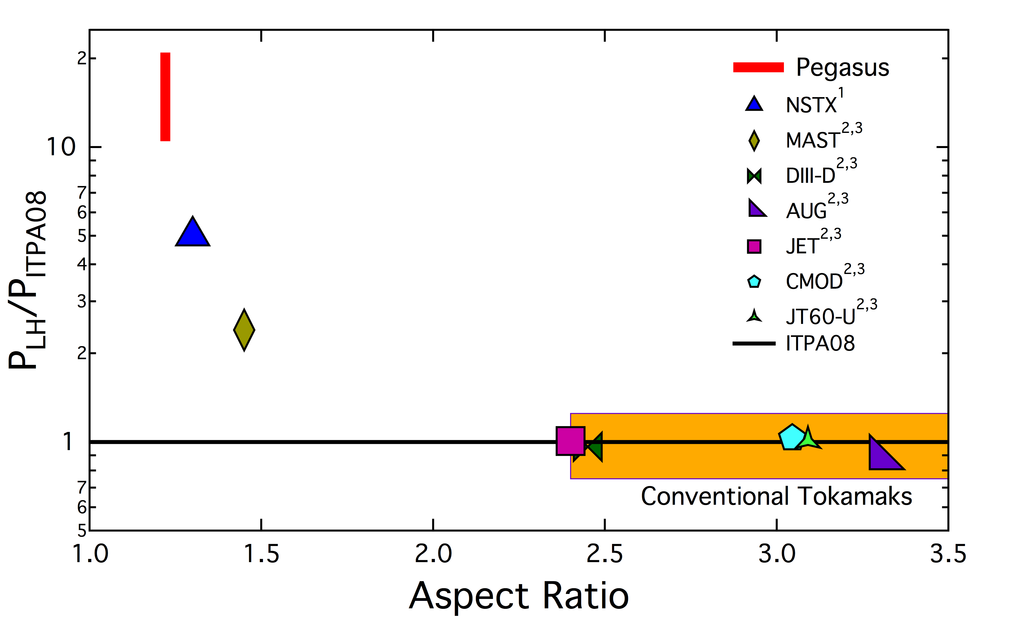
H-mode / ELM physics: High Priority Research Goal
Unmitigated ELMs could cause PFC damage in reactors
ST is in strongly shaped ELM regimes
Video images of MAST plasmas showing a filamentary ELM structure.
L-H power threshold scaling extended for low A
P.B. Snyder et al., PoP (2002).
MAST
(Type I)
NSTX, PEGASUS
(Type I)
FNSF
  N. Ben Ayed et al., PPCF (2009).
K.E. Thome et al., EPR (2014)
• NSTX/MAST/PEGASUS accessed H-mode at very low heating power < 1 MW and also in ohmic plasmas
• NSTX-U and MAST-U will provide H-mode access scaling for FNSF

Slide 23
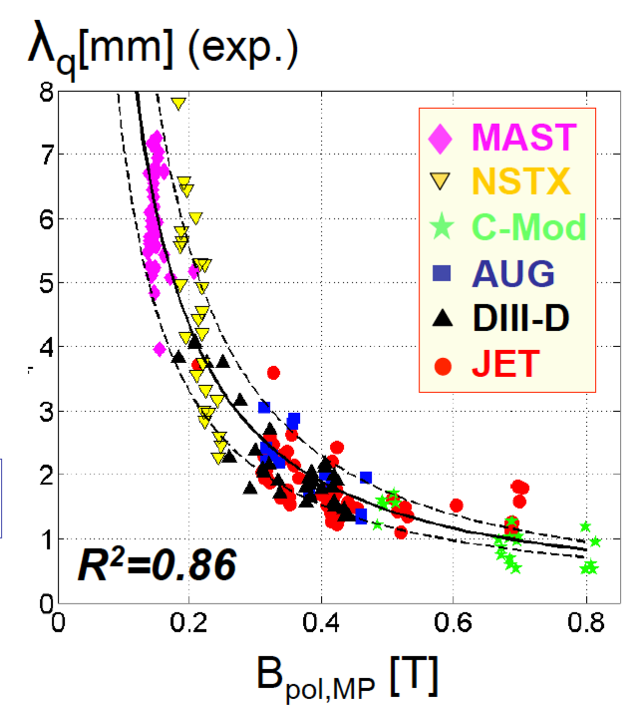
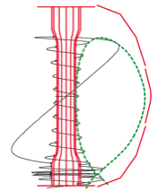
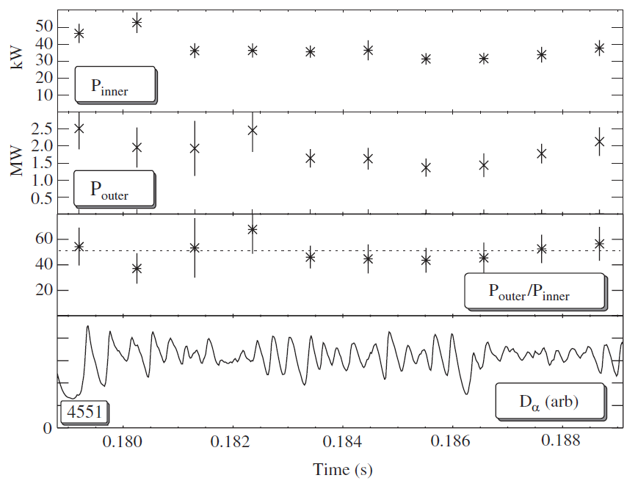
Divertor heat flux in Low-A regime
^{ST power flux} width clearly shows 1/Bp variation
STs data breaks A degeneracy of power flux width study.
Most divertor power arrives at outboard side in MAST and NSTX!
T. Eich et al., NF (2013).
P_{OB} >> P_{IB}
Inboad heat flux
Outboad heat flux
Ratio of outboard power flux vs. inboard in MAST
~ 40 kW
P_{IB} (kW)
~ 2 MW
Heuristic model by R.J. Goldston, NF (2012).
P_{OB} (kW)
* Unfavorable for large size, Ip devices such as ITER and Demo
"P B / R" as the new heat flux metric which is favorable for STs
~ 50
P_{OB}/P_{IB}
Time (s)
G.F. Counsell et al., PPCF (2002)

Slide 24
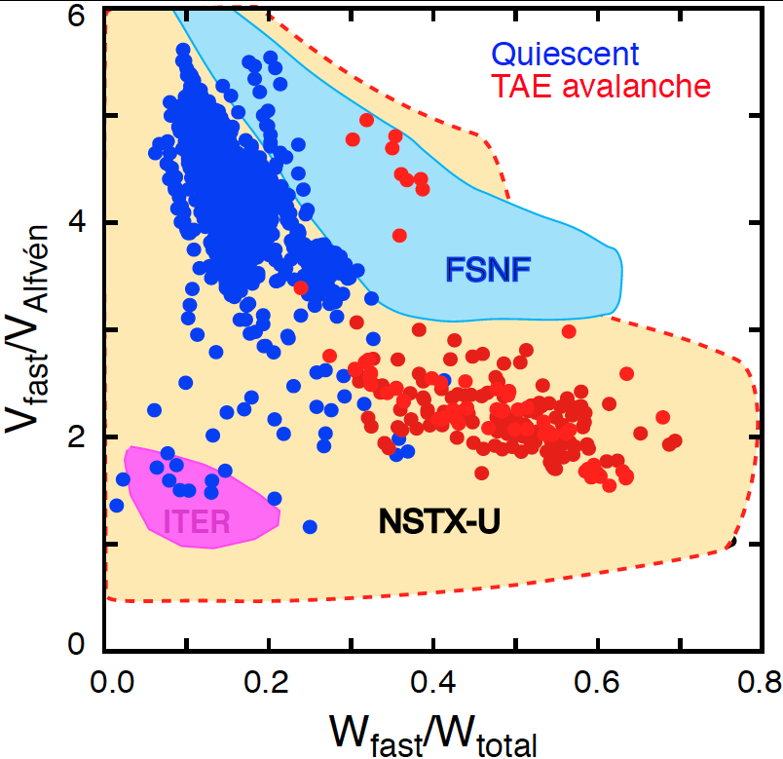
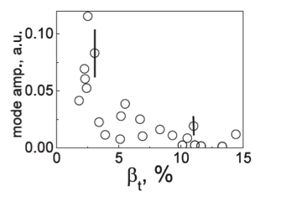
NBI heated ST plasmas provide an excellent testbed for α-particle physics
Alfvenic modes readily accessed due to high V_{α} > V_{Alf}
α-particles couples to Alfven-type mode strongly when V_{α} > V_{Alf} ~ β^{−0.5} Cs
V_{α} > V_{Alf} in ITER and reactors
In STs, the condition is easily satisfied due to high beta
A prominent instabilities driven by fast particles are global and called toroidal Alfven eigenmodes (TAE).
NSTX-U/MAST-U will also explore V_{α} < V_{Alf} regime giving more flexibility
EP parameter space
TAEs significantly modified at high β as V_{Alf} C_{s}
Stabilization of TAEs at high β in MAST
  M.P. Gryaznevich et al. PPCF (2004)
  E. D. Fredrickson et al., NF (2013)

Slide 25
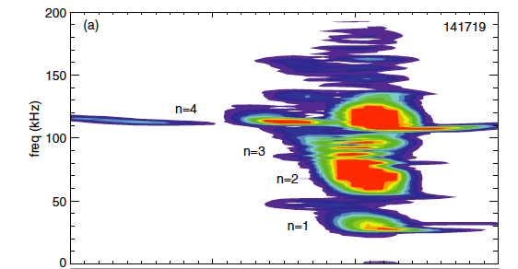
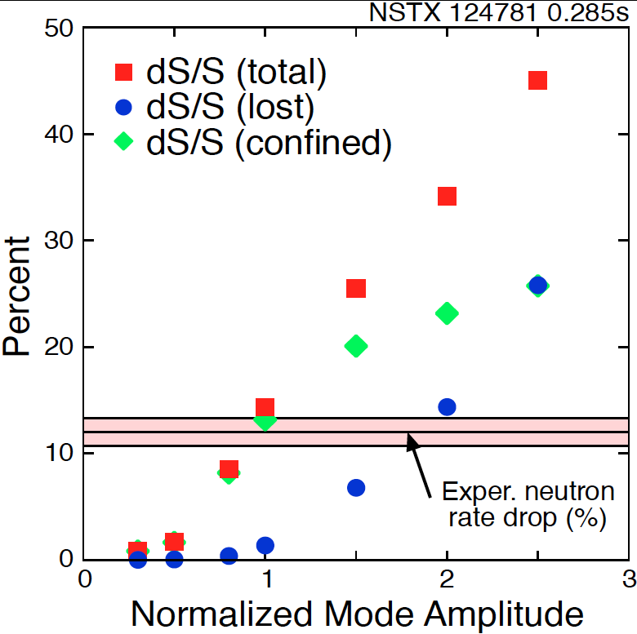
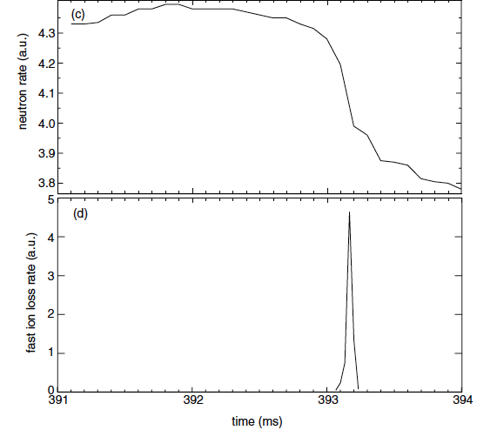
“TAE avalanche” shown to cause energetic particle loss
Uncontrolled α-particle loss could cause reactor first wall damage
Multi-mode TAE avalanche can cause significant EP losses as in “sea”of TAEs expected in ITER
Progress in simulation of neutron rate drop
due to TAE avalanche
(a)
Frequency (kHz)
Neutron rate (a.u.)
Fast ion loss rate (a.u.)
Time (ms)
Time (ms)
D.S. Darrow et al., NF (2013).
  E. D. Fredrickson et al., NF (2013)

Slide 26
Talk Outline
Unique ST properties
ST Fusion Energy Development Path
World ST Facilities
Unique ST Physics Regimes
ST-FNSF Targeted Experiments
ST Facility Upgrade Status
Summary
Notes:
Here is the outline of this review to give you an overview of the world ST research.

Slide 27
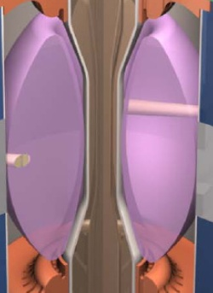
STs Addressing Critical Issues for FNSF and Demo
Compact ST-FNSF has no/small central solenoid
ST-FNSF Scenarios
high β_{T}, β_{N}, κ, disruption avoidance, high H, heat flux mitigation
I_{P} [MA]
Current ramp-up and profile control
NBI
Solenoid-free
Start-up
HHFW
EC/EBW, HI, PF
Time
• Three novel techniques for solenoid-free start-up and ramp-up investigated
  ECH/EBW
  Helicity Injection
  Merging-compression
~ 1-2 MA of solenoid-free start-up current needed for FNSF
Notes:
ST has been addressing critical issues for FNSF: A compact FNSF facility does not have solenoid. So, the solenoid-free start-up is a critical issue for ST-FNSF. But solenoid-free start-up is attractive for tokamak reactor design as well. Other issues are ramp-up….

Slide 28
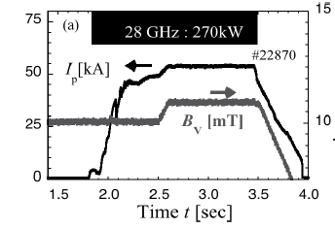
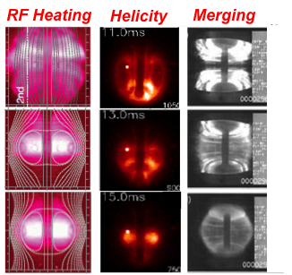
Efficient ECH/EBW start-up and sustainment demonstrated
RF start-up investigated in CDX, TST-2, LATE, MAST, QUEST, VEST, SUNIST
LATE ECH/EBW
55 kA sustained with 270 kW in QUEST, Japan
Initial Open Field Line Phase
Evolution Phase
ST formation Phase
H. Idei, et al., IAEA 2014
72 kA start-up current achieved with 75 kW in MAST, UK
TST-2
T.S. Bigelow et al., ISTW 2013
M. Uchida et al., PRL (2010).
ECH/EBW start-up to be tested at MW level in QUEST, NSTX-U and MAST-U.

Slide 29
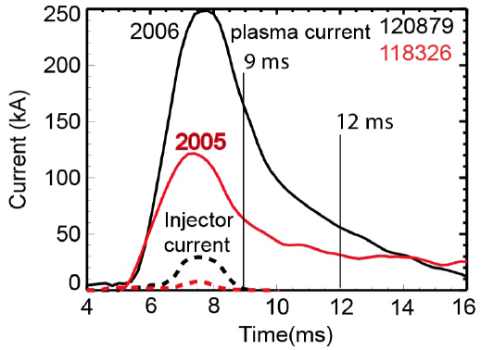
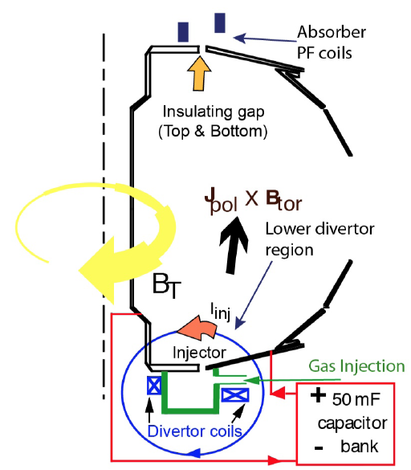
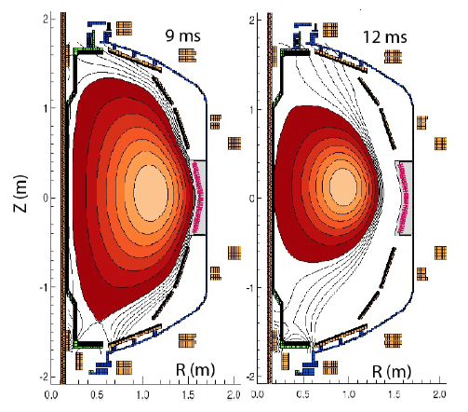
Helicity Injection Is an Efficient Method for Current Initiation
Coaxial Helicity Injection (CHI) Concepts Being Devloped
CHI developed on HIT and HIT-II and transferred to NSTX
Discharge evolution of 160 kA closed flux current produced by CHI alone in NSTX
R. Raman et al., PRL (2006)

Slide 30


Helicity Injection Is an Efficient Method for Current Initiation
Local Helicity Injection (LHI) Concepts Being Seveloped
  3-6 kA current injector array in plasma SOL
Long-Pulse Startup Demonstrated in PEGASUS with LHI
J. O’Bryan, PhD. Thesis, UW Madison 2014
Improving predictive capability for both CHI and LHI
CHI and LHI startup to be tested at higher current ~ 0.5-1.0 MA in NSTX-U.

Slide 31


Merging Start-Up Yielded High Current STs
Rapid ion heating observed from magnetic reconnection
Merging-compression start-up in MAST
CS Induction
Ultra high β STs produced by mergings in TS-3 Device
A. Sykes et al., NF (2001)
Y. Ono, et al., this APS
Y. Ono, et al., NF (2003)
Fig. 22. Schematic of UTST. Reprinted with permission from Y. Ono.

Slide 32


Current Ramp-Up and Profile Control Crucial for FNSF
Major Research Topics for MAST-U and NSTX-U
Efficient HHFW electron heating due to high β_{e} achieved in NSTX.
Near sustained discharges obtained with modest HHFW power.
NSTX
G. Taylor et al., PoP (2010), (2012)
HHFW current ramp-up will be tested in NSTX-U at higher power ~ 4 MW.

Slide 33
Current Ramp-Up and Profile Control Crucial for FNSF
Major Research Topics for MAST-U and NSTX-U
Off-axis NBI CD Required for Profile Control Demonstrated in MAST
Efficient HHFW electron heating due to high β_{e} achieved in NSTX.
Near sustained discharges obtained with modest HHFW power.
NSTX
  M. Turnyanskiy et al., NF (2009)
Off-axis current drive for profile control will be tested in both MAST-U and NSTX-U with major NBI upgrades.
G. Taylor et al., PoP (2010), (2012)
HHFW current ramp-up will be tested in NSTX-U at higher power ~ 4 MW.

Slide 34


NSTX has accessed A, β_{N}, κ needed for ST-based FNSF
Requires f_{BS} ≥ 50% for plasma sustainment
f_{BS} ≡ I_{BS} / I_{p} = C_{BS} β_{p} / A^{0.5} = (C_{BS}/20) A^{0.5} q* β_{N} ∝ A^{5} (1+κ²) β_{N}² / β_{T}
SC-ST
S.P. Gerhardt et al., NF (2011)
NSTX achieved f_{BS} ~ 50% and f_{NI} ~ 65-70% with beams.
NSTX-U expects to achieve f_{NI} ~100% with the more tangential (~ x1.5- 2 more current drive efficient) NBI.

Slide 35


NSTX Data Demonstrates a Favorable Operations Window For Reduced Disruptivity in an ST-FNSF
ST-FNSF
S=37
S=20
No strong increase in disruptivity as β_{N} increases
Reduction in disruptivity also with:
  Decreasing l_{i} (broader current profile)
  Decreasing pressure peaking
(S=q₉₅I_{P}/aB_{T})
Example: Disruptivity is reduced with strong shaping of the plasma boundary.
Upgrades will test and improve these favorable trends in a systematic way
S.P. Gerhardt et al., NF (2013)

Slide 36


High Confinement Needed for Compact FNSF
High confinement H-mode in the range of FNSF obtained
Fusion gain Q depends strongly on “H”, Q ∝ Η ⁵⁻⁷
Higher H enables compact ST-FNSF H = 1.2 – 1.3
Higher H gives more reactor design flexibility and margins.
• Ion energy transport in H-mode ST plasmas near neoclassical level due to high shear flow and favorable curvature.
• Electron energy transport anomalous
H-mode confinement in STs H ~ 1 (ITER98_{y,2}) but enhanced pedestal H-mode (EPH) has 50% higher H up to H ~ 2
NSTX
NSTX
EPH
FNSF
H-mode
Y. Ren.
S. Gerhardt NF (2014)
R. Maingi, PRL (2010)

Slide 37



ST-FNSF has high P/R due to small R
Innovative Heat Flux Mitigation via Divertor Flux Expansion
Lower toroidal field of outboard divertor leg of STs facilitates heat flux mitigation by divertor flux expansion solutions
Snow-flake
X-Divertor: CREST
Super-X: MAST-U
D. Ryutov, et al., PoP (2007)
P.M. Valanju, et al., PoP (2009).
Kotschenreuther, et al., PoP (2007)
Major mission of MAST-U is to investigate up-down symmetric Super-X configuration. NSTX explored Snow-flake / X-divertor.

Slide 38


Divertor flux expansion of ~ 50 achieved with
Snow Flake Divertor with large heat flux reduction in NSTX
Snowflake divertor in NSTX
NSTX-U will investigate novel divertor heat flux mitigation concepts needed for FNSF and Demo.
• Up-and-down symmetric Snow Flake / x-Divertors
• Lithium + high-z metal PFCs
OSP
Divertor heat flux (MW/m²)
V. A. Soukhanovskii et al., PoP (2012)

Slide 39
Talk Outline
Unique ST properties
ST Fusion Energy Development Path
World ST Facilities
Unique ST Physics Regimes
ST-FNSF Relevant Experiments
ST Facility Upgrade Status
Summary
Notes:
Here is the outline of this review to give you an overview of the world ST research.

Slide 40


NSTX and MAST are undergoing major upgrades
~ x 2 B_{T}, I_{p}, P_{NBI} and ~ x5 pulse length from NSTX/MAST
NSTX-U
MAST-U
Highly tangential 2nd NBI for non-inductive operations
Super X-divertor configuration for FNSF divertor solution

Slide 41





MAST-U to support novel exhaust concepts, ITER, and FNSF
Completed MAST operation in 2013 and began construction
Super X Divertors
• New Center Column for higher B_{T} and I_{p}
• Super-X Divertor for divertor heat flux mitigation
• Vertically off-axis NBI for current profile control.
Conventional
Super-X
End Plate Modules (LEP)
Centre Column (CC) Module
Off-Axis NBI
First plasma scheduled in 2016
J. Milnes SOFT 2014

Slide 42


NSTX-U to provide data base to support
ST-FNSF designs and ITER operations
Previous
center-stack
New
center-stack
New CS provides higher x2 TF (improves stability), 3-5s needed for J(r) equilibration
More tangential injection provides 3-4x higher CD at low I_{P}:
  2x higher absorption (40→80%) at low I_{P}
  1.5-2x higher current drive efficiency
~ X 5 - 10 increase in nτT from NSTX
NSTX-U average plasma pressure ~ Tokamaks
TF OD = 20cm
TF OD = 40cm
Key NSTX-U research topics for FNSF and ITER
Stability and steady-state control at high β
Confinement scaling (esp. electron transport)
Non-inductive start-up, ramp-up, sustainment
Divertor solutions for mitigating high heat flux
J. Menard, et al., NF (2012)
Present NBI
New 2nd NBI
Research operation to resume in Apr. 2015

Slide 43




NSTX Upgrade Project Is Nearly Complete
Recent aerial view of NSTX-U Test Cell (Oct. 27, 2014)
HHFW System
1st NBI
NSTX-U
CS Casing
2nd NBI

Slide 44


New Center-Stack Installed In NSTX-U
(October 24, 2014)
First plasma scheduled in Feb. 2015
M. Ono, et al., at this APS

Slide 45
Summary of Spherical Torus Research
World-wide effort with over 500 researchers and 140 students
• ST is a member of tokamak family with aspect ratio ≤ 2.0
• Unique ST features include natural elongation, compact geometry, and high beta which would be suitable for compact FNSF and PMI solutions.
• Extreme ST physics parameters exercise tokamak theory/modeling to validate and improve predictive capability needed for ITER and beyond where large extrapolations are needed.
• MA-class ST research began in 2000 with NSTX and MAST together with smaller ST facilities worldwide. Today, 16 ST facilities are operational.
• STs contributed strongly to fusion research program in all fusion energy science areas
• STs performed FNSF relevant experiments achieving many of the key plasma parameters and research objectives.
• Next phase of ST research begins shortly as 1T-2MA-class MAST-U and NSTX-U Facilities are coming on line for FNSF and ITER

Slide 46
ST Related Presentations at this APS Meeting
Invited Talks
  BI1.00001 (Mon): The effects of impurities and core pressure on pedestal stability in JET and MAST, Samuli Saarelma
  GI1.00003 (Tue): Broadening of the divertor heat flux footprint with increasing number of ELM filaments in NSTX, Joon-Wook Ahn
  NI2.00003 (Wed): High Power Heating of Magnetic Reconnection in Tokamak Merging Experiments, Yasushi Ono
  TI1.00001 (Thu): Simulation of 3D effects on partially detached divertor conditions in NSTX and Alcator C-Mod. Jeremy Lore
  TI1.00003 (Thu): Drift Kinetic Effects on 3D Plasma Response in High-beta Tokamak Resonant Field Amplification Experiments, Z.R. Wang
  VI2.00002 (Thu): Unification of Kinetic Resistive Wall Mode Stabilization Physics in Tokamaks. S.A. Sabbagh
  YI1.00006 (Fri): Energy Channeling and Coupling of Neutral-beam-driven Compressional Alfv’en Eigenmodes to Kinetic Alfv’en Waves in NSTX, Elena Belova
  YI2.00003 (Fri) : High Performance Discharges in the Lithium Tokamak eXperiment (LTX) with Liquid Lithium Walls, John Schmitt
Oral Session GO3 (Tue): MAST-U, PEGASUS, NSTX-U, LTX
Poster Session PP8 (Wed): NSTX-U, LTX, PEGASUS, MAST-U, QUEST, TS-4

Slide 47
Back-up slides

Slide 48


Nearly self-sustained ST-Demo regimes identified
q-profile appears to be a differentiating feature for ST and AT
f_{BS} ≡ I_{BS} / I_{p} = C_{BS} β_{p} / A^{0.5} ∝ A^{5} (1+κ²) β_{N}² / β_{T}
AT
ST
J. Menard et al., PPPL Report, 2003
Reversed shear AT likely suffers from infernal modes and/or double tearing at high beta, and we can potential reduce or eliminate reverse shear in ST due to higher edge q-shear from low-A
Notes:
Number of ST power plant /DEMO studies showing generally competitive COE.

Slide 49








ST research program supports and accelerates
a range of development paths toward fusion energy
Extend Predictive Capability
  Non-linear Alfvén modes, fast-ion dynamics
  Electron gyro-scale turbulence at low ν*
  High β, rotation, shaping, for MHD, transport
Burning Plasma Physics - ITER
Fusion Nuclear Science Facility
Pilot Plant or DEMO
FNSF-ST
ST Research
ARIES-ST
STs Narrow Gaps to Pilot/DEMO:
Goal: 100% non-inductive + high β
Plasma-Material Interface Research
  Strong heating + smaller R → high P/R, P/S
  Novel solutions: snowflake, liquid metals, Super-X, hot high-Z walls
FNSF-AT
Steady-State, Plasma-Material Interface R&D
ARIES-AT
Fusion Nuclear Science Facility
  High neutron wall loading
  Potentially smaller size, cost
  Smaller T consumption
  Accessible / maintainable
EAST
JT-60SA
VULCAN
NHTX
ARIES-CS
KSTAR
W7-X, LHD
QUASAR
J. Menard

Slide 50



ST Fusion Power Plants
Copper vs. Superconducting Coils
Nearly fully self-sustained ST/Tokamal reactor requires high κ and β_{N}
f_{BS} ≡ I_{BS} / I_{p} = C_{BS} β_{p} / A^{0.5} = (C_{BS}/20) A^{0.5} q* β_{N} ∝ A^{5} (1+κ²) β_{N}² / β_{T}
All of the ST power plant designs have q₉₅ ~ 10 which could give needed MHD stability
ARIES-ST
Cu Power Plant
JUST
SC ST Power Plant
Copper design – Compact but due to larger recirculating power leading to higher fusion power needing aggressive β_{T}, β_{N}, κ. designs..
SC design – Larger size due to SC shielding requirement. But smaller recirculating power provides more flexibility in design such as operating at lower fusion power, more moderate β_{T}, β_{N}, κ, etc.
R₀ ~ 3.2 m
R₀ ~ 4.5m
F. Najmabadi et al., FED (2003)
H. R. Wilson, et al., NF (2004)
Y. Nagayama et al., IEEJ (2012)
B.G. Hong, Yet al.,NF (2011)
K. Gi IAEA(2014)

Slide 51





Non-conventional ST Fusion Power Reactors
Taking advantage of compact and light weight ST fusion core
ST135
R = 1.35m
Q_{fus} ~ 5 Pilot Plants
The Discovery II
ST Fusion-Fission Hybrid
Realizing "2001: A Space Odyssey": Piloted Spherical Torus Nuclear Fusion Propulsion
front view
ST Fusion Core
ST-FNSF-like Q ~ 1 facility producing net energy by “burning” highly toxic long-live nuclear waste
With HTS magnet operating at 3.7T/7 MA P_{fusion} = 185 MW
aft view
M. Kotschenreuther et al., FE&D (2009).
A. Sykes, SOFT 2014
C.H. Williams, et al., NASA/TM-2005-213559

Slide 52



ELM Stabilization and Mitigation
Through application of lithium and 3-D fields
ELMs stabilized with edge pressure modification with Li in NSTX
ELM mitigation with n=3
3-D fields (ELM Coils) in MAST
D.K. Mansfield, et al., JNM (2009)
Increasing Type I ELM freq. by x 8 (900 Hz) has reduced heat flux
R. Maingi, et al., PRL (2009).
A. Kirk et al., NF (2013)

