Slide 1
Initial error field correction studies in the National Spherical Torus Experiment Upgrade
Clayton E. Myers¹, S. P. Gerhardt¹, J. E. Menard¹, N. M. Ferraro¹, J.-K. Park¹, R. E. Bell¹, B. P. LeBlanc¹, M. Podestà¹, and S. A. Sabbagh²
¹Princeton Plasma Physics Laboratory, ²Columbia University
APS-DPP 2016
San Jose, California
November 1, 2016

Slide 2
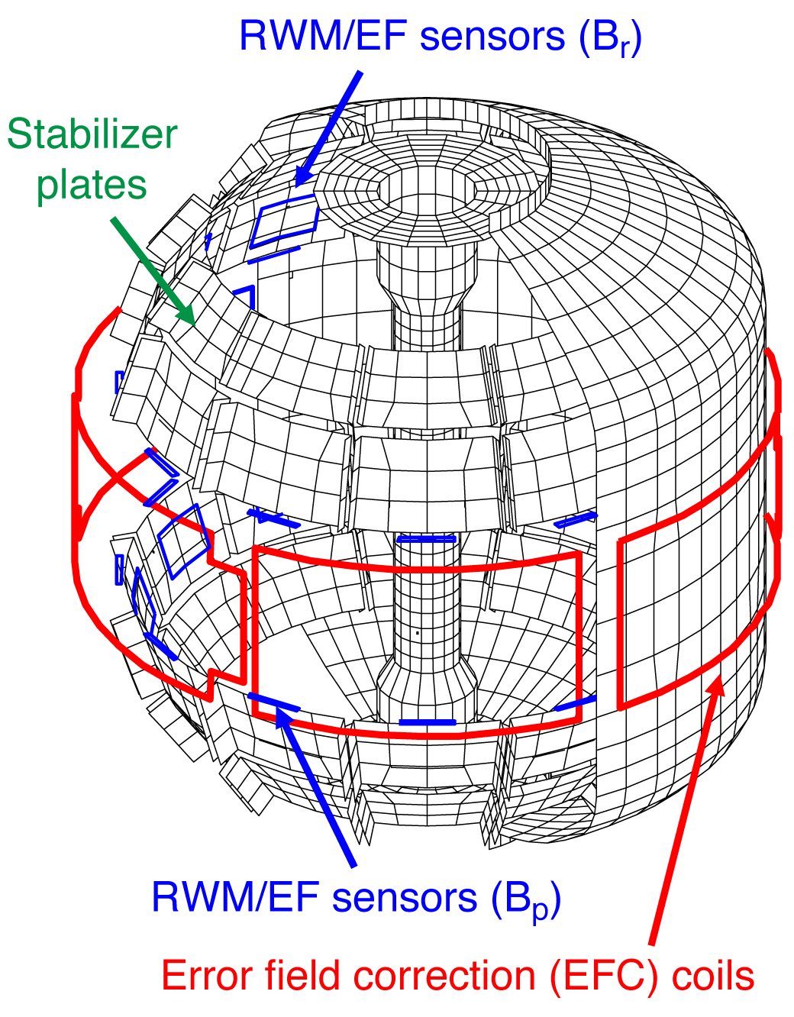
Error field correction is key to achieving high performance
Error field correction (EFC) objectives:
Probe the plasma response to applied 3D fields
Near-term empirical EFC prescription
Error field source identification
EFC sensors and actuators in NSTX-U:
Four sets of 3D magnetic field sensors with 12 toroidal locations each (B_{P}/B_{R}, Upper/Lower)
Six midplane EFC coils to apply n=1,2,3 fields simultaneously ← new capability for NSTX-U

Slide 3
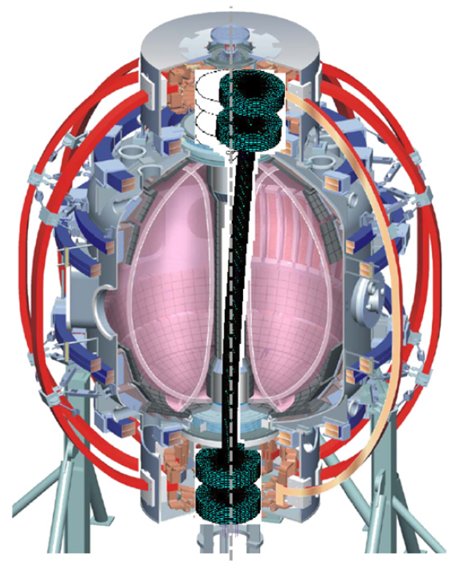
Candidate error field sources in NSTX-U
Candidate error field sources:
Non-circularity of the main vertical field coil (PF5)
Non-axisymmetry of vessel eddy currents
Tilt of the TF coil from the vertical
Tilt of the OH coil from the vertical
Time-dependent OH×TF interaction [see right]
Error field identification techniques:
Plasma-like vacuum shots
Feed-forward EFC coil currents
Compass scans (n = 1)
Menard et al. Nucl. Fusion 2010

Slide 4
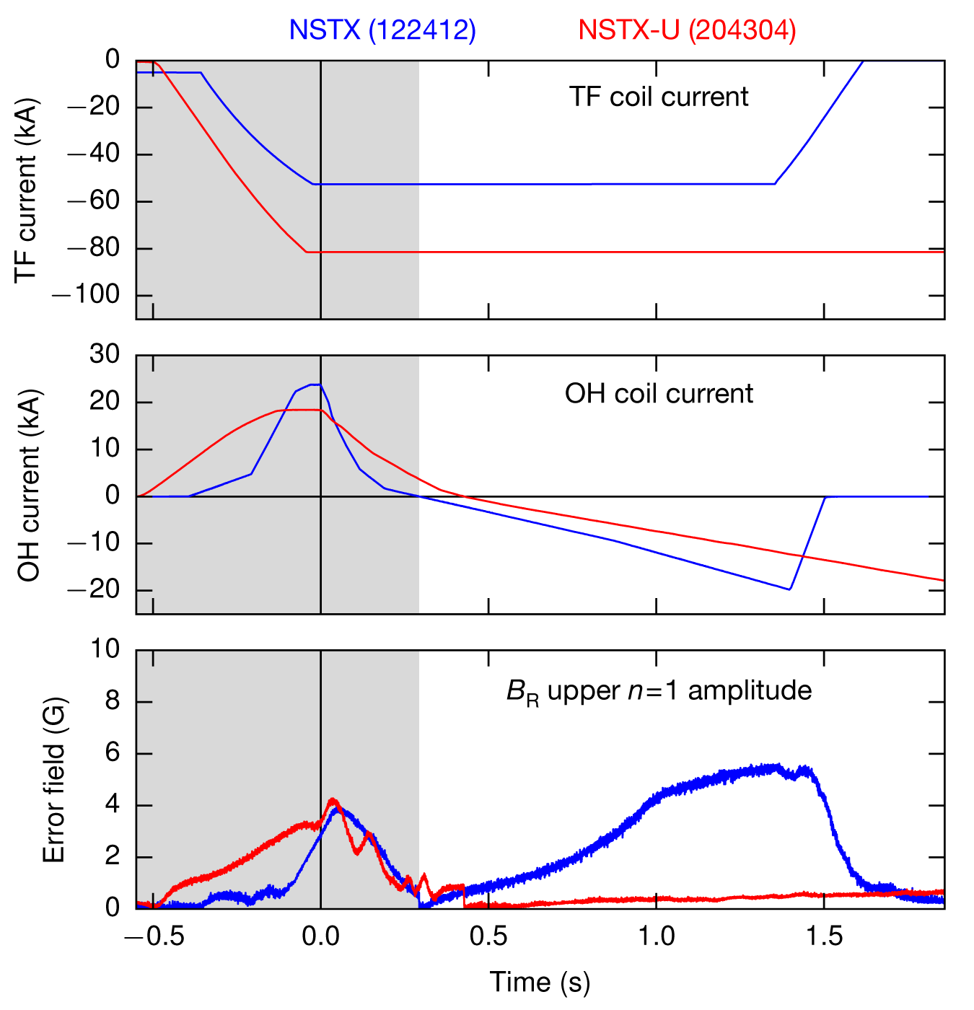
OH×TF interaction definitively ruled out
In NSTX, time-dependent OH×TF error field due to OH lead geometry
Designed out of NSTX-U with coaxial OH lead assembly [Menard NF 2012]
Compare plasma-like vacuum shots:
In NSTX, OH×TF error field visible in δB_{R} as I_{OH} swings negative
In NSTX-U, no such OH×TF error field is measured

Slide 5
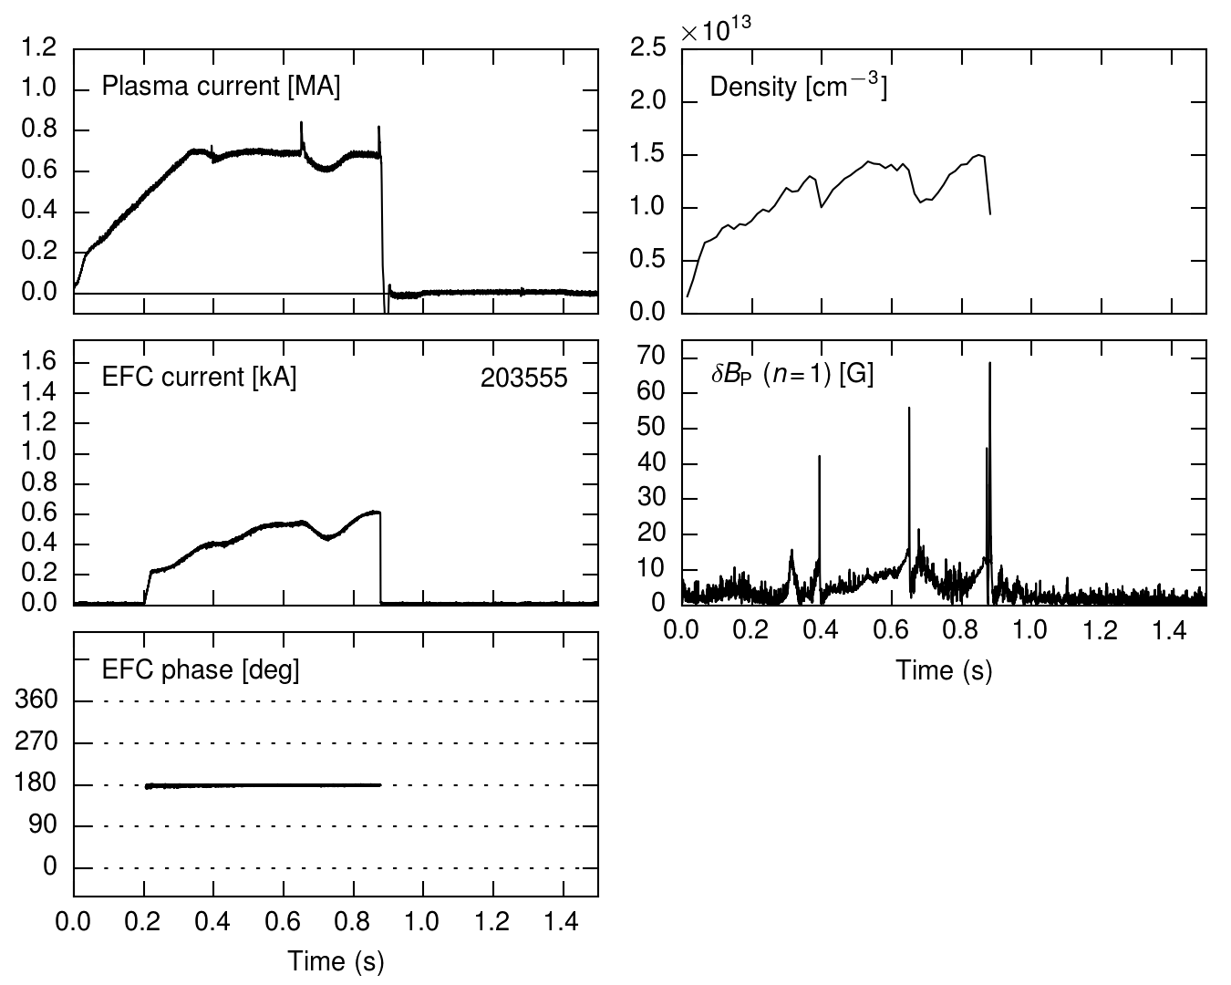
Seek initial n = 1 EFC with PF5-proportional 3D fields
Apply n = 1 fields at fixed phase
Set amplitude proportional to the main vertical field (PF5)
Locking events visible in the density and in δB_{P}

Slide 6
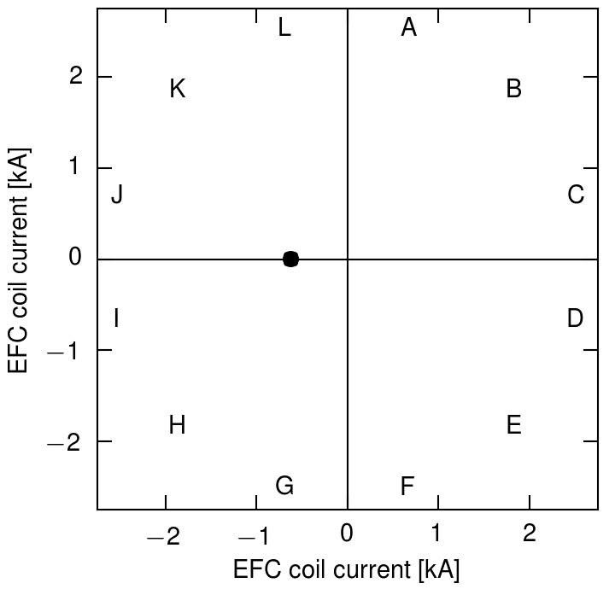
Seek initial n = 1 EFC with PF5-proportional 3D fields
Apply n = 1 fields at fixed phase
Set amplitude proportional to the main vertical field (PF5)
Locking events visible in the density and in δB_{P}

Slide 7
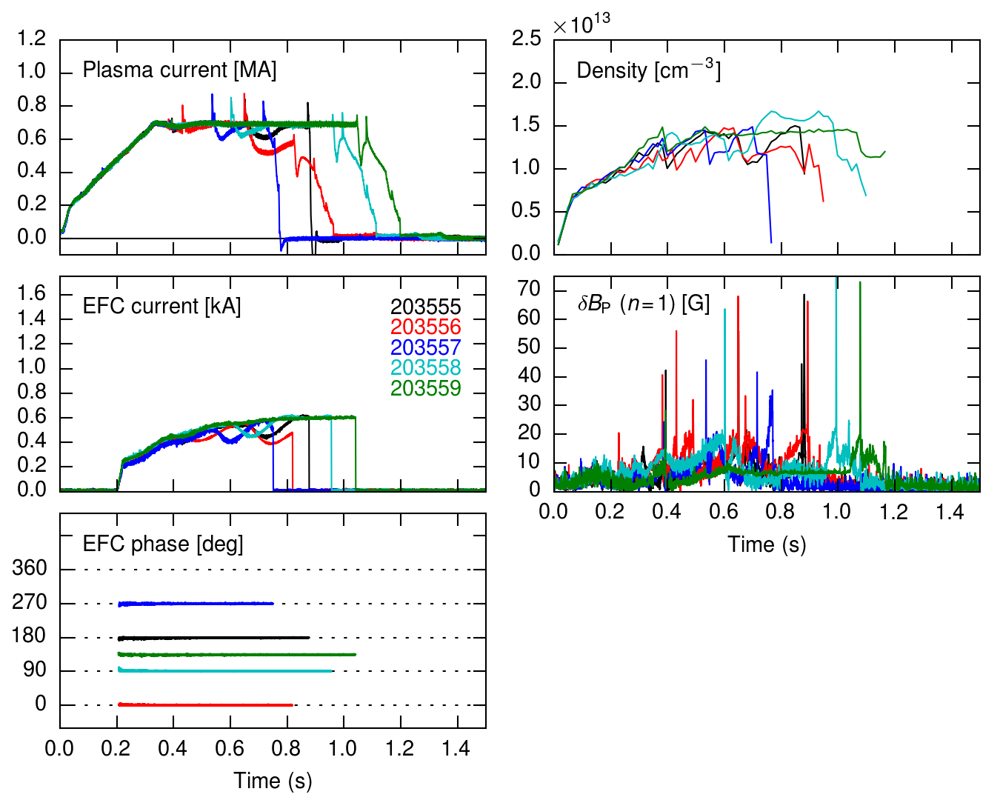
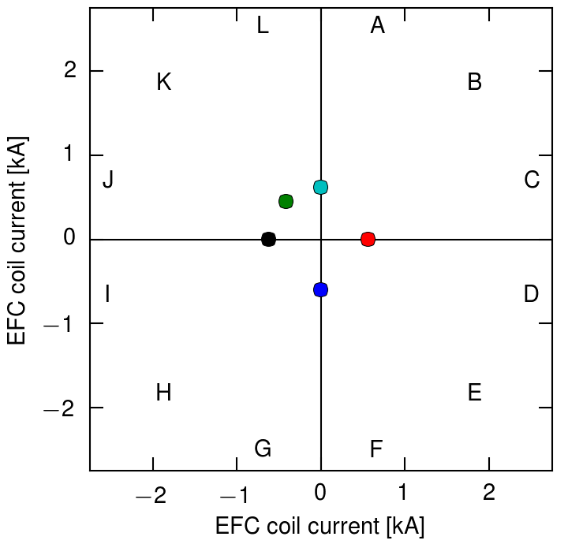
Feed-forward phase scan: φ = 135°
Apply n = 1 fields at fixed phase
Set amplitude proportional to the main vertical field (PF5)
Locking events visible in the density and in δB_{P}
Applied field phase scan:
Optimum phase = 135°

Slide 8
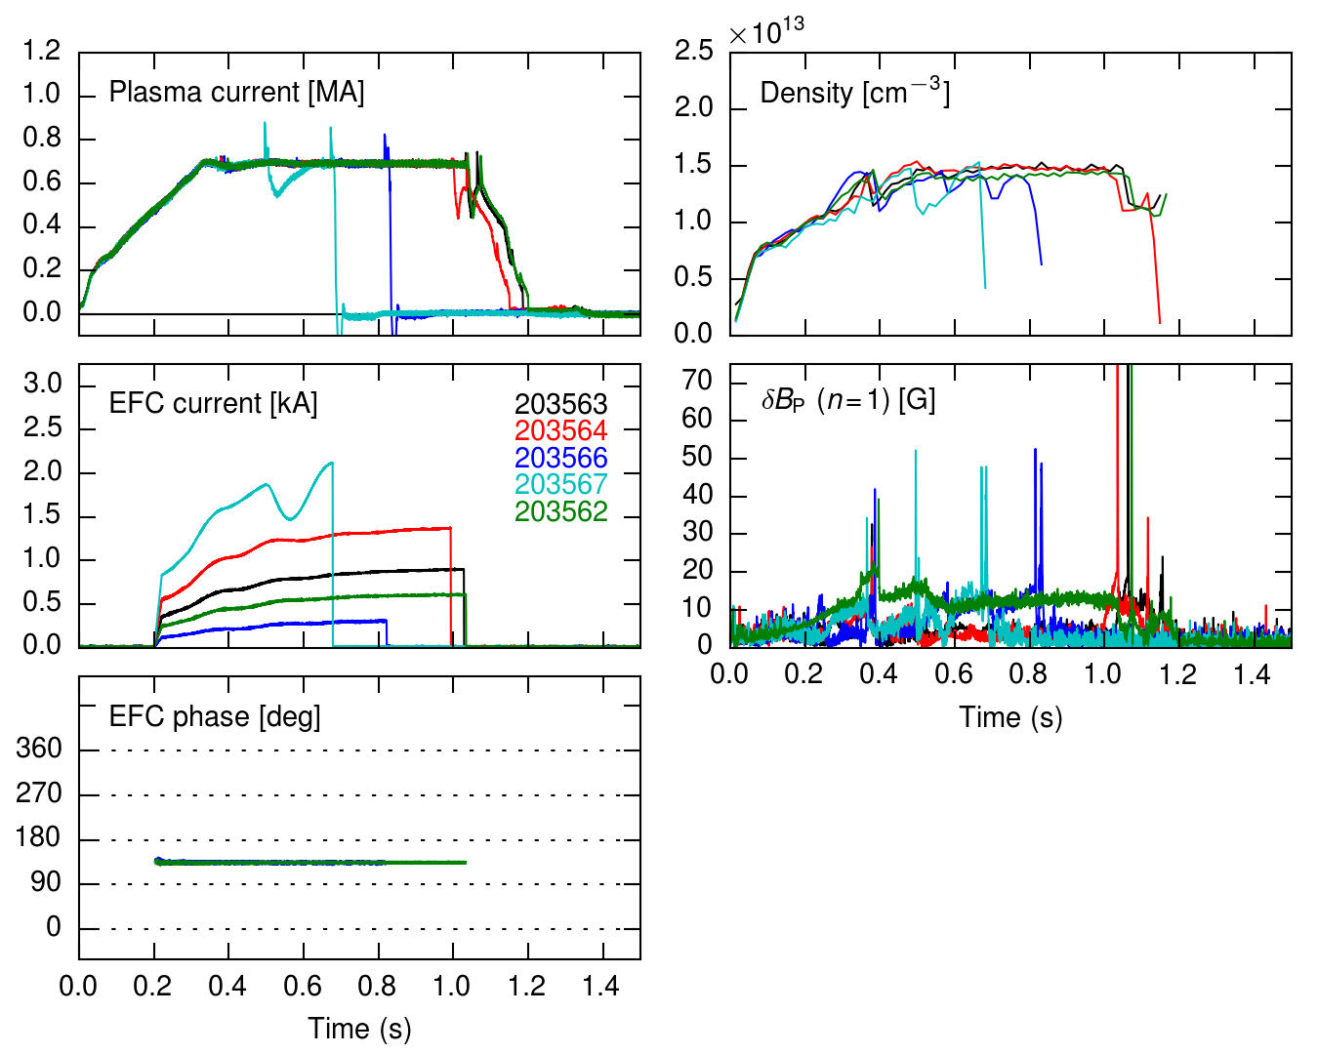
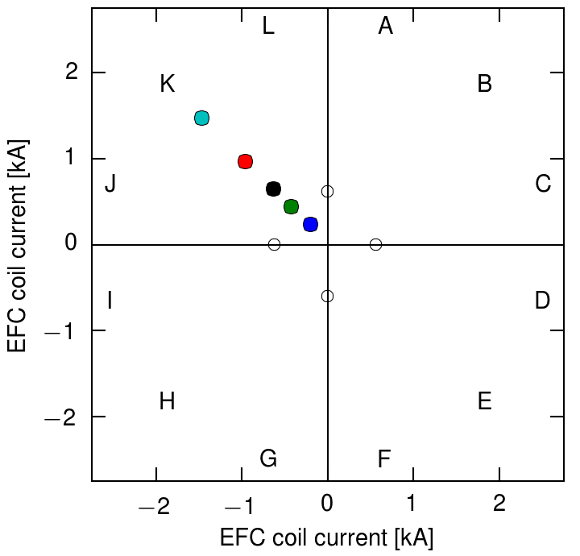
Feed-forward amplitude scan: I_{EFC} = 600 A
Apply n = 1 fields at fixed phase
Set amplitude proportional to the main vertical field (PF5)
Locking events visible in the density and in δB_{P}
Applied field phase scan:
Optimum phase = 135°
Applied field amplitude scan:
Optimum amplitude = 600 A
Proportional to PF5

Slide 9
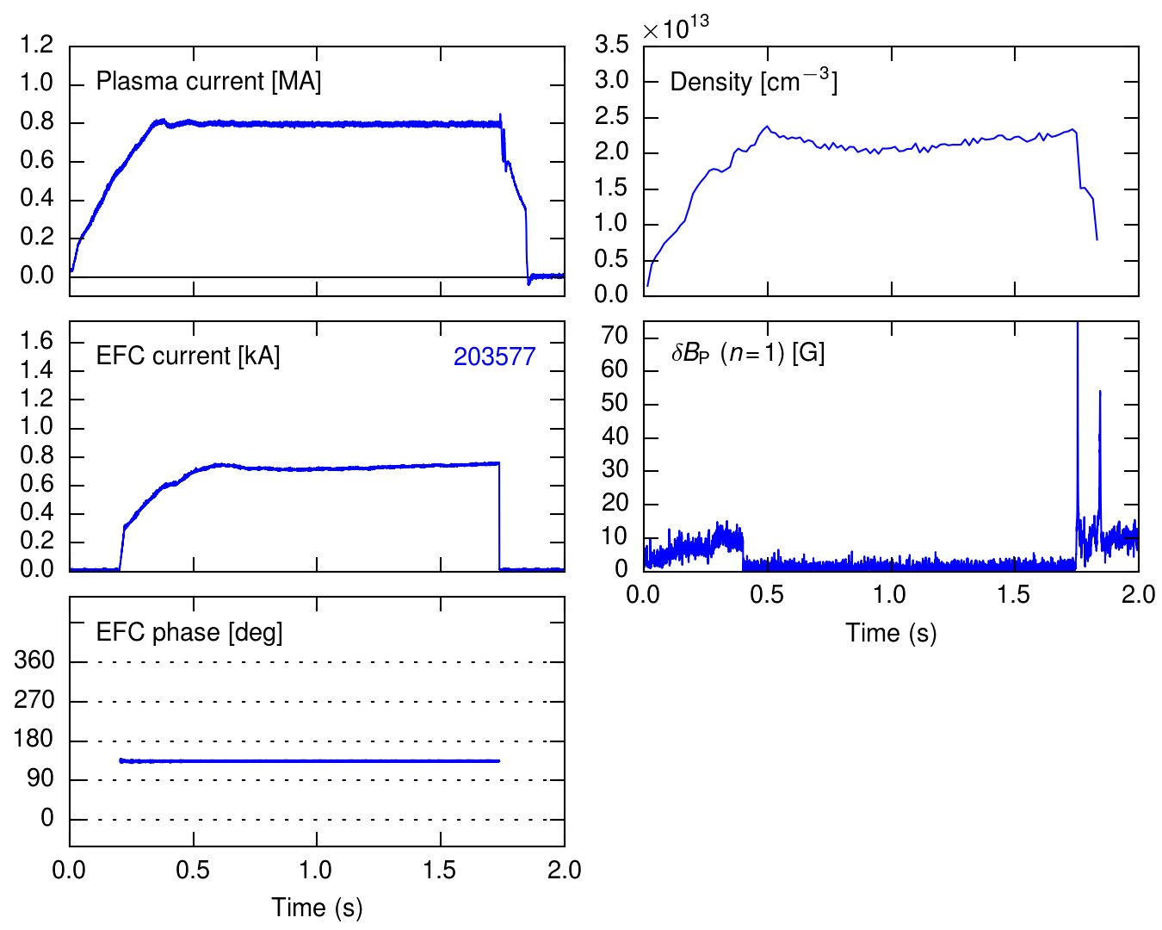
Long-pulse L-mode scenario established after implementing PF5-proportional EFC
Quickly established a robust 1 MW beam-heated L-mode scenario
I_{p} = 800 kA with flat density evolution and quiescent δB_{P}
The discharge terminates at ~1.7 sec due I_{OH} limit

Slide 10
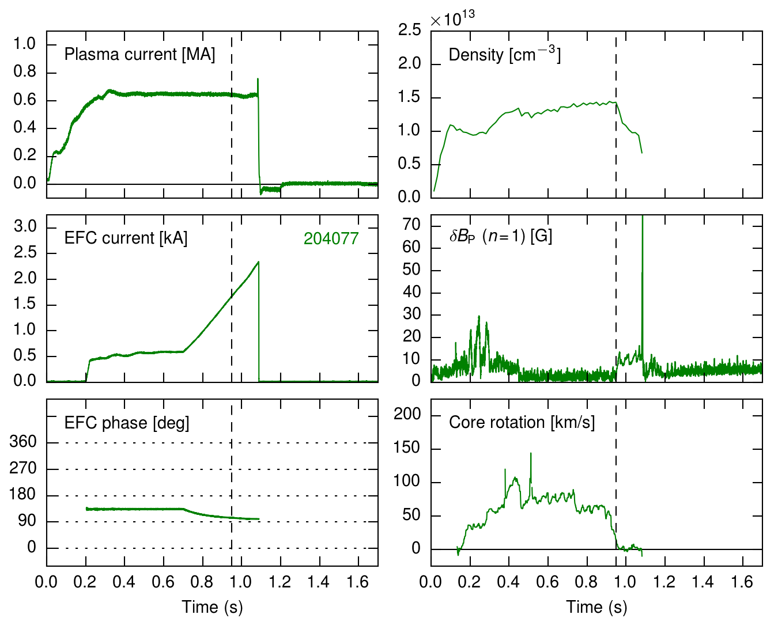
Refine optimum EFC with an n = 1 compass scan
Compass scan steps:
Select n = 1 phase
Ramp n = 1 amplitude until the discharge terminates

Slide 11
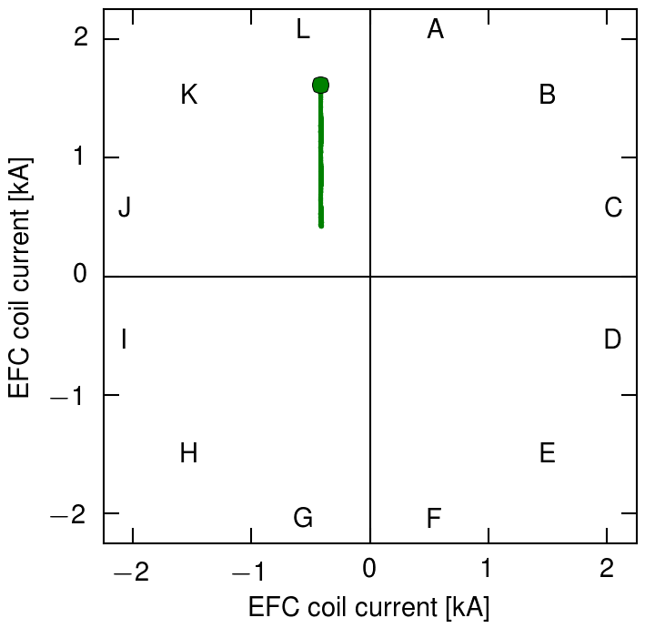
Refine optimum EFC with an n = 1 compass scan
Compass scan steps:
Select n = 1 phase
Ramp n = 1 amplitude until the discharge terminates

Slide 12
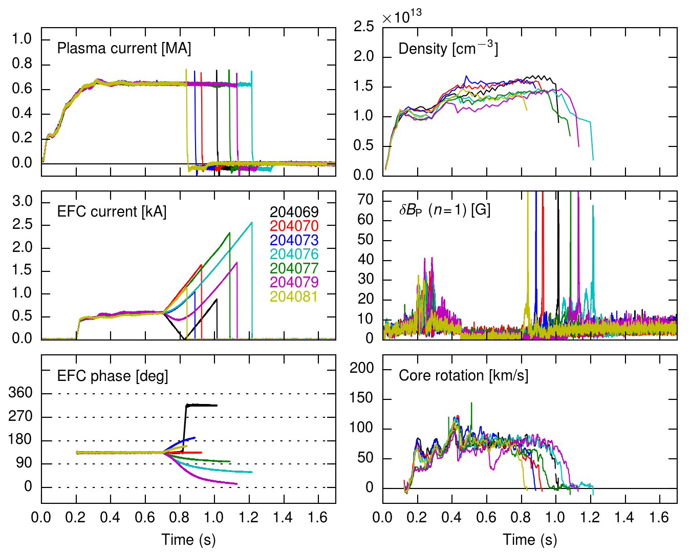
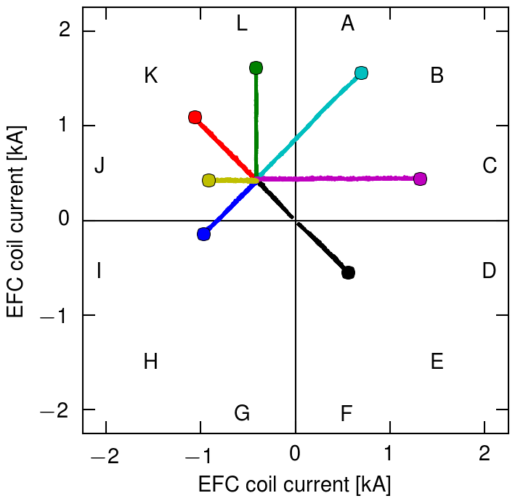
Refine optimum EFC with an n = 1 compass scan
Compass scan steps:
Select n = 1 phase
Ramp n = 1 amplitude until the discharge terminates
Repeat at multiple phases

Slide 13
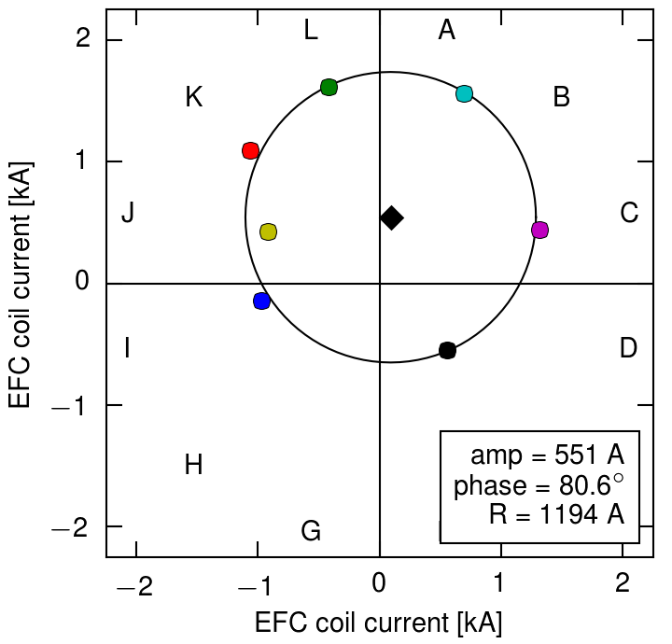
The optimum phase shifts from 135° to 80°
Compass scan steps:
Select n = 1 phase
Ramp n = 1 amplitude until the discharge terminates
Repeat at multiple phases
Fit circle to locking points
The optimum EFC is located at the center of the circle
Optimum EFC:
φ = 80° (prev. 135°)
I_{EFC} = 550 A (prev. 600 A)

Slide 14
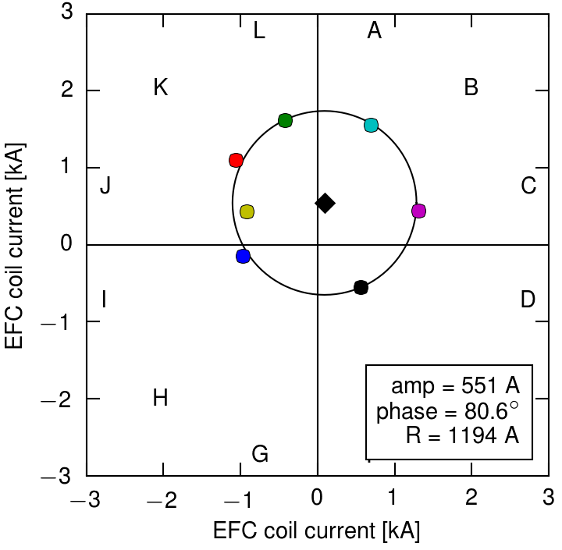
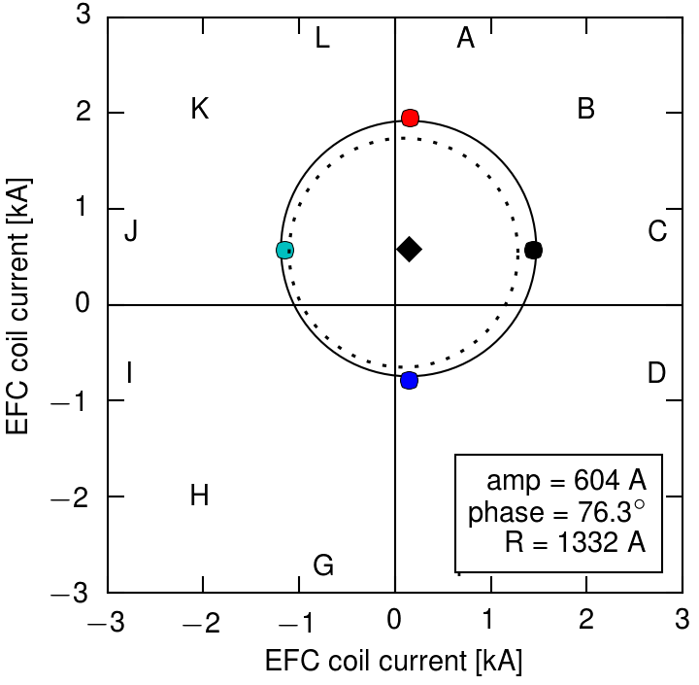
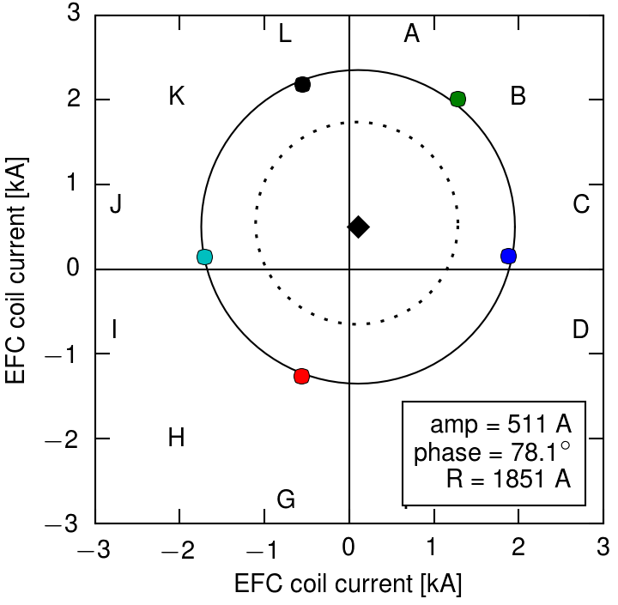
Additional compass scans confirm the optimum EFC
Original compass scan
Optimum amplitude: 550 A
Optimum phase: 80°
Higher density
Same optimum EFC
Rotation dominates the density scaling?
Different OH flux state
Same optimum EFC
Eliminates the OH as a major error field source

Slide 15
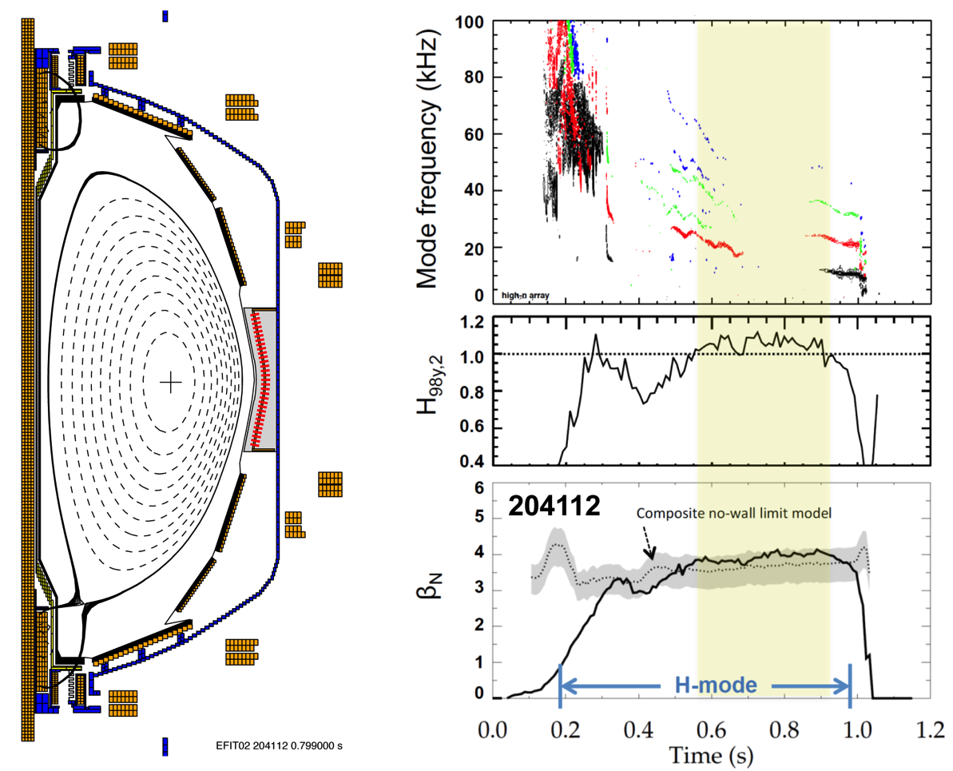
High performance H-modes achieved after implementing compass-scan-optimized EFC
Minimal core MHD
H_{98y,2} ≥ 1
β_{N}/β_{no-wall} ≥ 1

Slide 16
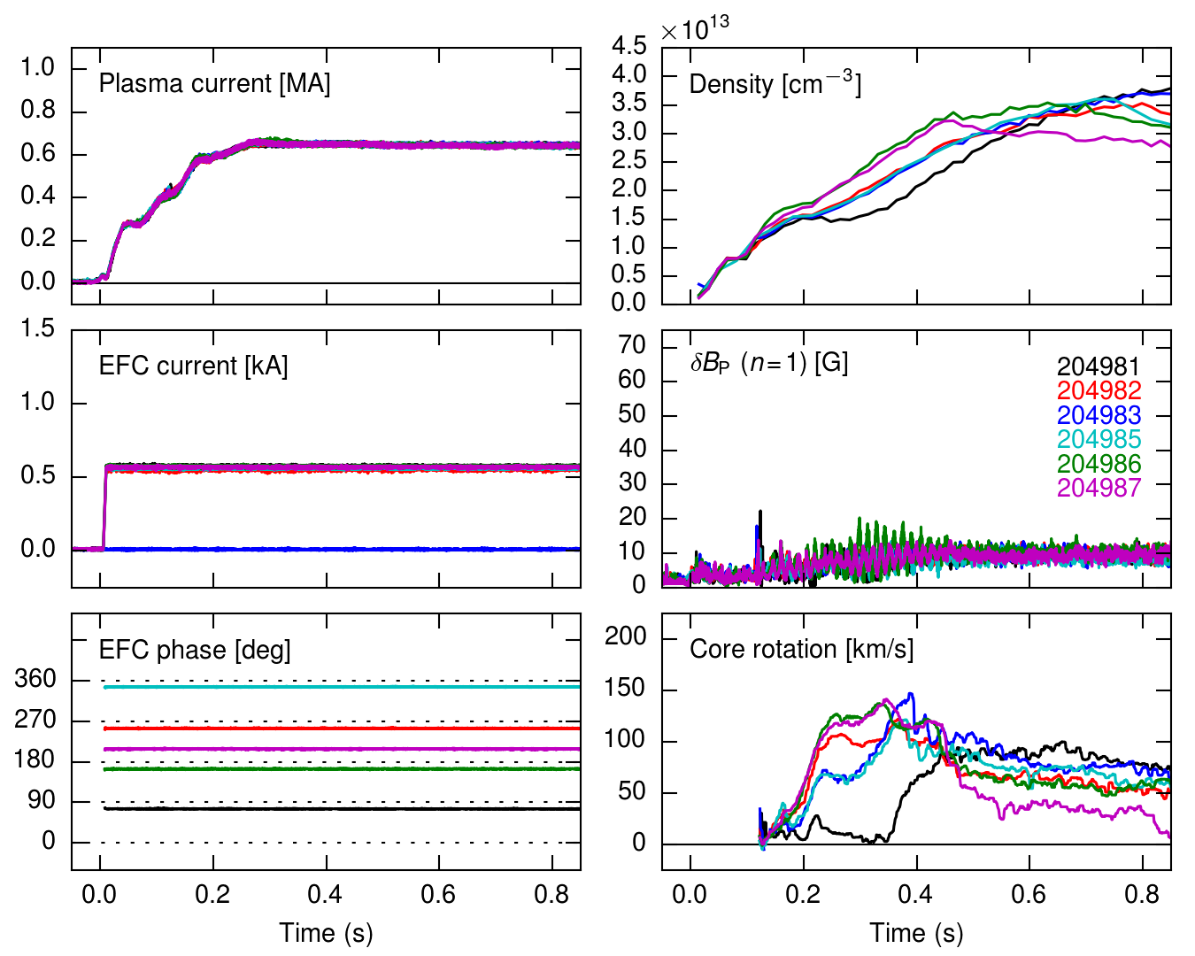
A different EFC phase is required early in time
A static applied n = 1 phase scan early in time shows a different optimum EFC phase
The optimum flattop phase of 80° is counter-productive early
The phase asymmetry is visible in the density and core rotation
Continue to search for the time-evolving error field source

Slide 17
Optimized EFC enables long-pulse L-modes and high-performance H-modes in NSTX-U
Summary:
Identified flattop EFC settings that enable long-pulse L-modes and high-performance H-modes
Eliminated two candidate error field sources:
OH×TF interaction
Tilt of the OH coil from the vertical
Identified an asymmetry in the optimum early time EFC with respect to the optimum flattop EFC
More analysis and metrology are ongoing:
Multiple error field sources are in play (PF5 + ??)
Suspect a static tilt of the TF bundle is contributing
Time-dependent plasma response?

