Slide 1


New microwave diagnostics to measure internal magnetic fluctuations, intermediate-k density fluctuations, and flows on NSTX-U*
T.L. Rhodes, Neal Crocker, Tony Peebles, Shige Kubota,
Physics and Astronomy Dept, UCLA
Presented at the 2016 APS-DPP Meeting
Supported by US DOE Grant DE-FG02-99ER54527

Slide 2
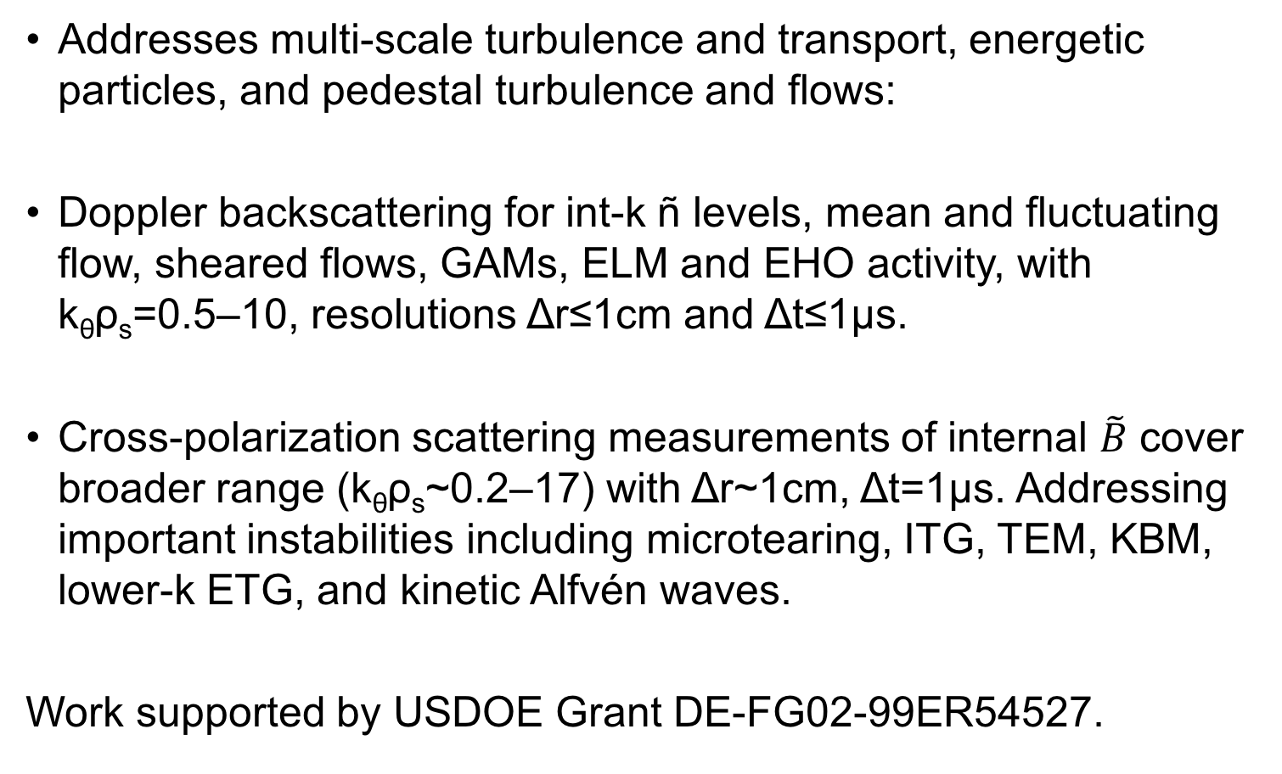
New microwave diagnostics are being installed on NSTX-U addressing range of important physics topics
Addresses multi-scale turbulence and transport, energetic particles, and pedestal turbulence and flows:
Doppler backscattering for int-k ñ levels, mean and fluctuating flow, sheared flows, GAMs, ELM and EHO activity, with k_{θ}ρ_{s}=0.5–10, resolutions Δr≤1cm and Δt≤1μs.
  Cross-polarization scattering measurements of internal $\tilde{B}$ cover broader range (k_{θ}ρ_{s}~0.2–17) with Δr~1cm, Δt=1μs. Addressing important instabilities including microtearing, ITG, TEM, KBM, lower-k ETG, and kinetic Alfvén waves.
Work supported by USDOE Grant DE-FG02-99ER54527.

Slide 3
Overview of new diagnostics

Slide 4
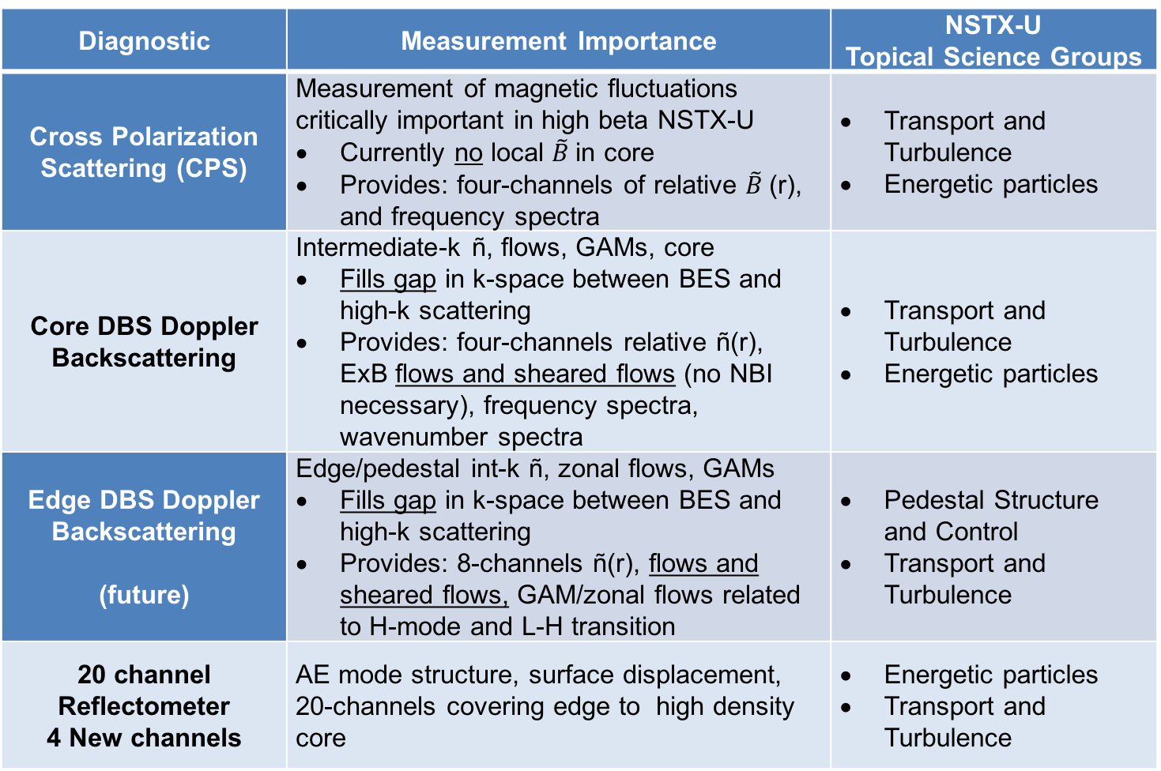
New mm-wave diagnostics
Diagnostic | Measurement Importance | NSTX-U Topical Science Groups
Cross Polarization Scattering (CPS) | Measurement of magnetic fluctuations critically important in high beta NSTX-U Currently no local $\tilde{B}$in core Provides: four-channels of relative $\tilde{B}$(r), and frequency spectra | Transport and Turbulence Energetic particles
Core DBS Doppler Backscattering | Intermediate-k ñ, flows, GAMs, core Fills gap in k-space between BES and high-k scattering Provides: four-channels relative ñ(r), ExB flows and sheared flows (no NBI necessary), frequency spectra, wavenumber spectra | Transport and Turbulence Energetic particles
Edge DBS Doppler Backscattering (future) | Edge/pedestal int-k ñ, zonal flows, GAMs Fills gap in k-space between BES and high-k scattering Provides: 8-channels ñ(r), flows and sheared flows, GAM/zonal flows related to H-mode and L-H transition | Pedestal Structure and Control Transport and Turbulence
20 channel Reflectometer 4 New channels | AE mode structure, surface displacement, 20-channels covering edge to high density core | Energetic particles Transport and Turbulence

Slide 5
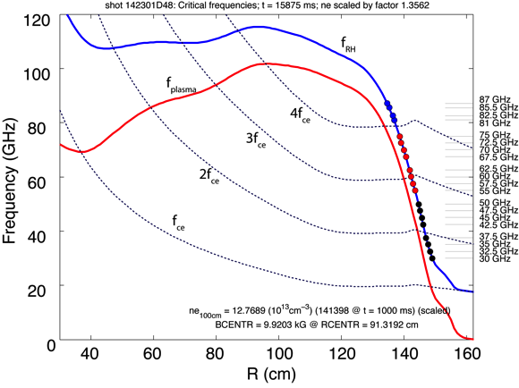
New four-channel high-frequency DBS/reflectometer/CPS system probes high densities on NSTX-U
  Expands existing fluctuation reflectometer (from 16 to 20 channels)
  81, 82.5, 85.5, and 87 GHz as shown

Slide 6
Example DBS and CPS results from other machines

Slide 7
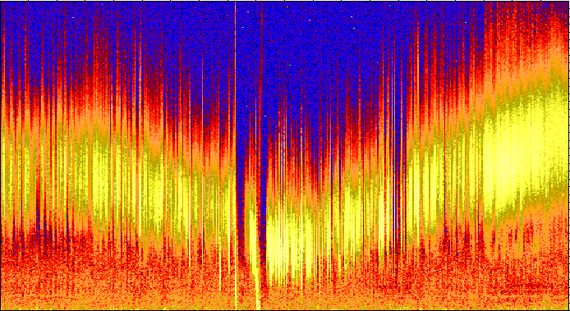
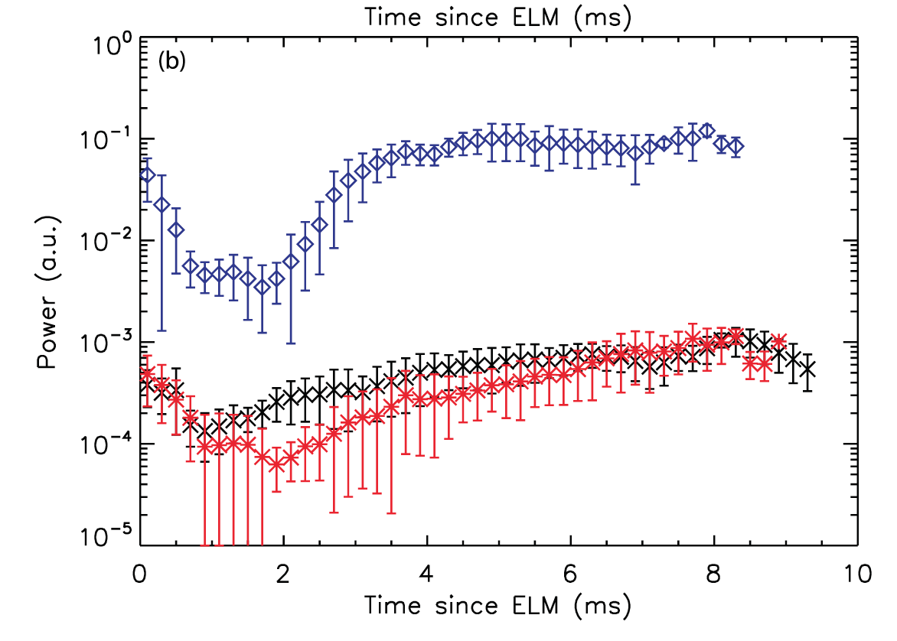
Multi-channel DBS for int-k ñ, flow, and ExB velocity
4
2
0
DBS int-k ñ, QH-mode torque ramp
DBS ñ
f (MHz)
CPS B_tilde
DIII-D
3000 3500 4000
time (ms)
MAST
k_{θ}ρ_{s} ~ 0.5–10, and typical spatial and temporal resolutions Δr≤1 cm and Δt≤1μs
Fills wavenumber gap between low-k BES and high-k forward scattering.
Directly impacts testing and validation of codes/simulations
First CPS on spherical tokamak, DBS ñ in deep core. Inter-ELM ñ, B_tilde behavior consistent with EM ETG [Hillesheim NF15]

Slide 8
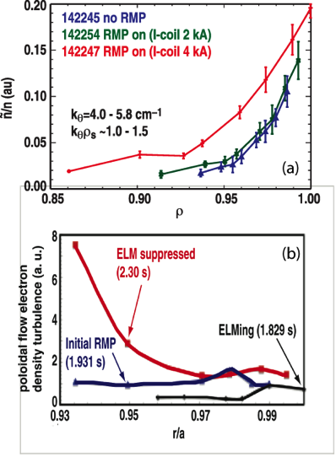
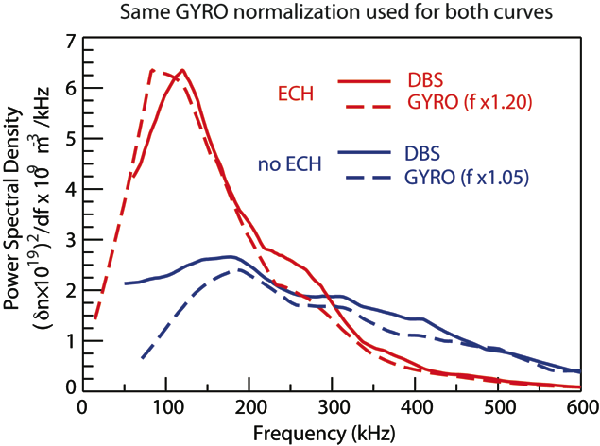
DBS can contribute significantly to discovery science and validating simulations/models
DBS ñ and flow, DIII-D RMP, kρ, At this k-scale, ñ increases only when enough RMP-coil current is applied. [Mordjick NF12].
Core DBS ñ in DIII-D QH-mode – GYRO shows very good comparison to experiment identifying instability as density gradient driven TEM [Ernst PoP16]

Slide 9
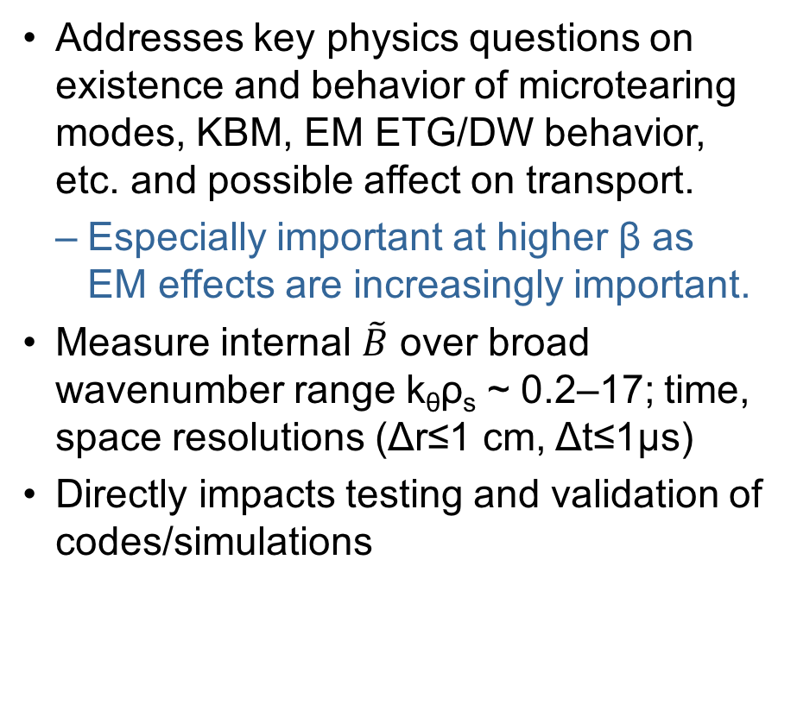
Cross-polarization scattering (CPS) to measure internal magnetic fluctuations on NSTX-U
DIII-D, β scan, Hmode
Addresses key physics questions on existence and behavior of microtearing modes, KBM, EM ETG/DW behavior, etc. and possible affect on transport.
  Especially important at higher β as EM effects are increasingly important.
Measure internal $\tilde{B}$ over broad wavenumber range k_{θ}ρ_{s} ~ 0.2–17; time, space resolutions (Δr≤1 cm, Δt≤1μs)
Directly impacts testing and validation of codes/simulations
Barada, et al., RSI, 2016

Slide 10
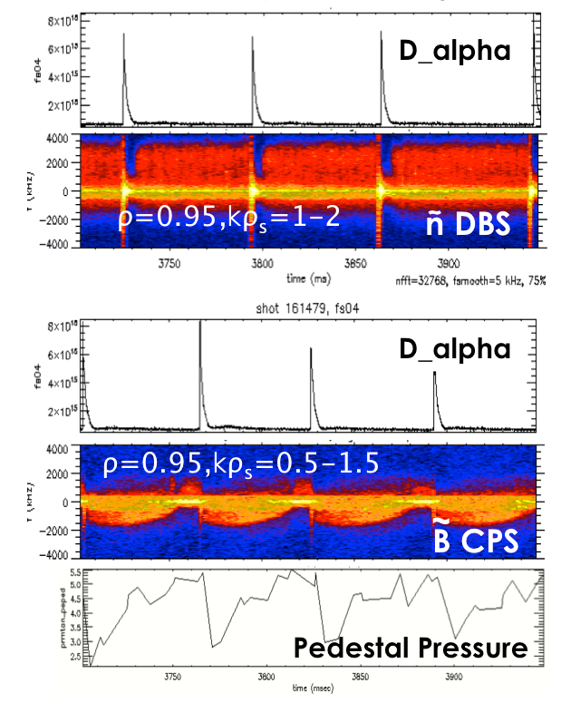
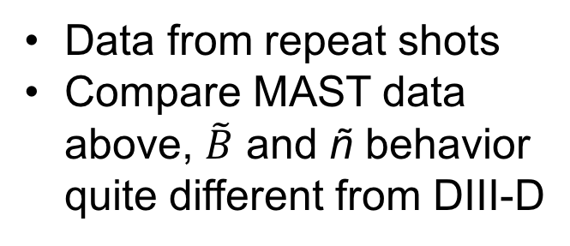

Inter-ELM $\tilde{B}$ and ñ behavior very different on DIII-D
Data from repeat shots
Compare MAST data above, $\tilde{B}$ and ñ behavior quite different from DIII-D

Slide 11
16-channel UCLA fluctuation reflectometer will be upgraded to twenty-channels
Example data from this year showing higher frequency GAEs, and lower frequencies that are likely TAEs and other MHD
Diagnostic addresses understanding of beam driven mode physics and code validation
Cross-Machine studies - NSTX-U and DIII-D
n_{e}(r), 204636, 232 ms
time (ms)
time (ms)

Slide 12
Physics of DBS and CPS measurements

Slide 13
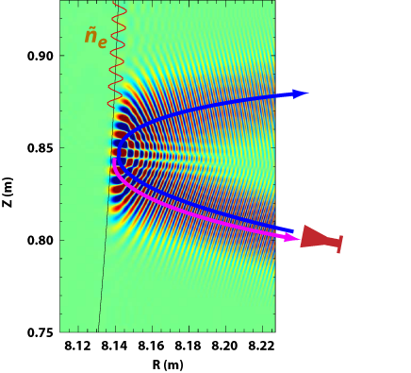
DBS technique first introduced on ASDEX-U (Hirsch, PPFC01) and is now a widely used technique
Radiation injected at angle θ, with wavenumber k_{i}
Scattering at k_{s} occurs according to Bragg scattering relation:
  For k_{i} ~ k_{s}, can show that
  k_{ñ} = 2k_{i}sin(θ/2), where θ is scattering angle
Scattered signal is proportional to ñ at k_{ñ}±Δk while Doppler shift is Δω= k_{ñ}V
Full wave calculation shows long wavelength propagating structure near cutoff
  It is this structure that scatters from longer wavelength ñ.
  Scattered k_{s}, spatial and k resolution Δk determined by this structure.
k_{ñ}
k_{i}
θ
k_{s}
Hirsch, PPCF 2001, Bulanin PPR 2000, Hennequin RSI 2004, Conway, PPCF 2008, Schmitz RSI 2008, Xiao PS&T 2008, Happel RSI 2009, Hillesheim NF 2015

Slide 14
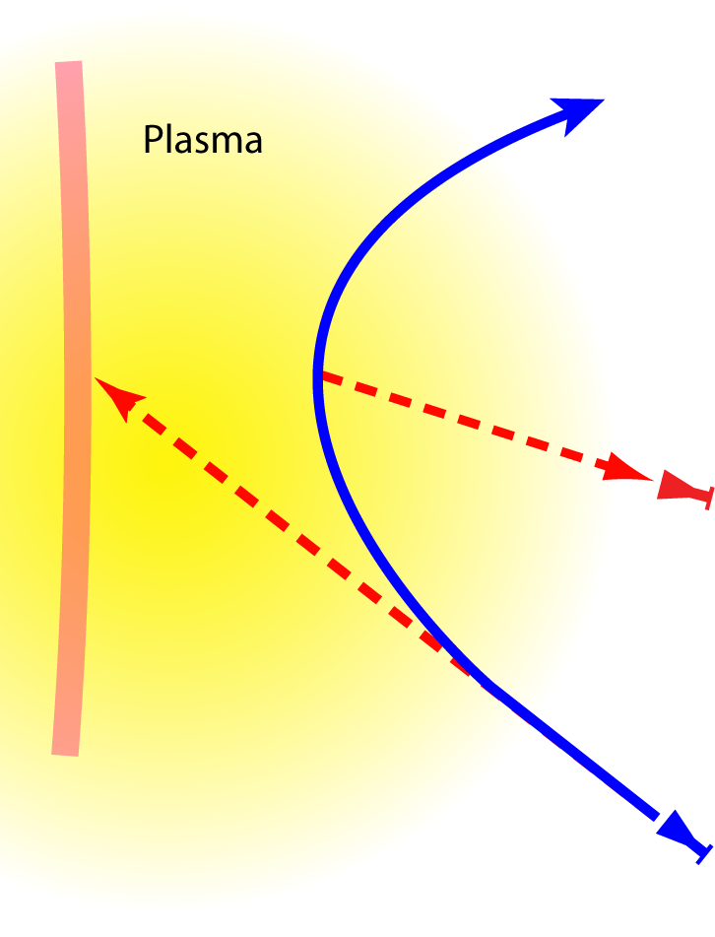
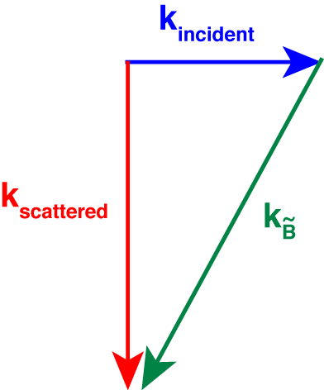
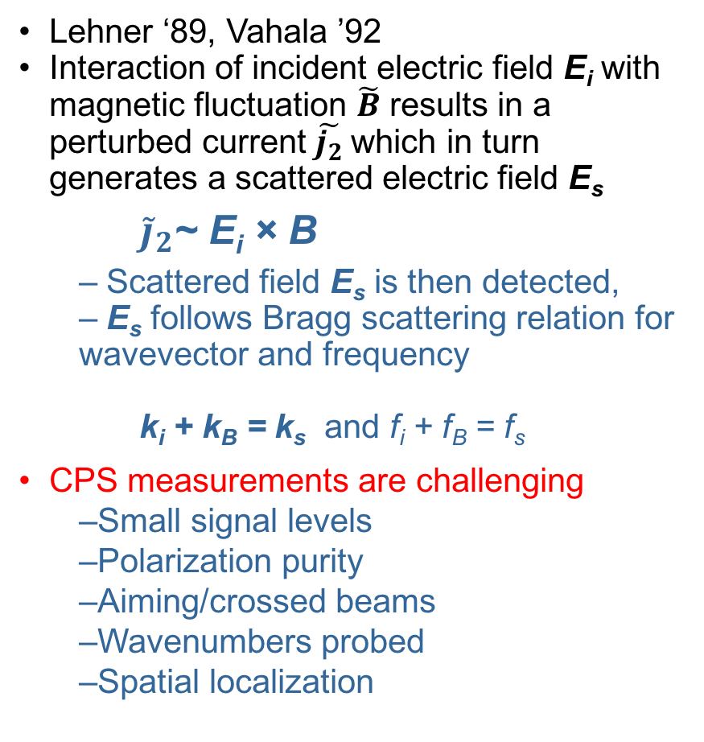
CPS: Vector nature of magnetic fluctuations scatter electromagnetic probe beam into orthogonal polarization
Lehner ‘89, Vahala ’92
Interaction of incident electric field E_{i} with magnetic fluctuation $\tilde{B}$ results in a perturbed current $\tilde{j_{2}}$which in turn generates a scattered electric field E_{s}
  ${\tilde{j}}_{2}$~ E_{i} × B
  Scattered field E_{s} is then detected,
  E_{s} follows Bragg scattering relation for wavevector and frequency
  k_{i} + k_{B} = k_{s} and f_{i} + f_{B} = f_{s}
CPS measurements are challenging
  Small signal levels
  Polarization purity
  Aiming/crossed beams
  Wavenumbers probed
  Spatial localization
X-mode DBS signal
~
~
f_{ce}
O-mode signal scattered by local B
~
CPS receiver
DBS launch beam, primarily X-mode, unwanted O-mode absorbed by f_{ce} resonance

Slide 15
Design goals

Slide 16
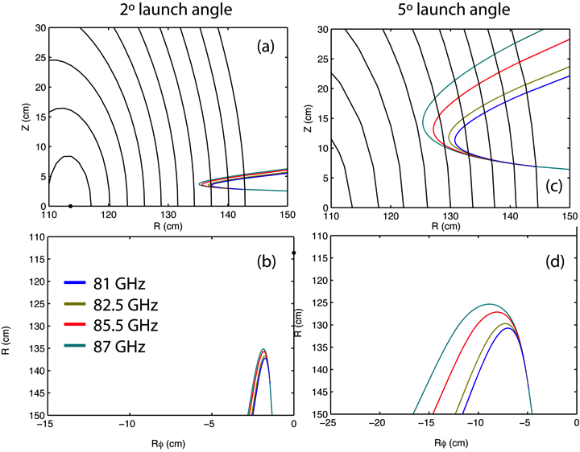
DBS design provides for k_{θ}ρ_{s} range ~1–10

Slide 17
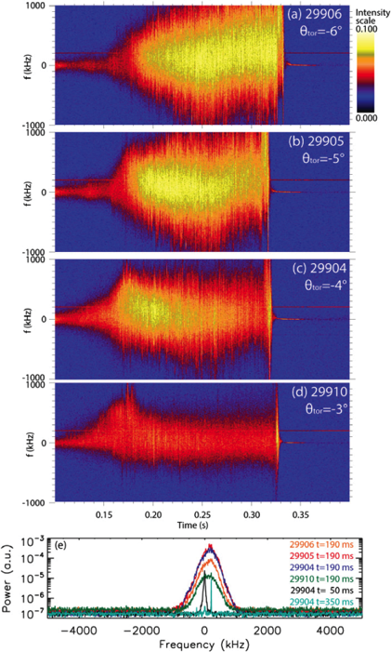
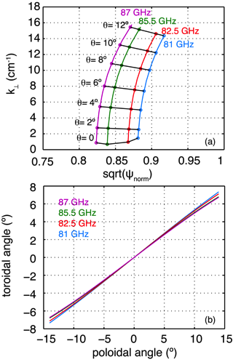
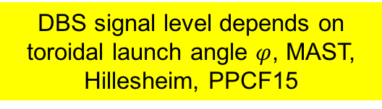




Important to match bi-normal k direction in plasma → optimum toroidal matching for each launch angle
DBS signal level depends on toroidal launch angle $φ$, MAST, Hillesheim, PPCF15
Optimum toroidal matching angle vs poloidal launch angle
$$φ=6º$$
$$φ=5º$$
NSTX
$$φ=4º$$
Optimum toroidal matching angle depends on launch angle, plasma parameters and shape
Optimum toroidal angle is nearly the same for all frequencies at a given poloidal angle.
Using NSTX H-mode and 3D GENRAY raytracing code.
MAST
$$φ=3º$$

Slide 18
Accessible range of DBS wavenumbers varies from 0–7 cm⁻¹

Slide 19
Design of DBS system and lab measurements

Slide 20
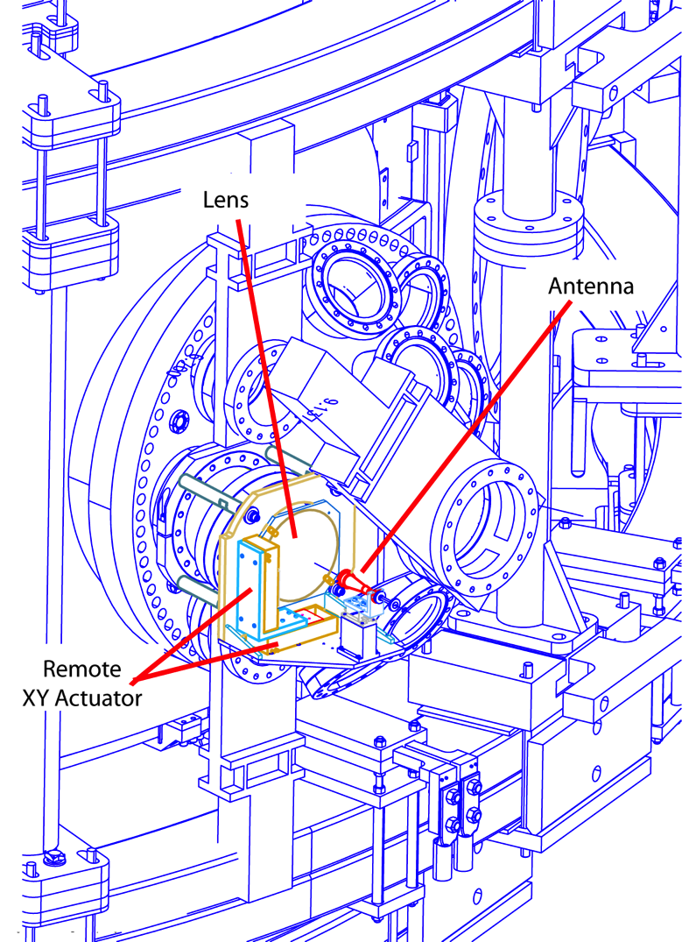
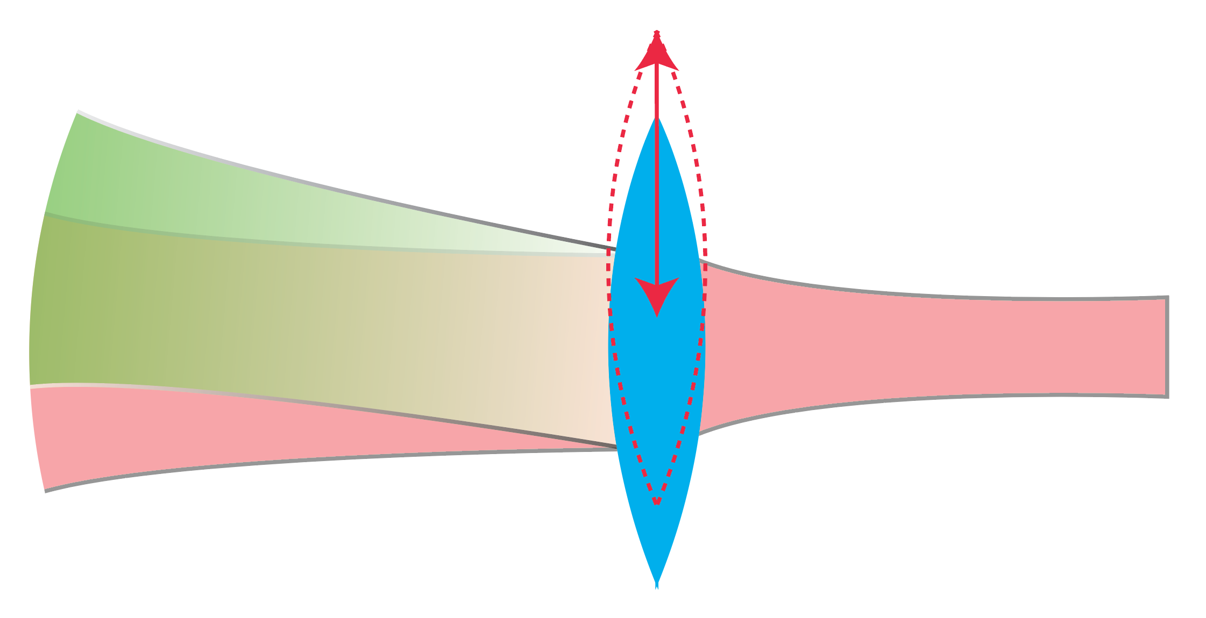
Quasi-optical design of DBS with remote control lens that changes launch angle
X–Y displacement of lens induces independent angular displacements (poloidal and toroidal angles) of DBS probe beam

Slide 21
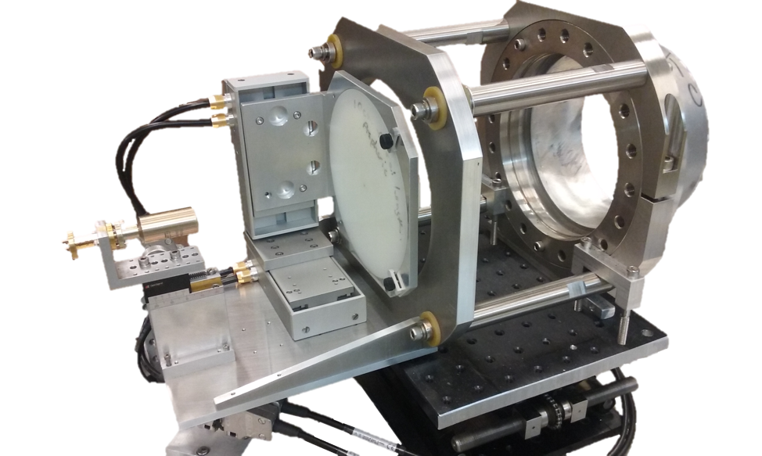
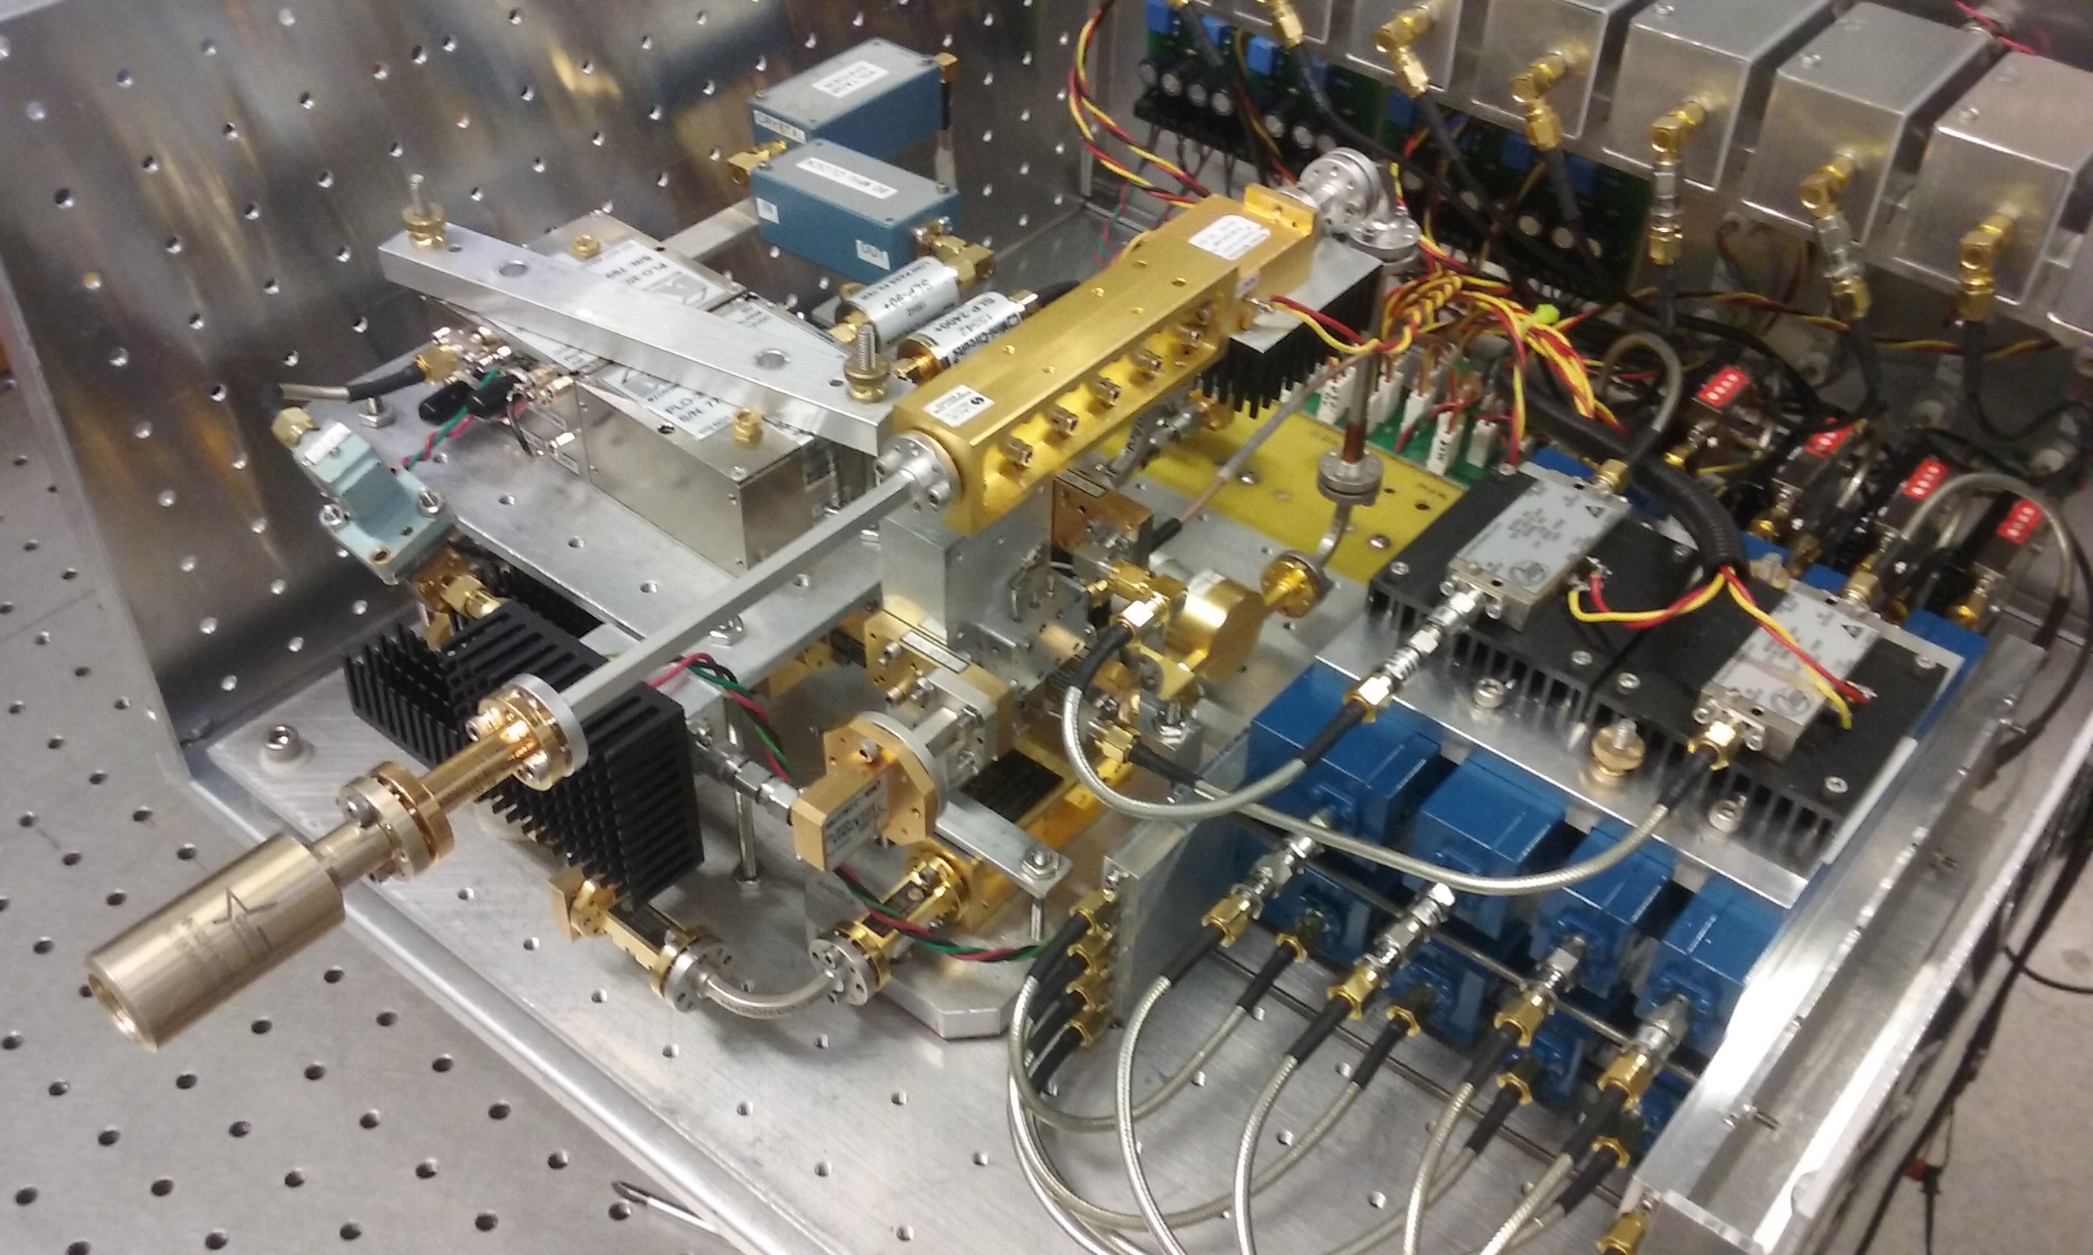
DBS quasi-optical system and electronics have been built and tested in laboratory
Launch antenna/optics, angle remote controlled
DBS source and receiver electronics
to tokamak
antenna
lens
antenna

Slide 22
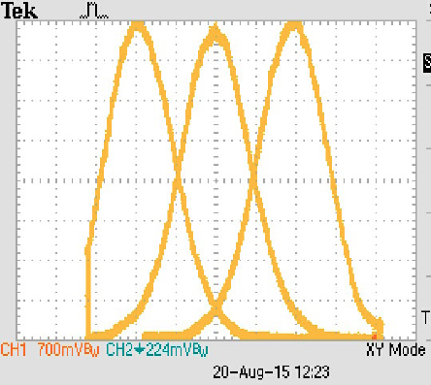
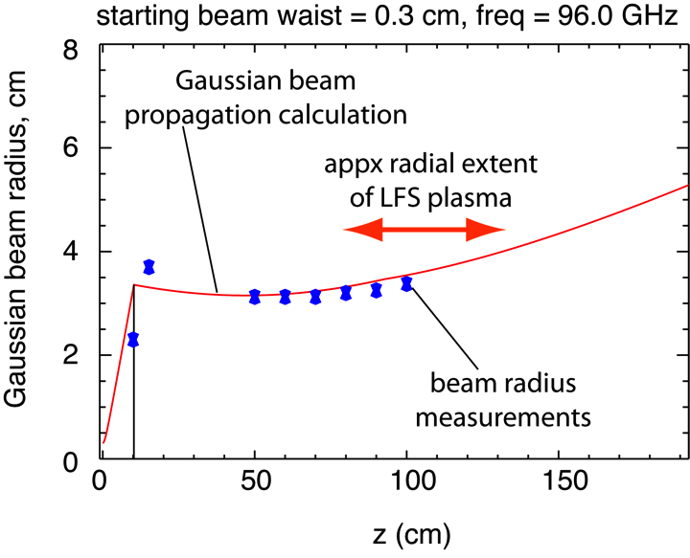
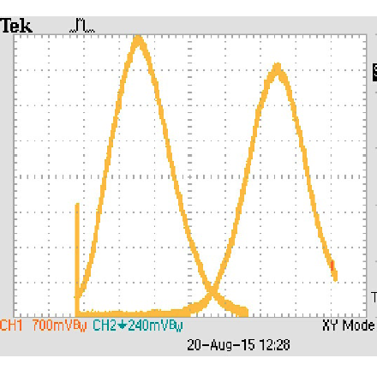
Probe beam measurements match desired Gaussian beam propagation code designs
Beam profile measurements vs lens position
±5mm lens movement → beam steering of ±2.2º
10mm lens movement → beam steering of ~4.5º

Slide 23
Design of CPS system

Slide 24
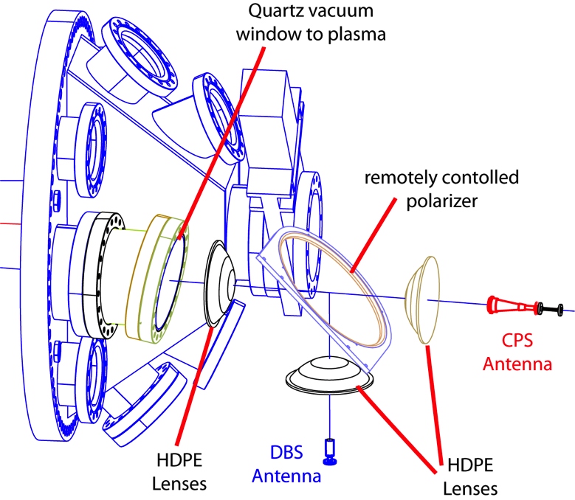
CPS quasi-optical design with DBS launch/receive antenna and CPS receive antenna
remote controlled polarizer.
Not shown is X–Y remote motion control of the last lens.

Slide 25
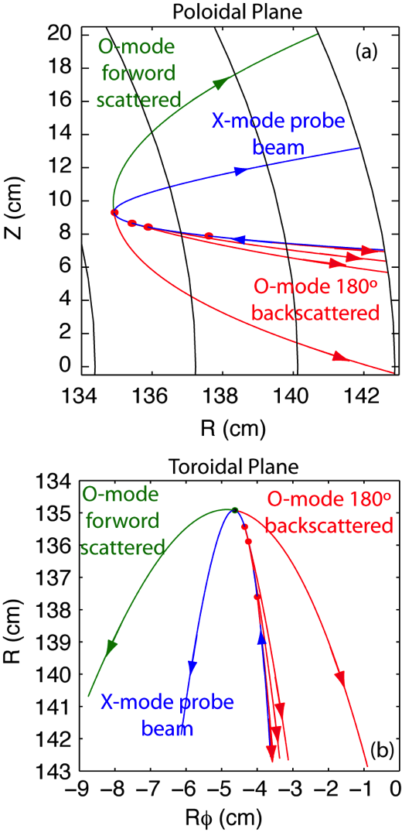
CPS scattering: O- and X-mode radiation propagate differently due to the different indices of refraction
CPS scattering from 87 GHz DBS probe beam (NSTX-U H-mode plasma).
Blue is DBS probe beam,
Red is backscattering O-mode and green is ~0º forward O-mode scattering.
Arrows show propagation directions and red disks show scattering centers.

Slide 26
Very different magnetic wavevectors can be measured using different CPS receive angles
The differences in magnitude of X and O-mode wavevectors illustrate differences in their respective indices of refraction.
(For diagrammatic purposes only, not to scale.)

Slide 27
Sources of error in measurements and mitigation techniques
N = index of refraction, k₀ = vacuum k
Tests of non-WKB effects.
Mode mixing is expected to be significant if |k_{O} − k_{X}| << |dN_{j}/dL|, Note x10 in |dN_{j}/dL|,
  |k_{O} − k_{X}| >> |dN_{j}/dL| → non-WKB effects resulting in mode mixing are negligible for these frequencies.
Testing WKB assumption via comparison of |dN/dl|/k₀ and N² Note x10 in |dN_{j}/(dLk₀)| indicating that the WKB assumptions are satisfied for these frequencies.
Using the NSTX-U H-mode plasma and 3D GENRAY raytracing
Non-WKB effects and mode mixing not an issue for this plasma but must examine each condition individually

Slide 28
(continued) Sources of error in measurements and mitigation techniques
Another potential error source in the CPS and DBS signals is due to probe beam having a non-zero wavevector component along the magnetic field B, ie k|| ≠ 0 (Faraday effect).
  If the probe wave is launched with linear polarization but couples to the plasma with non-vanishing k||, then it is a superposition of the true X- and O-modes which are slightly elliptized again producing a source of contamination.
  The necessity for toroidal steering discussed above in the context of optimal wavenumber or pitch angle matching will also serve to minimize this effect by reducing the k|| component to near zero.
  Also, if there is significant contamination due to this effect the CPS signal is expected to look very much like the DBS signal, again an indication of potential problems.
In addition to the WKB testing above, each CPS/DBS dataset on NSTX-U will be compared to each other, magnitude and spectral shape, etc. to determine if there is a potential problem (DBS and CPS data on NSTX-U will be simultaneous).
  While there is no reason, a priori, for B_tilde and ñ to be different, significant similarity is an indication to proceed cautiously.
  experience has been that CPS is very different in its response to plasma parameters (e.g. response to beta), spectral shape, and magnitude as compared to the DBS data

Slide 29
New microwave diagnostics are being installed on NSTX-U addressing range of important physics topics
Addresses multi-scale turbulence and transport, energetic particles, and pedestal turbulence and flows:
Doppler backscattering for int-k ñ levels, mean and fluctuating flow, sheared flows, GAMs, ELM and EHO activity, with k_{θ}ρ_{s}=0.5–10, resolutions Δr≤1cm and Δt≤1μs.
  Cross-polarization scattering measurements of internal $\tilde{B}$ cover broader range (k_{θ}ρ_{s}~0.2–17) with Δr~1cm, Δt=1μs. Addressing important instabilities including microtearing, ITG, TEM, KBM, lower-k ETG, and kinetic Alfvén waves.
Work supported by USDOE Grant DE-FG02-99ER54527.

Slide 30
UCLA is excited about the scientific prospects on NSTX-U
Multi-field diagnostics for turbulence and transport studies, beam driven modes, transients (ELMs, EHO, etc.)
Testing and validation of simulations and theory
Cross-device experiments are facilitated by similar diagnostics (e.g NSTX-U and DIII-D).
Work supported by USDOE Grant DE-FG02-99ER54527

