Slide 1


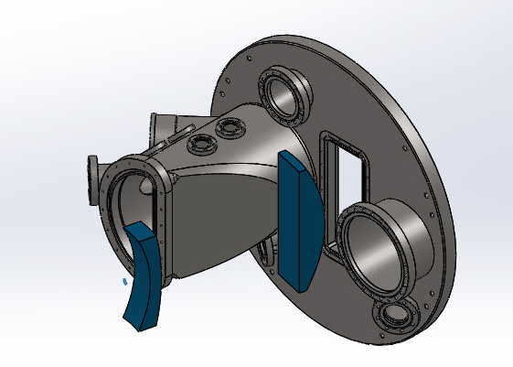
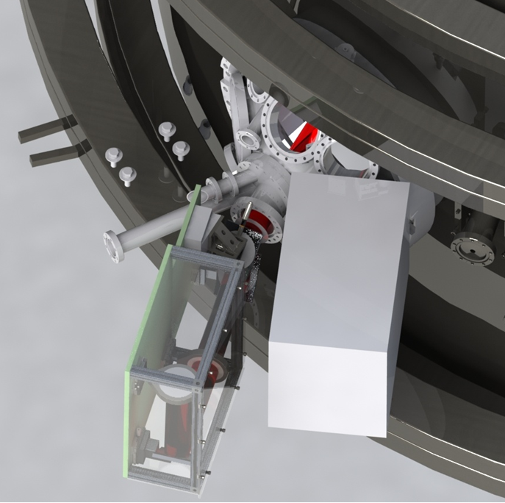
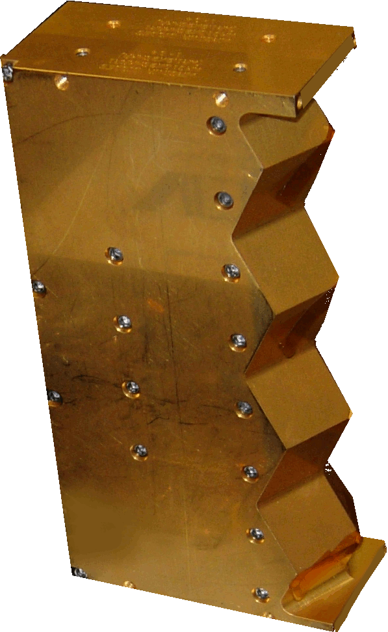
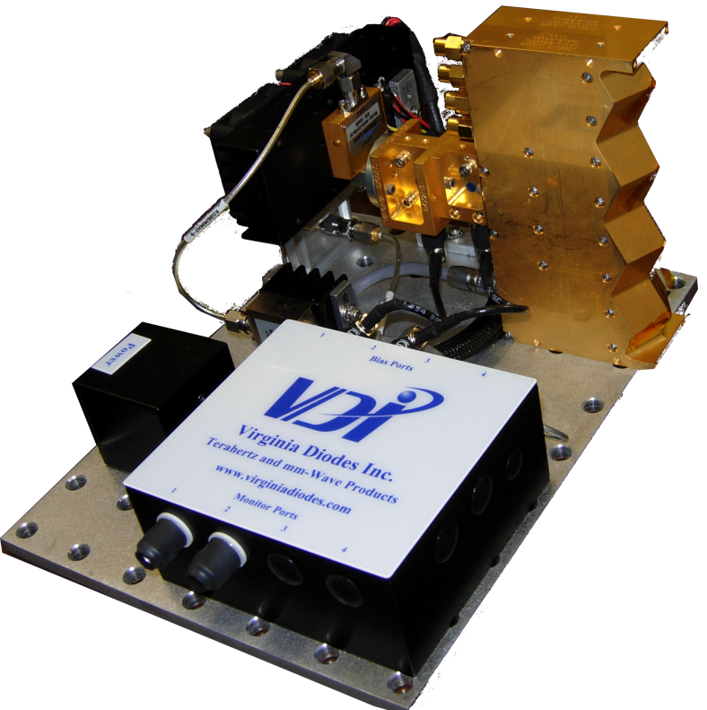
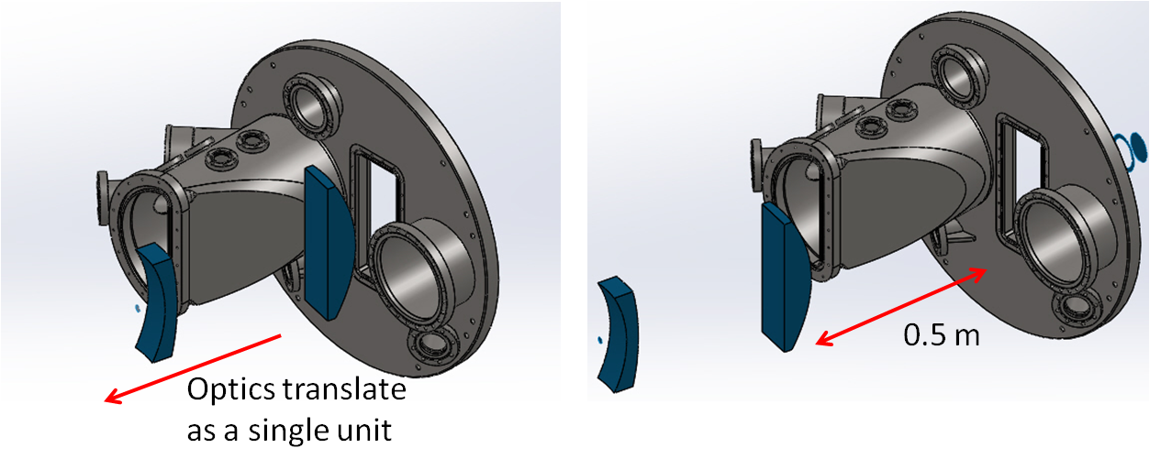
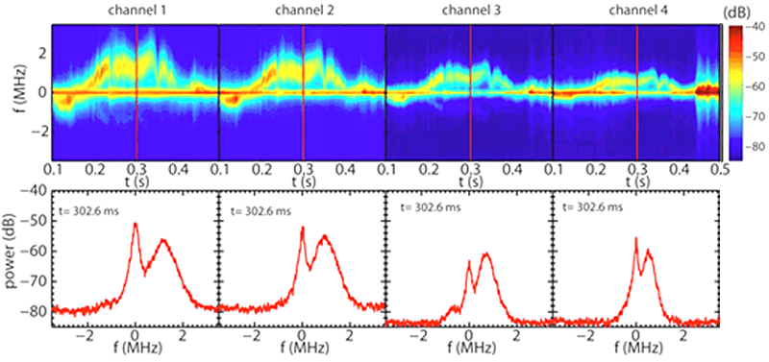
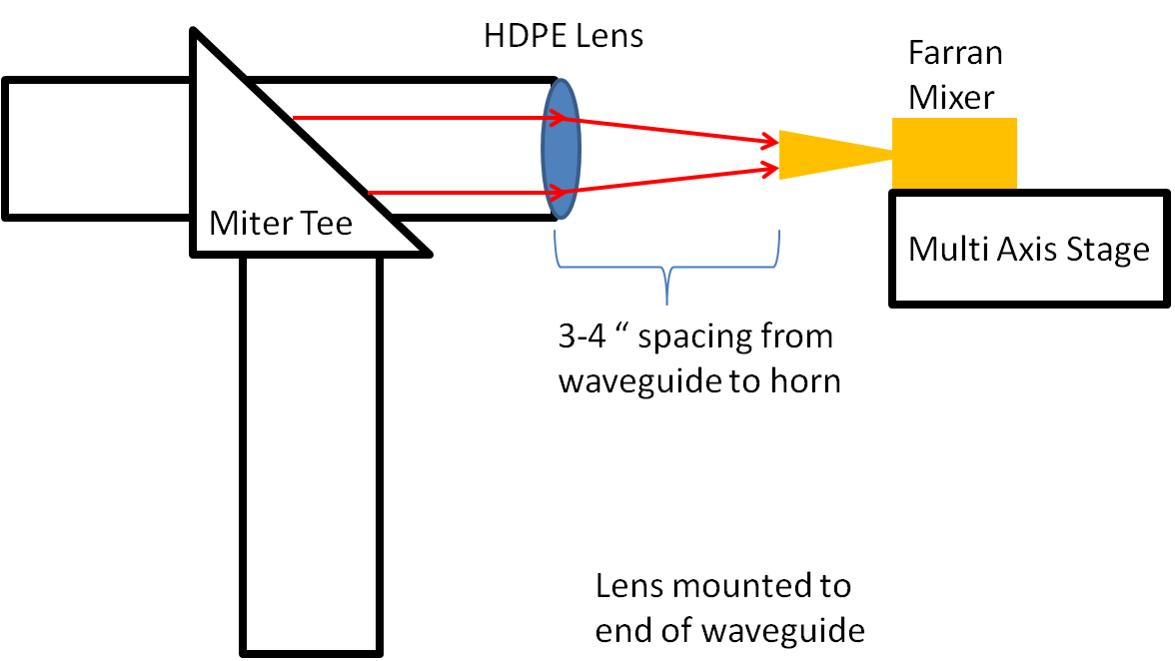
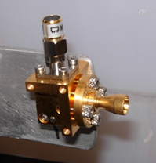
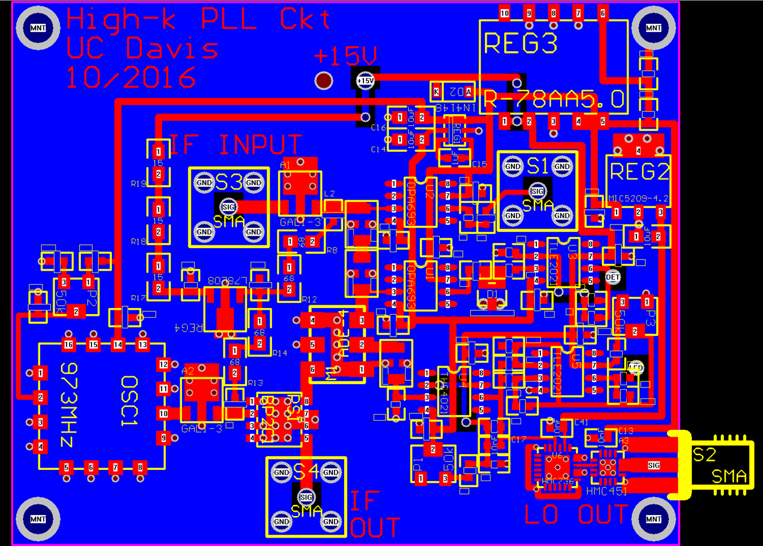
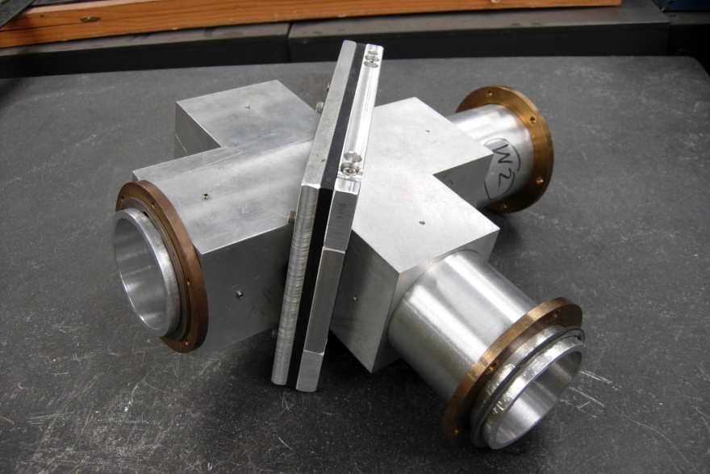
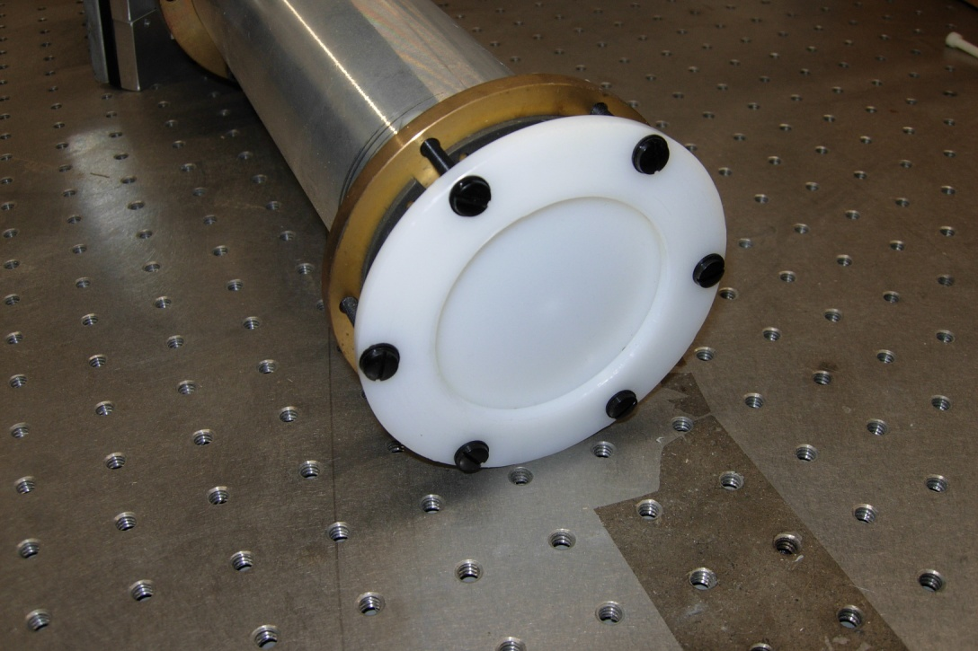
High-k Scattering System Receiver for NSTX-U
R. Barchfeld¹, E. Scott¹, C.W. Domier¹, P. Riemenschneider¹, N.C. Luhmann Jr^{.1,} Y. Ren², R. Kaita²
¹University of California, Davis, ²Princeton Plasma Physics Laboratory
Work supported in part by U.S. DOE Grant DE-FG02-99ER54518 and DE-AC02-09CH1146
The High-k Scattering System for NSTX-U features a 693 GHz probe beam directed from Bay G to Bay L. Scattered power is collected with receiving optics at bay L, and directed to a 4-channel subharmonic mixer array from Virginia Diodes Inc. An additional subharmonic mixer by Farran Technologies is located near the launch side of the probe beam to provide a reference channel. The probe beam and receiver are remote steerable to position the scattering volume from plasma core to edge at mid-plane ± 15 cm for various scattering schemes. This instrument will provide data on electron scale turbulence k_{θ} from 7 to 40 cm⁻¹, in support of anomalous transport and electron temperature gradient mode research .
Receiving Optics Bay L
NSTX-U Vacuum Vessel
Launch Optics Bay G
Receiving optics
Scattering Region
Waveguide from above
693 GHz probe beam via formic acid laser
High-k Scattering Receiver
VDI mixer array
VDI 693 GHz 4 x 1 sub-harmonic mixer array
Receiving optics shown in blue on bay L. Two HDPE lenses will collect and focus scattered signals. The system can translate in five axes (X, Y, Z, toroidal, and poloidal) to accommodate various measurements from core to edge at 2° to 15° scattering angles. A 4 x 1 mixer array is installed behind the second lens; however, the optics will accommodate a 8 x 1 array for later expansion in 2017.
Launch Optics
4-pixel linear array
30 mm channel spacing
x48 LO input (~14.4 GHz)
2 mm diagonal horn RF input
< 13 dB conversion loss at 693 GHz
16 dB IF amplifier gain
Launch optics enclosure. Corrugated waveguide delivers the 693 GHz beam from above. The launch optics expand, and then focus the beam through a z-cut quartz window on Bay G. The beam waist in the center of the scattering region has a radius of ~20 mm. The beam can be steered up/down/right/left ± 2.25°.
Example data from previous High-k_{r} 280 GHz scattering system. Top: freq. vs time, bottom: time slices of power vs freq.
FIR In
Reference
Box
Reference IF 880 MHz
Digitizer
FIR Out
Farran Mixer
PCB w/
LO Source &
Phase Locking
Printed Circuit Board
Receiver
IF outputs
Prior to the launch optics, a beam splitter in the waveguide run will sample a small amount of power (< 1 mW) for the Farran mixer for the reference channel.
IF 880 MHz
Lo multiplier
DC bias
IF amplifiers
IF output
Diplexer
Scattered signals RF input
RF input horn
LO 14.2 GHz
Receiver Array
Farran Reference Mixer
HDPE Lens
Miter Tee

