Slide 1
Status and Plans for NSTX-U Recovery
J. Menard, S. Gerhardt, C. Neumeyer, R. Hawryluk, and the NSTX-U Research and Engineering Teams
SESSION JO4: SPHERICAL TOKAMAKS, OTHER
Room: 201AB at 14:00
59th APS-DPP Meeting
Milwaukee, Wisconsin
October 24, 2017
This research was sponsored by the U.S. Dept. of Energy under contract DE-AC02-09CH11466

Slide 2
Background
NSTX-U operated 10 weeks in FY2016
Rapidly accessed H-mode
Exceeded NSTX record pulse duration and magnetic field
Commissioned 2nd NBI (12MW total), most major diagnostics
Fast-ion physics discoveries (E. Fredrickson APS invited talk)
But, several technical failures ended NSTX-U operations in July 2016 → 2 extensive reviews in 2017
Extent of Condition: Which designs, components are deficient?
Extent of Cause: Which practices, procedures are deficient?

Slide 3
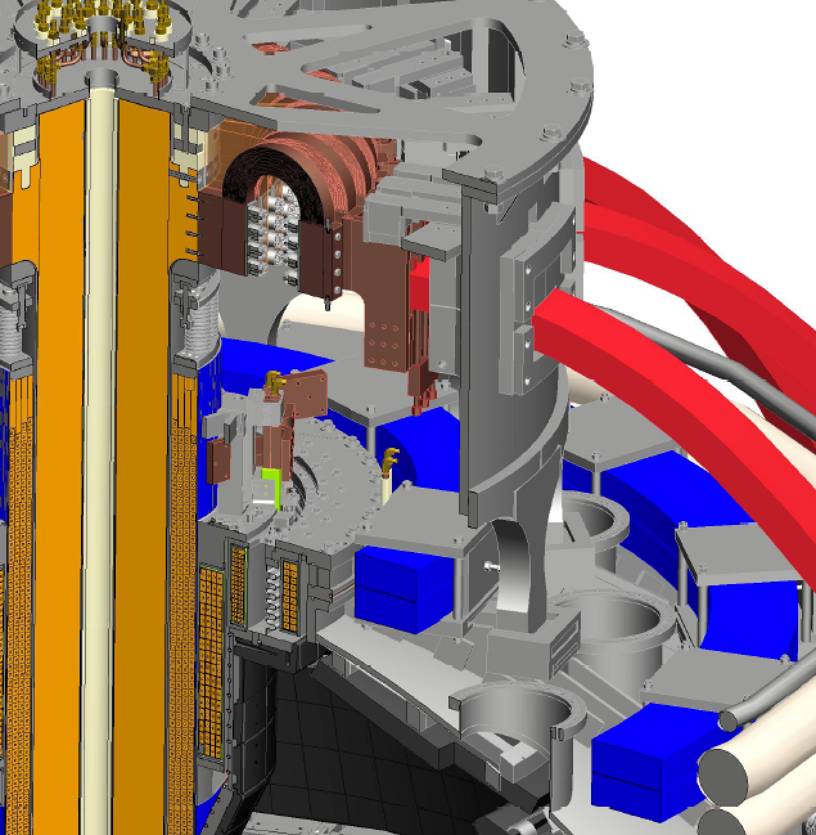
What is NSTX-U “Recovery”?
FY2017: DOE requested PPPL to review “Extent of Condition” and submit Corrective Action Plan (CAP)
Extent of Condition motivated by:
4/15: OH “Arc Flash” incident
9/15: Inadequate inboard divertor bake
5/16: CS cooling tubes wrong material, induced current/motion, breaches
5/16: Bent PF1AU bus bar
6/16: Internal short in PF1AU coil
Recovery = Implementation of Extent of Condition CAP
OH Ground Braid
PF1B
PF1C
Inboard Divertor
OH Coil
PF1A
Cooling tubes

Slide 4
NSTX-U Held 17 Reviews in FY2017
12 Design Verification and Validation Reviews (DVVRs)
1170 “chits” covering entire NSTX-U technical scope → 443 “DVVR Issues”
Then evaluated issue/event probability, duration, and severity → categorize / prioritize
2 Extent of Condition Reviews
Assessed issues and conclusions of the DVVRs and the PPPL planned response
Issued 2 reports → recommendations to ensure safety and reliability of the ST core
Design Integration Review
Conceptual Design Review
Cost and Schedule Review
→ 346 page report submitted: Recovery scope + CAP
Total of 47 external reviewers between Extent of Condition Reviews and DVVRs

Slide 5
6 Major Scope Areas Define Recovery
Improved Reliability Safety and Compliance
Rebuild all six inner-PF coils with a mandrel-free design
Replace plasma facing components that cannot be qualified for the full range of mechanical and projected thermal loads
Improve the “polar regions” (machine top and bottom)
Implement mechanical instrumentation to assess quality of mechanical models, trend machine behavior
Eliminate the safety issues identified with the medium temperature water system used during bakeout, improve He distribution system
Improve the neutron shielding of the test cell

Slide 6
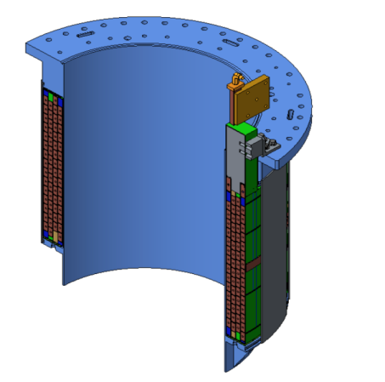
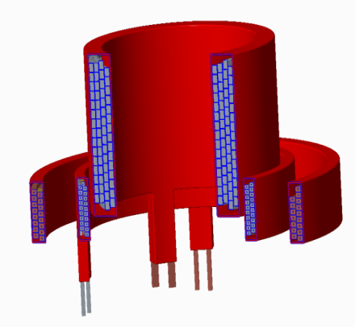
New Inner PF Coils Designed to Improve Testability and Manufacturability
Previous coils fabricated on permanent mandrels
Advantages: Precision winding surface, VPI mold, intrinsic structural support
Disadvantages: mandrel is passive conductor
Impacts turn-to-turn acceptance tests
Deemed unacceptable during extent of condition review
New coils: removable mandrels
Requires winding tooling
Major schedule impact: had been intending to use permanent mandrels until mid-May 2017
New coil design simplifies fabrication
Pure spiral winding (no “joggles”)
Single continuous Cu extrusion (no joints)
Softer copper (easier winding)
Original PF1A Coil with Mandrel
Three Mandrel-Free Coils
PF1A
PF1B
PF1C

Slide 7
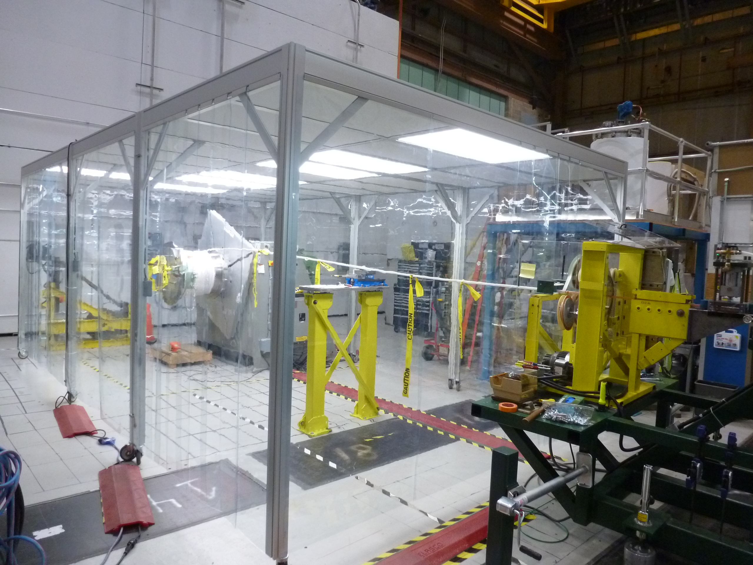
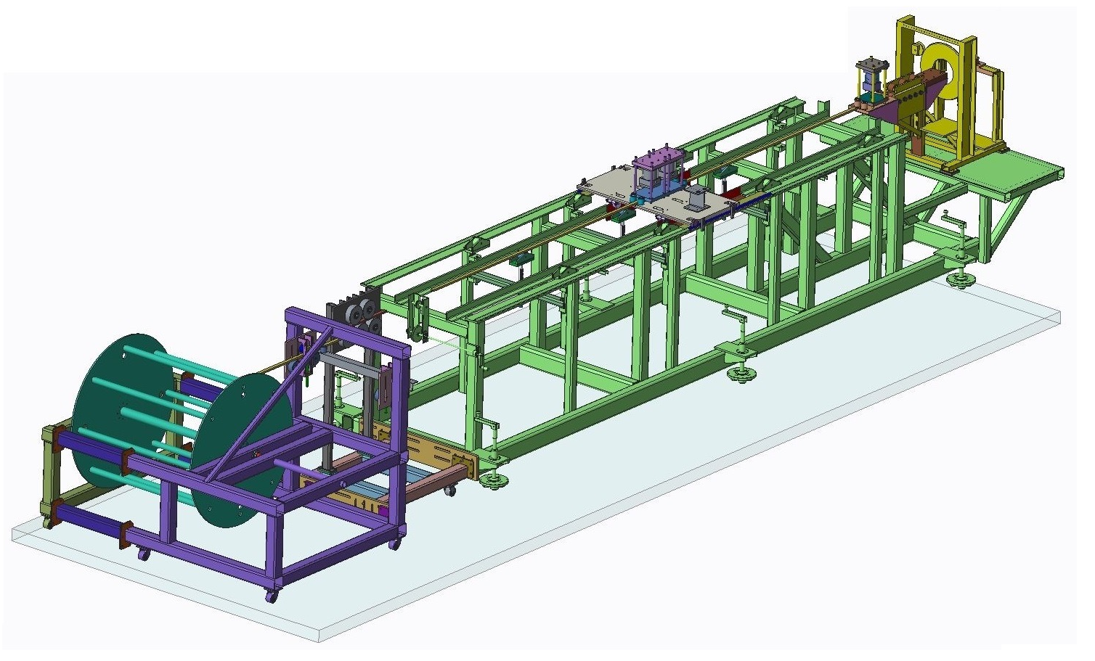
New Inner PF Coils Fabrication Strategy Devised to Ensure Quality
Address quality concerns: All coil manufacturers must first successfully produce a prototype PF1A coil
Quality will be assessed by:
On-site surveillance
High-pot and turn-to-turn testing
Destructive testing (sectioning)
Will use 4 manufacturers
Three industrial + PPPL
Will have on-site surveillance for industrial suppliers
All production coils will be tested to full current and full I²t on a custom test-stand before installation on NSTX-U
Portable Clean Room at PPPL
Winding line at PPPL

Slide 8
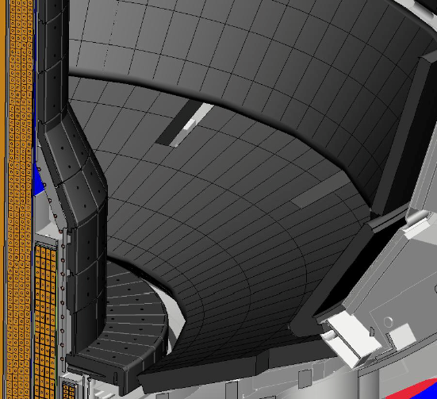
Improved PFC Designs
Two significant issues found with as-installed PFC designs
Halo loads not fully accounted for in initial tile fixturing design
Narrower SOL width now projected
Path Forward
Halo loads revisited based on NSTX, NSTX-U, MAST, other tokamak data
5 year plan research objectives + most recent SOL width models → updated heat flux specs
Divide tile scope into 2 regions:
“Targeted Improvement” to chamfers, fixture scheme, material
“Full Redesign” to enhance thermal performance → castellated tiles
All tiles will be designed to withstand B_{T}= 1.0 T, I_{P}=2.0 MA disruptions
Targeted Improvements
Full Redesign

Slide 9
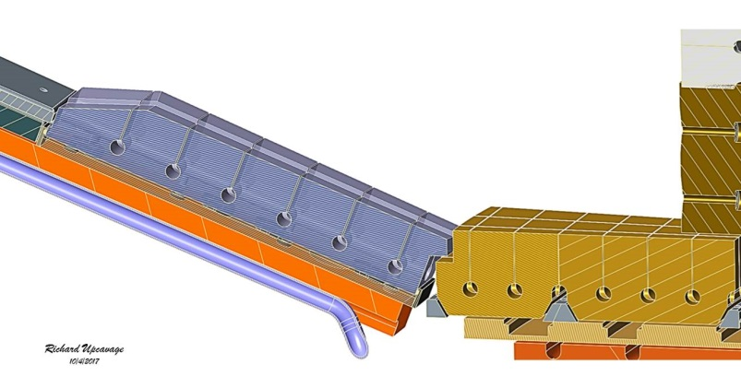
Improving Design of Polar Regions to Ensure High Performance and Reliability
Issues identified
PF1B coil limited divertor bakeout temperature
2 large ceramic insulators potential vacuum risk
Use of single O-rings → potential for leaks
Plasma can sometimes impinge on PF1C can
Solutions
PF1B supported by slings → thermally isolated
Lower ceramic insulator eliminated
Double O-rings with pumped interspaces
Tiles will bridge the CHI gap
Tile gap between inner and outer vessels only large enough to accommodate thermal and mechanical motion, fit-up tolerances
Castellated Outboard Tile
Castellated Inboard Tile
Research / Programmatic Impact:
Coaxial Helicity Injection (CHI)
as previously implemented is now excluded
Closed CHI Gap

Slide 10
Summary
Reviews have determined what needs to be repaired / replaced
Developed new designs to repair and improve components
Improving cost and schedule estimates
Following DOE O413.3B Program and Project Management guidelines
FY2017 / present NSTX-U operations budget ≈ sufficient to fund Recovery
Cost & Schedule Review estimated “Recovery” costs: $48M base + $15M contingency
Normal/planned outage costs for “Maintenance and Run Preparation”: $34M + $4M cont.
New PF1 coils are critical path, followed by PFCs
Resume operations between fall 2019 and summer 2020
Recovery will significantly enhance NSTX-U reliability & safety, provide highest-performance ST device as a robust user facility

Slide 11
Backup

Slide 12
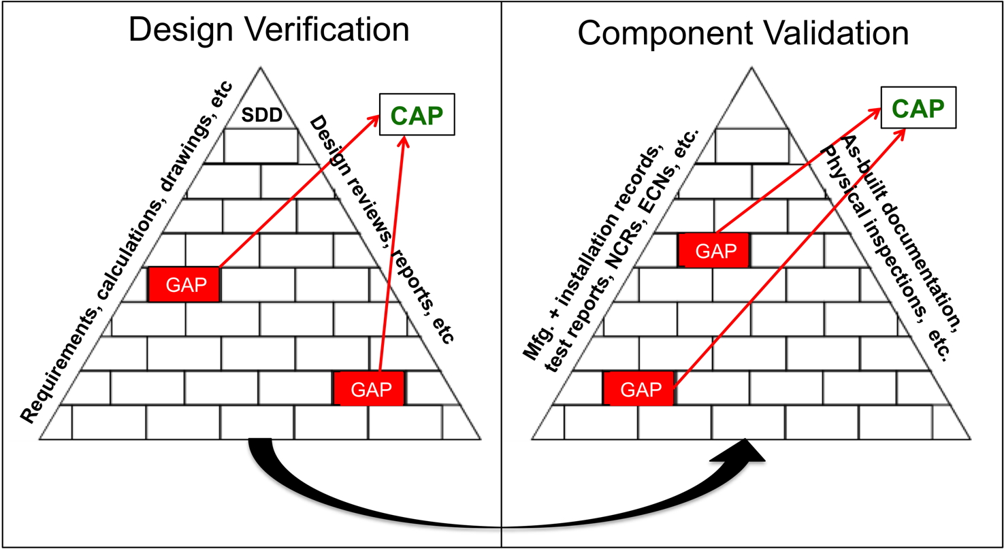
Developed DVVR Process DVVR = Design Verification and Validation Reviews
Is the design adequate?
Is installed component consistent with the intent of the design?
Prepared System Design Descriptions (SDDs) providing linkage to design-basis documentation
Gathered manufacturing, installation, and test documents (dating back to the beginning of the NSTX project circa 1998)

Slide 13
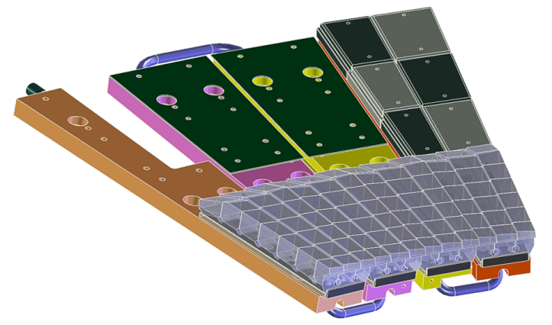
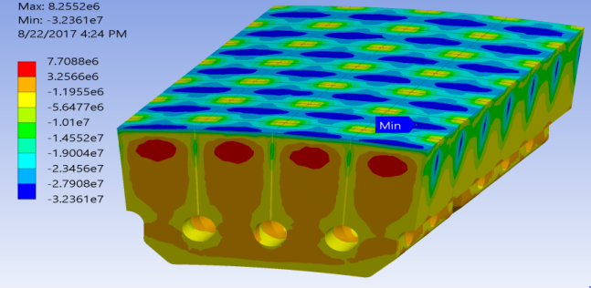
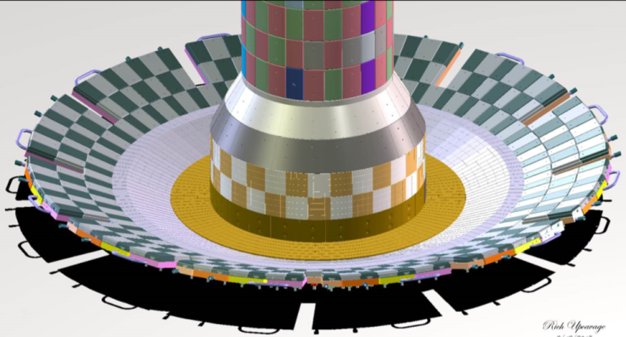
New “Castellated” Design Provides For High Heat Handling Capacity and Ease of Implementation
Design allows individual castellation to thermally expand under heat flux w/o exceeding compressive stress limits
→ Lower material stress for a given tile surface temperature
Outer divertor assembly with castellated tiles and exagerated fish-scale angles
Fully Assembled Divertor
Materials
Considering a range of isotropic graphites
Planning high heat flux tests using e-beam facilities at Applied Research Labs
Study both isolated samples and full tile modules
In collaboration with GA, ORNL
PFCs Being Updated

Slide 14
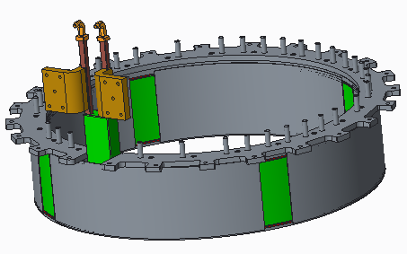
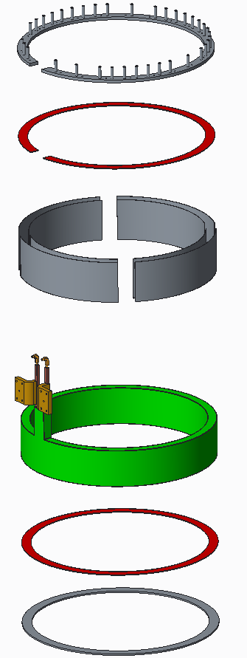
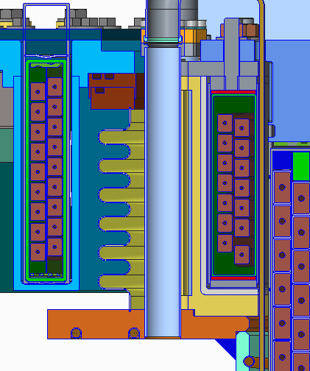
Improving Design of Polar Regions to Ensure High Performance and Reliability
Issues identified
Mechanical connection of PF1B coil to limited divertor bakeout temperature
2 two large ceramic insulators deemed a risk to reliability / vacuum integrity
Use of single O-rings → potential leaks
Plasma can sometimes impinges on PF1C can
Solutions
PF1B supported by “slings”, thermally isolated
Lower ceramic insulator eliminated
Double O-rings with pumped interspaces
Tiles will bridge the CHI gap
Mandrel-free coil mounted in slings, isolated from hot flanges
Thermal Isolation

Slide 15
Improving Design of Polar Regions to Ensure High Performance and Reliability
Issues identified
Mechanical connection of PF1B coil to limited divertor bakeout temperature
2 two large ceramic insulators deemed a risk to reliability / vacuum integrity
Use of single O-rings → potential leaks
Plasma can sometimes impinges on PF1C can
Solutions
PF1B supported by “slings”, thermally isolated
Lower ceramic insulator eliminated
Double O-rings with pumped interspaces
Tiles will bridge the CHI gap
Top of Machine: Double O-Rings + Ceramic Break

Slide 16
Improving Design of Polar Regions to Ensure High Performance and Reliability
Issues identified
Mechanical connection of PF1B coil to limited divertor bakeout temperature
2 two large ceramic insulators deemed a risk to reliability / vacuum integrity
Use of single O-rings → potential leaks
Plasma can sometimes impinges on PF1C can
Solutions
PF1B supported by “slings”, thermally isolated
Lower ceramic insulator eliminated
Double O-rings with pumped interspaces
Tiles will bridge the CHI gap
Tile gap between inner and outer vessels only large enough to accommodate thermal and mechanical motion, fit-up tolerances
Castellated Outboard Tile
Castellated Inboard Tile
Research / Programmatic Impact:
Coaxial Helicity Injection (CHI)
as previously implemented is now excluded
Closed Gap

Slide 17
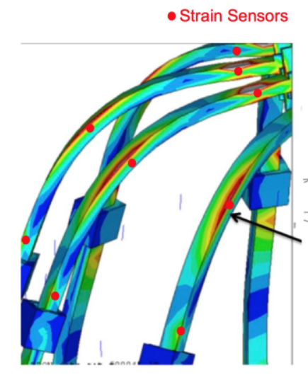
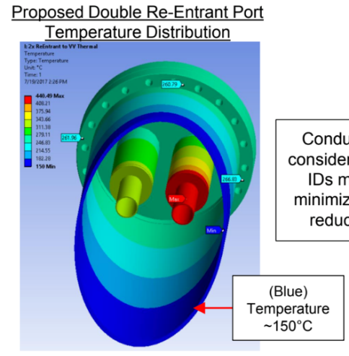
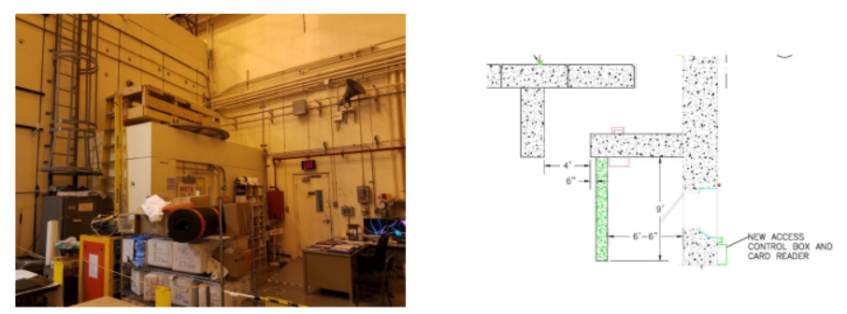
Bakeout, Instrumentation, and Shielding Scope will Improve Reliability and Safety
Bakeout Improvements
Improved hot helium feed-throughs, flow control, and instrumentation
Improved safety features on heated water system
Machine Instrumentation
Model validation and trending
Qualify design for full performance
Shielding Improvements
Construct/improve labyrinths at doors
Shielding in or in front of penetrations

