Slide 1
Divertor-localized fluctuations in NSTX-U L-mode discharges
F. Scotti¹, S. Zweben², V. Soukhanovskii¹
¹LLNL, ²PPPL
59th Annual Meeting of the APS Division of Plasma Physics
Milwaukee, WI, US
October 24, 2017

Slide 2
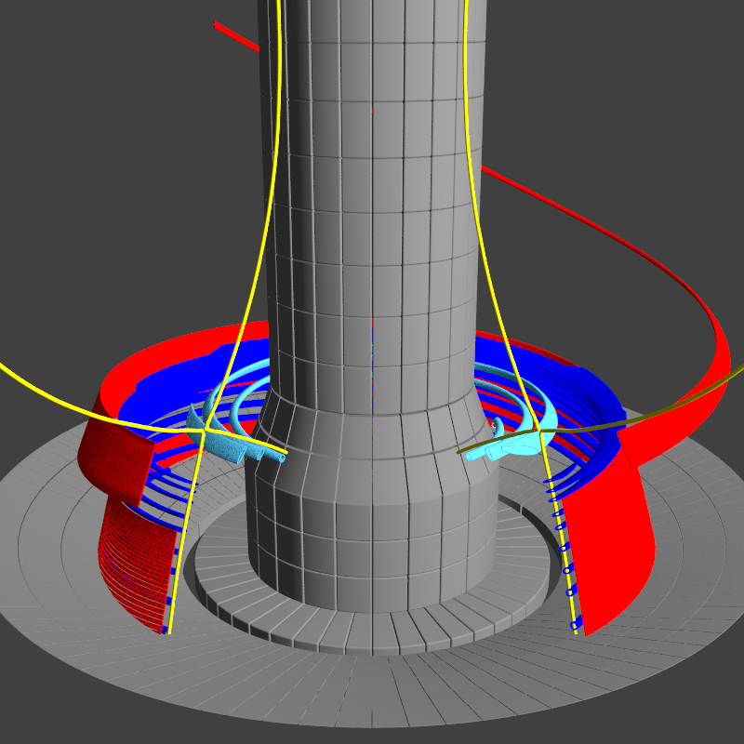
Characterization of divertor-localized turbulence in NSTX-U via imaging of divertor fluctuations
Divertor fluctuations due to:
Upstream turbulence (‘blobs’)
Divertor-localized instabilities:
First observed in MAST [Harrison PoP 2015], Alcator C-Mod [Terry, NME 2017]
Divertor-localized fluctuations observed in region where upstream turbulence is disconnected from divertor plate
Imaging fluctuations via emission from different species to isolate fluctuations in different regions
Possible implications for divertor heat/particle fluxes, interpretation of divertor measurements
Characterization of divertor localized fluctuations in NSTX-U
Statistical properties, correlation lengths, radial localization, dynamics

Slide 3
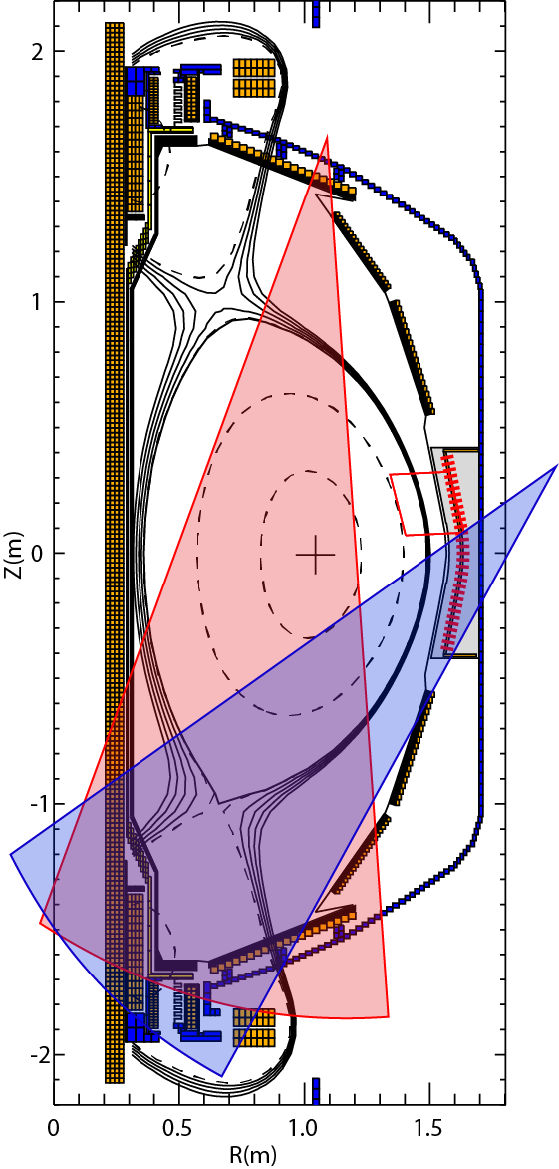
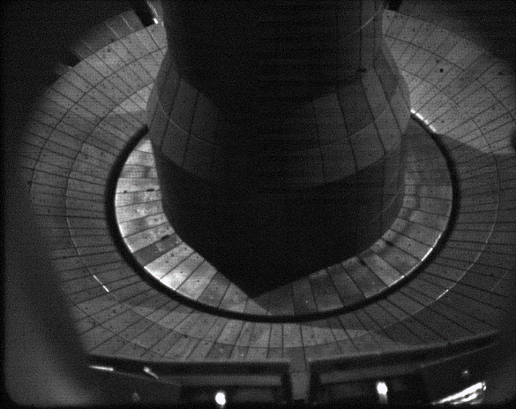
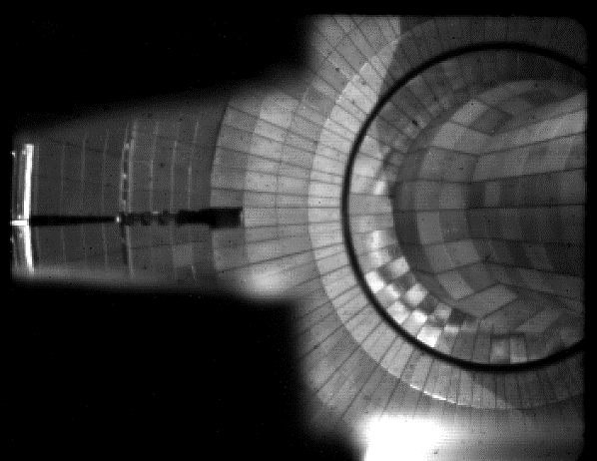
New fast camera and high X-point L-mode discharges enabled near-separatrix filaments imaging in NSTX-U
NBI-heated NSTX-U L-mode discharges
Lower divertor biased double null
I_{p} = 650 kA, f_{G} ~ 0. 3, BT=0.65T
X-point height ~ 0.5 m (κ~1.8, δ~0.45)
Simultaneous imaging with 3 fast cameras
Passive D-α imaging at midplane for upstream turbulence (GPI view)
100 kHz, 9μs exposure
Passive C III imaging in divertor
Emission along divertor leg
100 kHz, 9μs exposure
Passive D-α imaging in divertor
Surface localized emission
280 kHz, 3μs exposure

Slide 4
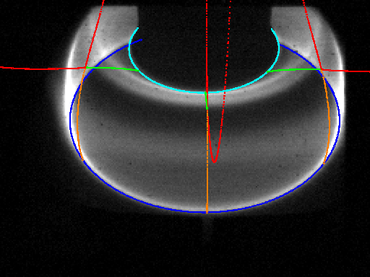
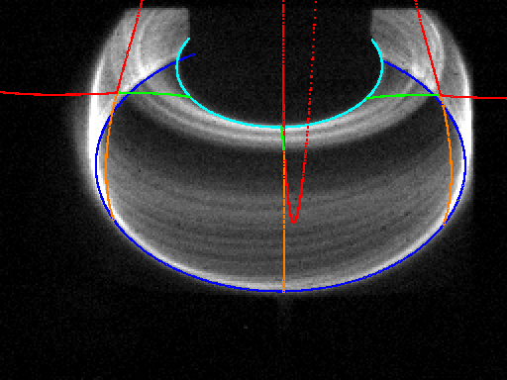
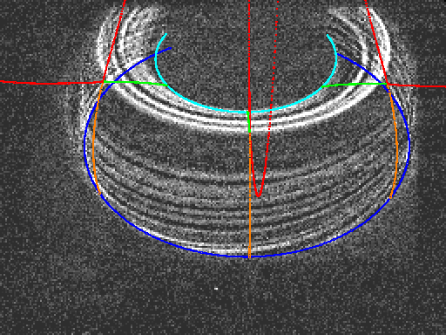
Field-aligned filaments observed in inner and outer divertor legs
Spatial calibration enables projection of 3D structures and spatial localization of emission
High pass filtering and cross correlation employed for analysis
Intermittent filamentary structures on both inner and outer divertor leg
Observed in lower divertor biased or double null shape with attached plasma conditions
1ms average
Raw image
High pass

Slide 5
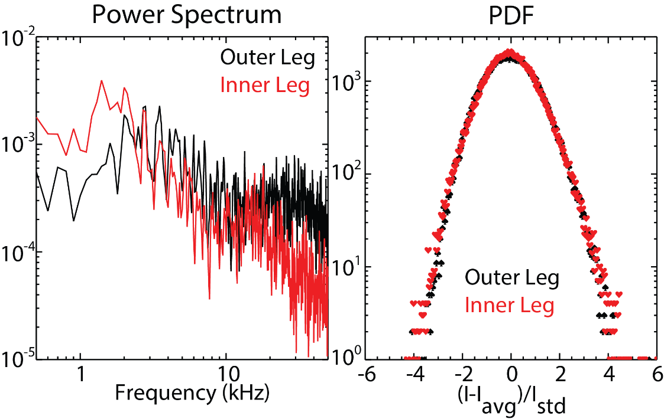
Divertor leg fluctuations are proportional to ~ ñ_{e}, no correlation with upstream fluctuations
Broadband fluctuations at 10-50 kHz, δI/I ~10-20%, lifetime ~50-100 μs
Intensity fluctuations ~ ñ_{e}
C III and D-α fluctuations are correlated (up to 0.7, peaked at zero delay)
Comparable near-Gaussian PDF for inner and outer legs filaments
No correlation with upstream turbulence
Cf. correlation observed for SOL blobs
Flute-like filament shape suggests generation in divertor region

Slide 6
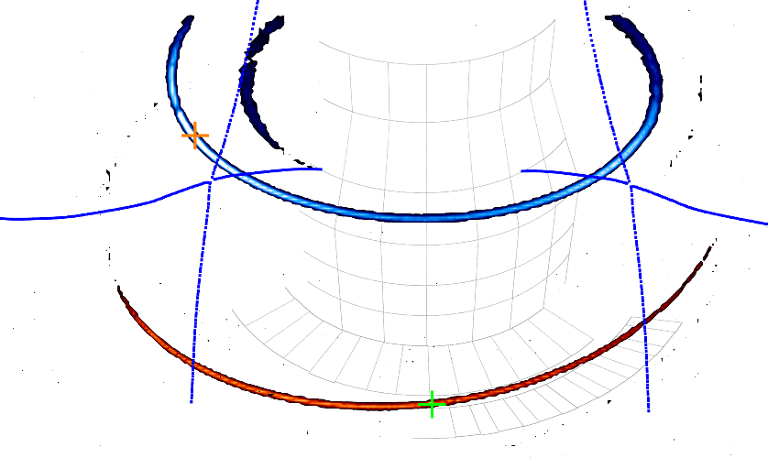
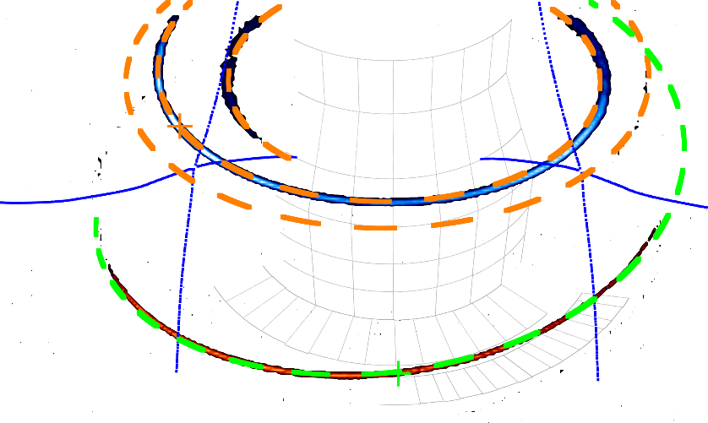
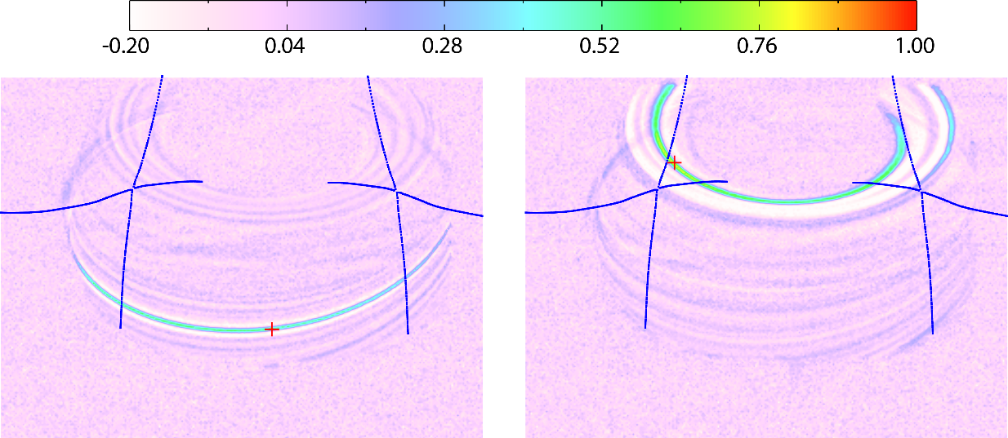
Field-aligned fluctuations, no correlation between inner and outer leg filaments
Zero-delay cross corr. of pixel with rest of images over 5 ms
No correlation inner to outer
Poloidal correlation lengths 1-3 cm ~ 10-50 ρ_{i}
Parallel correlation lengths ~ 3m
Toroidal mode number for outer leg filaments ~10-20
Field-aligned, radially localized around leg
Inner leg filaments localized to private flux region

Slide 7
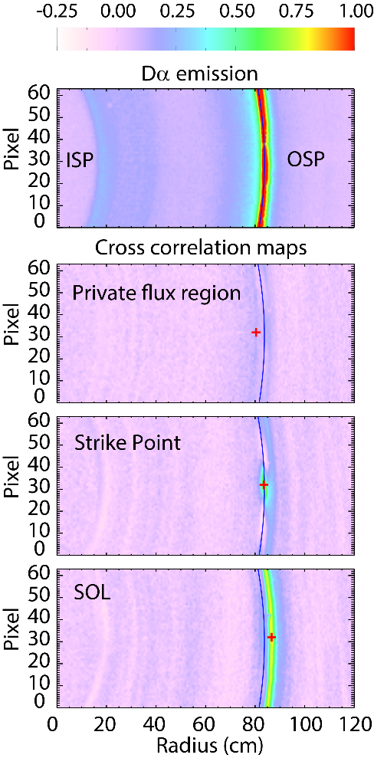
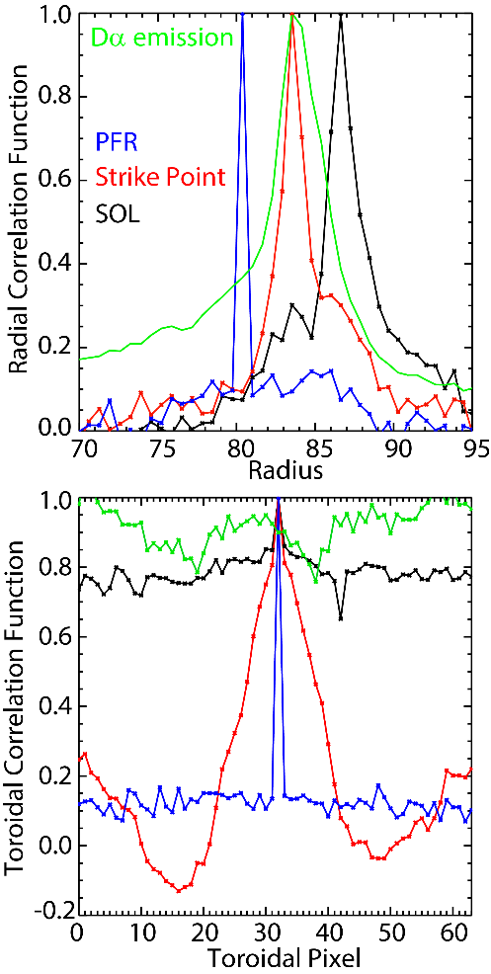
Outer leg filaments are connected to target plate, radially localized to strike point
Top-down view via D-α emission provides imaging of filaments footprint
Zero delay cross corr. at different radii:
In SOL cross correlation regions are spirals with uniform toroidal cross correlations
Footprint of upstream blobs
Approaching LCFS cross correlation regions have finite toroidal correlation length, radial corr. lentgth ~1-2 cm
Footprint of divertor filaments
No correlation regions observed in private flux region

Slide 8
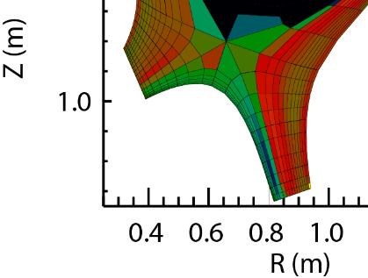
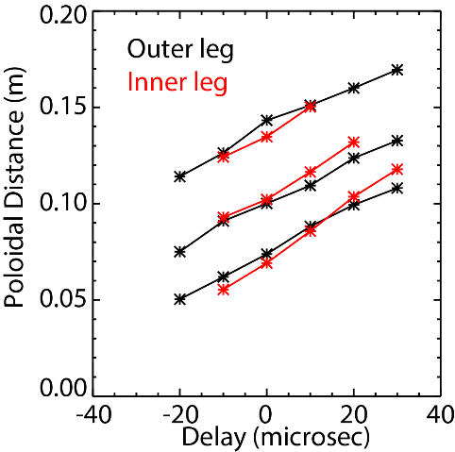
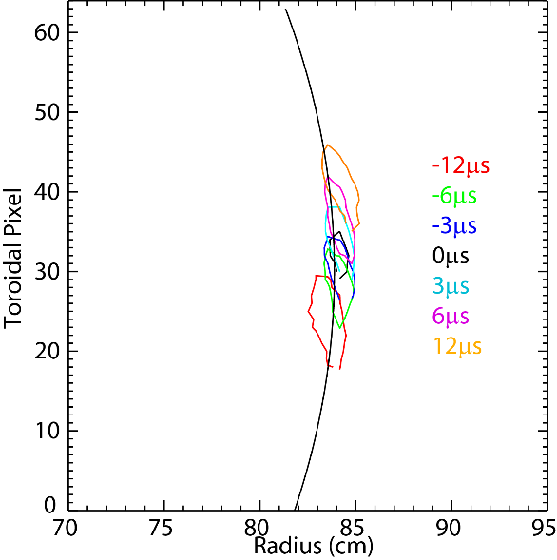
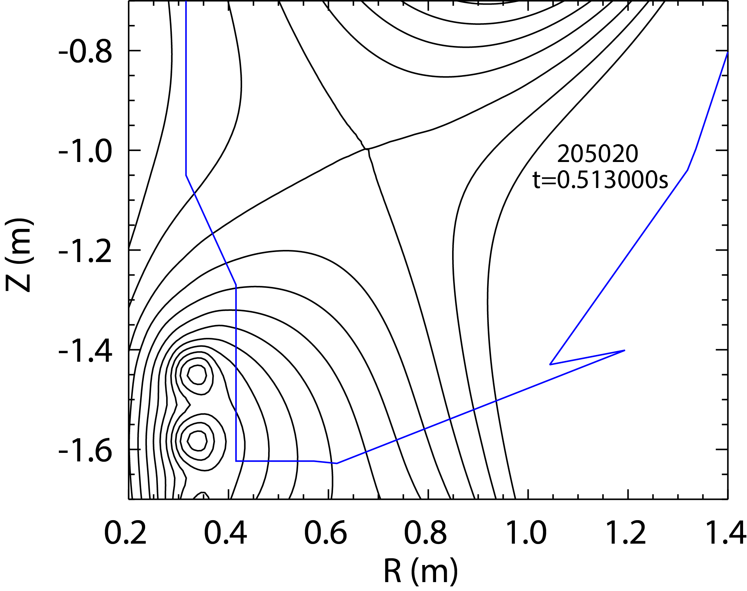
Inner and outer leg filaments rotate in opposite toroidal direction, poloidal velocity ~1 km/s
Time-delayed cross corr. for average filament propagation
Poloidal motion (1-2km/s) for inner/outer leg filaments towards X-point
Propagation reversal for inner leg filaments at low upstream density
Outer leg filaments propagate in counter current direction
Small but finite radial propagation observed
Opposite rotation to footprint of SOL blobs (downward poloidal motion)
Multi-fluid UEDGE simulations with full cross field drifts model
Filament velocity in outer leg qualitatively consistent with UEDGE estimates for ExB velocity
Divertor leg
filament

Slide 9
Summary
Observation and characterization of near-separatrix divertor-localized fluctuations in NSTX-U
Intermittent filaments in C III, D-α emission on divertor legs with no correlation with upstream blobs
Localized in private flux region on inner leg, separatrix on outer leg
Comparable poloidal and radial correlation lengths (1-3 cm)
Apparent filament motion is towards X-point on both legs
Shape, dynamics and absence of upstream correlation suggest fluctuations are generated and localized on divertor legs
Consistent observations with MAST, Alcator C-Mod

