Slide 1

Discharge start-up and ramp-up development for NSTX-U and MAST-U
D.J. Battaglia, M.D. Boyer, S.P. Gerhardt, J.E. Menard, D. Mueller (PPPL)
G. Cunningham, A. Kirk, L. Kogan, G. McArdle, L. Pangione,
A.J. Thornton, E. Ren (CCFE)
APS DPP Conference
Milwaukee, WI
October 25, 2017

Slide 2
Summary
Inductive start-up calculations completed for MAST-U and NSTX-U using LRDFIT
  Achieved similar metrics for breakdown and passive stability within the unique constraints of each device
High elongation on NSTX-U enabled by an L-H transition during the ramp-up phase
  L-mode database assembled to identify target conditions for a reproducible L-H timing in ramp-up
  Vertical oscillations at the time of diverting limited the elongation and hindered reproducible L-H transitions on NSTX-U
FY18 Research milestone aims to improve control and scenario development tools for the ramp-up phase
  Supports MAST-U / NSTX-U collaboration on start-up and ramp-up

Slide 3
MAST-U and NSTX-U are STs that have complementary scientific missions
MAST-U NSTX-U
MAST-U has unique divertor configuration
  Novel closed Super-X divertor concept to isolate divertor from main chamber
  Use ST configuration for divertor optimization studies at high heat flux
NSTX-U has unique heating and current drive flexibility at high field
  Explore confinement and stability at high non-inductive fraction
  Inform aspect ratio optimization of future devices
 | MAST-U (2018) Planned | NSTX-U (2016) Achieved | MAST-U (stage 1) Planned | NSTX-U (full field) Planned
Max I_{p} (MA) | 1.5 | 1.0 | 2.0 | 2.0
Max B_{T} at 0.936 m (T) | 0.513 | 0.635 | 0.684 | 1.0
NBI (MW) | 3.5 (75 keV) | 6 (90 keV) | 7.5 (75 keV) | 12 (90 keV)
t_{pulse} at full field (s) | 1 | 1 | 5 | 5

Slide 4
Start-up and Ramp-up collaboration has been initiated between MAST-U and NSTX-U
ST devices have common goals for optimizing startup and rampup scenarios
  Develop robust and flexible startup scenarios
  Maintain broad current profiles (low – l_{i}) during ramp-up
  Minimize ohmic flux consumption
  Achieve reproducible timing of diverting and L-H transition
Collaboration aims to develop similar models and metrics for optimizing startup and control
  Accelerate progress in developing and demonstrating scenarios and control necessary for high-performance

Slide 5
Common elements of startup and ramp-up phases on ST devices
Precharge
  Solenoid and outer PF coils start with positive current
  Inject neutral gas, turn on pre-ionization source
Startup (~ 20 - 40 ms)
  Ramp solenoid and outer PF current toward zero
    Achieve a field null and target V_{loop}
  Ramp outer midplane PF coils to provide equilibrium field
    Maintain passive R and Z stability
Solenoid
Coil current
Div PF
Outer mid PF
Outer PF
I_{p}
Time
Precharge
Ramp-up
Flattop
Startup
Ramp-up (I_{p} > Induced wall current ~ 100 - 300 kA)
  Transition from pre-programmed coil currents to active control of I_{p}, plasma shape and vertical stability
  Transition from limited shape to diverted shape
  Start external heating (NBI, RF)

Slide 6
Start-up model
Header slide

Slide 7
LRDFIT code used to examine start-up scenarios for NSTX-U and MAST-U
LRDFIT is a Grad-Shafranov solver used routinely at NSTX-U for data analysis
  An additional application is computing the vacuum field evolution for user defined or experimentally realized coil currents
  Primary tool on NSTX-U for magnetics calibration, axisymmetric wall model development, and breakdown scenario development
LRDFIT used to develop recipes for first plasma and startup optimization
  Identify target scenarios with best guess for the wall model
  Develop prescriptions for scanning parameters independently
    I_{OH} precharge, V_{loop}, null timing, B_{Z}/dt, field curvature …
  Enabled rapid progress with NSTX-U first plasma demonstration and refinement of the 2D wall model for equilibrium reconstructions

Slide 8
Differences between MAST-U and NSTX-U devices that influence start-up
Shorter solenoid of MAST-U = greater field curvature
  Motivates including the divertor coils to oppose radial field
NSTX-U: dB_{z}/dt provided primarily from a single high-voltage bipolar PF coil set
  MAST-U: Use a number of lower voltage PF coils to generate target dB_{z}/dt
Different induced currents in the conducting structures
  Copper cooling tubes on NSTX-U generated large induced currents during initial campaign
Differences in I, V and I²t limits on OH and PF coils

Slide 9
Startup scenarios use a different number of PF coils
MAST-U
NSTX-U
I_{OH} = 45 kA (22.5 kA/turn)
** Limit for 2018 operations
I_{OH} = 20 kA (20 kA/turn)
** Limit for 2016 operations
10 PF coils sets …
2 PF coils sets …
Ramp toward negative current at maximum voltage (350V per coil)
PF3: Provide positive nulling field, then ramp negative to establish positive field curvature (2 kV per coil w/ bipolar supplies)
P4 + DP + D6: Ramp from zero current
D5 + D7 + D3: Ramp from pos. current
PX + D1 + D2: Steady positive current to exclude solenoid B_{r} field
D1, D2 and D3 at 2018 current limit (5 kA)
PF5: Ramp from zero current to provide equilibrium field
P5: Ramp from zero current to provide equilibrium field

Slide 10
MAST-U can produce a field null with similar spatial and temporal quality to NSTX-U
B_{θ} averaged over first 2 ms
Midplane B_{Z} evolution over first 4 ms
MAST-U
NSTX-U
MAST-U
0 ms
4 ms
NSTX-U
0 ms
4 ms

Slide 11
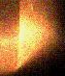
MAST-U breakdown and ramp-up metrics similar to demonstrated NSTX-U scenario
E_{ϕ}B_{ϕ}/B_{θ} averaged over first 2 ms
Field decay index evolution in ramp-up
MAST-U
NSTX-U
Visible light at 2 ms
MAST-U
4 ms
20 ms
Low R PF coils improve field null at the expense of field curvature
4 ms
20 ms
I_{TF} = 2.4 MA
V_{loop} = 4 V
I_{TF} = 3.0 MA
V_{loop} = 4 V
Similar field curvature for R > 0.5
NSTX-U

Slide 12
Plasma elongation in ramp-up was limited by large induced wall currents on NSTX-U
Current density (colors) and flux contours at 20 ms
MAST-U
NSTX-U
Large induced current in CS crown on NSTX-U limited the early elongation
MAST-U calculations predict modest induced currents
V_{loop} = 4V
V_{loop} = 4V

Slide 13
Summary of startup calculations
MAST-U should be able to achieve a startup scenario similar to startup demonstrated on NSTX-U
  I_{OH} = 45 kA, I_{TF} = 2.4 MA, V_{loop} ~ 4V satisfying 2018 PF coil limits
  Caveat: differences in pre-ionization may alter V_{loop} requirement
Experiments and modeling will further optimize startup
  What is the optimum dI_{p}/dt in the first 10 – 20 ms?
    Larger values tend to keep l_{i} low, but drives larger wall currents which can degrade passive stability and increase flux consumption
  What are the limits in the field curvature?
    Extending the vertical extent of the field null with low-R PF coils typically comes at the expense of field curvature in the ramp-up
    Aim would be to achieve maximum elongation that remains stable

Slide 14
Analysis of NSTX-U Ramp-up
Header slide

Slide 15
Early L-H transition enables low-l_{i} scenario on NSTX-U
L-H transition slows current diffusion toward axis
  Edge pressure gradient increases edge bootstrap current
  Higher temperature increases current diffusion time
Stable elongation increases as l_{i} decreases
  Larger κ permits larger I_{p} and β
  Increases bootstrap current drive
  Plot shows impact of earlier L-H timing
    Vertical dashed lines: L-H & H-L transitions
    Flattop l_{i} decreases as L-H moves earlier
NSTX
0.44 T
H-mode
NSTX-U
0.62 T
Week 3
No EFC
Week 5
EFC v1
Week 7
EFC v2

Slide 16
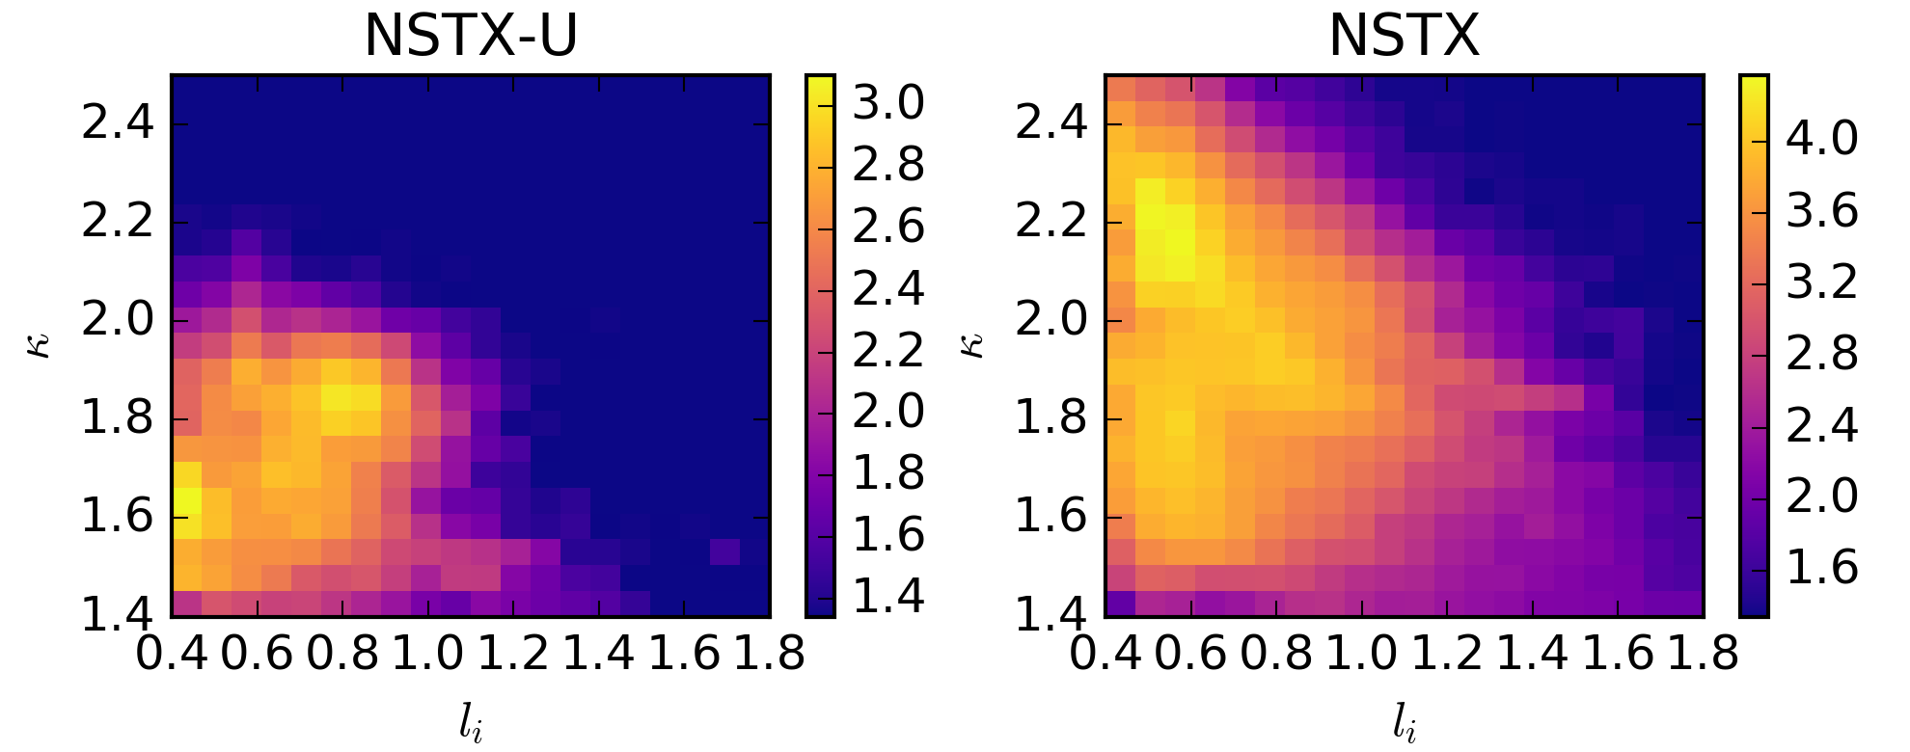
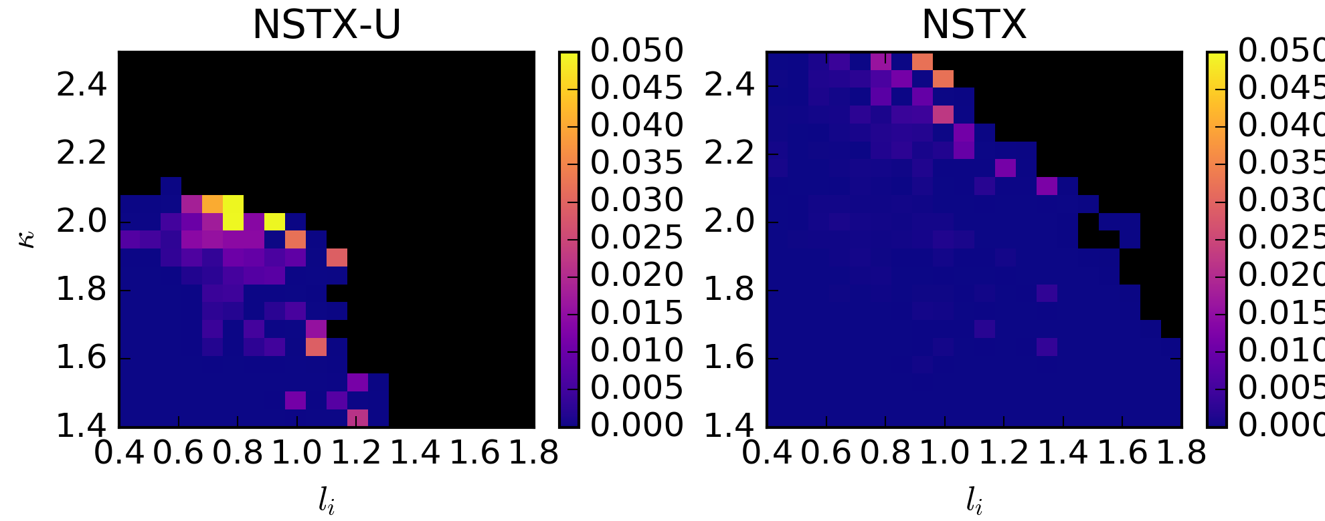
Increasing κ in NSTX-U ramp-up will require access to low-l_{i}
NSTX-U achieved a similar ramp-up shape to NSTX when l_{i} = 0.8
NSTX-U operated much closer to VDE limit in this condition
  Consistent with increase in aspect ratio
  Note: still optimizing control and EFC on NSTX-U
Motivates lowering l_{i} to expand κ range
EFIT01 for t < 0.3 s
Number of equilibrium
(log scale)
Probability of VDE
NSTX
NSTX
5%
0%
5%
0%
NSTX-U
NSTX-U
See M.D. Boyer, 11.00041 (next poster)

Slide 17
NSTX-U database provides guidance on target conditions for reliable L-H transition
Why do some discharges miss the L-H transition?
  NSTX-U database of times that are diverted L-modes
    100 L-mode times and 68 L-H transition times = 168 entries
  L-mode points: P_{NBI} ≥ 3 MW for at least 50 ms
    Beam slowing down time ~ 25 ms
Identified four criteria for L-H transition (next slide)
  No discharges miss L-H transition if all four criteria are met
  P_{NBI} ≥ 3MW can “power through” with only 3 conditions met
 | Total times | L-H times | L-mode times
Satisfy all 4 criteria | 39 | 39 (100%) | 0 (0%)
Satisfy 3 criteria | 57 | 24 (42%) | 33 (58%)
Satisfy less than 3 criteria | 72 | 5 (7%) | 67 (93%)

Slide 18
Target conditions for a reliable L-H transition in the early ramp-up with P_{NBI} ≥ 3 MW
Criteria | Details
n_{e} > 1.25 × 10¹⁹ m⁻³ | Line-averaged density is above a critical value
V_{surf} < 1.15 V | Surface voltage (EFIT02) is below a critical value
|dr_{sep} – 0.2 cm| < 0.6 cm | Shape is near double null (EFIT02) **
O II / D_{γ} < 1 (t = 0.15s) | Ratio of lower divertor filterscope channels ^^
** Offset in dr_{sep} (toward USN) may indicate a systematic error in computing dr_{sep}
^^ Filterscope ratio is specific to NSTX-U. It is a general metric for the oxygen
content of the plasma, which increases steadily following a boronization
Criteria guide targets for early ramp-up
  Fuel early to get desired n_{e} target and divert near DN
  Heat with P_{NBI} ≥ 3 MW (heating efficiency ~ 50%)
  Then, pause or slow I_{p} ramp and fueling to get V_{surf} < 1.15V

Slide 19
Vertical oscillation (“bobble”) when diverting near DN hindered shot reproducibility
Dither
Two repeat shots
(Except 204588 has larger P_{NBI})
Slight differences in shape at time of diverting lead to different behavior of vertical oscillations
204118 has dither at 0.22s, then an L-H transition at 0.241s
204588 does not have an L-H transition despite larger heating
Motion away from DN shrinks plasma volume, increasing V_{surf}, hindering L-H transition from 240 – 260ms
L-H
204118
204588

Slide 20
Control and scenario solutions have been identified for mitigating the bobble
Bobble more likely with large dZ/dt or VDE growth rates at time of diverting
  “Kick” in dZ/dt may be driven by control algorithm transitions or errors in rtEFIT
  Overshoot of target inner gap leads to larger VDE growth rate
Solutions pursued in FY16 operations
  Flux reference changes from limiter to X-point within a single control algorithm
  Inner gap feedback improves consistency of diverting time and mitigates overshoot
  Divert SN, then allow dr_{sep} feedback to alter the shape to near DN
Target
See M.D. Boyer, 11.00041 (next poster)

Slide 21
FY18 Research Milestone on
Startup and Ramp-up Modeling
Extend LRDFIT calculations to include I_{p} in breakdown
  Filament model and/or free-boundary GSE solution
Develop control solutions for ramp-up using TOKSYS
  Integrates power supply and real-time control with plasma model in order to satisfy system constraints
  Encompass transition from feed-forward currents with a limited plasma to active position feedback with a diverted plasma
Optimize NBI heating and current drive with TRANSP
  Consider impact of density, outer gap, and beam parameters on MHD and fast-ion stability

Slide 22
Summary of Analysis of NSTX-U Ramp-up
Expanding κ range on NSTX-U is facilitated by achieving an earlier L-H transition
  NSTX-U achieved similar κ to NSTX with l_{i} ~ 0.8, but ran closer to VDE stability limit
A database of diverted L-mode times identified four criteria that improves the reliability of an L-H transition
  Provides guidance on early ramp-up scenario, such as adding a “pause” to the I_{p} ramp and fueling
Vertical oscillations at the time of diverting near DN (“the bobble”) reduced the repeatability of the L-H transition
  Simulation framework is under development to advance the control and scenario solutions for the ramp-up phase

