Slide 1

Analysis of vertical stability limits and vertical displacement event behavior on NSTX-U
M. D. Boyer¹, D. J. Battaglia¹, S.P. Gerhardt¹, J.E. Menard¹, D. Mueller¹, C.E. Myers¹, S. A. Sabbagh², D. R. Smith³
¹Princeton Plasma Physics Laboratory, ²Columbia University, ³University of Wisconsin-Madison
59th Annual Meeting of the APS Division of Plasma Physics
Milwaukee, Wisconsin
October 23-27, 2017

Slide 2
Overview
Optimization of vertical control on NSTX-U is critical to achieving high performance
  High elongation improves beta limits, increases bootstrap current
  Oscillation-free control improves confinement and diagnostic quality
  NSTX-U operates at increased aspect ratio
Improvements to the control system were made for the last campaign
  Was able to realize elongation vs. l_{i} operating space similar to NSTX but at higher aspect ratio
  Shots typically evolved to high l_{i}, limiting achievable elongation
To study control limits, a database of VDEs and vertical oscillations on NSTX and NSTX-U was generated
  Specific attention paid to oscillations in ramp-up phase
Results provide guidance for future work:
  Ramp-up optimization
  Scenario development
  Control system improvements
This research was supported by the U.S. Department of Energy under contract number DE-AC02-09CH11466

Slide 3

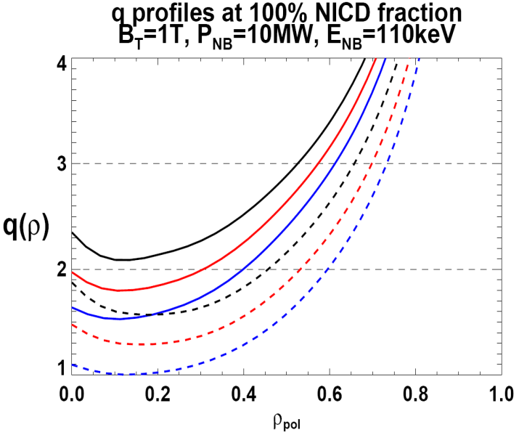
NSTX-U improves controllability and brings about new control requirements
New opportunities to use feedback control to optimize performance as a result of:
  Longer pulse length, increased toroidal field, increased heating and current drive
Advanced control will be necessary for achieving many operational goals, e.g.,
  Non-inductive scenarios, snowflake divertor, rotation control, current profile control
  2x higher CD efficiency from larger tangency radius R_{TAN}
100% non-inductive CD with core q(r) profile controllable by:
  NBI tangency radius
  Plasma density, position
f_{GW}
0.95
0.72
R_{TAN} [cm]
__________________
50, 60, 70, 130
60, 70,120,130
70,110,120,130
Present NBI
New 2nd NBI

Slide 4
Additional voltage differences improve estimation of vertical position
~60 NSTX-U equilibria generated with ISOLVER free boundary code
Flux loop weights determined by least squares fit to IpZp
Optimal weights will be established based on EFIT reconstructions of experimental discharges

Slide 5
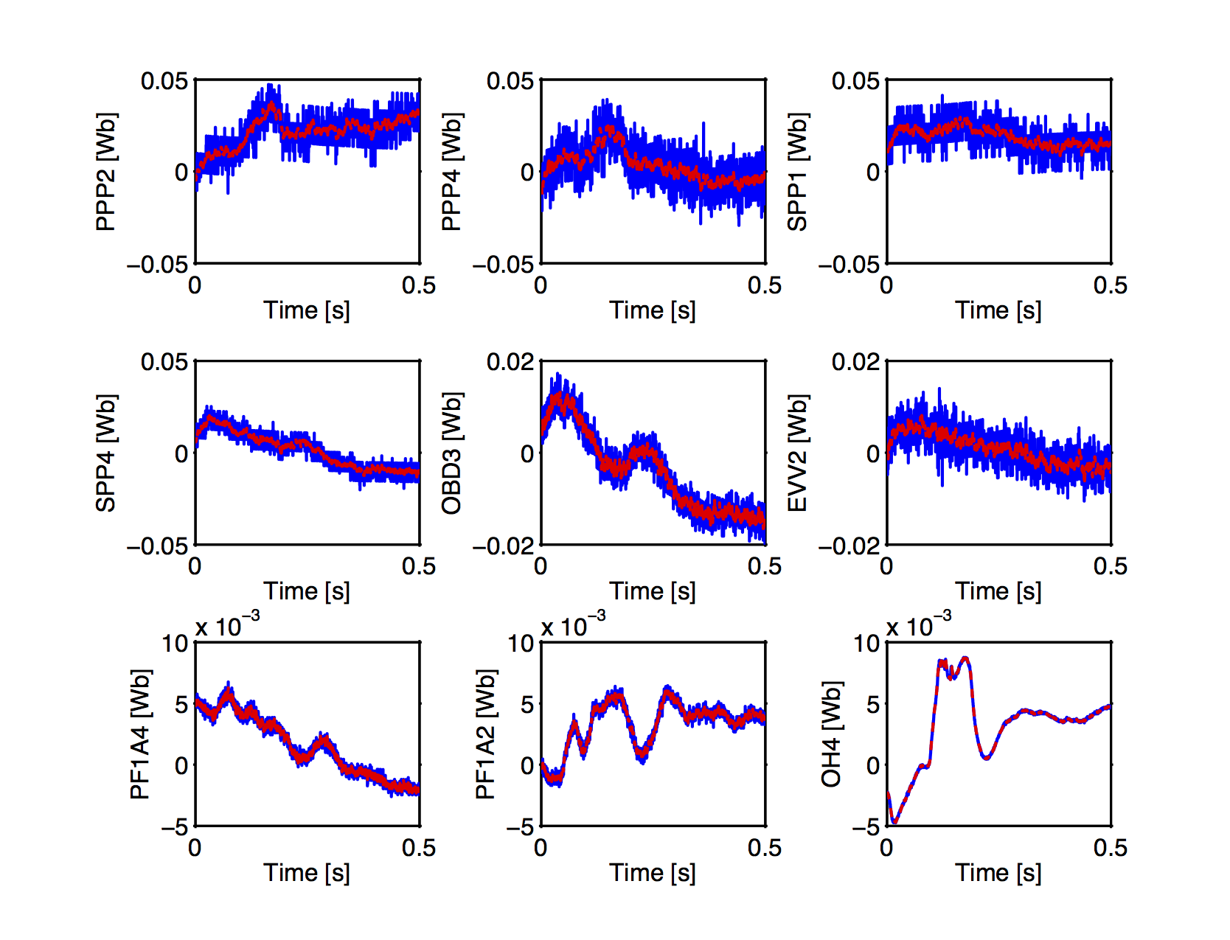
Kalman filtering used to improve noisy, low signal-to-noise flux differences
Voltage differences are hardware differenced, but flux loops are differenced in software
For small plasma motion, the differences are near the digitizer resolution
Could integrate voltages digitally in PCS, but would miss fast transients
Kalman filter weights integrated voltages and noisy measurements to obtain a smoothed estimate of the flux difference

Slide 6
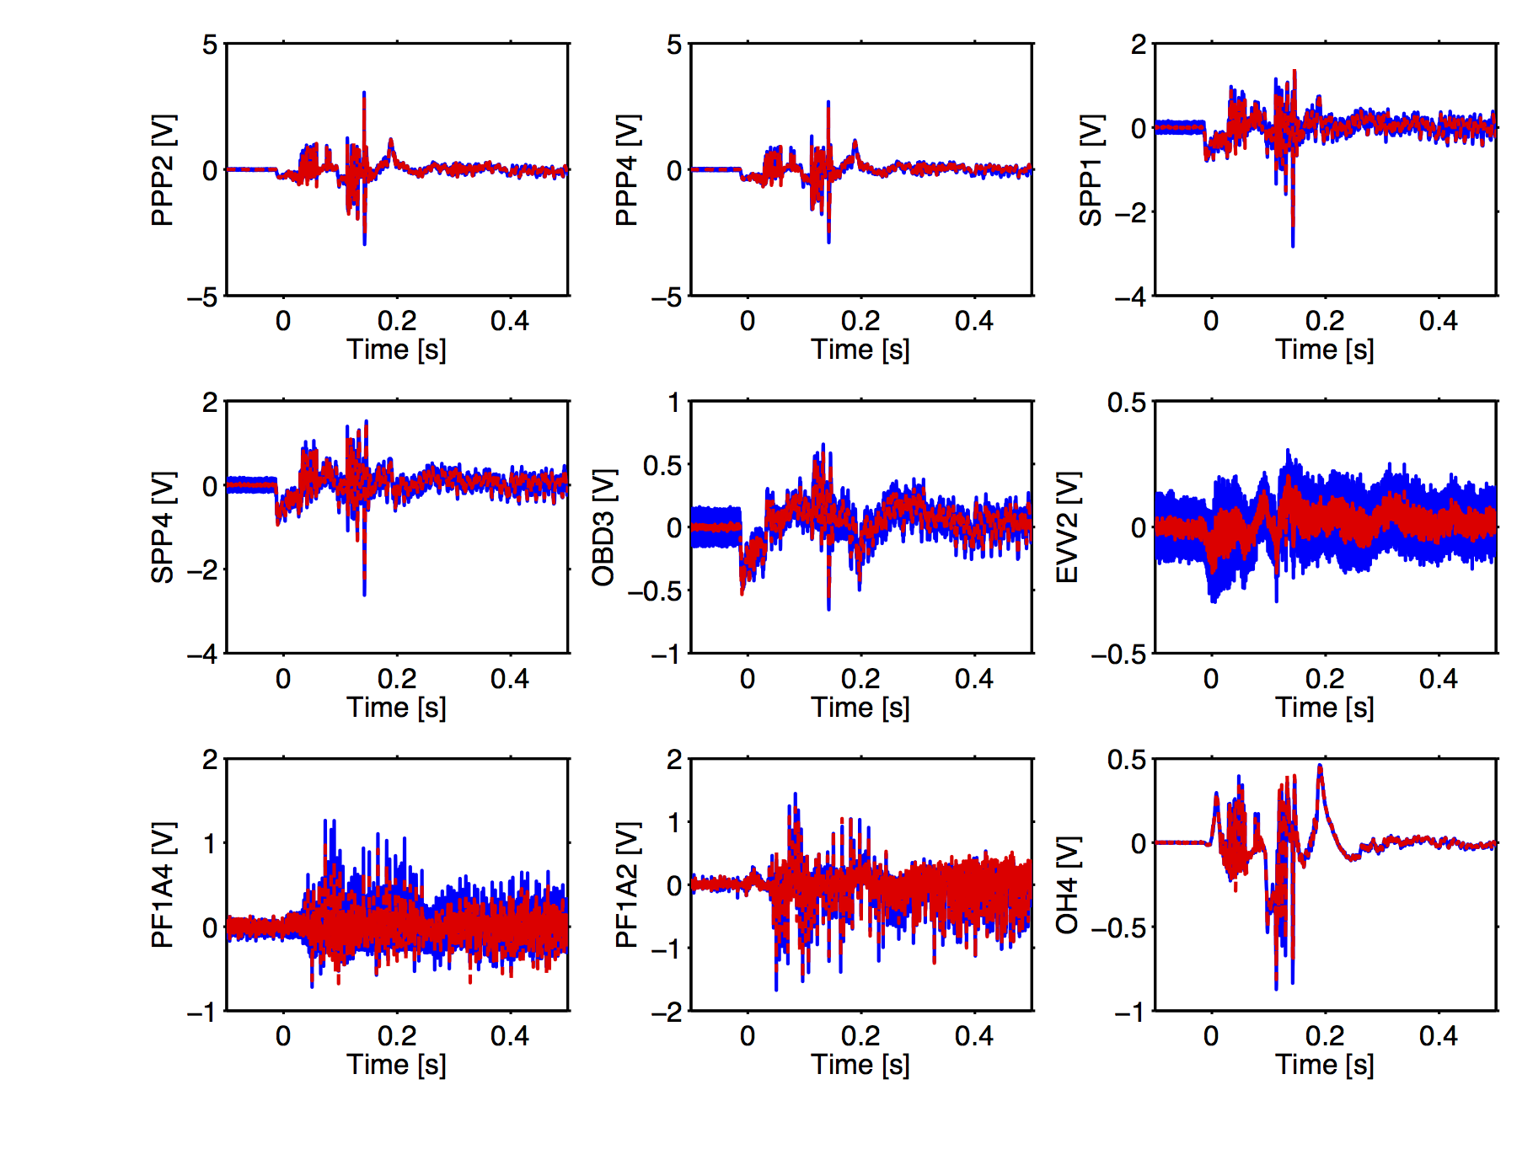
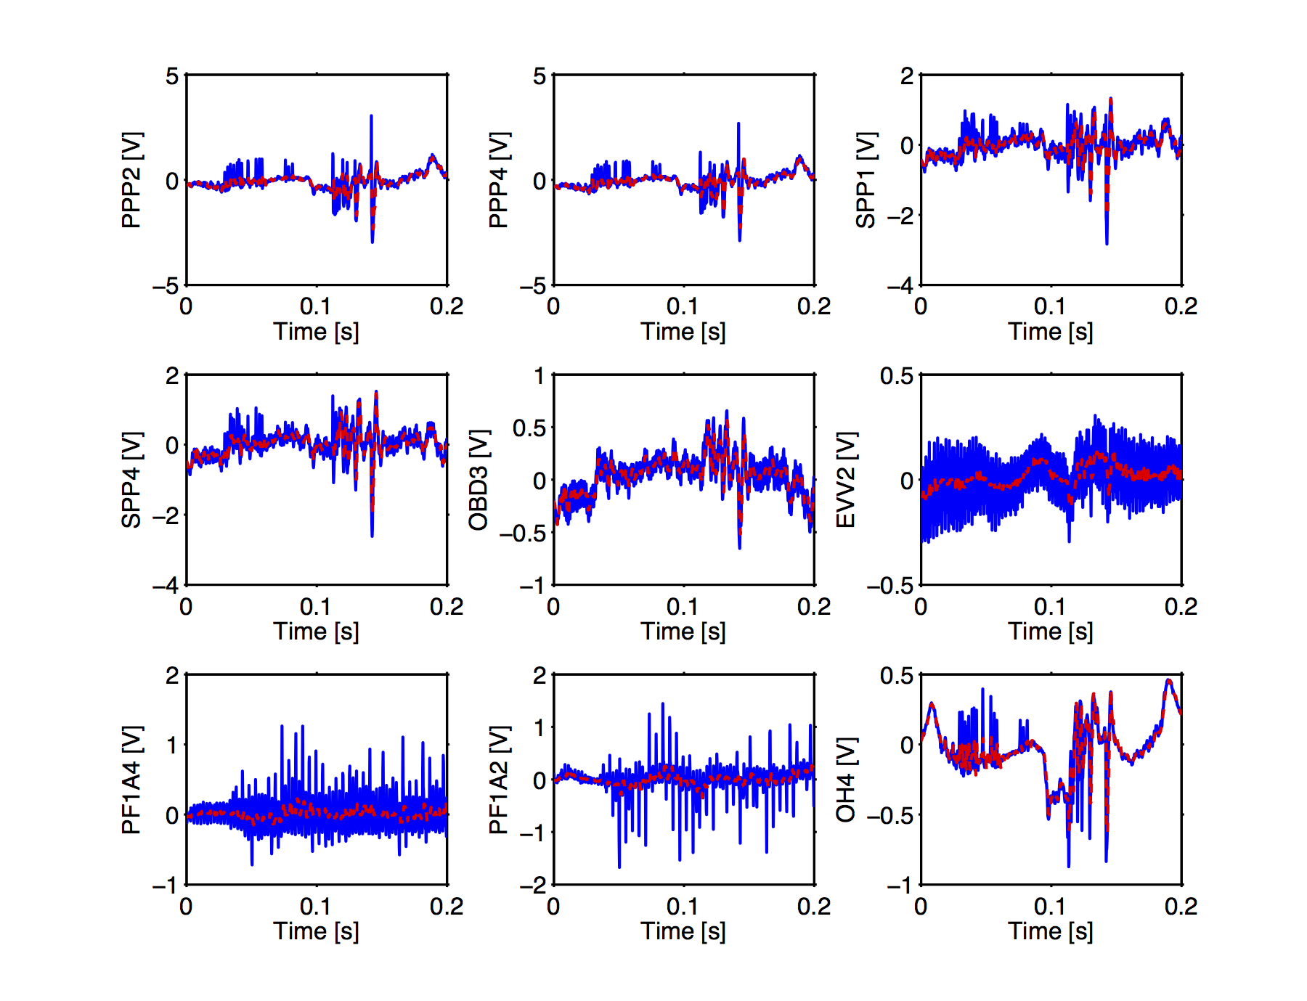
Notch and median filtering added to remove power supply ripple and MHD events
Notch at ~360Hz and ~720Hz removes power supply ripple and harmonic
Median filter removes noise spikes on sensors caused by MHD events during ramp-up

Slide 7
At time of maximum stored energy, NSTX-U operated in elongation vs. li space similar to NSTX
Database of achieved elongation at time of maximum stored energy
1
Extended NSTX trends to higher internal inductance
Similar elongation at mid-range internal inductance
Occasionally reached higher elongation, low li space
2
1
3

Slide 8
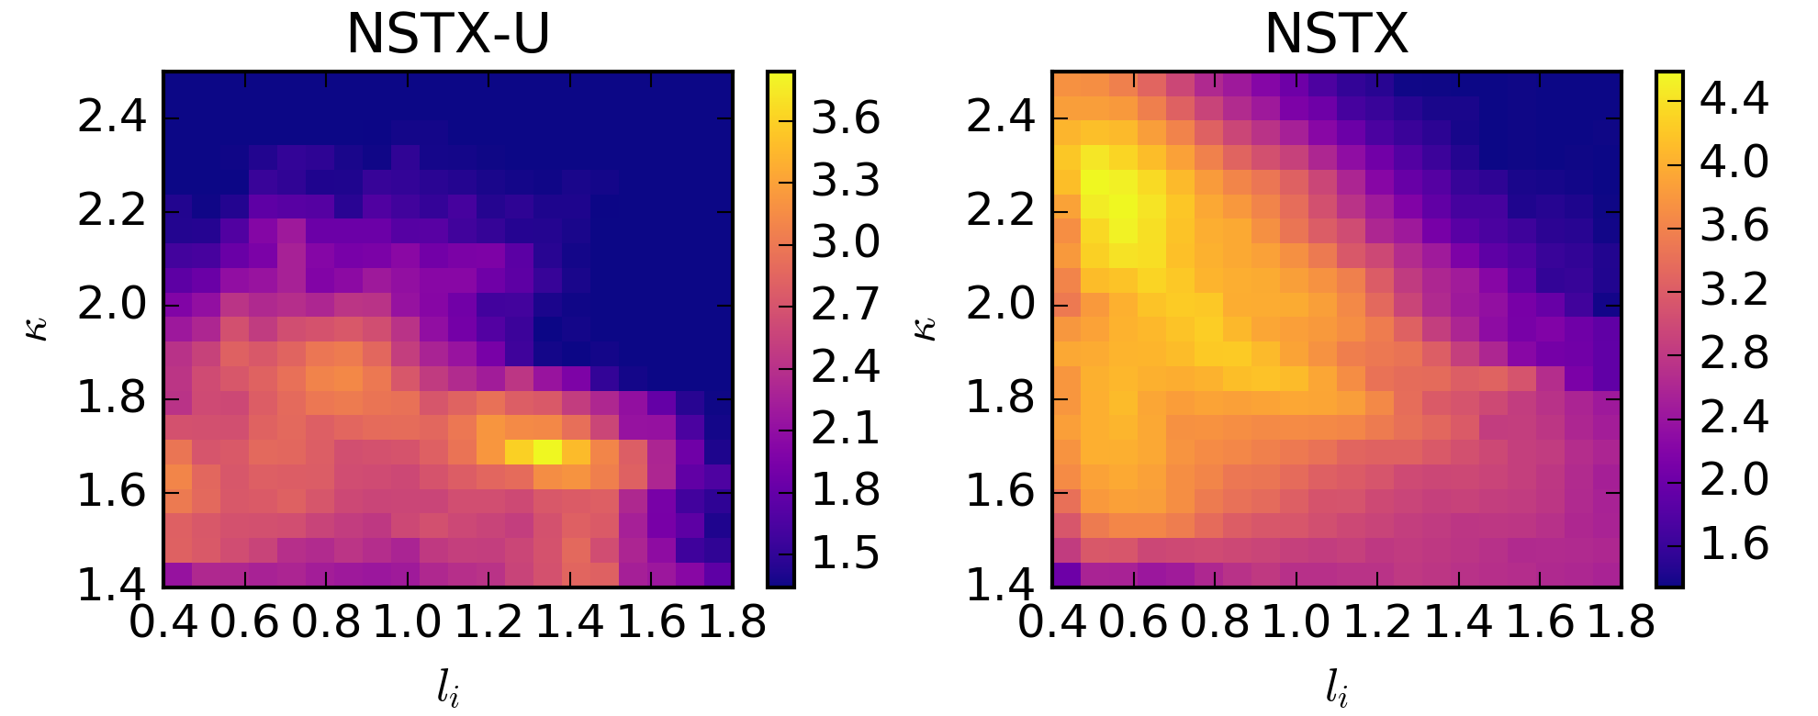
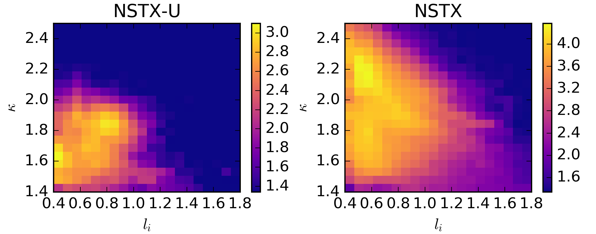
Comparing all EFIT01 slices for NSTX and NSTX-U: operated along similar paths, but NSTX achieved high elongation early
Log scale histogram of all EFIT01 slices
Typical NSTX low-l_{i} H-mode
High-l_{i} L-mode fiducial used in commissioning
Most frequent NSTX operation along these lines
Continued NSTX trend at higher l_{i}
Log scale histogram of all EFIT01 slices for t<0.3s
NSTX-U typically had low l_{i} early, but low elongation
NSTX reached final elongation and l_{i} early on

Slide 9
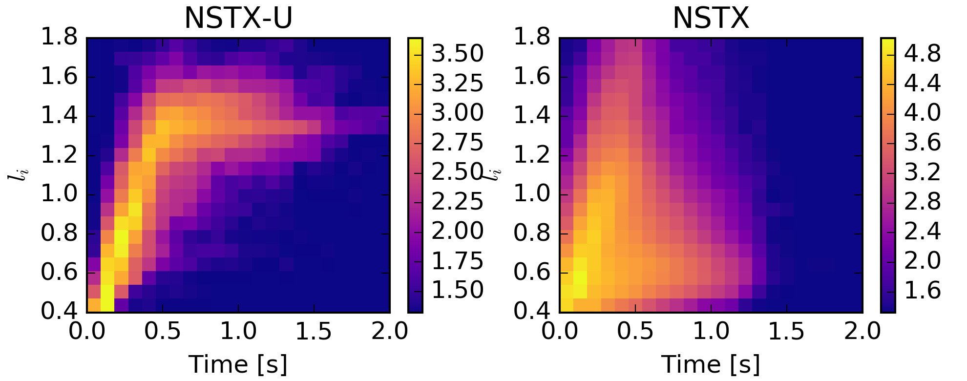
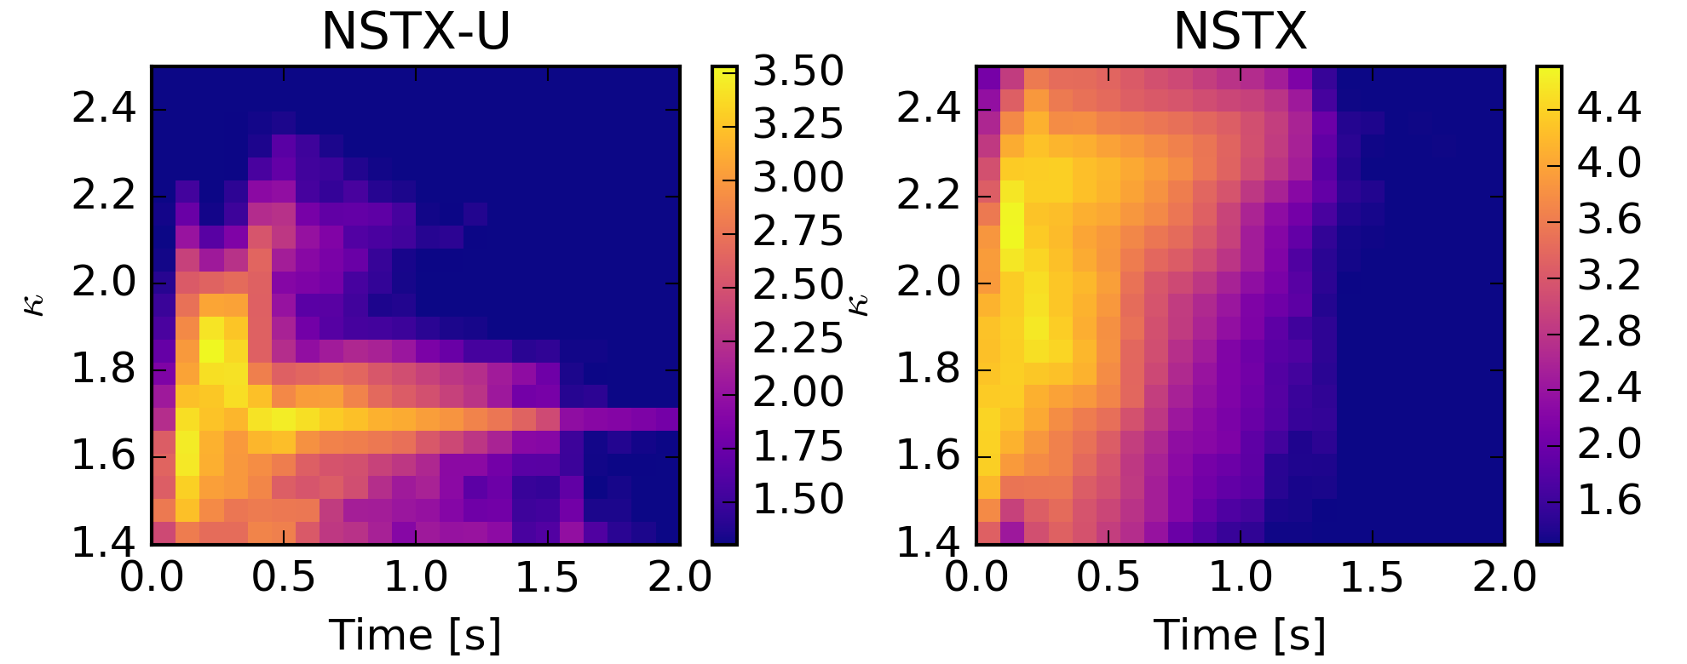
Longest NSTX H-mode shots occurred at low li and high elongation; NSTX-U exceeded these shots in L-mode despite operating at high li, low elongation
Log scale histogram of l_{i} vs. time for all EFIT01 slices
l_{i} ramp rate in L-mode is similar for NSTX-U and NSTX
NSTX-U achieved pulse lengths far exceeding NSTX even at high l_{i}
Longest NSTX pulse lengths occur at low l_{i,}
maintained by higher H-mode temperature
Log scale histogram of elongation vs. time for all EFIT01 slices
NSTX-U elongation low early, ramped toward target
NSTX reached high elongation early, then three common trajectories
κ reduced in L-mode for vertical stability at high l_{i}

Slide 10
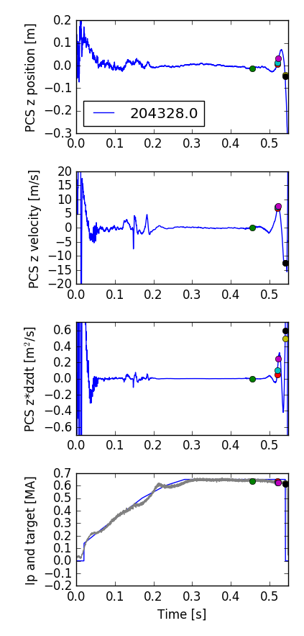
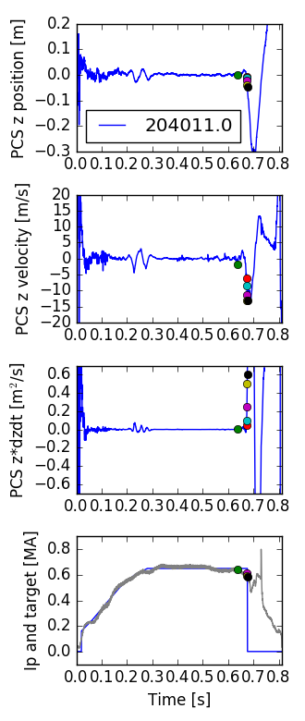
Database of VDE times generated to assess limits and triggers for VDEs
Shots analyzed for times of vertical excursions and recovery
  Last excursion without a recovery is flagged
  Times that vertical motion exceeds thresholds are flagged
  Also detects spikes in plasma current that occur during VDE to help distinguish between ‘pure VDEs’ and other disruptions

Slide 11
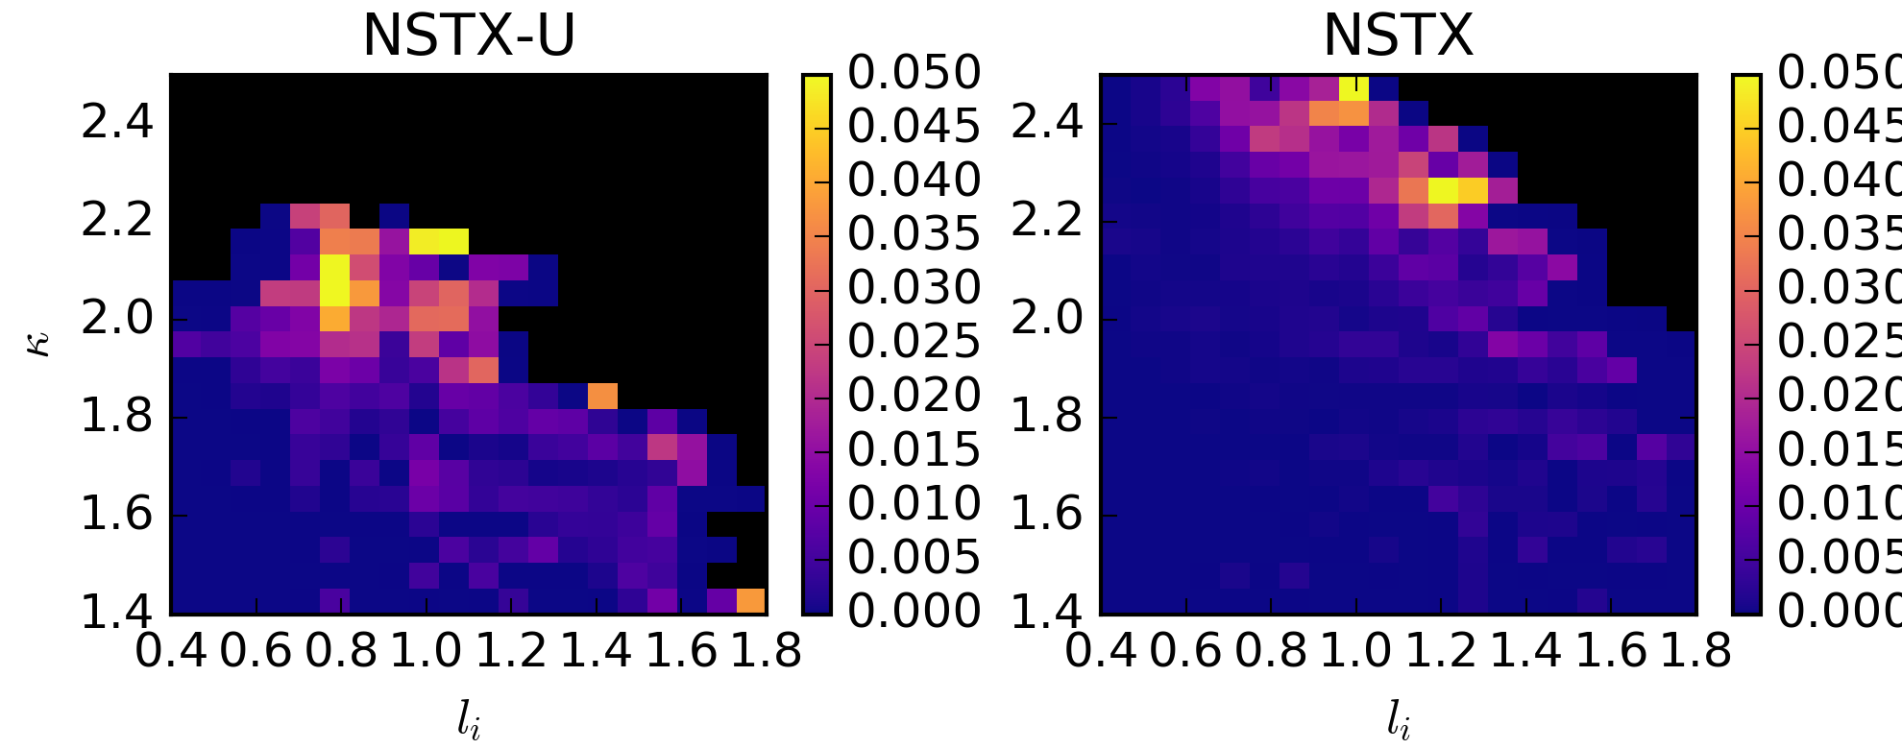
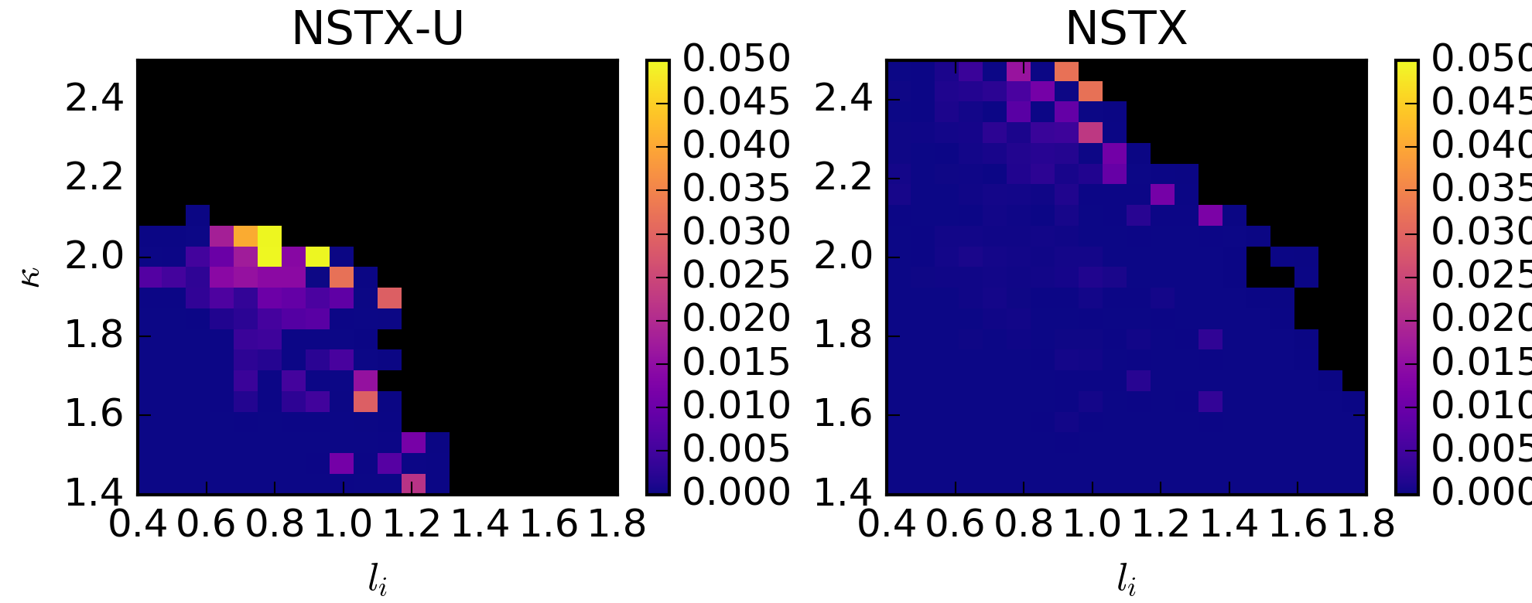
Probability of VDE higher at lower elongation for NSTX-U
#VDEs/#slices for all EFIT01 slices (regions with <30 slices colored black)
Highest VDE probability along a line in κ vs. l_{i} space for NSTX
High probability of VDEs in ramp-up for NSTX-U
  More on this later…
#VDEs/#slices for all EFIT01 slices for t<0.3s (regions with <30 slices colored black)
Caveats:
Much smaller data set for NSTX-U
NSTX-U shots dominated by
  control commissioning,
  error field identification experiments,
  ramp-up optimization experiments

Slide 12
Elongation vs. l_{i} at the time of VDEs for NSTX-U illustrates increase in VDE limit as campaign progressed
Initial time of VDE
During VDE
Elongation
Internal inductance
Internal inductance
High elongation shots typically seem to move toward higher l_{i} during VDE
  Likely caused by H-L back transition
  Results in increased growth rate, challenging control

Slide 13
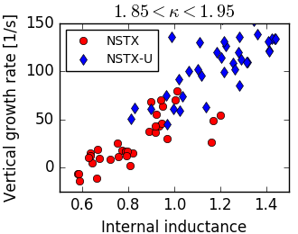
Growth rate calculations will guide projection of limits to planned scenarios
Using ISOLVER to calculate open loop vertical growth rate [Menard]
Calculations done at a time just before each VDE in the database
Maximum growth rates for NSTX-U and NSTX similar, maybe slightly higher for NSTX-U
Many ‘VDEs’ occur below the limit for both devices
  some at very low growth rate

Slide 14
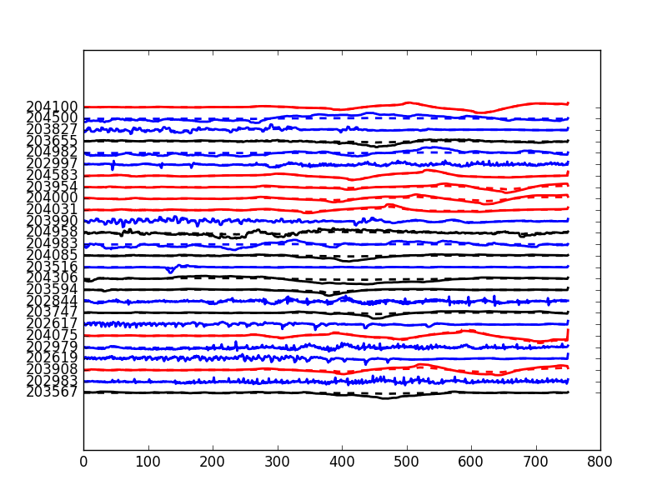
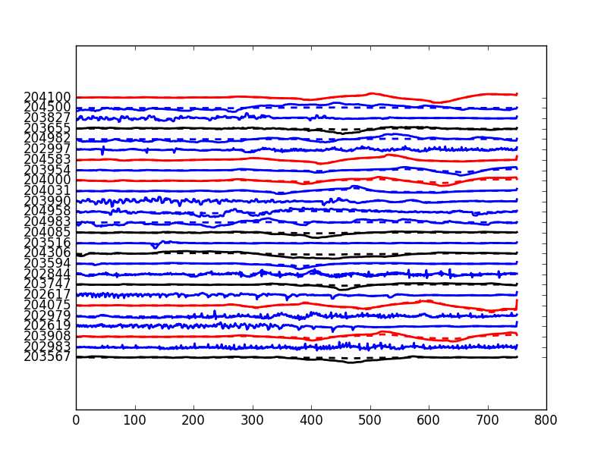
Database of vertical motion at time of diverting, used to classify of behavior
Clustering used to look for typical behaviors at time of diverting
Two main classes of oscillations ➔
Machine learning to automatically classify entire run into ‘bobbles’, ‘dips’ or other behaviors
Used to explore parameter regimes and root causes
Classifier performance on validation data set:
Expected
Predicted
Bobble
Dip
Other
Sample
Sample

Slide 15
Shots with large oscillations typically had positive drsep and up-down asymmetry in shape control errors
Comparison of rtEFIT and EFIT01 boundary at time of diverting
Small error asymmetry but positive drsep early – more dips
Smaller error, lower drsep decreased likelihood of bobbles
Bobbles most frequent during phase of campaign when both criteria were met

Slide 16
Vertical growth rate typically increased rapidly at time of diverting due to rapid increase in inner gap size
Time of diverting indicated by diamonds for shots with oscillations, circles for shots without.
Elongation is increasing at time of diverting
Inner gap increased quickly to ensure plasma diverted
Growth rate is strongly dependent on inner gap in these shots

Slide 17
Oscillations appear to be sustained by ‘kicks’
Kick size decreases later in shot
Kicks typically occur at or just above drsep=0, z=0.
Abrupt vertical motion near maximum velocity in oscillations, near zero crossings in drsep
Kick size is broadly distributed below 3m/s
Kicks occur most often before t=0.3s

Slide 18
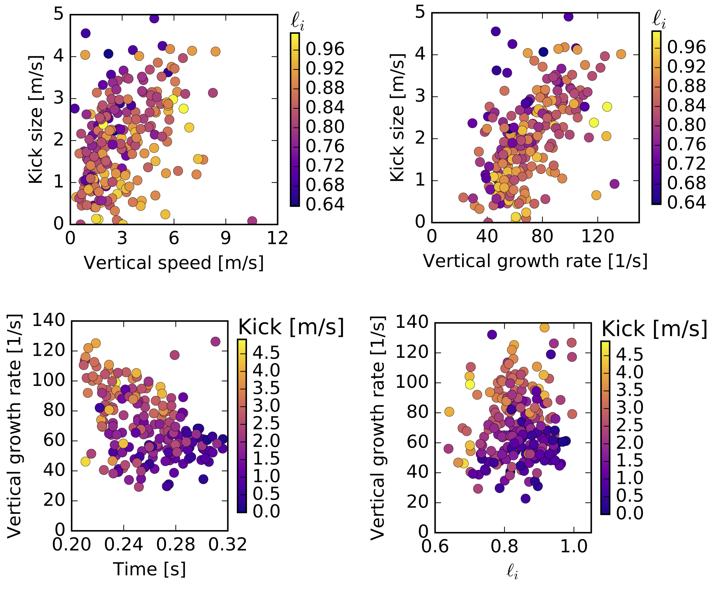
Size of kicks varies with vertical growth rate, vertical motion, and equilibrium
Kick size dependence on vertical speed at time of kick decreases as li increases
Kick size dependent on vertical growth rate
Vertical growth rate typically higher early
Smallest kicks at low growth rate, large li. May indicate equilibrium dependence
For same growth rate, kick size is larger early

Slide 19
Upgrades made to control algorithms will eliminate or reduce severity of the potential causes of oscillations
Multi-threading of rtEFIT
  Enable faster reconstruction and/or vessel current fitting
Automatic selection of reference flux in ISOFLUX algorithm
  Switch between limiter and X-point flux as boundary reference
  Avoid need for transition between separate algorithms
Inner gap control
  Automatically adjust X-point targets to control inner gap size
  Avoid overshoot and
  associated high vertical
  growth rates

Slide 20
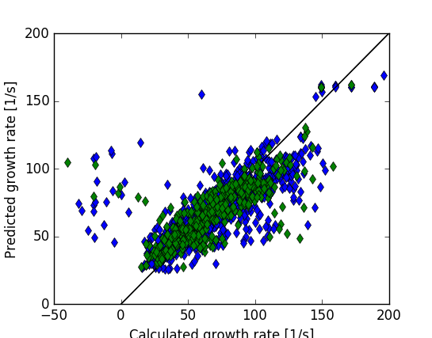
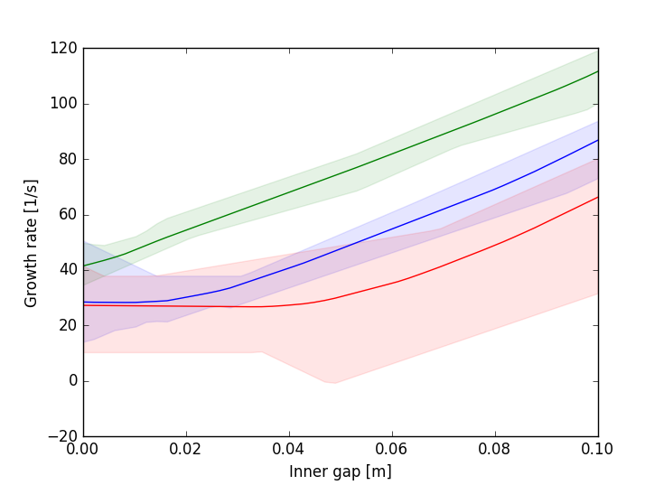
Neural network trained on growth rate calculations, can be used to study trends or adjust shape to avoid VDEs
Working on improving the fit...
Multiple NN used to provide sense of uncertainty
Predicted growth rate [1/s]
l_{i}=0.8, β_{p}=0.2, I_{p}=650k,z=0, outer gap: 0.05m
κ=1.6
κ=1.75
κ=1.9
Calculated growth rate [1/s]
Provides some guidance in designing target equilibrium
Planning to fit to probability of VDE to provide real-time indicator likelihood of loss of control

Slide 21
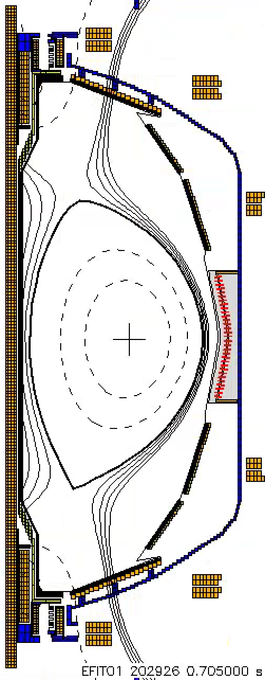
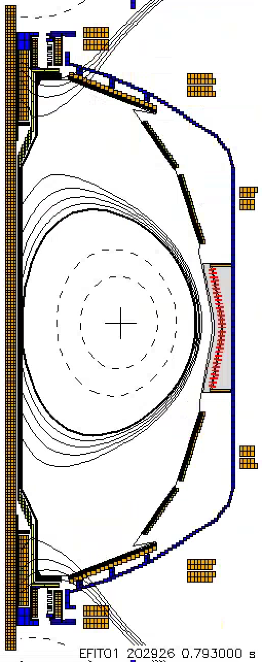
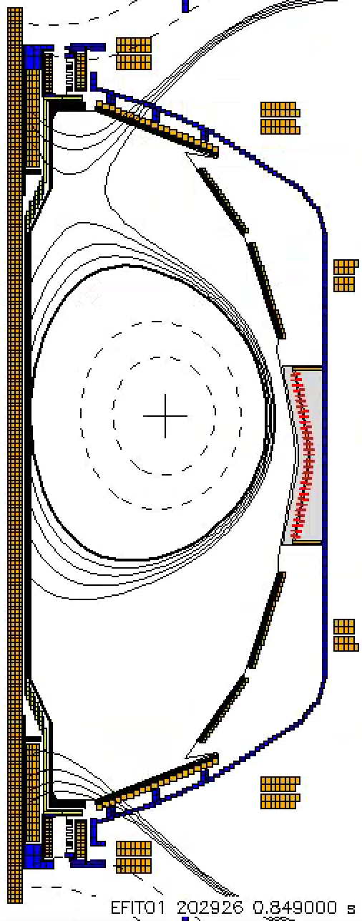
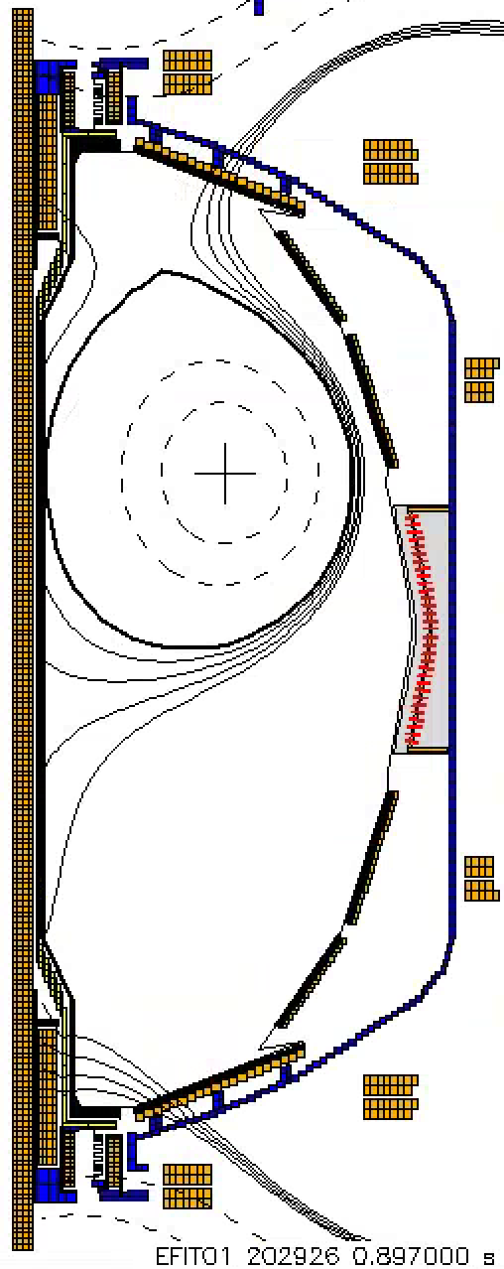
State-machine-based shutdown handler was used to end shots when VDE detected - future version planned to end or alter shot when approaching VDE limits
I_{P} [kA]
t=0.705
Nominal plasma prior to VDE
t=0.793
I_{P} Request
(including asynchronous transition to rampdown)
Feedback targets changed to decrease elongation decreased limit plasma
  Z_{P}(dZ_{P}/dt) threshold
  Z_{P}(dZ_{P}/dt) [m²/s]
t=0.849
t=0.897
“State”
Insufficient I_{P}
Plasma drifts slowly up (vertical control turned off to prevent excessive forces)
Fast I_{P} Rampdown
Normal
Plasma control system detects loss of control
  OH near max current
  Vertical oscillations exceed threshold
  ABS (I_{p} - I_{p request} ) too large
  Locked mode detected
Feedback control switches to new “states” that attempt to gently end the discharge

Slide 22
Conclusions and outlook
Improvements to vertical control helped achieve an operating space similar to NSTX, now at higher aspect ratio
  However, NSTX-U typically operated at high l_{i}
Database of VDEs generated to assess elongation limits
Largest difficulty for vertical control was around time of diverting
Large oscillations seem to be initiated by motion near the time of diverting and sustained by kicks
  Improvement to ISOFLUX removes need for algorithm transitions near time of diverting
  Multi-threading of rtEFIT should improve reconstruction near time of diverting
  Inner gap control will reduce overshoot and associate high growth rate
  Oscillations sustained by growth rate and equilibrium dependent ‘kicks’
    Modeling underway to find a suitable equilibrium that is less sensitive
Model of growth rate and VDE probability planned for use in real-time VDE avoidance algorithm

Slide 23

Vertical control challenges during ramp-up often occurred near time of diverting and transitioning to H-mode
Improvements to vertical control system helped achieve elongation vs. l_{i} at peak stored energy similar to NSTX at higher aspect ratio
PCS upgrades and modeling work aim to avoid oscillations and VDEs in the next campaign

