Slide 1


Advanced Plasma Shape Control to Enable High-Performance Divertor Operation on NSTX-U
P. J. Vail, E. Kolemen
Princeton University, Princeton, NJ 08540
M. D. Boyer
Princeton Plasma Physics Laboratory, Princeton, NJ 08544
A. W. Welander
General Atomics, San Diego, CA
Presented at the 59th Annual Meeting of the APS Division of Plasma Physics

Slide 2
Abstract
This work presents the development of an advanced framework for control of the global plasma shape and its application to a variety of shape control challenges on NSTX−­­­U. Operations in high-performance plasma scenarios will require highly-accurate and robust control of the plasma poloidal shape to accomplish such tasks as obtaining the strong-shaping required for the avoidance of MHD instabilities and mitigating heat flux through regulation of the divertor magnetic geometry. The new control system employs a high-fidelity model of the toroidal current dynamics in NSTX−U poloidal field coils and conducting structures as well as a first-principles driven calculation of the axisymmetric plasma response. The model-based nature of the control system enables real-time optimization of controller parameters in response to time-varying plasma conditions and control objectives. The new control scheme is shown to enable stable and on-demand plasma operations in complicated magnetic geometries such as the snowflake divertor. A recently-developed code that simulates the nonlinear evolution of the plasma equilibrium is used to demonstrate the capabilities of the designed shape controllers. Plans for future real-time implementations on NSTX−U and elsewhere are also presented.

Slide 3
Introduction
Goals of this work
The use of advanced divertor configurations, such as the snowflake divertor (SFD), is being considered as a possible means of reducing peak heat flux onto divertor surfaces in NSTX-U.
Develop an algorithm that is capable of real-time control of all divertor configurations of interest in NSTX-U.
Address primary limitations of the algorithm as previously implemented on DIII-D:
  Stable control of the SFD-Plus configuration.
  Recovery from high-field-side to low-field-side SFD-Minus.
Transition to model-based (non-PID) plasma shape control for NSTX-U.
E. Kolemen et al. J. Nucl. Mater. (2015).
Highlights
New modeling of X-point position response to PF coil currents.
PID-based control of the SFD with closed-loop controller tuning using relay feedback.
Initial development of model-based Linear-Quadratic-Integral control of the plasma shape.

Slide 4
Formalism for plasma shape control modeling
Coupled circuit equations describing dynamics of toroidal currents in coils, passive structures, and plasma.
coils
vessel
plasma
Vacuum mutual inductances
Applied voltages
Time-derivatives of plasma flux at coils, vessel, and plasma
Conductor resistances

Slide 5
Linearized circuit equations
Linearized response of plasma flux due to changes in external currents and bulk plasma current.
Outputs of a linear plasma response model

Slide 6
State-space representation of the dynamics
Express the linearized circuit equations in state-space form
for use with model-based control design tools
Perturbed currents
Resistance matrix
Map from voltages to coils
Time-dependent
mutual inductance matrix
Perturbed voltages
Vacuum mutual inductances
Effective mutual inductance due to plasma motion

Slide 7
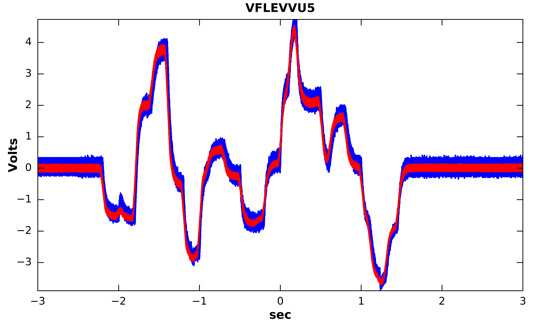
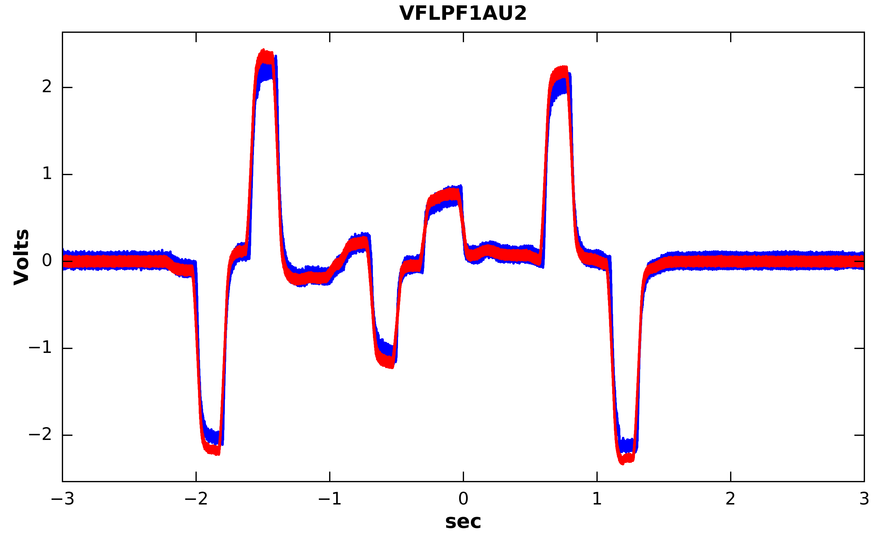
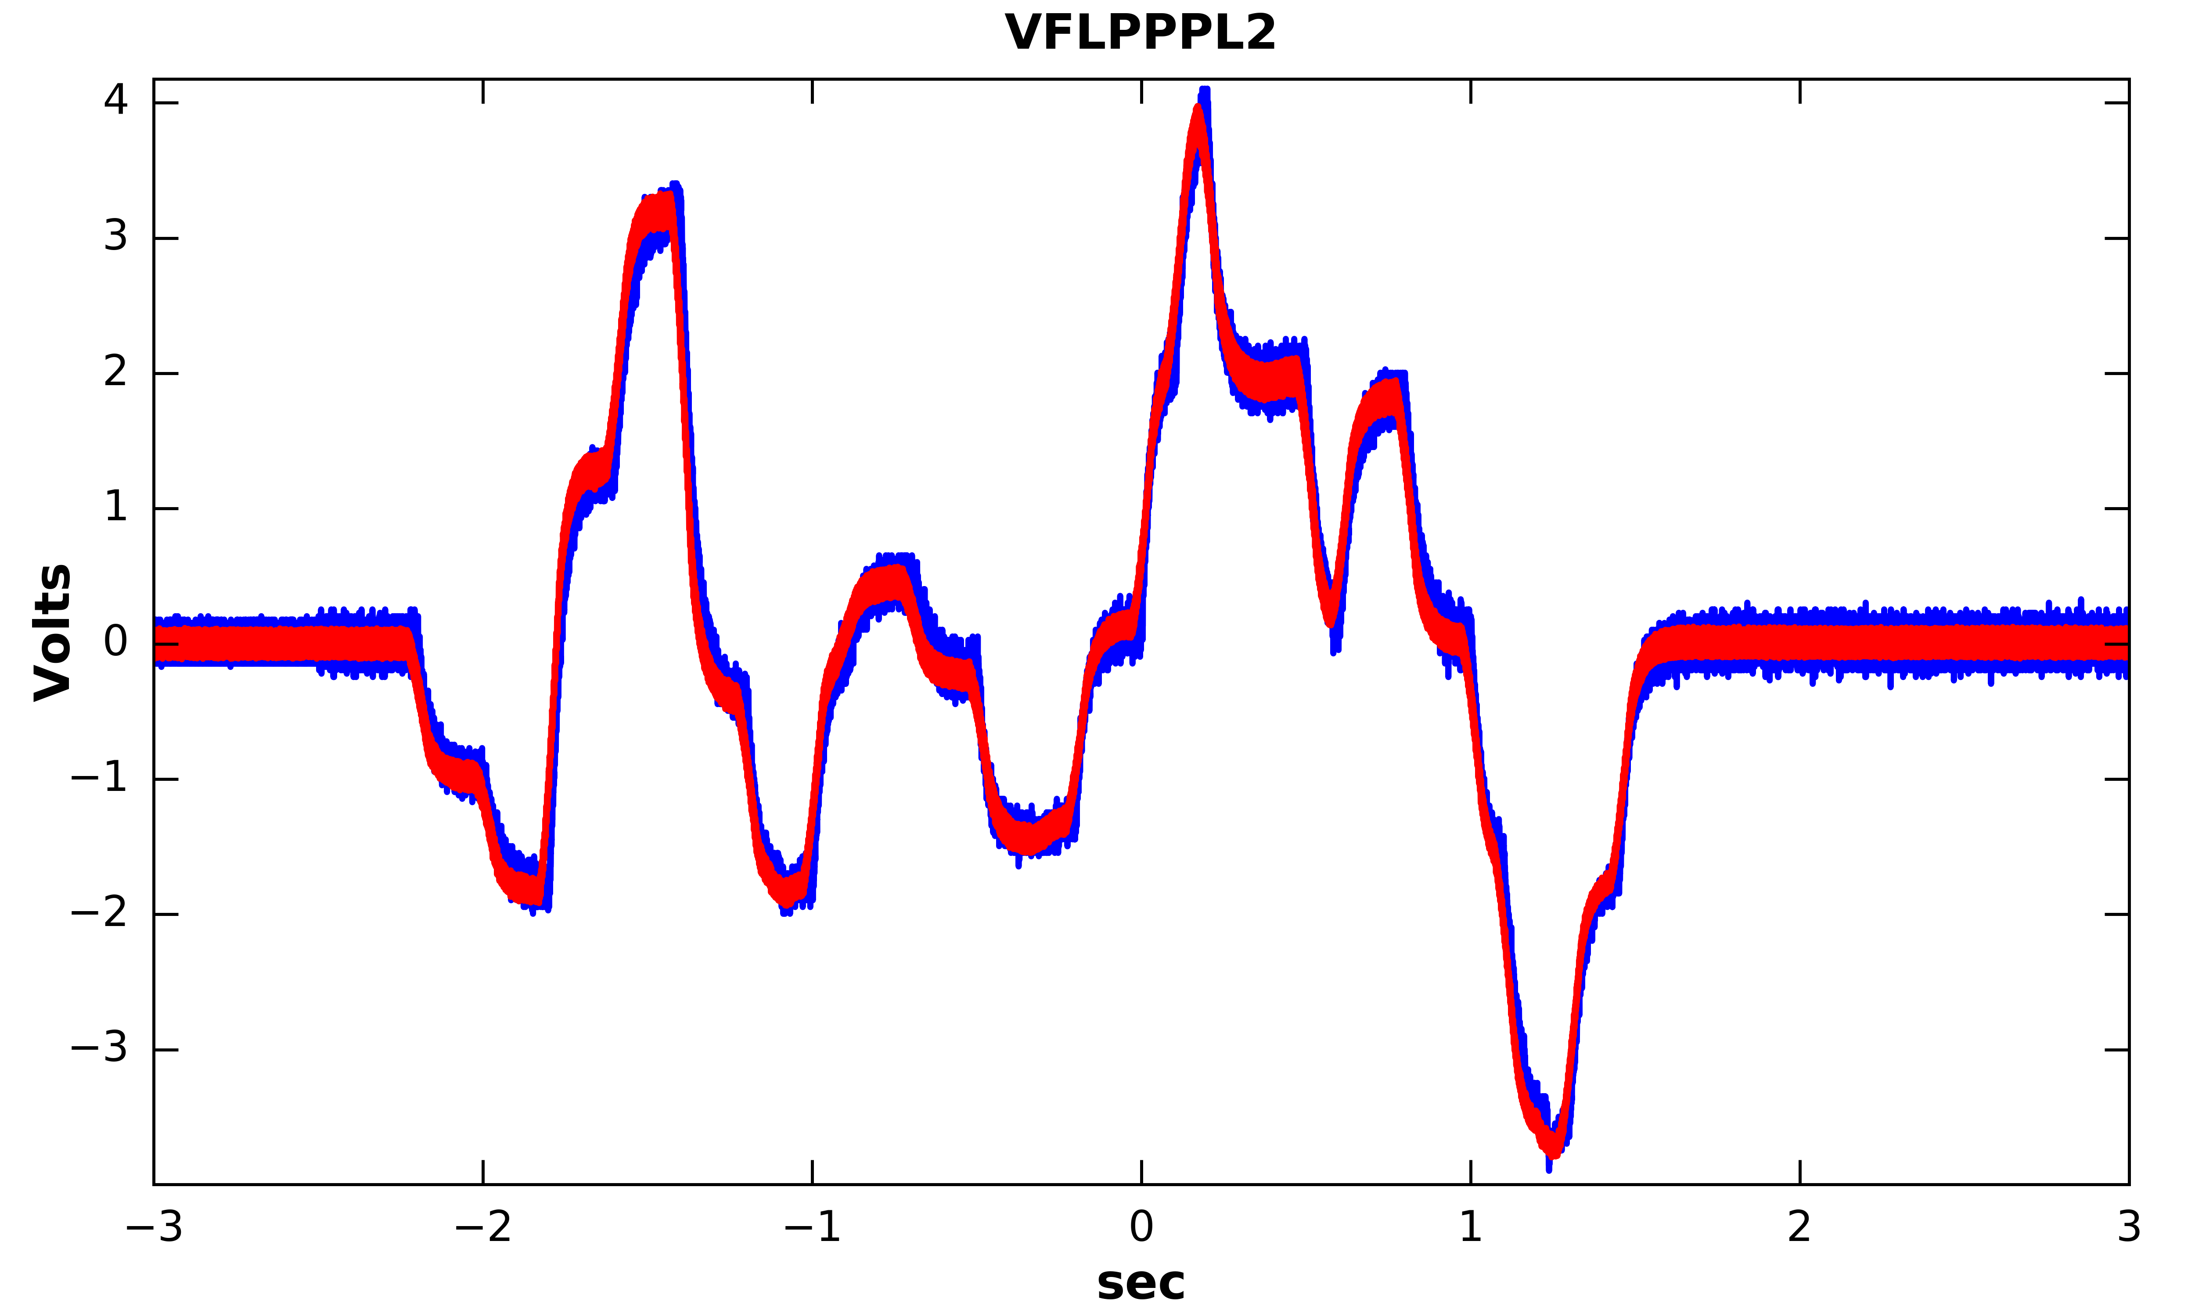
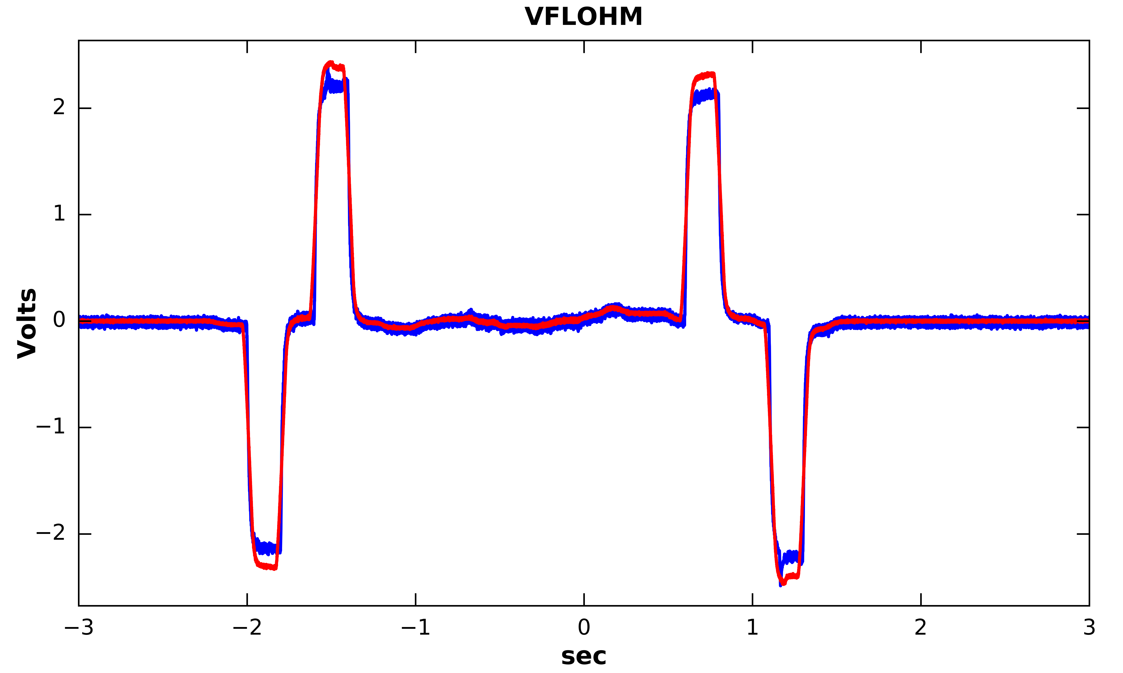
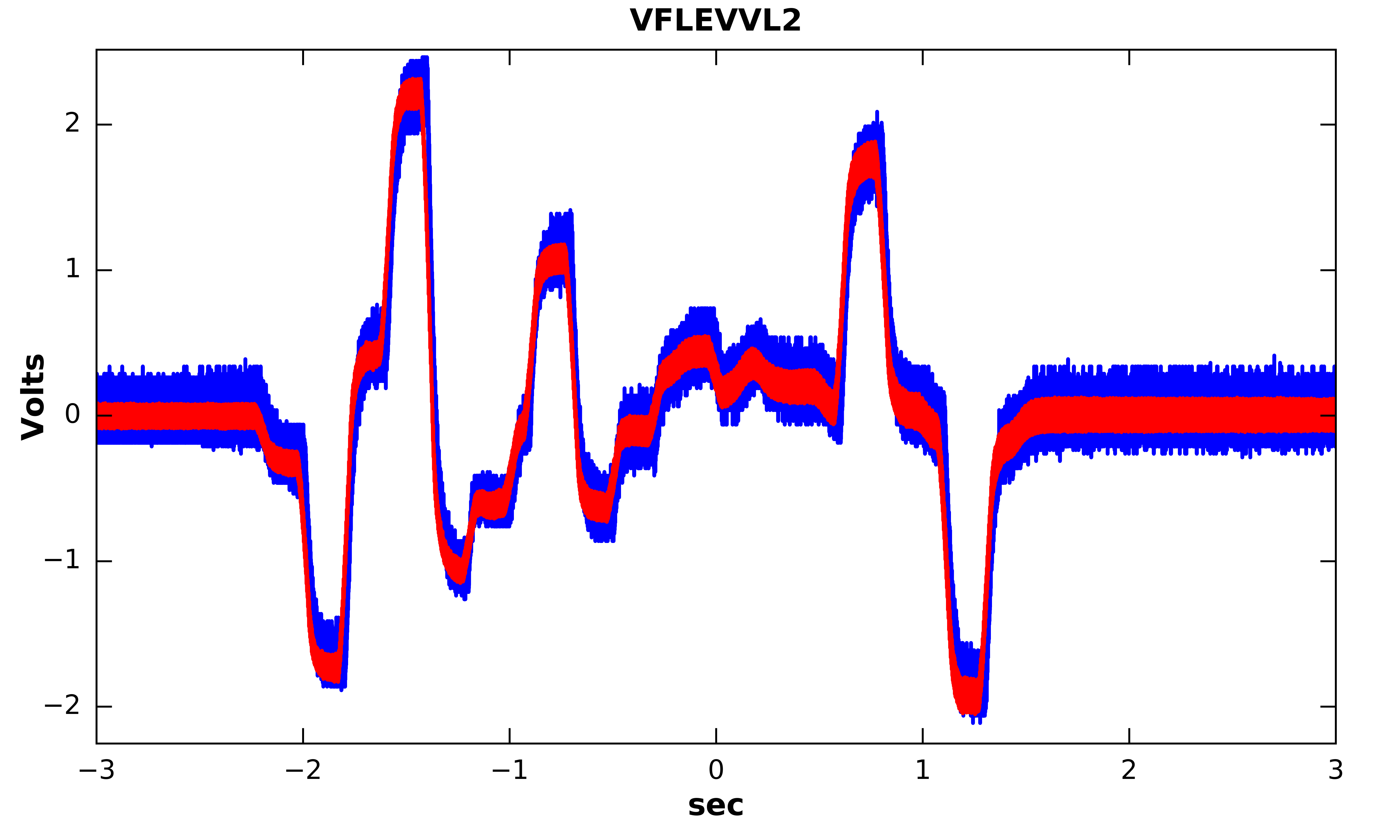
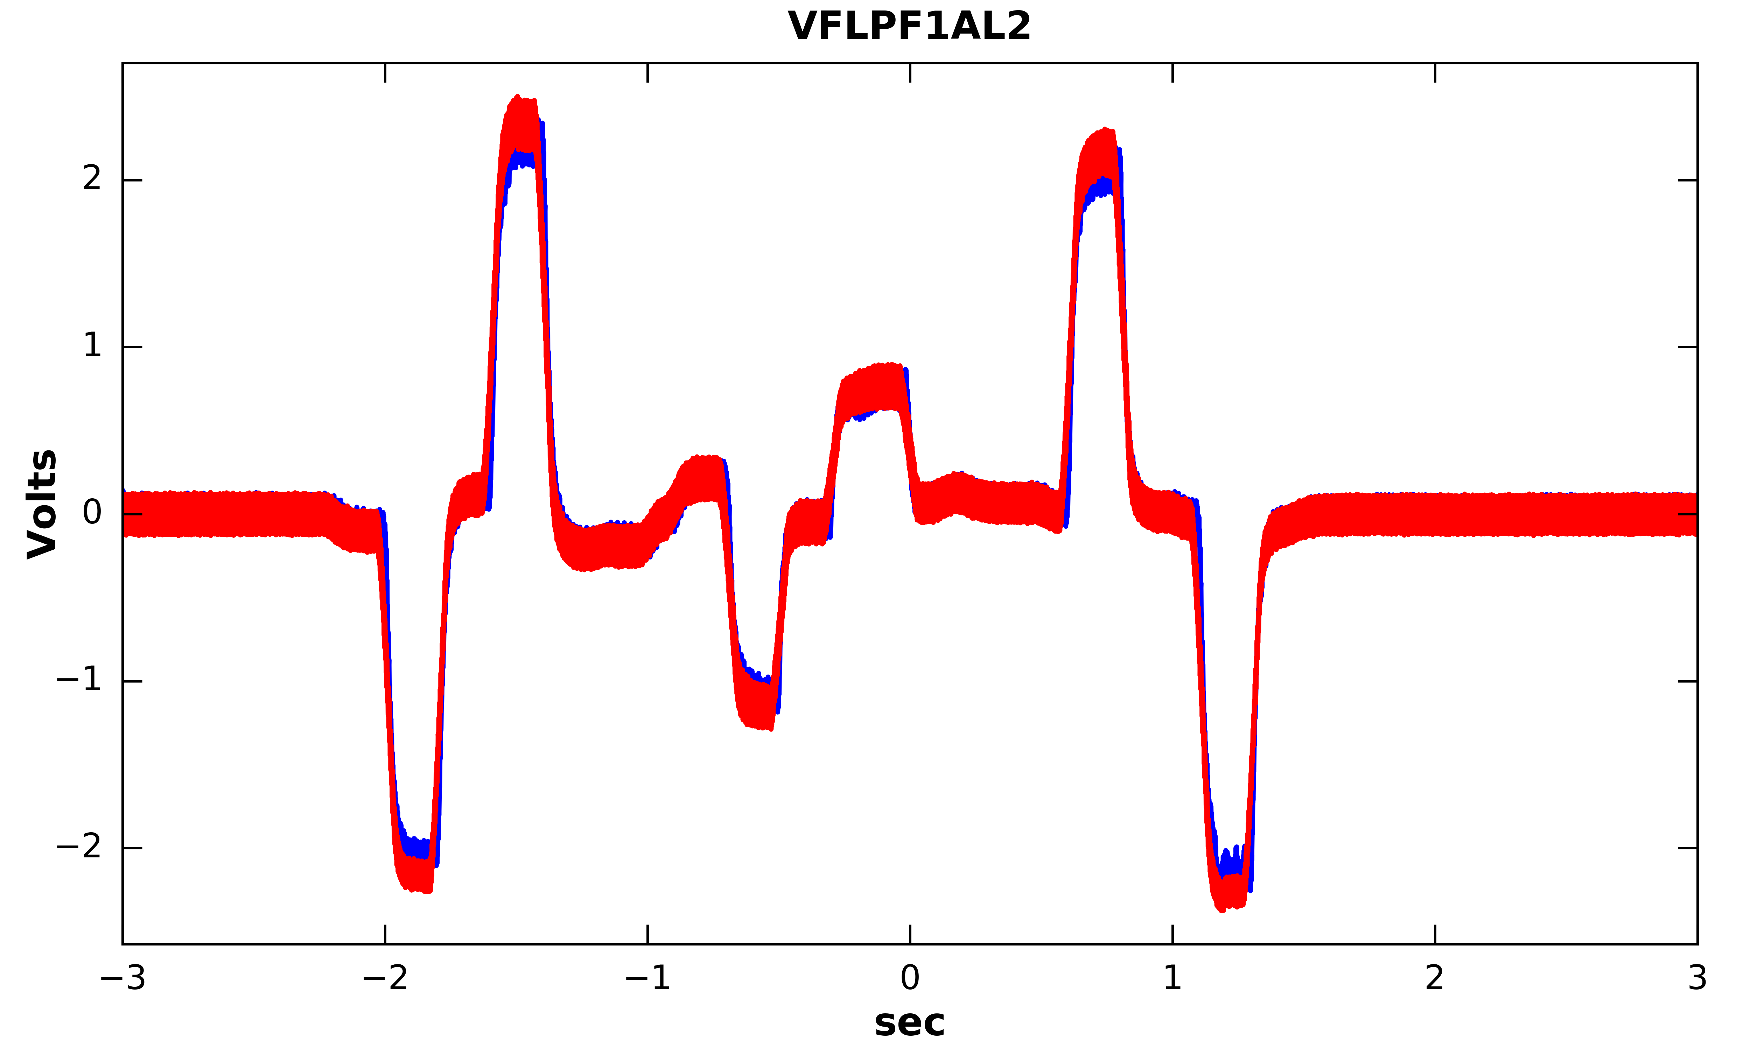
Validation of the no-plasma model
Wall model validated by comparing synthetic and measured magnetic diagnostic signals for NSTX-U vacuum shots.
Predicted
Measured

Slide 8
Dominant eigenmodes of the vacuum vessel
Future validation efforts will seek to identify source of the asymmetry in the vessel model.

Slide 9
Output equation for ISOFLUX control
State-space dynamics equation paired with output equation relating the inputs (voltages) and states (currents) to quantities of interest for control.
Control point fluxes
X-point
positions
In general, matrix entries are time-dependent.

Slide 10
Modeling of X-point response
Green’s functions for the
coil-only vacuum fields
Outputs of a
linear plasma response model
and
Computed analytically using saddle-point expansion of the magnetic flux
Flux
Field

Slide 11
Response of X-point position to B-field
Expand the flux function as a series to second-order. Solve for the series coefficients using measurements of B_{r} and B_{z} at two points.
Solve for the (r,z) coordinates of the X-point.
Compute derivatives of (r_{x},z_{x}) with respect to B_{r} and B_{z} .
Sample points near the null

Slide 12
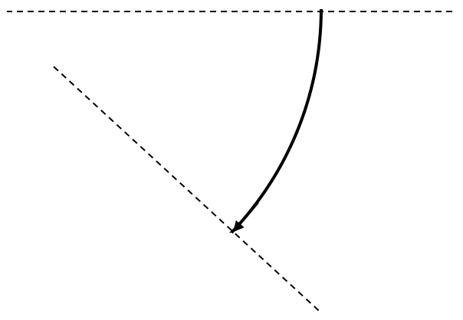




Snowflake Shape Descriptors
$$z_{Snow}$$
Four parameters used for control
$$r_{Snow}$$
$$θ$$
$$ρ$$

Slide 13
SFD control system with PID control
SFD position request
Pseudoinverse from SFD errors to PF coil current errors
Magnetics
Locate snowflake using local expansion of flux
Grad-Shafranov equilibrium reconstruction
D. D. Ryutov et al. Plasma Phys. Control. Fusion. (2010).
J. R. Ferron et al. Nucl. Fusion. (1998).

Slide 14
PID Control and Controller Tuning
Compute control action from the error between desired and measured signal
Terms proportional to error, integral of error, and derivative of error
Closed-Loop tuning of PID gains using Relay Feedback
Replace PID controller with relay
Ultimate
Gain

Slide 15
Snowflake radius scan in SFD-Minus
Scenario 1: Scan of the X-point separation in the SFD-Minus configuration.

Slide 16
Snowflake radius scan in SFD-Plus
Scenario 2: Scan of the X-point separation in the SFD-Plus configuration.

Slide 17
Snowflake angle scan at constant separation
Scenario 3: Scan of the angular orientation with constant X-point separation.

Slide 18
Future work
Test the designed controllers for the SFD in-the-loop with free-boundary Grad-Shafranov equilibrium solver (for verification of controller performance).
Integration of the SFD control into a model-based shape controller designed with LQI for reference tracking of plasma shape parameters.
Implementation of PID-based and LQI-based controllers for the SFD in the DIII-D and NSTX-U plasma control systems.
Test the new algorithms in DIII-D SFD scenarios.

