Slide 1


ORBIT modelling of fast particle redistribution induced by sawtooth instability
D. Kim, M. Podestà, D. Liu¹ and F. M. Poli
Princeton Plasma Physics Laboratory
¹University of California, Irvine
59th Annual Meeting of the APS Division of Plasma Physics
October 23 - 27, 2017 • Milwaukee, Wisconsin

Slide 2
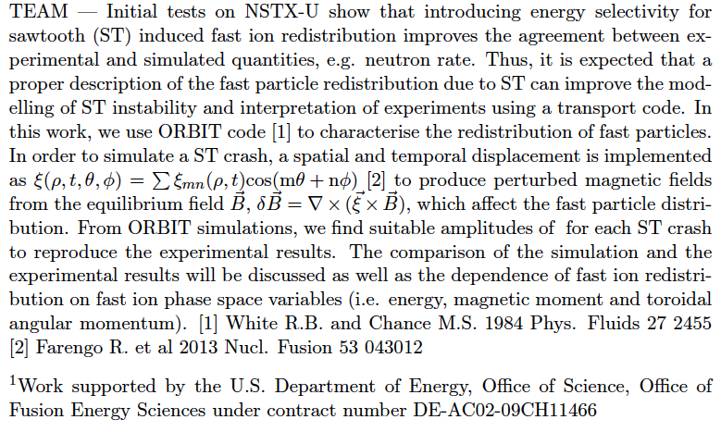
Abstract

Slide 3
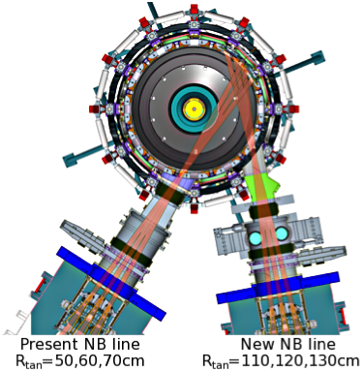
Long Sawtoothing Discharges on NSTX-U with the new 2nd NBI & Central Solenoid
Major radius: 0.95 m
Aspect ratio: 1.5
Elongation: 2.7
Triangularity: 0.8
Plasma current: < 2 MA
Toroidal field: < 1.0 T
Pulse length: ~1 - 5 s
6 Neutral Beam sources:
P_{NBI} ≤ 12 MW, E_{injection} ≤ 95 keV
No data
[Menard, NF 2012]
[Gerhardt, NF 2012]
Reproducible sawtoothing L-mode discharges are obtained on NSTX-U
  Neutron rate can drop as large as ~15% at sawtooth crash
  Flattening of T_{e} in the core indicated by MPTS and Soft x-ray diagnostics
  No MSE measurement is available for these discharges

Slide 4
TRANSP results indicate significant effect of thermal profile evolution on neutron rate
Neutron rate
TRANSP run using thermal profiles from conditional
average reconstruction
  Sawtooth model ON for q-profile evolution
  Sawtooth model OFF for fast ions
  Little/no modulation of fast ion profile
Neutron rate drops caused by thermal plasma profile evolution are significantly different from the measured ones
  Motivates improved analysis strategy to unfold fast ion effects
See D. Liu’s poster (PP11.00048)
for more experimental
and simulation results

Slide 5
Can effect of fast particle transport improve sawtooth model?
Sawtooth modelling in TRANSP [transpweb.pppl.gov]
  Several free parameters (e.g. partial reconnection fraction) in the model
  ➔ need to find an optimum set for each case
  Unable to determine self-consistent parameter setting
  Cannot reproduce experimental results with a fixed parameter set
Improvement of sawtooth model for fast ion redistribution in phase space?
  ORBIT simulations can be a guidance to develop a more comprehensive model for fast particle transport by sawteeth
  Implementation of a fast particle model into TRANSP is expected to enable self-consistent modelling including more physics
  NSTX-U data can guide model development and be used for validation

Slide 6
Simulation setting
Simulation code: ORBIT [White PoF84]
  Hamiltonian guiding center particle motion code
  Use of numerical equilibrium, field perturbations in flux coordinates (Boozer coordinate in this work)
  Analyzing test particle transport (especially energetic ions)
Target discharge: NSTX-U #204083
  Equilibrium data (eqdsk file from TRANSP) from one time slice before sawtooth crash (1093ms)
  Initial distribution of fast particles from TRANSP (NUBEAM)
  Number of particle for calculation: 10,000
  Radial displacement for the application of linear perturbation from sawtooth instability (constant in time)

Slide 7
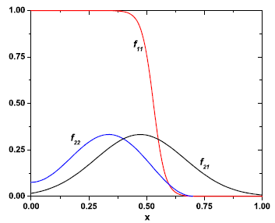
Displacement from sawtooth crash induces perturbed magnetic field δB
Perturbation magnetic field from displacement
Radial displacement model [Farengo NF13]
  ξ(ρ, t, θ, ζ) = Σξ_{m,n}(ρ, t)cos⁡(nζ – mθ – ωt)
  (m, n): poloidal and toroidal mode numbers
  (θ, ζ): poloidal and toroidal angles
  (1,1) mode is applied and temporal change
  of displacement is not considered
  Tested on cylindrical coordinate in Farengo NF13
  ➔ toroidal geometry effect, e.g. toroidal mode
  coupling, may need to be considered
q = 1 surface
Figure from [Farengo NF13]

Slide 8
In ORBIT code, perturbation is defined using α, not ξ
ξ
q=1 surface
α
Perturbation in ORBIT:
  ξ can be transformed into α [White PoP13]
  Radial component of resultant perturbation is equivalent to ξ model
  Mode amplitude is prescribed for ξ and is used for α after normalisation
  Only first order term is considered

Slide 9
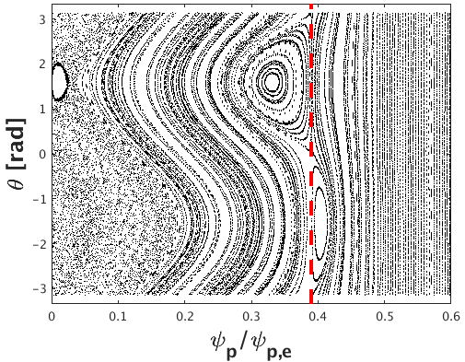
Assumed (1,1) mode perturbation rises to (2,2) mode like island structure
Need to modify perturbation form?
  To have a consistent island structure with more accurate physics models
  Shape : cut-off outside q=1 surface, modification of central part
  Central value
  Modified range of central region
Unperturbed q = 1 surface

Slide 10
Modification of perturbation profile
Central shape
Central value
Shape change position
ξ
ξ₀ = 0
0.1ρ_{q=1}
ξ₀ = 0.25
0.2ρ_{q=1}
ξ₀ = 0.5
0.5ρ_{q=1}
α
ξ₀ = 0, 0.2ρ_{q=1}
shape, 0.2ρ_{q=1}
shape, ξ₀ = 0

Slide 11
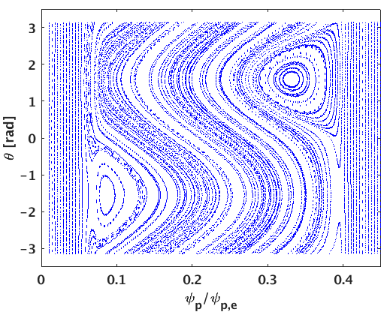
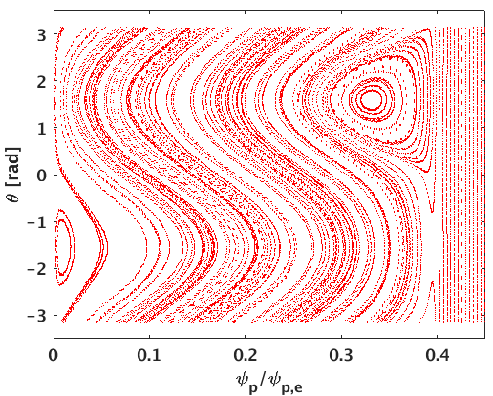
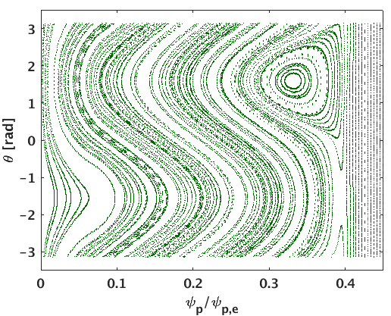
Modification of perturbation profile
- Central region shape test (biggest effect on result)
Shape 1
Shape 2
Shape 3
Looking for a perturbation shape that eliminates undesirable island structures (center and q=1 surface)
ξ decreases inside 0.2ρ_{q=1}, ξ₀ = 0
Island is formed where α has large gradient
Central shape case 3 (linear change) brings perturbation at the center but not enough to form an island

Slide 12
Modified perturbation shape
ξ
α
Central shape
modification
Cut-off outside
q=1 surface
The resultant α shape is similar to that from [Zhao PoP97]
Set as the default perturbation shape for the further analysis with different mode amplitude (default: 0.01)

Slide 13
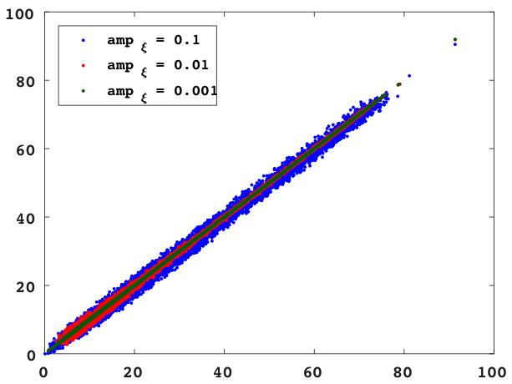
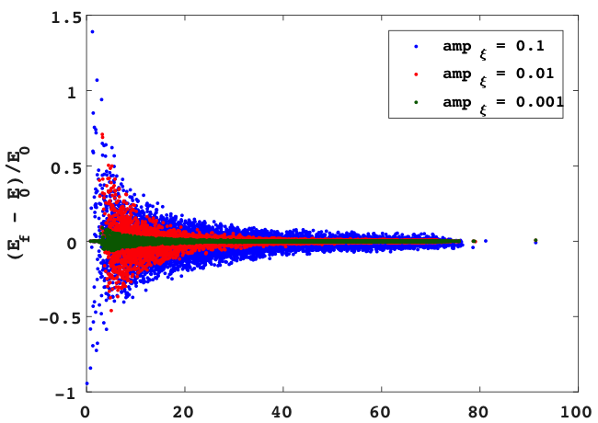
Fast ion energy is not changed significantly by sawtooth
ORBIT calculation shows the final energy is not deviated much from the initial energy
  With 100 times different amplitude (0.001 to 0.1), the change is little
  Relative change can show some variation among low energy particles
final energy E₀ [keV]
(E_{f} – E₀)/E₀
initial energy E₀ [keV]
initial energy E₀ [keV]

Slide 14
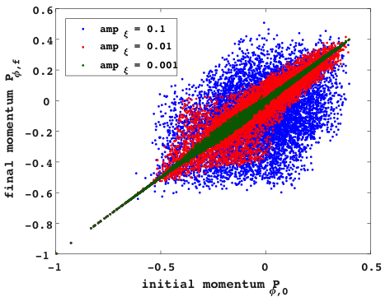
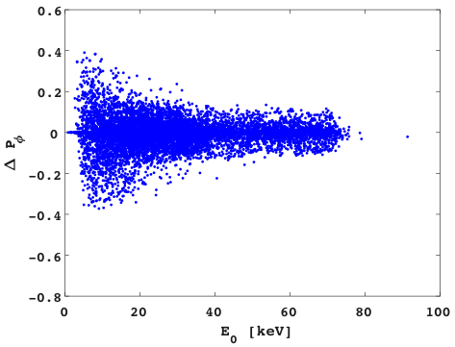
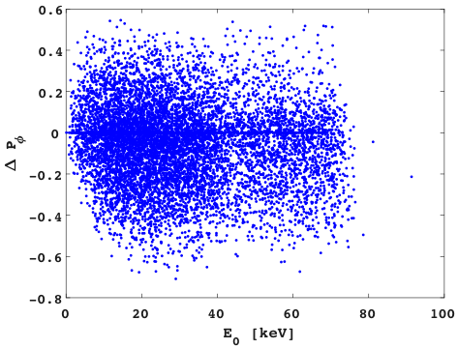
Fast ions are redistributed in phase space depending on the mode amplitude
As perturbation amplitude increases, particle redistribution in phase space becomes more significant
Smaller amplitude case, initially low energy particles are more redistributed while particles in all energy level are affected by larger amplitude sawtooth
final momentum P_{ζf}
ΔP_{ζ}
ΔP_{ζ}
amp = 0.01
amp = 0.1
initial momentum P_{ζ0}
E₀ [keV]
E₀ [keV]

Slide 15
Redistribution of different orbit types and energy level particles in phase space
In smaller amplitude case (0.01), particle redistribution is weak
Initial distribution E = [10, 30] keV
Initial distribution E = [50, 70] keV
Lower energy level [10 ~ 30keV] particles have more redistribution than higher energy [50 ~ 70keV] case
Final distribution E = [10, 30] keV
Final distribution E = [50, 70] keV
Initial orbit types
co-passing
counter-passing
Trapped
Stagnation
potato

Slide 16
Redistribution of different types and energy level particles in phase space
In lager amplitude case (0.1), particles with low and high energy redistributed
Initial distribution E = [10, 30] keV
Initial distribution E = [50, 70] keV
For both low and high energy level, particles are strongly affected by sawtooth and redistributed
Final distribution E = [10, 30] keV
Final distribution E = [50, 70] keV
Initial orbit types
co-passing
counter-passing
Trapped
Stagnation
potato

Slide 17
During redistribution, particles experience the change of orbit type
Orbit type 1: co-pass confined | Orbit type 3: ctr-pass confined | Orbit type 5: trapped confined | Orbit type 7: stagnation
Orbit type 2: co-pass lost | Orbit type 4: ctr-pass lost | Orbit type 6: trapped lost | Orbit type 8: potato confined
Amplitude = 0.01
8.35% of 10k particles’ orbit type change
Amplitude = 0.1
21.0% of 10k particles’ orbit type change
Final orbit type
Final orbit type
Initial orbit type
Initial orbit type
(i,f) = (a,b) : initially a orbit type turns into b type
Orbit types swapping brings almost no change in total number of each type
Co- passing and stagnation types particles mostly turn into trapped particles

Slide 18
Relative change of neutron rate – comparison with experimental result
Estimate relative neutron rate change
  Using deuterium density at each fast particle position, cross section and particle energy of each particle energy

Slide 19
Relative change of neutron rate – comparison with experimental result
Relative neutron rate change from experiment
  Difference between neutron rate post and pre crash is normalized by neutron rate before sawtooth crash
  Depending on calibration parameter, values are slightly different
Perturbation amplitude scan
  Δ calculation using ξ amplitude of
  [0.001 to 0.1]
  In lower amplitude case, Δ is almost
  constant since fast particles are not
  redistributed much
  Amplitude of between [0.045, 0.1]
  can reproduce experimental values
Δ neutron_rate_exp (1093ms)
Δ neutron_rate_TRANSP [900 – 1300ms]
[0.125 – 0.394]

Slide 20
Relative change of neutron rate – comparison with experimental result
Radial potential amplitude scan
  Δ calculation using potential amplitude of [0 to 10] keV
  With finite potential amplitude, a simple exponential radial potential profile is added
  With fixed perturbation amplitude of 0.01, Δ does not vary with potential
  Mode frequency is fixed to 10 kHz

Slide 21
Test of two mode case: (1,1)+(2,2) modes
- perturbation profile
(2,2) mode based on [Farengo] is added to (1,1) mode
  Mode amplitude is set to 1/3 of (1,1) mode and twice mode frequency
  Modification of profile is not applied to (2,2) mode perturbation profile
  ➔ additional island structure is found from Poincaré plot
ξ
α

Slide 22
Test of two mode case: (1,1)+(2,2) modes
- relative neutron rate change
Perturbation amplitude/potential scan
  Two modes case has the same trend as (1,1) mode case
  Since the mode amplitude of (2,2) mode is only 1/3 of (1,1) mode amplitude, the effect seems small

Slide 23
ORBIT simulation has been tested for sawtooth induced fast ion redistribution in phase space
Linear perturbation α is implemented into ORBIT code
  Transformation from ξ is applied
  Perturbation shape is modified to induce (1, 1) mode island at q=1 surface
Energy and particle redistribution due to sawtooth crash is investigated
  Regardless the amplitude of perturbation, E is not changed significantly while P_{ζ} variation becomes significant with increase of mode amplitude
  For low amplitude perturbation, low initial energy particles are redistributed more while all energy level are affected by high amplitude perturbation
Relative change of neutron rate induced by sawtooth crash is compared with experimental value
  Δ value increases as mode amplitude grows from amplitude of 0.02 (below Δ stays almost similar level)
  Experimental value can be reproduced by amplitude range of [0.045, 0.1]
  Modification of potential does not have significant effect on Δ value
  (2, 2) mode is added to (1, 1) mode but amplitude and potential scan results are almost the same as (1, 1) only mode case

Slide 24
On going work

Slide 25
Redistribution of particles
– comparison with theory [Kolesnichenko PoP97]
Criteria for sawtooth induced fast particle redistribution
Trapped particle
Passing particle
Δr_{b} = orbit width, r_{mix} = sawtooth mixing radius assuming full reconnection
ε_{mix} = inverse aspect ratio at r_{mix}, τ_{cr} = crash time, ω_{B} = ion cyclotron frequency
Radial position change vs initial orbit width – Comparison with critical value for different particle energy level and orbit type
  Passing particles: criterion is well satisfied
    Radial position change occurs only for orbit width smaller than the critical one
  Stagnation and potato particles: marginal
    Inside and near the critical value
  Trapped particle: criterion is not applied
    Particles with orbit width bigger than the critical one experiences radial position change

Slide 26
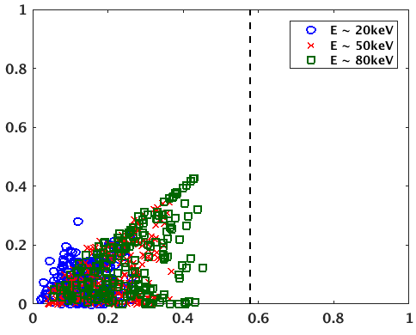
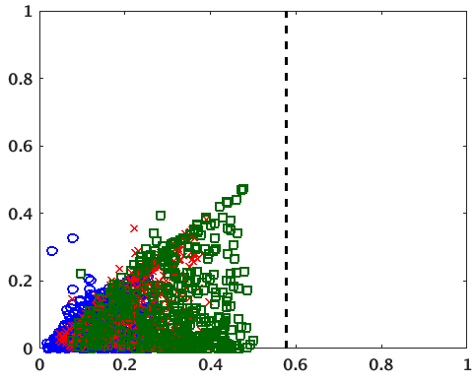
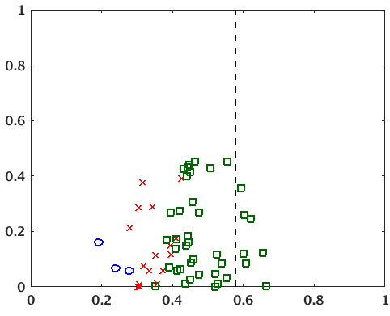
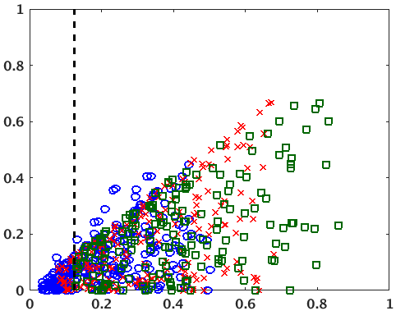
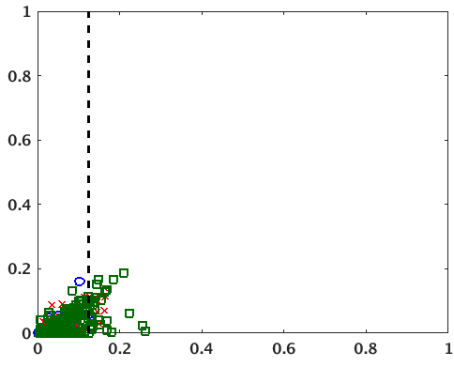
Redistribution of particles
– comparison with theory
Co-passing
Ctr-passing
potato
trapped
stagnation
Particle energy
~20keV
~50keV
~80keV

