Slide 1



Global modeling of wall material migration following boronization in NSTX-U
Jacob H. Nichols, PPPL
M.A. Jaworski¹, C.H. Skinner¹, F. Bedoya², F. Scotti³,
V.A. Soukhanovskii³, K. Schmid⁴
¹PPPL, ²UIUC, ³LLNL, ⁴IPP-Garching
59th APS-DPP
Milwaukee, WI, USA
Oct. 23-27, 2017

Slide 2
MOTIVATION

Slide 3
Plasma-wall interactions: a challenge for fusion that demands an integrated modeling approach
Plasma-wall system is highly coupled, but operates on a wide range of length (10⁻¹⁰-10² m) and time (10⁻⁹-10⁴ s) scales
Integrated simulations must make use of one of two approaches:
1. Exascale computing
2. Reduced models ← This work
  Caveat: Most reduced models have a large number of free parameters, which makes reaching ironclad conclusions difficult
WallDYN is a global integrated mixed-material reduced model that has shown great promise in high-Z devices (JET-ILW, AUG, ITER)
[K. Schmid JNM 2011], [K. Schmid NF 2015], [K. Schmid JNM 2015], [G. Meisl NF 2016]
Improvements have now been added to WallDYN that allow it to better capture the evolution of thin films used in wall conditioning
  Wall conditioning and impurity control (especially oxygen) are persistent challenges for every device
  Lower impurity influx means better plasma performance
  Validated models can help optimize this process

Slide 4
BORONIZATION IN NSTX-U

Slide 5
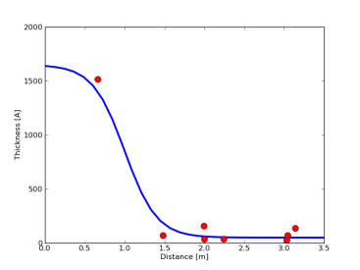
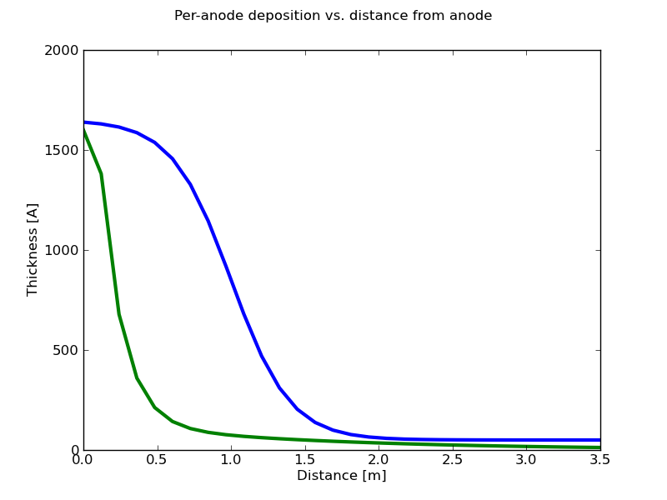
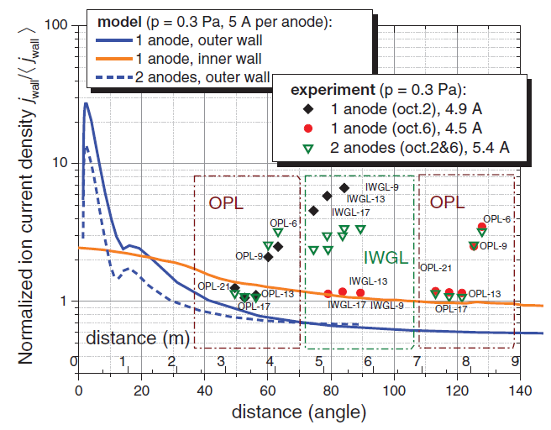
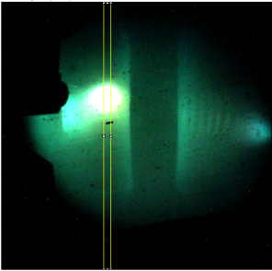
Boronization was used in NSTX-U to control impurity influx from the PFCs
NSTX-U conditioned with deuterated trimethylboron (dTMB) injected into dual-anode He GDC; leads to thin film formation on walls
  B(CD₃)₃: 17% boron by mass
  MAPP XPS measurement post-boronizations: 60%C / 35%B / 5%O
  “Full” boronization: 9.0g dTMB, ~weekly
  “Mini” boronization: 1.8g dTMB, ~nightly
Deposition highly peaked near GDC electrodes, but is more uniform when using multiple electrodes
Per-anode deposition probability
Comparable to 1 vs 2 anode JET results
One anode
QMB data
Multiple electrodes reduces size of high-deposition anode glow region
[Kogut PPCF 2015]
Two anodes

Slide 6
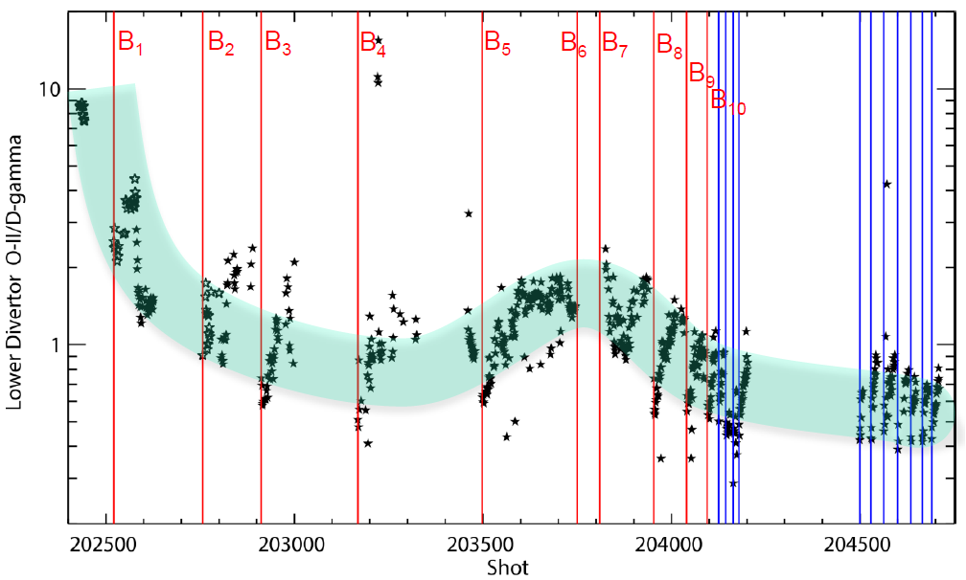
Filterscope data from FY2016 campaign show increasing impurity influx between boronizations
Full Boronization
Mini Boronization
Note: Langmuir probes inactive most of campaign → precludes absolute calibration of spectroscopic diagnostics
Divertor filterscopes observed sharp decrease in OII/D-γ signal after boronization, with return to pre-boronized O levels after plasma exposure
  Faster deconditioning following mini boronization than following full boronization

Slide 7
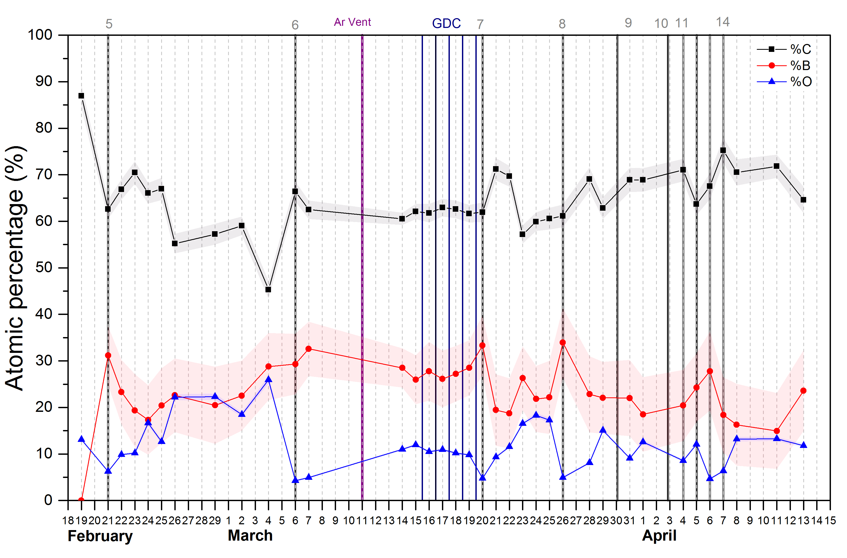
MAPP XPS data from FY2016 campaign corroborates filterscope trends
Boronization # →
MAPP XPS observed similar trends in total surface oxygen concentration on in situ lower divertor material probe
  Note: XPS information depth ≈ Ion penetration depth ≈ WallDYN reaction zone width ≈ 4 nm

Slide 8
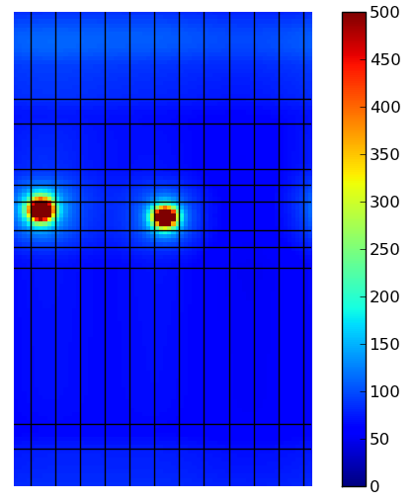
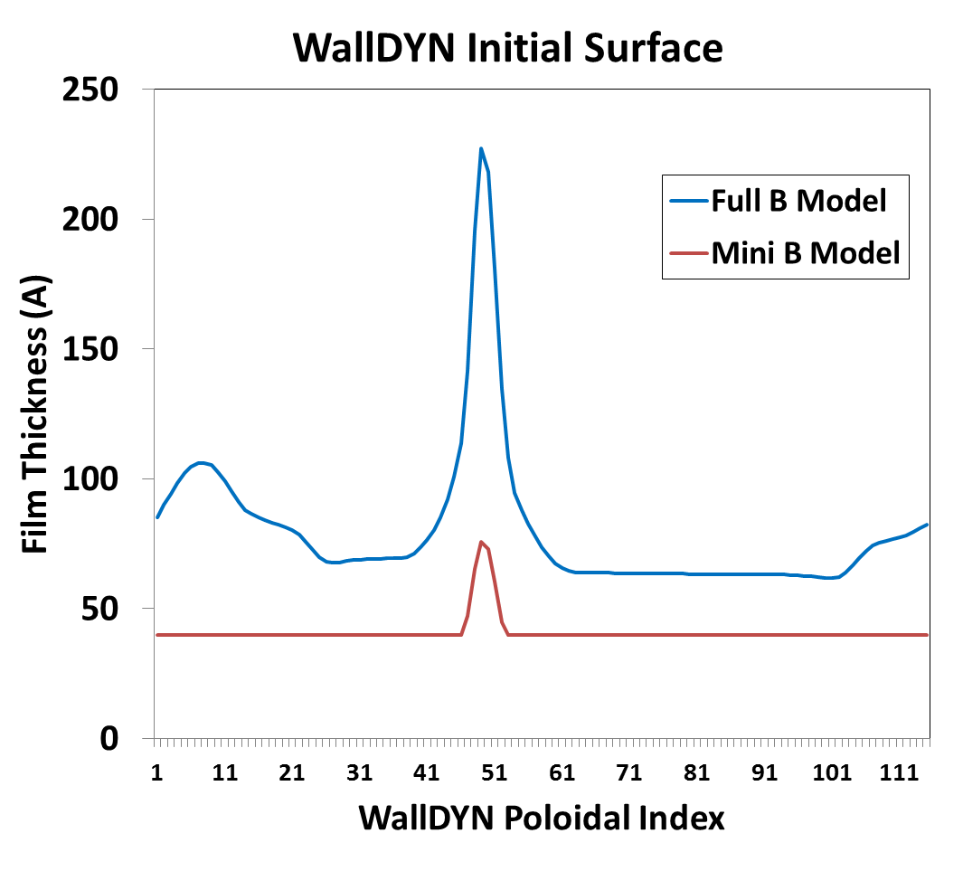
Boronization model developed that reproduces observed thin film deposition
= QMB = MAPP
+
Centerstack
Full Boronization | B Mid | E Top | F Bot
Exp. QMB | 1093 A | 66 A | 67 A
Model | 1096 A | 71 A | 69 A
Mini Boronization | B Mid | E Top | F Bot
Exp. QMB | 364 A | 30 A | 7 A
Model | 365 A | 40 A | 40 A
Upper Inner Div.
Upper Outer Div.
Upper PP2
Upper PP1
Outer Midplane
Lower PP1
Film Thickness (A)
Lower PP2
WallDYN Poloidal Index
Lower Outer Div.
Lower Inner Div.
Centerstack
A
B
C
D
E
F
G
H
I
J
K
L
Toroidal Bay
  Constrained by spatial distribution probability, film thickness scaled to match QMB data
    Note: Only accounts for ~30% boron injected as dTMB
  Film composition: 60%C / 35%B / 5%O (from MAPP)
  Toroidally averaged for use in WallDYN
Reservoir
Reaction Zone

Slide 9
WALLDYN MODEL

Slide 10
WallDYN: An integrated global model for mixed material migration
Plasma Model
Surface Model
Experimental Data
Plasma Assumptions
Mixed-Material Surface Binding Energies
Plasma Reconstruction
Physical Sputtering Calculations (vary energy, projectile, target composition)
OSM-EIRENE
SDTRIM.SP
Impurity Transport Probability Calculations
(charge-resolved)
Empirical chemical erosion formulae
Hydrogenic Fluxes
Wall Initial Conditions
DIVIMP
Continuous composition-dependent erosion yields
Coupled system of differential-algebraic equations for erosion fluxes and surface areal densities
WallDYN
D co-deposition
Wall evolution
Virtual diagnostics

Slide 11
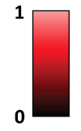
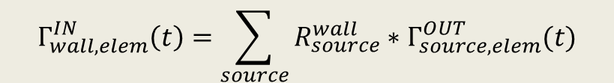
WallDYN parameterizes plasma impurity transport with DIVIMP 2D Monte Carlo code
20k neutrals launched from each wall bin
  Energy and angular distribution typical of sputtered particles
  Deposition location, charge state recorded
R ≡ Fraction of eroded flux from “source” that ends up in a certain charge state at “destination”
1 Algebraic equation for influx of each element & charge state:
Assumptions:
  Impurity concentrations are low enough not to disturb plasma (“trace impurity limit”)
  Plasma transport timescale << wall evolution timescale
  Plasma does not change in time
1
R
D
1→1
2→1
3→1
1→2
2→2
3→2
1→3
2→3
3→3
$$Γ_{wall,elem}^{IN}\left(t\right)=\sum_{source}{R_{source}^{wall}∗Γ_{source,elem}^{OUT}(t)}$$
3
D
D
2
Fig. adapted from Meisl NF 2016

Slide 12
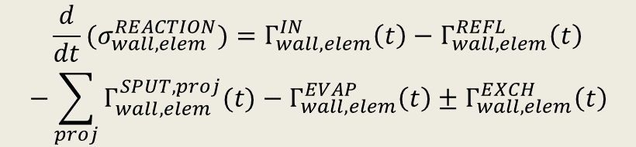
Previous WallDYN surface model
Homogenous reaction layer + homogenous bulk
  All erosion & deposition occurs homogenously in reaction layer
  Composition of reaction layer is variable, composition of bulk is fixed
  Reaction layer width held fixed via exchange with bulk (Γ^{EXCH})
  Assume that trapped hydrogen does not affect sputtering rates
  Physical sputtering and D-C chemical erosion included
1 Differential equation for areal density of each element in reaction layer:
Incident fluxes:
Constant D+, D-CX fluxes
Energy-resolved redeposited impurity fluxes
Outgoing fluxes:
Eroded impurity fluxes
Reflected impurity fluxes
Evaporated fluxes
Ion Depth (4 nm)
Reaction layer:
C, B, O
Semi-infinite
Bulk:
C, O
$$\frac{d}{dt}(σ_{wall,elem}^{REACTION})=Γ_{wall,elem}^{IN}\left(t\right)−Γ_{wall,elem}^{REFL}\left(t\right)$$
$$−\sum_{proj}{Γ_{wall,elem}^{SPUT,proj}(t)}−Γ_{wall,elem}^{EVAP}\left(t\right)±Γ_{wall,elem}^{EXCH}\left(t\right)$$
Well suited for surfaces > 1 μm

Slide 13

New WallDYN “thin film” surface model
The use of thin films for conditioning introduces an important new length scale in the system
  Thin film width = Reaction layer width + Reservoir layer width
  Composition of reservoir layer is variable
  Reservoir width is dynamic
    Net deposition → Reservoir grows
    Net erosion → Reservoir shrinks
  Reaction layer width held fixed via exchange with reservoir (Γ^{EXCH}), then bulk once reservoir is depleted
2 Differential equations for areal density of each element (1 for reaction layer, 1 for reservoir layer):
Incident fluxes:
Constant D+, D-CX fluxes
Energy-resolved redeposited impurity fluxes
Outgoing fluxes:
Eroded impurity fluxes
Reflected impurity fluxes
Evaporated fluxes
Ion Depth (4 nm)
Reaction layer:
C, B, O
Initial width set by boronization model; grows/
shrinks during simulation
Reservoir layer:
C, B, O
Semi-infinite
Bulk:
C, O
$$\frac{d}{dt}(σ_{wall,elem}^{REACTION})=Γ_{wall,elem}^{IN}\left(t\right)−Γ_{wall,elem}^{REFL}\left(t\right)$$
$$−\sum_{proj}{Γ_{wall,elem}^{SPUT,proj}(t)}−Γ_{wall,elem}^{EVAP}\left(t\right)±Γ_{wall,elem}^{EXCH}\left(t\right)$$
$$\frac{d}{dt}(σ_{wall,elem}^{RESERVOIR})=∓Γ_{wall,elem}^{EXCH}\left(t\right)$$

Slide 14
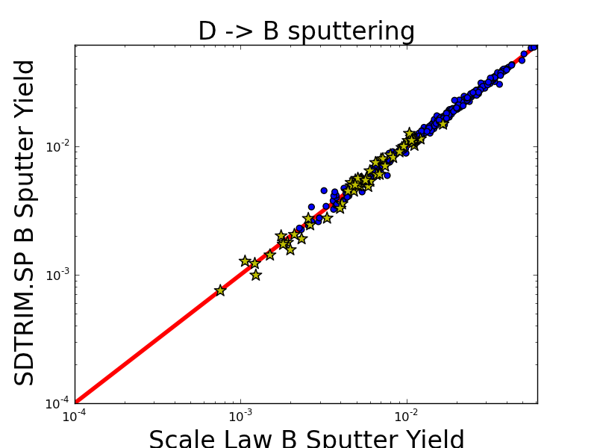
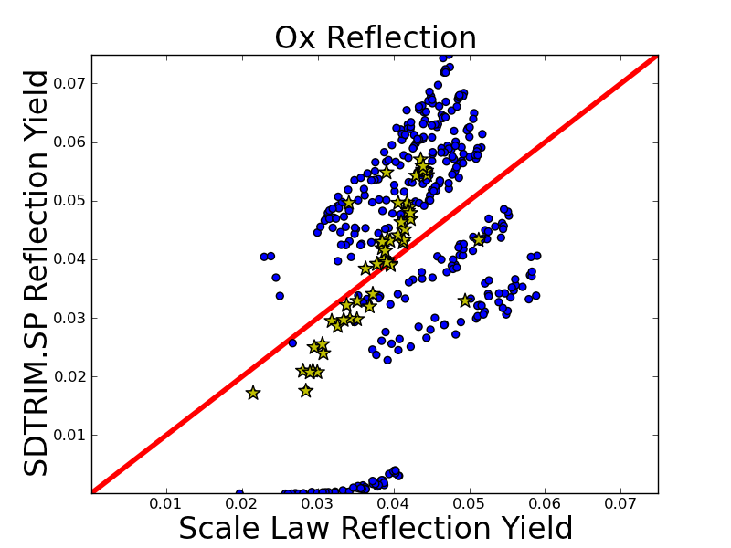
WallDYN parameterizes mixed material sputtering and reflection with SDTRIM.SP
SDTRIM.SP varied over projectile/energy/surface composition (1600+ runs)
E₀ = 50 eV
Variable σ
E₀ = 50 eV
Variable σ
Y_{sput}^{FIT} = Q * s_{n}(E₀/E_{TF}) * (1-(E_{th}/E₀)^{2/3})
* (1-E_{th}/E₀)² * (1 + Σ_{i} σ_{i} * a_{i})
Y_{refl}^{FIT} = ρ_{refl} * E₀^{α} * (1 + Σ_{i} σ_{i} * b_{i})
Composition dependence
Bohdansky formula
Composition dependence
σ_{i} = areal density of element i
σ_{i} = areal density of element i
Fit parameters: Q, E_{th}, a_{C}, a_{Li}, a_{O}
Fit parameters: ρ_{refl}, α, b_{C}, b_{Li}, b_{O}

Slide 15
PLASMA MODEL

Slide 16
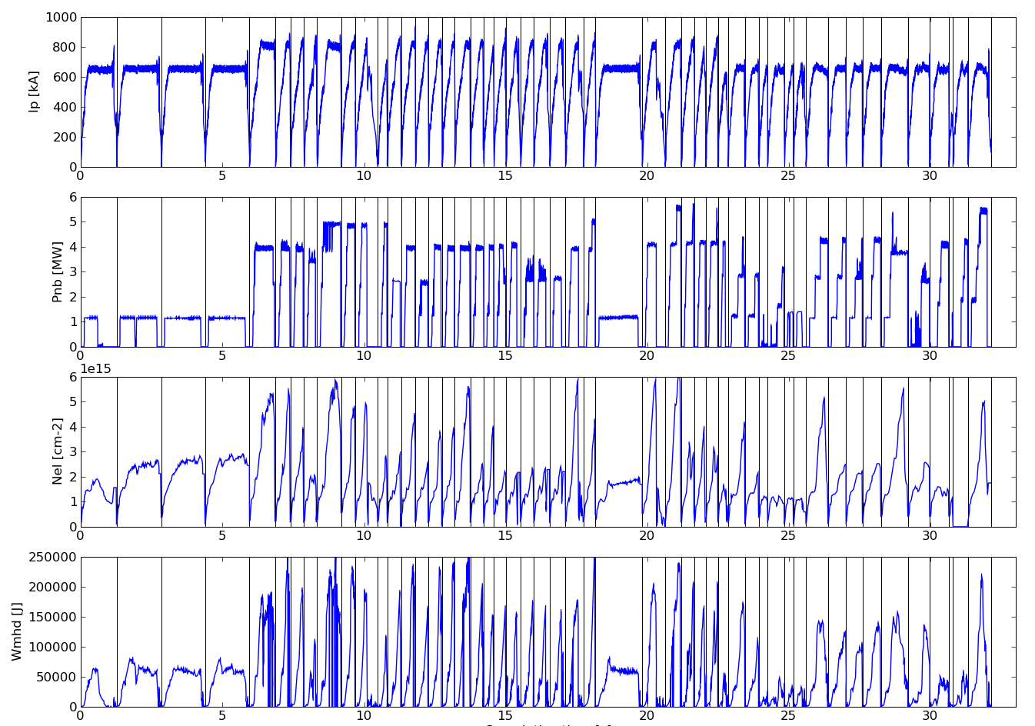
Campaign-relevant plasma parameters chosen for plasma model
NSTX-U shots were highly varied, transient, and not always controlled
  Still, “peak” performance, expected to be primary driver of erosion, can be decently represented by a medium-performance NSTX H-mode proxy
Plasma Operations following Boronization #8 (203953-204011)
Proxy (129015): 0.80 MA
Plasma Current
NBI Power
Proxy (129015):
4 MW
Line-avg Density
Proxy (129015):
5.5e15 cm⁻²
Stored Energy
Proxy (129015):
160 kJ
Cumulative plasma exposure since boronization (s)

Slide 17
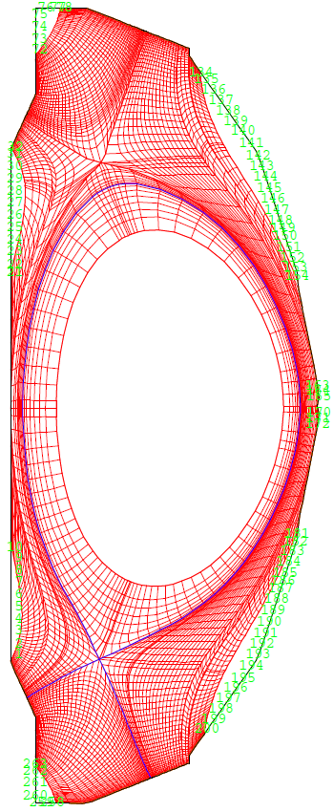
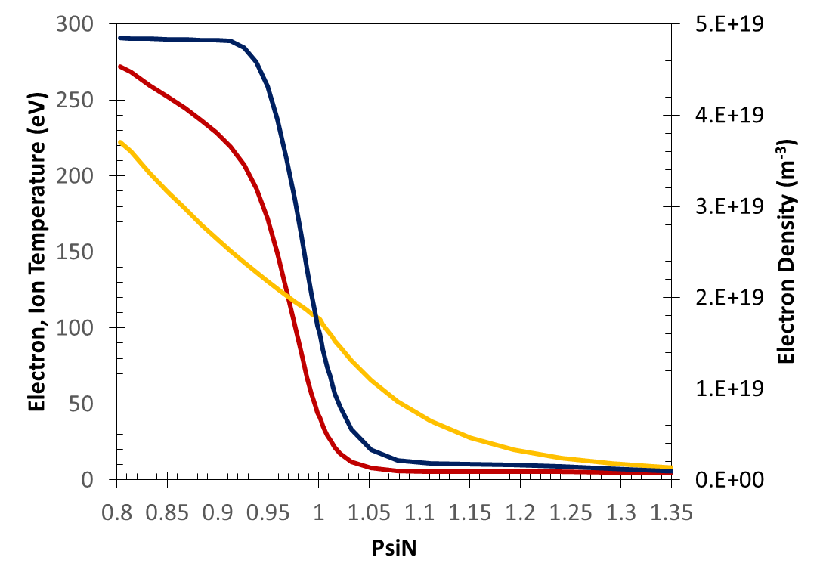
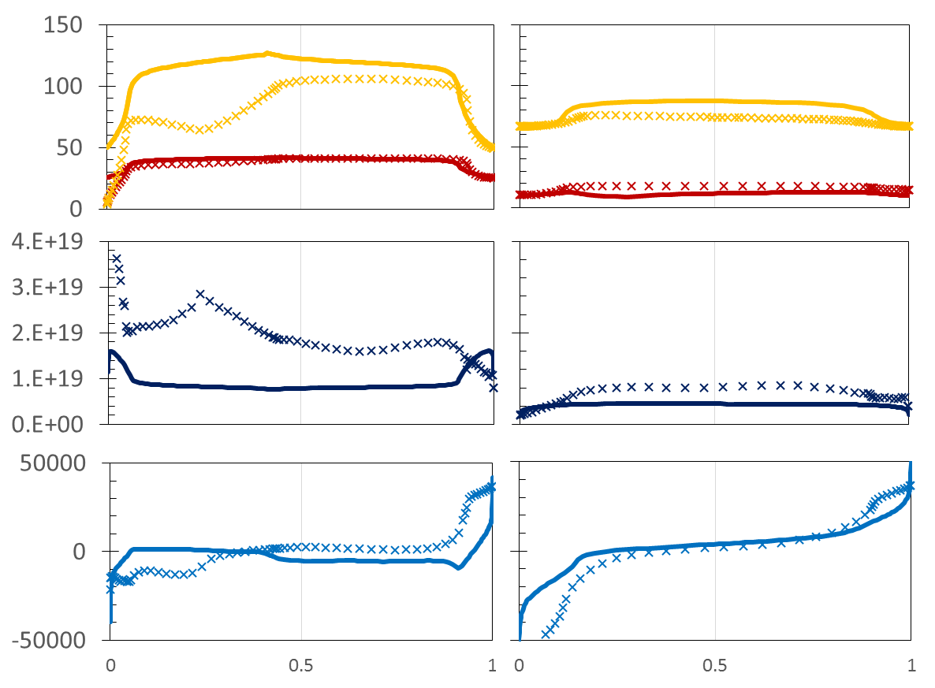
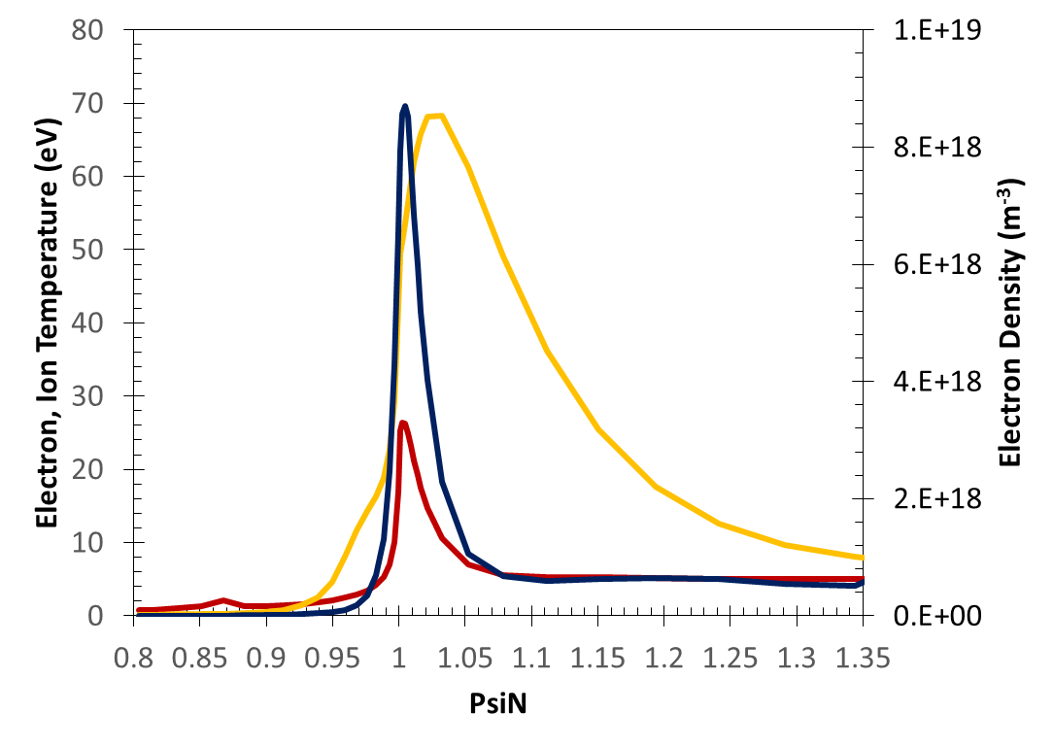
Extended grid SOL plasma solution generated with two-fluid onion skin solver
OSM/EIRENE applied to boundary conditions of validated SOLPS reconstruction of boronized NSTX H-Mode [Canik PoP 2011]
  No NSTX-U probe data available for direct reconstruction of discharges
Midplane Te/Ti/Ne
Along ring nearest primary separatrix
Along ring nearest secondary separatrix
Ne
Te
Te, Ti
(eV)
Ti
Ne
(m⁻³)
Outer Target Te/Ti/Ne
Vpar
(m/s)
Ne
Te
Ti
Lower Inner Target
Lower Outer Target
Upper Outer Target
Lower Outer Target
Normalized poloidal distance
Normalized poloidal distance
“Extended” grid fills far SOL → critical for migration simulations!
OSM/EIRENE
SOLPS

Slide 18
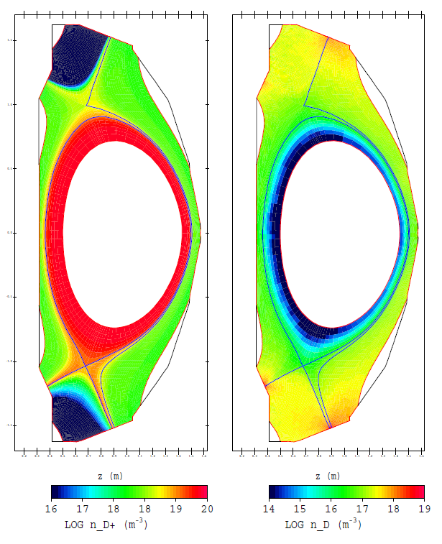
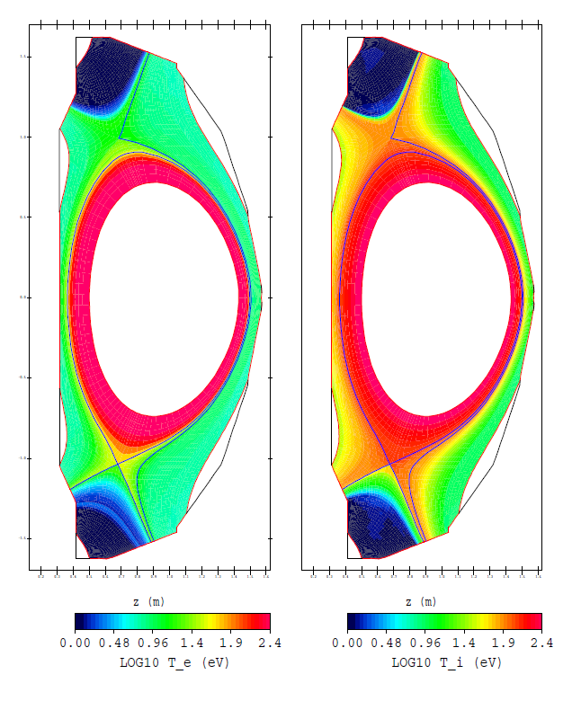
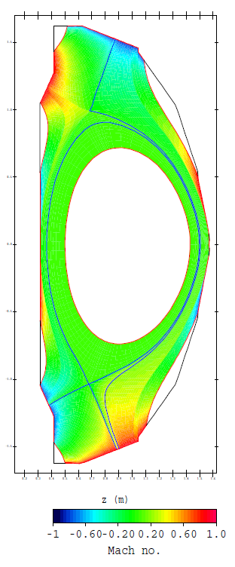
OSM/EIRENE edge plasma background generated for NSTX-U
Ion Density
Neutral Density
Electron Temp.
Ion Temp.
Parallel Flow
High strike point density/temperature, large radial gradients (H-Mode like)
No external flow/pinch applied

Slide 19
RESULTS

Slide 20
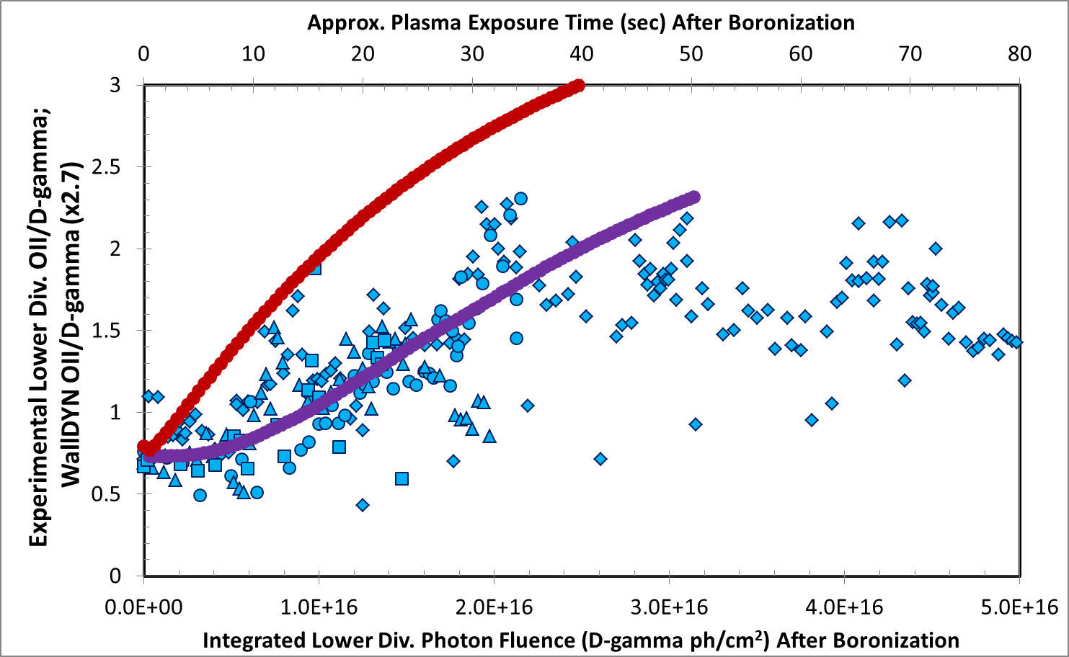
Results: agreement with OII emission trends greatly improved with thin film model
WallDYN (no thin film model)
OII/D-γ
WallDYN
(thin film model, full boronization)
NSTX-U Discharges Following Boronization
B5
B8
B9
B10

Slide 21
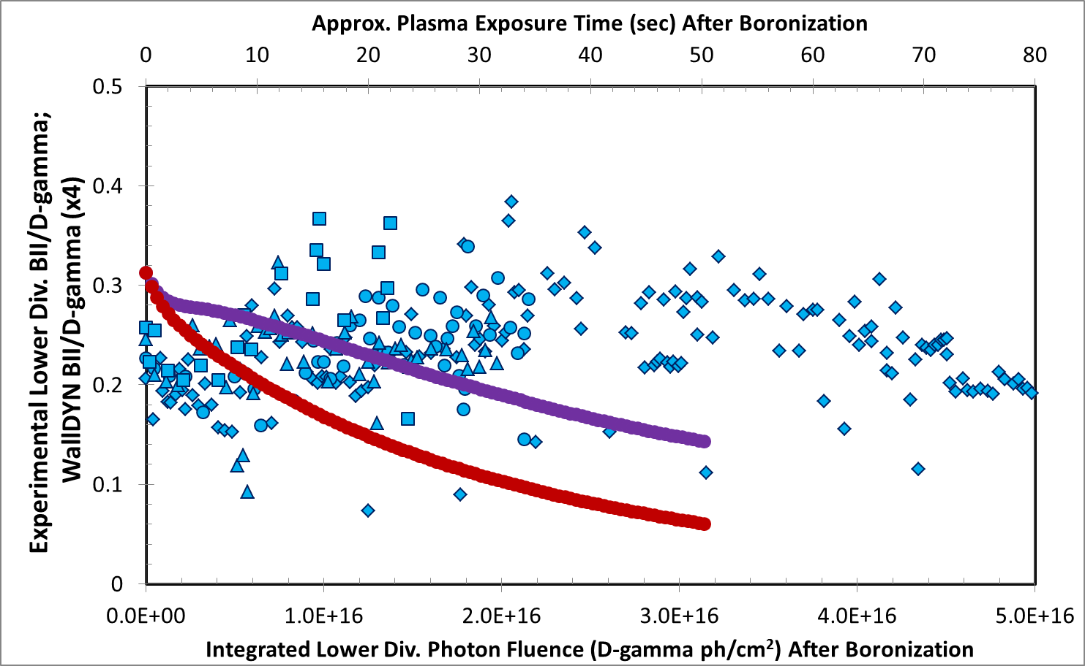
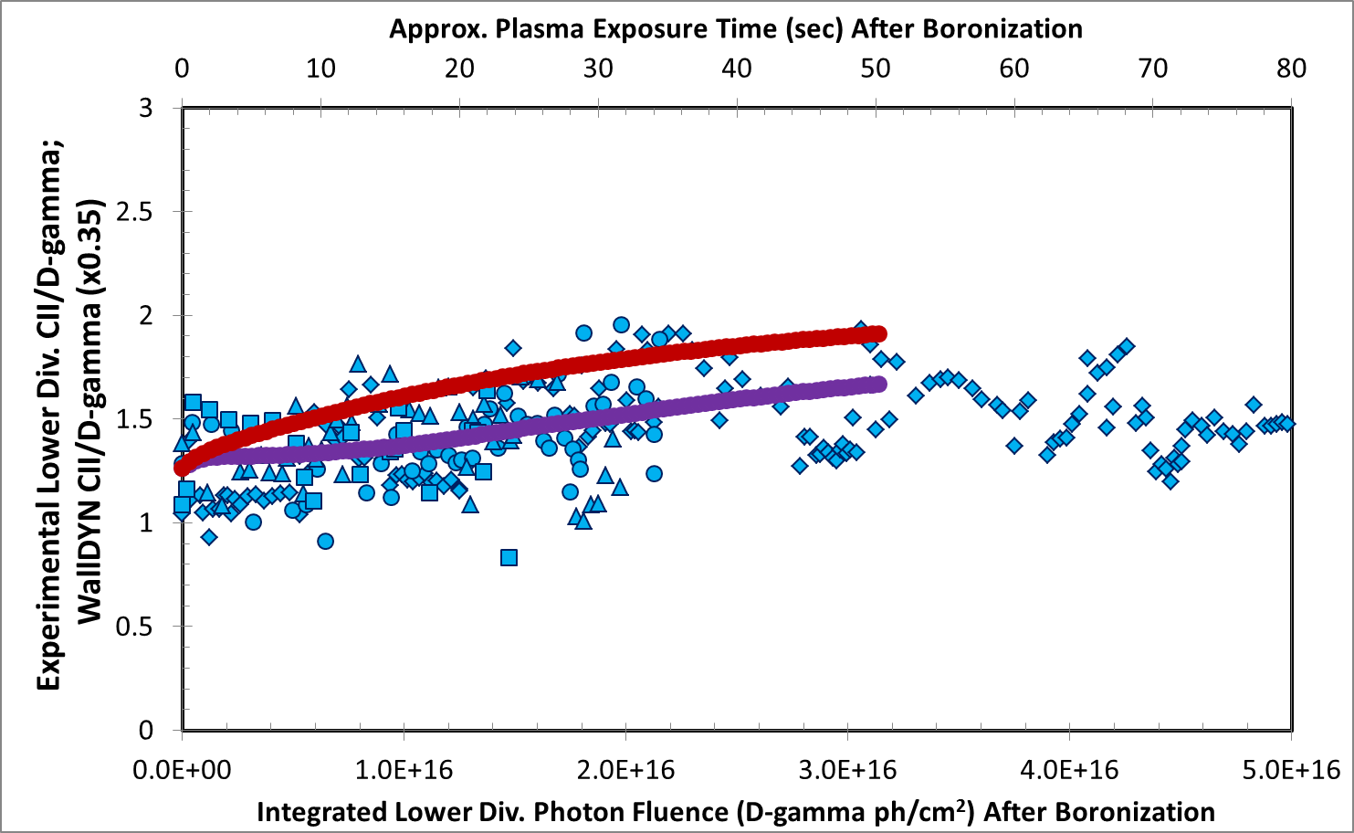
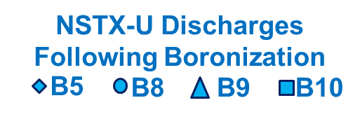

Results: agreement with BII, CII emission trends slightly improved with thin film model
BII/D-γ
WallDYN (no thin film model)
WallDYN (thin film model, full boronization)
CII/D-γ
WallDYN (no thin film model)
WallDYN (thin film model, full boronization)
Thin film model brings WallDYN into good agreement with experimental oxygen emission trends following full boronizations
No experimental trend in carbon emission following boronization
  Good agreement with both WallDYN models
No experimental trend in boron emission following boronization
  Poor agreement with both WallDYN models
  Reason for continued disagreement is under investigation

Slide 22
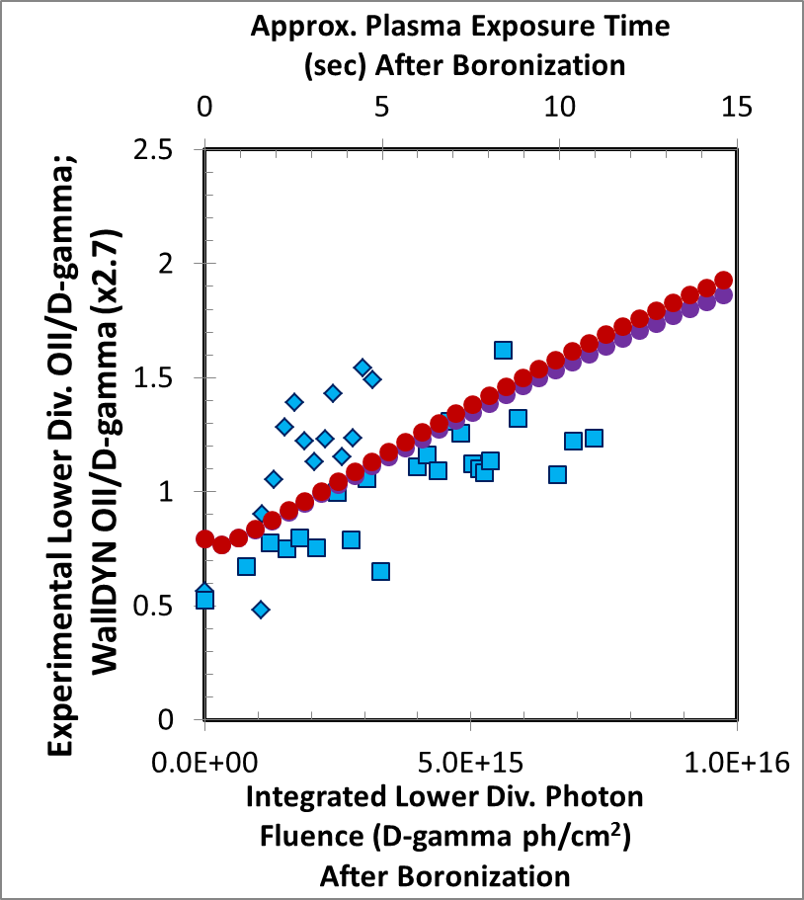
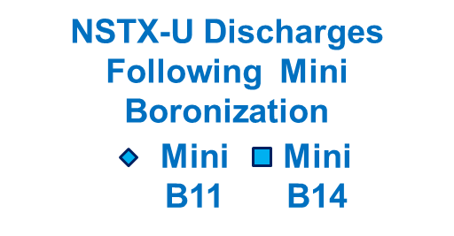
Results: agreement with mini boronization emission trends similar with either model
Thin film WallDYN model capable of differentiating between full and mini boronizations
  Captures faster rise in impurity influx following mini boronization
Both model and experiment show degradation of mini boronization coating on time scale of ~ 1 run day (15 sec plasma exposure)
For mini boronization, thin film WallDYN model is nearly identical to old WallDYN model
  Makes sense, because boron film applied to divertor (~30 A) is thinner than reaction layer (ion penetration depth ≈ 40 A)
OII/D-γ
WallDYN (thin film model, mini boronization)
WallDYN (no thin film model)

Slide 23
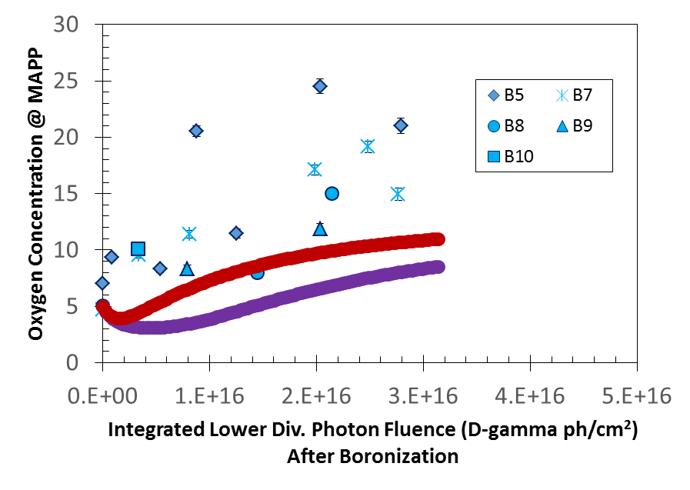
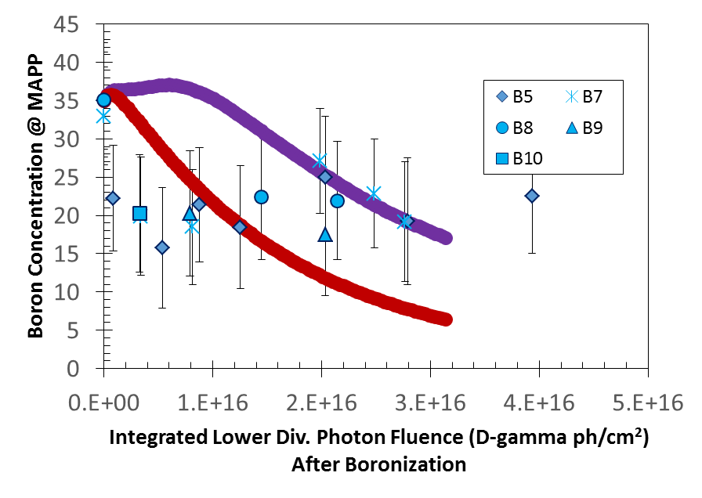
Results: surface concentration evolution during simulations
MAPP measurements following boronization
Both WallDYN models underestimate the rise in oxygen surface composition observed in MAPP
Surface boron agreement inconclusive
Models do not take into account chemical state of surface
  e.g. B-O vs. B-B vs. B-C bonds
  May be important!
  For more B/C/O surface discussion see:
  F. Bedoya JO4.10 Tue PM
  H. Schamis PP11.57 Wed PM
WallDYN (no thin film model)
WallDYN (thin film model, full boronization)
MAPP measurements following boronization
WallDYN (thin film model, full boronization)
WallDYN (no thin film model)

Slide 24
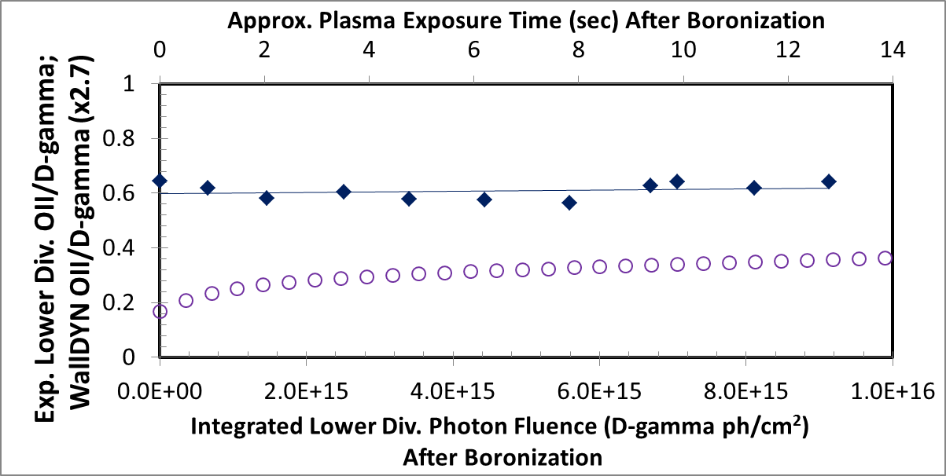
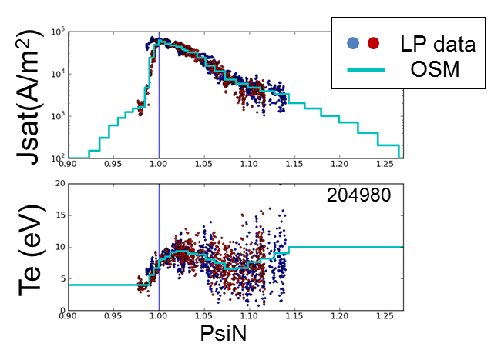
Closer look: No evolution observed after exposure to L-Mode fiducial only
Mini Boronization #12: 11 consecutive L-Mode fiducial discharges
  Limited Langmuir probe data available for late-campaign L-Mode fiducial
  Direct comparison is possible
No oxygen impurity emission evolution is observed over the course of the run day
  MAPP also shows similar surface oxygen concentration before + after
Model reproduces general trend after 2nd discharge
  OII/D-γ magnitude low
OII/D-γ
Shots after Mini B #12
(L-Mode fiducial)
WallDYN Mini B (L-Mode fiducial)
Highly likely that WallDYN L-Mode fiducial model does not fully capture evolution driven by higher-power general purpose L-Modes
  Not enough H-Modes in campaign to explain general OII evolution otherwise

Slide 25
PREDICTIONS

Slide 26
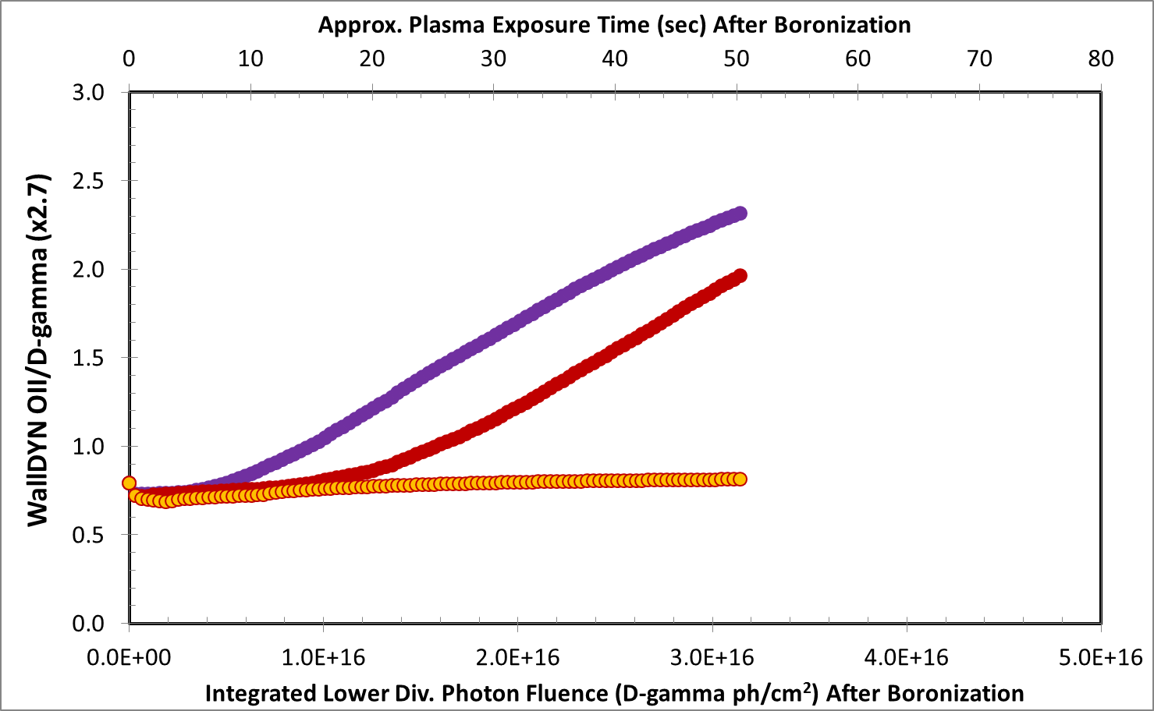
Effect of more uniform boron coverage on oxygen evolution (aka more GDC electrodes)
WallDYN
(“Realistic” coverage: 62-227 A)
WallDYN
(Uniform 104 A, same # B atoms as “Realistic”)
WallDYN
(Uniform 522 A, all B atoms in 9.0 g dTMB utilized)
Uniformity of boron coatings is controlled by properties of He glow discharge and the number of anodes

Slide 27
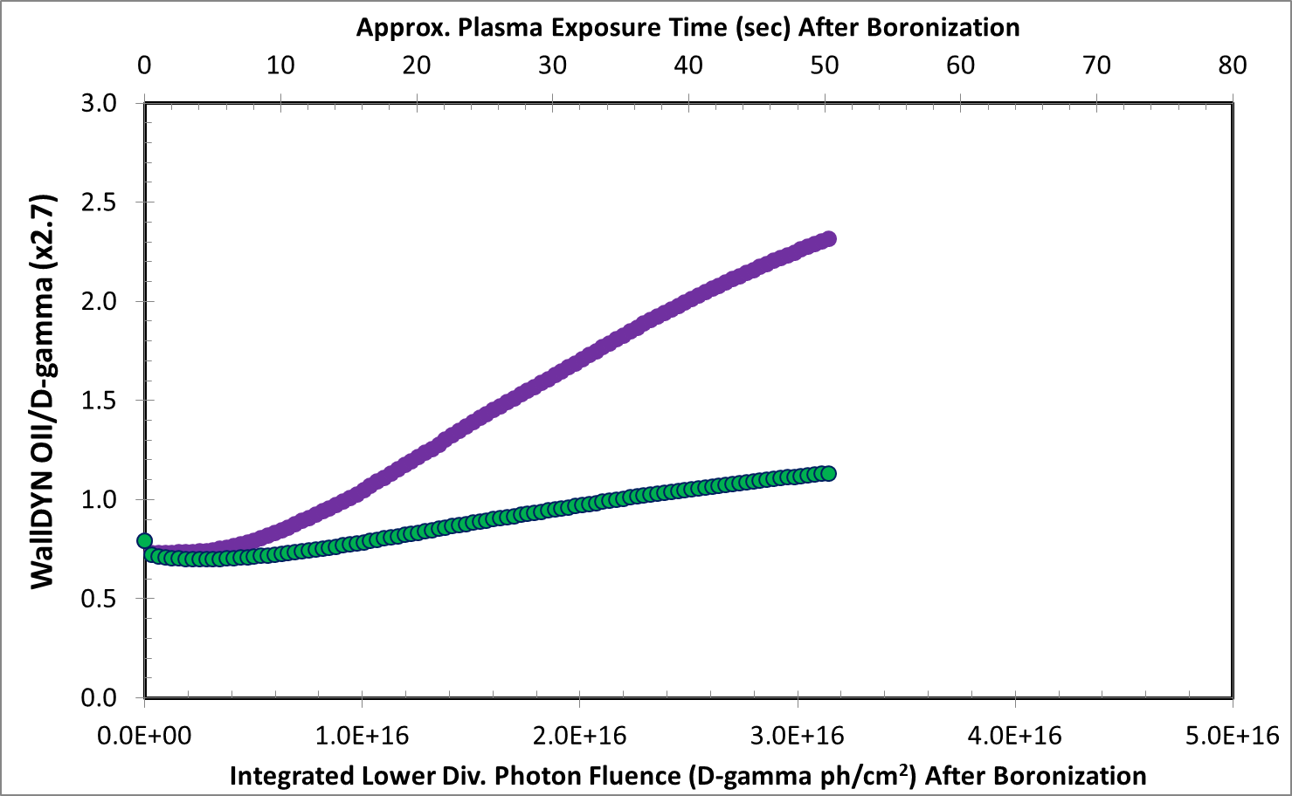
Effect of lower bulk oxygen concentration on oxygen evolution (aka better bakeout)
WallDYN
(Bulk 20% O)
WallDYN
(Bulk 10% O)
Bulk oxygen content is typically controlled by pre-campaign conditioning (bakeout, etc.)

Slide 28
CONCLUSIONS
The integrated material migration model WallDYN has been improved through comparison to NSTX-U experimental data
  WallDYN surface model modified to incorporate finite thin films, as used in wall conditioning
  Model reproduces impurity emission trends observed following boronization in NSTX-U
    Boronization suppresses OII emission
    OII emission increases with plasma exposure
    OII emission increases faster following a mini boronization
  Model qualitatively reproduces surface composition evolution observed with MAPP
  New multi-layer surface model improves agreement with measurables
Future work: Full-scale model validation
  Requires repeatable research-grade plasma scenario
  Requires absolutely-calibrated spectroscopic diagnostics
  Requires well-constrained SOL plasma reconstruction
    Independent plasma flow diagnostic highly desirable
  Requires independent validation of mixed-material sputtering model

Slide 29
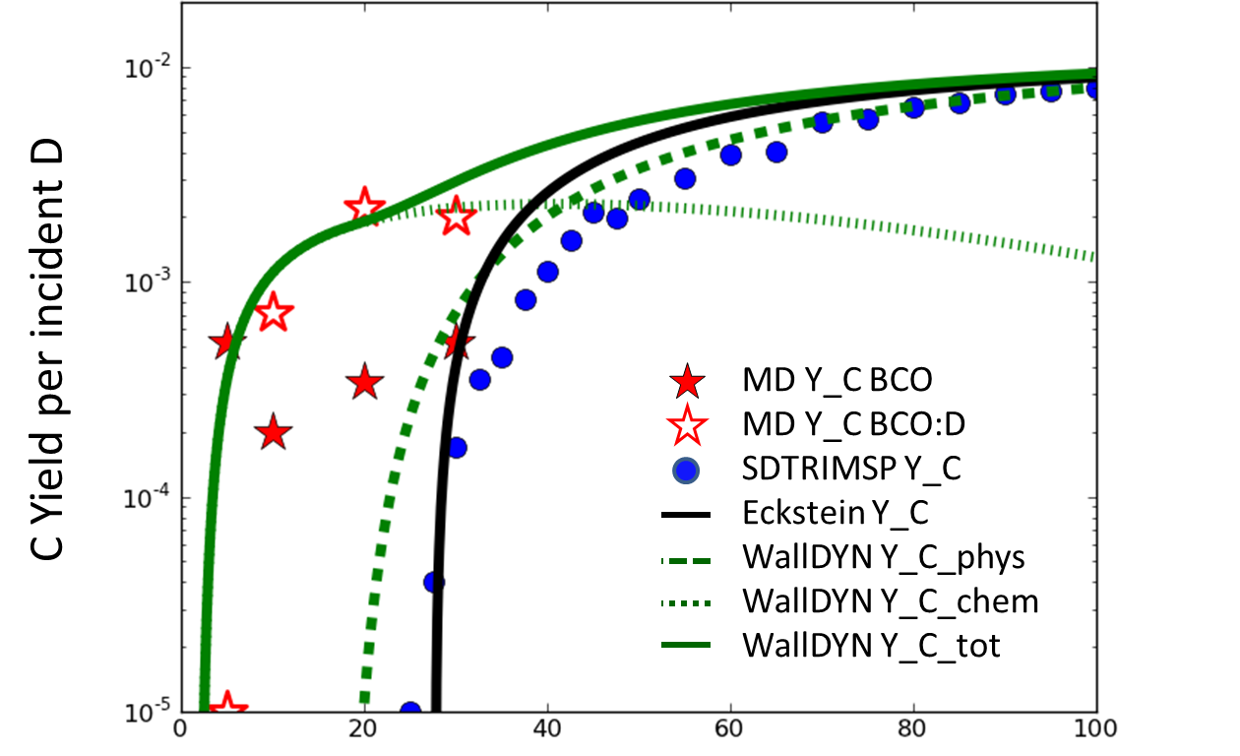
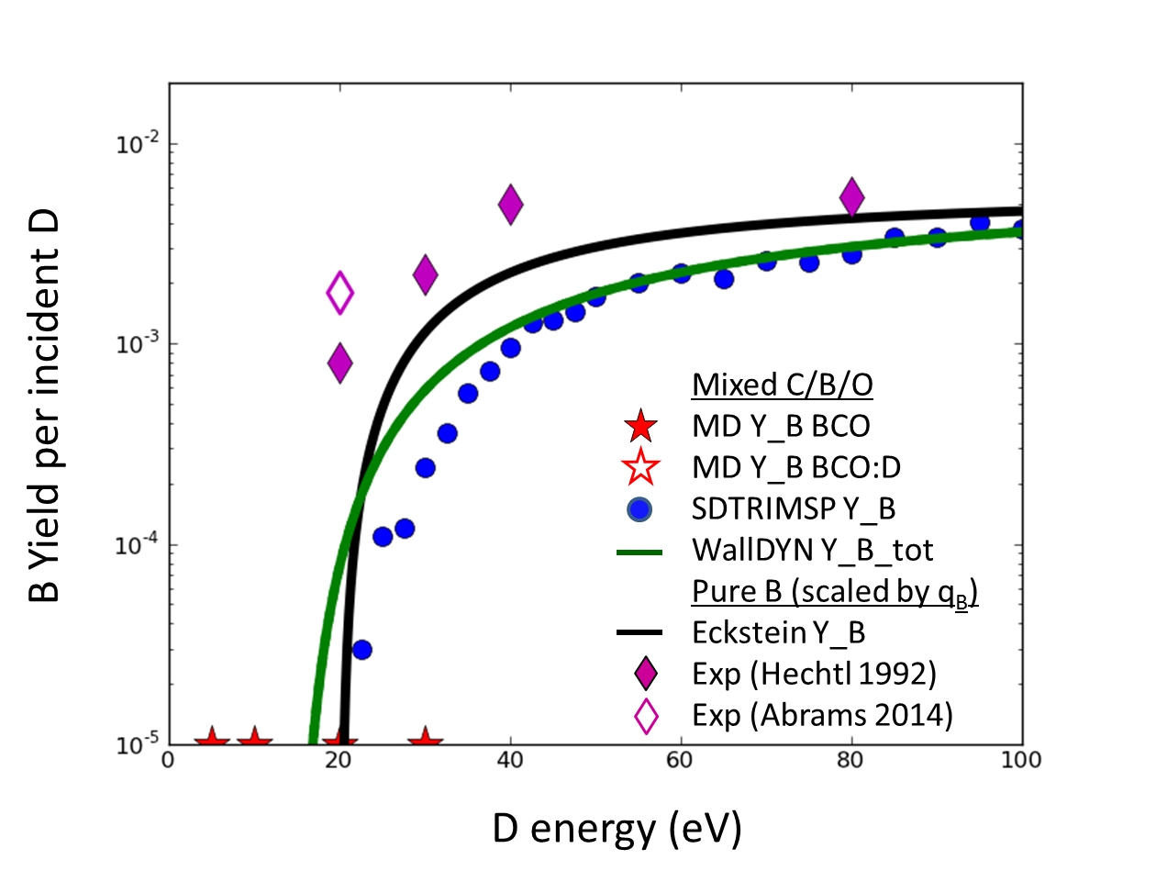
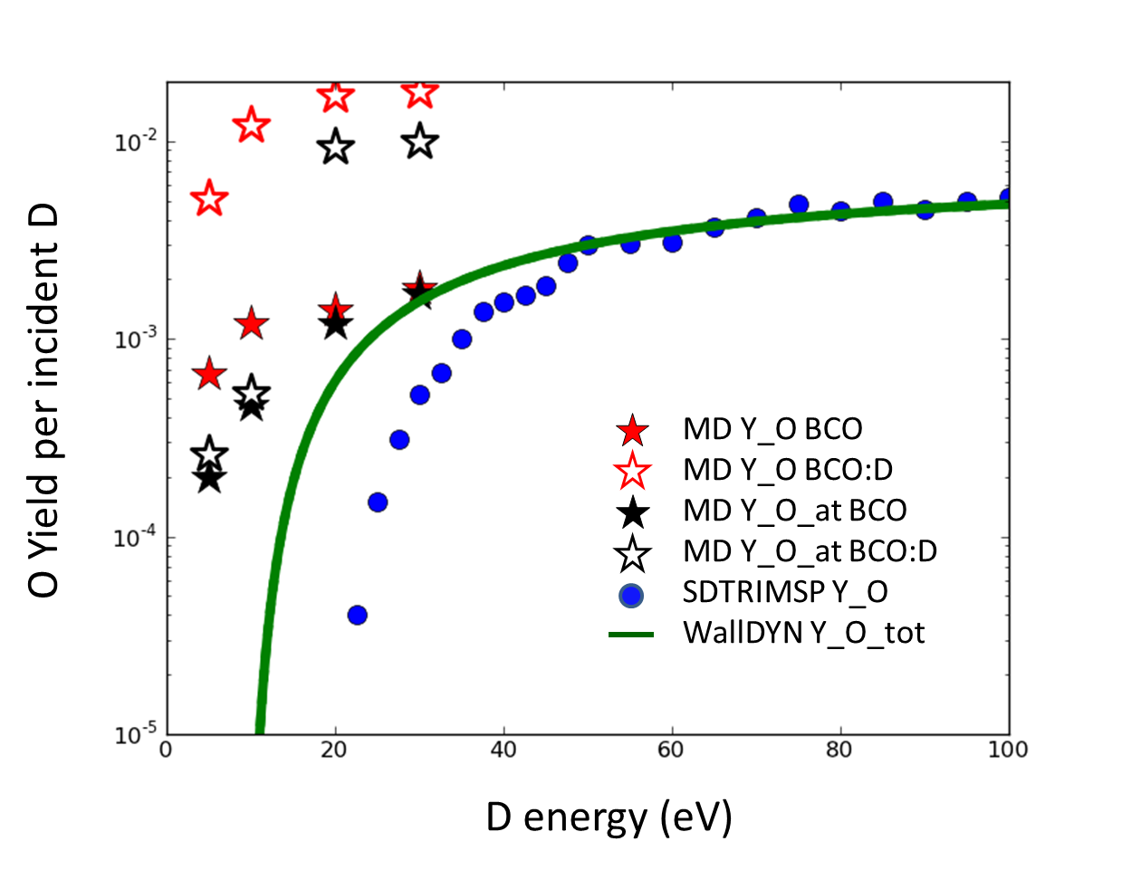
Notable area for model improvement: High-fidelity low-energy sputtering yields
(Φ=10²³ /m²s)
WallDYN/TRIM vs. Molecular Dynamics
D -> 60%C, 20%B, 20%O at normal incidence
MD: [J. Dominguez-Gutierrez JAP 2017]
Y_C well fit when including flux-dependent chem. erosion model
Y_O much higher than model
Y_B much lower than model

