Slide 1

Comparison of neutral density profiles measured using D_{α} and C⁵⁺ in NSTXU
R.E. Bell, F. Scotti, A. Diallo, B.P. LeBlanc, M. Podestà, S. A. Sabbagh
59th Annual Meeting of the APS Division of Plasma Physics
Milwaukee, Wisconsin
October 23-27, 2017

Slide 2
Abstract
Edge neutral density profiles determined from two different measurements are compared on NSTXU plasmas. Neutral density measurements were not typical on NSTX plasmas. An array of fibers dedicated to the measurement of passive emission of C⁵⁺, used to subtract background emission for charge exchange recombination spectroscopy (CHERS), can be used to infer deuterium neutral density near the plasma edge. The line emission from C⁵⁺ is dominated by charge exchange with neutral deuterium near the plasma edge. An edge neutral density diagnostic (ENDD) consisting of a camera with a D_{α} filter was installed on NSTXU. The line-integrated measurements from both diagnostics are inverted to obtain local emissivity profiles. Neutral density is then inferred using atomics rates from ADAS and profile measurements from Thomson scattering and CHERS. Comparing neutral density profiles from the two diagnostic measurements helps determine the utility of using the more routinely available C⁵⁺ measurements for neutral density profiles. Initial comparisons show good agreement between the two measurements inside the separatrix.

Slide 3
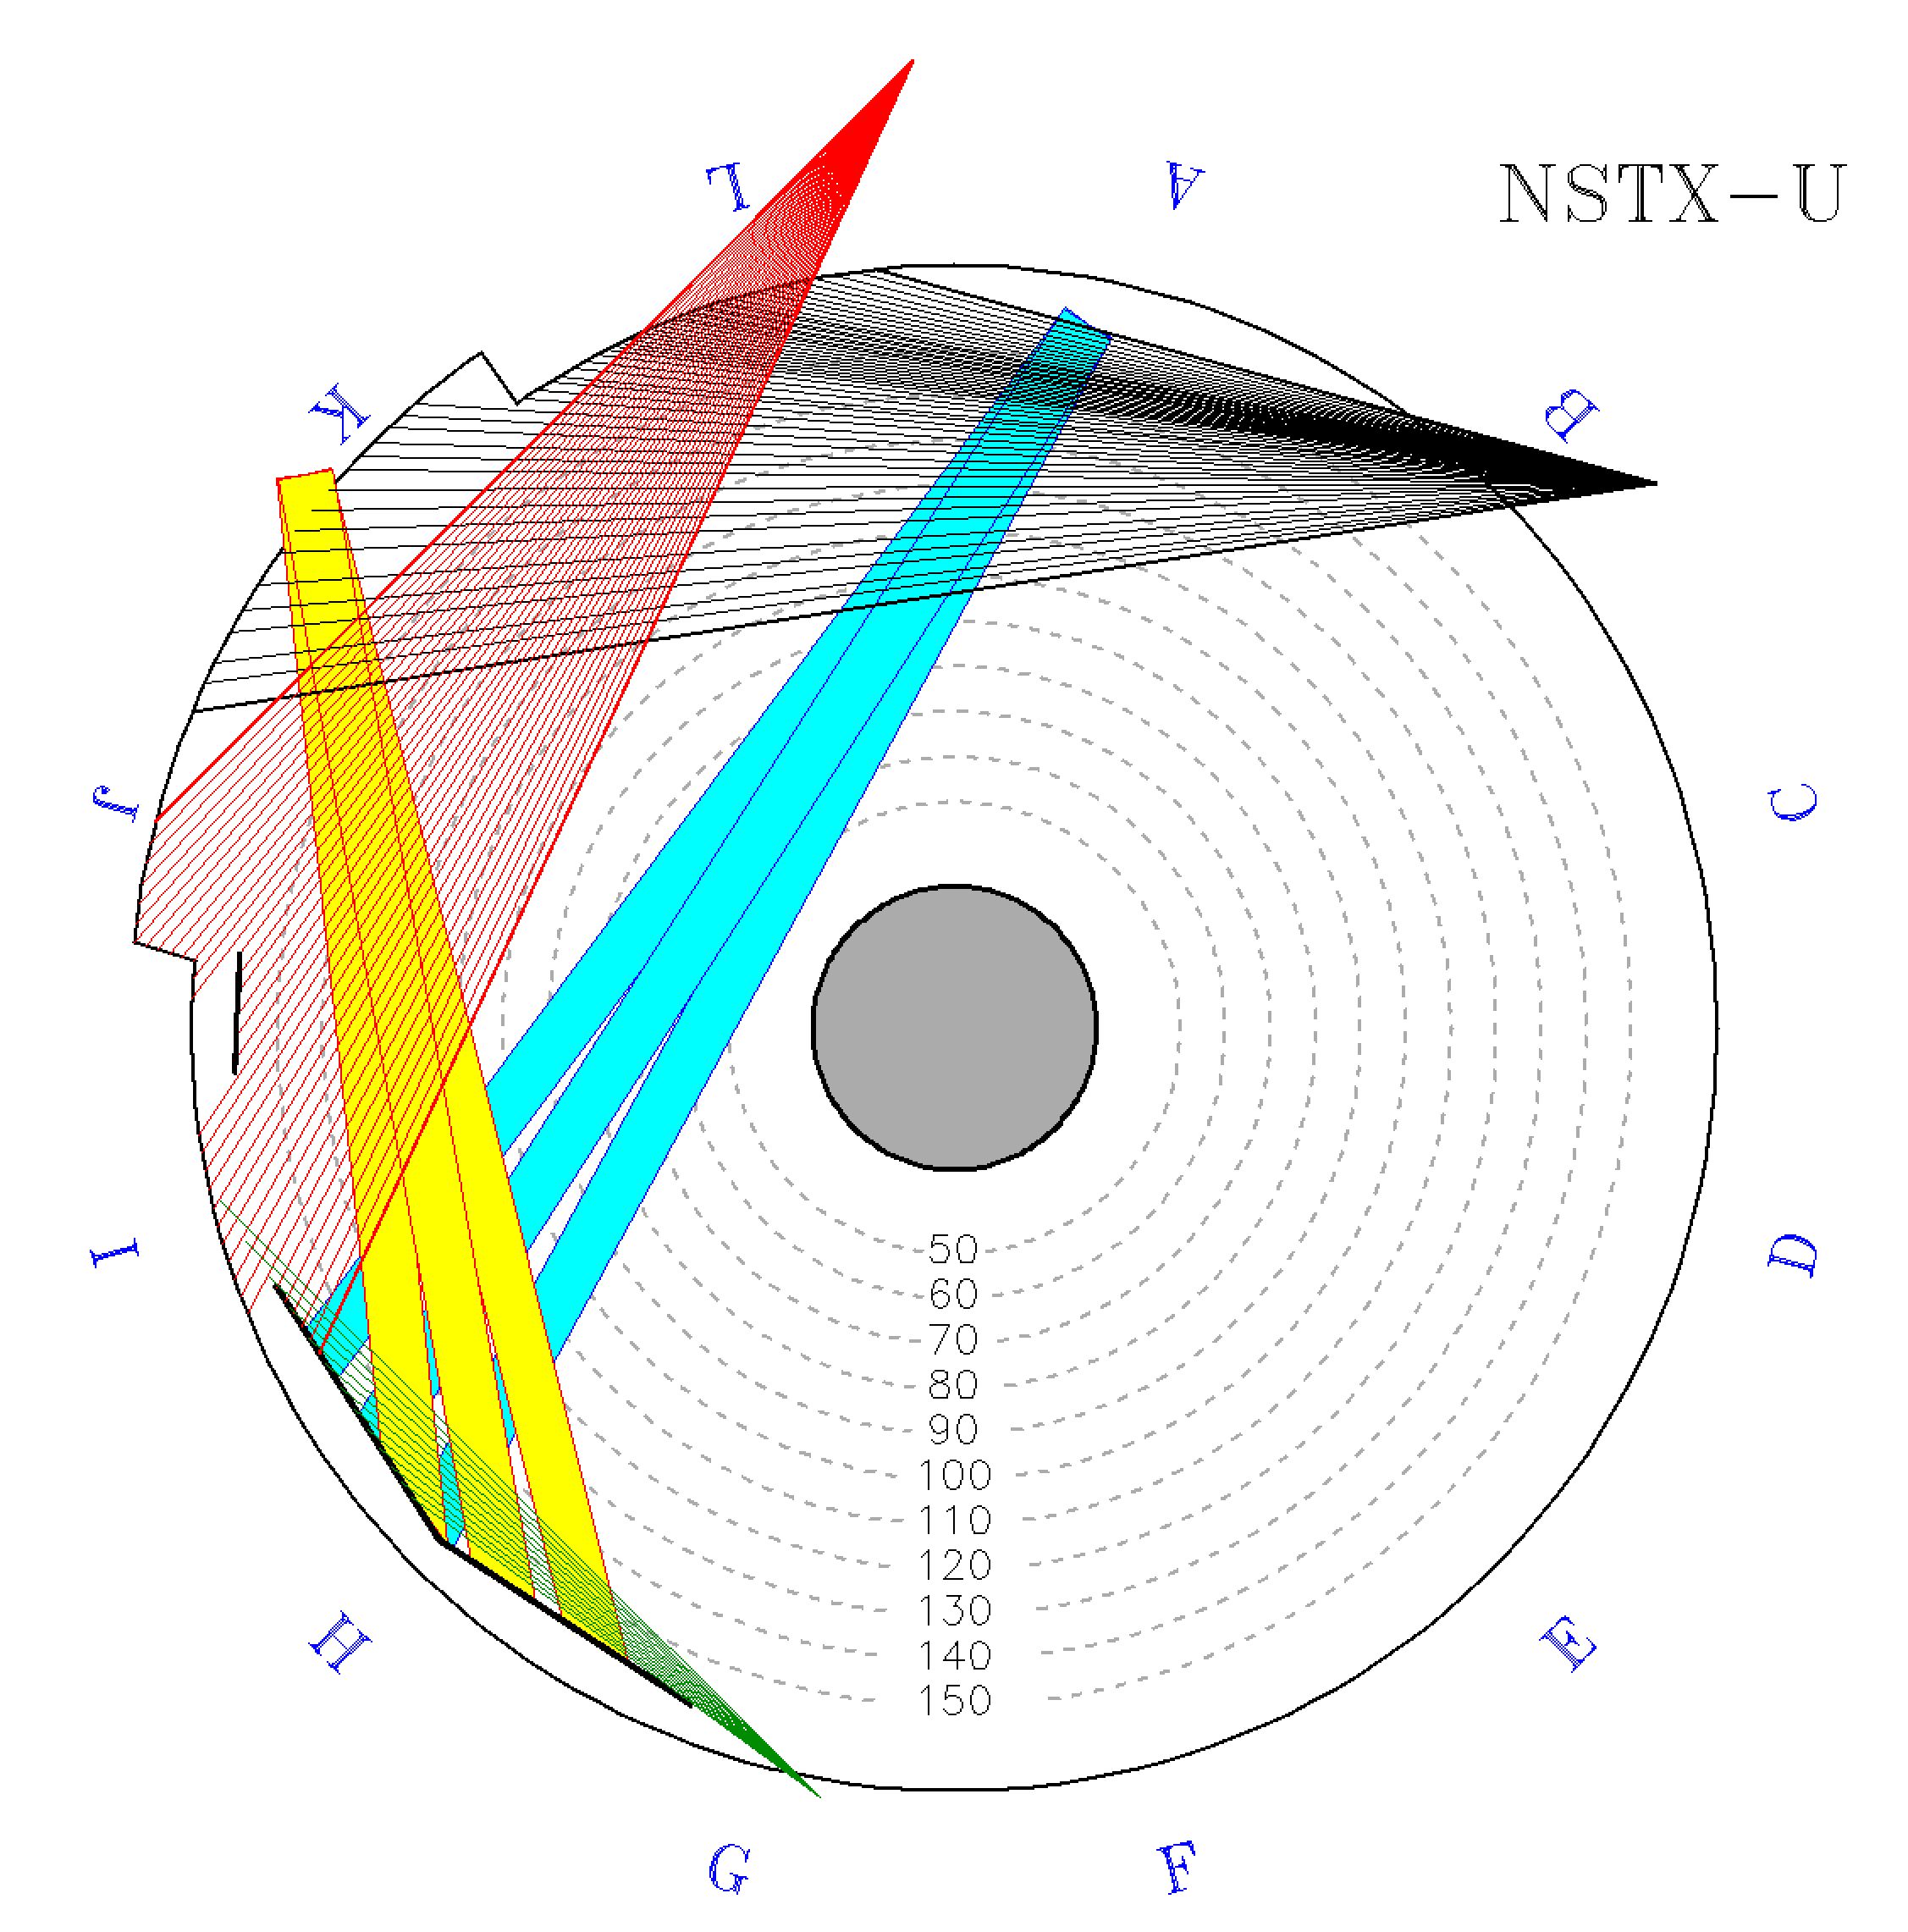
NSTXU Viewing Geometry
CHERS Background
Sightlines
CHERS Active views
  Charge exchange recombination spectroscopy measuring T_{i}, N_{C}, V_{φ}
  Optimized views across NB1
  Views CX emission and background emission for C⁵⁺
CHERS Background views
  View parallel to NB1
  View only C⁵⁺background emission
  Background measurement simultaneous with active measurement
ENDD
  Edge Neutral Density Diagnostic sightlines below midplane viewing upward
Second neutral beam (NB2) compromises CHERS Background views
  Bright CX emission contaminates background views
NB1
NB2
CHERS
Active
Sightlines
SFLIP
NB armor
ENDD
Sightlines

Slide 4
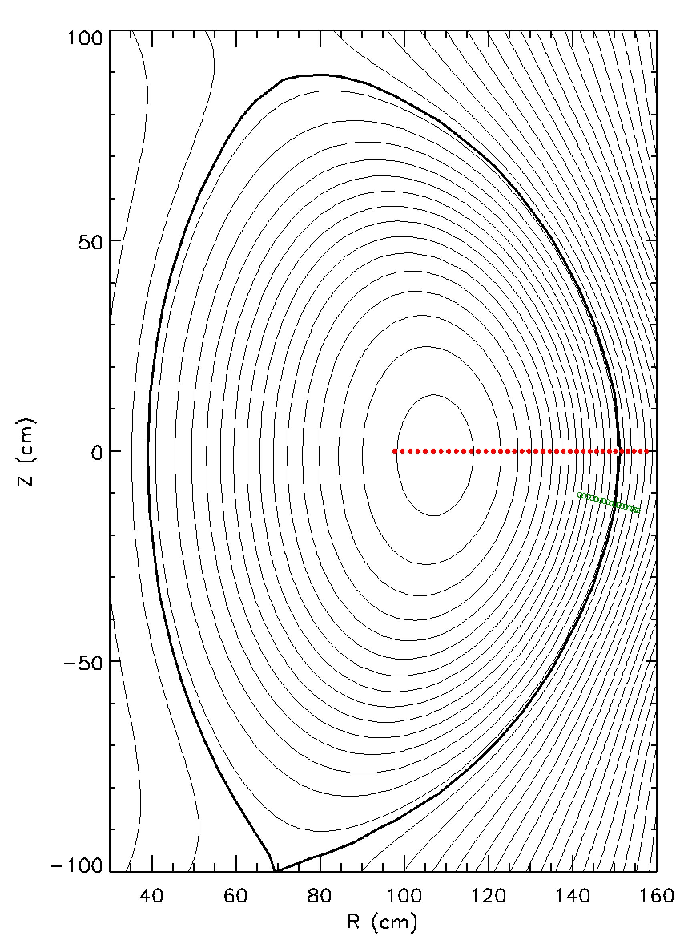
NSTXU Viewing Geometry
CHERS Background views
  On midplane
  CHERS exposure 10 ms
  37 fibers in background view
ENDD
  Edge Neutral Density Diagnostic sightlines below midplane viewing upward
  ENDD exposure 3.7 ms
  Camera with D_{α} filter
  Subset of 127 x 128 pixels used
CHERS Background
Sightlines
ENDD
Sightlines

Slide 5
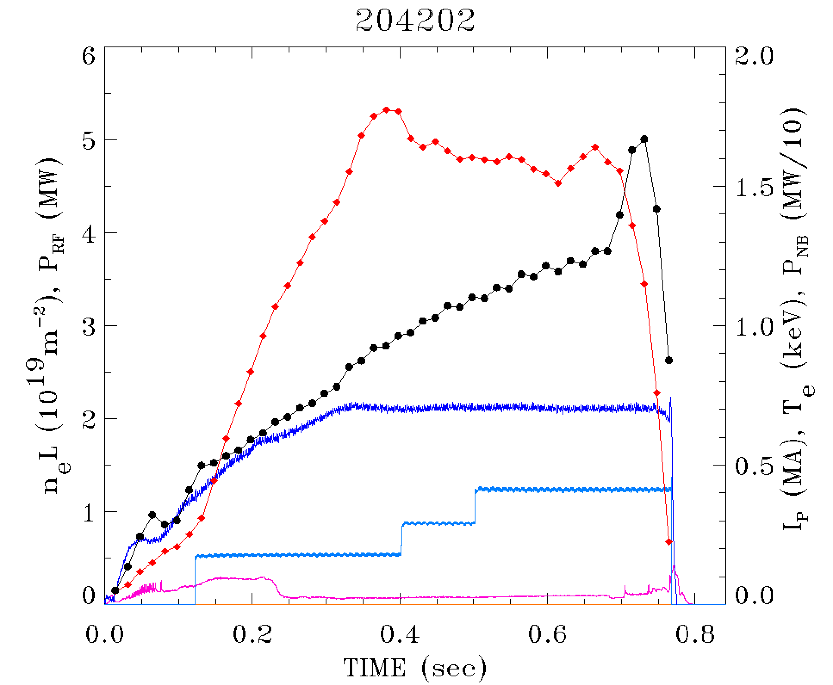
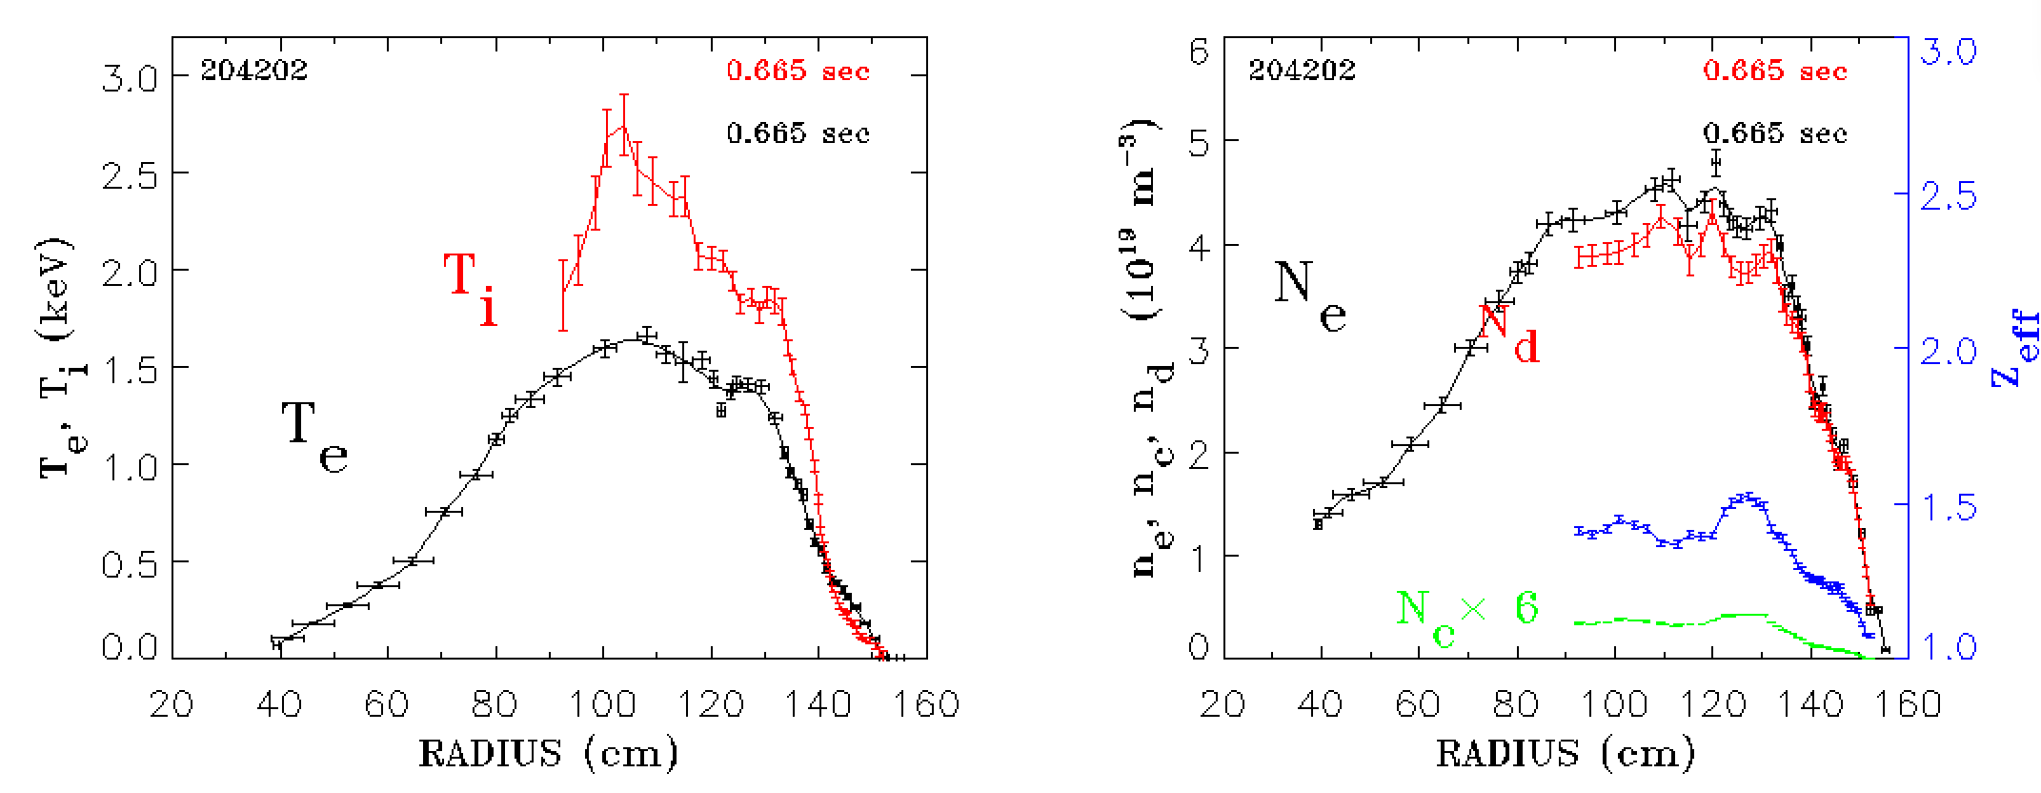
NSTX-U L-mode plasma
H-mode
L-mode plasma
Brief H-mode 690-700 ms
I_{p}= 700 kA
T_{e0}
n_{e}L
I_{p}
P_{NB}
D_{α}

Slide 6
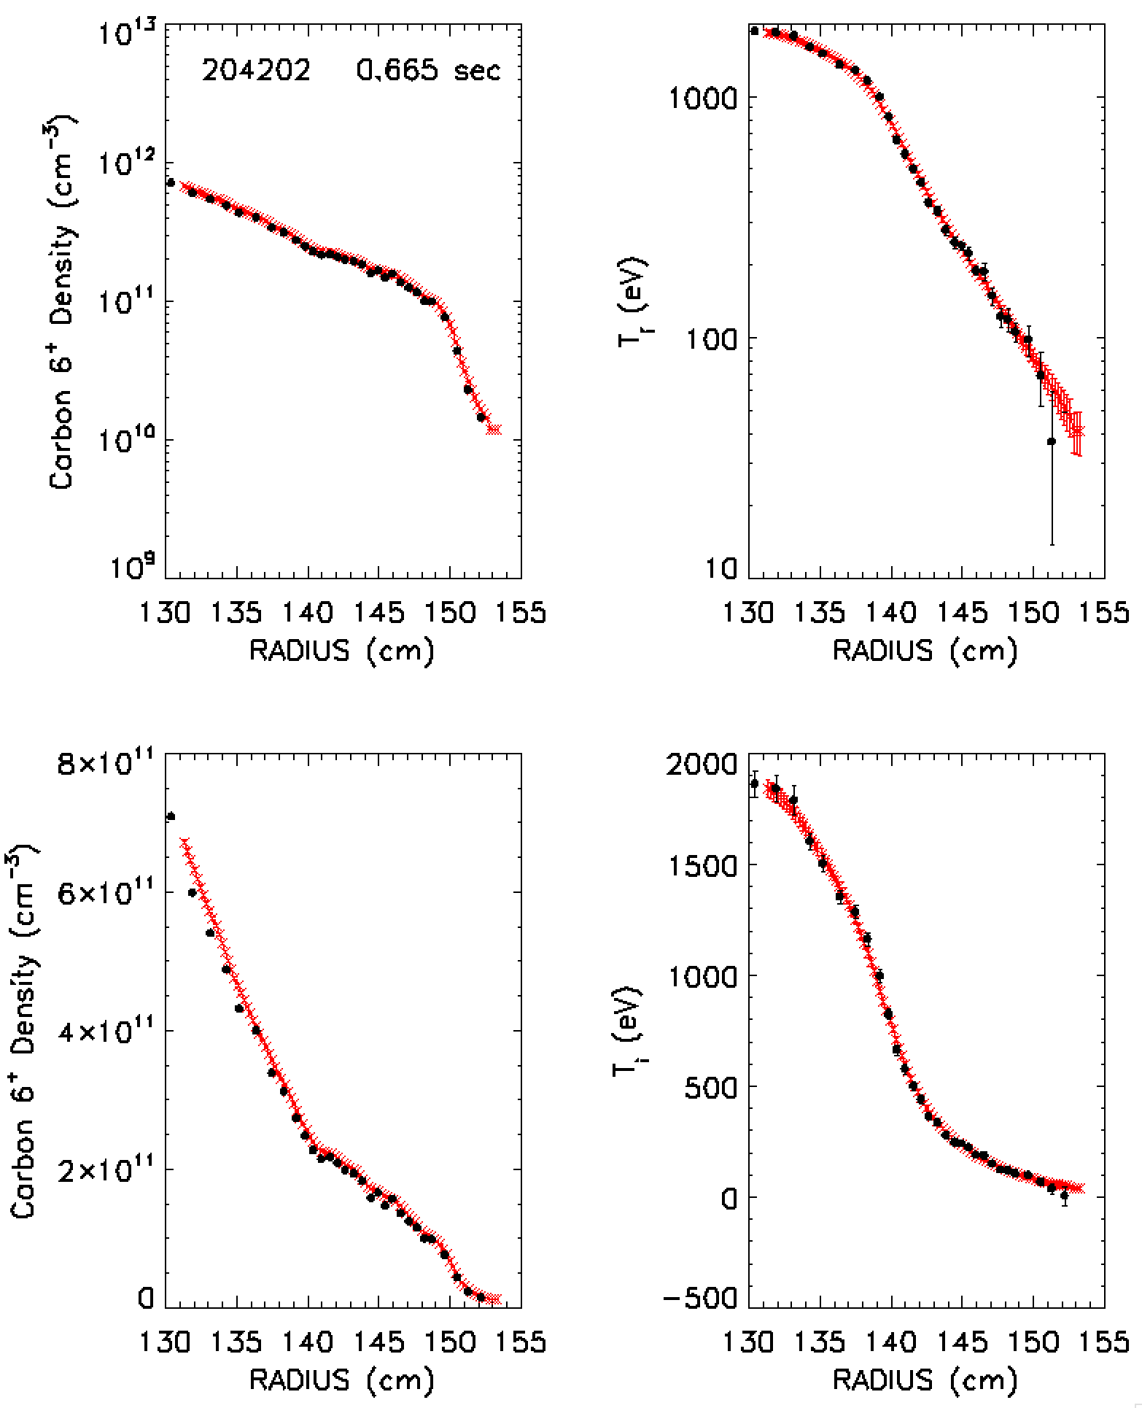
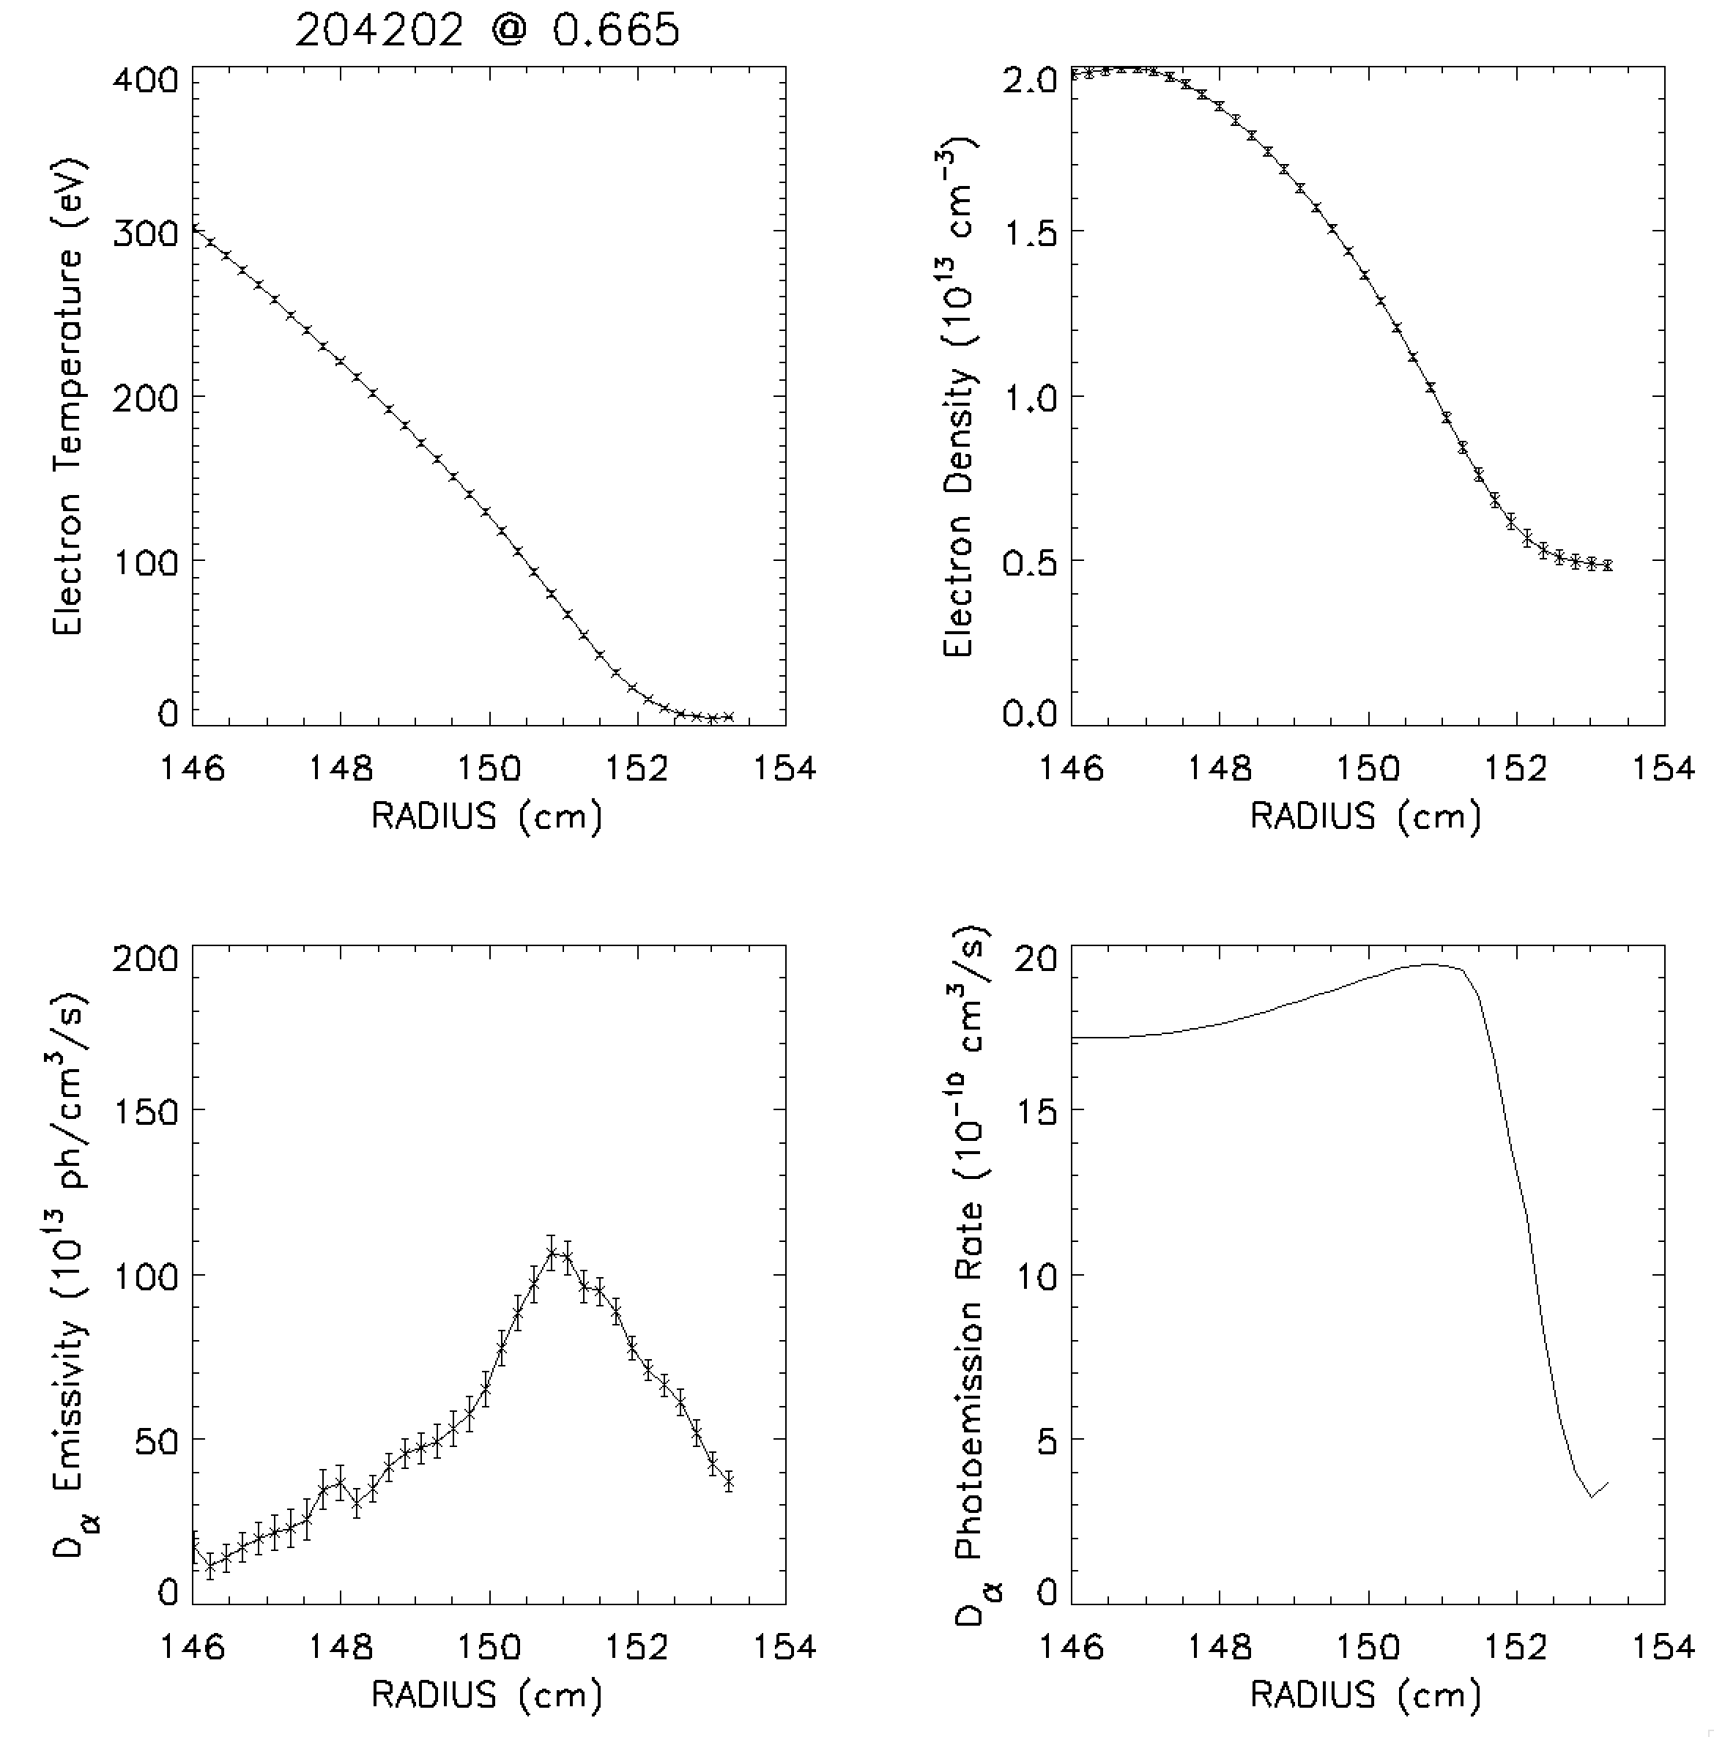
Measured profiles of temperature and density are interpolated or extrapolated onto common fine grid

Slide 7
Three Processes Contribute to
C⁵⁺ passive emission
Excitation
Recombination
Thermal Charge Exchange
UNKNOWN:
  n_{C}5+ Density of C⁵⁺
  n₀ Density of thermal deuterium neutrals
MEASURED:
  E Emissivity of passive emission from C⁵⁺ n = 87
  n_{e} Electron density
  n_{C}6+ Density of C⁶⁺
COMPUTED:
  Q_{ex} Photoemission rate for electron impact excitation, [T_{e}, n_{e}]
  Q_{rec} Photoemission rate for recombination from C⁶⁺ to C⁵⁺, [T_{e}, n_{e}]
  Q_{cx} Photoemission rate for thermalthermal charge exchange [T_{e}, n_{e}, Z_{eff}]

Slide 8
Cannot independently determine both C⁵⁺ density and thermal neutral density
Determination of density of C⁵⁺ requires thermal neutral deuterium (n₀) profile
Conversely, the thermal neutral density depends on the C⁵⁺ density or on the ratio of densities of C⁵⁺ to C⁶⁺

Slide 9
Effective thermal-thermal charge-exchange rate is dominated by n=2 excited population fraction
Effective CX rate:
Thermalthermal charge exchange rates for C⁶⁺ and D computed using ADAS 308 data.
Population fraction derived from ADAS photoemission coefficients, _________________________________________________________________________________or a from CollisionalRadiative model from DEGAS 2*
n=2 neutral fraction varies with electron density
n=2 population is less than a percent of the thermal neutral density
Contribution from n=1 ground state neutrals are only important at lower densities or low temperature
*http://w3.pppl.gov/degas2/ehr3.dat

Slide 10
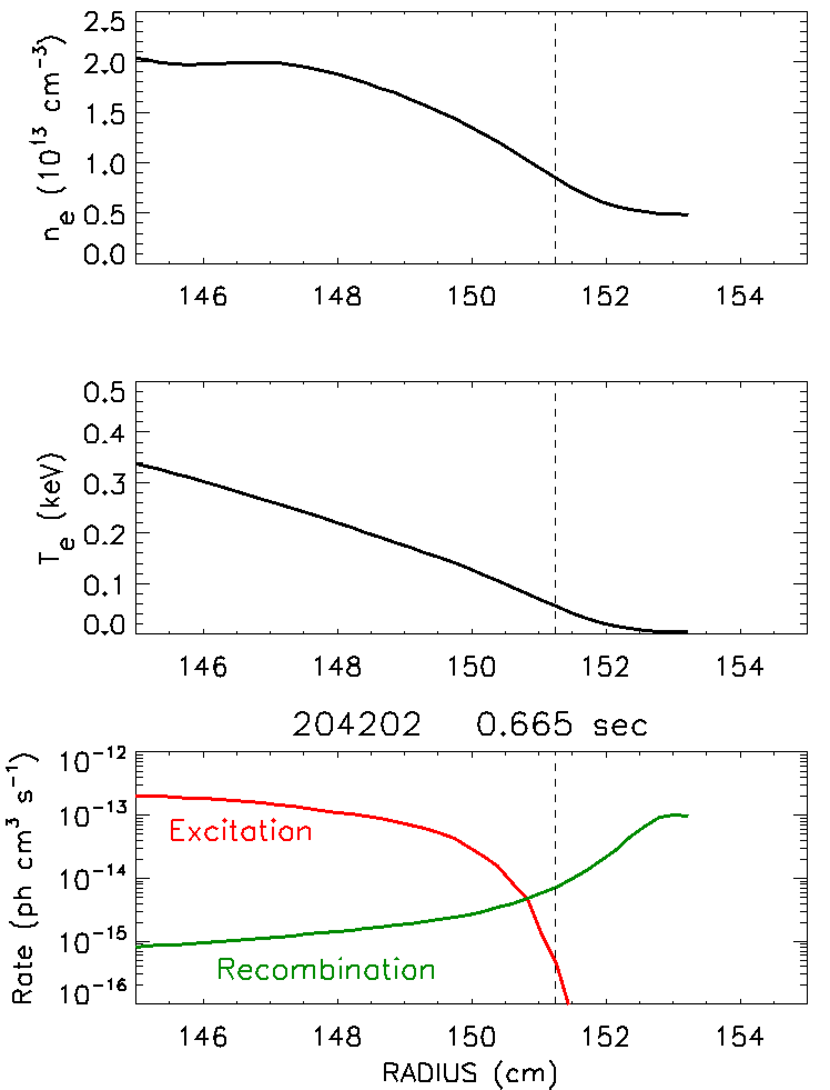
At lower temperature (plasma edge), electron impact excitation can be neglected for carbon
For T_{e} < 50 eV, the contributions to C⁵⁺ emission from electron impact excitation are negligible
Neglecting electron impact excitation:
Most of the emission is from thermal charge exchange (second term above is small)
This sets upper limit on thermal neutral density
Without electron impact excitation, knowledge of C⁵⁺ density is not needed to determine neutral density

Slide 11
Neutral density is determined from D_{α} emission
Excitation rate
UNKNOWN:
  n₀ Density of thermal deuterium neutrals
MEASURED:
  E Emissivity of passive emission from D_{α} (n = 3-2)
  n_{e} Electron density
COMPUTED:
  Q_{ex} Photoemission rate for electron impact excitation, [T_{e}, n_{e}]

Slide 12
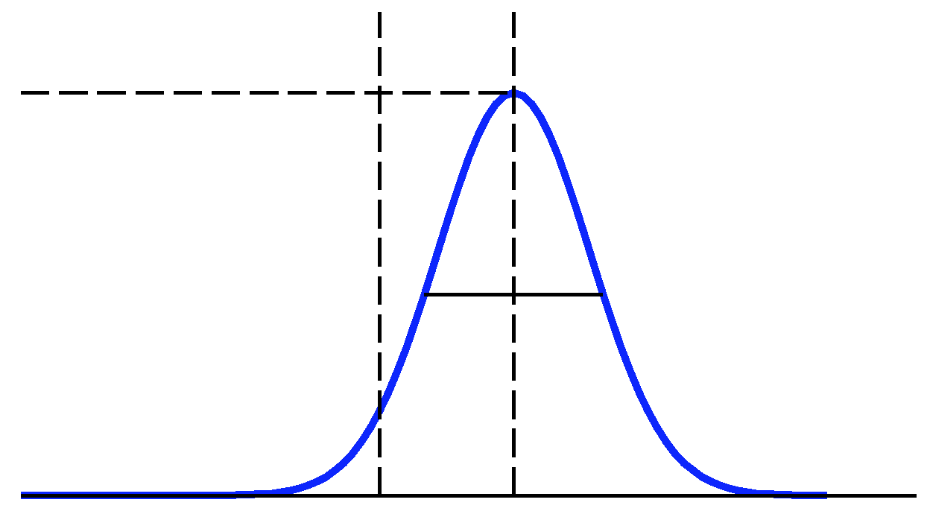
Local carbon values are extracted from line-integrated measurements with a matrix inversion approach
Line integrated measurements
Spectral Brightness, B^{λ}
Total Brightness,
Fitted Parameters
Amplitude, A
Line width, w
Line shift, (δλ)
A
w
λ₀
λ
Emissivity from Brightness
Subscript i refers to a particular sightline (line-integrated measurement)
Subscript j refers to a particular zone in the plasma (local value)
L_{ij} is a matrix of path lengths
Line-integrated brightness (ph/s/cm²/st) can be related
to local emissivity (ph/s/cm³) by length matrix
Local emissivity is obtained using inverted length matrix
(Form for a Gaussian line shape)

Slide 13
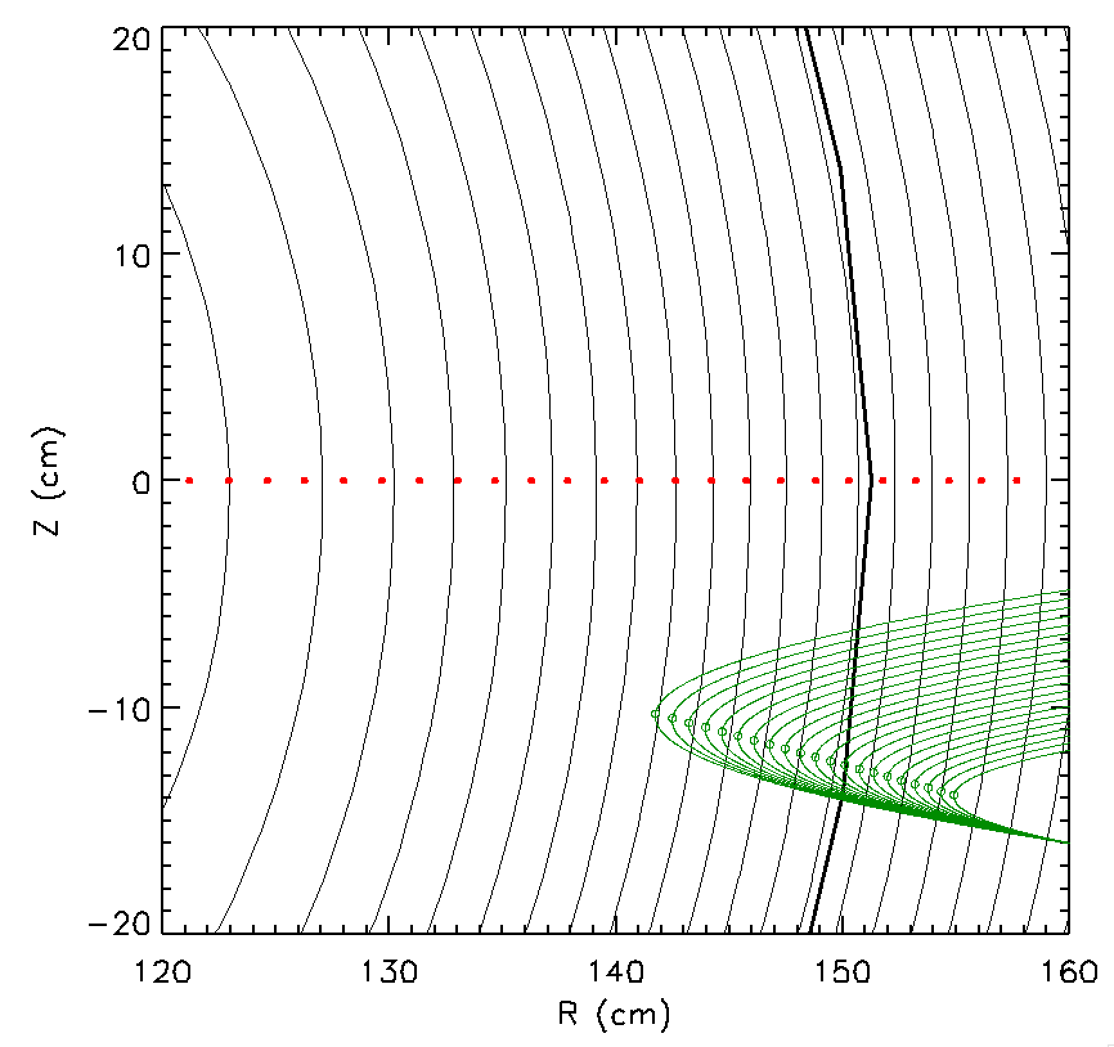
Local D_{α} emissivity from line-integrated measurements with a matrix inversion approach
Line-integrated measurements
  Camera with 127 x 128 pixels
  D_{α} filter
  Absolutely calibrated
Local tangency of sightline each pixel computed using EFIT equilibrium code
Tangency mapped to R at Z=0
Pixels binned to improve S/N
Emissivity from Brightness using matrix inversion with length matrix calculated for 3D geometry

Slide 14
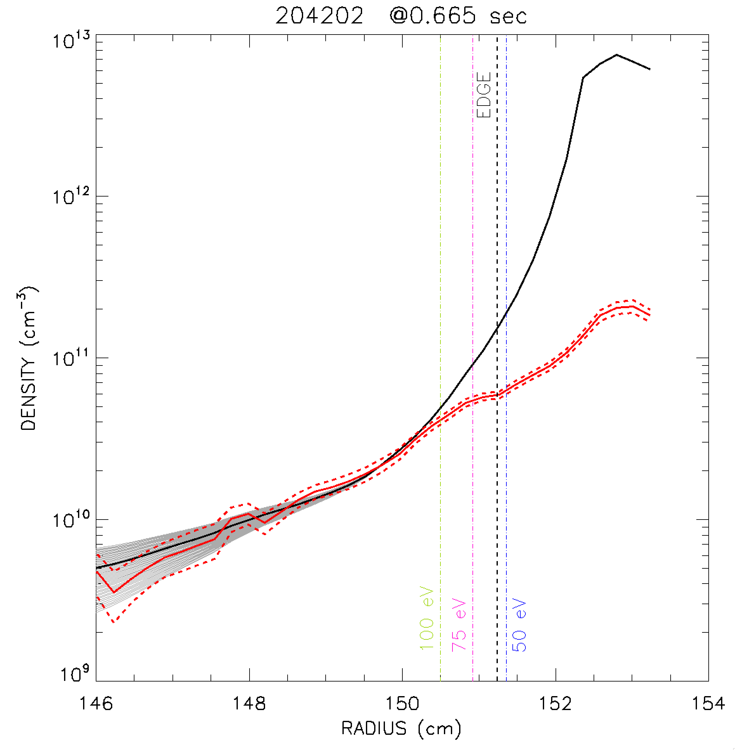
Neutral density profiles from C⁵⁺ and D_{α} are comparable inside plasma edge
L mode plasma edge
Similar neutral density profiles over 45 cm inside LCFS
Neutral densities strongly diverge outside LCFS
n₀ from C⁵⁺ exceeds n₀ from D_{α} by an order of magnitude just a few cm away from edge
n₀ C⁵⁺
n₀ D_{α}
Various curves reflect range of assumed C⁵⁺/C⁶⁺ density ratio
Electron impact excitation small outside this radius

Slide 15
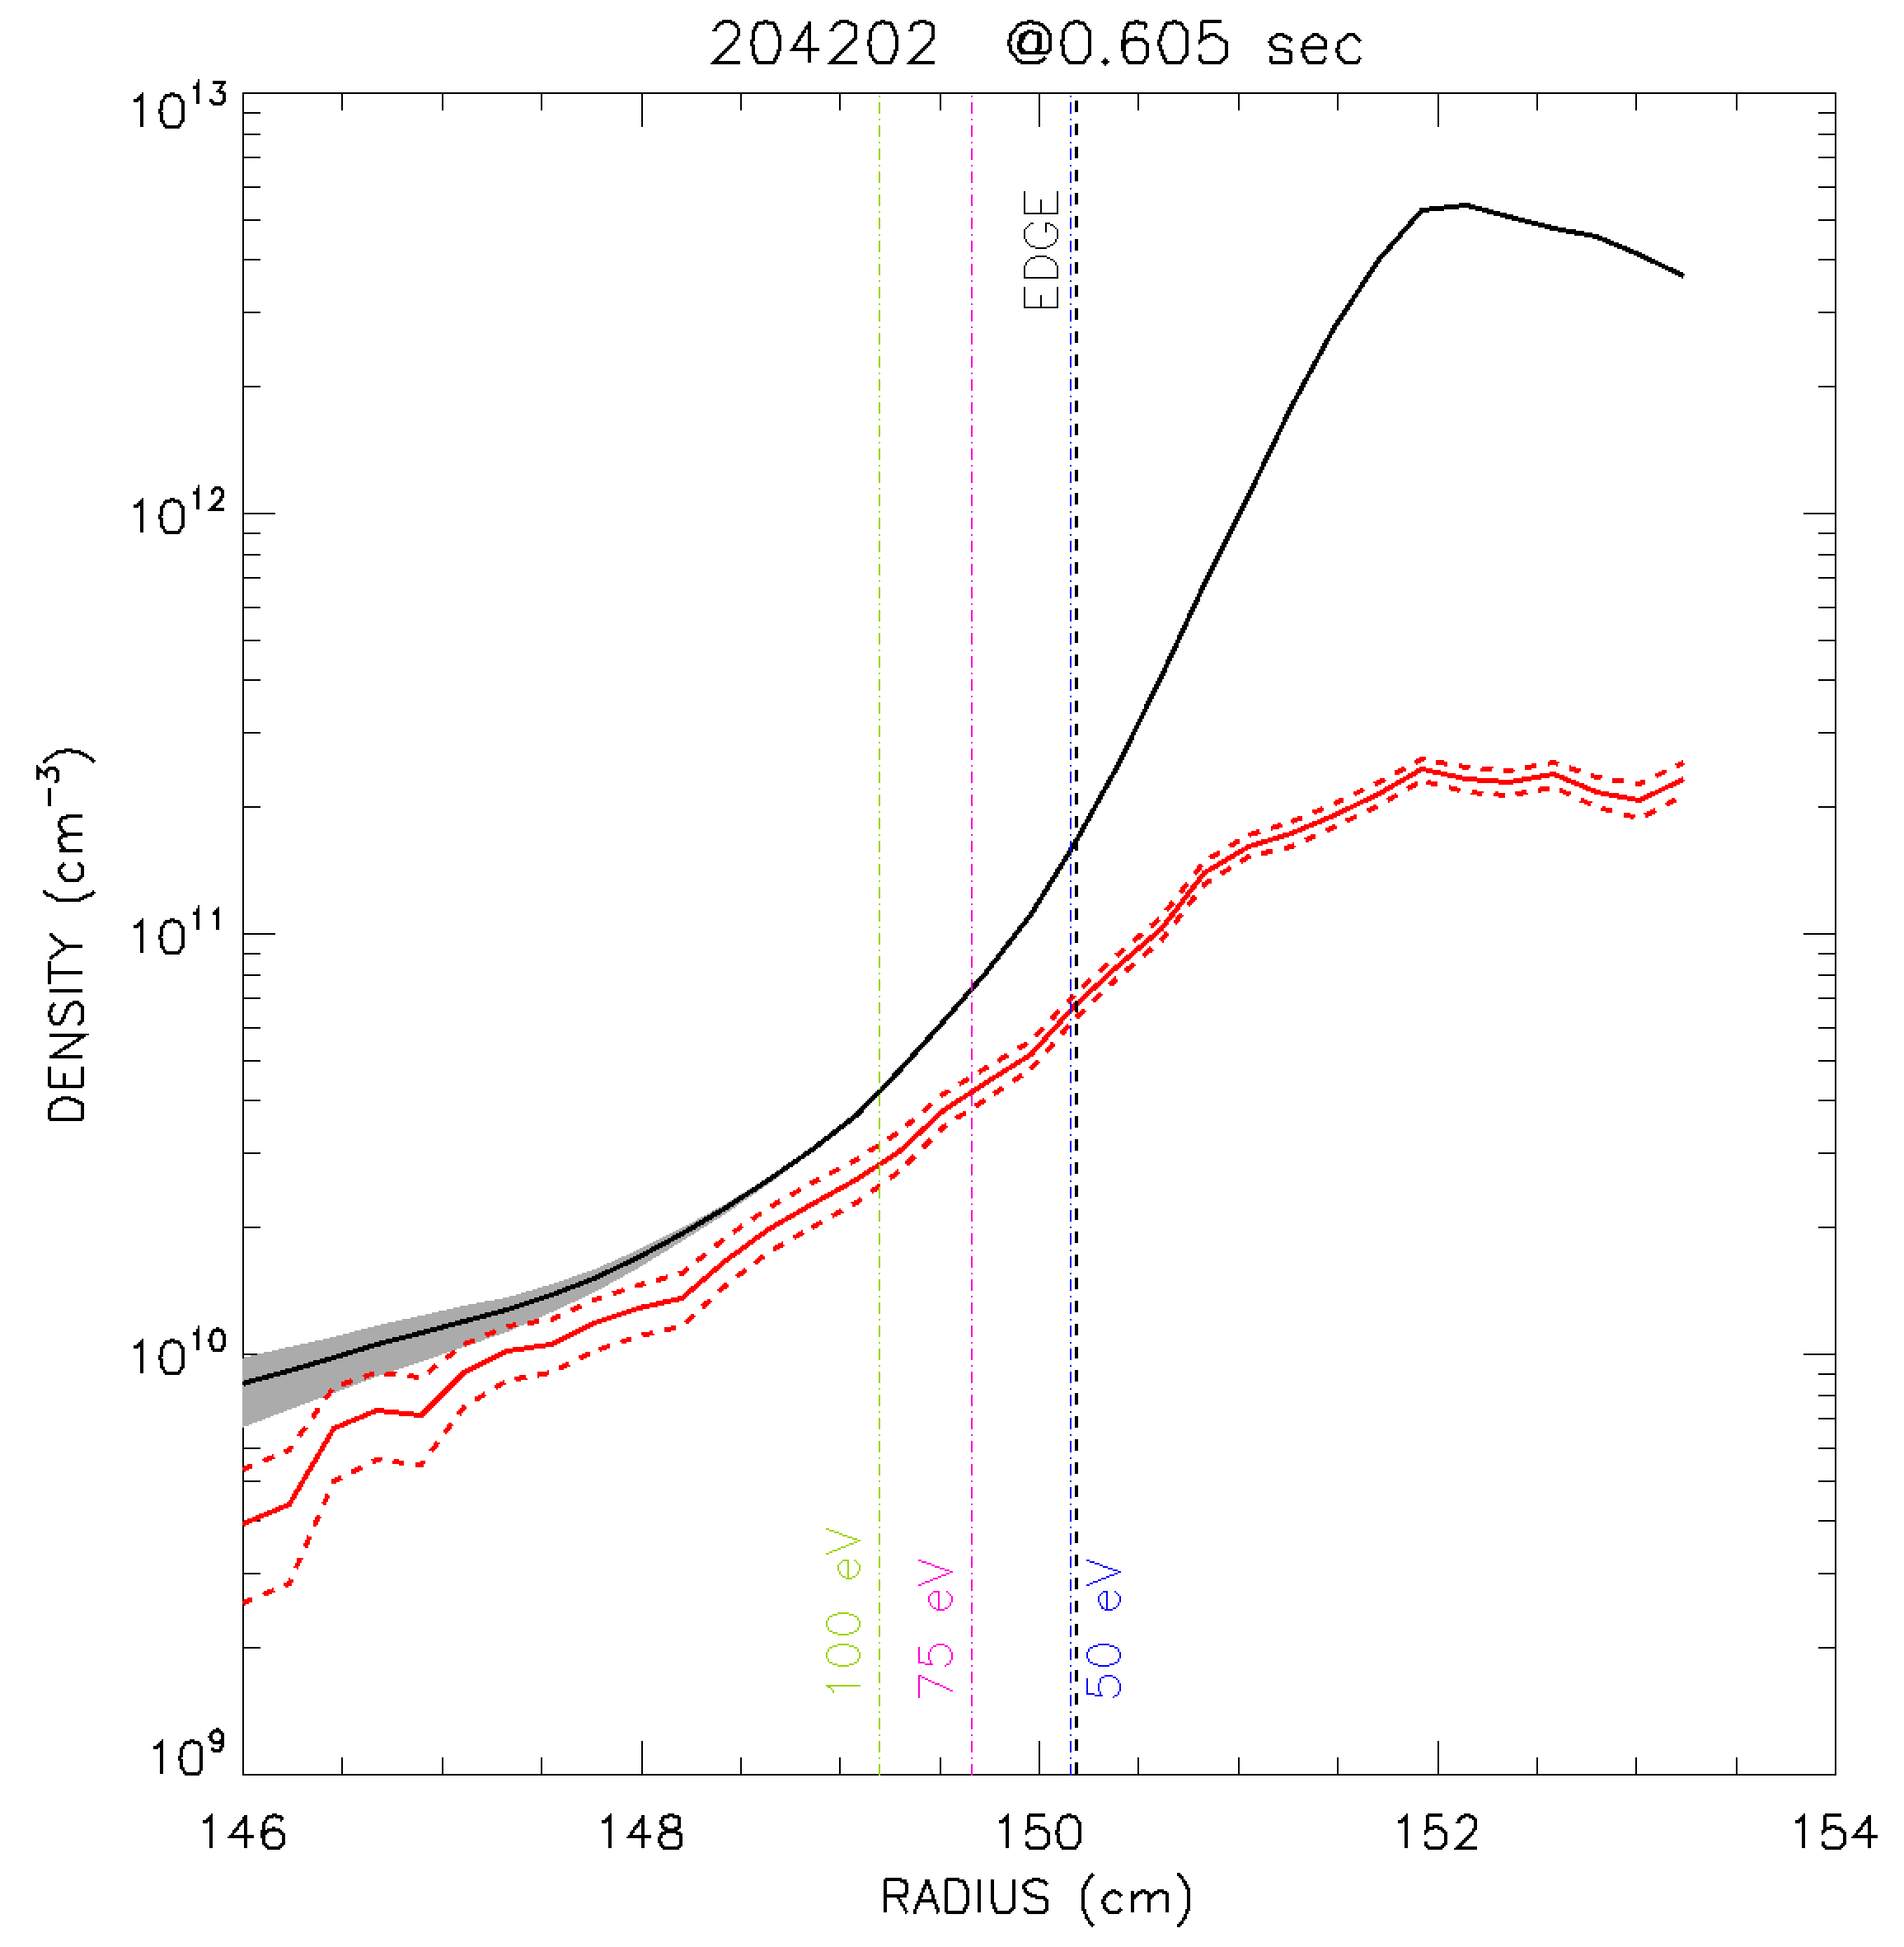
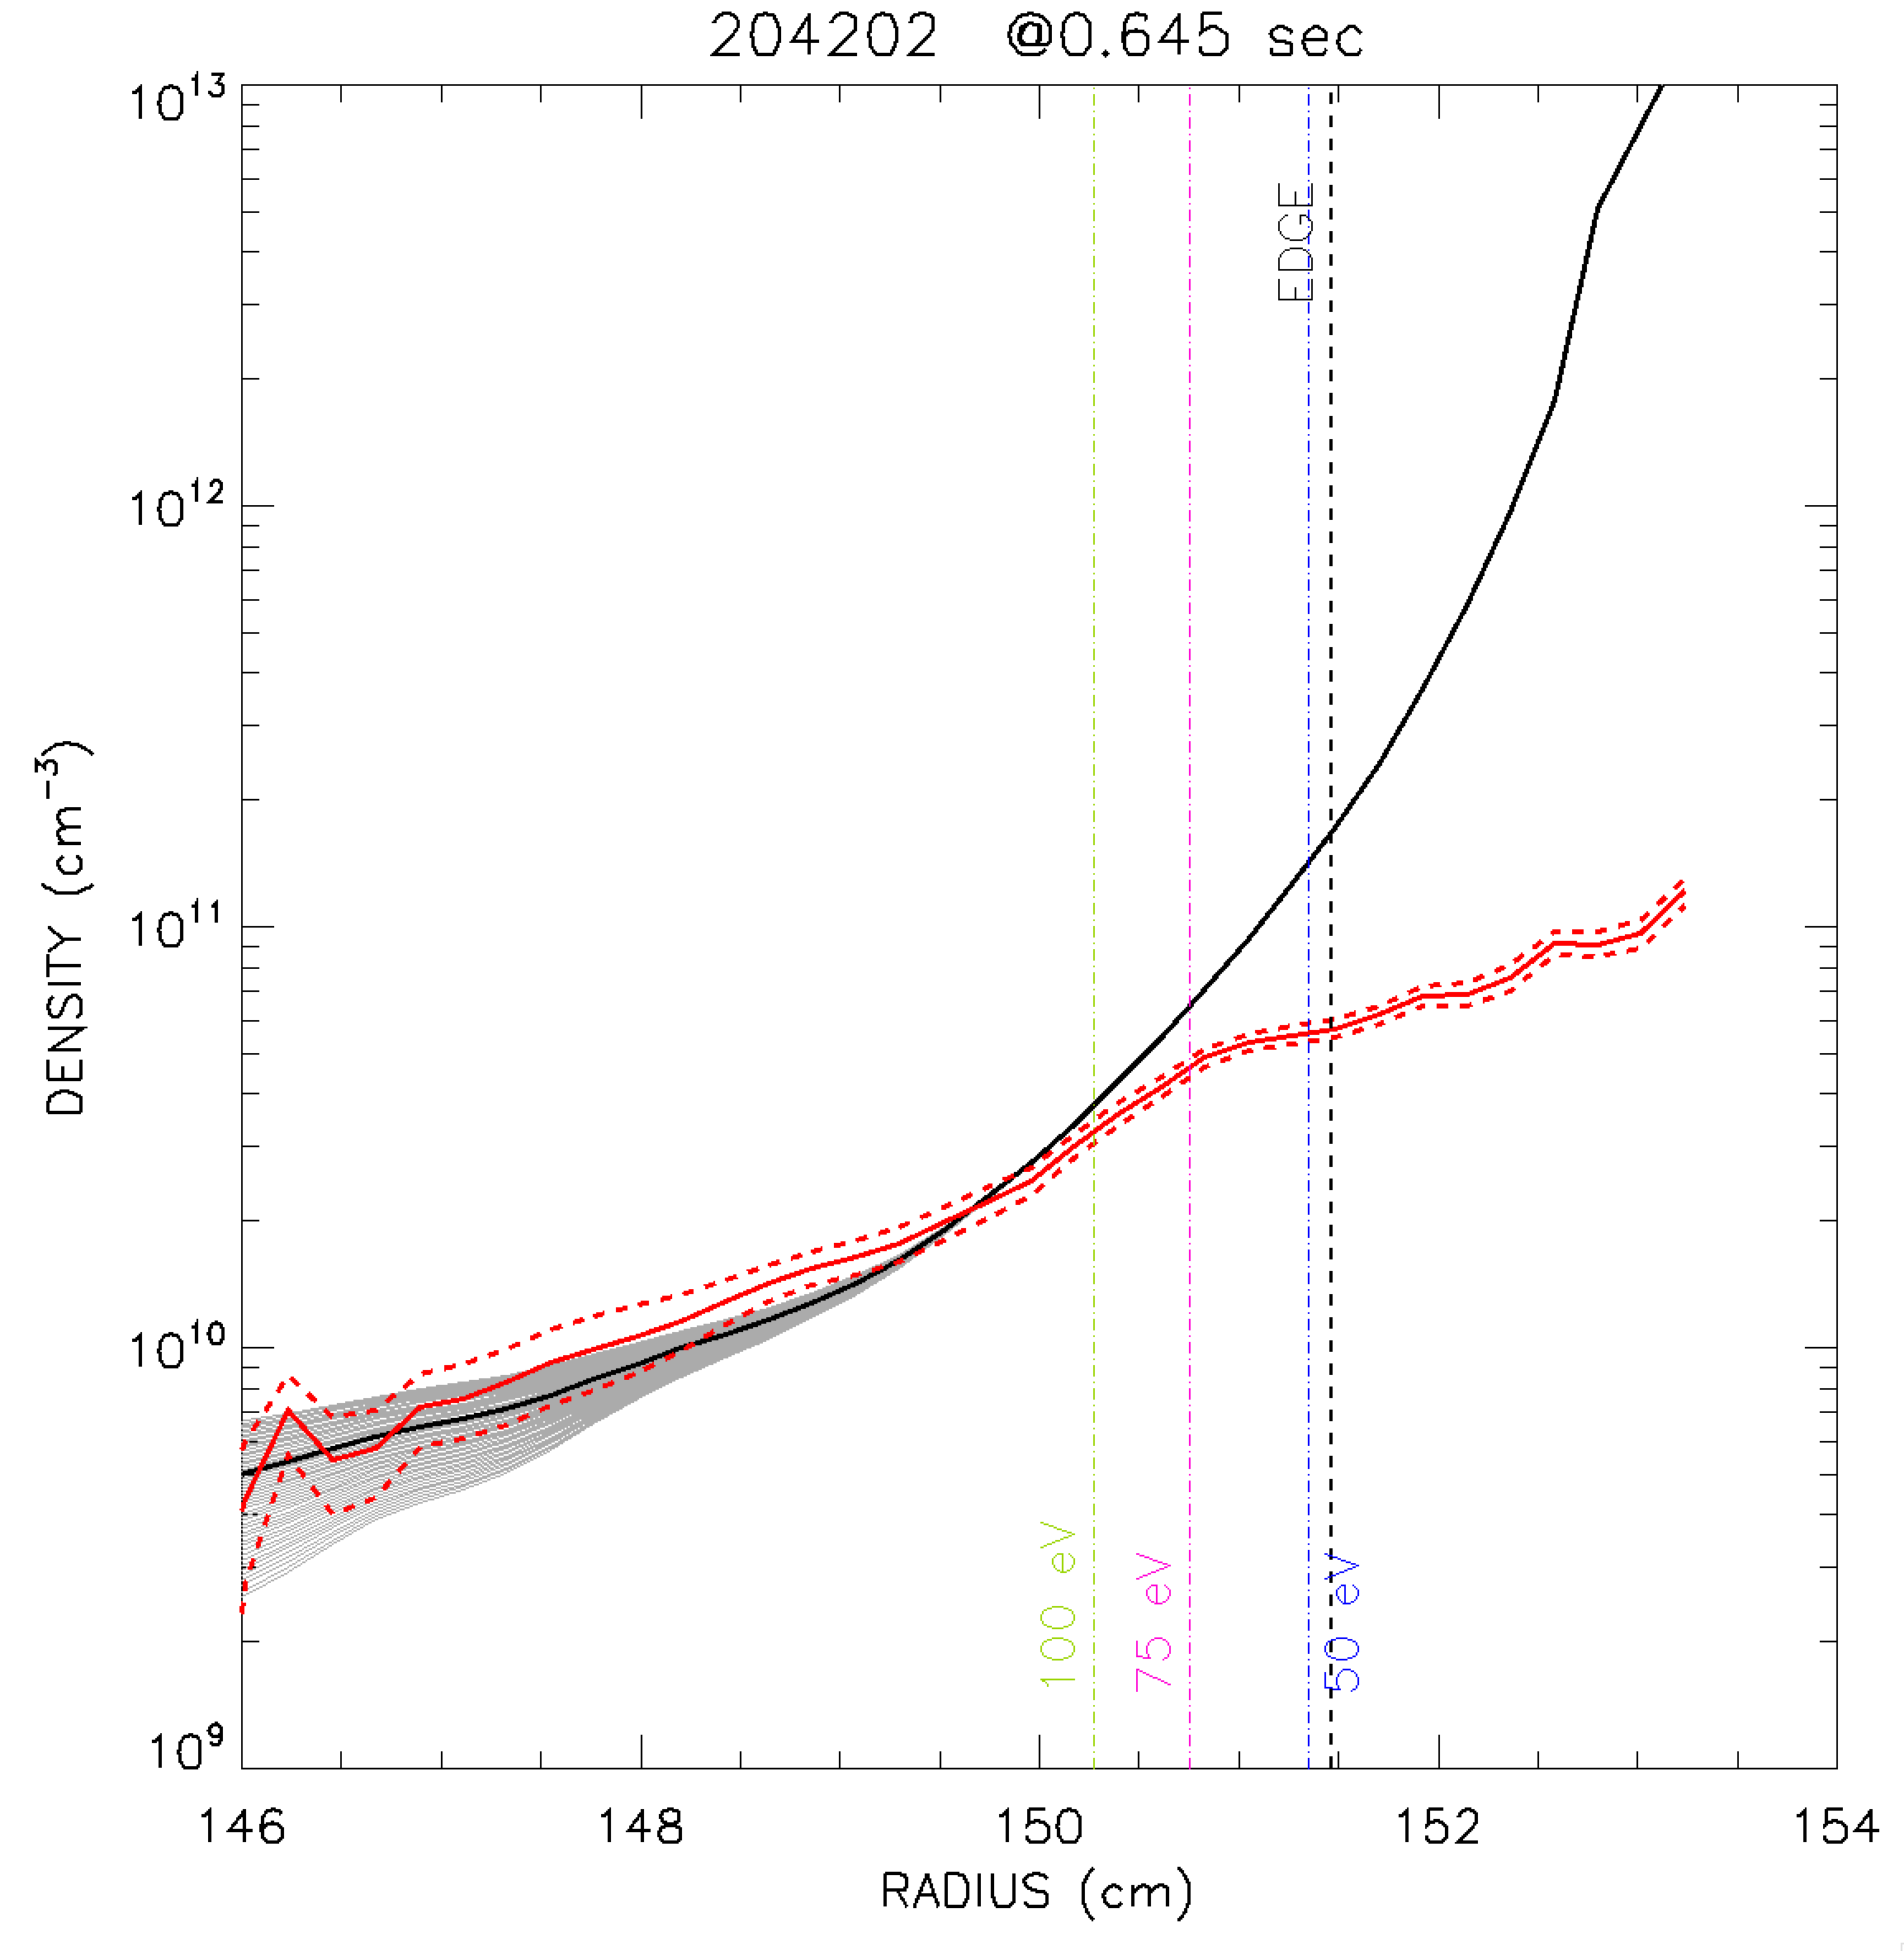
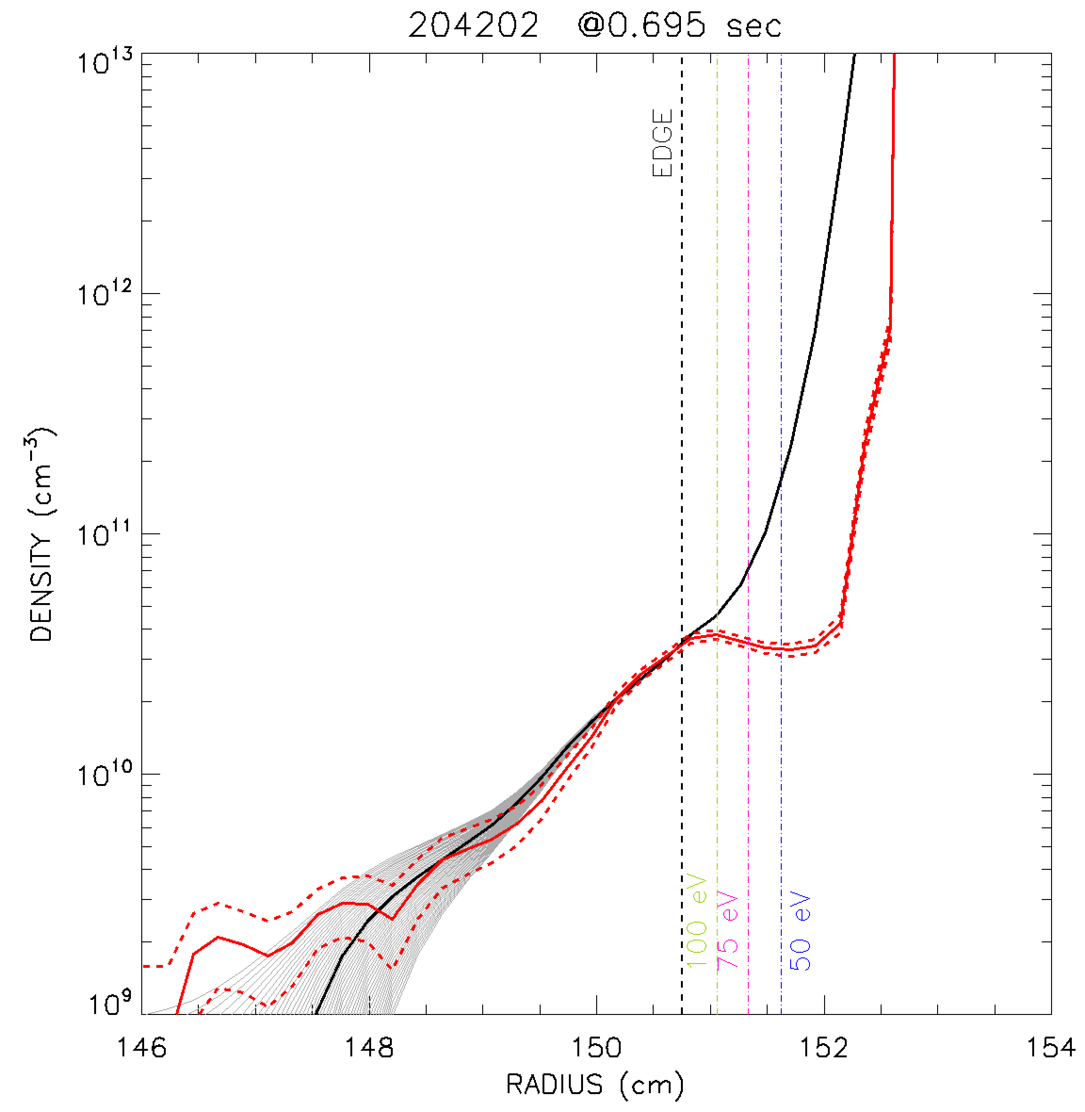
Some variation is observed in neutral density profiles inferred from C⁵⁺ and D_{α}
L mode
L mode
H mode

Slide 16
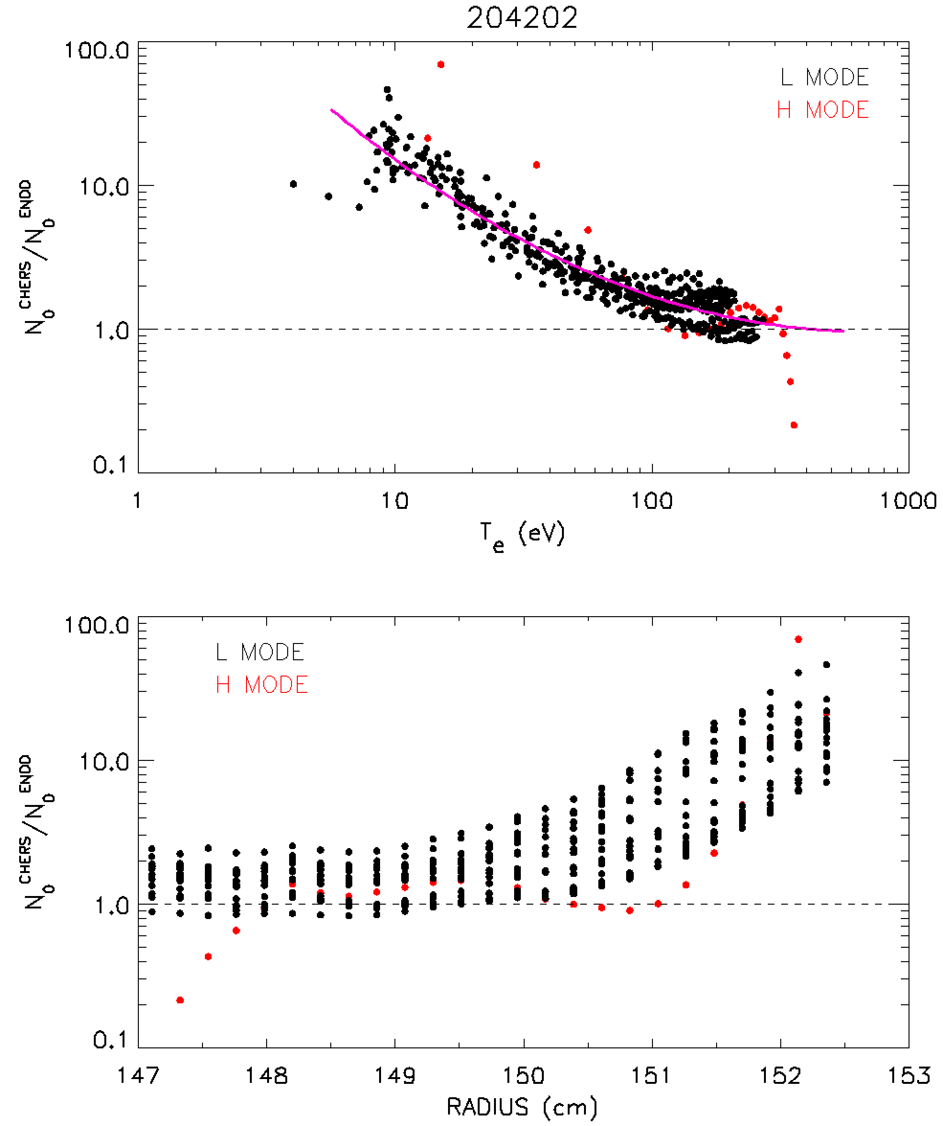
Better agreement between n₀ measurements at higher T_{e}
Ratio of neutral densities plotted for multiple time
Ratio trends toward 1 as T_{e} increases
At higher T_{e}, agreement within a factor of 2
At lower T_{e}, ratio of neutral densities ~10
Plotting data vs. R shows strong deviation outside LCFS

Slide 17
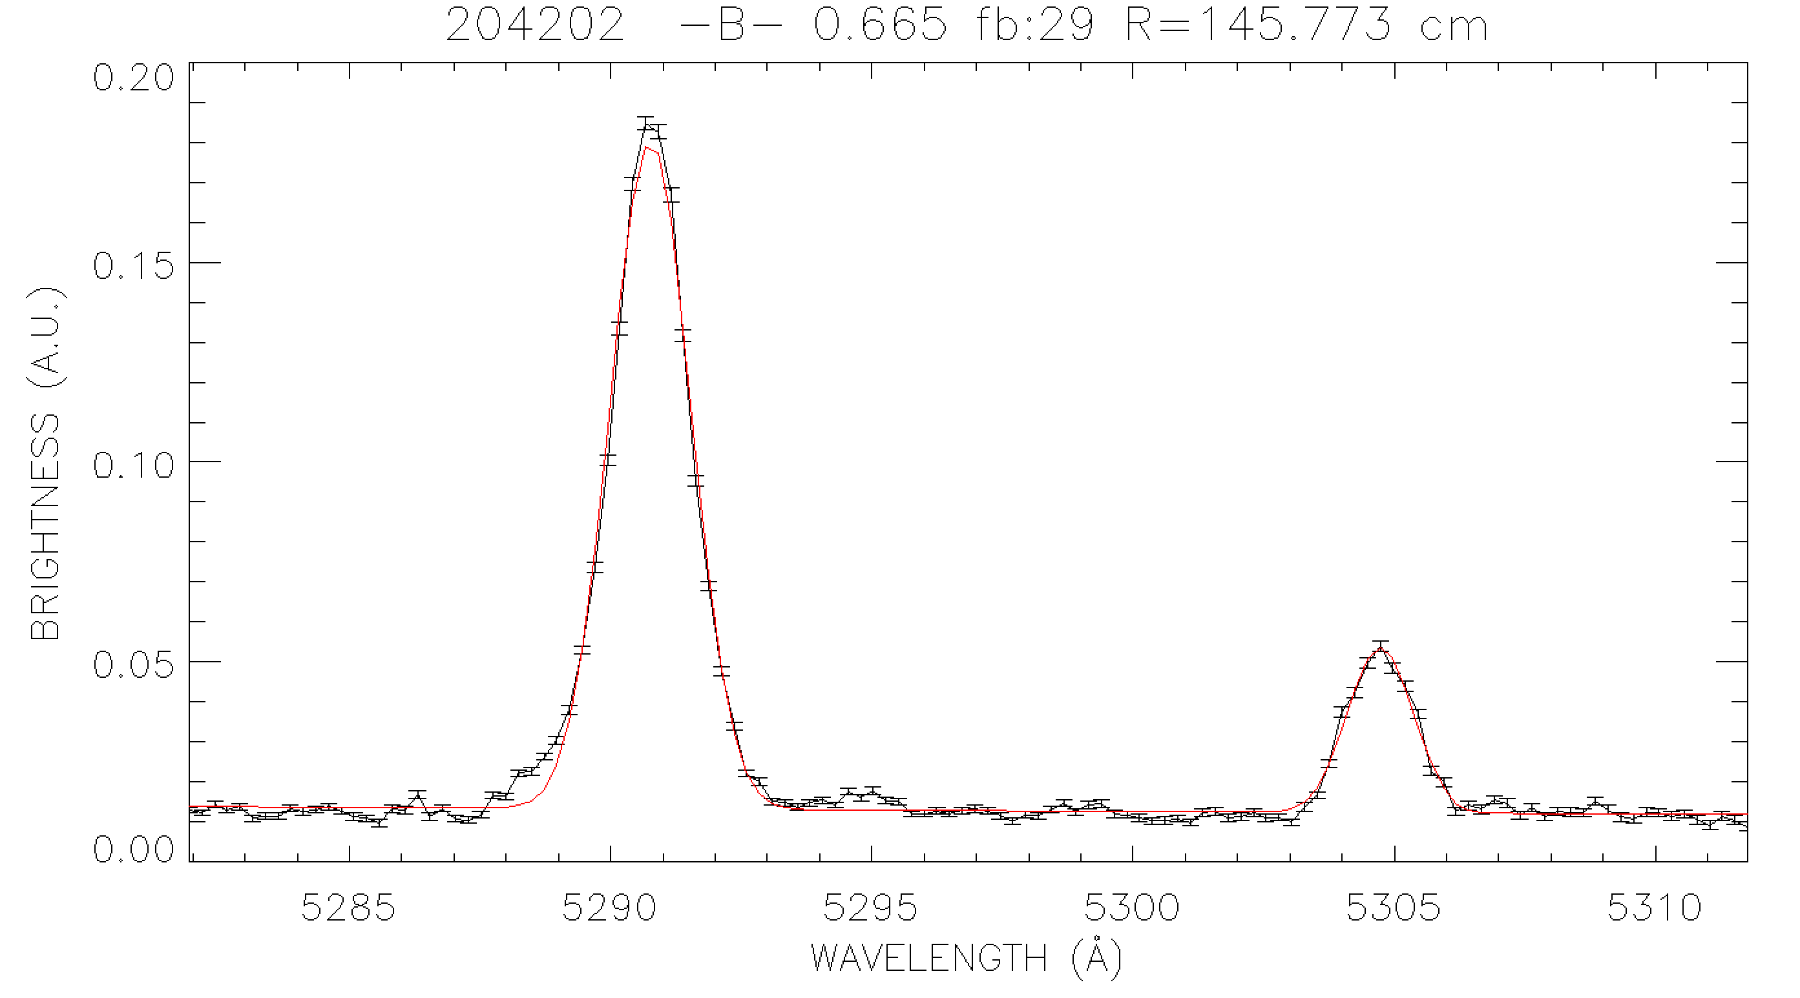
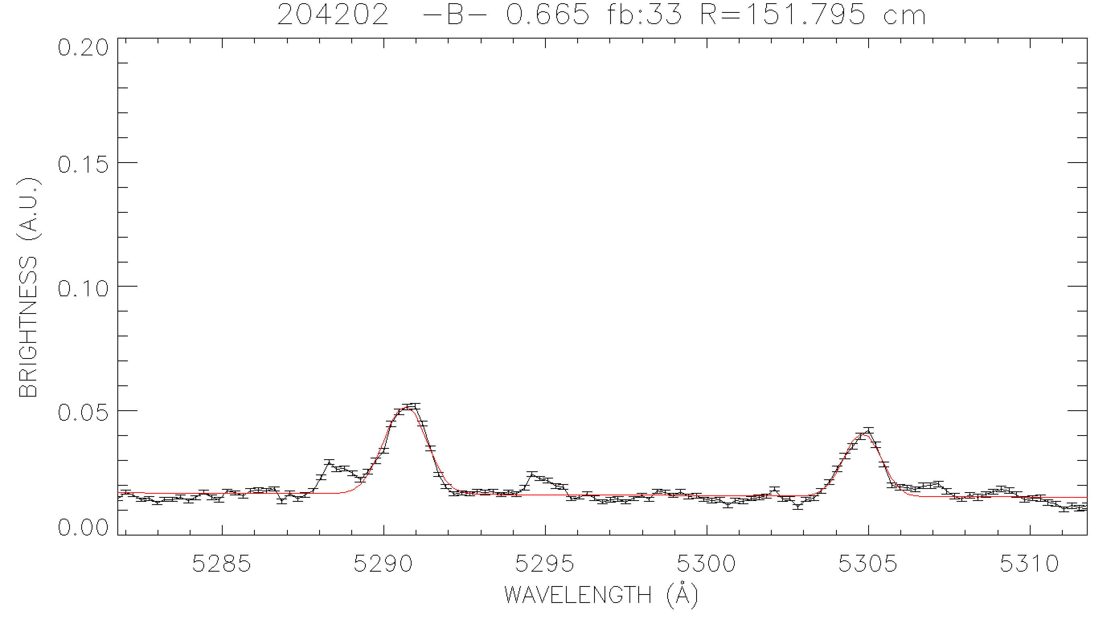
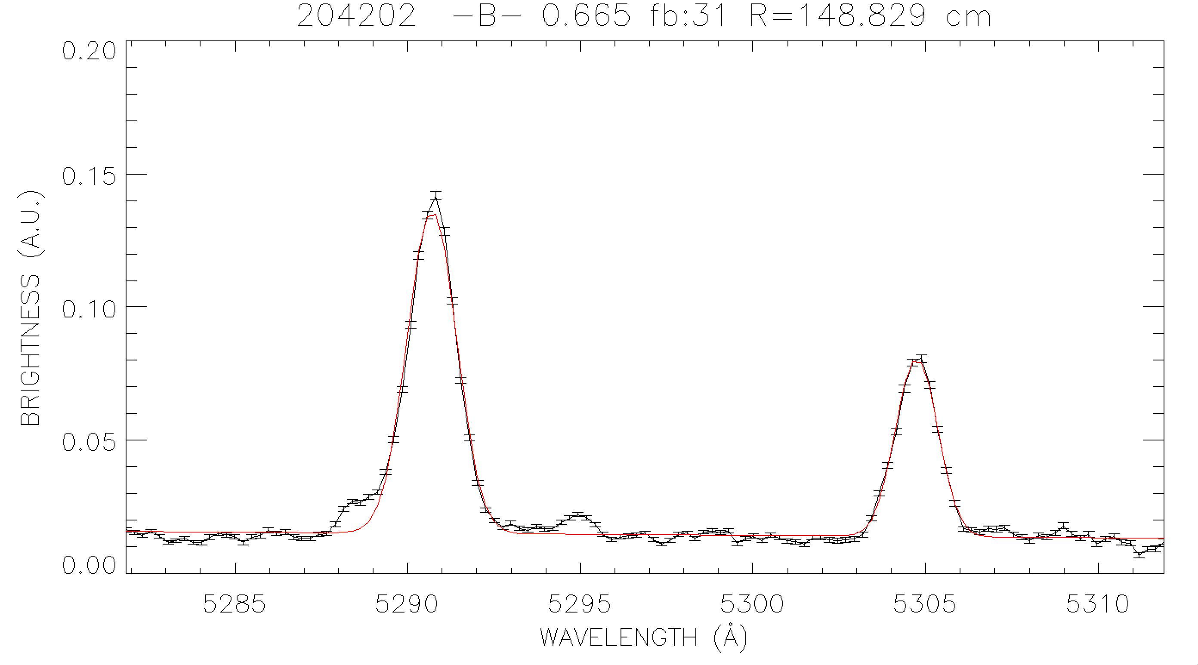
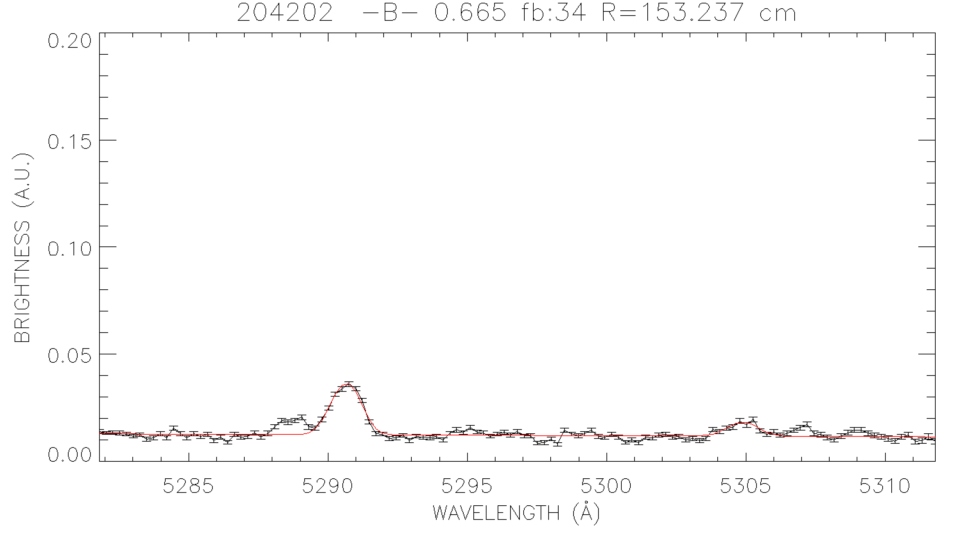
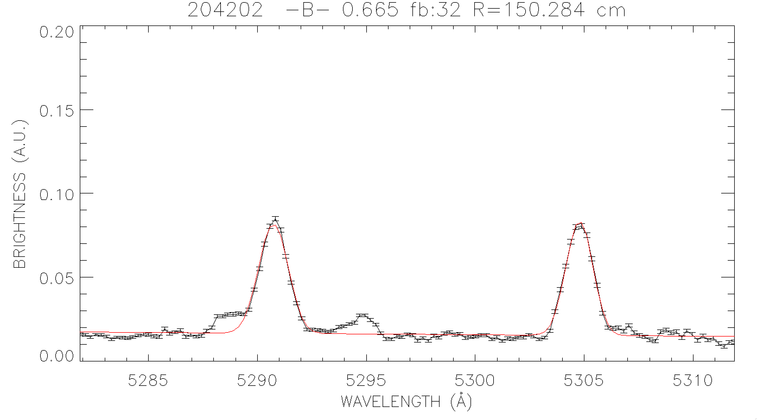
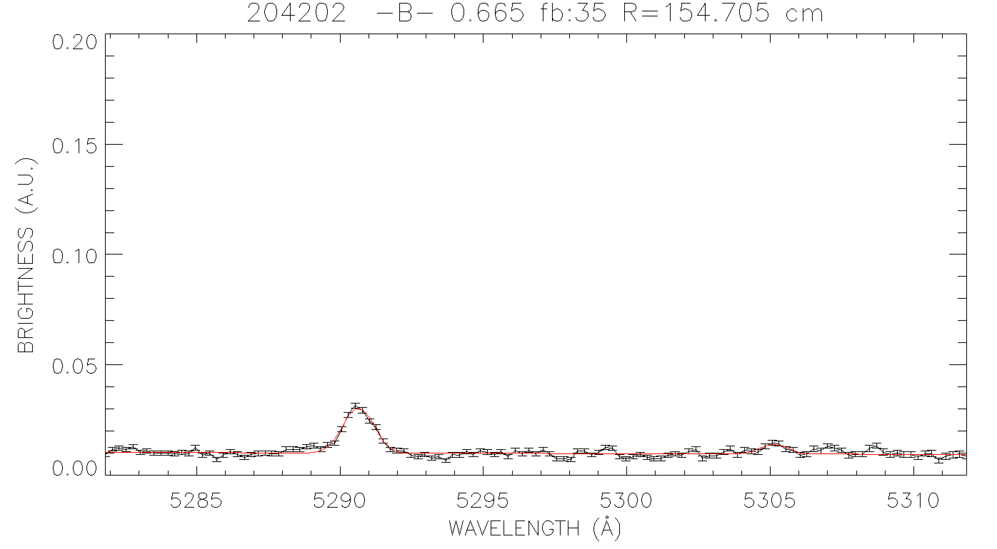
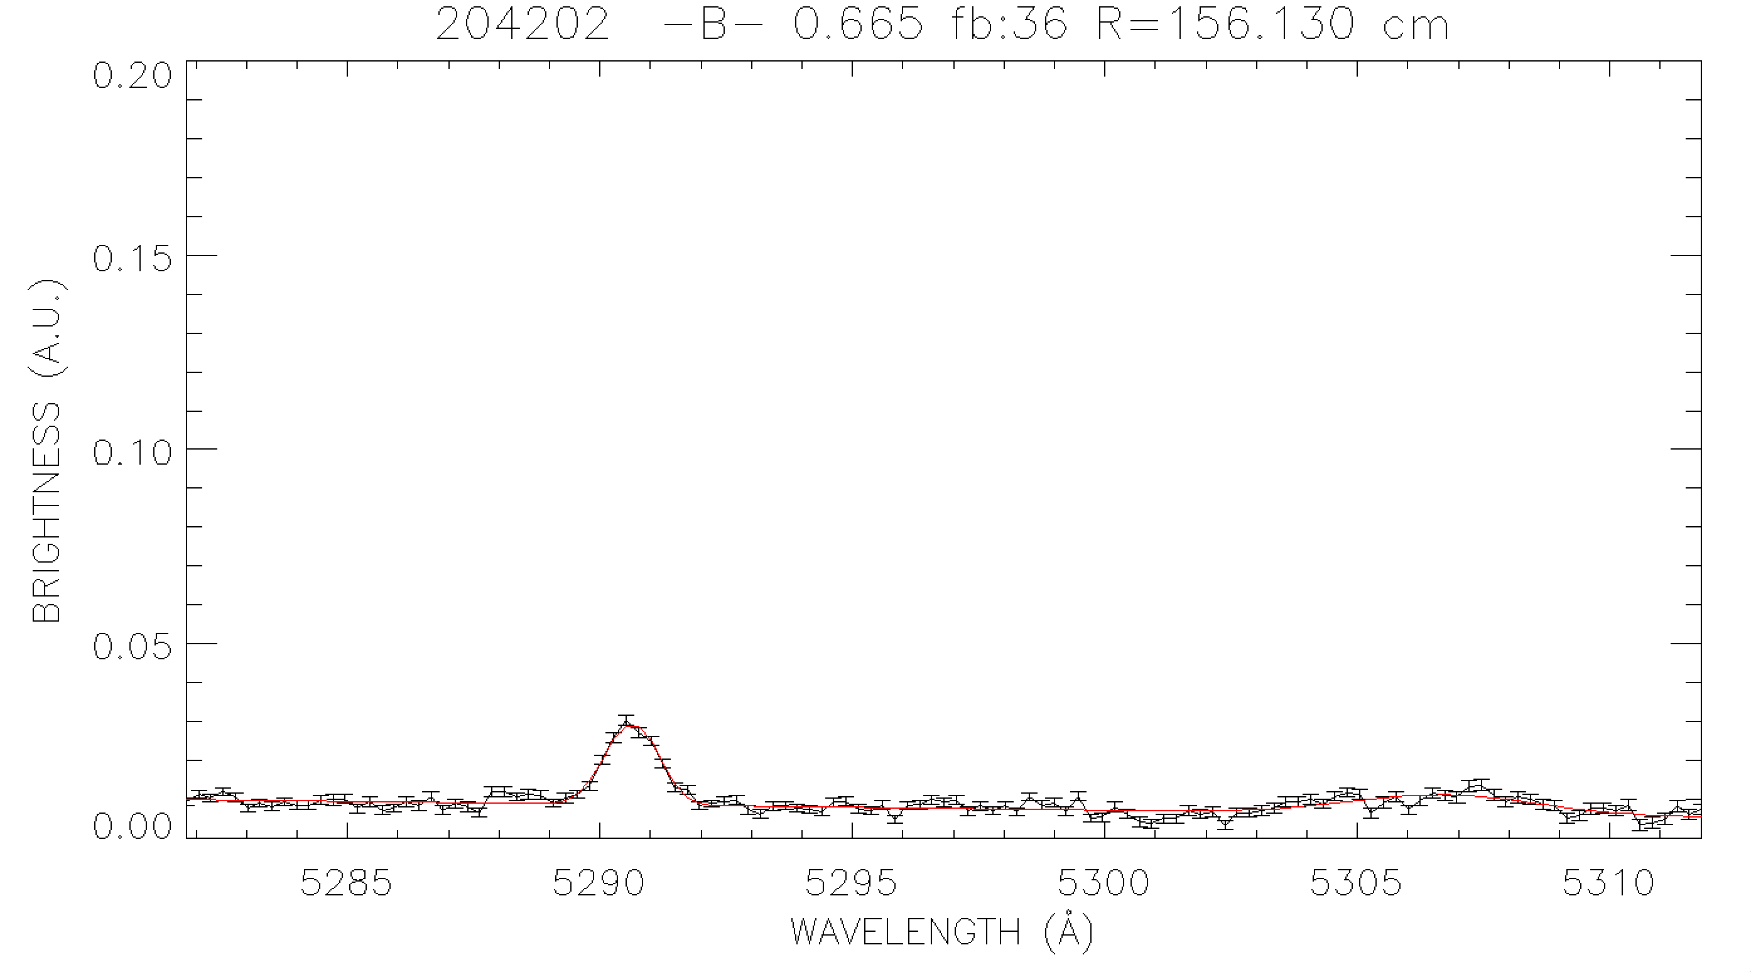
C⁵⁺ emission observed beyond the LCFS
R=145.8 cm
R=151.8 cm
C⁵⁺ emission in SOL is inconsistent with local T_{e}, N_{e}
C⁵⁺ emission is observed outside of C²⁺ emission shell
C²⁺
C⁵⁺
C²⁺
C⁵⁺
C⁵⁺
R=148.8 cm
R=153.2 cm
C²⁺
C⁵⁺
R=150.3 cm
R=154.7 cm
R=156.1 cm
C⁵⁺
C²⁺
C⁵⁺
C⁵⁺

Slide 18
Convective transport from “blobs” could explain “extra” C⁶⁺ beyond LCFS
C⁶⁺ lifetime ~ 10⁻⁹ sec
Distance into SOL ~ 5 cm
Blob velocity ~ 10⁵ cm/s
Edge T_{e} ~ 50 eV
Edge n_{e} ~ 10¹³ cm⁻³
Edge n₀ ~ 10¹¹ cm⁻³
Total recombination rate for Carbon Z=6
Q_{rec}(50 eV, 10¹³ cm⁻³) = 2.7 x 10⁻¹³ cm²/s
Total charge exchange rate for Carbon Z=6
Q_{cx}(50 eV, 10¹³ cm⁻³) = 6.9 x 10⁻⁸ cm²/s
Characteristic Times:

Slide 19
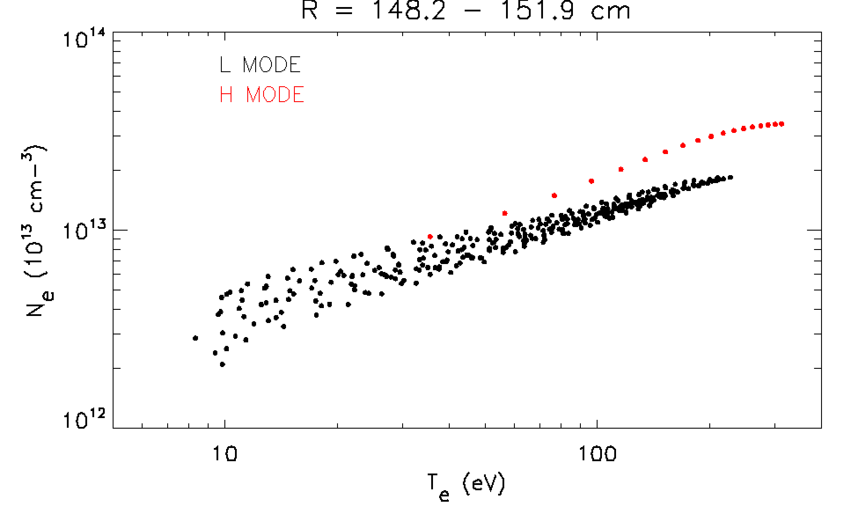
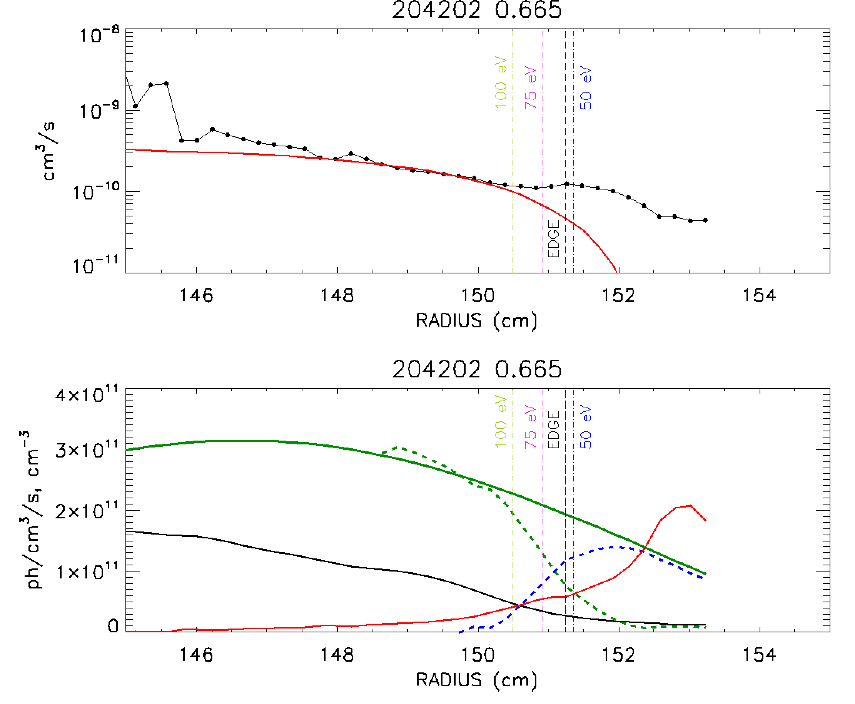
Neutral density from C⁵⁺ is overestimated outside LCFS due to “extra” C⁵⁺ emission
Measured C⁵⁺ emissivity exceeds that expected with local T_{e}, n_{e} measurements and D_{α} neutral density measurement
The required photoemission rate, Q_{CX}*=Q_{CX}(T_{e}*, n_{e}*) corresponds to different values of electron temperature and density
Subtracting the expected emission from the measured emission shows an excess signal, (E^{meas}-E^{calc})
E^{meas}
E^{meas}-E^{calc}
E^{calc}
n₀^{Dalpha}
n_{C6+}

Slide 20
Measured emissivity is a time average of steady emission and intermittent “blob” emission
Introduce a simple model to describe the measurements
Steady emission (E₀) is consistent with local measured T_{e}, n_{e}
Intermittent “blob” (E₁) emission would correspond to different values (T_{e}*, n_{e}*)
The “duty cycle” of the blobs is given as f
A. Inner radii
E^{meas}, E₀
Δt₁
Δt₂
B. Intermediate
radii
E_{b}
E^{meas}
E₀
If the neutral density remains relatively constant, then in the SOL,
C. SOL
Emissivity
E^{meas}
] E₁
E₀=0
time

Slide 21
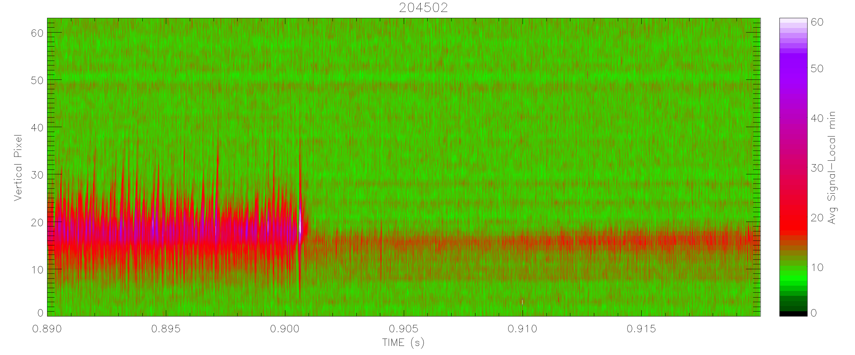
Intermittent signal from fast
Gas Puff Imaging (GPI) system
Signal from GPI across L-H transition
Estimated “duty cycle” of blobs ~ 8% during L-mode
ENDD and CHERS signals will be time-averaged over many milliseconds
L-mode
H-mode
Increasing R

Slide 22
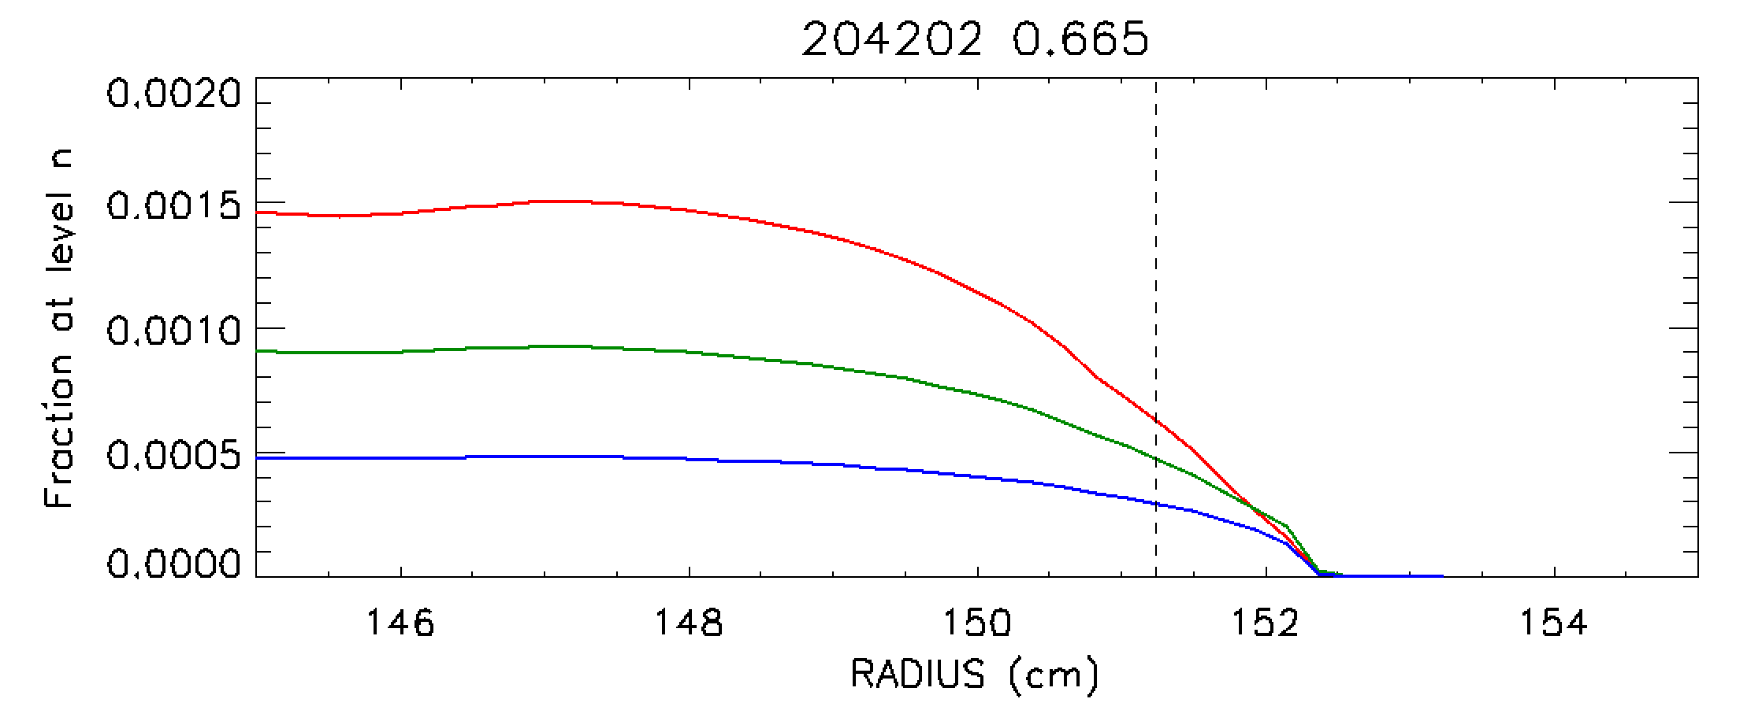
Other Comments
Reflections (ruled on for NSTX-U views) might cause unexplained emission in edge
n₀ from D_{α} is an upper limit due to contributions to emission from molecular D₂
The effective thermal-thermal charge exchange rate for carbon does not take into account contributions from n=3 and n=4 levels
n=2
n=3
n=4

Slide 23
Summary
Neutral density measurements made with C⁵⁺ emission and D_{α} emission
Neutral density profiles agree within a factor of 2 inside the LCFS for L-mode plasmas
Neutral density profiles outside the LCFS deviate up to an order of magnitude
C⁵⁺ emission is observed in SOL
Estimate of necessary photoemission rate outside LCFS suggests higher T_{e}, N_{e} values than local measurements
Convective transport (blobs) of C⁶⁺ could explain 'extra' C⁵⁺ emission in SOL

