Slide 1

Upgrade to the MPTS Thomson scattering diagnostic in preparation for NSTX-U restart∗
B.P. LeBlanc and A. Diallo
59th Annual Meeting of the APS Division of Plasma Physics
Milwaukee, Wisconsin
October 23 - 27, 2017
∗ This work is supported by US DoE Contract DE-AC02-09CH11466 and ECRP funding

Slide 2
Abstract
Upgrades to Multi-Pulse Thomson Scattering (MPTS) diagnostic are in progress. An innovative laser is being added to existing the two 30-Hz Nd:YAG lasers. The new laser also has30-Hz base operation, but diers notably in its capacity of generating rapid bursts of nominally 50 pulses at either 1 KHz or 10 KHz. This Pulsed-Bursting Laser System (PBLS) is described elsewhere [1]. The current laser delivery optics, which supports two paraxial beam paths, is maintained. One beam path will be occupied by PBLS. The other two laser beams will be actively combined coaxially and will occupy the second beam path. The new laser arrangement will result in a 90-Hzbaseline operation, plus the PBLS burst capability. While the existing sample-and-hold electronics is expected to track a 1-KHz sequence, it will not be able to follow a 10-KHz burst. For this purpose, ten radial channels, dedicated to the pedestal region, will be instrumented with 250-MHz digitizers. The NSTX-U longer plasma duration and increased heating power will be conducive to situations with sustained high background light, a condition exacerbated by the absence of viewing dump necessitated by machine geometry. Additional work is slated to study the behavior of the fast signal detection in presence of strong background light. [1] A. Diallo et al., HTPD 2016, Madison, WI
This work is supported by US DoE Contract DE-AC02-09CH11466 and
ECRP funding.

Slide 3
MPTS Upgrades for NSTX-U Restart
Laser system
  Three laser beams on two para-axial beam paths
    Two Spectra-Physics (SP) laser beams combined actively onto path “A”
    Pulse Bursting Laser System (PBLS) beam on path “B”
Detection electronics
  New fast digitizer for 20 of the 42 radial channels
    VME Struck S3316, 250-MHz, 14-bit, 16 inputs per module
      4 modules for the pedestal region; 10 radial locations
      4 modules for real-time plasma control; 10 radial locations
Calibration probe
  Viewing window spectral transmission monitoring
  Improve arrangement for faster measurement

Slide 4
Previous Laser Configuration
Two para-axial paths with two laser beams
The two laser beams follow almost identical paths, but crisscross at a very shallow angle about 1 meter before the focal point. (See Fig. 1) The laser beams enter the NSTX test cell (NTC) through a penetration in the east wall. The laser beams travel along the south wall at machine midplane elevation. Optical elements inside an enclosure focus and redirect the laser beams toward the vacuum vessel (VV). The laser beams enter the plasma chamber and are focused near the outside wall, R≈156 cm. The beams leave the plasma chamber and are directed through an exit flight path constituted of three mirrors and evacuated tube sections. At the end of this path the beams re-enter the air side through a vacuum window. A laser enclosure (BD) containing the beam dump and imaging equipment.

Slide 5
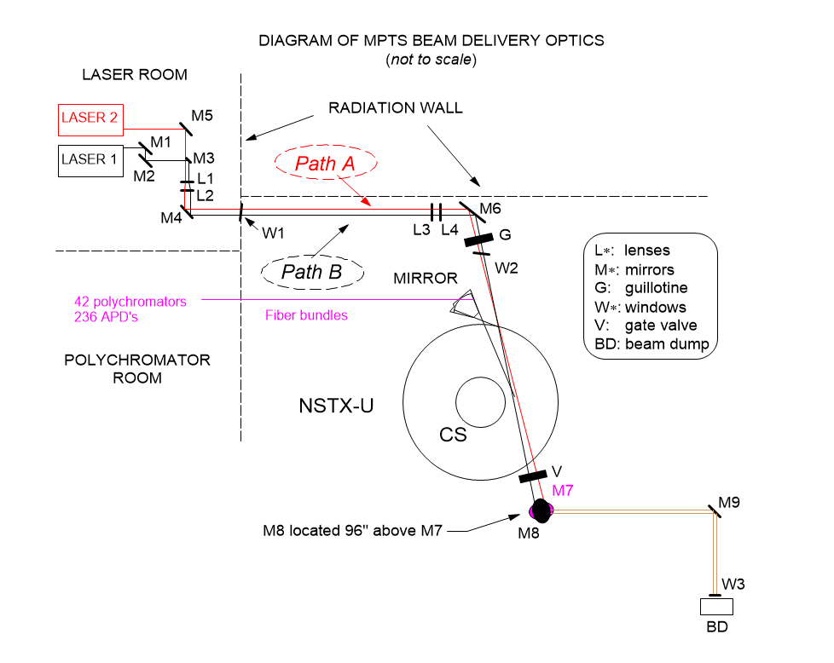
Previous Configuration
Two laser beams on two para-axial paths
Laser-1 beam on path A Laser-2 beam on path B
Fig. 1: Previous laser configuration

Slide 6
Configuration for NSTX-U Restart
Three laser beams on two para-axial paths
The laser-beam delivery optics retain the original two beam paths. In the past each SP laser beam followed one of these para-axial paths. The laser configuration has been changed such that PBLS will use one of the para-axial paths. The two SP lasers will use the other para-axial path after being made coaxial – and with same vertical polarization – by using an “active” combination technique. (See Fig. 2)
A thin-film polarizer (TFP) combines the two SP beams coaxially: one beam is transmitted through the TFP, while the other beam is reflected off it (the TFP). A Pockels cell (PC) actively rectifies the polarization of the transmitted beam. The PC is the active component and needs triggering coincident with the transmitted beam. (See Fig.3)

Slide 7
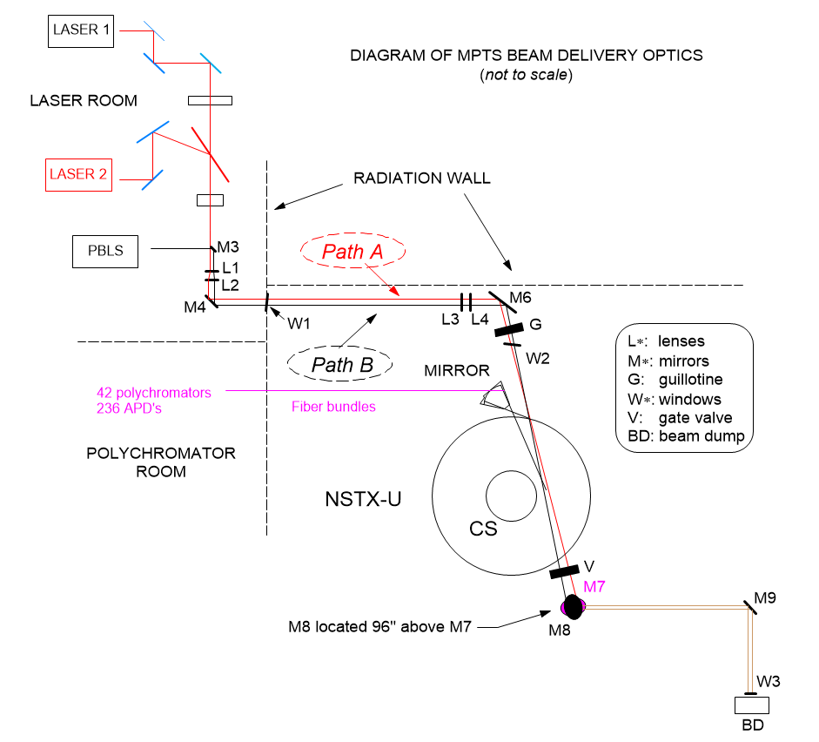
Configuration for NSTX-U Restart
Two para-axial paths with three laser beams
Laser-1 and -2 beams on path A, PBLS beam on path B
Fig. 2: Configuration for NSTX-U restart

Slide 8
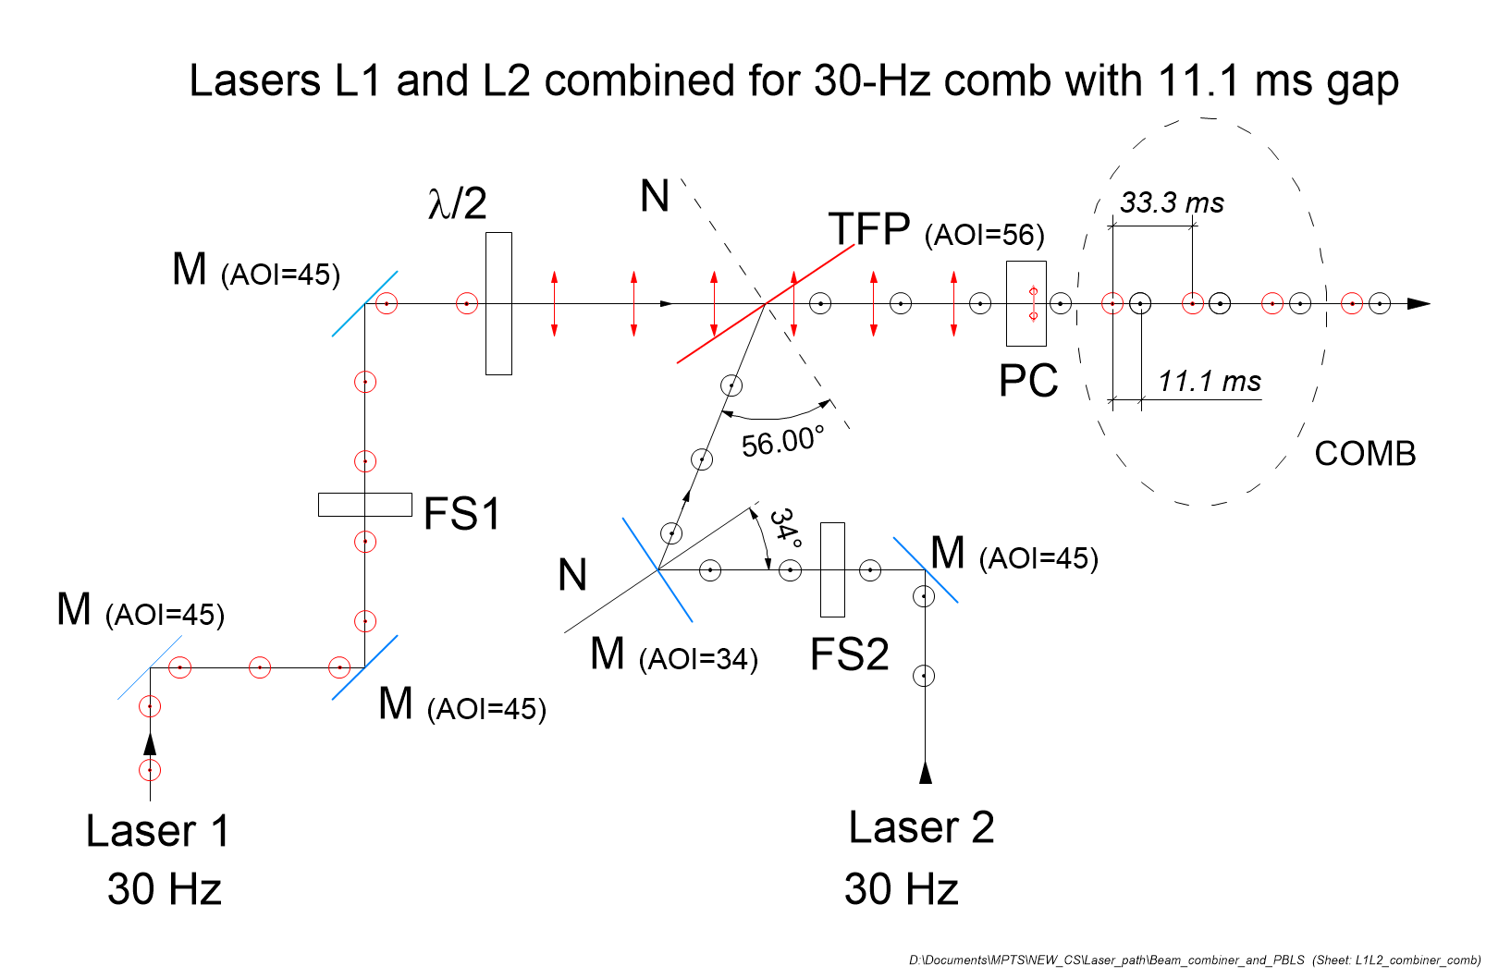
Beam Combiner
Overlay Lasers 1 and 2 on one para-axial beam path
Pockels cell rectifies
polarization of Laser 1
Fig. 3: Beam combiner
Fig. 3: Beam combiner

Slide 9
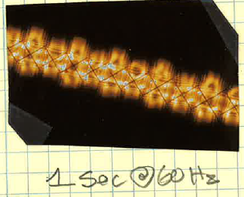
Two Laser Beams Combined with TFP
For this strip burn, the film was moved laterally up in front of a cross-hair located at about two meters away from the thin film polarizer (TFP). The TFP was used to combine the beams of our two PRO-290-30 30-Hz Spectra-physics lasers. The lasers are interwoven in time to produce a 60-Hz stream. The strip shows a succession of burns from laser 1 and laser 2. The shadow of the cross-hair shows that the two laser beams were combined on the same optical axis.
The burn strip was obtained without Laser-1 polarization rectification – no Pockels cell in the path.
Laser 1
Laser 2

Slide 10
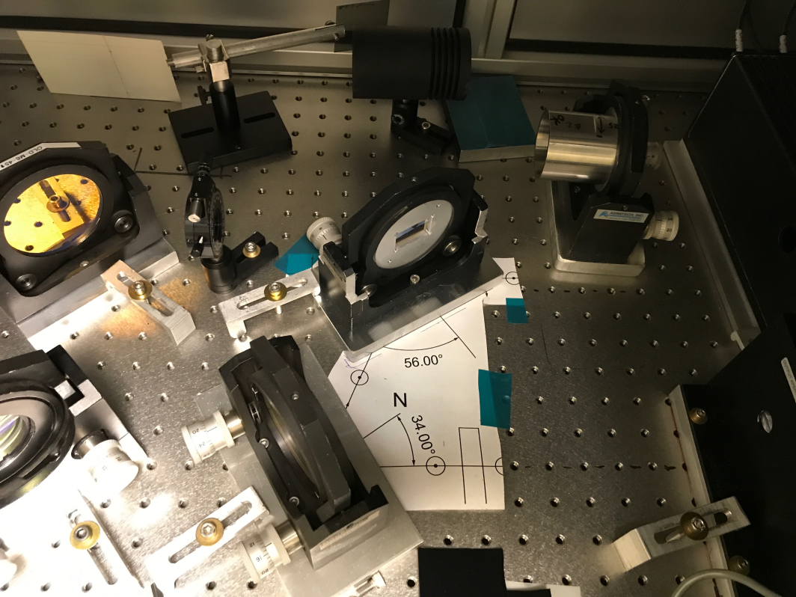
Beam Combiner Arrangement
TFP to combine beams, PC to rectify polarization

Slide 11
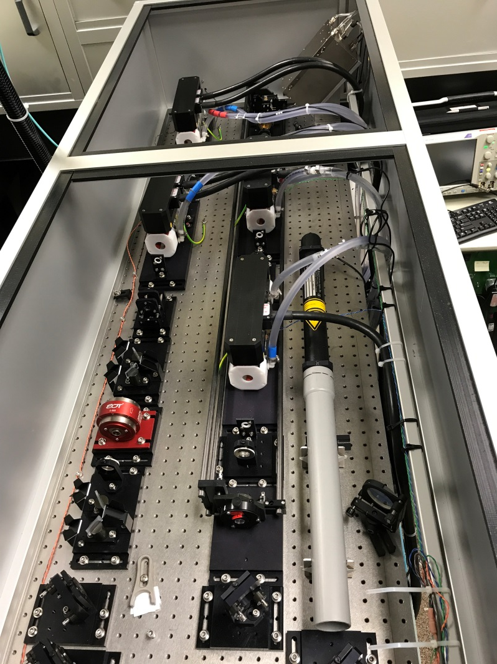
Pulsed Bursting Laser System (PBLS)
A laser operating on a base of 30 Hz, but capable of two burst modes:
  Slow burst: 50 pulses at 1 kHz
  Fast burst: 50 pulses at 10 kHz
  Work done in collaboration with D. Den Hartog of UW and PSL
  PBLS will supplement two existing 30-Hz lasers
PBLS made possible by DOE Early Career Research Program fellowship granted to Ahmed Diallo
A. Diallo et al, HTPD 2016, Madison, WI
D.J. Den Hartog et al 2017 JINST 12 C10002

Slide 12
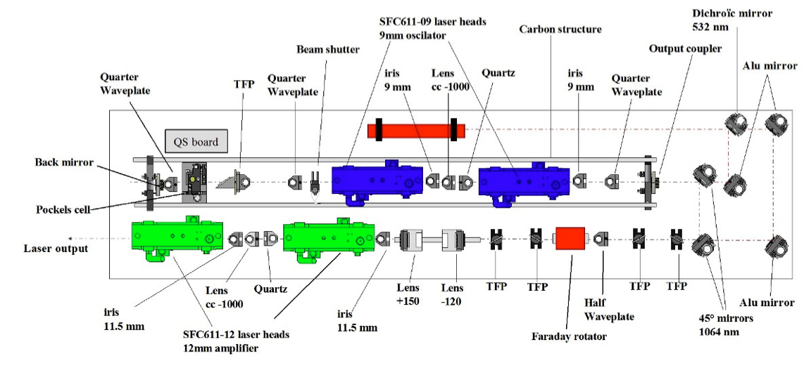
Quantel Laser Optics used on PBLS
OSC: 2 heads, 4 flashlamps
AMP2: 1 head, 4 flashlamps
AMP1: 1 head, 4 flashlamps

Slide 13
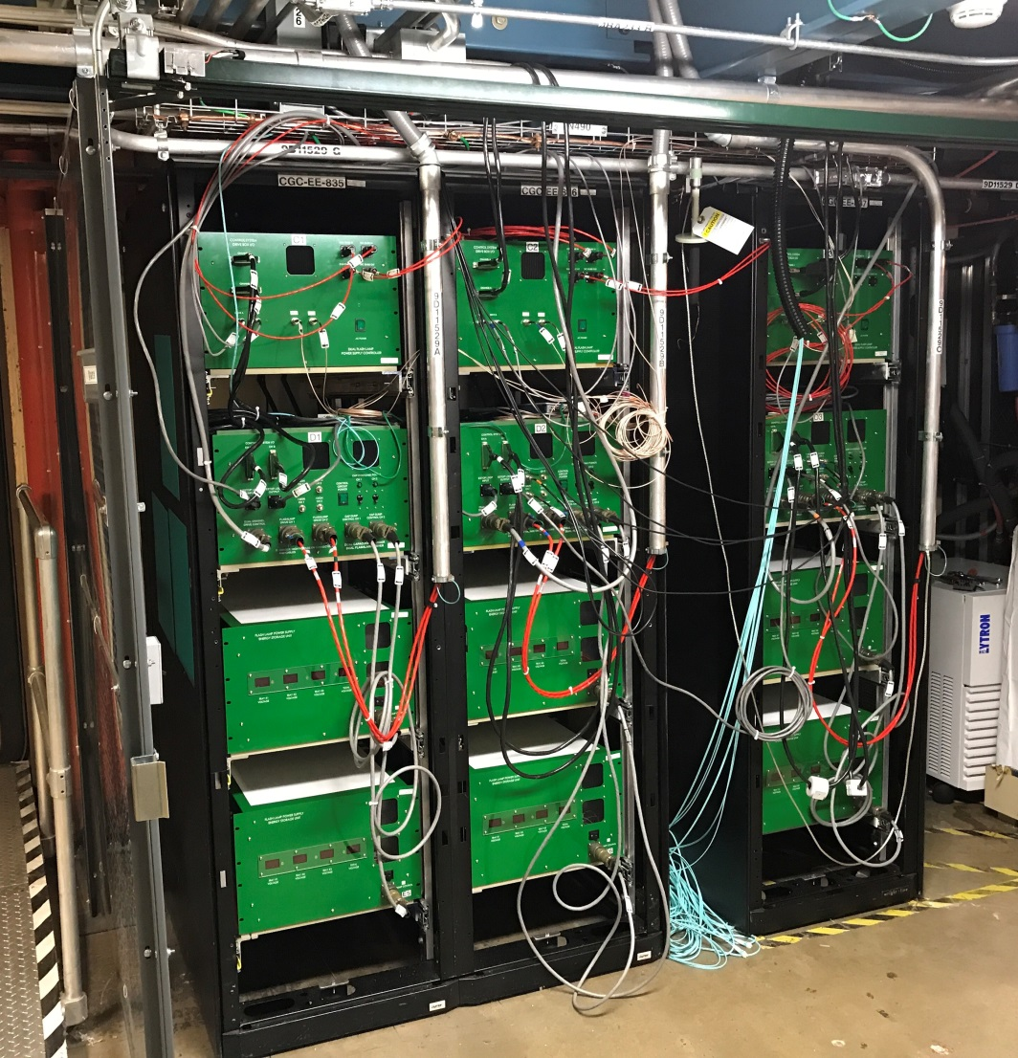
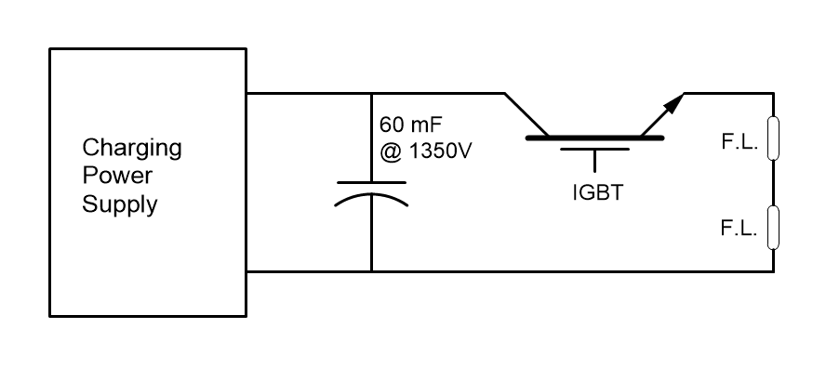
PBLS Power Supplies
PSL from University of Wisconsin
Control
OSC
AMP 1
AMP 2
Charging power supplies
Insulated-gate bipolar transistor (IGBT)
Capacitor banks

Slide 14
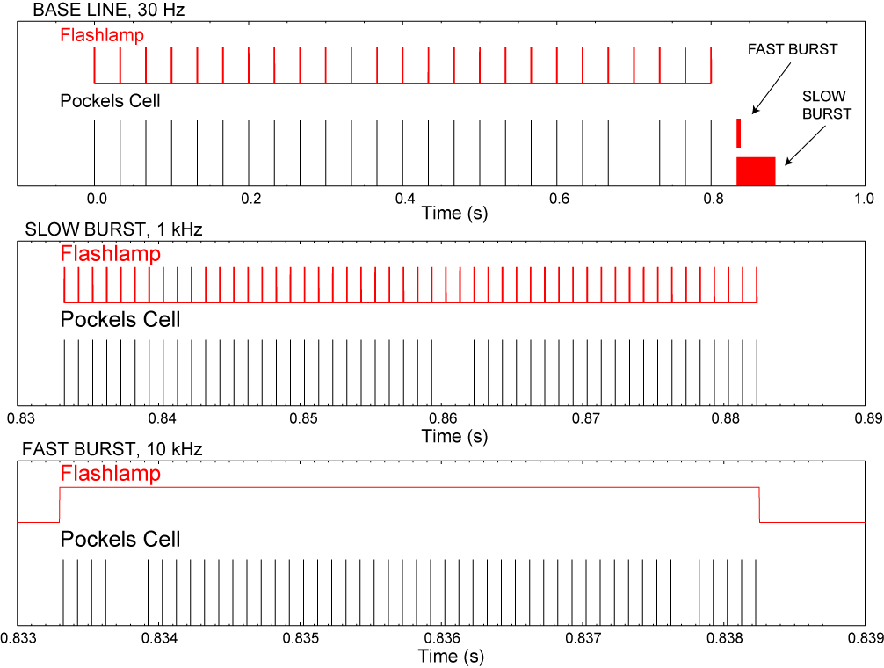
PBLS Time Patterns
Baseline
30 Hz
Slow Burst
1 kHz
Fast Burst
10 kHz

Slide 15
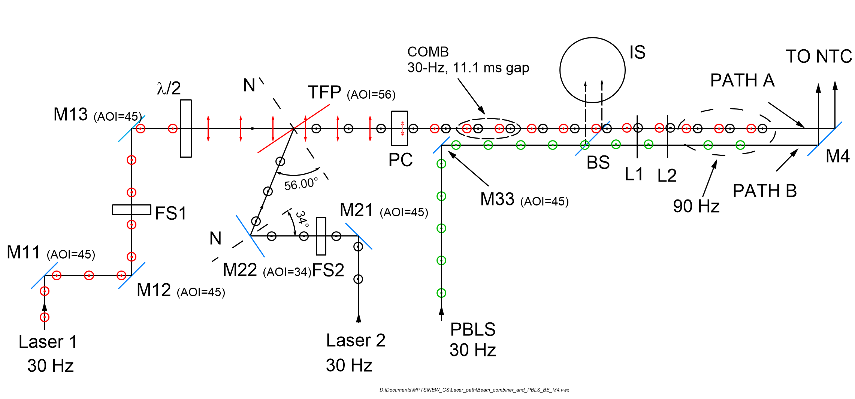
90-Hz Laser Configuration
Three 30-Hz lasers combined on two paths

Slide 16
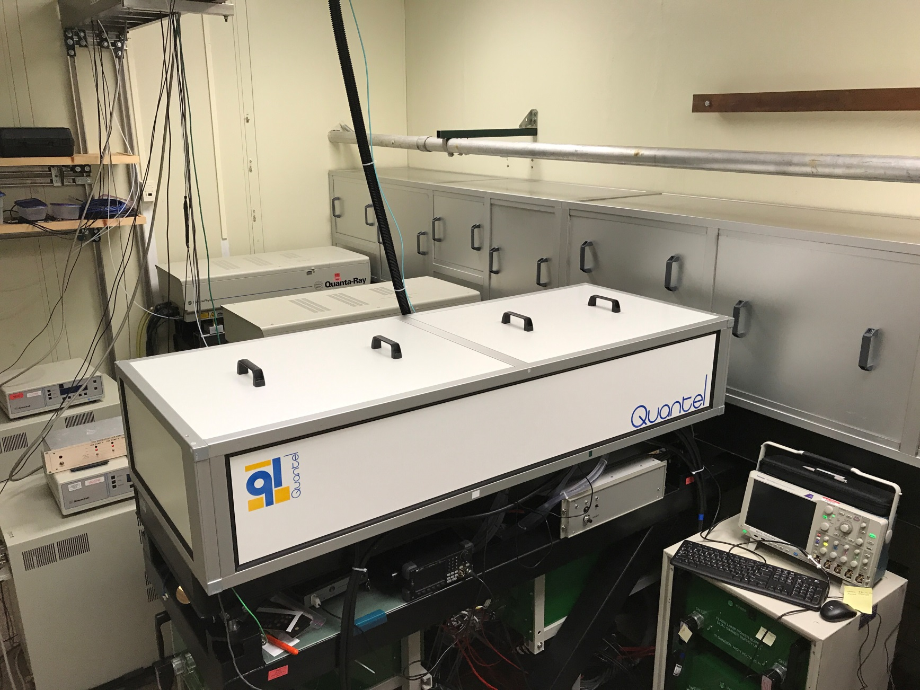
PBLS Installed in Laser Room
Lasers 1, 2 and PBLS
Laser 1
Laser 2
PBLS

Slide 17
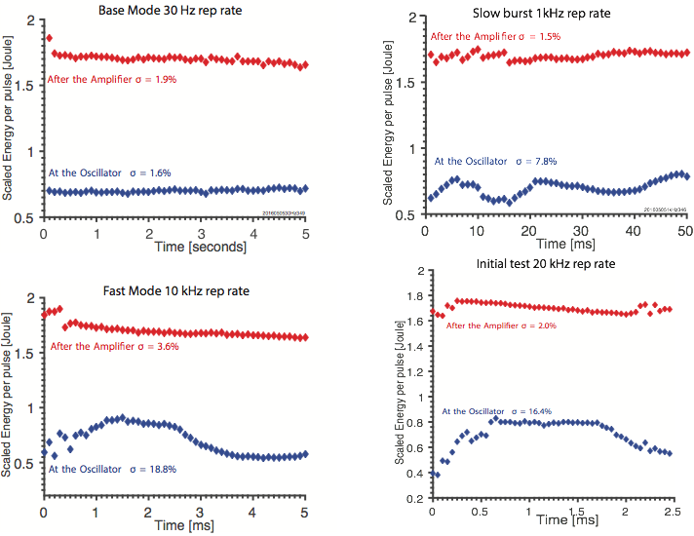
PBLS Pulse Energy Sufficient

Slide 18
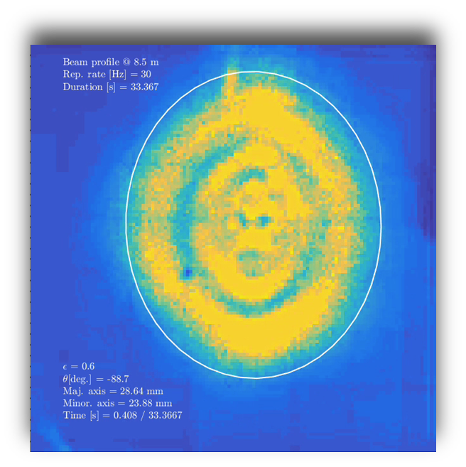
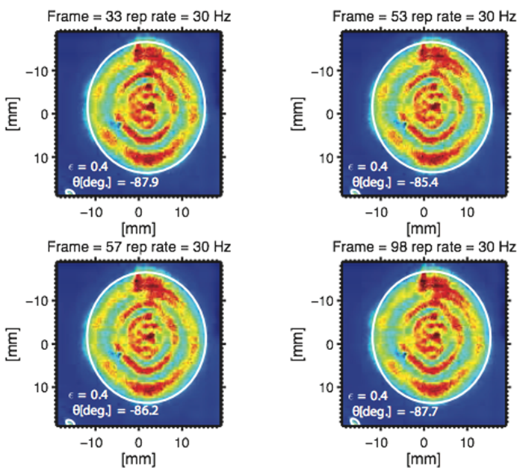
30-Hz Operation: beam profile in far field
Images at 8.5 m from laser
Thanks to R. Perkins, M. Jaworski, F. Scotti for the initial assistance in operating the camera.

Slide 19
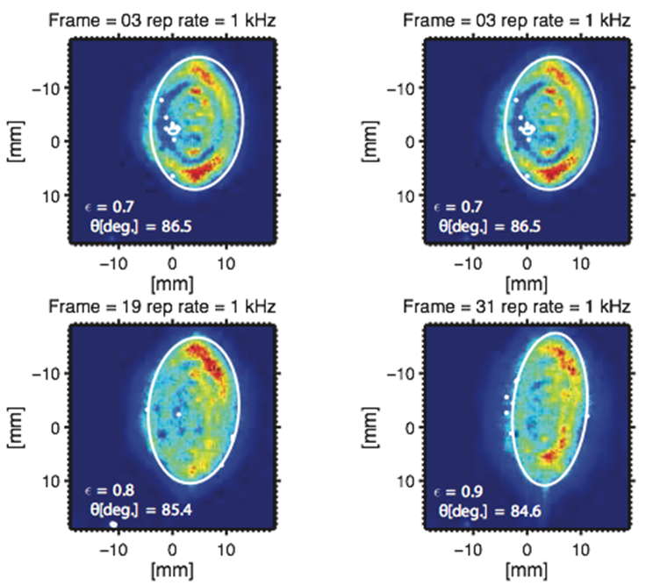
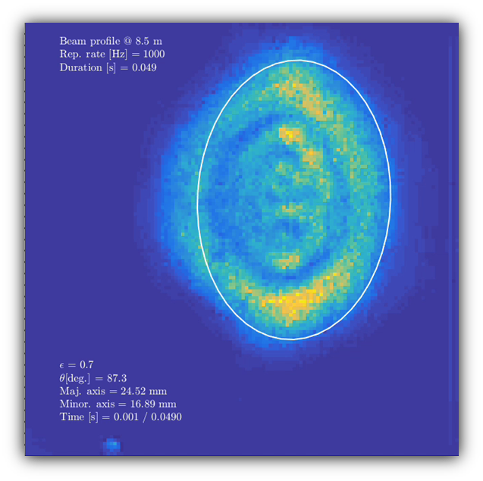
SLOW BURST: mode has increased elongation Further investigation warranted
Images at 8.5 m from laser

Slide 20
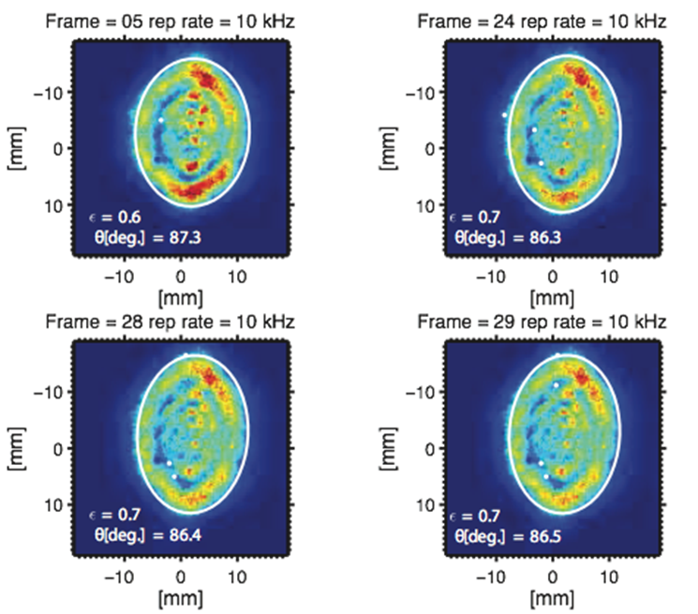
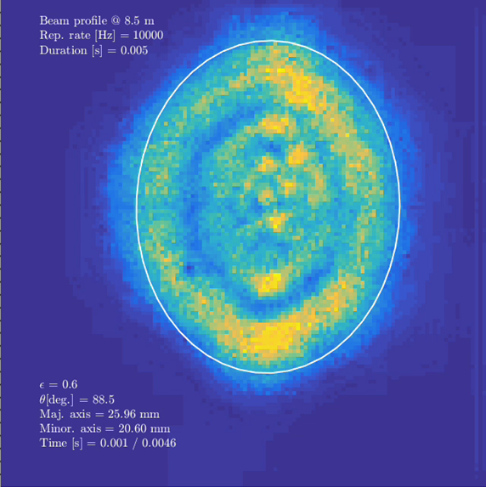
FAST BURST: mode has acceptable properties
Images at 8.5 m from laser

Slide 21
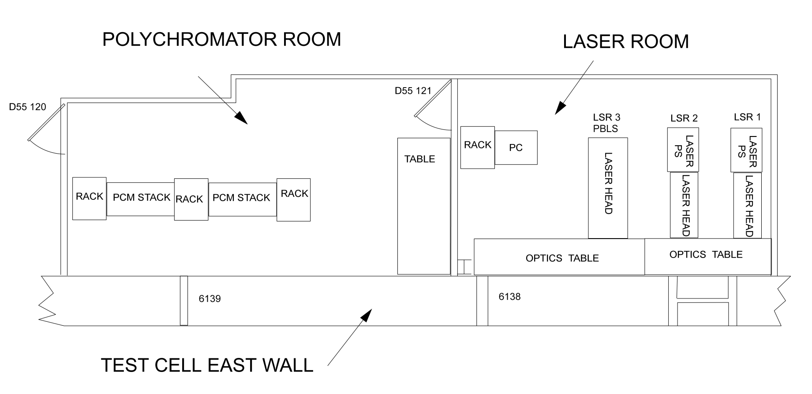
Polychromator and Laser Rooms

Slide 22
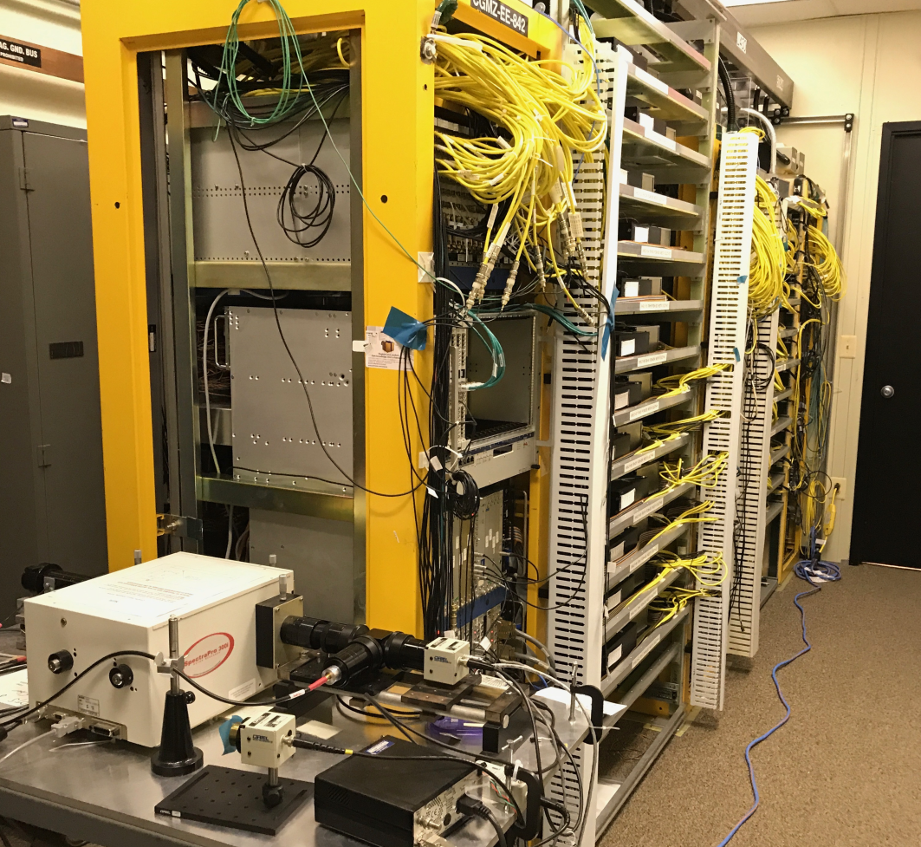
Polychromator Room
42 radial channels
  One polychromator (PCM) per radial position
  32 PCMs with 6 filters
  10 PCMs with 4 filters
232 APDs
Spectral calibration equipment shown

Slide 23
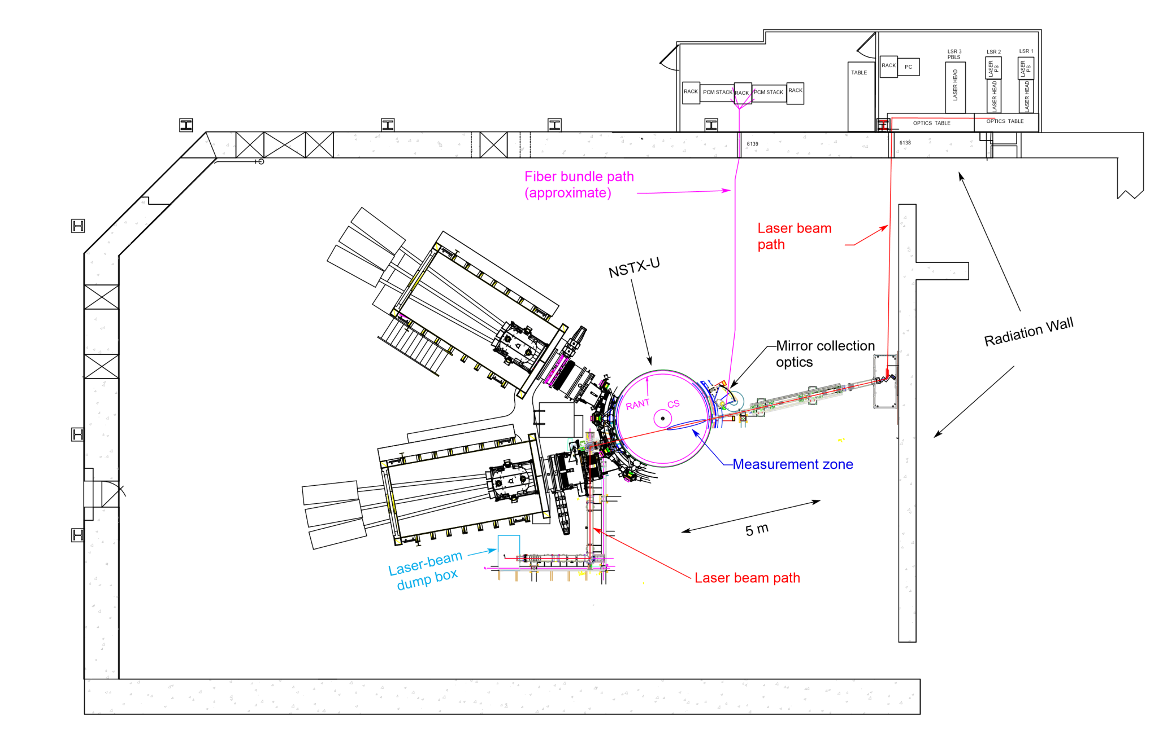
Laser Beam Delivery Path
Laser room and test cell

Slide 24
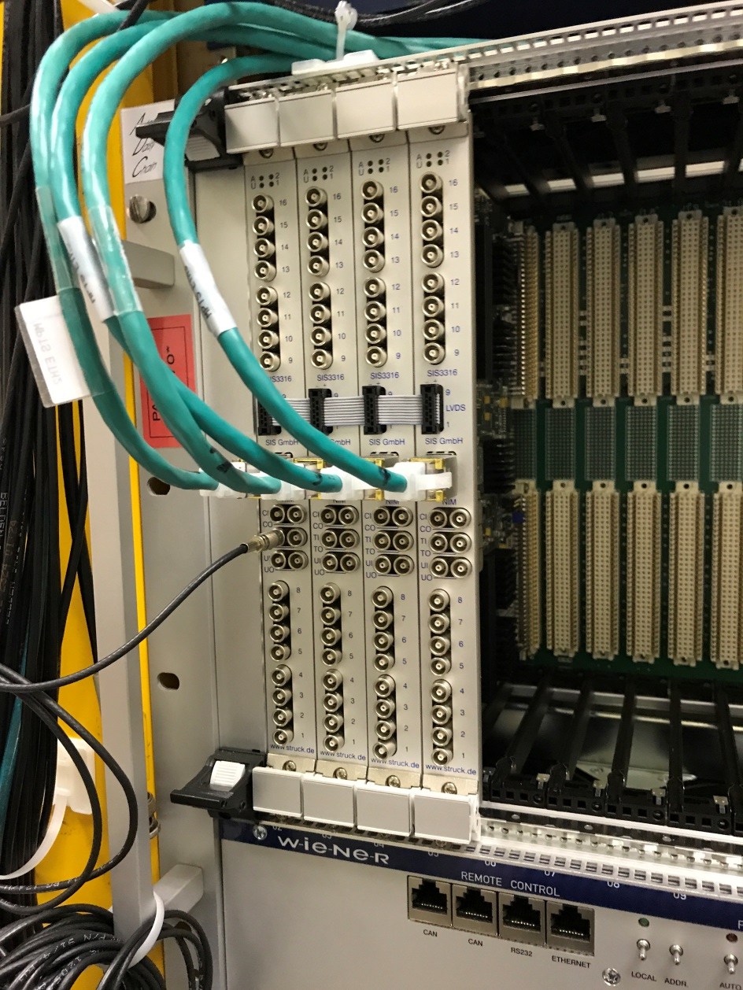
New Fast Digitizer Electronics
STRUCK S3316-250-14
S3316-250-14
Single width VME card
16 channels
250 MS/s per channel
14-bit resolution
Ultimately eight S3316 modules will be in service: enough to support 20 of the 42 radial channels
10 channels for pedestal physics¹
10 channels for real-time plasma control²
¹A. Diallo, DOE ECRP
²E. Kolemen, DOE-SC grant DE-SC0015480

Slide 25
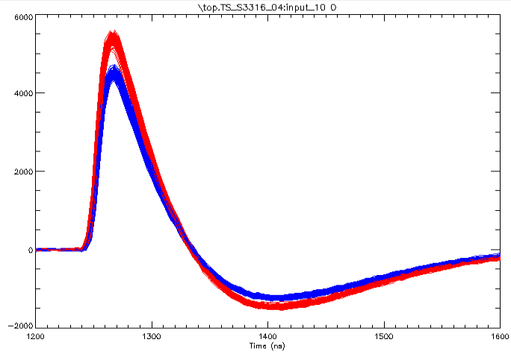
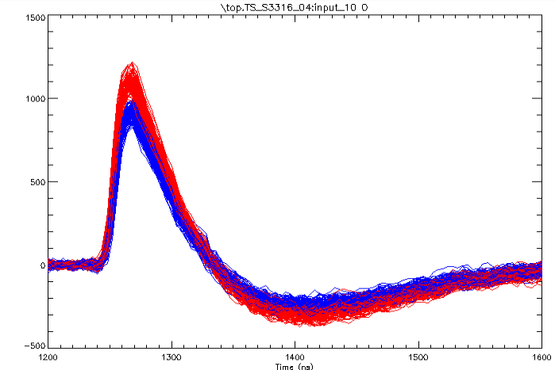
Fast-digitizer Signal
Raman scattering in Nitrogen
Laser 1
50 Torr
10 Torr
Laser 2
Time (ns)
Time (ns)

Slide 26
Calibration Probe
Used to track viewing window spectral transmission
  Typically weekly measurement…
  … or after special “event”
Light source outside vessel sends light though a fiber bundle
  Light is optically coupled through a window onto a in-vacuum fiber bundle
  The exit end of the vacuum fiber bundle illuminates a screen located a the focus point of one of the radial channels
  The screen is moveable along the laser beam path

Slide 27
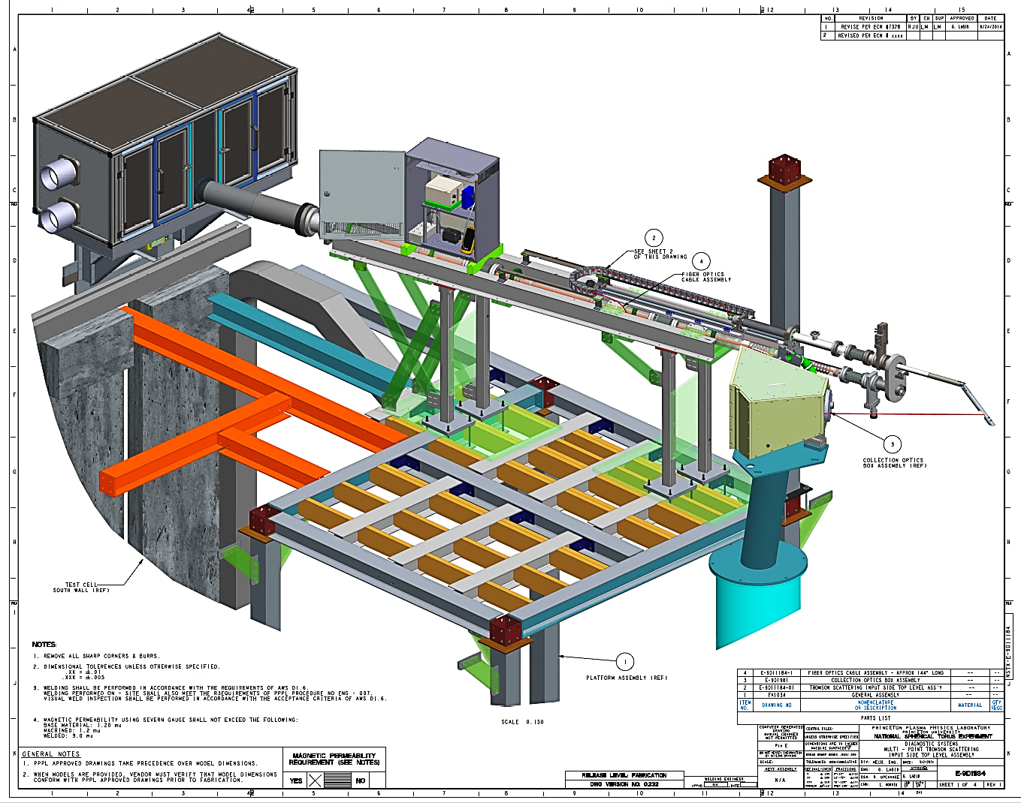
Calibration Probe Assembly

Slide 28
End Remarks
MPTS is undergoing a major reconfiguration of its laser system, which is expected to provide 90-Hz base operation with the added capability of 1-kHz or 10-kHz burst
  PBLS installed in laser room
  Beam combiner installed
  Both systems need further work and testing
128 fast digitizers will replace part of the existing sample-and-hold electronics in order to be able to measure during PBLS fast-burst (10 kHz) operation
  20 of the 42 radial channels will be fitted with fast digitizers
New viewing window calibration probe is also being implemented
This work is supported by US DoE Contract DE-AC02-09CH11466 and ECRP funding.

