Slide 1
Disruption Event Characterization and Forecasting (DECAF) in Tokamaks
S.A. Sabbagh¹, J.W. Berkery¹, Y.S. Park¹, J.H. Ahn¹, Y. Jiang¹, J.D. Riquezes¹, R.E. Bell², M.D. Boyer², A.H. Glasser³, J. Hollocombe⁴, J. Kim⁵, A. Kirk⁴, J. Ko⁵, W. Ko⁵, L. Kogan⁴, B. LeBlanc², J.H. Lee⁵, Y.K. Oh⁵, F. Poli², S.D. Scott², A. Thornton⁴, L. Terzolo⁵, S.W. Yoon⁵, S.J. Wang⁵, Z.R. Wang²
¹Department of Applied Physics, Columbia University, New York, NY
²Princeton Plasma Physics Laboratory, Princeton, NJ
³Fusion Theory and Computation, Inc., Kingston, WA
⁴Culham Centre for Fusion Energy, UKAEA, Abingdon, UK
⁵National Fusion Research Institute, Daejeon, Republic of Korea
60th APS Division of Plasma Physics Meeting
6 November 2018
Portland, OR
V2.7

Slide 2
A broadened disruption prediction and avoidance approach is progressing for ITER and future tokamaks
Motivation: Disruption prediction/avoidance is a critical need
  Why? A disruption stops plasma operation, might cause device damage
  A highest priority DOE FES (Tier 1) initiative - present “grand challenge” in tokamak stability research:
    Can be done! (JET tokamak: < 4% disruptions with carbon wall)
    ITER disruption allowance: < 1 - 2% (energy + E&M loads); << 1% (runaways)
Talk Outline
  Disruption predictor requirement metrics
  Disruption Event Characterization and Forecasting (DECAF) approach
  Physical models in DECAF, continued progress toward early prediction
  Initial multiple-device, large database analysis
  Present evolution of disruption forecasting performance

Slide 3
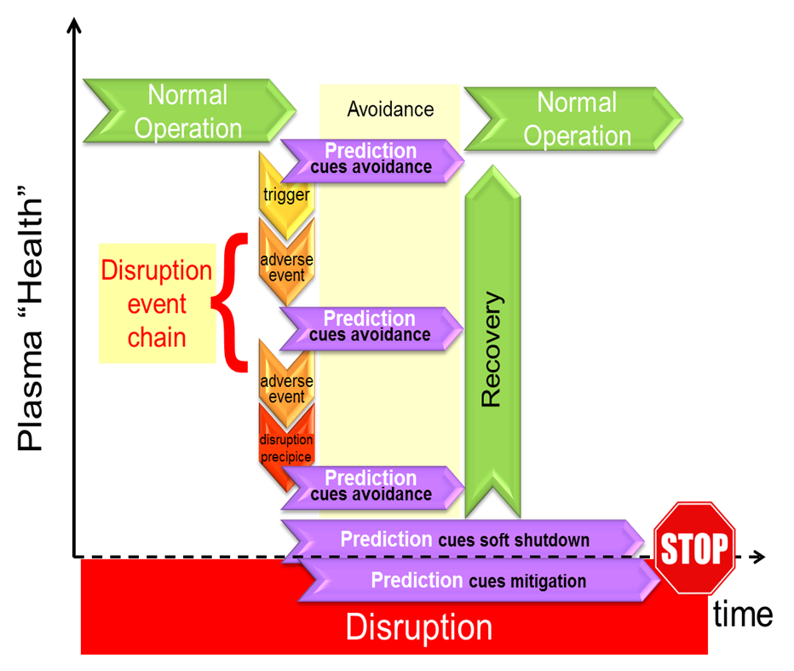
DECAF is a logical, physics-based paradigm that meets all disruption predictor requirement metrics
DECAF in disruption prediction / avoidance framework
Disruption predictor must
  Predict SPECIFIC pre-disruptive phenomena ➔ link to control
  Provide CONTINUOUS variable quantifying proximity (& can GENERATE triggers)
  Provide SUFFICIENT LEAD TIME for mitigation or avoidance
  Be EXTRAPOLABLE to new device (e.g. ITER) prior to operation
  Be REAL-TIME calculable
DECAF
D. Humphreys, et al., PoP 22 (2015) 021806

Slide 4
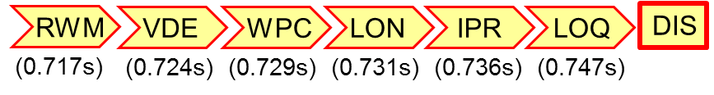
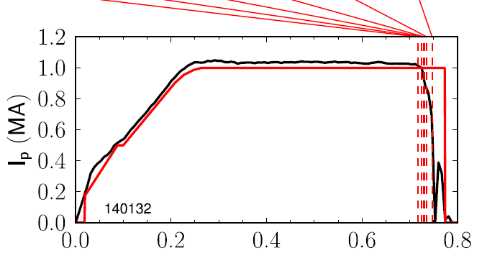
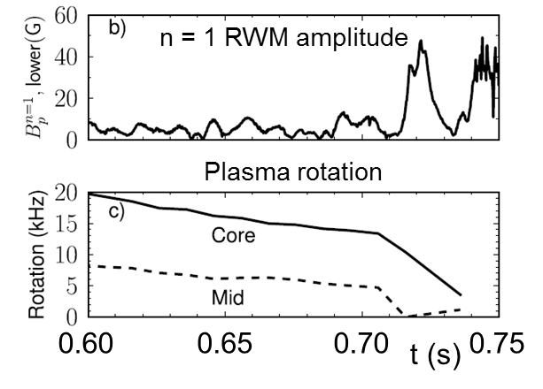







DECAF determines disruption triggers and automatically generates event chains
Global MHD mode trigger
Warning time: 30 ms
  Absolute: Just sufficient time for disruption mitigation in ITER
  Normalized: ~ 6 RWM growth times in NSTX – far longer time (~ s) in ITER
NSTX 140132
t (s)
Events (in this chain)
  resistive wall mode
  vertical instability
  wall proximity control
  low density warning
  not meeting I_{p} request
  low q warning
  disruption (current quench)

Slide 5
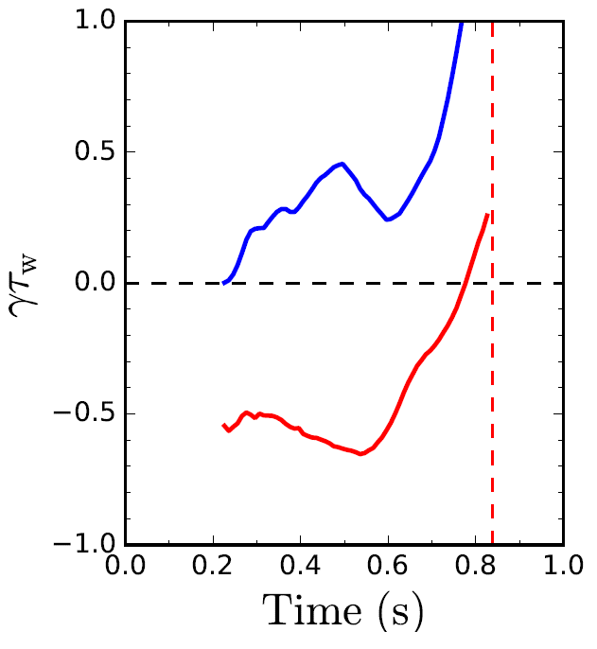
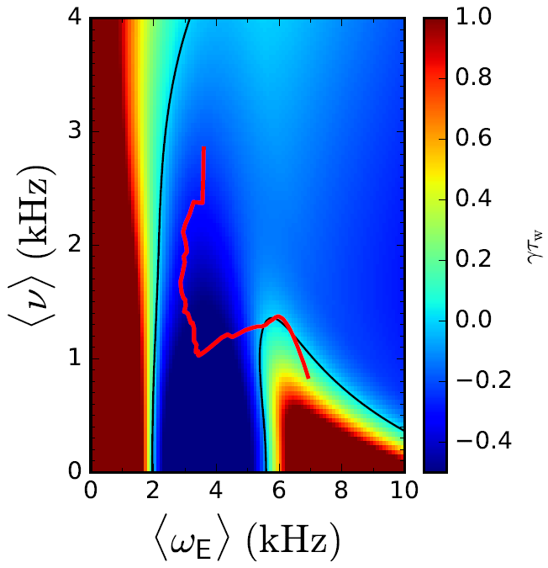
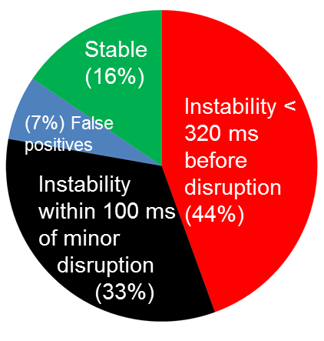
      Reduced kinetic MHD model in DECAF provides early forecast of instability boundary to global MHD modes
Norm. growth rate vs. time
Disruption forecasting
Predicted instability statistics
γτ_{w}
unstable
Increasing time
ideal
γτ_{w}
Collisionality (kHz)
stable
Global kinetic MHD mode growth
Ideal + kinetic
disruption
NSTX
139514
Rotation
predicted instability
84% of shots are predicted unstable (stringent evaluation)
44% predicted unstable < 320 ms (approx. 60τ_{w}) before current quench
33% predicted unstable within 100ms of a minor disruption
Full physics model (years of effort) reduced
  Stability contours CHANGE for each time point
  Allows real-time stability and mode growth rate prediction
J.W. Berkery, S.A. Sabbagh, R. Bell, et al., Phys. Plasmas 24 (2017) 056103

Slide 6
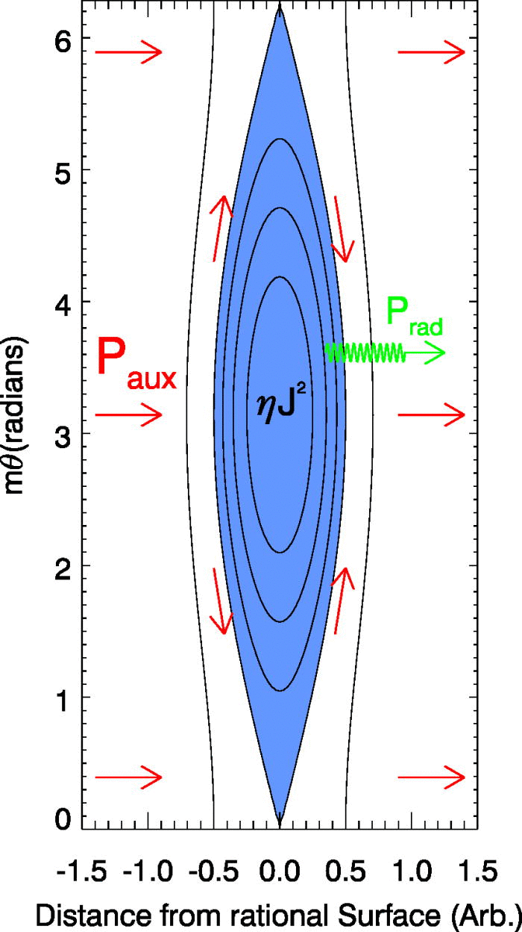
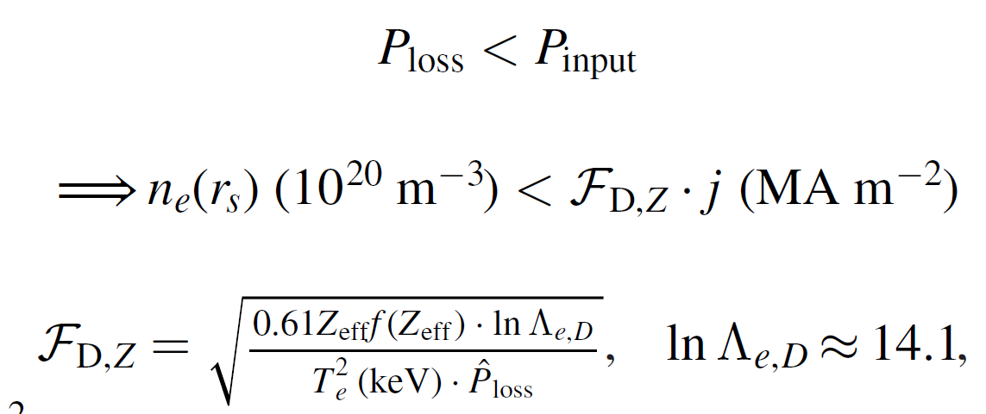
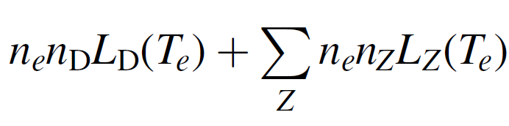
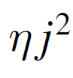
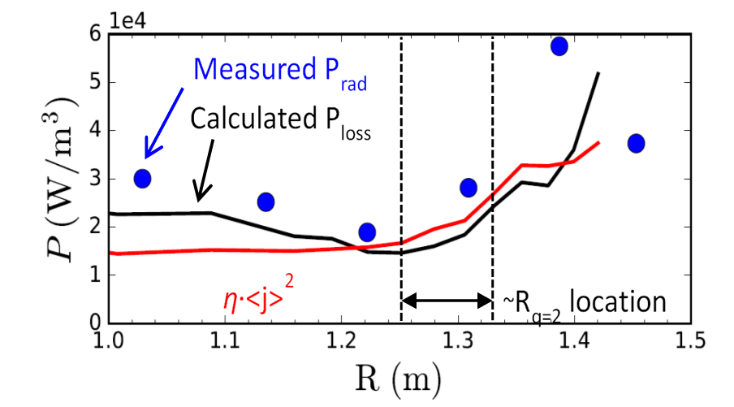
Recently a density limit model has been examined in DECAF based on power balance in an island
Local island power balance limit
  Power balance in island between Ohmic heating and radiated power loss
  If radiated power at the island exceeds the input power (P_{loss} > P_{input}), island grows
Power density balance:
NSTX
134020
D. Gates et al., Phys. Rev. Lett. 108 165004 (2012)

Slide 7
DECAF density limit analysis started: global, local density limits examined, correlation of MHD onset near limits
Disruptivity vs. density
DIS
Magnetic spectrogram
(toroidal array)
GWL
NSTX
GWL
GWL
Greenwald limit
  Near 0.9 when mode starts (range 0.75 – 1.05)
Rad. island power balance
  Near 1.0 when mode starts (range 0.60 – 1.50) ⬅ next step: reduce range
IPB
0.9
IPB
See CP11.00095: J.W. Berkery

Slide 8
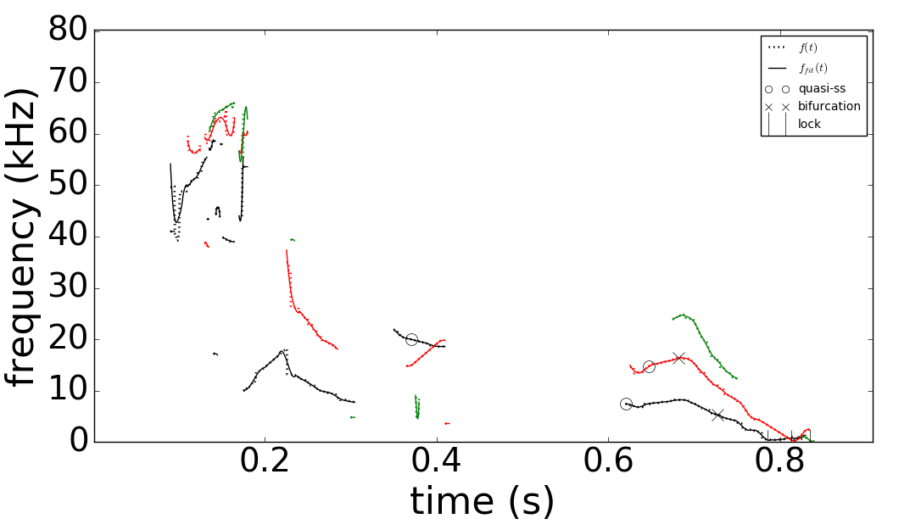
More powerful automated MHD event objects have been developed for DECAF
DECAF automated MHD events
Magnetic spectrogram
(toroidal array)
MHD-n3
MHD-n2
MHD-n1
NSTX
More capable MHD event objects required for analysis of wider tokamak databases
DECAF MHD events now include
  Mode number (n) discrimination
  Full history of mode evolution, including bifurcation and locking
  Many disruption warning criteria
GWL
IPB
0.9
See CP11.00110: J.D. Riquezes

Slide 9
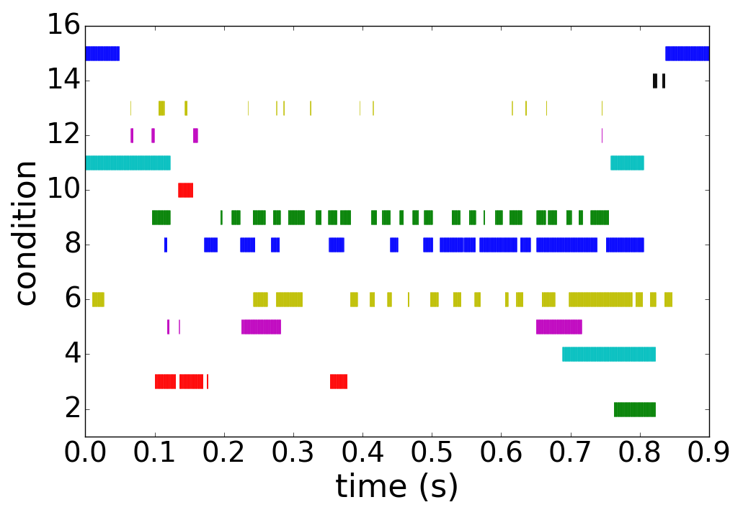
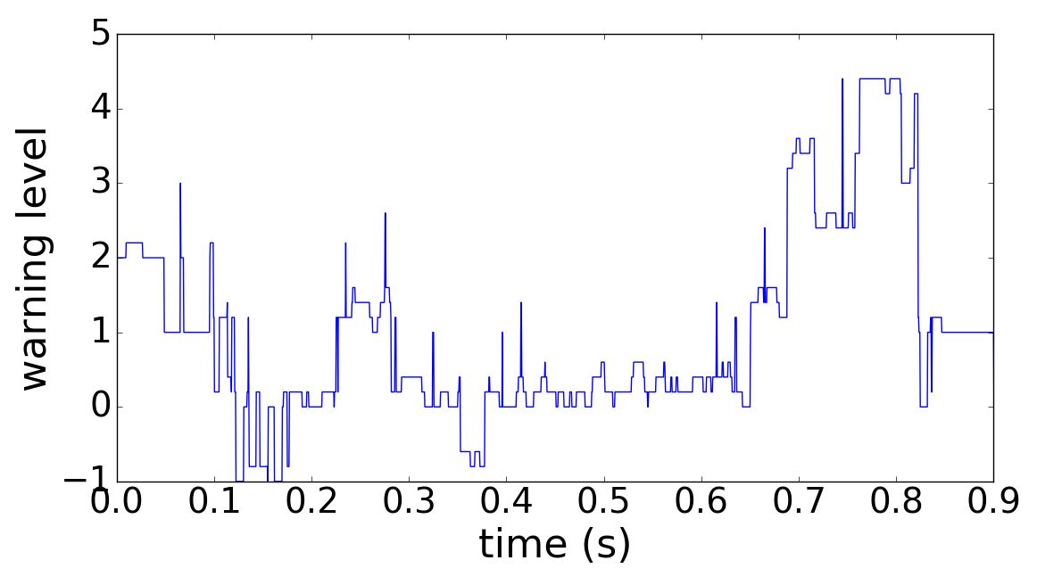
New DECAF MHD events utilize history of 15 criteria to define time evolving disruption warning level
DECAF automated MHD objects
DECAF “heat map” (for MHD)
MHD-n3
Locked mode > 25G ➔
MHD-n2
MHD-n1
⬅ Core plasma rotation < 6 kHz ➔
BIF-n2
“quasi-steady
state (O)”
BIF-n1
Decreasing plasma rotation ➔
LTM-n1
⬅ High amplitude ➔
LTM-n2
f below bifurcation ➔
Very low f mode ➔
DECAF MHD warning level
Key notables of MHD warning
  “Safe”/“unsafe” MHD periods found
  Early, slow warning level evolution
    Locked mode amplitude important, but warning comes in very late
  Mode frequency below bifurcation, decreasing plasma rotation key
Safe

Slide 10
Progress on DECAF now moving to processing of multi-machine databases
Analysis
  Kinetic equilibrium / stability analysis on KSTAR; planned for MAST
DECAF database started
  Requires storage of DECAF analysis
Device / Capability | KSTAR | MAST | NSTX | DIII-D | TCV
Full database access (type) | Yes (MDSplus) | Yes (UDA) | Yes (MDSplus) | Yes (MDSplus) | Yes (MDSplus)
Database analysis | continuing | continuing | continuing |  | started
Equilibrium analysis | Kinetic + MSE | scheduled | Kinetic + MSE | available
Stability | Ideal, Resistive Kinetic MHD | scheduled | Ideal, kinetic MHD (resistive) | Ideal, kinetic MHD
shot*seconds (for kinetic analysis) | 1,886 (2016+2017) | 2,667 (est) (M5 - M9 runs) | 2,000 / year (est)
Aim to add ASDEX-U next, then JET and C-Mod databases

Slide 11
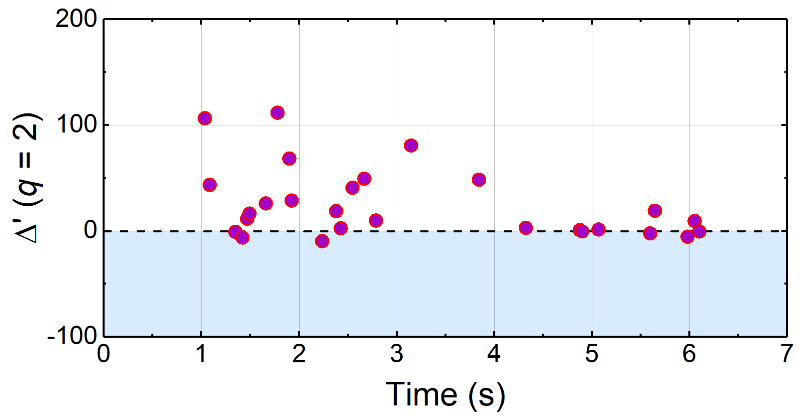
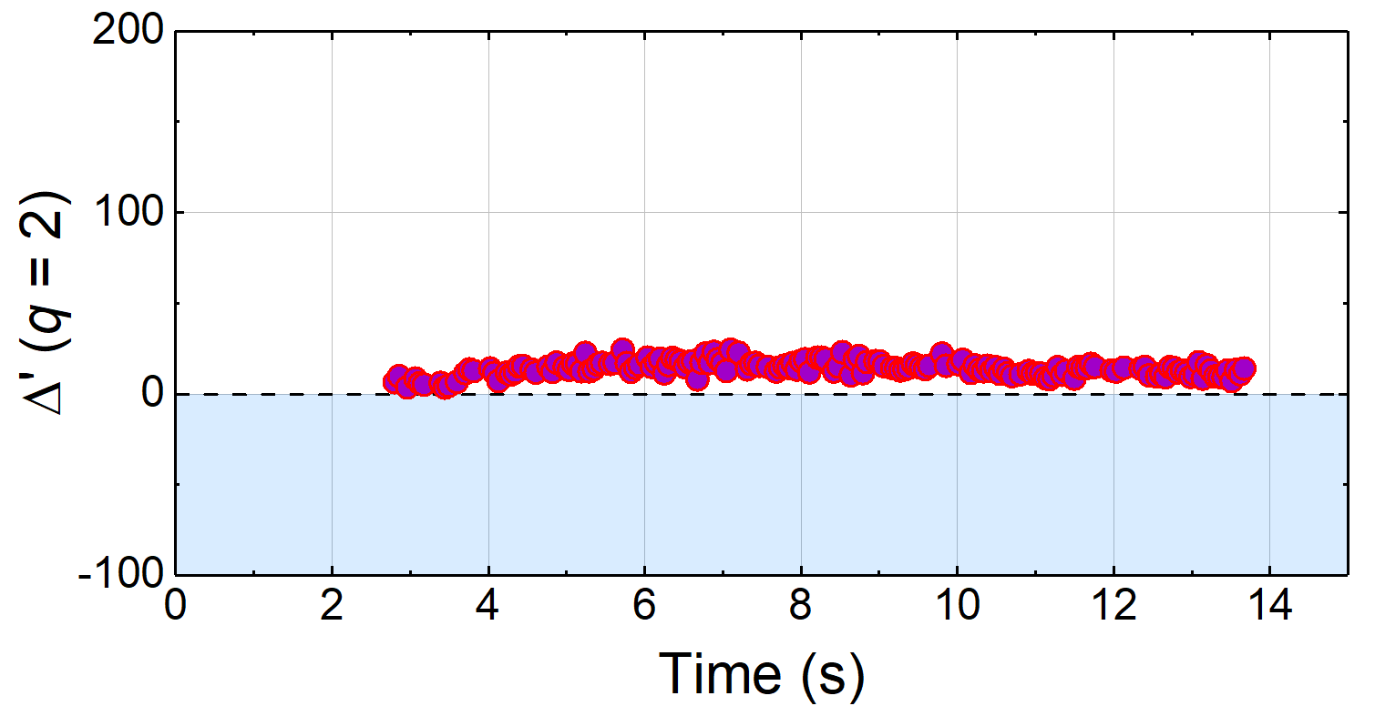



Tearing mode stability examined in KSTAR plasmas varied β_{N} , q₉₅ (supports future DECAF models)
High β_{N} plasma (tearing unstable)
Higher q₉₅ plasma (tearing stable)
*Resistive DCON $Δ′$
*Resistive DCON $Δ′$
β_{N} ~ 2
Experimentally
Unstable 2/1
Experimentally
2/1 stable
16295
β_{N} > 3
16325
*A.H. Glasser PoP (2016)
Classical tearing stability index, Δ′, computed at q = 2 surface using outer layer solutions
At higher q₉₅, Δ′ is mostly positive predicting unstable classical tearing mode
  Indicates neoclassical effects, additional physics are needed to produce stability
Time evolution of ideal MHD stability also computed with DCON to support DECAF
See POSTER version of talk (next session) for more
See CP11.00100: Y.S. Park
See CP11.00099: Y. Jiang

Slide 12
Initial DECAF analysis of large databases further supports result that disruptivity doesn’t increase with β_{N}
MAST
KSTAR
Plasma normalized beta
(~ plasma energy content)
NSTX
(internal inductance)
DIS
DECAF analysis of event alone
  Similar to a “standard” disruptivity analysis
  Analyzed at 10 ms intervals (> million tests)
Analysis during steady plasma current
  MAST: 8,902 plasmas analyzed
  NSTX: 10,432 plasmas analyzed
  KSTAR: 1,309 plasmas analyzed

Slide 13
DECAF provides early disruption warning and understanding of disruption event chain beyond disruptivity plots
NSTX
Example: What are the most important regions to study on this plot?

Slide 14
DECAF provides early disruption warning and understanding of disruption event chain beyond disruptivity plots
NSTX
Example: What are the most important regions to study on this plot?
  Studies usually focus on the high disruption probability regions
  What causes the disruptions? (low β_{N}, mid-l_{i} ???)
  Problem ➔plasma conditions can change significantly between first problem detected and when disruption happens
DIS
DIS

Slide 15
DECAF provides early disruption warning and understanding of disruption event chain beyond disruptivity plots
NSTX
Example: What are the most important regions to study on this plot?
  Studies usually focus on the high event probability regions
  What causes the disruptions? (low β_{N}, mid-l_{i} ???)
  Problem ➔plasma conditions can change significantly between first problem detected and when disruption happens
DIS
DIS
Answer: the circles mark the key region to study!
  DECAF shows the plasmas suffer several “events” that are started in this region, and end up far from that region when they disrupt (at the crosses )

Slide 16
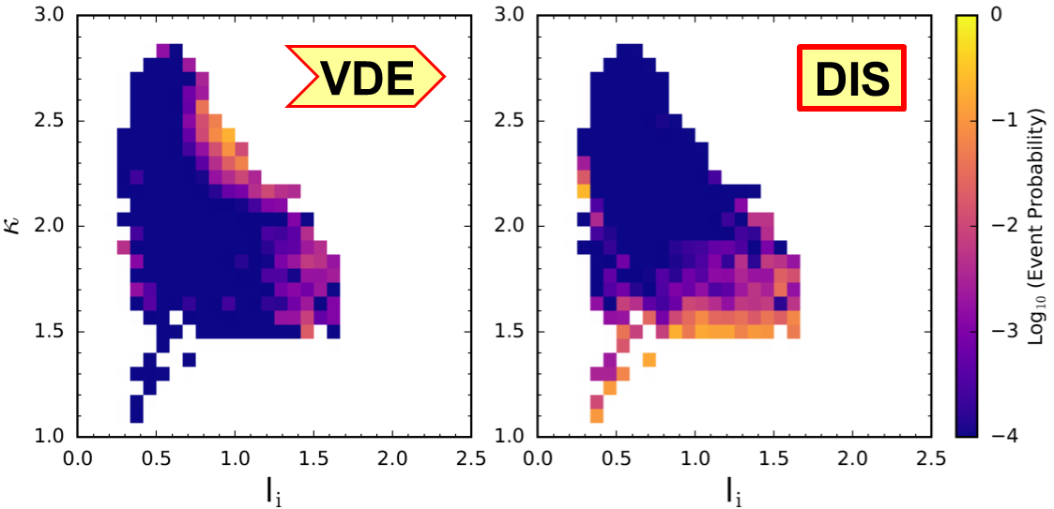
Example: DECAF shows plasma parameters of VDE event can occur far from those of DIS event
Plasma elongation
NSTX
(internal inductance)
Largest portion of detected VDE events appear at (l_{i},κ) with very small portion of DIS events detected

Slide 17
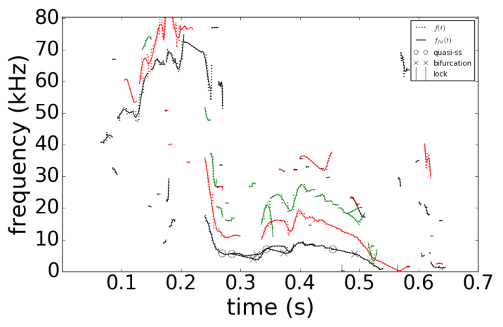
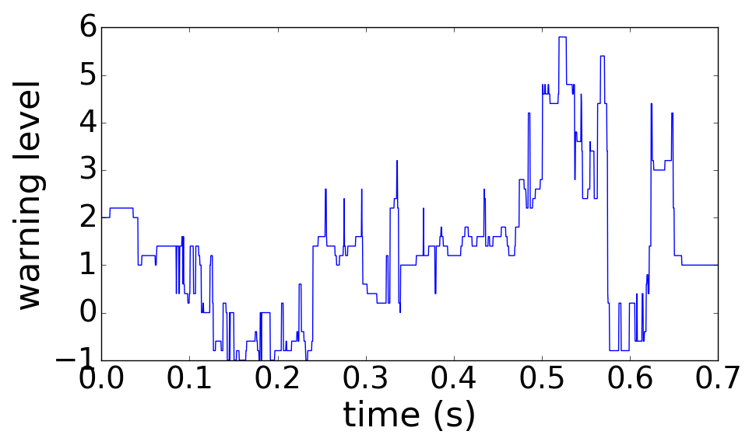
DECAF provides an early disruption forecast - on transport timescales – giving potential for disruption avoidance
DECAF event chain
MHD-n1
BIF-n1
LTM-n1
PRP
IPR
WPC
DIS
VDE
(0.490s)
(+.005s)
(+.045s)
(+.068s)
(+.073s)
(+.073s)
(+.077s)
(+.080s)
NSTX
n
DECAF MHD events
3
2
1
126962
Disruption forecast level
Safe
DECAF event chain reveals physics
  Rotating MHD slows, bifurcates, and locks
DIS
  Then, plasma has an H-L back-transition (pressure peaking warning PRP) before DIS
  Early warning gives the potential for disruption avoidance by plasma profile control

Slide 18
DECAF event analysis of large databases of different devices shows physical distinctions
VDE
Databases
  MAST: 8,789 shots (3,360 shots*seconds)
  NSTX: 10,094 shots (6,400 shot*seconds)
Loss of vertical stability control occurs closer in time to disruption in MAST compared to NSTX
  May be due to presence of copper stabilizing plates in NSTX
Understanding aids in DECAF extrapolation to new devices
DIS
MAST
DIS
NSTX

Slide 19
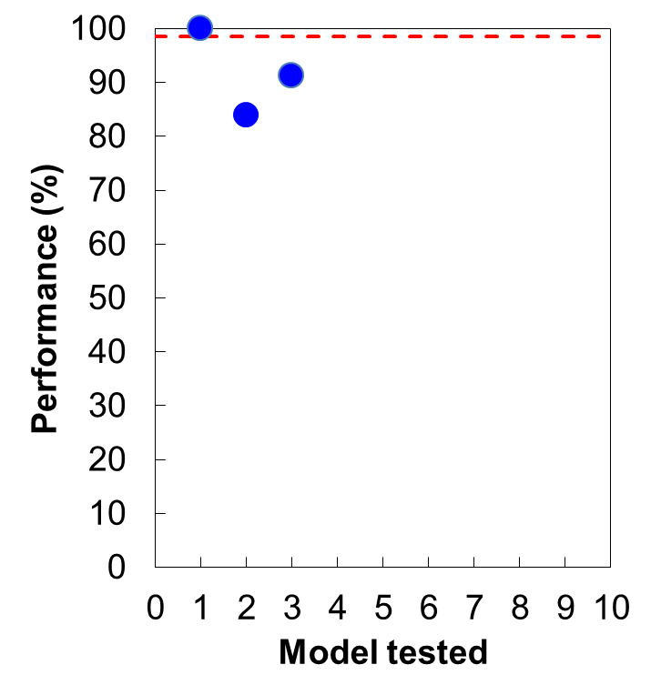
Limited event chain analysis of large databases evolves initial performance of disruption prediction
DECAF Disruption Forecasting Performance Evolution
First test on large, general database
Analysis with only 5 DECAF events tested for 10,094 discharges with disruptions (NSTX)
  Events used: VDE, GWL, LOQ, IPR, DIS
Performance (Model 3)
  91.2% true positives (warning occurs)
  8.7% false negatives (no warning)
    Somewhat high number of false negatives expected: only 5 DECAF events are used in this large database analysis
In 5,909 shots, vertical instability was part of the disruption chain
ITER need
5 events
~10⁴ shots*s
(general database)
~10 events, ~10² shots*s
(earlier forecasting)
~10 events, ~10² shots*s
(initial event validation)
VDE
greater realism

Slide 20
Rapidly-expanding DECAF code provides a new paradigm for disruption prediction research
Multi-faceted, integrated approach to disruption prediction and avoidance that meets disruption predictor requirement metrics
  Physics-based approach yields key understanding of evolution toward disruptions needed for confident extrapolation of forecasting
  Physics-based DECAF events can guide disruption avoidance by control
  Full multi-machine databases used (full databases needed!)
  Open to all methods of data analysis (physics, machine learning, etc.)
DECAF is now producing early warning disruption forecasts
  On transport timescales: potential disruption avoidance by profile control
Next steps
  Expand number of DECAF events evaluated in large database analysis
  Continue / expand disruption prediction performance analysis (➔ ITER)
  Implement DECAF disruption prediction models in real-time (➔ KSTAR)
We are hiring post-doctoral researchers! ➔ Email: sabbagh@pppl.gov

Slide 21
Supporting Slides Follow

Slide 22
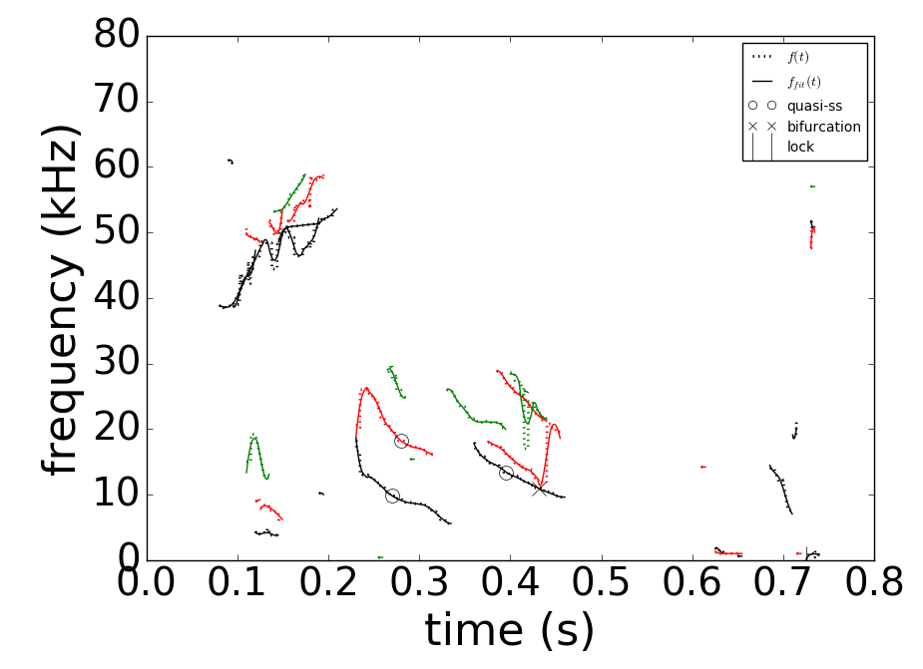
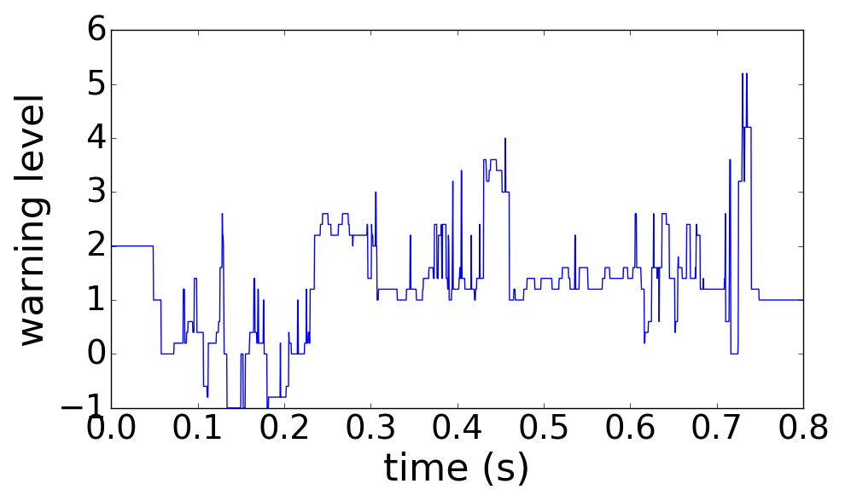
Global MHD modes can also be “slow” and allow early warnings for disruptions, potentially allowing avoidance
DECAF event chain
RWM
IPR
PRP
VDE
DIS
MHD-n1
LTM-n1
WPC
LOQ
(0.629s)
(+.010s)
(+.012s)
(+.058s)
(+.101s)
(+.101s)
(+.101s)
(+.106s)
(+.107s)
NSTX
DECAF MHD events
n
3
2
1
DECAF rotating MHD warning level
Safe
123856
Global MHD (RWM) can also be “slow”
  Rotating MHD warning level decreases after 0.46s ➔ DANGEROUS for RWM onset!
  H – L back transition (PRP) drags out time to disruption (> 100 ms – transport timescale)

Slide 23
DECAF code based on initial successful research/results is now advancing to a new level
DECAF brief highlights of prior results
  First automated event chain analysis (followed deVries’ manual work)
  Excellent performance on smaller, targeted databases (NSTX)
    Ex.: DIS, WPC, IPR, LOQ, RWM events found 100%, VDE event 91%
    Computed events accurately represented experiment (~ 10 events)
    Physics model forecasted global MHD disruptions with ~ 85% reliability
  Disruption chains often repeated, e.g.:
Recent progress
  Density limit model based on radiating island power balance being tested
  New MHD events in DECAF allow forecasting on transport timescales
  Linear resistive MHD analysis as first step to theory-based forecasting
  Analysis of disruption chains from general databases
  Multi-machine database analysis and disruption prediction with small number of verified events
RWM
VDE
WPC
IPR
DIS
J.W. Berkery, S.A. Sabbagh, R. Bell, et al., Phys. Plasmas 24 (2017) 056103

Slide 24
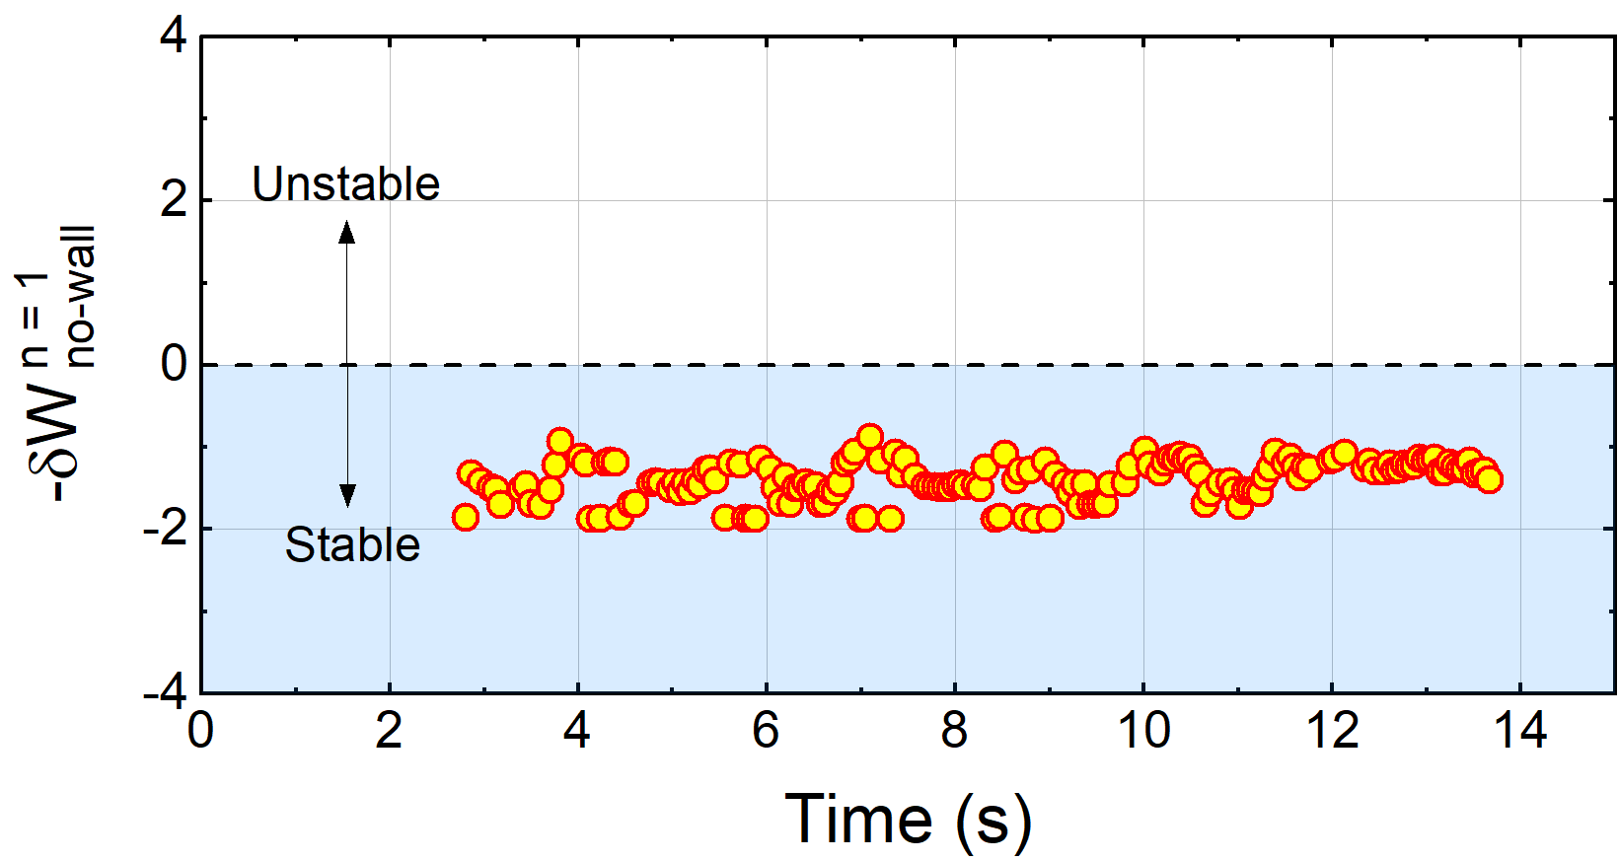
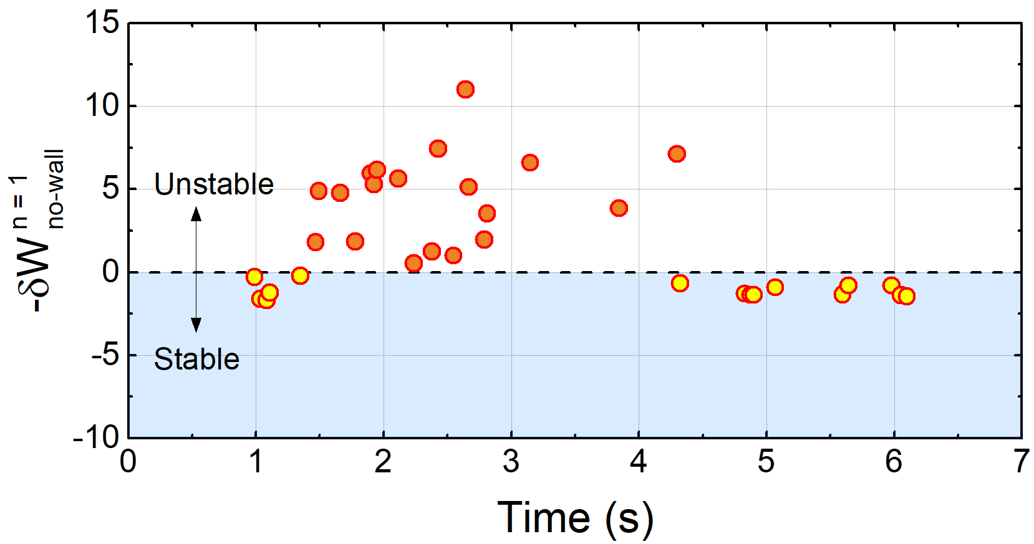
DCON stability calculation shows high β_{N} equilibria are subject to n = 1 ideal instability
KSTAR 16325
KSTAR 16295
DCON δW
DCON δW
β_{N} ~ 2
β_{N} > 3
DCON computed ideal MHD n = 1 δW with no-wall
Equilibria at lower β_{N} ~ 2 is consistently stable to n = 1 ideal modes in DCON
Unlike the lower β_{N} case, DCON calculates unstable n = 1 mode with no-wall (β_{N} > β_{N} ^{no-wall}) at the achieved high β_{N} > 3
The small deviations in the reconstructed profiles in the high β_{N} phase is responsible for reduced equilibrium convergence and the scatter in δW
See CP11.00100: Y.S. Park
See CP11.00099: Y. Jiang
A.H. Glasser, Phys. Plasmas 23 (2016) 072505

Slide 25
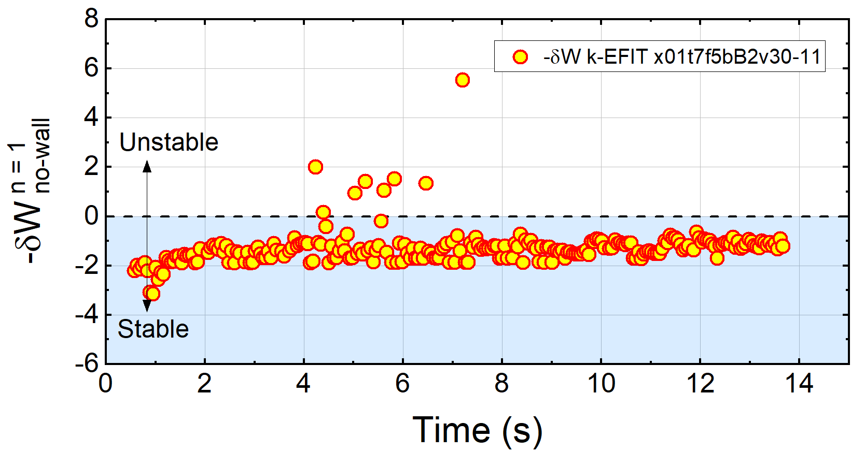
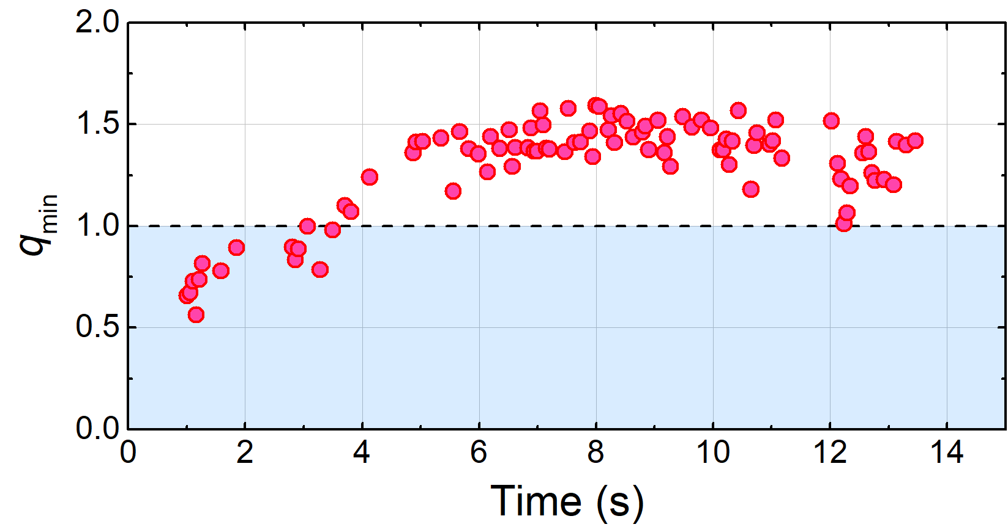
Higher q₉₅ plasma has greater ideal n = 1 no-wall stability computed in DCON
KSTAR 16325
Unlike higher β_{N} plasma, equilibria is mostly stable to n = 1 ideal modes in DCON
  Note generally smooth evolution of stability criterion – reached with improved kinetic equilibria
The q-profile at higher B_{T} evolves higher q_{min} above 1
  Sawteeth disappear
Reconstructed lower q shear at higher values of q does not lead to n = 1 instability in DCON
High q₉₅ equilibria
DCON
}
High q₉₅ equilibria
q_{min} (w/ MSE)
See CP11.00100: Y.S. Park
See CP11.00099: Y. Jiang

Slide 26
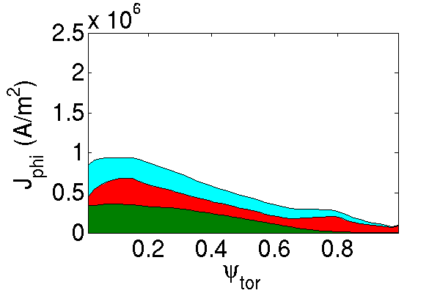
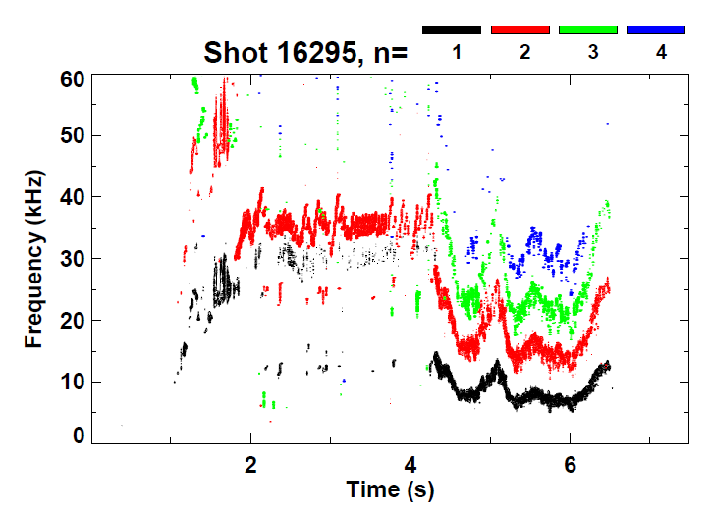
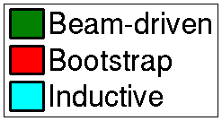
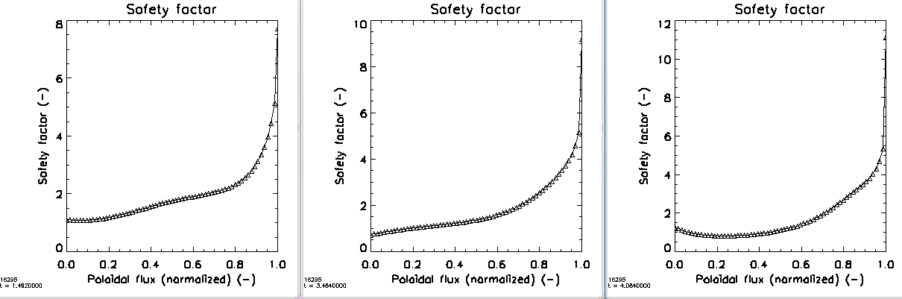
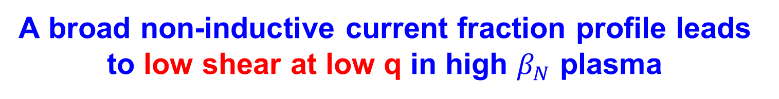
A broad non-inductive current fraction profile leads to low shear at low q in high $β_{N}$ plasma
10⁶
Current profile components
TRANSP
(67% non-inductive)
Magnetic spectrogram
Weak n = 2 mode
16295 t=1.75s
β_{N}>3
Kinetic + MSE reconstructed q profile evolution
8
10
12
10
8
6
4
2
0
t=1.482s
t=3.484s
t=4.084s
6
8
q
q
q
6
Evolves to low shear at low q
4
4
2
2
0
0
0.0 0.2 0.4 0.6 0.8 1.0
ψ_{N}
0.0 0.2 0.4 0.6 0.8 1.0
ψ_{N}
0.0 0.2 0.4 0.6 0.8 1.0
ψ_{N}

Slide 27
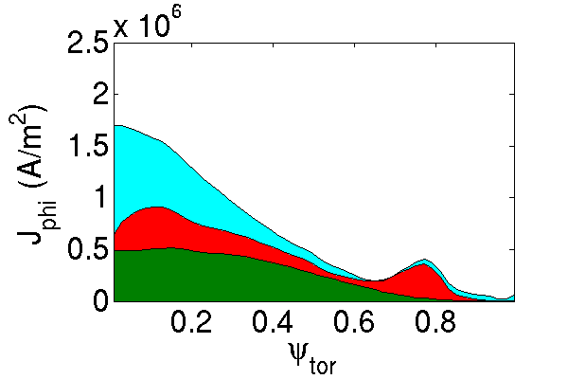
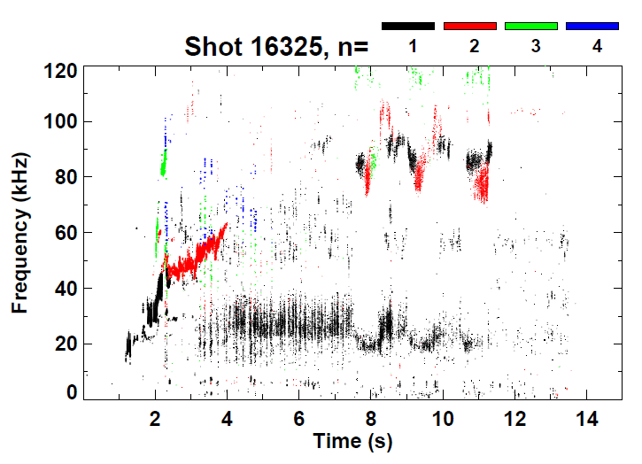
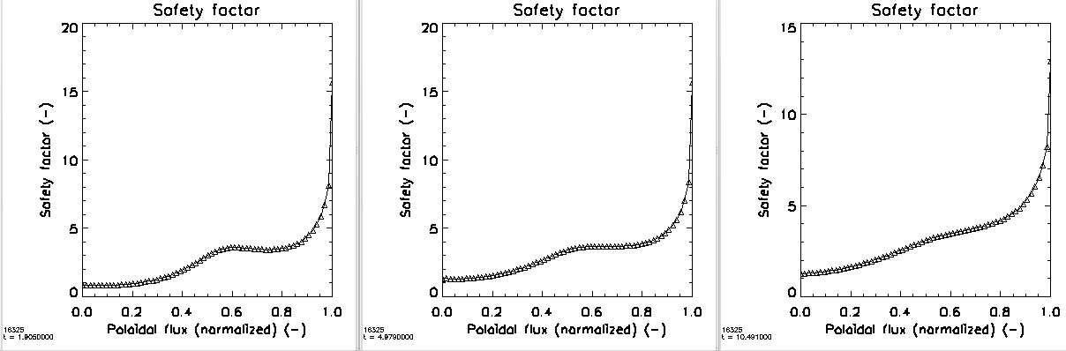

Kinetic EFIT reconstructed again shows evolution to low-sheared q-profiles but now at high q
10⁶
Current profile components
Magnetic spectrogram
TRANSP
(71% non-inductive)
16325 t=2.05s
Tearing modes absent
Kinetic + MSE reconstructed q profile evolution
20
20
15
t=1.906s
t=4.979s
t=10.491s
15
15
q
q
10
Low shear forms again, but at high q
q
10
10
$$q_{min}<1$$
5
5
5
0
0
0
0.0 0.2 0.4 0.6 0.8 1.0
ψ_{N}
0.0 0.2 0.4 0.6 0.8 1.0
ψ_{N}
0.0 0.2 0.4 0.6 0.8 1.0
ψ_{N}

Slide 28
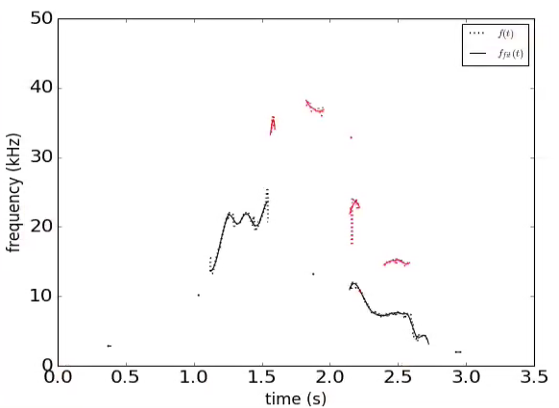
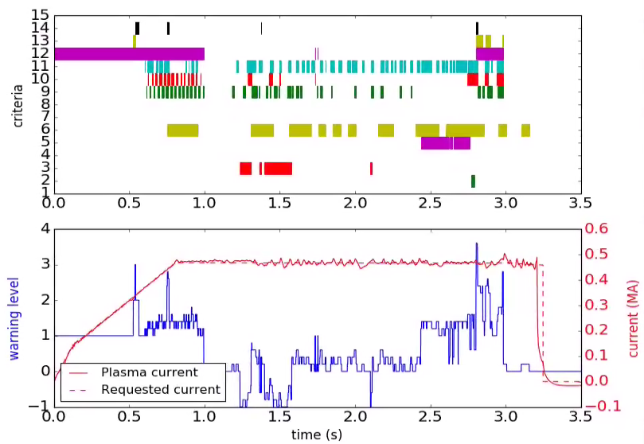
New DECAF MHD events are now being tested on KSTAR to define evolving disruption warning level
DECAF automated MHD objects
DECAF “heat map” (for MHD)
n
Plasma rotation profile
and dynamics
}
3
MHD-n1
2
MHD-n2
frequency (kHz)
condition
1
Decreasing β_{N} ➔
High amplitude mode ➔
KSTAR
16299
Very low frequency mode ➔
time (s)
MHD warning level
Mode locking at reduced plasma rotation
Key notables of MHD warning
  “Safe”/“unsafe” MHD periods
  Early disruption warning (300 ms) ➔ on transport timescale
warning level
Safe
See CP11.00110: J.D. Riquezes

Slide 29
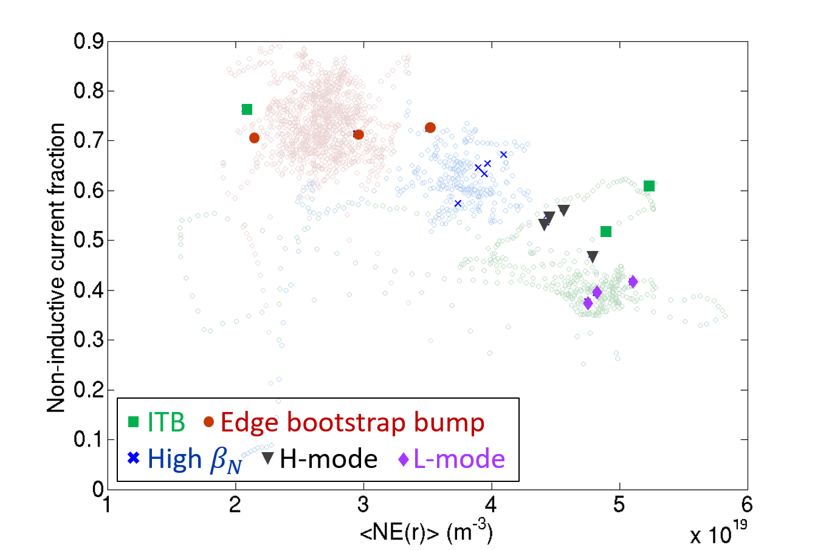
Kinetic reconstructions focused first on KSTAR plasmas with high-non-inductive fraction; NICF exceeds 75%
TRANSP analysis of experimental plasmas
Non-inductive fraction
  Beam-driven
  Bootstrap
Non-inductive fraction is key for stable high beta steady state operation
16498
16325
16295
18476
18492
Volume average electron density (m⁻³)
See CP11.00102: J.H. Ahn

Slide 30
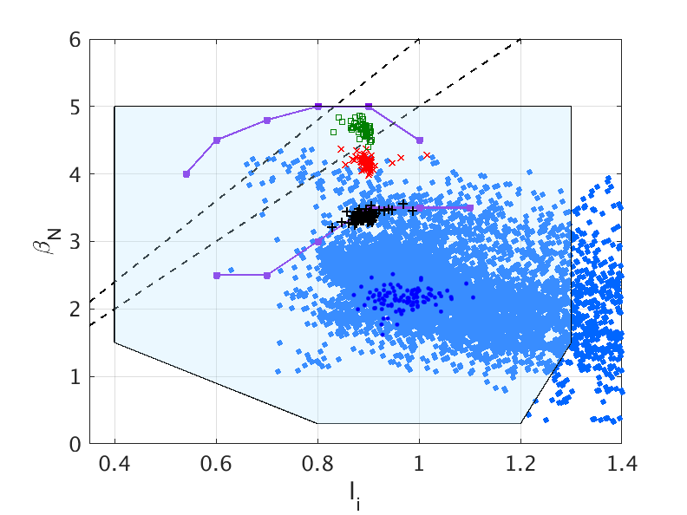
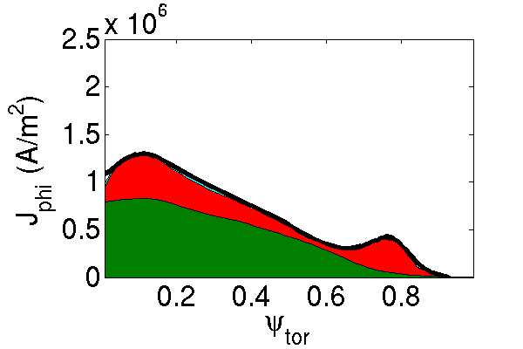



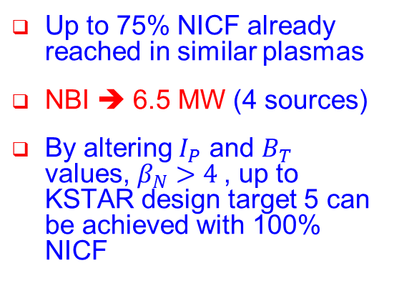

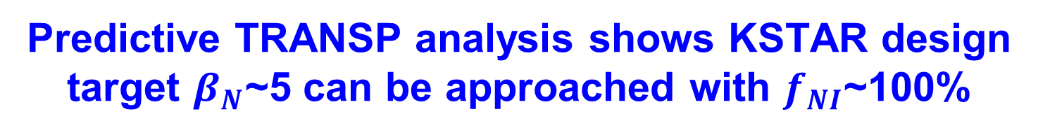

Predictive TRANSP analysis shows KSTAR design target $β_{N}$~5 can be approached with $f_{NI}$~100%
“Predict-first” analysis used to design high-β , 100% non-inductive current fraction (NICF) experiments for present KSTAR run campaign
$β_{N}$/$l_{i}$=6
$β_{N}$/$l_{i}$=5
<TRANSP>
$B_{T}$=1.5T
P_{NBI} = 6.5 MW
Predicted
n=1 with-wall limit
β_{N} = 3.4
f_{NI} = 96%
$B_{T}$=1.7T
$B_{T}$=2.0T
n=1 no-wall limit
Up to 75% NICF already reached in similar plasmas
NBI ➔ 6.5 MW (4 sources)
By altering $I_{P}$ and $B_{T}$ values, $β_{N}>4$, up to KSTAR design target 5 can be achieved with 100% NICF
Interpretive
See CP11.00102: J.H. Ahn

Slide 31
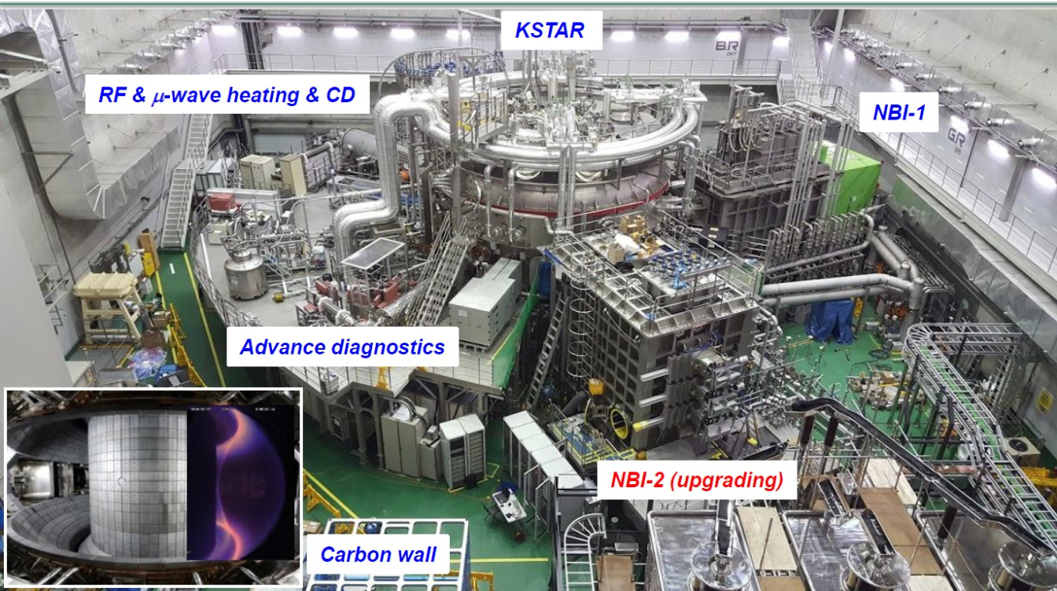
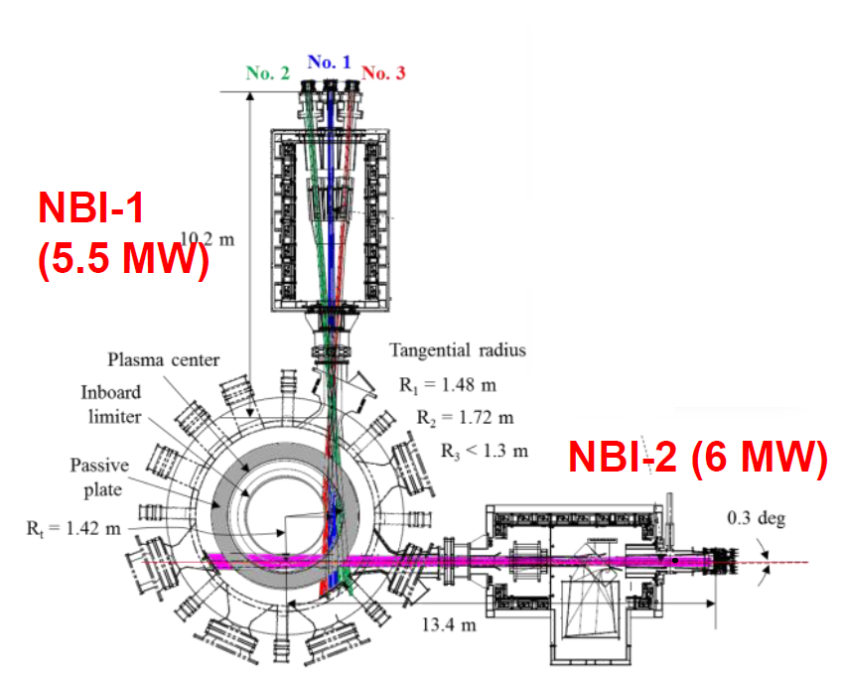
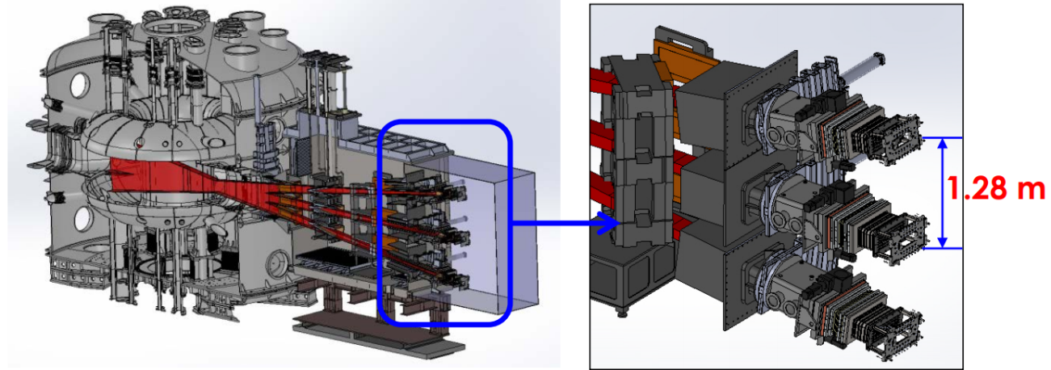
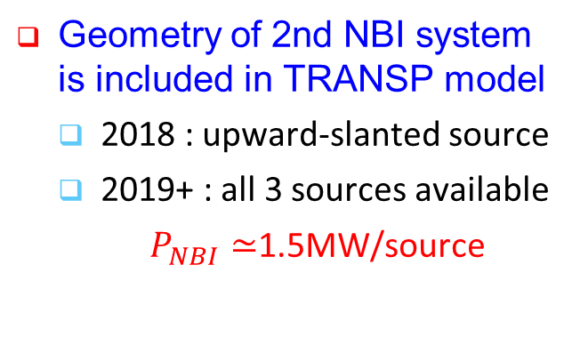
New 2nd NBI system is installed in KSTAR aims to be available for 2018 run campaign
90°
Geometry of 2nd NBI system is included in TRANSP model
  2018 : upward-slanted source
  2019+ : all 3 sources available
  $P_{NBI}≃$1.5MW/source

Slide 32
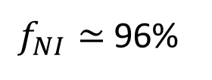
Predictive transport capability (TRANSP) allows “predict-first” projections for upcoming runs
6.5 MW NBI (2018)
$f_{NI}≃$96%
TRANSP 16325 | 2016 actual | 2018 NBI | 2019 NBI
NIC fract. (%) | 71% | 96% | 130%
β_{N} | 2.7 | 3.4 | 4.4
l_{i} | 0.9 | 0.91 | 0.95
T_{i}(0) (keV) | 4.5 | 5.5 | 7.2
T_{e}(0) (keV) | 4.6 | 3.3 | 3.3
n_{e}(0) (10²⁰m⁻³) | 5.2 | 5.6 | 5.5
f_{Greenwald} | 0.5 | 0.5 | 0.5
H_{98y2} | 1.25 | 1.25 | 1.25
16325 projection
Project from existing KSTAR plasmas
  Set fraction of Greenwald density and confinement factor ITER H_{98y2}
    Neoclassical ion transport, electron transport set to match H_{98y2}
  KSTAR 1st and 2nd NBI systems are modeled (incl. aiming angles); power levels set realistically based on MSE needs, etc.

Slide 33
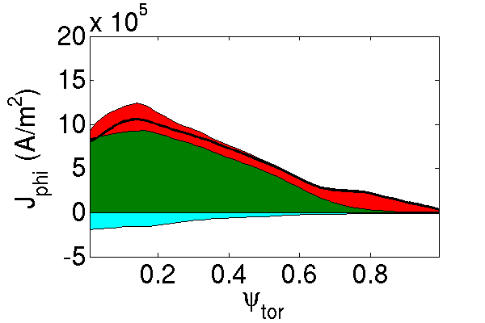
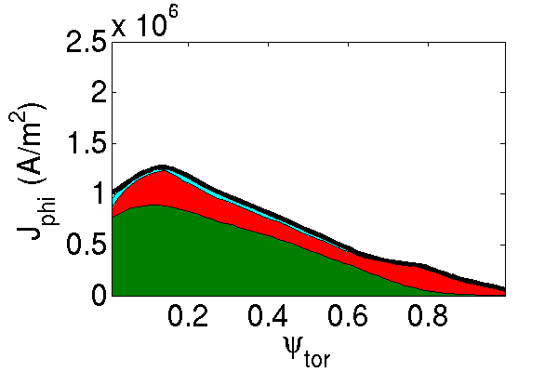
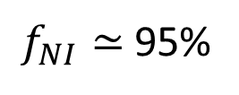

Transport analysis projections allow for variations of plasma parameters to meet targets
6.5 MW NBI (2018)
TRANSP 16295 (B_{T}; I_{p}) | 2016 actual (1.2T) | 2018 NBI (1.2T) | 2018 NBI | 2019 NBI
NIC fract. (%) | 67% | 105% | 95% | 126%
β_{N} | 3.5 | 5.4 | 3.5 | 4.4
l_{i} | 0.9 | 0.83 | 0.95 | 0.84
T_{i}(0) (keV) | 3.6 | 4.8 | 5.4 | 7.3
T_{e}(0) (keV) | 2.3 | 2.8 | 3.2 | 3.3
n_{e}(0) (10¹⁹m⁻³) | 6.0 | 4.8 | 5.6 | 5.6
f_{Greenwald} | 0.6 | 0.5 | 0.5 | 0.5
H_{98y2} | 1.25 | 1.25 | 1.25 | 1.25
$f_{NI}≃$105%
(2T, 0.5 MA)
16295
B_{T}=1.2T, I_{p}=0.44 MA
6.5 MW NBI (2018)
$f_{NI}≃$95%
B_{T} = 2T, I_{p} = 0.5 MA

Slide 34
Initial analysis of large databases further supports published result that disruptivity doesn’t increase with plasma β
MAST
KSTAR
NSTX
DIS
DECAF analysis of event
  Similar to a “standard” disruptivity analysis
  Shots analyzed at 10 ms intervals
Analysis during I_{p} flat-top
  MAST: 8902 plasmas analyzed
  NSTX: 10,432 plasmas analyzed
  KSTAR: 1309 plasmas analyzed

