Slide 1




Application of transient CHI plasma start-up to future ST and AT devices
K. C. Hammond,¹ R. Raman,² S. C. Jardin,³ and F. Volpe⁴
¹Max Planck Institute for Plasma Physics, Greifswald, Germany
²University of Washington, Seattle, Washington, USA
³Princeton Plasma Physics Laboratory, Princeton, New Jersey, USA
⁴Columbia University, New York, New York, USA
60th Annual Meeting of the APS Division of Plasma Physics
Portland, Oregon, USA
November 8, 2018
Notes:
S.C. Jardin

Slide 2
Motivation
The ability to start up a tokamak plasma without a central solenoid is desirable for reactor design
Multiple approaches pursued to date
  Induction from poloidal field coils
  Radio-frequency heating and current drive
  Helicity injection (point-source, coaxial)
Advantages of transient Coaxial Helicity Injection (CHI)
  Successful implementation on HIT-II, NSTX, QUEST
  Favorable scaling to larger devices
Notes:
Before, I show why, I will briefly go over some introductory material that is necessary to know.
One of the most important feedback from the last presentation was that you should say very early that:
What is new – spatially resolved calculations
First time these have been conducted, especially for CHI type plasmas.
Although in the past the experimental group was able to get by with adjusting the gas valve knobs and rely on intuition, calculations such as this are essential to future designs. It is through this study that the importance has now become known.
We need to figure out a way to say these early on – and then go over the introductory material. For the APS talk, it is Ok to go over the introductory material a bit faster (if time limit is an issue)
Try to think about how to start your talk by briefly saying that (1) I am going to talk about solenoid-free start-up in future reactors, 2) as part of this study we found that it is really important (essential) to do detailed modeling of the Townsen valance theory …, 3) this talk will say why, 4) First let me go over some intructory material that is necessary to put things in perspective.

Slide 3
Motivation
Plasma breakdown requirements must be carefully considered for future CHI implementations
  Plasma must break down in a particular location in order to work
  Weaknesses of previous designs could become show-stopping issues
In this talk: assessment of feasibility for next-step devices
  Review of transient CHI start-up
  Development model to predict CHI breakdown feasibility and location
  Modeling of breakdown in two previously-successful configurations
  Projections for attainable plasma parameters in larger devices
Notes:
That being said, the scaling laws all assume that the CHI technique was able to break down the plasma successfully.
However, until this work breakdown in CHI has not been modeled in detail.
But this does need to be taken into careful consideration.

Slide 4
Outline
Review of transient CHI start-up
Model to predict CHI breakdown feasibility and location
Assessment of different CHI electrode concepts
Predictions for CHI in next-step devices

Slide 5
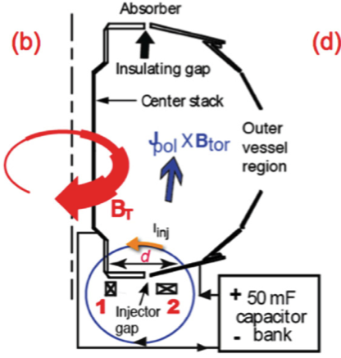
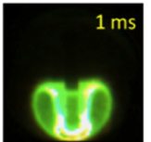
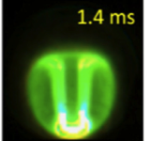
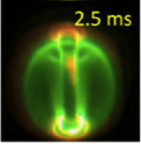
Transient CHI converts a brief DC plasma discharge to a toroidal plasma with closed flux surfaces
Hardware requirements
  Two axisymmetric electrodes
  Toroidal field + poloidal flux between electrodes
  Sufficient prefill gas for breakdown
Plasma development
  Current flows between electrodes along field lines
  J × B forces expand plasma into vessel
  Reconnection leads to closed flux surfaces
  Fast reduction of injector current enables
  efficient conversion of injector flux to
  poloidal flux
Raman et al., Phys. Plasmas 2011
Notes:
Transient CHI happens on a relatively fast time-scale. On NSTX note that the voltage application phase is over by 2.5ms. In reactors it will take about 10ms, after that the CHI system is turned off. This makes it easier to establish the breakdown in the region where we would like it happen (instead of someplace else). A good example is QUEST, where the undesirable arcing is much less pronounced than originally suspected.
Steady-state or driven CHI: After pulling the flux into the vessel, you continue to drive open field line currents and rely on non-axisymmetric MHD modes to drive current through dynamo action. While this was the approach originally tried on NSTX, the very low temperature of the resulting plasma did not allow it be coupled to inductive drive.
Transient CHI: On the time-scale that the plasma fills the vessel, we reduce the injector current. If in addition, the injector flux footprints are also narrow, then the expanded plasma can detach from the injection electrode and form a closed flux configuration (analogous to blowing a soap bubble)
Point to the parameter ‘d’ in the cartoon, and let them know that this will be used in the next page. ‘d’ is not the physical separation between the hardware electrode components, but rather the effective separation between the injector flux footprint widths, so it can be controlled and adjusted using the PF coils that are adjacent to the main injector flux coil.

Slide 6
Key parameters for CHI
Injector current I_{inj} must meet bubble-burst condition for plasma to expand from injector to main vessel
Toroidal current generation is proportional to the ratio of toroidal flux ψ_{tor} to injector flux ψ_{inj}
Capacity to generate plasma current I_{p} is proportional to ψ_{inj}
Jarboe, Fusion Technol. 1989
Notes:
The first relation is derived by balancing the magnetic field line tension with the force needed to stretch these field lines and is described in Jarboe’s 1989 paper.
As you reduce ‘d’ it becomes much more difficult to pull the injector flux out.
As you increase the injector flux, again it becomes much more difficult.
The Bt helps reduce the amount of injector current needed to pull a given amount of flux into the vessel, and this is very important because ultimately there will be limits on how much current can be driven on electrode surfaces before impurity influx starts to become an issue.

Slide 7
Milestones for transient CHI
HIT-II: closed flux surfaces and persistent I_{p} of 100 kA
(Raman et al., PRL 2003)
NSTX: 160 kA I_{p} = 60 × I_{inj} (Raman et al., PRL 2006)
NSTX: Handoff to Ohmic heating with inductive flux savings (Raman et al., PoP 2011)
NIMROD: confirms interpretation of flux surface formation (Ebrahimi et al., PRL 2015; Nucl. Fusion 2016)
QUEST: startup with localized single divertor toroidal electrode (Kuroda et al., PPCF 2018)
Pegasus (URANIA): double-biased toroidal divertor electrode
Notes:
I added divertor, to avoid confusion with point source helictiy injection which uses localized electrodes.

Slide 8
Outline
Review of transient CHI start-up
Model to predict CHI breakdown feasibility and location
Assessment of different CHI electrode concepts
Predictions for CHI in next-step devices

Slide 9
Assessment of CHI breakdown applies the Townsend avalanche theory on a flux-tube-resolved basis in the tokamak cross-section
Townsend avalanche theory
  Key parameters: gas pressure p, electric field E, connection length L_{c}
  Predictions: minimum E for breakdown, time τ_{bd} to break down
  (Lloyd et al., Nucl. Fusion 1991)
Spatially-resolved analysis of the tokamak cross-section
  Properties of each flux tube are considered independently
  DIII-D: breakdown occurs closer to location of maximum flux-tube electric potential than to the poloidal field null (Lazarus et al., Nucl. Fusion 1998)
Combined approach: apply avalanche theory to each flux tube
  Should indicate where breakdown can occur and is most likely to occur
  Helpful for Ohmic discharges; crucial for CHI
Notes:
Consider expanding on the DIII-D point
Even though the Townsend conditions were derived for parallel plate electrodes, it works well for toroidal systems as long as you do the detailed calculations for the field line configuration.

Slide 10
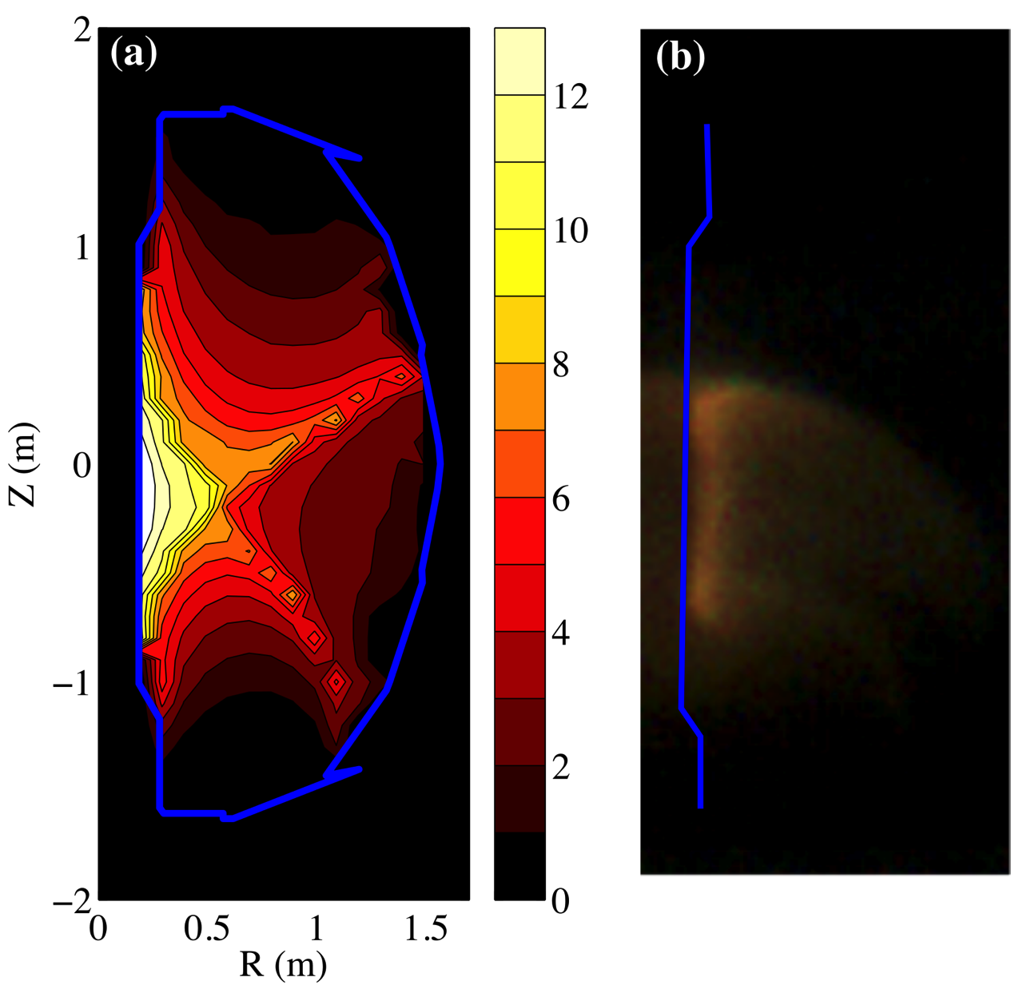
Flux-tube-resolved calculation successfully predicts breakdown location for Ohmic discharges in NSTX
Plasma should form in flux tubes with greatest relative electric field, E_{mean}/E_{min}
E_{mean}, E_{min} parametrized by r, z in poloidal cross-section
Calculation
Fast-camera image
Hammond et al., Nucl. Fusion 2018
Notes:
Before evaluating CHI breakdown in this flux tube resolved way, we first compared its predictions with results for Ohmic discharges in NSTX.
The quantity we’ll study here is the mean field in the flux tube relative to the minimum field required for breakdown.
We would expect that breakdown would tend to occur in flux tubes where this quantity is the greatest.
Here we parametrize the flux tubes in terms of the r and z coordinates of each flux tube in the poloidal plane.
The mean electric field comes from the average Ohmically induced field along each flux tube, and the minimum electric field is dictated by the Townsend avalanche theory.
Contours of this relative electric field are shown in the left-handed plot for a sample NSTX discharge.
The maximum is near the center post, slightly below the midplane.
Comparing to a fast-camera image of breakdown, with the silhouette of the center post shown as a blue line, we see that this maximum in relative electric field agrees well with the prediction.

Slide 11
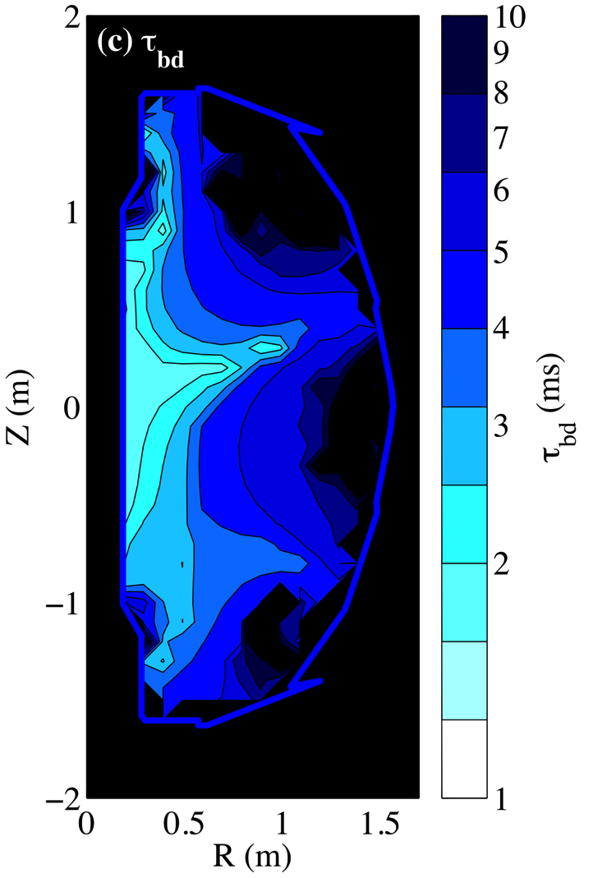
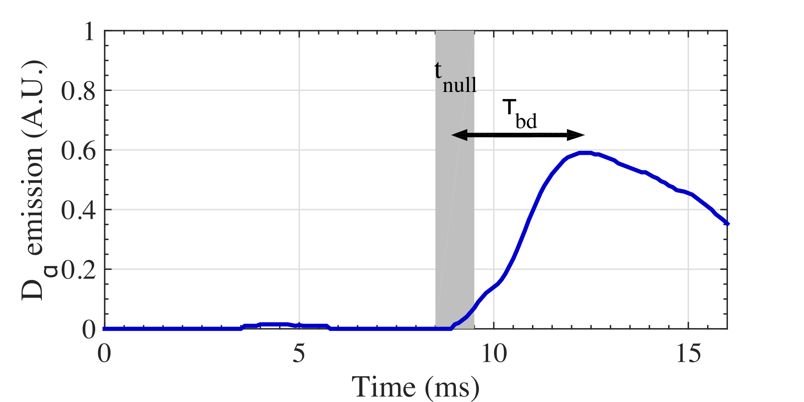
E_{mean}(r,z) can be used to predict the time required for breakdown
Model avalanche by balancing ionizations with end losses:
Time to reach
50% ionization:
Predicted τ_{bd} agrees well with experiment:
τ_{bd}, model prediction
Notes:
We can also use this mean electric field to predict the time required for breakdown on a given flux tube.
The time estimate comes a model of the avalanche as a particle balance accounting for impact ionizations and losses through the strike points of each field line.
The time constants for ionization and end losses both depend on the mean electric field, density, and species.
The breakdown time is defined as the time to attain 50% ionization.
On the left, I have plotted breakdown time, again as a function of flux tube in the RZ plane, for another sample NSTX shot.
As a verification, we can look at the signal from a D-alpha filterscope, which should show a peak around the breakdown time.
Here on the plot, we see that emission starts to rise around t=9 ms, the point in the PF coil ramp where a connection lengths are maximized in the vessel.
The curve reaches a peak about 3 ms after this null time, in good agreement with the smallest breakdown time predicted in the plot.

Slide 12
Adapting the model to CHI discharges
E_{mean} arises from electrode bias rather than loop voltage:
Difficult to model experiments precisely
  Breakdown occurs immediately after release of gas to injector
  Distribution of gas p(r,z) is non-uniform and time-varying
Can still estimate requirements for CHI breakdown
in future devices:
  At what pressure can breakdown occur?
  What plasma temperatures are attainable with the amount of gas used?
Notes:
Thus, decent agreement with the model has been established for Ohmic discharges.
To apply this to CHI discharges, the principal change is that the mean electric field now arises from electrode bias rather than loop voltage.
It does introduce a practical difficulty for model comparison, however.
In the case of Ohmic heating, it’s reasonable to assume a uniform background pressure throughout the vessel, which makes the modeling relatively straightforward.
This is not the case for the usual CHI breakdown scenario, where gas is expected to break down immediately after it is released into the lower divertor.
This makes precise modeling difficult.
However, we can use it to address some key questions about the feasibility of breakdown in proposed CHI configurations in future devices.
For one, by equating the mean electric field with the minimum required electric field, we can derive an expression for the lowest pressures at which breakdown is feasible.
This pressure will ultimately set a limit on the temperature that the discharge can attain, and therefore whether it can be efficiently handed off to steady-state heating sources.

Slide 13
Outline
Review of transient CHI start-up
Model to predict CHI breakdown feasibility and location
Assessment of different CHI electrode concepts
Predictions for CHI in next-step devices

Slide 14
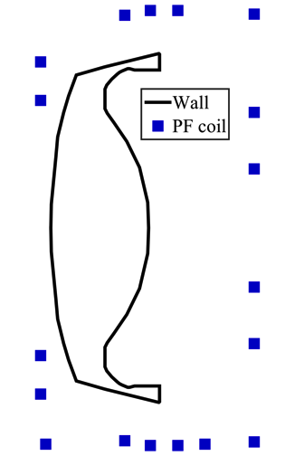
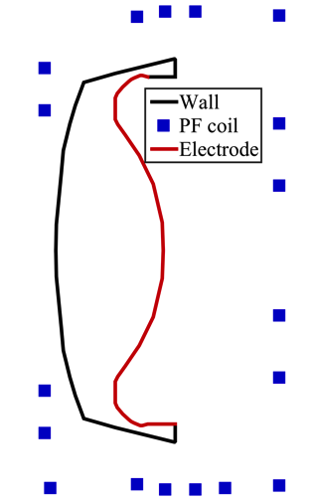
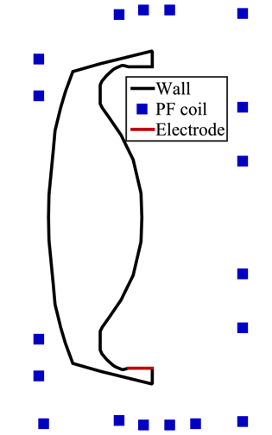
Electrode concepts will use the geometry of a ST-FNSF
Two concepts for CHI electrodes:
  “NSTX-like”: entire outer wall is biased
  “DIII-D-like”: axial ring in lower divertor
Brown, Menard, et al.,
Fusion Sci. Technol. 2015
Notes:
Added note to say this is Jon Menard / Tom Brown design
Note that on the top of the blanket region there is region where you can put an insulated toroidal electrode
The blanket structure shields the insulator from neutron irradiation for the life time of the reactor, and it can also be easily replaced if needed.

Slide 15
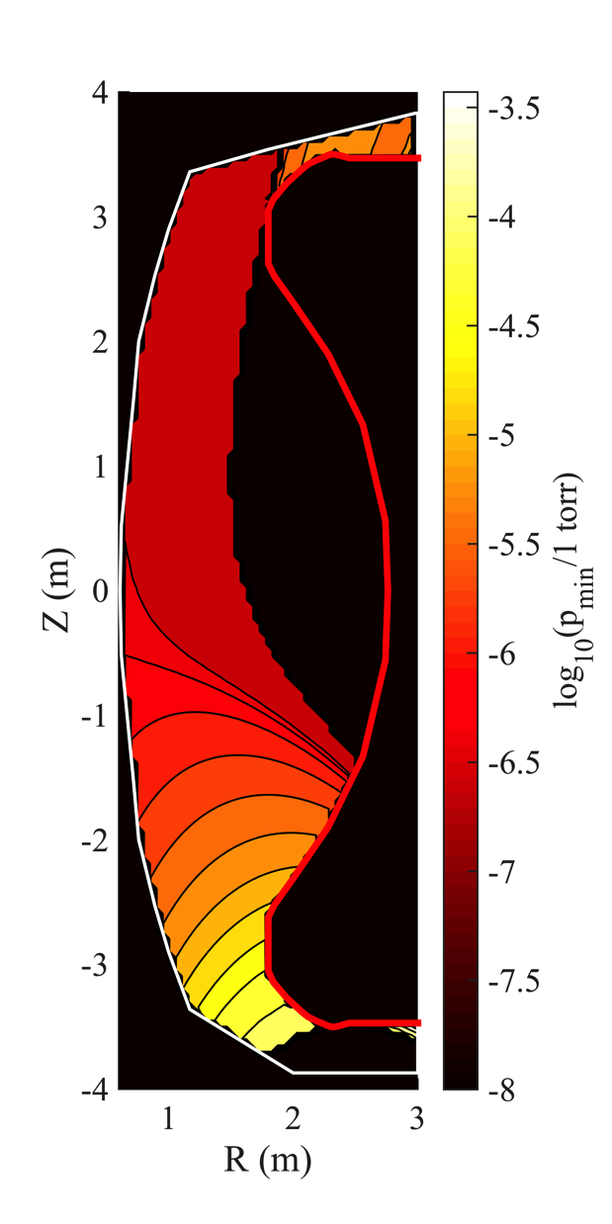
NSTX-like electrode concept is vulnerable to parasitic breakdown in main vessel
10⁻⁴
Breakdown is intended to occur in the divertor area
Longer connection lengths in main vessel could permit breakdown at p ~ 10⁻⁷ torr, where as p_{min} > 10⁻⁴-10⁻⁵ torr in injector
Breakdown in main vessel would prevent efficient injection of current and flux
10⁻⁵
p_{min} (torr)
10⁻⁶
10⁻⁷
10⁻⁸
Notes:
After evaluating the pressure requirement for breakdown in the NSTX-like setup, with the entire outer wall biased, one quickly sees a problem.
We see that in the lower divertor area, breakdown can occur at around 10^-5 torr, which is reasonably low.
However, the main part of the vessel is much more susceptible to breakdown, which could occur at pressures as low as 10^-8 torr.
Therefore, in this case, the discharge could occur in the main vessel even if a small amount of gas leaks in, before there is a chance for breakdown in the injector.
This would lead to spurious arcing, and would prevent the helicity injection from the lower divertor.
Hence, this electrode layout is not desirable for next-step devices with higher fields and larger vessels.

Slide 16
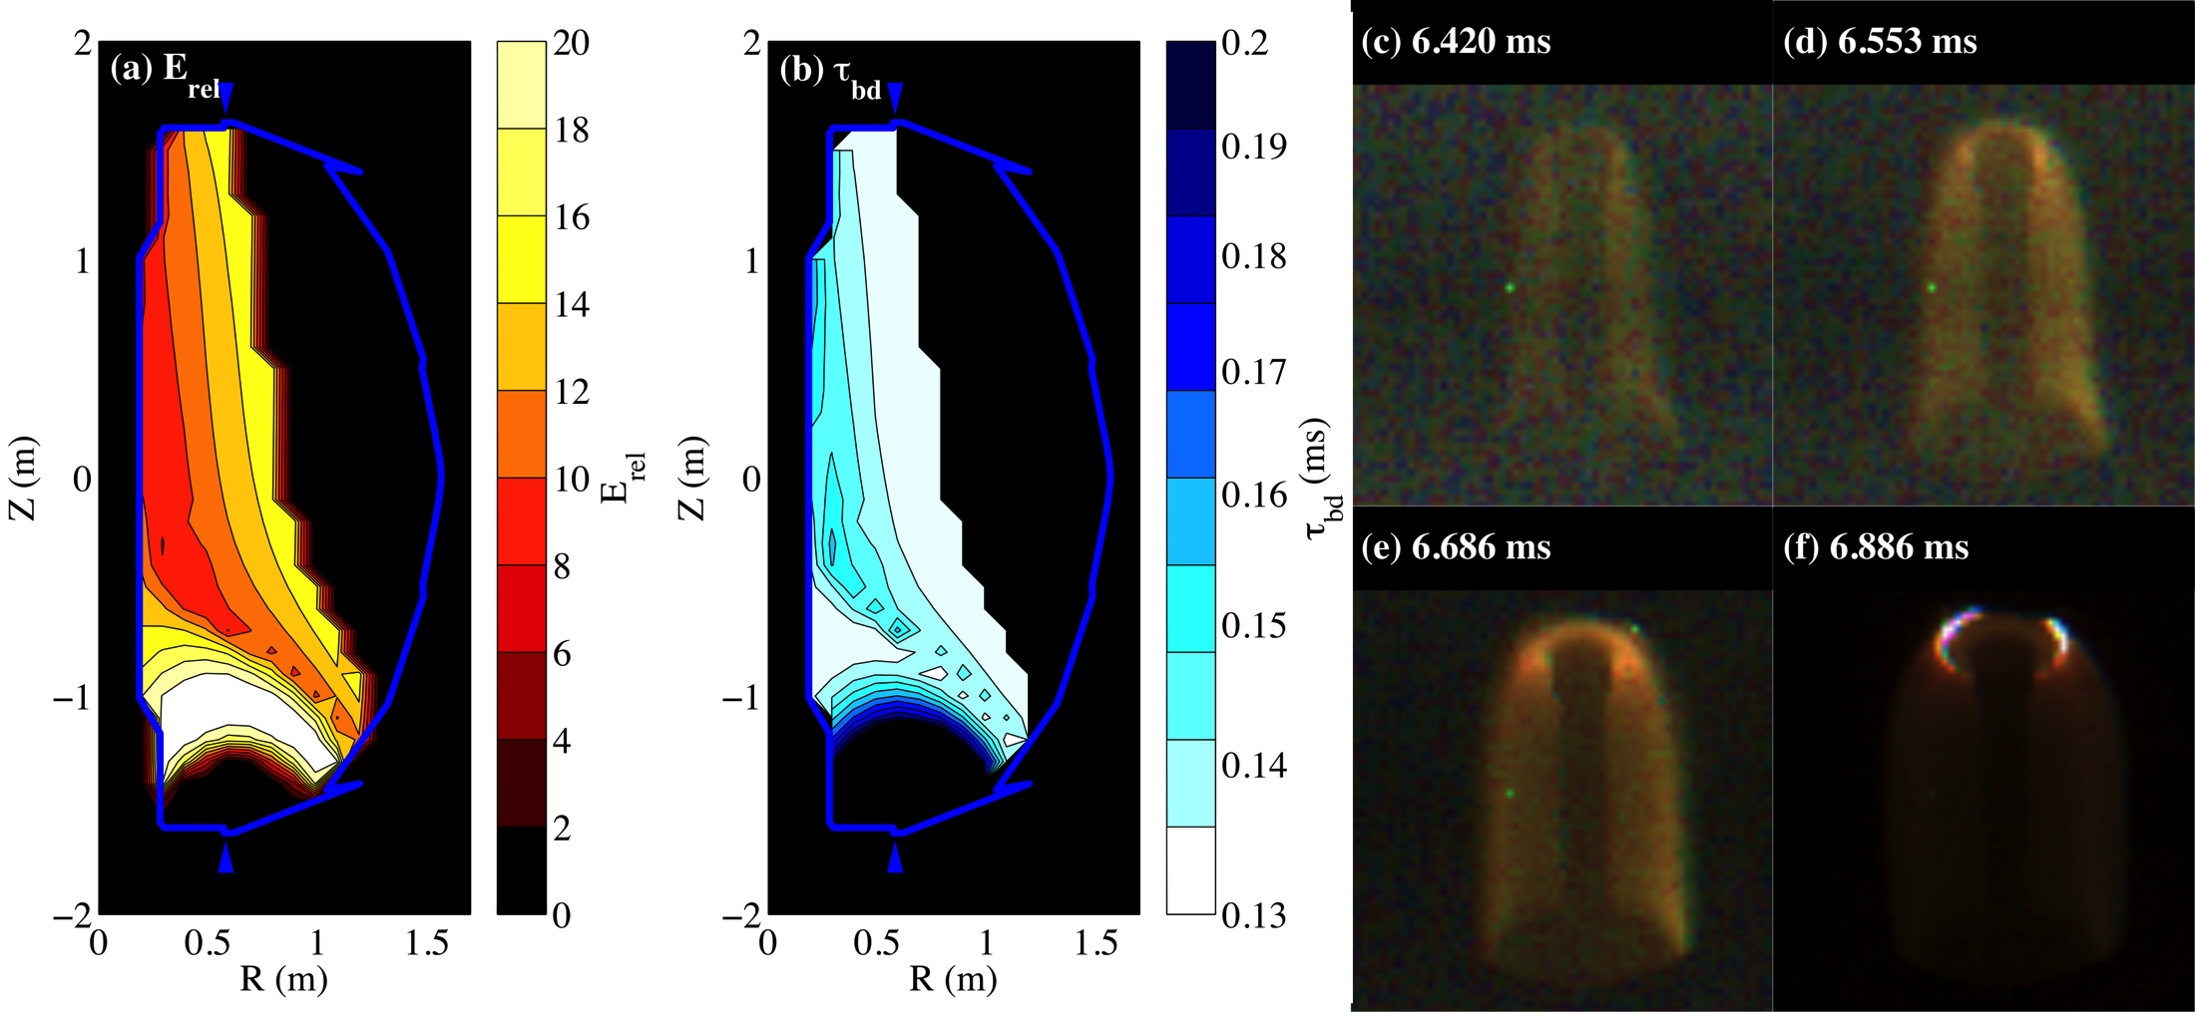
This effect was observed sometimes in NSTX, but NSTX was less vulnerable
Similar effect is predicted if
sufficient gas fills vessel
This was observed in some
cases where breakdown
failed in lower divertor
Occurrences were rare due to higher p_{min} in main vessel
Hammond et al., Nucl. Fusion 2018
Notes:
In future devices, the minimum breakdown pressure in the main chamber may not exceed the base pressure by very much, leaving less room for error.
And this isn’t just a theoretical concern – this effect was actually observed sometimes in NSTX.
If one assumes sufficient pressure in the main vessel and evaluates the relative electric field, it is in fact predicted that a bell-shaped discharge can form within a few hundred microseconds.
This would happen occasionally in cases where breakdown failed to occur immediately in the lower divertor area.
In that case, the unionized working gas would fill the entire vessel.
While the pressure wasn’t high enough to break down in the lower divertor, it did exceed the minimum requirement in the main vessel where the field lines were longer.
This wasn’t a show-stopper for NSTX in general, because the pressure still needed to be relatively high to enable these main-vessel discharges.
However, in a reactor with connection lengths more than two orders of magnitude longer, the vulnerability will be much greater.
Thus, the concept was OK for NSTX, but not for a reactor.

Slide 17
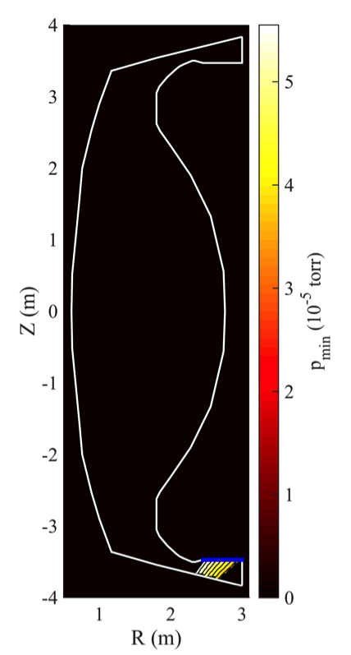
Localizing the biased electrode to the lower target eliminates this risk
In the “DIII-D-like” concept, breakdown is restricted to the lower divertor area
Minimum pressure still relatively low with comparable injector flux smaller devices
Notes:
Many years ago, (before the development of the transient CHI concept), d3d had a toroidal ring electrode in the lower divertor region. It was used for biasing experiments and it was also used to generate driven CHI discharge, and from an engineering point of view the system worked very well.

Slide 18
Outline
Review of transient CHI start-up
Model to predict CHI breakdown feasibility and location
Assessment of different CHI electrode concepts
Predictions for CHI in next-step devices

Slide 19
Configuration comparison
Injector flux will be much higher than previously used
  Permissible due to higher toroidal fields
  More injector flux will permit attainment of higher closed-flux currents (I_{p})
  More poloidal flux means more stored energy for Ohmic self-heating
Notes:
At the larger aspect ratio we are assuming that AT type discharges will be developed.
ST and AT type discharges share many similarities needed for Advanced Tokamak operation such as high fraction of bootstrap current made possible by operating the system with optimized pressure profiles to reduce auxiliary current drive requirements.

Slide 20
Key expected quantities
Quantity | ST, B₀ = 3 T | ST, B₀ = 6 T | AT, B₀ = 6 T | AT, B₀ = 9 T
R_{maj} | 1.7 m | 1.7 m | 2.4 m | 2.4 m
ψ_{inj} | 1.0 Wb | 1.0 Wb | 1.0 Wb | 1.0 Wb
Notes:
-- The first two rows cover the the major radius and our desired injector flux, which we have set to 1 Weber in every case. This is much higher than in any experiment to date, and will enable similarly higher plasma currents.
-- Next are some required values. To produce 1 Wb flux, the PF coil current will need to be between 600 and 800 kA-turns in each case (this is lower than the current limits in these coils, for example the Menard design permits >> 1MA-turn) – so, in principle it may be possible to generate closed flux currents in excess of the ~1MA assumed for these cases. Demonstration of current ramp-up from ~1MA to 2MA needs to be demonstrated.
-- With the connection lengths resulting from these fields, it should be possible to attain breakdown at just over 300 V injector bias, with pressures ranging from 4 mtorr in the low-field ST to 1 mTorr in the high-field AT.
-- These levels of injector flux should enable around a MA of plasma current through reconnection and the creation of closed flux in the vessel.
-- Considering the amount of gas in the injector region at the required breakdown pressure and expanding this into the main plasma volume, this leads to densities in the 10^-18 m^-3 range.
-- To address questions of whether this is viable for hand-off to steady-state sources, first consider that the CHI plasma will naturally heat itself Ohmically through the decay of its own poloidal flux. Assuming the plasma decays in 200 ms overall, this self-heating power will be in the MW range. For reference, it would typically take 20 ms for 50 mWb to decay away in NSTX. Should the decay time end up being shorter, this will just mean more self-heating power. Furthermore, as the temperature rises, confinement should improve, and the decay rate is expected to slow down.
-- In addition, one has the option of using ECRH to supplement the self-heating. Since the cutoff densities for ECRH are at least an order of magnitude above the expected plasma densities, it is not expected that the CHI plasma will be overdense.

Slide 21
Key expected quantities
Quantity | ST, B₀ = 3 T | ST, B₀ = 6 T | AT, B₀ = 6 T | AT, B₀ = 9 T
R_{maj} | 1.7 m | 1.7 m | 2.4 m | 2.4 m
ψ_{inj} | 1.0 Wb | 1.0 Wb | 1.0 Wb | 1.0 Wb
I_{inj} | 310 kA | 160 kA | 110 kA | 73 kA
PF coil current | 780 kA turns | 780 kA turns | 610 kA turns | 610 kA turns
V_{min} | 310 V | 310 V | 310 V | 310 V
p(V_{min}) | 4.0 × 10⁻³ torr | 2.0 × 10⁻³ torr | 1.5 × 10⁻³ torr | 1.0 × 10⁻³ torr
Notes:
-- The first two rows cover the the major radius and our desired injector flux, which we have set to 1 Weber in every case. This is much higher than in any experiment to date, and will enable similarly higher plasma currents.
-- Next are some required values. To produce 1 Wb flux, the PF coil current will need to be between 600 and 800 kA-turns in each case (this is lower than the current limits in these coils, for example the Menard design permits >> 1MA-turn) – so, in principle it may be possible to generate closed flux currents in excess of the ~1MA assumed for these cases. Demonstration of current ramp-up from ~1MA to 2MA needs to be demonstrated.
-- With the connection lengths resulting from these fields, it should be possible to attain breakdown at just over 300 V injector bias, with pressures ranging from 4 mtorr in the low-field ST to 1 mTorr in the high-field AT.
-- These levels of injector flux should enable around a MA of plasma current through reconnection and the creation of closed flux in the vessel.
-- Considering the amount of gas in the injector region at the required breakdown pressure and expanding this into the main plasma volume, this leads to densities in the 10^-18 m^-3 range.
-- To address questions of whether this is viable for hand-off to steady-state sources, first consider that the CHI plasma will naturally heat itself Ohmically through the decay of its own poloidal flux. Assuming the plasma decays in 200 ms overall, this self-heating power will be in the MW range. For reference, it would typically take 20 ms for 50 mWb to decay away in NSTX. Should the decay time end up being shorter, this will just mean more self-heating power. Furthermore, as the temperature rises, confinement should improve, and the decay rate is expected to slow down.
-- In addition, one has the option of using ECRH to supplement the self-heating. Since the cutoff densities for ECRH are at least an order of magnitude above the expected plasma densities, it is not expected that the CHI plasma will be overdense.

Slide 22
Key expected quantities
Quantity | ST, B₀ = 3 T | ST, B₀ = 6 T | AT, B₀ = 6 T | AT, B₀ = 9 T
R_{maj} | 1.7 m | 1.7 m | 2.4 m | 2.4 m
ψ_{inj} | 1.0 Wb | 1.0 Wb | 1.0 Wb | 1.0 Wb
I_{inj} | 310 kA | 160 kA | 110 kA | 73 kA
PF coil current | 780 kA turns | 780 kA turns | 610 kA turns | 610 kA turns
V_{min} | 310 V | 310 V | 310 V | 310 V
p(V_{min}) | 4.0 × 10⁻³ torr | 2.0 × 10⁻³ torr | 1.5 × 10⁻³ torr | 1.0 × 10⁻³ torr
I_{p} | 1.1 MA | 1.1 MA | 0.77 MA | 0.77 MA
n_{plasma} | 6 × 10¹⁸ m⁻³ | 3 × 10¹⁸ m⁻³ | 2 × 10¹⁸ m⁻³ | 1 × 10¹⁸ m⁻³
Notes:
-- The first two rows cover the the major radius and our desired injector flux, which we have set to 1 Weber in every case. This is much higher than in any experiment to date, and will enable similarly higher plasma currents.
-- Next are some required values. To produce 1 Wb flux, the PF coil current will need to be between 600 and 800 kA-turns in each case (this is lower than the current limits in these coils, for example the Menard design permits >> 1MA-turn) – so, in principle it may be possible to generate closed flux currents in excess of the ~1MA assumed for these cases. Demonstration of current ramp-up from ~1MA to 2MA needs to be demonstrated.
-- With the connection lengths resulting from these fields, it should be possible to attain breakdown at just over 300 V injector bias, with pressures ranging from 4 mtorr in the low-field ST to 1 mTorr in the high-field AT.
-- These levels of injector flux should enable around a MA of plasma current through reconnection and the creation of closed flux in the vessel.
-- Considering the amount of gas in the injector region at the required breakdown pressure and expanding this into the main plasma volume, this leads to densities in the 10^-18 m^-3 range.
-- To address questions of whether this is viable for hand-off to steady-state sources, first consider that the CHI plasma will naturally heat itself Ohmically through the decay of its own poloidal flux. Assuming the plasma decays in 200 ms overall, this self-heating power will be in the MW range. For reference, it would typically take 20 ms for 50 mWb to decay away in NSTX. Should the decay time end up being shorter, this will just mean more self-heating power. Furthermore, as the temperature rises, confinement should improve, and the decay rate is expected to slow down.
-- In addition, one has the option of using ECRH to supplement the self-heating. Since the cutoff densities for ECRH are at least an order of magnitude above the expected plasma densities, it is not expected that the CHI plasma will be overdense.

Slide 23
Key expected quantities
Quantity | ST, B₀ = 3 T | ST, B₀ = 6 T | AT, B₀ = 6 T | AT, B₀ = 9 T
R_{maj} | 1.7 m | 1.7 m | 2.4 m | 2.4 m
ψ_{inj} | 1.0 Wb | 1.0 Wb | 1.0 Wb | 1.0 Wb
I_{inj} | 310 kA | 160 kA | 110 kA | 73 kA
PF coil current | 780 kA turns | 780 kA turns | 610 kA turns | 610 kA turns
V_{min} | 310 V | 310 V | 310 V | 310 V
p(V_{min}) | 4.0 × 10⁻³ torr | 2.0 × 10⁻³ torr | 1.5 × 10⁻³ torr | 1.0 × 10⁻³ torr
I_{p} | 1.1 MA | 1.1 MA | 0.77 MA | 0.77 MA
n_{plasma} | 6 × 10¹⁸ m⁻³ | 3 × 10¹⁸ m⁻³ | 2 × 10¹⁸ m⁻³ | 1 × 10¹⁸ m⁻³
P_{self} | 4 MW | 4 MW | 3 MW | 3 MW
n_{co} for ECRH | 9 × 10¹⁹ m⁻³ | 35 × 10¹⁹ m⁻³ | 35 × 10¹⁹ m⁻³ | 78 × 10¹⁹ m⁻³
Notes:
-- The first two rows cover the the major radius and our desired injector flux, which we have set to 1 Weber in every case. This is much higher than in any experiment to date, and will enable similarly higher plasma currents.
-- Next are some required values. To produce 1 Wb flux, the PF coil current will need to be between 600 and 800 kA-turns in each case (this is lower than the current limits in these coils, for example the Menard design permits >> 1MA-turn) – so, in principle it may be possible to generate closed flux currents in excess of the ~1MA assumed for these cases. Demonstration of current ramp-up from ~1MA to 2MA needs to be demonstrated.
-- With the connection lengths resulting from these fields, it should be possible to attain breakdown at just over 300 V injector bias, with pressures ranging from 4 mtorr in the low-field ST to 1 mTorr in the high-field AT.
-- These levels of injector flux should enable around a MA of plasma current through reconnection and the creation of closed flux in the vessel.
-- Considering the amount of gas in the injector region at the required breakdown pressure and expanding this into the main plasma volume, this leads to densities in the 10^-18 m^-3 range.
-- To address questions of whether this is viable for hand-off to steady-state sources, first consider that the CHI plasma will naturally heat itself Ohmically through the decay of its own poloidal flux. Assuming the plasma decays in 200 ms overall, this self-heating power will be in the MW range. For reference, it would typically take 20 ms for 50 mWb to decay away in NSTX. Should the decay time end up being shorter, this will just mean more self-heating power. Furthermore, as the temperature rises, confinement should improve, and the decay rate is expected to slow down.
-- In addition, one has the option of using ECRH to supplement the self-heating. Since the cutoff densities for ECRH are at least an order of magnitude above the expected plasma densities, it is not expected that the CHI plasma will be overdense.

Slide 24
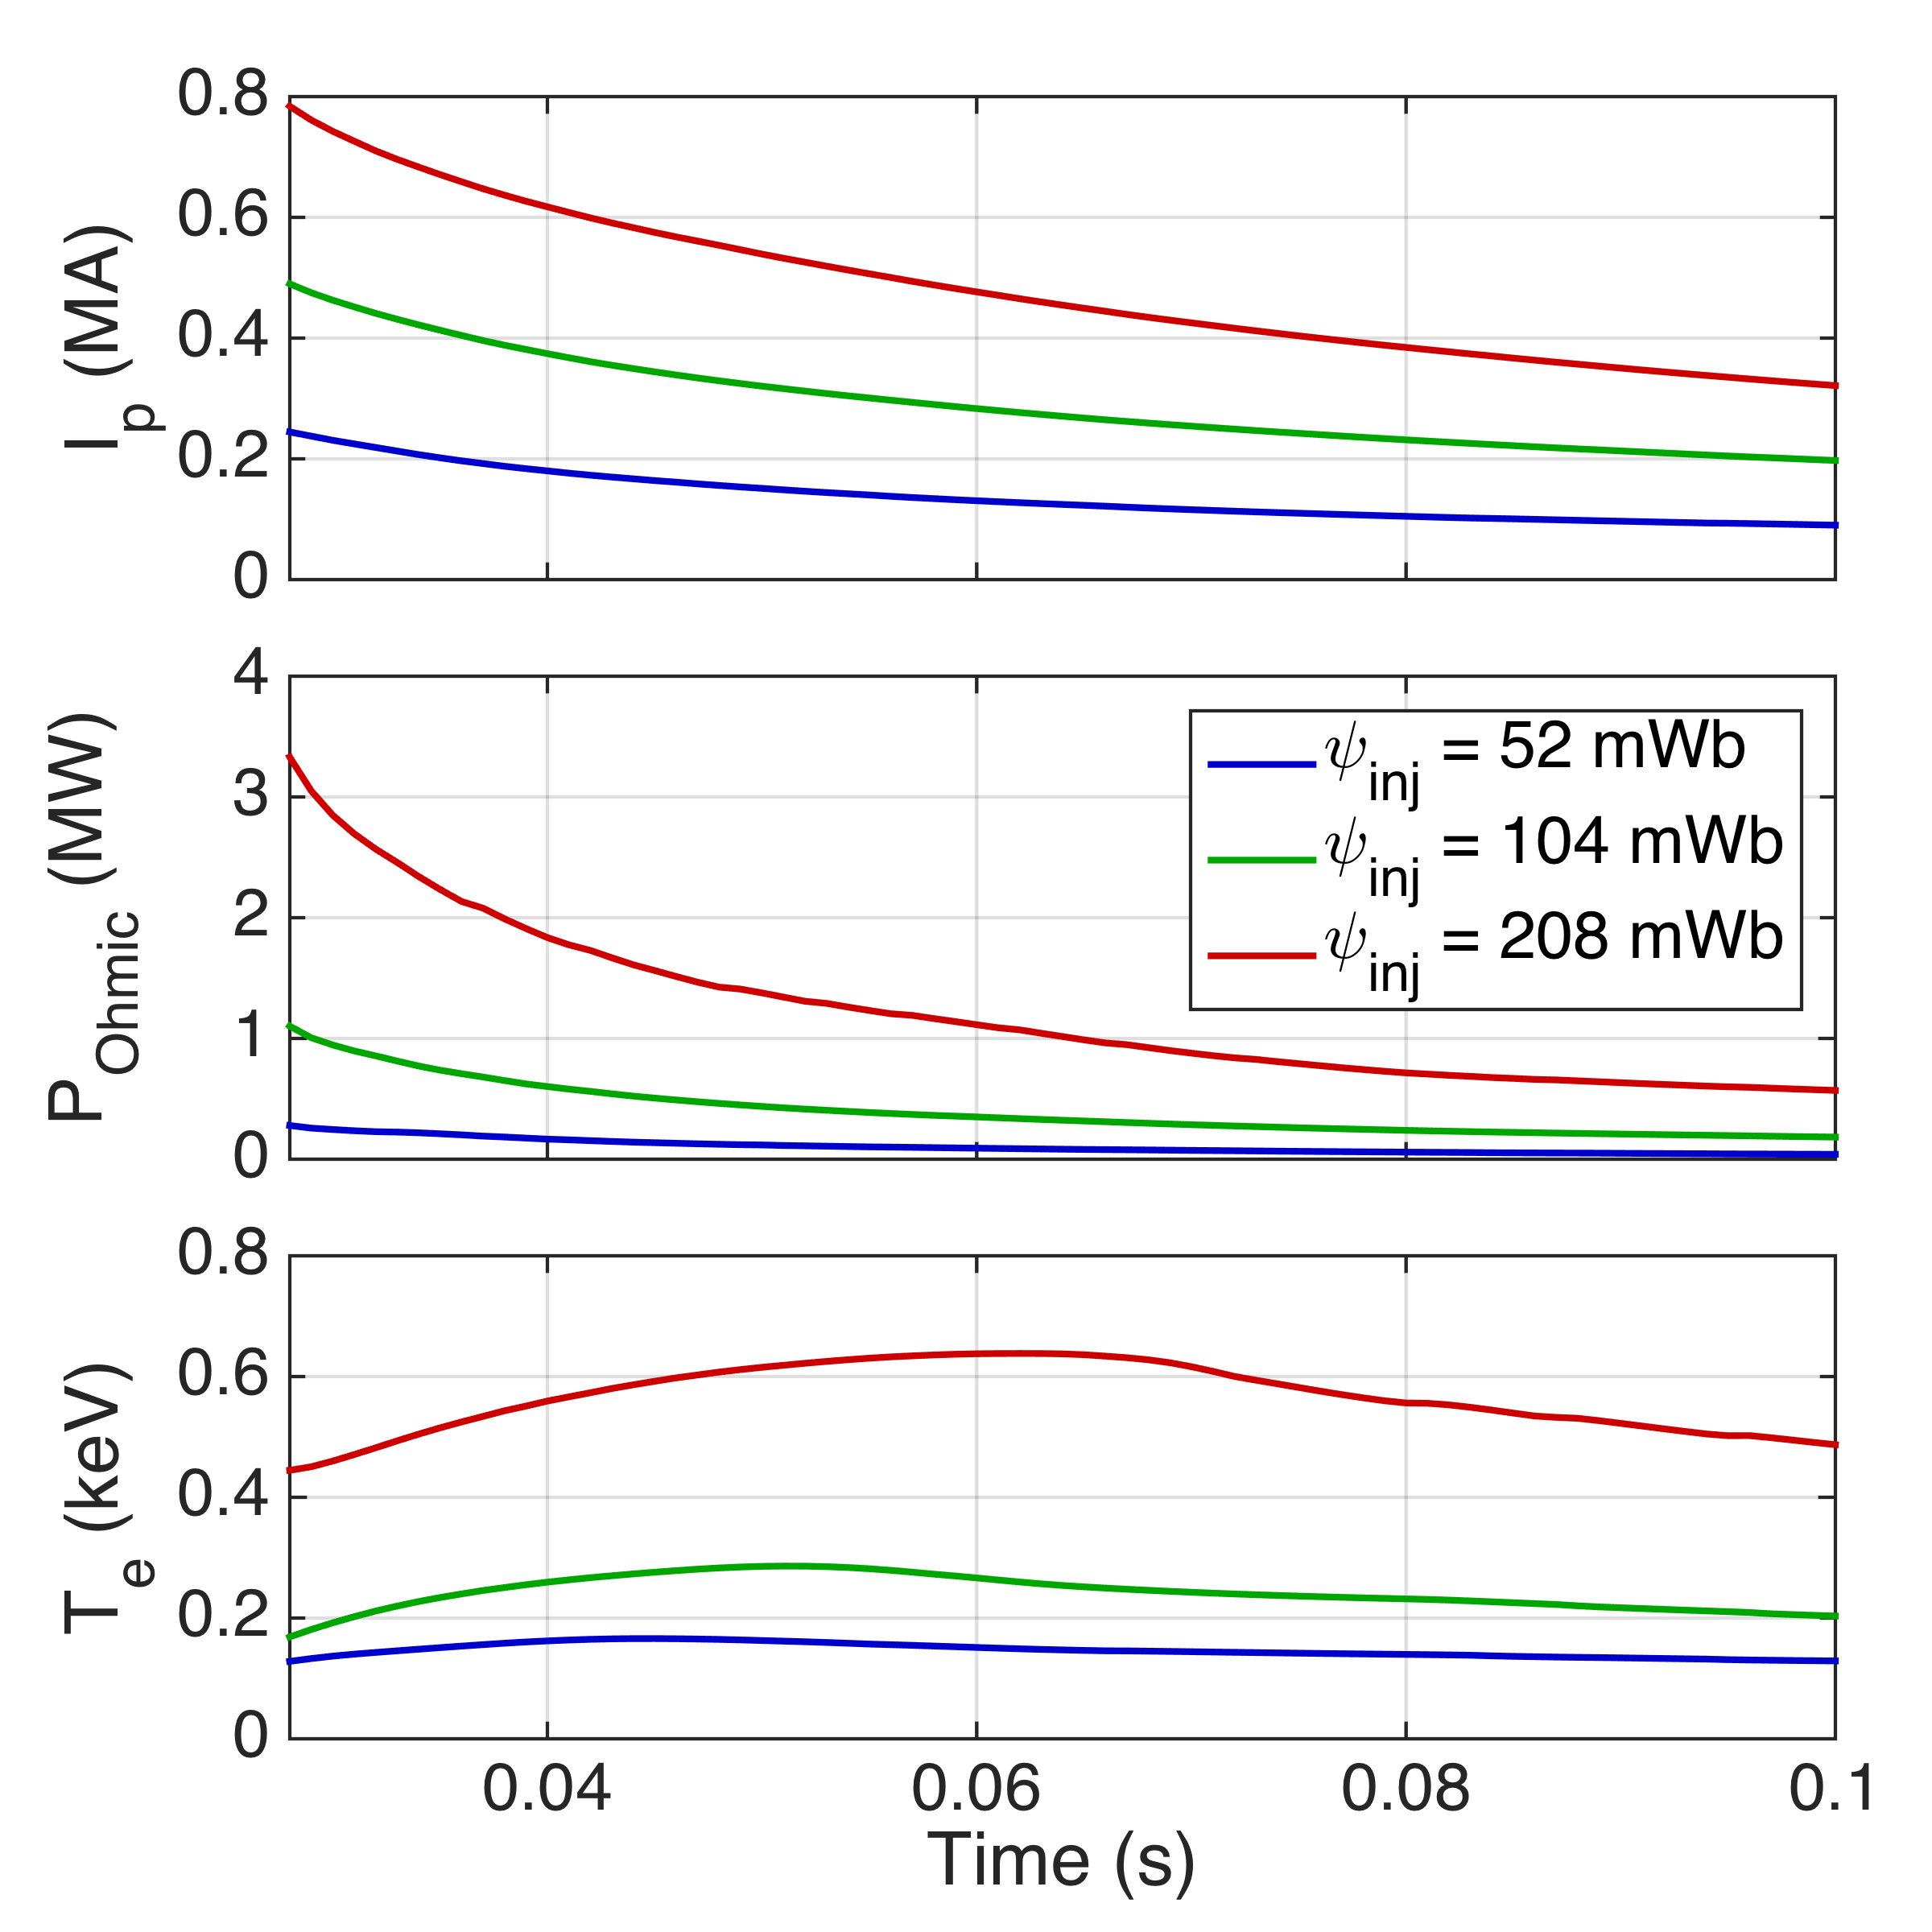
Simulations with TSC support expectations of higher current, self-heating power, and temperatures with increased injector flux
Tokamak Simulation Code (TSC)
  Time-dependent, free-boundary equilibrium and transport solver
  Solves MHD/Maxwell’s equations coupled to transport and Ohm’s law
Initial study: NSTX config. with increasing levels of injector flux:
  52 mWb (typical NSTX experiment), 104 mWb, and 208 mWb
Supports main predicted trends
  I_{p} increases in proportion with ψ_{inj}
  Heating power, T_{e} increase faster
Notes:
First plot demonstrates the scaling of current with injector flux
Fourth plot shows Ohmic self-heating power: note that Ohmic self-heating power increases substantially
Assumptions about energy transport are conservative; temperatures are probably underestimated
Note: low-Z electrodes are undesirable because their peak radiation occurs at low temperatures (20-30 eV)
So far, up to 25 kJ injected to NSTX transient CHI plasmas (charge in capacitors)
Future machines will use heavier elements; radiation power is relatively low below 100 eV
Third plot: normalized inductance: note that inductance starts out quite low (lower inductances are more MHD stable)
Time line: 17 ms is when transport equations start being solved (initially assumed to be zero), this is also where the injector bias is removed
Add backup slide on TSC information
1) Degraded Ohmic transport used (Te will be higher if standard Ohmic transport is used). NSTX geometry used (but this is not important)
2) Normally, tokamaks spend a lot of time to make a low inductance configuration by injecting neutral beams and to heat the edge plasma. The normalized plasma inductance for high performance plasmas on NSTX-U is projected to be less than ~0.7. One needs to injected NBI and heat the plasma to try to maintain this configuration during steady state operation. Transient CHI naturally gives you this initial condition.
3) Good possibility that transient CHI plasmas at high injector flux (with low-z impurity influx reduced through metal electrodes) will self heat to high Te, and this scaling favors extrapolation to reactor scale devices that rely on over 1 Wb of injector flux.
4) All discharges started with an initial Te of 100eV, but this is not important, starting with 50eV will produce the same result (I will try a case before your APS talk for a back-up slide, but I think this is not important)
5) I am also (separately) providing a plot starting at 17ms, at which time the transport equation calculations in TSC is turned on. Starting from this time TSC will find the correct temperature consistent with transport (so the initial 100 eV is not important). As you see, at the lower injector flux cases, the Te dips at about 25ms. This has something to do with the transoition from full open filed line discharge to the coil feed back system in TSCtrying to do the equilibrium control. Through better optimization of the runs, this dip can be avoided, but this may take quite a bit of time, and this is not important for the main point that is being made. To avoid getting distracted from the main issue, I plotted starting from 28ms.

Slide 25
Conclusions
Requirements for attaining plasma breakdown must be considered for future CHI implementations
  Breakdown modeling must be spatially resolved
  A simple model for assessing these requirements has been developed, which applies the Townsend avalanche theory to each flux tube
CHI systems in future reactors should avoid large electrodes and instead use toroidal rings localized to the divertor
Next-step devices will be able to use much more injector flux, permitting MA-level plasma currents and higher temperatures
Notes:
Although the experimental program so far has been able to get by without it, these studies have very clearly shown their importance for larger machines

Slide 26
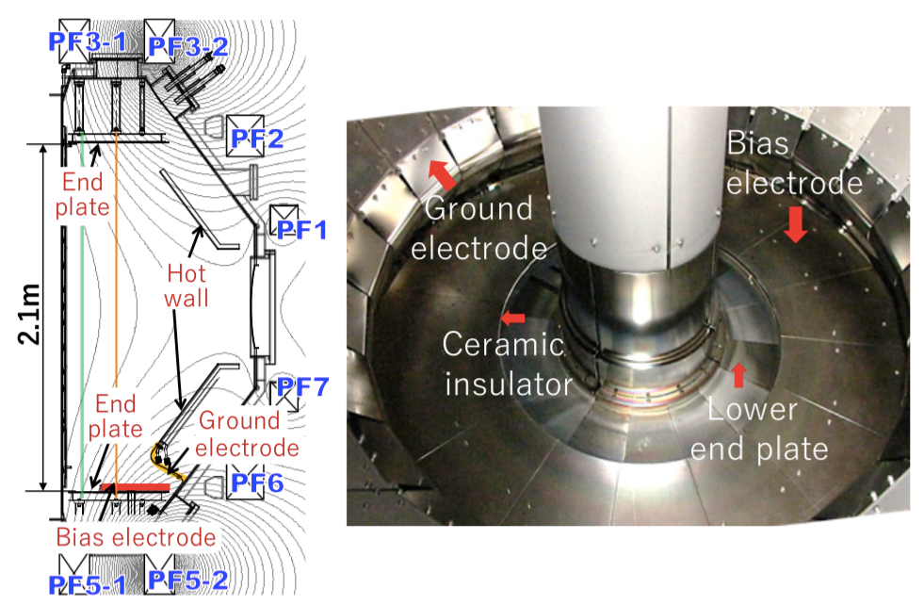
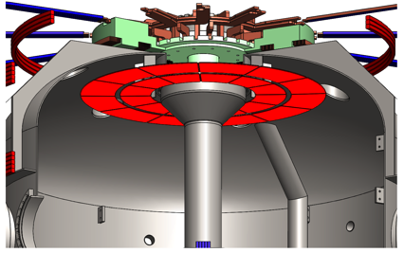
Upcoming CHI experiments in QUEST and URANIA will test concepts to be implemented in fusion reactors
Localized toroidal electrodes
  QUEST: single biased electrode
  URANIA: dual biased electrode
Low-field side injection
Coupling to ECRH heating
QUEST
Kuroda et al., Plasma Fusion Res. Rapid Comm. 2017
URANIA (currently Pegasus)
Notes:
Let us add the word toroidal electrodes to avoid confusing this with the localized small-surface area electrodes used in point source helicity injection.
Point source uses smaller area electrodes at a toroidal location and this is biased with respect to another electrode on the top (multiple electrodes can be used)
CHI: uses large surface area toroidal electrodes, so much more flux can be injected, so you do not need to count on some form of dynamo action to generate the needed *closed flux* current. This makes the scaling much easier, and is now well understood.

Slide 27
Application of transient CHI plasma start-up to future ST and AT devices
K. C. Hammond,¹ R. Raman,² S. C. Jardin,³ and F. Volpe⁴
¹Max Planck Institute for Plasma Physics, Greifswald, Germany
²University of Washington, Seattle, Washington, USA
³Princeton Plasma Physics Laboratory, Princeton, New Jersey, USA
⁴Columbia University, New York, New York, USA
60th Annual Meeting of the APS Division of Plasma Physics
Portland, Oregon, USA
November 8, 2018
Notes:
S.C. Jardin

Slide 28
Supplement: assumptions about the effective secondary electron emission coefficient for CHI breakdown calculations
E_{min} for tokamaks is a special case of Paschen’s Law with secondary electron coefficient γ = 0.58
Measurements for parallel plates indicate γ = 0.05 for D₂
Larger value may be valid in main vessel where L_{c} is large and particle paths make many revolutions
In the injector gap, less “enhancement” of γ is expected
  γ = 0.01 assumed for injector region (pessimistic for our purposes)
Tokamak model
Paschen’s Law

Slide 29
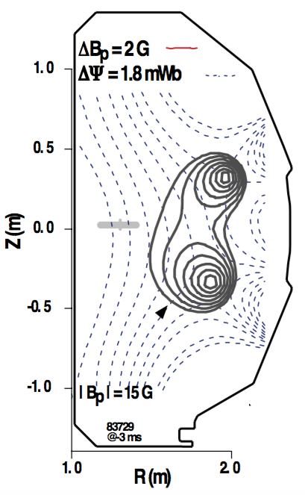
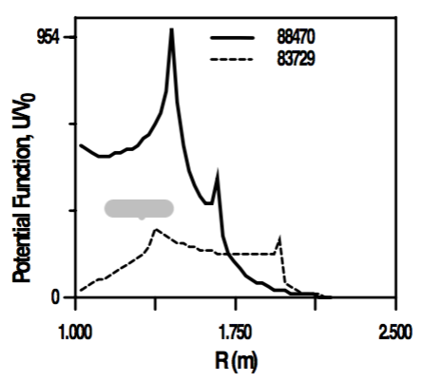
Supplement: spatially-resolved calculation assisted interpretation of breakdown in DIII-D
Breakdown location found to not coincide with poloidal field null
Better agreement found with maxima in electric field integrated along flux tubes
Lazarus et al., Nucl. Fusion 1998

Slide 30
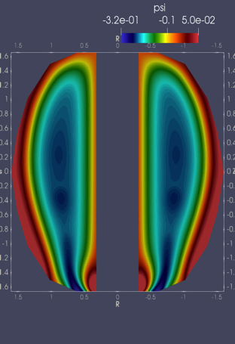
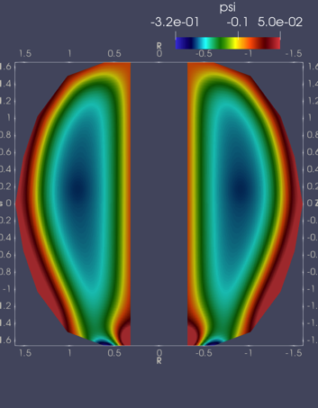
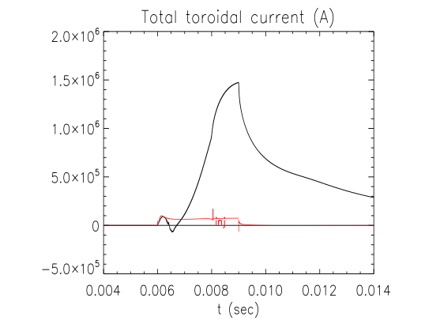
Supplement: NIMROD simulations with high ψ_{inj} show peak current generation over 1 MA
Simulations performed assuming ψ_{inj} = 0.35 mWb, B₀ = 4 T
T_{e} limited to 15 eV but will be increased to 100 eV in the future
8 ms
(injection phase)
9.3 ms
(decay phase)
Ebrahimi, Nucl. Fusion 2016

Slide 31
Supplement: additional values from the parameter comparison table
|-------------|----------------|------------------------------------|
| Quantity | Dimension | ST34 ST64 AT64 AT94 |
|-------------|----------------|------------------------------------|
| r_axis | m | 1.70 1.70 2.40 2.40 |
| aspect | | 1.70 1.70 2.40 2.40 |
| max_pf_curr | kA | 782.42 782.42 610.21 610.21 |
| inj_flux | mWb | 1000.00 1000.00 1000.00 1000.00 |
| tor_flux | Wb | 30.08 60.17 55.67 83.50 |
| gamma | | 0.01 0.01 0.01 0.01 |
| pAtVmin | 10^{-5} torr | 397.33 204.85 148.34 99.17 |
| vMin | V | 307.48 307.48 307.48 307.48 |
| bubbleCurr | kA | 310.42 155.21 109.94 73.29 |
| currMultFac | | 30.08 60.17 55.67 83.50 |
| I_p | MA | 1.09 1.09 0.77 0.77 |
| pol_flux | mWb | 700.00 700.00 700.00 700.00 |
| vol_ratio | | 22.50 22.50 25.75 25.75 |
| P_self | MW | 3.82 3.82 2.71 2.71 |
| n_plasma | 10^{17} m^{-3} | 56.74 29.25 18.51 12.37 |
| n_o1 | 10^{17} m^{-3} | 873.68 3494.46 3494.24 7861.98 |
| n_x2 | 10^{17} m^{-3} | 1747.36 6988.92 6988.47 15723.95 |
| fec1 | GHz | 83.87 167.72 167.72 251.58 |
| fec2 | GHz | 167.73 335.45 335.44 503.16 |
|-------------|----------------|------------------------------------|

Slide 32
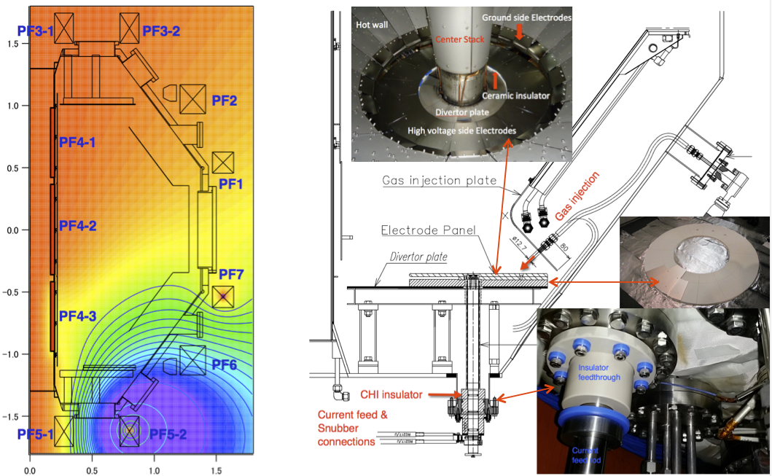
Supplement: CHI configuration on QUEST is developing ST-FNSF relevant single-biased electrode design
Kuroda et al.

Slide 33
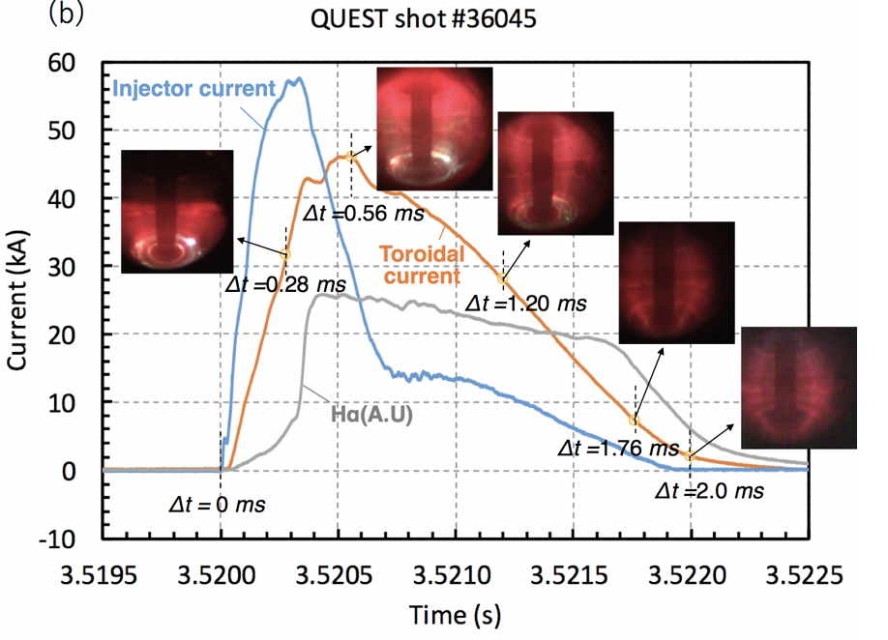
Supplement: Transient CHI start-up on QUEST
Kuroda et al., Plasma Phys. Control. Fusion 2018

Slide 34
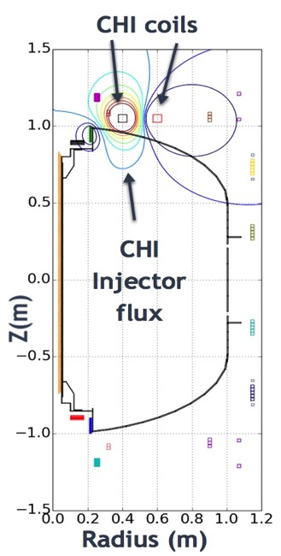
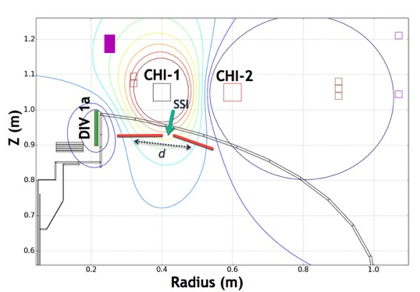
Supplement: CHI research on PEGASUS plans to develop a double-biased electrode configuration to better define current path
Goals on Pegasus:
High I_{p} ~300 kA (@ PF coil limits for I_{p})
Flux footprint width characterization
Role of impurities
Influence of current channel shape on reconnection
Dynamo current drive enhancement
ECH heating
Collaboration with Univ. of Wisconsin:
J. Reusch, R. Fonck, M. Bongard

Slide 35
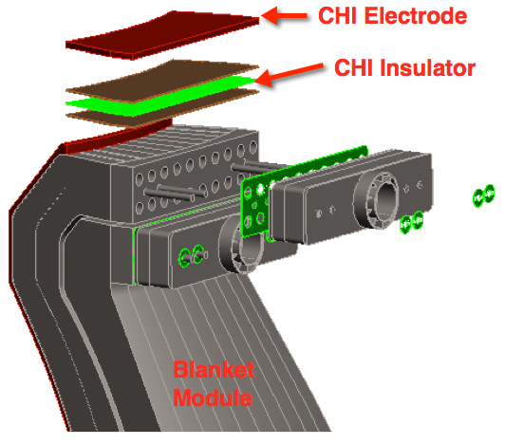
Supplement: implementation of a ring electrode in a ST-FNSF
Ring electrode is placed on top of the upper blanket section
  Insulator plate isolates electrode from blanket
  Injector flux connects upper portion of the vessel to the electrode plate on the upper portion of the blanket assembly
  Electrode is largely shielded from direct neutron streaming
Raman et al., Fusion Sci. Technol. 2015
Notes:
First plot demonstrates the scaling of current with injector flux
Fourth plot shows Ohmic self-heating power: note that Ohmic self-heating power increases substantially
Assumptions about energy transport are conservative; temperatures are probably underestimated
Note: low-Z electrodes are undesirable because their peak radiation occurs at low temperatures (20-30 eV)
So far, up to 25 kJ injected to NSTX transient CHI plasmas (charge in capacitors)
Future machines will use heavier elements; radiation power is relatively low below 100 eV
Third plot: normalized inductance: note that inductance starts out quite low (lower inductances are more MHD stable)
Time line: 17 ms is when transport equations start being solved (initially assumed to be zero), this is also where the injector bias is removed
Add backup slide on TSC information
1) Degraded Ohmic transport used (Te will be higher if standard Ohmic transport is used). NSTX geometry used (but this is not important)
2) Normally, tokamaks spend a lot of time to make a low inductance configuration by injecting neutral beams and to heat the edge plasma. The normalized plasma inductance for high performance plasmas on NSTX-U is projected to be less than ~0.7. One needs to injected NBI and heat the plasma to try to maintain this configuration during steady state operation. Transient CHI naturally gives you this initial condition.
3) Good possibility that transient CHI plasmas at high injector flux (with low-z impurity influx reduced through metal electrodes) will self heat to high Te, and this scaling favors extrapolation to reactor scale devices that rely on over 1 Wb of injector flux.
4) All discharges started with an initial Te of 100eV, but this is not important, starting with 50eV will produce the same result (I will try a case before your APS talk for a back-up slide, but I think this is not important)
5) I am also (separately) providing a plot starting at 17ms, at which time the transport equation calculations in TSC is turned on. Starting from this time TSC will find the correct temperature consistent with transport (so the initial 100 eV is not important). As you see, at the lower injector flux cases, the Te dips at about 25ms. This has something to do with the transoition from full open filed line discharge to the coil feed back system in TSCtrying to do the equilibrium control. Through better optimization of the runs, this dip can be avoided, but this may take quite a bit of time, and this is not important for the main point that is being made. To avoid getting distracted from the main issue, I plotted starting from 28ms.

Slide 36
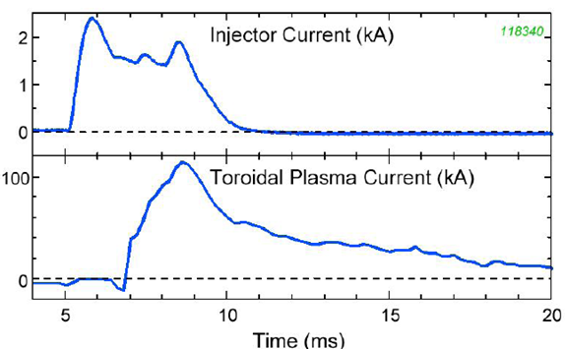
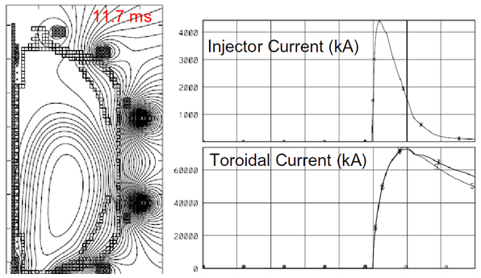
Supplement: Tokamak Simulating Code (TSC) simulations can help understand CHI scaling with machine size
NSTX experimental result
Time-dependent, free-boundary, predictive equilibrium and transport
Solves MHD/Maxwell’s equations coupled to transport and Ohm’s law
Requires as input:
  Device hardware geometry
  Coil electrical characteristics
  Assumptions concerning discharge characteristics
Models evolutions of free-boundary axisymmetric toroidal plasma on the resistive and energy confinement time scales
NSTX vacuum vessel is modeled as a metallic structure with poloidal breaks
  An electric potential is applied across the break to generate a desired injector current
TSC simulation
Raman et al.
Notes:
First plot demonstrates the scaling of current with injector flux
Fourth plot shows Ohmic self-heating power: note that Ohmic self-heating power increases substantially
Assumptions about energy transport are conservative; temperatures are probably underestimated
Note: low-Z electrodes are undesirable because their peak radiation occurs at low temperatures (20-30 eV)
So far, up to 25 kJ injected to NSTX transient CHI plasmas (charge in capacitors)
Future machines will use heavier elements; radiation power is relatively low below 100 eV
Third plot: normalized inductance: note that inductance starts out quite low (lower inductances are more MHD stable)
Time line: 17 ms is when transport equations start being solved (initially assumed to be zero), this is also where the injector bias is removed
Add backup slide on TSC information
1) Degraded Ohmic transport used (Te will be higher if standard Ohmic transport is used). NSTX geometry used (but this is not important)
2) Normally, tokamaks spend a lot of time to make a low inductance configuration by injecting neutral beams and to heat the edge plasma. The normalized plasma inductance for high performance plasmas on NSTX-U is projected to be less than ~0.7. One needs to injected NBI and heat the plasma to try to maintain this configuration during steady state operation. Transient CHI naturally gives you this initial condition.
3) Good possibility that transient CHI plasmas at high injector flux (with low-z impurity influx reduced through metal electrodes) will self heat to high Te, and this scaling favors extrapolation to reactor scale devices that rely on over 1 Wb of injector flux.
4) All discharges started with an initial Te of 100eV, but this is not important, starting with 50eV will produce the same result (I will try a case before your APS talk for a back-up slide, but I think this is not important)
5) I am also (separately) providing a plot starting at 17ms, at which time the transport equation calculations in TSC is turned on. Starting from this time TSC will find the correct temperature consistent with transport (so the initial 100 eV is not important). As you see, at the lower injector flux cases, the Te dips at about 25ms. This has something to do with the transoition from full open filed line discharge to the coil feed back system in TSCtrying to do the equilibrium control. Through better optimization of the runs, this dip can be avoided, but this may take quite a bit of time, and this is not important for the main point that is being made. To avoid getting distracted from the main issue, I plotted starting from 28ms.

Slide 37
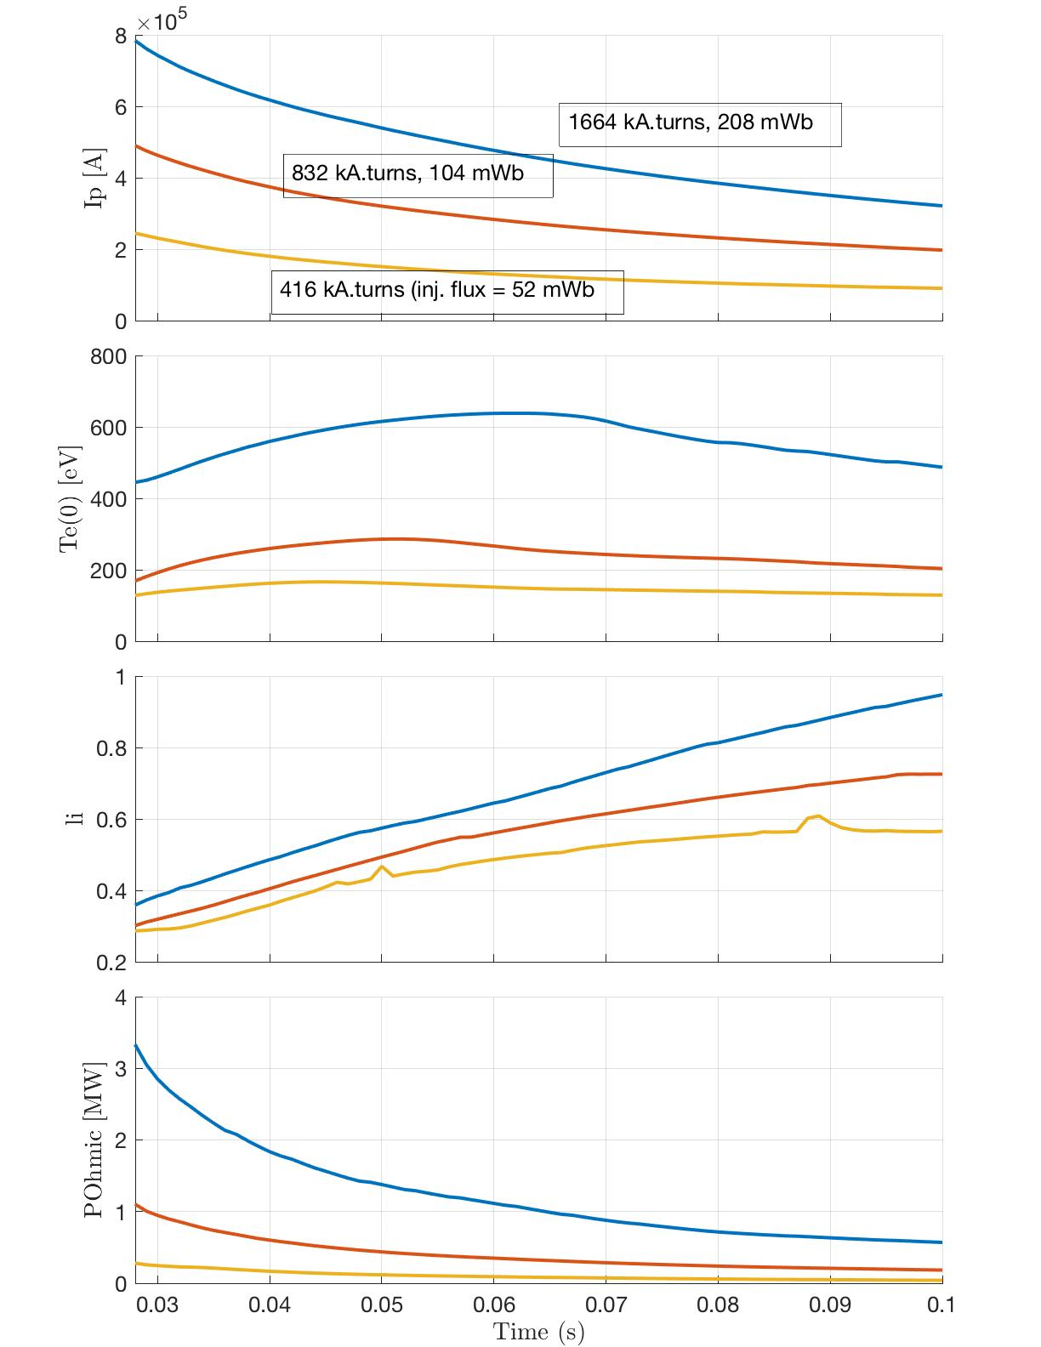
Supplement: further details on new TSC work
Time-dependent, free-boundary, predictive equilibrium and transport
Solves MHD/Maxwell’s equations coupled to transport and Ohm’s law
Transient CHI discharge initiated with injector flux values of 52, 104 and 208mWb (B_{T} = 1T)
  At the end of the CHI phase, injector current is reduced to zero
  Transport equations solved to calculate input power & heating
  Plasma allowed to decay without any additional external heating sources
  Transport parameters maintained same for all cases
Simulations show an initial low normalized inductance plasma, consistent with current being driven in the edge by the CHI process
  Inductance increases as current diffuses radially in
  Transient CHI naturally produces a low initial inductance discharge needed for high-performance ST and AT discharges (we may want to remove this frame and associated text – to not spend too much time on this – think about it)
The Ohmic input power increases with increasing injector flux
Electron temperatures for the 208 mWb cases increases to over 500eV on its own
  1 Wb plasmas may heat to the 1keV level on their own? (can delete sub bullets)
  Requires experimental verification
Notes:
First plot demonstrates the scaling of current with injector flux
Fourth plot shows Ohmic self-heating power: note that Ohmic self-heating power increases substantially
Assumptions about energy transport are conservative; temperatures are probably underestimated
Note: low-Z electrodes are undesirable because their peak radiation occurs at low temperatures (20-30 eV)
So far, up to 25 kJ injected to NSTX transient CHI plasmas (charge in capacitors)
Future machines will use heavier elements; radiation power is relatively low below 100 eV
Third plot: normalized inductance: note that inductance starts out quite low (lower inductances are more MHD stable)
Time line: 17 ms is when transport equations start being solved (initially assumed to be zero), this is also where the injector bias is removed
Add backup slide on TSC information
1) Degraded Ohmic transport used (Te will be higher if standard Ohmic transport is used). NSTX geometry used (but this is not important)
2) Normally, tokamaks spend a lot of time to make a low inductance configuration by injecting neutral beams and to heat the edge plasma. The normalized plasma inductance for high performance plasmas on NSTX-U is projected to be less than ~0.7. One needs to injected NBI and heat the plasma to try to maintain this configuration during steady state operation. Transient CHI naturally gives you this initial condition.
3) Good possibility that transient CHI plasmas at high injector flux (with low-z impurity influx reduced through metal electrodes) will self heat to high Te, and this scaling favors extrapolation to reactor scale devices that rely on over 1 Wb of injector flux.
4) All discharges started with an initial Te of 100eV, but this is not important, starting with 50eV will produce the same result (I will try a case before your APS talk for a back-up slide, but I think this is not important)
5) I am also (separately) providing a plot starting at 17ms, at which time the transport equation calculations in TSC is turned on. Starting from this time TSC will find the correct temperature consistent with transport (so the initial 100 eV is not important). As you see, at the lower injector flux cases, the Te dips at about 25ms. This has something to do with the transoition from full open filed line discharge to the coil feed back system in TSCtrying to do the equilibrium control. Through better optimization of the runs, this dip can be avoided, but this may take quite a bit of time, and this is not important for the main point that is being made. To avoid getting distracted from the main issue, I plotted starting from 28ms.

Slide 38
Supplement: required experimental developments
Experiments in QUEST and URANIA will test CHI with relevant properties:
  Localized toroidal electrodes
  Injection from the low-field side
  Coupling to ECRH heating
Parameters | HIT-II | NSTX | QUEST | URANIA (to be finalized)
Major radius [m] | 0.3 | 0.86 | 0.68 | 0.45
Minor radius [m] | 0.2 | 0.66 | 0.4 | ~0.3
B_{T} [T] | 0.5 | 0.55 | 0.25-0.5 | 0.15-0.6
Injector flux (mWb) | 16 | 50 | 28 | ~60
Projected Start-up current (kA) | 100 | 200 | <150 | ~300
Notes:
Let us add the word toroidal electrodes to avoid confusing this with the localized small-surface area electrodes used in point source helicity injection.
Point source uses smaller area electrodes at a toroidal location and this is biased with respect to another electrode on the top (multiple electrodes can be used)
CHI: uses large surface area toroidal electrodes, so much more flux can be injected, so you do not need to count on some form of dynamo action to generate the needed *closed flux* current. This makes the scaling much easier, and is now well understood.

