Slide 1

Enhanced Pedestal H-mode
Regime on NSTX
D.J. Battaglia, R.E. Bell, S.P. Gerhardt,
W. Guttenfelder, S.M. Kaye and R. Maingi
60th Annual APS DPP Meeting
Portland, OR
November 5 – 9, 2018
Place your institutional logo(s) here:

Slide 2
Enhanced Pedestal (EP) H-mode: ELM-free with improved τ_{E} and reduced particle confinement
ELM-free H-modes are attractive scenarios provided suitable particle transport is achieved
EP H-mode on NSTX achieves larger τ_{E} and particle transport compared to ELM-free H-mode
  Often observed after a large ELM
  Sustained without ELMs and large MHD activity
  H_{98y,2} ~ 1.2 – 2 with largest gains in ion stored energy
Observed over a wide range of shapes, I_{p}, B_{T}, q₉₅, P_{NBI}
  Requires reduced neutral fueling and large wall pumping
  About 50 EP H-mode discharges identified
Improved confinement
ELM-free
MHD quiescent
H-mode 141131
H-mode 141125
EP H-mode 141133
R. Maingi et al., J. Nucl. Mat. 390-1, 440-3 (2009)
R. Maingi et al., PRL 105, 135004 (2010)
S. Gerhardt et al., NF 54, 083021 (2014)
Slower density rise

Slide 3
Enhanced Pedestal (EP) H-mode: ELM-free with improved τ_{E} and reduced particle confinement
This talk aims to show…
Positive feedback in the pedestal transport and stability can occur at low ion collisionality
  Sufficiently low pedestal collisionality is achieved on NSTX with reduced neutral fueling
Reduced neutral recycling during the ELM recovery can trigger the positive feedback
EP H-mode occurs when …
  An increase in the edge turbulent transport…
  Reduces the edge density that …
  Drives a significant decrease in the neoclassical ion thermal transport
Improved confinement
ELM-free
MHD quiescent
H-mode 141131
H-mode 141125
EP H-mode 141133
Slower density rise

Slide 4
Significant improvement in temperature profiles with subtle differences in E_{r}, density and flow
Larger ∇T_{i}
  T_{e} pedestal can get wider and/or increase in gradient
  T_{C} – T_{e} increases
Reduction in ∇n and density at edge
  ∇P shifts inward, improving ELM stability
Lower v_{i}* due to lower n, larger T
Larger ∇E_{r} and ∇v_{ϕ} and shifted inwards
H-mode
H-mode
EP H-mode
T_{C} − T_{e}
141131
141125
141133
∇

Slide 5
Significant improvement in temperature profiles with subtle differences in E_{r}, density and flow
Larger ∇T_{i}
  T_{e} pedestal can get wider and/or increase in gradient
  T_{C} – T_{e} increases
Reduction in ∇n and density at edge
  ∇P shifts inward, improving ELM stability
Lower v_{i}* due to lower n, larger T
Larger ∇E_{r} and ∇v_{ϕ} and shifted inwards
H-mode
H-mode
EP H-mode
T_{C} − T_{e}
141131
141125
141133
∇

Slide 6
Significant improvement in temperature profiles with subtle differences in E_{r}, density and flow
Larger ∇T_{i}
  T_{e} pedestal can get wider and/or increase in gradient
  T_{C} – T_{e} increases
Reduction in ∇n and density at edge
  ∇P shifts inward, improving ELM stability
Lower v_{i}* due to lower n, larger T
Larger ∇E_{r} and ∇v_{ϕ} and shifted inwards
H-mode
H-mode
EP H-mode
T_{C} − T_{e}
141131
141125
141133
∇

Slide 7
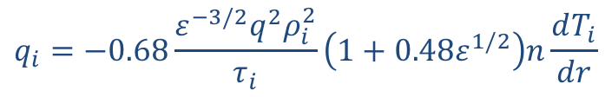
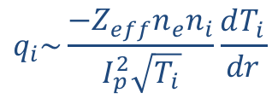
Larger ∇T_{i} in EP H-mode is consistent with neoclassical transport
Stabilization of ITG in high-rotation STs drives 𝜒_{i} → 𝜒_{i,neo}
Approximate banana regime main ion heat flux (Tokamaks, Wesson):
∇T_{i} increases as density decreases at constant q_{i,neo}
H-mode 141131
H-mode 141125
EP H-mode 141133
$$q_{i}=−0.68\frac{ε^{−3/2}q^{2}ρ_{i}^{2}}{τ_{i}}\left(1+0.48ε^{1/2}\right)n\frac{dT_{i}}{dr}$$
$$q_{i}\sim \frac{{−Z}_{eff}n_{e}n_{i}}{I_{p}^{2}\sqrt{T_{i}}}\frac{dT_{i}}{dr}$$
(Constant shape)

Slide 8
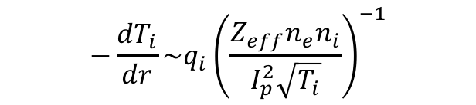
Database illustrates largest -∇T_{i} achieved when neoclassical transport expected to be small
Database of all NSTX CHERS profiles with P_{NBI} > 2 MW
  Identify max -∇T_{i,ped} for each profile
  Each color represents factor 2 increase in database entries
Rapid rise in ∇T_{i} at low density, high I_{p} at constant q_{i}
  10% of database entries satisfy typical EP H-mode designation
Lines of “constant q_{i}”
dT_{i}/dR > 0.12 keV/cm
$$−\frac{dT_{i}}{dr}\sim q_{i}{\left(\frac{Z_{eff}n_{e}n_{i}}{I_{p}^{2}\sqrt{T_{i}}}\right)}^{−1}$$

Slide 9
Database illustrates largest -∇T_{i} achieved when neoclassical transport expected to be small
Database of all NSTX CHERS profiles with P_{NBI} > 2 MW
  Identify max -∇T_{i,ped} for each profile
  Each color represents factor 2 increase in database entries
Rapid rise in ∇T_{i} at low density, high I_{p} at constant q_{i}
  10% of database entries satisfy typical EP H-mode designation
Lines of “constant q_{i}”
Most common
EP H-mode regime
dT_{i}/dR > 0.12 keV/cm
Most common H-mode regime
$$−\frac{dT_{i}}{dr}\sim q_{i}{\left(\frac{Z_{eff}n_{e}n_{i}}{I_{p}^{2}\sqrt{T_{i}}}\right)}^{−1}$$

Slide 10
1-D transport model illustrates large impact edge density has on T_{i} profile when 𝜒_{i,neo} >> 𝜒_{i,anom}
T_{e} pedestal becomes wider
Shift n pedestal inward by 1.5 cm
Data points: EP H-mode shot 141133
n_{e}
Green: data
Black dashed: model
q
n_{D}
n_{C}
T_{e} pedestal becomes wider
q_{i} is reduced
(q_{e} increased)
q_{total}
q_{i}
Big change in core T_{i} and edge dT_{i}/dR

Slide 11
Hypothesis: Lower neutral fueling during ELM recovery can trigger positive feedback at low collisionality
EP H-mode
Increase in ∇T_{i,edge}
(𝜒_{i,neo} > 𝜒_{i,anom})
Reduction in recycling during ELM recovery can reduce edge density, slow impurity pinch and reduce CX losses
Recovery
𝜓_{N} ~ 0.95
Increase in T_{i} > T_{e} in core
𝜓_{N} ~ 0.95
𝜓_{N} ~ 0.88

Slide 12
Hypothesis: Lower neutral fueling during ELM recovery can trigger positive feedback at low collisionality
EP H-mode
Increase in ∇T_{i,edge}
(𝜒_{i,neo} > 𝜒_{i,anom})
Reduction in recycling during ELM recovery can reduce edge density, slow impurity pinch and reduce CX losses
Recovery
𝜓_{N} ~ 0.95
Increase in T_{i} > T_{e} in core
Increase energy transfer from i → e
𝜓_{N} ~ 0.95
Increase q_{e,ped}
𝜓_{N} ~ 0.88

Slide 13
Hypothesis: Lower neutral fueling during ELM recovery can trigger positive feedback at low collisionality
EP H-mode
Increase in ∇T_{i,edge}
(𝜒_{i,neo} > 𝜒_{i,anom})
Recovery
𝜓_{N} ~ 0.95
Increase in T_{i} > T_{e} in core
Increase energy transfer from i → e
𝜓_{N} ~ 0.95
Increase q_{e,ped}
Increase anom transport (stiff T_{e} gradients)
𝜓_{N} ~ 0.88
+∆𝜒_{i,anom}

Slide 14
Hypothesis: Lower neutral fueling during ELM recovery can trigger positive feedback at low collisionality
EP H-mode
Increase in ∇T_{i,edge}
(𝜒_{i,neo} > 𝜒_{i,anom})
Recovery
Positive feedback when
-∆𝝌_{i,neo} >> +∆𝝌_{i,anom}
𝜓_{N} ~ 0.95
Increase in T_{i} > T_{e} in core
Increase energy transfer from i → e
𝜓_{N} ~ 0.95
Increase q_{e,ped}
Increase anom transport (stiff T_{e} gradients)
𝜓_{N} ~ 0.88
Reduce ∇n_{e}, n_{e}
+∆𝜒_{i,anom}
Reduce impurity pinch
-∆𝜒_{i,neo}

Slide 15
Ion-scale turbulence measurements and calculations indicate TEM drives transport at the pedestal foot
Wide pedestal on NSTX: predominantly TEM driven by ∇T_{e}
  Growth rates larger than E×B shearing rates (γ_{E}) for ψ_{N} > 0.9
  Weak low-k_{θ} MTM at at top of pedestal
BES fluctuation measurements and linear CGYRO calculations are similar for both H-mode and EP H-mode
  Ion-scale fluctuations shift to higher frequency in large ∇T_{i} region
    Qualitatively consistent with CGRYRO predicted Δω_{r} due to larger ∇T_{i}
H-mode 141131
H-mode 141125
EP H-mode 141133
TEM
H-mode 141131
H-mode 141125
EP H-mode 141133
BES
BES
CGYRO*
(linear)
*J. Candy, E.A. Belli, JCP (2016)

Slide 16
EP H-mode: Improved energy confinement and increased particle transport at low collisionality
Accessed at low-collisionality where 𝜒_{i,neo} is sensitive to small changes in density and Z_{eff}
  EP H-mode occurs when edge anomalous transport increases, but reduction in 𝜒_{i,neo} exceeds increase in 𝜒_{i,anom}
Temporary reduction in neutral recycling during an ELM recovery can trigger EP H-mode
Motivates edge density control that is compatible with n/n_{GW} →1 and heat flux mitigation
  Baffled divertor in MAST-U, lithium research on NSTX-U
  Increased field in Upgrade STs will access lower collisionality regimes

Slide 17
Backup

Slide 18
Reduced transport model illustrates large impact edge density has on T_{i} profile with 𝜒_{i,neo} > 𝜒_{i,anom}
Reduced 1D transport model illustrates impact of density on energy confinement
  Fixed geometry, q-profile & volumetric heating
  Density profiles are an input
  Neoclassical ion transport (Wesson)
  Fixed T_{esep}
  Fixed T_{e} gradient scale length when T_{e} < T_{i}
  Fixed 𝜒_{e} when T_{e} = T_{i}
  Ion-electron coupling
  Separatrix T_{i} proportional to q_{i}
Small change in edge density, large change in edge ∇T_{i} and core T_{i}
Shift n pedestal inward by 1.5 cm
n_{e}
n_{D}
n_{C}
Data points:
EP H-mode 141133

Slide 19
Differences in ion species v_{dia} may describe concurrent increase in ∇v_{ϕ} with ∇T_{i}
C⁶⁺ and D⁺ density pedestals are not aligned
  Difference in v_{dia} increases with ∇T_{i}
Concurrent increase in ∇v_{ϕ} and ∇E_{r} with ∇T_{i} is often observed during ELM recovery
  Simple model reproduces this when using many assumptions
    V_{pol} = 0 everywhere for all species
    V_{D} = V_{dia} + V_{ExB} does not change with density, T_{i}
    T_{D} = T_{C}
Change ∇T_{i} drives change in ∇v_{ϕ}
V_{tor,D}
V_{tor,C}
Data points: EP H-mode shot 141133
Edge gradients increase and location of maximum gradient shifts inward

Slide 20
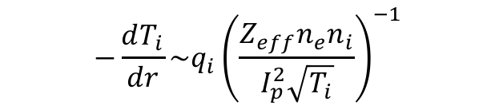
Max -∇T_{i} increases at decreasing density and increasing I_{p}, consistent with neo model
X-axis log plot to improve clarity
Lines of “constant q_{i}”
EP H-mode shot 141133 (P_{NBI} = 4 MW)
Most common
EP H-mode regime
Most common H-mode regime
$$−\frac{dT_{i}}{dr}\sim q_{i}{\left(\frac{Z_{eff}n_{e}n_{i}}{I_{p}^{2}\sqrt{T_{i}}}\right)}^{−1}$$

Slide 21
Position of max -∇T_{i} in model sensitive to the T_{e} profile
Two EP H-mode discharges
141133 (left):
max -∇T_{i} is near separatrix
141340 (right):
max -∇T_{i} is 4 cm inside separatrix
Top of T_{e} pedestal shifted inward compared to 141133
e → i coupling reduces q_{i}, and thus, dT_{i}/dR near separatrix
Provides explanation for why position of large T_{i} gradient can vary between examples

Slide 22
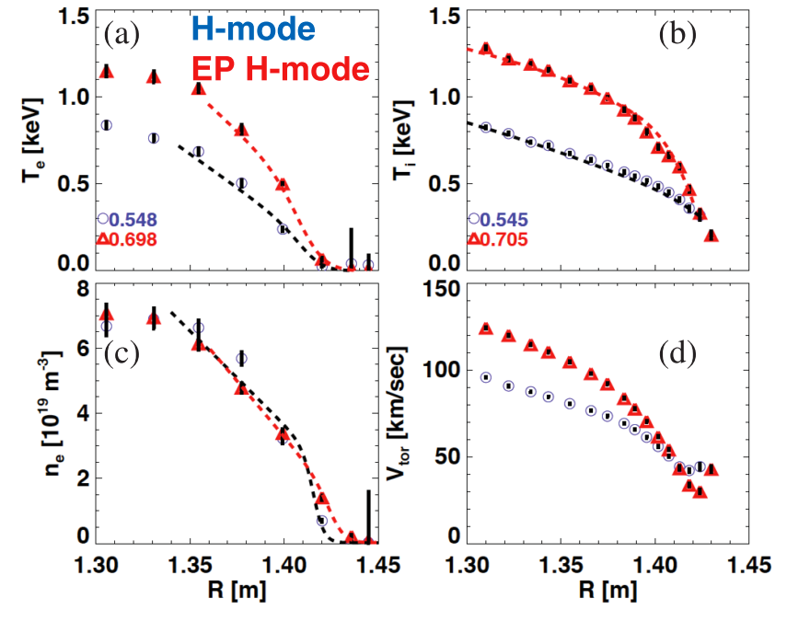
Characteristics of EP H-mode
Max -∇T_{i} can occur anywhere within wide pedestal on NSTX
  Location of max -∇T_{i} is outboard of other max gradients (v_{ϕ}, E_{r}, T_{e} …)
  Tends to align near minimum of E_{r} and v_{ϕ} well
Transition most often triggered by an ELM
  Increased -∇T_{i} develops over transport timescales (order 10 - 100 ms)
  Carbon rotation gradient grows concurrently
Observed over a wide range of shapes, I_{p}, B_{T}, q₉₅, β_{p,} P_{NBI}, applied n=3 field
  More common at low-q₉₅, but best performance at higher q₉₅
  Reduced neutral fueling and large wall pumping is a common characteristic
30 ms before ELM
120 ms after ELM
R. Maingi et al., J. Nucl. Mat. 390-1, 440-3 (2009)
R. Maingi et al., PRL 105, 135004 (2010)
S. Gerhardt et al., NF 54, 083021 (2014)

