Slide 1





NSTX-U
Supported by
Divertor heat flux mitigation with impurity-seeded standard and snowflake divertors in NSTX.
V. A. Soukhanovskii,
R. E. Bell , A. Diallo , S. Gerhardt, R. Kaita, S. Kaye,
E. Kolemen, B. P. LeBlanc, R. Maingi, A. McLean, J. E. Menard, D. Mueller, S. F. Paul , M. Podesta, R. Raman, A. L. Roquemore, D. D. Ryutov, F. Scotti
Coll of Wm & Mary
Columbia U
CompX
General Atomics
FIU
INL
Johns Hopkins U
LANL
LLNL
Lodestar
MIT
Lehigh U
Nova Photonics
ORNL
PPPL
Princeton U
Purdue U
SNL
Think Tank, Inc.
UC Davis
UC Irvine
UCLA
UCSD
U Colorado
U Illinois
U Maryland
U Rochester
U Tennessee
U Tulsa
U Washington
U Wisconsin
X Science LLC
Culham Sci Ctr
York U
Chubu U
Fukui U
Hiroshima U
Hyogo U
Kyoto U
Kyushu U
Kyushu Tokai U
NIFS
Niigata U
U Tokyo
JAEA
Inst for Nucl Res, Kiev
Ioffe Inst
TRINITI
Chonbuk Natl U
NFRI
KAIST
POSTECH
Seoul Natl U
ASIPP
CIEMAT
FOM Inst DIFFER
ENEA, Frascati
CEA, Cadarache
IPP, Jülich
IPP, Garching
ASCR, Czech Rep
39th EPS Conference
Stockholm, Sweden
2-6 July 2012

Slide 2
Various techniques developed for reduction of heat fluxes q|| (divertor SOL) and q_{peak} (divertor target)
Radiative divertor (partially detached strike point) is envisioned for present and future devices (e.g. ITER, ST-FNSF) as the steady-state heat flux mitigation solution
Recent ideas to improve standard divertor geometry
  Snowflake divertor (D. D. Ryutov, PoP 14, 064502 2007)
  X-divertor (M. Kotschenreuther et. al, IC/P6-43, IAEA FEC 2004)
  Super-X divertor (M. Kotschenreuther et. al, IC/P4-7, IAEA FEC 2008)

Slide 3


NSTX Upgrade will address critical plasma confinement and sustainment questions by exploiting 2 new capabilities
New center-stack
Reduces ν* → ST-FNSF values to understand ST confinement
  Expect 2x higher T by doubling B_{T}, I_{P}, and NBI heating power
  Provides 5x longer pulse-length
  q(r,t) profile equilibration
  Tests of NBI + BS non-inductive ramp-up and sustainment
TF OD = 20cm
TF OD = 40cm
Previous
center-stack
New
center-stack
New 2nd NBI
  2x higher CD efficiency from larger tangency radius R_{TAN}
100% non-inductive CD with q(r) profile controllable by:
  NBI tangency radius
  Plasma density
  Plasma position
Present NBI
New 2nd NBI
MENARD, J. et al., Proceedings of the 24th IEEE Symposium on Fusion Engineering (2011);
Accepted to Nuclear Fusion (2012)

Slide 4
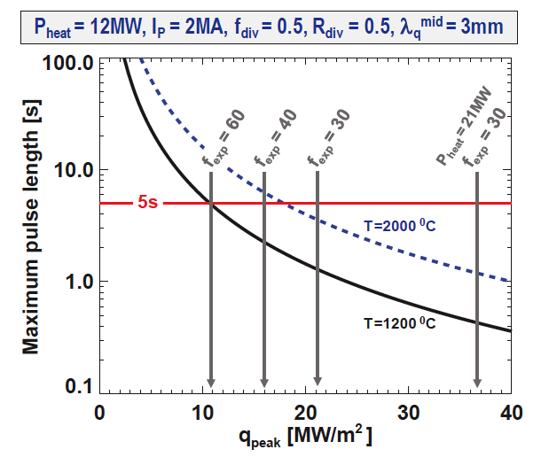
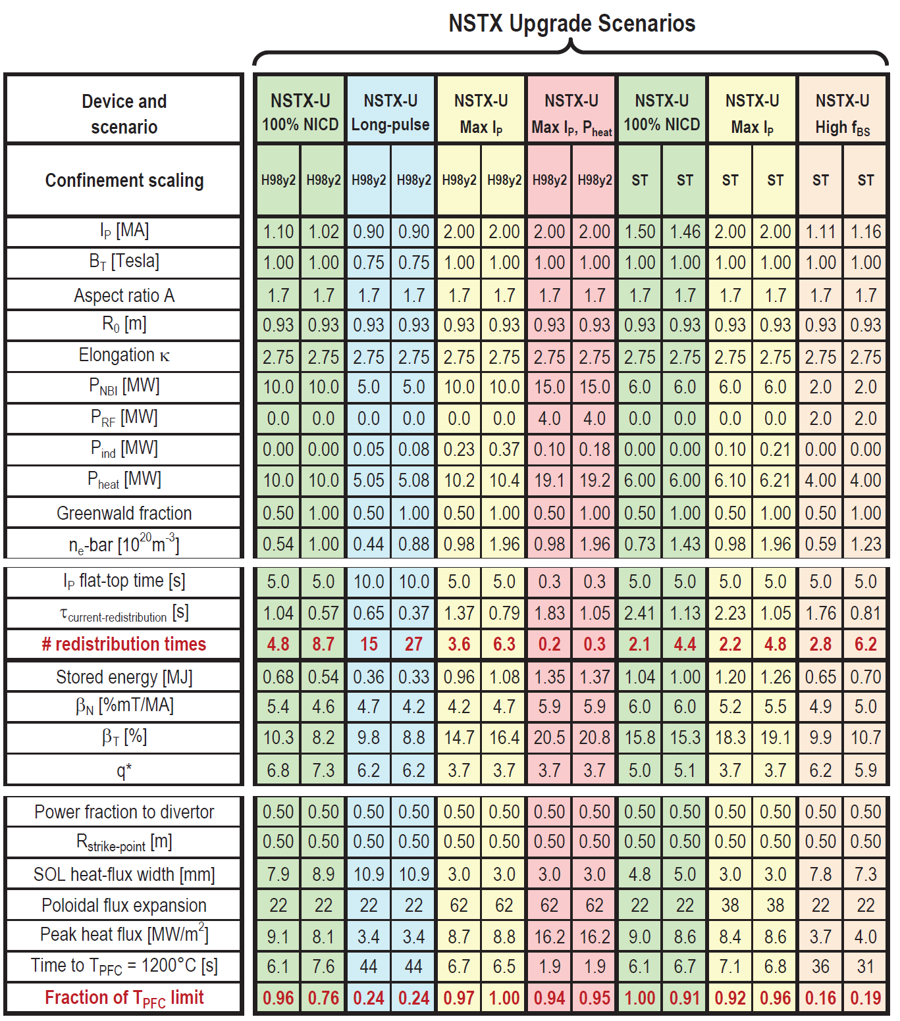
NSTX-U scenarios with high I_{p} and P_{NBI} are projected to challenge passive cooling limits of graphite divertor PFCs
MENARD, J. et al., Proceedings of the 24th IEEE Symposium on Fusion Engineering (2011).
R. Maingi (ORNL)
High I_{P} scenarios projected to have narrow λ_{q}^{mid} → ~3mm
  At high power, peak heat flux ≥ 9MW/m² even with high flux expansion ~60 with U/L snowflake
  Numbers shown ignore radiation, plate tilt, strike-point sweeping
Passive cooling ok for low-I_{P} scenarios
Long-pulse + high I_{P} and power may ultimately require active divertor cooling

Slide 5
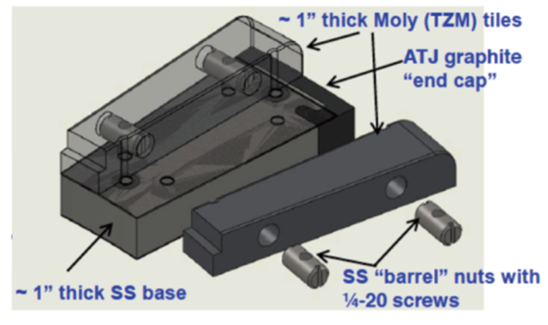
Radiative divertor control options are affected by NSTX-U plasma-facing component development plan
Possible progressions
Developing PFC plan to transition to full metal coverage for FNSF-relevant PMI development
Wall conditioning: GDC, lithium and / or boron coatings
PFC bake-out at 300-350ºC
C
BN
C
BN
C
BN
BN
Mo
Mo
Mo
Mo
Mo
W
Baseline
Upper
Mo divertor
All
Mo divertor
All Mo tiles
All Mo PFCs
Mo wall
+ W divertor
5 yr plan
Radiative divertor elements affected by PFC choice:
  Divertor impurity gas handling and injection system
    D₂, CD₄, Ar with graphite PFCs and lithium coatings
    D₂, N₂, CD₄, Ar with refractory metal PFCs
  Diagnostic sensors for control
  Plasma Control System development
Mo tiles

Slide 6
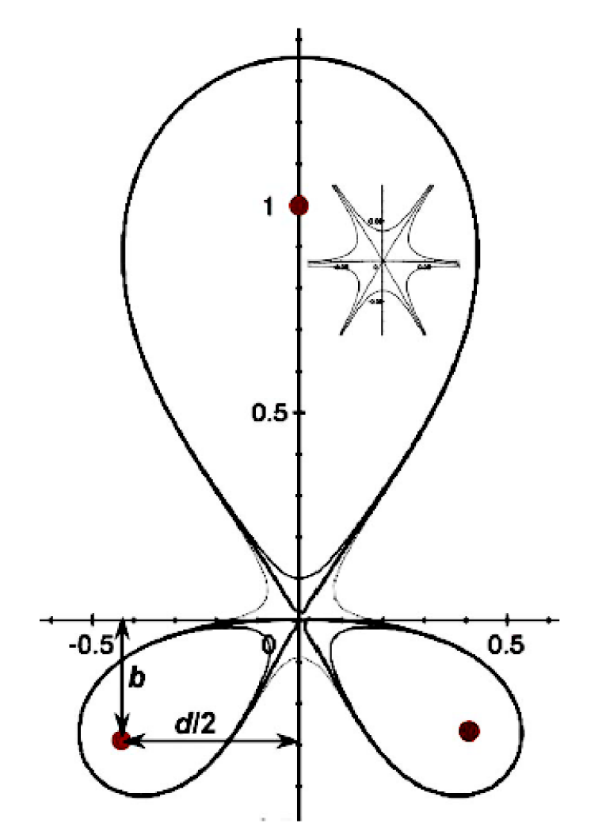
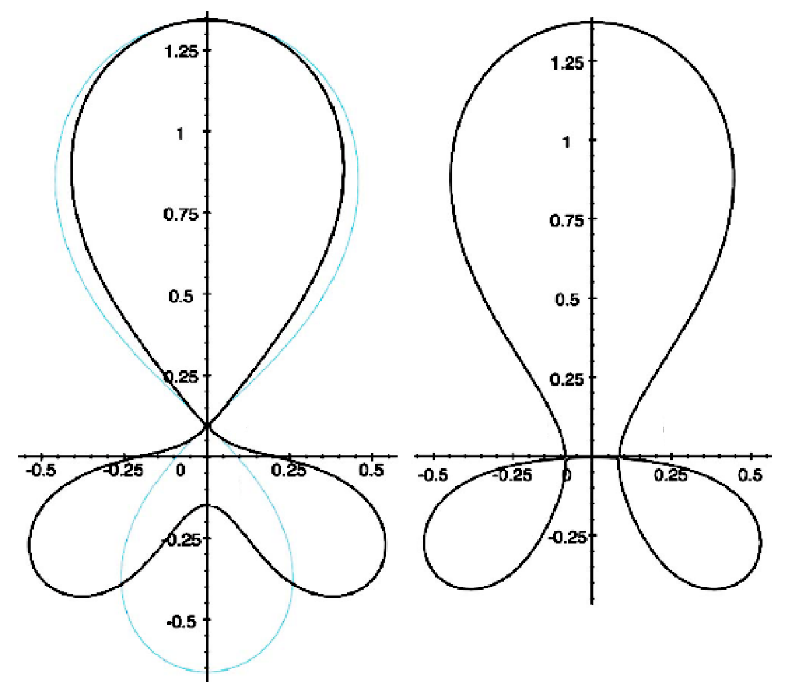
Snowflake divertor geometry has benefits over standard X-point divertor geometry
Snowflake divertor
  Second-order null
      B_{p} ~ 0 and grad B_{p} ~ 0 (Cf. first-order null: B_{p} ~ 0)
  Obtained with existing divertor coils (min. 2)
  Exact snowflake topologically unstable
  Deviation from ideal snowflake: σ = d / a
    d – distance between nulls, a – plasma minor radius
Predicted geometry properties (cf. standard divertor)
  Increased edge shear: ped. stability
  Add’l null: H-mode power threshold, ion loss
  Larger plasma wetted-area A_{wet} : reduce q_{div}
  Four strike points : share q_{II}
  Larger X-point connection length L_{x} : reduce q_{II}
  Larger effective divertor volume V_{div} : incr. P_{rad} , P_{CX}
Experiments: TCV and NSTX
Exact
snowflake
divertor
*
+
+
+
+
snowflake-minus
snowflake-plus
D. D. Ryutov, PoP 14, 064502 2007

Slide 7
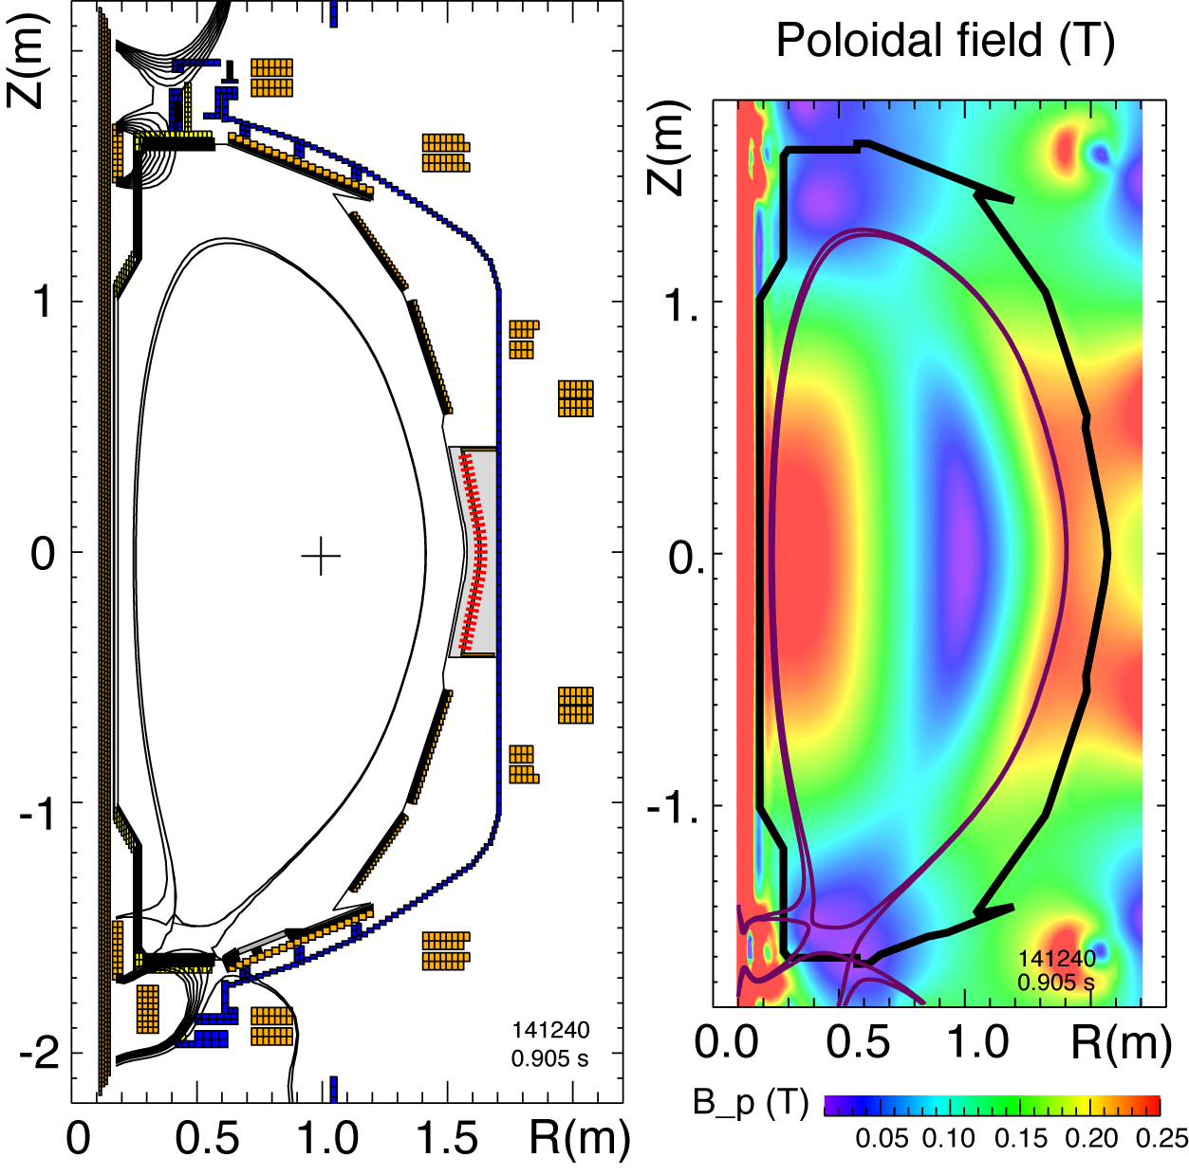
NSTX: Snowflake divertor configurations obtained with existing divertor coils

Slide 8
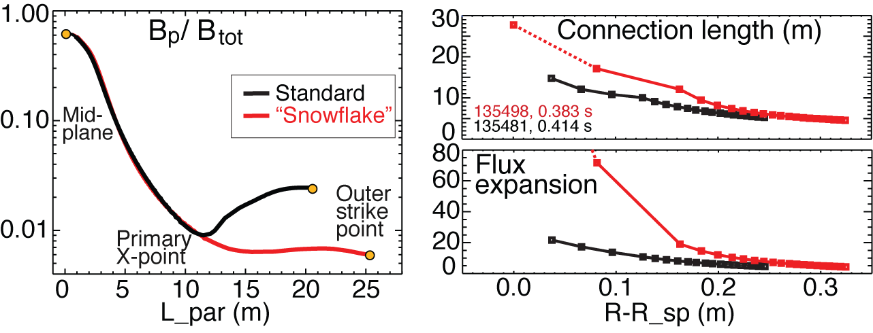
Plasma-wetted area and connection length are increased by 50-90 % in snowflake divertor
These properties observed in first 30-50 % of SOL width
B_{tot} angles in the strike point region: 1-2º, sometimes < 1º

Slide 9
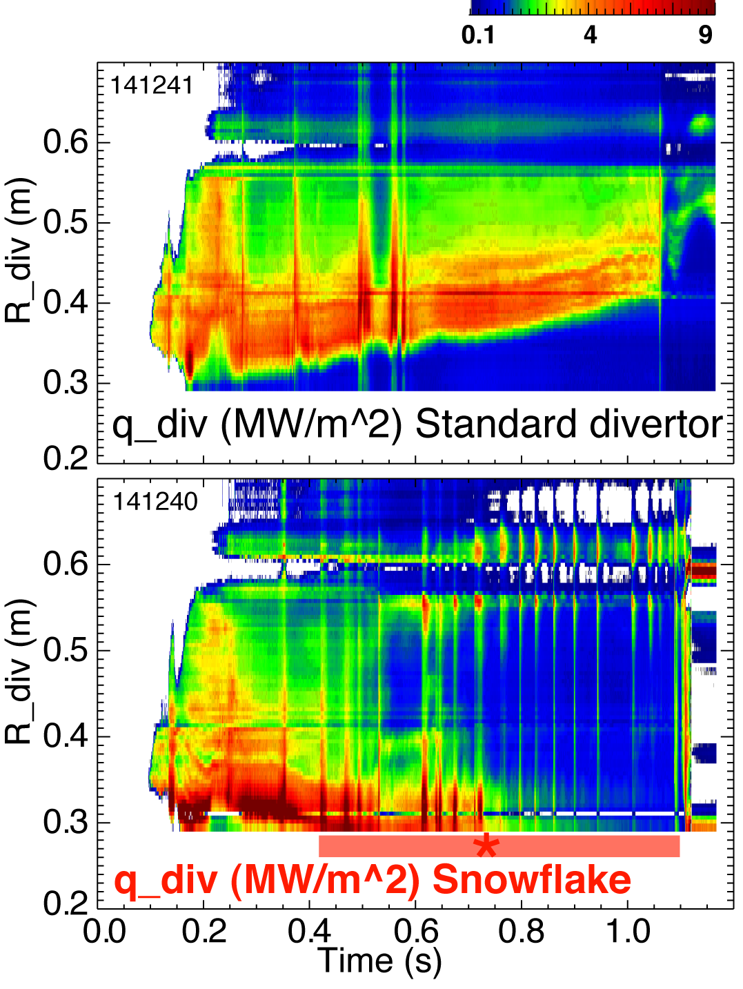
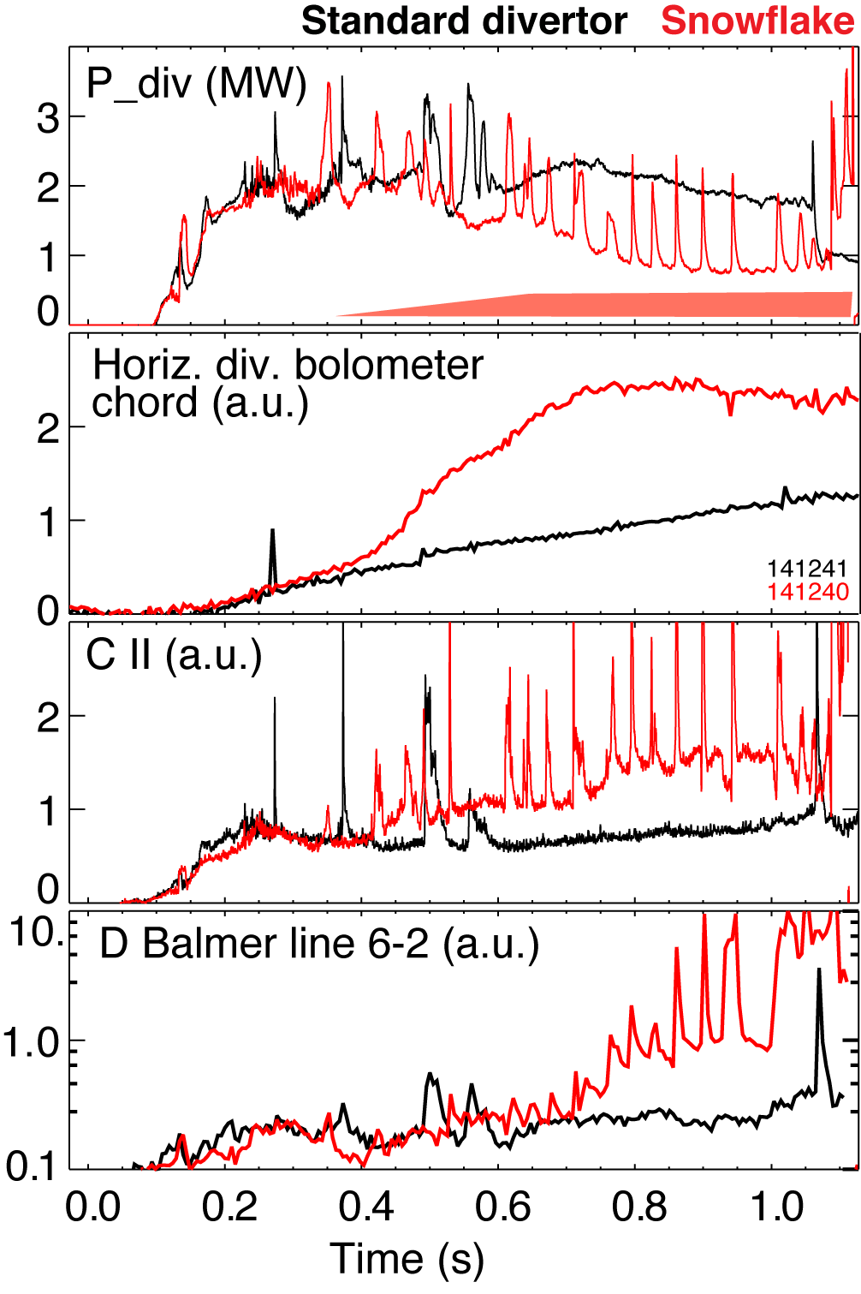
Significant reduction of steady-state divertor heat flux observed in snowflake divertor (at P_{SOL}~ 3 MW)
Partial detachment at or after snowflake formation time
  Heat and ion fluxes in the outer strike point region decreased
  Divertor recombination rate and radiated power are increased

Slide 10
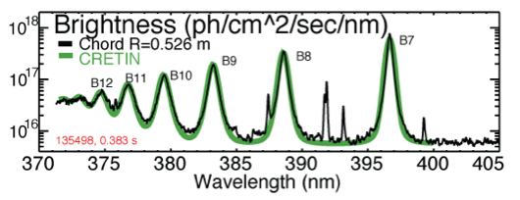
Divertor profiles show low heat flux, broadened C III and
C IV radiation zones in the snowflake divertor phase
Heat flux profiles reduced to nearly flat low levels, characteristic of radiative heating
Divertor C III and C IV brightness profiles broaden
High-n Balmer line spectroscopy and CRETIN code modeling confirm outer SP detachment with T_{e} ≤ 1.5 eV,
n_{e} ≤ 5 x 10²⁰ m⁻³
  Also suggests a reduction of carbon physical and chemical sputtering rates

Slide 11
No leading edge PFC tile heating observed at shallow magnetic field incidence angles
Reduction of q|| due to radiative detachment is considered

Slide 12
NSTX experiments compared standard and snowflake divertors with and without extrinsic CD₄ seeding
Goal of the experiment – develop high-performance H-mode discharge with reduced divertor heat flux
  Use highly-shaped configuration
    κ=2.1, δ=0.8, drsep=6-7 mm (similar to λ_{SOL})
  B x grad B toward lower divertor
  4 MW NBI, I_{p}=0.9 MA
    Reference (attached standard divertor)
    Snowflake divertor (partially detached divertor due to intrinsic carbon radiation)
    Radiative divertor in standard geometry with CD₄ seeding (partially detached divertor due to enhanced divertor density and carbon concentration)
    Snowflake divertor with CD₄ seeding (partially detached divertor due to enhanced carbon radiation in low T_{e} snowflake divertor)

Slide 13
  Good H-mode confinement properties retained or slightly reduced with radiative divertor and snowflake divertor
0.9 MA, 4 MW H-mode
κ=2.1, δ=0.8
Core T_{e} ~ 0.8-1 keV, T_{i} ~ 1 keV
β_{N} ~ 4-5
Plasma stored energy ~ 250 kJ
H98(y,2) ~ 1 (from TRANSP)
ELMs
  Suppressed in standard divertor H-mode via lithium conditioning
  Re-appeared in snowflake H-mode
  Disappeared again in snowflake with CD₄ seeding
Reference
Snowflake
Radiative divertor w/ CD₄
Snowflake+CD₄

Slide 14
  Core carbon reduction obtained with snowflake divertor
Core carbon reduction due to
  Type I ELMs
  Edge source reduction
    Divertor sputtering rates reduced due to partial detachment
  Good divertor screening for puffed CD₄
Reference
Snowflake
Radiative divertor w/ CD₄
Snowflake+CD₄

Slide 15
Divertor heat flux reduced by radiation and/or geometry in radiative and snowflake divertors in NSTX
Reference
Snowflake
Radiative divertor w/ CD₄
Snowflake+CD₄

Slide 16
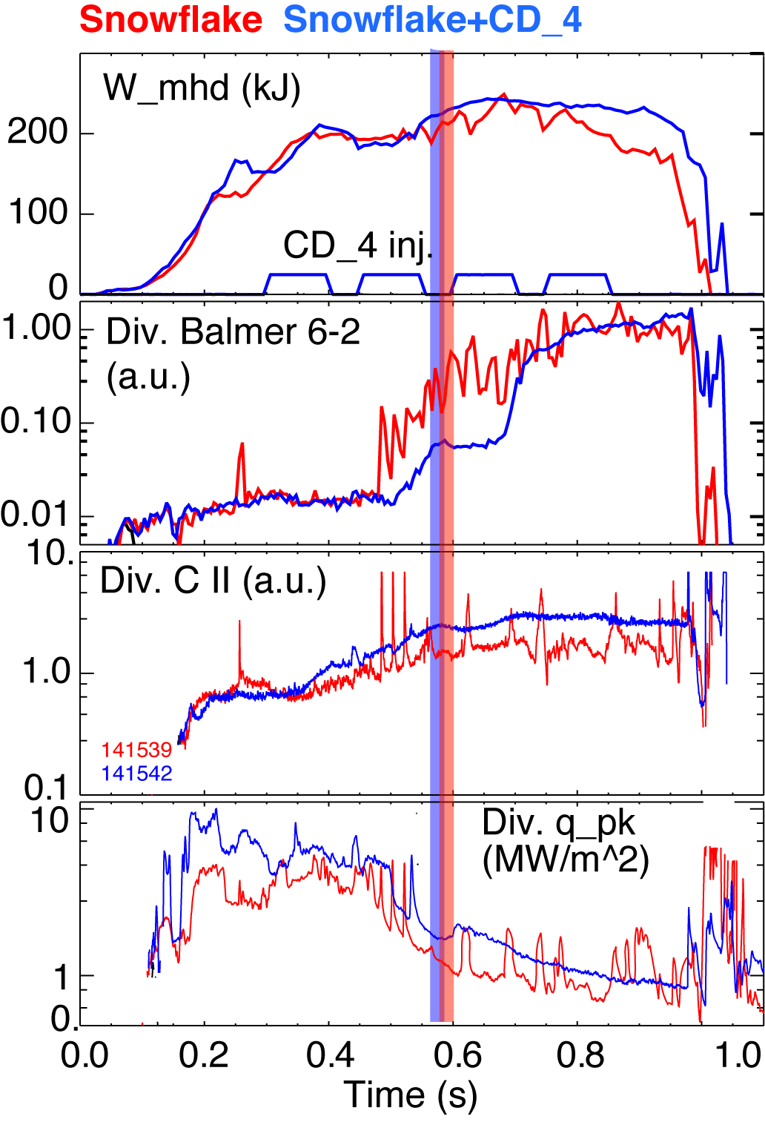
Snowflake divertor with CD₄ seeding leads to increased divertor carbon radiation
I_{p}=0.9 MA, P_{NBI}=4 MW, P_{SOL}=3 MW
Snowflake divertor (from 0.6 ms)
  Peak divertor heat flux reduced from 4-6 MW/m² to 1 MW/m²
Snowflake divertor (from 0.6 ms)
+ CD₄
  Peak divertor heat flux reduced from 4-6 MW/m² to 1-2 MW/m²
  Divertor radiation increased further

Slide 17
Divertor profiles show enhanced radiation and recombination zone in snowflake divertor w/ and w/o CD₄
Reference
Snowflake
Radiative divertor w/ CD₄
Snowflake+CD₄

Slide 18
Summary of divertor profiles
Divertor heat flux
  In snowflake divertor, flat ~ 1-2 MW/m² profiles due to geometry and radiative heating
  In radiative divertor, peak reduction in strike point region only
Volumetric recombination
  Large ion sink in both radiative and snowflake discharges
  Larger in snowflake due to higher Lx (higher ion residence time)
    Ion recombination time: τ_{ion}~ 1−10 ms at T_{e} =1.3 eV
    Ion residence time: τ_{ion} ≤ 3-6 ms in standard divertor, x 2 in snowflake
Divertor carbon radiation
  C III and C IV are main radiators
  Both C III and C IV radiation enhanced in snowflake geometry due to low T_{e} and larger volume
Reference
Snowflake
Radiative divertor w/ CD₄
Snowflake+CD₄

Slide 19
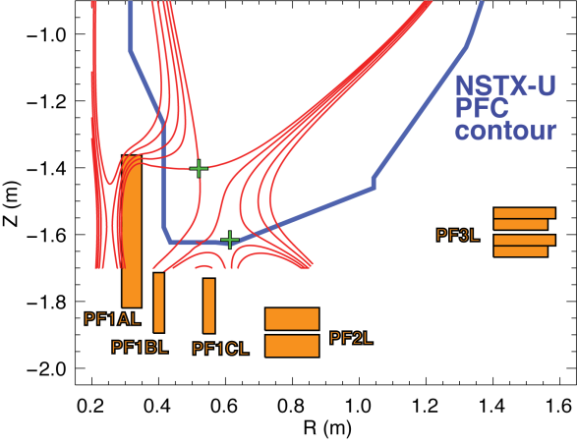
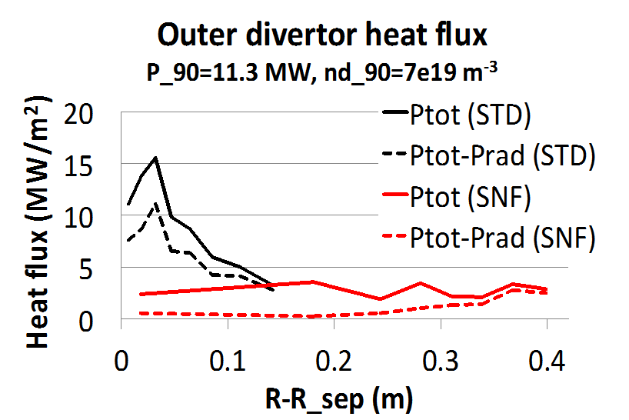
Impurity-seeded radiative divertor with feedback and snowflake geometry are the leading NSTX-U heat flux mitigation candidates
NSTX-U scenarios with high I_{p} and P_{in} projected to challenge thermal limits of graphite divertor PFCs
Single and double-null radiative divertors and upper-lower snowflake configurations considered
  Supported by NSTX-U divertor coils and compatible with coil current limits
Snowflake divertor projections to NSTX-U optimistic
  UEDGE modeling shows radiative detachment of all snowflake cases with 3% carbon and up to P_{SOL}~11 MW
    q_{peak} reduced from ~15 MW/m² (standard) to 0.5-3 MW/m² (snowflake)
  Snowflake divertor with impurity seeding for P_{SOL} ~ 20 MW under study
NSTX-U
snowflake
simulation
E. Meier (LLNL)

