Slide 1

Motivation, Status, and Plans for NSTX Upgrade
J. Menard, PPPL
For the NSTX-U Research Team
Fusion Energy Sciences Advisory Committee Meeting
Bethesda North Marriott Hotel & Conference Center
January 13-14, 2016

Slide 2
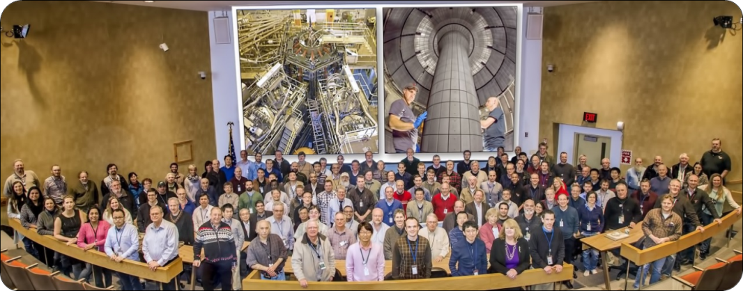
NSTX-U = National Spherical Torus eXperiment - Upgrade
Highly collaborative research program
Domestic (33)
International (22)
402 team members
290 scientists
(~70% non-PPPL)
55 institutions
22 US Universities

Slide 3

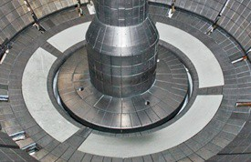
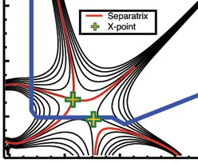
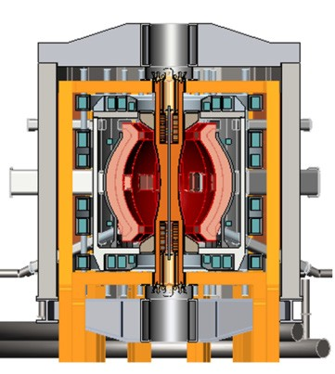
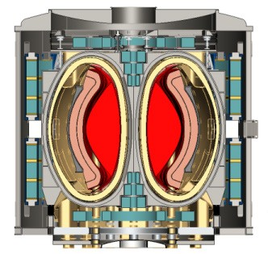
NSTX-U Mission Elements:
Explore unique ST parameter regimes to advance predictive capability - for ITER and beyond
ITER
Develop solutions for plasma- material interface (PMI)
Liquid metals / Lithium
Snowflake/X
ST-FNSF /
Pilot-Plant
Advance ST as Fusion Nuclear Science Facility and Pilot Plant

Slide 4
Outline
Physics Goals, Performance Parameters
Highlights from Construction Project
Operational Status
Research Priorities
Schedule
Summary

Slide 5
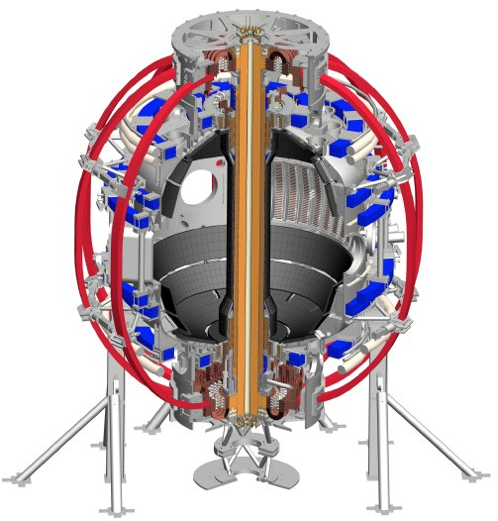
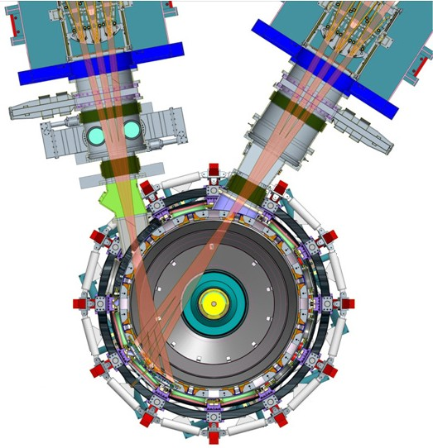
NSTX-U will access new physics with 2 major new tools:
1. New Central Magnet
2. Tangential 2nd Neutral Beam
Higher T, low collisionality at high β
→ Unique regime, study new transport and stability physics
Full non-inductive current drive
→ Not demonstrated in ST at high-β_{T}
Essential for any future steady-state ST

Slide 6
NSTX-U will have major boost in performance
1. New Central Magnet
2. Tangential 2nd Neutral Beam
➢2× heating power (5 → 10MW)
Tangential NBI → 2× current drive efficiency
➢4× divertor heat flux (→ ITER levels)
➢Up to 10× higher nTτ_{E} (~MJ plasmas)
➢2× toroidal field (0.5 → 1T)
➢2× plasma current (1 → 2MA)
➢5× longer pulse (1 → 5s)

Slide 7
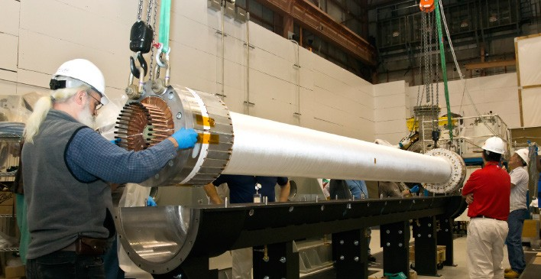
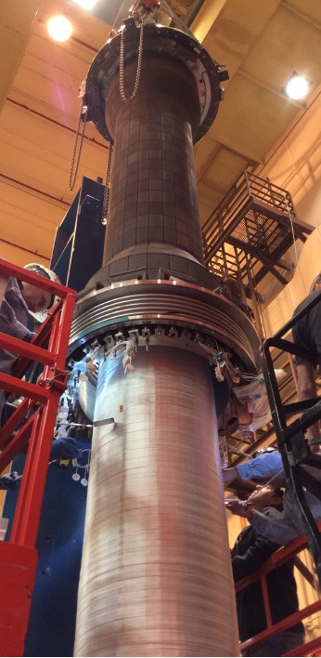
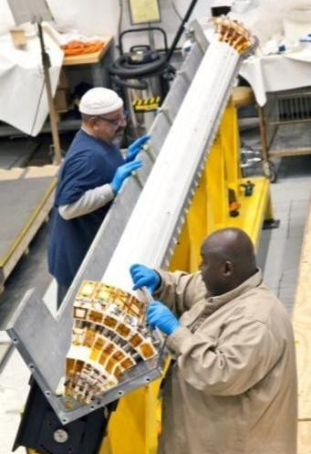
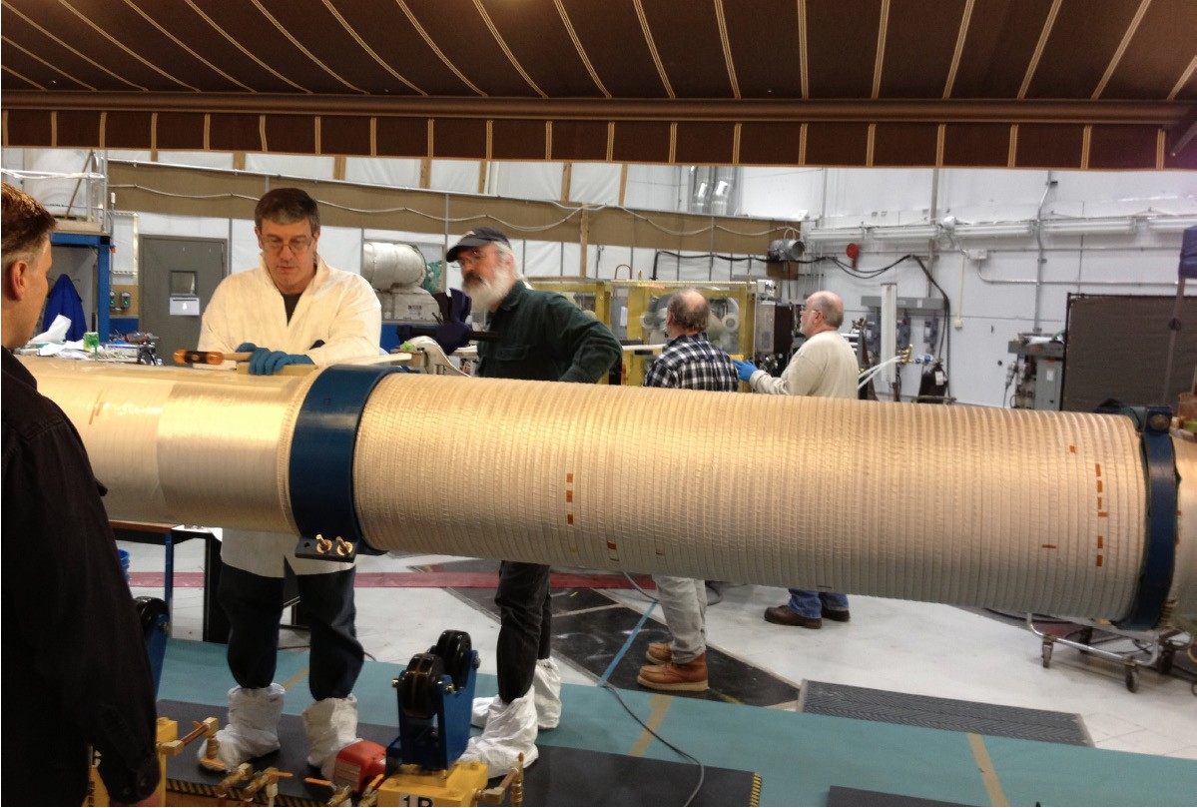
Central magnet construction was complex, multi-stage, multi-year effort
Built 4 toroidal field (TF) quadrants
Install vacuum- tight casing over TF + OH bundle
Combine quadrants (5th VPI)
Wind ohmic heating (OH) coil over TF, then final 6th VPI
4 vacuum pressure impregnations (VPI)

Slide 8

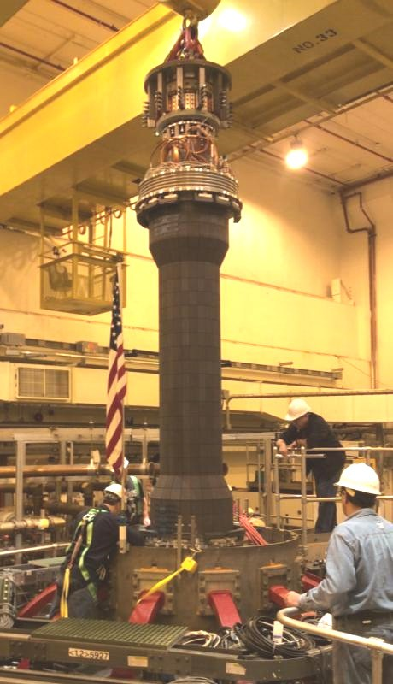


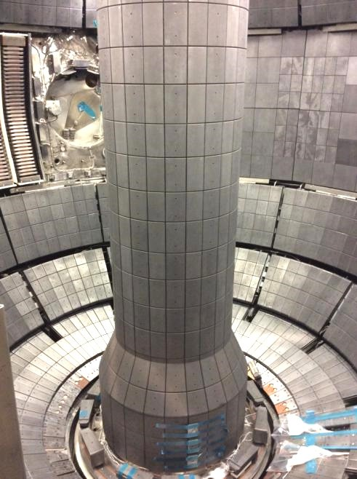
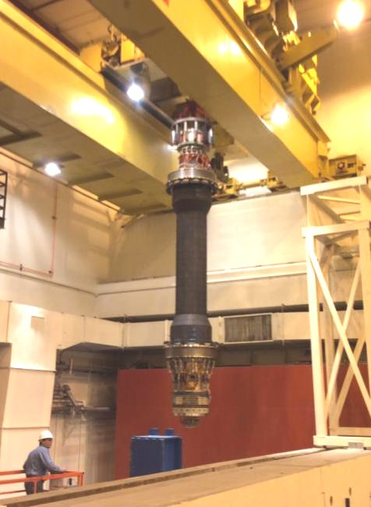
Fabrication and installation of central magnet ultimately successful
Over the machine
Over shield wall
Inside NSTX-U!

Slide 9
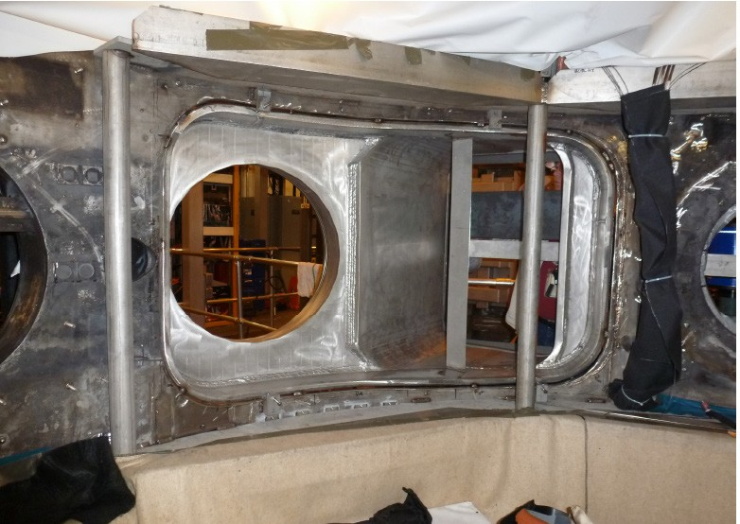
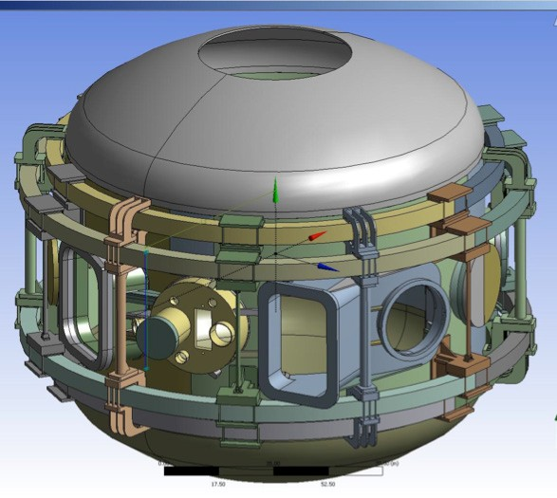

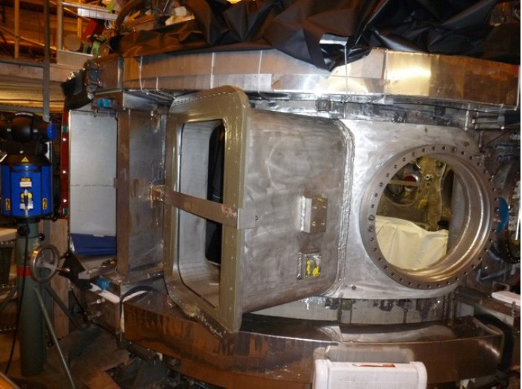

Tangential neutral beam required major vacuum vessel modifications
Interior View of Bay J-K
Exterior View of Bay J-K
JK cap

Slide 10
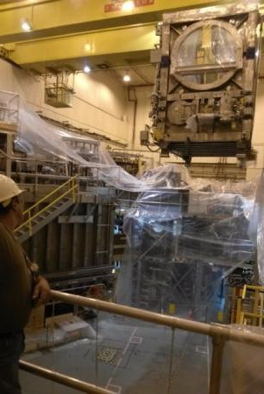
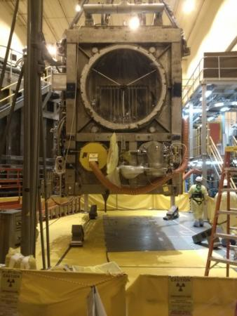
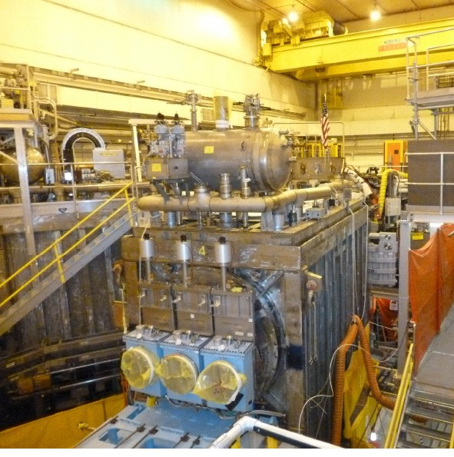
2nd beam (from TFTR DT campaign) required T decontamination, NSTX test-cell re-arrangement
Beam Box being lifted over NSTX
Beam Box placed in its final location and aligned
Beam Box being populated with components

Slide 11
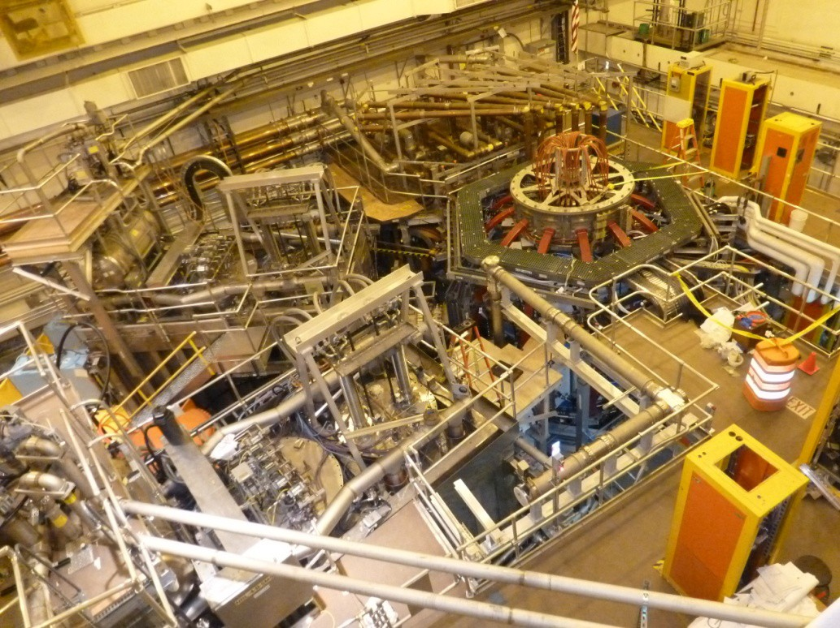



NSTX Upgrade project complete
New Central Magnet
Original Neutral Beam
New 2nd Neutral Beam

Slide 12
Outline
Physics Goals, Performance Parameters
Highlights from Construction Project
Operational Status
Research Priorities
Schedule
Summary

Slide 13
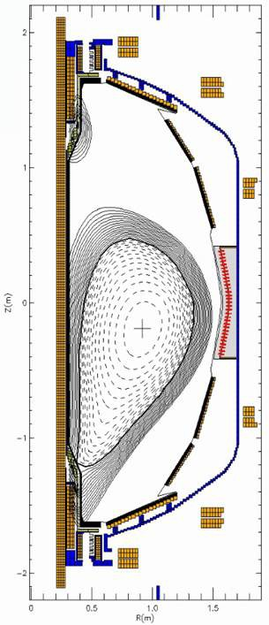
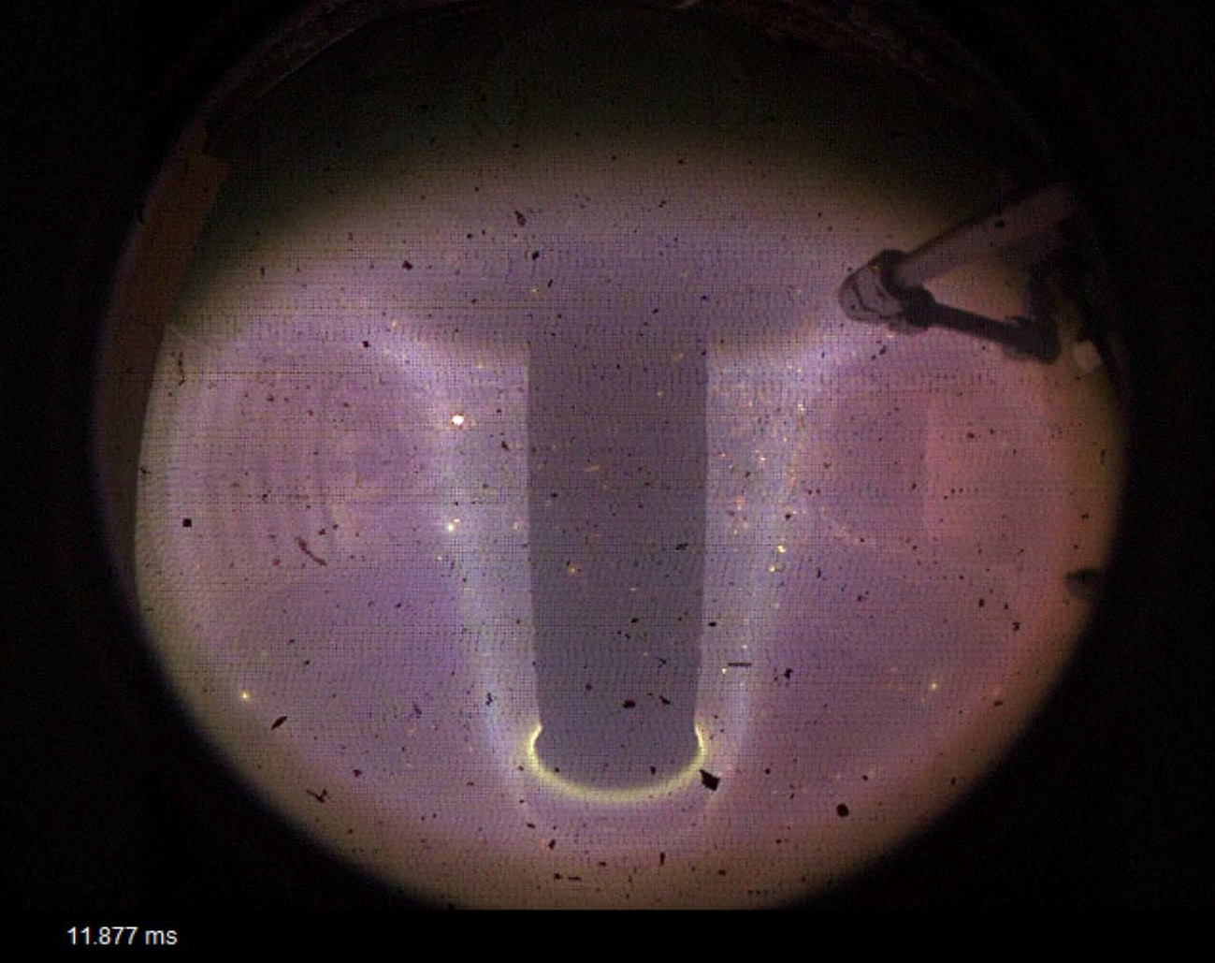
Achieved 110kA test plasma August 10, 2015
F. Scotti, LLNL
EFIT - S. Sabbagh Columbia University

Slide 14
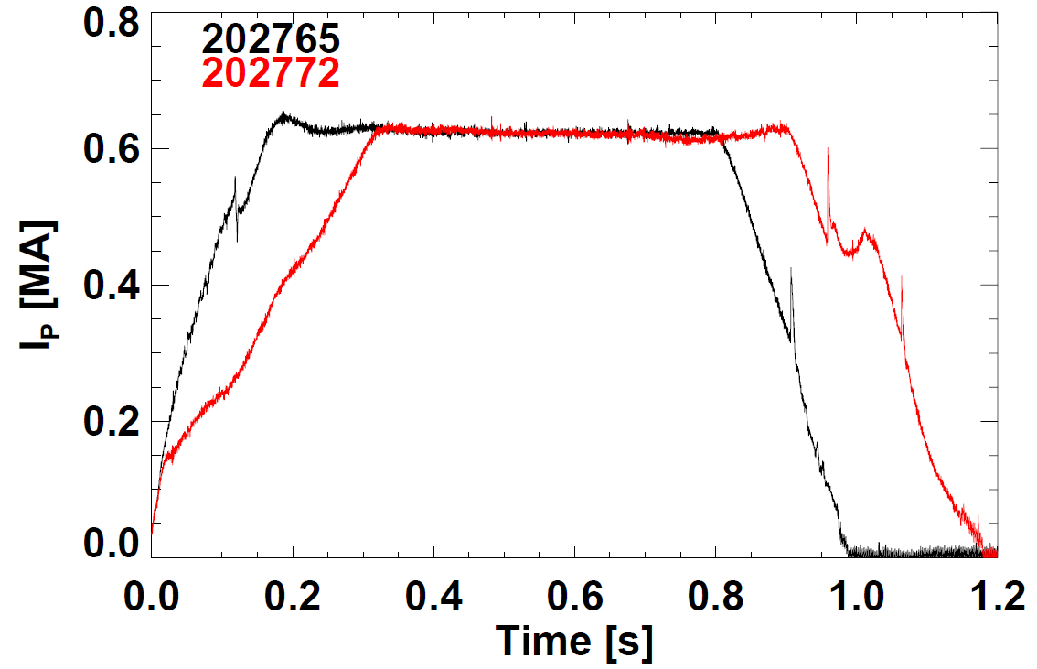
NSTX-U is now an operating facility!
Plasma commissioning progressing rapidly thus far
Completed wall conditioning (bake-out, boronization)
Began operation in late December
Routinely making 0.8-1s plasmas (0.6MA, 0.6T)
Optimizing control
  I_{P}, gap, elongation κ
Increasing κ, P_{NBI}
Next steps:
  Optimize H-mode / timing
  Measure/correct error fields
  Access NSTX-levels of performance, then surpass
B_{T} already above highest NSTX B_{T}

Slide 15
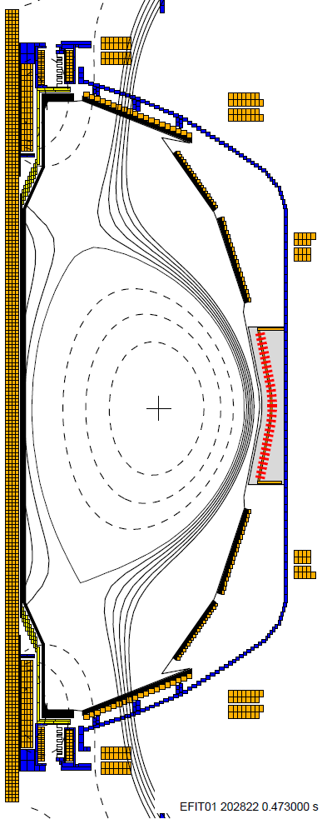
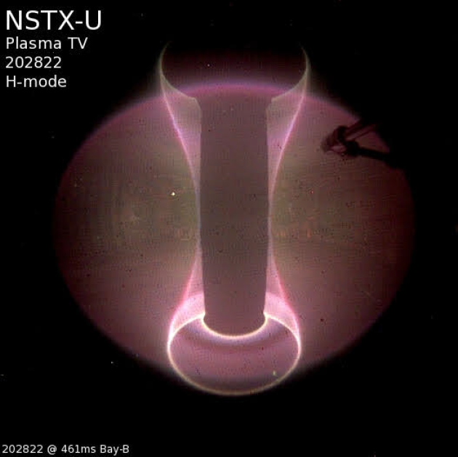
Yesterday made first sustained diverted plasmas and accessed first H-modes with 2.5MW NBI

Slide 16
NSTX-U Mission Elements
5 Highest Research Priorities
Explore unique ST parameter regimes to advance predictive capability - for ITER and beyond
  Understand energy confinement at high normalized pressure (high β)
  Study energetic particle physics prototypical of burning plasmas
Develop solutions for PMI challenge
3.Dissipate high edge heat loads using expanded magnetic fields + radiation 4.Compare performance of solid vs. liquid metal plasma facing components
Advance ST as possible FNSF / Pilot Plant
5.Form and sustain plasma current without transformer for steady-state ST

Slide 17
NSTX-U Mission Elements
5 Highest Research Priorities
Explore unique ST parameter regimes to advance predictive capability - for ITER and beyond
  Understand energy confinement at high normalized pressure (high β)
  Study energetic particle physics prototypical of burning plasmas
Develop solutions for PMI challenge
3.Dissipate high edge heat loads using expanded magnetic fields + radiation 4.Compare performance of solid vs. liquid metal plasma facing components
Advance ST as possible FNSF / Pilot Plant
5.Form and sustain plasma current without transformer for steady-state ST

Slide 18
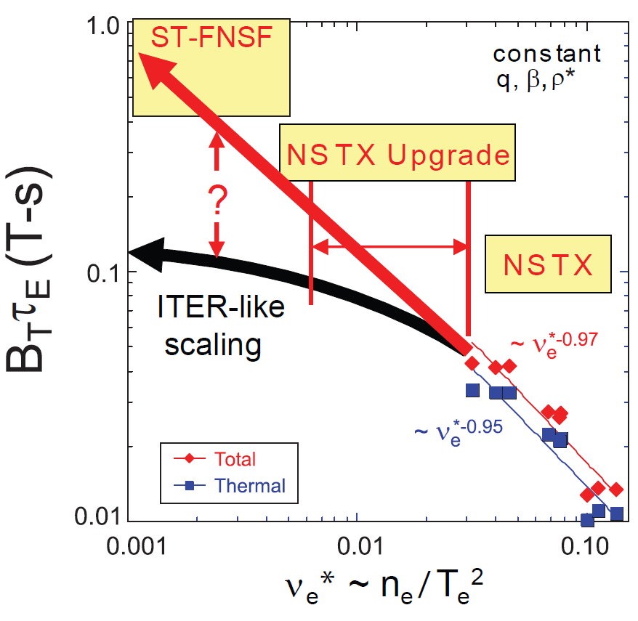
Favorable confinement trend with collisionality and β found in ST experiments
τ_{E, th} ∝ ν_{*e}^{-0.8} β^{-0.0} ST scaling observed in NSTX and MAST
τ_{E, th} ∝ ν_{*e}^{-0.1} β^{-0.9} tokamak empirical scaling (ITER 98y,2)
Promising scaling to ST-FNSF / Pilot, will trend continue on NSTX-U / MAST-U?

Slide 19
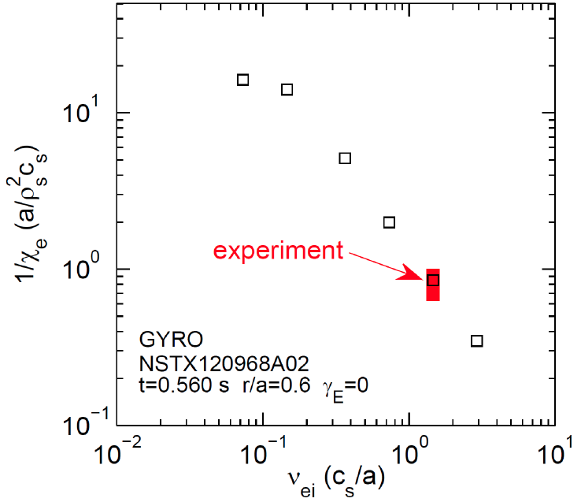


Electromagnetic effects may play important
role in collisionality scaling of ST confinement
Micro-tearing τ_{E-e} vs. ν_{ei} similar to experiment
High β → small-scale overlapping tearing modes → transport from magnetic turbulence
(GYRO – W. Guttenfelder)
Other electrostatic turbulence may also have similar ν* scaling: Dissipative Trapped Electron Mode (GTS - W. Wang)
NSTX-U
χ_{e}⁻¹
(a/ρ_{s}²c_{s})
∝ τ_{E-e}
NSTX
Will NSTX-U observe confinement improvement at lower collisionality?

Slide 20
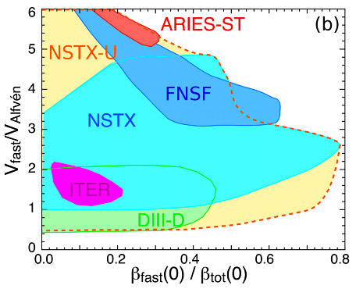
NBI-heated STs excellent testbed for α-particle physics
α-particles couple to Alfvénic modes when V_{α} > V_{Alfvén}~ β^{-0.5} C_{sound}
V_{fast} > V_{A} condition easily satisfied in high-β ST with NBI heating
NSTX-U: large fast-ion dynamic range spanning ST and conventional A
  Toroidal field 2× NSTX → V_{fast} < V_{A} → stabilize modes
  Tangential 2nd NBI → very flexible fast-ion distribution
    Vary pitch angle, pressure profile
Can we find TAE-quiescent, high-performance regimes in NSTX-U?

Slide 21
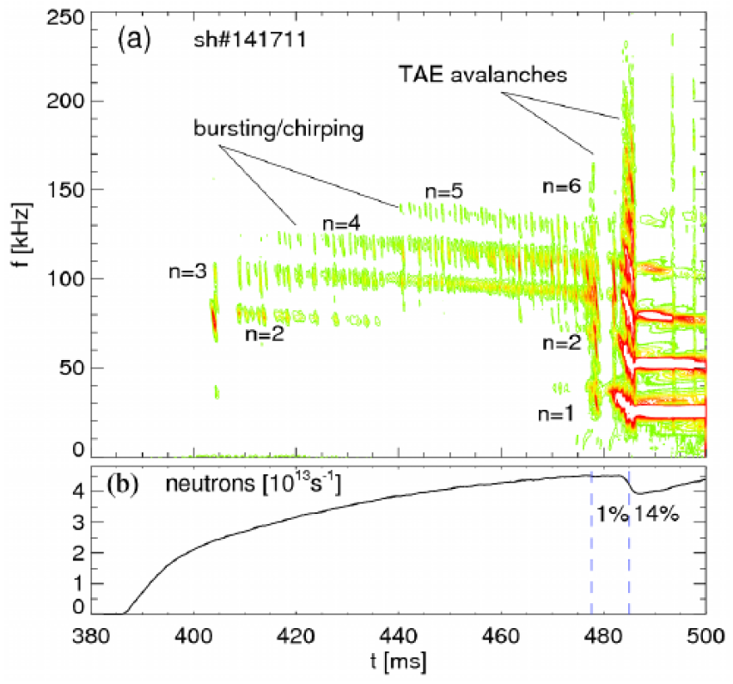
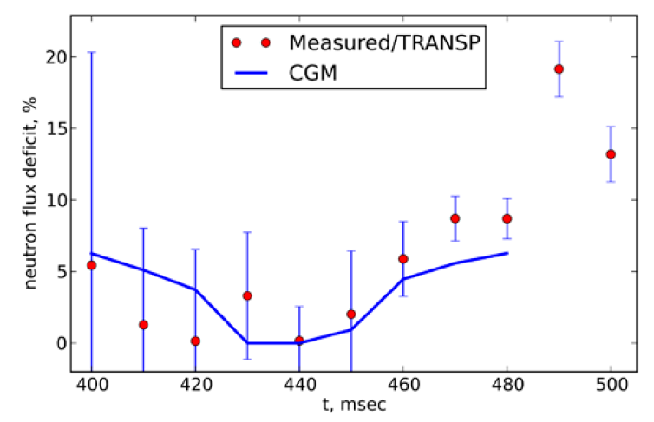
“TAE avalanche” can cause energetic particle loss
Uncontrolled α-particle loss could cause reactor first wall damage
Quasi-linear “Critical Gradient Model” (CGM) consistent with transport before avalanche
NSTX 141711
Working towards fully non-linear multi-mode simulations (e.g. M3D-K) for avalanche phase

Slide 22
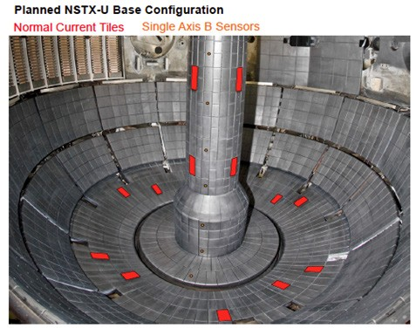
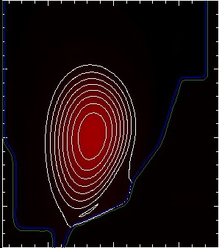
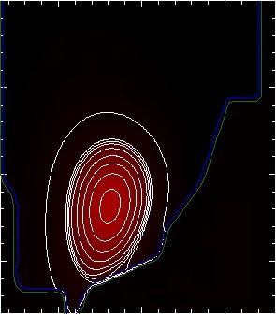
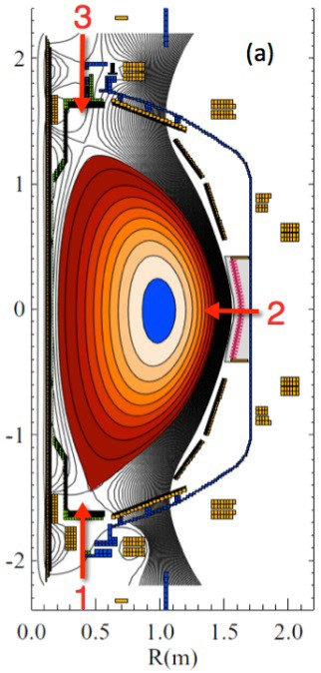
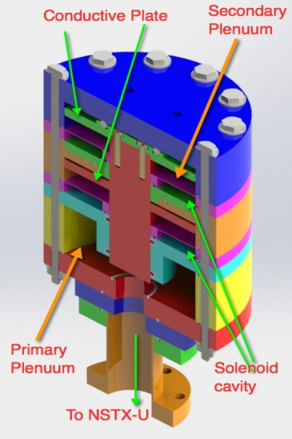
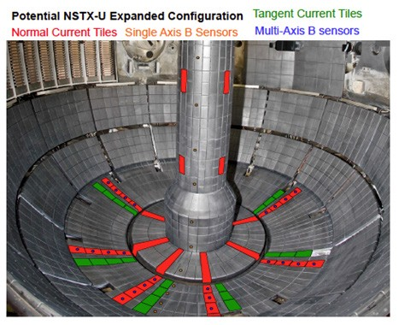
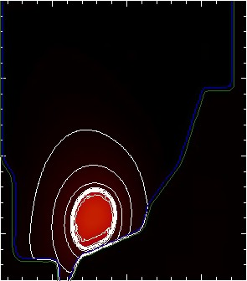
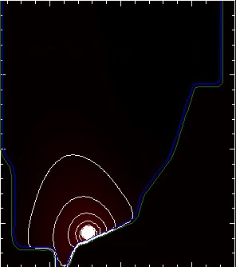
NSTX-U aims to play leading role in understanding halo current dynamics, disruption mitigation physics
Advanced non-linear MHD modelling of vertical displacement events (VDE) + halo currents with M3D-C¹
Enhance measurements of halo-current dynamics
Test ITER-like Massive Gas Injection (MGI) valves
  Test poloidal dependence of density assimilation
  First data expected FY16
RB_{T} t = 2850
RB_{T} t = 2875
FY16
RB_{T} t = 2900
RB_{T} t = 2918
FY17-18
University of Washington
NSTX Discharge 132859
NSTX-U / PPPL
Theory Partnership

Slide 23
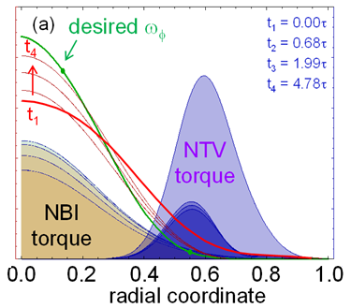
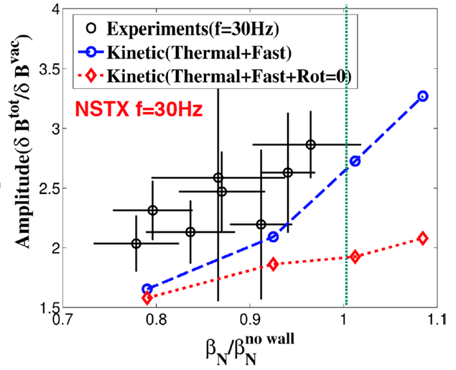
NSTX-U will play key role in understanding stability limits, developing disruption avoidance
Leaders in understanding kinetic effects in MHD stability
  NSTX: Drift-kinetic damping, fast-ions, rotation all important
Developing advanced rotation control to optimize performance
  Actuators: Beams, 3D fields (NTV)
n=1 resonant field amplification
MARS-K simulations
Princeton, Columbia, PPPL collaboration

Slide 24
NSTX-U Mission Elements
5 Highest Research Priorities
Explore unique ST parameter regimes to advance predictive capability - for ITER and beyond
  Understand energy confinement at high normalized pressure (high β)
  Study energetic particle physics prototypical of burning plasmas
Develop solutions for PMI challenge
3.Dissipate high edge heat loads using expanded magnetic fields + radiation 4.Compare performance of solid vs. liquid metal plasma facing components
Advance ST as possible FNSF / Pilot Plant
5.Form and sustain plasma current without transformer for steady-state ST

Slide 25
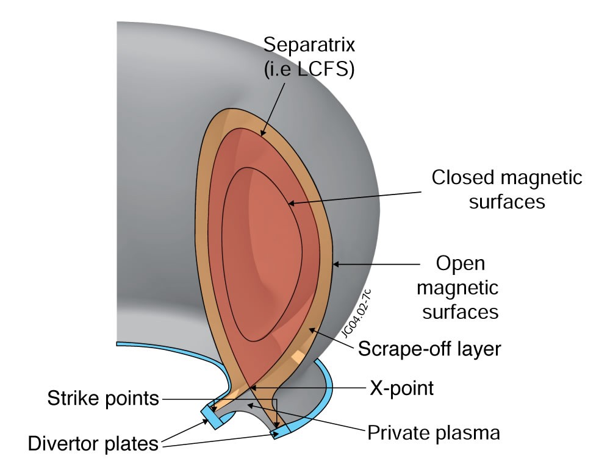
All modern tokamaks / STs use a “divertor” to control where power and particles are exhausted
Power exhaust width outside main plasma can be very narrow (few mm)
Power / particles contact target plates here

Slide 26
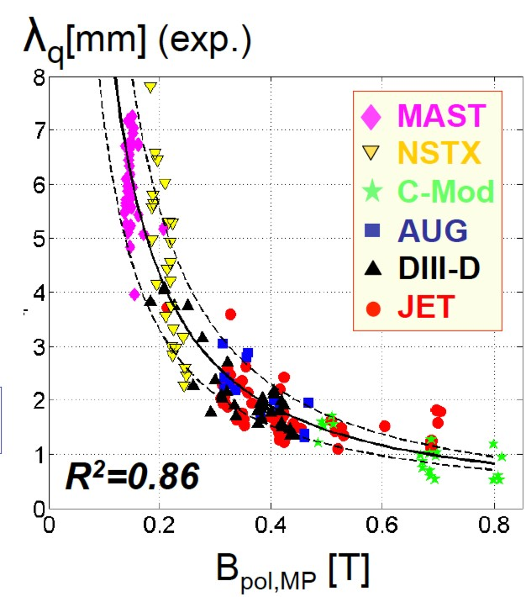
Dedicated tokamak + ST experiments found power exhaust width varies as 1 / B_{poloidal}
ST data breaks aspect ratio degeneracy of data set
Will 1/B_{poloidal} variation continue at higher I_{P}? What about detached conditions?

Slide 27




XGC1 simulations aiding in understanding of SOL heat flux width trends in NSTX
Experiment shows contraction of SOL heat flux width at midplane with I_{p} as well as influence of Li conditioning
XGC1 w/ collisions → similar trends
20
NSTX
Experiment
0 mg
150 mg
300 mg
XGC-1:
15
XGC1
B_{P} scan
Using 139047 at 665ms, 50 mg Li
Full-f, global PIC, kinetic ions, fluid electrons (kinetic electrons under development)
Good candidate for exascale computing initiative
λ_{q} (mm)
10
5
0
0.4 0.6 0.8 1 1.2 1.4
I_{P} (MA)
Heat flux width determined primarily by neoclassical processes
NSTX-U / PPPL
Theory Partnership

Slide 28




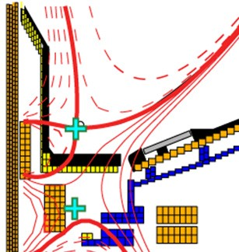
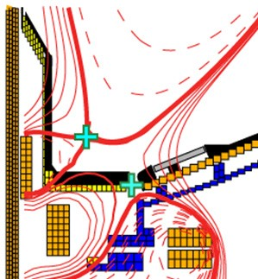
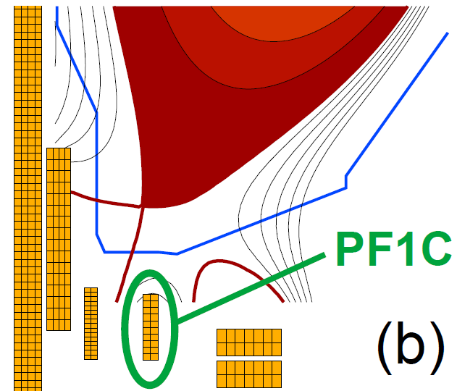
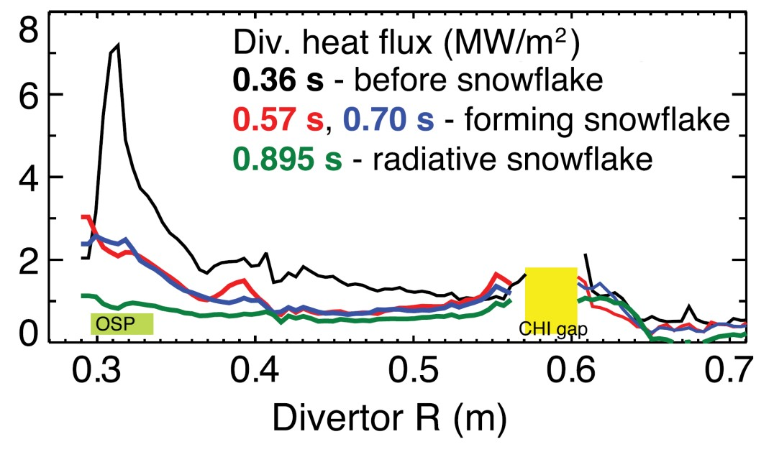
NSTX-U will test ability of radiation and advanced divertors to mitigate very high heat-fluxes
NSTX: reduced heat flux 2-4×via radiation (partial detachment)
Additional null-point in divertor expands field, reduces heat flux
Standard Divertor
Snowflake/X Divertor
NSTX-U peak heat fluxes will be up to 4-8× higher than in NSTX
NSTX-U has additional coils for up-down symmetric snowflake/X, improved control

Slide 29
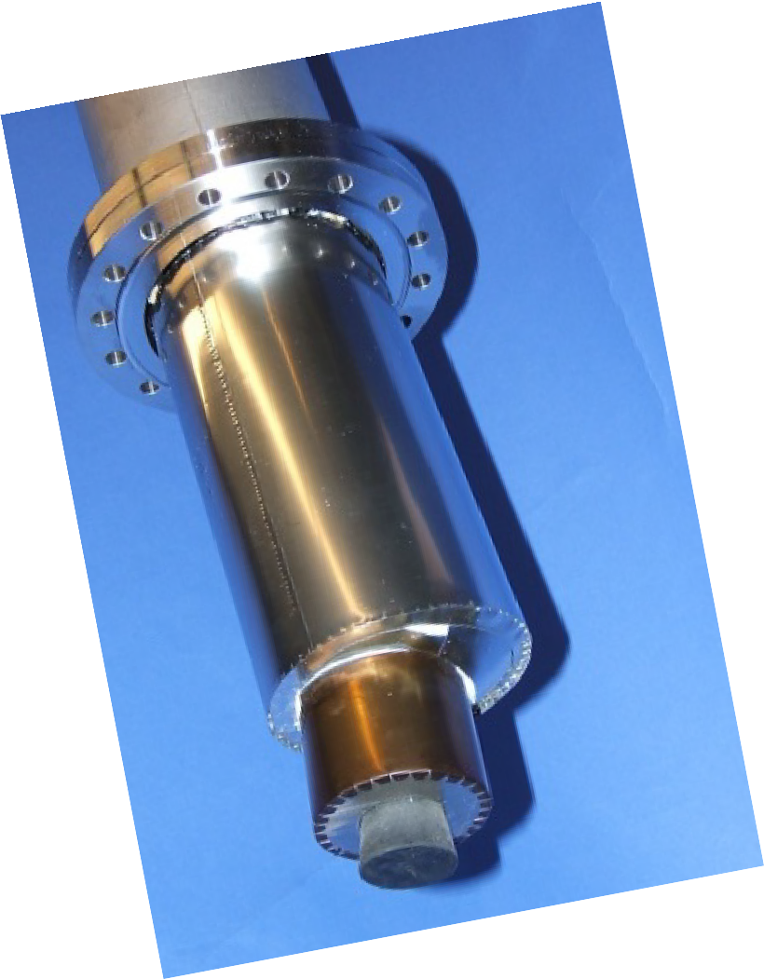
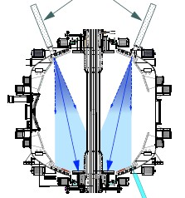
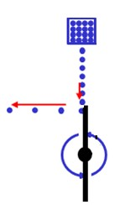
NSTX-U will employ multiple particle control tools to access long-pulse scenarios
3: Granule injector (GI) for ELM pacing
3: Granule injector (GI) for ELM pacing
2: Lithium Evaporator (LiTERs)
LiTERs
Test during FY16 run to trigger rapid ELMs, flush impurities
Granular Reservoir
TMB
TMB
Pumps deuterium
Improves confinement
Often stabilizes ELMs → can cause impurity accumulation
Rotating Impeller
TMB
Successfully tested on EAST and DIII-D
NSTX-U will test several granule types: Li, B₄C, C
f_{injection} ~ up to 500 Hz
1: Boronization (TMB)

Slide 30

Plasma confinement increased continuously with increasing Li coatings in NSTX – what is limit?
Global parameters improve
  H_{98y2} increases ~0.9 → 1.4
  No core Li accumulation
High H critical for compact FNSF / Pilot Plants
Energy Confinement Time (ms)
Pre-discharge lithium evaporation (mg)
R. Maingi, et al., PRL 107 (2011) 145004
NSTX-U will double Li-wall coverage with upward evaporators
Will further assess contributors to confinement improvement:
  Lower-recycling / reduced neutral source / higher T_{e}
  Edge profile / turbulence changes
  Influence of (low-Z) impurities in pedestal region

Slide 31
NSTX-U boundary / PFC plan: add divertor cryo-pump, transition to high-Z wall, study flowing liquid metal PFCs
5yr goal: Integrate high τ_{E} and β_{T} with 100% non-inductive
10yr goal: Assess compatibility with high-Z & liquid lithium PFCs
2016
2017
2018-19
2020-21
2022-23
High-Z tile row
All high-Z FW +
divertors
+ flowing LLD
module
Cryo + full lower outboard high-Z divertor
Cryo + high-Z FW
B+C BN
Li High-Z
Lower OBD
high-Z row of tiles
and OBD
+ liquid Li divertor (LLD)
Downward Li evaporator +
Li granule injector
High-Z tile row
Up + downward Li evaporator
Bakeable high-Z PFCs for liquid Li
or
Flowing Li module
Cryo-pump

Slide 32
NSTX-U Mission Elements
5 Highest Research Priorities
Explore unique ST parameter regimes to advance predictive capability - for ITER and beyond
  Understand energy confinement at high normalized pressure (high β)
  Study energetic particle physics prototypical of burning plasmas
Develop solutions for PMI challenge
3.Dissipate high edge heat loads using expanded magnetic fields + radiation 4.Compare performance of solid vs. liquid metal plasma facing components
Advance ST as possible FNSF / Pilot Plant
5.Form and sustain plasma current without transformer for steady-state ST

Slide 33


Design studies show ST potentially attractive as
Fusion Nuclear Science Facility (FNSF) or Pilot Plant
FNSF: Provide neutron fluence for material/component R&D (+ T self-sufficiency?)
Pilot Plant: Electrical self-sufficiency: Q_{eng} = P_{elec} / P_{consumed} ≥ 1 (+ FNSF mission?)
FNSF with copper TF coils
A=1.7, R₀ = 1.7m, κ_{x} = 2.7
Fluence = 6MWy/m², TBR ~ 1
FNSF / Pilot Plant with HTS TF coils
A=2, R₀ = 3m, κ_{x} = 2.5
6MWy/m², TBR ~ 1, Q_{eng} ~ 1

Slide 34
Steady-state operation required for ST/AT FNSF or Pilot Plant
NSTX achieved 70% “transformer-less” current drive
NSTX-U designed to achieve 100% (TRANSP):
H_{98y2}
ITER H-mode confinement scaling multiplier
I_{P}=1 MA, B_{T}=1.0 T, P_{NBI}=12.6 MW
Will NSTX-U achieve 100% as predicted by simulations?

Slide 35




ST-FNSF may need solenoidless current start-up method
Coaxial Helicity Injection (CHI) effective for current initiation
CHI developed on HIT, HIT-II
Transferred to NSTX / NSTX-U
NSTX: 150-200kA closed flux current
NSTX-U: Project 300-400kA
TSC (axisymmetric 2D ) simulation of CHI startup
1.0 ms 1.6 ms 2.7 ms
2
Z (m)
0
-2
2
0
2
0
R (m)
R (m)
0
R (m)
2
R. Raman et al., PRL 2006

Slide 36


CHI in NSTX has resemblance to 2D Sweet-Parker reconnection (NIMROD simulations)
Toroidal electric field generated in injector region by reduction of injector voltage and current
  E_{toroidal} × B_{poloidal} drift brings oppositely directed field lines closer and causes reconnection, generating closed flux
Direction of plasma flows
In Injector Region only
Elongated Sweet-Parker-type current sheet
n > 0 modes / MHD not strongly impacting 2D reconnection
Current
sheet
F. Ebrahimi, PoP 2013, PoP 2014

Slide 37




CHI current sheet unstable → plasmoids → merging
Possible lab observation of plasmoids → contribute to lab-astro
Possible plasmoids during NSTX CHI
F. Ebrahimi , PRL 2015
NSTX-U will extend NSTX results, contribute to basic reconnection physics

Slide 38
Outline
Physics Goals, Performance Parameters
Highlights from Construction Project
Operational Status
Research Priorities
Schedule
Summary

Slide 39
Latest run plan schedule for 2016
Goal is to operate 18 run weeks
FY16 budgets are favorable enough to support 18 weeks
Want as much data as possible for IAEA synopses/meeting, APS-2016
December: 0.5 run weeks (XMP)
January: ~ 2-3 run weeks (XMP, XP), PAC-37
February: ~ 2-3 run weeks (Ar-PS, LITER, LGI, MGI)
March ~ 3 run weeks
  Mid-run assessment in March/April
April – June 9.5 run weeks, complete FY16 run
July: Start outage: install high-k, high-Z tiles, …
Resume operations winter 2017 for FY17: ~16 run weeks

Slide 40
NSTX-U device performance progression:
1st year: Limit forces to ½ way between NSTX and NSTX-U, and ½ of the design-point heating of any coil
  Will permit up to ~5 second operation at B_{T} ~ 0.65T
2nd year goal: Full field and current, coil heating to ¾ of limit
3rd year goal: Full capability
Parameter | NSTX (Max.) | Year 1 NSTX-U Operations | Year 2 NSTX-U Operations | Year 3 NSTX-U Operations | NSTX-U Ultimate Goal
I_{P} [MA] | 1.2 | ~1.6 | 2.0 | 2.0 | 2.0
B_{T} [T] | 0.55 | ~0.8 | 1.0 | 1.0 | 1.0
Allowed TF I²t [MA²s] | 7.3 | 80 | 120 | 160 | 160
I_{P} Flat-Top at max. allowed I²t, I_{P}, and B_{T} [s] | ~0.4 | ~3.5 | ~3 | 5 | 5

Slide 41
Summary: NSTX-U will make fundamental and world-leading contributions to toroidal fusion science
Investigate unique high-β, low collisionality regime for understanding transport and stability
Explore advanced divertors, high-Z and Li walls
Inform optimal configuration for next-steps
FY2016 run campaign is now underway!
  Thank you for your attention!

Slide 42
Backup

Slide 43
Summary of FY2016-18 NSTX-U Research Milestones
FY2016
  Obtain first data at 60% higher field/current, 2-3× longer pulse:
    Re-establish sustained low l_{i} / high-κ operation above no-wall limit
    Study thermal confinement, pedestal structure, SOL widths
    Assess current-drive, fast-ion instabilities from new 2nd NBI
FY2017
  Extend NSTX-U performance to full field, current (1T, 2MA)
    Assess divertor heat flux mitigation, confinement at full parameters
  Access full non-inductive, test small current over-drive
  First data with 2D high-k scattering, prototype high-Z tiles
FY2018
  Study low-Z and high-Z impurity transport
  Assess causes of core electron thermal transport
  Test advanced q profile and rotation profile control
  Assess CHI plasma current start-up performance

Slide 44
NSTX-U Milestone Schedule for FY2016-18
FY2016
FY2017
FY2018
Run Weeks:
Incremental
18
16
18
12
16
R16-1
R17-1
R18-1
Boundary Science
+ Particle Control
Assess H-mode confinement, pedestal, SOL characteristics at higher B_{T}, I_{P}, P_{NBI}
Assess scaling, mitigation of steady-state, transient heat-fluxes w/ advanced divertor operation at high power density
Assess impurity sources and edge and core impurity transport
R17-2
IR18-1
Assess high-Z divertor PFC performance and impact on operating scenarios
Investigation of power and momentum balance for high density and impurity fraction divertor operation
R16-2
R17-3
IR18-2
Assess effects of NBI injection on fast-ion f(v) and NBI-CD profile
Assess τ_{E} and local transport and turbulence at low ν* with full confinement and diagnostic capabilities
Assess role of fast-ion driven instabilities versus micro-turbulence in plasma thermal energy transport
Core Science
Begin ~1 year outage for
major facility enhancement(s) sometime during FY2018
IR17-1
R18-2
R16-3
Assess fast-wave SOL losses, core thermal and fast ion interactions at increased field and current
Control of current and rotation profiles to improve global stability limits and extend high performance operation
Integrated Scenarios
Develop physics + operational tools for high-performance: κ, δ, β, EF/RWM
R17-4
R18-3
Develop high-non-inductive fraction NBI H-modes for sustainment and ramp-up
Assess transient CHI current start-up potential in NSTX-U
FES 3 Facility Joint Research Target (JRT)
C-Mod leads JRT
DIII-D leads JRT
NSTX-U leads JRT
Assess disruption mitigation, initial
tests of real-time warning, prediction
Examine effect of configuration on operating space for dissipative divertors
TBD

Slide 45






Five Year Facility Enhancement Plan (green – ongoing)
2015: Engineering design for high-Z tiles, Cryo-Pump, NCC, ECH
Fiscal Year:
2015 | 2016 | 2017 | 2018 | 2019
Major enhancements:
Base funding
+15% incremental
Upgrade Outage
1.5 → 2 MA, 1s → 5s
Run Weeks:
18
16
12-16
10-12
New
center-stack
Pulse-burst MPTS
Lower divertor cryo-pump
Boundary Science
+ Particle Control
Boronization
High-Z tile row on lower OBD
High-Z PFC diagnostics
Li granule injector
Upward
LiTER
LLD using bakeable cryo-baffle
MAPP
MGI disruption mitigation
Upgraded halo sensors
Off-midplane 3D coils (NCC)
Core Science
δB diag. - incremental
Enhanced MHD sensors
Laser blow-off
42 ch MPTS
DBS, PCI, or other intermediate-k
48 ch BES
High k_{θ}
MSE/LIF
Charged fusion product
Neutron collimator
4 coil AE antenna
Establish control of:
Rotation
q_{min}
HHFW limiter upgrade
Snowflake
Integrated Scenarios
FIReTIP
n_{e}
Divertor P_{rad}
2nd NBI
1 MW ECH/EBW
Upgraded CHI for ~0.5MA
0.5-1 MA CHI
up to 1 MA plasma gun

Slide 46
NSTX-U diagnostics available during first year
MHD/Magnetics/Reconstruction
  Magnetics for equilibrium reconstruction
  Halo current detectors
  High-n and high-frequency Mirnov arrays
  Locked-mode detectors
  RWM sensors
Profile Diagnostics
  MPTS (42 ch, 60 Hz)
  T-CHERS: T_{i}(R), V_{φ}(r), n_{C}(R), n_{Li}(R), (51 ch)
  P-CHERS: V_{θ}(r) (71 ch)
  MSE-CIF (18 ch)
  MSE-LIF (20 ch)
  ME-SXR (40 ch)
  Midplane tangential bolometer array (16 ch)
Turbulence/Modes Diagnostics
  Poloidal FIR high-k scattering (installed in 2016)
  Beam Emission Spectroscopy (48 ch)
  Microwave Reflectometer,
  Microwave Interferometer
  Ultra-soft x-ray arrays – multi-color
Energetic Particle Diagnostics
  Fast Ion D_{α} profile measurement (perp + tang)
  Solid-State neutral particle analyzer
  Fast lost-ion probe (energy/pitch angle resolving)
  Neutron measurements
  Charged Fusion Product
Edge Divertor Physics
  Gas-puff Imaging (500kHz)
  Langmuir probe array
  Edge Rotation Diagnostics (T_{i}, V_{φ}, V_{pol})
  1-D CCD H_{α} cameras (divertor, midplane)
  2-D divertor fast visible camera
  Metal foil divertor bolometer
  AXUV-based Divertor Bolometer
  IR cameras (30Hz) (3)
  Fast IR camera (two color)
  Tile temperature thermocouple array
  Divertor fast eroding thermocouple
  Dust detector
  Edge Deposition Monitors
  Scrape-off layer reflectometer
  Edge neutral pressure gauges
  Material Analysis and Particle Probe
  Divertor VUV Spectrometer
Plasma Monitoring
  FIReTIP interferometer
  Fast visible cameras
  Visible bremsstrahlung radiometer
  Visible and UV survey spectrometers
  VUV transmission grating spectrometer
  Visible filterscopes (hydrogen & impurity lines)
  Wall coupon analysis
New capability,
Enhanced capability

Slide 47
Backup - Facility Enhancements

Slide 48

Cryopump Physics Design Done in Collaboration with ORNL
Initial designs used semi-analytic models to determine pump geometry.
  Conclusion on optimum geometry:
    duct height h~2.5 cm,
    length h~2 cm,
    Radius of 0.72 m.
  Allows pressures>1 mT over a range of plasma shapes and SoL widths.
  Should allow the full beam fuelling to be pumped.
Calculation then benchmarked against SOLPS
J. Canik, ORNL
g = throat height
h = throat length
Baffle
h
Cryo
g

Slide 49


Physics Studies are Transferring to the Initial
Engineering Design in Collaboration with MIT
Initial in-vessel geometry has been laid out.
  Pump radius, throat dimensions taken from the modeling.
  Is a significant perturbation, requiring a rebuild of basically the entire lower outer divertor.
Specification in progress for the Liquid He refrigerator.
  Likely suitable model found
  Location in room adjacent to NSTX-U has been identified.
Ex-vessel liquid He plumping and transfer Dewar is under design.
Cryo-ring
Transfer line layout

Slide 50


Outboard row of high-Z tiles can access high heat-flux, maintain operational flexibility
High-performance discharge
Shape developed to perform dedicated tests on outboard PFCs
  ISOLVER free-boundary solver utilized with specified β_{N}
  0D-analysis obtains heating power for assumed confinement multiplier H_{98y2}
Zero-radiation power exhaust provides heat flux figure-of-merit (FOM)
  FOM calculates incident power accounting for magnetic shaping only
  High-Z shape FOM is 66% of similar full-power, high-triangularity scenario
FOM ~ 60 MW/m²
High-Z reference discharge
FOM ~ 40 MW/m²

Slide 51




Single row of TZM molybdenum tiles will be installed for the FY-2017 run campaign
Goals:
  Initial assessment of plasma performance with high-Z PFC
  Develop expertise in analysis, manufacture, installation with the new material
Design constrained to by a one-for-one replacement of the existing tiles.
Raw material procurement underway
Edge and access-way chamfers introduced to reduce heat-flux peaking.
Seamless integration with existing mounting scheme minimizes installation time
Surface heat flux
Temperature

Slide 52



Suppressed erosion and trapping at target observed in linear plasma device (Magnum-PSI)
Mixed-material effect reduces erosion due to LiD formation
Plasma pre-sheath potential well large enough to retain eroded Li
Significant implications for evaporative cooling concepts
T. Abrams 2014 PhD Princeton U.,
T. Abrams 2016 Nucl. Fusion,
M. Chen 2016 Nucl. Fusion.
Li-I emission, t=2.5s
Neutral Li emission
Li Trapping
Plasma
Target
T>700C
Neutral D emission
10 mm
Jaworski, 3rd ISLA, 2013

Slide 53


Pre-filled target concept integrates Li reservoir with high-Z tile scheme
Similar to CPS device but applicable as divertor PFC
Utilizes wire-EDM fabrication to obtain complex geometry
Emphasizes passive replenishment via capillary action
P. Rindt, TU/Eindhoven Thesis, Jaworski FED submitted

Slide 54





A three-step progression can achieve flowing, liquid metal PFCs
High-Z divertor tiles + LITER
Pre-filled liquid-metal target
Flowing LM PFC
NSTX-U High-Z Divertor Upgrade 1
Conceptual design for pre-filled LM target
Flowing PFC loop integration

Slide 55
High-Z divertor tiles + Li evaporated coatings provide divertor analogue of Magnum-PSI experiments
High-Z divertor tiles + LITER
  Technical goals:
    Establish non-intercalating substrate for evaporated Li
    Provide high-heat flux substrate for Li experiments
  Scientific goals:
    Quantify maintenance of Li on high-temperature substrate and protection of substrate
    Re-examine suppression of erosion in high-flux divertor
    Understand impact and core-edge compatibility of high-temp. target with limited inventory of Li
NSTX-U High-Z Divertor Upgrade 1
Conceptual design for pre-filled LM target
Flowing PFC loop integration

Slide 56
Pre-filled targets test LM coverage, resupply and impact of significant Li source
Pre-filled liquid-metal target
  Technical goals:
    Achieve introduction of Li in NSTX-U without evaporation
    Realize complex target production as high-heat flux target
  Scientific goals:
    Test models of maintenance of LM wetting and coverage
    Understand limits of LM passive resupply
    Understand impact and core-edge compatibility of high-temp. target with larger inventory of Li
NSTX-U High-Z Divertor Upgrade 1
Conceptual design for pre-filled LM target
Flowing PFC loop integration

Slide 57
Final integration demonstrates LM introduction/extraction and inventory control
Flowing LM PFC
  Technical goals:
    Integrate parallel effort on loop technology with confinement experiment
    Achieve active introduction and extraction from exp.
  Scientific goals:
    Assess material inventory control from LM target
    Understand performance of passive + active replenishment techniques
    Understand impact and core-edge compatibility of high-temp. target
NSTX-U High-Z Divertor Upgrade 1
Conceptual design for pre-filled LM target
Flowing PFC loop integration

Slide 58

Non-Axisymmetric Control Coils (NCC) will dramatically improve NSTX-U 3D physics capabilities
Three primary options considered for the NCC implementation:
Metrics under consideration:
  n=1
    RWM control
    Ability to scan the relative ratio of resonant to non-resonant n=1 contributions
  n>1
    Variation of available NTV torque profiles.
    NTV normalized to the Chirkov parameter
Conclusion: 2x12 is best, 2x6-Odd is a good step in a staged implementation

Slide 59


NCC physics design completed: Optimization for
NTV braking performed with IPEC coupling matrix
NCC and midplane coils can be combined to remove the dominant resonant modes up to the second, giving the optimized NTV for core
  NCC 2x12 provides n=1,2,3,4,6 optimized NTV, and 2x6 provides n=1,2,6
  Optimized NTV can be used to control local torque with minimized resonance
n=1
*Ratio of coil currents (phasing)
*T_{max} is based on max. 3kAt
Higher n’s
n=6

Slide 60


Study of RMP characteristics with NCC extended with TRIP3D (T. Evans) – 2x12 NCC (and 2x7) favorable for RMP
Vacuum Island Overlap Width (VIOW) analysis shows full NCC 1kAt can produce sufficient VIOW in a wide range of q₉₅, but partial NCC needs more currents with low q₉₅ targets
  Also shows 2x7, with “one” more additional array upon partial NCC can provide the greater VIOW by toroidal coupling (n=2,4,9)

Slide 61



NCC is Undergoing Conceptual Design in Parallel with the Cryopump
Considering a mineral insulated conductor
Order of 20’ test sample is placed:
  Both solid and hollow center conductors
Goal is to assess
  Manufacturability/formability,
  electrical characteristics, including end-sealing methods,
  fabrication lead time and cost.
Hollow conductor will allow He cooling, but analysis indicates thermal ratcheting with solid conductor is likely manageable.
2 x 12
Coil
Tile
PP
Assumptions In Solid Conductor Calculation
3 kA 5s pulse 1200 s repetition prate
T_{max}=142 C after 8 hours

Slide 62

TRANSP modelling: ECH is game-changer for non-inductive ramp-up
Heats low temperature plasma to 1-1.5keV in ~30ms
ECH accessibility limited to low density, but compatible with CHI

Slide 63

EC + FWCD synergistic for lowest FW phasing k_{φ}=3m⁻¹
Half power needed to drive 400kA compared to no EC
ECH enables sustained T_{e} conditions for higher FW k_{φ}
Need to optimize FW phasing during shot to sustain H&CD
(heating phasing)

Slide 64



28 GHz Gyrotron System Will Facilitate
Non-Inductive Startup Research
Coupling CHI to NB overdrive will be aided by electron heating
TSC simulations indicate 0.6MW of absorbed ECH power could increase T_{e} to ~400eV in 20ms
28 GHz, 2 MW tubes developed by Tsukuba University planned to provide this power.
Have found location for gyrotron, appropriate commercial waveguide manufacturer.

