Slide 1
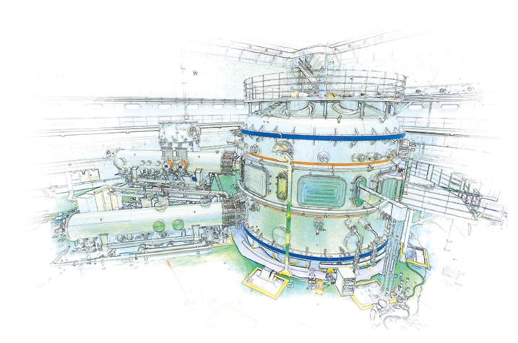






Supported by
Isolation of Neoclassical Toroidal Viscosity Profile Under Varied Plasma and 3D Field Conditions in Low and Medium Aspect Ratio Tokamaks*
S.A. Sabbagh¹, Y.S. Park¹, R.E. Bell², J. Kim³, J. Ko³, W.H. Ko³, K.C. Shaing⁴, Y. Sun⁵, B. LeBlanc², S.G. Lee³, J. Lee³, J.W. Berkery¹, S.P. Gerhardt², S.H. Hahn³, Y. In³, Y.M. Jeon³, Y.K. Oh³, J.W. Yoo³
¹Department of Applied Physics, Columbia University, New York, NY, USA
²Princeton Plasma Physics Laboratory, Princeton University, Princeton, NJ, USA
³National Fusion Research Institute, Daejeon, Republic of Korea
⁴National Cheng Kung University, Tainan, Taiwan
⁵ASIPP, Hefei Anhui, China
26th IAEA Fusion Energy Conference
19 October 2016
Kyoto, Japan
V1.2
*This work supported by the US DOE contract DE-AC02-09CH11466, DE-FC02-04ER54698, and DE-FG02-99ER54524

Slide 2
Key physical characteristics of NTV are investigated in low and medium aspect ratio tokamaks
Motivation
  Low magnitude (δB/B₀ ~ O(10⁻³)) 3D magnetic fields are used favorably used in tokamaks (e.g. ELM suppression, MHD mode control)
  3D fields of this magnitude can produce neoclassical toroidal viscosity (NTV), which can:
    Alter plasma rotation non-resonantly (without mode locking)
    Potentially create stabilizing plasma rotation, V_{φ}, V_{φ} shear (e.g. in ITER)
  Therefore, it is important to understand NTV in tokamaks, backed by accurate (~O(1)) quantitative modeling
Outline
  NTV profile isolation experiments in NSTX and KSTAR
  NTV comparison of theory to experiment in NSTX
  Recent NTV offset rotation experiments in KSTAR (Sept 2016)

Slide 3
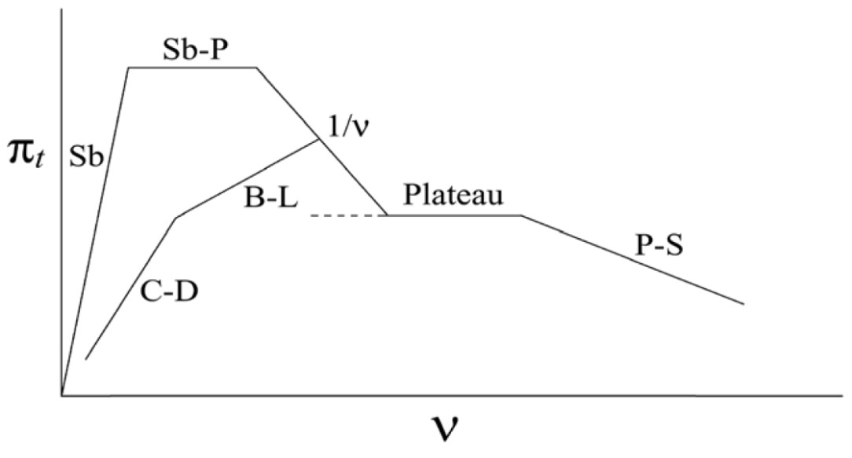
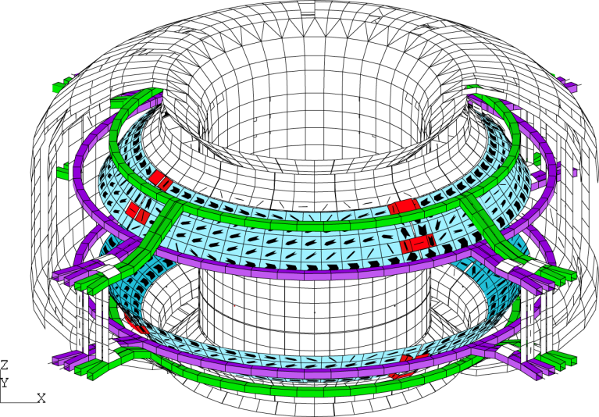
Neoclassical Toroidal Viscosity (NTV) can be studied through the application of 3D fields in tokamaks
NSTX 3D coils
Theory: NTV strength varies with plasma collisionality ν, δB², rotation
(K.C. Shaing, K. Ida, S.A. Sabbagh, Nucl. Fusion 55 (2015) 125001)
KSTAR 3D coils (IVCC)
NTV “offset” rotation
NTV force in “1/ν” collisionality regime
K.C. Shaing, et al.,
PPCF 51 (2009) 035004
T_{i}^{5/2}
plasma rotation

Slide 4
3D field perturbation experiments conducted to isolate and measure the T_{NTV} profile in NSTX and KSTAR
High normalized beta plasma targets typically chosen
  Typically near or above n = 1 no-wall limit (for higher T_{i})
Apply or otherwise change 3D field on a timescale significantly faster than the momentum diffusion time, τ_{m}
  Analysis before/after 3D field application isolates T_{NTV} in the momentum diffusion equation; ‑dL/dt = T_{NTV}
dL/dt measured experimentally and compared to theoretically computed T_{NTV} on this timescale
  dL/dt profile can change significantly on timescales > τ_{m}, (diffuses radially, broadens, leads to significant error compared to T_{NTV})
Emphasize non-resonant applied 3D field configurations
  Use n = 2 and 3 field configurations to avoid driving MHD modes
  n = 1 field configurations with different pitch investigated in KSTAR

Slide 5
Theoretical NTV torque density profiles, T_{NTV} are computed for NSTX using theory applicable to all collisionality regimes
Non-axisymmetric coils fully modelled in 3D
3D field definition
z(m)
plasma displacement
General considerations
  In tokamaks, ξ not typically measured, can lead to large error
  “Fully-penetrated field constraint” used to define ξ
    Singularities avoided by standard finite island width assumption
  For NSTX, |ξ | ~ 0.3 cm << ε^{0.5}ρ_{i}, therefore, ion banana width-averaging is used for ion channel
    Can explain why strong resonant peaks in NTV profile are not observed in experiment
y(m)
x(m)
NTV analysis of NSTX – data interfaced to NTVTOK
  Use Shaing’s “connected NTV model”, covers all ν, superbanana plateau regimes
  Full 3D coil specification and δB spectrum, ion and electron components computed, no aspect ratio assumptions
(Y. Sun, Liang, Shaing, et al., NF 51 (2011) 053015)
(K.C. Shaing, Sabbagh, Chu, NF 50 (2010) 025022)

Slide 6
Measured NTV torque density profiles quantitatively compare well to computed T_{NTV} using fully-penetrated 3D field
n = 3 coil configuration
n = 2 coil configuration
NSTX
NSTX
x0.6
x1.7
Experimental
-dL/dt
Experimental
-dL/dt
NTVTOK
code
NTVTOK
ψ_{N}
ψ_{N}
T_{NTV} (theory) scaled to match peak value of measured -dL/dt
  Scale factor ((dL/dt)/T_{NTV}) = 0.6 and 1.7 for cases shown above – O(1) agreement
Banana orbit-averaging reduces computed resonant perturbation effects
K.C. Shaing, and S.A. Sabbagh, et al., Phys. Plasmas 23 (2016) 072511

Slide 7
KSTAR experiment using different 3D field spectra established isolated NTV profile using fast power supply
IVCC n = 2 configuration
n = 1 pitch non-aligned
n = 1 pitch aligned
Plasma rotation
Change in plasma rotation
Results show non-resonant NTV characteristics; broad NTV torque profile
  Δω_{φ} does not change sign across profile (non-resonant); Δω_{φ} ~ 0 near plasma edge
  3D field spectrum varied: similar Δω_{φ} profiles, n = 1 pitch non-aligned has largest NTV
KSTAR n = 2 NTV experiments do not exhibit hysteresis (linear behavior)
See recent NTV review paper: K.C. Shaing, K. Ida, S.A. Sabbagh, et al., Nucl. Fusion 55 (2015) 125001

Slide 8
The NTV Offset Rotation Profile, V₀^{NTV}, was recently directly measured in KSTAR
Motivation
  Plasma rotation highly important for tokamak stability and confinement
  Future fusion devices are envisioned to have far less momentum input
  ➔ If sufficiently strong, this rotation could provide stabilization and improved performance in ITER and future devices
Experiment overview
  Used ECH for plasma heating, avoided issues of strong NBI torque
  Measured intrinsic rotation using NBI as a diagnostic beam for CES
Issues related to experiments with NBI torque
  T_{NBI} term is
    Computed, not directly measured
    Typically much larger than the T_{NTV} component due to offset rotation ➔analysis is prone to error
    The T_{NBI} profile matters – not just zero net input torque from NBI

Slide 9
Intrinsic Torque due to Neoclassical Toroidal Viscosity (NTV) – a controllable momentum source via 3D field
(K.C. Shaing, K. Ida, S.A. Sabbagh, Nucl. Fusion 55 (2015) 125001)
Full Theory
  The non-ambipolar difference of ion and electron flux due to the application 3D fields yields a so-called “offset rotation profile”, V₀^{NTV}
  Generally, the local rotation speed can be either in the co- or counter-I_{p} direction if dominated by electron/ion flux, respectively
Highly Simplified Theory
  Consider a highly simplified theory to help understand characteristics
  Simplified NTV torque profile: T_{NTV} = C₁ δB² (V_{φ} – V_{0-NTV})
  Simplified V₀^{NTV} profile: V₀^{NTV} = C₂ dT_{i}/dr – C₃ dT_{e}/dr (for future analysis)
    Electron effects can dominate at low collisionality – important for ITER
  Unlike “intrinsic rotation”, the T_{NTV} can be controlled by the applied 3D field spectrum and strength
(Y. Sun, K. Liang, K.C. Shaing, et al. Nucl. Fusion 51 (2011) 053015)

Slide 10
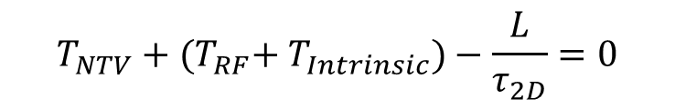
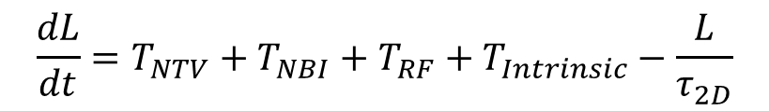

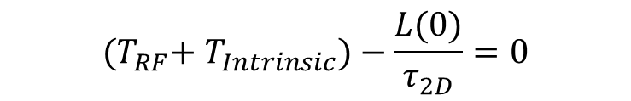
Consider simple torque balance equation to further understand expected dynamics when measuring V₀^{NTV} profile
$$\frac{dL}{dt}=T_{NTV}+T_{NBI}+T_{RF}+T_{Intrinsic}−\frac{L}{τ_{2D}}$$
Simple torque balance
Consider equations with/without 3D field (in steady-state)
Use simple NTV model to express offset rotation
(e.g. W. Solomon, et al., Phys. Plasmas 17 (2010) 056108, Equation 8)
$$T_{NTV}+{(T}_{RF}+{ T}_{Intrinsic})−\frac{L}{τ_{2D}}=0$$
(with 3D field ➔ L ➔ IV/R)
$${(T}_{RF}+{ T}_{Intrinsic})−\frac{L(0)}{τ_{2D}}=0$$
(without 3D field ➔ L(0) ➔ IV_{I}/R)
$${T_{NTV}=C}_{1}δB^{2}{(V_{∅}−V}_{0−NTV})$$

Slide 11
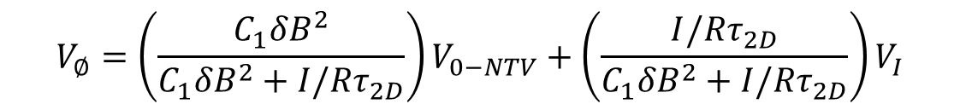
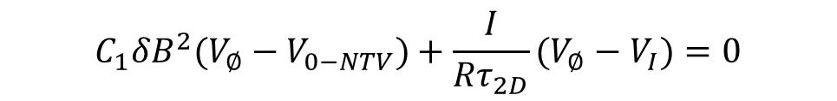
As 3D field strength increases, V_{φ} evolves from V_{intrinsic} toward a saturated profile V₀^{NTV}
Combine equations
  Assume (T_{RF} + T_{intrinsic}) not function of 3D field; use simple T_{NTV} model
Expected dynamics (4 different “conditions”)
    δB = 0: V_{φ} = V_{I}
    low δB: measured V_{φ} profile close to V_{I}
    increased δB and (|V_{φ}| >> |V₀^{NTV}|): V_{φ} ➔ V₀^{NTV}
    sufficiently high δB: V_{φ} saturates to V₀^{NTV}
$$C_{1}δB^{2}{(V_{∅}−V}_{0−NTV})+\frac{I}{Rτ_{2D}}(V_{∅}−V_{I})=0$$
- (V_{I} is the toroidal velocity measured without 3D field applied)
- I ➔ moment of inertia
$${V_{∅}=\left(\frac{C_{1}δB^{2}}{C_{1}δB^{2}+I/Rτ_{2D}}\right)V}_{0−NTV}+{\left(\frac{I/Rτ_{2D}}{C_{1}δB^{2}+I/Rτ_{2D}}\right)V}_{I}$$
(on each ψ surface)
a)
V_{I}
b)
V_{φ}
c)
d)
V₀^{NTV}
δB

Slide 12
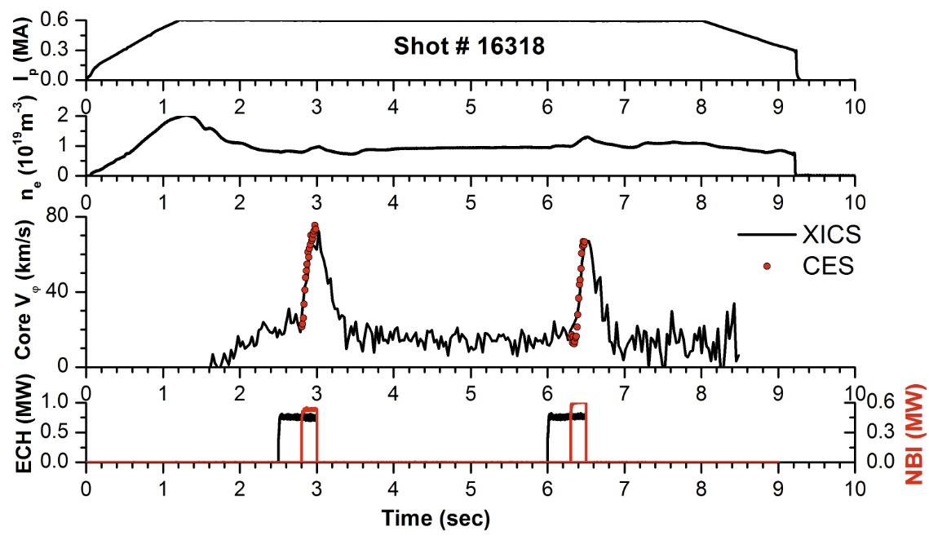
Target plasma with CES and XCIS measurement of plasma toroidal velocity (apply n = 2 field to this)
X-ray crystal (XCIS) and charge exchange spectroscopy (CES) data agreement shows that plasma velocity is well described by the early CES time point
NBI spins plasma in co-NBI direction – NOT ALWAYS true with 3D field!

Slide 13
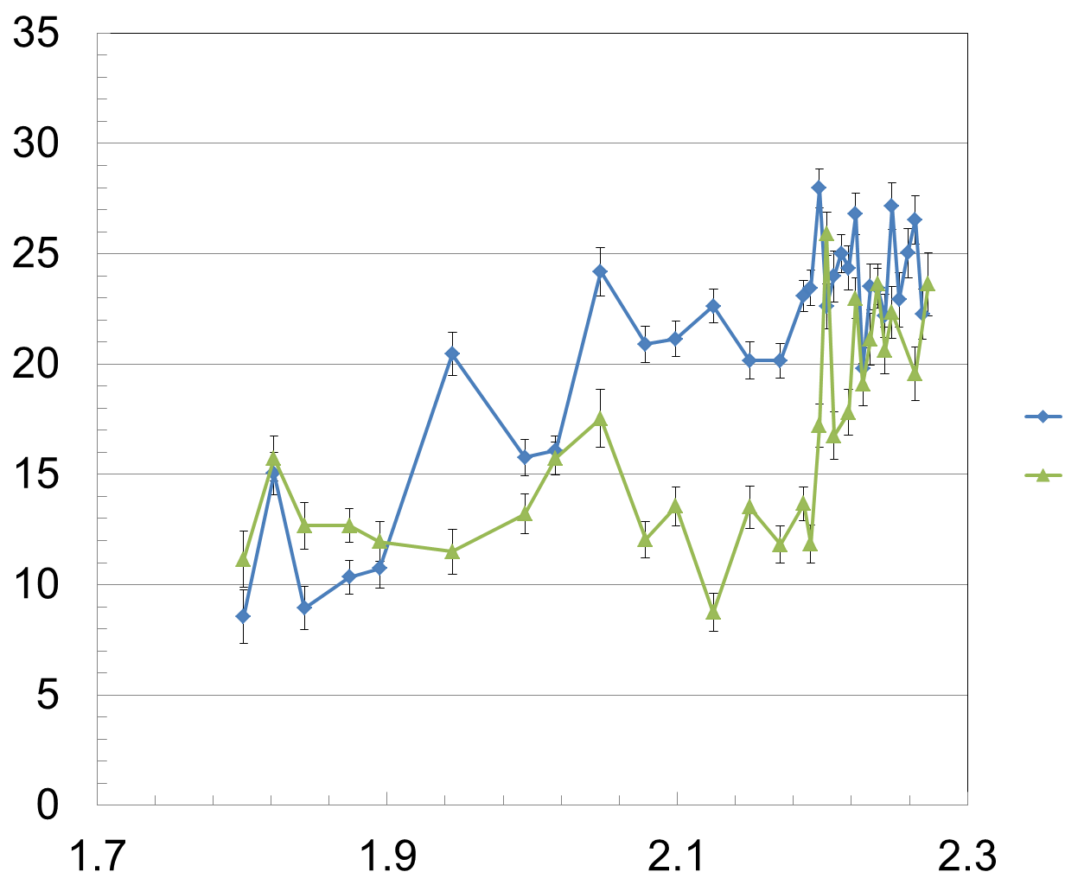
Comparison of measured intrinsic rotation profile (δB = 0) and low level of applied n = 2 field clearly alters V_{φ}
Intrinsic rotation profile (δB = 0)
⬅ Condition (a)
Shot (I_{n=2} current) (kA/turn)
V_{φ} (km/s)
16317 (0.0)
16315 (1.0)
Low n = 2 field strength
⬅ Condition (b)
t = 6.305s
R (m)
Intrinsic rotation is defined as measured rotation profile with no applied 3D field
  Note: ECH applied in this case, but ohmic cases were run as well

Slide 14
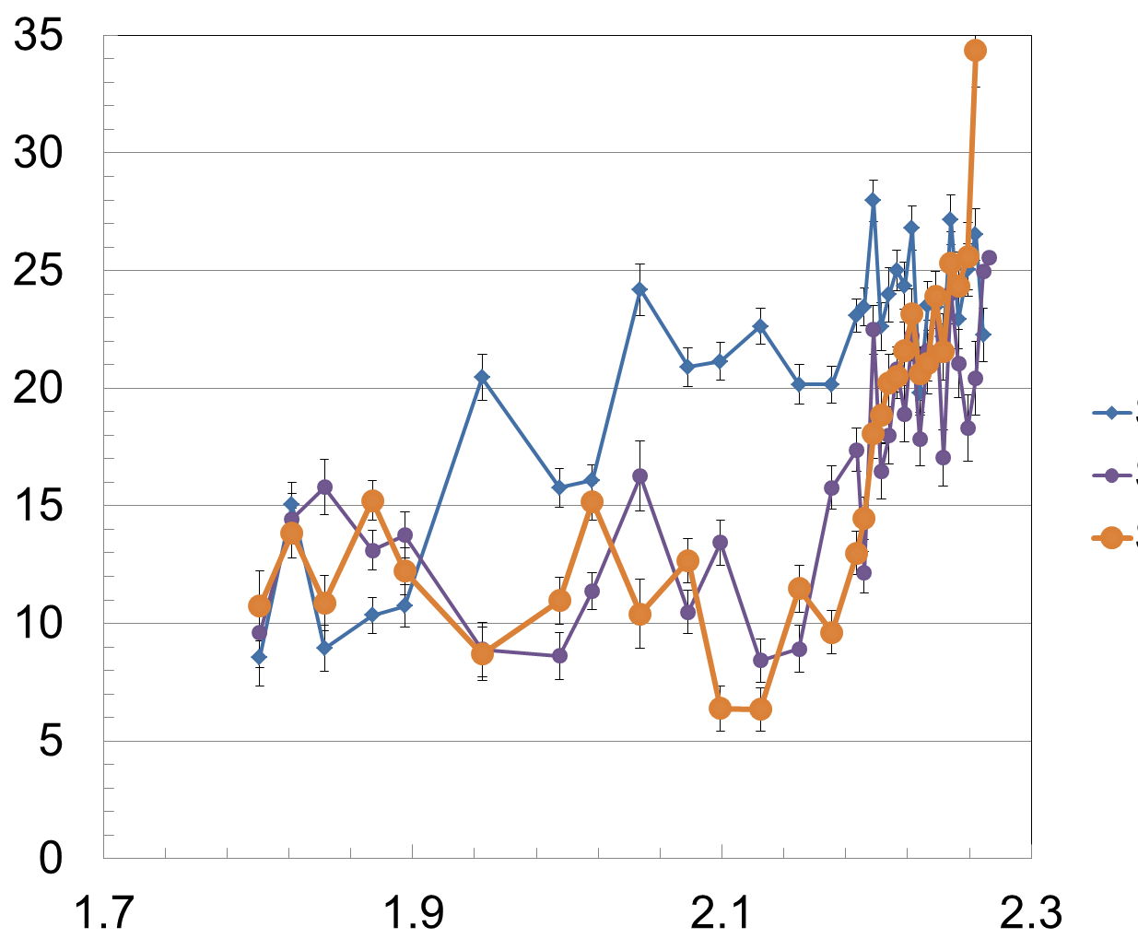
Increasing the applied n = 2 field strength leads to the saturation of the V_{φ} profile expected for NTV offset profile
Intrinsic rotation profile (δB = 0)
Shot (I_{n=2} current) (kA/turn)
V_{φ} (km/s)
16317 (0.0)
16314 (1.6)
16313 (2.4)
Increasing = 2 field strength
⬅ Conditions (c), (d)
t = 6.305s
R (m)
More than 2.2x increase in δB² in this step, with almost no change to V_{φ} profile
NTV drag with V_{φ} profile >> V₀^{NTV} would produce change (more than 2.2x torque)

Slide 15
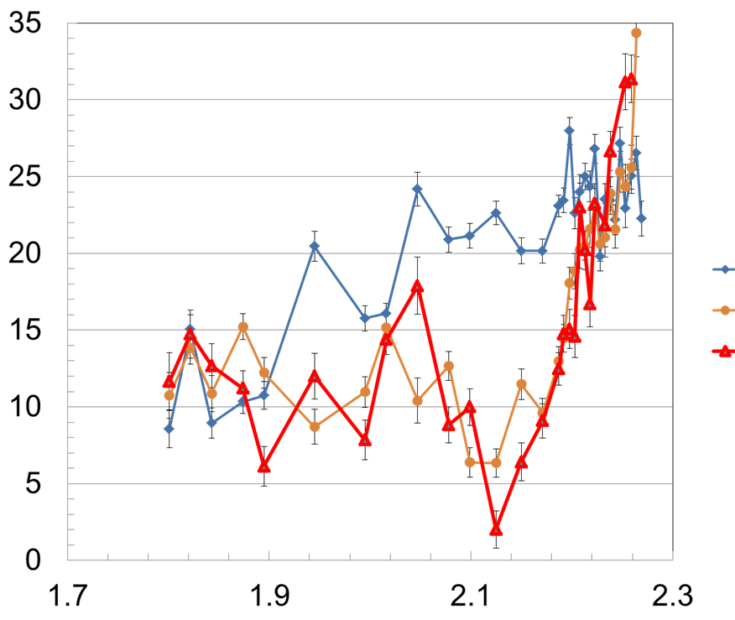
Final saturated NTV offset V_{φ} profile has much stronger V_{φ} shear at large R compared to the intrinsic rotation profile
Intrinsic rotation profile (δB = 0)
15 times greater shear !
Shot (I_{n=2} current) (kA/turn)
V_{φ} (km/s)
16317 (0.0)
16313 (2.4)
16312 (3.2)
Average shear (R > 2.14m)
    V⁻¹(dV/dr) (ECH) = 1.1 m⁻¹
    V⁻¹(dV/dr) (V_{0-NTV}) = 15.4m⁻¹
NTV offset V_{φ} profile
t = 6.305s
R (m)
NTV offset V_{φ} profile has 15 times greater shear at large R
Saturated profile at highest applied n = 2 current confirms increased V_{φ} at large R

Slide 16
The present results are potentially significant for ITER to provide strong plasma rotation and shear in outer plasma
Why unique?
  First time that V₀^{NTV} profile has been directly measured w/ T_{NBI} = 0
  First time V₀^{NTV} has been measured dominated by electron effects
    V₀^{NTV} profile measured in the co-I_{p} direction
Why important?
  Co-I_{p} directed V₀^{NTV} can be higher than ECH-induced co-I_{p} rotation in edge region and is controllable
  Rotation shear in the outer plasma region is 15 times stronger than rotation shear due to ECH
ITER relevant: |V₀^{NTV}| strong compared to simulations
  ITER 15 MA ASTRA simulation: Ω_{φ} ~ 2 krad/s in edge region
  Recent KSTAR experiment: Ω_{φ} > 12 krad/s in edge region (scaling?)
  Potential to greatly increase rotation shear in outer plasma region

Slide 17
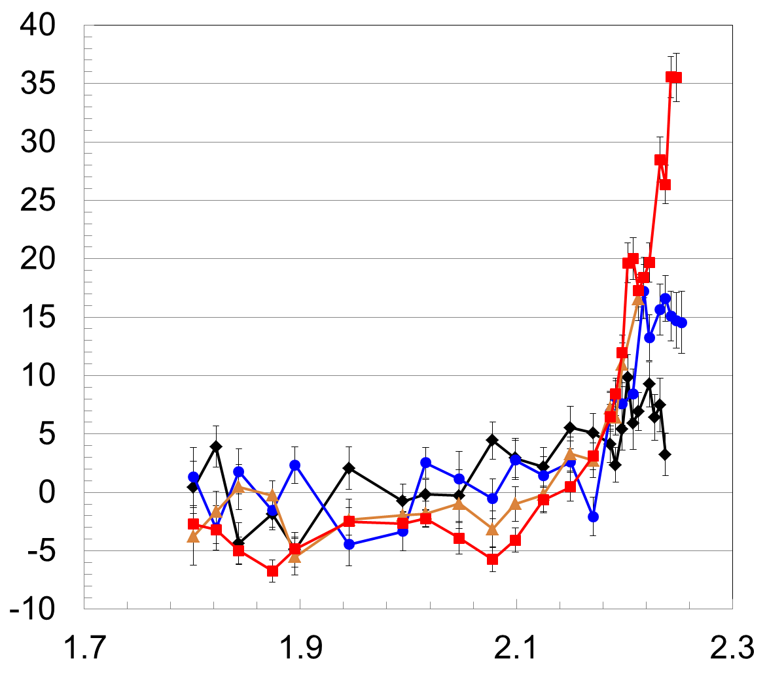
The NTV offset effect is produced in ohmic plasmas, and is observed to be accentuated by ECH heating
Measured V₀^{NTV} profiles (when I_{n=2} > 4)
Ohmic plasma V_{φ} ~ 0 in core, weak further out
Applied n = 2 field increases V_{φ} ~ in outer region
  Effect appears saturated at 4kA/turn (but no CES data outside R = 2.213m)
Stronger n = 2 field + ECH heating clearly yields counter-I_{p} rotation in core, co-I_{p} rotation in outer region
  Ctr-I_{p} only possible by V₀^{NTV}
  Large outer V_{φ} shear
ECH, I_{n=2} = 4.9 kA/turn
V_{φ} (km/s)
Ohmic, I_{n=2} = 4.0 kA/turn
Co-I_{p} direction
Ohmic, I_{n=2} = 2.4 kA/turn
Ohmic, I_{n=2} = 0
R (m)

Slide 18
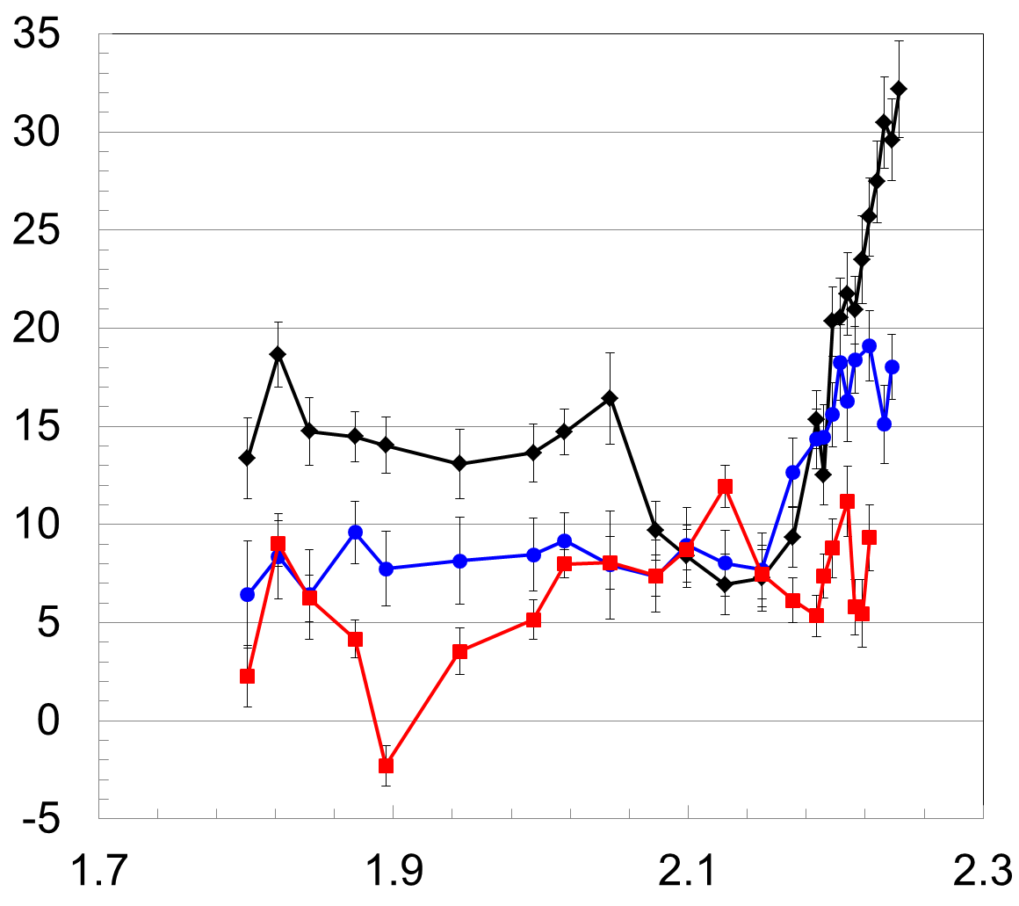
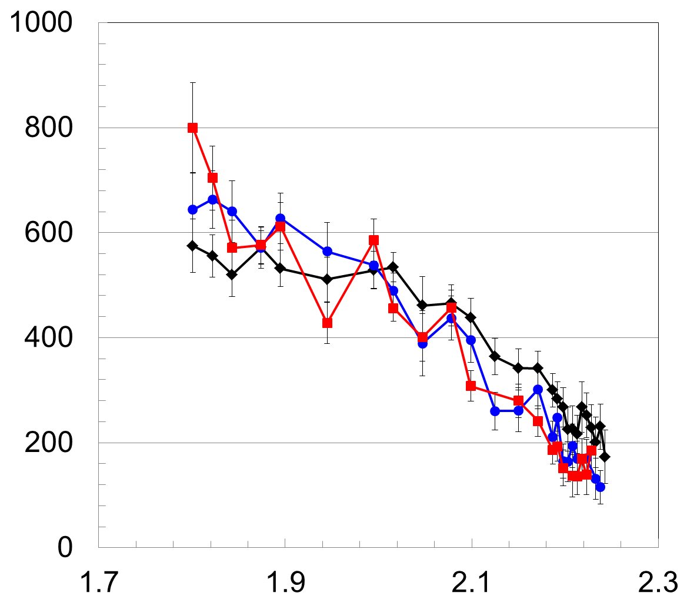
Varying plasma temperature shows V₀^{NTV} more strongly in co-I_{p} direction when T_{e} is higher
I_{n=2} = 4.0 kA/turn
Core T_{e} = 3.4 keV
Core T_{e} = 2.2 keV
V_{φ} (km/s)
T_{i} (eV)
Co-I_{p} direction
16308 (6.3s) core T_{e} = 3.4 keV
16311 (6.3s) core T_{e} = 2.2 keV
17014 (2.8s) core T_{e} = 1.8 keV
Core T_{e} = 1.8 keV
R (m)
R (m)
Applied current for n = 2 field constant (4 kA/turn)
Plasma temperature varied by altering density
Results qualitatively follow NTV theory
  V₀^{NTV} is more strongly in co-I_{p} direction when T_{e} is higher

Slide 19
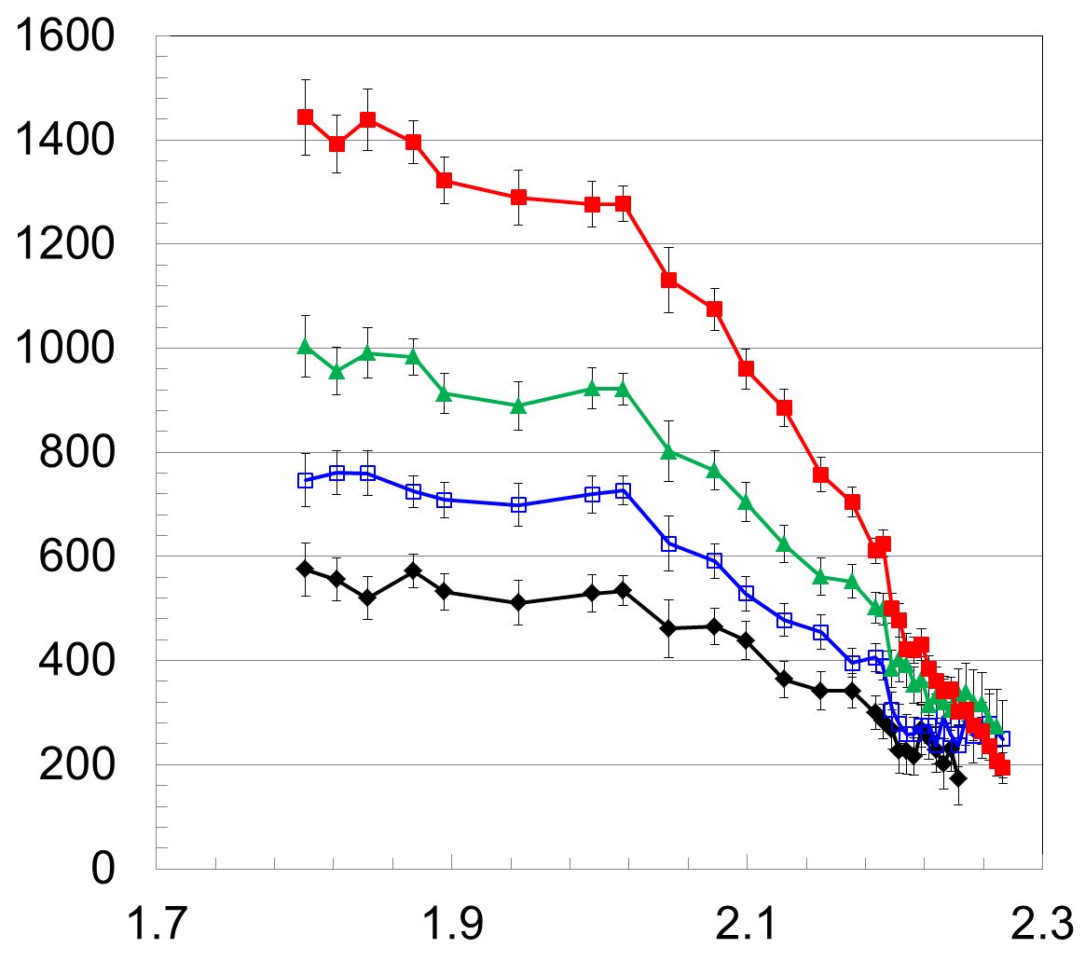
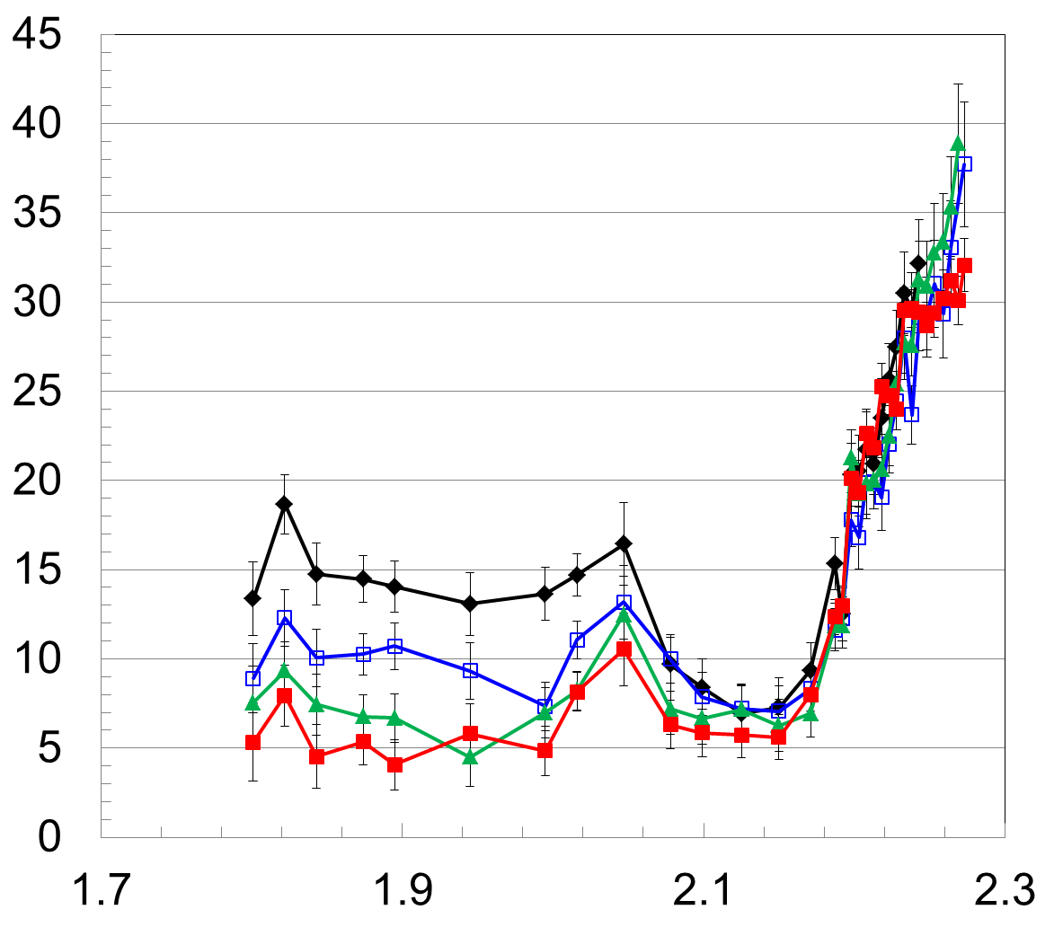
co-NB injection produces less co-rotation away from V₀^{NTV} as T_{i} increases in strong 3D field
I_{n=2} = 4.0 kA/turn
6.465s
Measured V₀^{NTV} profile
T_{i} (eV)
6.385s
V_{φ} (km/s)
Co-I_{p}
6.345s
6.305s
6.305s
6.345s
6.385s
Start of NBI
6.465s
16308
16308
R (m)
R (m)
Core plasma spins down with 3D field constant if δB, T_{i} are sufficiently high
Outer plasma velocity remains at V₀^{NTV} profile value
Non-intuitive result is consistent with NTV: Higher T_{i} increases NTV drag and/or makes NTV offset rotation migrate toward counter-NBI direction

Slide 20
Experiments on NSTX and KSTAR isolated the NTV profile, and KSTAR XPs directly measured the offset rotation profile
Measured, isolated NTV torque density profiles created in KSTAR / NSTX, quantitatively compare well to theoretical T_{NTV} using fully-penetrated 3D field (NSTX)
The NTV offset rotation profile was recently directly measured in KSTAR
  Incl. plasmas dominated by electron effects – measured in co-I_{p} direction
  shown to reverse sign in the core region to counter-I_{p} outside of error bars - can only happen if the NTV offset rotation profile is non-zero (not drag)
Relatively strong rotation and rotation shear were generated in outer region of the plasma by V₀^{NTV} - potentially highly important to ITER
  Suggests use of ITER ELM coils to generate rotation/shear
The |V₀^{NTV}| is strongest and in co-I_{p} direction in outer part of plasma and remains steady in higher temperature plasmas
  |V₀^{NTV}| shown to decrease as temperature (temperature gradient?) decreases
ANALYSIS CONTINUES on both NTV isolation analysis (e.g. plasma parameter and 3D spectrum dependence), NTV offset rotation profile comparison to theory

Slide 21
Supporting Slides Follow

Slide 22
Measured NTV torque density profiles quantitatively compare well to computed T_{NTV} using fully-penetrated 3D field
n = 3 coil configuration
n = 2 coil configuration
NSTX
NSTX
x1.7
x0.6
Experimental
-dL/dt
Experimental
-dL/dt
NTVTOK
NTVTOK
ψ_{N}
ψ_{N}
T_{NTV} (theory) scaled to match peak value of measured -dL/dt
  Scale factor ((dL/dt)/T_{NTV}) = 0.6 and 1.7 for cases shown above – O(1) agreement
Banana orbit-averaging reduces computed resonant perturbation effects
K.C. Shaing, and S.A. Sabbagh, et al., Phys. Plasmas 23 (2016) 072511

Slide 23
Measured NTV torque density profiles quantitatively compare well to computed T_{NTV} using fully-penetrated 3D field
n = 2 coil configuration
n = 3 coil configuration
NSTX
NSTX
x1.7
x0.6
NTVTOK code
Experimental
-dL/dt
Experimental
-dL/dt
NTVTOK
code
ψ_{N}
ψ_{N}
T_{NTV} (theory) scaled to match peak value of measured -dL/dt
  Scale factor ((dL/dt)/T_{NTV}) = 1.7 and 0.6 for cases shown above – O(1) agreement
Banana orbit-averaging reduces computed resonant perturbation effects
K.C. Shaing, and S.A. Sabbagh, et al., Phys. Plasmas 23 (2016) 072511

