Slide 1
Outline
Introduction to Kinetic RWM Stability Theory (column 1)
  Rotational resonances and collisionality effects included
Modification of Ideal Stability by Kinetic Effects (2)
  MISK code calculation can explain experimental instability
Disruption Event Characterization and Forecasting (3)
  New DECAF code developed and used to analyze NSTX disruptions
Reduced Kinetic Model (4)
  Implemented in DECAF, successfully used on database
  Will enable real-time prediction of RWM growth rate
*This work supported by the US DOE contracts DE-AC02-09CH11466 and DE-FG02-99ER54524

Slide 2
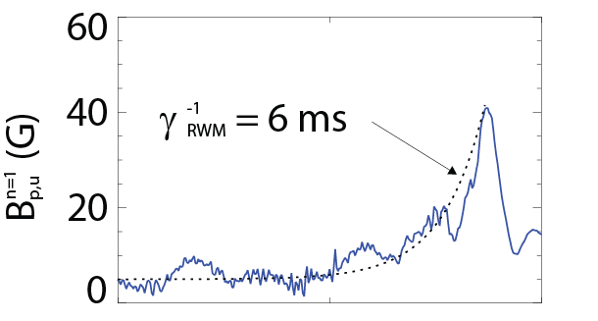

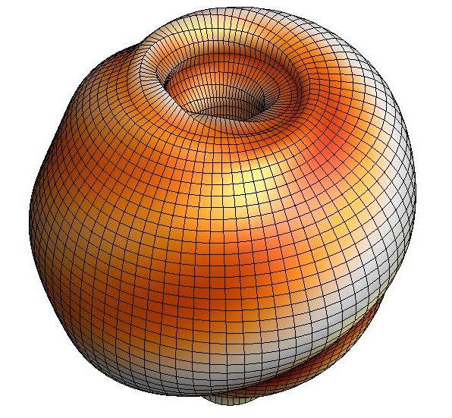


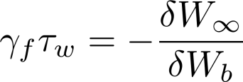
An unstable RWM is an exponential growth of magnetic field line kinking that can cause disruptions
The resistive wall mode (RWM) is a kinking of magnetic field lines slowed by penetration through vessel structures
Copper plate
where
NSTX 130235
B_{p}
Resistive Wall Mode
Ideal Kink
Mode
γ
~τ_{w}⁻¹
unstable
0
stable
[S. Sabbagh et al., Nucl. Fusion 46, 635 (2006)]
β_{N}^{no-wall}
β_{N}^{with-wall}
RWMs can cause a collapse in β, disruption, and termination of the plasma

Slide 3
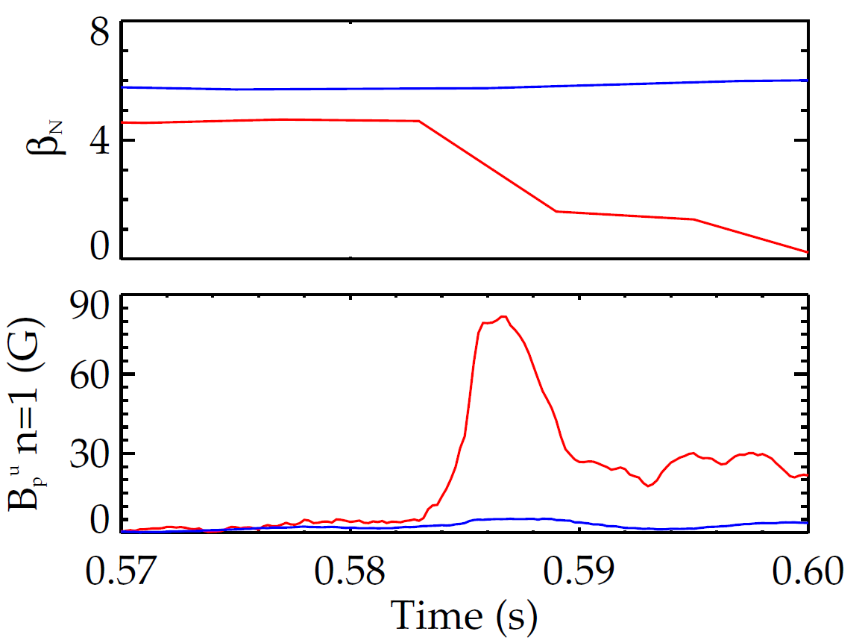
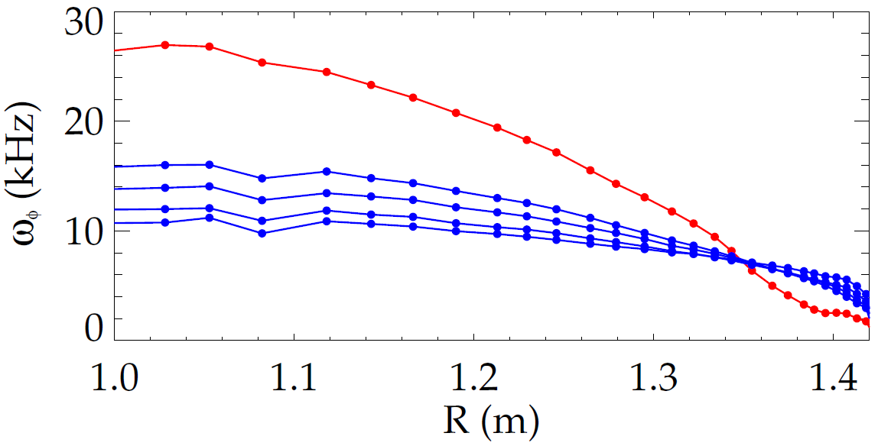
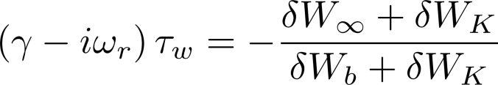
A scalar critical plasma rotation model can not explain RWM stability; it depends on the ω_{φ} profile
Early stability theories:
  Collisional dissipation of mode energy
  Rotational damping
140102
NSTX
137722
    But models with scalar “critical rotation” for stability could not explain experiments
unstable RWM
Unexplained experiments
New theory: consider kinetic effects
Ideal Stability
Kinetic Effects
Plasma rotation
unstable
slowed by n=3 braking
[B. Hu et al., Phys. Rev. Lett. 93, 105002 (2004)]

Slide 4
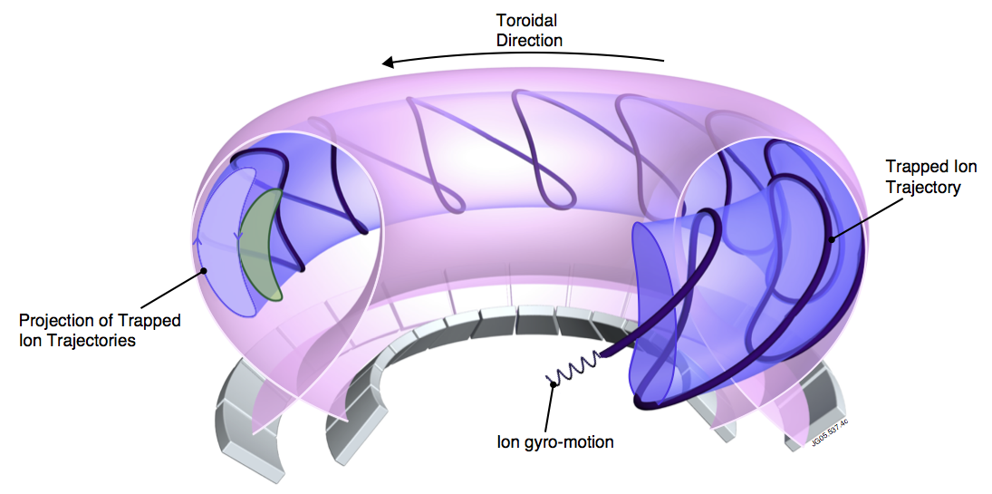

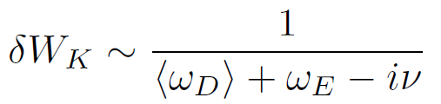
“Kinetic effects” means taking into account complicated particle motion rather than treating the plasma as a fluid
MISK code
Solves for RWM growth rate
is solved by using from the drift kinetic equation
[R. Pitts et al., Physics World, March 2006
D. Pace et al., Physics Today 68, 34 (2015)]
Precession Drift
~ Plasma Rotation
Rotational resonance effect
[J. Berkery et al., Phys. Rev. Lett. 104, 035003 (2010)]

Slide 5
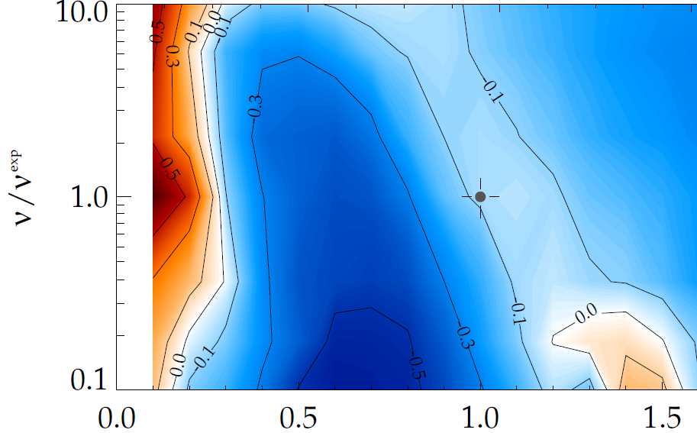
Kinetic theory consistent with RWM destabilization at intermediate plasma rotation and collisionality affects the strength of resonances
MISK calculations of γτ_{w} contours vs. ν and ω_{φ}
Destabilization appears between:
  precession resonance at low ωφ
  bounce resonance at high ωφ
Stabilizing resonant kinetic effects enhanced at low ν
(marginal stability)
instability
(NSTX
experiment)
ν/ν^{exp (marginal stability)}
Precession drift resonance stabilization
unstable
ω_{φ}/ω_{φ}^{exp (marginal stability)}
Precession Drift
~ Plasma Rotation
Collisionality
Rotation and Collisionality effects
[J. Berkery et al., Phys. Rev. Lett. 104, 035003 (2010)]
[J. Berkery et al., Phys. Rev. Lett. 106, 075004 (2011)]

Slide 6
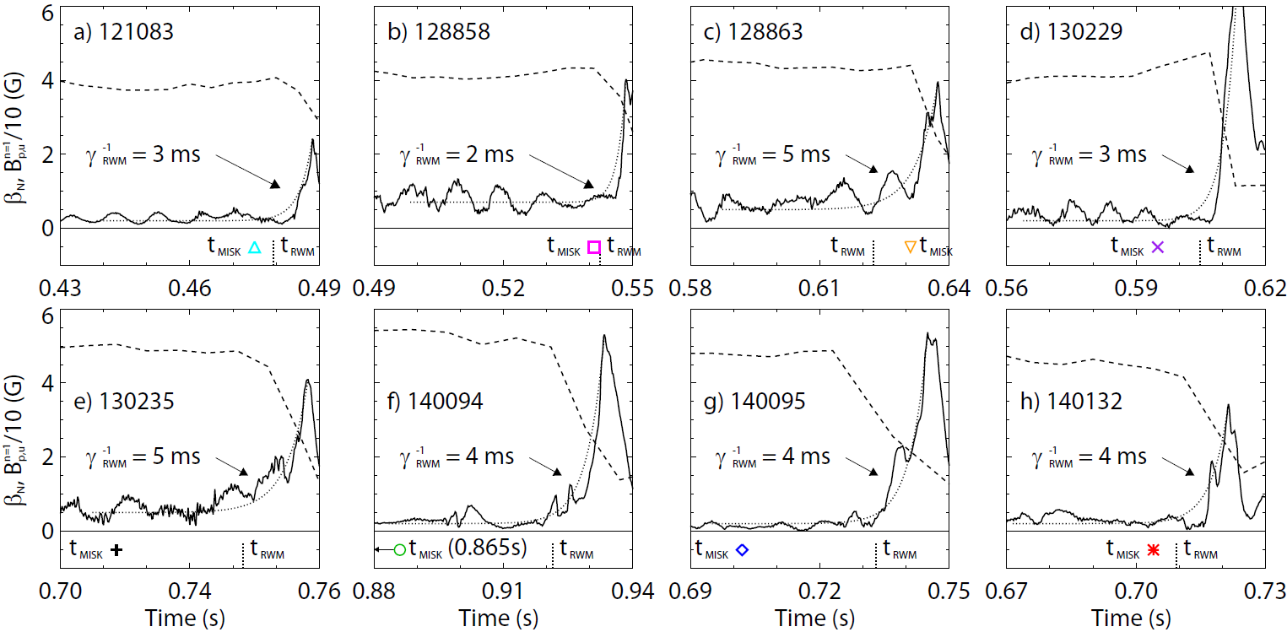
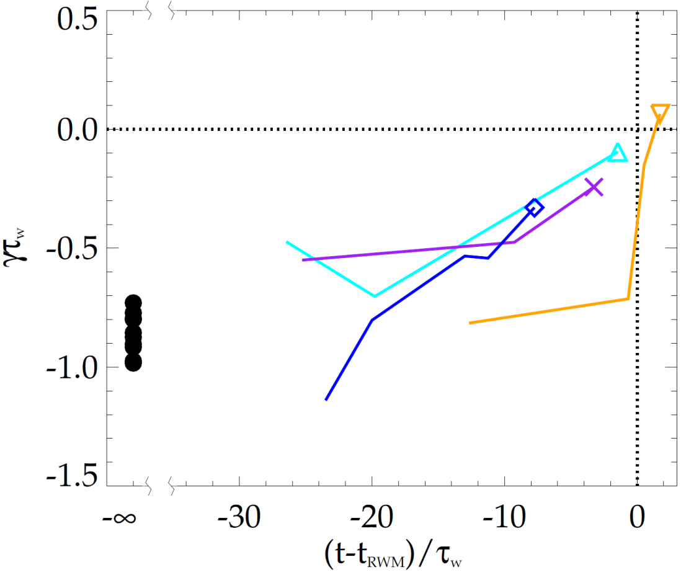
MISK calculations validated against unstable experimental plasmas; reproduce approach towards marginal stability
NSTX
NSTX
unstable
stable
[J. Berkery et al., Nucl. Fusion 55, 123007 (2015)]
MISK calculations including kinetic effects have been tested against many marginally stable NSTX experimental cases

Slide 7
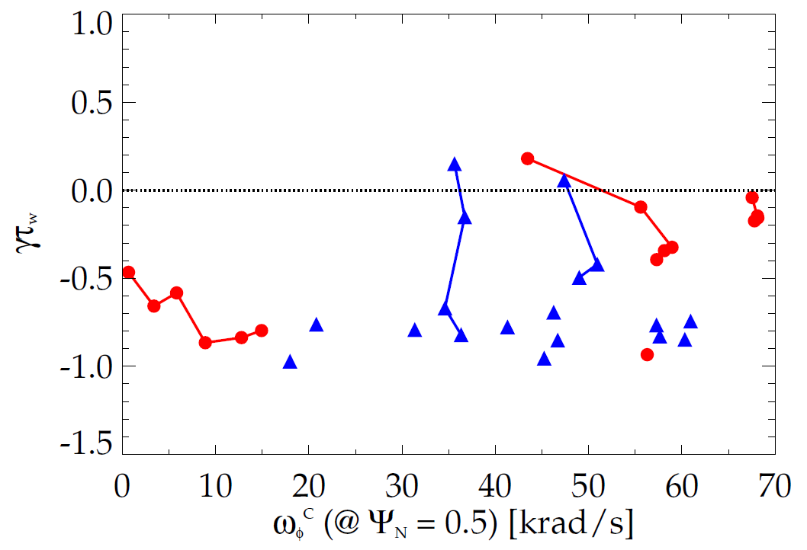

Kinetic RWM stability physics unites results from
DIII-D and NSTX plasmas
Kinetic RWM stability analysis for experiments (MISK)
Addition of kinetic effects yields agreement with marginal point in NSTX
Further testing against DIII-D experiments shows good agreement
Strong bursting MHD modes can lead to non-linear destabilization before linear stability limits are reached
DIII-D
unstable
NSTX
Normalized growth rate (γτ_{w})
“weak stability” region
major disruption
minor disruption
stable
Plasma rotation [krad/s] (Ψ_{N} = 0.5)
[S. Sabbagh, J. Berkery, J. Hanson, et al., APS invited 2014]

Slide 8
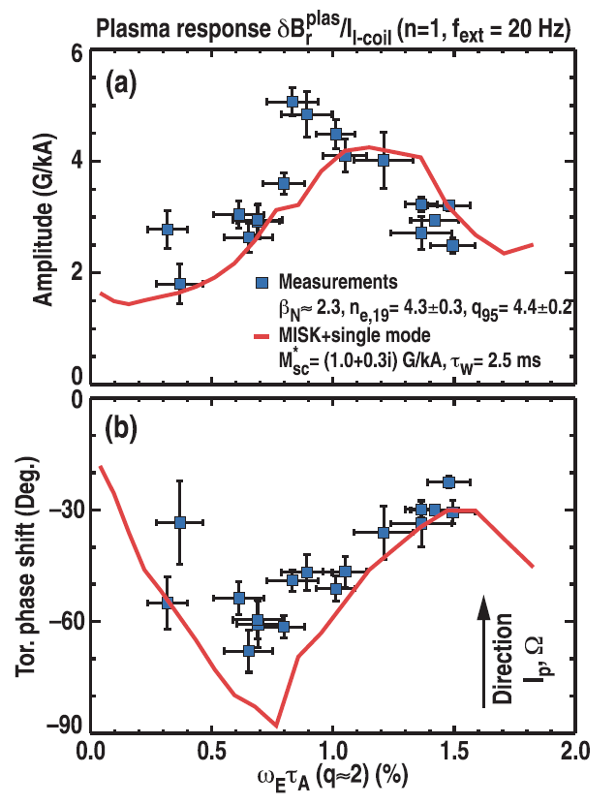
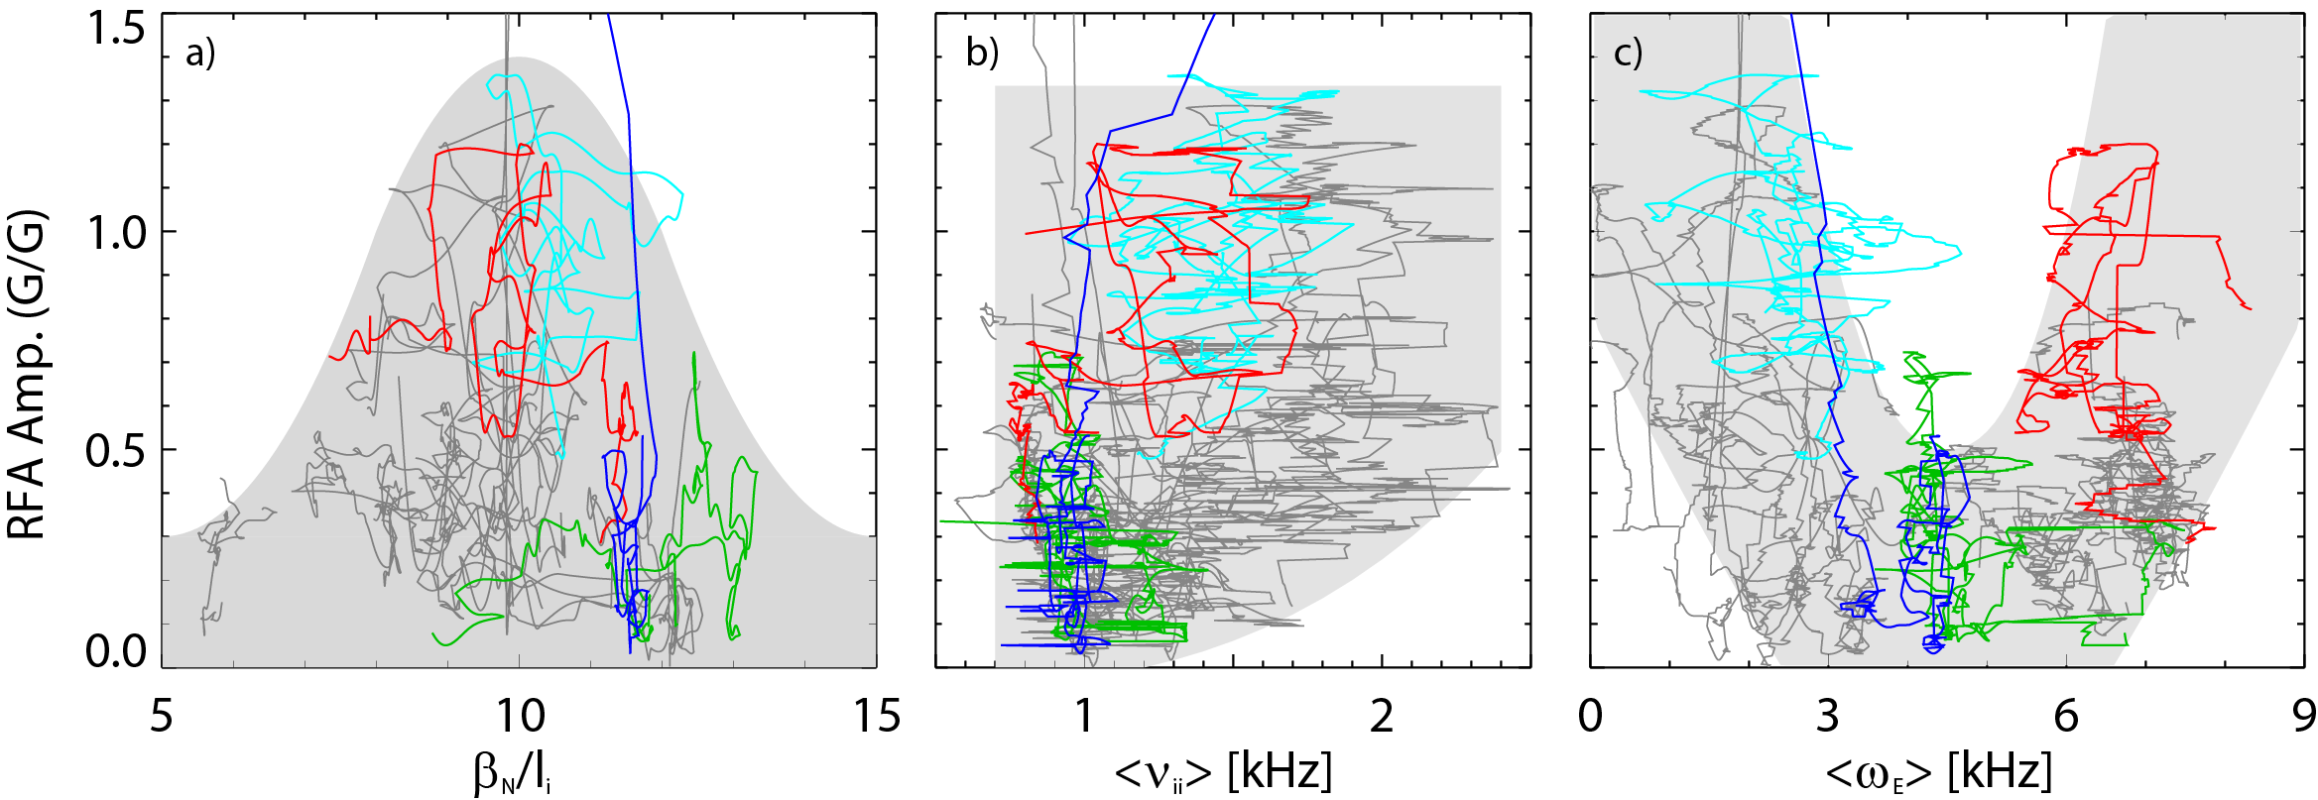
Active MHD spectroscopy experiments show the importance of kinetic effects in stable plasmas as well
Favorable rotation range
NSTX
DIII-D
[H. Reimerdes et al., Phys. Rev. Lett. 106, 215002 (2011)]
[J. Berkery et al., Phys. Plasmas 21, 056112 (2014)]
Resonant field amplification indicates weakening stability
  Plasma response is enhanced where kinetic effects and RWM stability are weak
Discharge trajectories for 20 NSTX plasmas shows favorable ω range
  Matches theoretical expectation for precession drift resonance
MISK calculations match experiments

Slide 9
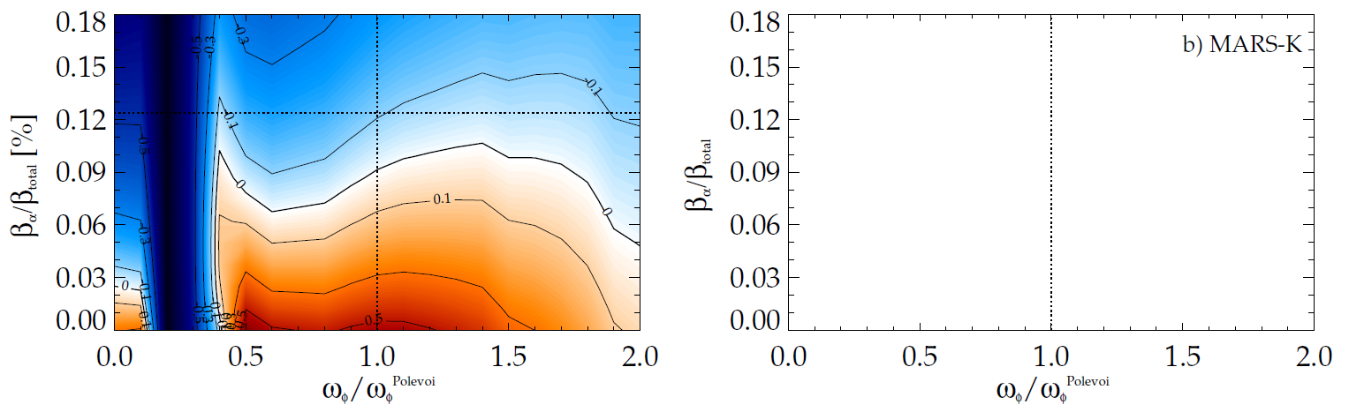
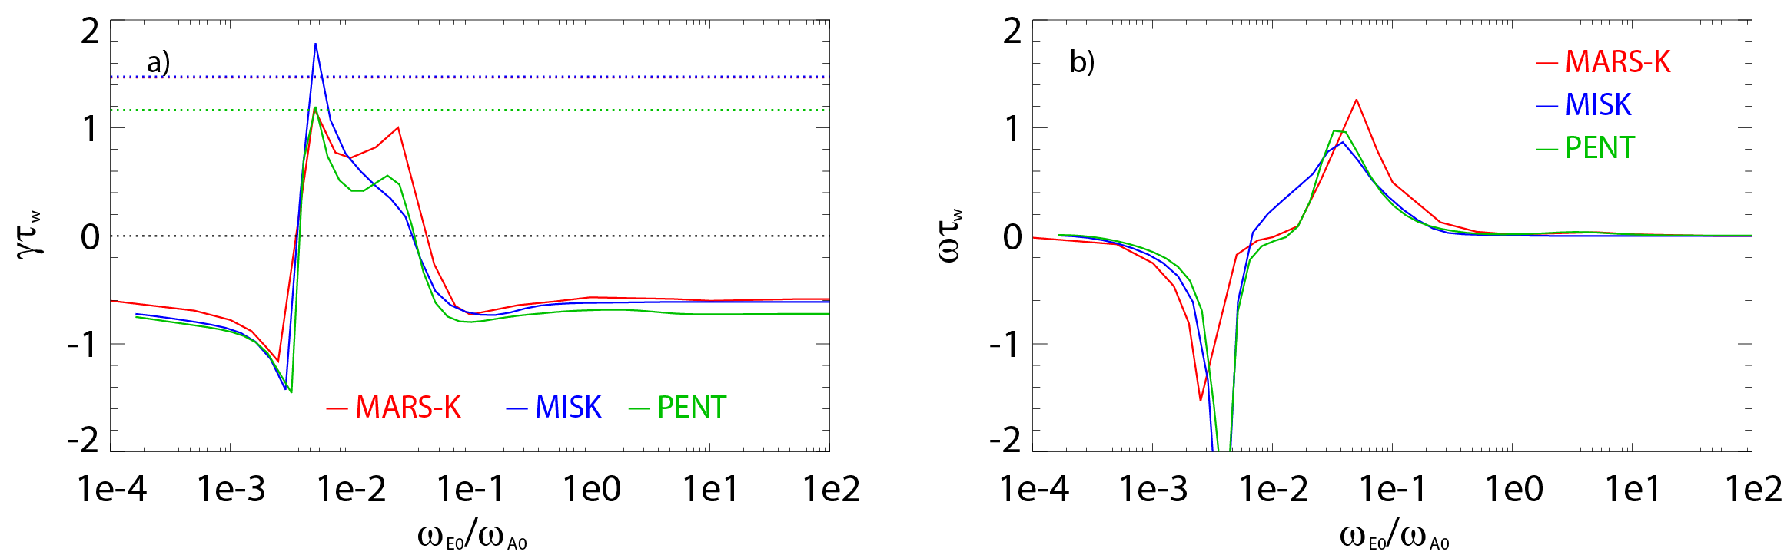
Key analysis codes MARS-K and MISK were brought into agreement in γτ_{w} vs ω_{E} for analysis of ITER
Code benchmarking (growth rate vs. rotation)
MISK calculation for ITER
stable
fluid growth rates
expected β_{α}
unstable
expected ω_{φ}
stable
fluid plus kinetic growth rates
unstable
low rotation
precession
resonance
high rotation
bounce/transit
resonance
Case: β_{N} = 2.9 (20% > no-wall limit)
Alpha particles are required for RWM stabilization at all ω_{φ}
Near RWM marginal stability at β_{α}/β_{total} = 0.1 at expected rotation
[J. Berkery et al., Phys. Plasmas 21, 052505 (2014)]
The codes support the present understanding that RWM stability can be increased by kinetic effects

Slide 10
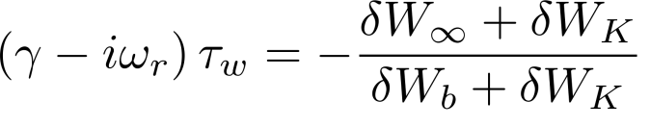
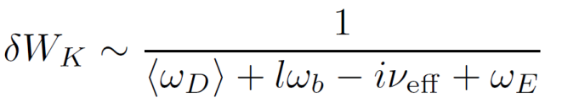
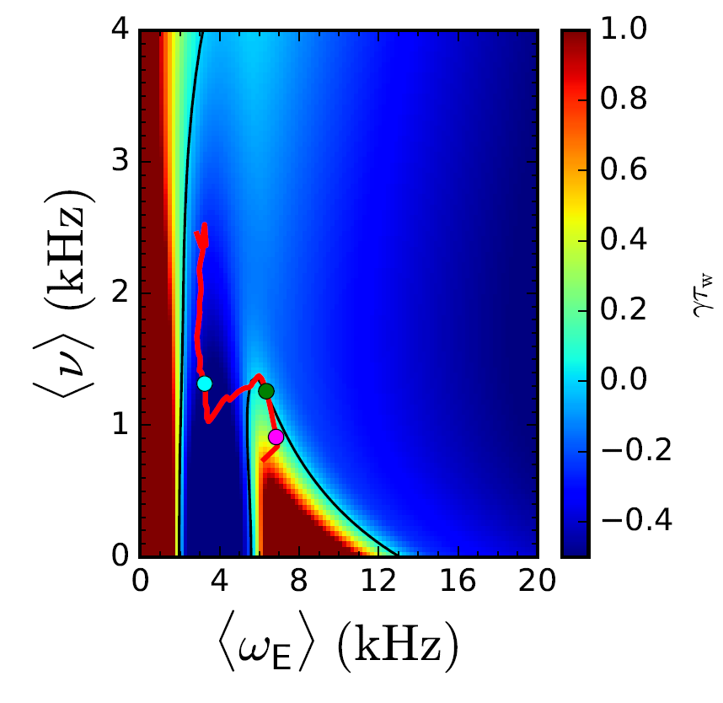
Physics understanding from previous research used to construct a reduced kinetic model
Goal is to forecast γ in real-time using parameterized reduced models for δW terms
Need δW_{K} as a function of the most important, real-time measurable quantities
[J.W. Berkery et al., Nucl. Fusion 55, 123007 (2015)]
MISK² Calculations
  Benchmarked⁸
  Compared to Experiments^{3,4,6,7,9}
Fluid terms¹⁰
Kinetic effects¹:
Collisionality⁵
Rotation³
+ Energetic
Particles⁴
Reduced Kinetic Model
References
[1] B. Hu et al., Phys. Rev. Lett. 93, 105002 (2004)
[2] B. Hu et al., Phys. Plasmas 12, 057301 (2005)
[3] J. Berkery et al., Phys. Rev. Lett. 104, 035003 (2010)
[4] J. Berkery et al., Phys. Plasmas 17, 082504 (2010)
[5] J. Berkery et al., Phys. Rev. Lett. 106, 075004 (2011)
[6] H. Reimerdes et al., Phys. Rev. Lett. 106, 215002 (2011)
[7] J. Berkery et al., Phys. Plasmas 21, 056112 (2014)
[8] J. Berkery et al., Phys. Plasmas 21, 052505 (2014)
[9] S. Sabbagh APS invited (2014)
[10] J. Berkery et al., Nucl. Fusion 55, 123007 (2015)
… more

Slide 11
Disruption event chain characterization capability started for NSTX-U as next step in disruption avoidance plan
Disruption prediction/avoidance framework
Approach to disruption prevention
  Identify disruption event chains and elements
  Predict events in disruption chains
  Cues disruption avoidance systems to break event chains
    Attack events at several places with active control
  Builds upon both physics and control successes of NSTX
t
[DOE report on Transient events (2015)]

Slide 12
Disruption Event Characterization And Forecasting (DECAF) code is structured to ease parallel development
Physical event modules
Physical event modules
  Present grouping expands work of deVries [P.C. de Vries et al., Nucl. Fusion 51, 053018 (2011)]
  – BUT, easily appended or altered
Warning algorithm
  Present approach expands [S.P. Gerhardt et al., Nucl. Fusion 53, 063021 (2013)]
  More flexible: arbitrary number of tests, thresholds, and user-defined levels and warning points
Code control workbooks
Density Limits
Confinement
Main data structure
Technical issues
Tokamak dynamics
Output processing
Power/current handling
Kinetic RWM analysis used as a reduced stability model in DECAF
Mode stability

Slide 13
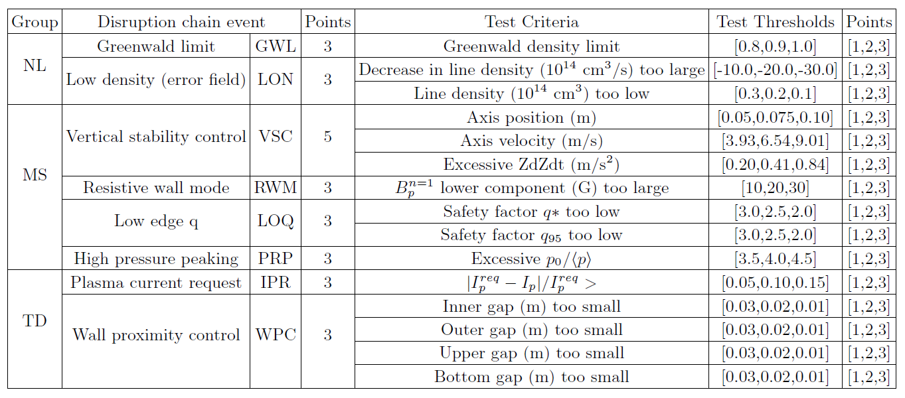
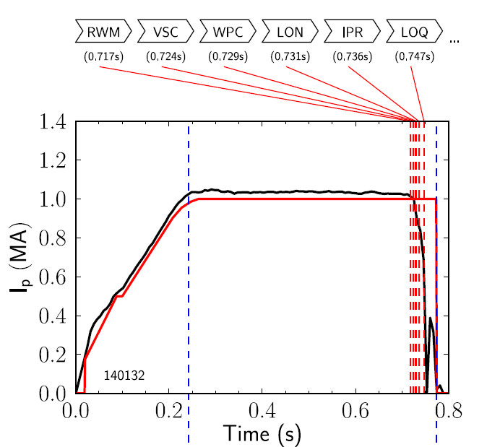
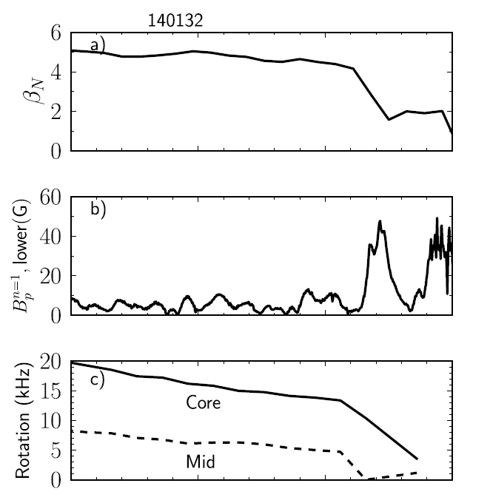

The DECAF code is being used to characterize disruption event chains on NSTX, including RWMs
Several threshold tests are currently included in DECAF
Disruption event chain
  Resistive wall mode (RWM)
  Vertical stability control (VSC)
  Wall proximity control (WPC)
  Low density (LON)
  Plasma current not meeting request (IPR)
  Low q (LOQ)
  Excessive pressure peaking (PRP)
  Disruption (DIS)

Slide 14
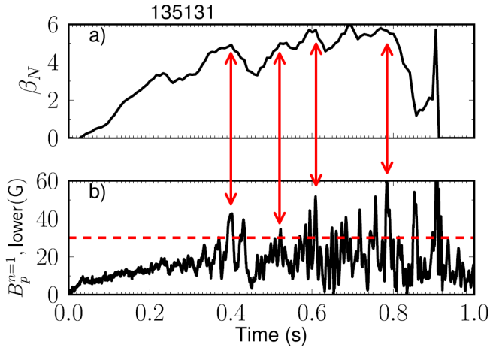
Initial DECAF analysis already finding common disruption event chains, giving new insight
Identifying common chains of events can provide insight into how to cue avoidance systems
  6 (out of theoretically 42) two-event combinations following RWM accounted for 70% of the cases in the database
Earlier RWM events not false positives
  cause large decreases in β_{N} and stored energy with subsequent recovery (minor disruptions)
VSC
PRP
15.9%
WPC
PRP
13.6%
IPR
WPC
11.4%
RWM
PRP
IPR
11.4%
WPC
VSC
9.1%
VSC
WPC
9.1%
Other
29.5%

Slide 15
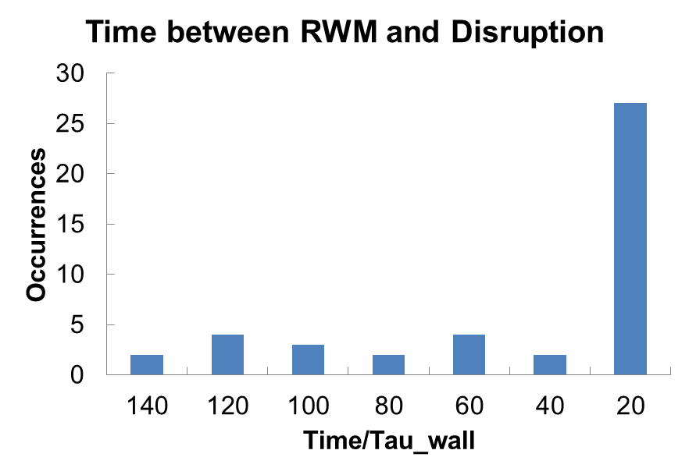
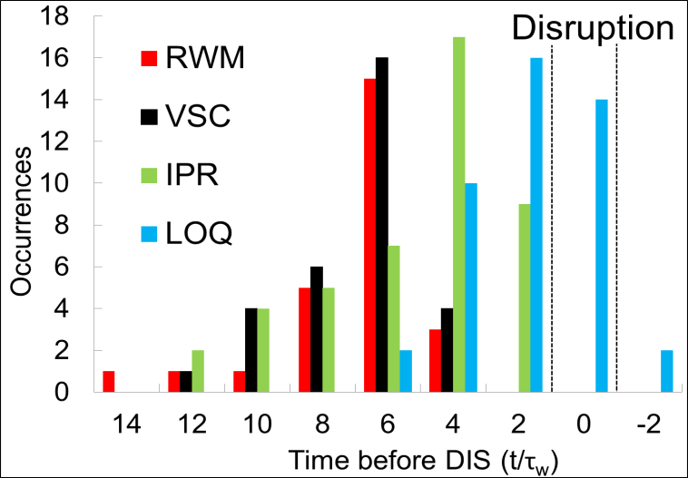
Initial DECAF results detects disruption chain events when applied to dedicated 44 shot NSTX RWM disruption database
RWM threshold near disruption limit
  RWM B_{P}^{n=1} lower threshold 30G (δB/B₀ ~ 0.67%)
  61% within 20 τ_{w} of disruption time (τ_{w} = 5 ms)
Several events detected for all shots
  DIS: Disruption occurred
  RWM: RWM event warning
  WPC: Wall proximity control
  IPR: Plasma current request not met
  LOQ: Low edge q warning
  Others:
    PRP: Pressure peaking warning (34/44)
    VSC: Vertical stability control (31/44)
    LON: low density warning (11/44)

Slide 16
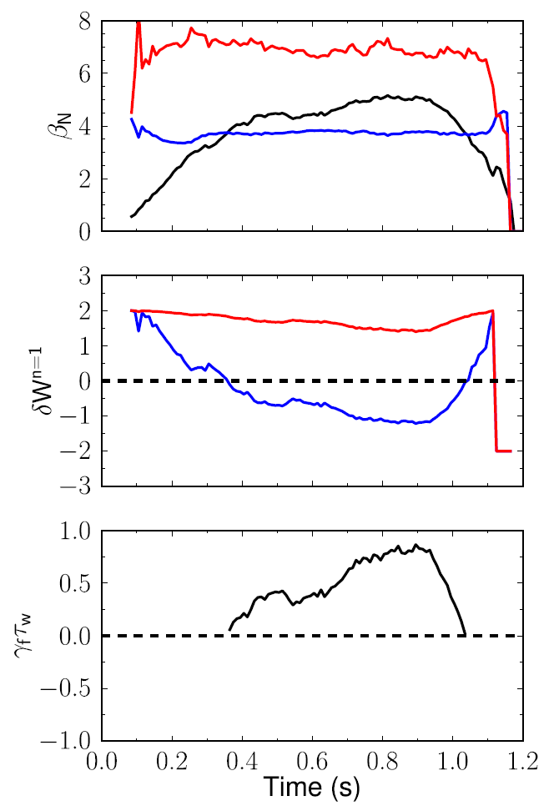
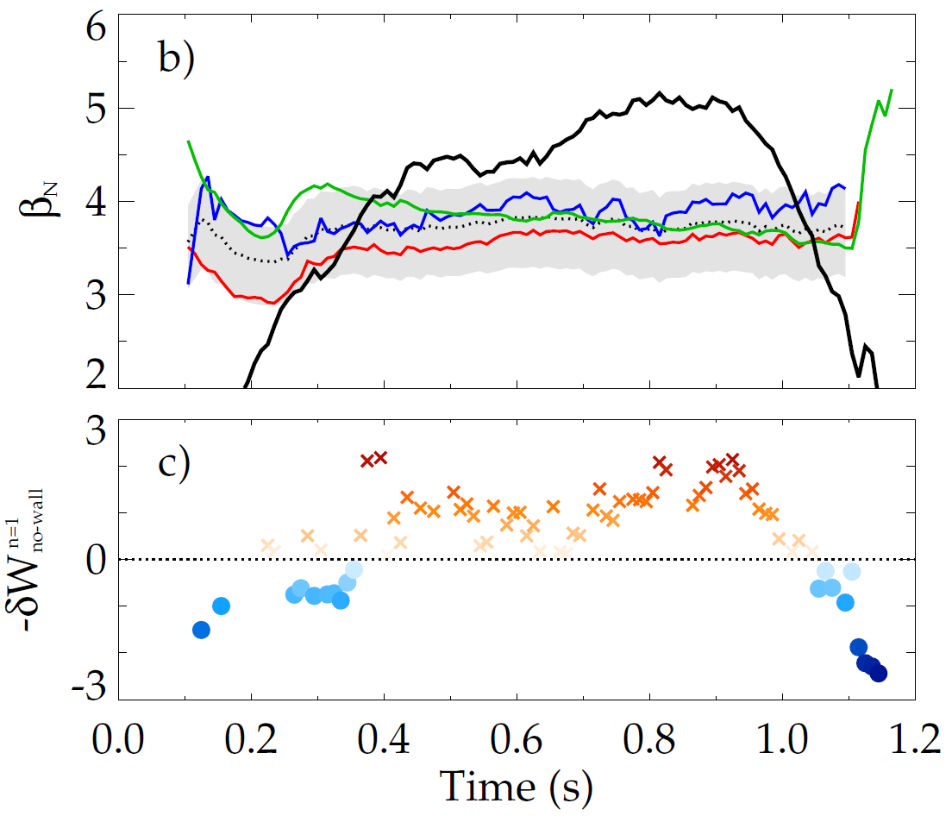
Goal is to forecast γ in real-time using parameterized reduced models for δW terms
Modeled estimates for NSTX no-wall limit
with-wall limit
Internal inductance
Pressure peaking
Aspect ratio
Composite no-wall limit model
β limits
no-wall limit
NSTX 138556
with-wall limit
δW
[J.W. Berkery et al., Nucl. Fusion 55, 123007 (2015)]
RWM dispersion relation
no-wall limit
Growth rate
Fluid terms
Kinetic effects
fluid RWM growth
rate
growth
rate
(γτ_{w})
stabilized by kinetic effects
[B. Hu et al., Phys. Rev. Lett. 93, 105002 (2004)]

Slide 17
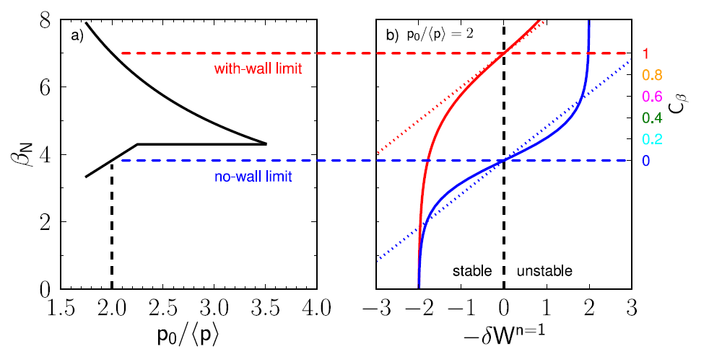
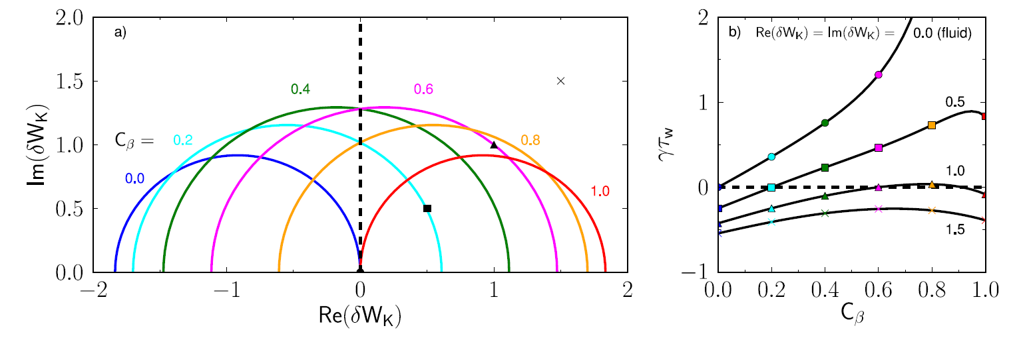
The unstable region of the stability diagram is determined by the fluid δW terms; Kinetic effects can stabilize the RWM
Stability diagram in kinetic stability space
Large kinetic effects – robustly stable
The unstable region, inside the circle, moves when β changes
The size and position of the circle is determined by the fluid δW terms
Moderate levels of kinetic effects stabilize the RWM at certain beta values

Slide 18
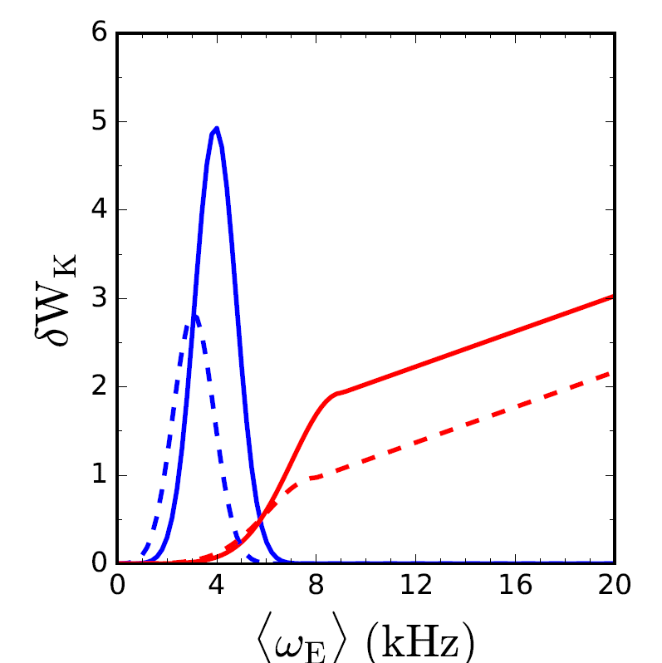
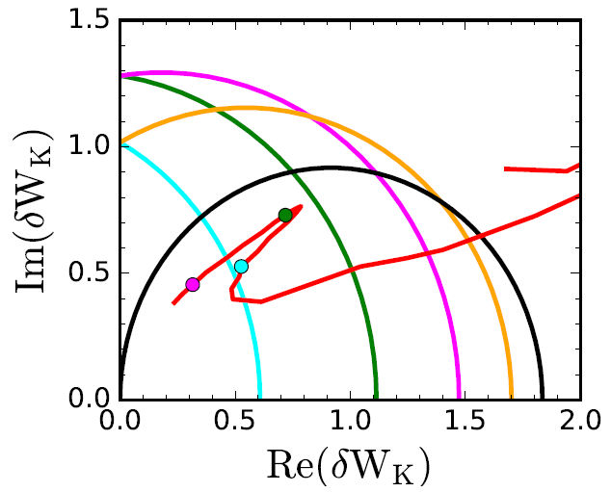
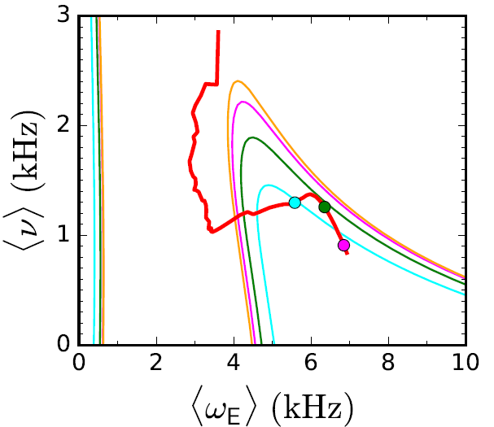
DECAF contains modeled kinetic quantities for generation of stability maps
Gaussian functions are used to model broad resonances
  Positions in <ω_{E}> determined by ω_{D} and ω_{b}
  Height, width, and position dependent on ν
  Coefficients selected to reflect NSTX experience
Stability diagrams show trajectory of a discharge towards unstable regions
Kinetic effects
Precession resonance
Bounce resonances
<ν> = 1 kHz

Slide 19
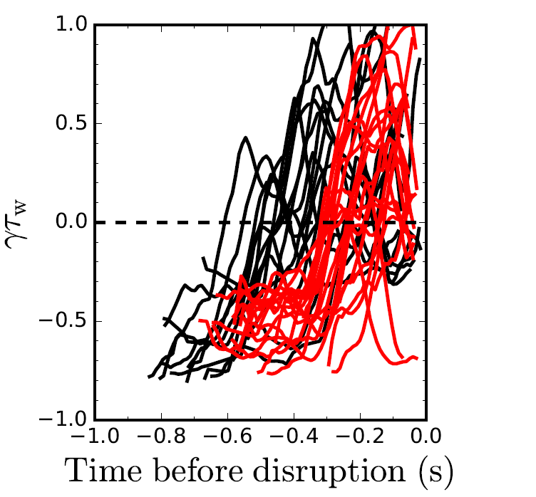
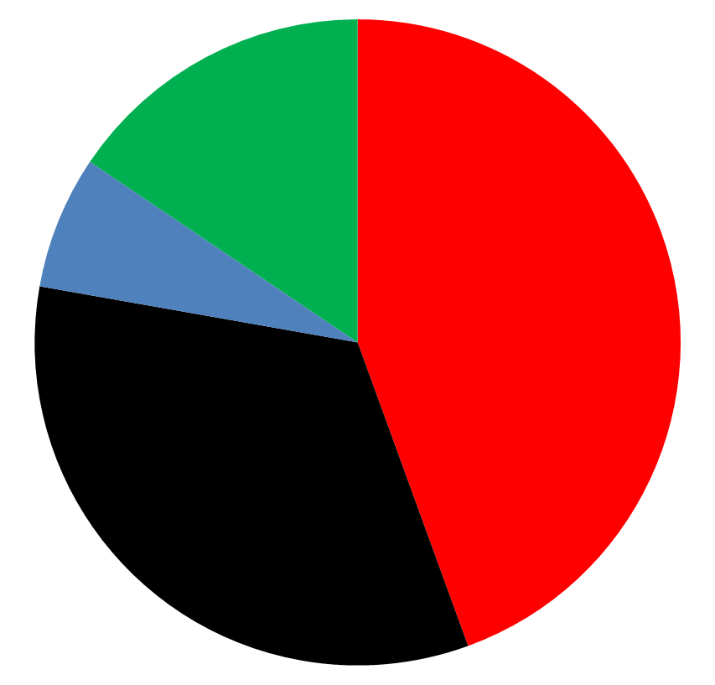
DECAF reduced kinetic model results initially tested on a database of NSTX discharges with unstable RWMs
Normalized growth rate vs. time
Predicted instability statistics (45 shots)
Stable
(16%)
Instability < 320 ms
before disruption
(44%)
(7%) False
positives
unstable
Instability within 100 ms of minor
disruption
(33%)
stable
84% of shots are predicted unstable
44% predicted unstable < 320 ms (approx. 60τ_{w}) before current quench
33% predicted unstable within 100 ms of a minor disruption

Slide 20
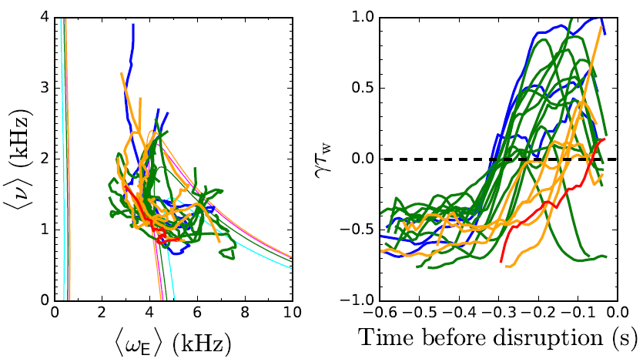
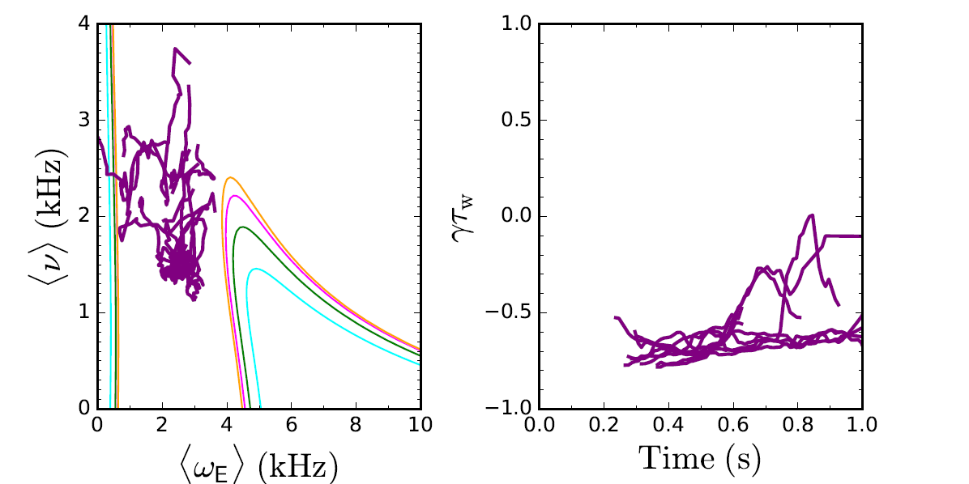
Reduced kinetic model distinguishes between stable and unstable NSTX discharges
Reduced kinetic model tested on a database of stable and unstable NSTX discharges
Model fails to capture an experimentally unstable RWM in 7/45 cases, 15.6%
Sometimes the model warning is associated with minor disruptions that subsequently recover
If <ω_{E}> ~ 0 warnings are ignored, 10/13, or 77%, of stable cases are stable in the model
Model is successful in first incarnation - development continues to improve forecasting performance
Unstable cases
Stable cases

Slide 21
Summary
Disruption prevention in tokamak fusion plasmas requires accurate identification and prediction of global MHD instabilities
  Resistive wall modes are crucial components of disruption event chains
DECAF code developed for disruption characterization and forecasting
Kinetic theory modifies ideal stability, includes rotation, collisionality
  MISK code calculations can explain experimental stability
Full MISK code calculations of δW_{K} can not be performed in real time, but physics insight used to create a reduced model
Reduced kinetic model for disruption avoidance is implemented
  Success rate is surprisingly high given its initial state and relative simplicity
  This approach will enable, for the first time, for an unstable growing kinetic RWM to be anticipated, rather than responding to an already unstable growing mode

Slide 22
MISK

Slide 23
DECAF

Slide 24
Reduced Kinetic Model

Slide 25
Abstract of paper EX/P4-34
The new Disruption Event Characterization and Forecasting (DECAF) code has been written to analyze disruptions in tokamaks. A quantitative statistical characterization of the chains of events which most often lead to disruption in a database of discharges from NSTX which disrupted due to an unstable resistive wall mode (RWM) is presented. The recently implemented reduced kinetic model for RWM stability is described and shown to have the potential to track RWM stability in real-time for disruption avoidance. The reduced model was tested on a database of discharges from NSTX and experimentally stable and unstable discharges were separated noticeably on a stability map in ExB frequency, collisionality space. Initial results show the reduced model only failed to predict an unstable RWM in 15.6% of cases with an experimentally unstable RWM and performed well on predicting stability for experimentally stable discharges as well.

Slide 26


Characterization and Forecasting of Unstable Resistive Wall Modes in
NSTX and NSTX-U
Jack Berkery
Columbia University
S.A. Sabbagh¹, Y.S. Park¹, R.E. Bell², S.P. Gerhardt², C.E. Meyers²
¹Columbia University, ²Princeton Plasma Physics Laboratory
26th IAEA Fusion Energy Conference
Kyoto, Japan, October 17-22, 2016
*This work supported by the US DOE contracts DE-AC02-09CH11466 and DE-FG02-99ER54524

