Slide 1
Disruption Event Characterization and Forecasting (DECAF) in Tokamaks
S.A. Sabbagh¹, J.W. Berkery¹, Y.S. Park¹, J.H. Ahn¹, Y. Jiang¹, J.D. Riquezes¹, R.E. Bell², M.D. Boyer², A.H. Glasser³, J. Hollocombe⁴, J. Kim⁵, A. Kirk⁴, J. Ko⁵, W. Ko⁵, L. Kogan⁴, B. LeBlanc², J.H. Lee⁵, Y.K. Oh⁵, F. Poli², S.D. Scott², A. Thornton⁴, L. Terzolo⁵, S.W. Yoon⁵, S.J. Wang⁵, Z.R. Wang²
¹Department of Applied Physics, Columbia University, New York, NY
²Princeton Plasma Physics Laboratory, Princeton, NJ
³Fusion Theory and Computation, Inc., Kingston, WA
⁴Culham Centre for Fusion Energy, UKAEA, Abingdon, UK
⁵National Fusion Research Institute, Daejeon, Republic of Korea
27th IAEA Fusion Energy Conference
25 October 2018
Gandhinagar, India
V1.4s

Slide 2
A broadened disruption prediction and avoidance analysis is progressing for ITER and future tokamaks
Motivation: Disruption prediction/avoidance is a critical need
  A highest priority DOE FES (Tier 1) initiative - present “grand challenge” in tokamak stability research:
    Can be done! (JET: < 4% disruptions w/C wall, < 10% w/ITER-like wall)
    ITER disruption allowance: < 1 - 2% (energy + E&M loads); << 1% (runaways)
Talk Outline
  Disruption Event Characterization and Forecasting (DECAF) introduction
  Present DECAF progress and initial multi-device examination (now including MAST)
    Density limits, disruption forecasting w/ rotating MHD, global MHD forecasting
    Disruption event chain analysis for arbitrary discharges
  Key supporting analysis
    KSTAR ideal/resistive stability analysis, high normalized beta, high non-inductive plasmas with 100% NICF “predict-first” projections

Slide 3
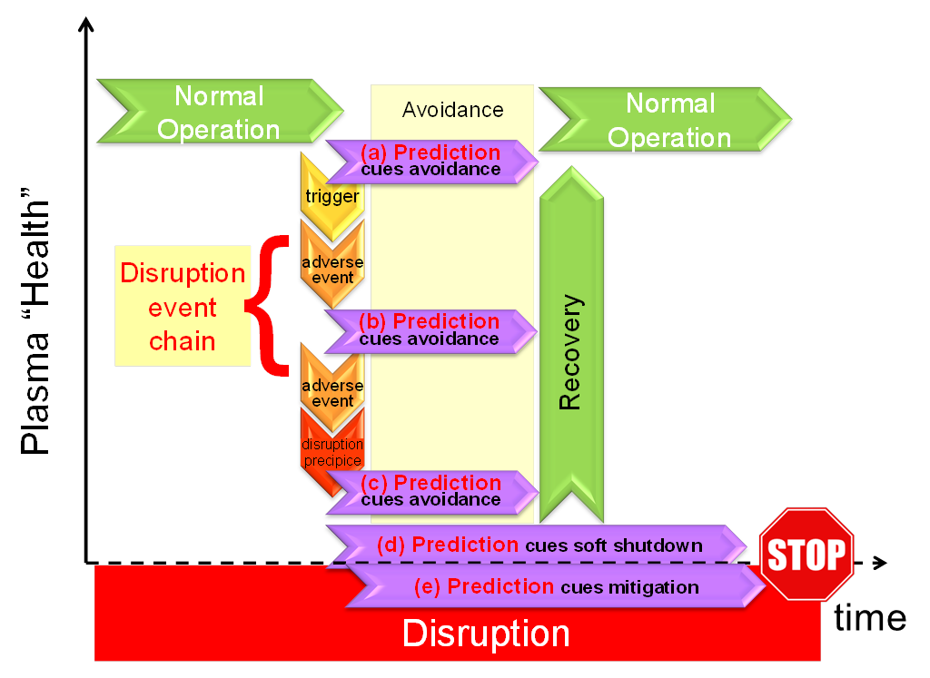
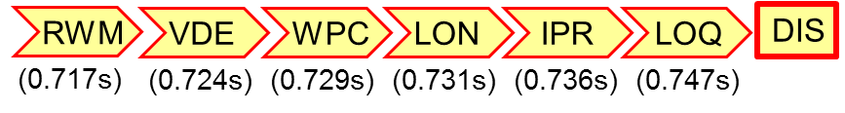
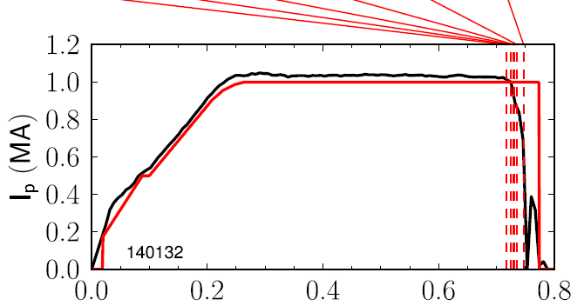
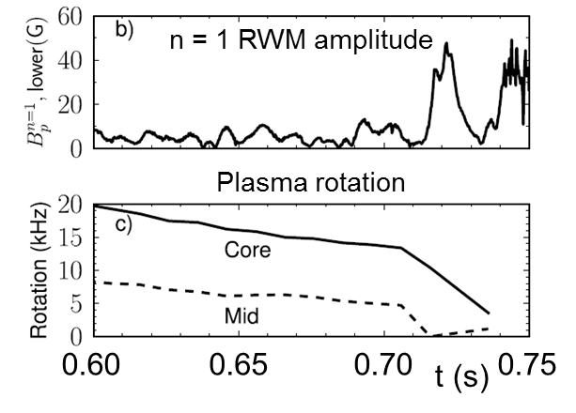







Disruption event characterization is a critical and logical step in a disruption avoidance plan
Disruption event chain
Disruption prediction/avoidance framework
(a)
(b)
NSTX 140132
t (s)
(c)
(d)
  wall proximity control
  low density warning
  not meeting I_{p} request
  low q warning
  disruption (current quench)
Events (in this chain)
  resistive wall mode
  vertical instability

Slide 4
DECAF code and initial successful research/results is now advancing to a new level
DECAF brief highlights of prior results
  First automated event chain analysis (followed deVries’ manual work)
  Excellent performance on smaller, targeted databases (NSTX)
    Ex.: DIS, WPC, IPR, LOQ, RWM events found 100%, VDE event 91%
    Computed events accurately represented experiment (~ 10 events)
    Physics model forecasted global MHD disruptions with ~ 85% reliability
  Disruption chains often repeated, e.g.:
Recent progress
  Density limit model based on radiating island power balance being tested
  New MHD events in DECAF allow forecasting on transport timescales
  Linear resistive MHD analysis as first step to theory-based forecasting
  Multi-machine database processing with small number of verified events
  Analysis of disruption chains from general databases
RWM
VDE
WPC
IPR
DIS
J.W. Berkery, S.A. Sabbagh, R. Bell, et al., Phys. Plasmas 24 (2017) 056103

Slide 5
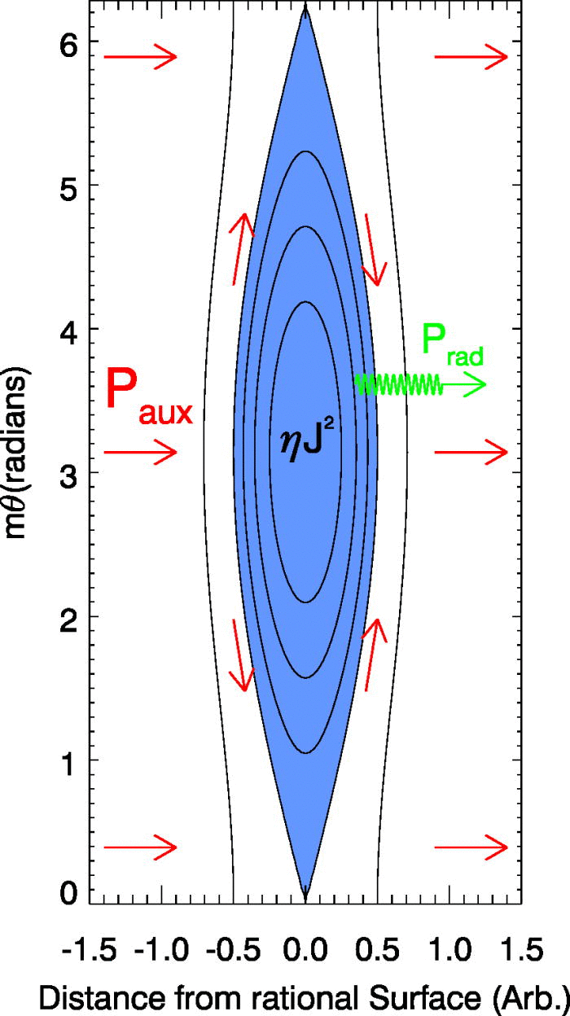
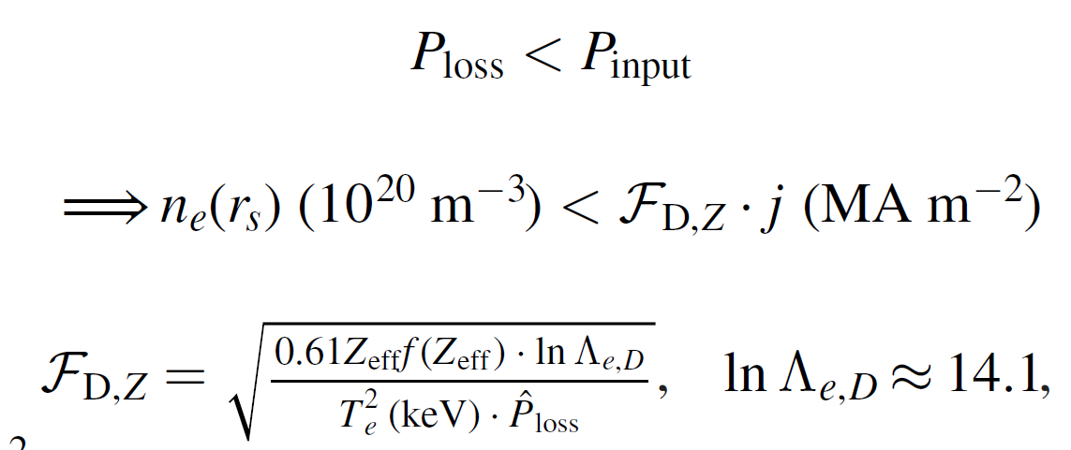
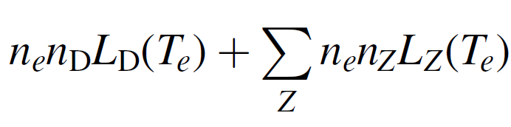
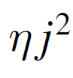
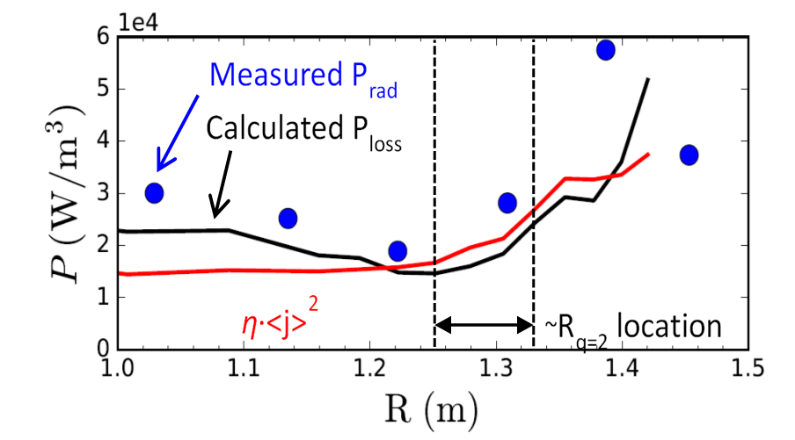
Recently a density limit model has been examined in DECAF based on power balance in an island
Local island power balance limit
  Power balance in island between Ohmic heating and radiated power loss
  If radiated power at the island exceeds the input power (P_{loss} > P_{input}), island grows
Power density balance:
NSTX
134020
D. Gates et al., Phys. Rev. Lett. 108 165004 (2012)

Slide 6
DECAF density limit analysis started: global, local density limits examined, correlation of MHD onset near limits
Disruptivity vs. density
DIS
Magnetic spectrogram
(toroidal array)
GWL
GWL
GWL
IPB
Greenwald limit
  Near 0.9 when mode starts (range 0.75 – 1.05)
Rad. island power balance
  Near 1.0 when mode starts (range 0.60 – 1.50) ⬅ next step: must reduce range
IPB

Slide 7
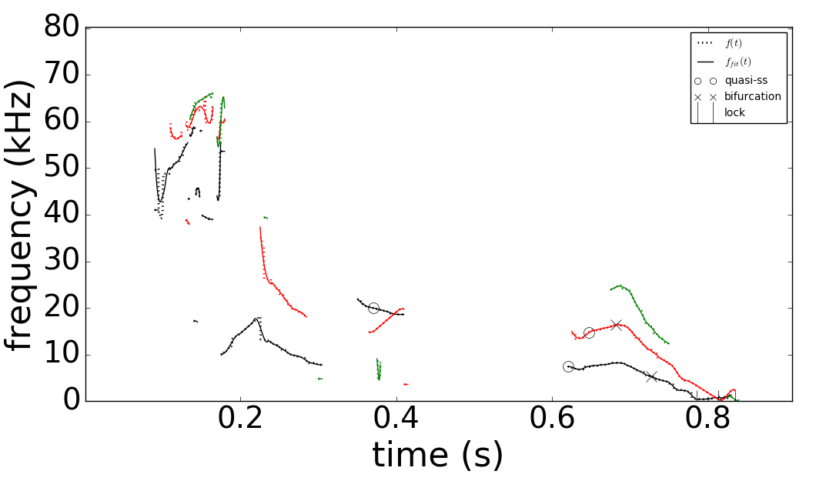
More powerful automated MHD event objects have been developed for DECAF
DECAF automated MHD events
Magnetic spectrogram
(toroidal array)
MHD-n3
MHD-n2
MHD-n1
GWL
More capable MHD event objects required for analysis of wider tokamak databases
DECAF MHD events now include
  Mode number (n) discrimination
  Full history of mode evolution, including bifurcation and locking
  Many disruption warning criteria
IPB

Slide 8
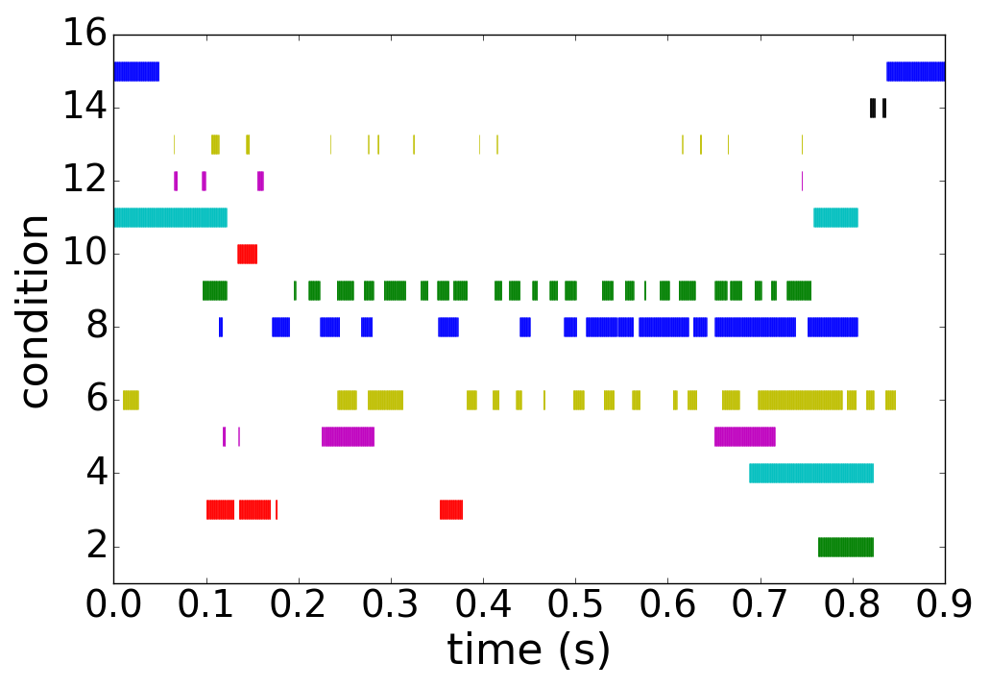
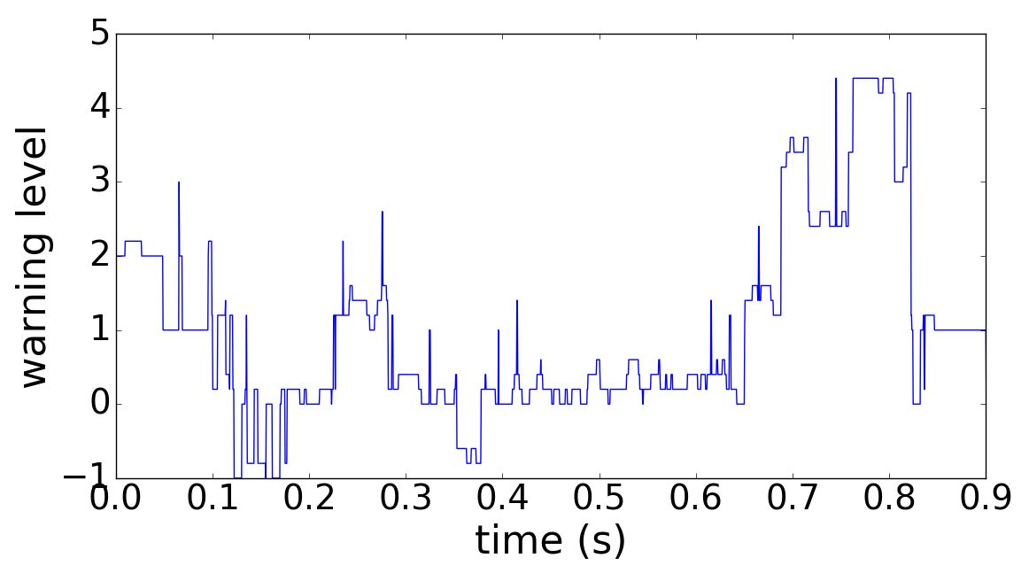
New DECAF MHD events utilize history of 15 criteria to define time evolving disruption warning level
DECAF automated MHD objects
DECAF “heat map” (for MHD)
MHD-n3
Locked mode > 25G ➔
MHD-n2
MHD-n1
⬅ Core plasma rotation < 6 kHz ➔
BIF-n2
“quasi-steady
state (O)”
BIF-n1
Decreasing plasma rotation ➔
LTM-n1
⬅ High amplitude ➔
LTM-n2
f below bifurcation ➔
Very low f mode ➔
DECAF MHD warning level
Key notables of MHD warning
  “Safe”/“unsafe” MHD periods found
  Early, slow warning level evolution
    Locked mode amplitude important, but warning comes in very late
  Mode frequency below bifurcation, decreasing plasma rotation key

Slide 9
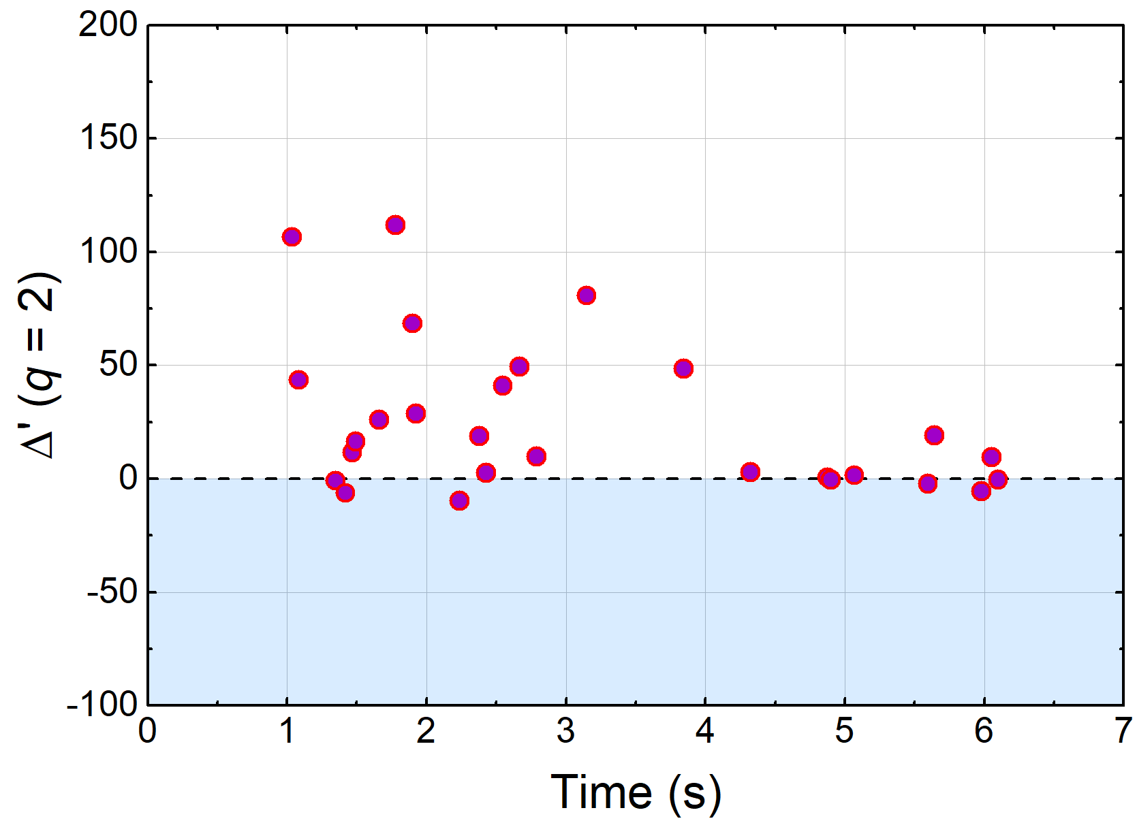
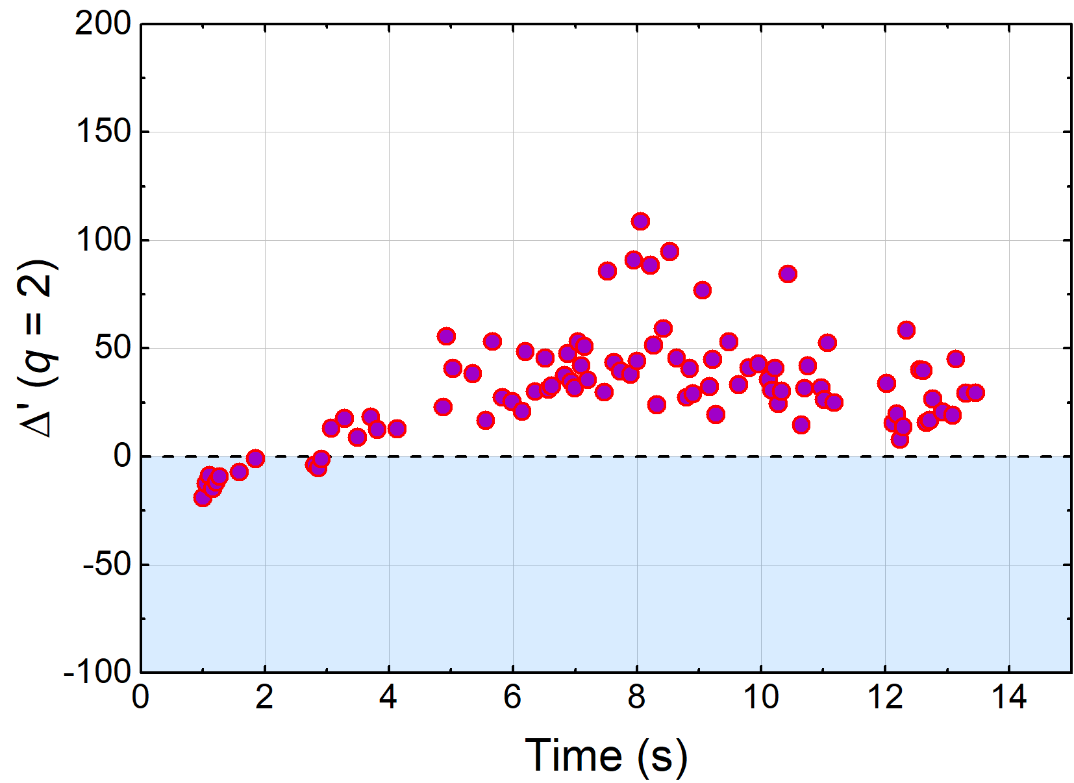

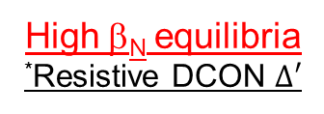
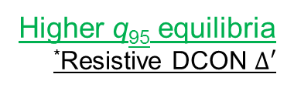
Classical tearing stability examined in KSTAR plasmas varied β_{N} , q₉₅ (for future DECAF models)
16295
High β_{N} equilibria
*Resistive DCON $Δ′$
16325
Higher q₉₅ equilibria
*Resistive DCON $Δ′$
Experimentally
Unstable 2/1
Experimentally
2/1 stable
Classical tearing stability index, Δ′, computed at the q = 2 surface using outer layer solutions
At higher q₉₅, Δ′ is mostly positive predicting unstable classical tearing mode
  Indicates that neoclassical effects or wall effects need to be invoked to produce stability
*A.H. Glasser, et al., Phys. Plasmas 23 (2016) 112506
See paper EX/P7-16 this conference (Friday) Y.S. Park, S.A. Sabbagh, J.H. Ahn, et al., for further detail

Slide 10
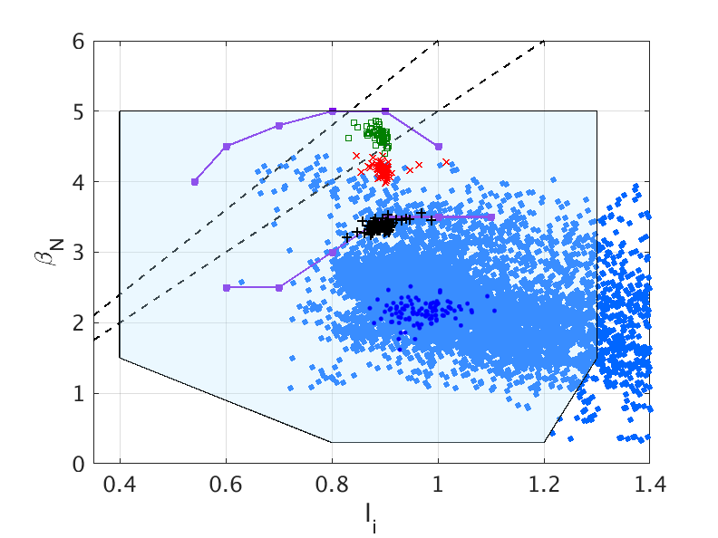
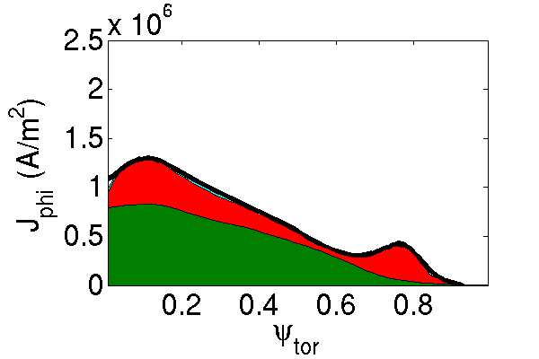
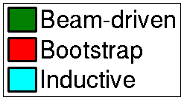



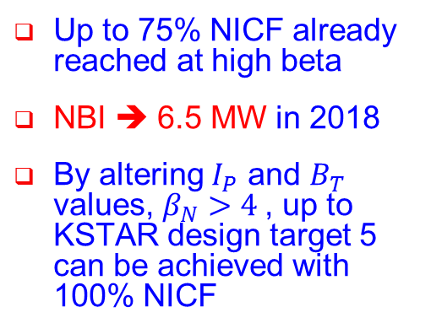

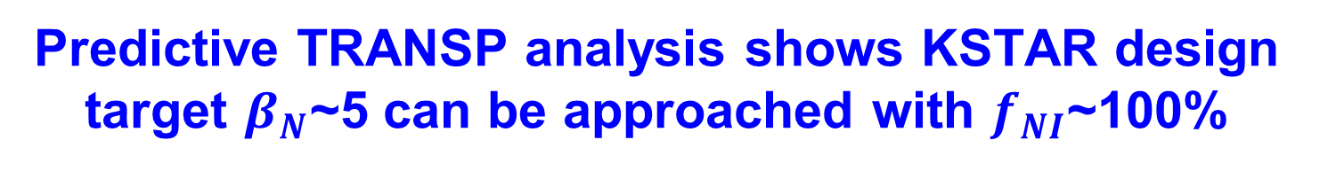

Predictive TRANSP analysis shows KSTAR design target $β_{N}$~5 can be approached with $f_{NI}$~100%
“Predict-first” analysis used to design high-β , 100% non-inductive current fraction (NICF) experiments for present KSTAR run campaign
$β_{N}$/$l_{i}$=6
$β_{N}$/$l_{i}$=5
<TRANSP>
$B_{T}$=1.5T
P_{NBI} = 6.5 MW
Predicted
n=1 with-wall limit
β_{N} = 3.4
f_{NI} = 96%
$B_{T}$=1.7T
$B_{T}$=2.0T
n=1 no-wall limit
Up to 75% NICF already reached at high beta
NBI ➔ 6.5 MW in 2018
By altering $I_{P}$ and $B_{T}$ values, $β_{N}>4$, up to KSTAR design target 5 can be achieved with 100% NICF
Interpretive
See paper EX/P7-16 this conference (Friday) Y.S. Park, S.A. Sabbagh, J.H. Ahn, et al., for further detail

Slide 11
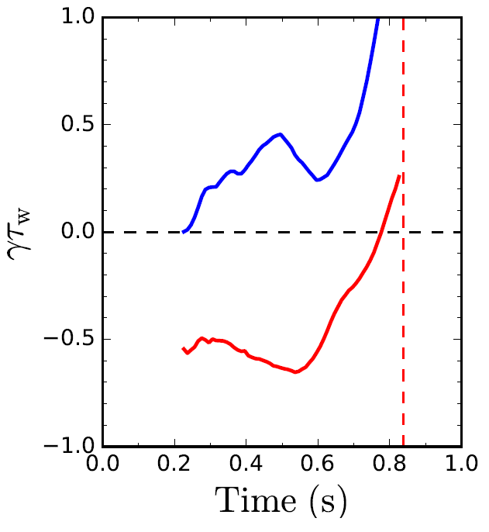
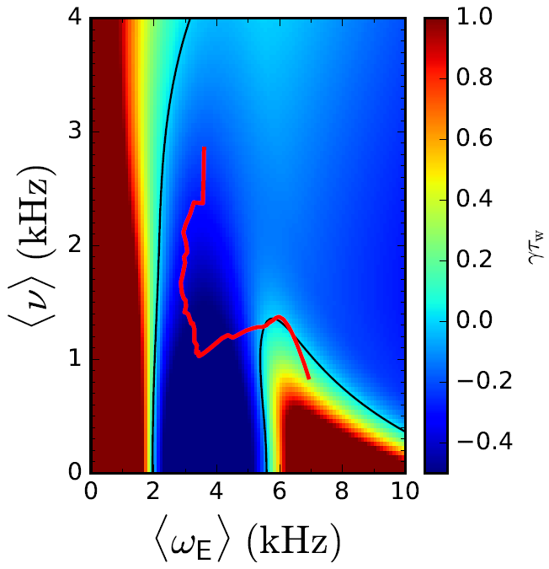
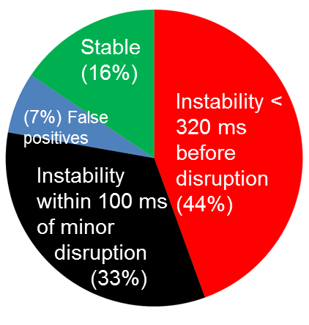
      DECAF reduced kinetic MHD model computations forecast the instability boundary to unstable global MHD modes
Norm. growth rate vs. time
Disruption forecasting
Predicted instability statistics
γτ_{w}
unstable
Increasing time
ideal
γτ_{w}
Collisionality (kHz)
stable
Global kinetic MHD mode growth
Ideal + kinetic
disruption
NSTX
139514
Rotation
predicted instability
84% of shots are predicted unstable (stringent evaluation)
44% predicted unstable < 320 ms (approx. 60τ_{w}) before current quench
33% predicted unstable within 100ms of a minor disruption
Favorable characteristics
  Stability contours CHANGE for each time point
  Possible to compute growth rate prediction in real time
J.W. Berkery, S.A. Sabbagh, R. Bell, et al., Phys. Plasmas 24 (2017) 056103

Slide 12
Progress on DECAF now moving to processing of multi-machine databases
Analysis
  Kinetic equilibrium / stability analysis on KSTAR; planned for MAST
DECAF database started
  Requires storage of DECAF analysis
Device / Capability | KSTAR | MAST | NSTX | DIII-D | TCV
Full database access (type) | Yes (MDSplus) | Yes (UDA) | Yes (MDSplus) | Yes (MDSplus) | Yes (MDSplus)
Database analysis | started | started | started |  | started
Equilibrium analysis | Kinetic + MSE | scheduled | Kinetic + MSE | available
Stability | Ideal, Resistive Kinetic MHD | scheduled | Ideal, kinetic MHD (resistive) | Ideal, kinetic MHD
shot*seconds (for kinetic analysis) | 1,886 (2016+2017) | 2,667 (est) (M5 - M9 runs) | 2,000 / year (est)
Aim to add AUG next, then JET and C-Mod databases

Slide 13
Initial analysis of large databases further supports published result that disruptivity doesn’t increase with β_{N}
MAST
KSTAR
NSTX
DIS
DECAF analysis of event
  Shots analyzed at 10 ms intervals
  NEXT STEP: DECAF event chain analysis
Analysis during I_{p} flat-top
  MAST: 8902 plasmas analyzed
  NSTX: 10,432 plasmas analyzed
  KSTAR: 1309 plasmas analyzed

Slide 14
While disruptivity plots provide important information, they can be misleading when used incorrectly
Example: What are the most important regions to study on this plot?
  A human might focus on the high event probability regions
  Machine learning alone might segregate disruptive from non-disruptive regions of the plot and learn from that division
  Problem ➔plasma conditions can change significantly between first problem detected and when disruption happens
NSTX
DIS
DIS
Answer: the circles mark the key region to study!
  The shots suffer different “events” that are started in this region, and end up far from that region when they disrupt (at the crosses )

Slide 15
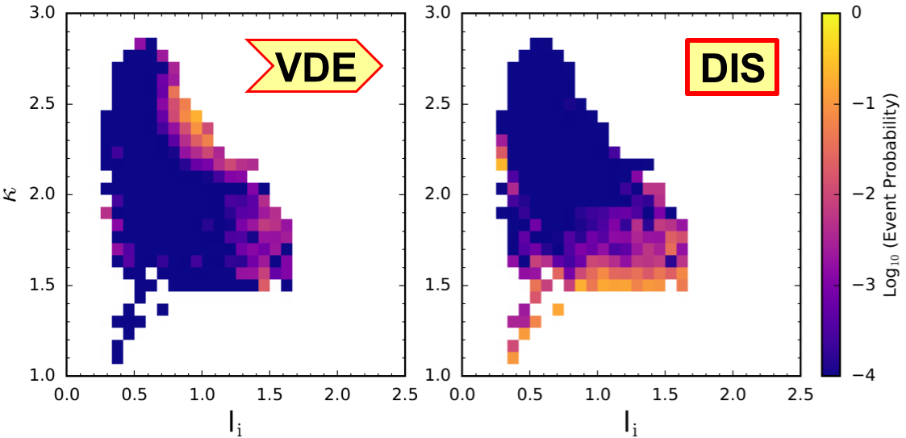
Example: DECAF shows plasma parameters of VDE event can occur far from those of DIS event
NSTX
Largest portion of detected VDE events appear at (l_{i},κ) with very small portion of DIS events detected

Slide 16
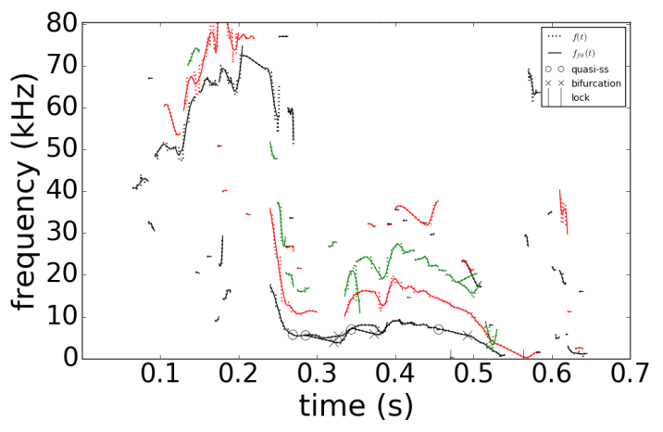
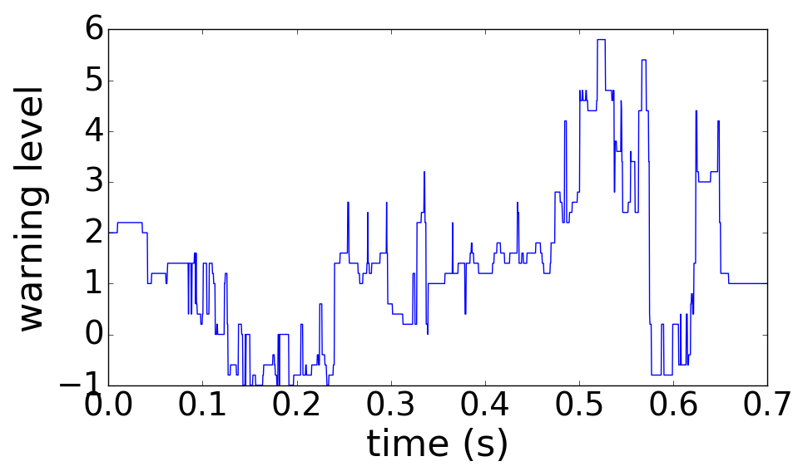
DECAF provides an early disruption forecast - on transport timescales – potential for disruption avoidance
DECAF event chain
MHD-n1
BIF-n1
LTM-n1
PRP
IPR
WPC
DIS
VDE
(0.490s)
(+.005s)
(+.045s)
(+.068s)
(+.073s)
(+.073s)
(+.077s)
(+.080s)
NSTX
n
DECAF MHD events
3
2
1
126962
Disruption forecast level
Safe
DECAF event chain reveals physics
  Rotating MHD slows, bifurcates, and locks
  Then, plasma has an H-L back-transition (pressure peaking warning PRP) before DIS
  Early warning gives the potential for disruption avoidance by plasma profile control

Slide 17
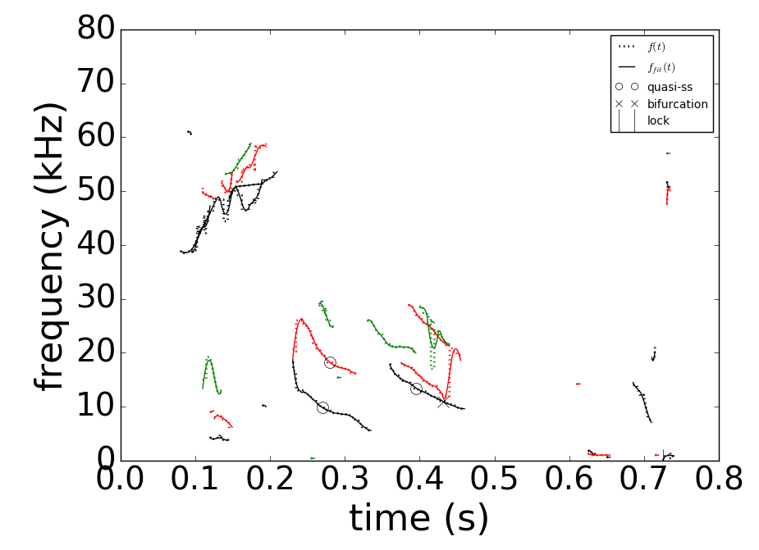
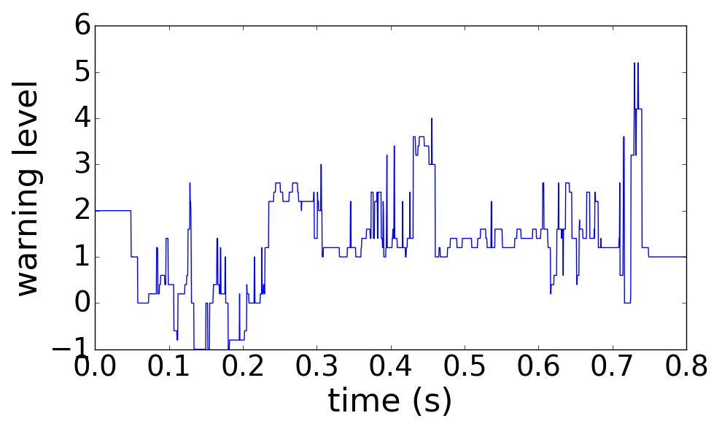
Global MHD modes can also be “slow” and allow early warnings for disruptions, potentially allowing avoidance
DECAF event chain
RWM
IPR
PRP
VDE
DIS
MHD-n1
LTM-n1
WPC
LOQ
(0.629s)
(+.010s)
(+.012s)
(+.058s)
(+.101s)
(+.101s)
(+.101s)
(+.106s)
(+.107s)
NSTX
DECAF MHD events
n
3
2
1
DECAF rotating MHD warning level
Safe
123856
Global MHD (RWM) can also be “slow”
  Rotating MHD warning level decreases after 0.46s ➔ DANGEROUS for RWM onset!
  H – L back transition (PRP) drags out time to disruption (> 100 ms – transport timescale)

Slide 18
Rapidly-expanding DECAF code provides a new paradigm for disruption prediction research
Multi-faceted, integrated approach to disruption prediction and avoidance with several key characteristics
  Physics-based approach yields understanding of evolution toward disruptionss needed for confident extrapolation of forecasting
  Physics-based DECAF events can guide how to avoid disruption
  Full multi-machine databases used (full databases needed!)
  Open to all methods of data analysis (physics, machine learning, etc.)
DECAF analysis producing early warning disruption forecasts
  Sufficiently early for potential disruption avoidance by profile control
Next steps
  Expand number of DECAF events evaluated in large database analysis
  Begin evaluation of simple quantitative disruption forecasting figures of merit on expanded databases ➔ first results are imminent

Slide 19
Sign-up Sheet for Reprints (include email address)

Slide 20
Initial analysis of large databases further supports published result that disruptivity doesn’t increase with plasma β
MAST
KSTAR
NSTX
DIS
DECAF analysis of event
  Similar to a “standard” disruptivity analysis
  Shots analyzed at 10 ms intervals
Analysis during I_{p} flat-top
  MAST: 8902 plasmas analyzed
  NSTX: 10,432 plasmas analyzed
  KSTAR: 1309 plasmas analyzed

Slide 21
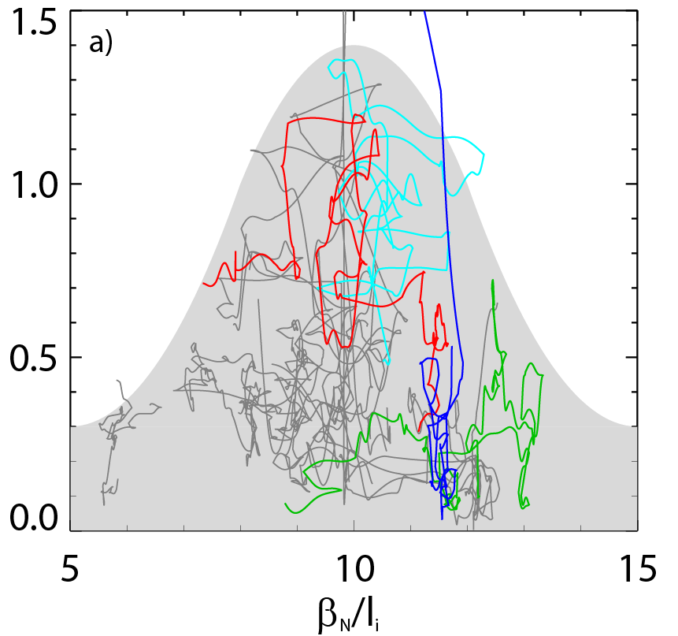
Experiments directly measuring global MHD stability verify that highest β_{N}/l_{i} is not the least stable scenario (NSTX)
Resonant Field Amplification (RFA) measurement of stability
Non-intuitive stability increase at high β_{N}/l_{i}
  decreases up to β_{N}/l_{i} = 10, increases at higher β_{N}/l_{i}
Understanding: Results consistent with kinetic stabilization theory invoking physical resonances
RFA Amp. (G/G)
Less stable
More stable
Less stable
J. Berkery, et al., PoP 21 (2014) 156112
S. Sabbagh,et al., 2016 EPS Landau-Spitzer Award lecture

Slide 22
DECAF is fueled by coordinated research that continues to validate/develop physics models
Global MHD
  Detection: available magnetic diagnostics, plasma rotation, equilibrium
  Forecasting: Kinetic MHD model has high success in NSTX, DIII-D
Resistive MHD
  Detection / forecasting: available magnetic diagnostics, plasma rotation
  Forecasting: starting examination of MRE ➔ start with Δ’ evaluation
Density limits
  Detection: rad. power, global empirical limit
  Forecasting: starting examination of rad. island power balance model
Physics analysis / experiments to build DECAF models
  Interpretive and “predict-first” analysis of KSTAR long-pulse, high beta plasmas with high non-inductive fraction

Slide 23
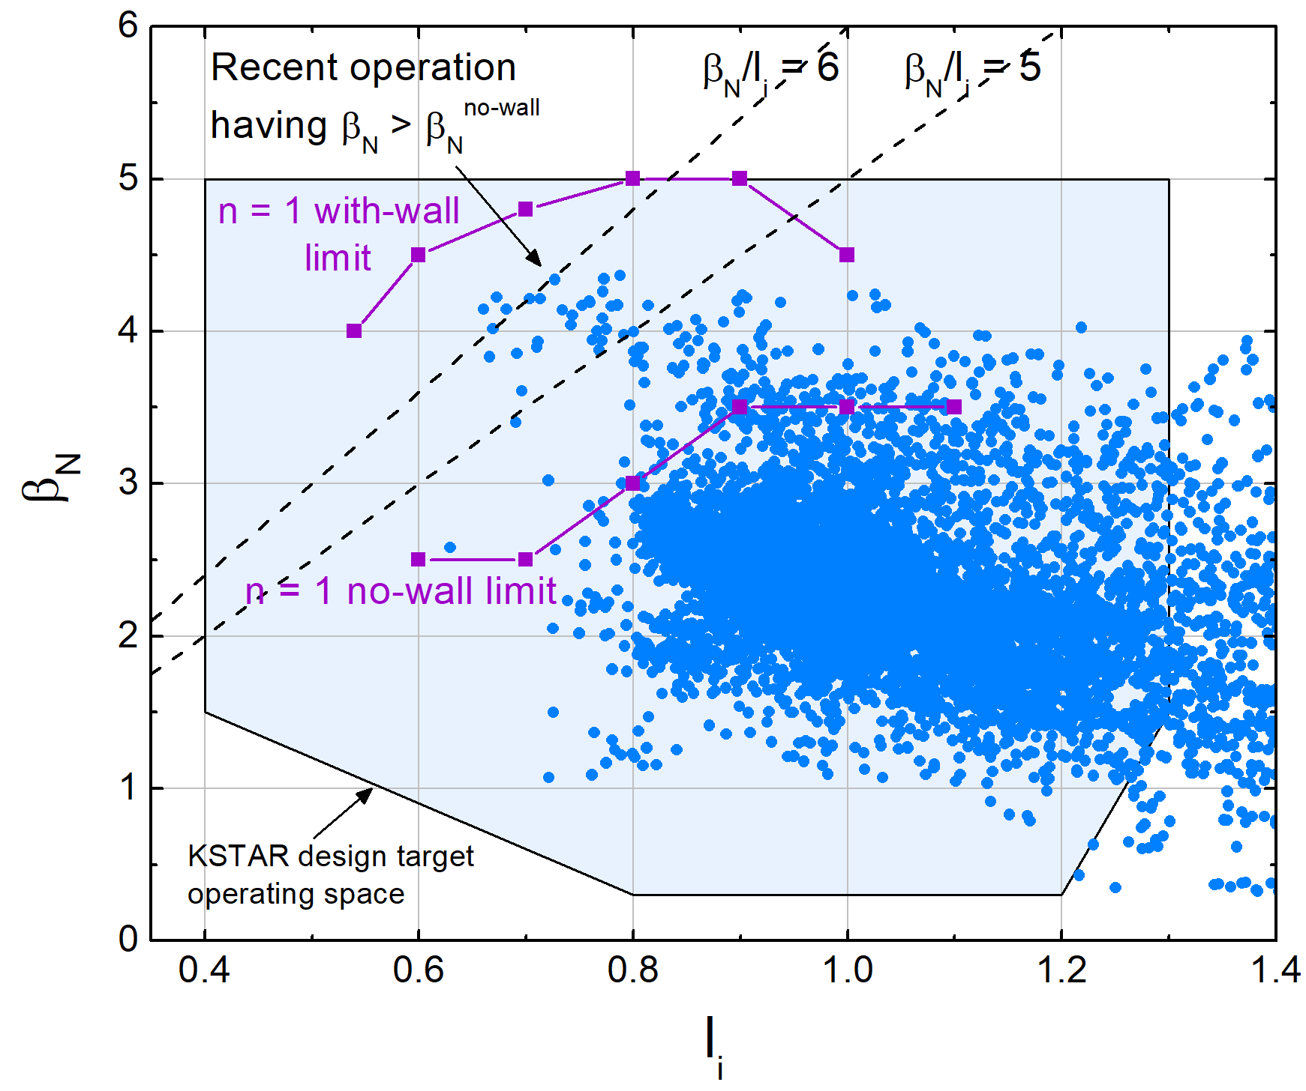
KSTAR kinetic equilibria w/ MSE are examined in the context of past published database
Examples in talk
16295
  High β_{N} plasma
16325
  Higher B_{T} (q₉₅)
  Higher edge bootstrap current
18476 & 16498
  Internal Transport Barrier (ITB)
16295
(high β_{N})
16325
18476 & 16498 (ITB)
Many thousands of kinetic equilibria run during testing
Y.S. Park, S.A. Sabbagh, et al., Nucl. Fusion 53 (2013) 083029 (magnetics-only)

Slide 24
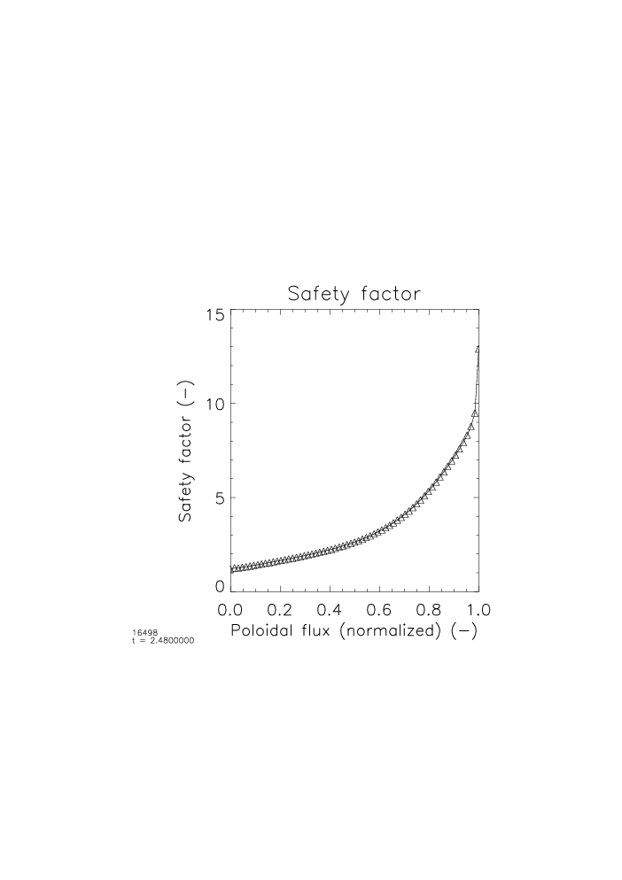

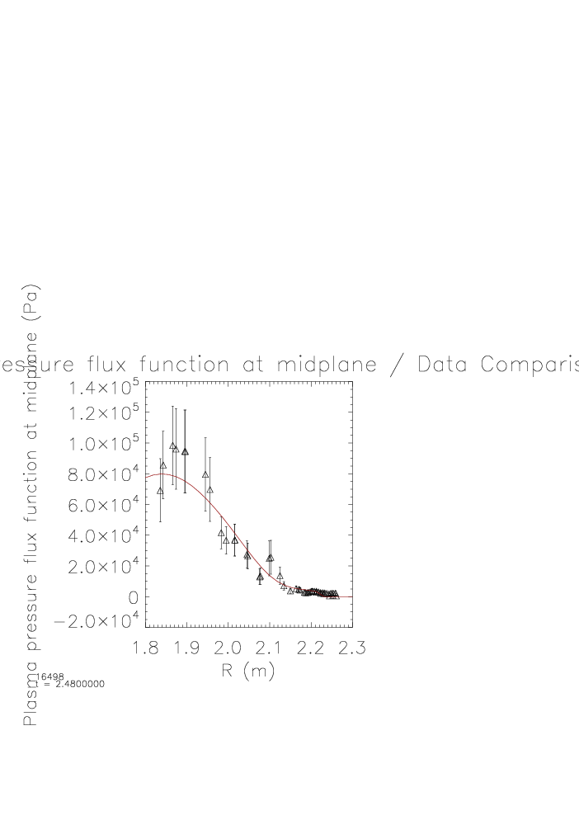
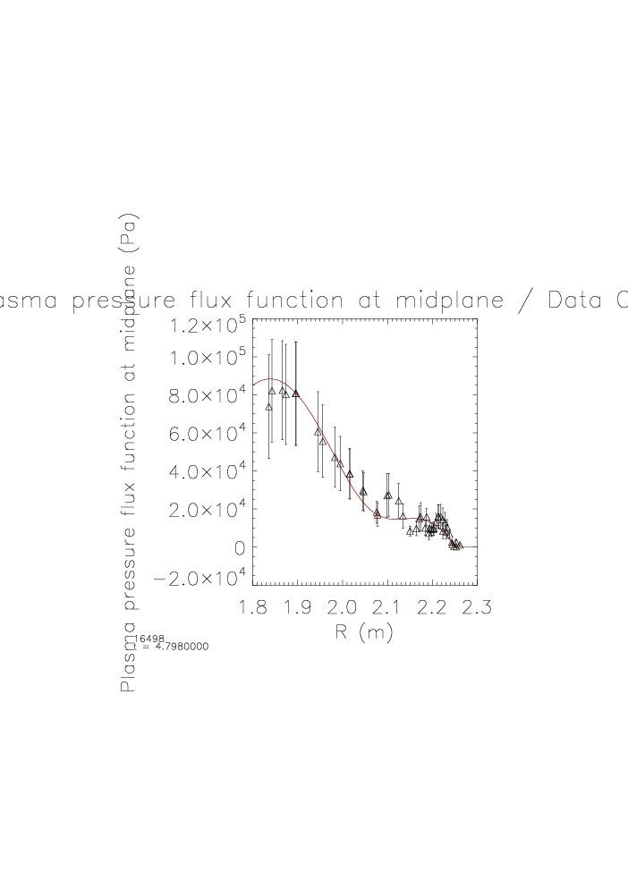
Clear pressure profile distinction between Internal Transport Barrier and H-mode phases
15
10
5
0
15
10
5
0
ITB phase
H-mode phase
t = 2.5s
t = 4.8s
Safety factor
t = 2.5s
Safety factor
t = 4.8s
Safty factor q
ITB
H-mode
L-mode
0.0 0.2 0.4 0.6 0.8 1.0
ψ_{N}
0.0 0.2 0.4 0.6 0.8 1.0
ψ_{N}
1.2
1.0
0.8
0.6
0.4
2
0.0
-0.2
1.2
1.0
0.8
0.6
0.4
2
0.0
-0.2
Total Pressure
t = 2.5s
Total Pressure
t = 4.8s
Total Pressure (10⁵Pa)
2.5
4.8
△ data
— fitted
△ data
— fitted
16498
1.8 1.9 2.0 2.1 2.2 2.3
R (m)
1.8 1.9 2.0 2.1 2.2 2.3
R (m)
Broad pedestal pressure reconstructed in H-mode is not observed in earlier ITB phase
Xp by Jinil Chung

Slide 25
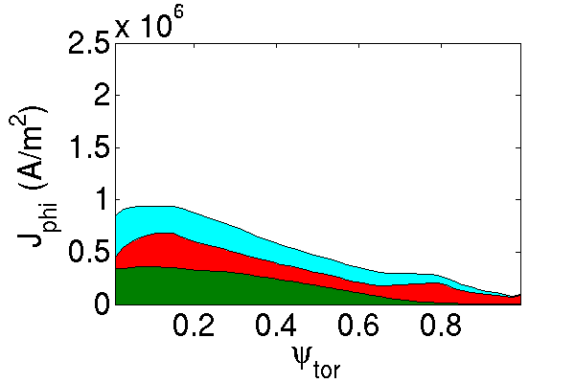
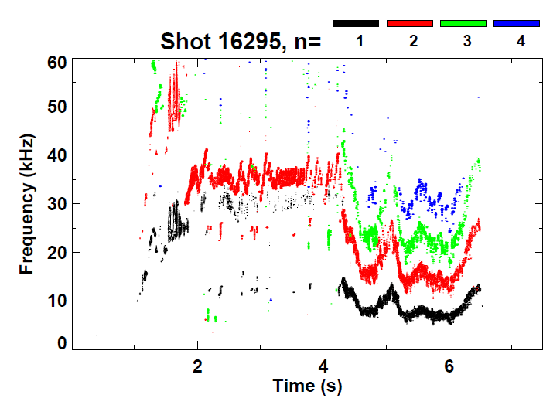
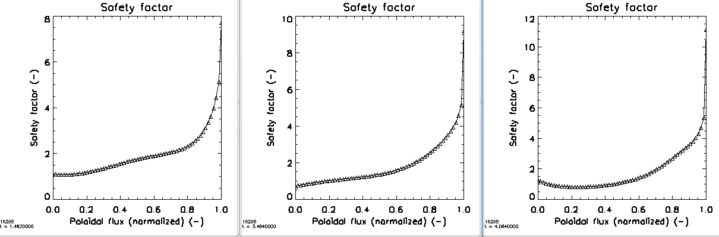
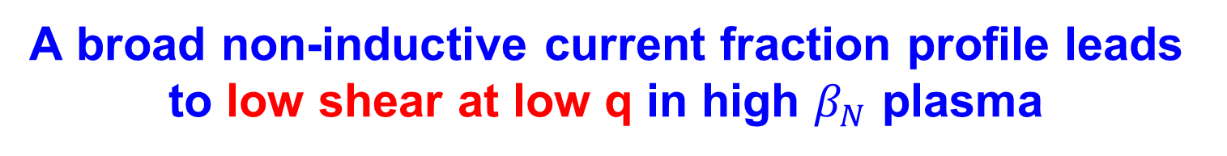
A broad non-inductive current fraction profile leads to low shear at low q in high $β_{N}$ plasma
10⁶
Current profile components
TRANSP
(67% non-inductive)
Magnetic spectrogram
Weak n = 2 mode
16295 t=1.75s
β_{N}>3
Kinetic + MSE reconstructed q profile evolution
8
10
12
10
8
6
4
2
0
t=1.482s
t=3.484s
t=4.084s
6
8
q
q
q
6
Evolves to low shear at low q
4
4
2
2
0
0
0.0 0.2 0.4 0.6 0.8 1.0
ψ_{N}
0.0 0.2 0.4 0.6 0.8 1.0
ψ_{N}
0.0 0.2 0.4 0.6 0.8 1.0
ψ_{N}

Slide 26
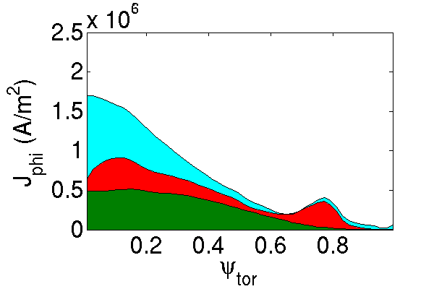
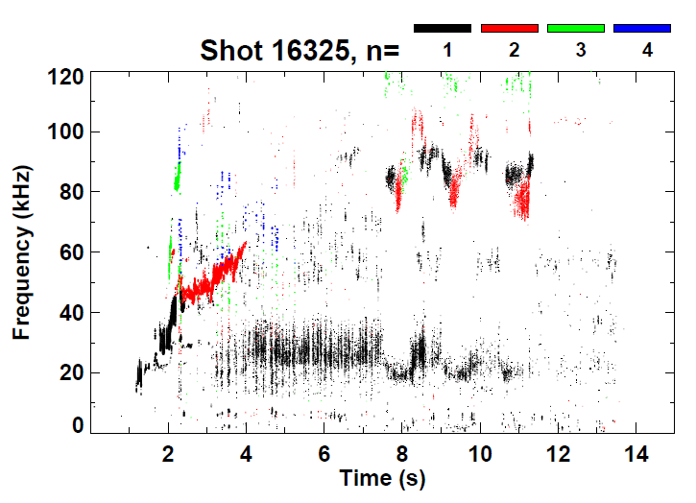
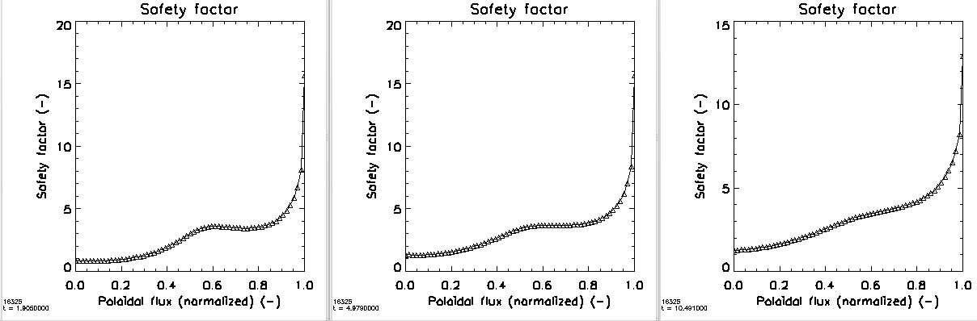

Kinetic EFIT reconstructed again shows evolution to low-sheared q-profiles but now at high q
10⁶
Current profile components
Magnetic spectrogram
TRANSP
(71% non-inductive)
16325 t=2.05s
Tearing modes absent
Kinetic + MSE reconstructed q profile evolution
20
20
15
t=1.906s
t=4.979s
t=10.491s
15
15
q
q
10
Low shear forms again, but at high q
q
10
10
$$q_{min}<1$$
5
5
5
0
0
0
0.0 0.2 0.4 0.6 0.8 1.0
ψ_{N}
0.0 0.2 0.4 0.6 0.8 1.0
ψ_{N}
0.0 0.2 0.4 0.6 0.8 1.0
ψ_{N}

Slide 27
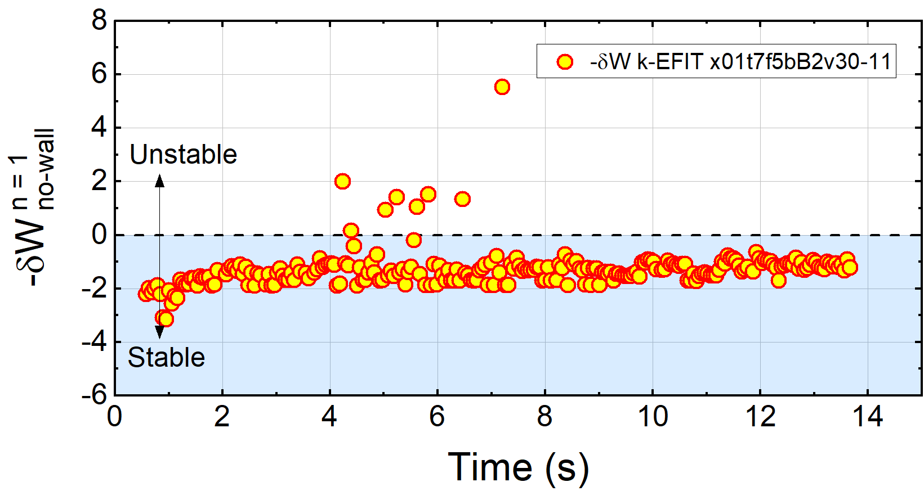
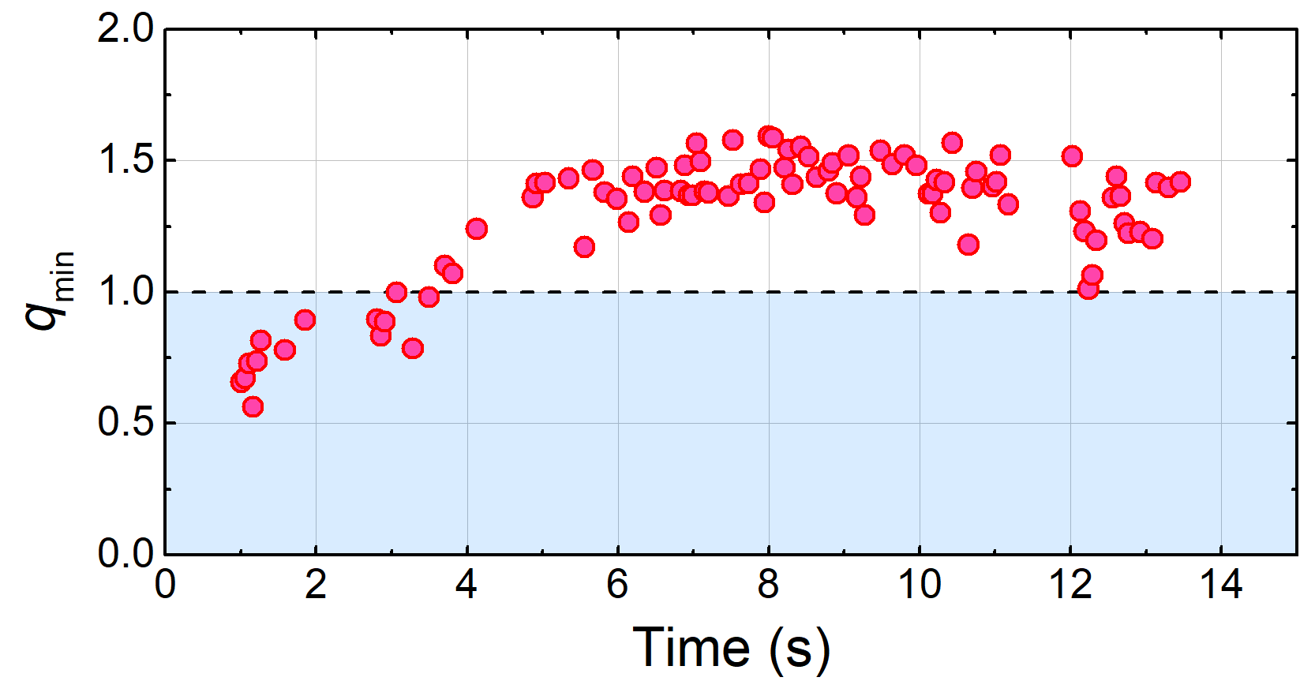
Higher q₉₅ plasma has greater ideal n = 1 no-wall stability in DCON, closer to marginal stability
KSTAR 16325
Unlike higher β_{N} plasma, equilibria is mostly stable to n = 1 ideal modes in DCON
  Note generally smooth evolution of stability criterion – reached with improved kinetic equilibria
The q-profile at higher B_{T} evolves higher q_{min} above 1
  Sawteeth disappear
Reconstructed lower q shear at higher values of q does not lead to n = 1 instability in DCON
High q₉₅ equilibria
DCON
}
High q₉₅ equilibria
q_{min} (w/ MSE)

Slide 28
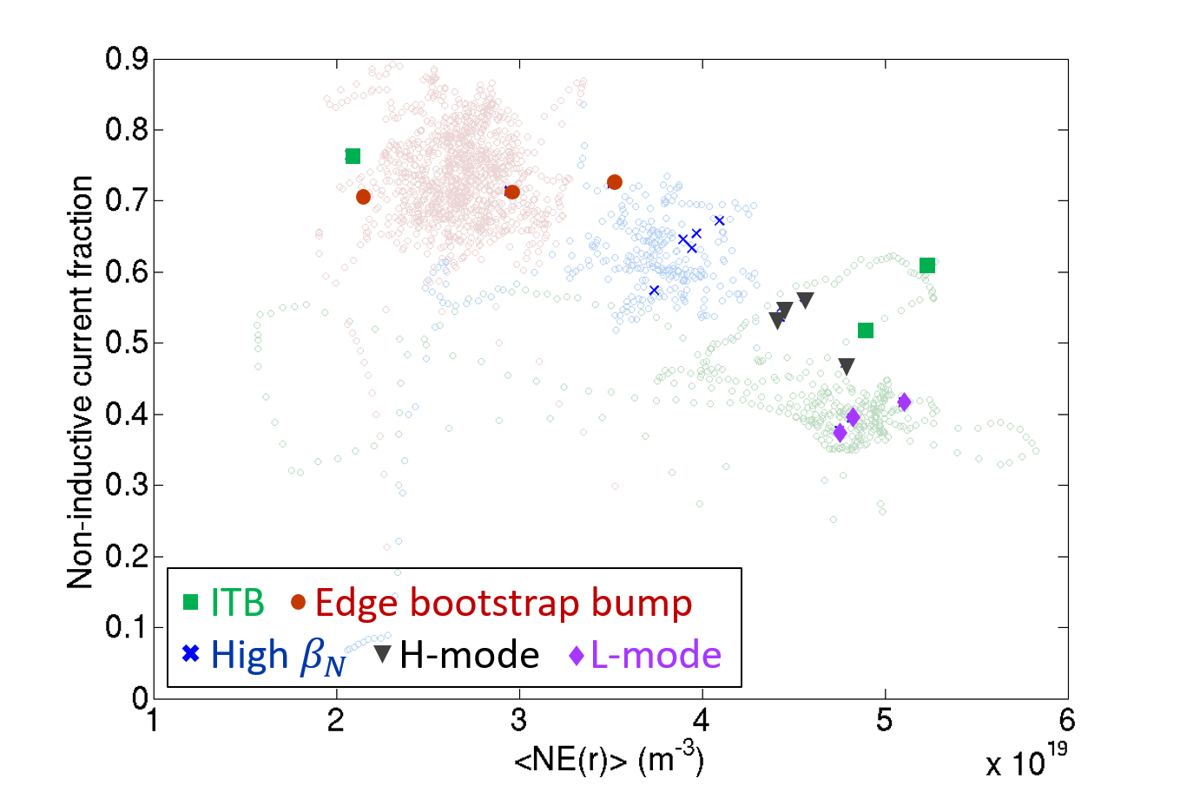
Kinetic reconstructions focused first on KSTAR plasmas with high-non-inductive fraction; NICF exceeds 75%
TRANSP analysis of experimental plasmas
Non-inductive fraction
  Beam-driven
  Bootstrap
Non-inductive fraction is key for stable high beta steady state operation
16498
16325
16295
18476
18492
Volume average electron density (m⁻³)

Slide 29
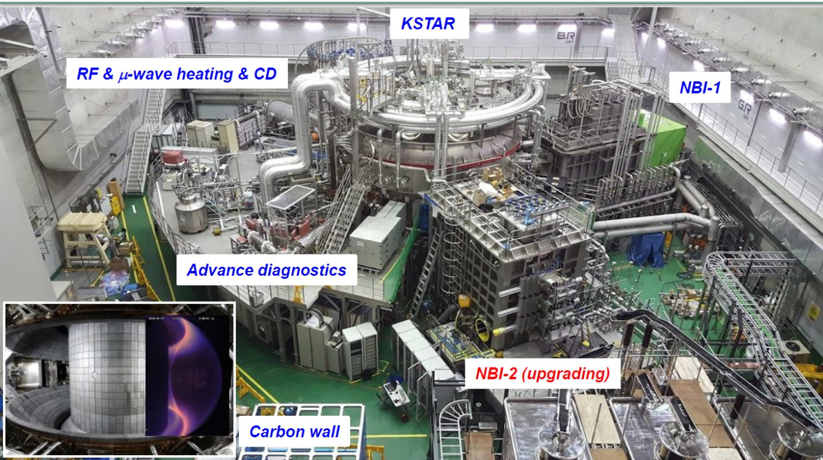
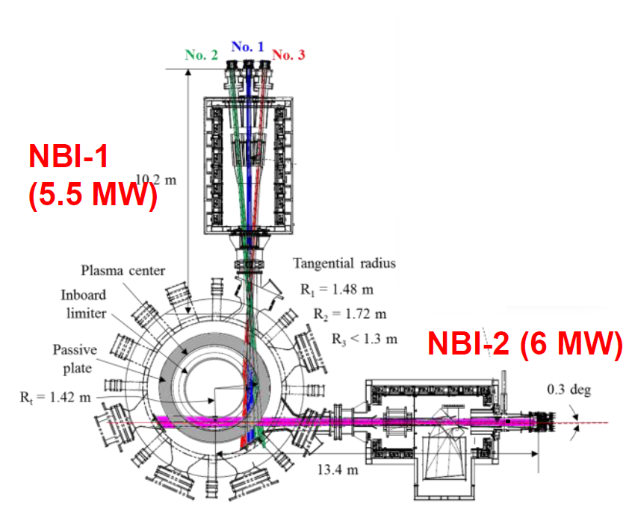
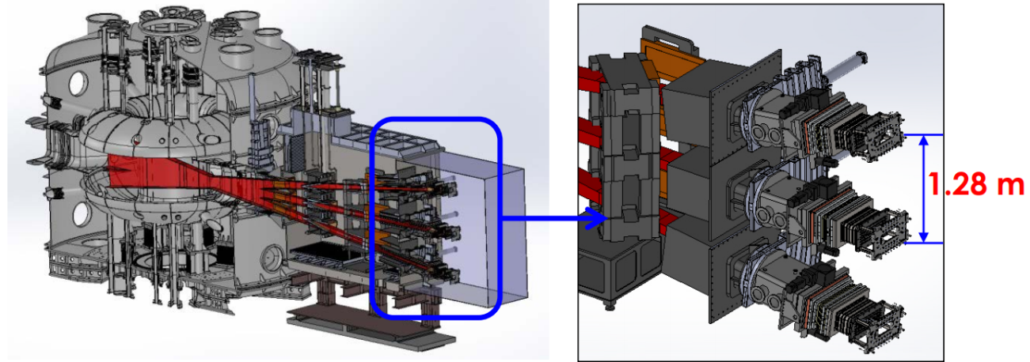
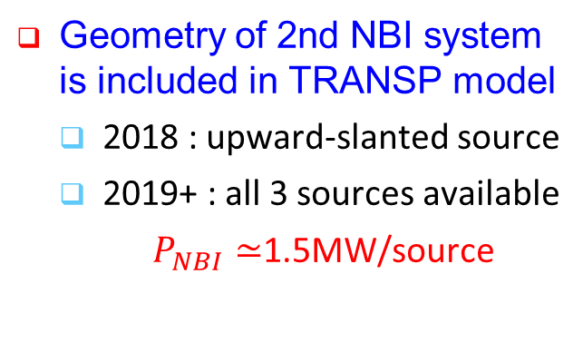
New 2nd NBI system is installed in KSTAR and will be available for 2018 run campaign
90°
Geometry of 2nd NBI system is included in TRANSP model
  2018 : upward-slanted source
  2019+ : all 3 sources available
  $P_{NBI}≃$1.5MW/source

Slide 30
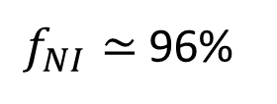
Predictive transport capability (TRANSP) allows “predict-first” projections for upcoming runs
6.5 MW NBI (2018)
$f_{NI}≃$96%
TRANSP 16325 | 2016 actual | 2018 NBI | 2019 NBI
NIC fract. (%) | 71% | 96% | 130%
β_{N} | 2.7 | 3.4 | 4.4
l_{i} | 0.9 | 0.91 | 0.95
T_{i}(0) (keV) | 4.5 | 5.5 | 7.2
T_{e}(0) (keV) | 4.6 | 3.3 | 3.3
n_{e}(0) (10²⁰m⁻³) | 5.2 | 5.6 | 5.5
f_{Greenwald} | 0.5 | 0.5 | 0.5
H_{98y2} | 1.25 | 1.25 | 1.25
16325 projection
Project from existing KSTAR plasmas
  Set fraction of Greenwald density and confinement factor ITER H_{98y2}
    Neoclassical ion transport, electron transport set to match H_{98y2}
  KSTAR 1st and 2nd NBI systems are modeled (incl. aiming angles); power levels set realistically based on MSE needs, etc.

Slide 31
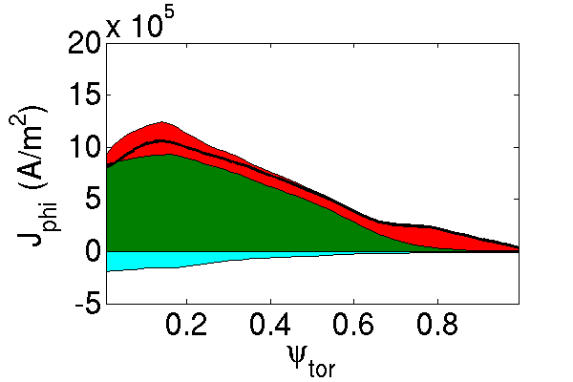



Transport analysis projections allow for variations of plasma parameters to meet targets
6.5 MW NBI (2018)
TRANSP 16295 (B_{T}; I_{p}) | 2016 actual (1.2T) | 2018 NBI (1.2T) | 2018 NBI | 2019 NBI
NIC fract. (%) | 67% | 105% | 95% | 126%
β_{N} | 3.5 | 5.4 | 3.5 | 4.4
l_{i} | 0.9 | 0.83 | 0.95 | 0.84
T_{i}(0) (keV) | 3.6 | 4.8 | 5.4 | 7.3
T_{e}(0) (keV) | 2.3 | 2.8 | 3.2 | 3.3
n_{e}(0) (10¹⁹m⁻³) | 6.0 | 4.8 | 5.6 | 5.6
f_{Greenwald} | 0.6 | 0.5 | 0.5 | 0.5
H_{98y2} | 1.25 | 1.25 | 1.25 | 1.25
$f_{NI}≃$105%
(2T, 0.5 MA)
16295
B_{T}=1.2T, I_{p}=0.44 MA
6.5 MW NBI (2018)
$f_{NI}≃$95%
B_{T} = 2T, I_{p} = 0.5 MA

Slide 32






“Predict-first” analysis being used to design
2018 high-$β$ experiments
THREE CU group experiments scheduled for 2018 (3 days)
Predictive TRANSP is being used to develop scenarios for 2018 high-β experimental runs in KSTAR – aiming to obtain :
  long-pulse, MHD stable high beta plasmas
TRANSP calculations with $I_{P}$ value
set lower predict $β_{N}$ higher than
experiments
Projection using KSTAR #16325
$β_{N}\sim 4.4$
$β_{N}$/$l_{i}$=6
$β_{N}$/$l_{i}$=5
n=1 with-wall limit
Predicted
n=1 no-wall limit
$I_{P}$=$I_{P,ref}$
$I_{P}$=$I_{P,ref}$*1.3
$I_{P}$=$I_{P,ref}$/1.1
$I_{P}$=$I_{P,ref}$/1.2
“Predict-first” before running sets of experiments

Slide 33






Predictive TRANSP analysis shows KSTAR design target $β_{N}$~5 can be approached with $f_{NI}$~100%
NBI increased
  existing shot: 4.5 MW
  2018 NBI taken as 6.5 MW
By altering $I_{P}$ and $B_{T}$ values, $β_{N}>4$, up to KSTAR design target 5 can be achieved with 100% non-inductive current fraction
$β_{N}$/$l_{i}$=6
$β_{N}$/$l_{i}$=5
$B_{T}$=1.5T
Predicted
n=1 with-wall limit
$B_{T}$=1.7T
$B_{T}$=2.0T
n=1 no-wall limit
Interpretive

Slide 34


Classical tearing stability examined using resistive DCON code for high β_{N} and higher q₉₅ plasmas
16295
High β_{N} equilibria
Resistive DCON $Δ′$
16325
Higher q₉₅ equilibria
Resistive DCON $Δ′$
Experimentally
Unstable 2/1
Experimentally
2/1 stable
Classical tearing stability index, Δ′, computed at the q = 2 surface using outer layer solutions
At higher q₉₅, Δ′ is mostly positive predicting unstable classical tearing mode
  Indicates that neoclassical effects or wall effects need to be invoked to produce stability
A.H. Glasser, et al., Phys. Plasmas 23 (2016) 112506

