Slide 1




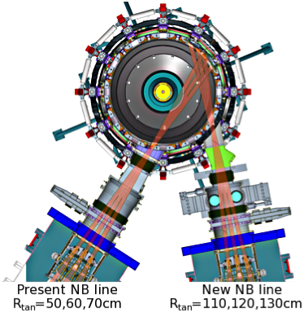
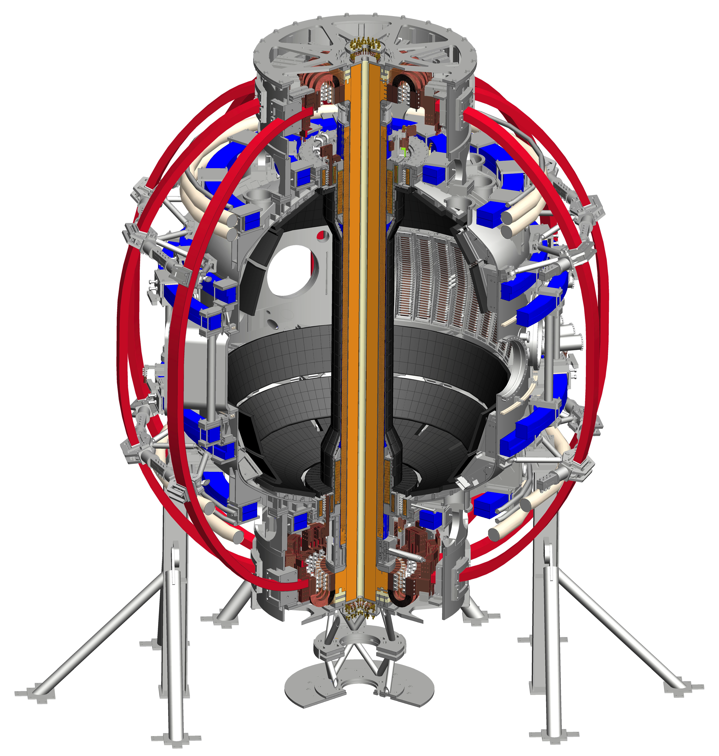
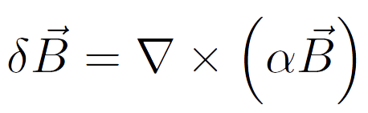
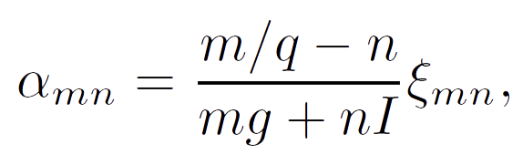
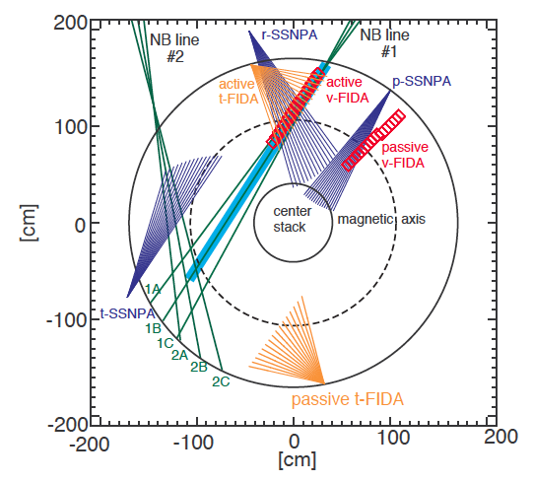
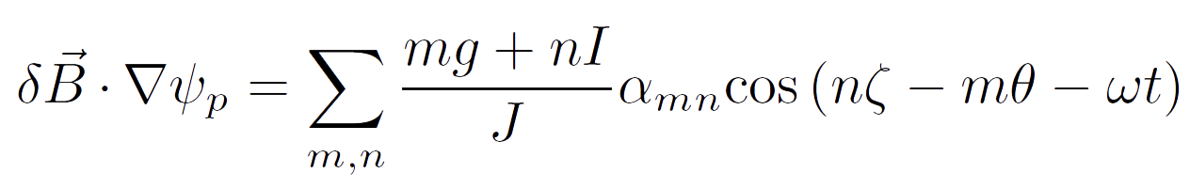
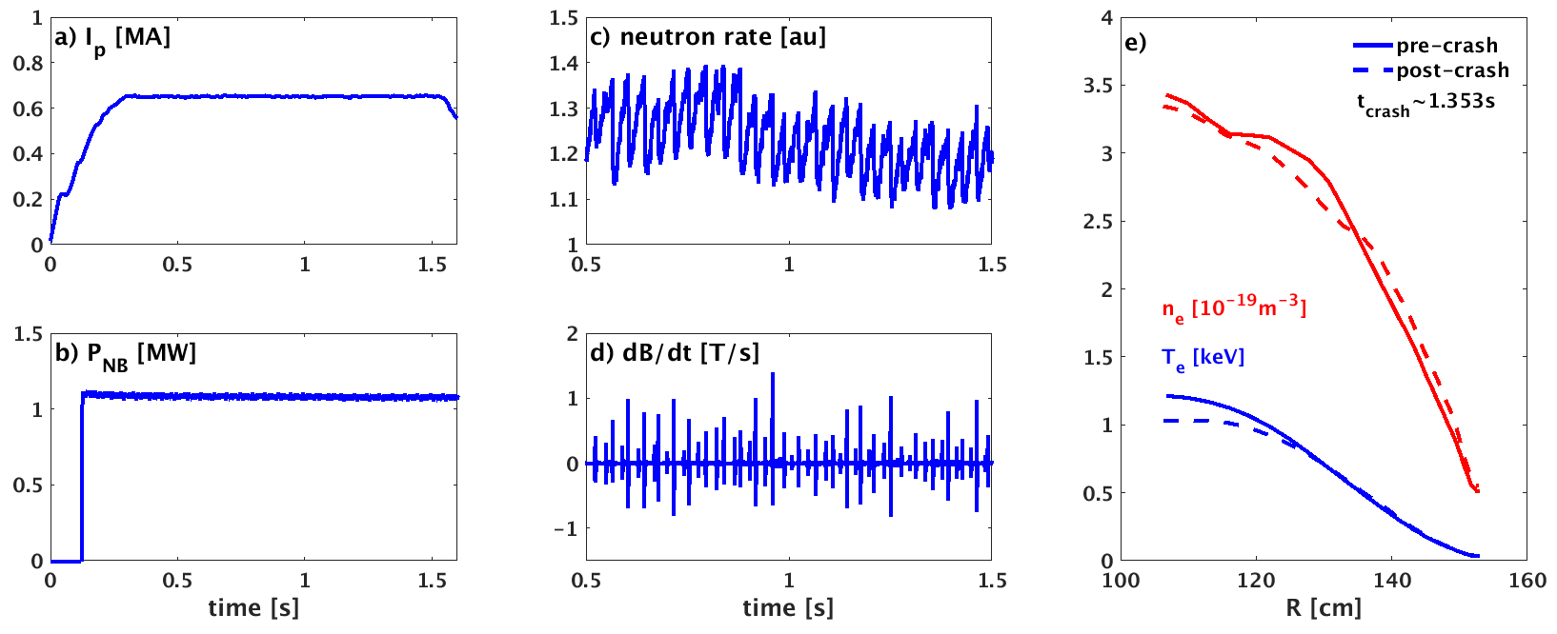
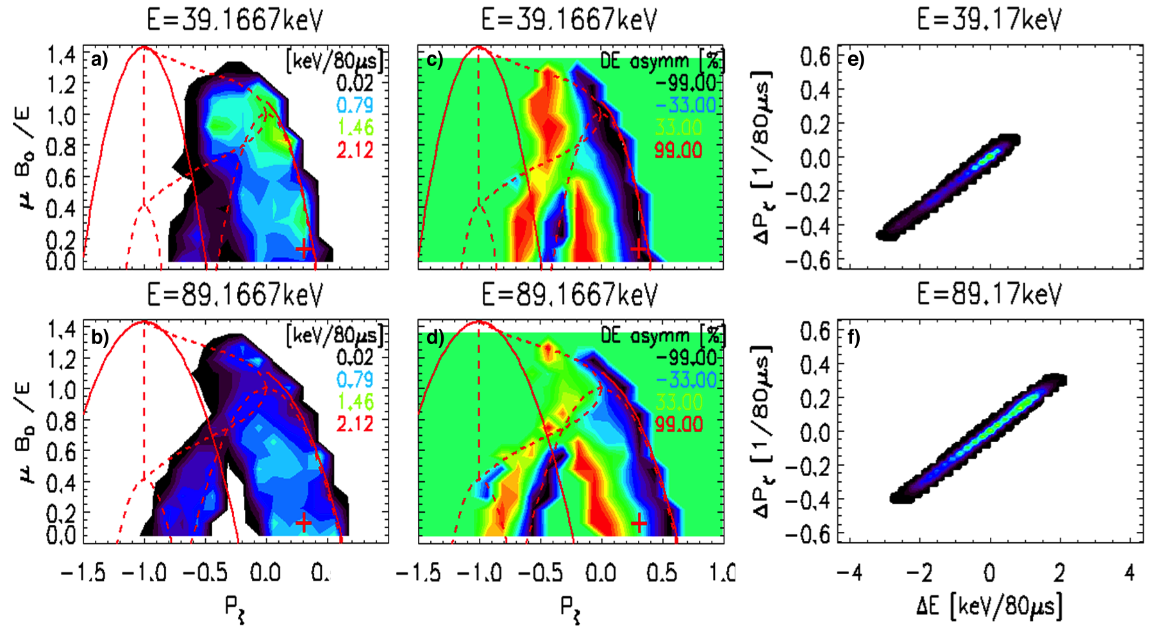
EX/P6-33
Investigation of fast particle redistribution
induced by sawtooth instability in NSTX-U
D. Kim¹⁾, M. Podestà¹⁾, D. Liu²⁾, G. Hao²⁾ and F.M. Poli¹⁾
¹⁾ Princeton Plasma Physics Laboratory, Princeton, NJ 08543, USA
²⁾ Department of Physics and Astronomy, University of California, Irvine, CA 92617, USA
Introduction
Experimental Scenario
Motivation
NSTX-U L-mode sawtoothing discharges analysis [1] using TRANSP code [2]
  Conventional sawtooth models cannot fully reproduce the behaviour of fast ion during sawtooth crashes
    - Some global features (e.g. neutron rate) can be reproduced
    - Fast ion properties (e.g. distribution function) may not be adequately be recovered
  Free parameters in TRANSP (e.g. redistribution and/or reconnection fraction) need to be determined in priori
A more reliable model to describe sawtooth-induced fast ion transports is required
  Phase space dependences (fast ion energy, pitch, canonical momentum, etc.) needs to be considered
  Kick model [3] is applied to provide modelling results as an input for NUBEAM [4] in TRANSP
National Spherical Torus Experiment Upgrade (NSTX-U) [7]
Major radius: 0.95 m Aspect ratio: 1.5
Plasma current: < 2 MA Triangularity: 0.8
Toroidal field: < 1.0 T Elongation: 2.7
pulse length: ~ 1 - 5 s
6 Neutral Beam sources:
P_{NBI} ≤ 12 MW, E_{injection} ≤ 95 keV
Simulation tools
ORBIT [5]: Hamiltonian guiding-centre code
  Analyse energetic particle transport induced by instabilities in tokamaks
  Sawtooth instability is applied as (1,1) mode magnetic field perturbation
  using a linear displacement
Kick model [3]: Reduced fast ion transport model
  Compute transport probability matrices to represent the fast ion transport induced by instabilities
  Test the dependencies of fast ion redistribution during sawtooth crashes on the fast ion phase space variables
TRANSP / NUBEAM [4]: Tokamak transport code / Monte Carlo module
  Enable time dependent integrated interpretative/predictive simulations of tokamak discharges
  Use the probability matrix from ORBIT-kick model as an input for NUBEAM calculation in TRANSP simulation
FIDASIM [6]
  Calculate a synthetic FIDA diagnostic signal
  Predict and integrate the active D_{α} emission for FIDA profile to compare with measurements
Diagnostics for Fast Ion Measurements
Fast Ion Deuterium Alpha (FIDA) [8]
  Measures the Doppler-shifted D_{α} emission of re-neutralized fast deuterons
  Fast ion distribution function from active/passive tangential and vertical FIDA
Solid State Neutral Particle Analyser (SSNPA) [9]
  Measures neutral particle fluxes from CX reactions between fast ions and neutrals
  Consists of r-SSNPA (radial component), t-SSNPA (tangential component) and p-SSNPA (passive signal)
NSTX-U #204163 – L-mode sawtoothing discharge
Flat-top plasma current: I_{p} = 0.7MA
NBI power: P_{inj} = 1.1MW (E_{inj} = 72keV)
Sawtooth crashes are identified by
  - Neutron rate drops at each crash
  - n=1 signal from Mirnov coil
T_{e}/n_{e} profiles are conditionally averaged
  - Sampling time of diagnostics (Thompson, CHERS) is comparable to sawtooth periods
Reconstructed profiles are averaged before and after ~10ms a sawtooth crash at t = 1.353s
ORBIT Modelling Results
Mode amplitude estimation using ORBIT code and application of kick model to ORBIT modelling
Relative change of neutron rate drop: ORBIT [10] vs measurements
Kick model is applied for the probability matrix calculation
  - ΔE and ΔP_{ζ} calculation with the ORBIT-estimated mode amplitudes
Comparison of neutron rate from simulations and experiments
  - TRANSP using kick model results over-estimates neutron rate
  - Input data for the estimation of mode amplitude has uncertainties
  - The amplitude in ORBIT modelling remains as a free parameter
Application to TRANSP Simulations
Interpretative TRANSP simulations for sawtoothing discharges
  Sawtooth crash time is given by measurements (no prediction using crash criteria)
  Input thermal profile data include the sawtooth effect
  Reconnection of flux surface, q-profile, fast ion redistribution are described based on models (full/partial reconnection, kick model) at each crash time
  Free parameters for full/partial reconnection: fraction of fast ion redistribution, partial reconnection fraction, etc.
  Input data for kick model: mode amplitudes and probability matrices
  The probability matrix depends on the particles’ position in phase (orbit type) and real space (relative location to ρ_{inv})
  Passing particles in all energy range are affected by a crash
  Trapped particles under a certain energy are redistributed
  Negative averaged ΔP_{ζ} (blue): particles move outside ρ_{inv}
  Positive averaged ΔP_{ζ} (red): particles move inside
  Balanced averaged ΔP_{ζ} (green): particles are initially located near ρ_{inv} and move similarly both inside and outside
Comparison of neutron rate using kick model and conventional sawtooth models
Trapped
  Simulation condition for kick model
  - One probability matrix with normalised mode amplitudes
  - Mode amplitudes are estimated using neutron rate drops
  Free parameter setting for Full/Partial reconnection
  - Fast ion redistribution fraction: 20% / 50%
  - Partial reconnection fraction: 50%
  Reference data
  - Normalised measured neutron rate (blue)
  Without considering sawtooth effects on fast ion redistribution (red), the neutron drop can be reproduced
  The neutron rates from full/partial reconnection, kick model cases match the measurement with the given parameters
  Comparison of neutron rate is not sufficient to determine a model to describe the sawtooth effect on fast ion transport
Counter
passing
Co
passing
Comparison of Simulation Results with Experiments / Theory
Comparison of fast ion distribution functions with FIDA measurements
  Synthetic FIDA signal from FIDASIM using TRANSP simulation results with different models
  - Comparison of measured FIDA spatial profiles
  Average simulated FIDA profiles over 1, 3, 5ms before and after a crash
  - compensate the FIDA temporal resolution (10ms)
  Measurement from t-FIDA (mostly sensitive to passing particles) is considered
Comparison of fast ion density profiles
  Kick model (blue): clear effect from sawteeth
  - Drop at the centre and increase outside ρ_{inv}
  Full/partial (red/gree) reconnection: negligible change
  - Lower fast ion redistribution fraction (20%, 50%)
  Fast ion driven current profiles
  - About 50% of central drop for the kick model case
  - Larger drop near ρ_{inv} for full/partial reconnection case
Fast ion density [10¹²cm⁻³]
Fast ion current [A cm⁻²]
  FIDA measurement: fast ions in the centre are expelled to outside the inversion radius (R~122cm) after a crash
  Kick model: qualitatively reproduces the measured FIDA signal
  - After a crash t-FIDA signal drops up to 50% inside the inversion radius (R~125cm)
  - The shoulder of increased signal is seen outside the inversion radius
  Full/partial reconnection: no clear sign of the sawtooth-induced fast ion redistribution
  - t-FIDA signal decreases all across the radius after a crash
  - Can be similar to kick model case with larger fast ion redistribution fraction (with largely over-estimated neutron rate)
ρ_{N}
ρ_{N}
Fast ion distribution functions in phase space (outside the q=1 surface, ρ_{N} ~ 0.55)
Comparison of critical energy with theory [11]
  Redistribution criterion for trapped particles
  Kick model: redistribution of fast ions in phase space can be seen from low energy particles
  - Passing particles (high pitch): max. ~60% decrease
  - Trapped particles (low pitch): max.~100% increase
  Partial reconnection case: no significant variation after a crash
  - Decrease of passing particles (~20%) but no clear change in trapped particles
  Kick model can show changes of fast ion features that the conventional models cannot describe
  No-redistribution condition for passing particles
  The maximum ΔP_{ζ} values vs energy show that
  - The critical energy for passing particles redistribution is not clearly seen (blue and red, estimated E_{crit} ~ 1.1MeV)
  - Trapped particles with energies over ~30keV are weakly affected by the crash (green, violet, estimated E_{crit} ~ 28keV)
  The kick model estimation is consistent with the theory [11] and ORBIT modelling [10]
Summary and Future work
References [1] D. Liu et al., Nucl. Fusion 58, 082028 (2018), [2] R. Hawryluk, An empirical approach to tokamak transport Physics Close to Thermonuclear Conditions vol 1 ed B. Coppi et al. (Brussels: Commission of the European Communities) p 19. (1980), (http://w3.pppl.gov/~pshare/help/transp.htm), [3] M. Podestà et al., Plasma Phys. Control. Fusion, 56, 055003 (2014), [4] A. Pankin et al., Comput. Phys. Commun., 159, 157 (2004), [5] R.B. White et al., Phys. Fluids, 27, 2455 (1984), [6] W.W. Heidbrink et al., Ncommun. Comput. Phys., 10, 716 (2011), [7] J. Menard et al., Nucl. Fusion, 52, 083015 (2012), [8] M. Podestà et al., Rev. Sci. Instrum. 79 10E521 (2008) [9] D. Liu et al., Rev. Sci. Instrum. 85 11E105 (2014) [10] D. Kim et al., Nucl. Fusion 58, 082029 (2018), [11] Ya.I. Kolesnichenko, V.V. Lutsenko and Yu.V. Yakovenko, Phys. Plasmas, 4, 2544 (1997)
Conventional sawtooth models in TRANSP have a limited capability to reproduce experimental results
Application of kick model to TRANSP simulation improves the modelling of fast ion redistribution
  TRANSP simulation can take into account the phase space variables using kick probability matrix in NUBEAM
  Neutron rate is in a good agreement with the measurement
  Fast ion distribution function from synthetic FIDASIM results qualitatively match the FIDA measurement
The simulation results confirm the theoretical criteria for fast ion redistribution
  Fast ions with energy higher than the critical energy are less affected by sawteeth for the redistribution
  More quantitative criteria to describe the level of redistribution of fast ions beyond the 0-D prediction are required
The improvement from the application of kick model needs to be validated on other tokamaks
27th IAEA Fusion Energy Conference, Gandhinagar, India, 22-27 October, 2018
Doohyun Kim (dkim@pppl.gov)

